Slide 1
Nuclear-Molecular Version of Processes of Dynamical Self-organization of Solar Interiors and their Possible Role in Formation of Solar Activity
Yu. S. Kopysov (Institute for Nuclear Research of Russian Academy of Sciences)
Report on the 2nd international conference on particle physics and astrophysics
Moscow, MEPhI, October 11, 2016

Slide 2
Abstract
The new model of solar interior structure is discussed. It is consistent with results of years INR RAS measurements of solar neutrino fluxes and with the multi-year observations of 160-minute solar atmosphere oscillations in the Crimean astrophysical observatory. The model is based on two hypotheses:
There is a slightly subadiabatic solar troposphere under the superadiabatic convective zone, which is a resonator for 160-minute g-mode oscillations.
In addition to thermal branch of pp-reaction of hydrogen chain, which gives the main contribution into solar luminosity, there is a side nuclear-molecular catalytic brunch of pp-reaction, which gives a small contribution into solar luminosity, but controls solar activity and supplies energy to processes of dynamical solar interiors self-organization which are responsible for vigorous solar activity.
This new model can justify the necessity of further searches and investigations of non-stationary solar neutrino fluxes in form of short time neutrino flairs.

Slide 3
Introduction
The present report is the first publication from the series of works dedicated to 100-year anniversary of birthday of academician G. T. Zatsepin. Foreign colleagues have called him a scholar of the Fermi scale, and I would say simpler: it is a natural scientist, laid in the Soviet Union and Russia the foundations of modern cosmic ray physics, neutrino astronomy and neutrino astrophysics. It was possible with his efforts in the Baksan neutrino Observatory, created by him, not only to test existing ideas about the structure of the Sun, but also to lay the foundations of a new science of solar activity.

Slide 4
What do we know about the internal structure of the Sun?
Surprisingly, almost all the information about the structure of the Sun comes to us from observation of other stars.
We can build a two-dimensional diagram (Hertzsprung-Russell), on which the abscissa shows the star spectral class (surface temperature), and the ordinate shows the luminosity.
It turns out that every star, with its unique location on the diagram, falls into one or another family of stars.
Our Sun, being at its spectral class a yellow dwarf, falls on the main sequence.
Astrophysical calculations based on known physical laws allow us to calculate the internal structure of stars and their evolution.
Due to the fact that we believe that we know the sources of energy that provide luminosity, it is possible to calculate the evolution of stars.

Slide 5
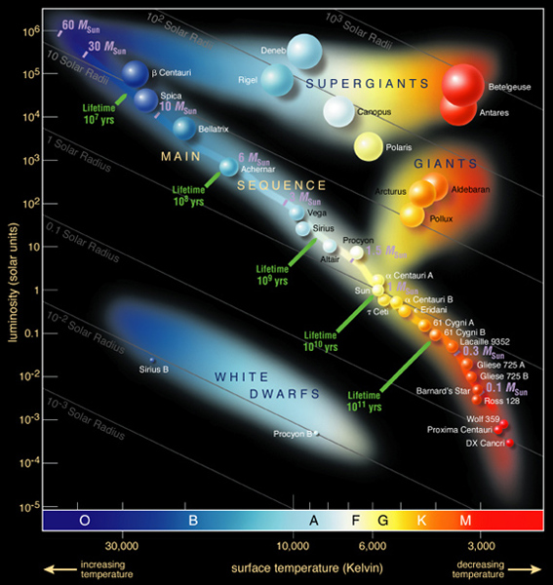
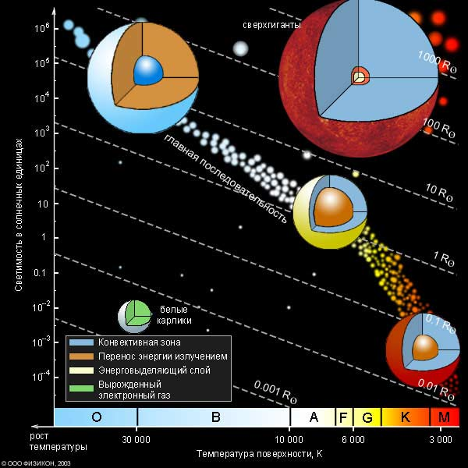
Hertzsprung-Russell diagram
The sun on the diagram looks like quite ordinary star. If we would be able to calculate the structure and evolution of each star theoretically, then we could reproduce the entire diagram.
Hertzsprung-Russell diagram
The cut shows here the internal structure of stars. On the model of the Sun, we see the mantle (brown) and the convective shell around (blue color). This is so-called the Sun standard model.

Slide 6
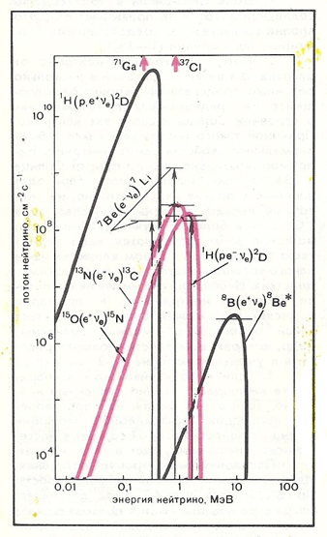
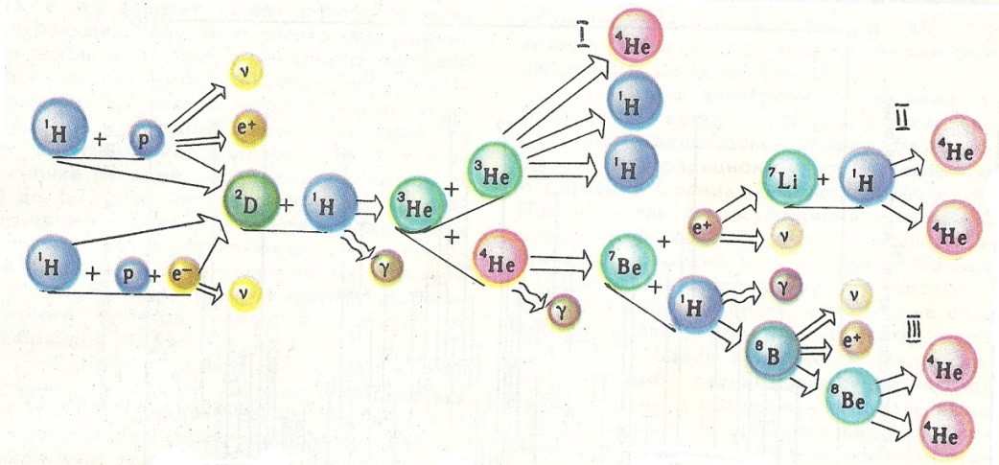
Hydrogen chain of hydrogen transformation into helium
The first detector of solar neutrinos
The understanding of the possibility and necessity of measuring the fluxes of solar neutrinos has appeared among specialists in nuclear physics and nuclear astrophysics USA and the Soviet Union in the middle of the last century. Such a possibility was provided by radiochemical methods for the detection of neutrinos through reactions:
${}_{ }^{37}{Cl}\left(ν,e^{−}\right){}_{}^{37}{Ar}$ (B. M. Pontecorvo), (1)
${}_{}^{71}{Ga}\left(ν,e^{−}\right){}_{}^{71}{Ge}$ (V. Kuzmin), (2)
${}_{}^{7}{Li}\left(ν,e^{−}\right){}_{}^{7}{Be}$ (G. T. Zatsepin, V. A. Kuzmin). (3)
The first was the chlorine-argon experiment. For 2.5 years the underground space with an area of 3x6 sq. m. and a height of 9.6 m was prepared at the Homestake mine at a great depth (to protect against background cosmic ray) thanks to the titanic efforts of the outstanding American scientist R. Davis. There was a huge tank, containing 610 tons of perchloroethylene ($C_{2}{Cl}_{4}$) in this room.
This diagram indicates in which nuclear reactions electronic neutrinos (𝜈) are emitted.
In the framework of the Sun standard evolutionary model of the one can to calculate the fluxes and spectra of emitted neutrinos accurately. The next slide shows the energy spectrum of these neutrinos in double logarithmic scale (proposal of G. T. Zatsepin).
The spectrum of solar neutrinos from pp-chain reactions (black lines) and CNO-cycles (colored lines). The vertical straight arrows depict the line part of the pp-chain spectrum. The horizontal lines mark full value of the neutrino flux generated in the corresponding reaction. Colored arrows indicate the magnitude of the threshold energy for reactions of neutrino capture by nuclei ${}_{}^{37}{Cl}$ and ${}_{}^{71}{Ga}$.

Slide 7
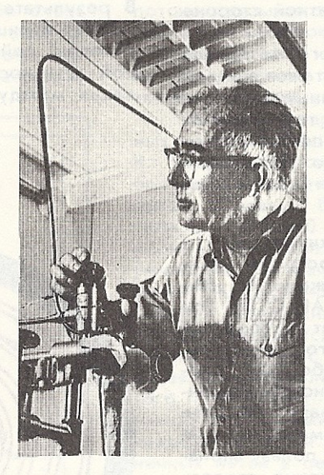
The first results of the Brookhaven experiment
Indeed, an unexpected and somewhat dramatic results of Brookhaven experiment became an important first step of neutrino astronomy that started to develop in those days. They put the research problem, which has been called "the mystery of solar neutrinos".
The first extract of ${}_{}^{37}{Ar}$ formed during exposure in chlorine detector gave only an upper limit for the rate of formation ${}_{}^{37}{Ar}$. This limit has appeared significantly below the theoretical predictions of standard evolutionary models.
R. Davis with a touch of some confusion and bewilderment announced in early 1968, in a telegram to G. T. Zatsepin, who led the work on the preparation of neutrino experiments in the USSR, about his first unsuccessful attempt to register solar neutrinos. iG. T. Zatsepin with amazing insight n the response telegram noted that the result might be even more interesting than if the flux of solar neutrinos would has been discovered.
R. Davis

Slide 8
The Crimean observations of the pulsations of the Sun at 1974-2014.
The observing global oscillations of the Sun, started at the Crimean astrophysical Observatory in 1974, continue for decades. Doppler measurements in 2011-2014 have confirmed the mysterious to astronomy phenomenon of the pulsation of the photosphere with a period 9597.929(15) s that preserved initial phase for 41 years. The nature of the pulsation is not established.
It is noted, however, that it beats with a cosmological fluctuations 9600.606(12) s occur with a period 398.4(2.9) days, coinciding with the synodic period of Jupiter is 398.9 days within errors.
Отмечено, однако, что её биения с космологическим колебанием 9600.606(12) с происходят с периодом 398.4(2.9) суток, совпадающим в пределах ошибки с синодическим периодом Юпитера 398.9 суток.
The hypothesis that the beating of the Sun are induced by gravity field of Jupiter applying to a privileged reference system "Sun–Earth".
According to V. A. Kotov, V. I. Haneychuk (May 2016).

Slide 9
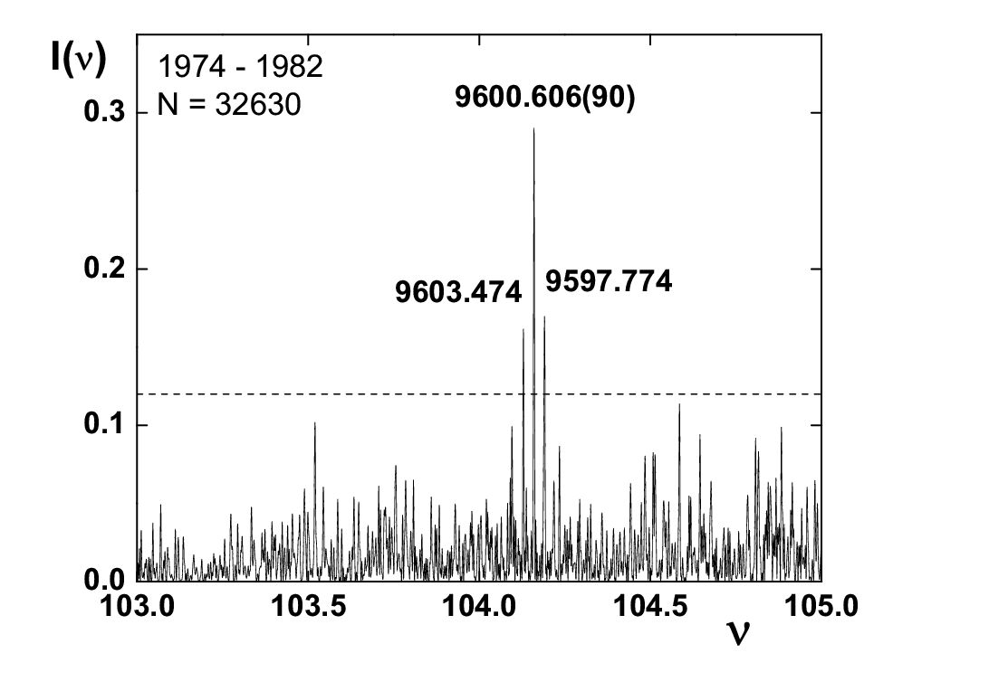
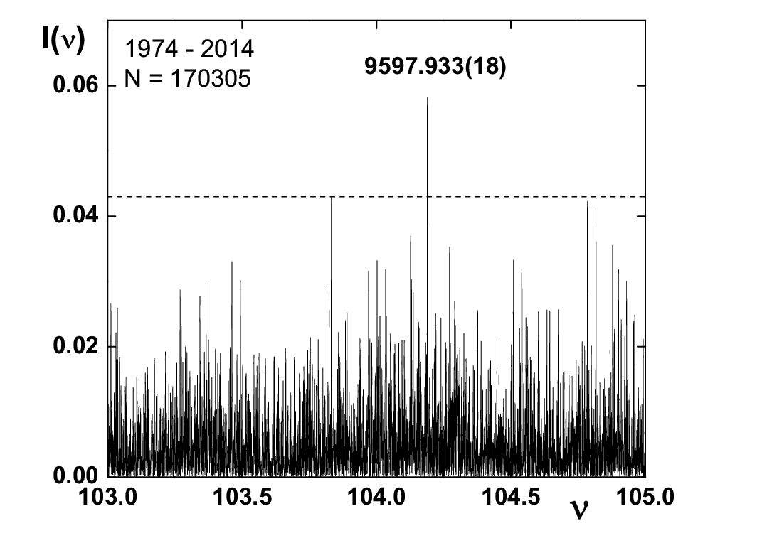
The power spectrum (SM) according to the CrAO (the report of V. A. Kotov)
The power spectrum of the oscillations of the Sun in 1974-1982 according to CrAO, N = 32630.
Same as on the left picture for the full number of Crimean measurements for 41 years, N = 170305.

Slide 10
A possible interpretation of Helio-seismological data of the CrAO
At the time the first results of the Crimean astrophysical Observatory for 160-minute oscillations of the solar surface which were presented by academician A. B. Severny, caused great interest in the laboratory of INR RAS, headed by G. T. Zatsepin.
Models have been developed in which 160-minute oscillations could be explained on the basis of 𝑔-modes of the Sun core (gravity waves).
The solar model proposed in [Bulletin of Peoples’ Friendship University of Russia . Series “Mathematics. Information Sciences. Physics.” – 2013 – No. 4 – p. 170-180] provides yet greater opportunities. The model assumes the existence under a convective zone of the solar troposphere with weak subadiabatic temperature gradient that is very sensitive to the tidal action of the gravitational field at the moments of connection the Sun-Earth-Jupiter.

Slide 11
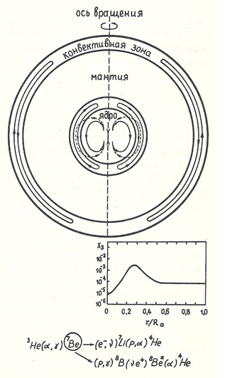
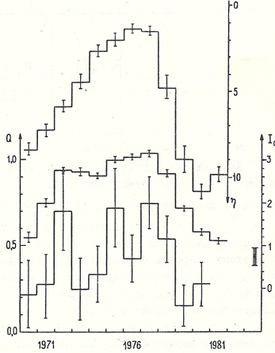
The seismonuclear mechanism of excitation of gravity modes (gravity waves)
The relationship of the counting rate of solar neutrinos with different manifestations of the 11-year solar activity cycle
The axis of rotation
$$δS=\frac{δQ}{T(r)}$$
when some portion of ${}_{}^{3}{He}$ that responsible for the production of heat 𝛿𝑄 is transferred, the entropy production 𝛿𝑆 decreases from a larger radius to the smaller. This corresponds to possible mechanical work.
Solar troposphere
Convective zone
Mantle
The supposed view of the streamlines in the core of the sun, describing the motion of substance in gravitational oscillations of the dipole type. The graph represents the equilibrium distribution of the mass concentration of ${}_{}^{3}{He}$, $X_{3}$ along the radius of the Sun.
The time course of annual values of the number of groups of sunspots (top curve), the rate of formation of ${}_{}^{37}{Ar}$, $Q$ in Brookhaven neutrino detector (middle curve), and of the flux of galactic cosmic rays, $I_{0}$ (lower curve).

Slide 12
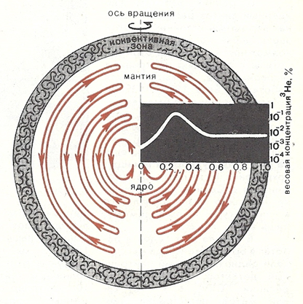
A possible model of the thermal pulsation of the Sun
There is higher content of ${}_{}^{3}{He}$ inside the Sun in the area of radii 0.2 – 0.4 its radius, which accumulates during the thermonuclear burning of hydrogen in chain reactions
${}_{}^{1}H\left(p,e^{+}ν\right){}_{}^{2}D\left(p,γ\right){}_{}^{3}{He}$. (1)
Under suitable conditions ${}_{}^{3}{He}$ could start to fade in the reaction
${}_{}^{3}{He}+{}_{}^{3}{He}→{}_{}^{4}{He}+pp$, (2)
causing thermal pulsation with Kelvin’s time scale.
A good explanation of geological periods! Enabling factors: the catalytic acceleration of reaction (1) and the resonance in the reaction (2).
The nature of the flows of substances that occur in the solar interior in the presence of gravitational fluctuations of the dipole type. The picture also shows the change in the mass concentration of ${}_{}^{3}{He}$ along the Sun's radius.

Slide 13
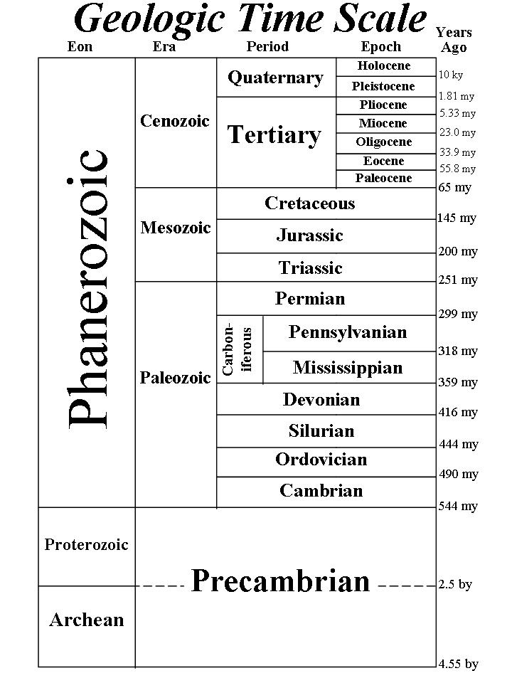
Geochronology and possible thermal Sun pulsations
If there would exist only thermal pulsations of the solar sphere, the characteristic time scale for the period of these pulsations would be tens of millions of years. This time scale is determined Kelvin scale $t_{K}$ of star cooling in its free gravitational compression:
$t_{K}=k∙1.54∙{10}^{7}\frac{M^{2}}{RL}$,
where $k$ – dimensionless coefficient ~1, and $M$, $R$ и $L$ – mass, radius and luminosity of the star in units of the corresponding quantities of the Sun.

Slide 14
The problem of nuclear catalysis in reactions of the hydrogen chain
In [Yu. S. Kopysov. Solar Neutrino and the Catalytic Role of a Third Particle in Hydrogen Burning. AIP Conf. Proc. 52, 28 New York, 1979.] discussed the possibility of accelerating of the collision of two protons with the third particle (with the nucleon), which formed the so-called activated nuclear complex (ANC). Such a nuclide could serve as the catalyst for the pp-reaction. It was noted in the report, that for the implementation of a catalytic process, ANC should be a friable core that provides a significant reduction of the Coulomb barrier between the interacting nuclei.
In the present work, the problem of the development of the "classical" astrophysical nuclear catalysis and of the theory of cold (laboratory) transmutation of atomic nuclei (cold nuclear transmutation), and the way to solve it by developing further the ideas discussed in the review is outlined. The term "classical" theory means that it is ad hoc not introduced a new entity, however, it is postulated the existence of new extended (friable) states which are not prohibited by any principles and can be obtained by solving the corresponding equations. We call such States the nuclear-molecular activated complexes (NMAC).

Slide 15
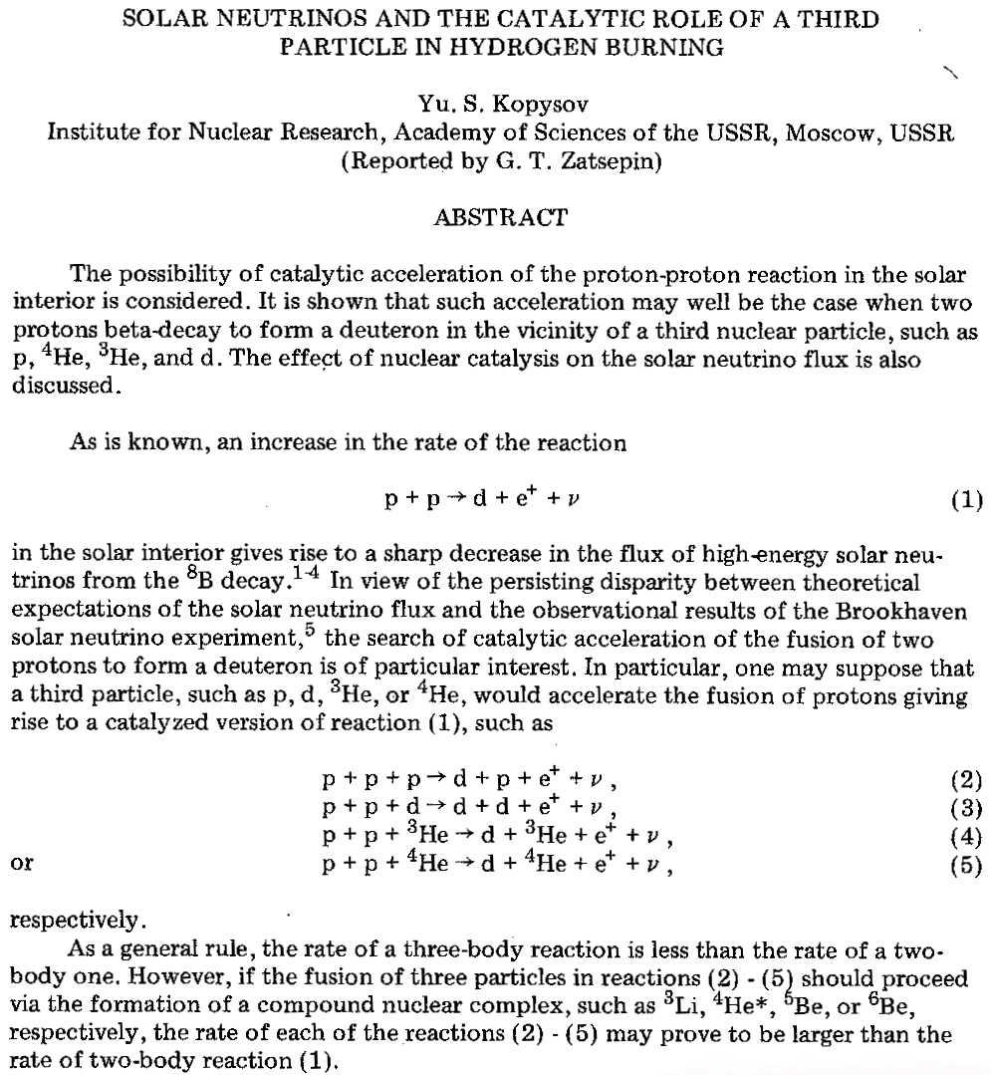
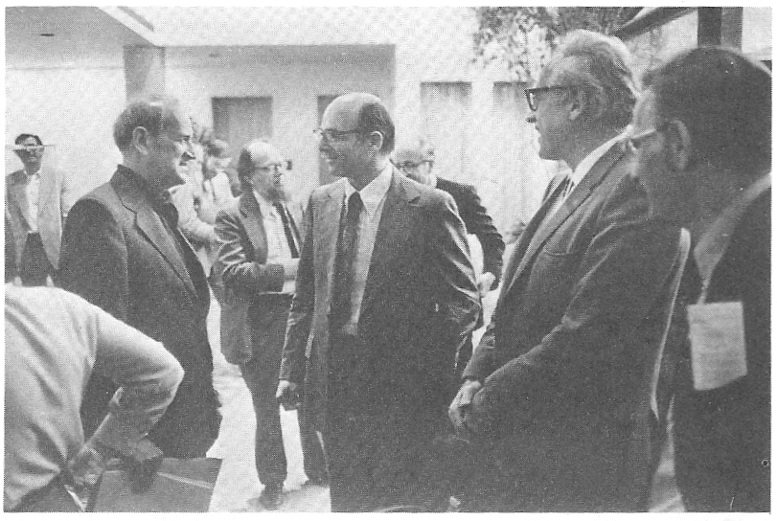
The cited work was presented at the memorial conference of the American physical society, dedicated to the memory of Cowen.
This report is another work from the series of research works dedicated to the centenary of academician G. T. Zatsepin, which aims to develop the theory of nuclear catalysis in chain reactions of hot and "cold" transformations of the hydrogen isotopes to helium isotopes and other heavier nuclei.
G. Zatsepin (left) conversing with (from left) K. Lande, F. Reines, N. Seeman. Background: L. Wolfstein, M. Shapiro.
Photos by Marvin T. Jones, Washington DC.
In this work it was noted that the nucleus ${}_{}^{6}{He}$ (alpha particle) can serve as the most likely catalyst. It meant the existence of a new level, lower than the main quasi-stationary state ${}_{}^{6}{Be}$ (g.s).

Slide 16
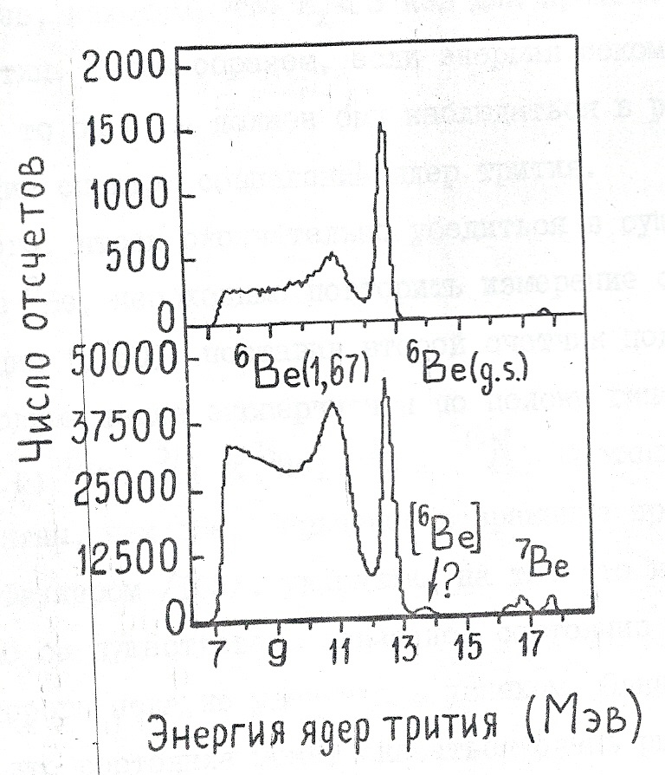
The experiment that indicates the possibility of existence in the ${}_{}^{6}{Be}$ the level below the ground state ${}_{}^{6}{Be}(g.s.)$.
The spectrum of the nuclei of tritium from reaction ${}_{}^{6}{Li({}_{}^{3}{He},{}_{}^{3}H){}_{}^{6}{Be}}$ when the energy of the incident particles is equal to 24 MeV.
The upper curve is the spectrum of the nuclei of tritium measured in the mode of coincidence with alpha-particles and protons.
The lower curve is the spectrum of isolated nuclei of tritium. Arrow with sign ? shows the location of the assumed friable state of $[{}_{}^{6}{Be}]$, lying below the ground state, marked with the symbol ${}_{}^{6}{Be}(g.s)$.
/164/ D.F.Geesman at al, Phys.Rev. C15, 1835 (1977).
The hypothesis: $\left[{}_{}^{6}{Be}\right]$ - nuclear-molecular activated complex consisting of an α-particle and correlated Cooper pairs of protons.

Slide 17
The possible nature of a new level of ${}_{}^{6}{Be}$
As can be seen from the figure, the possibility of the existence of the new level cannot be considered to be statistically secured.
Further experiments are necessary!
However, it is possible to give a theoretical explanation of the reasons for the existence of such level.
Let the level of the ${}_{}^{6}{Be}(g.s.)$, considered the main, describes by the single-particle shell model.
Lower level can be considered as consisting of an α-particle surrounded by a halo of correlated pairs (Cooper pairs) of protons.
This state may be implemented in nuclear-molecular crystal consisting of alpha particles and protons of the solar plasma in the solar interior.

Slide 18
Resonant nuclear-molecular activated complexes $\left[{}_{}^{5}{Li}\right]$ and $\left[{}_{}^{6}{Be}\right]$ in the solar plasma
$${}_{}^{3}{He}+{}_{}^{3}{He}⟹\left[{}_{}^{6}{{Be}^{∗}}\right]\begin{matrix}↗\begin{matrix}\begin{matrix} \\ {}_{}^{4}{He}\end{matrix}+p+p \\ \end{matrix} \\ ↘\left[{}_{}^{5}{Li}\right]+p \end{matrix}$$
There other ways of producing of ${}_{}^{5}{Li}$
$${}_{}^{4}{He}+2{}_{}^{3}{He}⇒\left[{}_{}^{10}{C^{∗}}\right]\left.\begin{matrix}↗{}_{}^{5}{Li}+{}_{}^{5}{Li} \\ ↘{}_{}^{4}{He}+{}_{}^{4}{He}+pp\end{matrix}\right\}$$
Ready-made blocks for nuclear-molecular crystals

Slide 19
Nuclear-molecular crystal composed of a chain of nuclei ${}_{}^{6}{Be}$
New (friable) states of nuclear matter
$${}_{}^{4}{He}$$
Proton Cooper pairs
With the penetration of Cooper pairs of protons into the nucleus ${}_{}^{4}{He}$ the cumulative mechanism to overcome the Coulomb barrier manifests.

Slide 20
The formation of a nuclear-molecular complexes in the solar plasma
In the central region of the Sun where the energy releases, in 1 ${cm}^{3}$ for 1 s are produced about ${10}^{8}$ fast protons in the interval from 0 to 12 MeV.
These protons in the process of energy loss have multiple elastic collisions with alpha particles and other protons of the plasma, forming a nucleus ${}_{}^{5}{Li}$.
The ${}_{}^{5}{Li}$ nuclei being a quasi-stationary states, resonance transfer their energy and proton to the neighboring alpha-particles forming a friable nuclear-molecular complex $\left[{}_{}^{9}B\right]$.
There is only the Coulomb interaction and the interaction of each alpha particle with a shared proton in this NMC between alpha particles.

Slide 21
Quantum-mechanical description of nuclear-molecular complex $\left[{}_{}^{9}B\right]$
$${\left({}_{}^{5}{Li}\right)}_{1}$$
$$p$$
$$α_{1}$$
$$α_{2}$$
$$d$$
The wave function of the nuclear-molecular complex $\left[{}_{}^{9}B\right]$:
$${\left({}_{}^{5}{Li}\right)}_{2}$$
|$\left.\left[{}_{}^{9}B\right]\right\rangle =\left\{\begin{aligned}|\left.1\right\rangle \left\langle {\left({}_{}^{5}{Li}\right)}_{1}α_{2} | \left[{}_{}^{9}B\right]\right\rangle \\ + \\ |\left.2\right\rangle \left\langle {\left({}_{}^{5}{Li}\right)}_{2}α_{1} | \left[{}_{}^{9}B\right]\right\rangle \end{aligned}\right.=$
$$=\left\{\begin{aligned}|\left.1\right\rangle C_{1} \\ + \\ |\left.2\right\rangle C_{2}\end{aligned}\right.$$
$$p$$
$$α_{1}$$
$$α_{2}$$
$$d$$

Slide 22
The Schrodinger equation for the nuclear-molecular complex $\left[{}_{}^{9}B\right]$
$$iℏ\frac{dC_{i}}{dt}=\sum_{k=1}^{2}{H_{ik}}C_{k}$$
$H_{11}=H_{22}=E_{r}+U_{кул.}(d)$; $H_{12}=H_{21}=Γ$
$$E_{I}=\frac{H_{11}+H_{22}}{2}+{\left\{{\left(\frac{H_{11}+H_{22}}{2}\right)}^{2}+H_{12}H_{21}\right\}}^{1/2}=E_{r}+U_{кул.}(d)+Γ$$
$$E_{II}=\frac{H_{11}+H_{22}}{2}−{\left\{{\left(\frac{H_{11}+H_{22}}{2}\right)}^{2}+H_{12}H_{21}\right\}}^{1/2}=E_{r}+U_{кул.}\left(d\right)−Γ$$
$|\left.I\right\rangle =\frac{1}{\sqrt{2}}\left(|\left.1\right\rangle −|\left.2\right\rangle \right)$; $|\left.II\right\rangle =\frac{1}{\sqrt{2}}\left(|\left.1\right\rangle +|\left.2\right\rangle \right)$
One can hope that the state II is stable at certain values of the parameters $E_{r}$ (resonance energy), $Γ$ (the level width) and the distance 𝑑.

Slide 23
On stability and thermodynamic properties of the nuclear-molecular hydrogen-helium crystal.
The presence of the Coulomb barrier strongly hinders the penetration of protons inside the resonating system.
However, a model of cumulative process we have proposed can greatly facilitate the overcoming of the Coulomb barrier.
Apart from the kinetics of formation of nuclear-molecular crystal, we will discuss dynamic properties and stability of such a crystal in the solar plasma. Nuclear-molecular crystal, consisting of alpha-particles and Cooper pairs of protons, is the activated complex, in which can leak pp-reaction. The existence of superfluidity of Cooper pairs and energy gap between the basic and excited States of the crystal may give to such a complex the special stability. Check the stability of the crystal using the criterion of Landau.

Slide 24
L. D. Landau in work 1941 got the formula for assessment calculations in the order of magnitude of the energy gap $Δ$ for liquid He II:
$$Δ≈\frac{ℏ^{2}ρ^{\frac{2}{3}}}{M^{\frac{5}{3}}},$$
where $M$ – the mass of a helium atom. If this formula is applied to the unit cell nuclear of molecular crystal, we obtain instead of the previous formula
$$Δ={\left(\frac{ℏc}{Mc^{2}V^{\frac{1}{3}}}\right)}^{2}Mc^{2},$$
where now 𝑀 is the mass of the unit cell, 𝑐 is the speed of light, 𝑉 – the volume of the elementary cell nuclear-molecular crystal composed of nuclei ${}_{}^{4}{He}$ and protons.
In our case, we have to take, instead of the mass of the helium, the mass of a Cooper pair of protons: $M=2M_{p}$. The table shows the results of calculation of Δ for different sizes of lattices (and Cooper pairs).

Slide 25
The table of values of the energy gap $Δ$(keV) depending on the mass of the cell M and its size $a$
M \ a | $${10}^{−13}$$ | $${10}^{−12}$$ | $${10}^{−11}$$ | $${10}^{−10}$$ | $${10}^{−9}$$ | $${10}^{−8}$$
$$M_{α}$$ | $${10,7∙10}^{3}$$ | $$107$$ | $$1,07$$ | $${1,07∙10}^{−2}$$ | $${1,07∙10}^{−4}$$ | $${1,07∙10}^{−6}$$
$${2M}_{p}$$ | $${2,133∙10}^{4}$$ | $$213,3$$ | $$2,133$$ | $${2,13∙10}^{−2}$$ | $${2,13∙10}^{−4}$$ | $${2,13∙10}^{−6}$$
From this table it can be seen that if the cell size is 10 fm, the magnitude of the energy gap is much more than the temperature of protons, which in the core of the Sun is ~1 Kev. This means that when the cell sizes of the crystal are ~10 fm or greater, the Cooper pairs can be in the superfluid state. There can occur a phase transition with the formation of the superfluid condensate in the form of nuclear-molecular crystals.

Slide 26
Conclusion
The possibility of existence of nuclear-molecular structures in the solar plasma and the possibility of pp-reactions in them are shown.
An additional release of energy can lead to formation of the ascending hot streams of solar plasma and the formation of cyclones, tornadoes and other vortex structures.
This, in turn, can support a slightly subadiabatic temperature gradient in the solar troposphere.
These phenomena can be considered as a new mechanism of solar activity.

Slide 27
Thank you
for
attention!

