Slide 1
Solar gamma-ray and neutron registration capabilities of the GRIS instrument onboard the International Space Station
Yu. A. Trofimov, Yu. D. Kotov, V. N. Yurov, E. E. Lupar, R. M. Faradzhaev, A. S. Glyanenko, A. V. Kochemasov
National Nuclear Research University MEPHI
2nd International Conference on Particle Physics and Astrophysics
(ICPPA-2016)
October 10-14, 2016

Slide 2
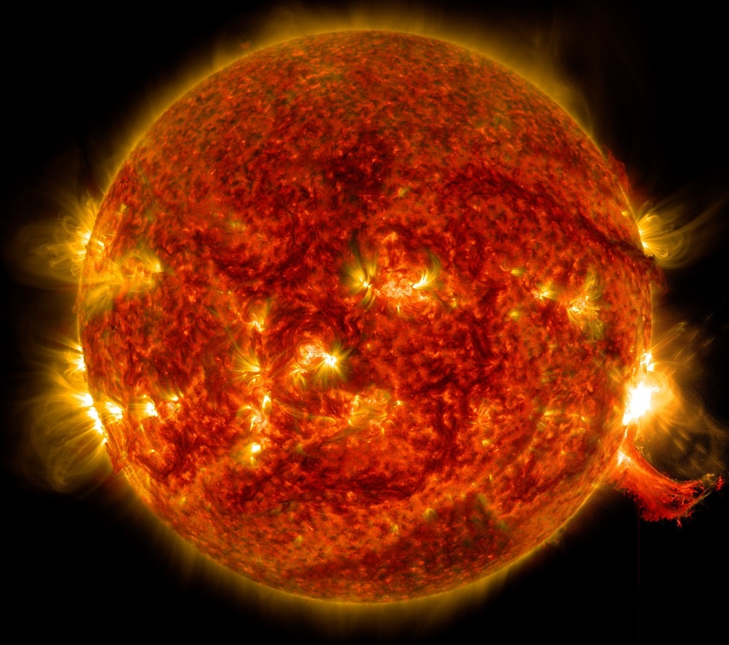
Solar flares
A solar flare is a huge explosion in solar atmosphere occurring as a result of energy release when the configuration of solar magnetic fields is changing (so-called magnetic reconnection).
SDO View of M7.3 Class Solar Flare on Oct. 2, 2014
NASA/Goddard/SDO

Slide 3
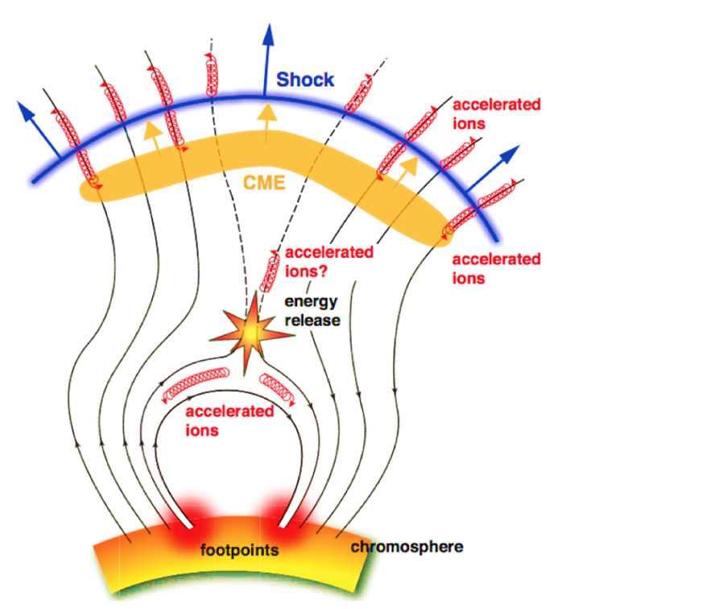
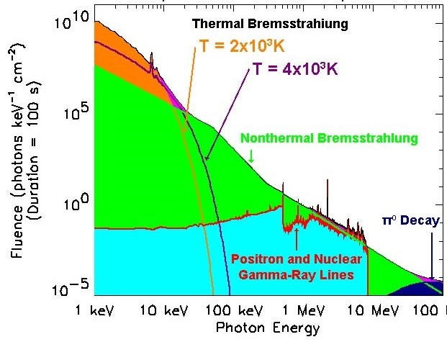
Gamma ray emission from solar flares
Electrons, protons and ions, accelerated by released energy, migrate along magnetic loops and interact with ambient plasma. These interactions produce hard X-rays, gamma-rays and neutrons via direct (e.g. bremsstrahlung) or secondary processes (e.g. exited nuclei or secondary particles generation).
X ray and gamma-ray spectrum of
a solar flare
The figure of Fermi LAT and
GBM Collaborations

Slide 4
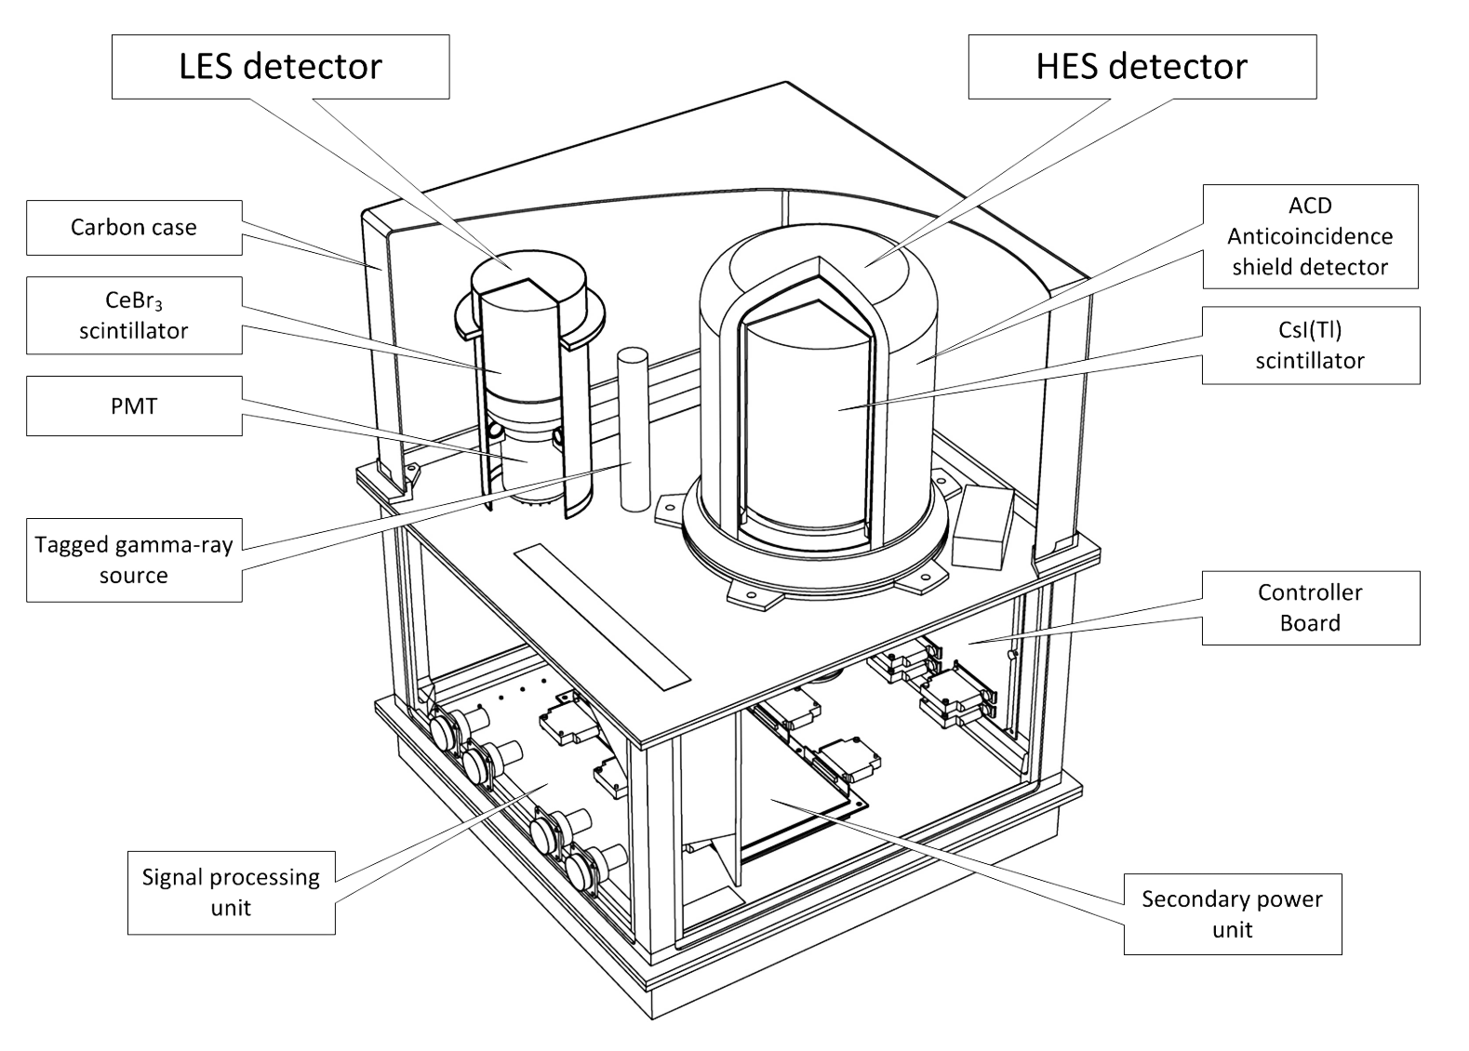
GRIS (Gamma and X-ray Irradiation of the Sun)
The instrument intends for spectroscopy of hard X-rays and gamma-rays of solar flares in the range of 50 keV – 200 MeV and for registration of solar neutrons with energies above 30 MeV.
The experiment will start onboard the Russian Orbital Segment of the International Space Station in 2020.

Slide 5
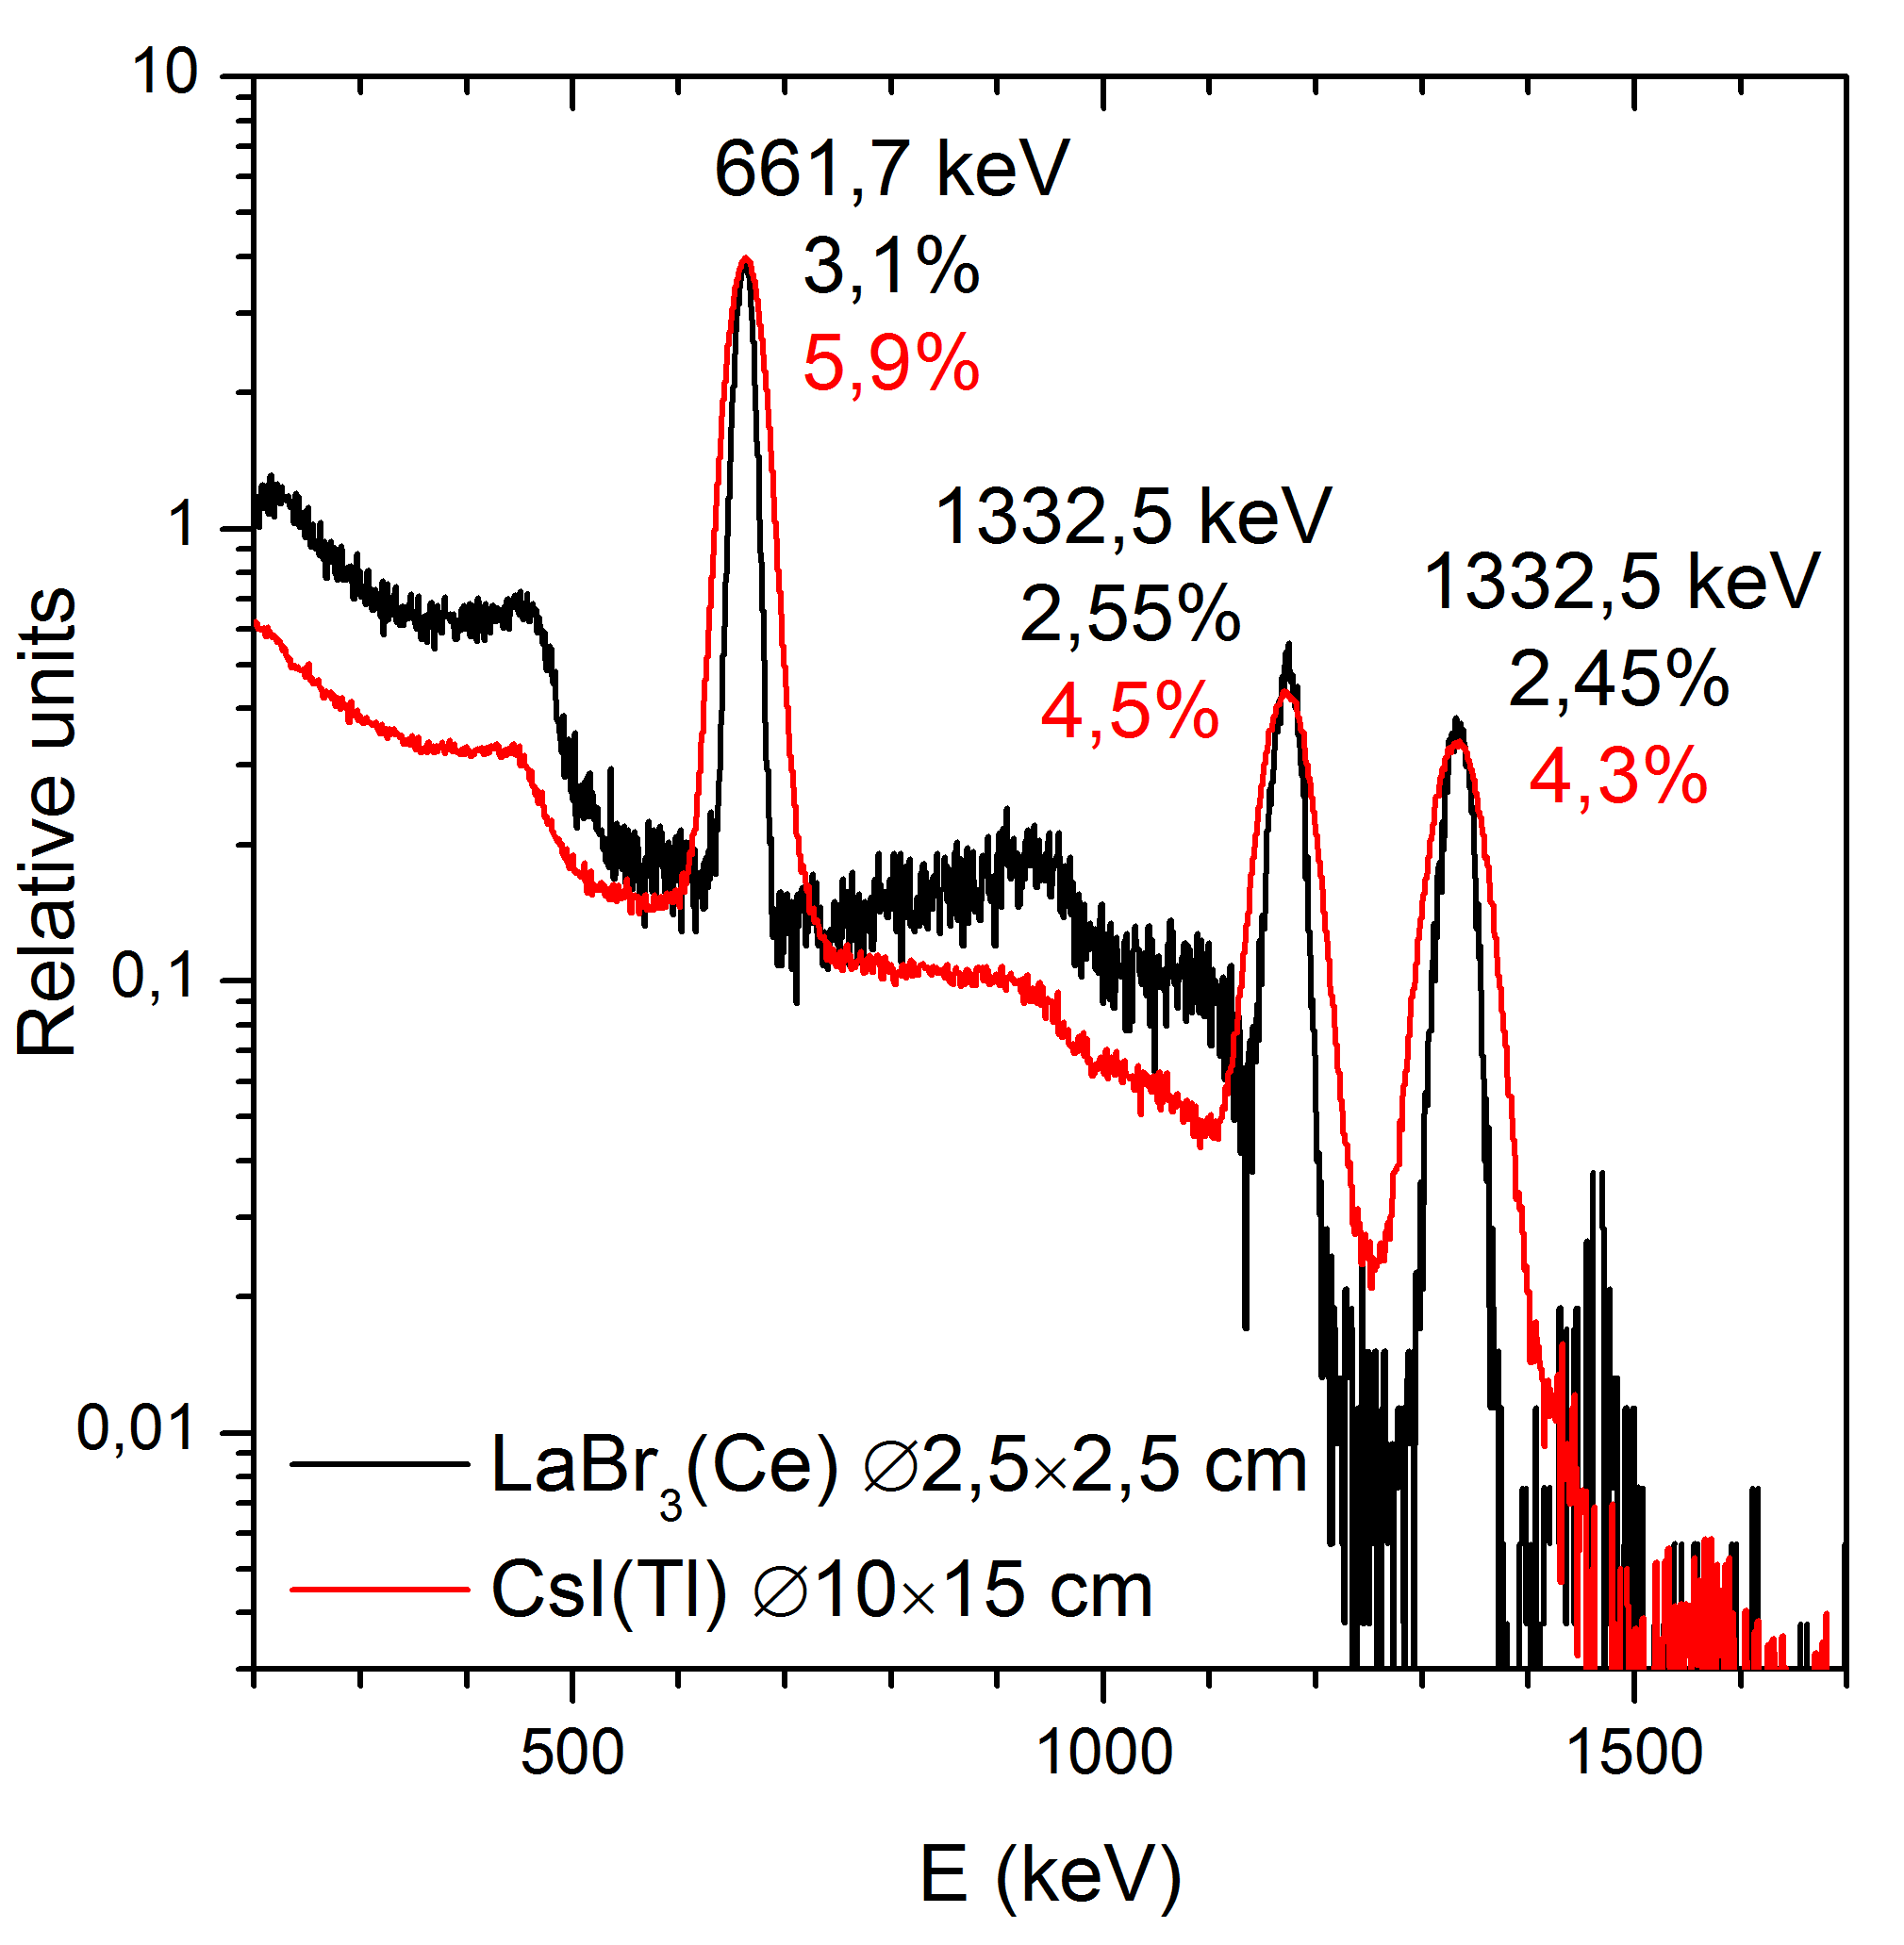
GRIS characteristics
¹³⁷Cs and ⁶⁰Co gamma spectra obtained with the LES and HES prototypes and FWHM of corresponding peaks
High Energy Spectrometer (HES)
Prime detector Shield detector Gamma Energy range Gamma energy resolution Neutron energy range n/γ discrimination quality | CsI(Tl) ø12×15 cm polystyrene scintillator 0.2 to 200 MeV 7-8 % FWHM @662 keV >30 MeV 1/1000
Low Energy spectrometer (LES)
Prime detector Gamma-ray energy range Gamma-ray energy resolution | LaBr₃(Ce) or CeBr₃ ø7.62×7.62 cm 0.05 to 15 MeV 3-4% FWHM @ 662 keV

Slide 6
GRIS detector unit location at the ISS
GRIS will be mounted on the biaxial oriented platform outside the Zvezda service module of the ISS. This platform will be used for maximization of the Sun observation time inside the detectors field of view (30°).
GRIS
Oriented
platform
Zvezda
module

Slide 7
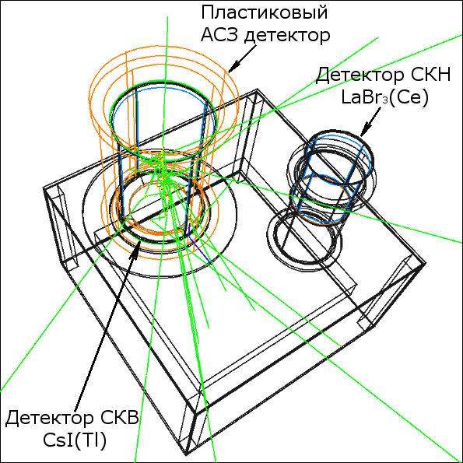
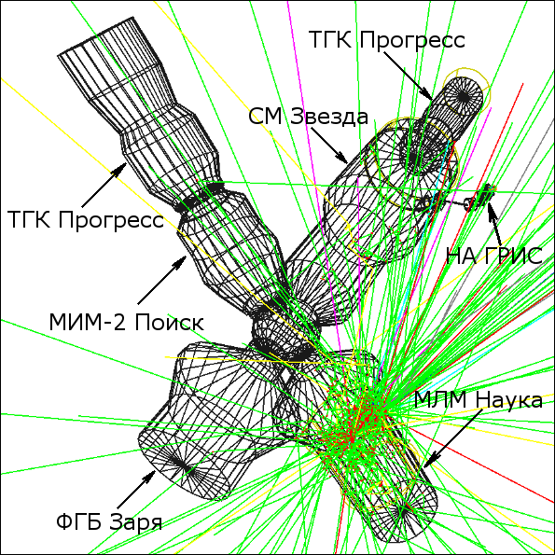
GRIS response simulation
Mathematical models of the GRIS detector unit and some of the ISS modules with dimensions, mass and chemical composition similar to real ones were developed for simulation with GEANT4 toolkit.
GRIS detector unit
Eγ = 200 MeV
ISS modules
Ep = 200 GeV

Slide 8
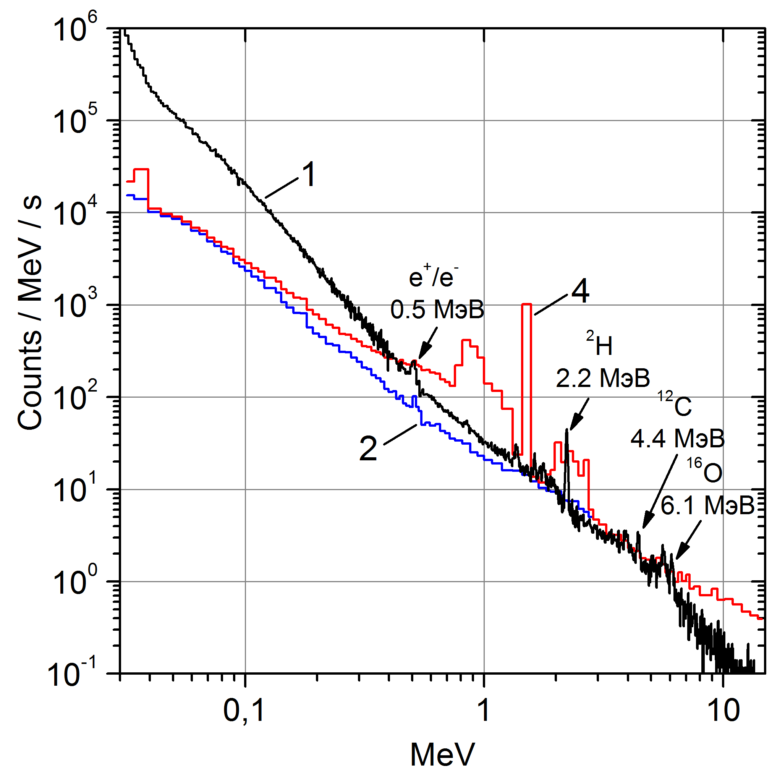
Simulation of LES response to the solar flare
SOL2002-07-23(X4.8)
1 – Response to the solar flare;
2 – Cosmic background count rate;
4 – Cosmic background + LaBr3(Ce) intrinsic activity.
G.H. Share, R.J. Murphy, J.G. Skibo et al. 2003, ApJ, Vol.595, P. 85-88

Slide 9
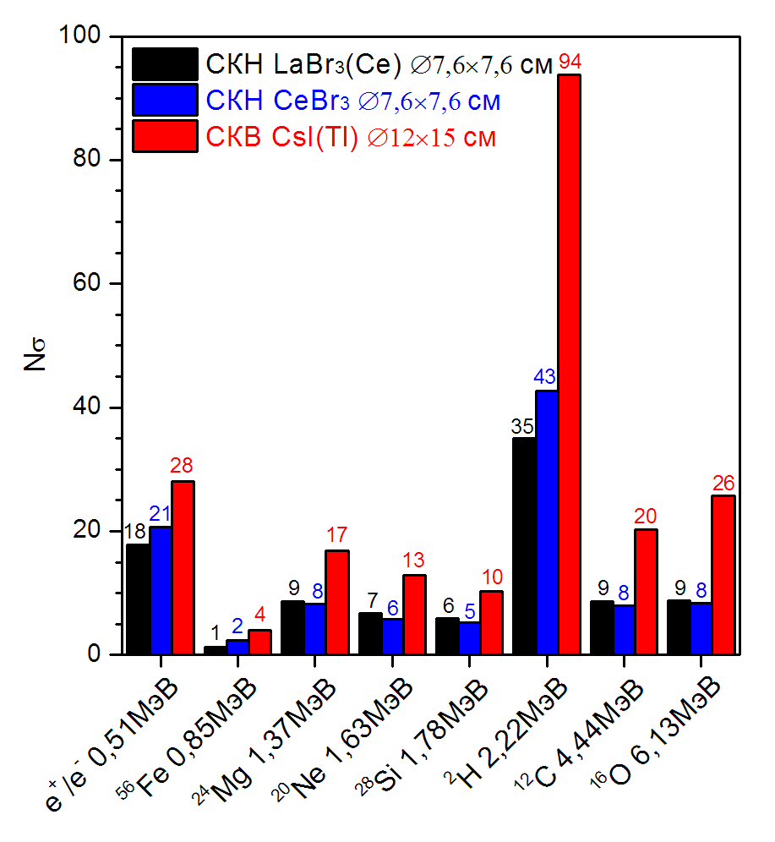
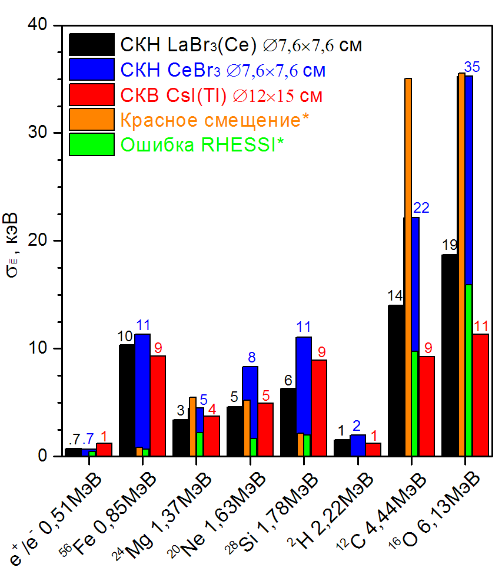
Gamma-lines in SOL2002-07-23 (X4.8) spectrum
Statistical significance of the gamma-lines counts relatively continuum component of the flare spectrum and the background
Measurement errors of gamma-lines energy of the GRIS and RHESSI detectors, as well as red shifts of the lines.
* Smith et al. 2003 ApJ. Vol. 595. P. 81-84

Slide 10
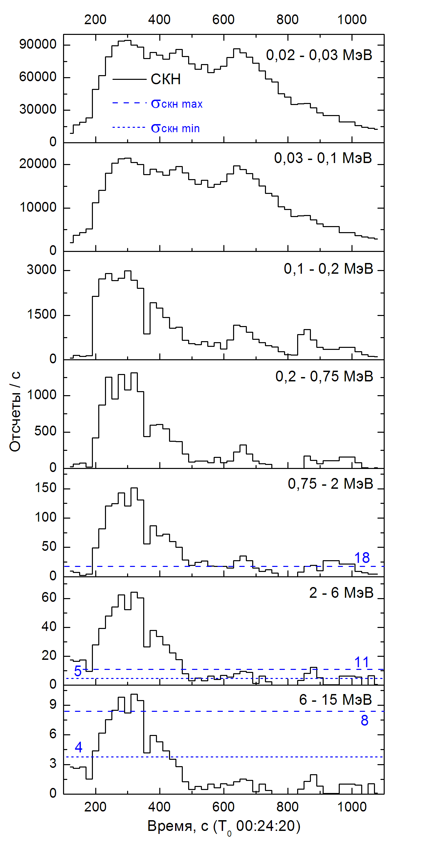
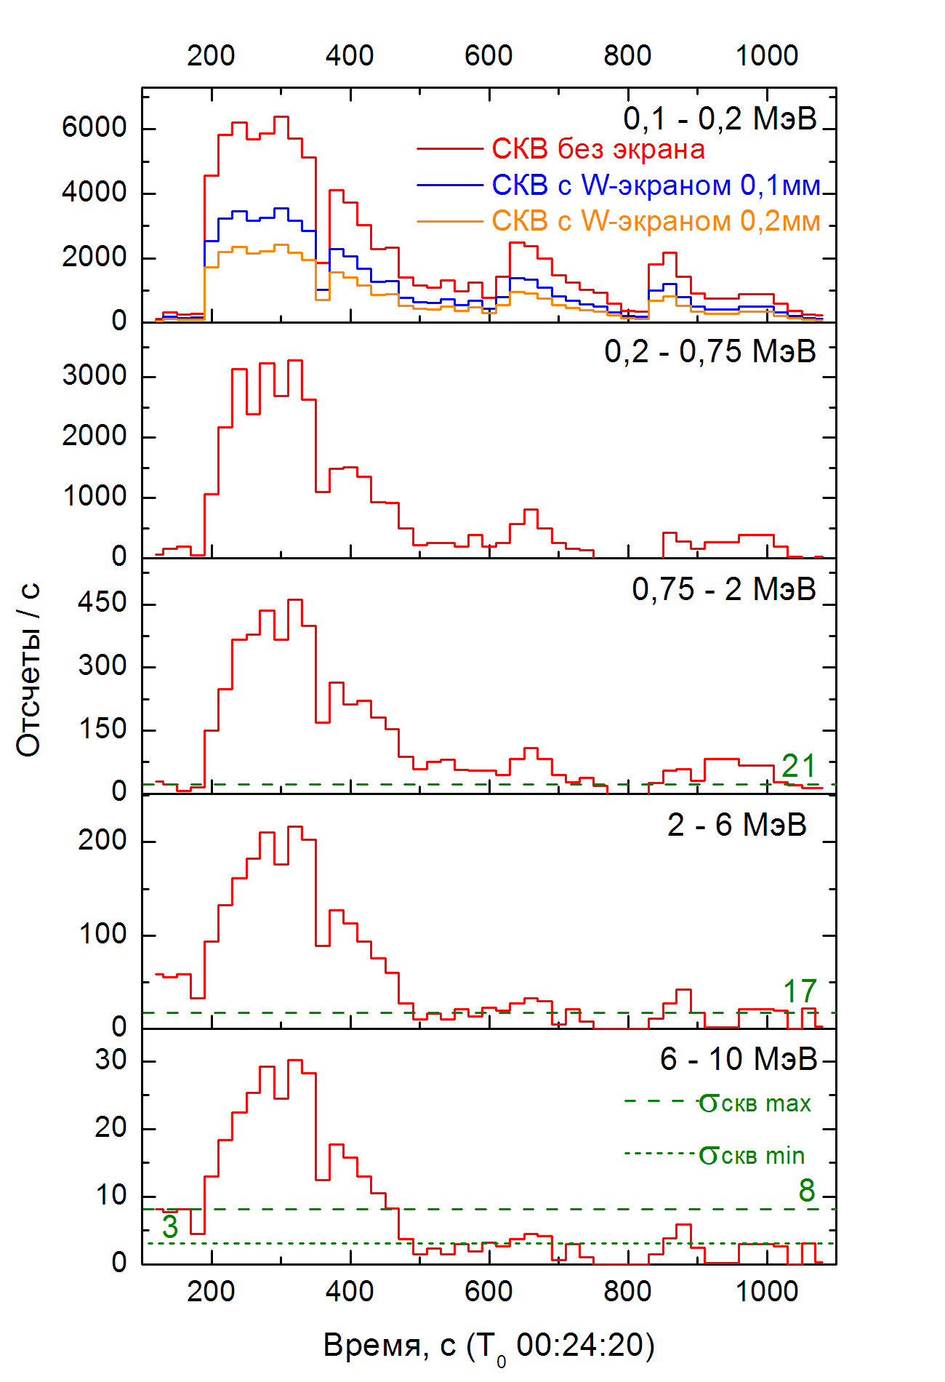
GRIS detectors count rates during
SOL2002-07-23 (X4.8)
Count rate (cts/s) | Dead time*
LES, threshold 30 keV
2×10⁴ | 2%
LES, threshold 20 keV
~10⁵ | ~10%
HES, threshold 200 keV
4×10³ | 4%
HES, threshold 100 keV
6×10³ | 6%
Time curve of HES and LES response to SOL2002-07-23 (X4.8) and standard deviation of the background for the best and the worst conditions.
* - for integration time of the signal 1 us for LES and 10 us for HES

Slide 11
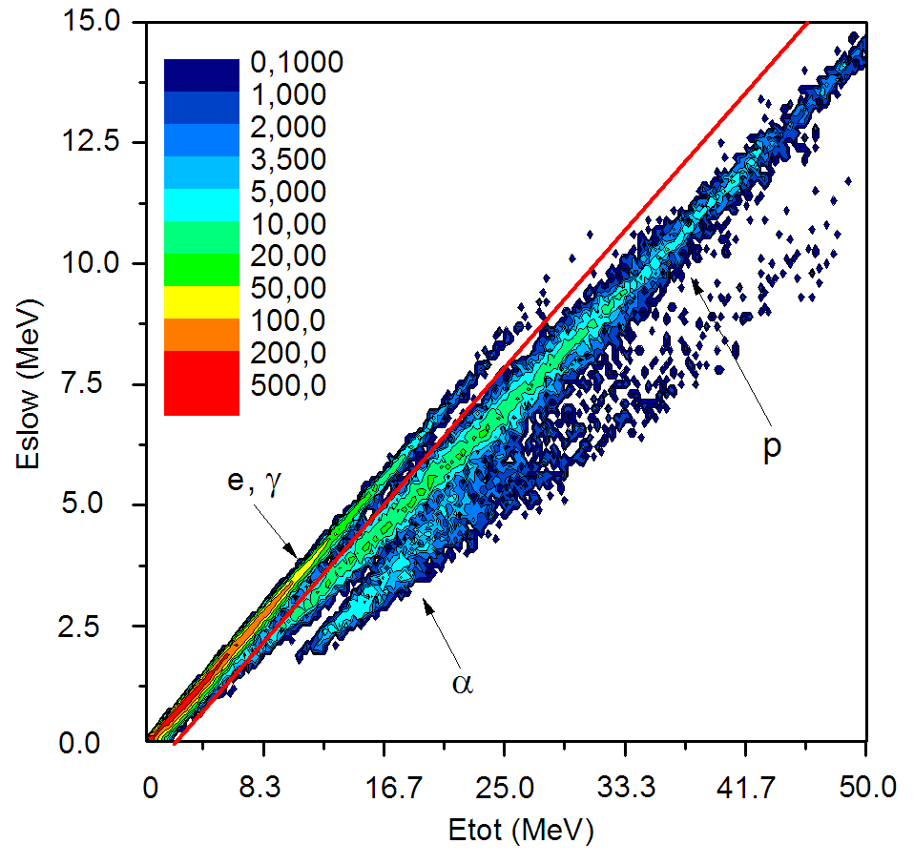

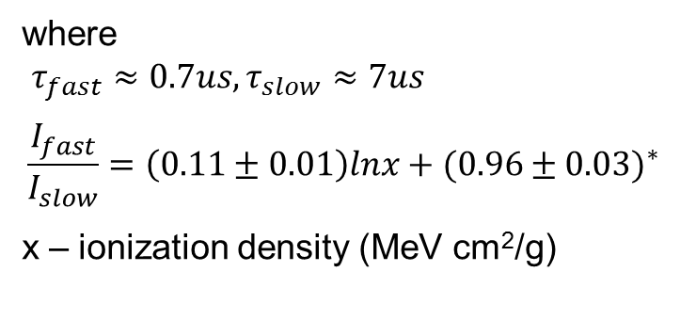
GRIS neutron response simulation
Light output of CsI(Tl) could be described as a sum of two exponents that associated with the fast and slow components:
$$L=\frac{I_{fast}}{τ_{fast}}e^{{−t}/{τ_{fast}}}+\frac{I_{slow}}{τ_{slow}}e^{{−t}/{τ_{slow}}}$$
where
$τ_{fast}≈0.7us, τ_{slow}≈7us$
$$\frac{I_{fast}}{I_{slow}}=\left(0.11±0.01\right)lnx+{(0.96±0.03)}^{∗}$$
x – ionization density (MeV cm²/g)
Simulated response of the HES detector to 50 MeV neutrons.
Eslow – integral of the slow component of the signal after 2.25 us
* Богомолов и др. 1996 ПТЭ №1 С. 13-19

Slide 12
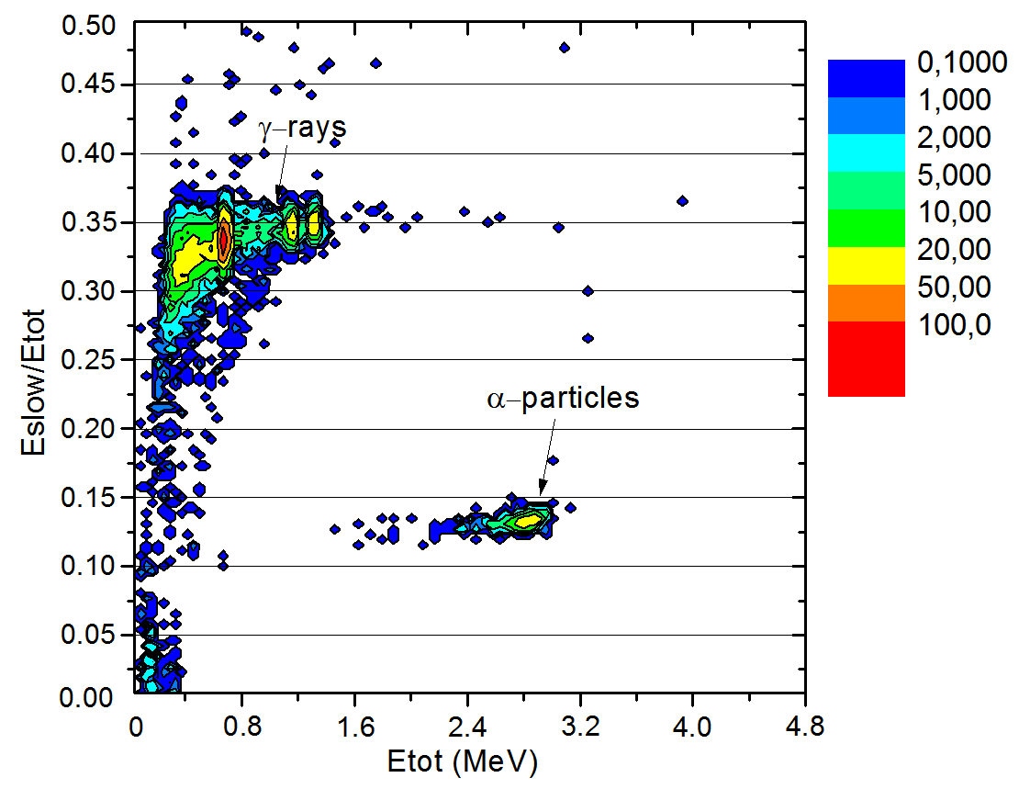
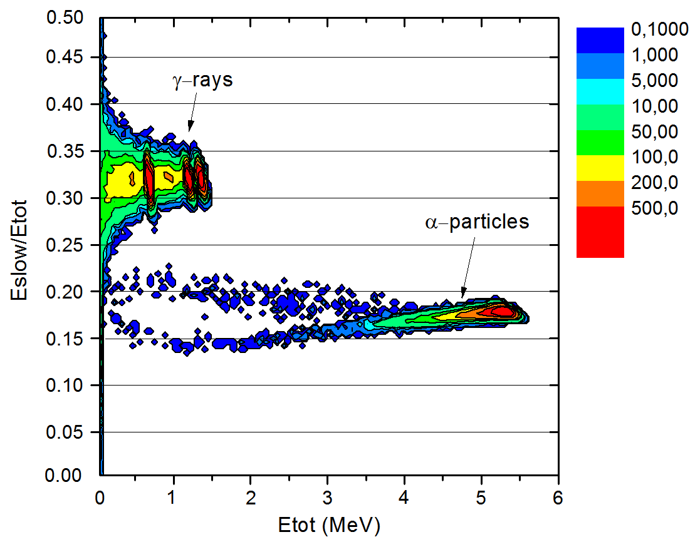
Comparison of the simulated response with the measurements
For verification of the mathematical model we compared the simulated response with the data obtained by a prototype of the HES detector. The figures represents the measured (left) and simulated (right) spectrograms of α-particles and γ-rays of sources ²⁴¹Am, ¹³⁷Cs and ⁶⁰Co
Measured response of a HES detector prototype to α-particles and γ-rays
FOM (>1MeV) = 8.2
Simulated response of the HES detector to α-particles and γ-rays
FOM (>1MeV) = 4.8

Slide 13
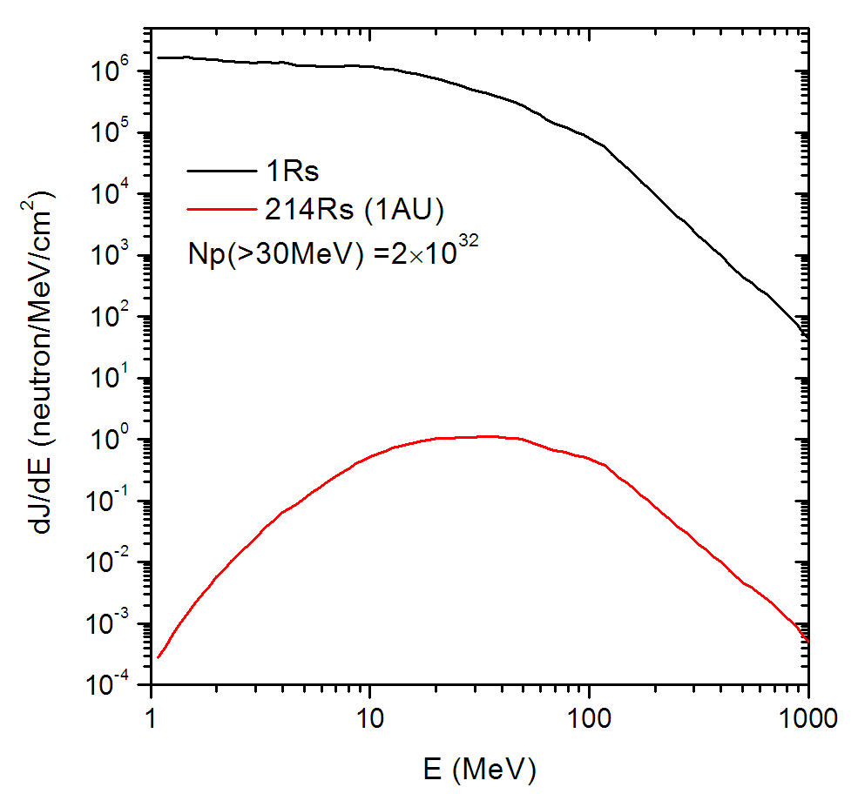
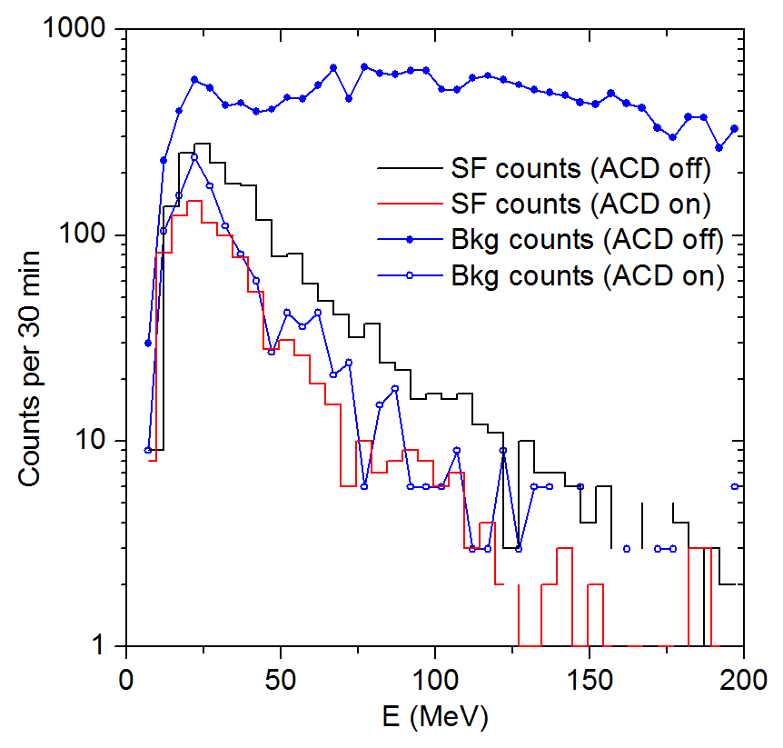
Simulation of HES response to solar flare neutrons
Spectrum of solar neutrons calculated for SOL2002-07-23 (X4,8) like flare.
Used data of
Murphy et al. 2006 ApJ Vol. 168
Response of the HES detector to solar neutron spectra at 1AU and background spectra for the same time at the equatorial region of orbit.

Slide 14
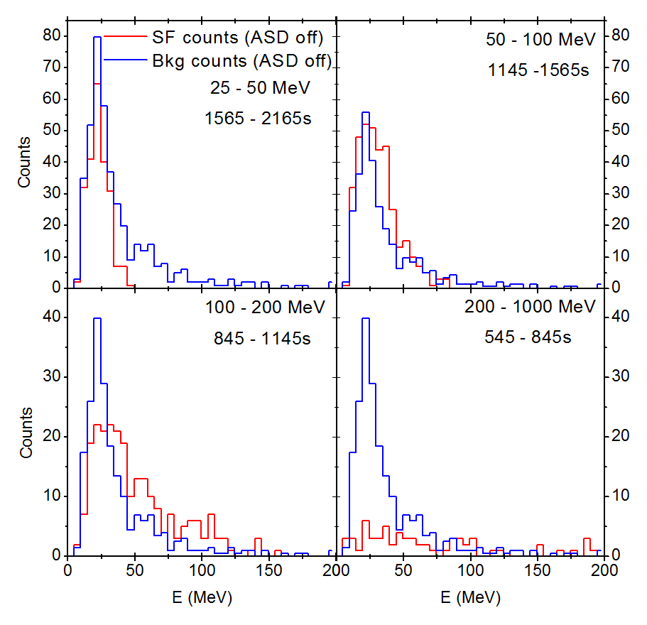
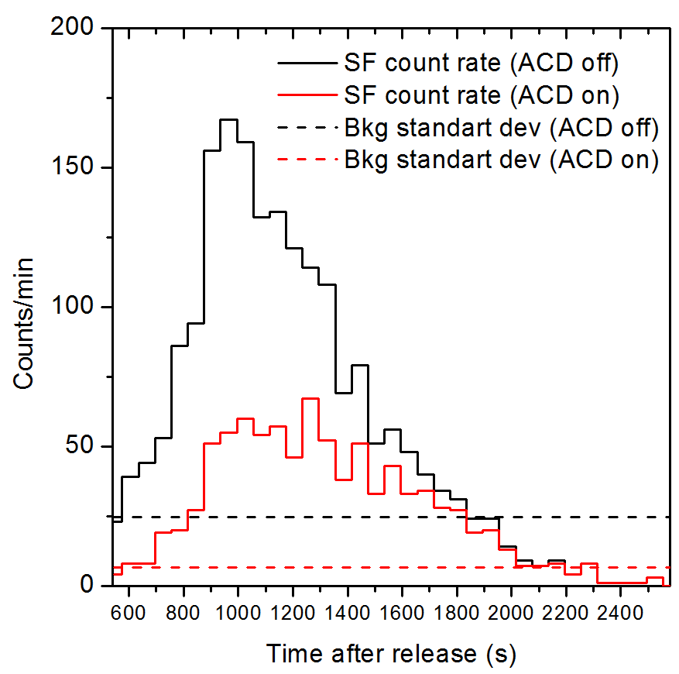
Simulation of HES response to solar flare neutrons
Neutron arrival time depends on the velocity of the particle, so we can estimate energy via time of registration with the assumption of noncurrent release.
Response of the HES detector to solar neutron spectra at 1AU at the particular time intervals and background spectra. ACD off for the all cases
Time curve of the HES response with and without ACD rejection and standard deviation of the background at the equatorial region of orbit.

Slide 15
Conclusion
The GRIS detectors have sufficient effective areas and energy resolution for precision spectroscopy of different components of solar flares spectra (narrow nuclear lines with high energy resolution on the one hand and fluxes of the solar neutrons on the other hand)
The two detectors approach of GRIS makes it possible to measure different spectral components of solar flares in the broad energy range: intensive fluxes of bremsstrahlung due to the fast LES detector, high energy pion decay radiation and direct solar neutrons by means of the HES detector and narrow gamma-ray lines by both detectors.

Slide 16
Thank you
for your attention!

