Slide 1
Computer modeling of PMT Hamamatsu R11410-20
Dmitry Akimov, Ekaterina Kozlova
NRNU MEPhI
ICPPA-2016, 10-14 October 2016, Moscow

Slide 2
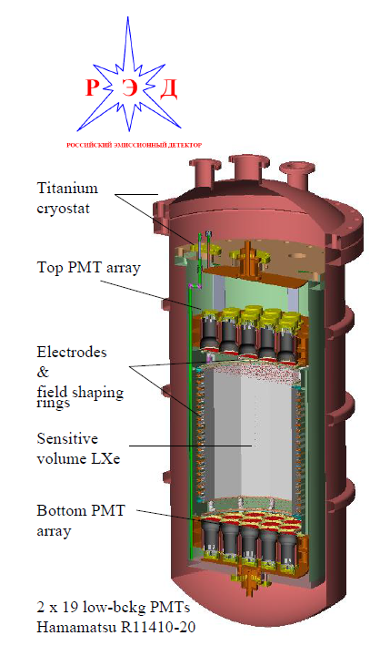
Emission two-phase detectors for rare processes
Electroluminescence signal is very intensive (about two orders higher than scintillation signal) ->coming to edge of linear PMT work
RED-100 inner construction

Slide 3
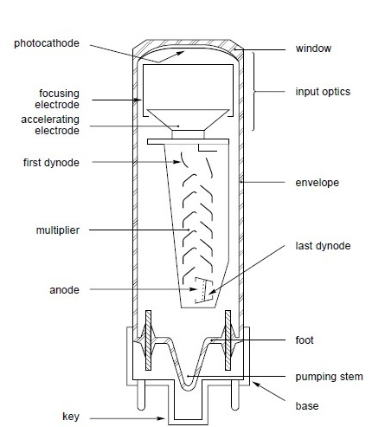
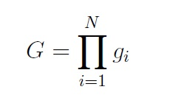
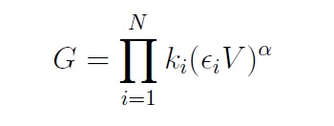
PMT’s principle of work
It is possible to describe reproduction on the i-th dynode with secondary emission coefficient δ and electron collection efficiency coefficient n:
where k and α are coefficients depending dynode’s behavior.
Based on this, it is possible to represent gain for each dynode:
Accordingly, total gain is:
Or the overall gain can be expressed in terms of the high-voltage supply:
where V is supply voltage, ε_{i} is a fraction of the supply voltage VB owed to the action of the voltage divider circuit.

Slide 4
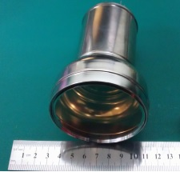
PMT’s principle of work
Voltage divider circuit for R11410-20
For each dynode ε is:
R_{i} is resistance of i-th circuit part and R is total resistance.
PMT R11410-20

Slide 5
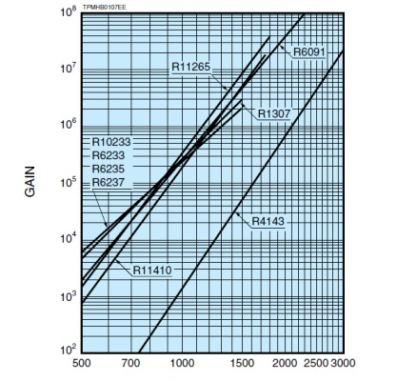
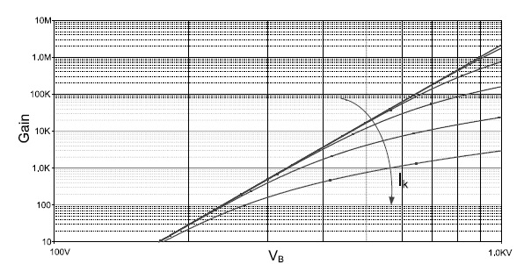
PMT’s principle of work. Gain dependence on supply voltage
Dependence on voltage:
Deviation from power law at high anode currents
Sample gain dependences on voltage for some Hamamatsu models

Slide 6
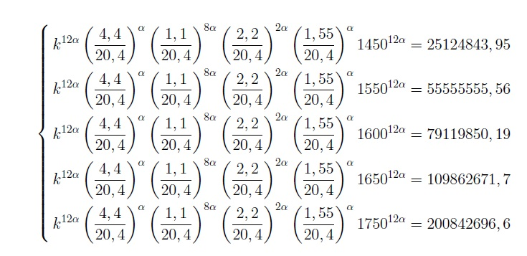
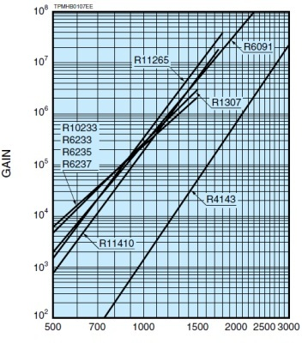
Coefficients calculation at formula
From experimental data for PMT №KB0278:
Solution is:
For Hamamatsu typical gain:

Slide 7
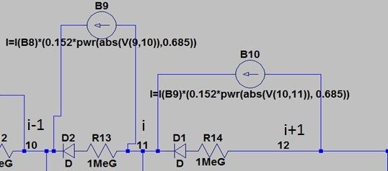
First divider models
For current reconstruction between i-th and i+1-th dynodes arbitrary behavioral dependent source was used and current can be set according to formula:
right
wrong
Simplified scheme

Slide 8
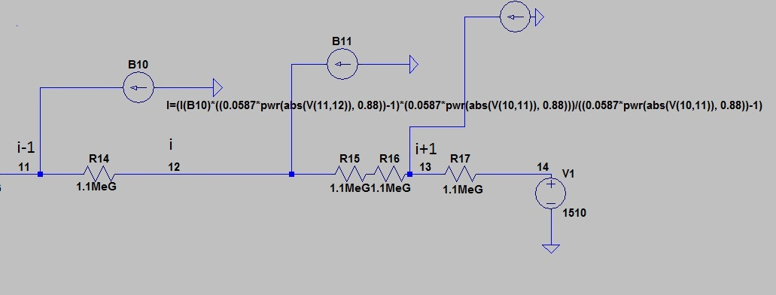
First divider models
Dynode current is:
Anode current is:
right
wrong
That model is also wrong because potential is changing incorrectly during work.

Slide 9
Problems and solutions
And problem in PMT modeling was found – because of voltage source has zero resistance, current from last dynodes flows through it to earth and don’t come to divider circuit. It leads to incorrect potential between dynodes and accordingly to incorrect total gain.
And there are solution – let’s change voltage source to current voltage-controlled source! Current source has infinite resistance!

Slide 10
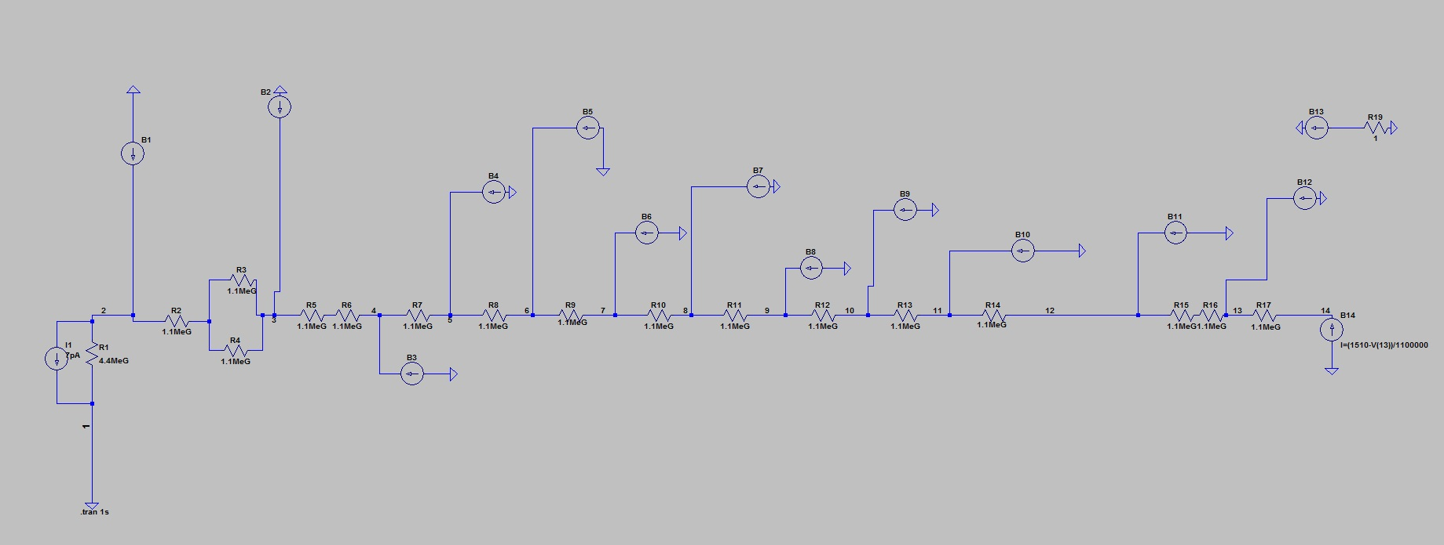
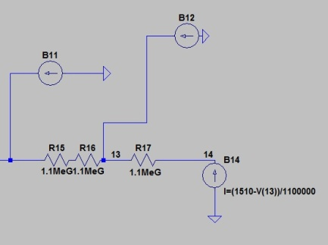
Final model
Divider current is determined instead of voltage source by current source which is controlled by potential difference between last dynode and anode:

Slide 11
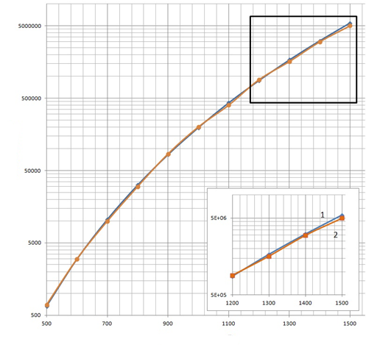
Modeling results, G=f(V)
Gain
Voltage, V
Gain dependence on supply voltage. Model(1) and experimental (2) characteristics for PMT№ KB0278
Gain dependence on supply voltage. Model(1) and typical gain(2) characteristics for Hamamatsu R11410-20

Slide 12
Modeling results, G/G0=f(Ia)
Gain dependence on anode current for PMT № КВ0278: 1 - experimental, 2, 3, 4, 5 – modeling for Ri = 1,5, 1,1, 1 и 0,5 MOhm

Slide 13
Modeling results, G/G0=f(Ia)
Experimental (1) and model (2) gain dependences (for R = 1.1 MOhm) on anode current for PMT № КВ0278 enlarged

Slide 14
Conclusion
A SPICE model for the simulation of the divider behavior of a PMT has been constructed. Model parameters were extracted from experimental and typical Hamamatsu gain. Problem with incorrect potential behavior was found and solved (as we know, first time in the world). The results of simulation are in a reasonable agreement with the experimentally measured characteristics of the PMT with serial # KB0278. The model can be used for simulation of any type of PMT.

Slide 15
Thank you for attention!

