Slide 1
Hybrid method for identifying mass groups of primary cosmic rays in the joint operation of IACTs and wide angle Cherenkov timing arrays
E.B. Postnikov¹, A.A. Grinyuk², L.A. Kuzmichev¹,
L.G. Sveshnikova¹, L.G. Tkachev²
¹SINP MSU, Moscow; ²JINR, Dubna

Slide 2
Slides
Joint operation of 2 kinds of installations
TAIGA experiment
5−7. TAIGA site
TAIGA setup
Wide angle timing array
IACT
Cosmic ray rejection
12−13. Hillas technique
14−15. Night sky background
Stereo technique
Hybrid technique
New set of parameters for hybrid analysis
Optimal parameter combination and cosmic ray rejection quality
Discrimination of primary nuclei
21−22. Hillas technique for nuclei
Optimal parameter combination and discrimination quality
Conclusion

Slide 3
Joint operation of 2 kinds of installations
TeV and sub TeV gamma-ray astronomy → stereo IACT
Ultra high energy gamma-ray astronomy (>30 TeV) → TAIGA
(Tunka Advanced Instrument
for cosmic ray physics and Gamma-ray Astronomy)
Cost-effective timing-array technique + IACTs:
area up to a few km²;
(dα~0.1⁰ at >100 TeV) → strong suppressing hadron background

Slide 4
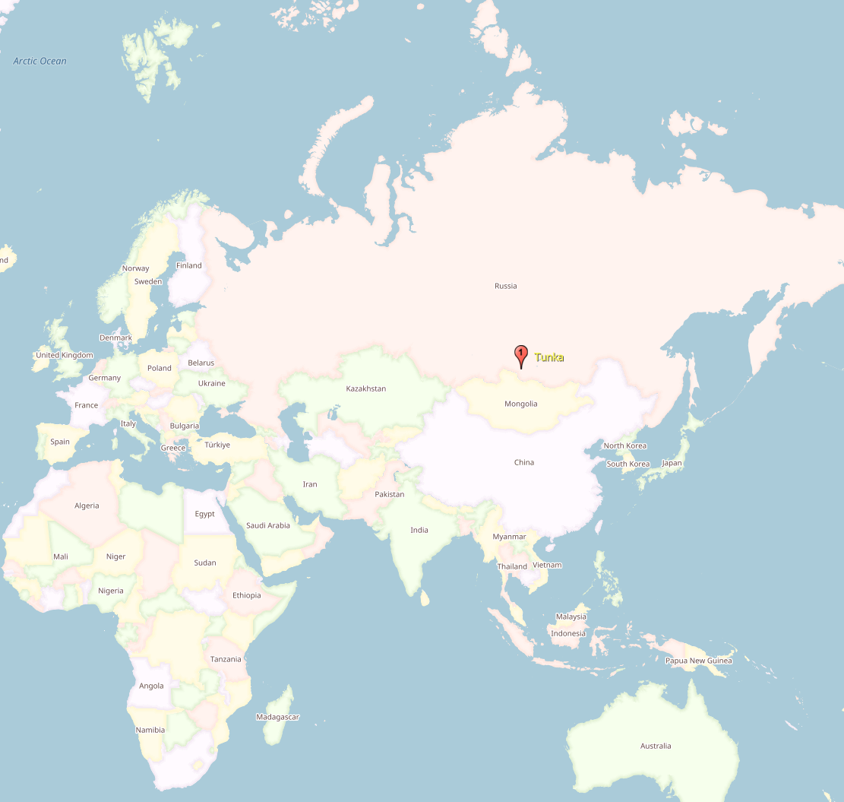
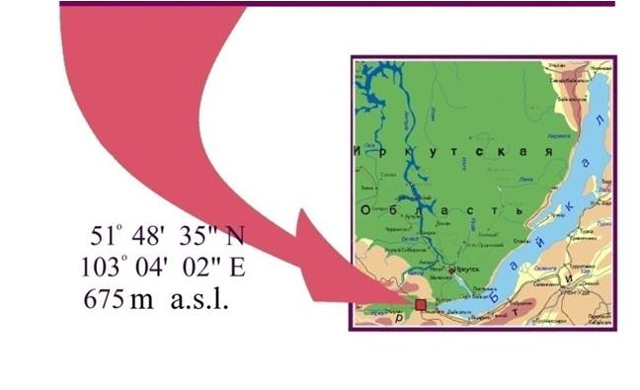
TAIGA experiment
Location

Slide 5
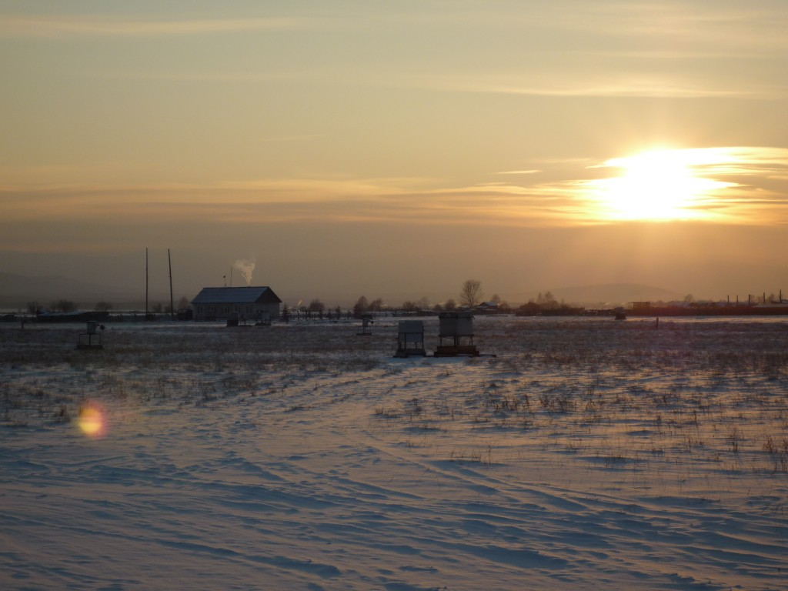
TAIGA site

Slide 6
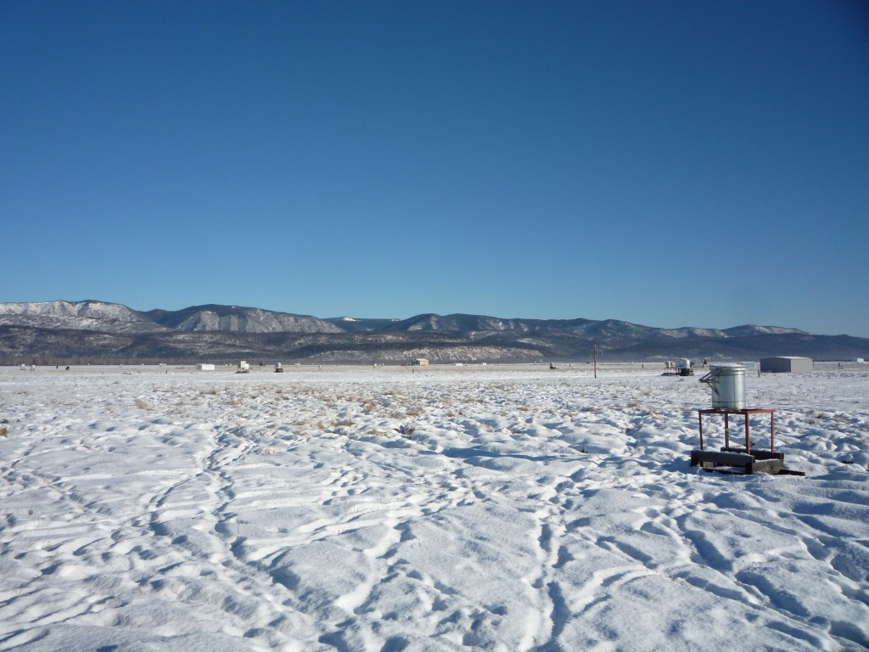
TAIGA site

Slide 7
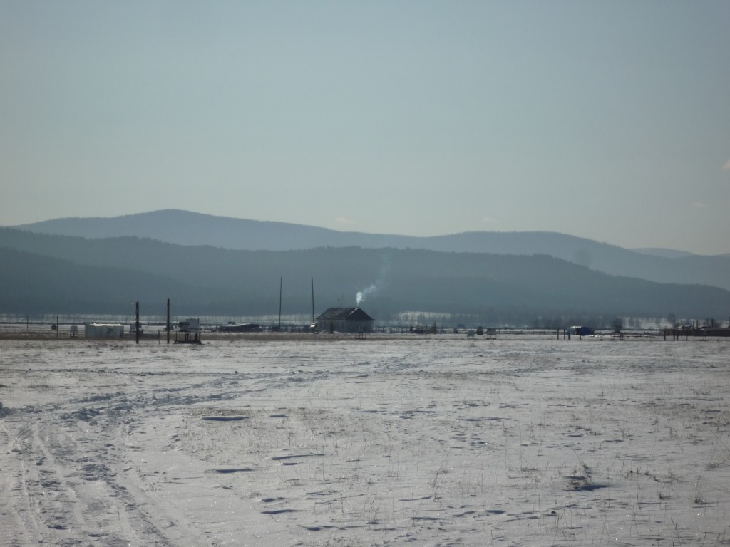
TAIGA site

Slide 8
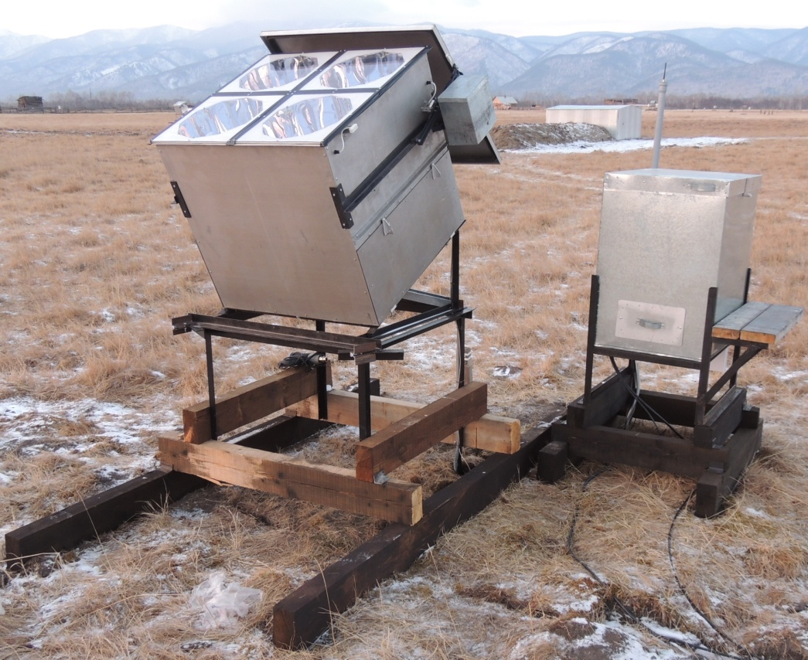
TAIGA setup
28 wide angle stations on the area 0.25 km²
(prototype 2015/2016)
an IACT (since 2017)

Slide 9
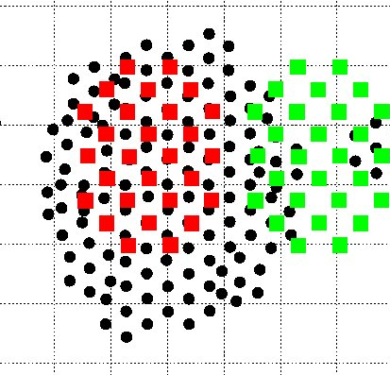
TAIGA arrangement
1200 m
Current
wide angle
stations
600 m
Future wide angle stations
Optical detectors of Tunka-133

Slide 10
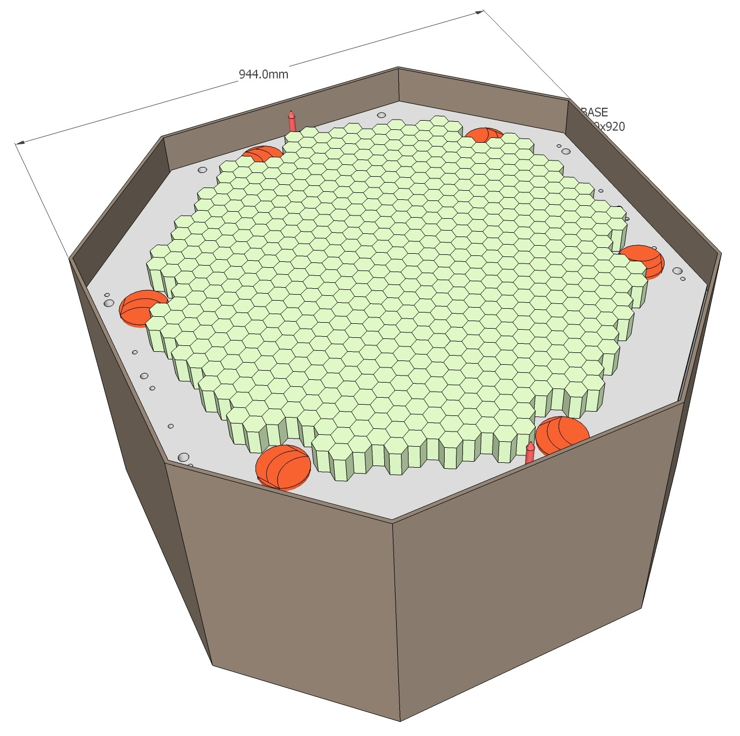
IACT
34 mirrors
of 60 cm Ø
D = 4.32 m, F = 4.75 m
Camera : 547 PMTs 15 mm Ø
1 single pixel = 0.36⁰
full angular size 9.6х9.6⁰
Energy threshold ~1.5 TeV
Commission of the telescope – October 2016

Slide 11
Cosmic ray rejection
Gamma ray showers ← CR background several orders of magnitude more abundant (mostly protons)
Image features (IACT)
Arrival direction (non-imaging arrays)

Slide 12
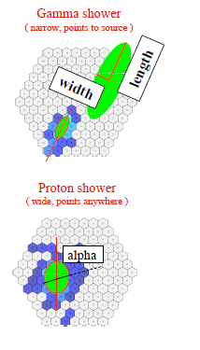
Cosmic ray rejection:
Hillas technique
Gamma
−
Proton
discrimination

Slide 13
Cosmic ray rejection:
Hillas technique
Gamma
−
Proton
discrimination

Slide 14
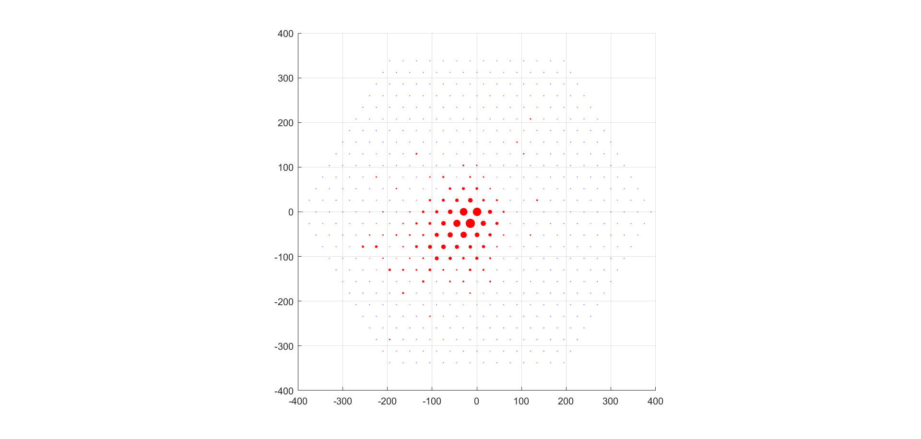
Night sky background (off)

Slide 15
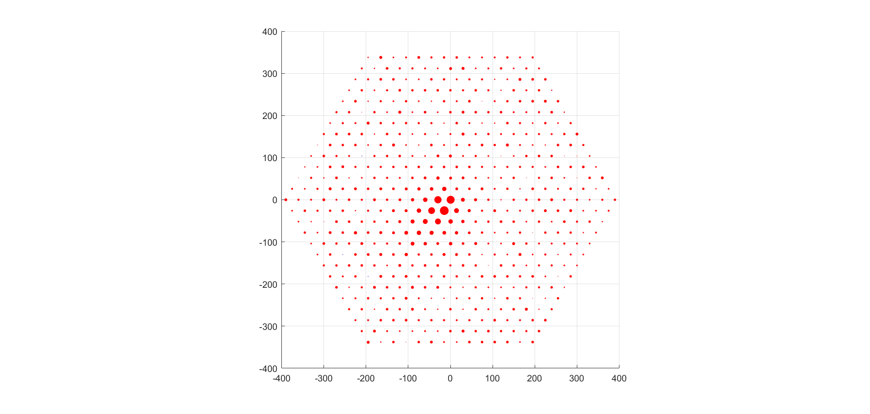
Night sky background (on)

Slide 16
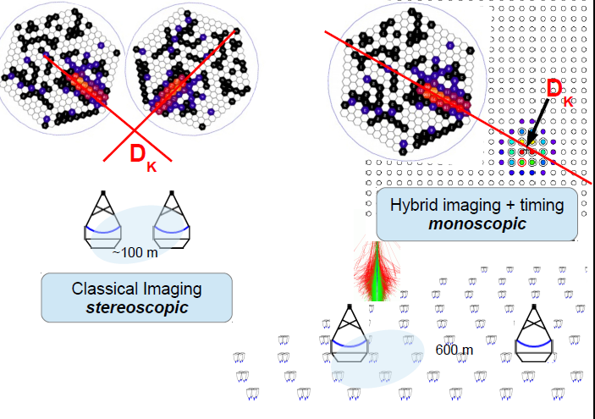
Core position reconstruction: stereo technique

Slide 17
Core position reconstruction: hybrid technique

Slide 18
New set of parameters for hybrid analysis
Timing arrays shower reconstruction data:
  Source direction (±0.1−0.4⁰)
  Core position (±10−15 m)
  Energy (~15%, up to ~5%)
IACT Image

Slide 19
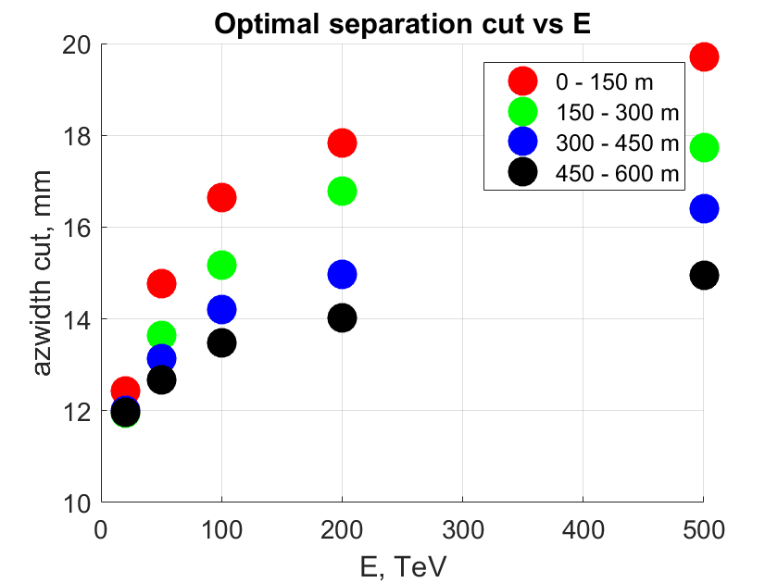
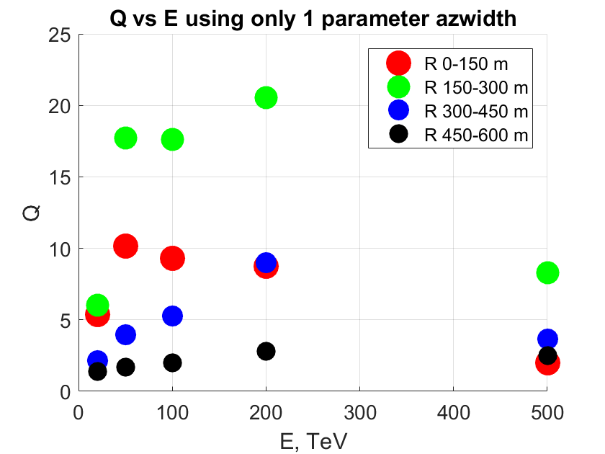
Optimal parameter combination and cosmic ray rejection quality
Q = Significance after selection / Significance before selection
Q = (N_{γ after}/N_{γ}) / (N_{p after}/N_{p})^{1/2}

Slide 20
Discrimination of primary nuclei
CR mass composition (hundreds of TeV) – can we distinguish between nuclei and protons?
TAIGA is Tunka Advanced Instrument for cosmic ray physics and Gamma-ray Astronomy, so cosmic ray is also an option. What is about hybrid technique in this case?

Slide 21
Cosmic ray rejection:
Hillas technique
Both protons
and nuclei
arrive
from isotropic
directions →
alpha parameter

Slide 22
Cosmic ray rejection:
Hillas technique
Both protons
and nuclei
arrive
from isotropic
directions →
alpha parameter
azimuthal width
So again:
Core position
Energy
Hillas parameters
(this time
no azwidth)

Slide 23
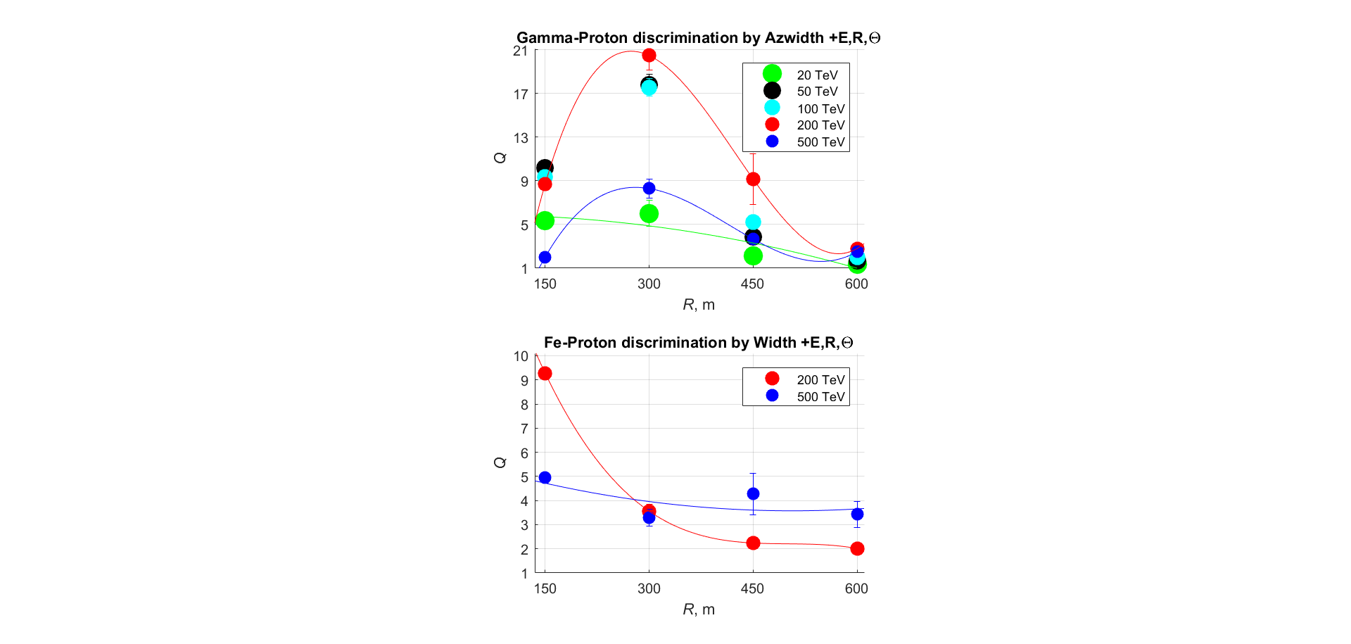
Optimal parameter combination and discrimination quality

Slide 24
Conclusion
Gamma-proton: Q>5 (E>50 TeV, R<450 m)
x100 in ~0.4⁰
Fe-proton: Q>2 (E>200 TeV, R<600 m)
x16 in ~5⁰
Selection of both gamma and nuclei is quite possible
Joint operation of two kinds of installations is significant

Slide 25
Backup slides

Slide 26
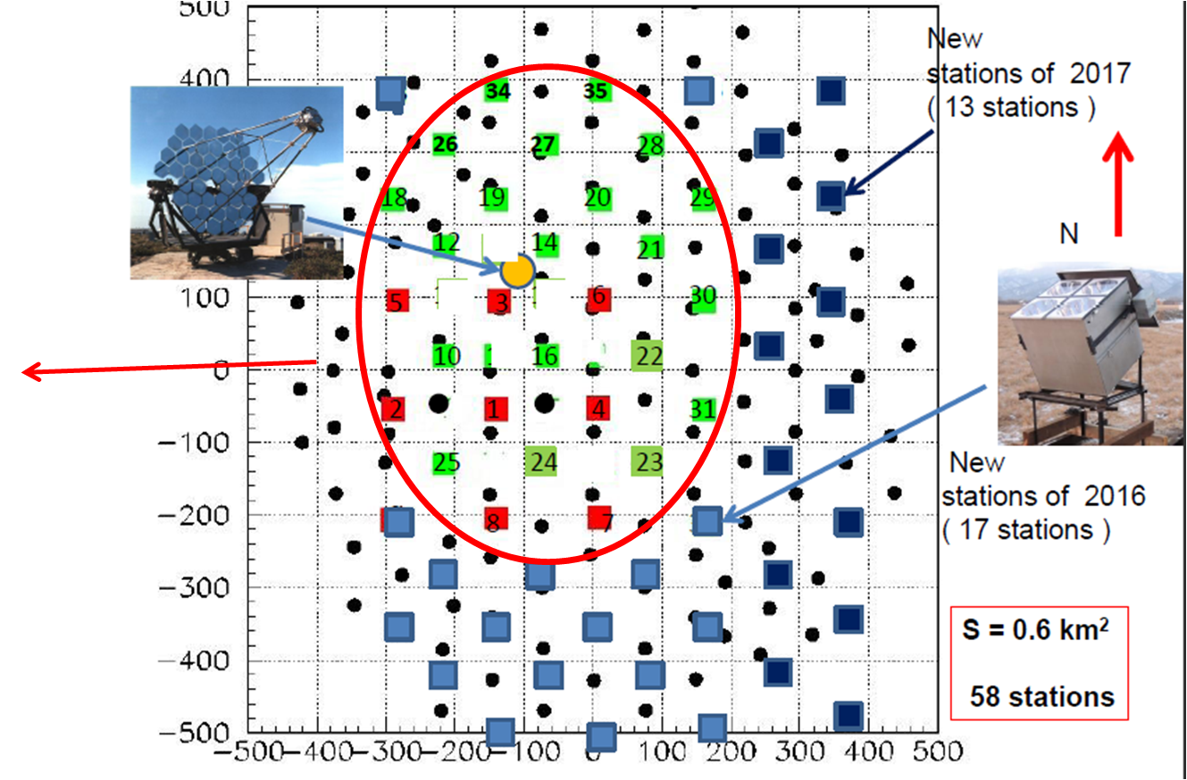
Wide angle timing array
28 detectors
106 m distance
0.25 km²
All stations
are tilting
to the South (25⁰)

Slide 27
Рис. 2. Зависимость оптимального порогового значения ширины имиджа (а) и достигающегося при этом пороге Q-фактора (б) от первичной энергии ШАЛ. Тип маркера соответствует расстоянию до оси ШАЛ: 0–150 м (1), 150–300 м (2), 300–450 м (3), 450–600 м (4)

Slide 28
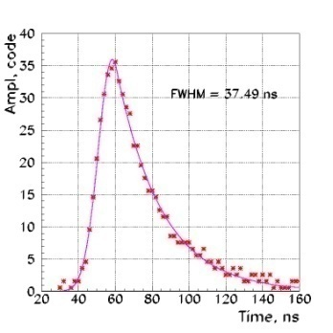
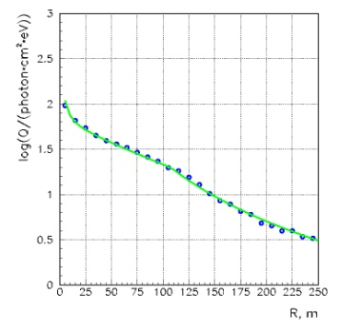
Registration of Cherenkov light from EAS
θ, φ
Accuracy: core location ~ 10 m
Energy resolution ~ 15%
: P
X_{max}
X₀

Slide 29
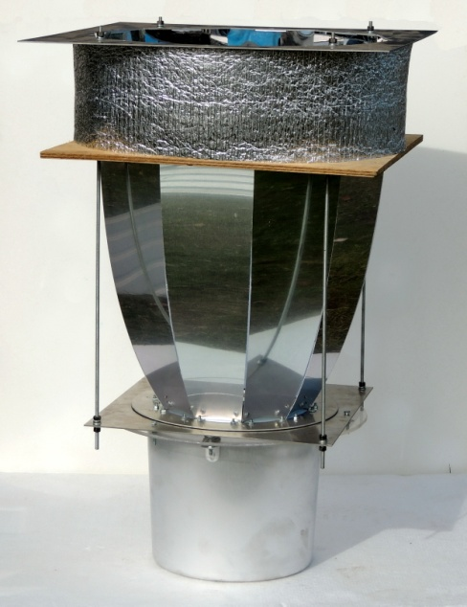
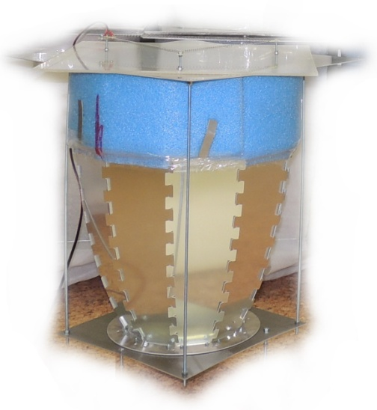
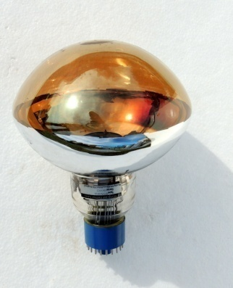
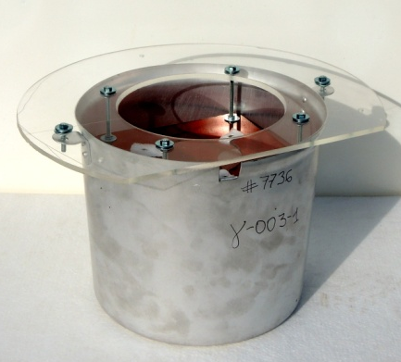
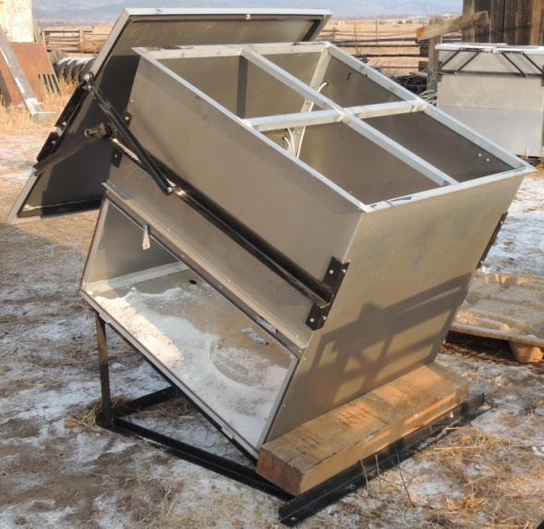
HiSCORE optical station
40 cm
20 cm
S = 0.5 m²
FOV = 0.6 ster
( ±30° )

