Slide 1
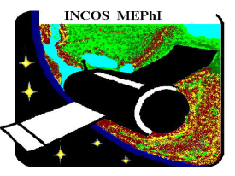
NRNU MEPHI, INSTITUTE of COSMOPHYSICS (INCOS) ¹RSC “ENERGY”, Korolev, Moscow region ² JSC “ROBIS”, Moscow
The 2nd International Conference on Particle Physics and Astrophysics
Институт Космофизики НИЯУ МИФИ
Data Collecting and Treatment Control System in the «Alpha-Electron» Space Experiment onboard the International Space Station
А.Batischev, А.Galper,
P.Yu.Naumov, P.P.Naumov, Yu.Smirnov¹, V.Stasevich²
10-14 October 2016 Milan Hotel

Slide 2
AE experiment cooperation
Head of Executive jobs: NRNU MEPhI, INCOS Organizations - collaborators: Limited Liability Company "Scientific and Production Enterprise ROBIS", Moscow - a developer and manufacturer of electronics for modes control unit (MCU) of the spectrometer and remote data collection and processing systems also; Closed Joint Stock Company "Novator", Istra - manufacturer of mechanical design elements and assemblies for monoblock of multilayer scintillation spectrometer (MSS).
Scientific Supervisor for "ALFA-ELECTRON": Director of the Institute of Cosmophysics MEPhI, professor A.Galper, E-mail: AMGalper@mephi.ru Technical Manager for "ALFA-ELECTRON": Deputy of Scientific Supervisor, leading engineer A. Batischev,
E-mail: Alexey-Batischev@mail.ru

Slide 3
The goals and objectives of the AE experiment
The main goal of this experiment is investigation of accelerated electron beams in the Earth’s magnetosphere.
The objectives of the space experiment:
measurements of high-energy electron fluxes (in the energy range 3-30 MeV) in the Earth's magnetosphere;
detection of short time particle bursts (duration of up to 1 ms);
measurements of the energy spectra and pitch-angular distributions of beams of high-energy electrons;
measurements of time profiles and spatial dimensions of high-energy electron beams in the Earth's magnetosphere;
registration of gamma-ray bursts are formed in upper-atmospheric lightning and other processes.

Slide 4
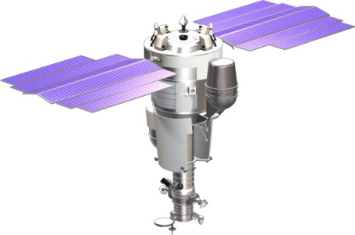
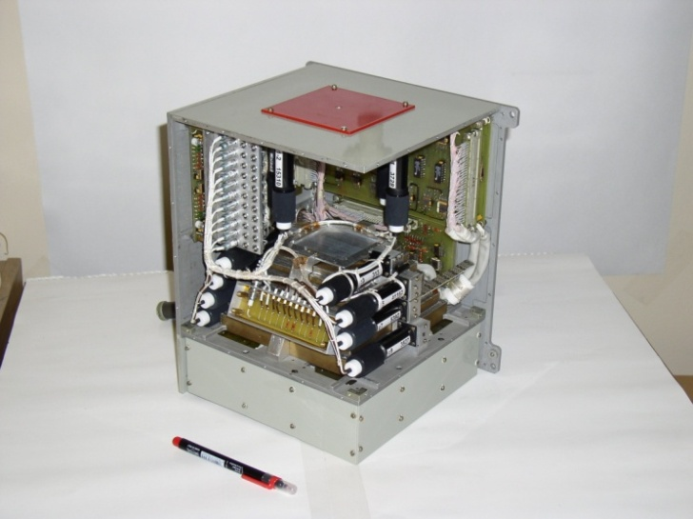
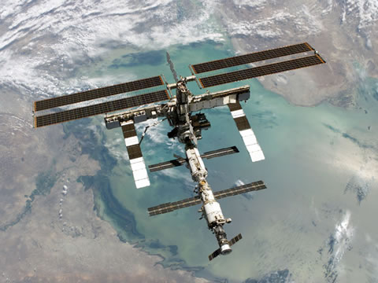
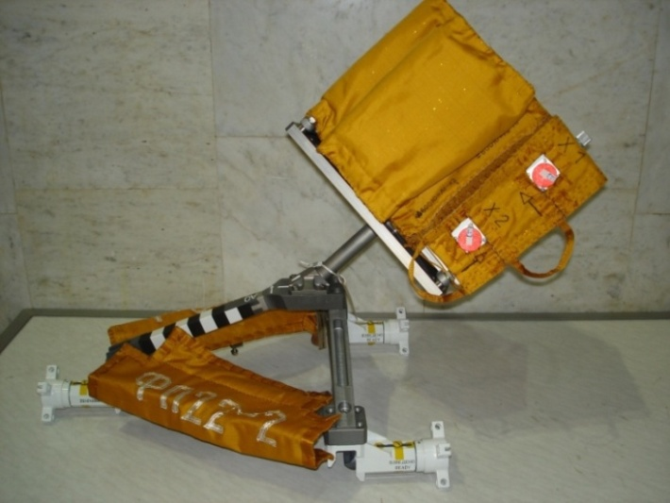
SCIENTIFIC SPACE INSTRUMENTS OF INCOS MEPHI
Spectrometer«ARINA» on aboard «Resource-DK1» №1 (2006)
Spectrometer«VSPLESK» on aboard Russian Segment of ISS (2007)

Slide 5
Modern INCOS scientific space instruments
Features | «ARINA» 2006 | «VSPLESK» 2007 | «ALFA-ELECTRON»
Particles type | electrons (3-30 МeV) protons (30-100 МeV) |  | electrons (3-30 МэВ), protons & light nuclei (30-100 МeV/nucl)
Geometric factor | 10 cм²×sr | 10 cм²×sr | 60 cм²×sr
Power | 13,5 W | 15 W | 55 W
Dead time | 1 msec | 1 msec | 0,5 microsec
Work in vacuum | NO | YES | YES
Memory | 8 МB | 8 МB | 128 МB
Interface | HVRL | BITS 2-12, CAN | BITS 2-12, RS-422, ETHERNET
Given resource | 3 years | 3 years | more than 4 years
Method | dE/dx |  | dE/dx-E

Slide 6
Main physical characteristics of the AE
Energy range
Electrons 3 - 30 МeV
Positrons
Protons & nucleus 30 - 100 МeV/nucl
Energy resolution
Protons & nucleus 1,5 – 4%%
Electrons & positrons 5 – 10%%
Geometric factor 60 cм²*sr
Aperture 80 grad
Time resolution 100 ns
Energy consumption about 55 W

Slide 7
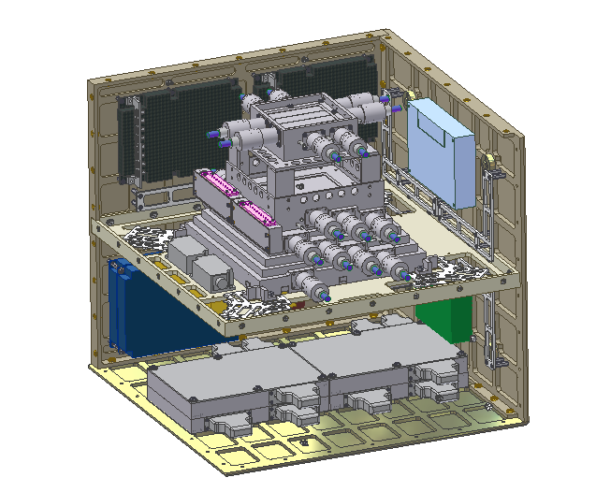
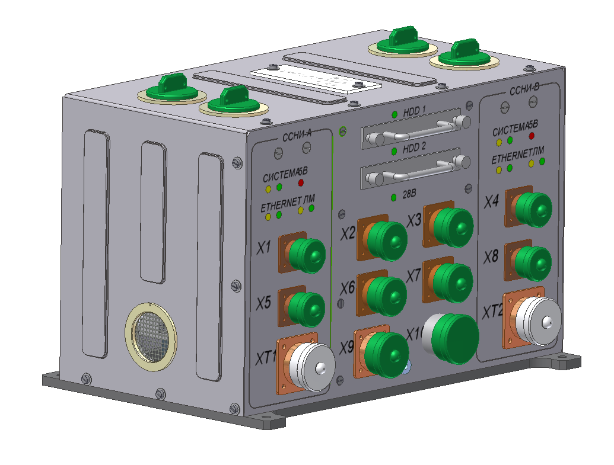
ALFA-ELECTRON substations
The scientific instrument ALFA-ELECTRON includes the two main parts:
multilayer scintillation detector (NRNU MEPHI) at the outer station (RS ISS) surface;
spectrometer mode control unit (JSC ROBIS) in the station
The Multilayer Scintillation Detector (MSD)
The Spectrometer Mode Control Unit (MCU)

Slide 8
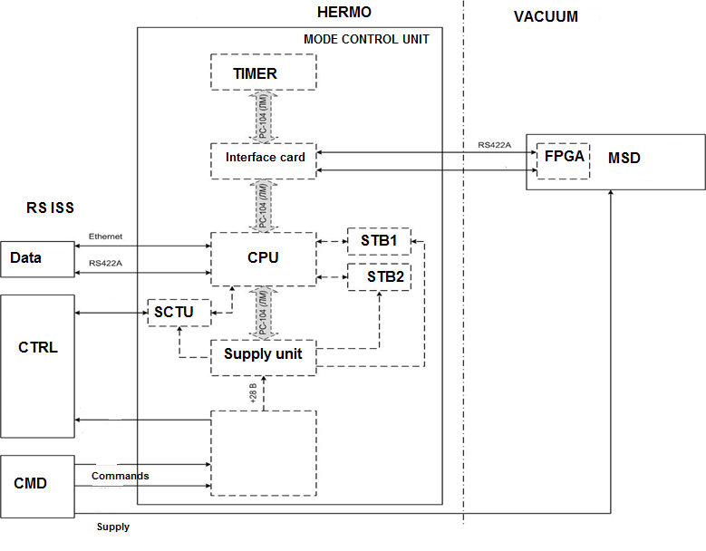
MSD & MCU connections aboard RS ISS

Slide 9
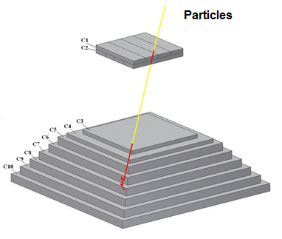
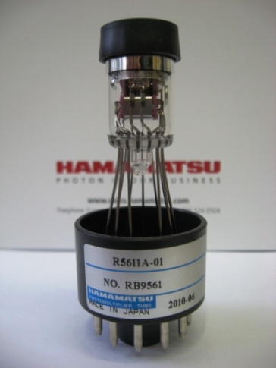
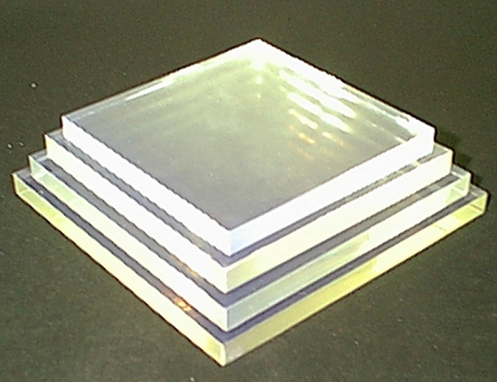
CHARGE PARTICLES: MST_C = С1×С2×С3× (anti С10) NEUTRAL PARTICLES: МSТ_N = (anti С1) ×С2×С3×С4× (anti С10)
МSD STRUCTURE & MAIN TRIGGERS
PMT Hamamatsu
R5611А-01
MSD calorimeter scintillator tiles
МSD physical scheme
C1,C2 – “thin” detectors +aperture trigger detectors
C3…C10 – calorimeter detectors
C1,C10 – anticoincidence trigger detector

Slide 10
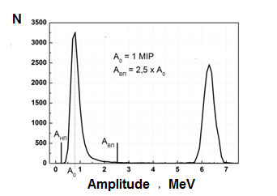
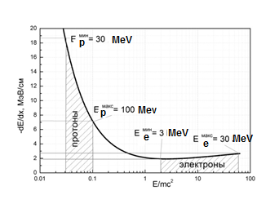
LOGIC CHANNEL SUBSYSTEM (LCS)
LT - Lower permanent threshold suppresses noise pulses from the photomultiplier, UT - Upper adjustable threshold, selects the pulses whose amplitude corresponds to the beneficial developments with "proton" energy release. LT exhibiting at 0.5 MIP, which corresponds to the amplitude of the A left, the UT at the level of the 2.5 MIP, which corresponds to the amplitude of the A right. LCS allows the rapid identification of the type of the detected particles (relativistic, non-relativistic). The separation of particles is carried out by their energy released in MSD detectors, the energy of the particles is determined by their tracks.
The dependence of the energy loss of charged particles from the kinetic energy in polystyrene
Amplitude spectra obtained during the passage of electrons with E= 20 MeV and protons with E= 60 MeV through C4 MSD Detector

Slide 11
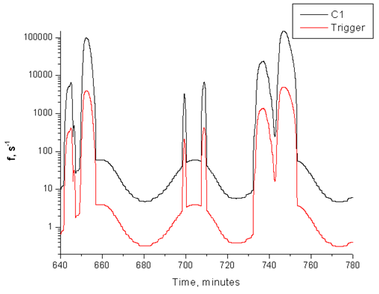
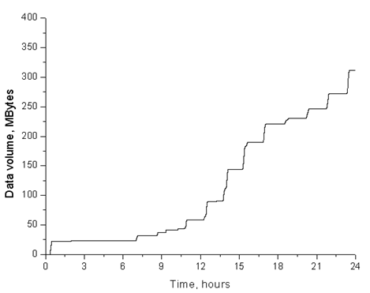
Statistics calculation and AE memory volume problem
CPU data volume from time (for 1 day exposition in normal registration mode)
Typical statistics for particle registration on ISS orbit (for C1 detector and the main trigger for charge particles

Slide 12
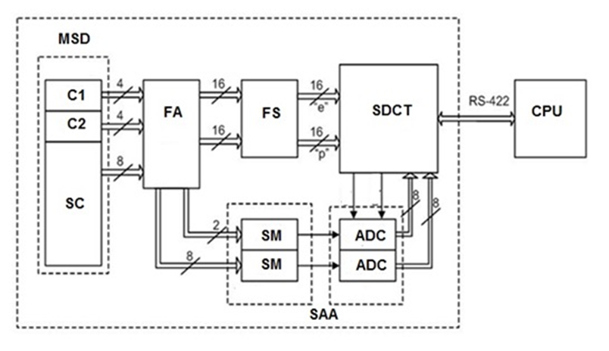
MSD electronics functional block-scheme
The MSD electronics include:
the Fast Amplifiers (FA) of signal pulses from PMT and Fast Shapers (FS) of logical pulses, that have thresholds for discrimination for the electrons «e» and protons «p» from electronics noise,
the System of Data Collection and Transmission (SDCT), made on the basis of radiation-tolerant FPGA manufactured by Actel,
the System of Amplitude Analysis (SAA), based on high-speed ADC AD9058 with a sampling frequency of 50 MHz with parallel two-channel digitizing amplitude pulses from FA.
MSD functional block-scheme
The basis of the SDCT is the Unit of Event Selection (UES), implemented on the Logic Array (LA) and the microcontroller (MC), that combined local data highway from the buffer memory for temporary storage of the events and RS-422 data protocol for connecting with Control and Processor Unit (CPU) placed in ISS.

Slide 13
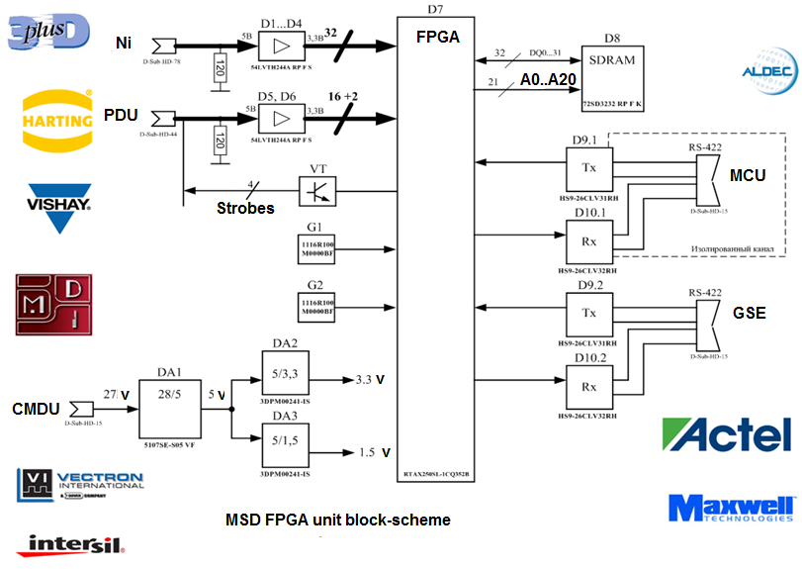
FPGA UNIT ELECTRICAL SCHEME

Slide 14
FEATURES of AE EXPLOITATION MODES
Mode | Description
«SURVIVAL» | Designed to provide a temperature control when MSD power is off
«BACKGROUND» | Designed for recording burst included in the MSD aperture, identification, measuring the energies and angles of arrival, formation and recording of scientific information in the CPU memory (used when working in the area of the BMA only).
«BURST_1» | Used when working in the BMA, which flows intensity 2-3 orders of magnitude higher than the mean intensity of the particle flow in BMA.
«ВURST_2» | Used to register the bursts of high flow intensity up to 10⁵ cm-2 s-1 sr-1
«ТЕST» | Designed for testing ON during test trials as part of the COP and to the TC, as well as for periodic inspection characteristics on during normal operation onboard the ISS RS
«СOUNT» | Designed for operation at high rates of signal counts (implementing a shortened format of the data)
«EVENT» | Designed to operate at low rate of signal counts (implementing a full data format)
«CALIBRATION» | It is used to calibrate the amplitude channels of MSD
«ТHERMO» | It is used for autonomous monitoring of MSD temperature during normal operation
«SYSTEM» | It is used to check the memory performance and verify the information transfer from the MSD to MCU by RS-422

Slide 15
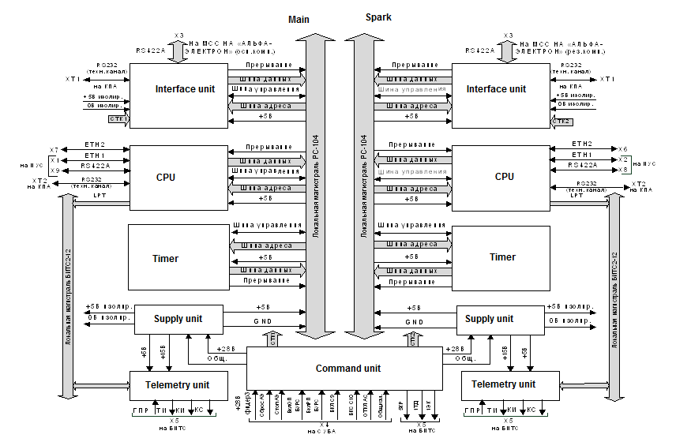
Main and Spark MCU systems

Slide 16
RULES FOR ONBOARD ISS RS ELECTRONICS
According to the specification for any automatic on-board spectrometers (ABS) installed on the ISS RS (including - "ALFA-ELECTRON"), each set shall consist of: - power supply unit (PSU); - single-board computer (SBC); - autonomous timer unit (ATU); - interface to ISS RS. For the release of information in the telemetry channels BITS2-12 Protocol, each set corresponds to one set of Mode Control Unit. Both sets have a single non-redundant command unit

Slide 17
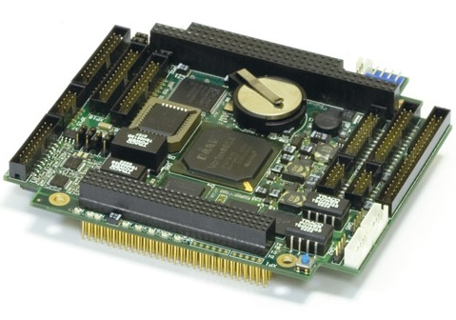
Choosing the SBC prototype for AE MCU
Testing of СРС-306 FASTWEL
- Discovered a large inrush current of about 4A, requiring replacement of the developed power supply; - The increased size of the board, and increased power consumption (about 6W - the maximum value according spec.)

Slide 18
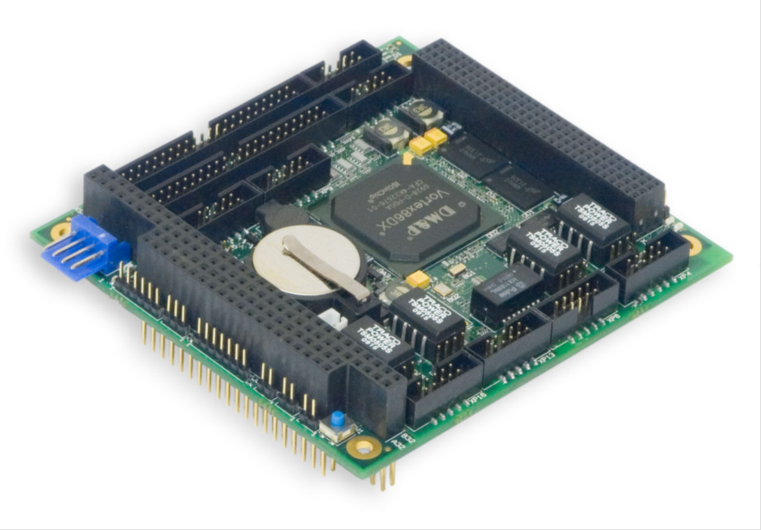
Choosing the SBC prototype for AE MCU
Testing of СРС-307 FASTWEL
- Discovered inrush current less than 2A, which does not require replacement of the developed power supply; - Standard size card (PC\104) and low power (less than 3 Watts).

Slide 19
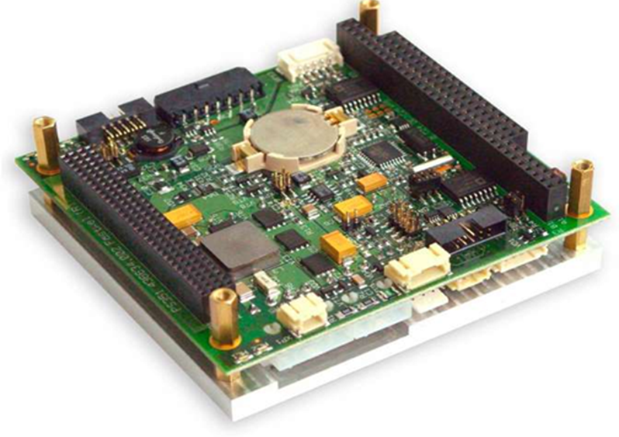
Choosing the power supply prototype for AE MCU
The power supply module PS-351 (Fastwel) has a complex structure and does not meet the parameter "maximum power".
It was decided to focus on others sources of supply…

Slide 20
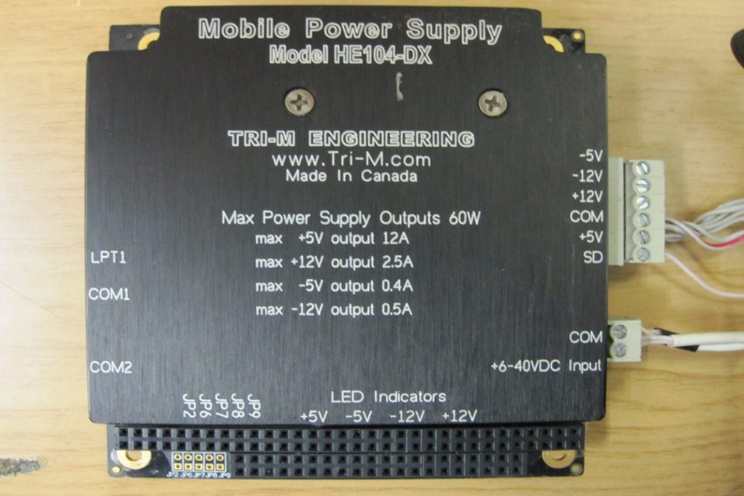
Choosing the power supply prototype for AE MCU
Mobile power supply unit HE104-DX ( TRI-M, Canada)
MPS has everything necessary to meet the parameters of AE specification. Economical, efficient (90%), manage, it has a built-in heat sink. The most appropriate solution for the power supply for MCU

Slide 21
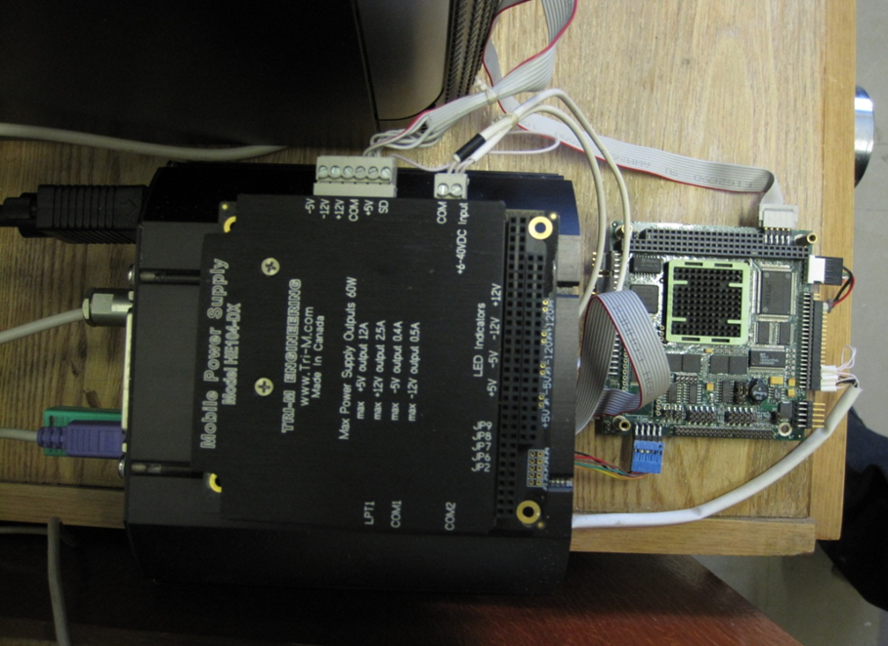
Joint testing of SBC СРС-307 and MPS HE-104DX
Testing of basic MCU systems - SBC and MPS showed reliable operation of the tandem.

Slide 22
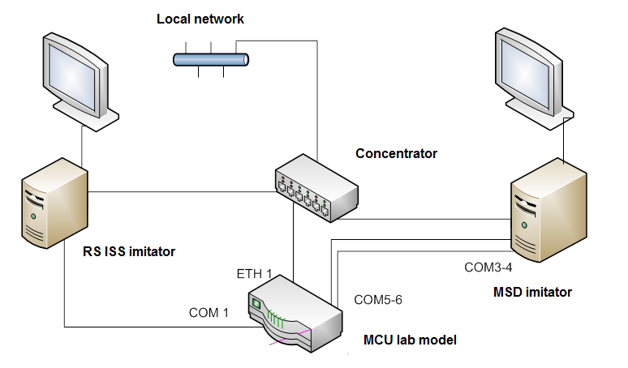
Autonomous MCU lab model testing

Slide 23
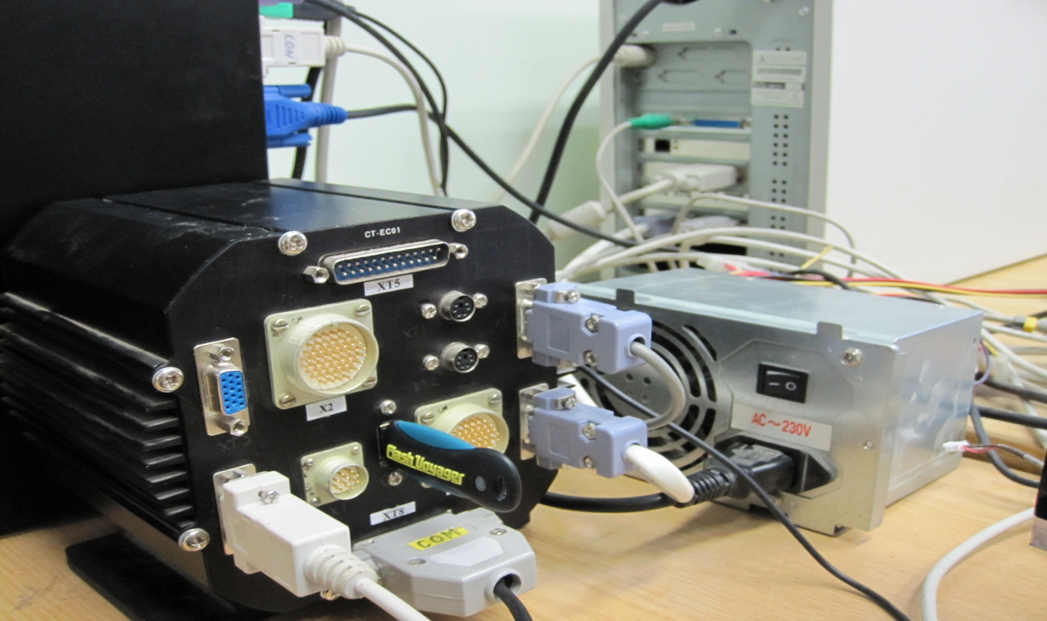
Autonomous MCU lab model testing

Slide 24
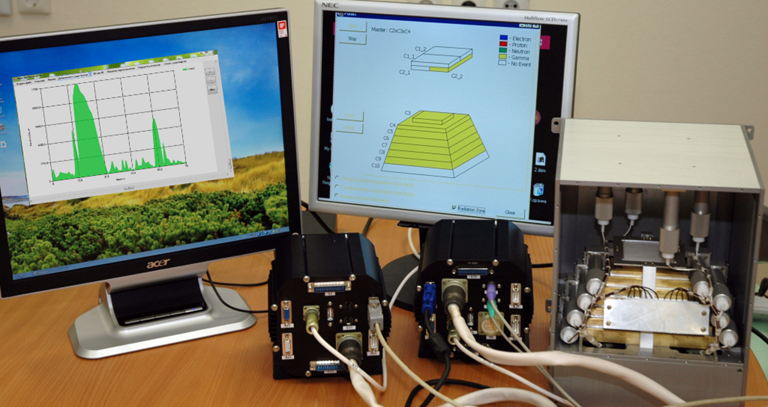
Demonstration of AE prototype on exhibition in Russian Space Agency
МSD
RS ISS
MCU

Slide 25
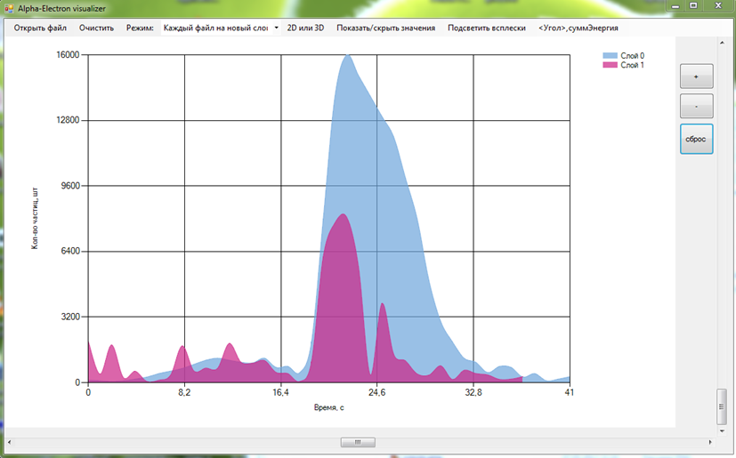
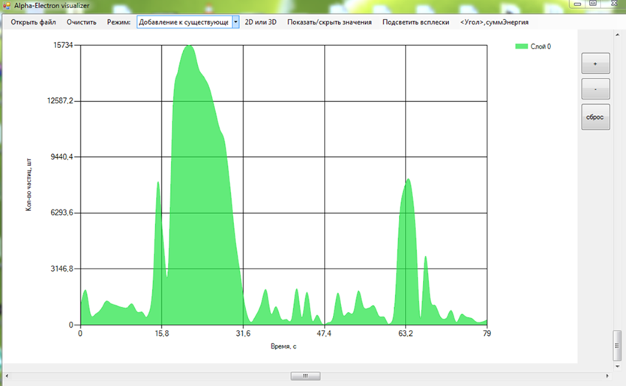
Bursts time profiles on RS ISS laptop

Slide 26
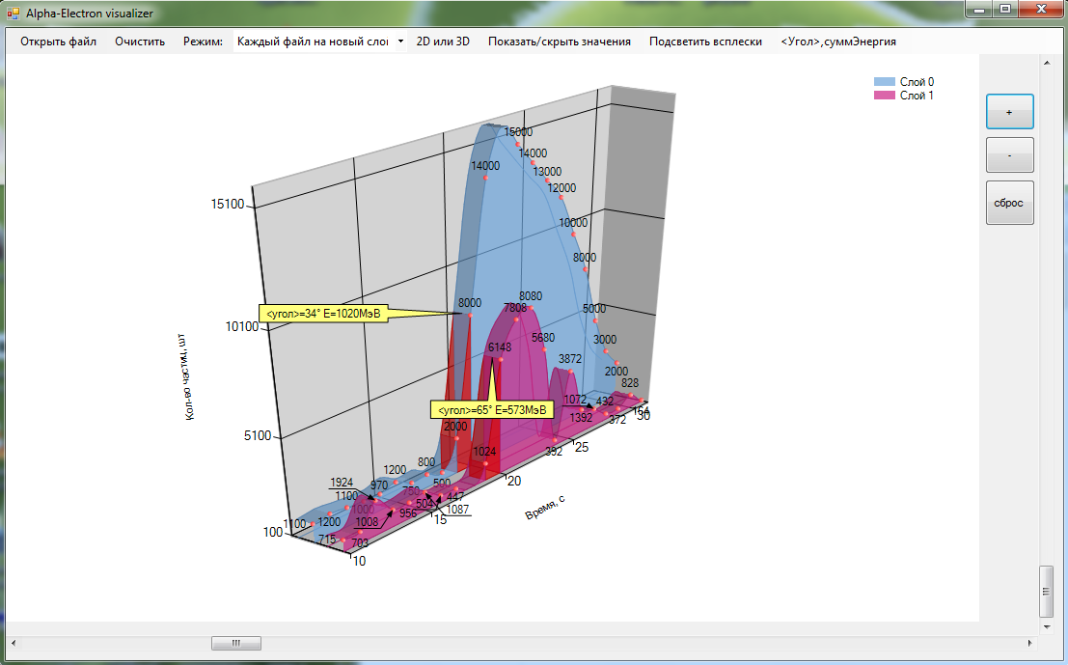
3D burst distribution on RS ISS laptop
It is possible to build up a burst energy spectra and angular distribution in time and in attachment to the Earth coordinates

Slide 27
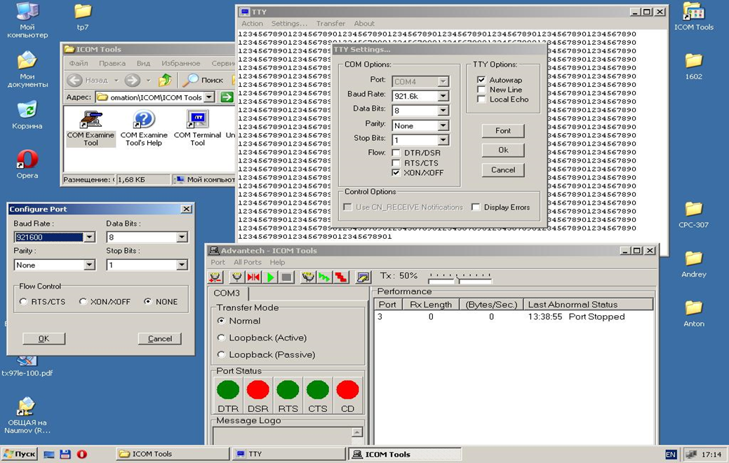
Testing of MSD interface prototype
Ground support equipment (GSE). Common view to operator panel

Slide 28
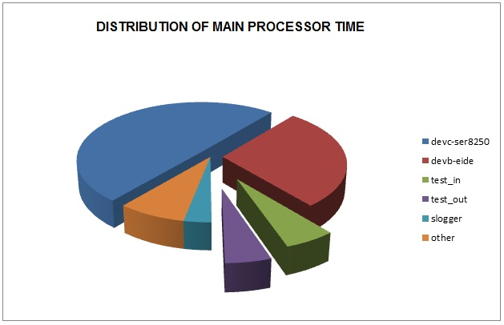
Research of MCU CPU performance at different modes of the processor loads
When UART baud rate of about 1M there is increased CPU loading (including buffering data EIDE)

Slide 29
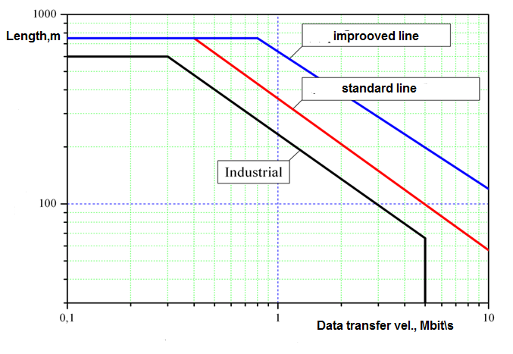
Problem of data rate transfer increasing
With a length of cable network MSD- MCU about 50 m – the possible maximum data transfer rate is about 2 Mbit/s only….

Slide 30
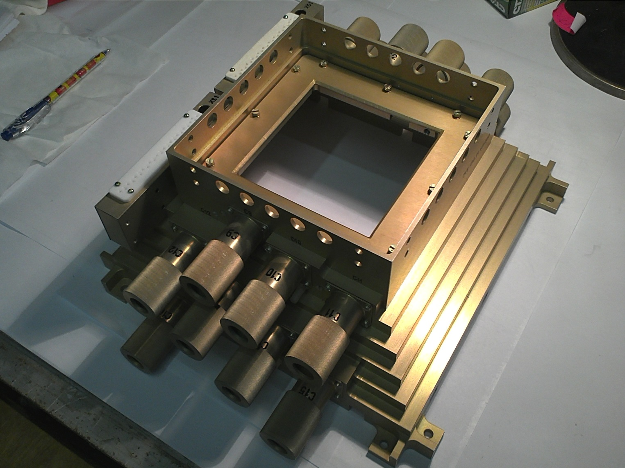
Assembling of MSD in INCOS

Slide 31
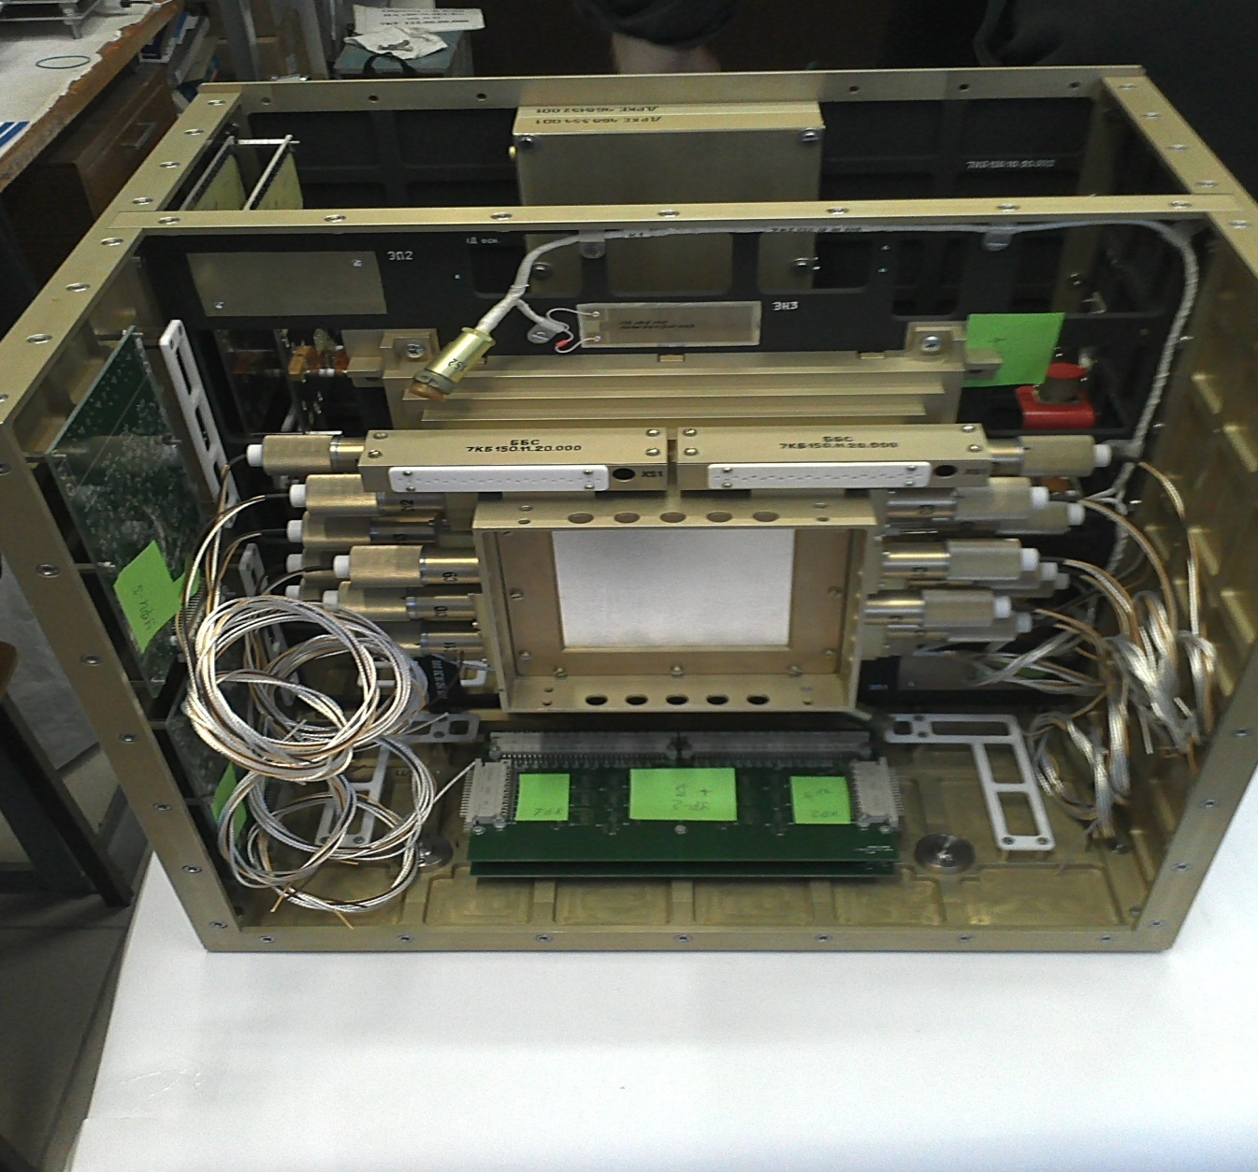
Assembling of MSD in INCOS

Slide 32
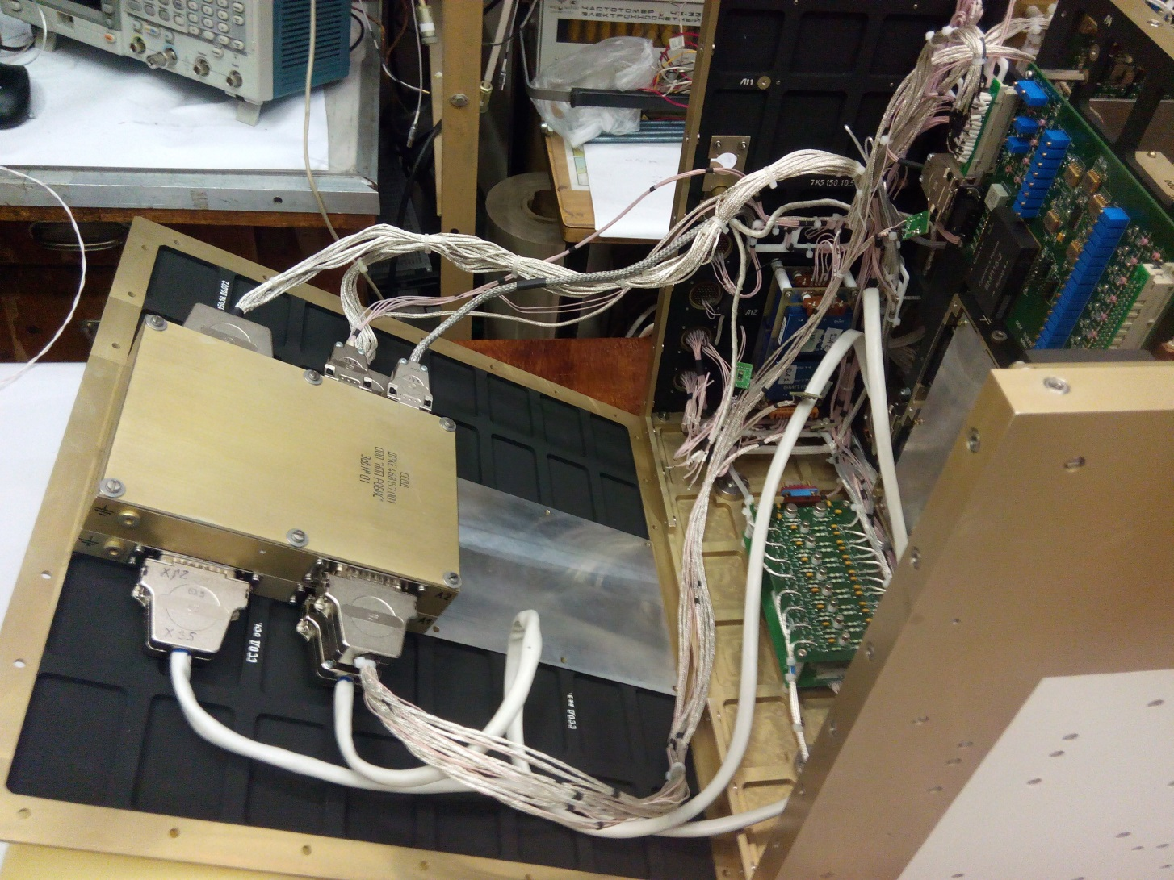
Assembling of MSD in INCOS

Slide 33
THANKS FOR YOUR ATTENTION
TO THE PROJECT

