Slide 1
Polarization experiment SPASCHARM at U70 accelerator complex
V. Mochalov
(on behalf of the SPASCHARM collaboration)

Slide 2
Outline
SPASCHARM Project
  Physics Program
  Polarized proton and antiproton beams
Current SPASCHARM studies (stage 1)
  Physics
  Experimental Setup
  Current activity and plans
First SPASCHARM physics results

Slide 3
Motivation
The project is aimed at studying the spin structure of the nucleon and the spin dependence of the strong interaction at energies up to 50 GeV. The fixed target SPASCHARM experiment will systematically study polarization phenomena in exclusive and inclusive hadronic reactions.
The universal setup will detect dozens of particles, produced on a polarized proton and nuclear targets. In parallel with single-spin asymmetries, the polarization of hyperons and the elements of the density spin matrix of vector mesons will be measured.
The ultimate goal of the experiment is to study spin structure of the proton, primarily the determination of the contribution of gluons to the spin of the proton through the investigation of spin effects in the formation of various charmonium states

Slide 4
SPASCHARM-2 physics program
Stage 2 with polarized and un-polarized beams and without polarized target:
  Single-spin asymmetry А_{N} in J/ψ and χ₁/χ₂ inclusive production polarized proton beam. Expected statistics (conservative) for 40 days of data taking is:.
    p (40 GeV) beam (5⋅10⁷ р/cycle): 20000 J/ψ and 2500 χ₁/χ₂ states.
  Statistic error of J/Ψ asymmetry measurements is 7% for
  The cross-section ratio for χ₁/χ₂ production will be measured to determine the mechanism of charmonium production using pion and proton beams.
Stage 2 with longitudinally polarized beam and target:
  Double-spin asymmetry А_{LL} measurements to study ΔG/G(x).
  А_{NN} measurements for Drell-Yan pairs to study transversity h(x). Simultaneously А_{NN} and A_{N} in J/ψ, χ₁/χ₂. production will be studied.
  Double spin asymmetry measurements at different channels

Slide 5
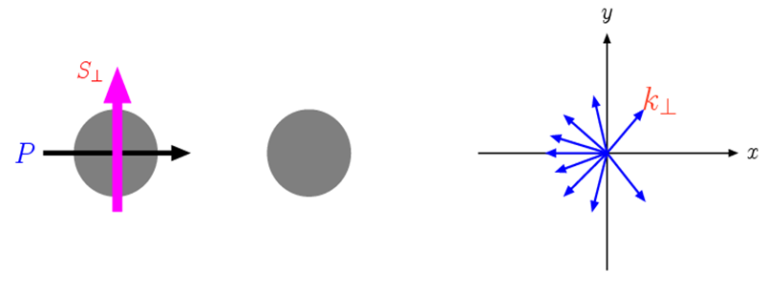

Asymmetry definitions
Single-spin asymmetry (SSA):
  $A_{N}^{}=\frac{σ^{↑}−σ^{↓}}{σ^{↑}+σ^{↓}}$, or $A_{N}=\frac{σ_{left}^{↑}−σ_{right}^{↑}}{σ_{left}^{↑}+σ_{right}^{↑}}$,
Double-spin Asymmetry
  $A_{LL(NN)}=\frac{1}{(P_{B}∙P_{T}^{eff})}∙\frac{(I\left(++\right)−I\left(+−\right))}{(I\left(++\right)+I\left(+−\right))}$

Slide 6
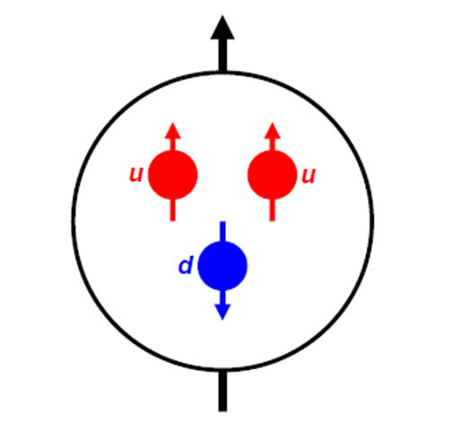
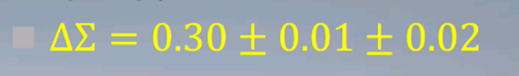
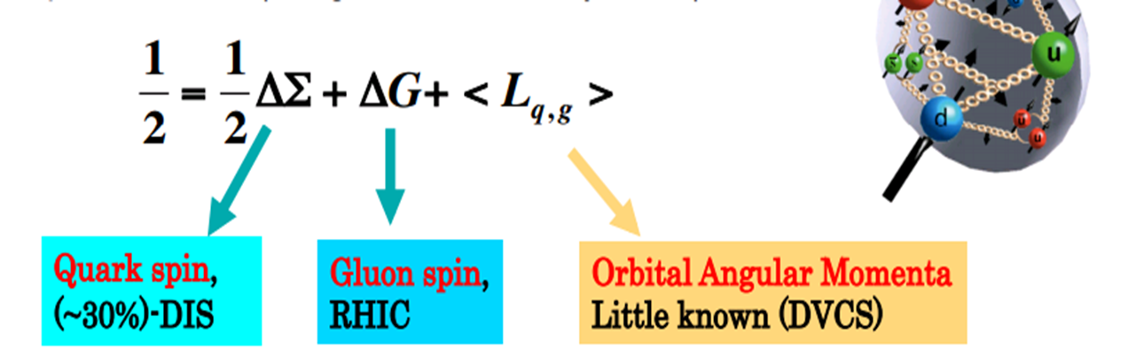
Proton in naïve quark model
It was expected that proton spin is simply sum of quark spins, but really

Slide 7
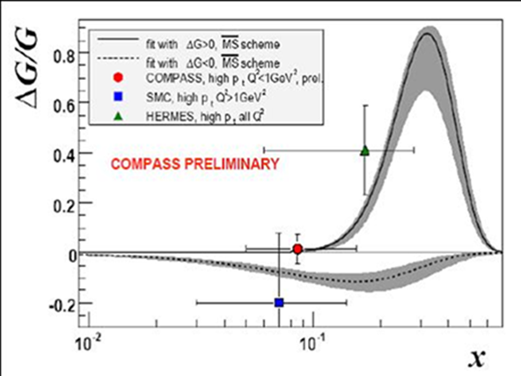
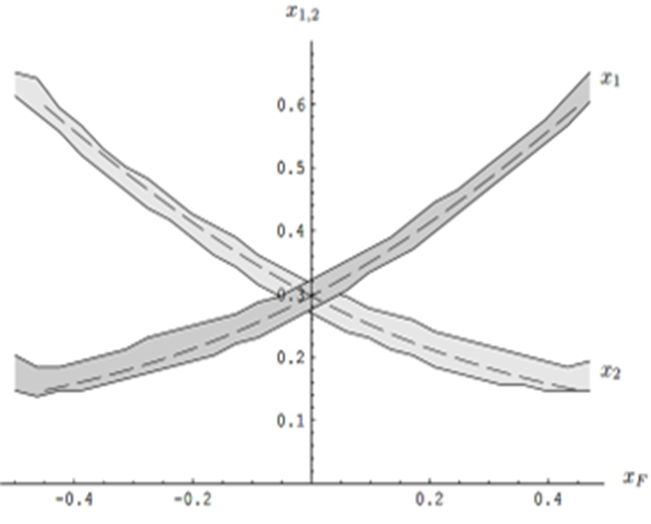
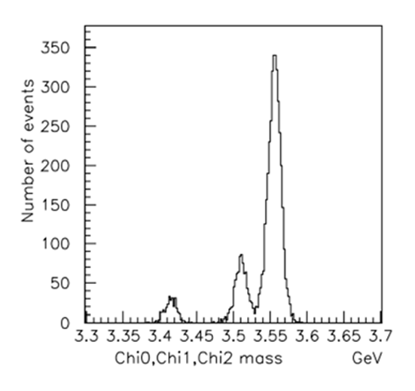
Measurements of A_{LL} in SPASCHARM
SPASCHARM kinematic region exactly coincides with expected maximal value of ΔG/G

Slide 8
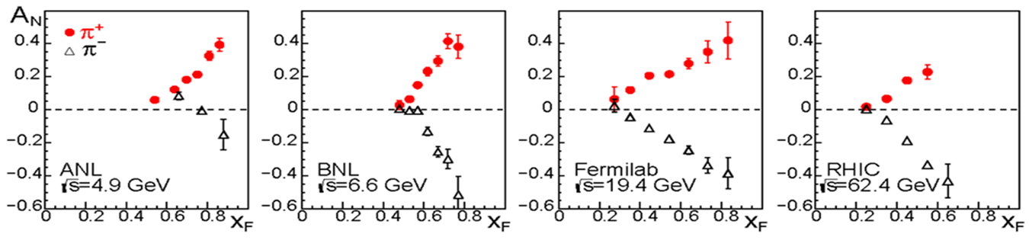
Single-spin asymmetry measurements
Figure from C. Aidala
Single–spin asymmetries and hyperon polarization almost do not depend on beam energy – accuracy is more important: SPASCHARM energy range is adequate to study spin effects

Slide 9
Motivation 2
The presence of polarized both protons and antiprotons in the CP neutral system potentially opens up opportunities for studying and comparing CP conjugate reactions with one another. This allows us to look at CP invariance in a new perspective, inaccessible to collisions of unpolarized particles.
Finally, the presence of eight types of unpolarized beams (π±, K±, p, p͂, d, C), in combination with a polarized and nuclear targets, extends the range of studies of polarization phenomena by an order of magnitude and enhances the uniqueness of the project. The study of energy dependence of spin effects reveals the dynamics of interaction. The measurements might be conducted at several energies in order to estimate the model parameters.

Slide 10
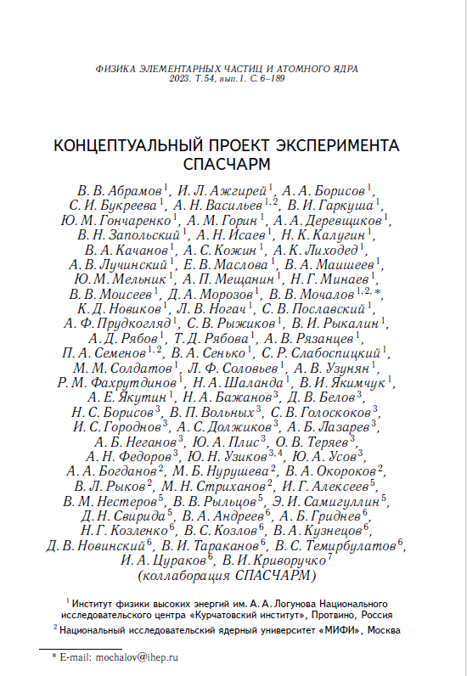
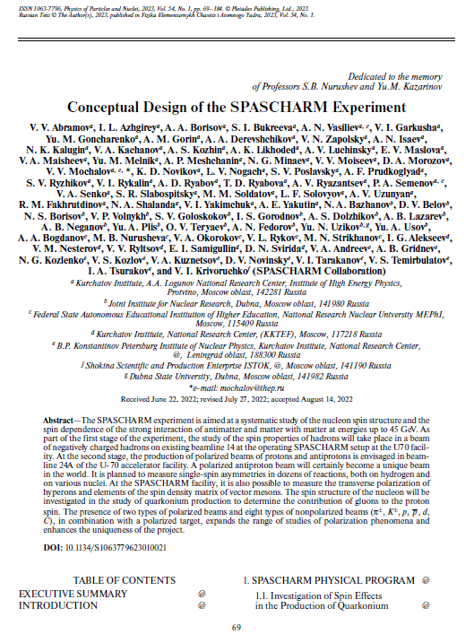
Conceptual Design Report

Slide 11
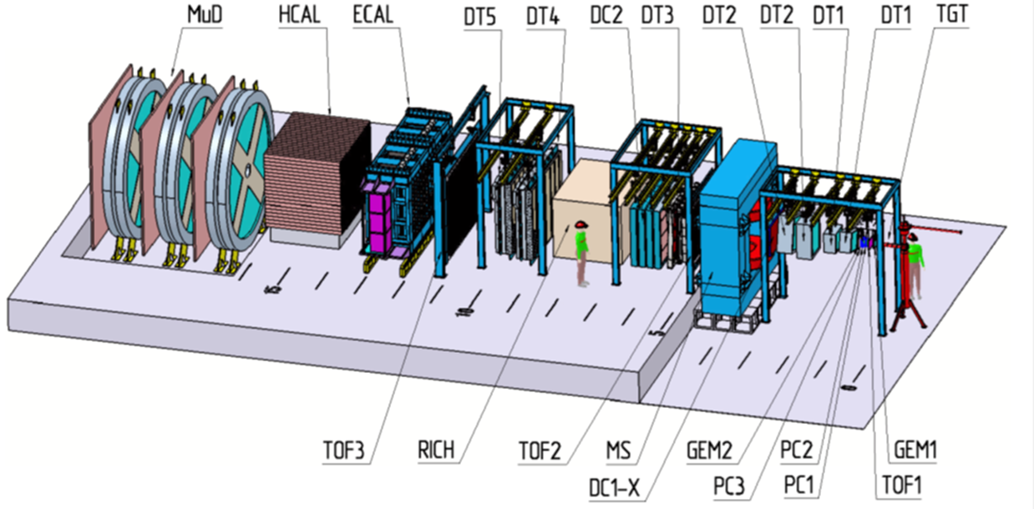
SPASCHARM Setup at beamline 24

Slide 12
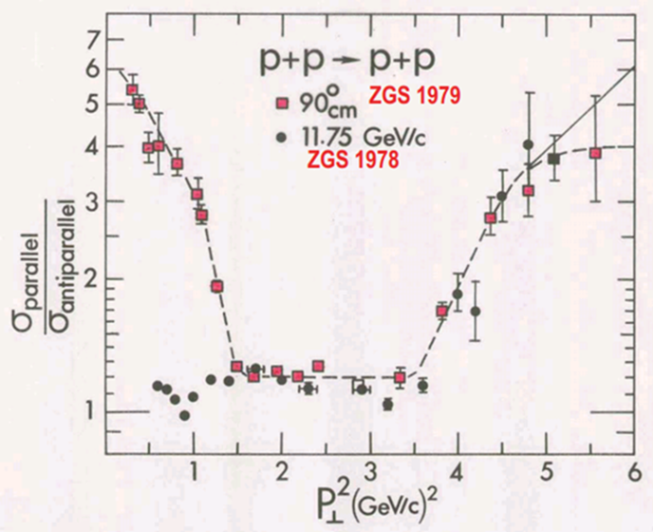
MEPhI – polarimetry and elastic scattering
MEPhI contributes to study of elastic scattering. Reconstruction of all
Feasibility of Model-Independent Reconstruction of the Amplitudes of the pp Elastic Scattering Matrix at the SPASCHARM Facility at U-70 and Measurements the analyzing power in pp and p(bar)p elastic scattering was reported at ICPPA-2022 and DSPIN 2023 (published Physics of Atomic Nuclei, 2024, Vol. 87, No. 4, pp. 464–470)
Possibility to measure A_{NN} is discussed in A. Bogdanov Talk (Wednesday HEP section)

Slide 13
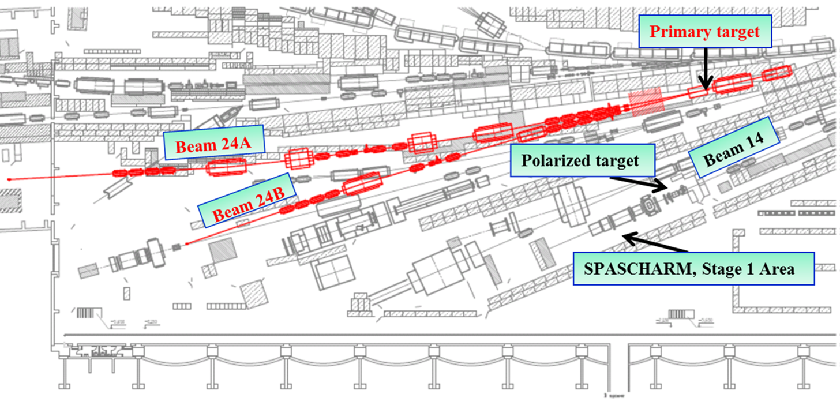
SPASCHARM beam-line 24A

Slide 14
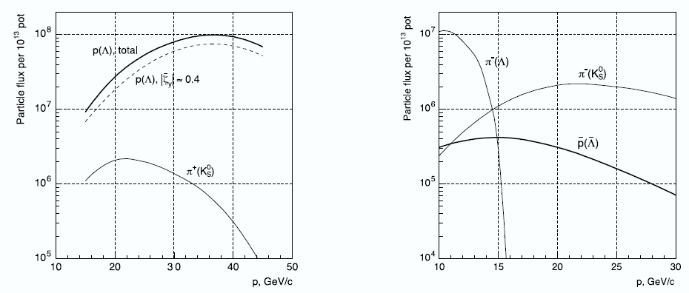
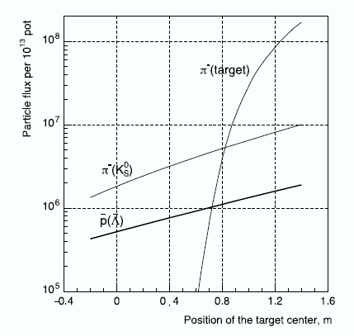
Beam intensity
V.Abramov et al, The polarized proton and antiproton beam project at U-70 accelerator
Nuclear Inst. and Methods in Physics Research, A 901 (2018) 62–68

Slide 15
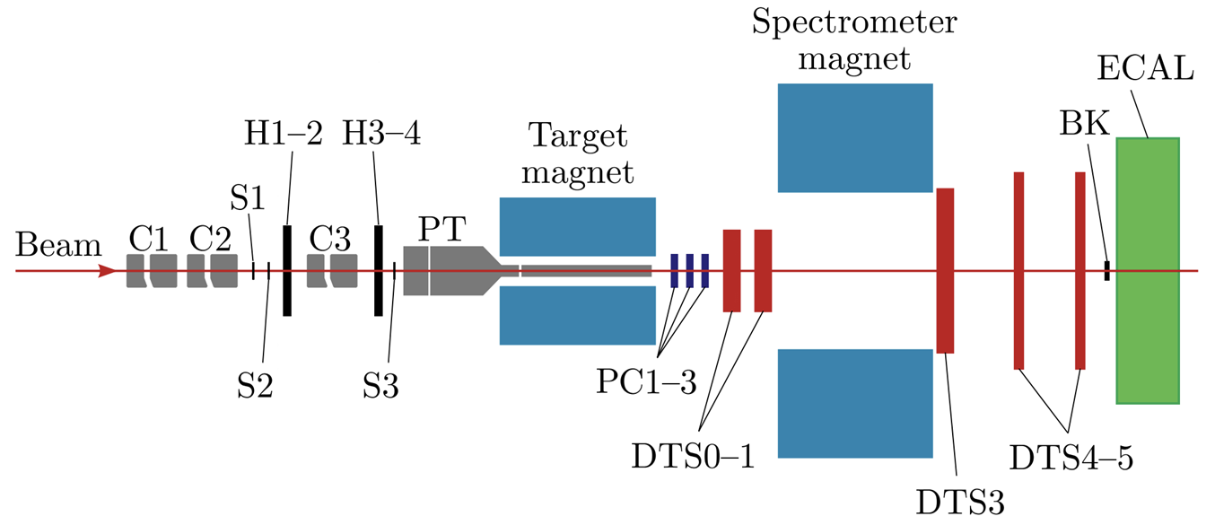
SPASCHARM at beamline 14
Energy 26,5 GeV, Particles pi/K/pbar=98%, 1.75%,0.15%, Intensity: up to 10⁶
Charged: Δθ_{x} > ±180 mrad, Δθ_{y} ≈ ±120 mrad, 0 < x_{F} < 1, p_{T} < ~2.5 GeV/c
γ and π⁰: Δθ_{x} ≈ ±50 mrad, Δθ_{y} ≈ ±40 mrad, 0 < x_{F} < 1, p_{T} < ~1 GeV/c
Field in spectrometer magnet 0,7 T (BxL)

Slide 16
SPASCHARM physics program at beamline 14
A_{N} measurements in charged pion, K⁰ and ω(782) production with polarized target and negative charge particle (and proton) beam
  π⁻ + p↑ → π⁻ X, π⁻ + p↑ → π⁺ X (data are collected),
  π⁻(K⁻)+p↑ → π⁰ (K⁰)X, π⁻(K⁻) + p↑ → ω(π⁻ π⁺ π⁰) X
  New Polarized target is under construction
Spin density matrix of vector mesons and hyperon polarization with negative charge particle (and proton) beam on Nuclei targets

Slide 17


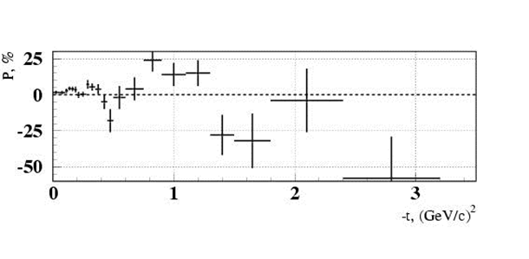
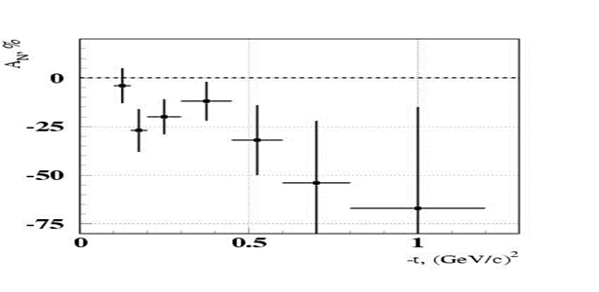
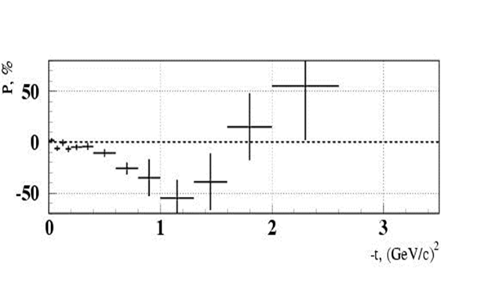
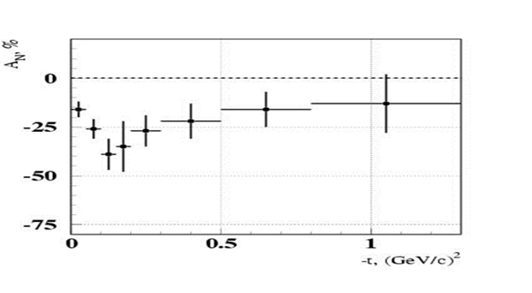


Beamline 14 motivation (exclusive)

Slide 18
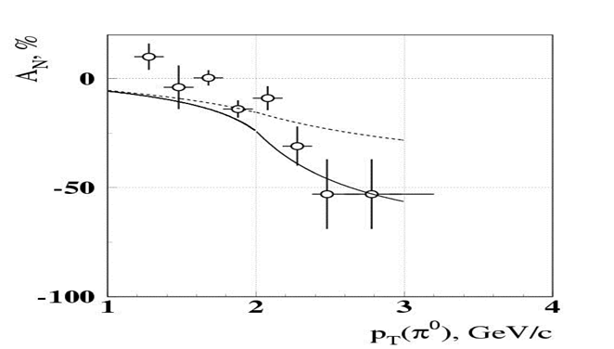
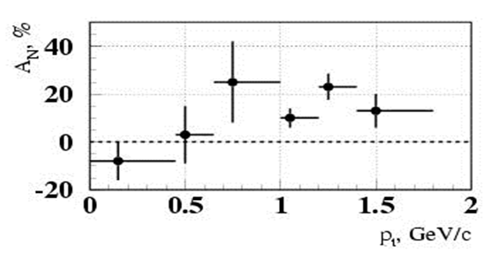
SPASCHARM at Beam-line 14
(motivation inclusive)
pp↑→π⁰X at x_{F}=0
pd↑→π⁰X at x_{F}>0.7
Phys.Lett. B243 (1990) 461-464, Sov.J.Nucl.Phys. 50 (1989) 432-437, Yad.Fiz. 50 (1989) 695-704
Phys.Atom.Nucl. 73 (2010) 2017-2021, Yad.Fiz. 73 (2010) 2072-2076
A_{N} = (16±5)% at p_{T} =(0.7-1.8) GeV/c and at x_{F} > 0.7.
A quite sizeable asymmetry showed up at p_{T} ~ 1 GeV/с and above even in the unpolarized beam fragmentation region.

Slide 19
SPASCHARM strategy
2021-2026 Study spin alignment of vector mesons and hyperon polarization with p, K⁻ and π⁻ beams and nuclei targets (including dependence on nucleus number)
  New polarized target (Contract with JINR signed on April,2024) – new target to be ready before Fall 2026)
  Production new EM calorimeter
2027-2032 Study SSA with p, K⁻ and π⁻ beams and polarized target on beamline 14
  Development beamline 24 (polarized beam, including spin flipper)
  SPASCHARM setup modernization (FARICH?, beam tagging, setup for elastic scattering)
2032->Study spin effects with polarized beams

Slide 20
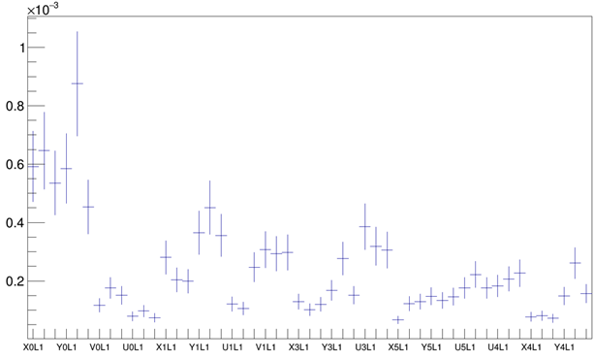
SPASCHARM setup status
Special study was carried out to improve tracking detectors efficiency (up to 95-98%) and stability
Efficiency instability is not worse than 0.03%
New improvements
  New fiber hodoscope
  Large drift chambers (PINP and KI)
  New crystal Deflector to extract proton beam on experiment targets

Slide 21

SPASCHARM first physics
Single spin asymmetry of charge pions on negative pion beam on polarized target
Inclusive production of strange mesons. A-dependence is reported this conference,
Polarization of Λ and $\overline{\text{Λ}}$ inclusive production

Slide 22
SSA of charged pions
All tracks are reconstructed, but
SSA of charged pions in negative particle beam is strongly depended on tracking reconstruction efficiency (on kinematic parameters and azimuthal angle)
  MC study of reconstruction efficiency for each “5 hour interval” was developed and analyzed
  Algorithm to calculate asymmetry with efficiency corrections is prepared and adjusted
  “False asymmetry” was studied
SSA result is expected this Fall

Slide 23
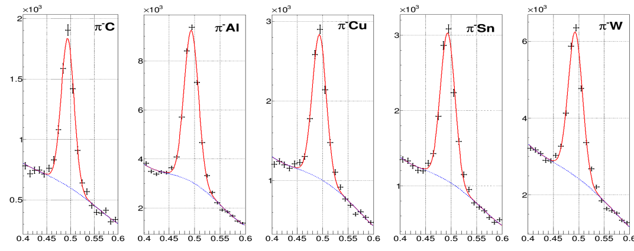
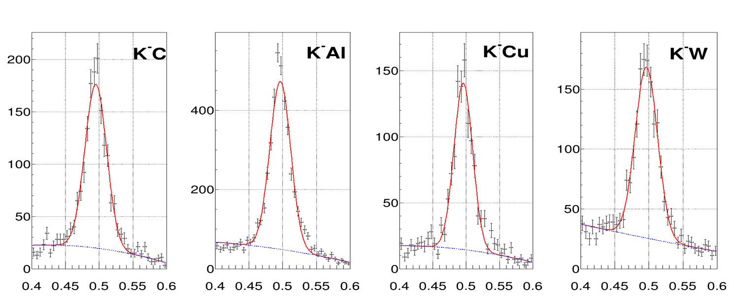
K_{s} reconstruction

Slide 24
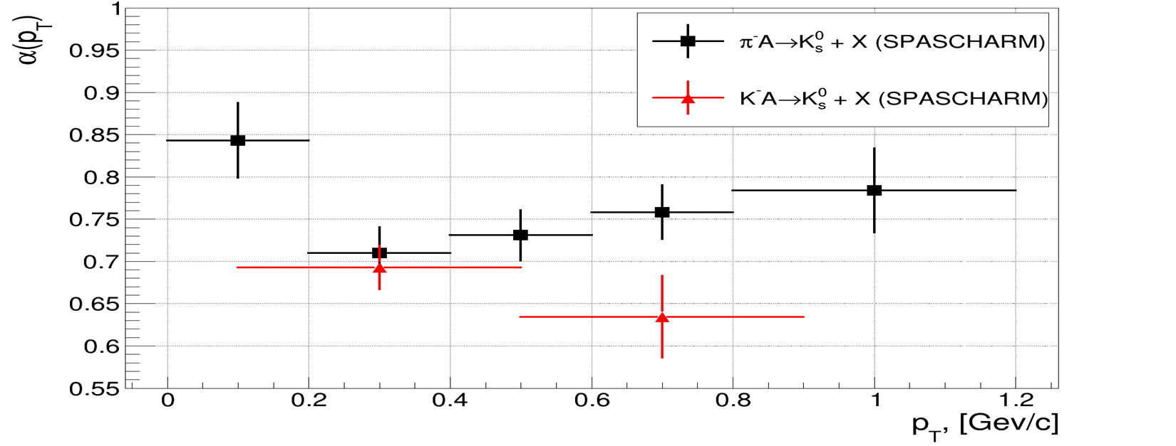
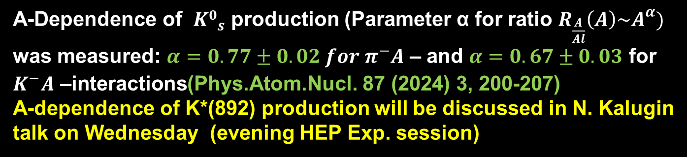
A-dependence
A-Dependence of ${K0}_{s}^{}$ production (Parameter α for ratio $R_{\frac{A}{Al}}\left(A\right)\sim A^{α})$ was measured: $α=0.77±0.02 for{ π}^{−}A$ – and $α=0.67±0.03$ for $K^{−}A \text{–}\text{interactions}$(Phys.Atom.Nucl. 87 (2024) 3, 200-207)
A-dependence of K*(892) production will be discussed in N. Kalugin talk on Wednesday (evening HEP Exp. session)

Slide 25
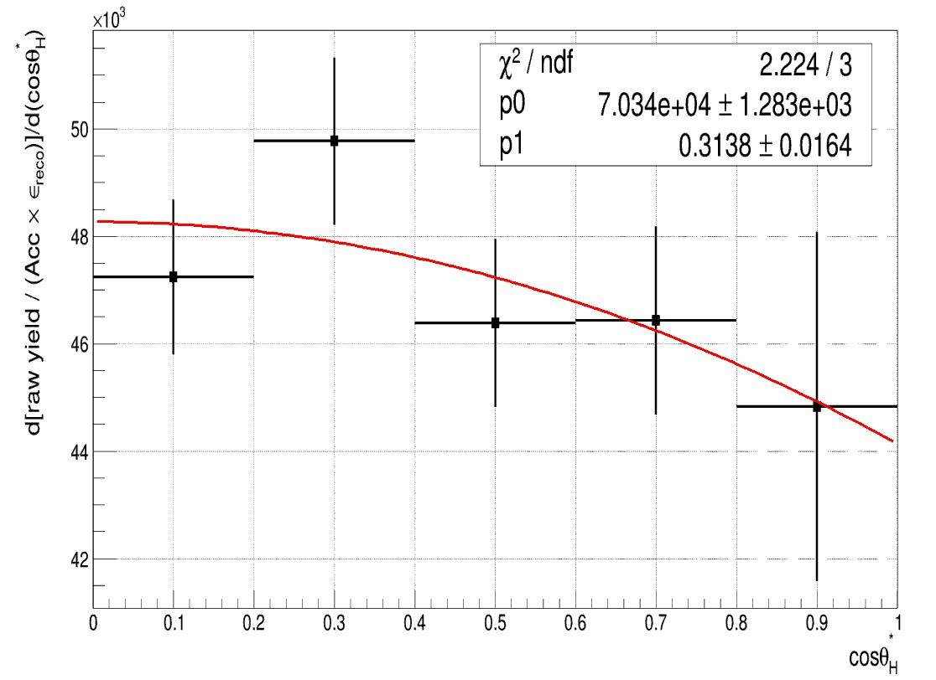
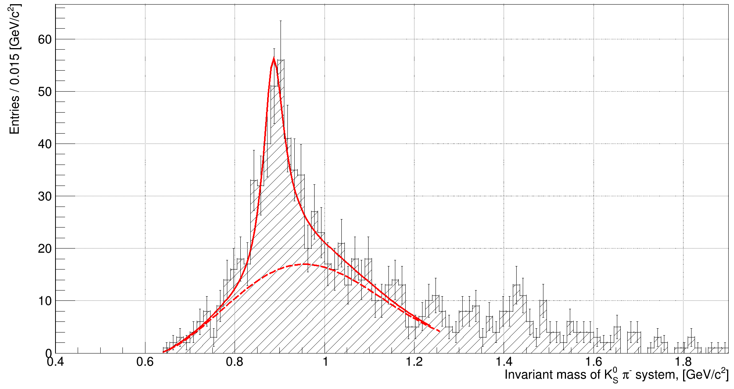

Spin Alignment of K*(892)
Spin density matrix elements can be measured using angular distributions of vector meson decay to pseudoscalar particles
ρ_{ii} =1/3 if there is no spin alignment
Intriguing new result of spin alignment in reaction $K^{−}A→K^{∗−}(892)X$is expected this Fall

Slide 26


Polarization measurements
$\frac{dN}{dΩ}=\frac{1+αPe_{p}}{4π}$ = $\frac{1+αPcosθ_{p}}{4π}$ α_{Λ} = 0.732 ± 0.014
Polarization was measured on $π^{−}$ and $K^{−}$beams on nuclei targets

Slide 27
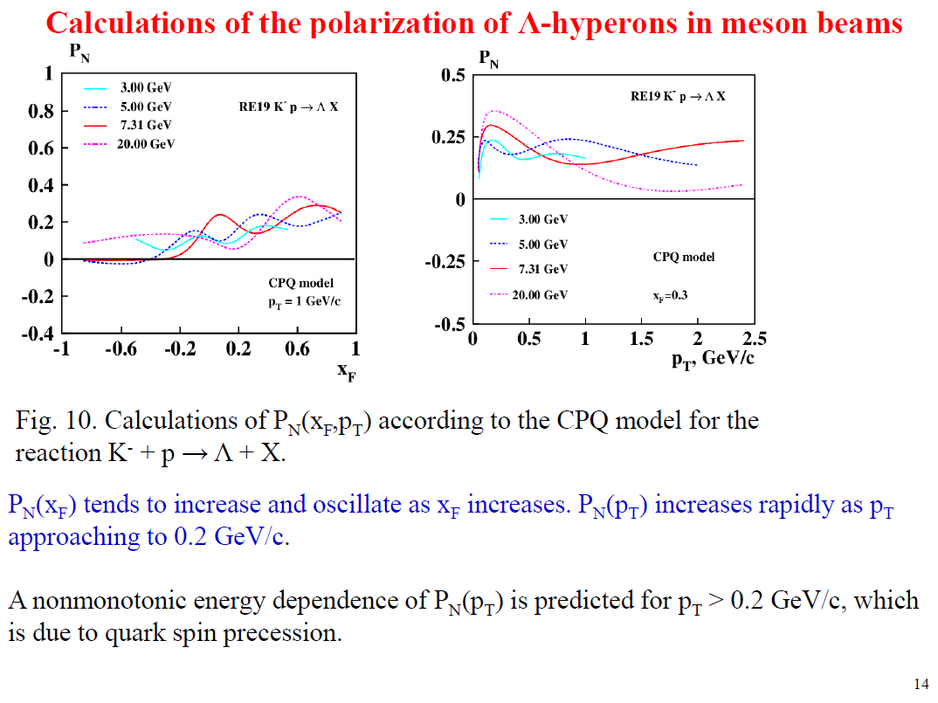

Slide 28
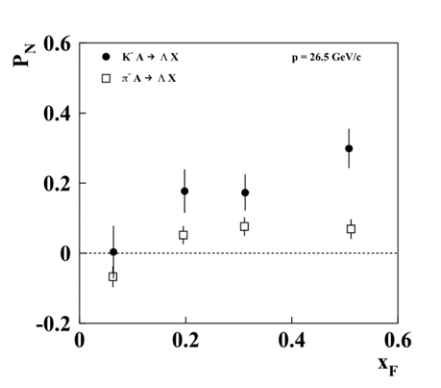
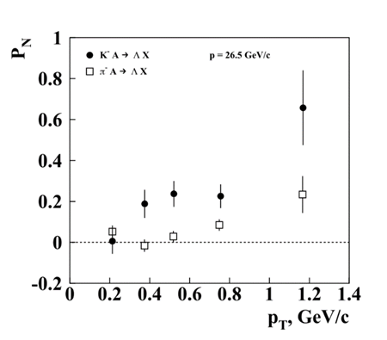
Lambda Polarization
In the region 𝑝_{𝑇}>0.3 GeV/𝑐 the average polarization P_{N} = is 23.6 ± 3.6%, which is a 6.5 sigma effect.
JETP Letters, Vol. 120, No. 6, pp. 381–387.DOI: 10.1134/S0021364024602811

Slide 29
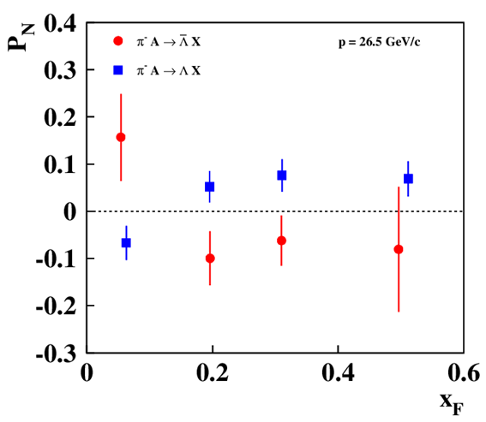
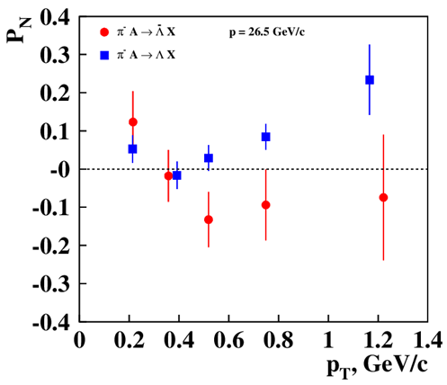

antiLambda Polarization
Polarization of Λ and $\overline{\text{Λ}}$ inclusive production in detail will be reported in V. Moiseev talk on Wednesday
(evening HEP Exp. session)

Slide 30
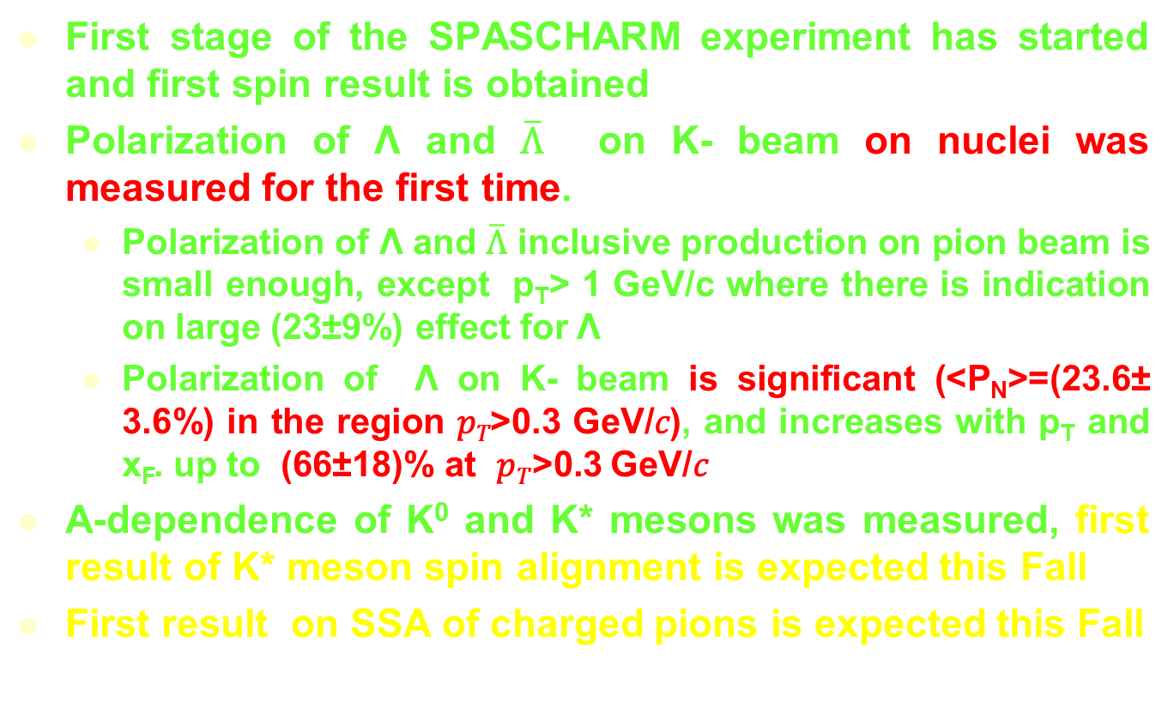
Conclusion
First stage of the SPASCHARM experiment has started and first spin result is obtained
Polarization of Λ and $\overline{\text{Λ}}$ on K- beam on nuclei was measured for the first time.
  Polarization of Λ and $\overline{\text{Λ}}$ inclusive production on pion beam is small enough, except p_{T}> 1 GeV/c where there is indication on large (23±9%) effect for Λ
  Polarization of Λ on K- beam is significant (<P_{N}>=(23.6± 3.6%) in the region 𝑝_{𝑇}>0.3 GeV/𝑐), and increases with p_{T} and x_{F}. up to (66±18)% at 𝑝_{𝑇}>0.3 GeV/𝑐
A-dependence of K⁰ and K* mesons was measured, first result of K* meson spin alignment is expected this Fall
First result on SSA of charged pions is expected this Fall

Slide 31
New data taking run to improve significantly accuracy of measurements on hyperon polarization and vector meson spin alignment as well as to measure their A-dependence will start in a week
The Talk was supported by RSCF grant 22-12-00164

Slide 32
Backup slides

Slide 33
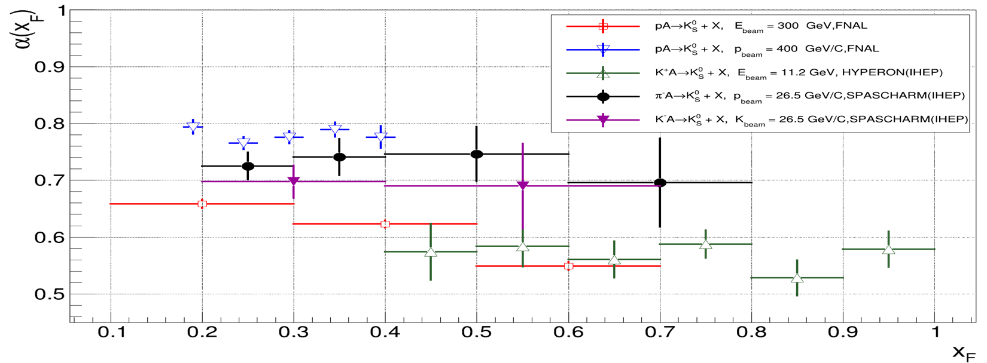
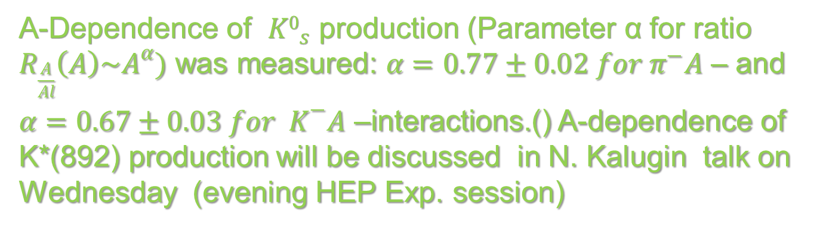
A-dependence
A-Dependence of ${K0}_{s}^{}$ production (Parameter α for ratio $R_{\frac{A}{Al}}\left(A\right)\sim A^{α})$ was measured: $α=0.77±0.02 for{ π}^{−}A$ – and $α=0.67±0.03 {for K}^{−}A \text{–}\text{interactions}\text{.}$() A-dependence of K*(892) production will be discussed in N. Kalugin talk on Wednesday (evening HEP Exp. session)

Slide 34
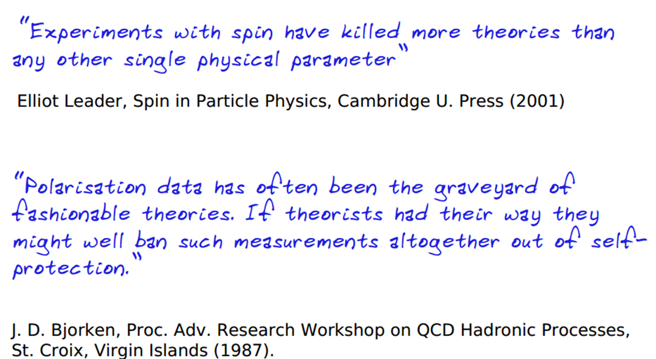

Slide 35
Преимущества СПАСЧАРМ
Широкая физическая программа и систематические исследования явления поляризации
Разнообразие пучков: поляризованные пучки протонов и антипротонов, неполяризованные π±, K±, p, анти-p, d, C.
Исследование десятков реакций одновременно.
Поперечно и продольно поляризованные и ядерные мишени.
Множество изучаемых поляризационных величин: A_{N}, P_{N}, A_{NN}, A_{LL}, D_{NN}, ρik, …
Полное покрытие азимутальных углов для снижения систематических ошибок, большой кинематический диапазон
Идентификация вторичных частиц, и заряженных, и нейтральных, например γ, π0, π±, K±, p, анти-p, d.
Использование спин-ротатора для получения поперечно- и продольно поляризованные пучки и уменьшения систематики.
Система сбора данных, быстро собирающая большой объем информации.

Slide 36
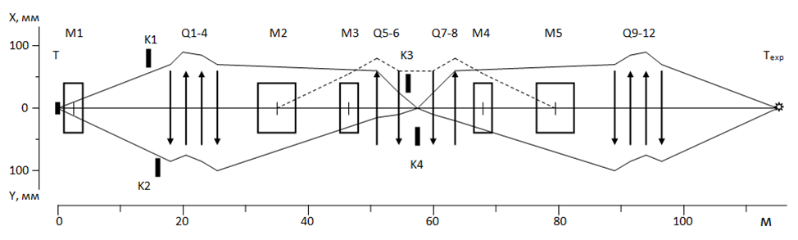
Optical scheme channel 24A
Main optic scheme for polarized beam p≤45 GeV/c from hyperon-decay.
Q – quads, М – dipoles К – collimators, Т , Т_{exp} – targets (channel and experiment), green – spin flipper (BINP, Novosibirsk)

Slide 37
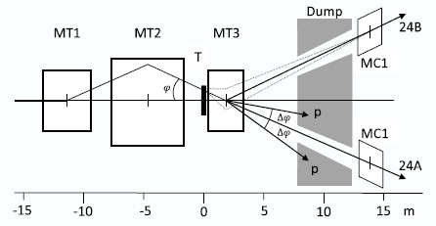
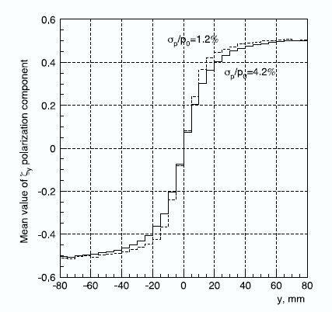
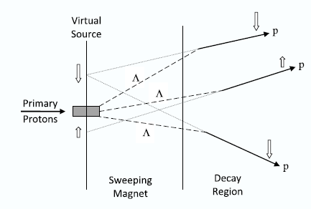
Beam target
(beam extracted from U70)
MT3 parameters have been chosen as a compromise between contradictory requirements to its length : 𝐿 = 2.6 m, aperture 𝐻 × 𝑉 = 140 × 56 mm², 𝐵𝑚𝑎𝑥 = 1.9 T. Target: Aluminum plate, 400 mm long, 3 mm high, and 100 mm wide

Slide 38
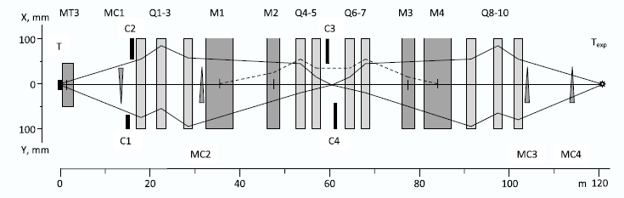
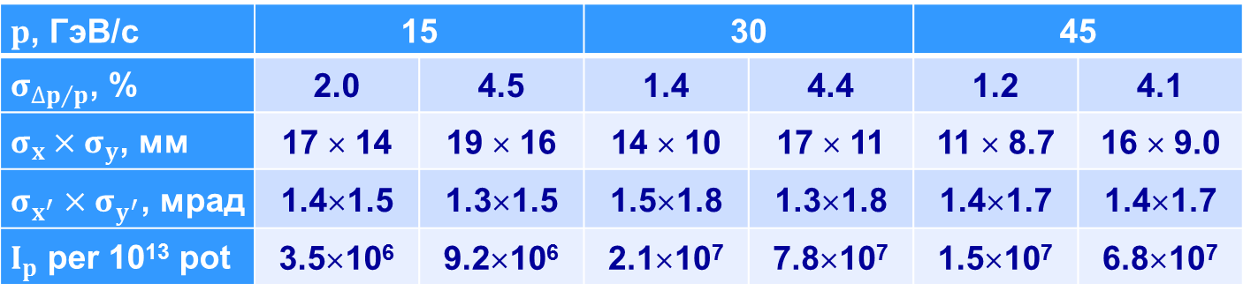
Optical scheme and properties
$p$, ГэВ/с | 15 |  | 30 |  | 45
$σ_{{∆p}/p}$, % | 2.0 | 4.5 | 1.4 | 4.4 | 1.2 | 4.1
$σ_{x}×σ_{y}$, мм | 17 × 14 | 19 × 16 | 14 × 10 | 17 × 11 | 11 × 8.7 | 16 × 9.0
$σ_{x^{′}}×σ_{y^{′}}$, мрад | 1.4×1.5 | 1.3×1.5 | 1.5×1.8 | 1.3×1.8 | 1.4×1.7 | 1.4×1.7
$I_{p}$ per 10¹³ pot | 3.5×10⁶ | 9.2×10⁶ | 2.1×10⁷ | 7.8×10⁷ | 1.5×10⁷ | 6.8×10⁷

Slide 39
Polarized antiproton beam (14 GeV/c)
Momentum collimator position | Min | Max
Momentum interval Δp/p, % | ±5.5 (σ=2.3) | 12.0 (σ=5.6)
Beam size, σ_{X} × σ_{Y} , mm | 18 × 19 | 20 × 19
Beam divergence σ_{X} × σ_{Y} , mrad | 1.6 × 1.9 | 1.5 × 2.0
Full intensity for 10¹³ protons | 1.4×10⁵ | 3.9×10⁵
Anti-proton P, GeV/c | Full anti-proton beam intensity for 10¹³ p/cyc. @ ext. target
10 | 1.9×10⁵
14 | 3.9×10⁵
20 | 3.4×10⁵
30 | 9.3×10⁴
40 | 1.6×10⁴

Slide 40
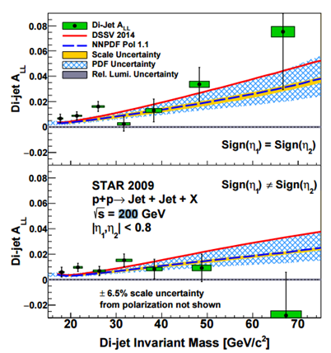

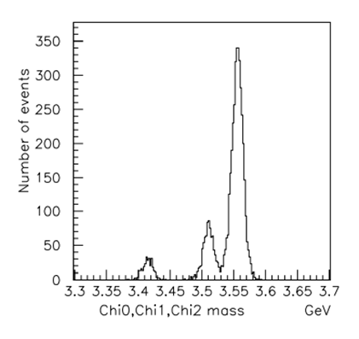
Исследования вклада глюонов в спин протона

Slide 41

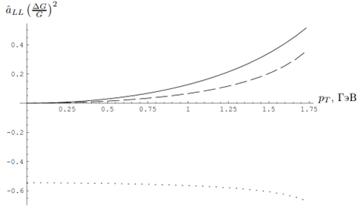

Кинематика и асимметрия «СПАСЧАРМ 24»
Зависимость партонных спиновых асимметрий $gg→ψg$ (сплошная линия), $gg→χ_{c1}g$ (пунктирная линия) и $gg→χ_{c2}g$ (точечная линия) от поперечного импульса чармония

Slide 42
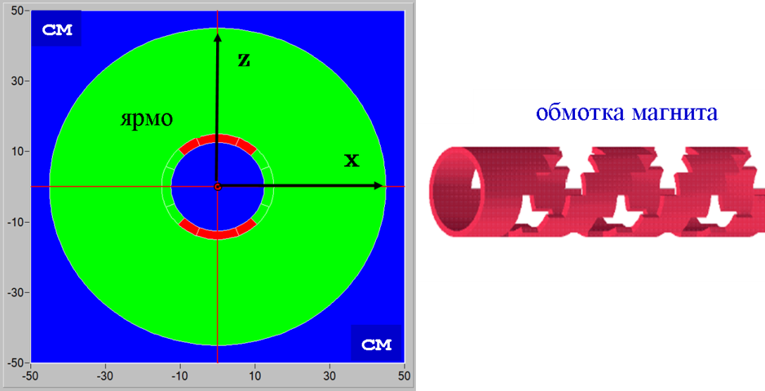

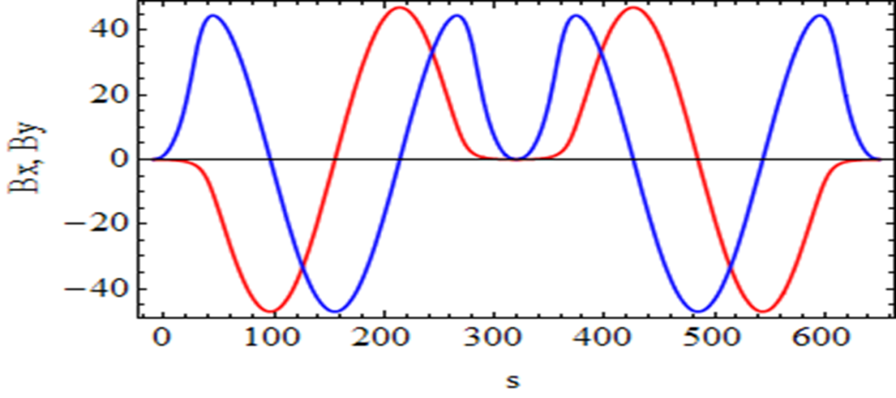

SPIN flipper
2 Helical magnets:
B_{max} = 47 kGs; λ= 2.5 m
Correctors:L=30 cm; B= 23 kGs; tilt = ± 0.1 rad;
Total length 6.5 m
Flipper optics: practically is equal to empty straight 6.5 m;
Spin transparency ≈ 97%

Slide 43

Получение поляризованного пучка от распада гиперонов
Λ - hyperon creates the longitudinally polarized proton aligned with proton momentum (in Λ rest frame)
Protons will have transverse spin component in lab. frame depending on proton emission angle. Therefore the spin states of protons are separated in space
Base for building the polarized particle tagging system (PPTS).

Slide 44

Доставка поляризованного пучка на мишень

Slide 45



SPIN alignment

Slide 46



New 15 mm drift chamber
4 planes (X,Y, U,V).
Placed together with prop. chambers
Additional chamber is required for vertex reconstruction (K0, Λ)
Increase efficiency and accuracy of track reconstruction

Slide 47

Track system
New gas system
Study of dependence of efficiency and stability on gas mixture on cosmics and beam.
It was found at least 1 (better 1.5) volume blowing through the chamber
TDC was reconfigured to decrease redout time twice

Slide 48
Achieved stability in 2021

Slide 49

Proportional chambers efficiency

Slide 50


New profilometer to prove beam position

Slide 51

Fiber Hodoscope

Slide 52

Study of ρ0 – meson spin alignment.

Slide 53


Electromagnetic Calorimeter
Fine-segmented “shashlyk”-type calorimeter,
Cell structure: Scintillator: 1.5 mm, Lead: 0.3 mm (380 layers)
2400 cells of the size 55×55×700 mm³, depth ~20X₀ About 11-12 m from target
Photodetectors: Hamamatsu R7899

