Slide 1
Heating of a molecular cloud by a primordial black hole
The work was supported by the RSF Grant 24-22-00146
Alexander Melikhov, Elena Mikheeva
LPI RAS
Moscow, 2024

Slide 2
What is primordial black hole (PBH)?
The idea was proposed by Zeldovich and Novikov (1966).
One of the mechanisms of PBH formation is gravitational collapse of inhomogeneities of primary matter in the early Universe. This is possible when $δρ/ρ\sim 1$.
The mass of the PBH and the age of the Universe at the time of PBH formation are related as follows
$$M\sim \frac{c^{3}t}{G}$$

Slide 3
Evaporation of PBH
Black holes radiate thermally with temperature
T$=\frac{ℏc^{3}}{8πkGM}\sim {10}^{−7}{\left(\frac{M}{M_{0}}\right)}^{−1}K$
evaporate completely in time $t_{evap}\sim {10}^{64}{\left(\frac{M}{M_{0}}\right)}^{3}$y
PBHs with masses $M\sim {10}^{15}$ g have evaporated by now
PBH emission spectrum $\frac{dN}{dtdE}=\frac{Γ}{2πℏ}{\left(\exp\left(\frac{E}{kT}\right)−1\right)}^{−1}$

Slide 4
Why is it interesting to study PBHs?
LIGO detection gravitational waves from merging BHs (Abbott B. et. al., 2016)
the intrinsic angular momentum of these BHs is close to zero
the masses of these BHs turned out to be much larger than the masses of BHs known from other observational data
Unsolved question about dark matter: what is it?

Slide 5
The goal
The heating of a molecular cloud by photons emitted by a PBH located inside the cloud was considered. The dependence of the dust temperature for graphite and silicate dust grains as a function of the distance to the PBH and the emission spectrum of the dust grains were constructed.

Slide 6
Model
spherically symmetric cloud with a radius of 5 pc
PBH is located in the center of the cloud with a mass from ${10}^{16}$ to ${10}^{20}$g
PBH is the only source of dust heating
molecular cloud is located in the CMZ
the dust number density was calculated based on the gas number density in the CMZ (from ${10}^{3}$ to ${10}^{7}{ cm}^{−3}$)
the thermal structure of the cloud is determined by interstellar dust
the cloud consists of dust particles of the same size (0.01, 0.02, 0.05 and 0.1 µm)
only absorption is taken into account (without scattering)

Slide 7
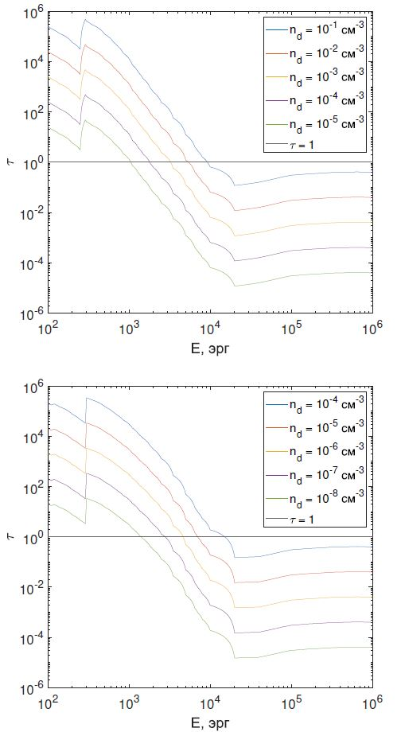
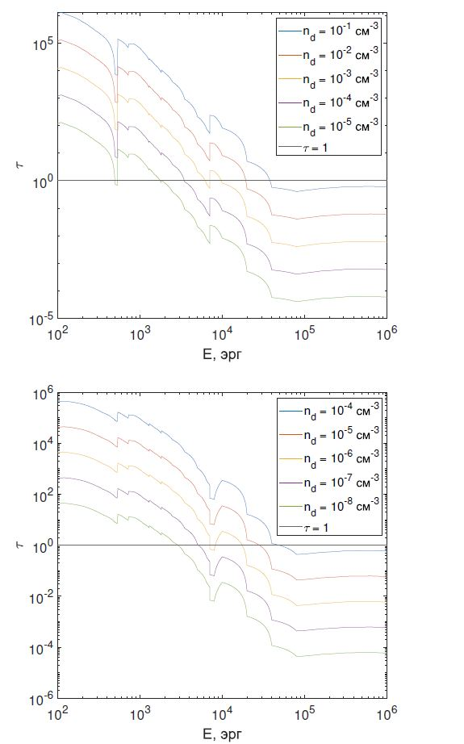
graphite dust grains,
a = 0.01 и 0.1 мкм
silicate dust grains,
a = 0.01 и 0.1 мкм
$$τ\left(E\right)=\int_{0}^{r}{πa^{2}n_{d}Q\left(E\right)dr′}$$
𝑄(𝐸) for X-ray: E. Dwek and
R. Smith (1996) table 5.1. and table 5.2.,
for ultraviolet:
$$Q_{abs}(λ)=\left\{\begin{aligned}1, λ≤2πa \\ \frac{2πa}{λ},λ>2πa\end{aligned}\right.$$

Slide 8
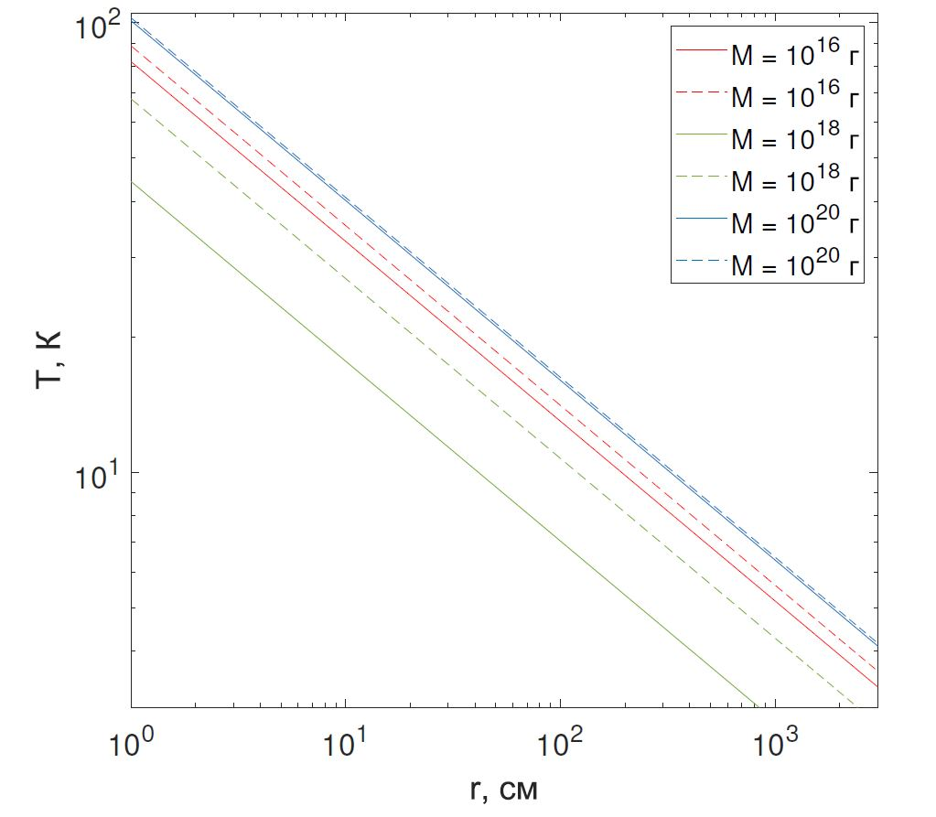
$$\frac{L_{PBH}(M)}{4πr^{2}}=4π\int{Q\left(λ\right)B_{λ}\left(T_{d}\right)dλ}$$
$$L_{PBH}\left(M\right)= \int_{0}^{E}{Q\left(E\right)}E\frac{Γ}{2πℏ}{(e^{\frac{E}{kT}}−1) }^{−1}dE$$
$$T(r)∝L_{PBH}^{1/5}\left(M\right)r^{−2/5}$$
Dependence of the temperature of graphite (solid lines) and silicate (dashed lines) dust grains on the distance to the PBH with masses 𝑀 = ${10}^{16}$ g, 𝑀= ${10}^{18}$ g and 𝑀= ${10}^{20}$ g (see legend). The dust grains have size a = 0.01 µm.

Slide 9
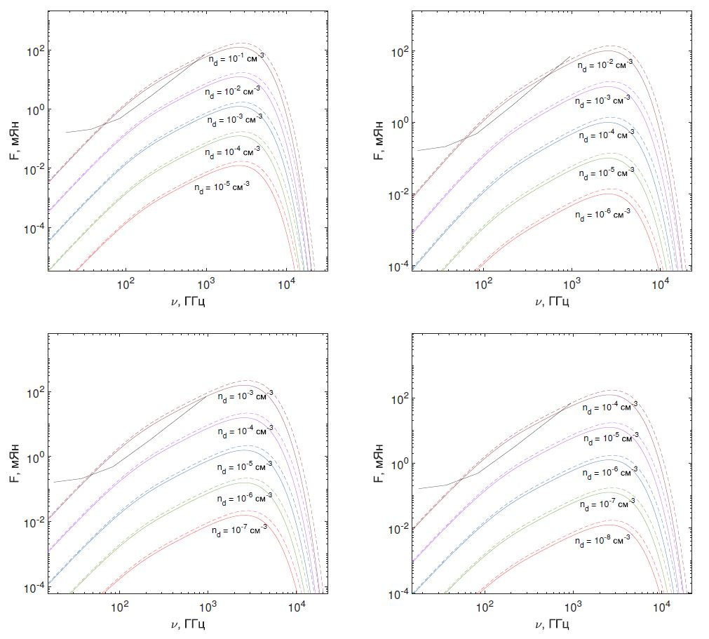
Emission spectra of dust grains heated by a PBH with a mass of 𝑀=${10}^{16}$ g for different dust number density in the molecular cloud. The dust grain sizes are 𝑎=0.01 μm (top left), 𝑎=0.02 μm (top right), 𝑎=0.05 μm (bottom left), 𝑎=0.1 μm (bottom right). Solid colored lines indicate the spectra of graphite dust grains, dotted colored lines indicate silicate dust grains.

Slide 10
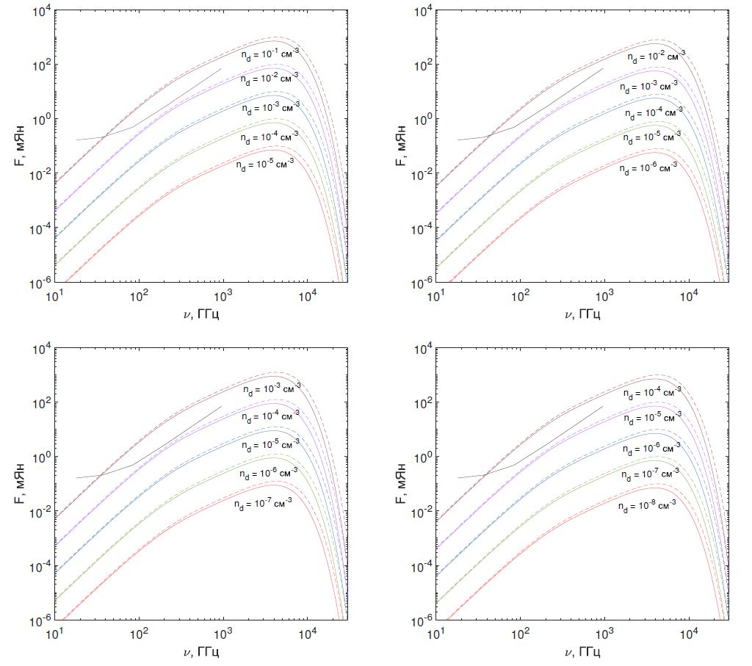
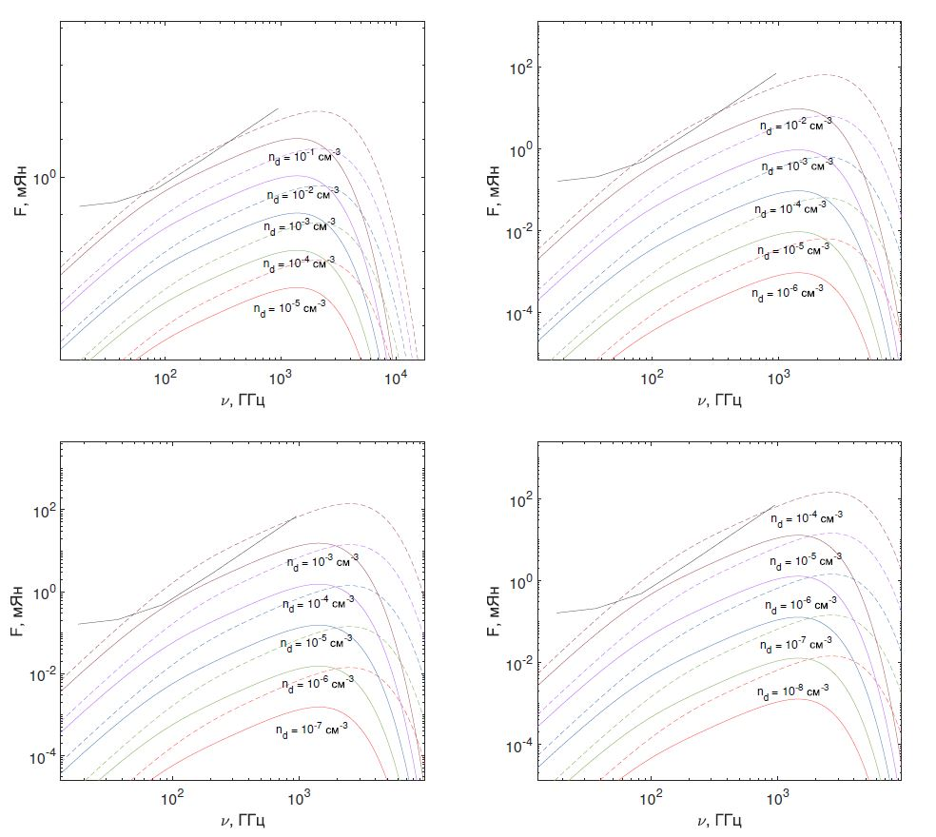
The same but for M = ${10}^{17}$ g
The same but for M = ${10}^{18}$ g

Slide 11
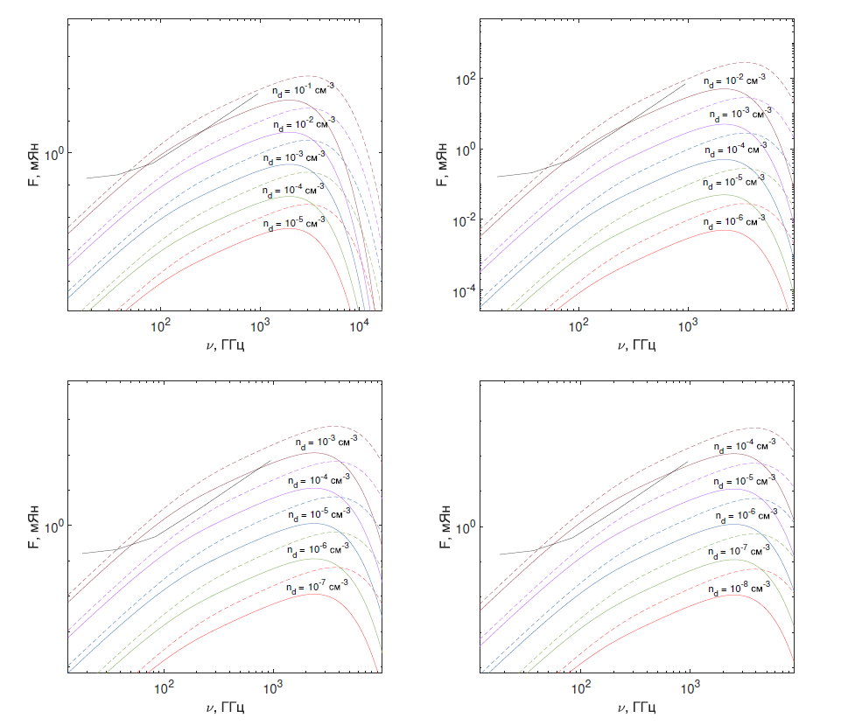
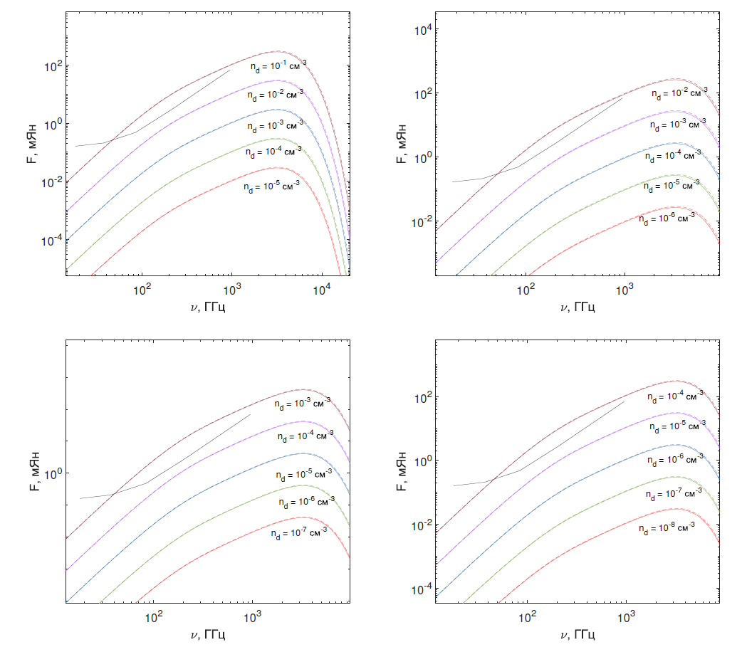
The same but for M = ${10}^{19}$ g
The same but for M = ${10}^{20}$ g

Slide 12
Conclusions
The process of dust heating by photons from PBH with masses $M={10}^{16}−{10}^{20}$ g for the first time. Assuming that the dust particles are uniformly distributed in a spherically symmetric cloud and have sizes of 𝑎 = 0.01, 0.02, 0.05, and 0.1 μm, the dust temperature was calculated as a function of the distance to the PBH. Immediately next to the PBH, the dust grains are heated to a temperature of $T≤ {10}^{2}$ K, and with increasing distance the temperature drops sharply. Thus, PBH can only heat a spherical layer of molecular cloud with radius no larger than ${10}^{3}$cm. In addition, the emission spectra of dust grains heated by PBH were plotted and it was shown how the appearance of the spectra depends on the dust number density and on the size of the dust grains.

