Slide 1
Nucleosynthesis in the crust of minimal mass neutron star. Stripping model.
01
Introduction
02
Stripping model
Speaker: Anton Ignatovskiy
Coauthors: Igor Panov, Andrey Yudin
Affiliations: MIPT, NRC «KI»
03
Nucleosynthesis results
04
Conclusions and Discussion
October, 2024
ICPPA, Moscow

Slide 2
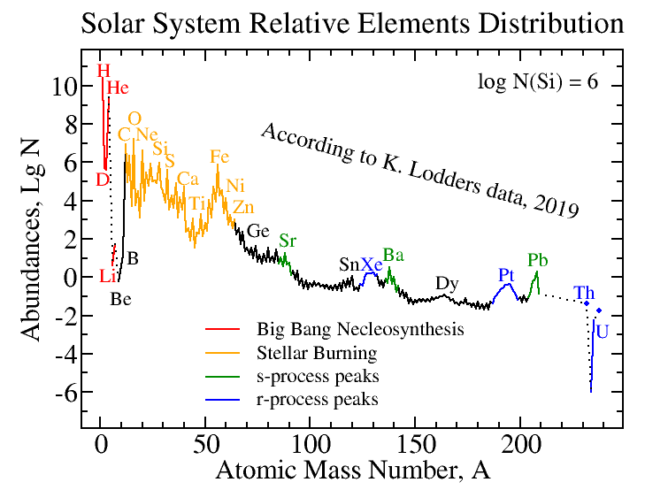
trans-iron:
s-/r-processes
s-process
r-process

Slide 3
Close binary neutron stars
A scetch of the mechanisms of merging (arrow up) and stripping (arrow down)
Blinnikov et al./ Particles 5/ 198-209 (2022)
Observations: GW & GRB: Abbott et al./ Astrophys. J. Lett. 848/ 1-59 (2017) Lanthanides: Tanaka et al./ Publ. Astron. Soc. Jpn. 69 (6)/ 102 (2017)

Slide 4
Stripping scenario
a) Close binary neutron star system evolution with mass asymmetry
b) LMNS is the first to fill its Roche cavity
c) LMNS approaches the lower mass limit , reaching a hydrodynamically unstable configuration and exploding
Blinnikov et al./ Astronomy Reports 65/ 385-391 (2021)

Slide 5
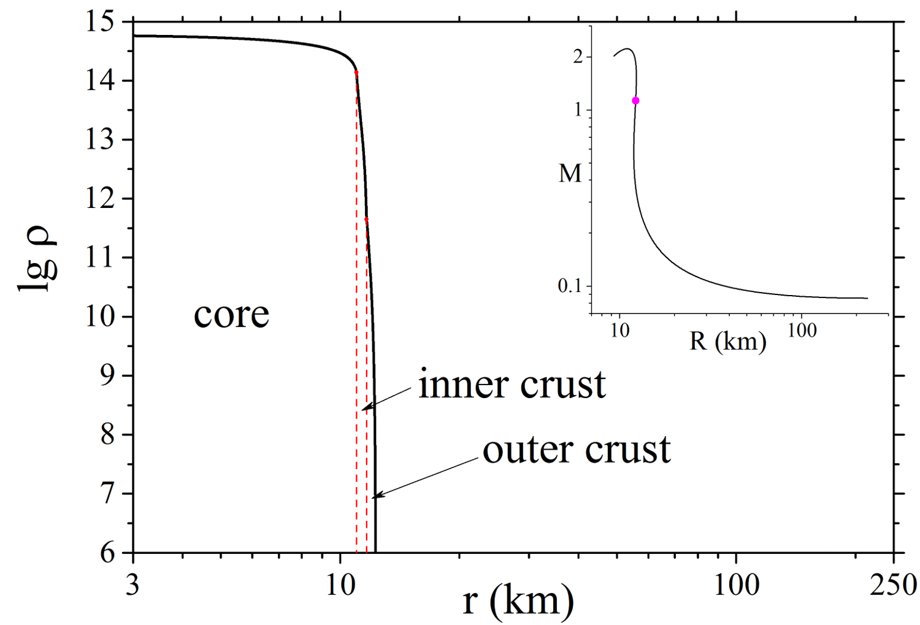
LMNS structure evolution

Slide 6
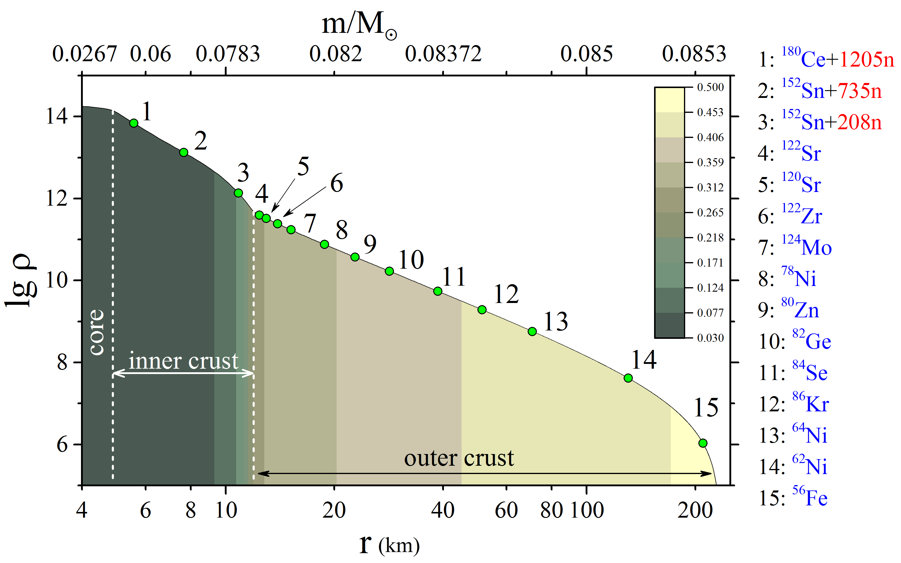
LMNS structure before the explosion

Slide 7
Density (a) and temperature (b) dependance versus time for a number of trajectories in stripping scenario + merging (NSM)

Slide 8
Free neutrons concentration for outer (a) and inner (b) neutron star crust trajectories in stripping scenario

Slide 9
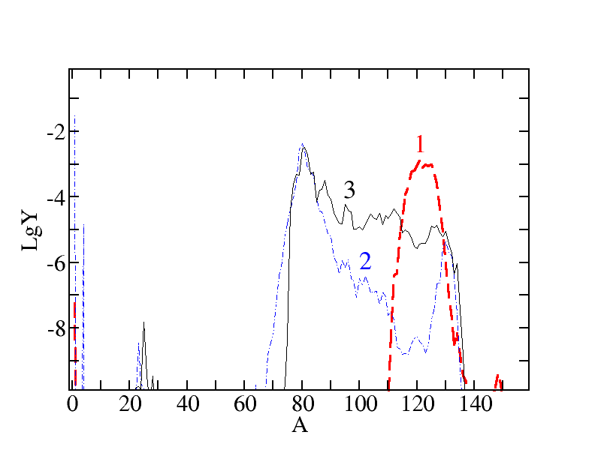
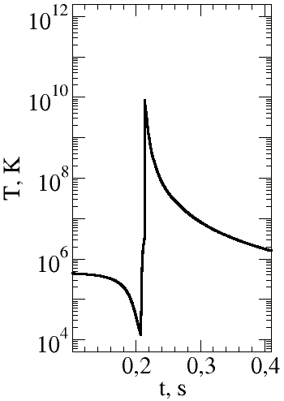
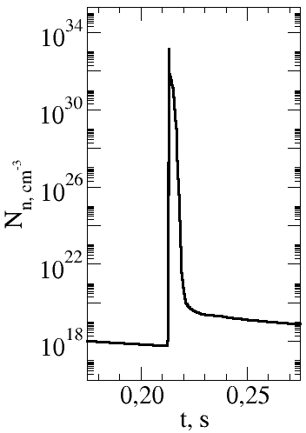
Normalized concentration Y versus atomic mass number A for trajectory 4
1 - before shockwave; 2 – post shockwave; 3 - the end

Slide 10
Normalized concentration Y versus atomic mass number A summed over trajectories 1-15
Red – relative solar system abundances:
Lodders/ arXiv/ 1912.00844
Blue – merging scenario:
S. Rosswog et al./ Astron. Astrophys. 341/ 499-526 (1999)

Slide 11
Inner and Outer crust contributions to stripping scenario nucleosynthesis

Slide 12
Conclusions and Discussion
01
Crust nucleosynthesis in the stripping scenario was calculated for the first time
02
Most of the outer and inner crust ejected mass ~97% made of heavy nuclei A>80 and is approximately equal to 0.04 , while merging provides only 0.01-0.02
03
Generated shockwave affects the outer crust nucleosynthesis, heating layers up and starting explosive nucleosynthesis, while in the inner crust the r-process occurs
Merging OR Stripping? -> Merging AND Stripping: GRB170817A event parameters indicate stripping scenario rather than merging one (energy E ∼ erg), making it equal for consideration along with other scenarios
Blinnikov et al./ Astronomy Reports 65/ 385-391 (2021)

