Slide 1
Crust of accreting neutron stars
M.E. Gusakov, A.I. Chugunov, E.M. Kantor,
A.Y. Potekhin (Ioffe Insitute)
N.N. Shchechilin (Universit e Libre de Bruxelles)
A.I. Chugunov & N.N. Shchechilin, MNRAS:Lett., 495, L32 (2020)
M.E. Gusakov & A.I. Chugunov, Phys. Rev. Lett., 124, 191101 (2020)
M.E. Gusakov & A.I. Chugunov, Phys. Rev. D:Lett., 103, L101301 (2021)
M.E. Gusakov, E.M. Kantor & A.I. Chugunov, Phys. Rev. D:Lett., 104, L081301 (2021)
N.N. Shchechilin, M.E. Gusakov & A.I. Chugunov, MNRAS, 507, 3860 (2021)
N.N. Shchechilin, M.E. Gusakov & A.I. Chugunov, MNRAS:Lett., 515, L6 (2022)
A.Y. Potekhin, M.E. Gusakov & A.I. Chugunov, MNRAS, 522, 4830 (2023)
N.N. Shchechilin, M.E. Gusakov & A.I. Chugunov, MNRAS, 523, 4643 (2023)
M.E. Gusakov & A.I. Chugunov, Phys. Rev. D, 109, 123032 (2024)
A.Y. Potekhin, A.I. Chugunov, N.N. Shchechilin & M.E. Gusakov, submitted
7th International Conference on Particle Physics and Astrophysics (ICPPA-2024)
October 21-25, 2024

Slide 2
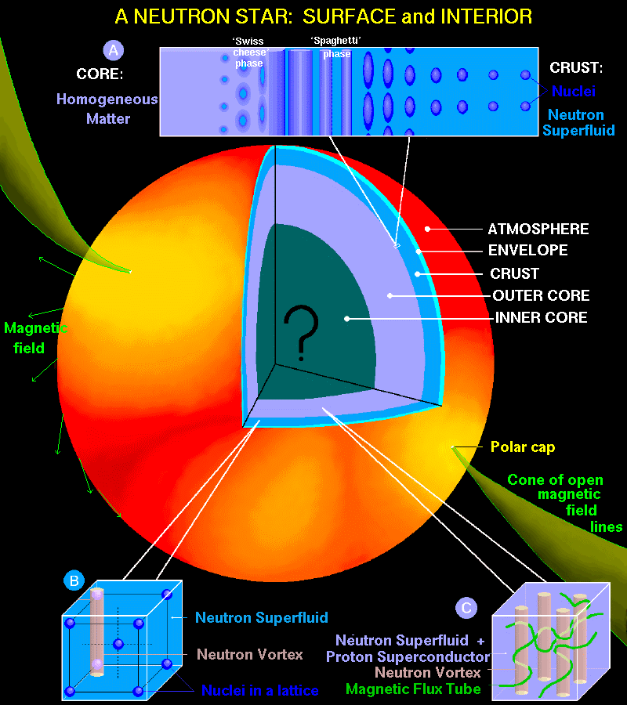
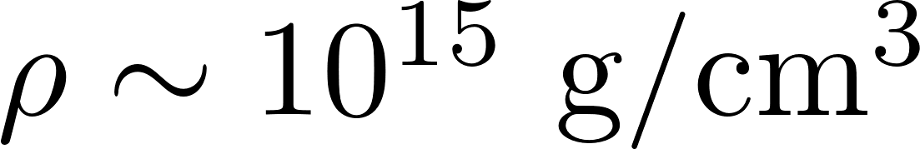

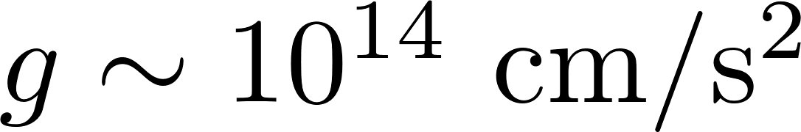
Motivation: neutron stars
Observations of neutron stars allow to check theory of the dense matter
© Dany Page, UNAM

Slide 3
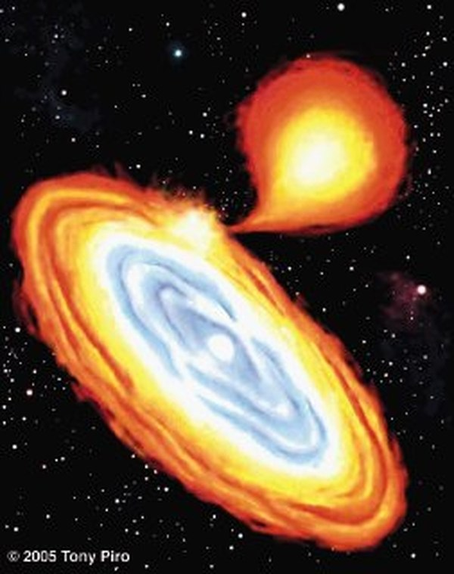
Motivation: accreting neutron stars
Many neutron stars accrete, i.e., have a closely located companion and matter flows from the companion to the neutron star.
During the "quiescence" period, thermal emission is observed (from some of these neutron stars); it is possible to track the thermal evolution in real time!!!
Information on the properties of neutron star matter

Slide 4
Motivation: the crustal models are crucial
To calculate thermal evolution one needs:
Heating power and its distribution
Thermal conductivity
Specific heat
Structure (thickness of the crust)
…
Crustal models
(heating and profile, composition, …)
is a key to interpret thermal emission,
observed from accreting neutron stars

Slide 5
Motivation
Crustal models
(heating and profile, composition, …)
is a key to interpret thermal emission,
observed from accreting neutron stars
The essence of the work
The previously used (1979+) approach to crustal modeling neglects an essential phenomenon (neutron redistribution between crustal layers), which means that the results obtained with its help may be incorrect (use of incorrect results may lead to errors in interpretation of observations).
An approach, allowing for redistribution of neutrons is formulated, respective models are constructed
It is shown that the physical processes occurring in the crust are qualitatively different from the previous works

Slide 6
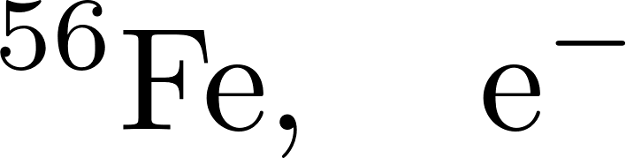
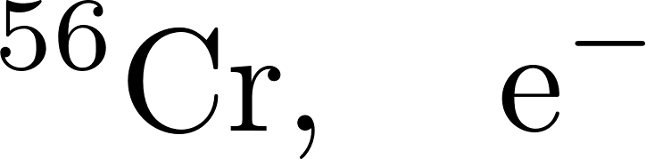
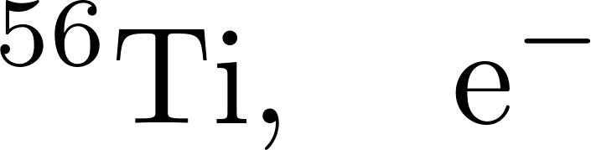
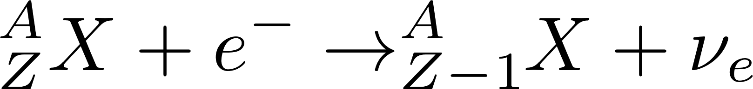
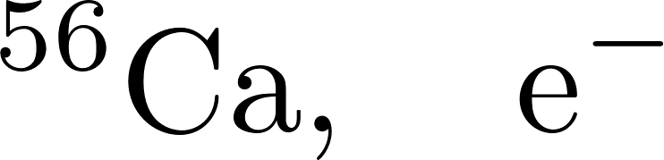
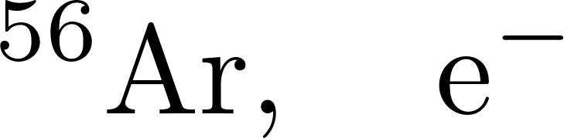
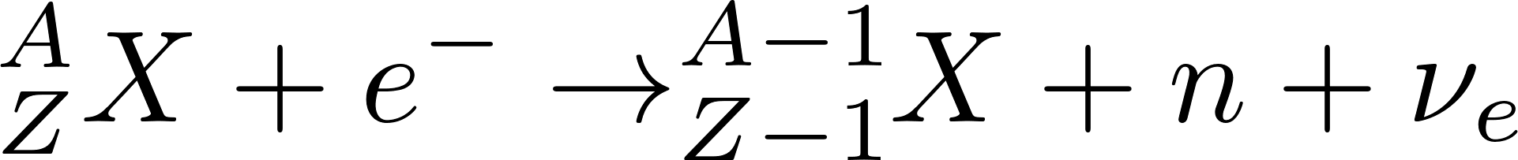
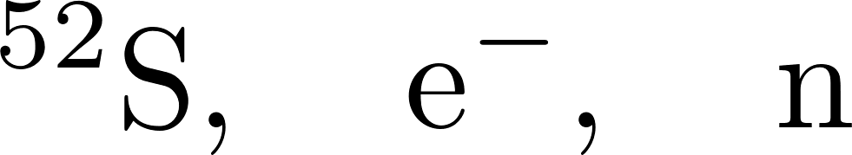
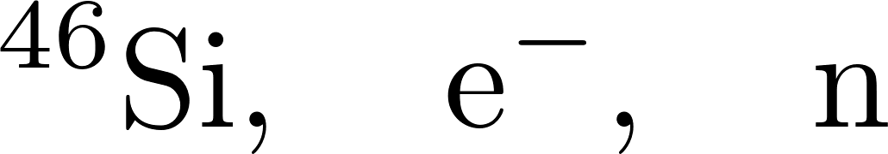

What happens to matter after accretion?
Traditional approach: nuclear reactions driving by compression
Thermonuclear reactions in the surface layers lead to the formation of heavy elements ("ashes")
Continued accretion compresses the underlying matter
Compression leads to beta-captures
Beta captures increase fraction of neutrons
At a certain pressure, beta-capture leads to neutron emission
Fully accreted crust consists of matter at different stages of compression
Initial problem: Initial composition (ashes) determine whole evolution
Transition to inner crust is determined by neutron drip

Slide 7
What happens to matter after accretion?
Traditional approach: nuclear reactions driving by compression
Thermonuclear reactions in the surface layers lead to the formation of heavy elements ("ashes")
Continued accretion compresses the underlying matter
Compression leads to beta-captures
Beta captures increase fraction of neutrons.
At a certain pressure, beta-capture leads to neutron emission
Fully accreted crust consists of matter at different stages of compression
Unbound neutrons are not in equilibrium in the inner crust
Redistribution between layers is energetically favorable

Slide 8
What happens to matter after accretion?
Traditional approach: nuclear reactions driving by compression
Thermonuclear reactions in the surface layers lead to the formation of heavy elements ("ashes")
Continued accretion compresses the underlying matter
Compression leads to beta-captures
Beta captures increase fraction of neutrons.
At a certain pressure, beta-capture leads to neutron emission
Fully accreted crust consists of matter at different stages of compression
A.I. Chugunov & N.N. Shchechilin, MNRAS:Lett., 495, L32 (2020)
Even if traditional crust is constructed ‘by hands’, neutrons start to move and redistribute themselves. The structure of the crust will be changed.

Slide 9
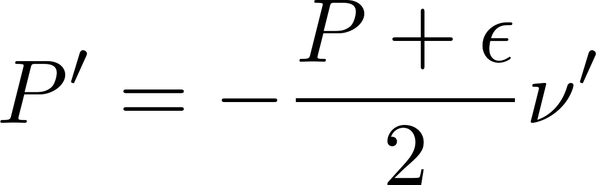
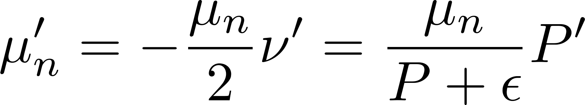

Thermodynamically consistent model:
neutron Hydrostatic/Diffusion equilibrium (nHD)
The statement of problem is crucially modified in the inner crust (=region, where free neutrons exist):
Instead of considering of nuclear reactions in compressing volume element one should consider whole inner crust, accounting for redistribution of neutrons between the layers
Two conditions:
General hydrostatic equation
neutron Hydrostatic/Diffusion equilibrium
General relativity
Transfer of a neutron from one layer to another does not lead to any energy gain

Slide 10
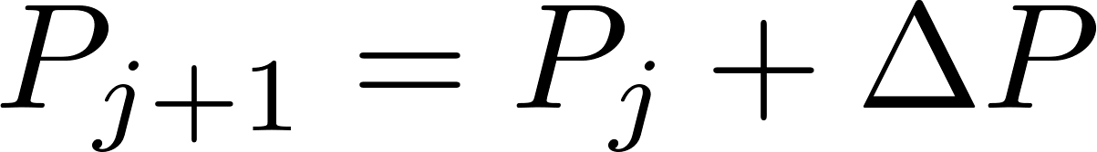
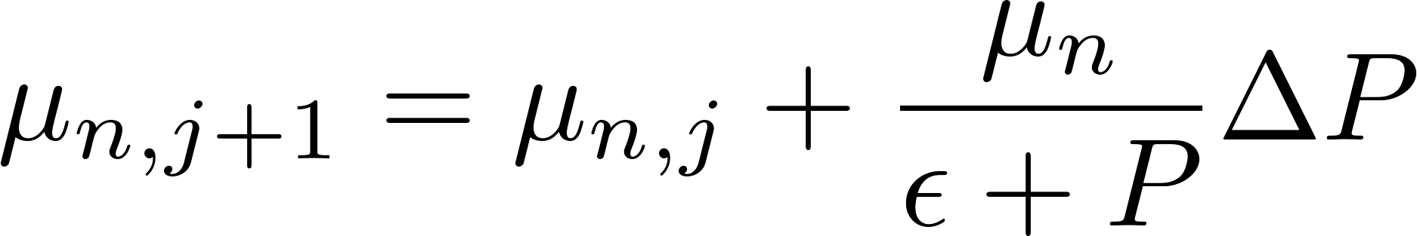
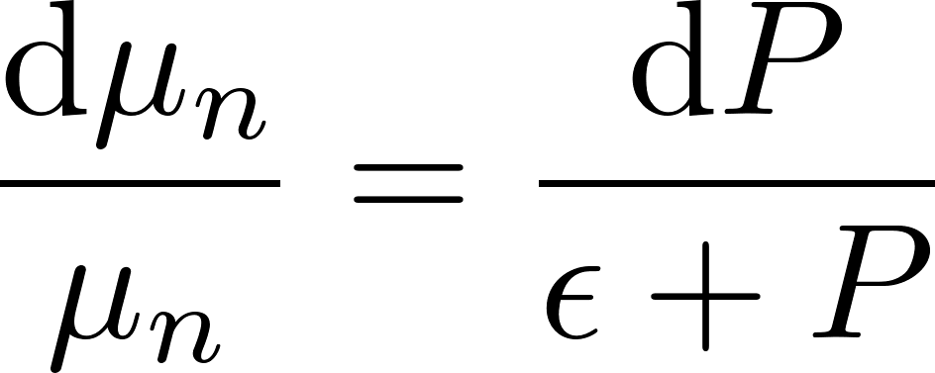


Modeling of accreted crust (schematically)
Traditional approach
(Haensel & Zdunik 1990, ….)
nHD approach (for P>P_{oi})
(Gusakov&AIC, Gusakov, Kantor&AIC)
Switch to the next, j+1, layer:
Increase of pressure
Switch to the next, j+1, layer:
Increase of pressure
and neutron chemical potential μ_{n}
TOV equation
+ nHD condition
Determine composition of this layer, specified by pressure P
Minimization of the Gibbs potential Φ
Determine composition of this layer, specified by pressure P
and neutron chemical potential μ_{n}
Minimization of the appropriate thermodynamic potential Ψ
Initial composition determines evolution
Family of models, parametrized by P_{oi}

Slide 11

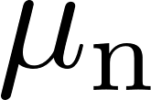



Thermodynamics of nHD inner crust
Gusakov, Kantor, AIC (2021)
In the fully accreted inner crust nuclear reactions take place at the conditions, specific for a given layer:
Pressure (hydrostatic equilibrium with overlying layers)
Neutron chemical potential (nHD condition)
Appropriate thermodynamic potential is not the Gibbs energy , but:
Nuclear physics
Total number of baryons (beta equilibrium is assumed)
The heat release equals to the decrease of thermodynamic potential
Ground state:
(see GKA21 for ‘textbook’ proof)

Slide 12
Where does accreted crust end? At the instability!
Construction of the crust within nHD approach:
Increase P and μ_{n} + minimization of the appropriate thermodynamic potential Ψ
One component example:
ψ(Z) with grow of P
Can be minimized
Can not be minimized
Can not be minimized
Unstable
Strictly unstable
Stable
Instability:
Nuclei dissociation as a result of
beta-capture/neutron emission sequence
Similar instability without neutrons:
G. S. Bisnovatyi-Kogan&V. M. Chechetkin,
Astrophys. Space Sci. 26, 25 (1974).

Slide 13
How to chose P_{oi}?
M.E. Gusakov & A.I. Chugunov, Phys. Rev. Lett., 124, 191101 (2020)
Accretion supply nuclei into the crust
Instability dissociate nuclei => stationary structure is possible
We need to describe neutron star: a boundary between crust and the core should be thermodynamically stable (continuous pressure and neutron chemical potential)
Formation of fully accreted crust:
Instability is active (and compensate nuclei supply by accretion)
Crust is thermodynamically consistent with the core

Slide 14
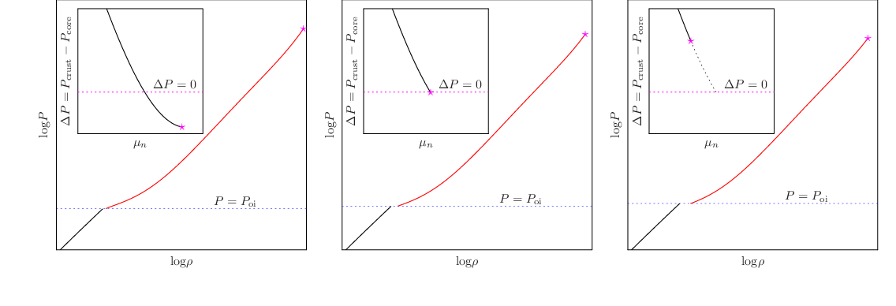
Construction of FAC EOS via shooting method
Depend on nuclear physics of innermost crustal layers. Example: (smooth) SLY4 case
Can not be FAC state
The instability does not take place in the crust
P_{oi} is too low
The FAC state
The instability take place exactly at the crust-core boundary
Can not be FAC state
The instability takes place, but crust EOS can not be connected with core
P_{oi} is too high

Slide 15
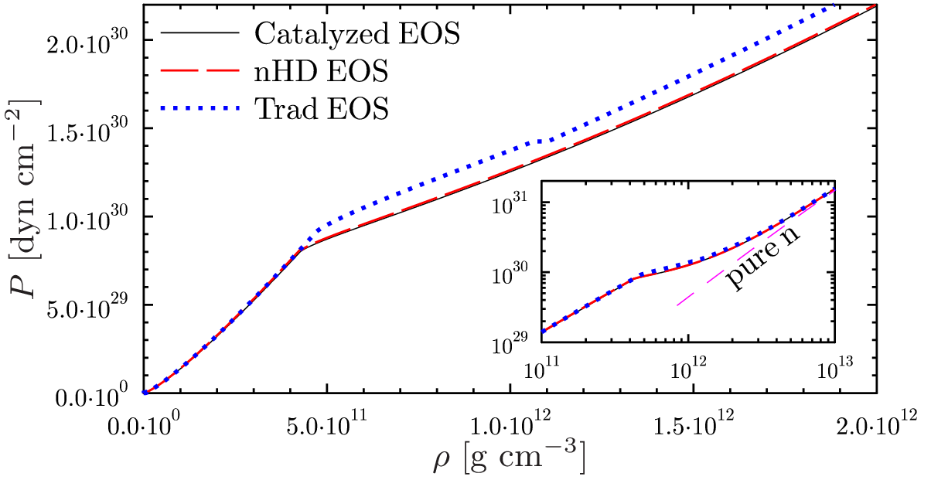
Equation of state of fully accreted crust
M.E. Gusakov & A.I. Chugunov, Phys. Rev. Lett. 124, 191101 (2020)

Slide 16
Accreted neutron star crust
M.E. Gusakov & A.I. Chugunov, Phys. Rev. Lett. 124, 191101 (2020),
M.E. Gusakov, E.M. Kantor & A.I. Chugunov, Phys. Rev. D: Lett., 104, L081301 (2021),
N.N. Shchechilin, M.E. Gusakov & A.I. Chugunov, MNRAS:Lett., 515, L6 (2022)
N.N. Shchechilin, M.E. Gusakov & A.I. Chugunov, MNRAS, 523, 4643 (2023)
M.E. Gusakov & A.I. Chugunov, Phys. Rev. D, 109, 123032 (2024)
(almost) everything is not as it was generally believed
Boundary of outer and inner crust is not associated with neutron emission
The main reactions in outer layers of inner crust is electron emission and neutron capture
Two ‘liquids’ dynamics: there is an upward flow of neutrons (to compensate neutron capture)
Stationary structure of the crust is supported by instability
(sorry, it’s not the end. The remaining part is about energetics and applications)

Slide 17
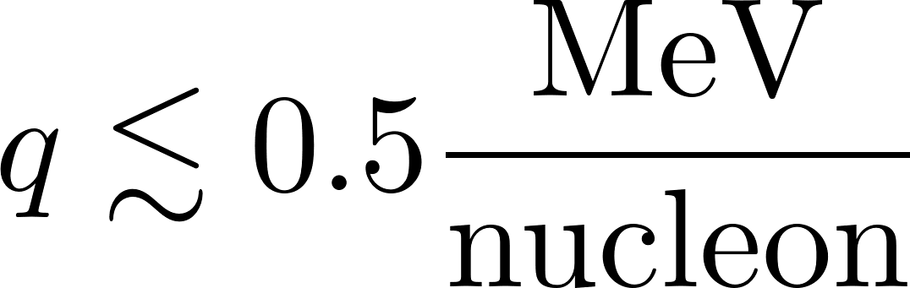
Heating efficiency: nHD crust
Deep crustal heating is factor of few less efficient,
than it was supposed in traditional models!
Shchechilin, Gusakov, Chugunov,
MNRAS: Letters, 515 (2022), L6

Slide 18
Thermal evolution (example MXB 1659-20)
Additional heating is required
Some crustal models seems preferable
Observations of neutron stars allow to check theory of the dense matter
A.Y. Potekhin, A.I. Chugunov, N.N. Shchechilin & M.E. Gusakov
(submitted)

Slide 19
Summary
It is shown that neutron redistribution in the inner crust have a crucial role
First nHD models are constructed. They qualitatively differ from the traditional ones.
Nuclei shell effects are crucial.
Stationary structure of the crust is supported by nuclei dissociation by instability in inner layers
Observations of accreting neutron stars require additional shallow heating source (as in traditional models). The nature of this source is unknown…
To do list
Improve of nuclear physical model (currently: CLDM + tabulated Strutinsky corrections).
Partially accreted crust
Mystery of the shallow heating source
Supported by Russian Science Foundation (grant 22-12-00048)

Slide 20
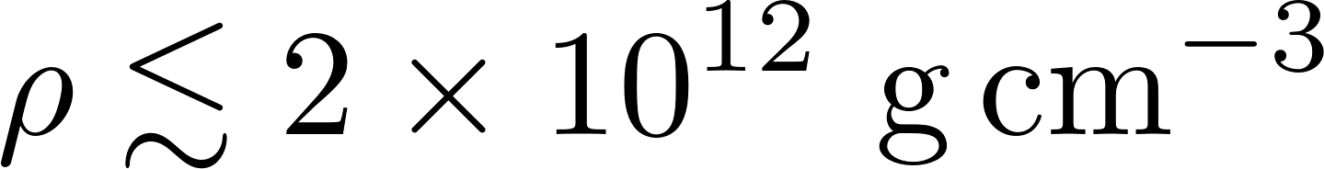
Термодинамика nHD коры (немного деталей)
Равновесная кора:
А как его рассчитать?
Нужно уметь рассчитывать все входящие в него термодинамические величины при заданном составе вещества по заданному давлению и хим. потенциалу нейтронов
(теоретические) таблицы атомных масс
Капельная модель
Капельная модель
+ оболочечные поправки
Физически обоснована
Гарантированная термодинамическая согласованность (если делать последовательно)
Улучшенная точность описания
Быстро, удобно, но таблицы ограничены, применимо при
Физически обоснована
Гарантированная термодинамическая согласованность (если делать последовательно)

Slide 21
Поверхностная энергия в капельной модели
Centelles et al. Nucl. Phys. A, 635 (1998), 193
Двухфазная система с плоской границей
Референсная (модельная) система

Slide 22
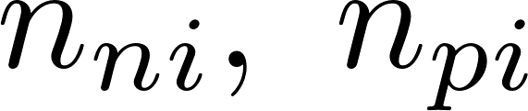

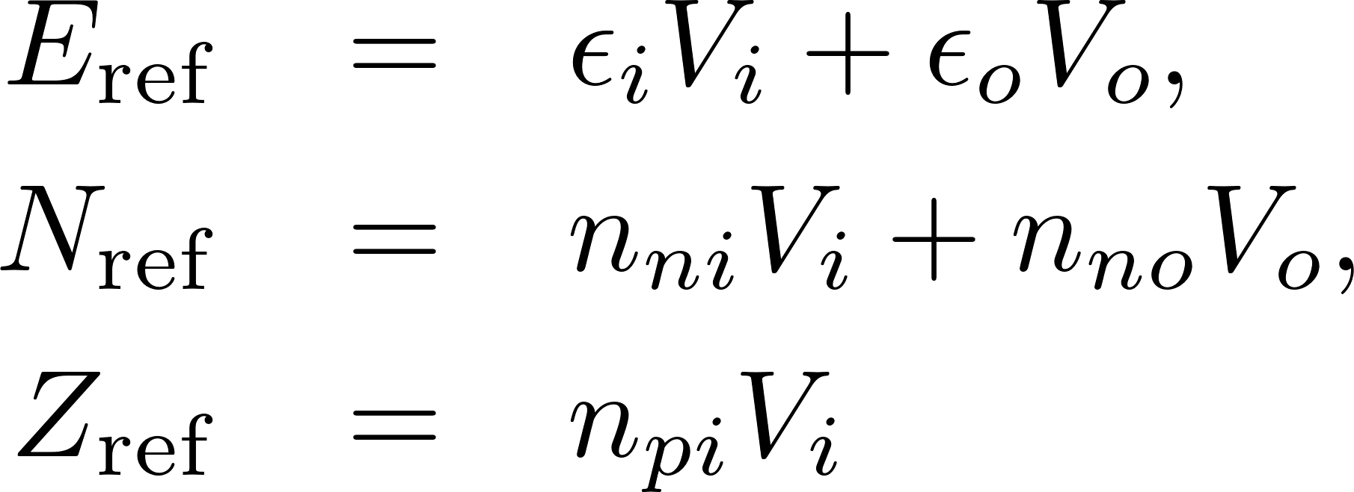
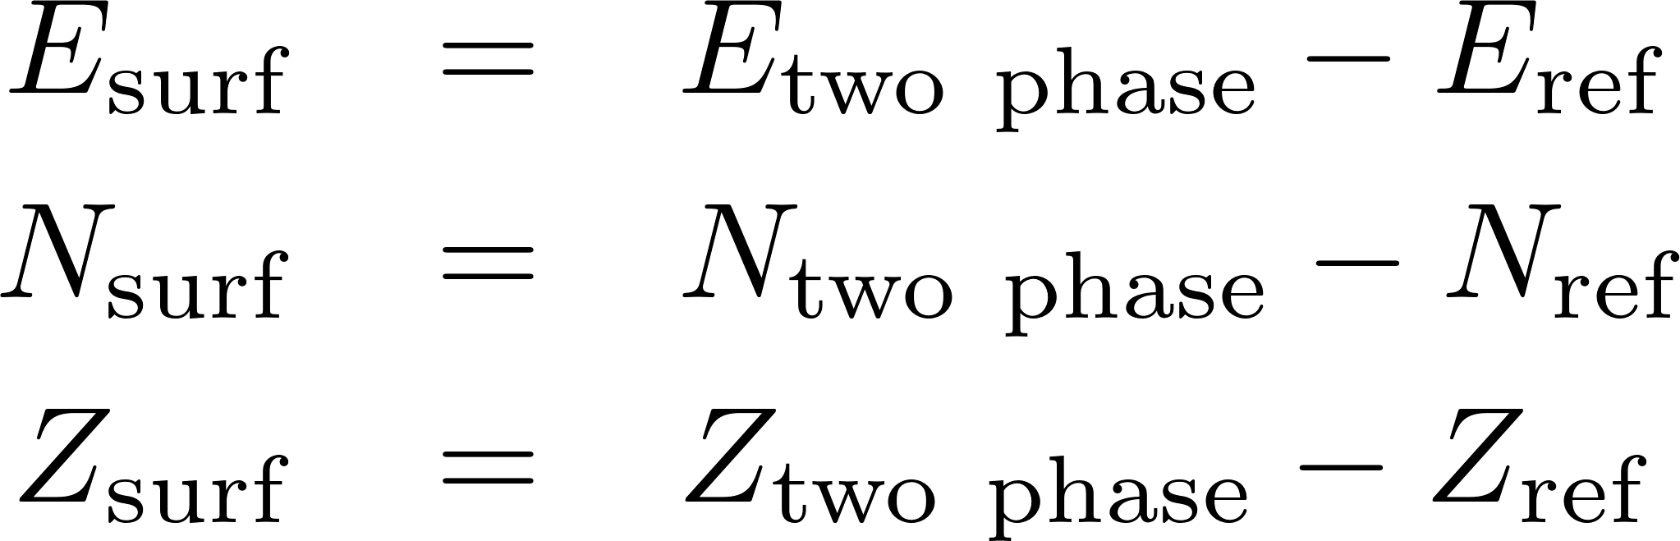
Поверхностная энергия в капельной модели
Centelles et al. Nucl. Phys. A, 635 (1998), 193
Двухфазная система с плоской границей
Референсная (модельная) система
Поверхностная энергия может быть рассчитана (поправка, для воспроизведения параметров двухфазной системы)
Термодинамическое описание границы требует учета адсорбции (нейтронов)
Может быть обнулено выбором границы

Slide 23
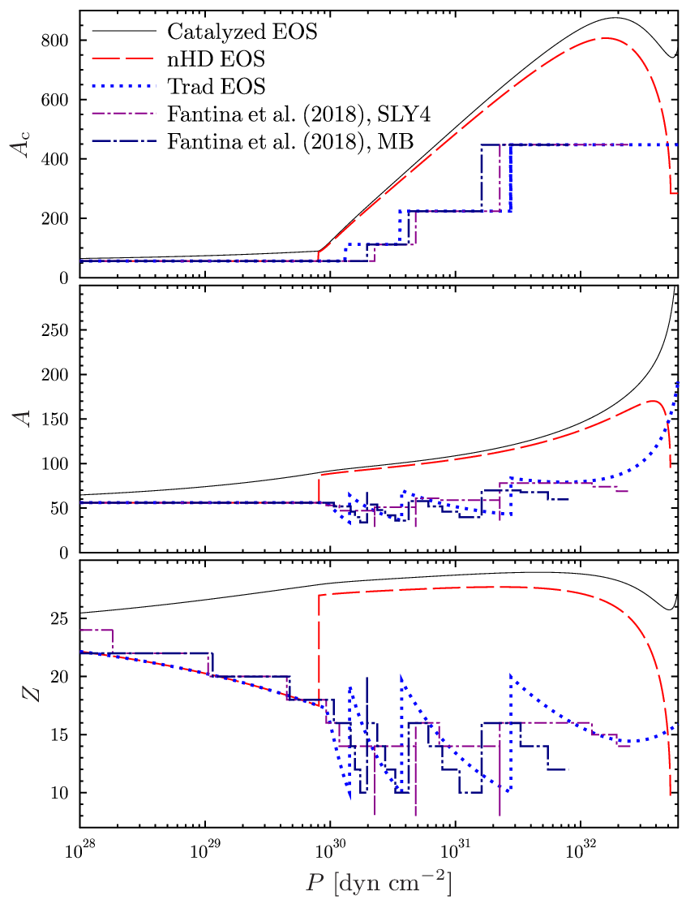
Состав аккрецированной коры
Phys. Rev. Lett., 124, 191101 (2020)
Shchechilin et al. (submitted)

Slide 24
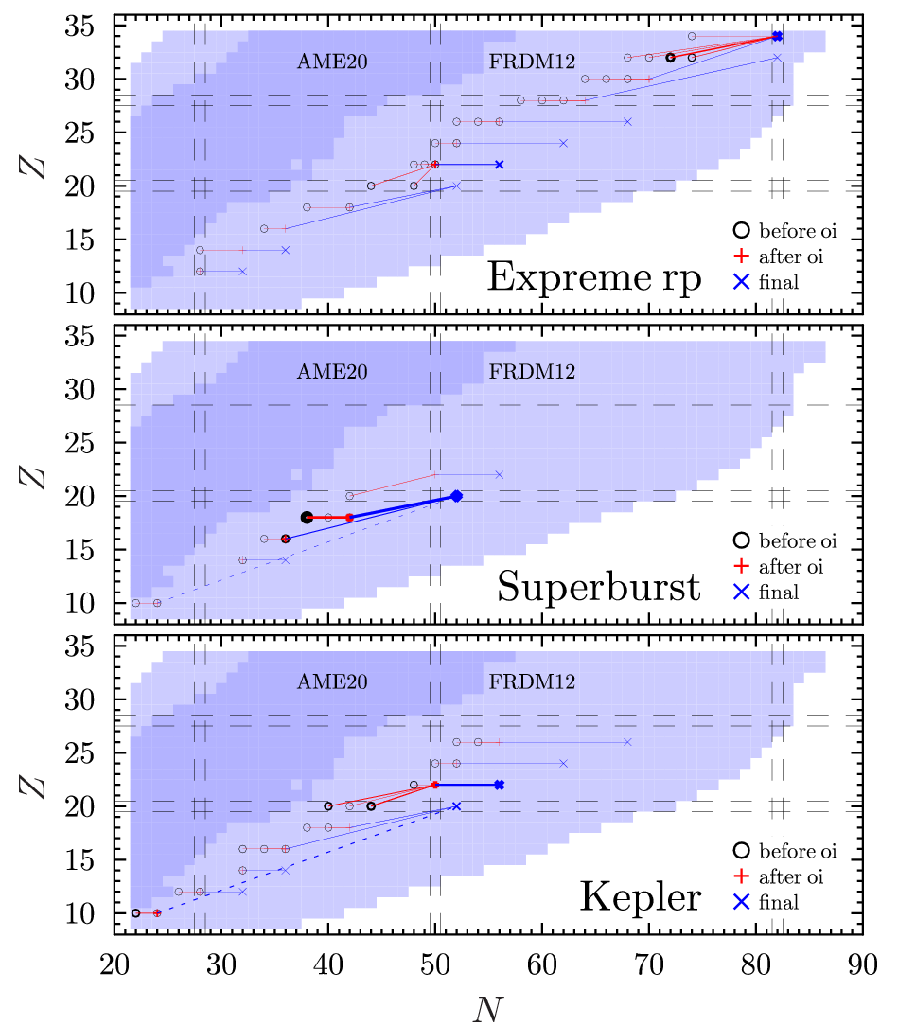
Состав аккрецированной коры
Shchechilin et al. (submitted)

Slide 25
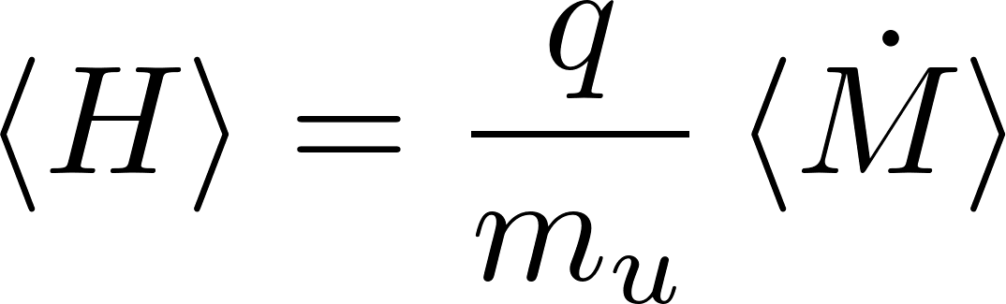

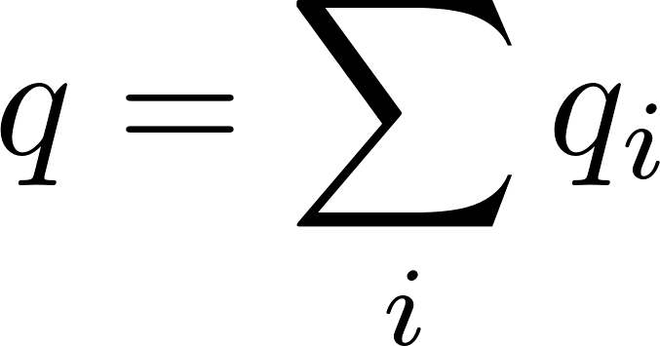
Heating power
M.E. Gusakov & A.I. Chugunov, Phys. Rev. D:Letters, 103, L101301 (2021)
«Book-keeping» approach:
(previously applied)
Total heating
=
Sum of the heat in each reaction
Thermodynamic approach
To assumptions:
Equilibrium composition of the core
Stationary structure of the crust
Detailed information on kinetics is not required
Require detailed information on all reactions
Agrees with «book-keeping» approach

Slide 26

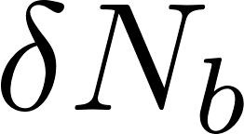
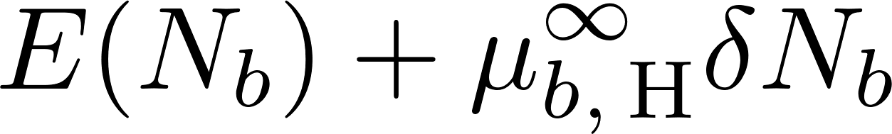
Heating efficiency: general consideration
Plane-parallel consideration (to simplify presentation)
Thought experiment I:
«The accretion process»
Accreted crust
NS (outer) core
(npe-matter)
Let us add baryons (in form of hydrogen) to the surface and keep them there `by hands’.
The energy of the system is
Hydrogen energy per baryon, including gravitational energy
Release the baryons
  The baryons compress the crust and core, initiate reactions, but total energy should be conserved

Slide 27
Heating efficiency: general consideration
Plane-parallel consideration (to simplify presentation)
Thought experiment II:
«The result of accretion»
Accreted crust
NS (outer) core
(npe-matter)
For fully accreted crust the EOS is fixed
  the number of baryons in the crust is fixed
  Additional baryons appear in the core of NS
The core is in equilibrium, thus the change of the energy is

Slide 28
Heating efficiency: general consideration
Plane-parallel consideration (to simplify presentation)
Thought experiment I:
«The accretion process»
Accreted crust
NS (outer) core
(npe-matter)
Thought experiment II:
«The result of accretion»
Which answer is the correct one?

Slide 29
Heating efficiency: general consideration
Plane-parallel consideration (for simplicity of the talk)
Thought experiment I:
«The accretion process»
Accreted crust
NS (outer) core
(npe-matter)
Thought experiment II:
«The result of accretion»
Which answer is the correct one?
Both are accurate!!!
The heat was released in the first experiment!

Slide 30
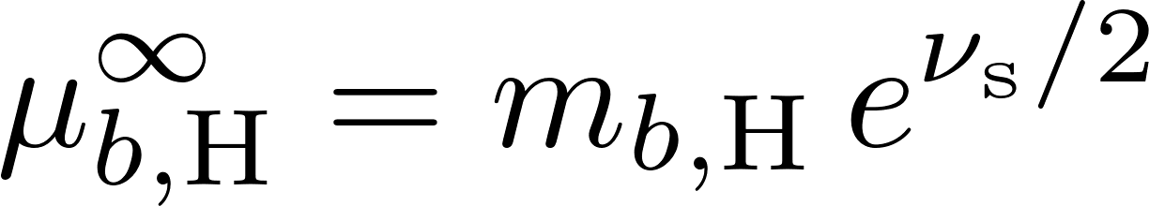
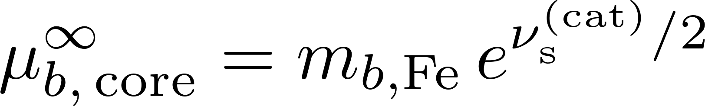
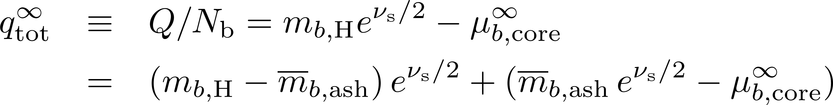

Heating efficiency: general consideration
The result is the same for a spherical general relativistic star
M.E. Gusakov & AIC [Phys. Rev. D:Letters, 103 (2021), L101301]
The «nuclear» part, associated with thermonuclear burning to the ashes (≈ ⁵⁶Fe).
Released from the surface, does not heat up the NS core
The gravitational energy, associated with larger thickness of the accreted crust. Released in the depths of the crust, heats up NS core
Catalyzed crust
Fully accreted crust

Slide 31
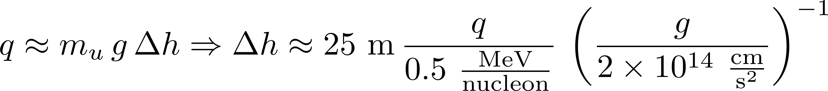
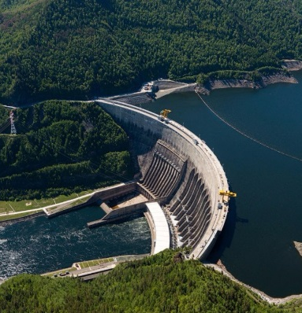
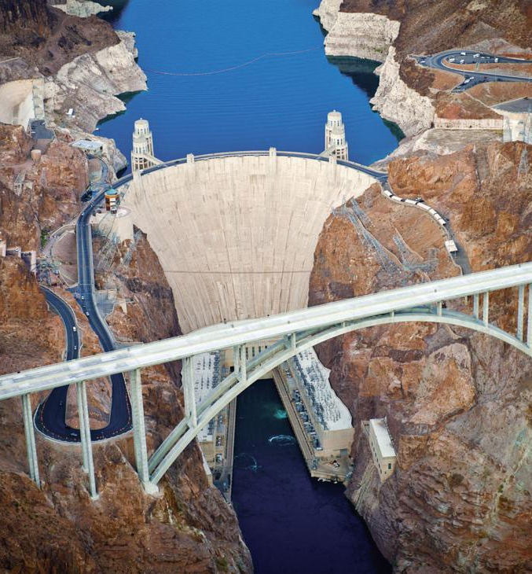
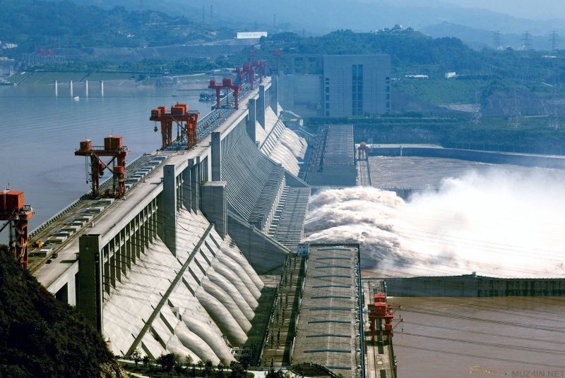
Heating efficiency: general consideration
Within traditional one component approach derived by Zdunik et al. [A&A, 599 (2017), 119]
Deep crustal heating: conversion of the gravitational energy into the heat
(in some sense similar to the gravity dams)
Sayano-Shushenskaya Dam
242 m
Hoover dam
221 m
Three Gorges Dam
181 m

Slide 32

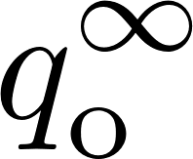

Heating efficiency: nHD crust
Baryon chemical potential at the bottom of outer crust
For nHD crust the energy release is given by
EOS in the outer crust
Pressure at the outer-inner crust interface

