Slide 1
Modulation of the all-particle spectrum of cosmic rays in an anisotropic diffusion approach
Borisov V.D., MSU
Yurovsky V. O., MSU
Kudryashov I.A., Skobeltsyn Institute of Nuclear Physics, MSU
ICPPA, October 25, 2024

Slide 2
Problem Statement:
Large inhomogeneities are observed in the spatial distribution of matter and the magnetic field of the Galaxy.
There is no generally accepted interpretation of the cutoff around ${4∙10}^{15} eV$ (big knee).
Recent numerical experiments indicate significant anisotropy of the diffusion tensor and a strong dependency of its components on the magnitude of the large-scale Galactic magnetic field.
Recent comprehensive studies, including full-sky Faraday rotation measures of extragalactic sources and polarized synchrotron intensity, along with investigations into changes in the CR leakage mechanism from the Galaxy, support the use of an anisotropic diffusion model to describe CR’s propagation.
Introduction
2/15

Slide 3
Model. Diffusion equation:
$$∇(\hat{D}∇f)=S\left(R,z\right)$$
Here, $\hat{D}=\left(\begin{matrix}D_{xx} & D_{xy} & D_{xz} \\ D_{yx} & D_{yy} & D_{yz} \\ D_{zx} & D_{zy} & D_{zz}\end{matrix}\right),$
$∇$ – Del operator, $S\left(R,z\right) −$
Source Distribution Function;
Model parameters:
h = 300 pc, a = 17 kpc — major semi-axis, OA = 9 kpc — Galactic halo height.
Model
3/15

Slide 4
Partial differential equations:
$\frac{∂}{∂x_{i}}D_{ij}(\vec{r})\frac{∂}{∂x_{j}}f(\vec{r})$ = S $\left(\vec{r}\right),$
here S $(x_{j})$ - concentration of sources at a point $\vec{r}=\left(x_{1},x_{2},x_{3}\right).$
Expansion of all derivatives to simple terms:
$$\frac{∂D_{ij}(\vec{r})}{∂x_{i}}\frac{∂f(\vec{r})}{∂x_{j}}$$
$$D_{ij}(\vec{r})\frac{∂^{2}f(\vec{r})}{∂x_{i}∂x_{j}}$$
и
Recursive replacement:
$$\frac{∂g (\vec{r})}{∂x_{i}} → \frac{g\left(\vec{r}+\vec{x_{i}}h_{i}\right)−g(\vec{r}−\vec{x_{i}}h_{i})}{2h_{i}}$$
Model
4/15

Slide 5
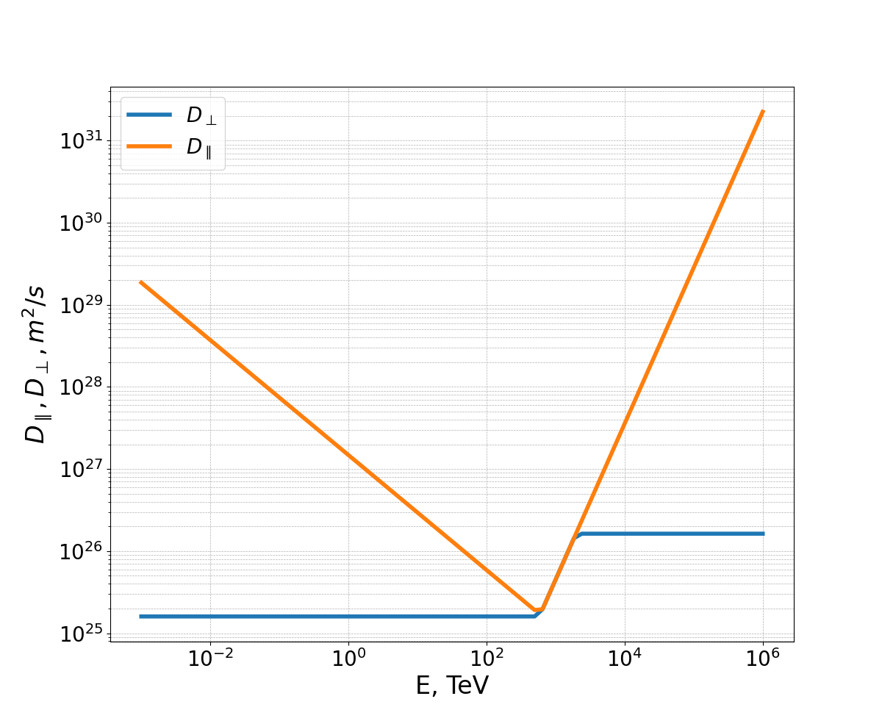
Results. GCR concentrations:
dependence of the GCR concentration on the coordinates in the disk plane z = 0 for different E, TeV. The star marks the position of the Sun.
Results
5/15

Slide 6
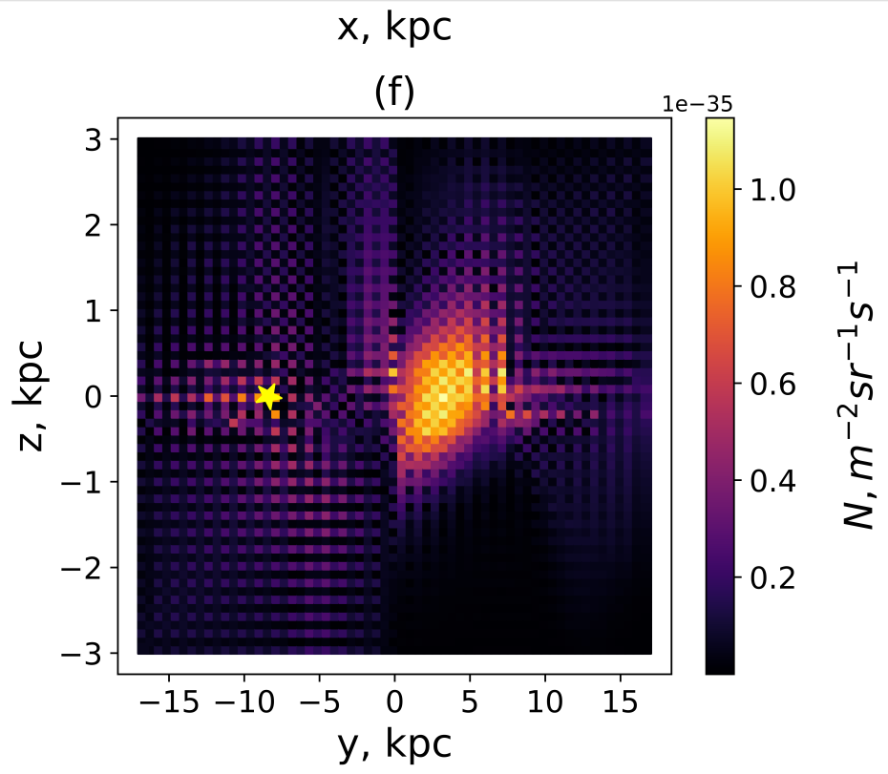
Directed flows of CR outflow from the disk into the Galactic halo
Position of
The Sun
Results
6/15

Slide 7
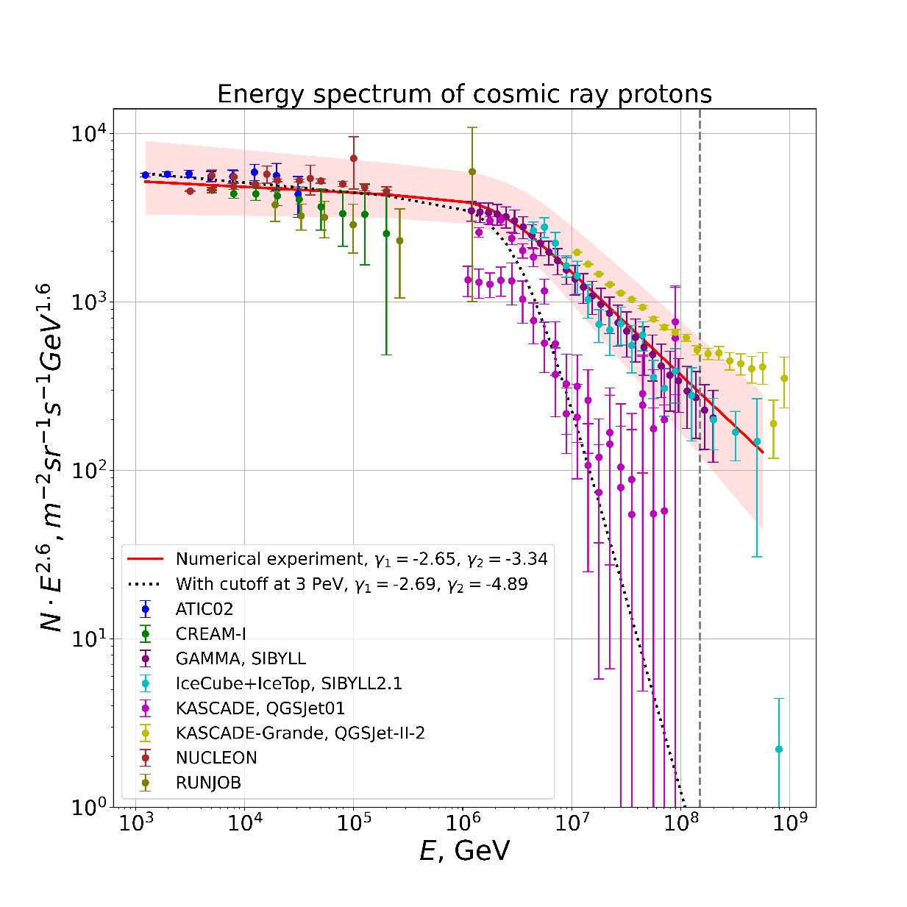
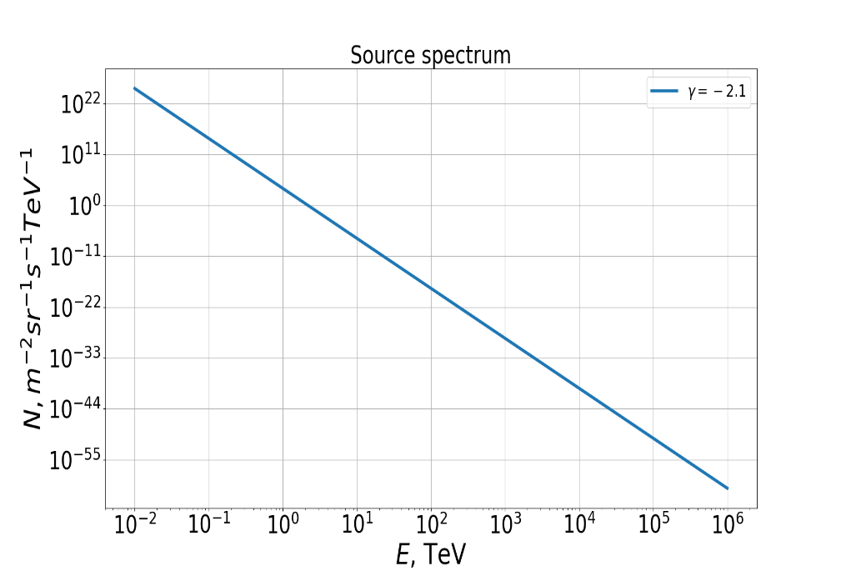
Energy spectrum of protons:
$F_{s}(γ_{1}$, $γ_{2},N_{0},E_{o},E)=N_{0}{\left(\frac{E}{E_{0}}\right)}^{−\frac{γ_{1}}{2}}{\left(\frac{E}{E_{0}}\right)}^{−\frac{γ_{2}}{2}}{\left[\frac{{{{(E}_{o}}/E)}^{\frac{s}{2}} +{{(E}/{E_{0})}}^{\frac{s}{2}}}{2}\right]}^{\frac{γ_{1} −γ_{2}}{s}}$
Results
7/15

Slide 8
All-particle spectrum:
Results
8/15

Slide 9
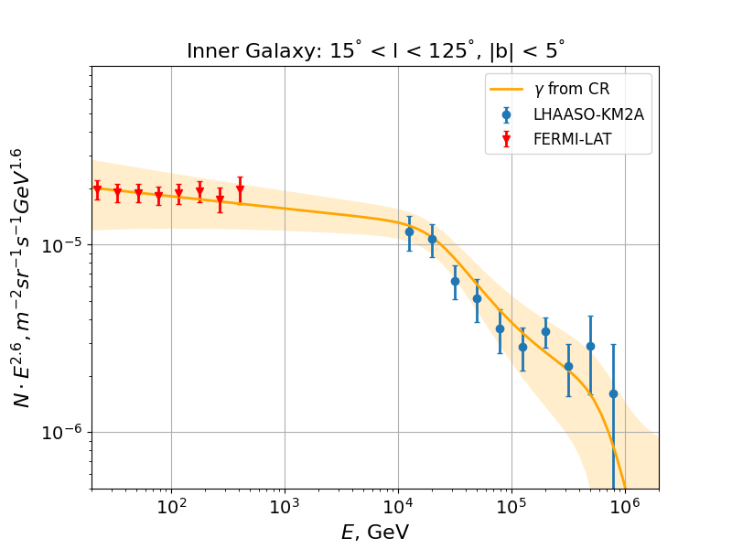
Spatial modulation:
Results
9/15

Slide 10
Conclusions:
A mathematical model was developed to describe the anisotropic transport of cosmic rays (CRs) with a general tensor form, and a software package was designed to simulate the CR proton concentrations throughout the galaxy;
This model describes the modulation effect on the energy spectrum of CR all-particle spectrum, with the break position aligning well with experimental data;
The characteristics of the break vary significantly depending on the spatial position within the galaxy, which is consistent with the latest experimental findings and underscores the significant influence of CR transport in interpreting experimental data.
Conclusions
10/15

Slide 11
Backup: GCR concentrations:
We hypothesize that the mechanism of CRP leakage from the galactic disk into the halo is intricately linked to the anisotropic diffusion characteristics of CRPs and their complex energy-dependent behavior.
Backup
11/15

Slide 12
Spatial modulation in the isotropic approach:
C. Prevotat, M. Kachelrieß, S. Koldobskiy, A. Neronov and D. Semikoz, 2024
Backup
12/15

Slide 13
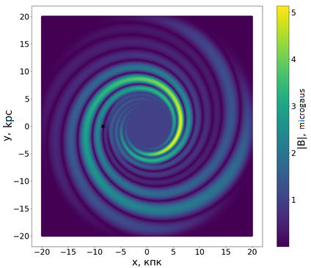
Magnetic field model:
MICHAEL UNGER & GLENNYS R. FARRAR. 2024
The magnetic field in a cylindrical coordinate system at a point (𝑟,𝜑,𝑧) is given by the expression:
Where,
Backup
13/15

Slide 14
Distribution of sources:
Yusifov I. & Kucuk I. 2004
Backup
14/15

Slide 15
Energy dependence of the ratio of the diffusion tensor components:
Graphs of the dependence of $\log_{10}\left(\frac{D_{‖}}{D_{⊥}}\right)$ on the coordinates in the disk plane for different E, TeV.
Backup
15/15

