Slide 1
7th International Conference on Particle Physics and Astrophysics
Analysis of Reasons of the Geomagnetic Storm on December 1-2 2023 from Interplanetary Scintillation Observations at the BSA LPI Radio Telescope
Lukmanov V.R., Chashei I.V., Tyul’bashev S.A., Subaev I.A.
Lebedev Physical Institute of Russian Academy of Sciences
2024

Slide 2
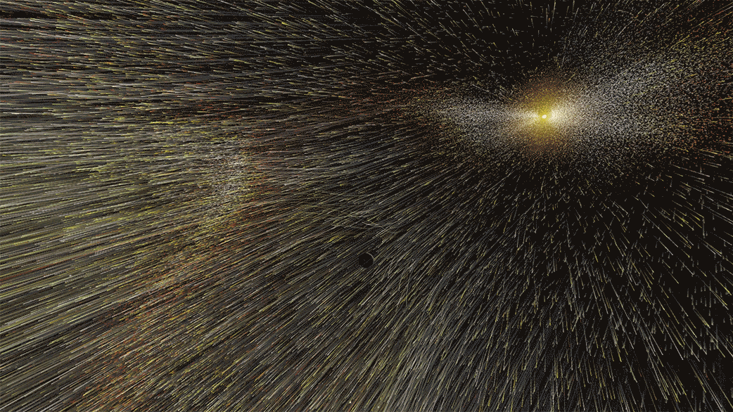
Solar wind
Solar wind is a flow of ionized particles going from solar corona into surrounding space
Main characteristics (near Earth’s orbit):
V = 300 – 800 km/s;
<n> = 5 cm⁻³;
<B> = 5∙10⁻⁵ G;
Tₚ = 10⁴ – 10⁵ K;
Tₑ = 10⁵ K.
Solar wind
Quasi-stationary
Disturbed
Slow streams
(300-500 km/s)
Fast streams
(500-800 km/s)
Coronal mass ejections
Corotating interaction regions

Slide 3
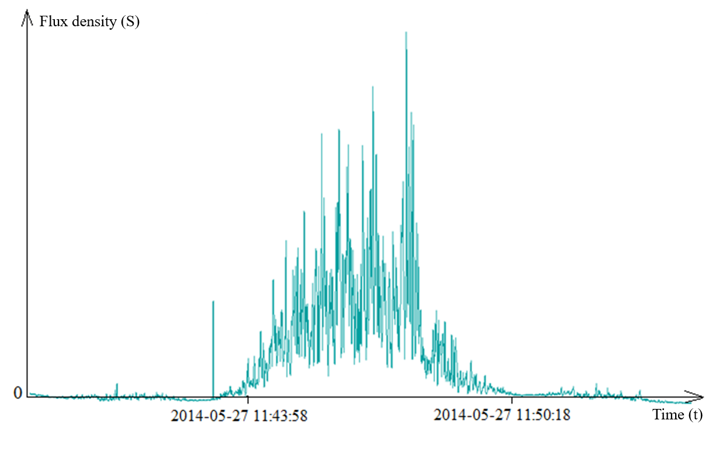
Interplanetary scintillation [*]
Scintillation is fluctuations in the flux (intensity) of the radio signal from a source associated with diffraction on inhomogeneities of solar wind density.
* Hewish A., Scott P. F., Wills D. Interplanetary Scintillation of Small Diameter Radio Sources. // Nature. – 1964. – V. 203. – P. 1214 – 1217.

Slide 4
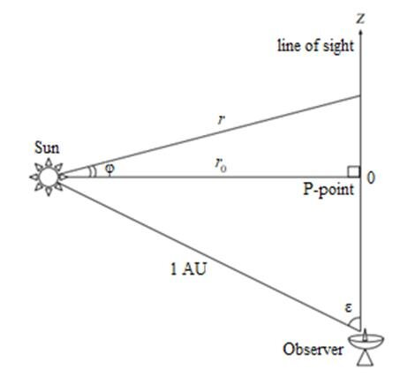
The observation scheme [*]
z-axis is directed towards the observed scintillating radio source.
z = 0 corresponds to the aiming point (P-point), in the vicinity of which located is the main layer which contributes the most to interplanetary scintillation.
The concentration of solar wind particles $n(r)\sim \frac{1}{r^{2}}$ [**].
* Glubokova S.K., Tyul'bashev S.A., Chashei I.V., Shishov V.I. Parameters of the Turbulence of the Interplanetary Plasma Derived from Scintillation Observations of the Quasar 3C 48 at the Solar-activity Minimum. // Astronomy Reports. – 2013. – V. 57. – С. 586 – 593.
** Cohen M. H., Clark B. C., Jauncey D. L. Angular Size of 3C 273B. // The Astrophysical Journal. – 1967. – V. 147. – P. 449 – 456.

Slide 5
Scintillation index
$$m^{2}=\frac{\left\langle {(I(t)−\left\langle I(t)\right\rangle )}^{2}\right\rangle }{{\left\langle I(t)\right\rangle }^{2}},$$
where $I(t)$ is the flux density measured, $\left\langle I(t)\right\rangle$ is it’s time average value;
The theoretical formula [*] (for the mode of weak scintillation):
$$m^{2}=2π\int_{−1AU\cos{ε}}^{+∞}{C(r)dz}\int_{0}^{+∞}{Φ_{e}\left(q\right)\sin^{2}\left(\frac{q^{2}z^{′}}{2k}\right)F^{2}\left(q\right)qdq},$$
Integration is over the line of sight and spatial frequencies.
The structure constant $C(r)\sim r^{−4}$ (the model is spherical symmetric), r is the distance from the Sun center to a point at the line of sight, $r_{0}=1AU\sin{ε}$ is the distance from the Sun center to the aiming point, ε is the elongation of a source;
$Φ_{e}(q)$ is the spatial spectrum of fluctuations of the concentration of the interplanetary plasma (suggested as a power function $Φ_{e}\left(q\right)=q^{−n},$ the turbulence index n = 3,6);
$\sin^{2}\left(\frac{q^{2}z^{′}}{2k}\right)$ is the Fresnel filter, $k=\frac{2π}{λ}$ is the wave number, λ = 2,7 m is the wavelength;
$F(q)$ is the spatial spectrum of a radio source (suggested as gaussian $F\left(q\right)\sim \exp\left(−\frac{1}{4}θ_{0}^{2}{z′}^{2}q^{2}\right)$, where $θ_{0}$ – is the source radius at the level of $\frac{1}{e}$, $z^{′}=z+1AU\cos{ε}$ is the distance from a point at the line of sight to the observer). In this work all the sources are suggested as point-like, $θ_{0}=0,$ тогда $F(q)≡const$ .
* Salpeter E. E. Interplanetary Scintillations. I. Theory. // Astrophysical Journal. – 1967. – V. 147. – P. 433.

Slide 6
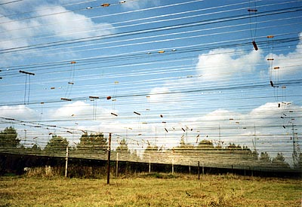
The radio telescope BSA LPI [*]
The size is 187х384 m in the directions East-West and North-South respectively;
16384 wave dipoles;
The meridional type radio telescope;
The telescope pattern has 128 ray, only 96 of them are active, they cover declinations from -8˚ to +42˚;
The central frequency is 111 MHz;
The frequency bandwidth is 2,5 MHz;
6 frequency channels.
Interplanetary scintillation has been monitored since 2014. Scintillation of all sources (about 5,000 per day) falling into the multiray pattern of the radio telescope is observed daily for 24 hours. When analyzing the data of mass measurements of scintillation, two-dimensional maps characterizing the spatial and temporal distribution of the scintillation level are used, not records of individual sources.
*https:\\www.prao.ru

Slide 7
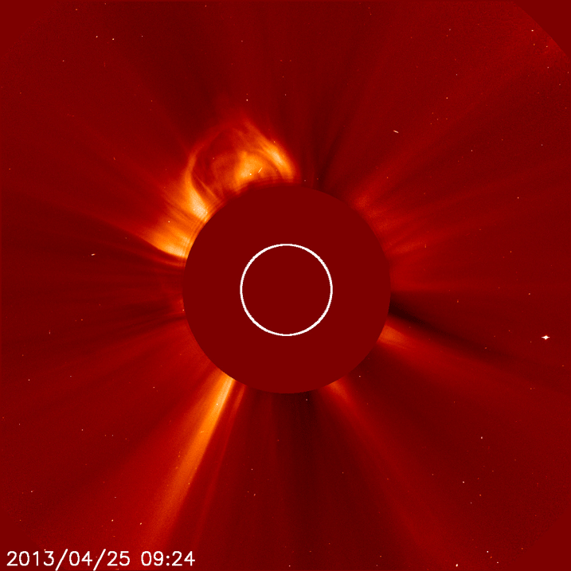
Coronal mass ejections (CME)
As a rule, CMEs occur as a result of strong and long solar flares;
Speed of CME spreading in the interplanetary medium is 500 – 2500 km/s;
If a CME comes at Earth, it can cause a geomagnetic storm. The most dangerous cases are when a CME spreads symmetrically relative to the Sun-Earth line (a CME of halo type);
CMEs can be detected by an enhancement of interplanetary scintillation inside Earth’s orbit at distances from .4 AU from the Sun center.

Slide 8
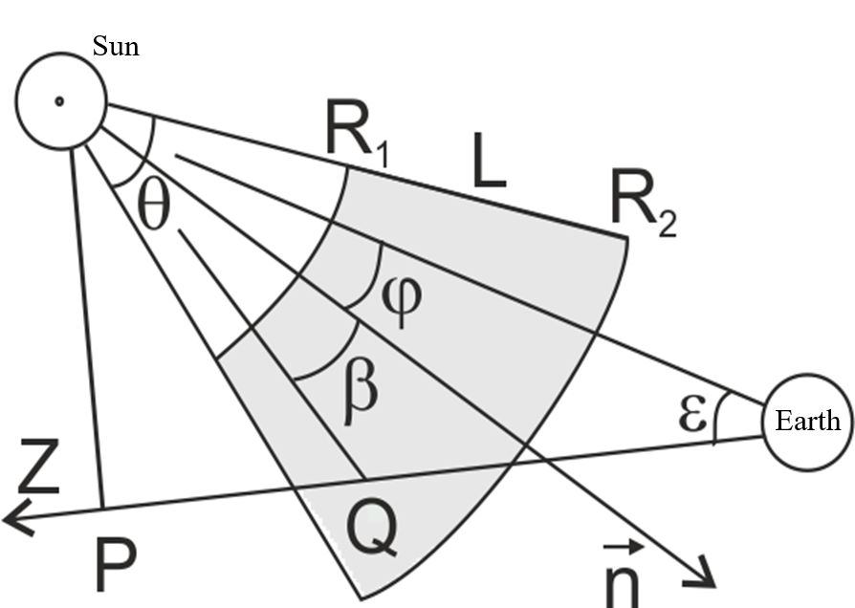
CME modeling [*]
$$m^{2}=2π\int_{−1AU\cos{ε}}^{+∞}{dz}\int_{0}^{+∞}{C(r)q^{1−n}\sin^{2}\left(\frac{q^{2}z^{′}}{2k}\right)dq},$$
$n=3,6$ is the index turbulence,
$k=\frac{2π}{λ}$ is the wave number, 𝜆 = 2,7 m is the wavelength,
$z^{′}=z+1AU\cos{ε}$,
$z$ – from the aiming point, $z^{′}$ – from the observer,
$$C(r)=\left\{\begin{aligned}C_{0}r^{−4} outside of the CME, \\ C_{0}r^{−4}N^{2} inside the CME.\end{aligned}\right.$$
$r$ is the distance of a point from the Sun center,
$N$ is the coefficient of plasma density increase inside the CME.
Suggested that θ = 100˚, L = 0,1 AU, N = 3
* Lukmanov V. R., Chashei I. V., Tyul’bashev S. A., Subaev I. A. Analysis of the Possibilities of Short-Term Prediction of Geomagnetic Perturbations from Observations of Coronal Mass Ejections at the BSA LPI Radio Telescope. // Astronomy Reports. – 2023. – V. 67. – P. 607 – 617.

Slide 9
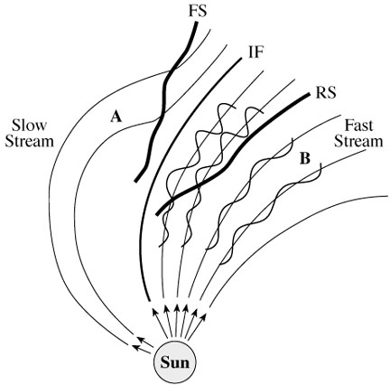
Corotating interaction regions (CIR)
CIRs are formed as a result of interaction fast and slow streams of the solar wind, plasma compression, enhancement of the magnetic field;
Rotate together with the Sun, come at Earth with a period of about 27 days;
If a CIR arrives at Earth it can cause a geomagnetic storm, as a rule, weaker than that caused by a CME;
They can be detected by an attenuation of night scintillation 2-3 days before their arrival at the Earth as well as by an enhancement of afternoon and evening scintillation before arrival. After arrival the enhancement of scintillation shifts to the night and morning area.

Slide 10
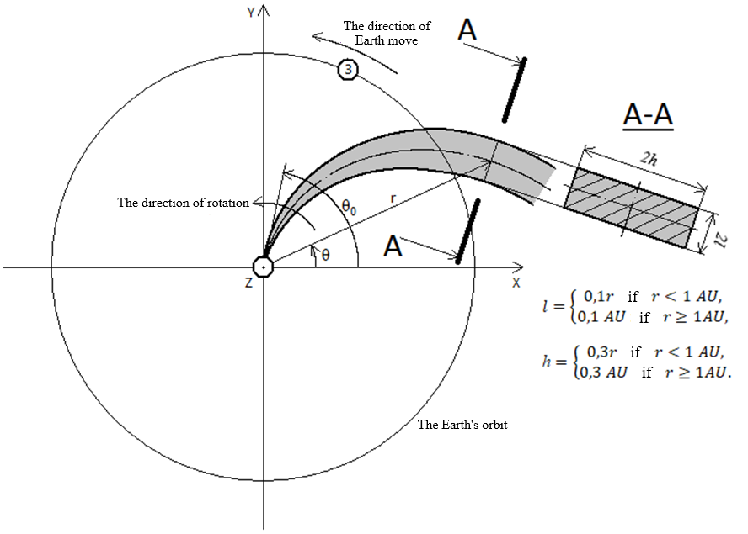
CIR modeling [*]
CIR axis: $r=a(θ_{0}−θ)$
$$m^{2}=2π\int_{−1AU\cos{ε}}^{+∞}{dz}\int_{0}^{+∞}{C(r)q^{1−n}\sin^{2}\left(\frac{q^{2}z^{′}}{2k}\right)dq},$$
$n=3,6$ is the index turbulence,
$k=\frac{2π}{λ}$ is the wave number, 𝜆 = 2,7 m is the wavelength,
$z^{′}=z+1AU\cos{ε}$,
$z$ – from the aiming point, $z^{′}$ – from the observer,
$$C(r)=\left\{\begin{aligned}C_{0}r^{−4} outside of the CIR, \\ C_{0}r^{−4}N^{2} inside the CIR.\end{aligned}\right.$$
$r$ is the distance of a point from the Sun center,
$N$ is the coefficient of plasma density increase inside the CIR.
Suggested that $θ_{0}−θ=\frac{π}{4}$ if $r=1AU$, $N=3$
* Lukmanov V. R., Chashei I. V., Tyul’bashev S. A., Subaev I. A. Corotating Disturbances of the Solar Wind in the Monitoring Data of Interplanetary Scintillations: Simulation and Observation. // Astronomy Reports. – 2023. – V. 67. – P. 618 – 628.

Slide 11
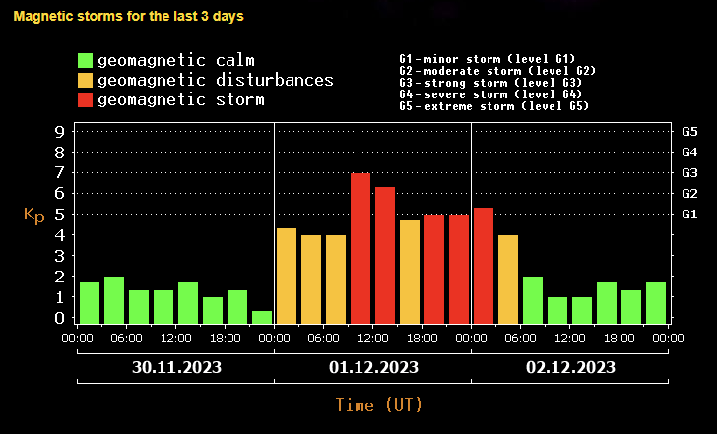
The magnetic storm on December 1-2, 2023 г.
In data of scintillation observation signs of a CIR as well as of a CME after a strong solar flare on November 28 were observed

Slide 12
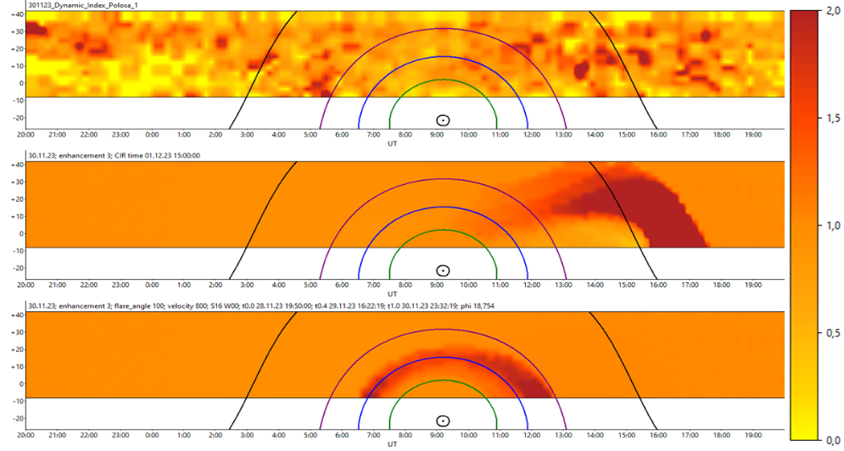
Dynamic maps of the scintillation index for November 30, 2023

Slide 13
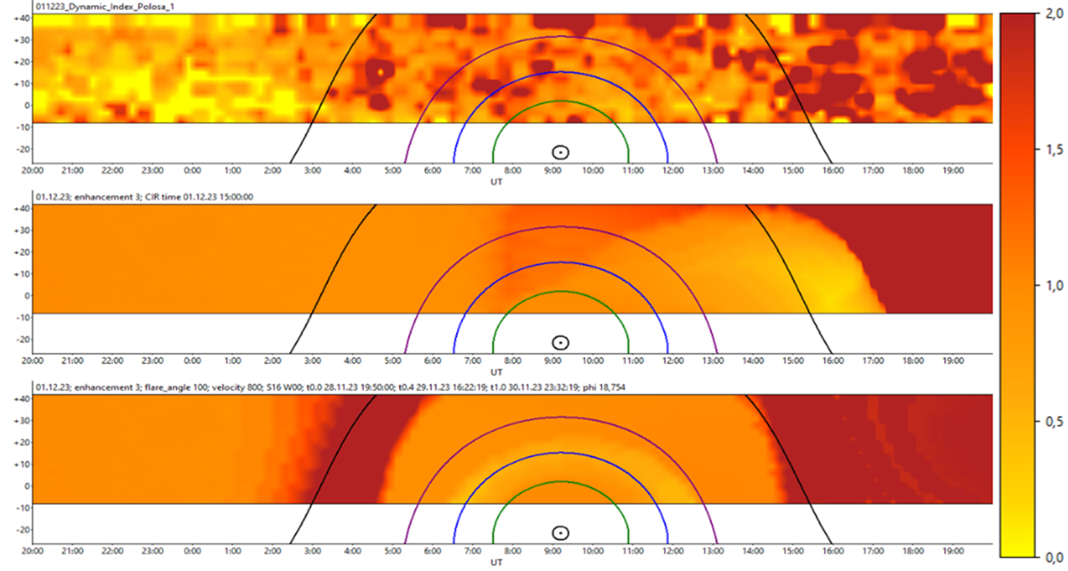
Dynamic maps of the scintillation index for December 1, 2023

Slide 14
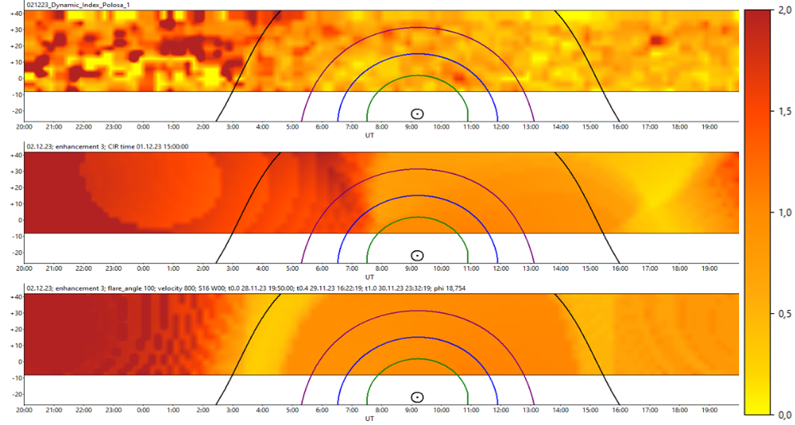
Dynamic maps of the scintillation index for December 2, 2023

Slide 15
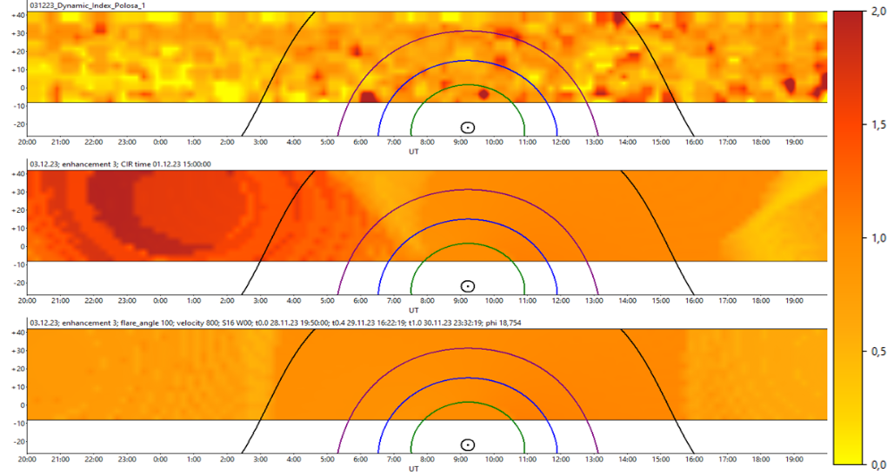
Dynamic maps of the scintillation index for December 3, 2023

Slide 16
Conclusion
Using the example of a magnetic storm on December 1-2, 2023, the possibility of predicting the arrival of CIR–type disturbances to Earth was demonstrated. On November 30, signs of CIR spreading towards Earth were observed in the interplanetary scintillation data. However, after the magnetic storm start, signs of CME propagation were also observed after a powerful solar flare on November 28. It is obvious that this magnetic storm was the result of a combination of both CIR and CME types of disturbances. Since CIR and CME were separated in time, their combination affected mainly the duration of the magnetic storm. In more complex cases, when both types of disturbances overlap, an appropriate modification of the model is required. It can be noted that even in the case of combined CIR/CME disturbances, monitoring interplanetary scintillation makes it possible to detect large-scale disturbances before they arrive at Earth.
Lukmanov V. R., Chashei I. V., Tyul’bashev S. A., Subaev I. A. Analysis of the Causes of the Magnetic Storm on December 1–2, 2023 Based on Observations of Interplanetary Scintillations at the BSA Radio Telescope of the Lebedev Physical Institute. // Astronomy Reports. – 2024. – V. 68. – P. 650 – 656.

Slide 17
THANK YOU FOR ATTENTION

