Slide 1

PHELEX:
Results and Perspectives
Anatoly Kopylov, Igor Orekhov, Valery Petukhov, Alexei Solomatin
Institute for Nuclear Research of Russian Academy of Sciences

Slide 2
The aim of experiment: the search for Dark Matter as Hidden Photons
Virial theorem: kinetic energy of gravitationally bound system of objects should be equal to – 0.5 of their potential energy
Zwicky (1937) – analyses of red shifts of the Coma Cluster of galaxies: surprisingly high mass-to-light ratio
To-day, according to a combination of all data: the dark matter accounts for about 84 % of the matter content of the Universe
WIMPS, Axions …. ?
What if: dark photons?

Slide 3
P. Fayet, On the search for a New Spin 1 Boson, Nucl. Phys B 187 (1981) 184-204.
L. B. Okun, Limits of Electrodynamics: Paraphotons, Sov. Phys. JETP 56 (1982) 502 [Zh. Eksp. Thedor. Fiz. 83 (1982) 892.
H. Georgi, P. H. Ginsparg, and S. L. Glashow, Photon Oscillations and the Cosmic Background Radiation, Nature 306 (1983) 765 – 766.

Slide 4
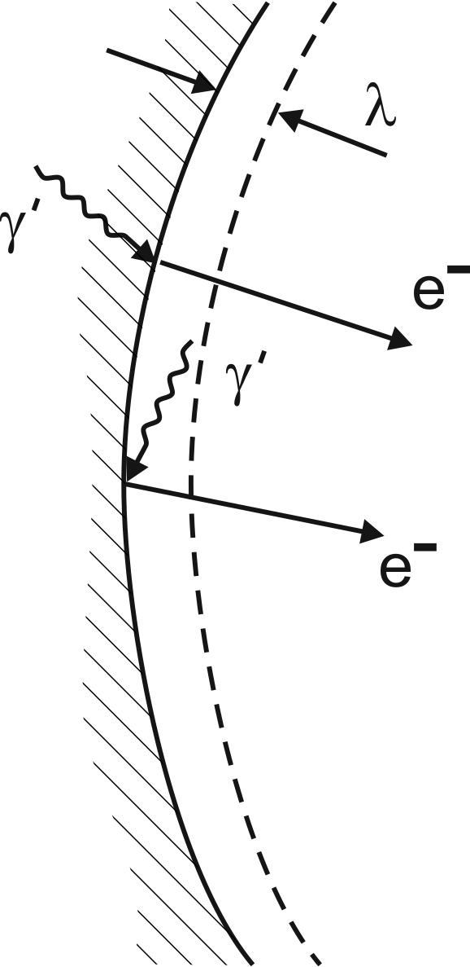

PHELEX – PHoton-ELectron EXperiment
multicathode counter technique as an extension of
a method of a dish antenna to higher masses (energies)
ρ_{CDM} ≈ 0.4 GeV/cm³
^{ρ}⊙ = (0.43 ± 0.06) GeV/cm3 (Salucci et al 2010)
Galactic dark matter halo.
But locally, near the Sun?
Primordial Solar dark matter halo?
arXiv:2007.11016
(N.B.Anderson, A.Partenheimer,
and T.D.Wiser)
θ – angle between electric field of a photon and the surface
χ- dimensionless parameter quantifying a kinetic mixing
(D.Horns, J.Jackel, A.Lindner, A.Lobanov, J.Redondo, A.Ringwald , “Searching for wispy cold dark matter with a dish antenna” Journal of Cosmology and Astroparticle Physics, vol.4. article 16, 2013)
In our case: due to low reflectivity of the surface
the photon gets absorbed and emits an electron
Sensitivity:

Slide 5
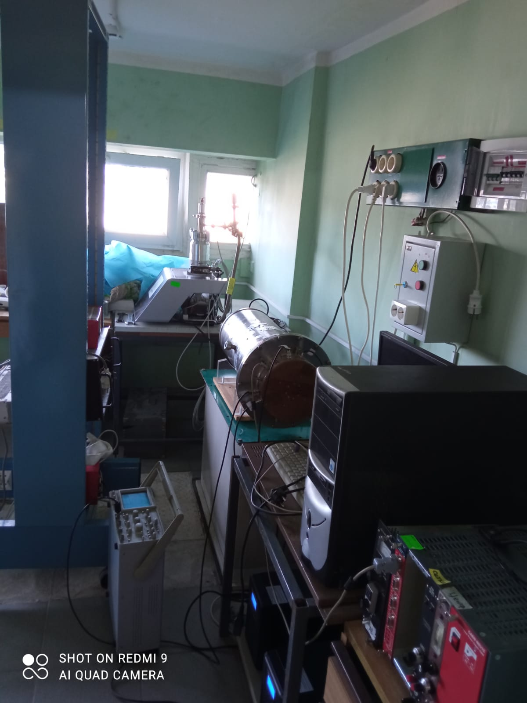
Testing of the detector
in Troitsk,
Moscow

Slide 6
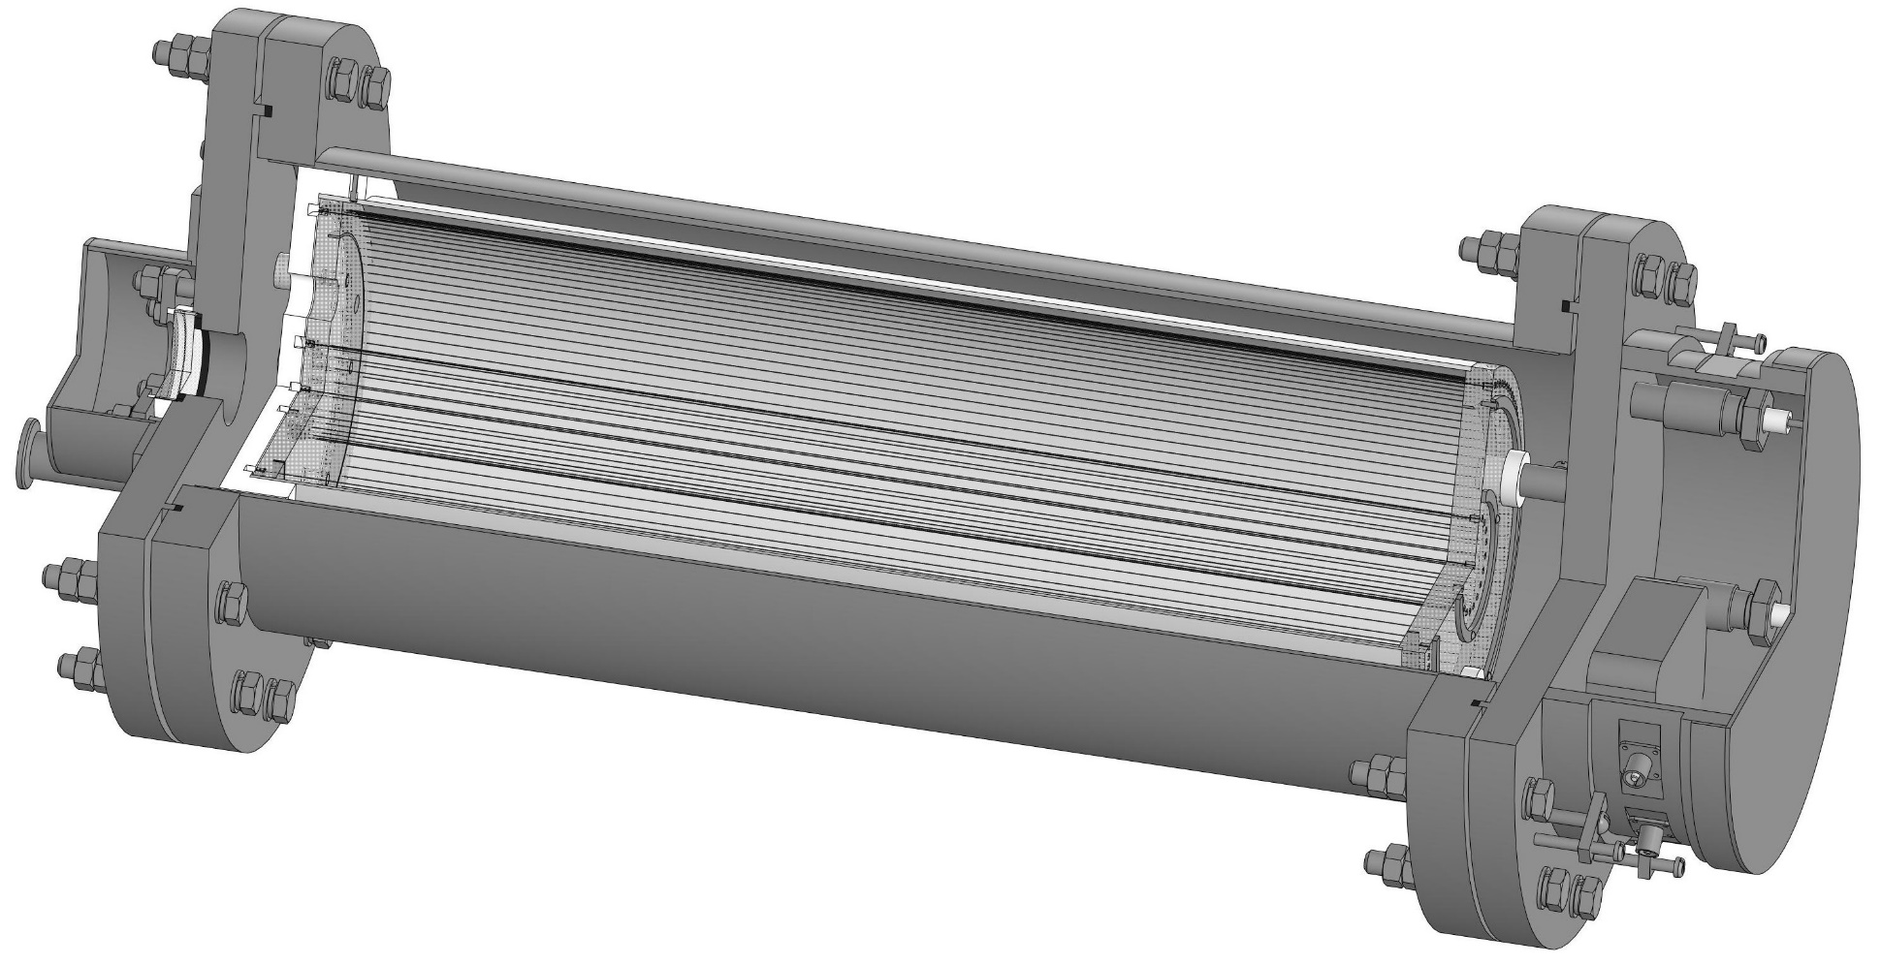
Multicathode counter, calibration from the end of the counter
Working gas: Ar, Ne + 10% CH₄, Р = 1 atm
Anode
Cathode 1
Cathode 2
Cathode 3
Preamplifier

Slide 7
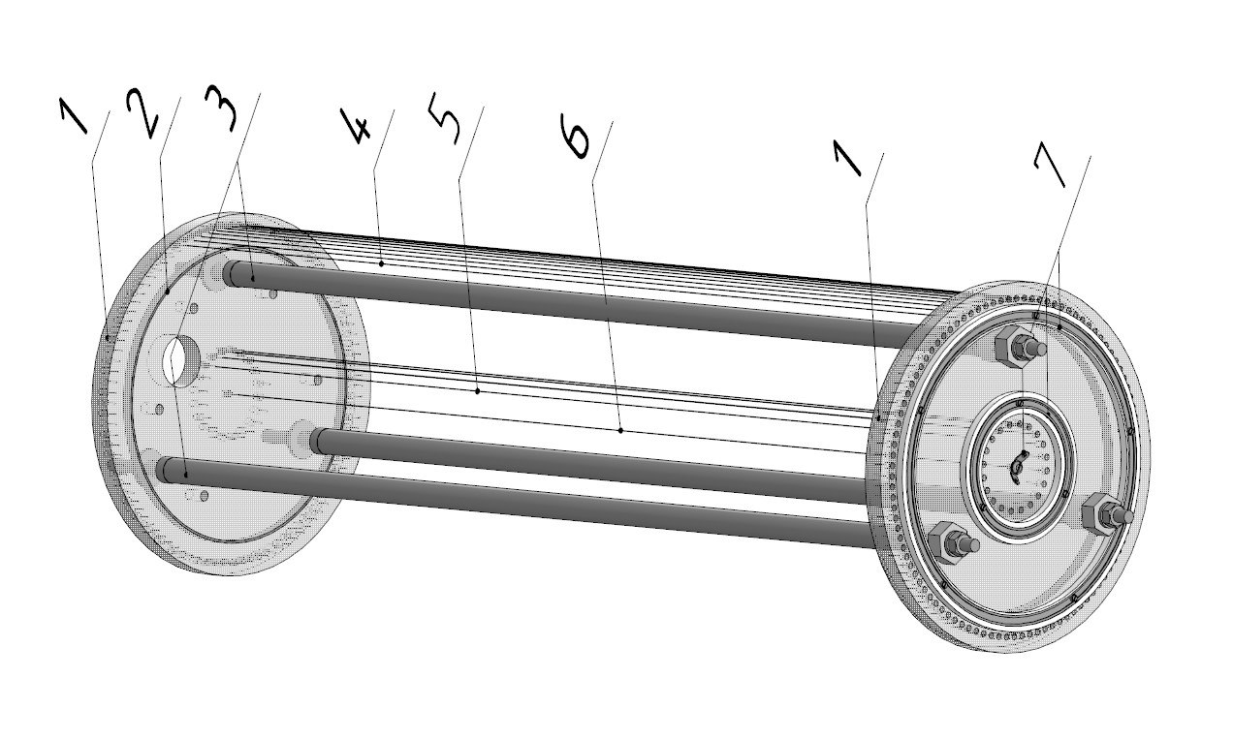
During the assembly of the counter wires
6. Anode
5. 1st cathode
4. 2nd cathode
3. Assembling rods

Slide 8
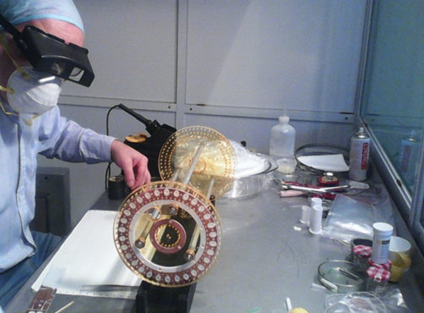
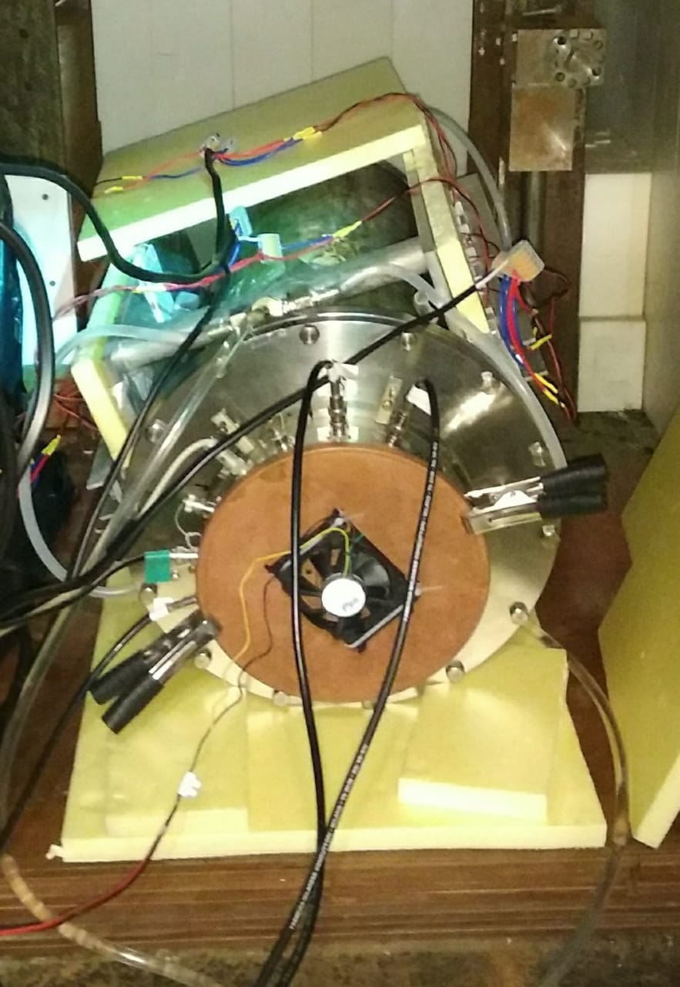
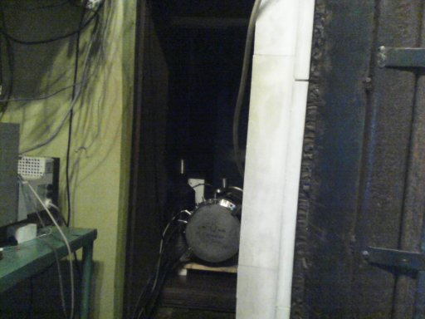
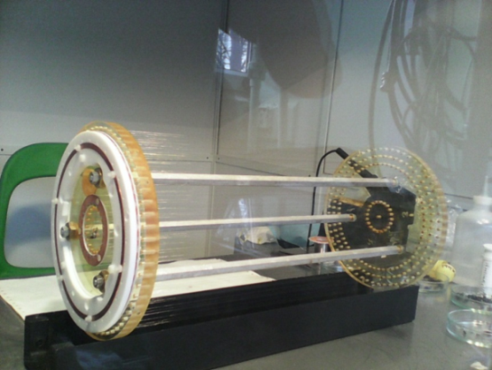
Multicathode counter: assembling and testing

Slide 9
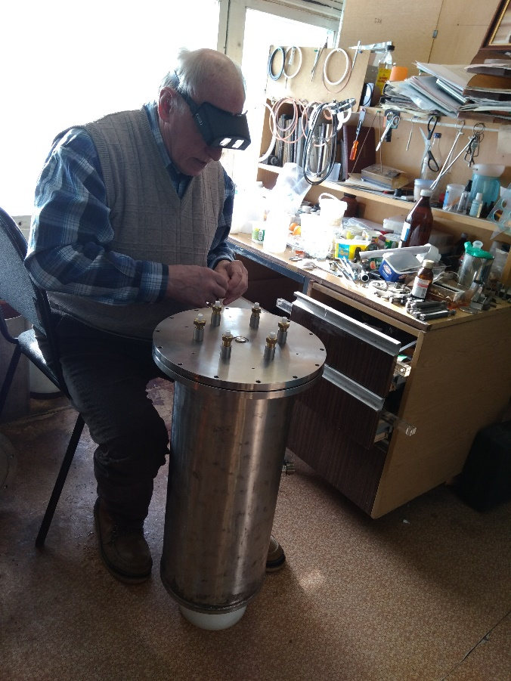
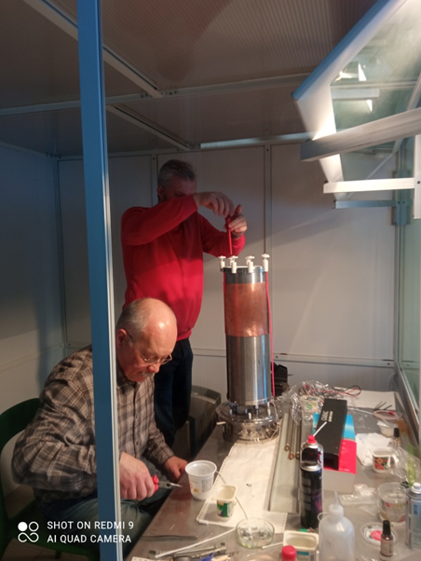
Assembling the counter

Slide 10
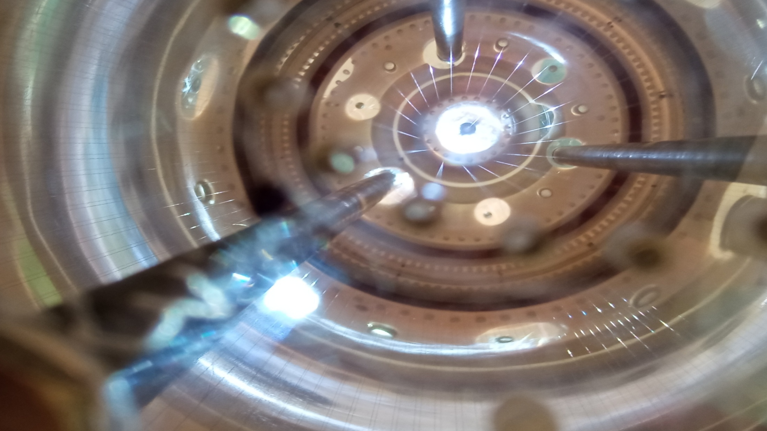

Slide 11
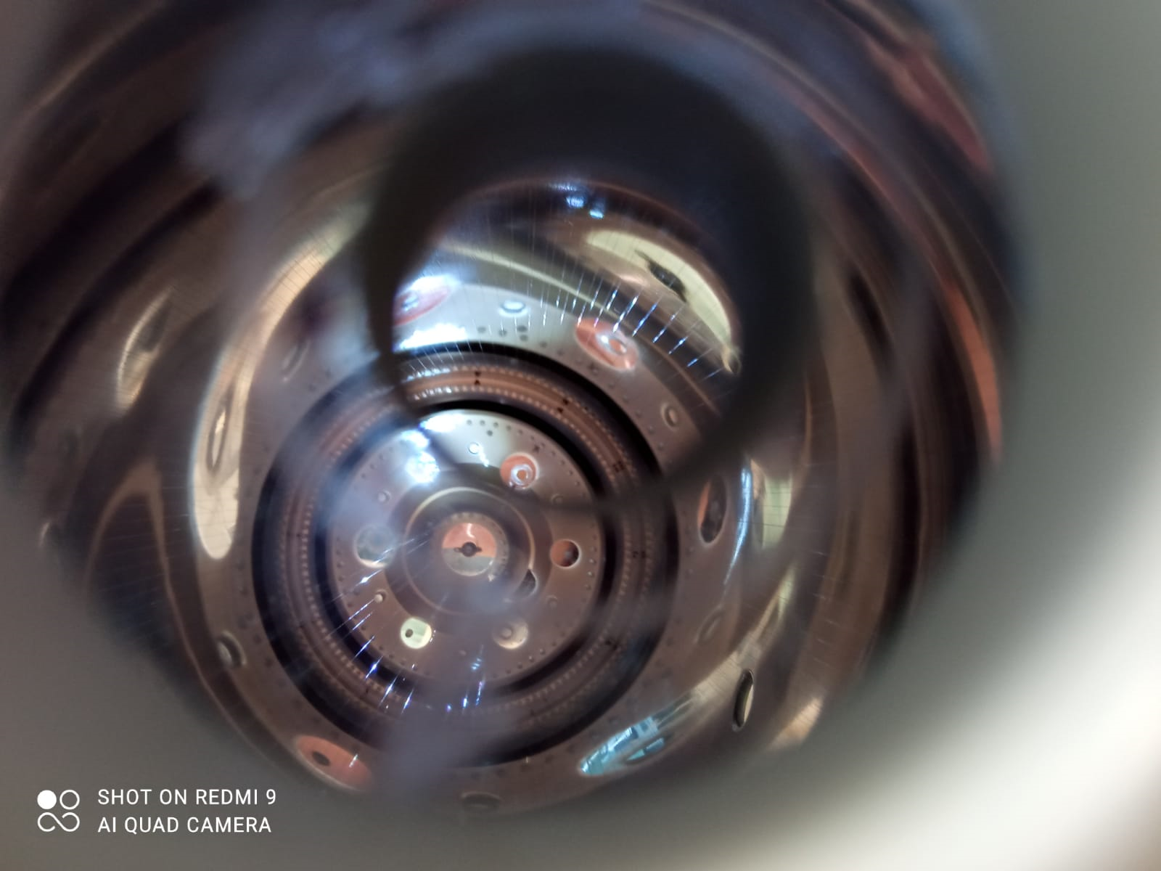

Slide 12
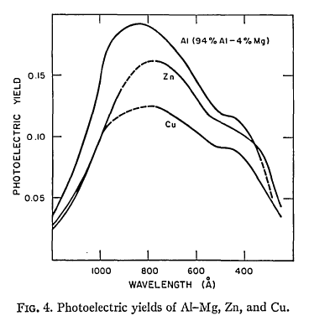
Mass of Dark Photon from 10 to 40 eV
R.B.Cairns and J.A.R.Samson Journal of optical society of America
Vol. 56, Number 11, November 1966, 1568-1573
≈ 8(p/h)³
T_{ν} = 1.95 ⁰K
In 1 cm³:
≈ 150 relic neutrinos
≈ 500 relic photons
Dark photons in the vicinity of
The Sun:
From 10 to 40 millions/cm³ !

Slide 13
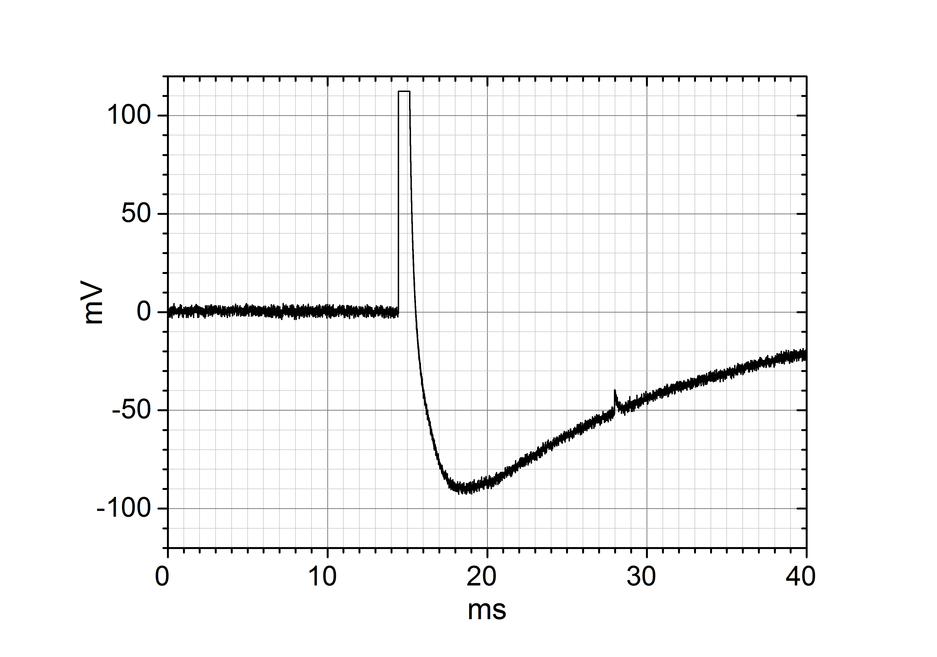
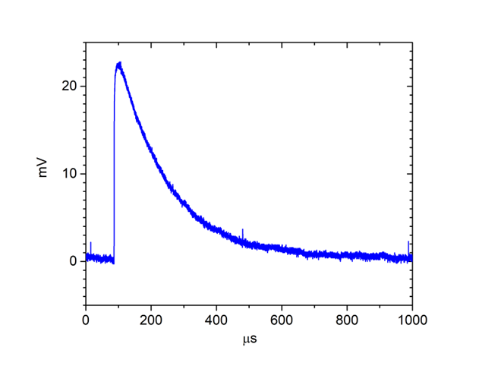
Pulse from muon crossing the counter
The restored shape of the pulse
Pulse from single electron
From muons at sea level: ≈ 15 pulses per second → ≈ 15% dead time (10 ms per each pulse)

Slide 14

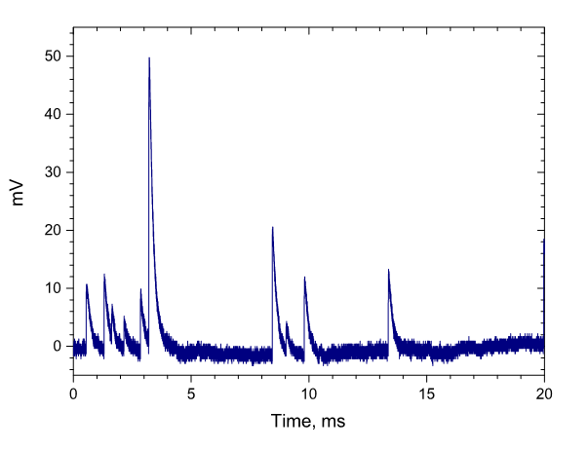
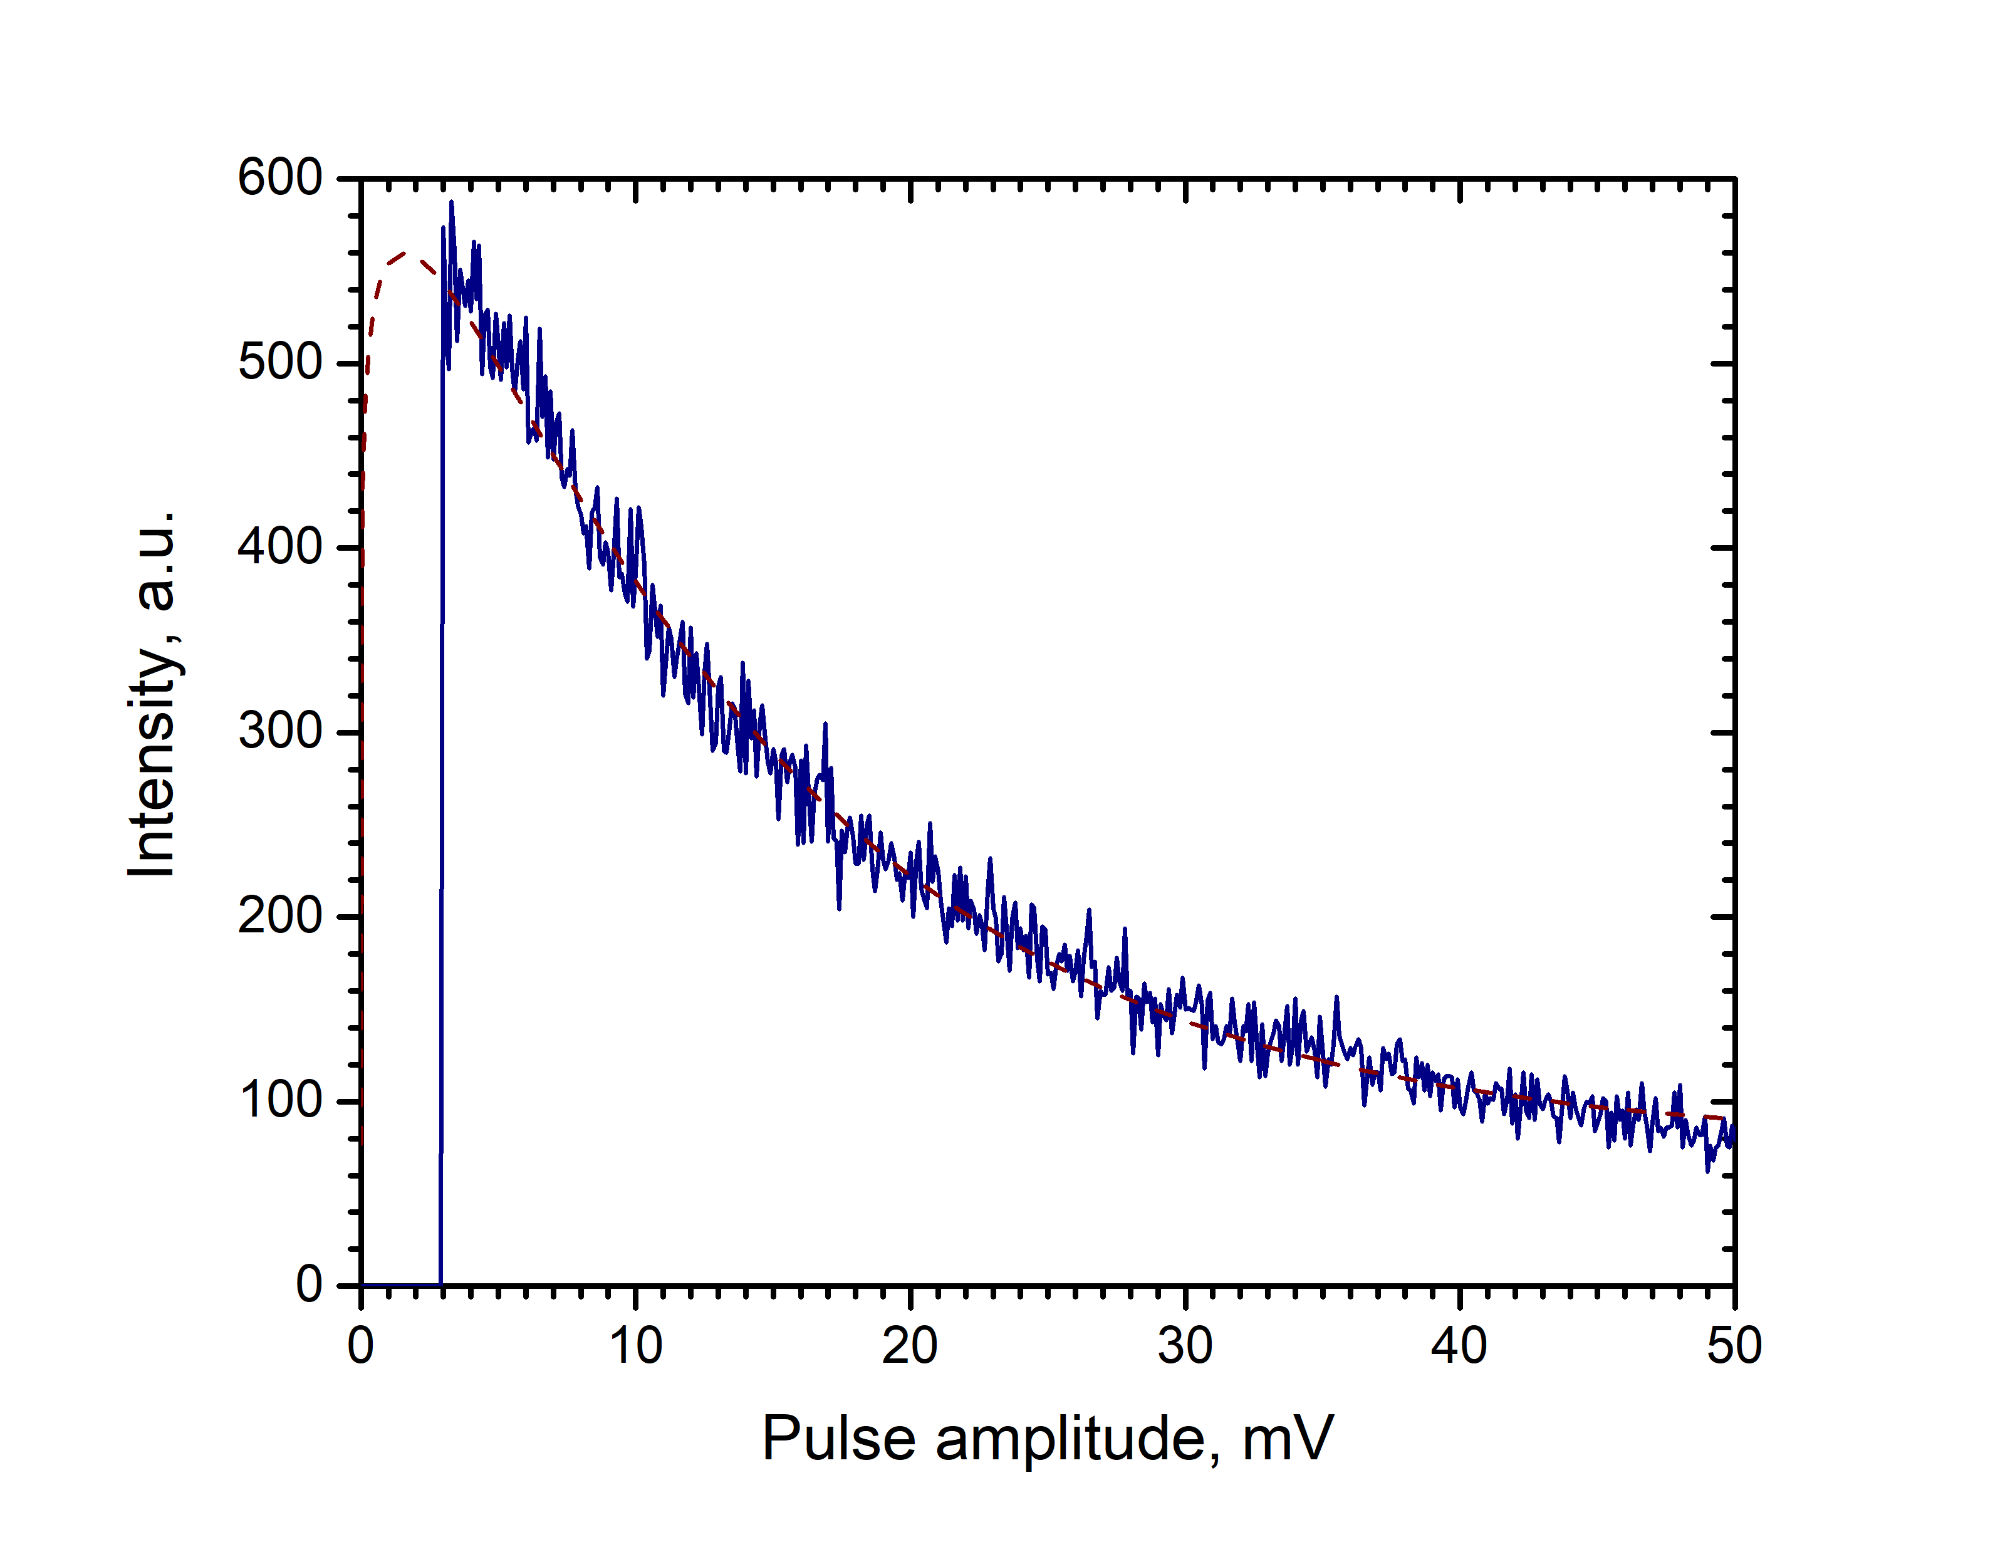
Pulses from single electrons during calibration
Polya distribution
Pulse from muon crossing the counter
Pulse from single electron
From muons at sea level: ≈ 15 pulses per second → ≈ 15% dead time (10 ms per each pulse)

Slide 15
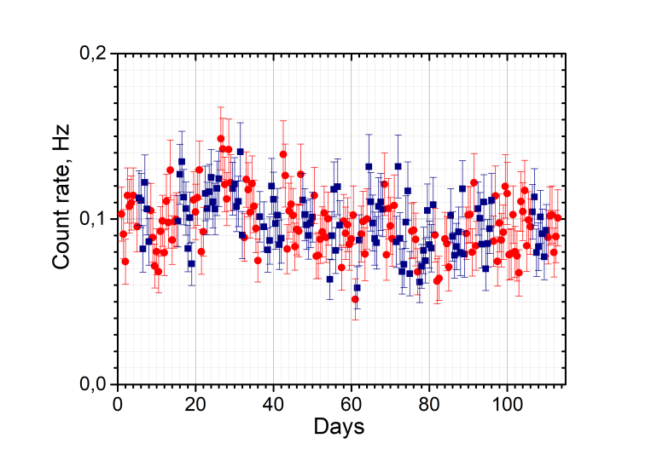
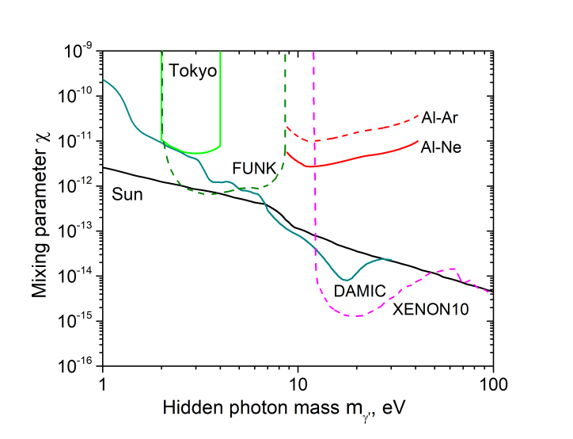
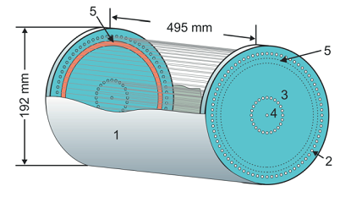
Results of measurement with gas mixture Ar +CH₄(10%) и Ne + CH₄(10%)
Target – free electrons of a degenerate electron gas of a metal
Result is included in compilation of the data
Review of Particle Physics in Prog. Theor. Exp. Phys. 2020, 083C01 (2020).
HV2
HV1
R₁ – red, R₂ - blue
Target – valence electrons
r_{MCC} = (- 0.33 ± 0.7)˖10⁻⁶ Hz/cm²

Slide 16

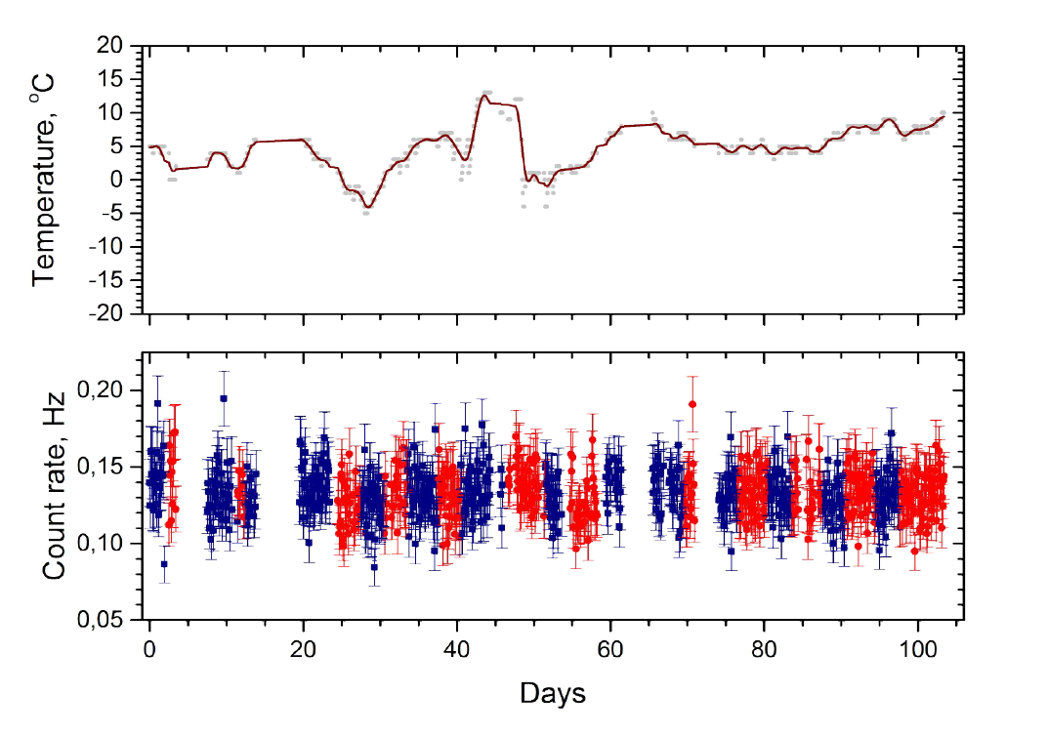
New measurements Al – (Ne + CH₄(10%) 1 Bar)
Red – configuration 1
Blue – configuration 2
871 points;
In previous
measurements – 200
points

Slide 17
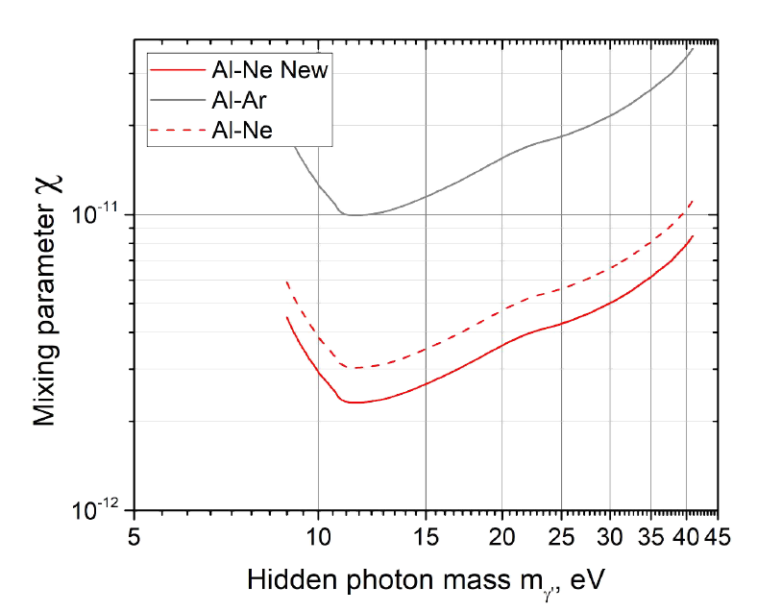
New upper limit
Result is included in compilation of the data by PDG
Review of Particle Physics in Prog. Theor. Exp. Phys. 2022, 083C01 (2022).
New result:
C1-C2 = - 0.00018 ± 0.00101 Hz
Then @ 95 C.L.
R_{MCC} = 1.646σ/ε = 0.00164/0.608 =
= 0.0027
ε – efficiency of counting

Slide 18
Directionality of the counting
θ – angle between a field of a hidden photon and the surface
χ- dimensionless parameter quantifying a kinetic mixing
Field along the axes of the counter
(D.Horns, J.Jackel, A.Lindner, A.Lobanov, J.Redondo, A.Ringwald , “Searching for wispy cold dark matter with a dish antenna” Journal of Cosmology and Astroparticle Physics, vol.4. article 16, 2013)
Field normal to the axes of the counter
By rotation of the counter – variation of the count rate
If the surface is mirror-like!
The counter with a matt surface –
for the control measurements

Slide 19
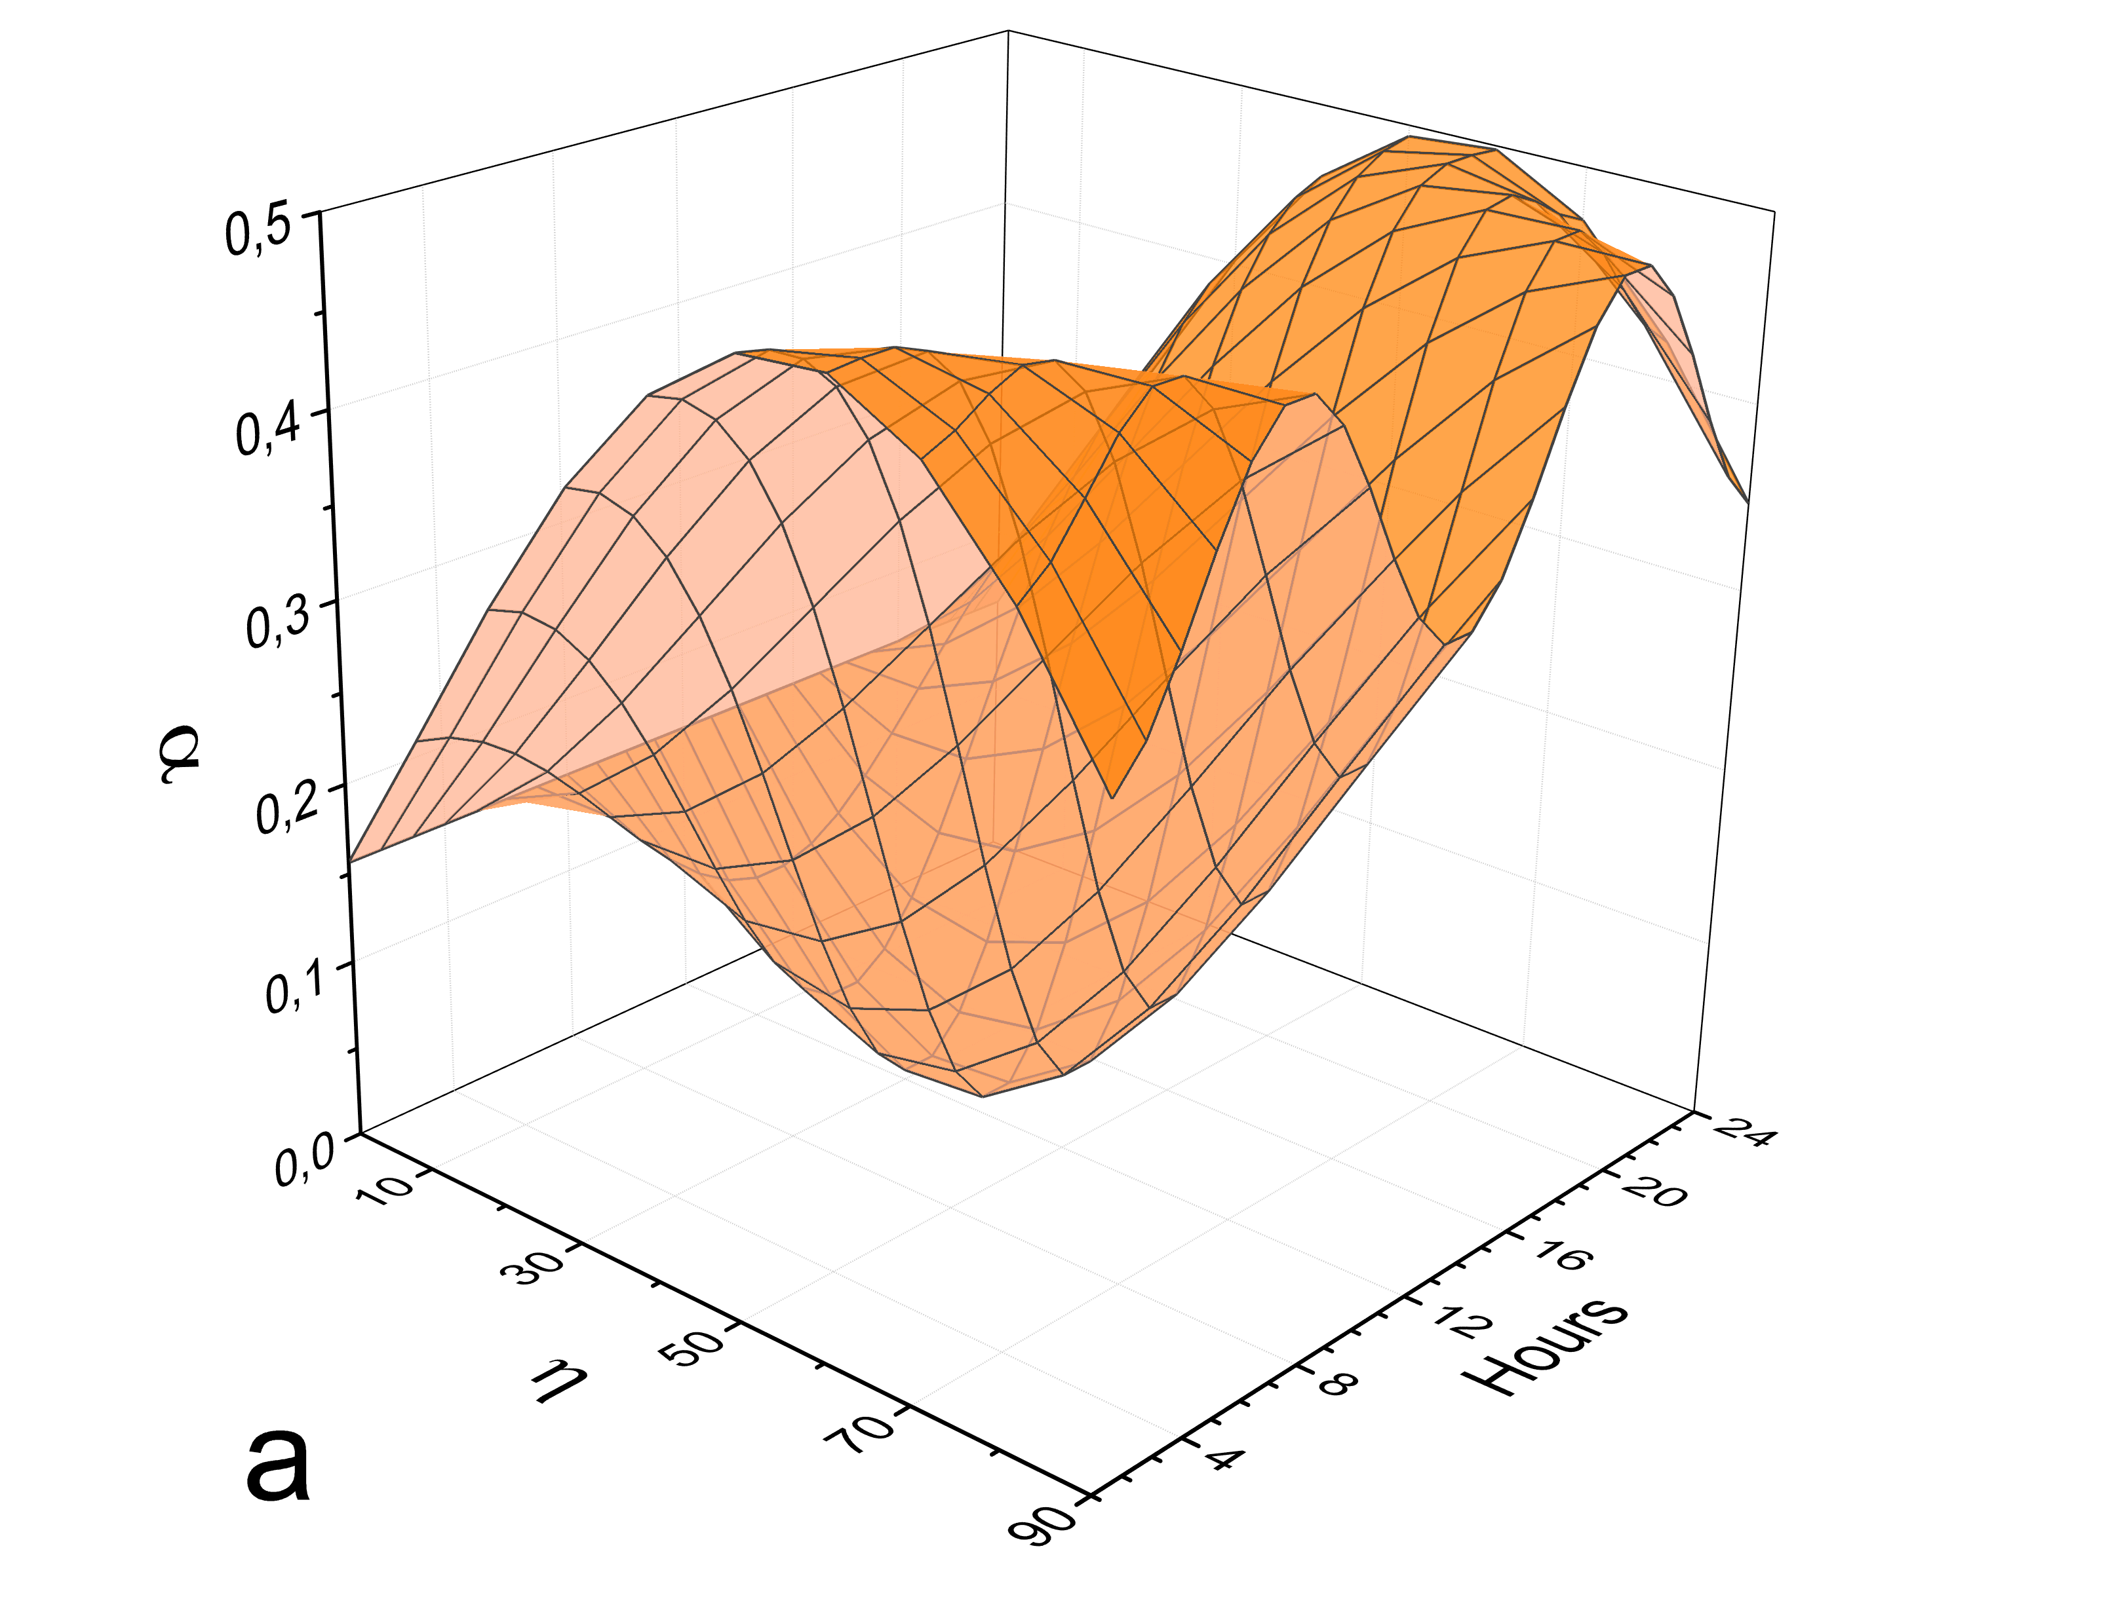
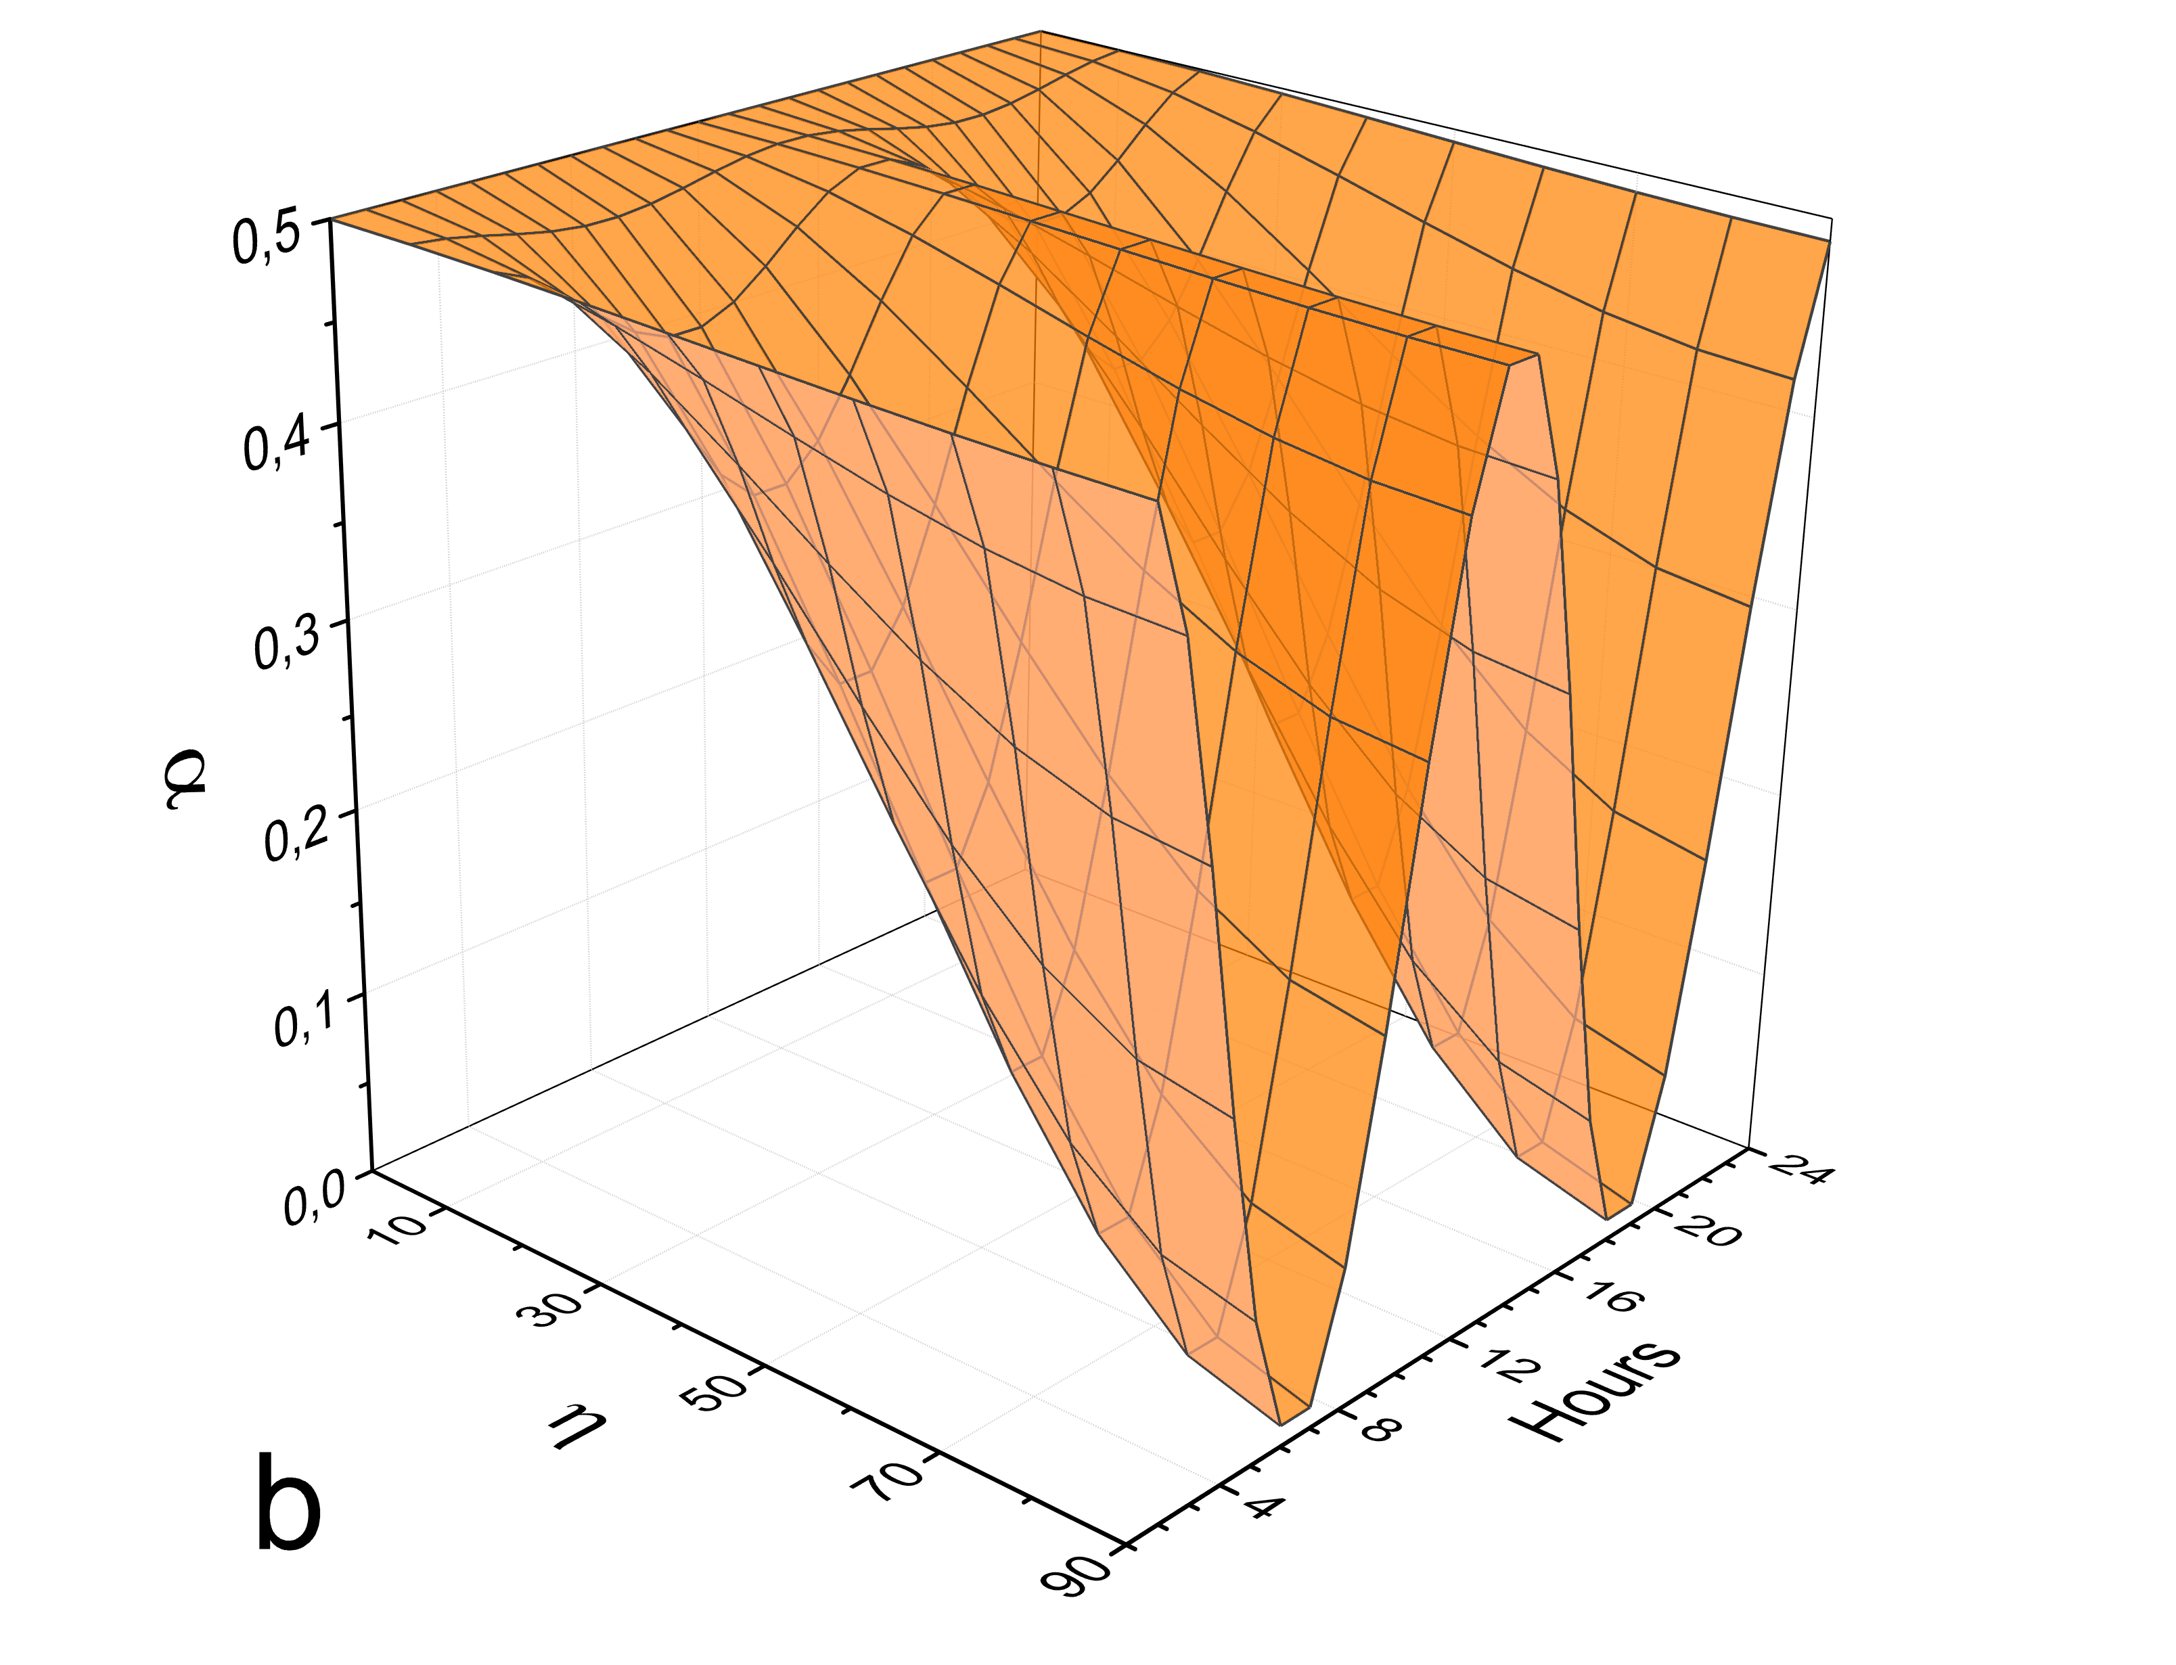
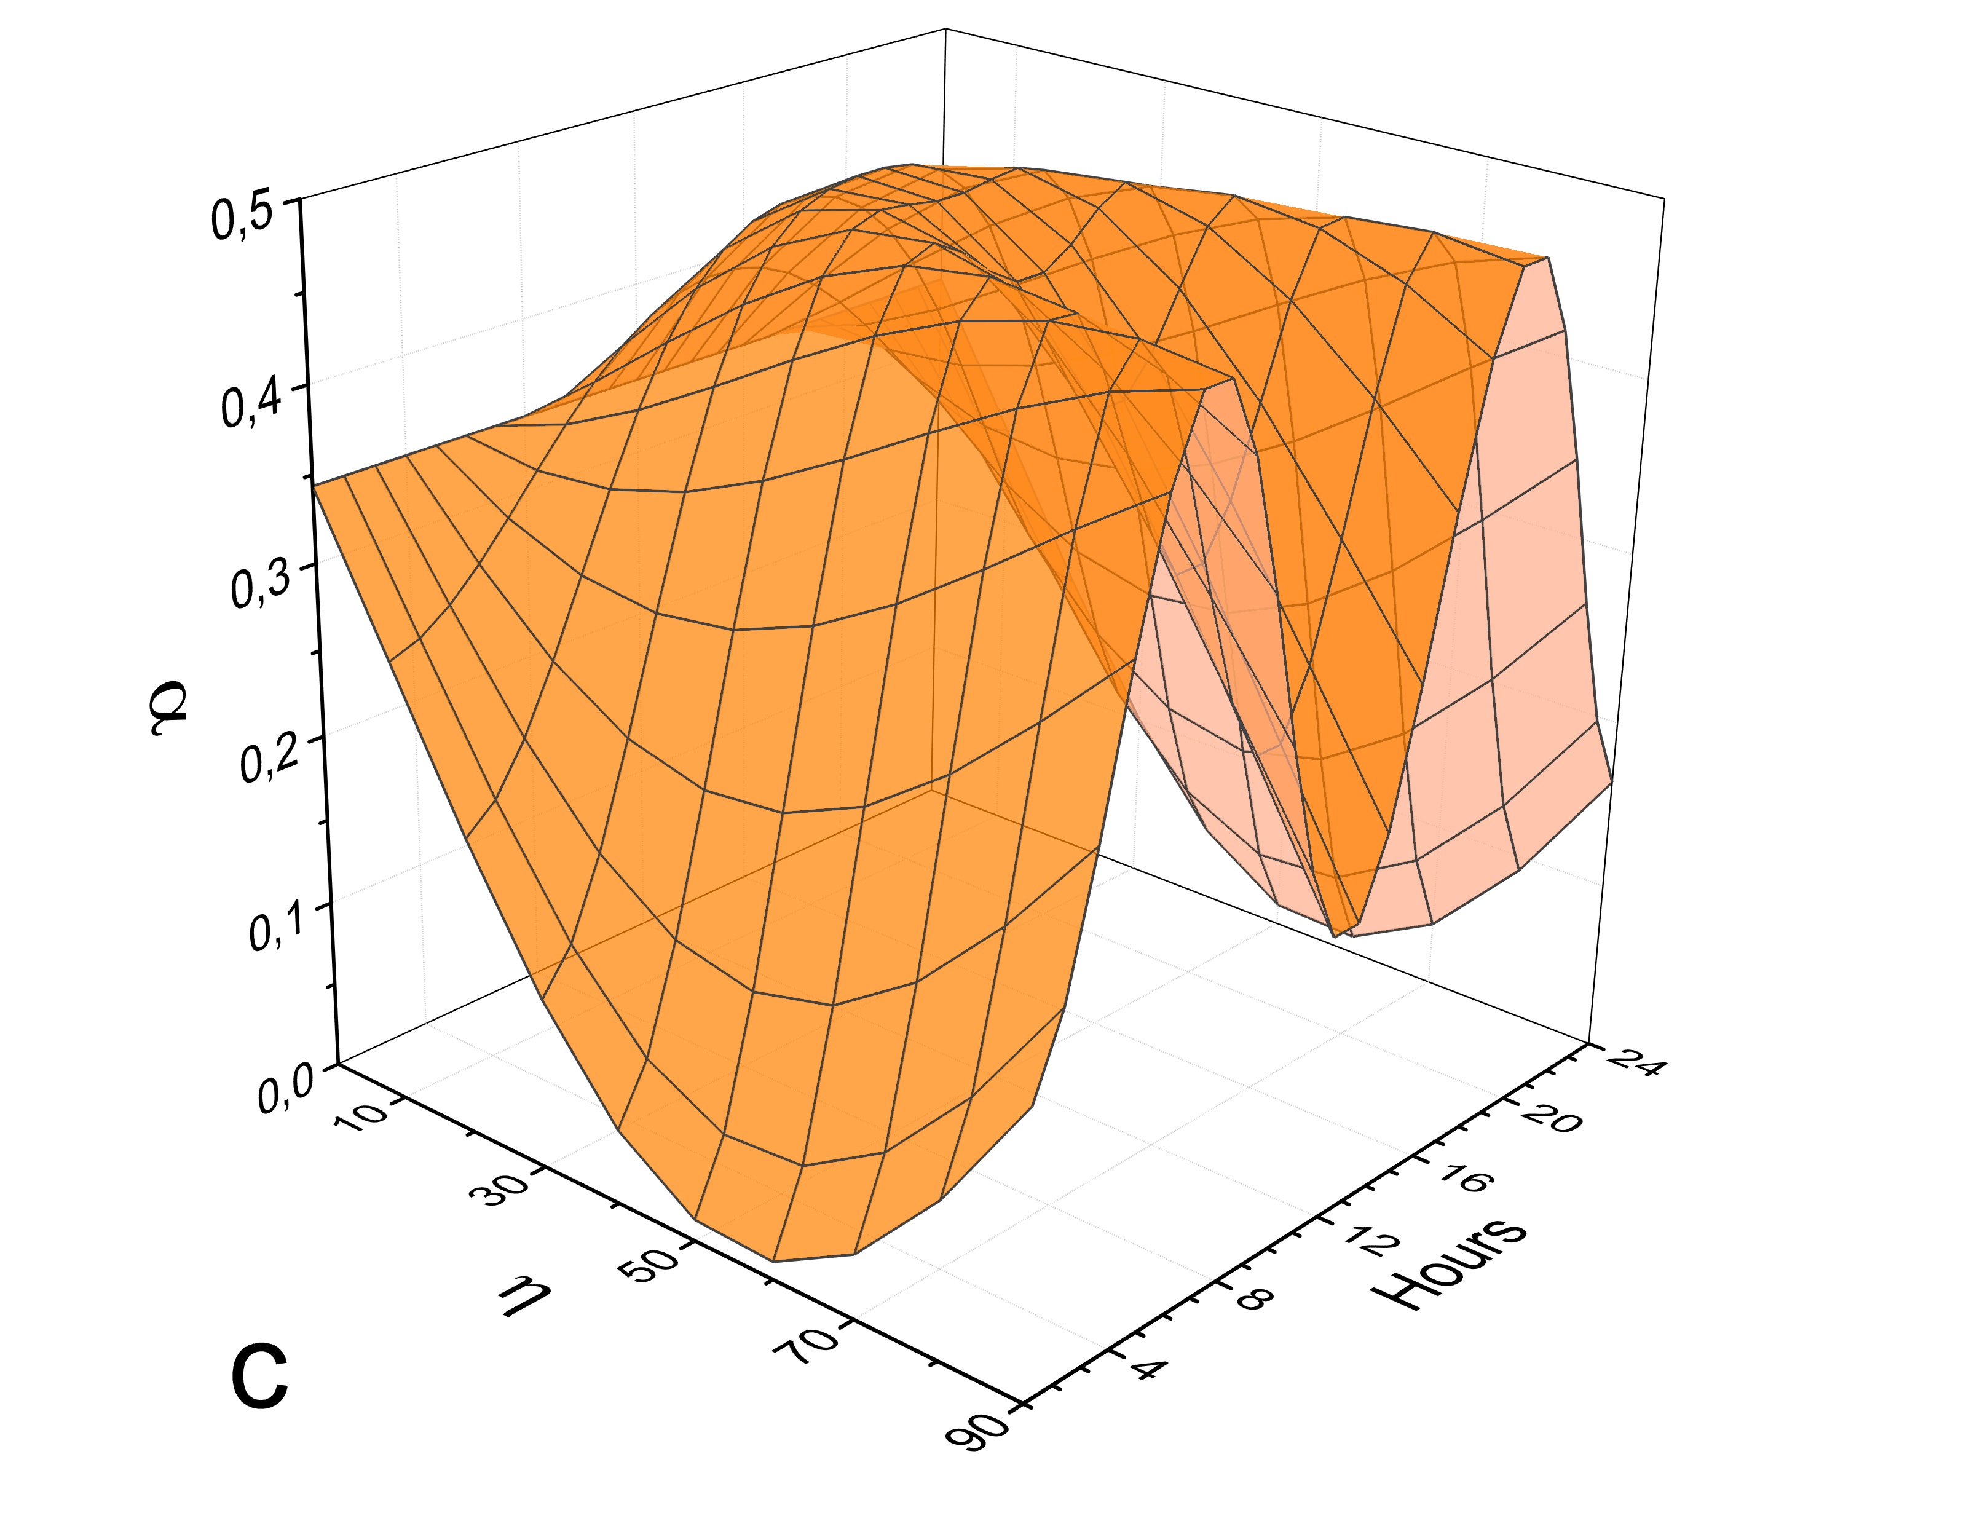
Diurnal variations, Moscow, Russia 55º 45’ N
Vertical orientation
East-West orientation
North-South orientation

Slide 20
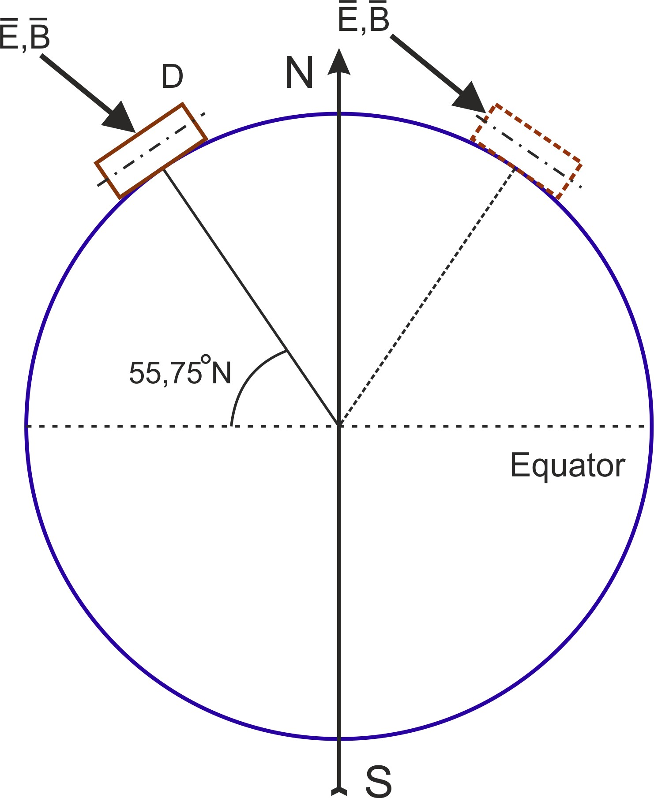
Left: for maximum and
Right: for minimum of the count rate
The direction of the vector of Е-field in case of the observation of one peak for the counter oriented along the meridian

Slide 21
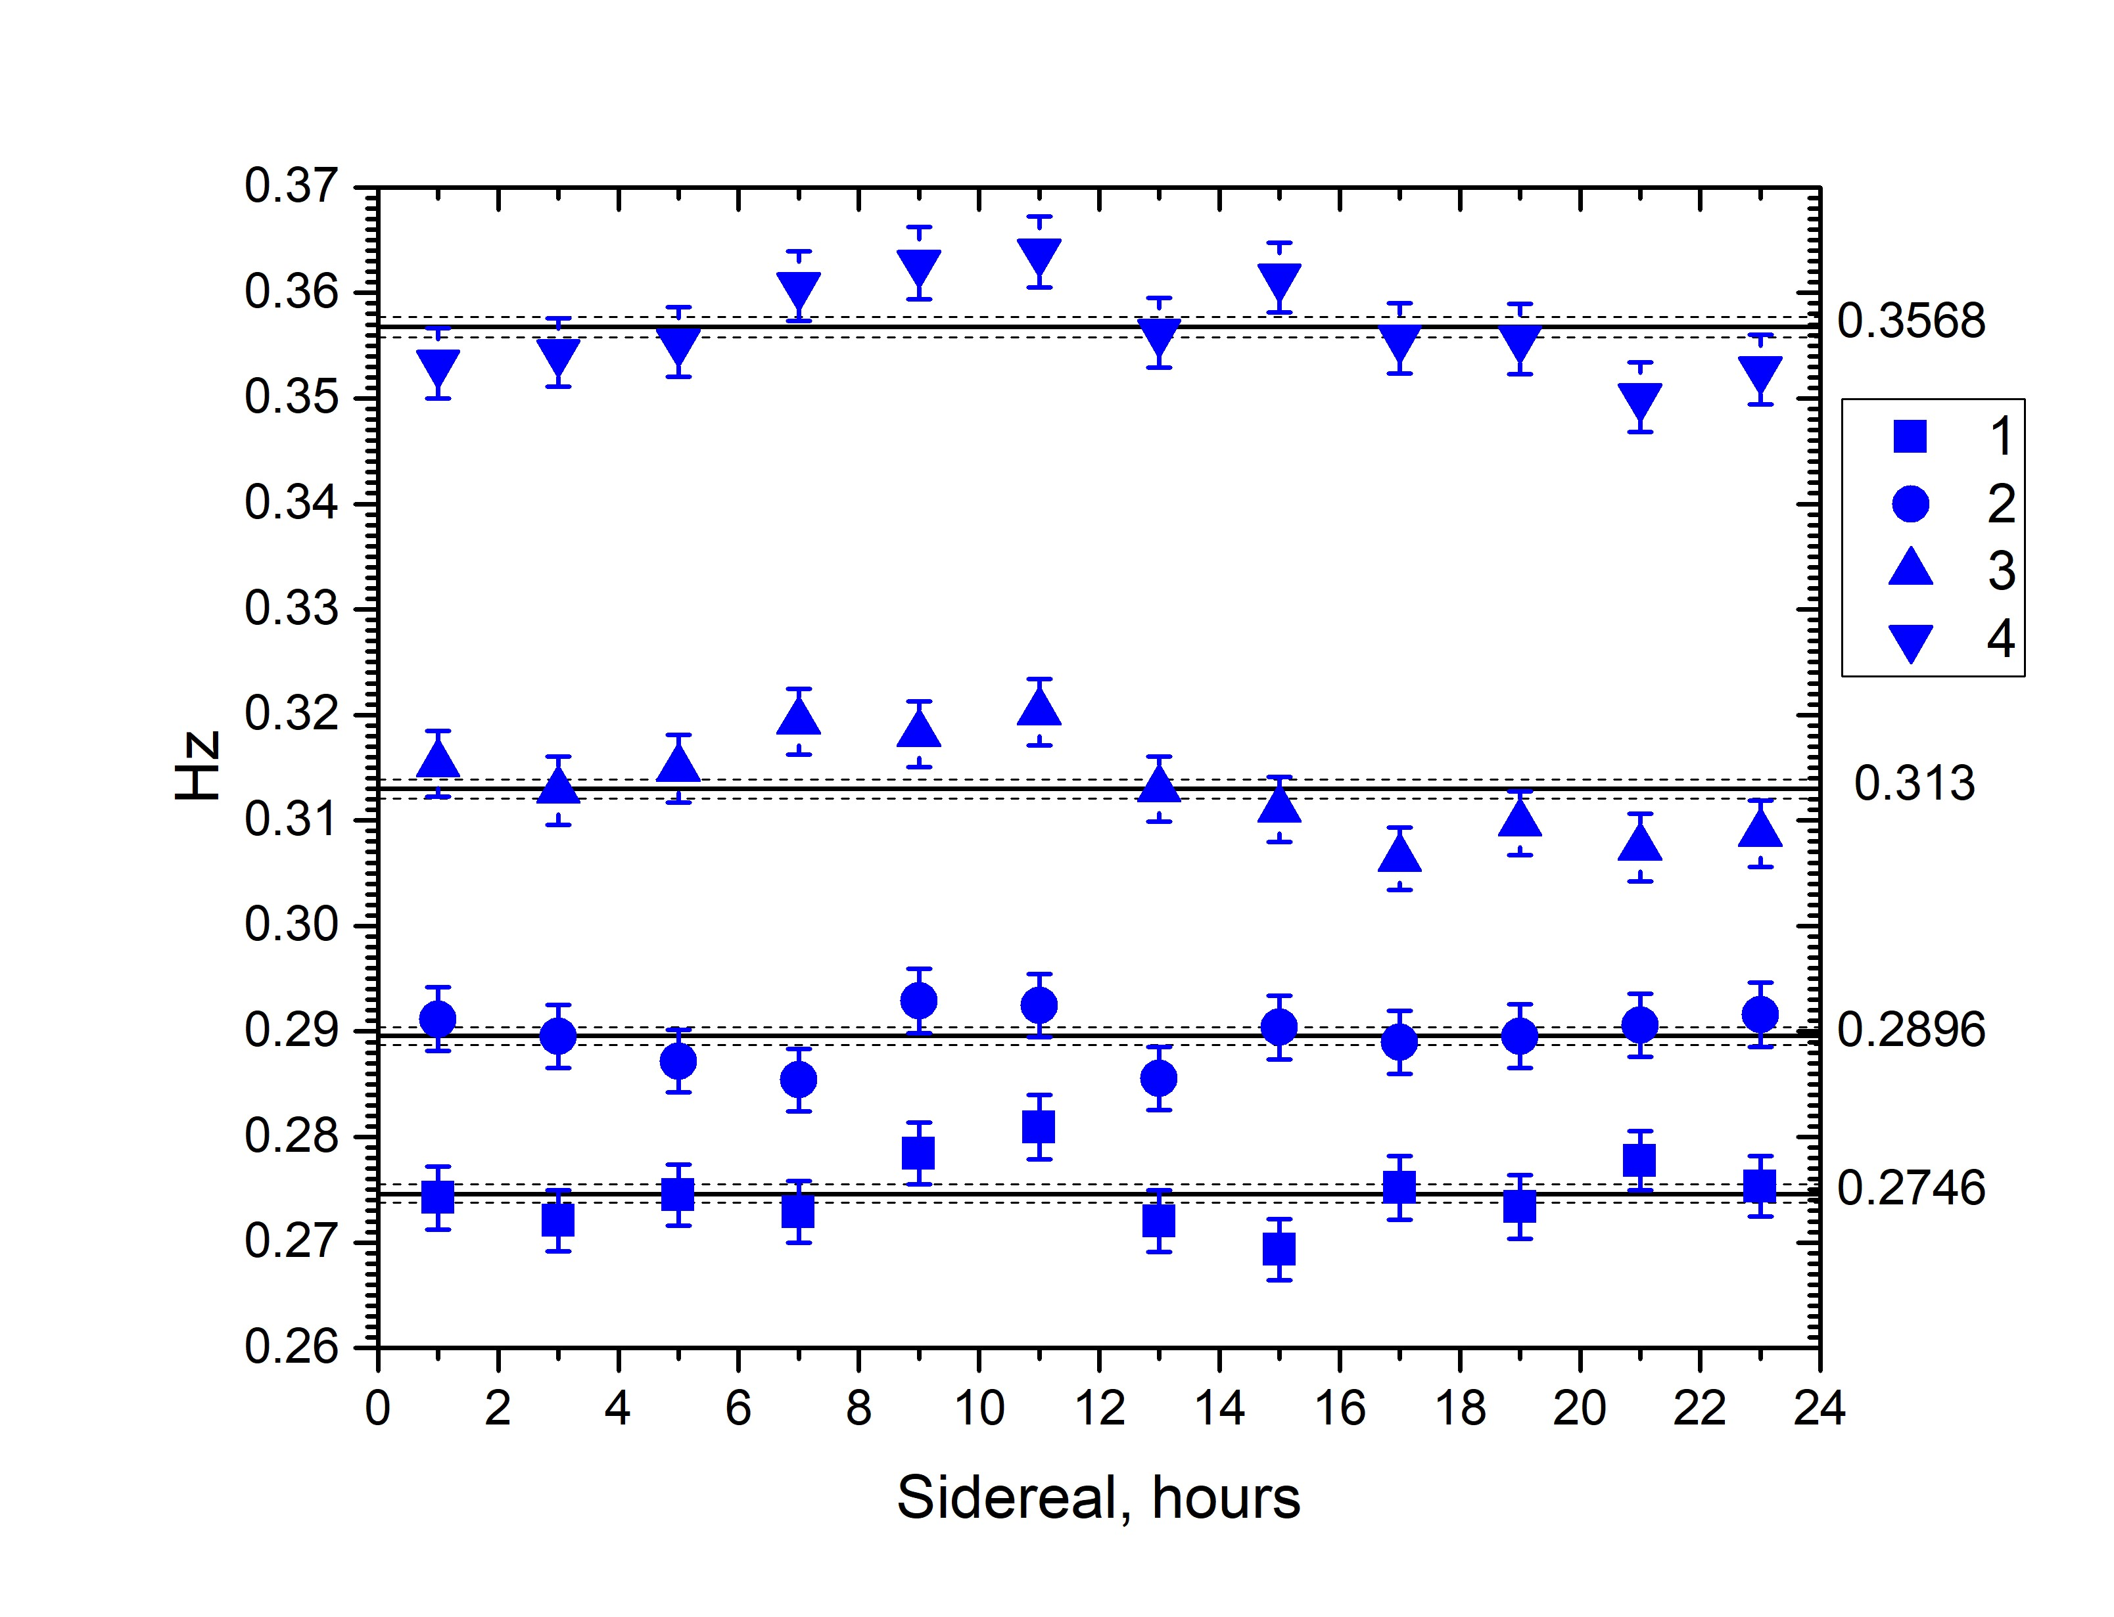
DIURNAL VARIATIONS IN SIDEREAL TIME (configuration 1)
1st series of measurements
in 2023 y
(January –July)
Time of start-stop in each 4 Runs of measurements
1: 27.12.22 12:00 - 25.02.23 20:00
2: 25.02.23 22:00 - 15.04.23 16:00
3: 15.04.23 18:00 - 4.06.23 10:00
4: 4.06.23 12:00 - 24.07.23 10:00

Slide 22
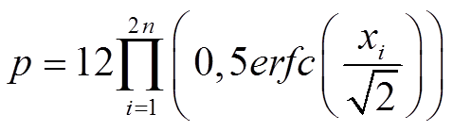
here: n – number of Runs,
x_{i} – the deviation from an average value in σ for each 2h interval between 8-00 and 12-00 of sidereal time in each 4 Runs of measurements
For sidereal time p = 7.6х10⁻¹⁰,
Confidence level > 6 σ (1х10⁻⁹).
The possible interpretation:
in first half year of 2023 y the solar system has been moving through space where the vector of E-field of dark photons in the time interval between 8-00 and 12-00 of sidereal time was in the plane of Moscow meridian with an angle to the axes of the Earth between 20⁰ and 50⁰.

Slide 23
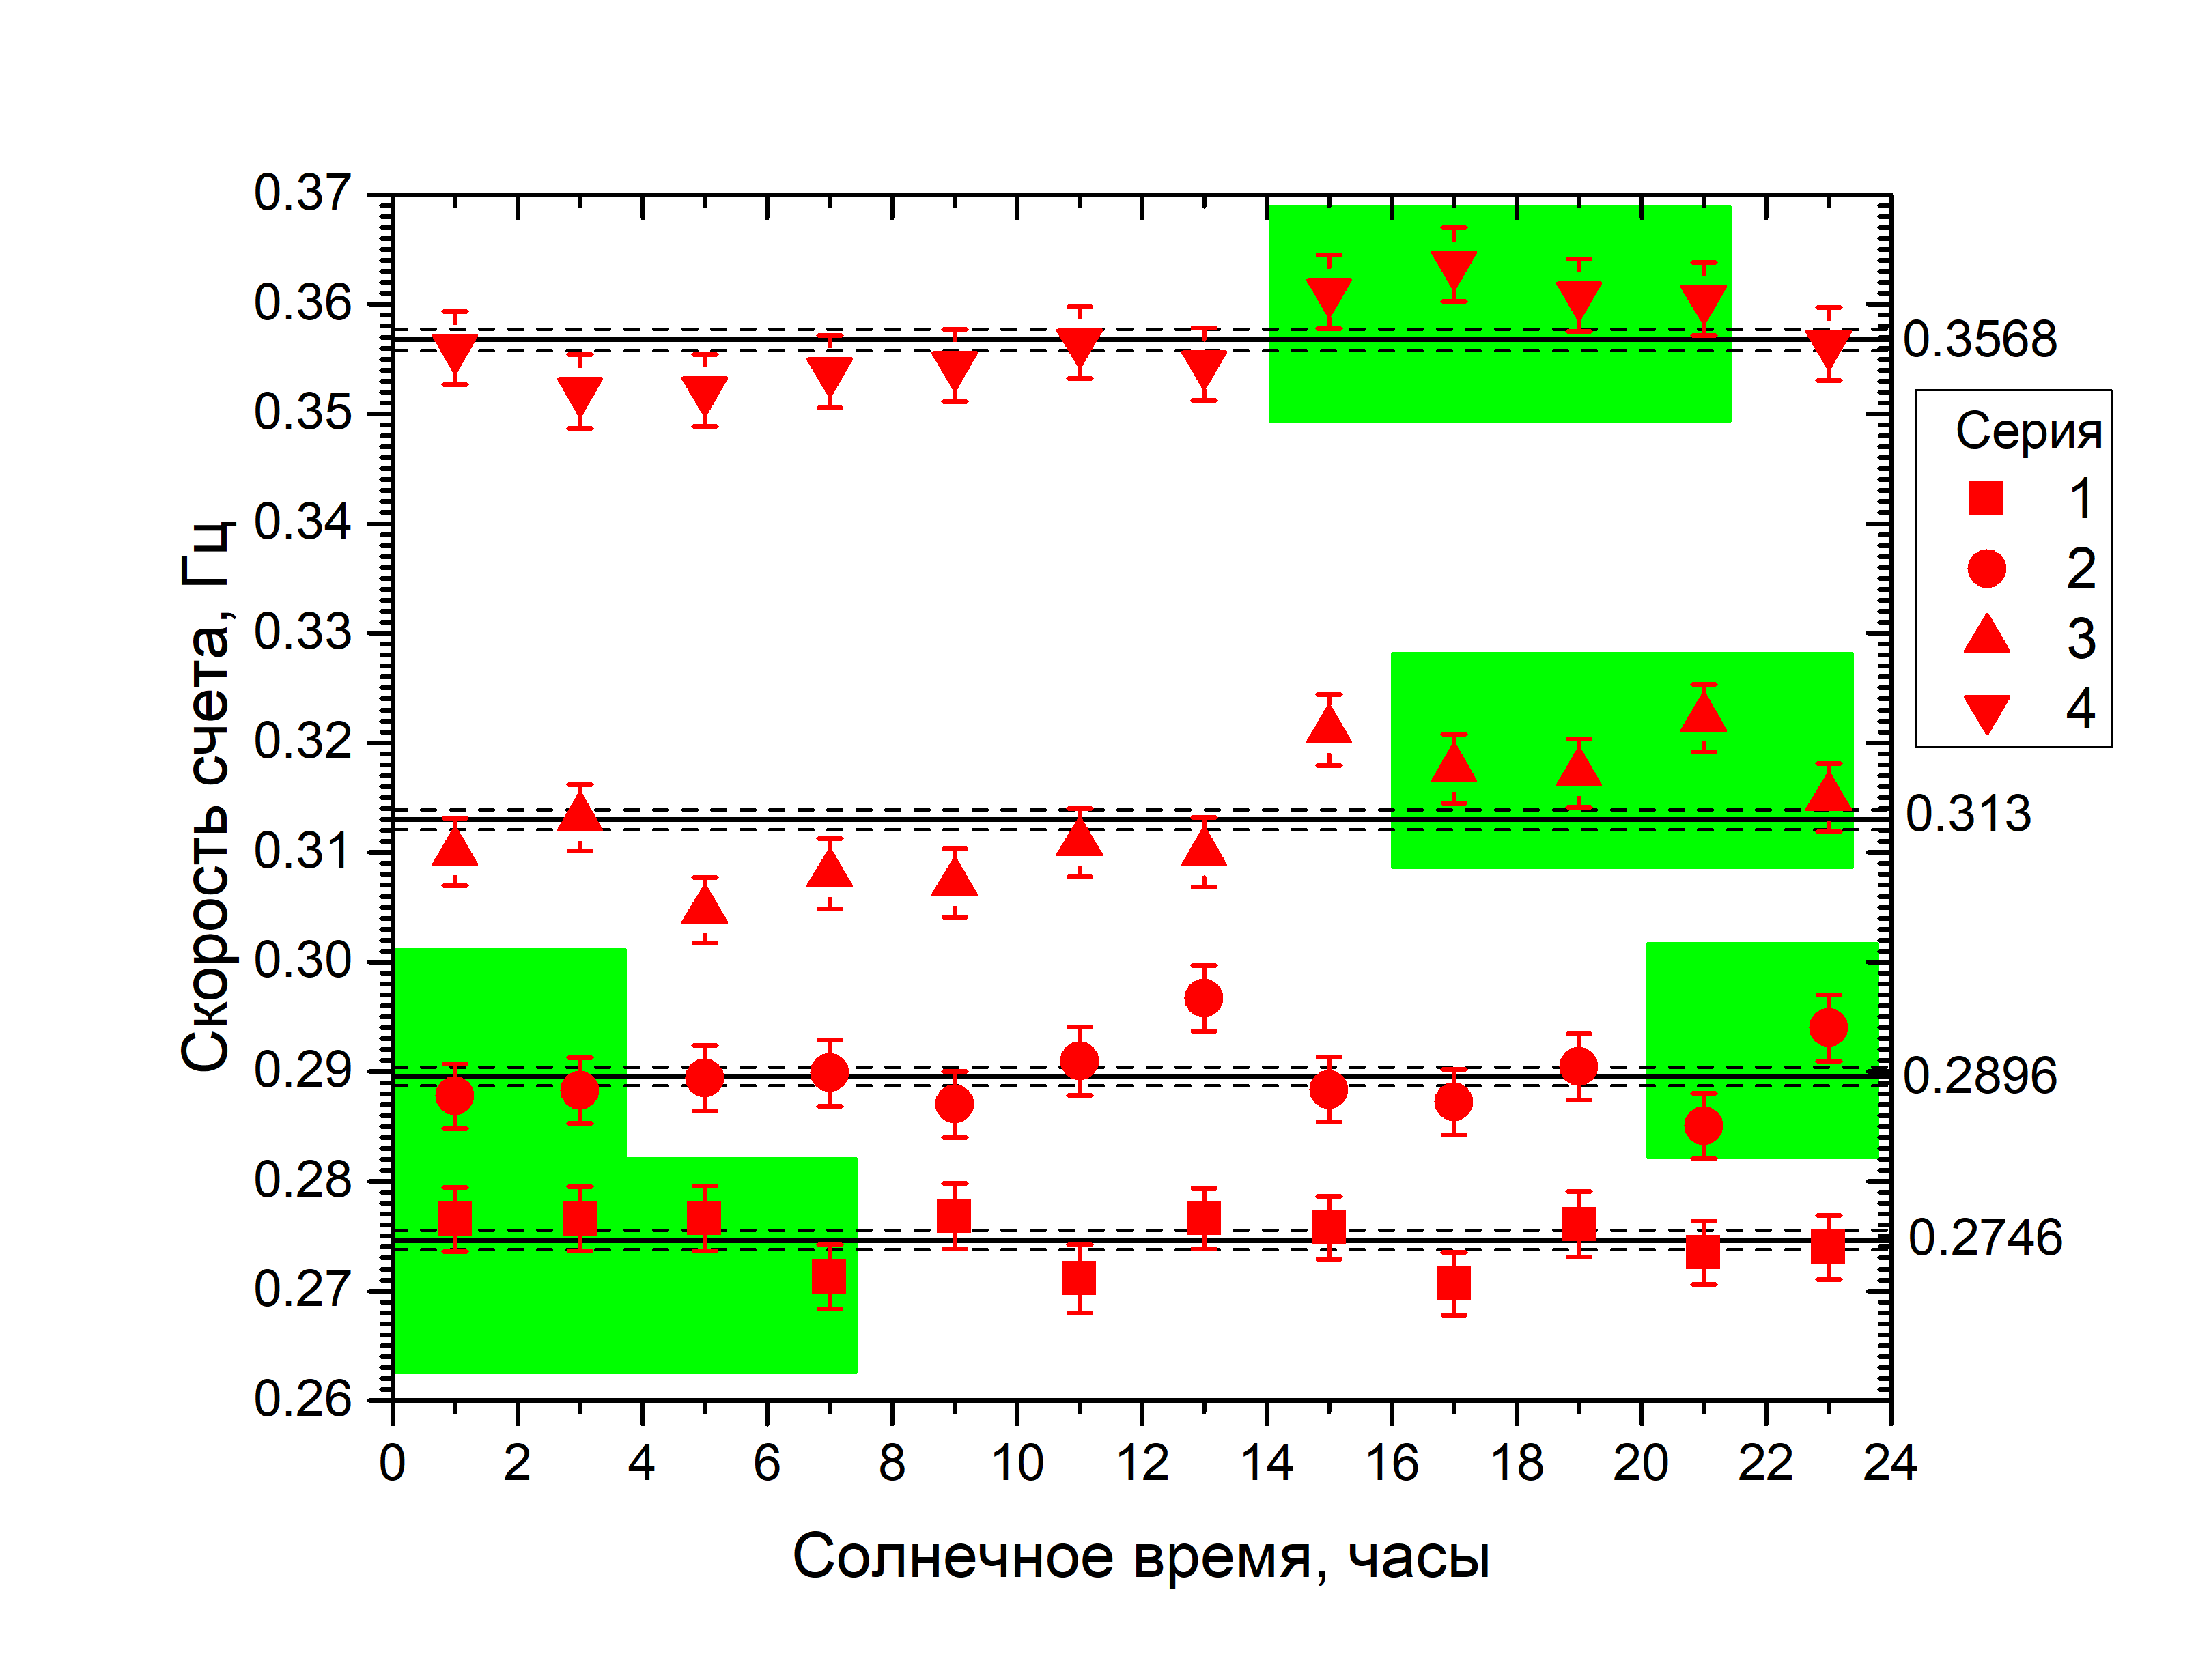
p =1.6x10⁻⁵
> 4 σ (3.17x10⁻⁵)
p = 5.05x10⁻⁶
> 4 σ (3.17x10⁻⁵)
DIURNAL VARIATIONS IN SOLAR TIME

Slide 24
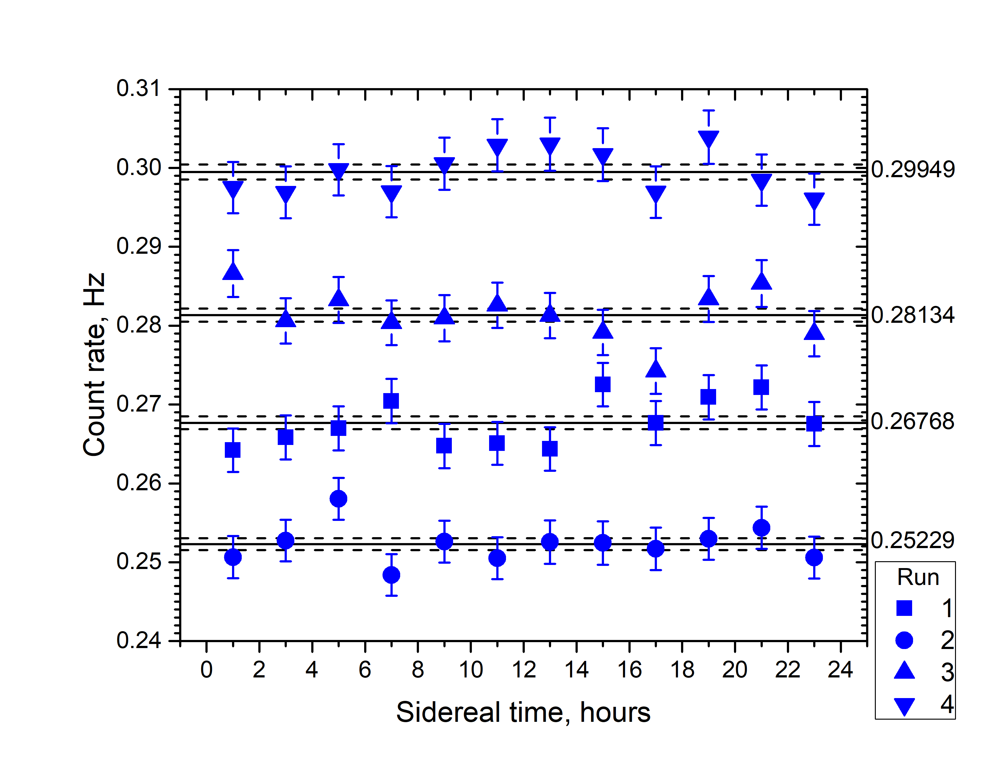
DIURNAL VARIATIONS IN SIDEREAL TIME (configuration 1)
p = 3.0x10⁻²
(< 2 σ)
2nd series of measurements
end of 2023 y –
1st quarter of 2024 y
Time of start-stop in each 4 Runs of measurements
1: 21.09.23 12:00 - 9.11.23 22:00
2: 10.11.23 00:00 - 29.12.23 22:00
3: 30.12.23 00:00 - 21.02.24 10:00
4: 21.02.24 12:00 - 3.04.24 8:00

Slide 25
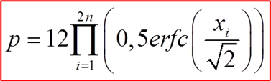
here n – number of Runs,
x_{i} – deviation from an average value in σ в in each 2h intervals between 18-00 and 22-00 of sidereal time in each 4 Runs of measurements.
For sidereal time p = 9.1х10⁻⁶,
Confidence level > 4 σ (3.17х10⁻⁵).
The possible interpretation:
Since September 2023 till March 2024 the solar system has been moving through space region, where the vector of E-field of dark photons between 18-00 and 22-00 of sidereal time was in the plane of Moscow meridian with an angle to the axes of the Earth between 20⁰ and 50⁰.

Slide 26
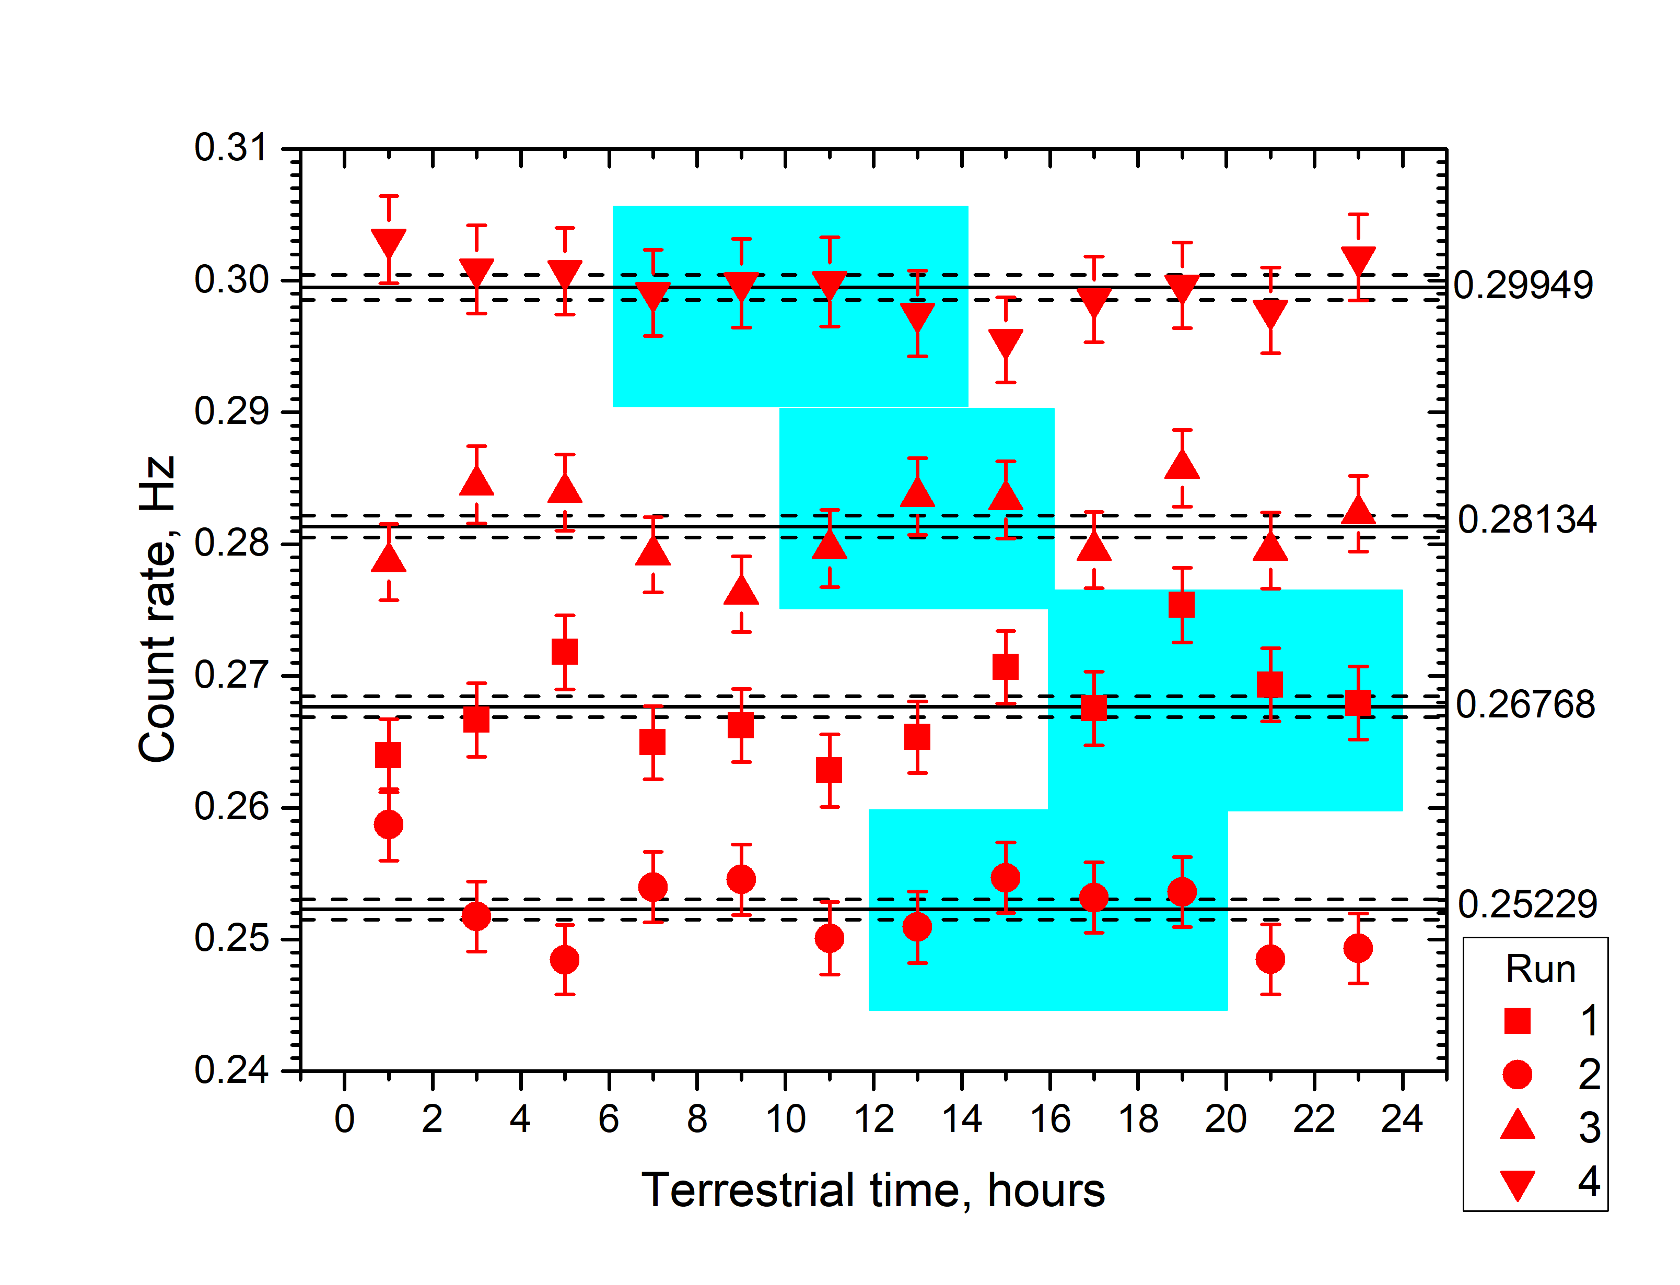
No similar effect has been observed in solar time
In solar time we have not observed
any synchronous fluctuations
In all 4 Runs which could be
connected with any technogenic
or other processes at the Sun or
at the Earth
To get into the time interval
between 18-00 and 22-00 of
sidereal time the events should
belong to the time intervals of solar
time, colored in blue, which are
regularly shifted in time
If C.L. < 3.5 σ – noise, if C.L. > 4 σ –
Candidate for the effect
< 3.5 σ
DIURNAL VARIATION IN SOLAR TIME

Slide 27
Summary
The method has shown its efficiency, the results obtained are included in the world compilation of data in PDG
There are some indications on the possible existence of diurnal variations of count rate in sidereal time which can be used as an argument in favor of its galactic origin. No similar effect has been observed in solar time. This can be interpreted as the effect from dark photons with a certain polarization in galactic system.
ArXiv:2408.03620 A.Kopylov, I.Orekhov, V.Petukhov and A.Solomatin
PHELEX: Two Series of Measurements in the Search for Dark Photons
To check this we plan:
to add in measurements the second detector placed at the same site with the same orientation. Observation of the simultaneous effect in both detectors will strengthen the argument that the observed effect is due to dark photons.

Slide 28
Our publications:
A.K., I.Orekhov, V.Petukhov, Latest Results on the Search of Dark Photons with a
Multicathode Counter, Physics of Atomic Nuclei, 2023, Vol.86, No. 6, pp 1009-1013
DOI: 10.1134/S106377882306011X
2. A.K., I.Orekhov, V.Petukhov, PHELEX: Present Status, Moscow University Physics Bulletin, 2022, Vol. 77, pp, 315-318. DOI: 10.3103/S0027134922020539
3 . A.K., I.Orekhov, V.Petukhov, Diurnal Variations of the Count Rates from Dark Photons, Particles 2022, 5, 180-187. https://doi.org/10.3390/particles5020016
4. A.K., I.Orekhov, V.Petukhov, Мульти катодный счетчик как детектор скрытых фотонов, Physics of Atomic Nuclei, 2022, Vol.85, No. 6, pp 1-9, (2022).
DOI: 10.31857/S0044002722060083
5. A.K., I.Orekhov, V.Petukhov, Present Status of the Experiment on the Search for Dark Photons by a Multi-Cathode Counter, Physics of Atomic Nuclei, 2021, Vol.84, No. 6, pp 860-865
6. A.K., I.Orekhov, V.Petukhov, On the possibility of observing diurnal variations in the count rate of dark photons using a multicathode counters, Physics of Particles and Nuclei, 2021, Vol.52, No.1, pp. 31 - 38

Slide 29
Our publications:
7. A.K., I.Orekhov, V.Petukhov, First results and future prospects with PHELEX, Journal of Physics, Conference Series, 1690 (2020) 012002, doi:10.1088/1742-6596/1690/1/012002
8. A.K., I.Orekhov, V.Petukhov, Results from a hidden photon dark matter search using a multi-cathode counter, JCAP, 07, 008 (2019)
9. A.K., I.Orekhov, V.Petukhov, Method of search for hidden photons of Cold Dark Matter using a multi-cathode counter, Physics of Atomic Nuclei, Vol.82, No. 9, pp 1-8, (2019)
10. A.K., I.Orekhov, V.Petukhov, Search for Hidden Photon Dark Matter using a Multi-Cathode Counter. Proceedings of the 4th International Conference on Particle Physics and Astrophysics (ICPPA-2018), Journal of Physics: Conference Series, 1390 (2019) 012066
11. A.K., I.Orekhov, V.Petukhov, A multi-cathode counter in a single-electron counting mode, NIM A, 910, 164 (2018)
12. A.K., I.Orekhov, V.Petukhov, Tech. Phys. Lett 42, 102 (2016)
13. A.K., I.Orekhov, V.Petukhov, Adv. High Energy Phys., 2058372 (2016)

Slide 30
Thank you for attention !

Slide 31
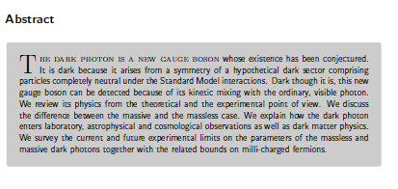
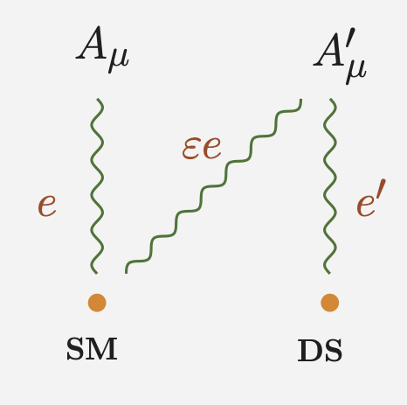
The dark Photon
M. Fabbrichesi, E. Gabrielli, G. Lanfranchi
The Physics of the Dark Photon, Springer Briefs in Physics (Springer, 2021)

Slide 32
V. Dzunushaliev, V. Folomeev, A.Tlemisov
Linear Energy Density and the Flux of an Electric Field in Proca Tubes
Symmetry 2021, 13, 640. https://doi.org/10.3390/sym13040640
V. Dzunushaliev, V. Folomeev
Axially symmetric particlelike solutions with the flux of a magnetic field in the non-Abelian Proca-Higgs theory
Phys. Rev. D 2021, 104, 116027
V. Dzunushaliev, V. Folomeev
Proca balls with angular momentum or flux of electric field
Phys. Rev. D 2022, 105, 016022
arXiv:2112.06227v.2 [hep-th] 16 Feb 2022

Slide 33
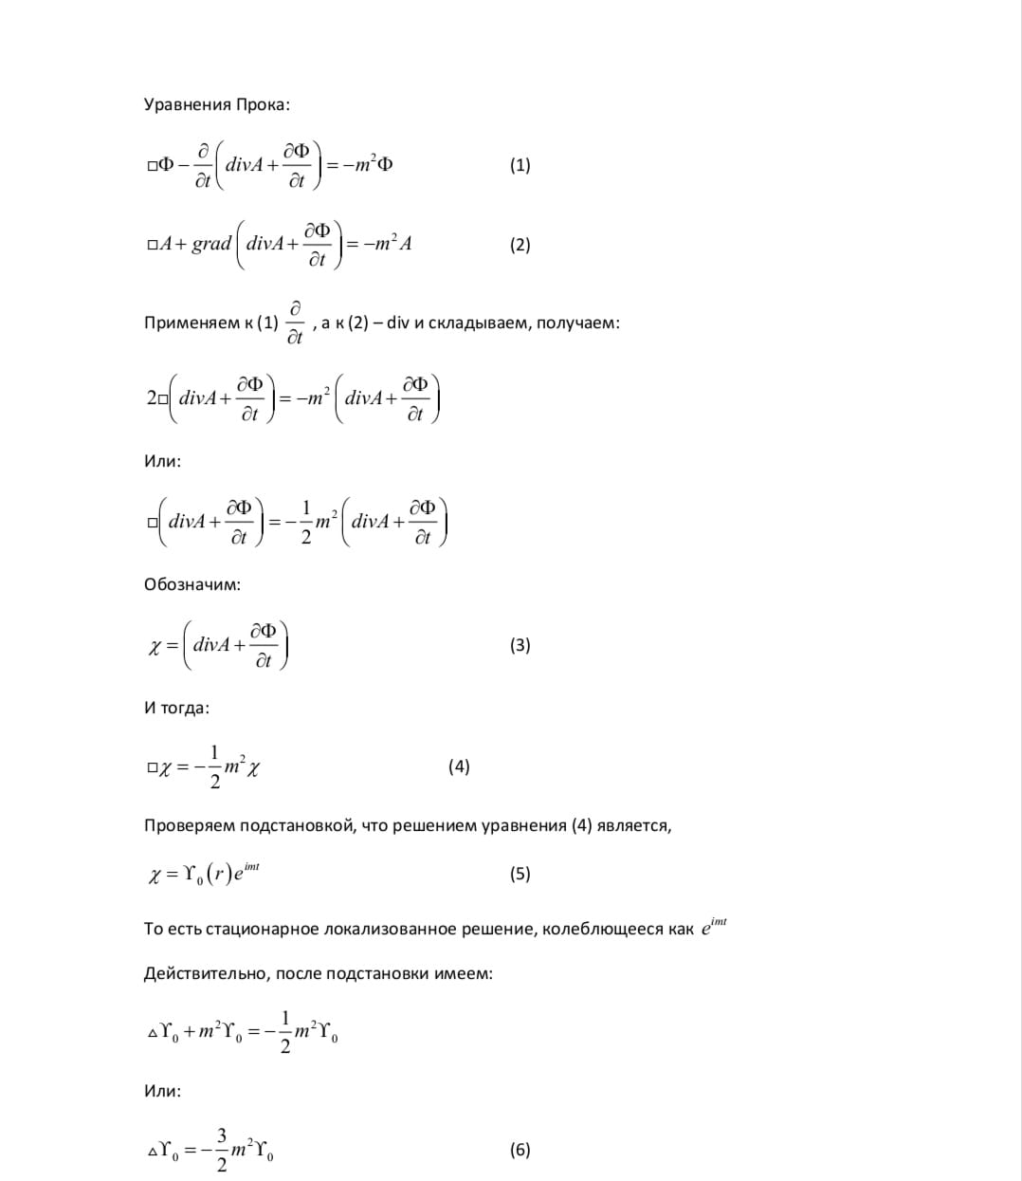
Масса фотона ≠ 0
Уравнения Прока
Калибровка Лоренца Х
B ≠ rot A
div B ≠ 0
div E ≠ 0
Продольная мода электрического Е и магнитного B поля

Slide 34
Ref: R.B.Cairns and J.A.R.Samson Journal of optical society of America
Vol. 56, Number 11, November 1966, 1568-1573
10
30
eV

Slide 35
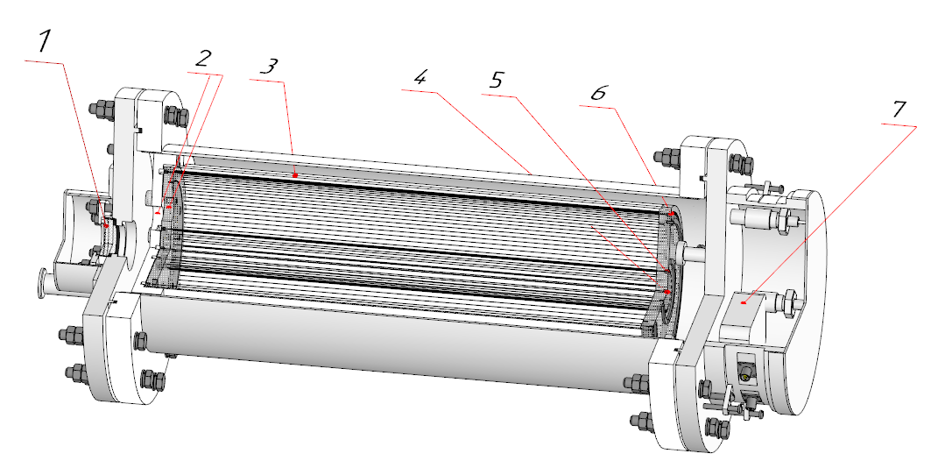
Мультикатодный счетчик, калибровка с торца
Рабочий газ: аргон, неон + 10% метан, Р = 1 атм
Кварцевое окно
Окна со смещением от центра
Сплошной катод 3
Анод
Нитяной катод 1
Нитяной катод 2
Предусилитель

Slide 36
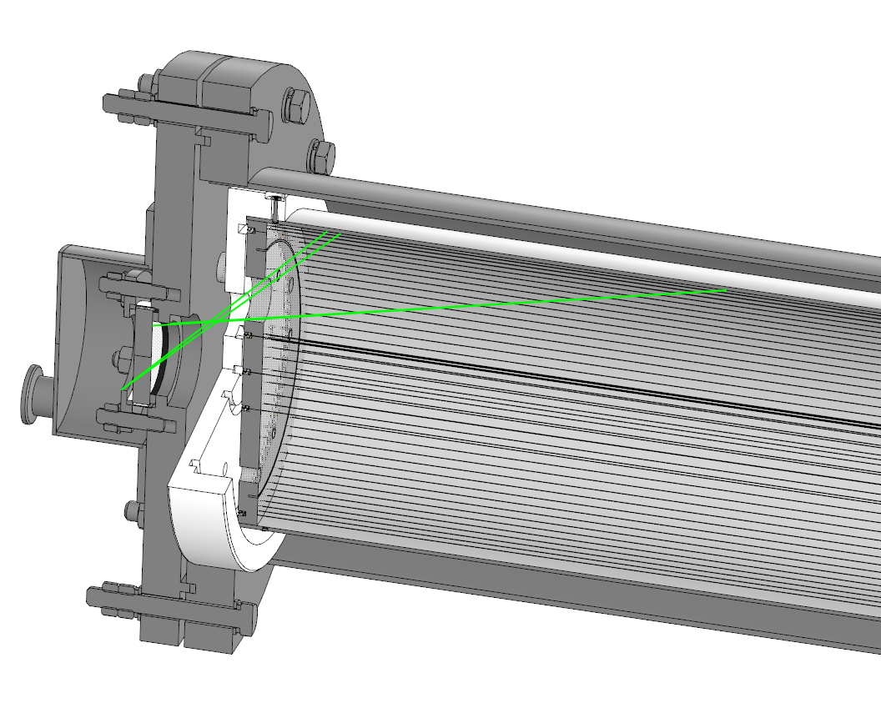
Мультикатодный счетчик, калибровка с торца
Калибровка
УФ лампой

Slide 37
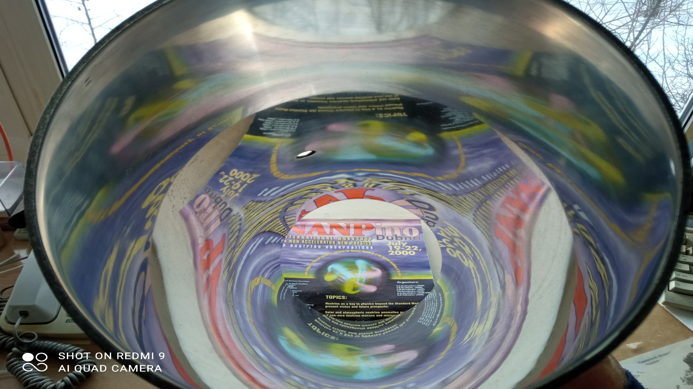

Slide 38
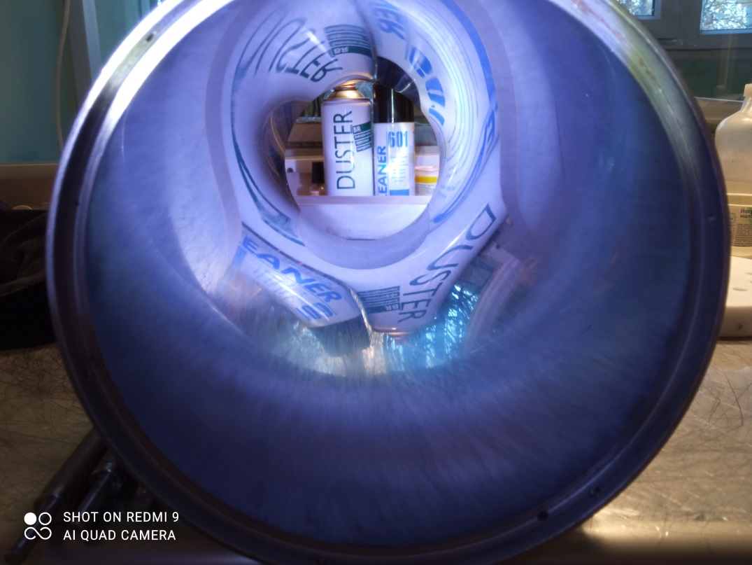

Slide 39

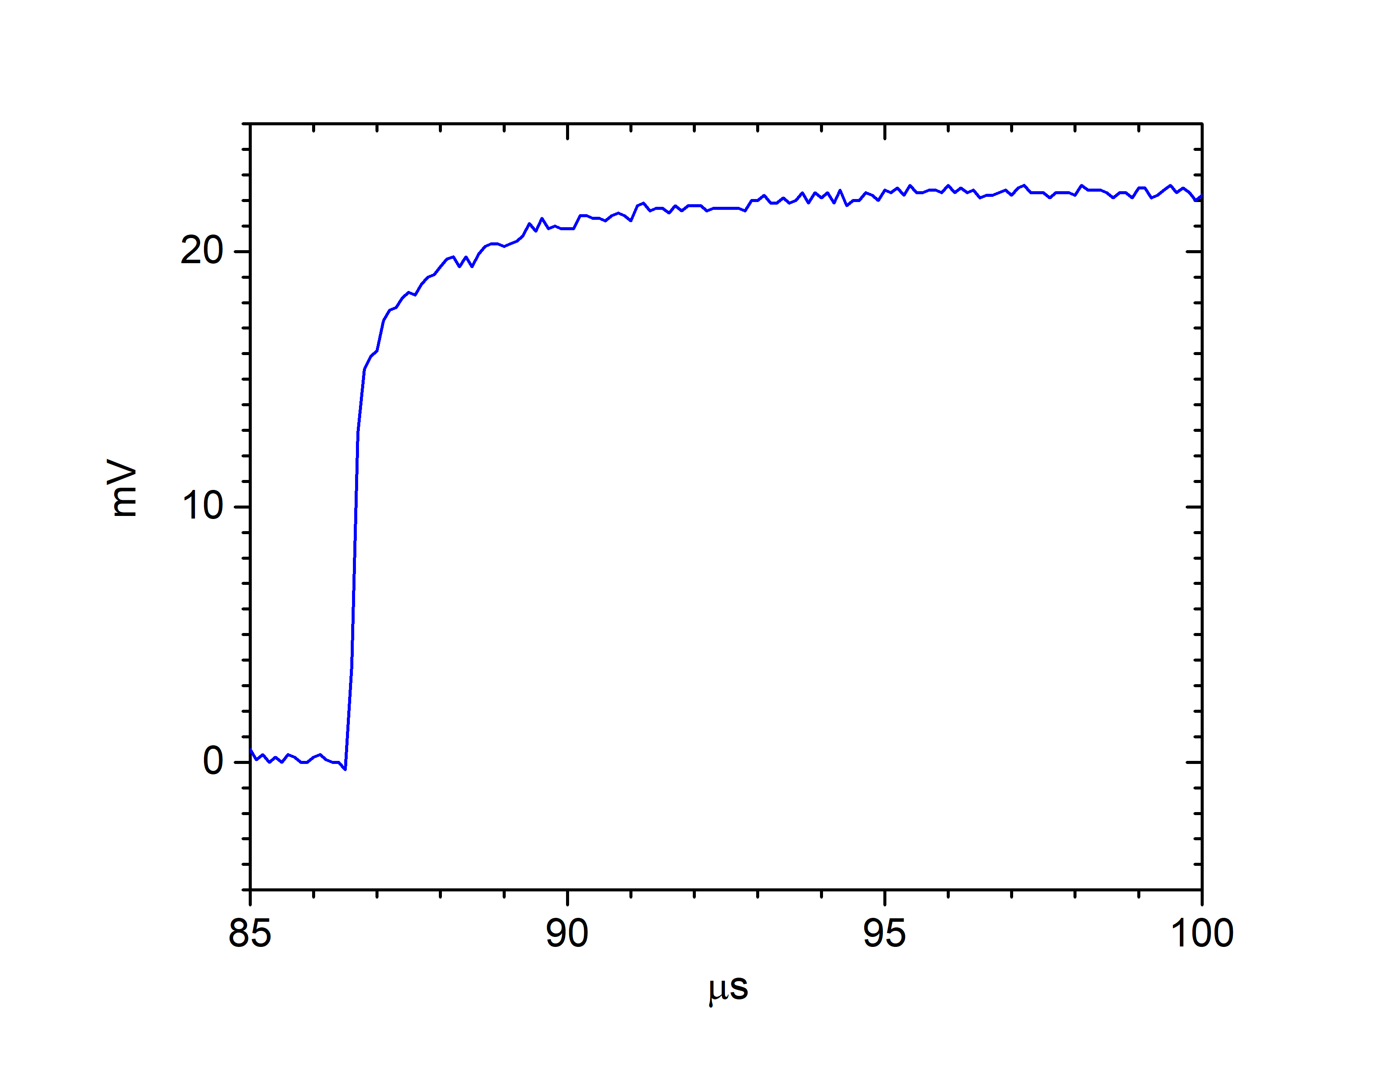
Одноэлектронный импульс
Форма импульса
Передний фронт

Slide 40
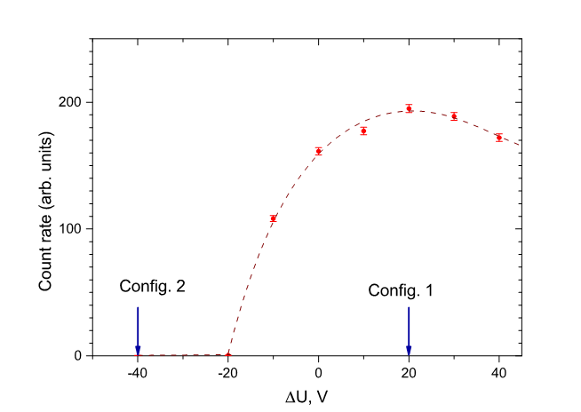
Принцип работы мультикатодного счетчика:
Отталкивающий потенциал второго катода в конфигурации 2
Эффект: r_{MCC} = R₁ – R₂
HV2
HV1
ΔU = HV2 – HV1
R₁ – red, R₂ - blue

Slide 41
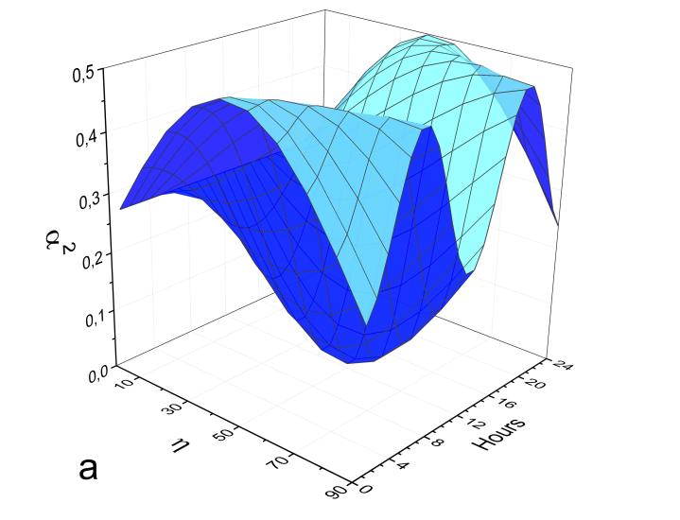
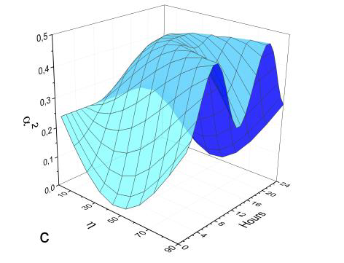
Diurnal variations, BNO, Russia 43º
<α²> averaged for 1 hour
Vertical orientation
North-South orientation
East-West orientation

Slide 42
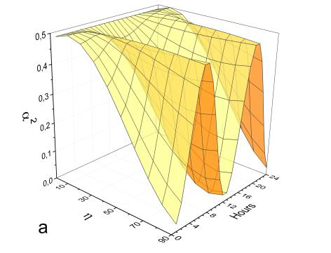
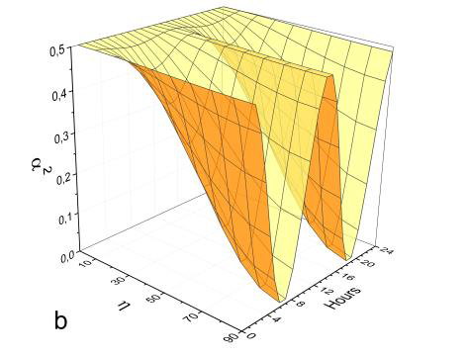
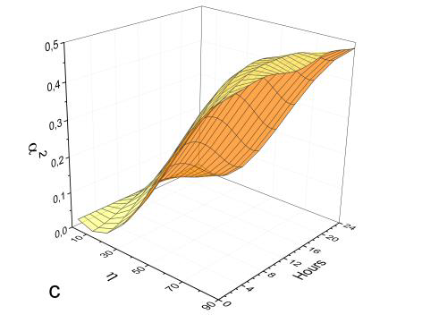
Diurnal variations, INO, India 10º
Vertical orientation
East-West orientation
North-South orientation

Slide 43
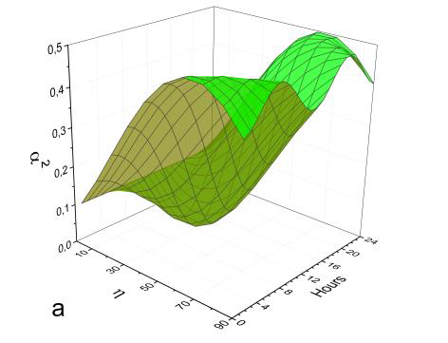
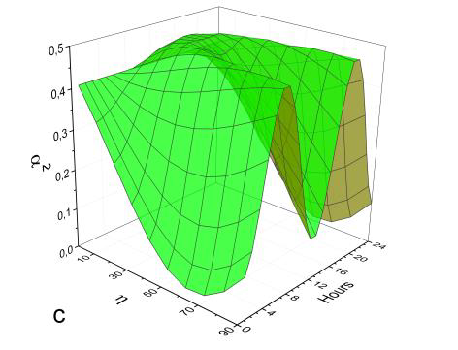
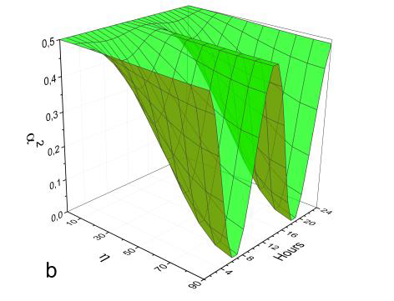
Diurnal variations, Pyhäsalmi, Finnland 64º
Vertical orientation
East-West orientation
North-South orientation

Slide 44
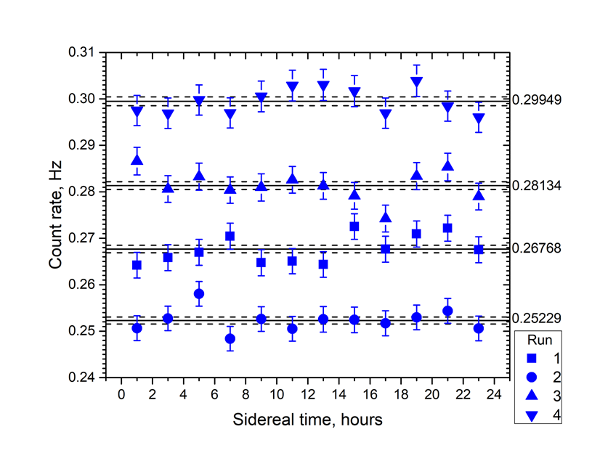
Сравниваем две серии, каждая серия 4 рана
6σ!
4σ!
Эффект наблюдается в звездных (!) сутках
Поляризация (вектор E) меняется в течение года

Slide 45
Проверка по интервалу с 0-00 до 4-00 солнечных суток
где n – количество ранов,
x_{i} – отклонение от среднего в единицах стандартного отклонения в каждом из интервалов с 00-00 до 02-00 и с 02-00 до 04-00 солнечных суток в каждом из четырех ранов измерений.
Получаем, что для солнечных суток вероятность p = 7х10⁻⁴,
что соответствует достоверности менее 3.5 σ (2.3х10⁻⁴).
Видно, что этот критерий работает:
если < 3.5 σ – шум, если > 4 σ – кандидат на эффект

Slide 46
Сравниваем две серии, каждая - 4 рана
Нет превышения нигде!
в земных (!) сутках

Slide 47
Эффект > 6 σ плюс эффект > 4 σ
это хороший знак!
Однако! Для получения доказательной базы еще нужно:
- Провести измерения с двумя детекторами
(1) оба ориентированы вдоль меридиана
(2) один - вдоль меридиана, другой – вдоль параллели
- Эффект не должен наблюдаться во второй конфигурации
Провести измерения с детектором, расположенным на той же широте, но на другой долготе – должен наблюдаться эффект со сдвигом по времени, соответствующим разности долгот
Например: г. Томск с широтой 56.495⁰ и 4 часами разницы с Москвой. Эффект наблюдаемый в Москве должен запаздывать на 4 часа относительно Томска.
Провести измерения с детекторами с другим материалом катода

Slide 48
Authors: A. Kopylov, I. Orekhov, V. Petukhov
Title: Results from a Hidden Photon Dark Matter Search Using a Multi-Cathode Counter
Received: 2019-01—29 08:16:45.0
Referee report:
Their experiment is very interesting and their idea has both novelty and originality. I consider that this preprint is acceptable for publication in JCAP.

Slide 49
Нет пророка в своем Отечестве
Dr. н
‘The new guiding principle should be “no stone left unturned”: we should look for dark matter not only where theoretical prejudice dictates that we “must”, but wherever we can.
G.Bertone and T.M.P.Tait A New Era in the Quest for Dark Matter arXiv:1810.01668

Slide 50

Сумма по четырем ранам (конфигурация 1)

Slide 51


Slide 52

Сумма по четырем ранам (конфигурация 1)
Серия измерений
в 2023 году (январь –
июль)
Время начала-конца в каждом
из 4х измерений (4 Runs)
1: с 27.12.22 12:00 до 25.02.23 20:00
2: с 25.02.23 22:00 до 15.04.23 16:00
3: с 15.04.23 18:00 до 4.06.23 10:00
4: с 4.06.23 12:00 до 24.07.23 10:00

Slide 53

Сумма по четырем ранам (конфигурация 1)
Серия измерений
в 2023 году (январь –
июль)
Время начала-конца в каждом
из 4х измерений (4 Runs)
1: с 27.12.22 12:00 до 25.02.23 20:00
2: с 25.02.23 22:00 до 15.04.23 16:00
3: с 15.04.23 18:00 до 4.06.23 10:00
4: с 4.06.23 12:00 до 24.07.23 10:00

Slide 54
Dark photons as a Dark Matter

Slide 55

Измерение индуцированного электрического поля
Наш препринт: A.Kopylov, I.Orekhov, V.Petukhov, About the possibility to observe diurnal variations
of the count rate of dark photons by the multicathode counters. arXiv:2006.05452

Slide 56

arXiv:2105.04565
Наш препринт: A.Kopylov, I.Orekhov, V.Petukhov, About the possibility to observe diurnal variations
of the count rate of dark photons by the multicathode counters. arXiv:2006.05452

