Slide 1
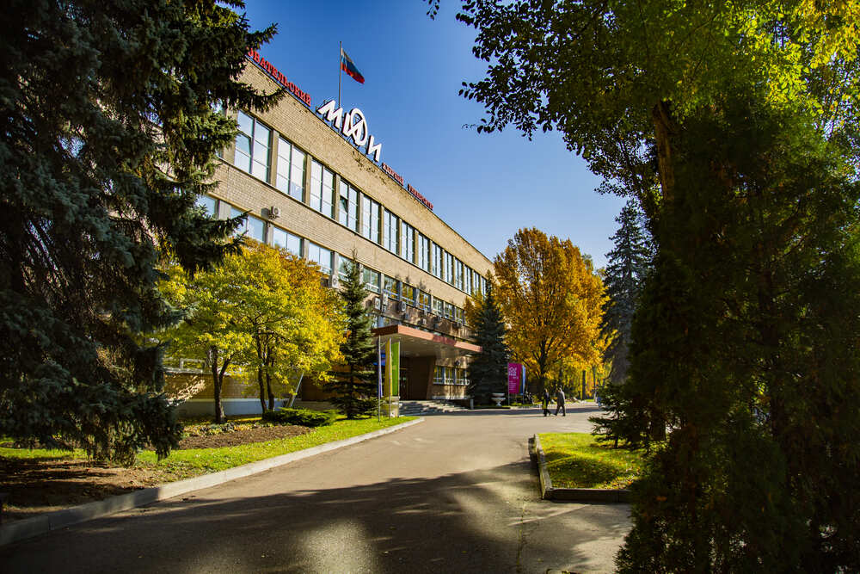

ASTRONOMY of
ULTRA HIGH ENERGY
COSMIC RAYS
Daniele Fargion- Inaf-Italy

Slide 2

A century of useless Cosmic Ray deflections?
Is there any good reason for a never ending,
« blind man’s fly» ? Did we find , finally, an UHECR Astronomy?

Slide 3
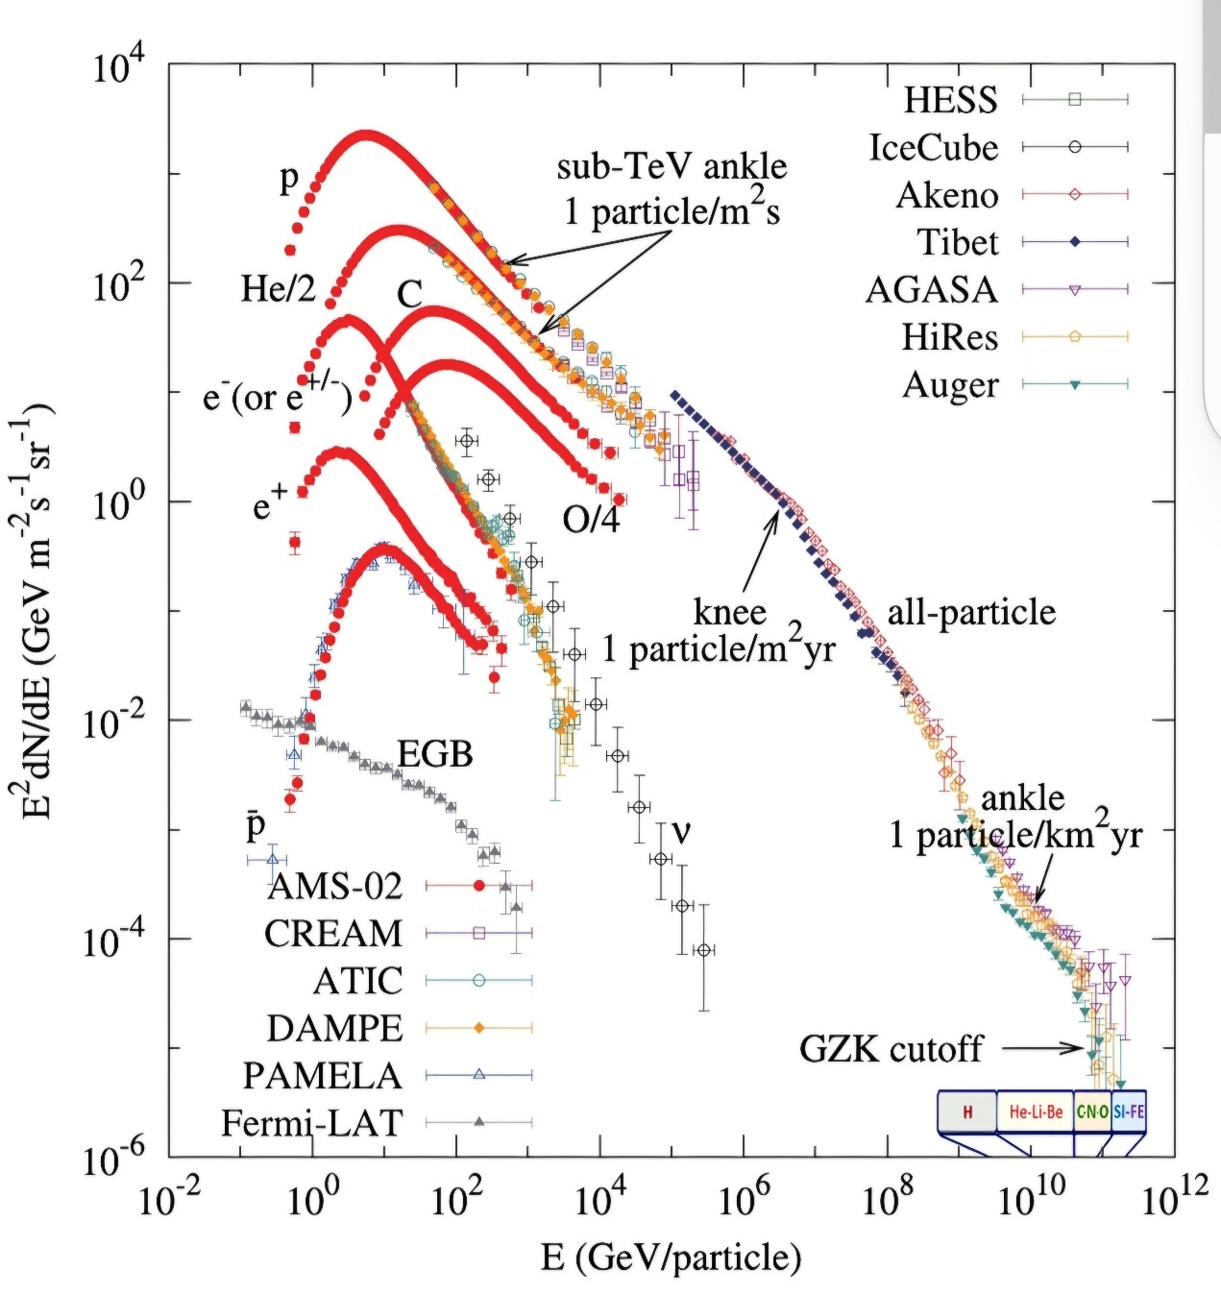
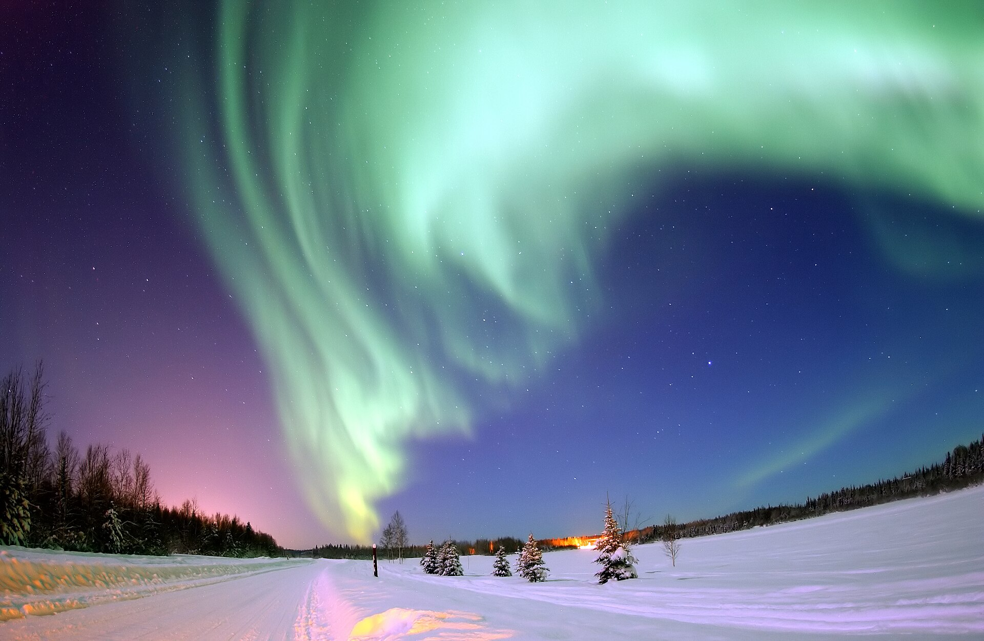
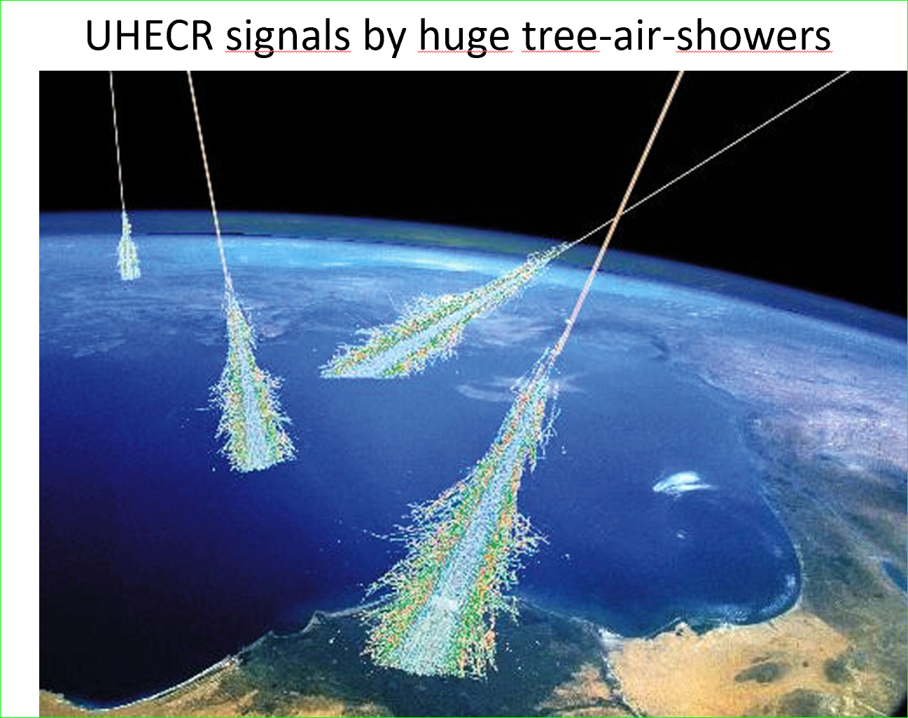
A brief Summary of «Cosmic Rays»
UHECR
UHECR

Slide 4
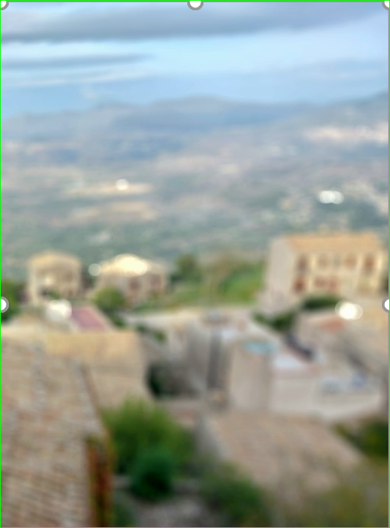
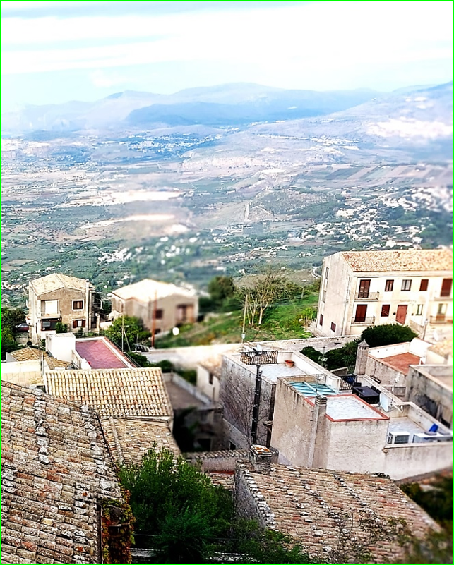
Cosmic Rays are Charged, bent and much smeared.
But, UHECR, are less smeared and more bounded:
Toward a new UHECR (> tens EeV) « Astronomy» ?

Slide 5
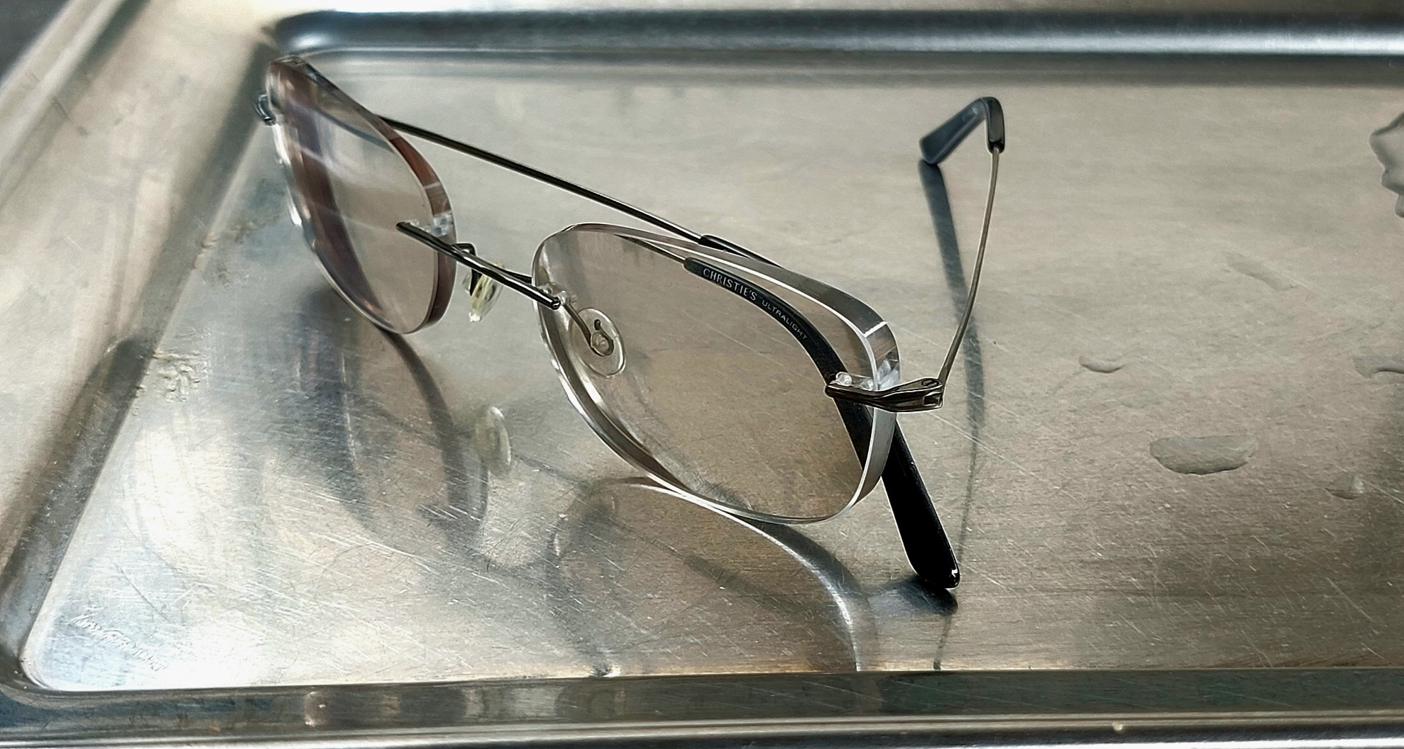

A smeared view of UHECR Astronomy

Slide 6
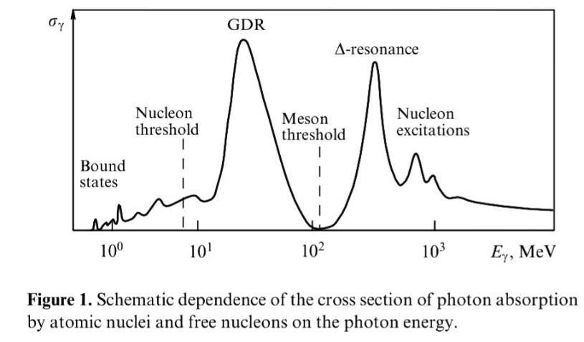
The Two different nuclear cut off to UHECR by relic 1:photons: GZK: Greisen, Zatzepin,Kuzmin
2:and GDR : Giant Dipole Resonance
GZK photopion cutoff occur at tens EeV, it makes UHECR constrained near, ………………………………………………………40 Mpc (1% Cosmic radius)
GDR = photonuclear distruption by Giant Dipole resonance
makes (to lightest nuclei ) a severe cut off at tens EeV ,
constrained in a nearer, ………… 4 Mpc (0.1% Cosmic radius)
GDR
GZK

Slide 7
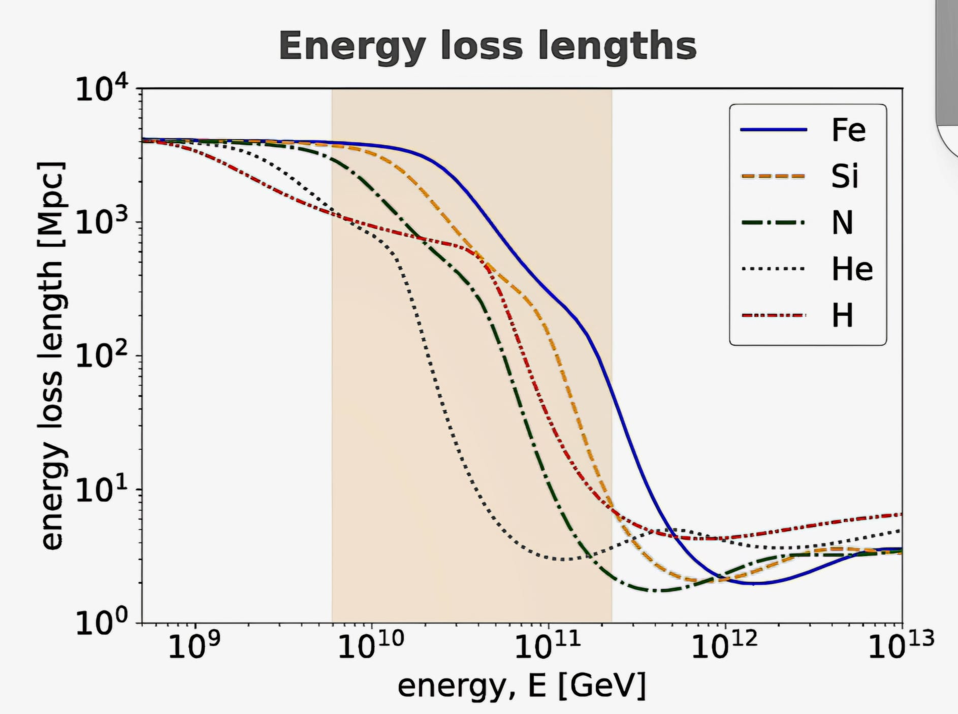
UHECR bounded by GZK (p) and GDR (He) cut off both in energy and distances
GZK (p)
GDR (He)

Slide 8
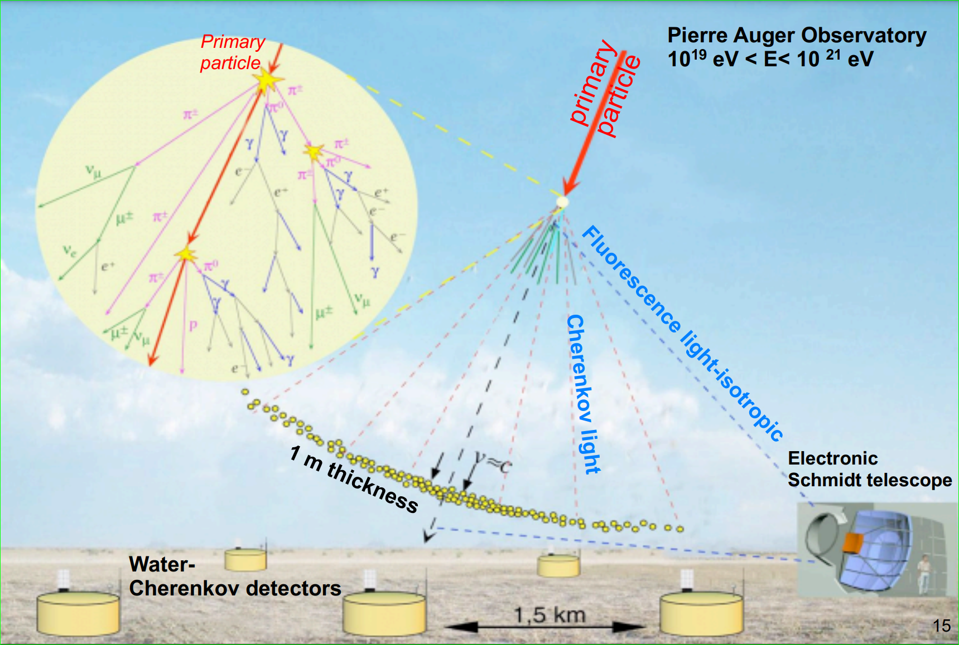
Rare Air Shower detection for UHECR, energy and composition. Largest (3000 km square)
Auger arrays (South) and TA (600 km square) (North)

Slide 9
ASTRONOMY of
(Lightest Nuclei) in ULTRA HIGH ENERGY
COSMIC RAYS by
Daniele Fargion see also
UHECR Clustering: Lightest Nuclei from Local Sheet Galaxies; D. F., Maxim Khlopov, P.G.Lucentini https://doi.org/10.3390/universe10080323

Slide 10
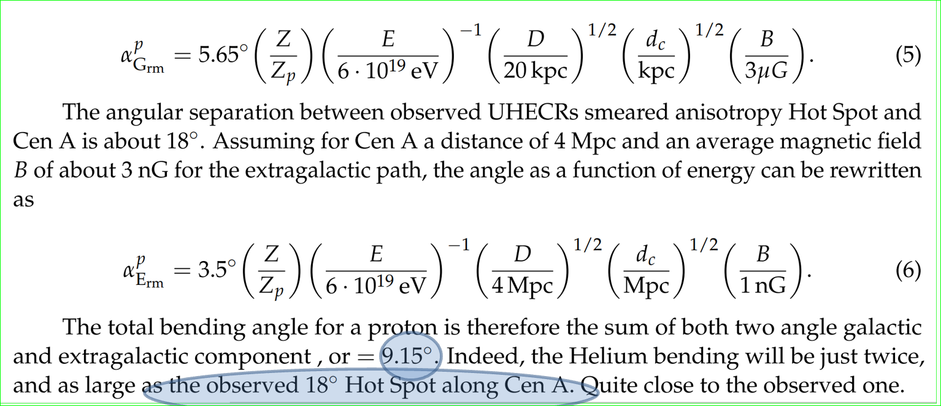
Bending charges , nucleon, nuclei in UHECR at GZK: for Proton <-> 9°, for He-> 18°
Therefore: Who and Where are the sources ?
Random Galactic and Extra Galactic bending

Slide 11
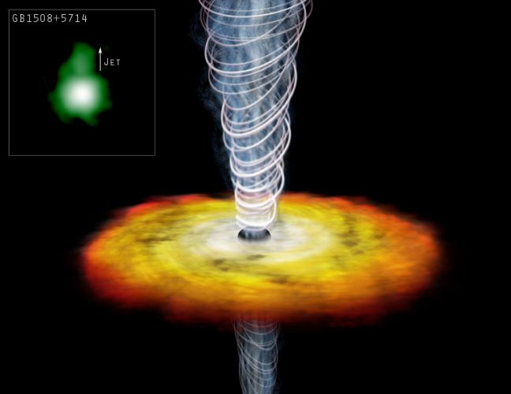
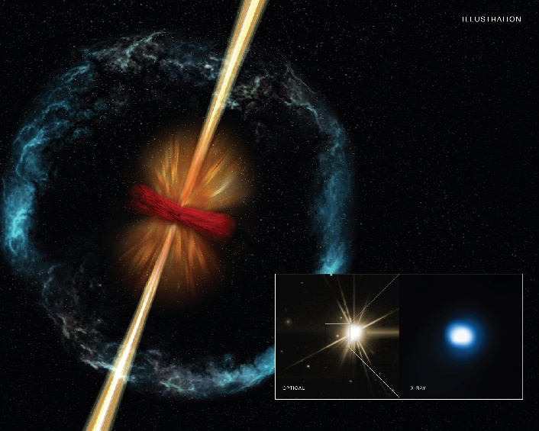
AGN and GRB Jets: BH+Accretion disk
Ideal smoking gun sources for UHECR!

Slide 12
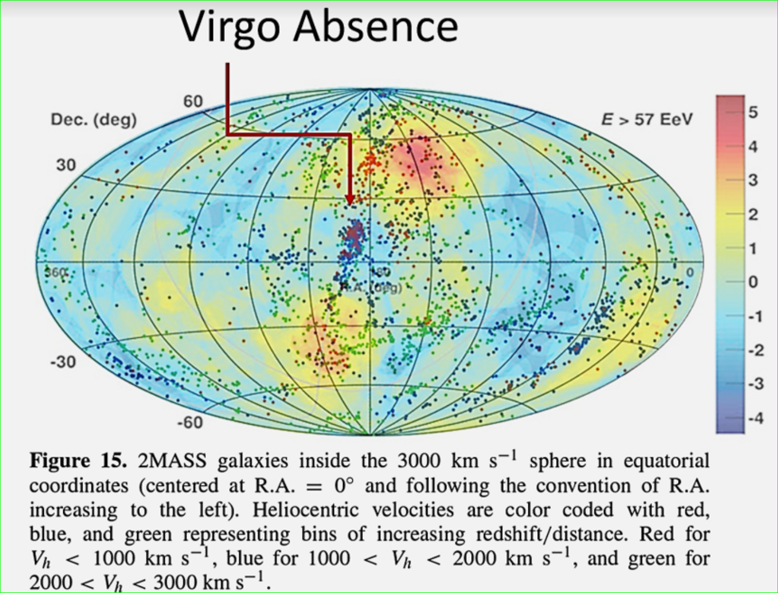
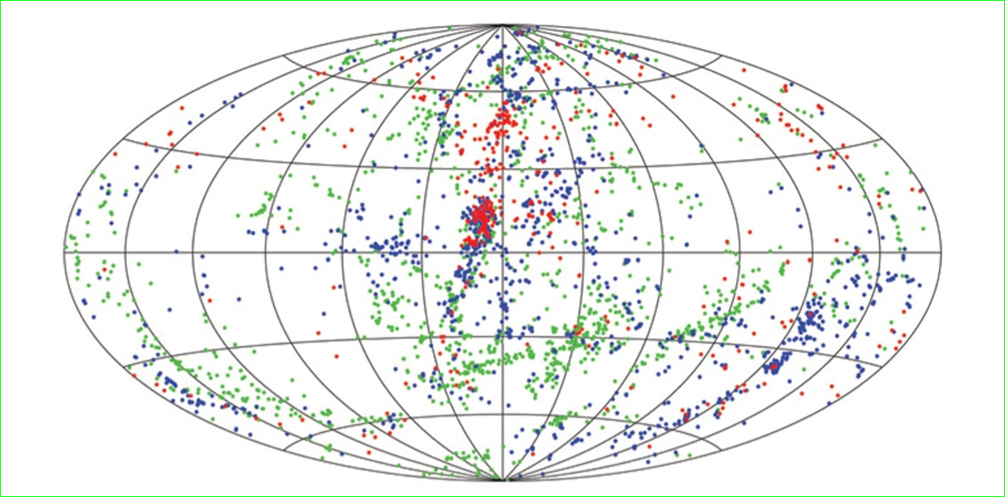
THE GZK cut off UNIVERSE
CAS A
M 82
M 31
Cyg X3
Virgo
Crab
SS 433
NGC 253
CenA
VELA
LMC
SMC

Slide 13
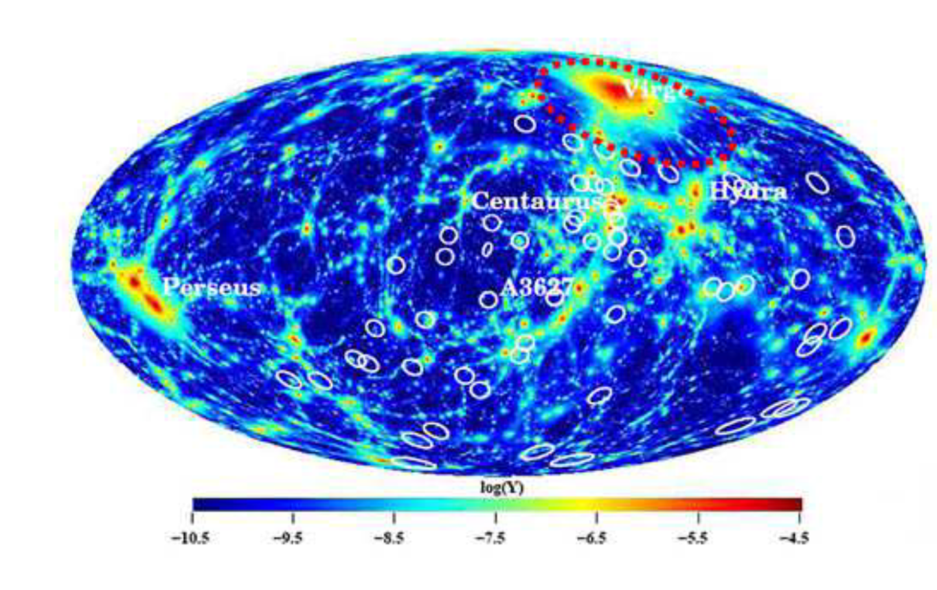
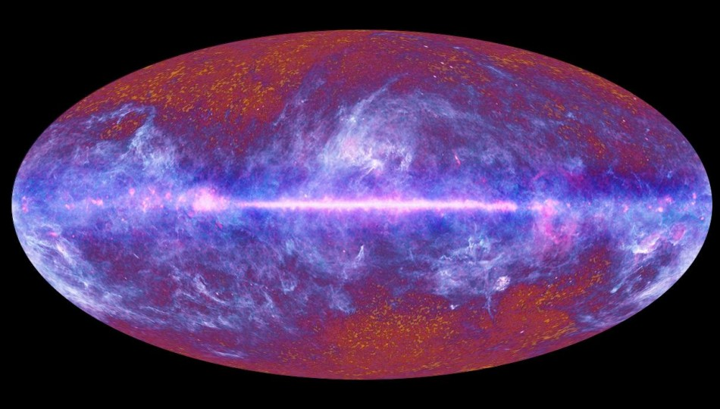
AGAIN: expected VIRGO CLUSTER DOMINANCE (40 Mpc):
GALACTIC COORDINATE : but, only 1 clustering-→ Cen A

Slide 14
How to make Virgo opaque, while only Cen A observable?
if Proton are the UHECR, than Virgo should shine at GZK cut off , 40 Mpc… (but it doesn’t)
But, if UHECR are (He,..Lightest nuclei),
They should shine at a GDR cut off, much smaller, …………………4 Mpc,…therefore….:
Virgo is absent (as it is far),
but, Cen A, not: it is within 4 Mpc.

Slide 15
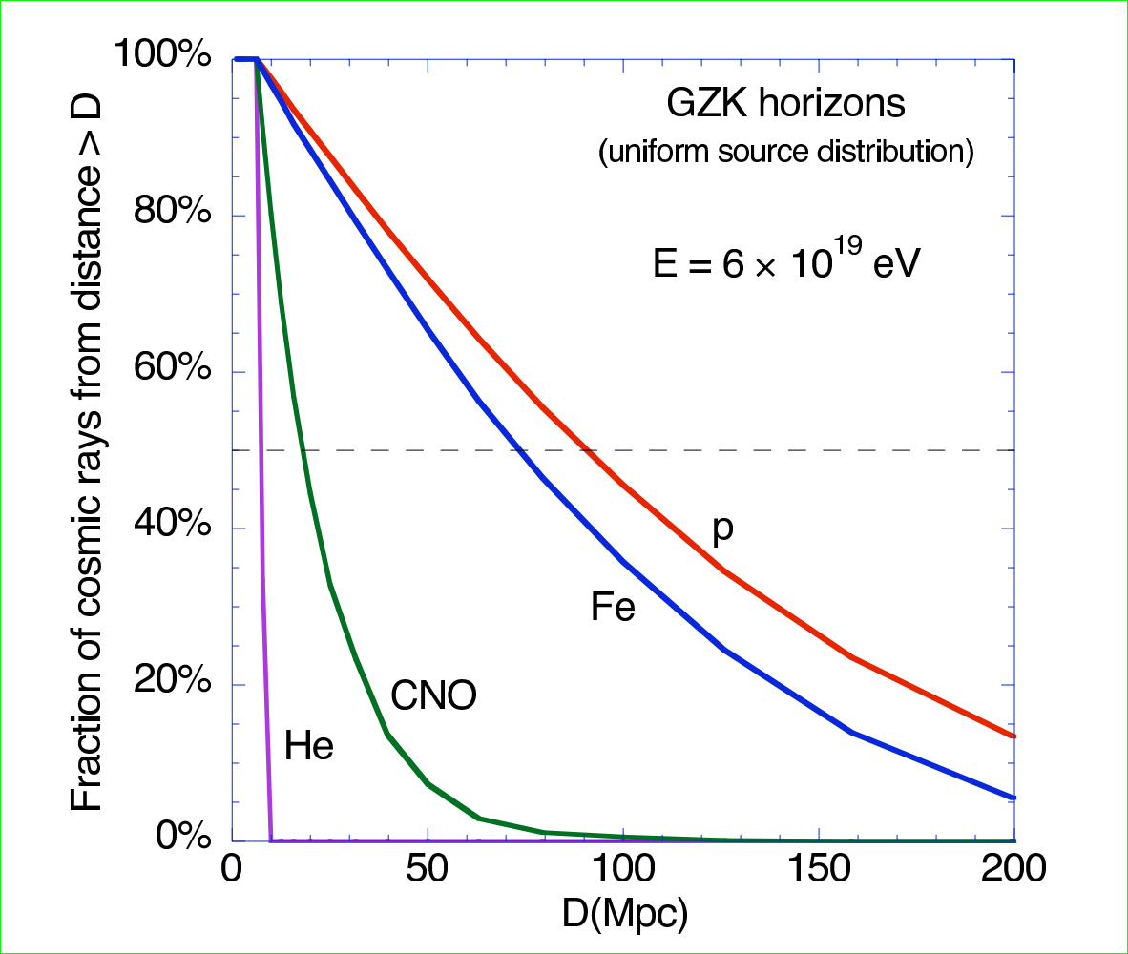
Distances flight for lightest UHECR Nuclei:
D-He-Li-Be, very narrow→ 4 Mpc cut off
VIRGO (20 Mpc) IS FILTERED !! BUT Cen A, M82, NGC 253, NOT!!.

Slide 16
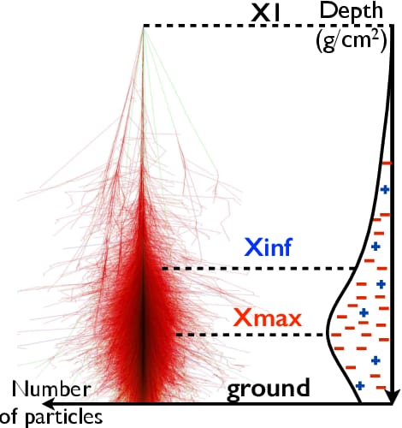
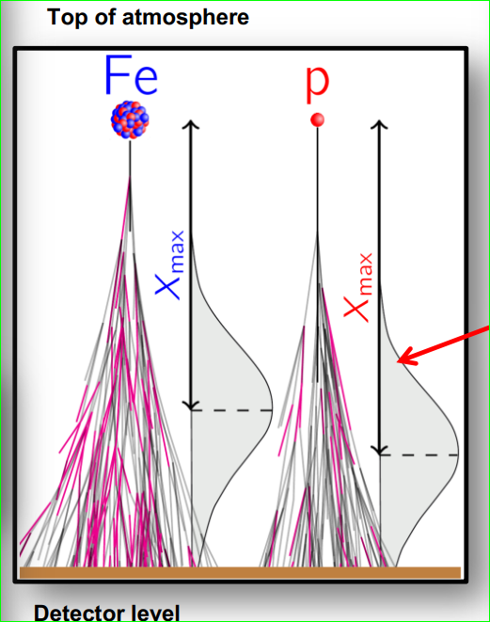
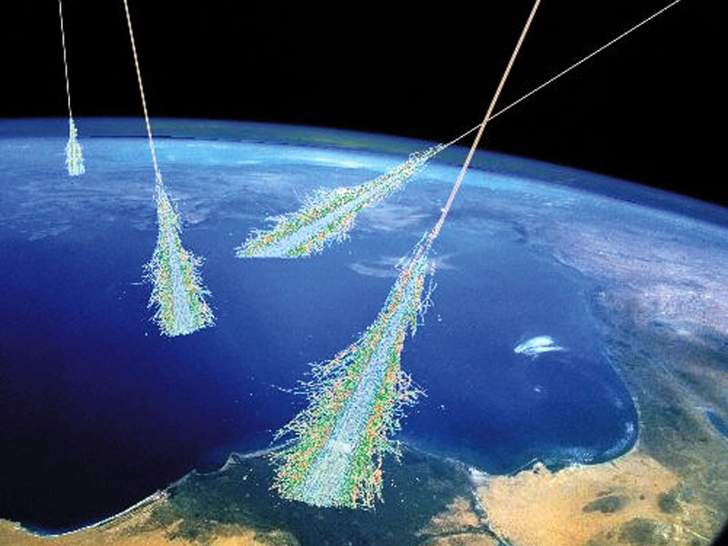
A different way to verify the COMPOSITION : A Test for UHECR observed by their huge tree-air-showers.
AUGER JCAP 2018: arxiv:1612.07155
Their air shower «three» structure = Slanth Depth <=> is the imprint.
The lightest, less cross section, more penetrating, lower altitude
The heavier,larger cross section, less pennetrating, higher altitude

Slide 17
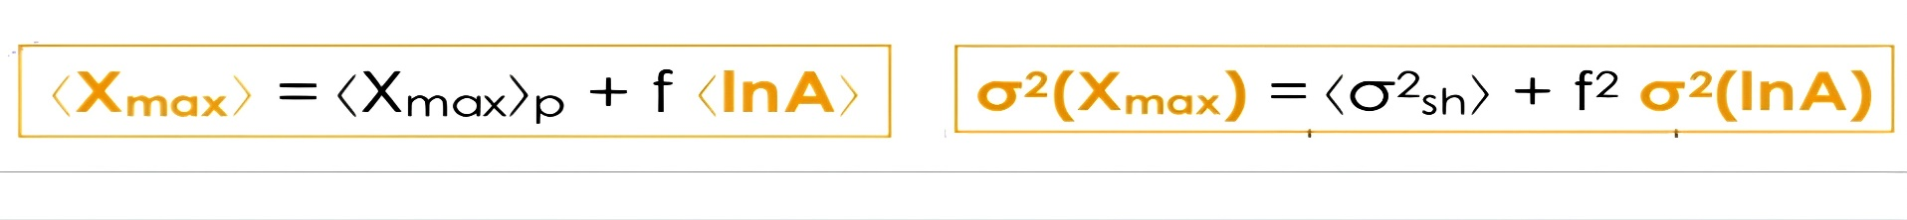
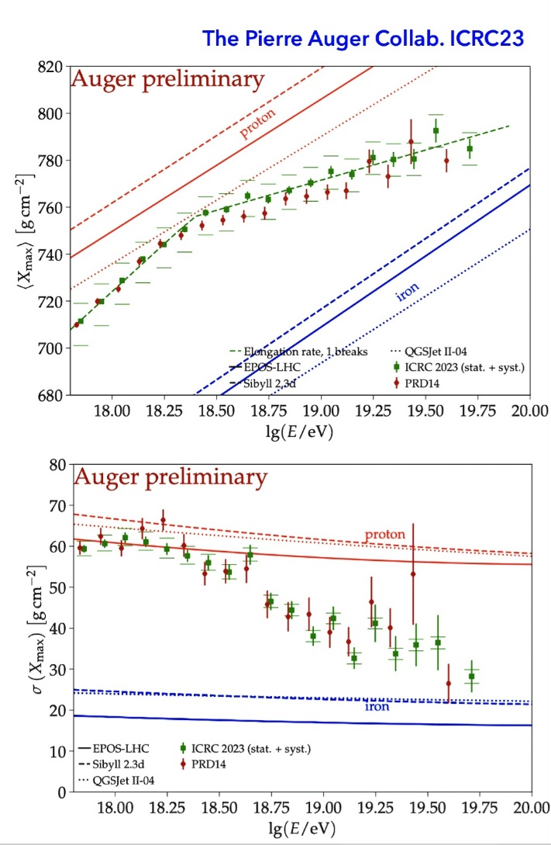
Composition ICRC 2023

Slide 18
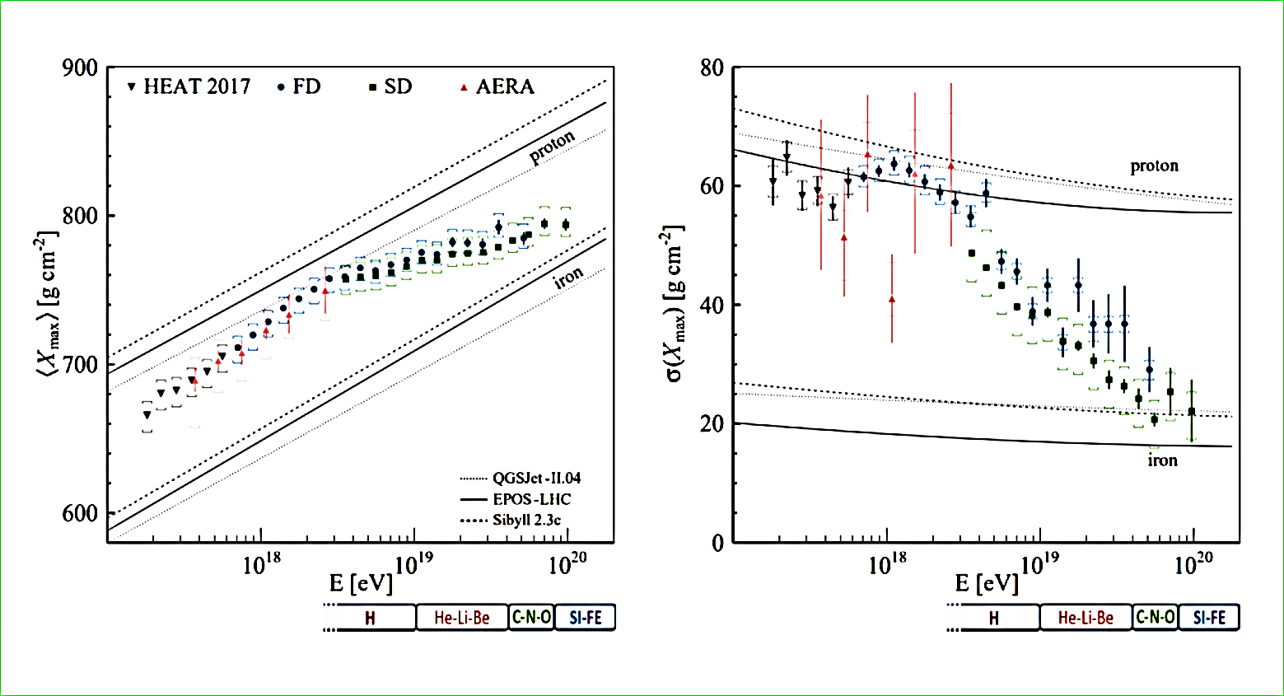
Composition evolution : from lightest to heavy nuclei (lnA) with UHECR energy growth

Slide 19
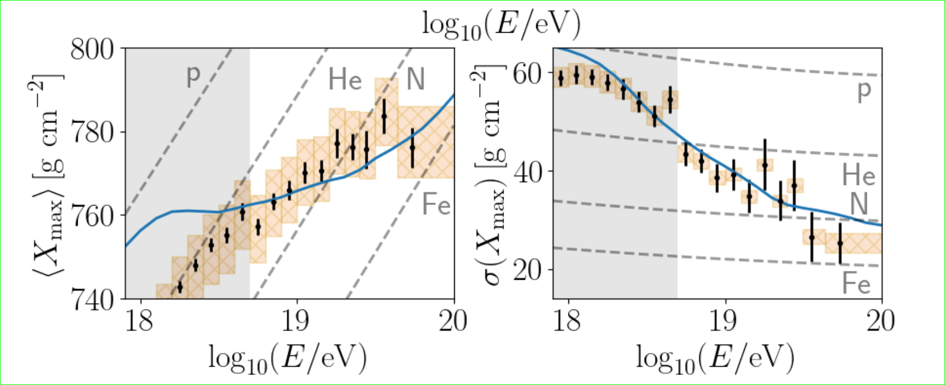

Composition evolution with UHECR energy growth by Slanth Depth, Xmax :He-Be dominant from ten EeV up to 40 – 50 EeV

Slide 20
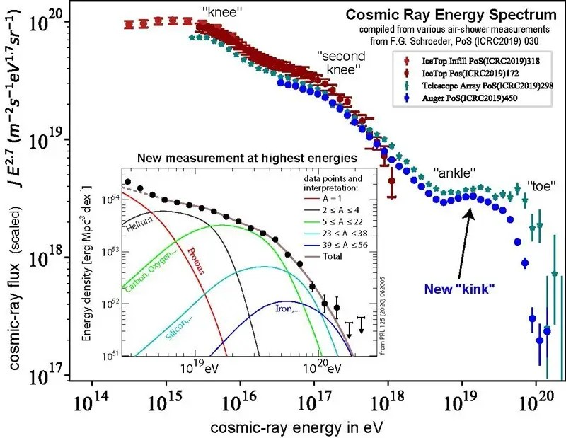
UHECR spectra evolution: 2019 composition models

Slide 21
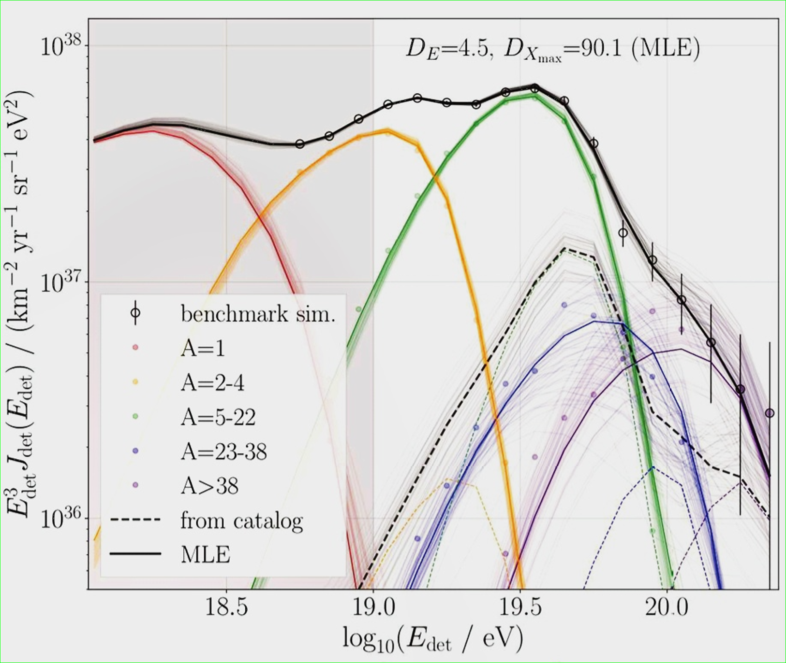

Last fourth: Simulations 2022 ←→Our view
He-BE

Slide 22
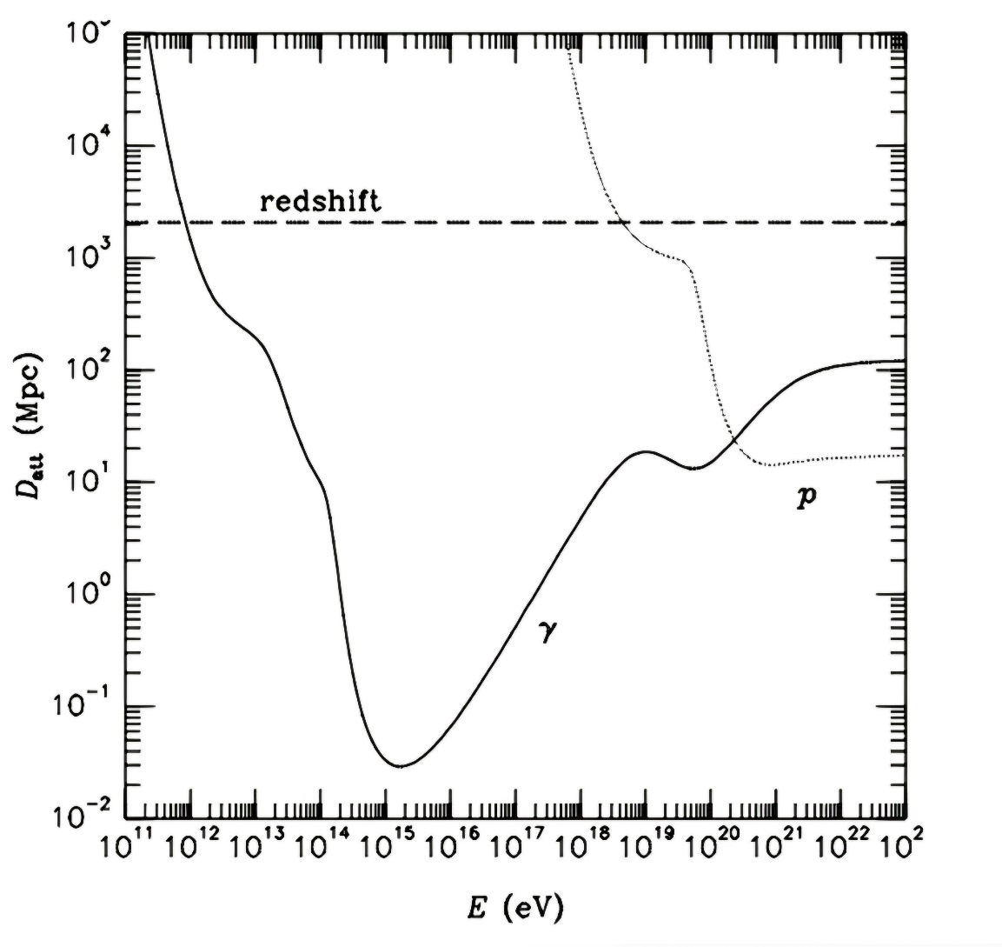
Photon Astronomy versus UHECR
(by proton or Lightest Nuclei)

Slide 23
UHECR clustering + associated sources: all within 4 Mpc: observations up 2024
Cen A,(AUGER) 2007,
M82 (Telescope Array) 2009,
NGC 253 (D:F: and AUGER) 2014
Other, not yet widely accepted
LMC (DF) , Cas A, Cyg X3 , (2012-2024)
SS 433 (DF) (2014-2024)
M31 (DF) (2018-2024),
Maffei Galaxies (Taylor, DF), (2023-2024)
LOCAL SHEET GALAXIES (2023-2024)

Slide 24
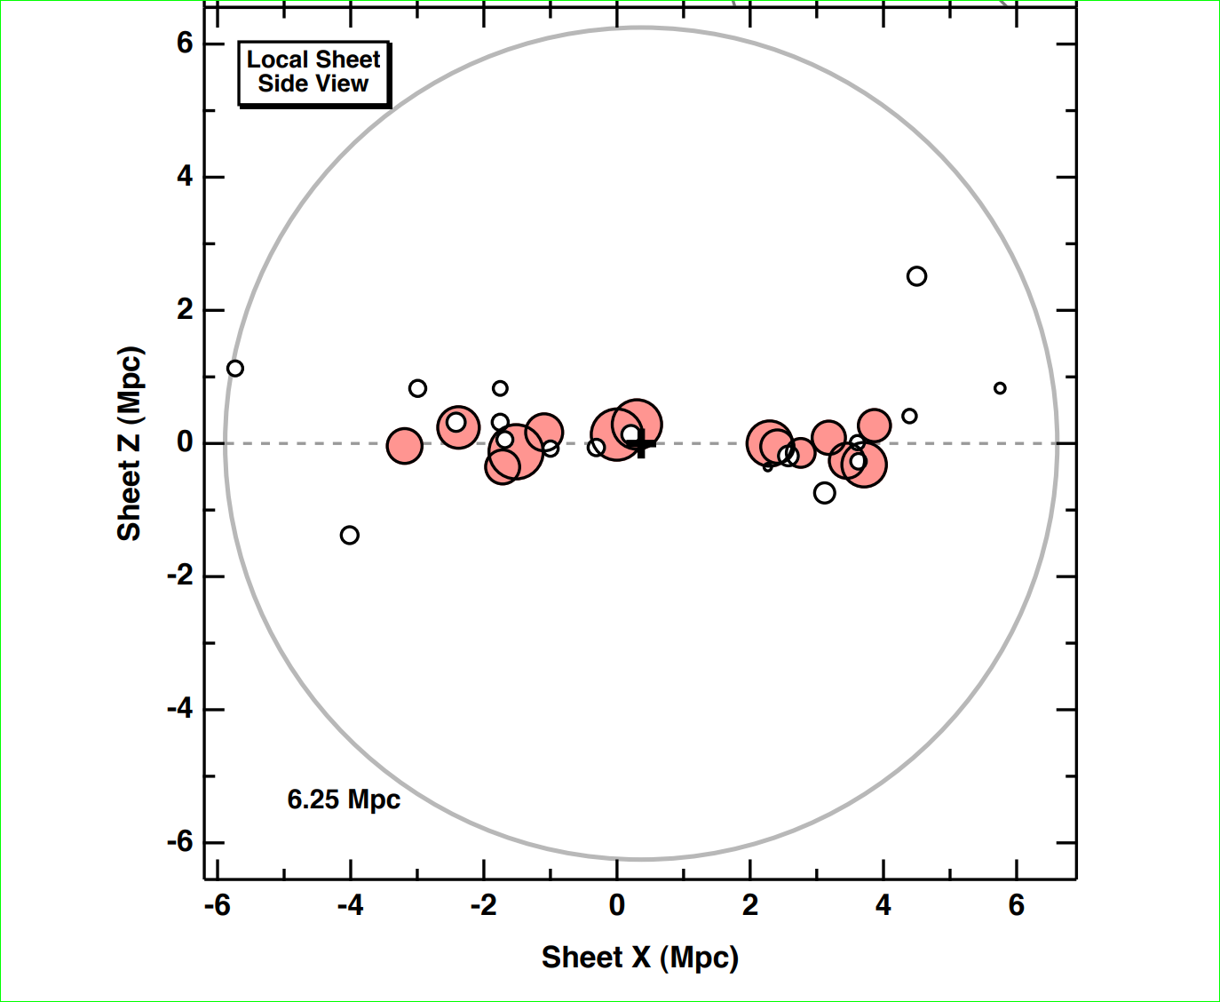
2014 :the Council of Giants at Local Sheet
Within the GDR cut off

Slide 25
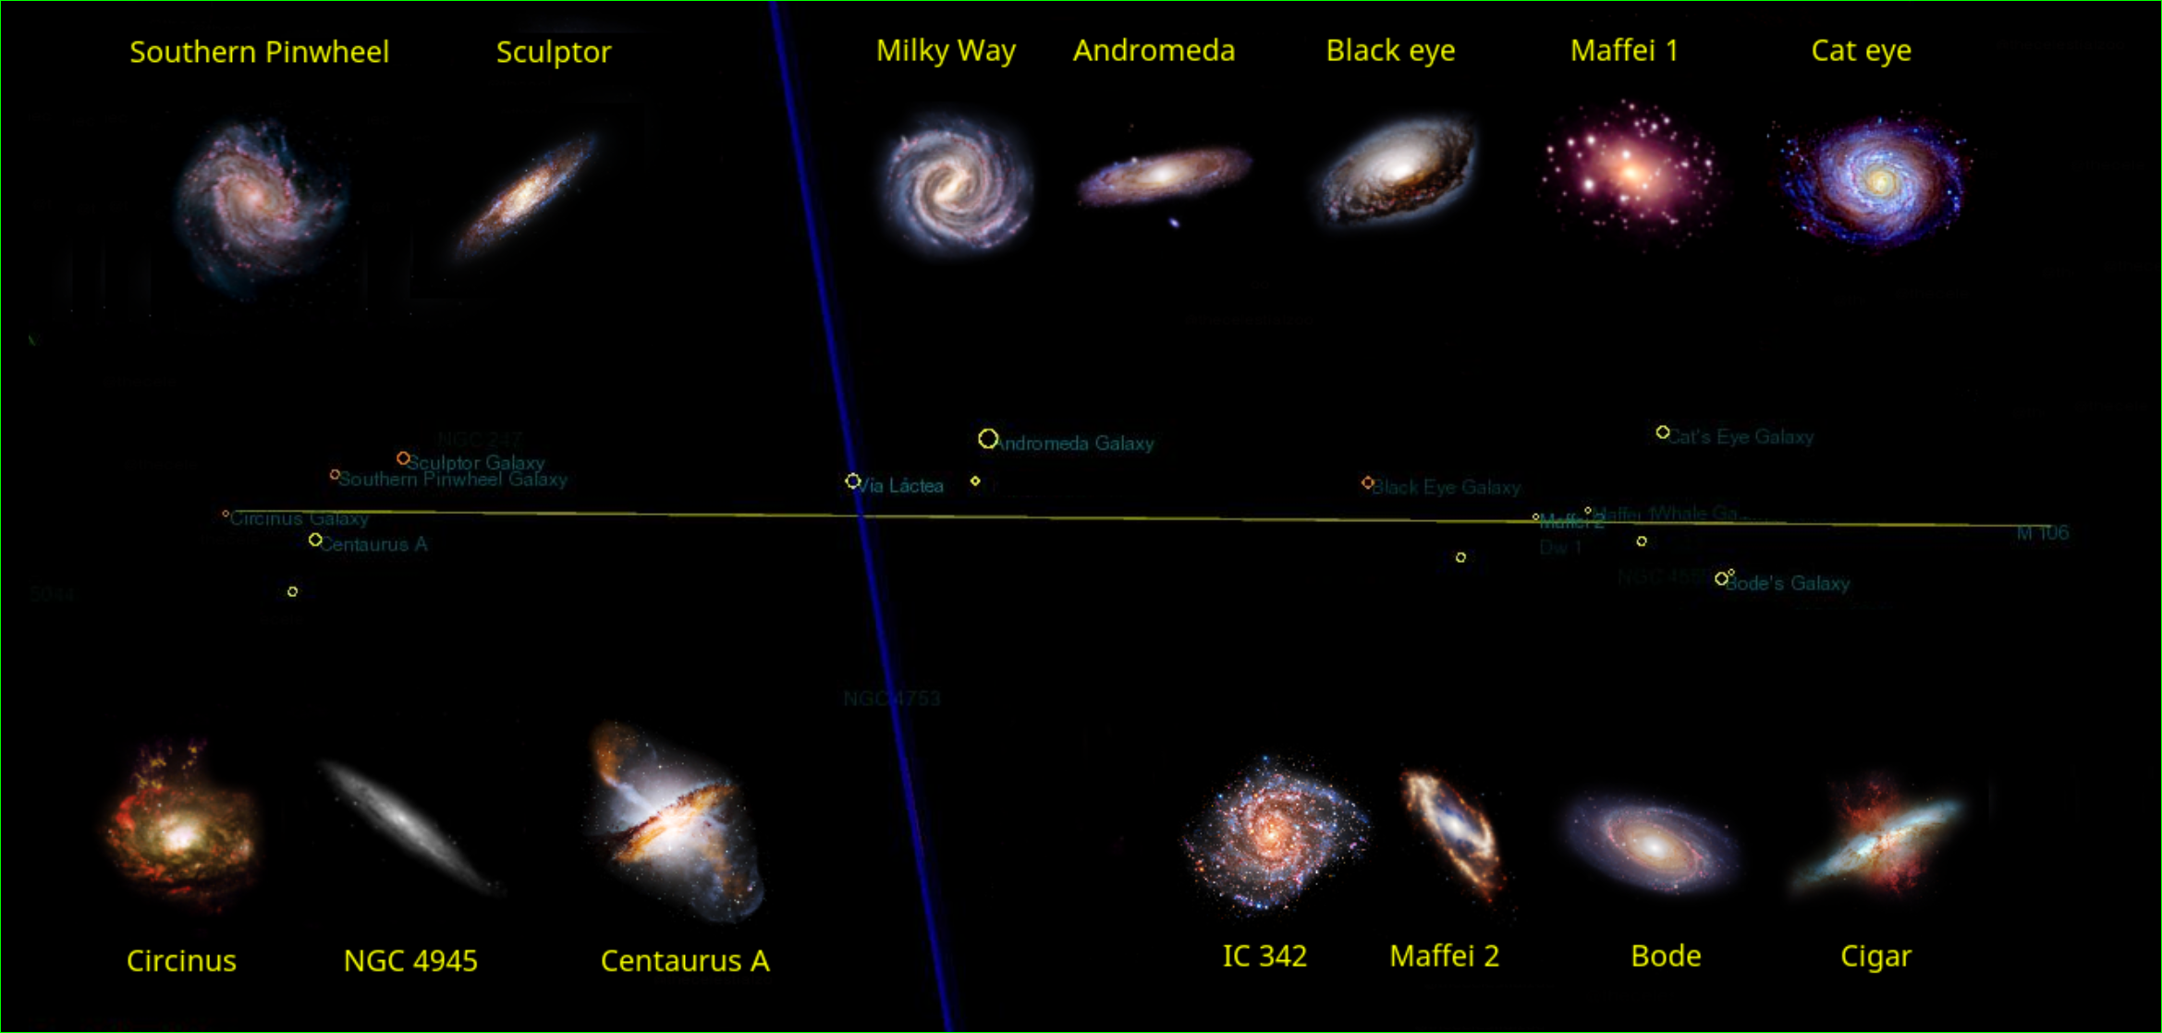
Council of Giants: just a dozen of objects

Slide 26
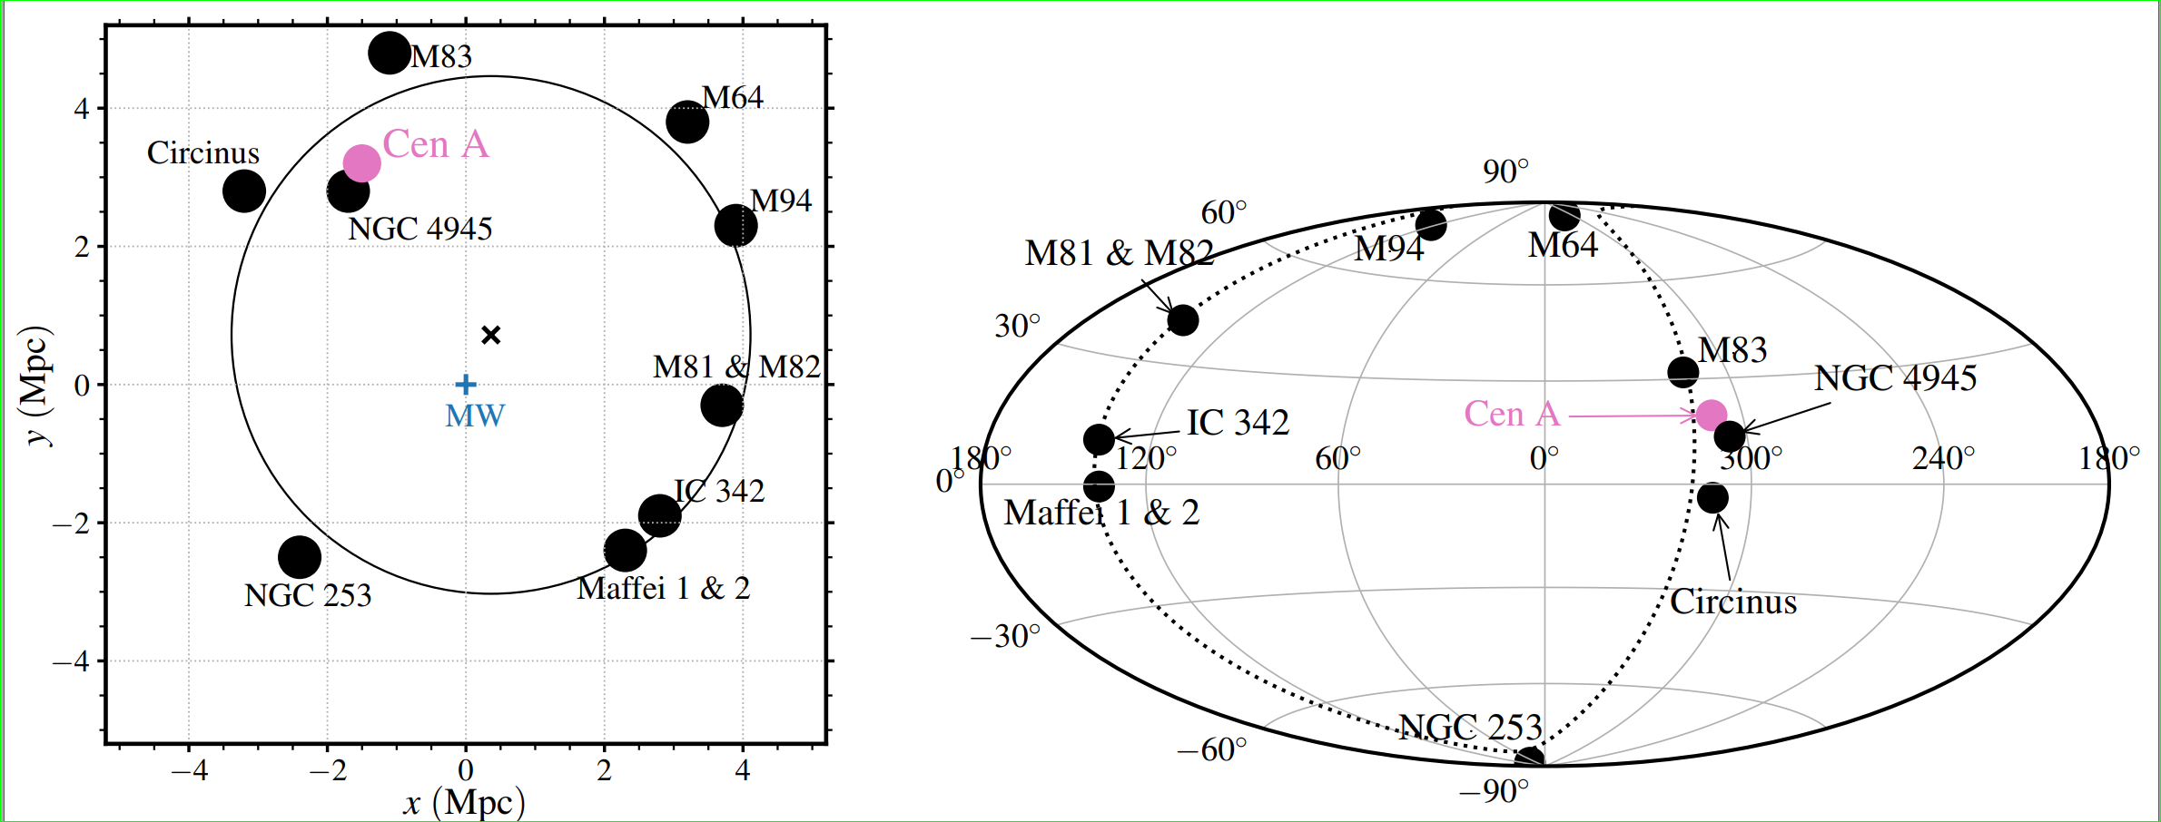
The Local Sheet Galaxies, or the Council of Giants map, galactic coordinate

Slide 27
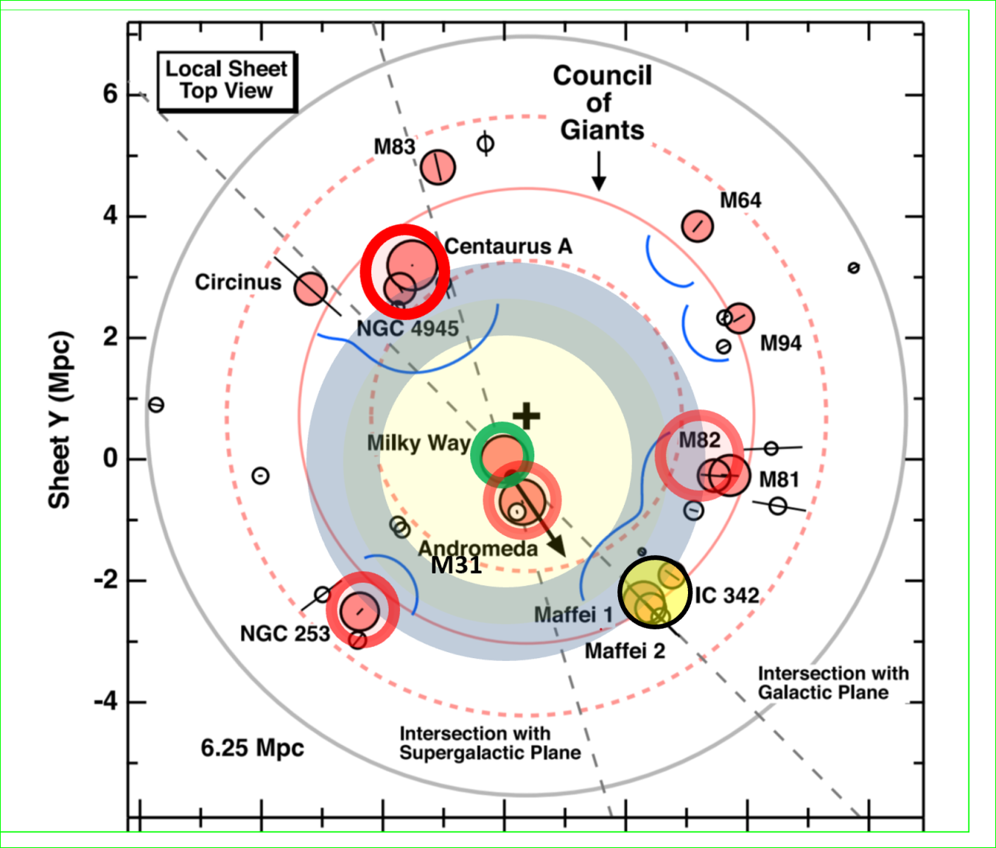
The Local Sheet- A Few Mpc distances
South-North UHECR sky asymmetry
South
North

Slide 28
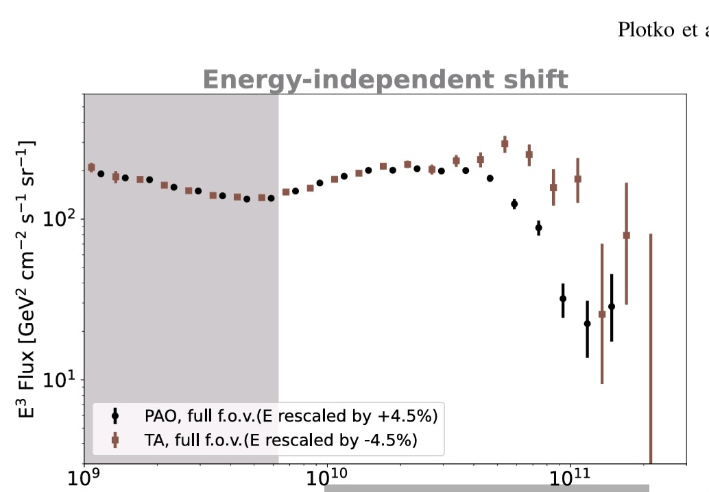
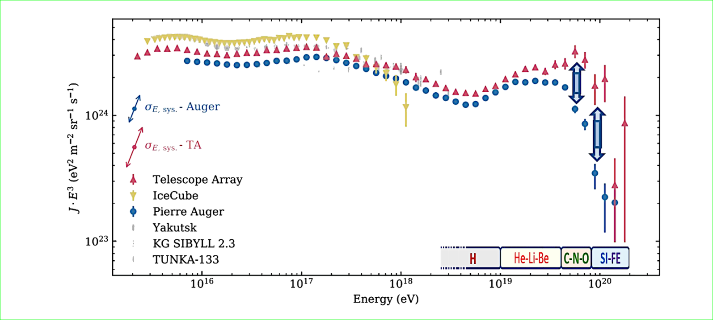
North versus South , AUGER-TA sky puzzling asymmetry along the UHECR GZK cut off
North
South

Slide 29
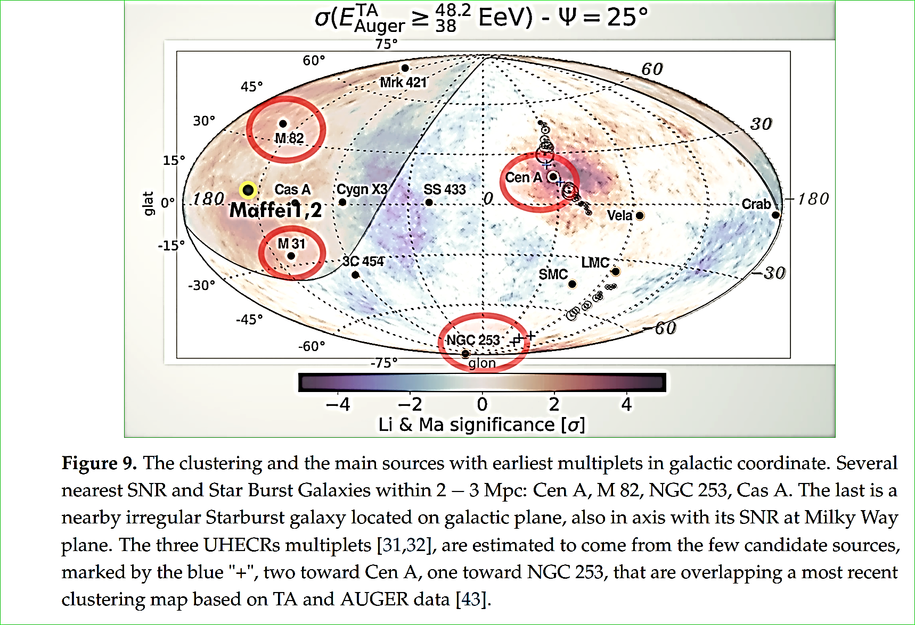
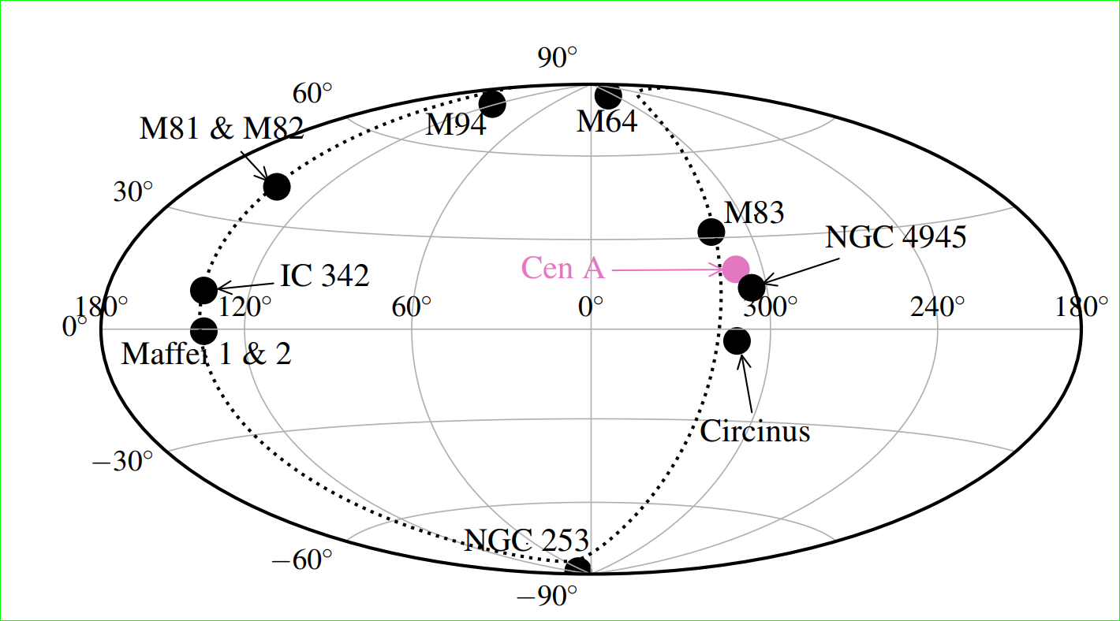
Galactic Coordinate: Hot Spots and Local Sheet Sources++ Multiplets
https://arxiv.org/pdf/2302.06489
North
South

Slide 30
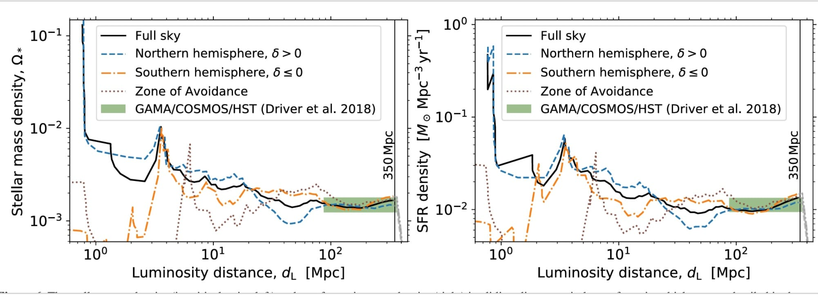
Stellar Mass and Star Formation Rate within a Billion Light-years, by Jonathan Biteau 2021 the Andromeda-Local Sheet-VIRGO mass distribution
North
South

Slide 31
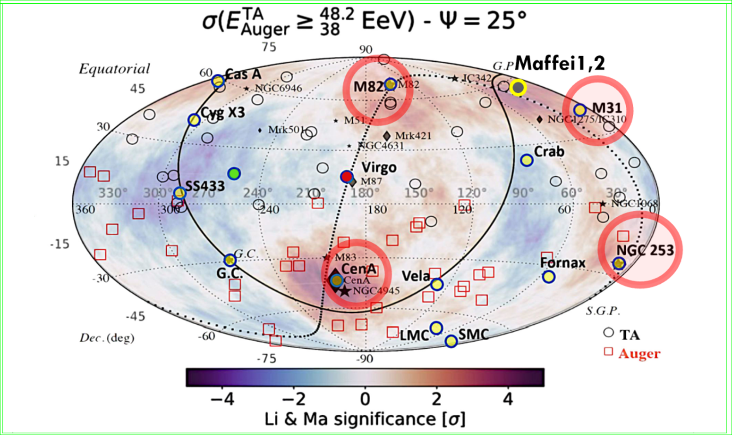
2024, Celestial Coordinate Hot Spots and Amaterasu

Slide 32
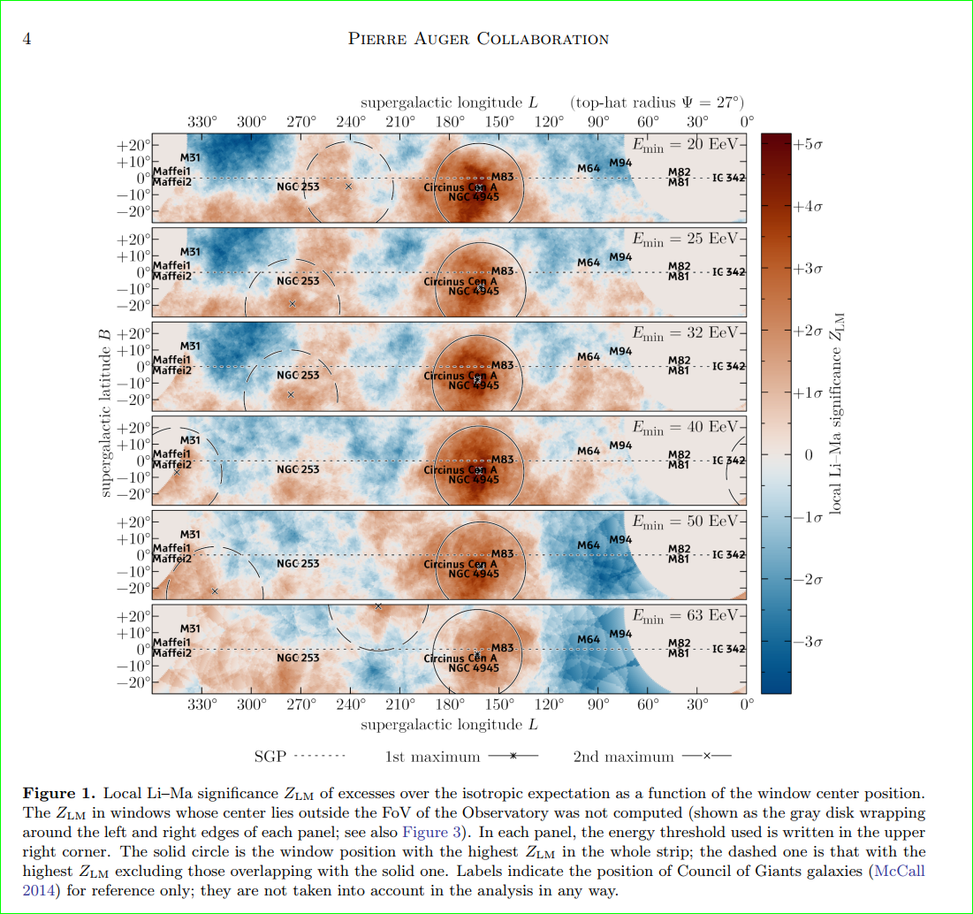
AUGER : the Supergalactic versus LOCAL SHEET= Plane , July 2024 ,
A very missing Virgo
https://arxiv.org/pdf/2407.06874

Slide 33
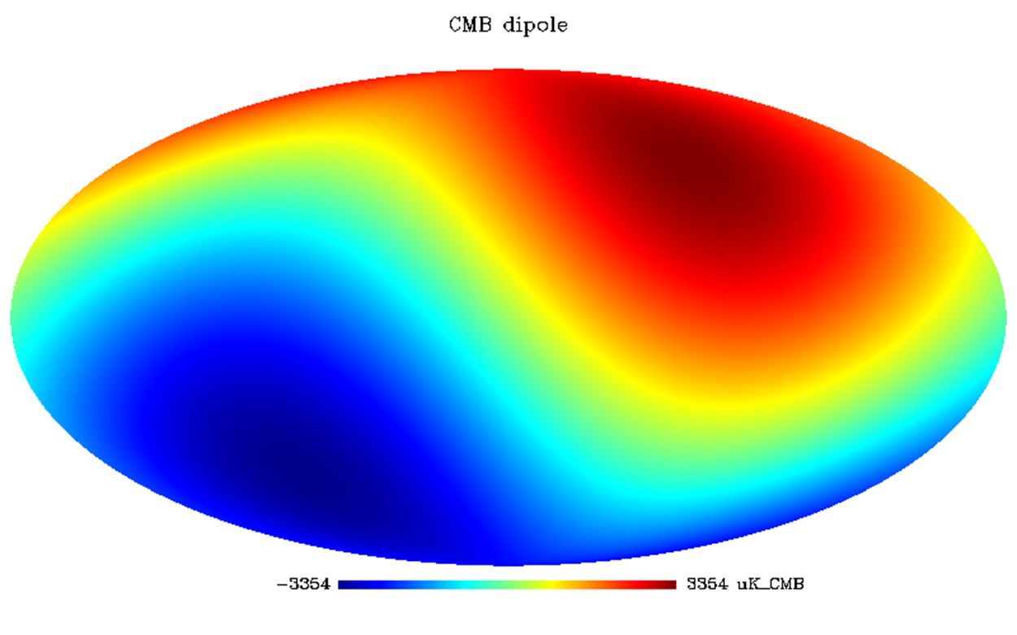
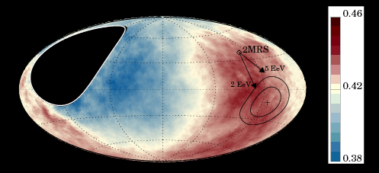
UHECR DIPOLE: Different direction and SIZE of EeV AUGER anisotropy respect to the cosmic big bang dipole-Virgo-- - Great Attractor-and the galactic speed

Slide 34
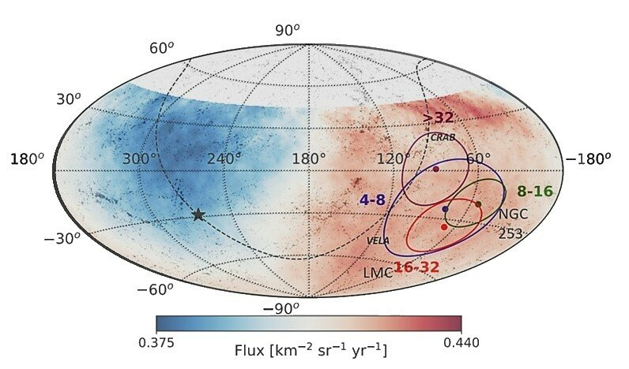
Auger Dipole at 4-8, 8-16, 16-32, >32 EeV

Slide 35
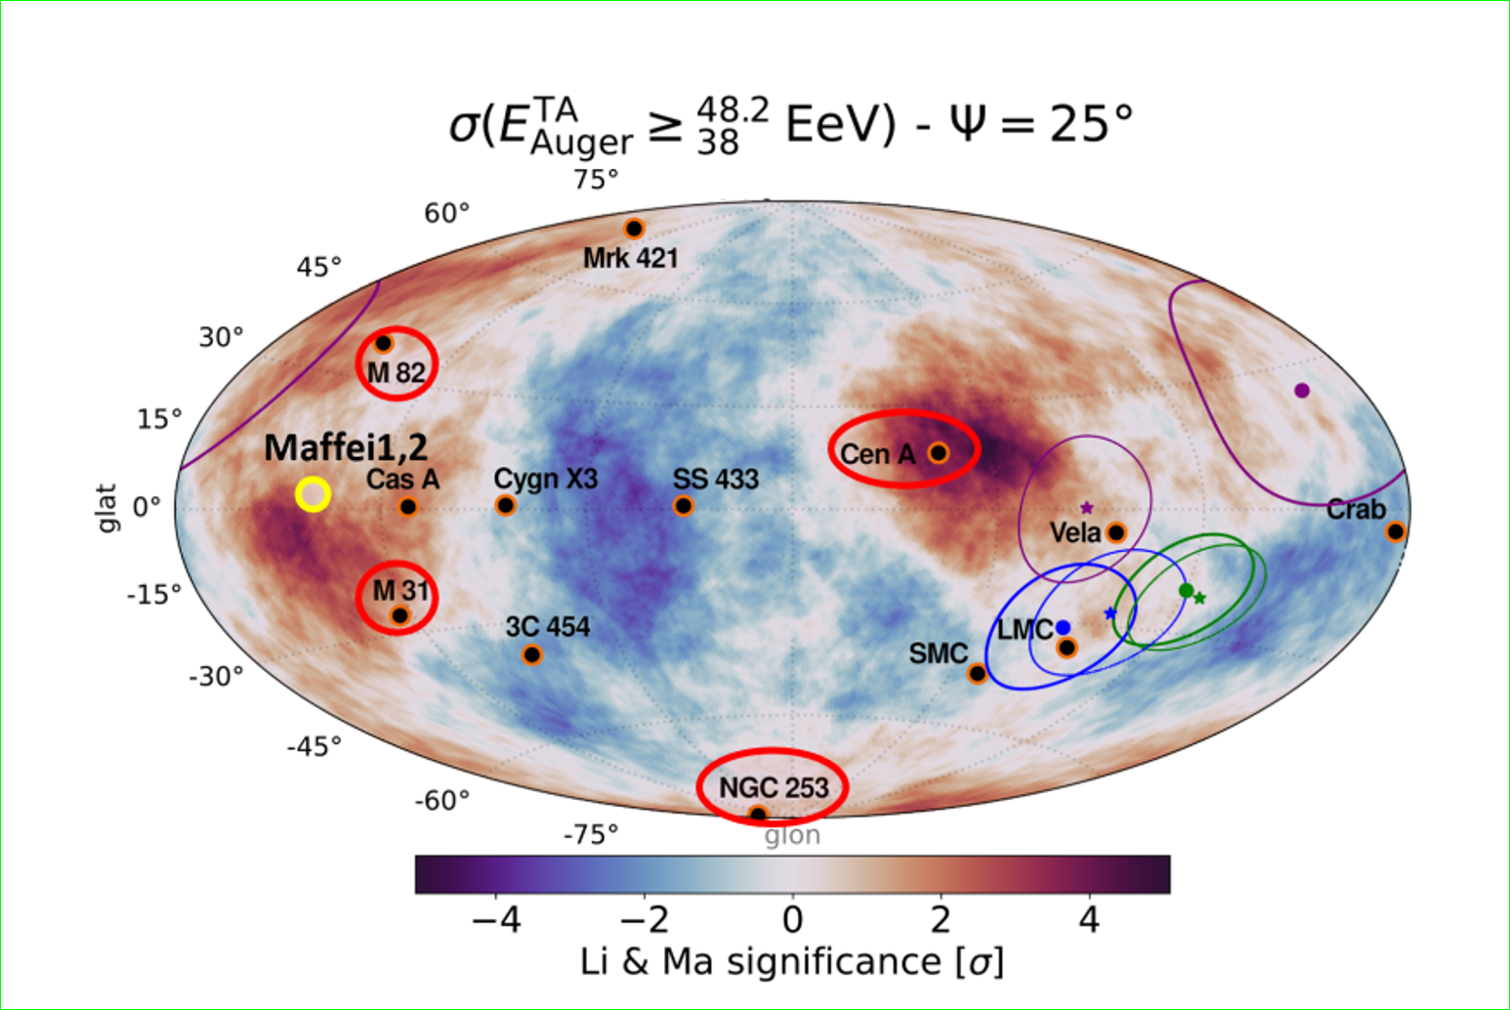
Galactic coordinate—AUGER Dipole Anisotropy-Hot spots- Local Sheet Sources

Slide 36
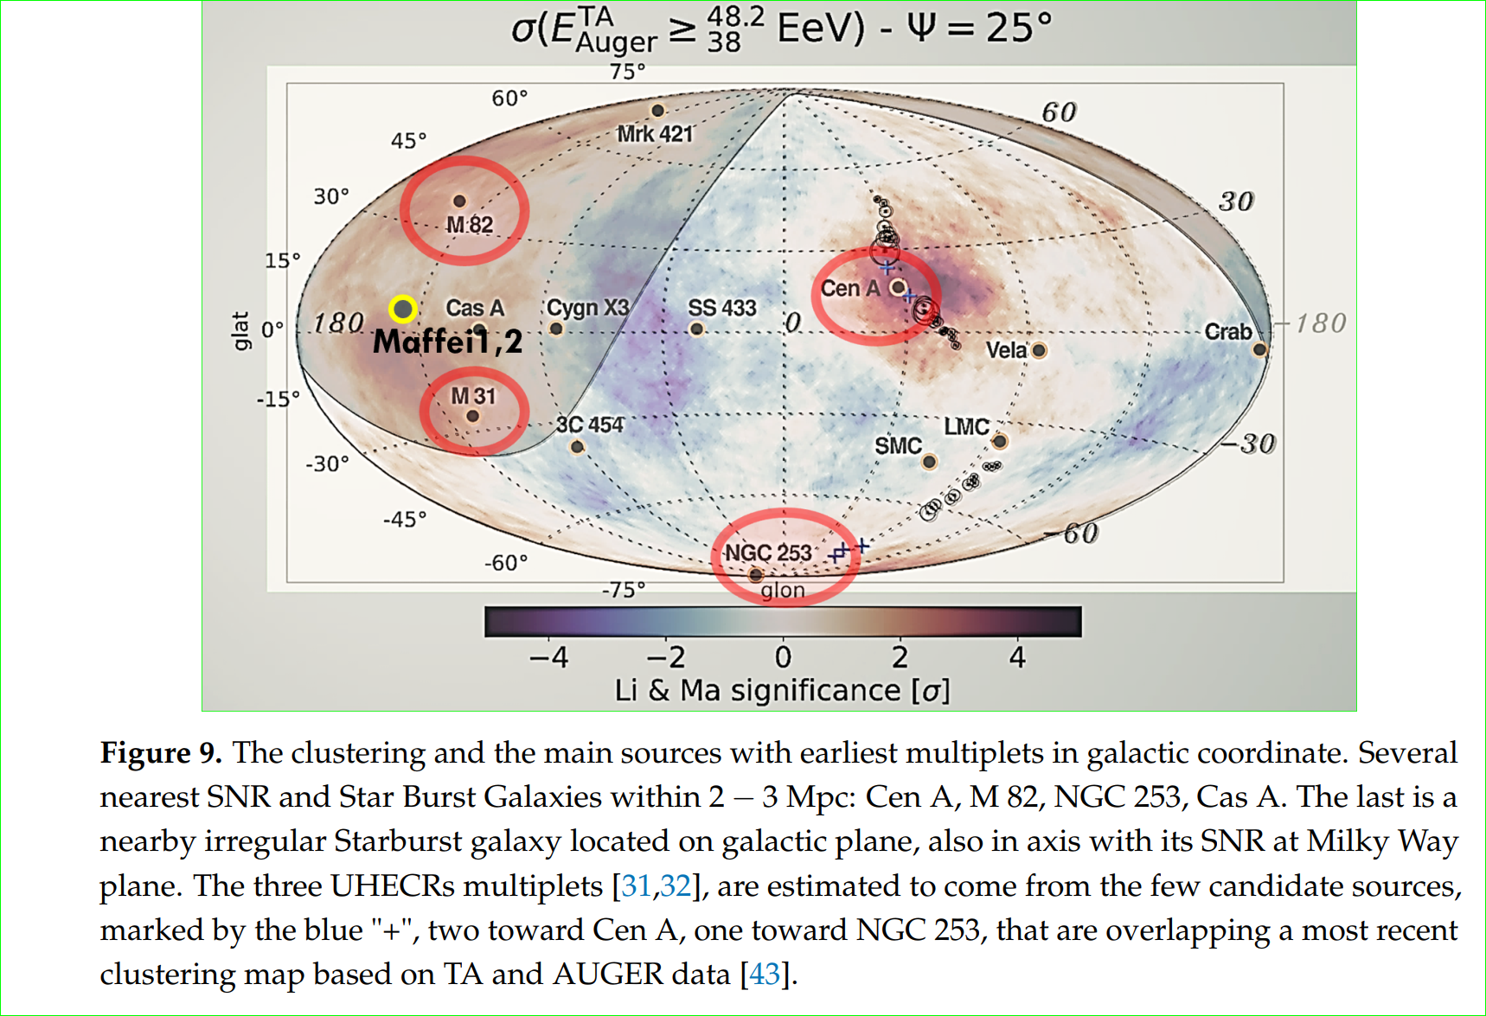
Galactic Coordinate: Hot Spots and Local Sheet Sources++ Multiplets

Slide 37
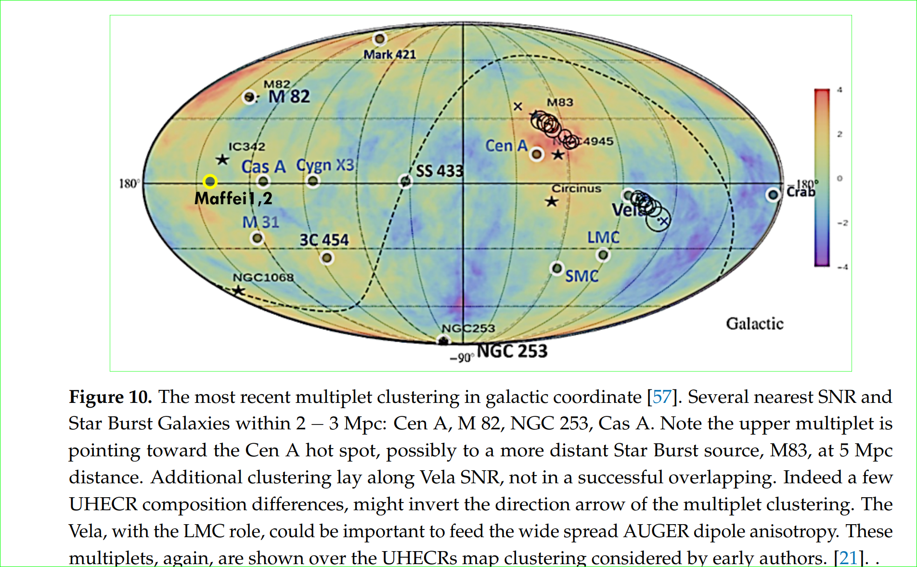
Additional Multiplets and puzzling clustering at 3C454

Slide 38
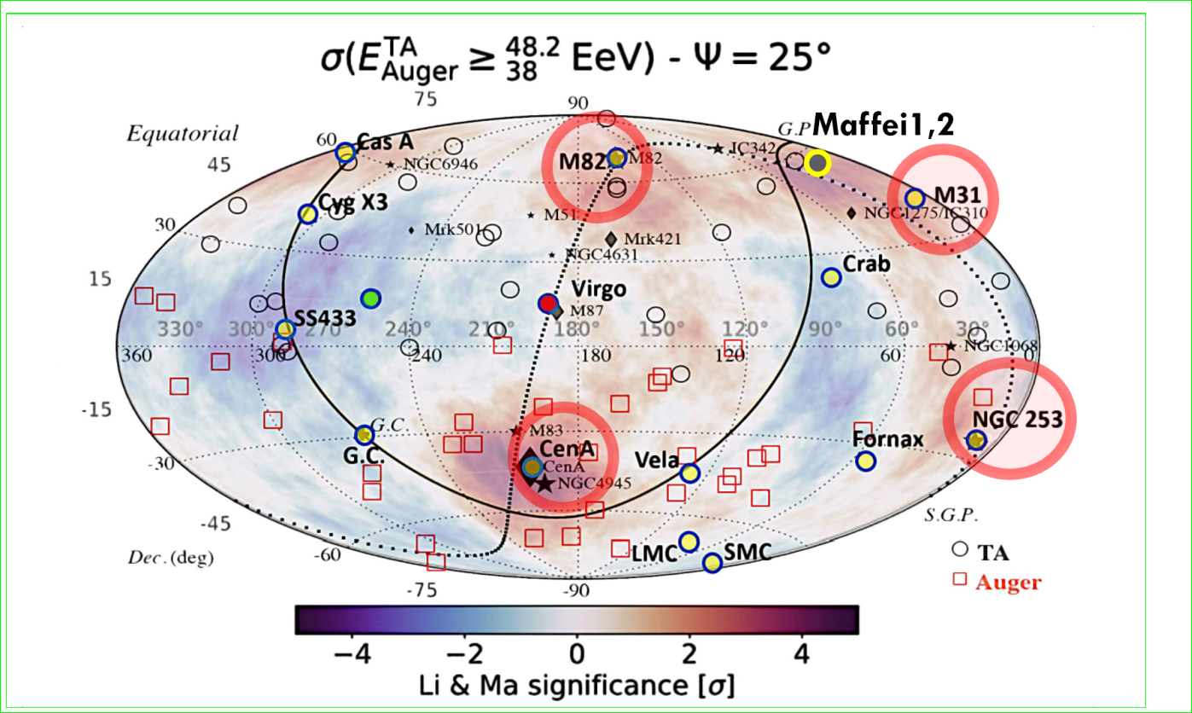
Amaterasu, most recent TA 220 EeV UHECR: a SS433 heavy bent Ni UHECR?

Slide 39
Conclusions
UHECR clustering are mostly due to lightest nuclei: D,H,Be,Li
UHECR are mainly made by GRBs and AGN jets
Such UHECR are bounded within about 4 Mpc in Local Sheet Galaxies
UHECR Asymmetry North South made by few Local Sheet masses asymmetry in sky, due to asymmetry in the N-S mass distribution
The first clustering : Cen A, M82, NGC 253 are found and confirmed; M31, Maffei Galaxies, Cas A, also start to arise.
Multiplets from Cen A and NGC 253 have been foreseen (2009-2017)/observed.
UHECR AUGER Dipole fed by NGC 253 and , possible also LMC, Vela, Crab

Slide 40
New Particle Physics UHECR connection ?
If Mrk421 and 3C454 AGN
are along more UHECR clustering with time, and if their composition is mainly nucleon like, then ….
A Z resonant model based on ZeV neutrino scattering onto relic cosmic ones , with eV mass, in dark halo, overcome the puzzle: It would be the most revolutionary neutrino discover in UHE and cosmology physics.

Slide 41
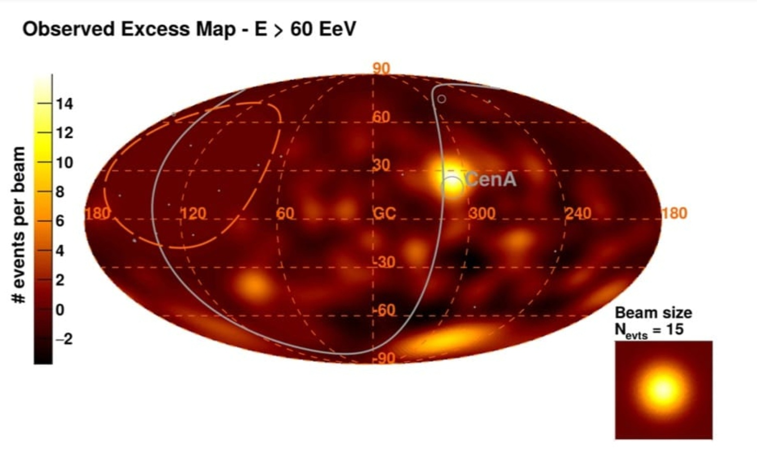
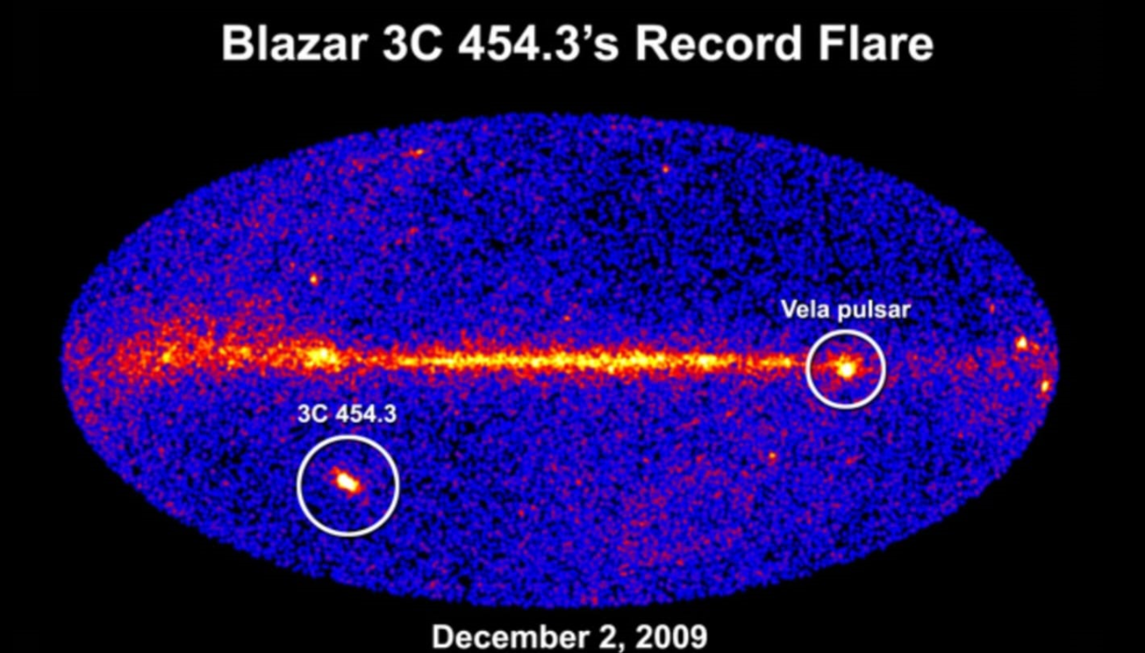
Z-resonance on 3C454 : neutrino-neutrino relic in UHECR puzzle?
3C454

Slide 42
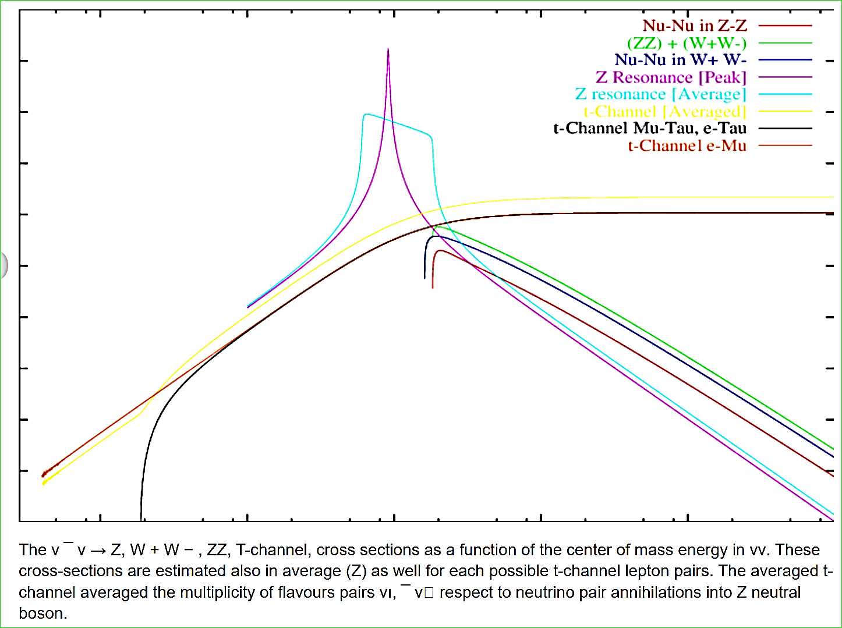
Uhe ZeV neutrino scattering on relic ones (about 1-0.2 eV mass)

Slide 43
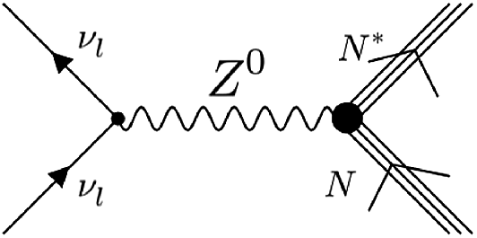
ZeV neutrino scattering on eV relic neutrino in dark halo overcoming any GZK cut off:
The Z boson decay in UHECR via barion-antibarion and nucleon-antinucleon channel

Slide 44
Conclusion 2
Ten EeV dipole is fed by NGC 253 AGN and by the local Vela, Crab. LMC and possibly, also, by Andromeda, Fornax D.
Puzzling 3C454 clustering , Amaterasu, if a real one, might be related to UHE ZeV neutrino scattering onto relic ones in a hot, dark halo.
THE Z-BURST lead to nucleon-anti nucleon composition
Heavy galactic nuclei lead to Ni-like composition

Slide 45
Far AGN correlating UHECR and UHE ZeV neutrino scattering on relic eV ones
arXiv:2310.19227 [pdf, other]
The unprecedented flaring activities around Mrk 421 in 2012 and 2013: The test for neutrino and UHECR event connection
Authors: Nissim Fraija,et al

Slide 46
2008-2024: UHECR Lightest nuclei
Model evolution
arXiv:2408.07172 , UHECR Clustering: Lightest Nuclei from Local Sheet Galaxies
arXiv:2303.08922 , UHECR Signatures and Source➔......
arXiv:1412.1573, The meaning of the UHECR Hot Spots: A Light Nuclei Nearby Astronomy ➔…….
arXiv:0908.2650, Coherent and random UHECR Spectroscopy of Lightest Nuclei along CenA…
arXiv:0801.0227
Light Nuclei solving Auger puzzles. The Cen-A imprint

Slide 47


Slide 48

Nuclear (Fermi) and Gravity (Einstein) connection
Thank you

Slide 49

Thank You for your «Ultra High Energy» attention

Slide 50

Summary 2 (2014, ten years ago)
Same message in earliest time:

Slide 52


A UHECR heaviest nuclei CR connection?
Most energetic UHECR much heavy, much bent

Slide 53
UHECR spectra evolution: 2019 composition models

Slide 54


10 years ago

Slide 55

Bending charges in magnetic fields
The TeVs CR Lunar and Solar Shadows bending

Slide 56

Amaterasu Highest event: From SS433?

Slide 57
Apparent GZK cut off at 100 EeV in UHECR led to models based on photopion opacity =
Most preferred protons as
UHECR
These UHECR protons could fly almost undeflected, 40 Mpc , at hundred EeV energy
Within such «GZK distances» Virgo cluster should shine bright

Slide 58
However
UHECR the clustering observed by AUGER since 2007 is showing on a mysterious VIRGO absence….
IF UHECR were proton than…
VIRGO at 20 Mpc, it had to rise bright

Slide 59

The UHECR suffer of photo-pion opacity: the GZK cut off
(and also photo nuclear disruption by Giant Dipole Resonance, GDR)
GDR
GZK

