Slide 1
Non-Gaussianities in the bouncing Universe model
Kotenko Maxim, Yulia Ageeva, Pavel Petrov
Lomonosov Moscow State University
Institute for Nuclear Research of the RAS,
IBS Center for Theoretical Physics of the Universe
7th International Conference on Particle Physics and Astrophysics,
25th October 2024

Slide 2
Inflation theory and General relativity
Inflation
General relativity
Leads to an initial singularity
Arbitrariness in the choice of the model
Provides an incomplete history of the universe
Requires very special initial conditions
Extreme fine tuning of Λ
Fundamentally UV incomplete
Dark matter of modification of gravity?

Slide 3
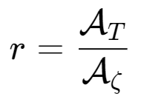
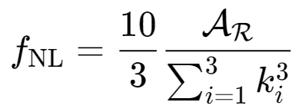
Model parameters
Spectral index
Tensor-to-scalar ratio
Amplitude of the power spectrum
Non-Gaussianity

Slide 4
Horndeski theory
It is the most general scalar-tensor theory with second-order equations of motion

Slide 5
Our model of the contracting Universe

Slide 6
After using unitary gauge for φ and integrating out the α and β,
we obtain a more useful form of the action
Which is an extrinsic curvature of the hypersurface

Slide 7
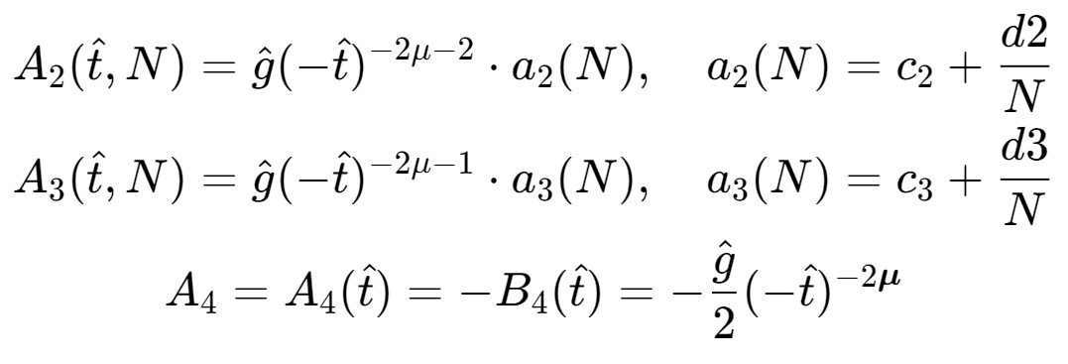
How to admit contraction

Slide 8
Calculating the non-Gaussianity

Slide 9
The recipe
From the second order action for ζ we acquire ζ(k)
We calculate the three-point function to get a bispectrum
Using one of the momenta configurations we relate the bispectrum to one of the non-Gaussianities
Voilà! Bon Appétit

Slide 10
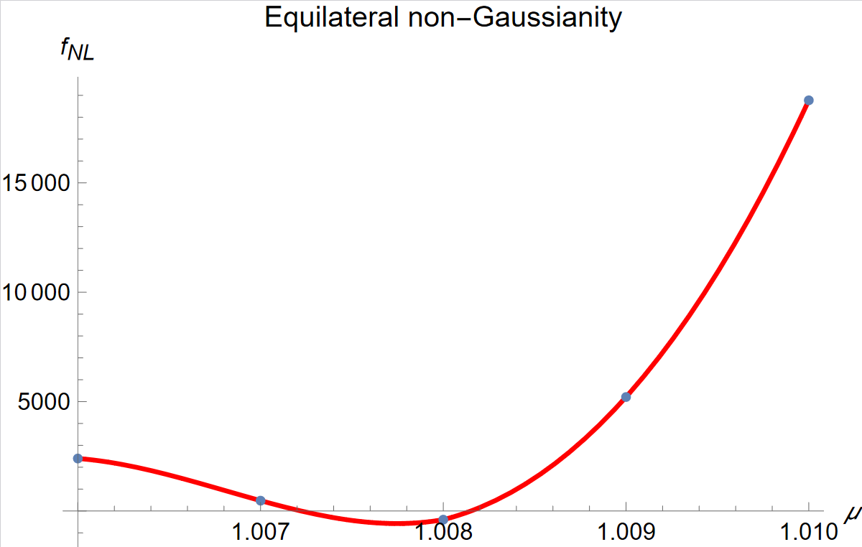
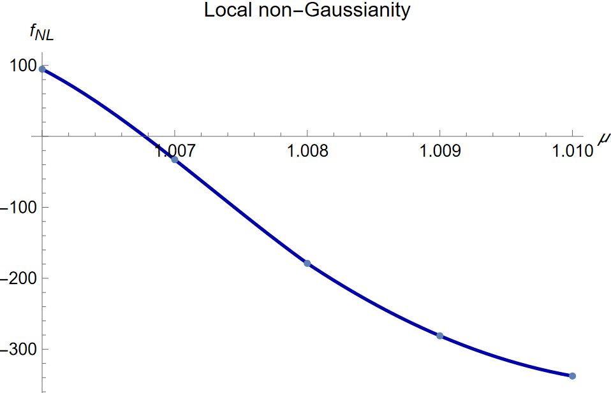
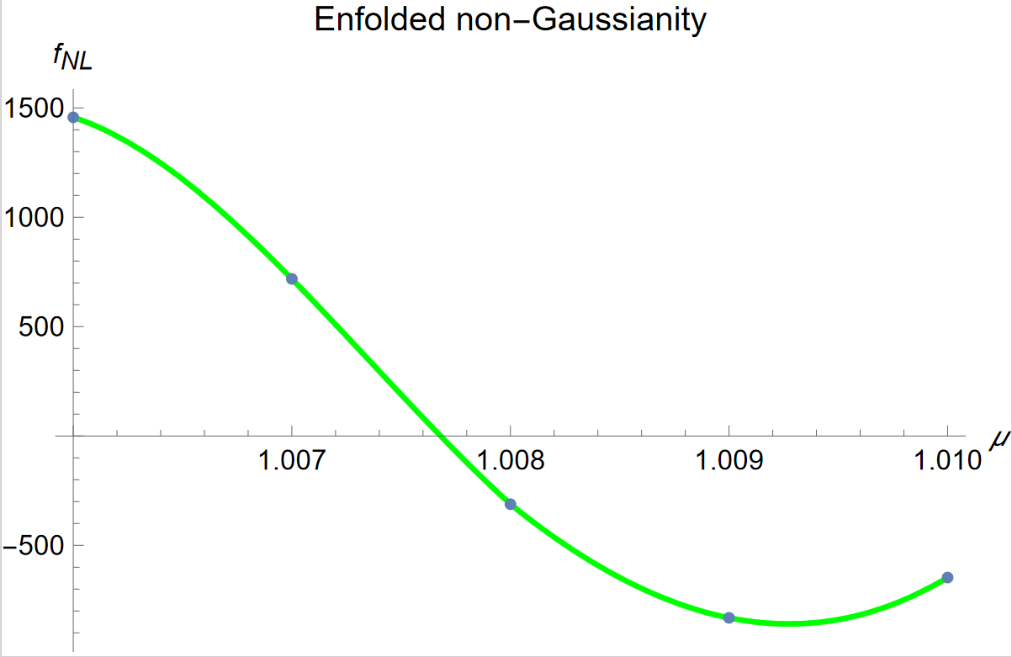

Slide 11
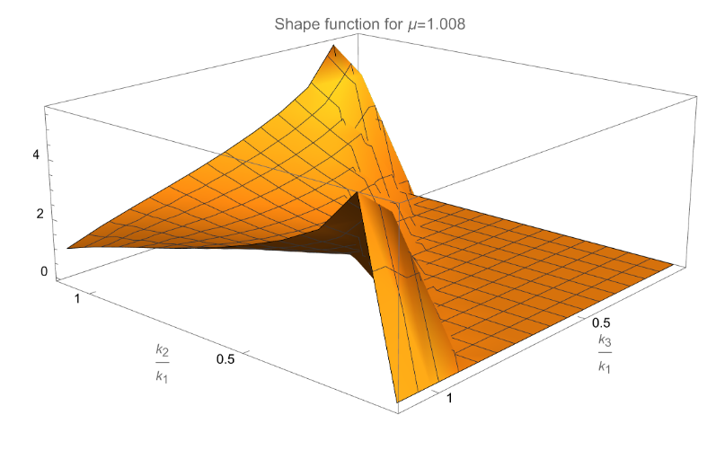
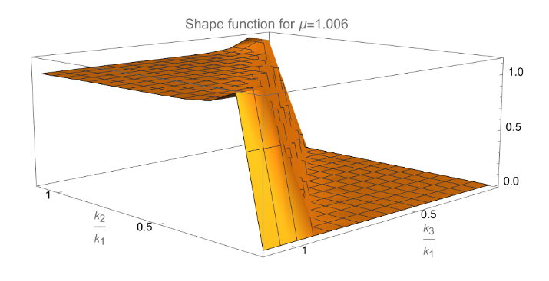
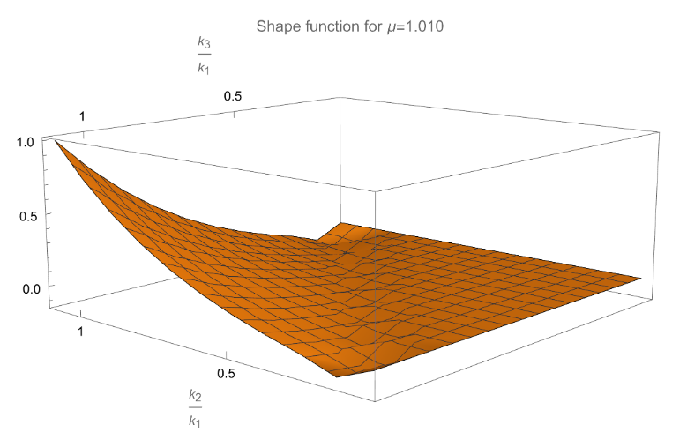
Our shapes of non-Gaussianities

Slide 12
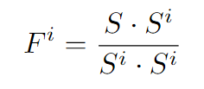
Dessert
A stricter approach would be to use a fudge factor

Slide 13
Overview
Modified gravity theories and alternatives to Inflation are a viable prospect of research
In our proposed model of a Universe with a Bounce it is possible to satisfy all the non-Gaussianty constraints
But we can’t satisfy them all at the same time
Nonetheless, we believe that the allowed ranges of the parameter μ may overlap in a stricter approach to non-Gaussianity calculation

