Slide 1
Evolution of the mass spectrum of primordial black holes in the Friedmann Universe
Author: Lidiia Solnyshko (MIPT)
Supervisor: Elena Mikheeva (ASC LPI)

Slide 2
Acknowledgments
The work was supported by the Russian Science Foundation
(grant number 23-22-00259)

Slide 3
Introduction
Primordial black holes (PBHs) are black holes that may have formed shortly after the birth of the Universe.
For many years, PBHs have remained a viable candidate for dark matter.
The Friedmann model gives us a homogeneous isotropic Universe.
The processes under consideration
Bondi-Hoyle-Littleton accretion
Hawking radiation

Slide 4
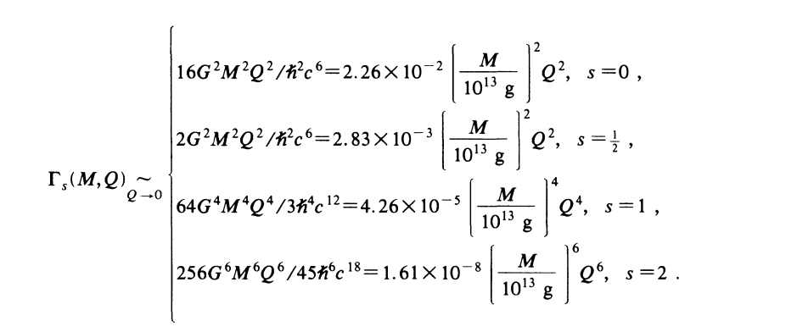
Introduction
The gray factor is a dimensionless quantity that characterizes the probability of absorption of the emitted substance.
MacGibbon Jane H., Webber B. R. Quark- and gluon-jet emission from primordial black holes: The instantaneous spectra // . — 1990. — . — Vol. 41, no. 10. — P. 3052–3079

Slide 5
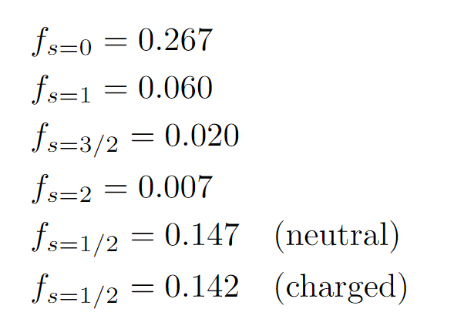
Introduction
Process efficiency coefficients
Accretion
Radiation
λ
where are you running...
PBH

Slide 6
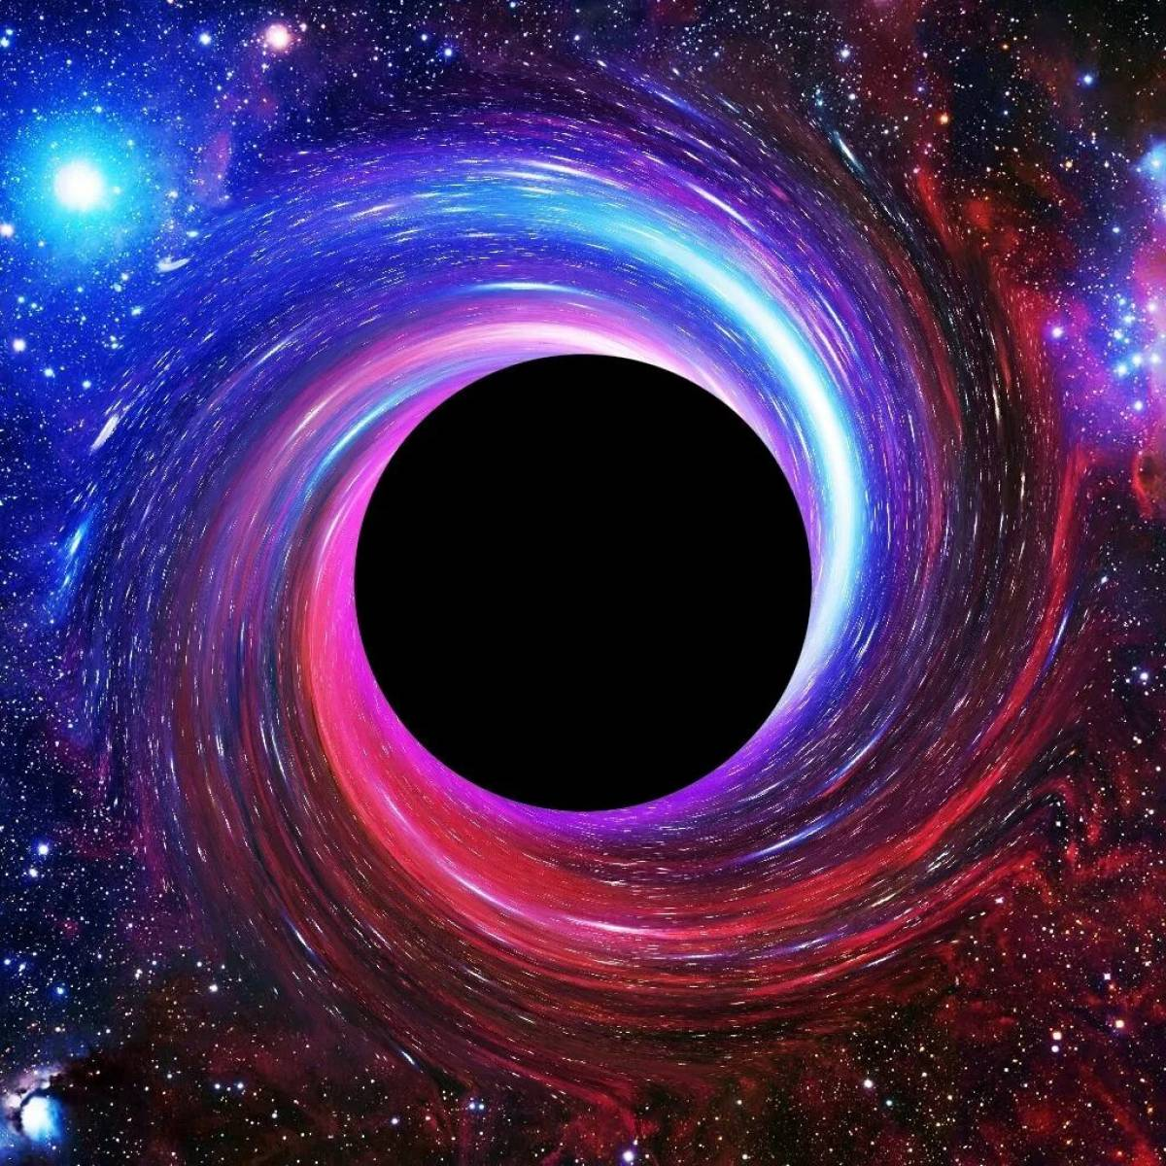
Mass spectrum

Slide 7
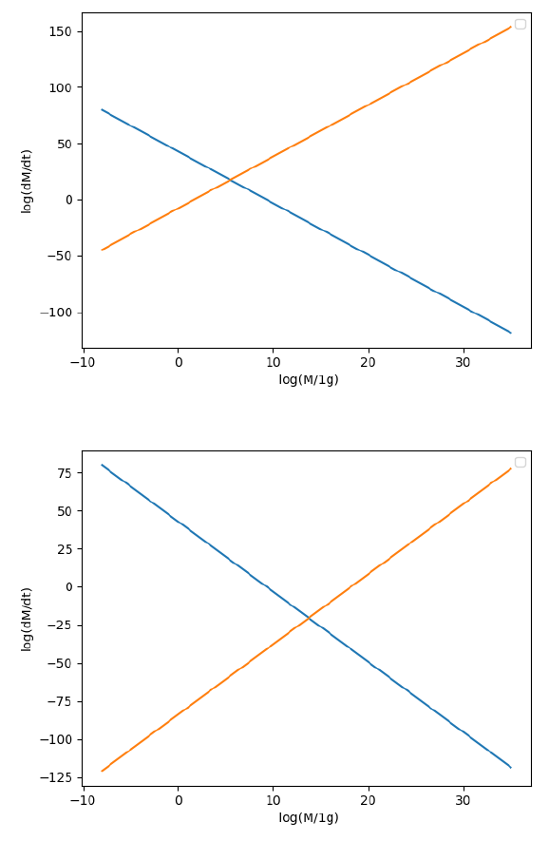
Beginning of the Radiation-Dominated Era (1e-32 seconds from the birth of the Universe)
End of the radiation-dominated era - Beginning of the matter-dominated era (47 thousand years)

Slide 8
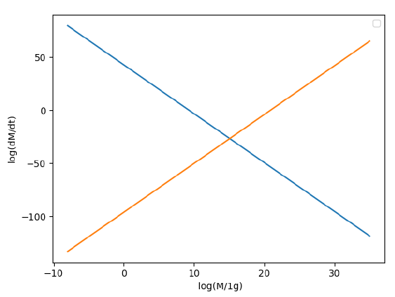
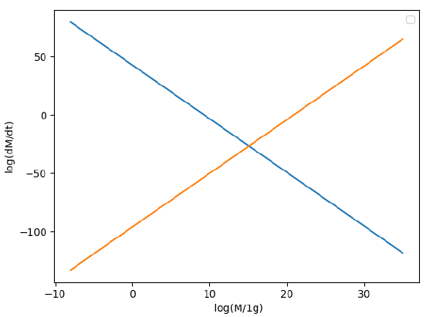
End of matter-dominated era –
Beginning of dark-matter-dominated era (9.8 billion years)
Our time
(13.8 billion years)

Slide 9
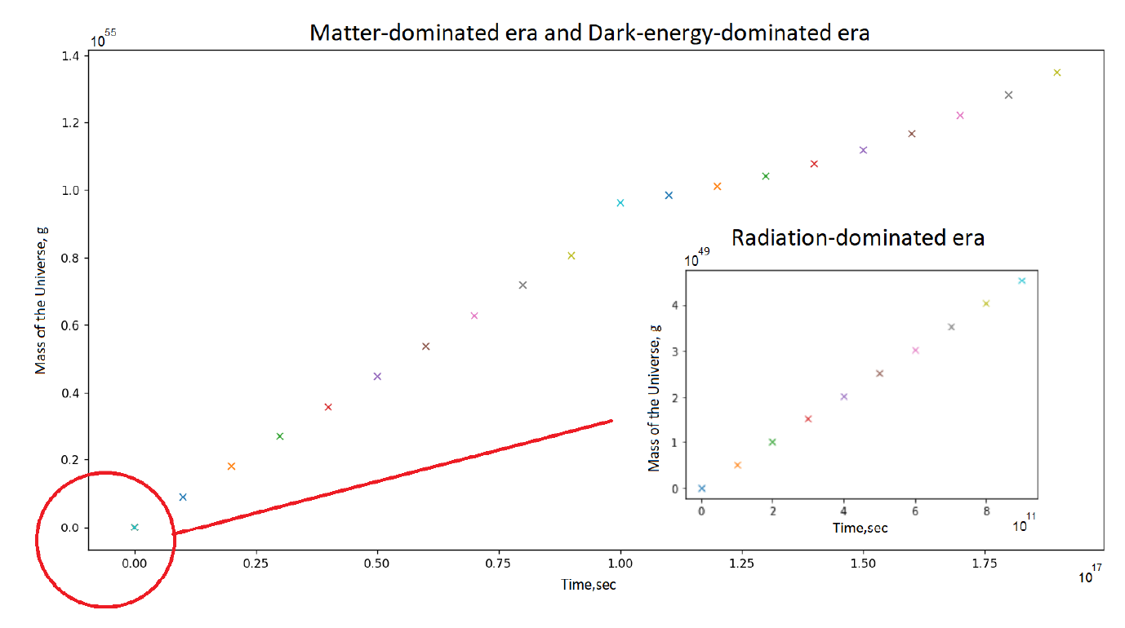

Slide 10
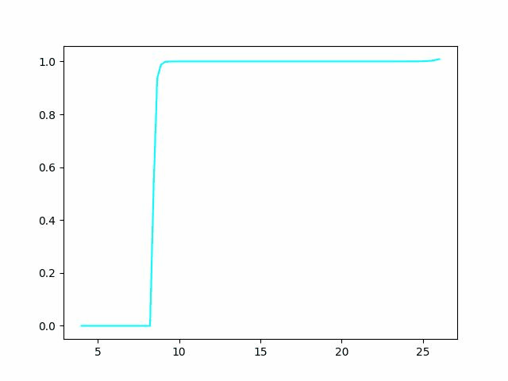
Numerical modeling
Количество ПЧД, N
Массы ПЧД, log(M/1kg)

Slide 11
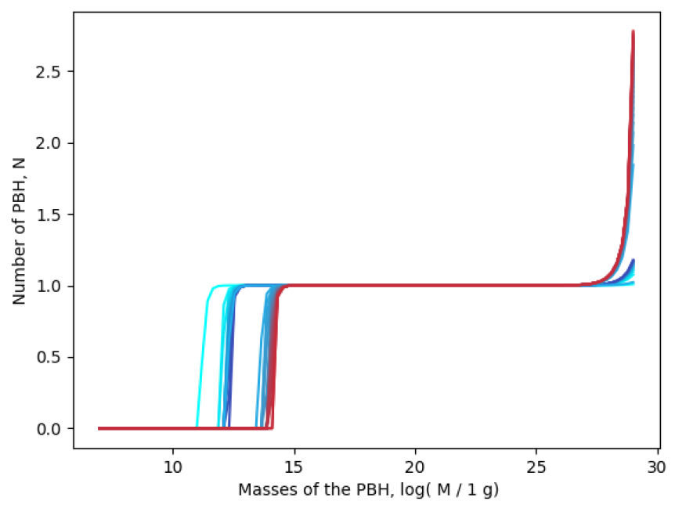
Numerical modeling
1.4·10¹⁴ g !!!!

Slide 12
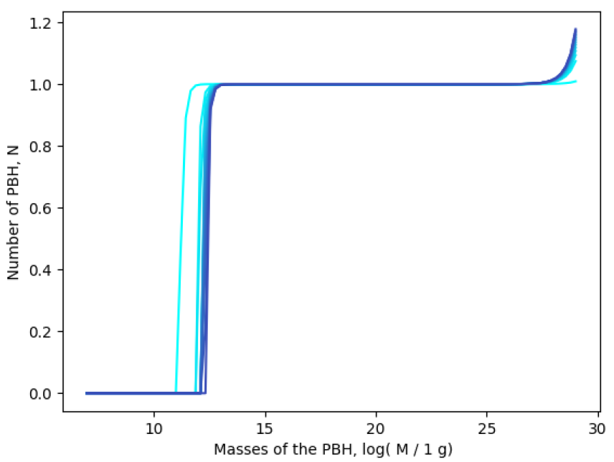
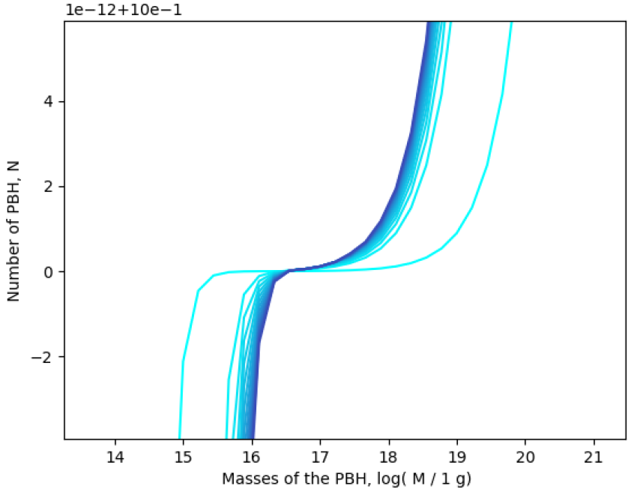
Mass spectrum: radiation-dominated era

Slide 13
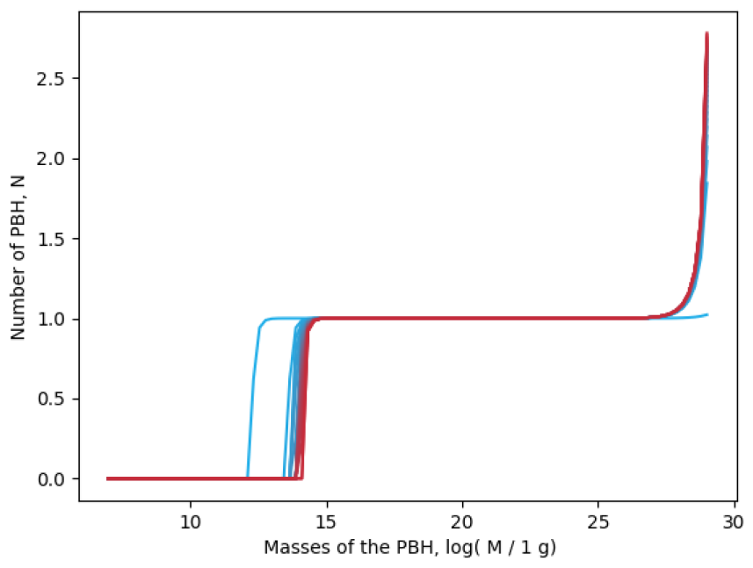
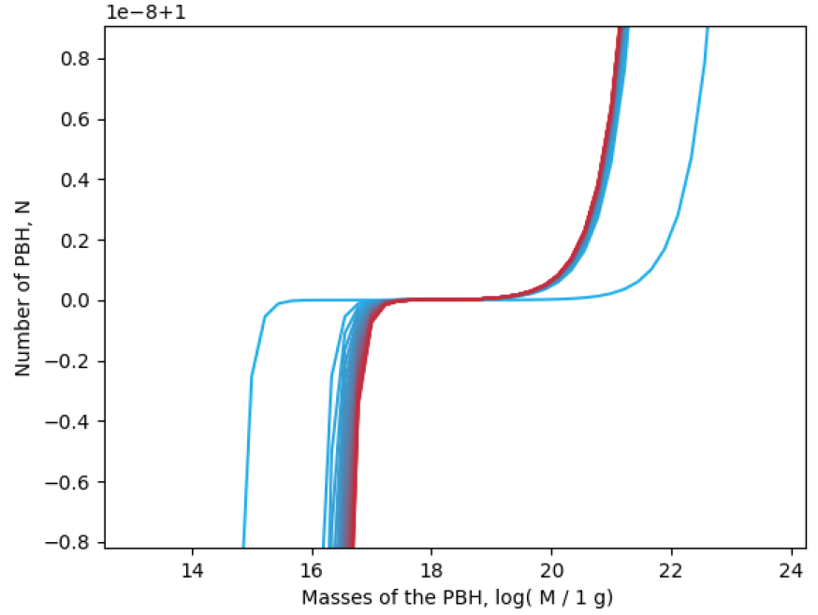
Mass spectrum: matter-dominated era

Slide 14
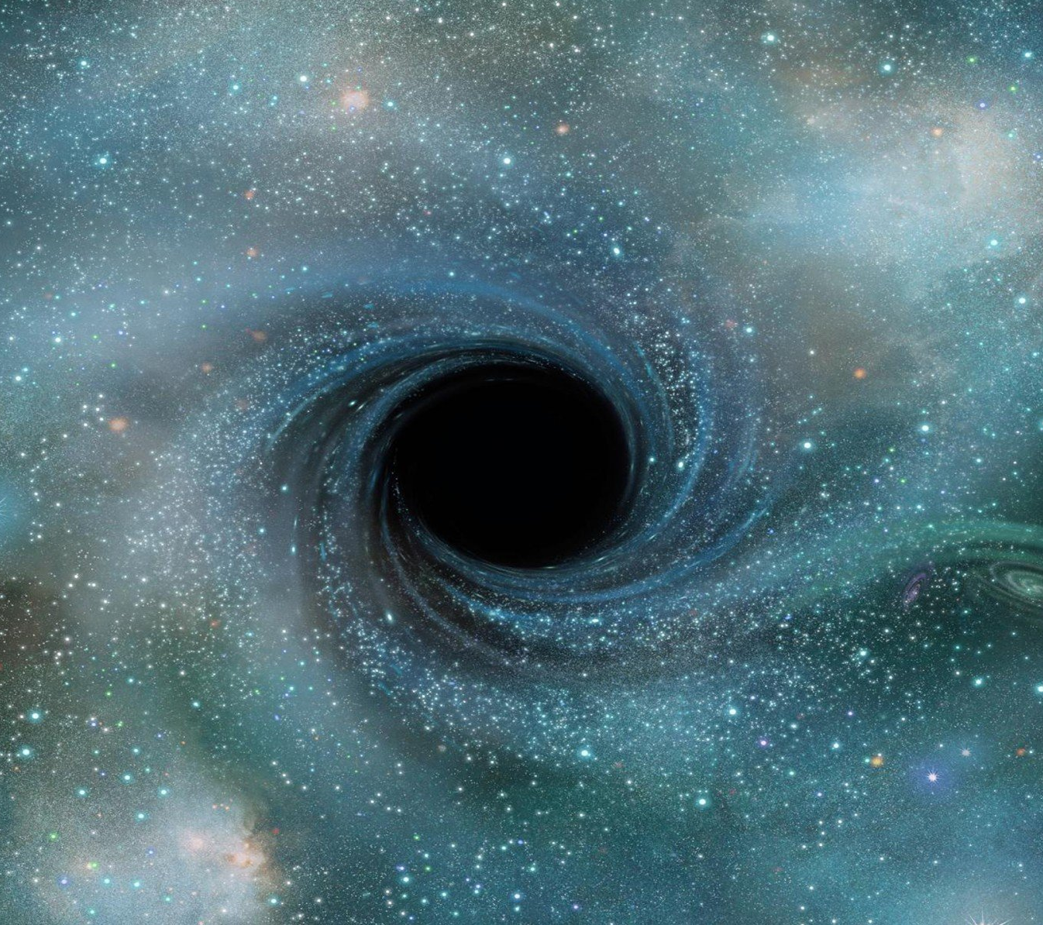
Conclusions
The critical mass value for primordial black holes at which they evaporate in our time has been confirmed. It is 1.4·10¹⁴ g.
The critical mass of primordial black holes for different eras of the Universe has been studied.
A strong dominance of one of the observed processes is observed: Hawking radiation for small masses and Bondi accretion for large masses.

Slide 19
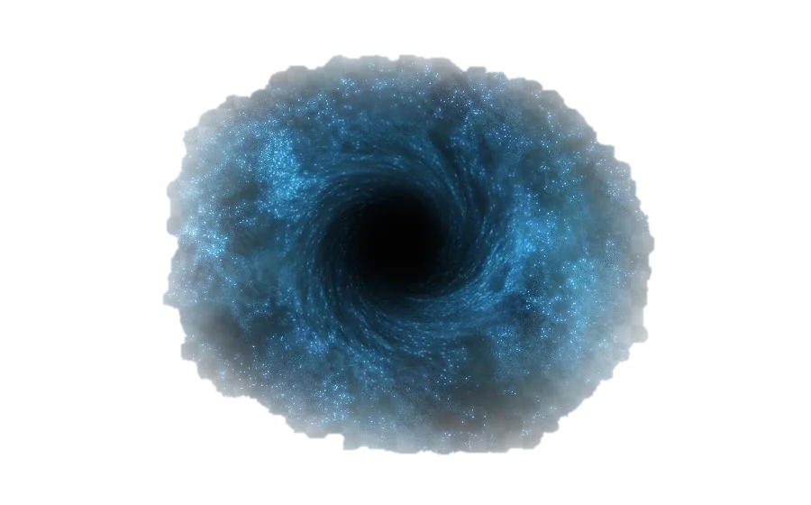
ВАШ КАНДИДАТ
В ТЕМНУЮ МАТЕРИЮ
ПЕРВИЧНАЯ
черная дыра
Партия «Сингулярное ЕдРо»

