Slide 1






Study of the ⁶Li low-lying excited states
A.S. Demyanova
NATIONAL RESEARCH CENTRE
"KURCHATOV INSTITUTE“
VII International Conference on Particle Physics and Astrophysics (ICPPA-2024)
22 Oct. – 25 Oct. 2024, Moscow, Russia

Slide 2


Author’s team
Burtebayev N¹, Nassurlla Marzhan¹, Nassurlla Maulen^{1,2}, Zhdanov V.S.¹, Alimov D.K.¹, Khodzhaev P^{1,2}, Sabidolda A^{1,2} , Isaev D.A.^{1,2}
¹ Institute of Nuclear Physics, ME of Republic of Kazakhstan, Almaty 050032, Republic of Kazakhstan
² al-Farabi Kazakh National University, Almaty 050040, Republic of Kazakhstan
Demyanova A.S., Danilov A.N., Starastsin V.I. Dmitriev S.V., S.K. Raidun
NRC Kurchatov Institute, pl. Akademica Kurchatova 1, Moscow 123182, Russia
Goncharov S.A.
Lomonosov Moscow State University, Moscow 119991, Russia
S.S. Stukalov¹, Yu.G. Sobolev^{1,2}, Yu.E. Penionzhkevich^{1,3}, V.A. Maslov¹, Yu.B. Gurov^{1,3}, A.V. Shakhov¹, H.C. Nguyen¹
¹ Joint Institute for Nuclear Research, Dubna, Moscow Region 141980, Russia
²NRC Kurchatov Institute, pl. Akademica Kurchatova 1, Moscow 123182, Russia
³ National Research Nuclear University MEPhI, Moscow 115409, Russia

Slide 3
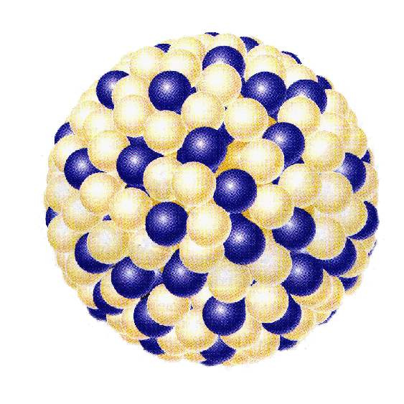
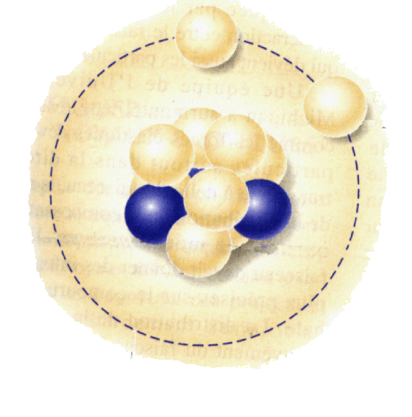
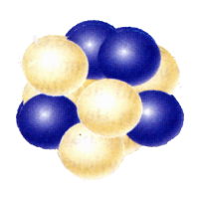
STRUCTURE OF EXOTIC NUCLEI
Halo nuclei: *Abnormally large sizes
*Some neutrons are separated from protons
¹¹B
¹¹Li
²⁰⁸Pb
⁸He: 4 neutrons in external field
¹⁰Не models

Slide 4
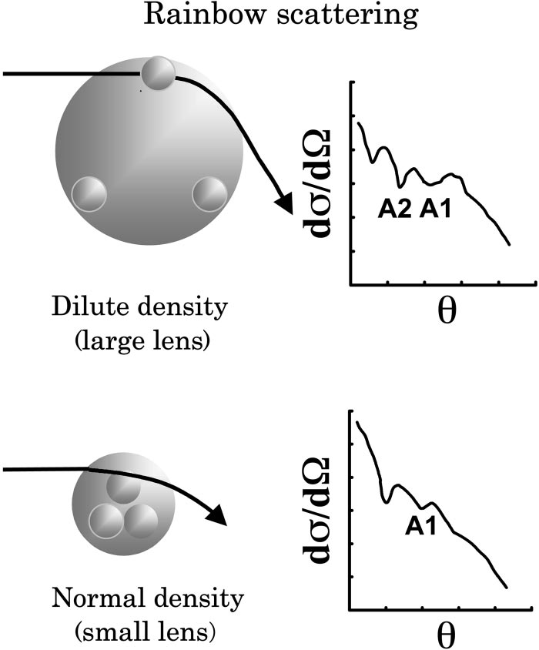

Proposed methods: MDM, NR, ANC
Modified diffraction model
(MDM) of inelastic scattering
A.N. Danilov et al., (2009)
R*rms = R_{0.0} + [R*(dif) – R_{0.0}(dif)]
R(dif) are determined from positions of diffraction min/max in angular distributions
Inelastic nuclear
rainbow (NR) scattering S.Okhubo, Y.Hirabayashi, (2007)
A.S. Demyanova et al., (2008)
Shift of Airy minima
Radii are determined from empirical relation
Θ(Airy) ~ A^{2/3}_{t} ~ R²_{t}
Asymptotic normalization coefficients (ANC) from transfer reactions
L.D. Blokhintsev, A. Muhametdzanov
Z.H. Liu et al., Phys. Rev. C 64, 034312 (2001),
T.L. Belyaeva et al., Phys. Rev. C 90, 064610 (2014).
Transfer reactions are mainly peripheral
For peripheral reactions Asymptotic normalization coefficients (ANC) can be calculated with proper approximation
ANC

Slide 5
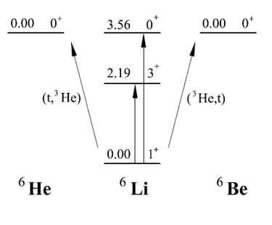
Isospin triplet A=6: ⁶He-⁶Li-⁶Be
Among these triplet states, the neutron halo in ⁶He is well known. A proton-neutron halo is predicted in the excited state of 0+, 3.56 MeV in ⁶Li, which lies only 137 keV below the ⁶Li →⁴He + p + n threshold. Its radius is not known, but it is predicted by about 0.25 Fm larger than the radius of ⁶He [Arai]. We can expect the appearance of a two-proton halo in the ground state of ⁶Be. The table shows the known radii of states shown in Fig.
A S Demyanova et al. (2018),in The 3rd International Conference on Particle Physics and Astrophysics, KnE Energy & Physics, pages 1–9. DOI 10.18502/ken.v3i1.1715
Nucleus | Е*, MeV | I^{π} | R_{rms}, fm
⁶Li | 0.00 | 1⁺ | 2.36 ± 0.03
⁶Li | 3.56 | 0⁺ | 2.73 (prediction)
⁶He | 0.00 | 0⁺ | 2.50 ± 0.05
The resulting radius for the state 0⁺, 3.56 MeV in ⁶Li practically equals to the radius of the ground state of its ”Borromian” isobar analogue ⁶He. It is equal 2.49 ± 0.16 fm.
It can be said preliminary that 0⁺, 3.56 MeV state in ⁶Li is ”Borromian” also and is neutron-proton halo.

Slide 6
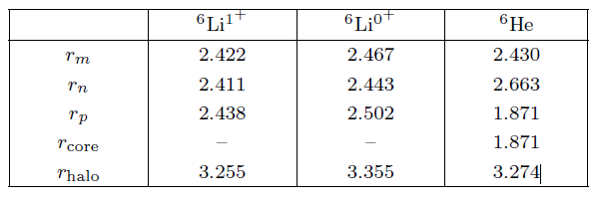
Ab initio calculations for A=6 multiplet
D.M.Rodkin, Yu.M. Tchuvil’sky, JETP Letters, 118, issue 3, p. 147 (2023)
Similar radius values were obtained for ⁶Li in the ground state and 3.56 MeV state and for ⁶He (two-neutron halo). According to the authors, this indicates the presence of a neutron-proton halo in the ⁶Li states under discussion.
Similar result was obtained: I.N. Izosimov, Phys. At. Nucl. 80(5), 867 (2017).

Slide 7
Experiment ⁷Li(d,t)⁶Li
Typical spectrum of the ⁷Li(d,t)⁶Li experiment at E(d)=14.5 MeV for θ_{lab} = 20º. Black squares – experimental data. Colored curves—Gaussian fit.
The experiment was carried out on a deuteron beam with an energy of 14.5 MeV, extracted from the U-150M isochronous cyclotron of the Institute of Nuclear Physics (Almaty, Republic of Kazakhstan). The target was a thin film of lithium with a thickness of (0.39±0.03) mg/cm2 enriched in 7Li up to 90%. The substrate was an alundum film. Since lithium is a highly oxidizing element, during sputtering we used a specially made lock chamber made of stainless steel, which allows us to keep targets in a vacuum when moving them from VUP-2 (VUP - a vacuum universal station for sputtering lithium on an alundum substrate) to the scattering chamber. The thickness of the target was determined from the energy losses of α-particles from the radioactive source with an accuracy of about 8%. The energy spread in the beam was about 150 keV. Charged particles, products of nuclear reactions, were recorded by a telescope consisting of two silicon detectors: a thin one (∆E) with thicknesses from 30 to 50 microns and a thick one (E) with thicknesses of 1-2 mm. The separation of charged particles was carried out by a two-dimensional analysis system (∆E-E) using electronics in the CAMAC and ORTEC standards and a processing program implemented on a personal computer. The total energy resolution was determined mainly by the beam energy spread.

Slide 8
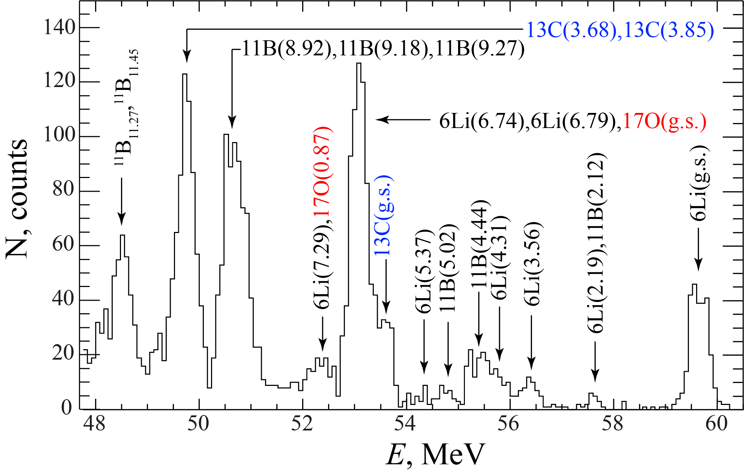
Experiment ¹⁰B(⁷Li,⁶Li)¹¹B
Energy (dE + E) spectrum of ⁶Li recorded at Θ_{lab} = 10○. Black color indicates the ⁶Li peaks from the reaction on the ¹⁰B target, blue and red indicate the ⁶Li peaks obtained in reactions on ¹²C and ¹⁶O impurities, respectively
Experiment was done using U-400 accelerator beam of the FLNR JINR, Dubna. The ⁷Li ion beam with energy E = 58 MeV and energy resolution ΔE_{(FWHM)}= 0.5 MeV was focused using a system of magnets in the ion guide channel, a position-sensitive multiwire “X-Y” chamber, and was formed by diaphragms, which formed a beam collimator. The beam formed by the collimator in the target position had a beam spot diameter Ø = 3.6 mm and an angular aperture of ΔΘ ≈ 0.2^{о}. A self-supporting target of the isotope ¹⁰B (t ≈ 0.05 mg/cm2, Ø = 1.0 cm), containing impurities of the isotopes ¹²C (9%) and ¹⁶O (6%), was installed in the center of the reaction chamber perpendicular to the beam axis. The beam current data measured by Faraday cup and the beam integrator unit (ORTEC – 439) was recorded together with the experimental data by the data acquisition system (DAQ). The DAQ of the experimental setup consisted of the VME electronics units (MVLC crate controller, MADC-32 ADC) and NIM standard logical units and operated by MVME Mesytec program. The DAQ system was used to measure the angular distributions of the differential cross sections of the reaction products, which were recorded using two detector groups. Each detector group consisted of four dE-E telescopes of Si detectors. In front of each telescope, there were lead diaphragms of square cross section ~3×4 mm2, providing a solid angle of the detectors of the telescopes of the first and second groups Ω = 1.3x10⁻⁴ sr and 2.2x10⁻⁴ sr, respectively.

Slide 9
DWBA method
Direct transfer reactions in most cases are characterized as peripheral, i.e. their angular distributions are sensitive only to the surface (asymptotic) part of the reaction form factor. This makes it possible to obtain empirical values of parameters (G², ANC) from the description of the main peak of the experimental angular distribution of the transfer reaction.
We base on a more general concept of the form factor as an overlap integral of the wave functions of the participating nuclei which is determined by the corresponding inhomogeneous equation.
There are various ways to determine form factors, such as directly calculating overlap integrals using model nuclear wave functions. Other approaches involve an approximate solution.
In this approach, an approximate homogeneous equation for the form factor is considered with a phenomenological effective potential, which is naturally not identical to the single-particle shell potential. We use a simple form of this potential with a minimum number of parameters (2), which are determined from the analysis of experimental data and taking into account additional information about the asymptotic normalization coefficients (ANC). ANC determine the normalization of the form factor at large distances, where, due to the short-range of the effective potential, its behavior is determined from the neutron separation energy equation. These ANC were obtained empirically in other reactions, as well as calculated in model calculations, and a comparison with these values is given in Table
Notes:
The inhomogeneity is replaced by some local interaction, which, together with the average field, forms some effective potential.

Slide 10
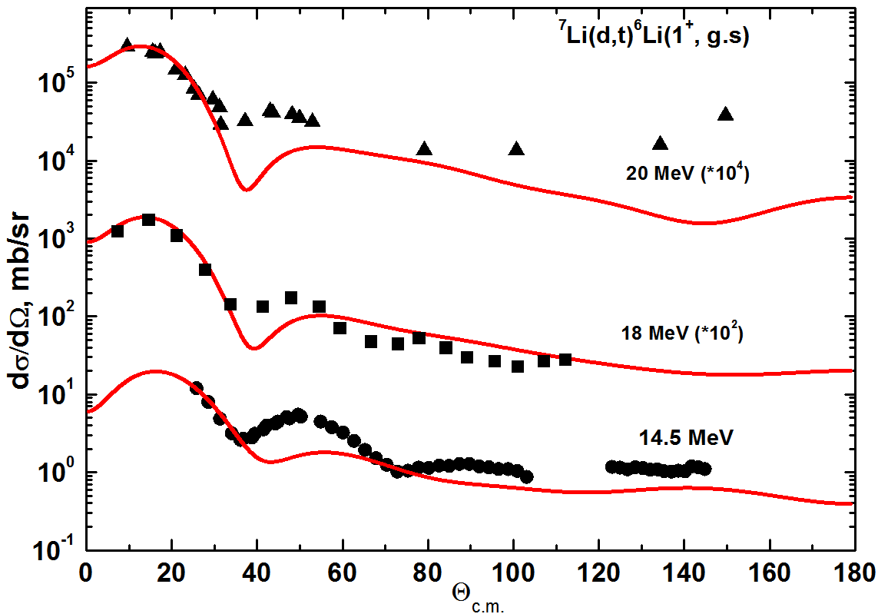
DWBA analysis results for ⁷Li(d,t)⁶Li(g.s.)
Asymptotic normalization coefficients of the radial form factor (⁷Li, n⁶Li)
NC²_{theor} , Фм⁻¹ | NC²(20. MeV), Фм⁻¹ | NC²(18. MeV), Фм⁻¹ | NC²(14.5 MeV), Фм⁻¹
2.94ª, 4 .35^{b} | 4.56(80) | 2.91(44) | 3.05(46)
ª N. K. Timofeyuk, Phys .Rev. C 81, 064306 (2010)
^{b} D. M. Rodkin, and Yu.M. Tchuvil’sky, Phys. Rev. C 103, 024304 (2021)
NC² = G^{2*}(µc)²/pħ²

Slide 11
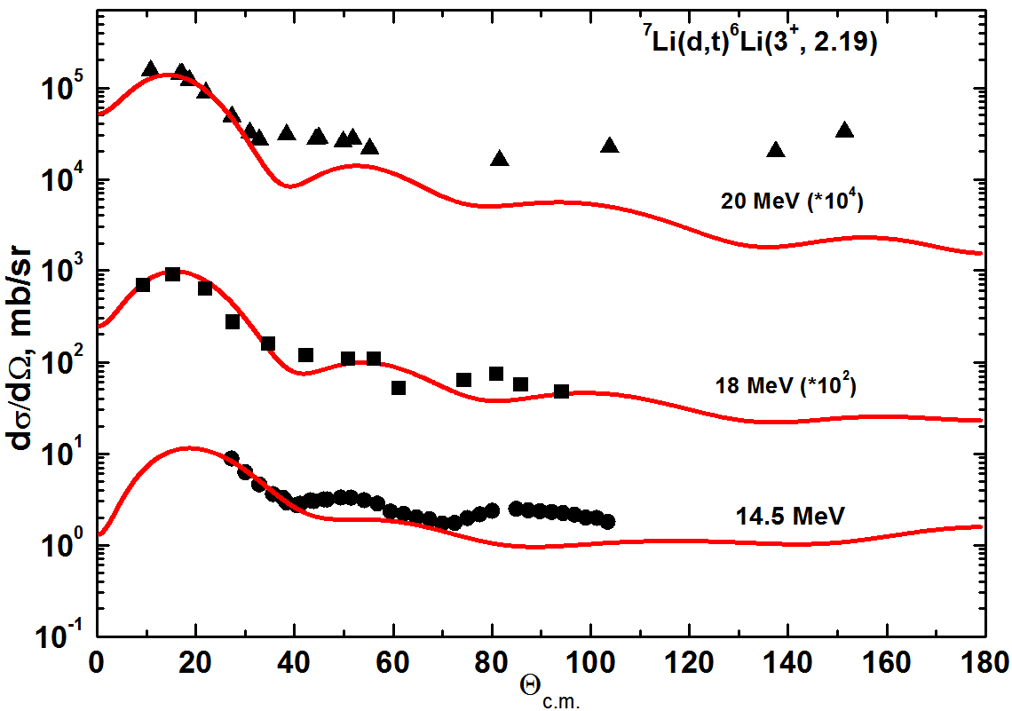
DWBA analysis results for ⁷Li(d,t)⁶Li(2.19)
Asymptotic normalization coefficients of the the radial form factor (⁷Li, n⁶Li)
NC²_{theor} , Фм⁻¹ | NC²(20. MeV), Фм⁻¹ | NC²(18. MeV), Фм⁻¹ | NC²(14.5 MeV), Фм⁻¹
4.52ª | 5.34(80) | 3.77(57) | 4.19(63)
ª N. K. Timofeyuk, Phys .Rev. C 81, 064306 (2010)

Slide 12
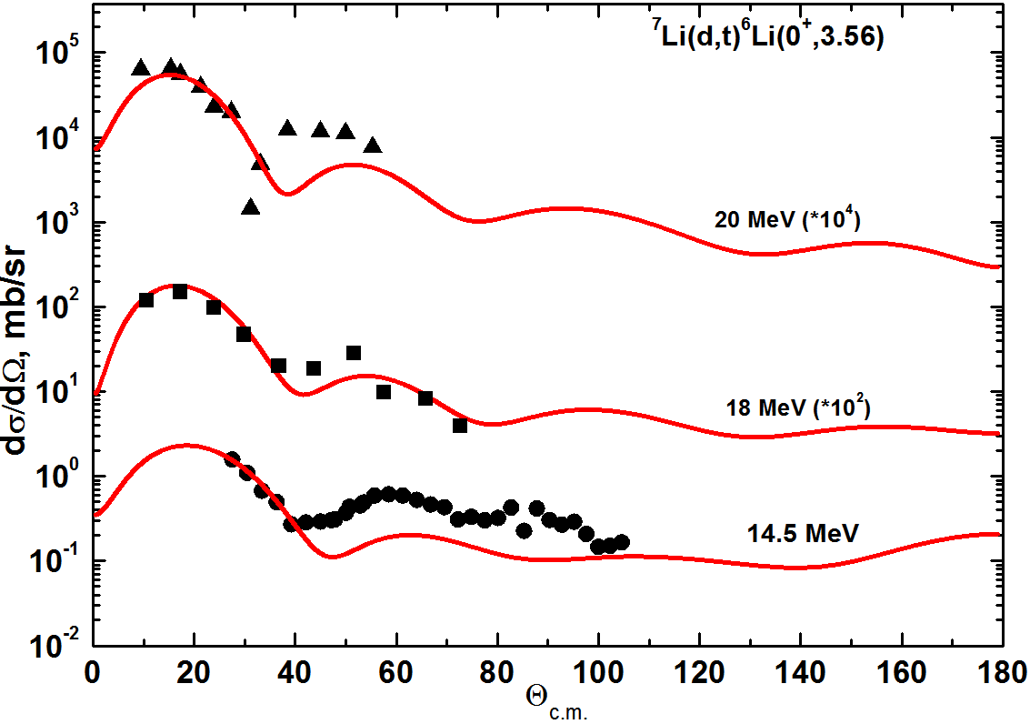
DWBA analysis results for ⁷Li(d,t)⁶Li(3.56)
Asymptotic normalization coefficients of the the radial form factor (⁷Li, n⁶Li)
NC²_{theor} , Фм⁻¹ | NC²(20. MeV), Фм⁻¹ | NC²(18. MeV), Фм⁻¹ | NC²(14.5 MeV), Фм⁻¹
2.47ª | 7.26(1.09) | 2.33(35) | 3.16(47)
ª N. K. Timofeyuk, Phys .Rev. C 81, 064306 (2010)

Slide 13
Radial dependence of form factor r²I(r)
Figure shows a comparison of the radial dependences of the values r⁴I_{lj}²(r), which are the integrands in calculating the mean-square radii for all three form factors normalized to1.
3.56 MeV state has more extended radial dependence of form factor. This fact is an argument in favour of increased radius of this state in compare with g.s and 2.19 MeV states. Moreover, small increase is seen for g.s. in compare with 2.19 MeV state.
13

Slide 14
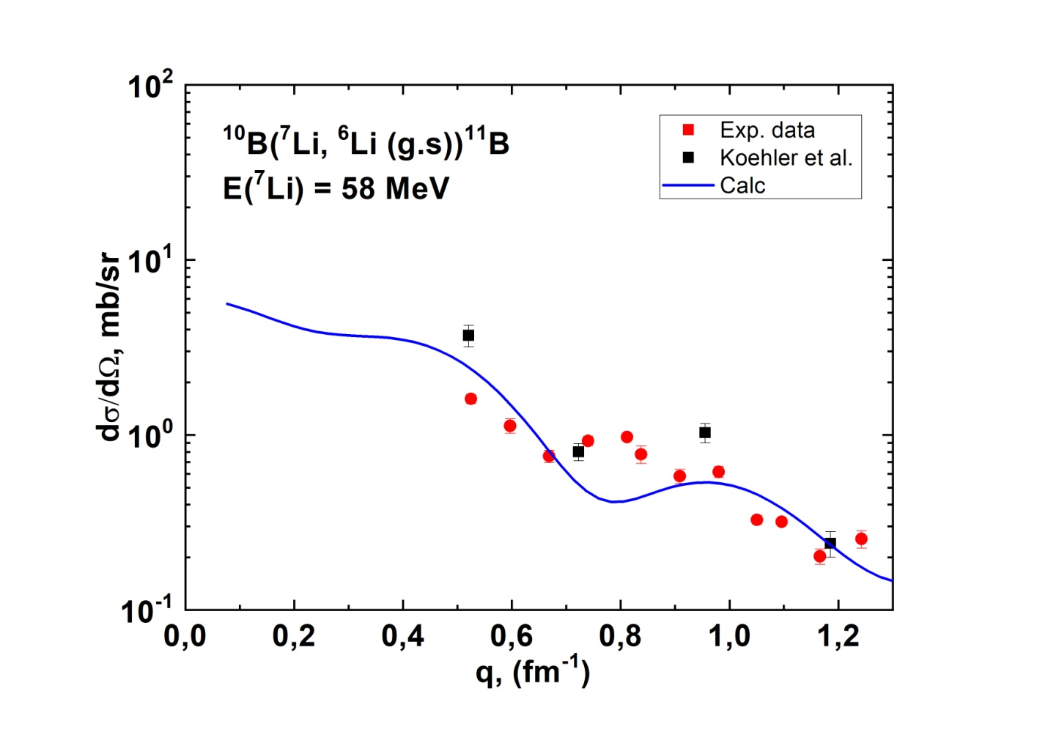
DWBA analysis results for ¹⁰B(⁷Li,⁶Li _{(g.s.)})¹¹B
Differential cross sections of the reaction ¹⁰B(⁷Li,⁶Li)¹¹B for ground state of ⁶Li. Red circles – our data at 58 MeV, squares – data at 24 MeV, solid line – the DWBA calculations.
Tabl. The values of the obtained model potential parameters and ANC
A+1(I^{π},Τ, E’), nA(I^{π},Τ, E’) | (l , j) | -V, MeV | R , fm | a , fm | <r²>^{1/2}, fm | NC², fm ⁻¹ | NC²_{theor} , fm ⁻¹ | NC²_{eхp}, fm ⁻¹
⁷Li(3/2–, 1/2, g.s.), n⁶Li(1⁺, 0, g.s.) | (1, 3/2) + (1, 1/2) | 60.2 | 2.36 | 0.9 | 3.23 | 3.05(46) | 2.94 | 3.17(53)

Slide 15
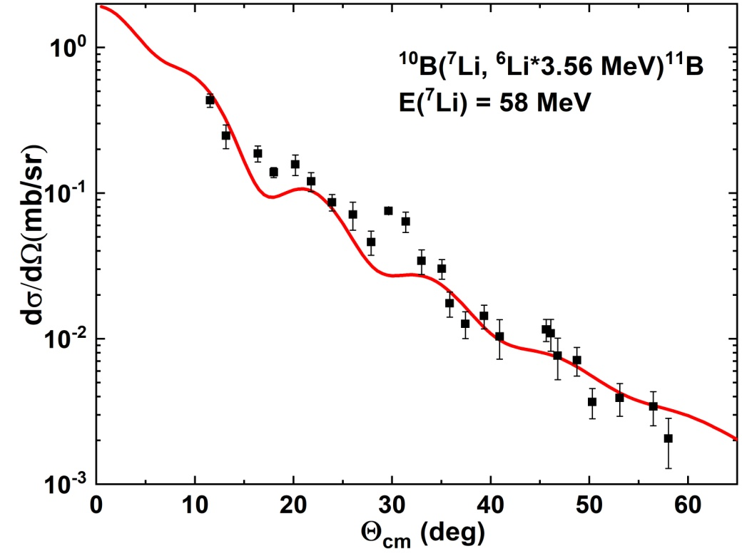
DWBA analysis results for ¹⁰B(⁷Li,⁶Li*_{3.56})¹¹B
Differential cross sections of the reaction ¹⁰B(⁷Li,⁶Li*)¹¹B at 58 MeV with excitation of the 3.56 MeV state of ⁶Li. Black circles are experimental data, solid lines are the DWBA calculations
Tabl. The values of the obtained model potential parameters and ANC
A+1(I^{π},Τ, E’), nA(I^{π},Τ, E’) | (l , j) | -V, MeV | R , fm | a , fm | <r²>^{1/2}, fm | NC², fm ⁻¹ | NC²_{theor} , fm ⁻¹ | NC²_{eхp}, fm ⁻¹
⁷Li(3/2–, 1/2, g.s.), n⁶Li(0⁺, 1, 3.56) | (1, 3/2) | 66.7 | 2.18 | 1.6 | 3.50 | 2.76(39) | 2.47 | 2.91(35) 3.16(47)
¹¹B(3/2⁻, 1/2, g.s.), n¹⁰B(3⁺,0,g.s.) | (1, 3/2) | 43.3 | 3.34 | 0.5 | 2.89 | 12.4(1.9) | 13.1 | 31.4(3.0)

Slide 16
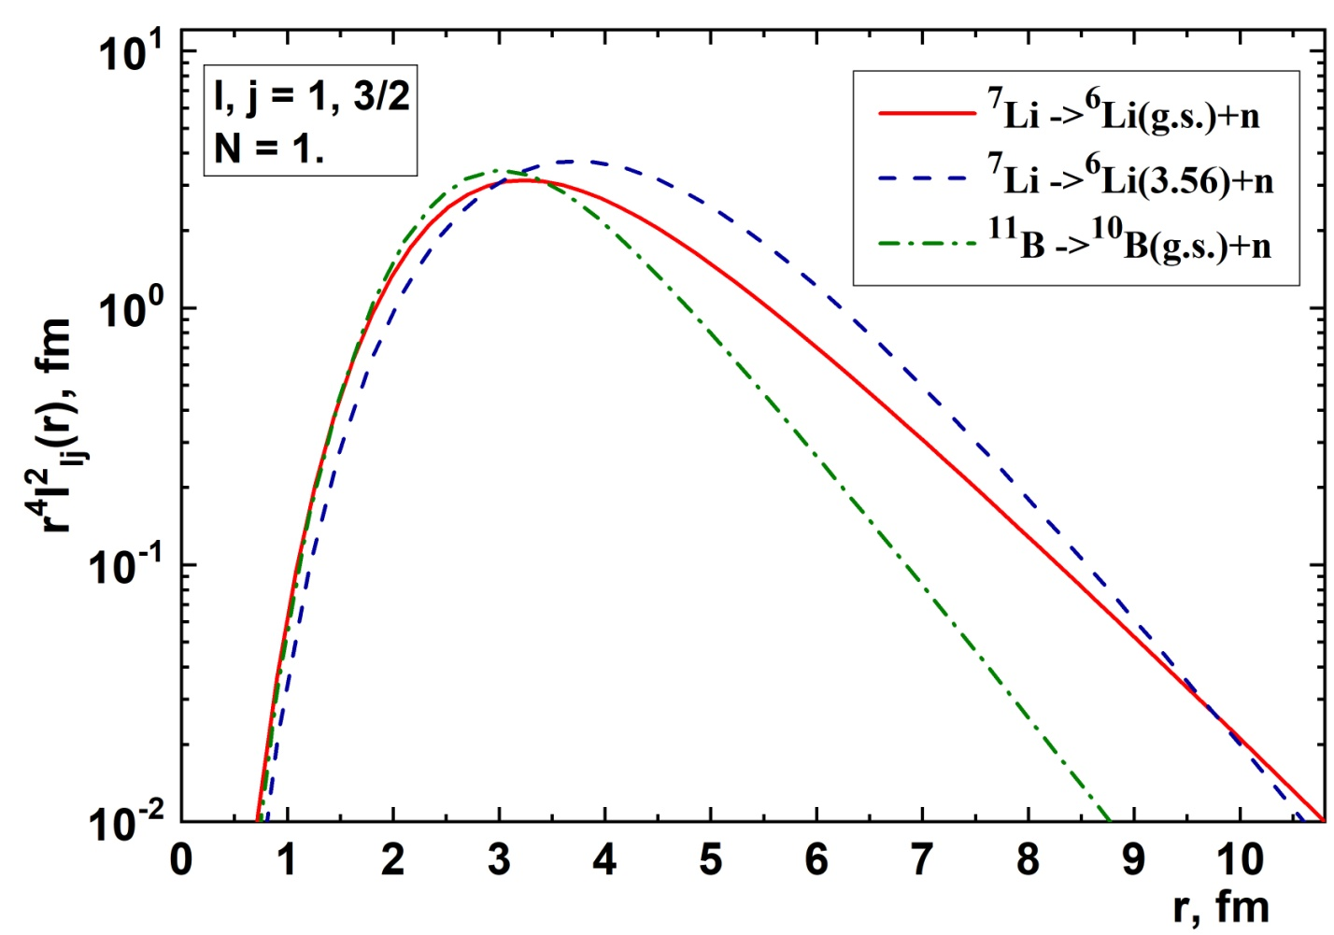
Radial dependence of form factor r⁴I²(r)
Figure shows a comparison of the radial dependences of the values r⁴I_{lj}²(r), which are the integrands in calculating the mean-square radii for all three form factors normalized to1.
. Fig. shows the radial dependences of the form factors, and not the wave functions of the neutron in ⁷Li. Since these are precisely the overlap integrals, and in both cases they are determined by the same wave function of the ⁷Li nucleus in the ground state and different wave functions of the ⁶Li nucleus in the ground and excited states. Therefore, a comparison of their radial dependences in Fig. gives us information about the difference in the radial behavior of the wave functions of the ⁶Li nucleus in the ground and excited states. In addition, Table shows the root-mean-square radii of the form factors, and not the wave functions of the neutron in ⁷Li, and Fig. gives us an understanding that this radius is increased for the excited state compared to the ground state due to the visible difference in the form factors in the region from 2 to 9 fm, and the differential cross section of the direct transfer reaction, as is known, in the region of the main peak is most sensitive to the behavior of the form factor in this region.
Considering that in both cases the contribution to the form factor comes from the same wave function of the ground state of the ⁷Li nucleus, it is possible to assert that it is the wave function of the ⁶Li nucleus that is responsible for this difference. However, this gives us only a qualitative estimate that the dimensions of the ⁶Li nucleus in the excited state are "larger" than in the ground state. The reason for this may be, among other things, the presence of a halo structure.

Slide 17
Conclusions
1) 2 experiments were performed:
Angular distributions of differential cross sections for the ⁷Li(d,t)⁶Li reaction for the ground (J^{π} = 1⁺) and excited states (2.186 MeV, J^{π} = 3⁺; 3.56 MeV, J^{π} = 0⁺) were measured;
Angular distributions of differential cross sections for the ¹⁰B(⁷Li,⁶Li)¹¹B reaction for the ground and the 3.56 MeV excited states of the ⁶Li were measured.
2) The DWBA analysis was done.
The optical model potentials were obtained by fitting of measured elastic scattering data and evaluating parameters for the output reaction channels. Phenomenological approach based on solving an approximate equation for the reaction form factor was used to determine its radial dependence and empirical values of asymptotic normalization coefficient (ANC). Obtained values of ANC’s for the ⁶Li_{g.s}. and ⁶Li*(3.56 MeV) states are in agreement with the literature ones.
3) Comparison of the radial dependences of form factors shows that the wave function of the ⁶Li nucleus in excited (J^{π}=0⁺, T=1, E=3.56 MeV) state has increased spatial dimension compared to the ground state. This result is an argument in favor of a halo existence in ⁶Li*(3.56 MeV) state, while the question of a halo in ⁶Li_{g.s}.still leaves open.

Slide 18
THANKS FOR THE ATTENTION

Slide 19

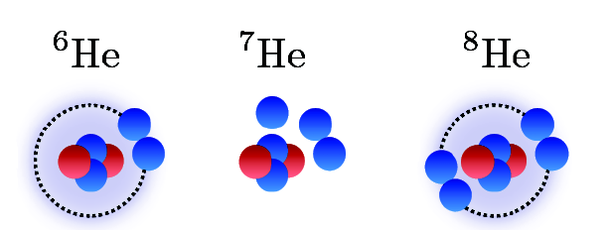
⁷He
2n halo
3n halo? double halo?
skin halo
Our results:
From pion absorption: the ⁴Не+3n structure is not manifested in the ground state of ⁷Не. It is possible existence of a complicated “halo-like” configuration in ⁷Не with all three neutrons located outside of the alpha particle core. The structure of this complicated halo-like state would be determined by correlations of neutrons in the p_{3/2} and p_{1/2} shells.
B.A. Chernyshev et al., JETP Letters 110, 97–101(2019)
From MDM
The ⁷He radius is fairly well inscribed in the systematics of the ⁶He - ⁷He - ⁸He radii. It occurred to be close to the radii of ⁶He and ⁸He having two-neutron halo and neutron skin correspondingly indicating to some intermediate three-neutron halo-like structure of ⁷He
A.S. Demyanova et al. J. Phys.: Conf. Ser. 1643 012128 (2020)
14
III INTERNATIONALSCIENTIFIC FORUM "NUCLEAR SCIENCE AND TECHNOLOGIES“, 2021 Almaty, Republic of Kazakhstan

