Slide 1
Study of the ⁸Li low-lying excited states
A.N. Danilov
Notes:
For measuring the radii of excited states we proposed a method based on the analysis of the inelastic diffraction scattering. We applied the model to studying the α- and ³He-scattering on ¹²C. The analysis allowed determining the enhanced radii of some excited states in ¹²C including the famous Hoyle state (0⁺, E* = 7.65 MeV). Besides the diffraction method the inelastic nuclear rainbow scattering also can be used for measuring the radii of unstable states. The enhancement of the radius of the excited state is detected by the shift of the inelastic rainbow minimum relatively the elastic one. The application of this approach to the inelastic scattering leading to excitation of the Hoyle state gave results consistent with those obtained by the diffraction method. Considerable attention has been drawn to the studies of α-cluster states in ¹²C, especially the second 0⁺ state, at E_{x}= 7.65MeV (so called the Hoyle state).

Slide 2
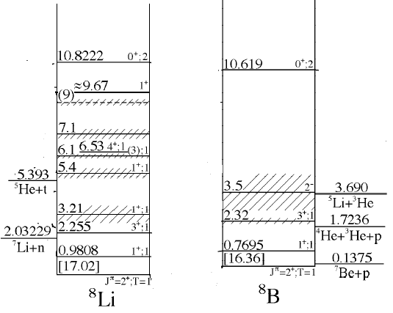
Mirror nuclei ⁸Li and ⁸B
⁷Li(n,γ)⁸Li and ⁷Be(p,γ)⁸B reactions have a crucial role in nuclear astrophysics
⁷Li(n,γ)⁸Li is considered to be a key reaction in jumping the A = 8 gap in the nucleosynthesis. Its cross sections at low energy are crucial in determining the amount of heavier neutron-rich elements.
⁷Be(p,γ)⁸B, the mirror reaction, is responsible for high-energy solar neutrinos that are detected in terrestrial laboratories that look for physics beyond the standard model.

Slide 3
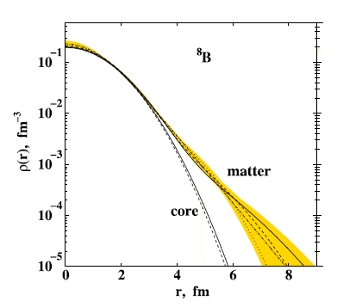
Literature overview on ⁸Li and ⁸B
Proton halo was discovered in g.s. of ⁸B based on increased quadrupole moment T. Minamisono et al., Phys. Rev. Lett. 69, 2058 (1992) (the momentum distribution of ⁷Be measured indicated that the 3/2p state valence proton in ⁸B had a halo structure).
Many experiments have been employed to investigate structure of ⁸B
I. Tanihata et al., Physics Letters B, 206, 592 (1988) (Glauber model) R_{rms} = 2.38 ± 0.04 fm
G. W. Fan et al., Phys. Rev. C 91, 014614 (2015) (modified Glauber model)
G.A. Korolev et a., Phys. Lett. B 780, 200 (2018). the presence of a proton halo in ⁸B was confirmed using the total cross section, as well as the root-mean-square radius R_{rms} = 2.58 fm and the halo radius R_{h} = 4.24 fm
Main results:
an obvious tail structure in the density distribution
Some new results:
Y. Y. Yang et al., Phys. Rev. C 87, 044613 (2013).⁸B +^{Nat}Pb
R. Spartà et al., Physics Letters B 820 (2021)136477.⁸B+⁶⁴Zn
in spite of the extremely low ⁸B breakup threshold and its extended nuclear matter density distribution, experimental results clearly show that the ⁸B reaction dynamics is very different from that of n-halo nuclei.

Slide 4
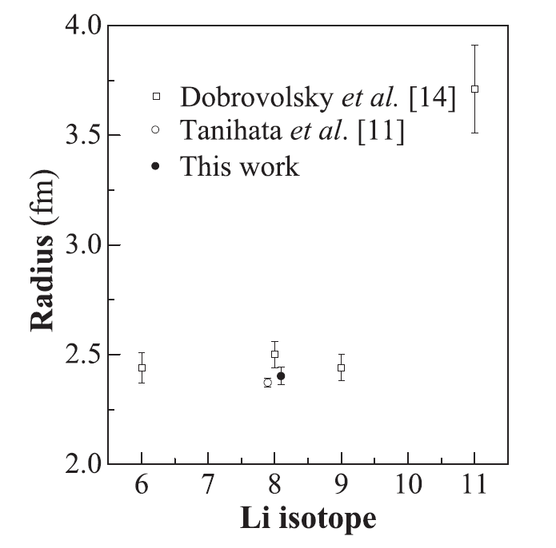
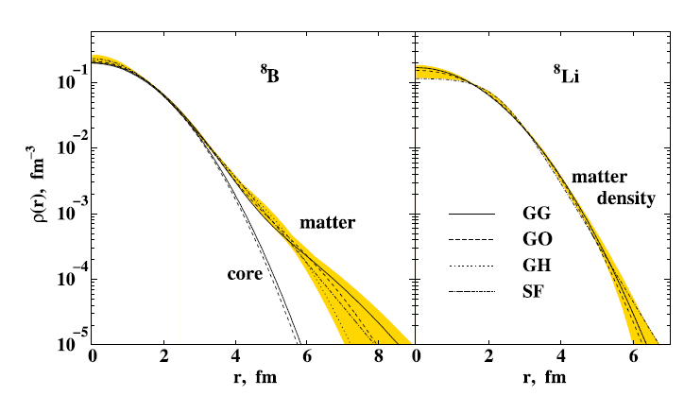
Literature overview on ⁸Li and ⁸B
Natural question arises about possible exotic structure in mirror nuclei – ⁸Li (main results are obtained for the g.s.)
Glauber model
I. Tanihata et al., Phys. Rev. Lett. 55, 2676 (1985) (Glauber-type calculation)
R_{rms}(⁸Li) ~ 2.5 fm
A.V. Dobrovolsky et al., Nucl. Phys. A 766, 1 (2006).
G. W. Fan et al., Phys. Rev. C 90, 044321 (2014)
all experiments point out that ⁸Li(g.s.) has a skin structure

Slide 5
MDM (Modified diffraction model)
Diffraction radii are determined from minima (maxima) positions in dσ/dΩ
Elastic scattering
Inelastic scattering (0⁺ → 0⁺)
R_{dif} is the only parameter of the model. As it has the dimension of length it can be directly connected with a real (rms) nuclear radius
Model:
R_{rms} (exc.st) = R_{rms} (gr.st) + [R_{dif} (in) - R_{dif} (el)]
The method was tested in the analysis of the radius of Hoyle state in ¹²C
A.S. Demyanova et al., Int. J. Mod. Phys. E17, 2118 (2008). A.N. Danilov et al., Phys. Rev. C 80, 054603 (2009).

Slide 6
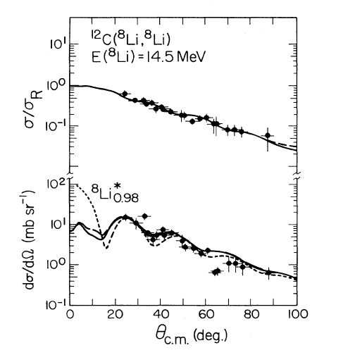
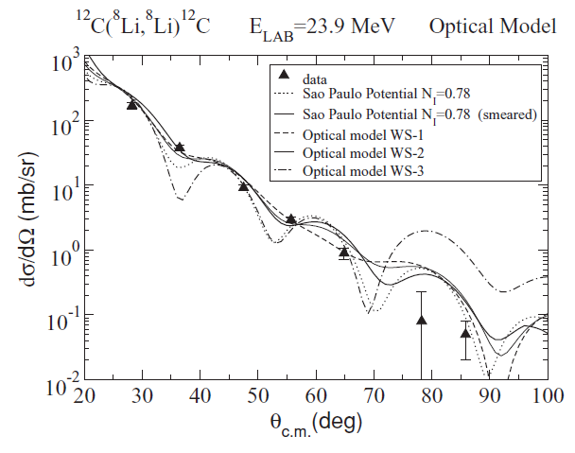
MDM analysis ¹²C(⁸Li,⁸Li)¹²C
We applied MDM to existing literature scattering data on ⁸Li+¹²C
A. Barioni et al., Phys. Rev. C 80, 034617 (2009)
R_{rms}(0.98) – R_{rms} (g.s.) ~ 0.2 fm
Small increase of radius for the 0.98 MeV
R.J. Smith et al., Phys. Rev. C 43 2346 (1991)

Slide 7
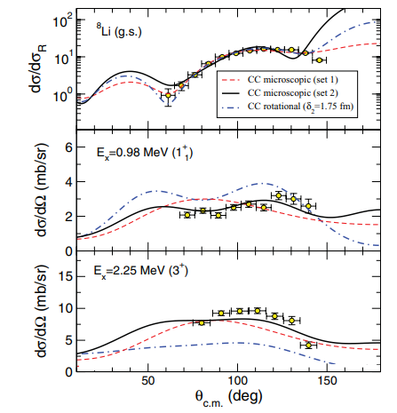
MDM analysis ²H(⁸Li,⁸Li)²H
We applied MDM to existing literature scattering data on ⁸Li+²H
R_{rms}(0.98) – R_{rms} (g.s.) ~ 0.5 fm
R_{rms}(2.26) – R_{rms} (g.s.) ~ 1 fm (unreal?)
E. Tengborn et al., Physical review C 84, 064616 (2011)

Slide 8
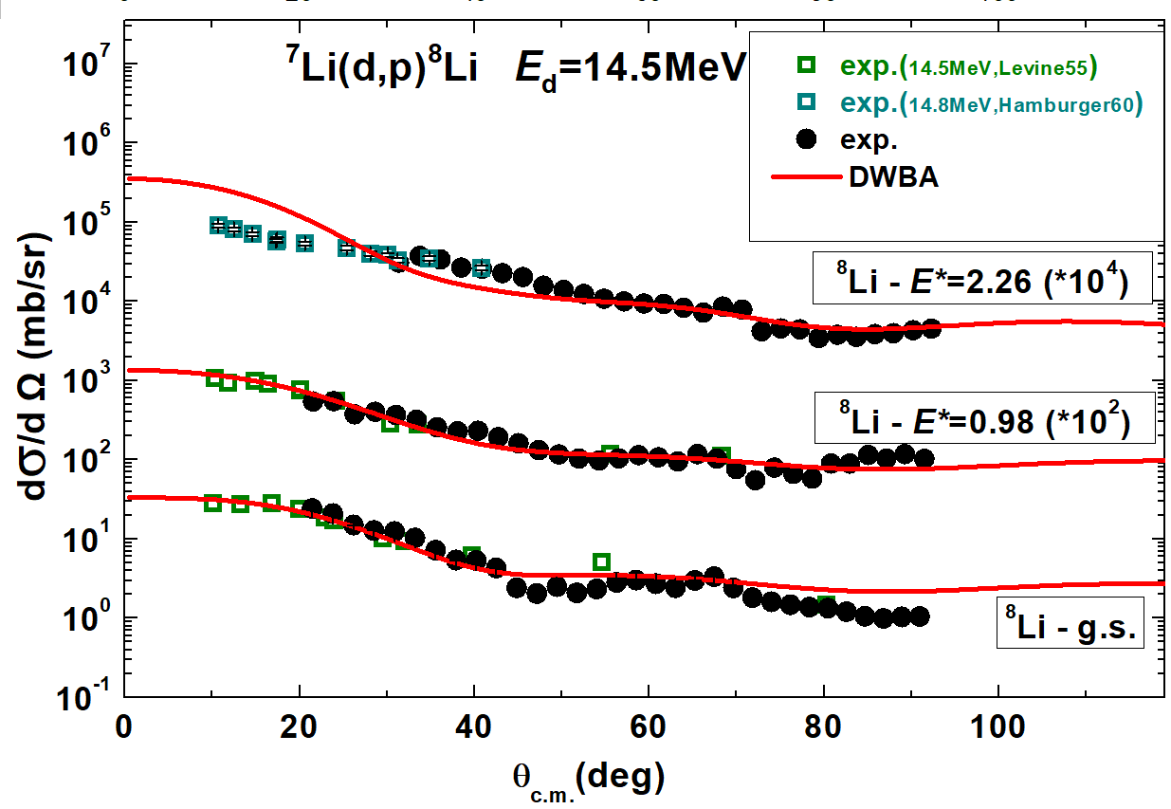
DWBA analysis ⁷Li(d,p)⁸Li

Slide 9
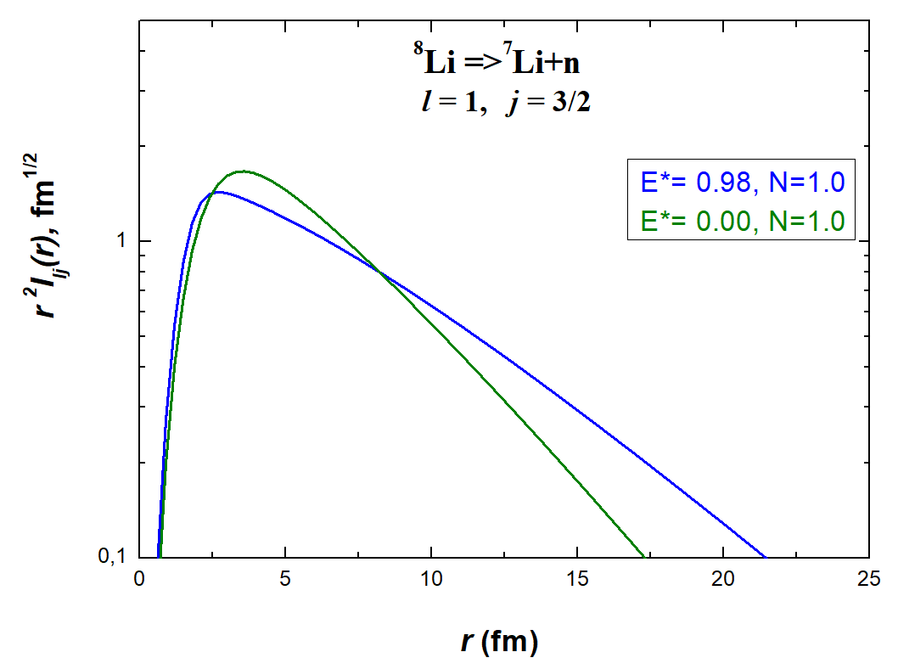
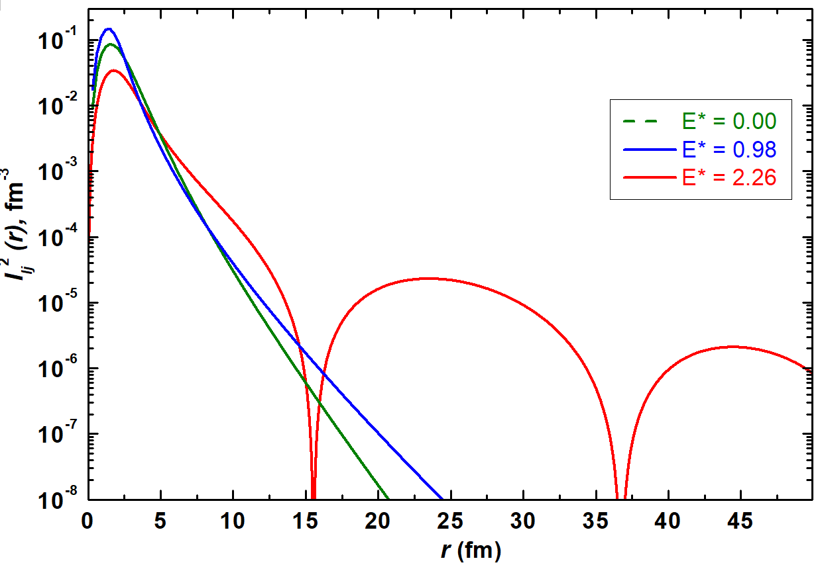
DWBA analysis ⁷Li(d,p)⁸Li
Radial dependence of form-factor r²I(r) and I(r)²
Comparison of radial dependence of form-factor for the g.s. and 0.98 MeV states shows that radii of these states are close, while 2.26 MeV state has increased dimensions

Slide 10
Overview of results
 | A.V. Dobrovolsky et al. | MDM ⁸Li+¹²C | MDM ⁸Li+d | DWBA ⁷Li(d,p)⁸Li
g.s. 2⁺ | 2.5 ± 0.1
0.98 MeV 1⁺ |  | 2.7 ± 0.2 | 3.0 ± 0.4 | ~ 2.5
2.26 MeV 3⁺ |  |  | ~ 3.5 | increased
Existing problems:
Data for MDM analysis are only at small energies, at the limits of MDM applicability
DWBA analysis gave only qualitative estimation

Slide 11
Conclusions
MDM is applied to existing literature data on ⁸Li scattering and radii for low-lying states were estimated: radii of the 0.98 and 2.26 MeV states are increased
DWBA analysis is done for the ⁷Li(d,p)⁸Li reaction to the g.s. and 0.98 MeV states of ⁸Li, preliminary for the 2.26 MeV state
Compare of radial dependences of form-factor for the g.s. and 0.98 MeV shows that these states have close radii, while radius for the 2.26 MeV state is increased

Slide 12
Collaboration team
Institute of Nuclear Physics, ME of Republic of Kazakhstan
N. Burtebayev , Marzhan Nassurlla, Maulen Nassurlla,
V.S. Zhdanov, D.K. Alimov, P. Khodzhaev , A. Sabidolda,
D.A. Isaev
NRC Kurchatov Institute, Russia
A.S. Demyanova, A.N. Danilov, V.I. Starastsin, S.V. Dmitriev
Lomonosov Moscow State University, Russia
S.A. Goncharov

Slide 13
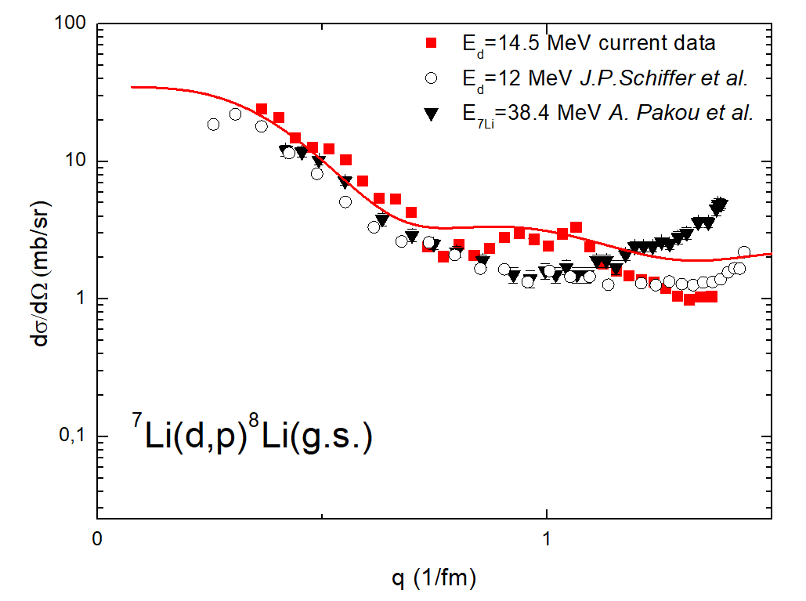
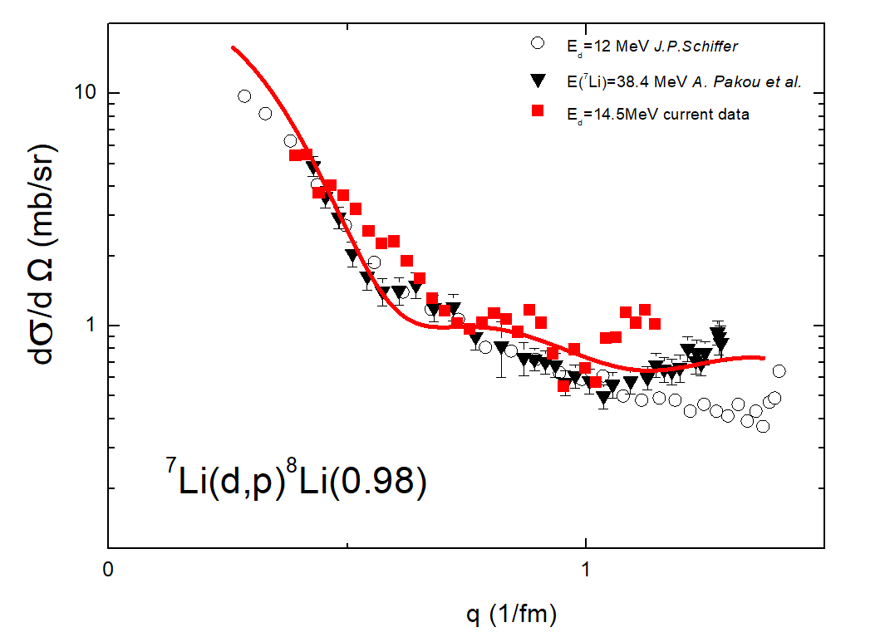
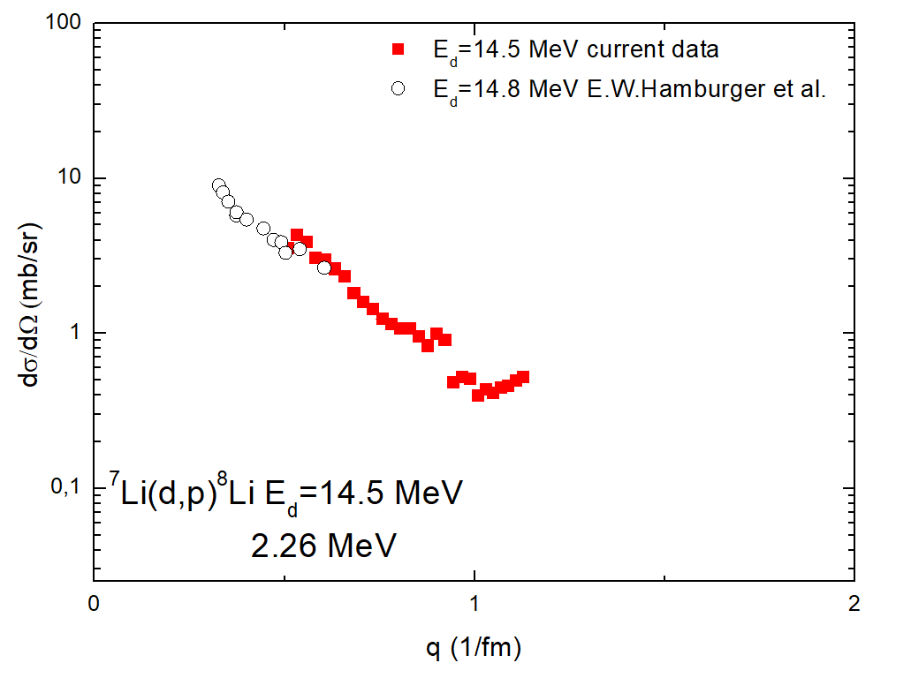
Experimental results

Slide 14
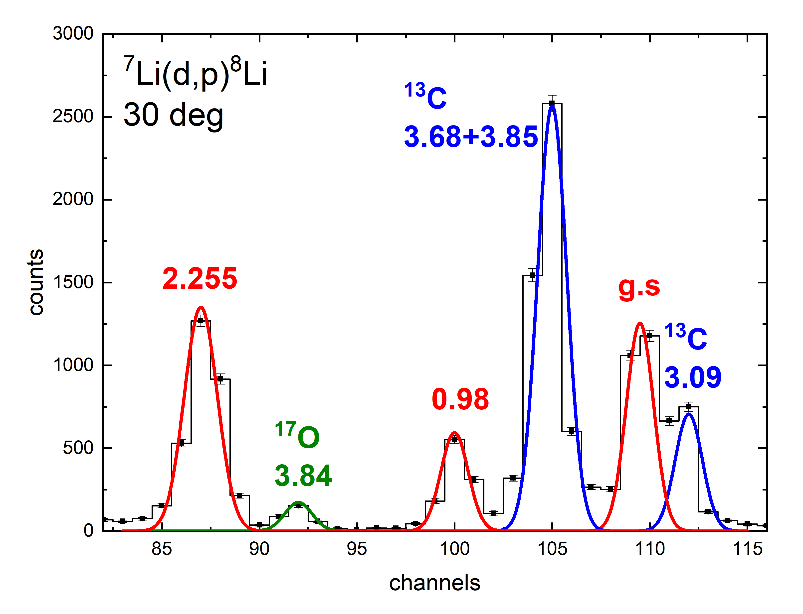
Experiment
The ⁷Li(d,p)⁸Li experiment was performed using the deuteron beam of the U-150M cyclotron at the Institute of Nuclear Physics (Almaty, Republic of Kazakhstan) at an energy of 14.5 MeV. The ⁷Li isotope (enrichment ≈ 90%) was used as a target. The angular distributions were measured in the angle range from 18° to 80° (lab). Angular distributions were obtained for the ground and first two excited states 0.98 and 2.26 MeV
While value of impurities (¹²C,¹⁶O, less than 10%) is low,
it’s influence is noticeable!

Slide 15
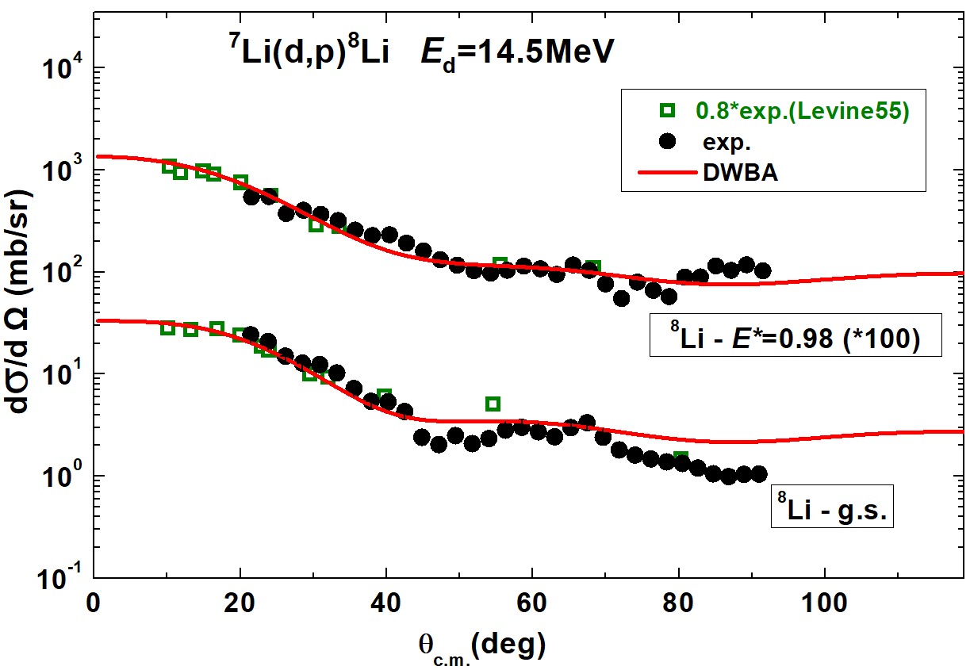
Experimental results
Angular distributions are received for the g.s., 0.98 and 2.26 MeV states
Preliminary DWBA analysis is done for the g.s. and 0.98 MeV states
Reaction is peripherical -> application of DWBA is quite adequate
Main task is to describe first main maximum

Slide 16
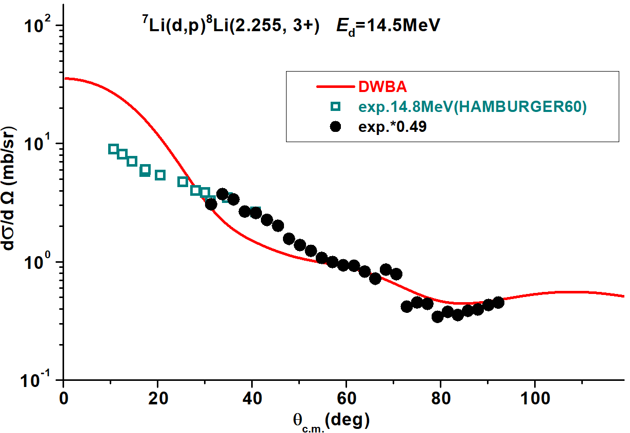
Experimental results
2.26 MeV state is unbound, 200 keV above neutron-emission threshold.
DWBA analysis is in progress. Open question regarding absolute values of dσ/dΩ: the only existing literature data (E.W. Hamburger et al.) with excitation of this state is lying 20-30% lower

Slide 17
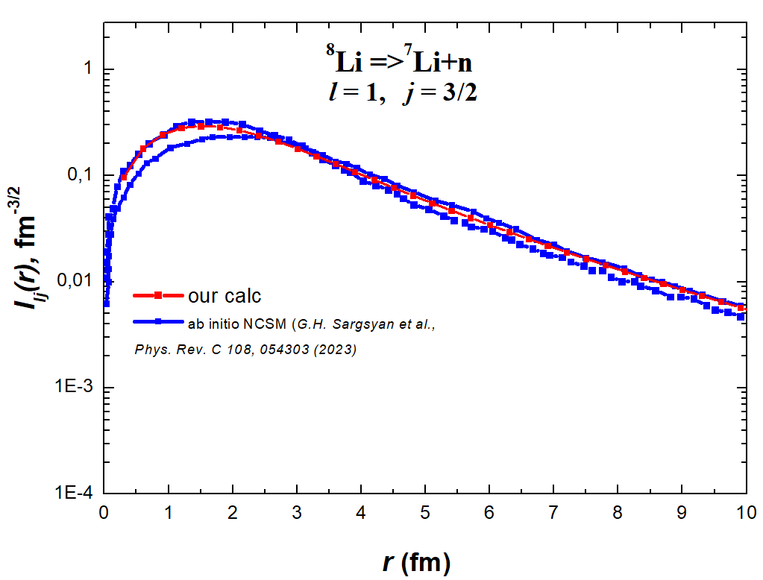
NC², Фм⁻¹ | NC²_{theor} , Фм⁻¹
0.529(79) | 0.576(60)

Slide 18
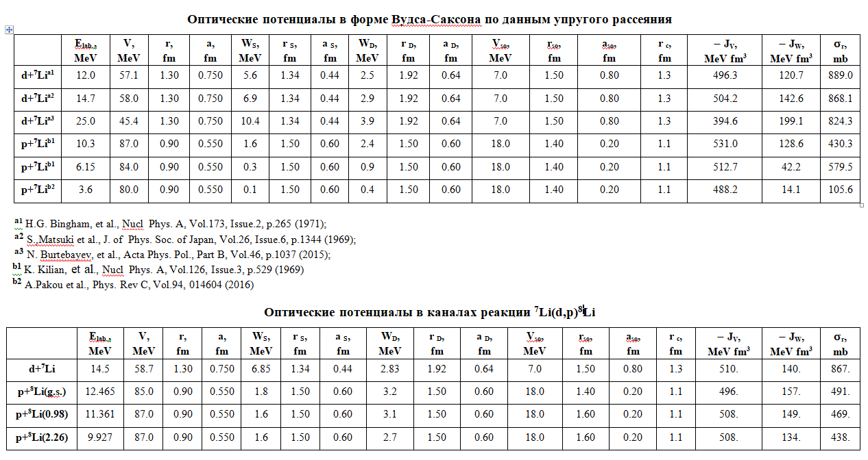

Slide 19
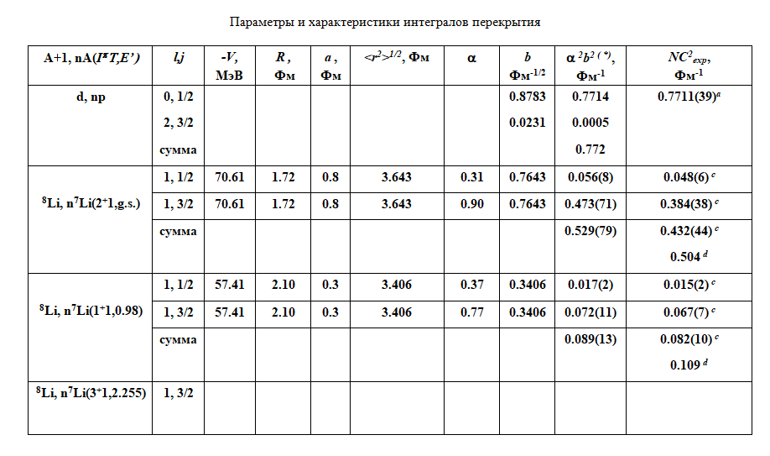

Slide 20
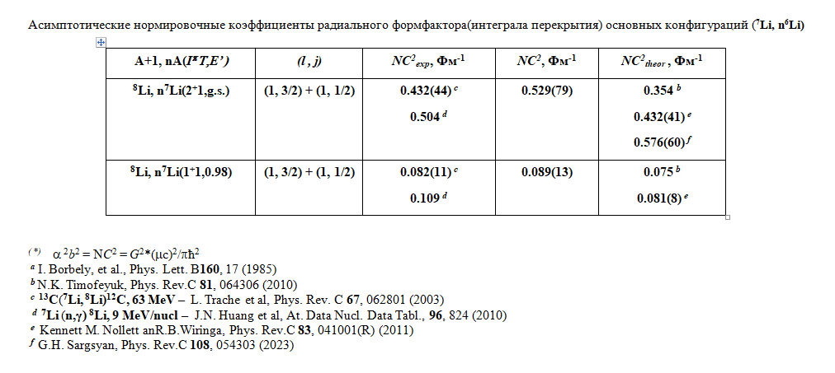

Slide 21
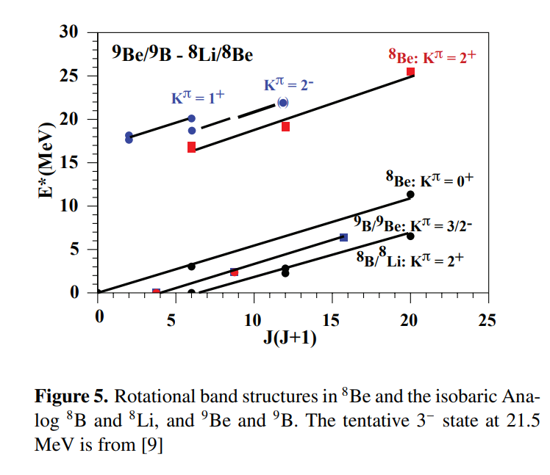
Rotational bands

Slide 22
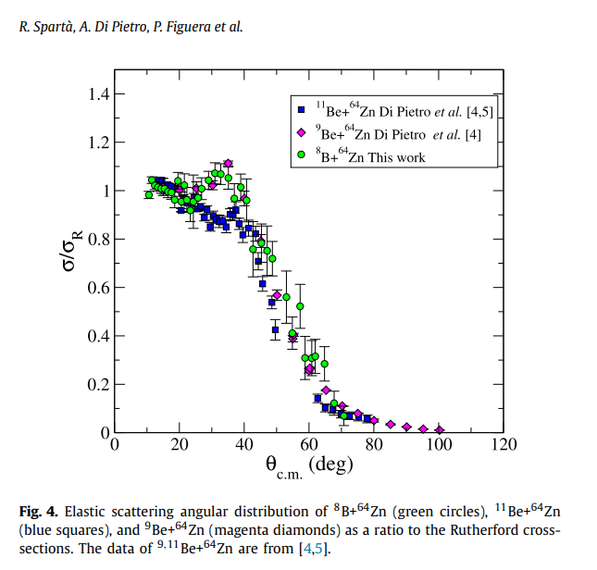

Slide 23
