Slide 1
Manifestation of the N=32, 34 subshell closures in the ternary decays of heavy nuclei.
Yu.V. Pyatkov^{1,2}, D.V. Kamanin², V.E. Zhuchko², Z.I. Goryainova², E.A. Kuznetsova², Yu. M. Sereda², A.N. Solodov², O.V. Strekalovsky², A.O. Zhukova²
¹National Nuclear Research University “MEPHI”, 115409 Moscow, Russia
² Joint Institute for Nuclear Research, 141980 Dubna, Russia

Slide 2
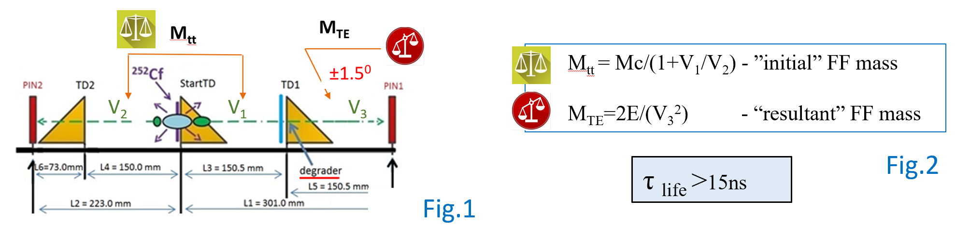
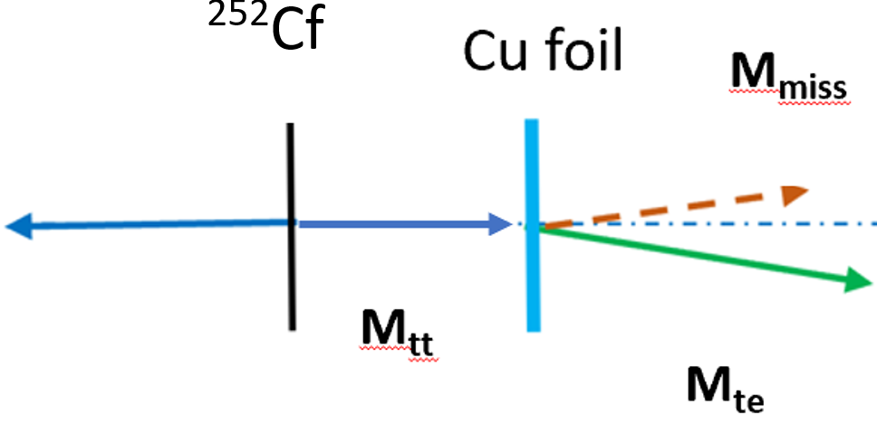
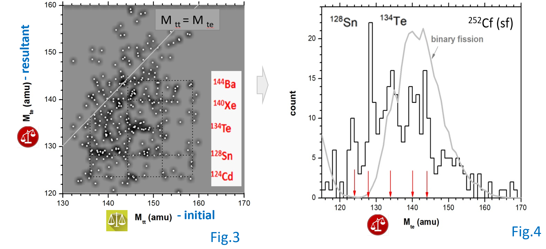
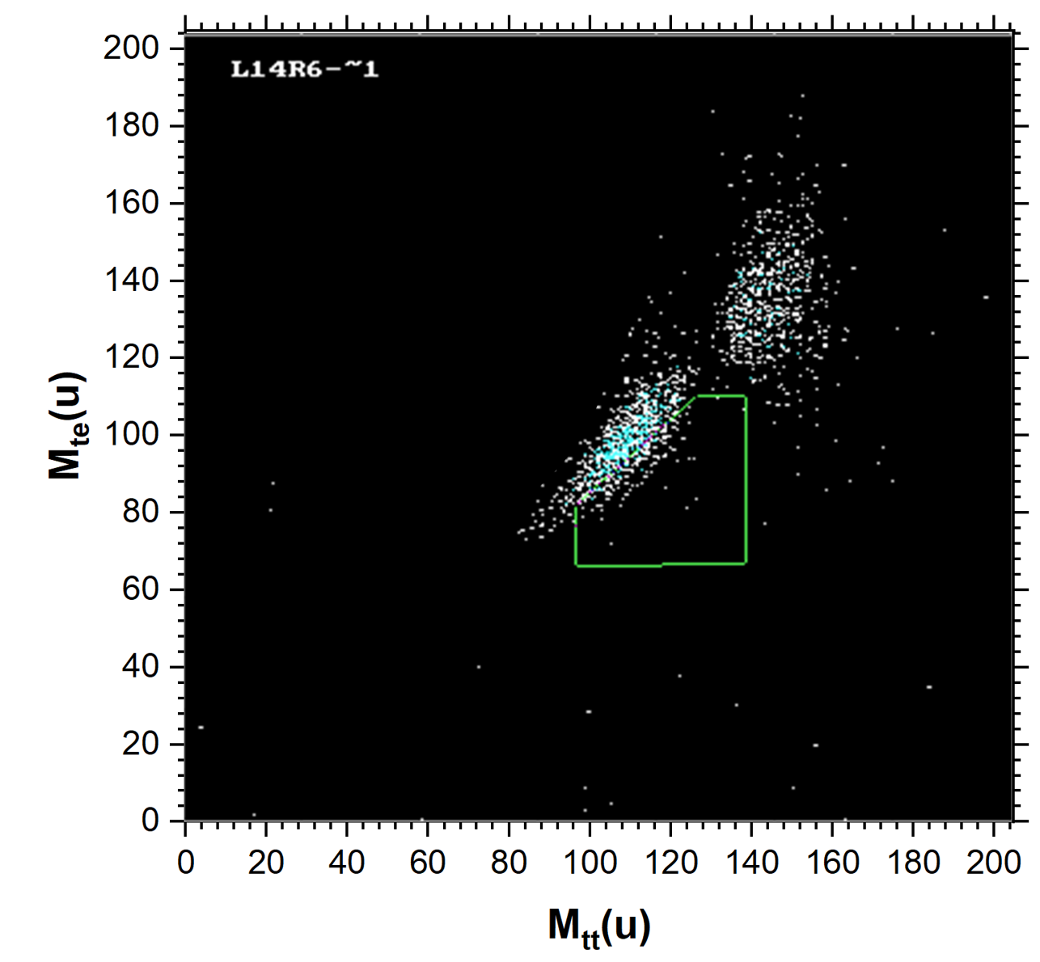
Twofold weighing & Cu foil at LIS spectrometer
Fig 2
Fig 1
shape isomer
S_{tot}~8000
Fig 3
w1
Fig 4
Fig 5
Observation of the break-up of the heavy FF in the shape isomer state to be a di-nuclear system with the magic core.

Slide 3
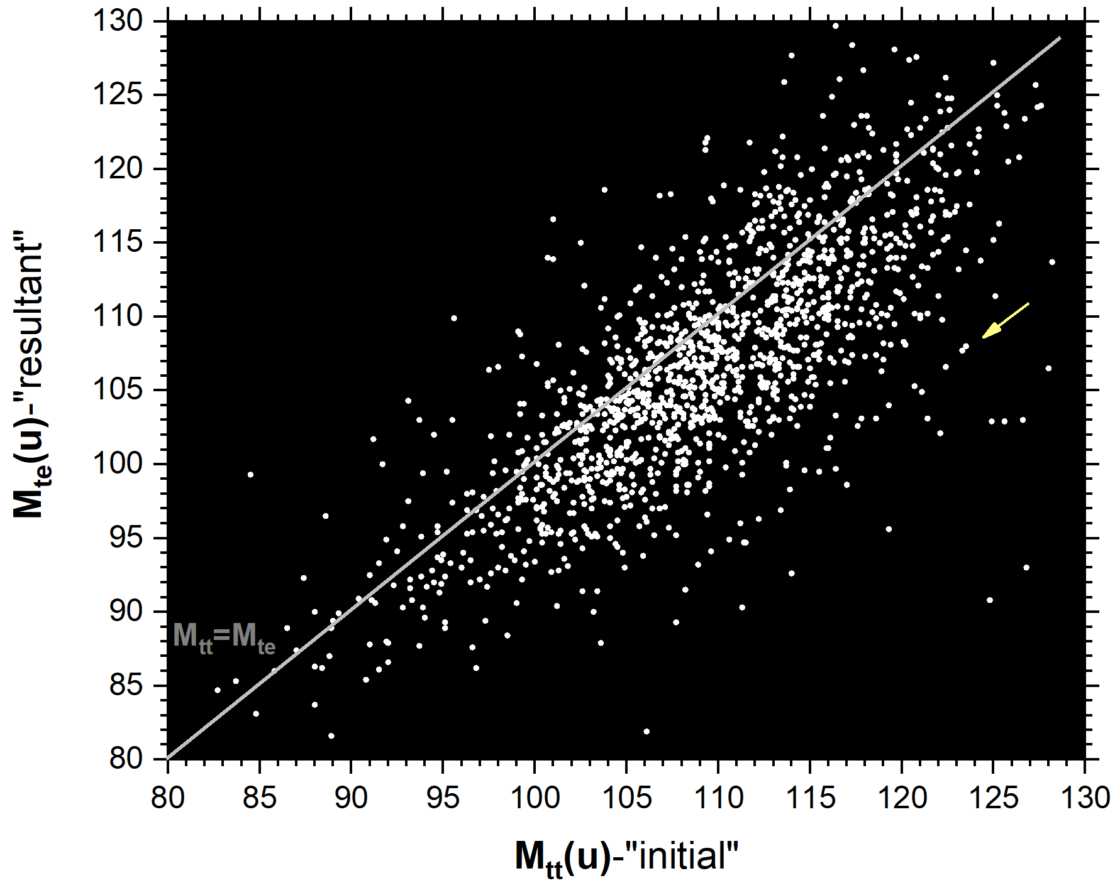
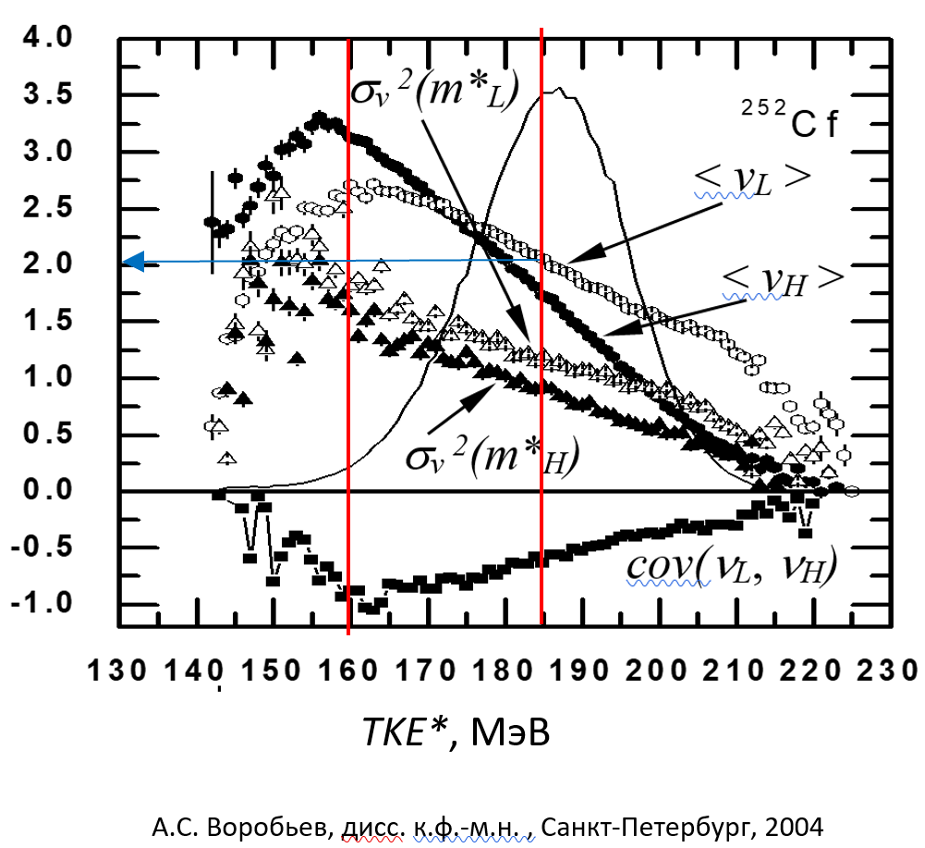
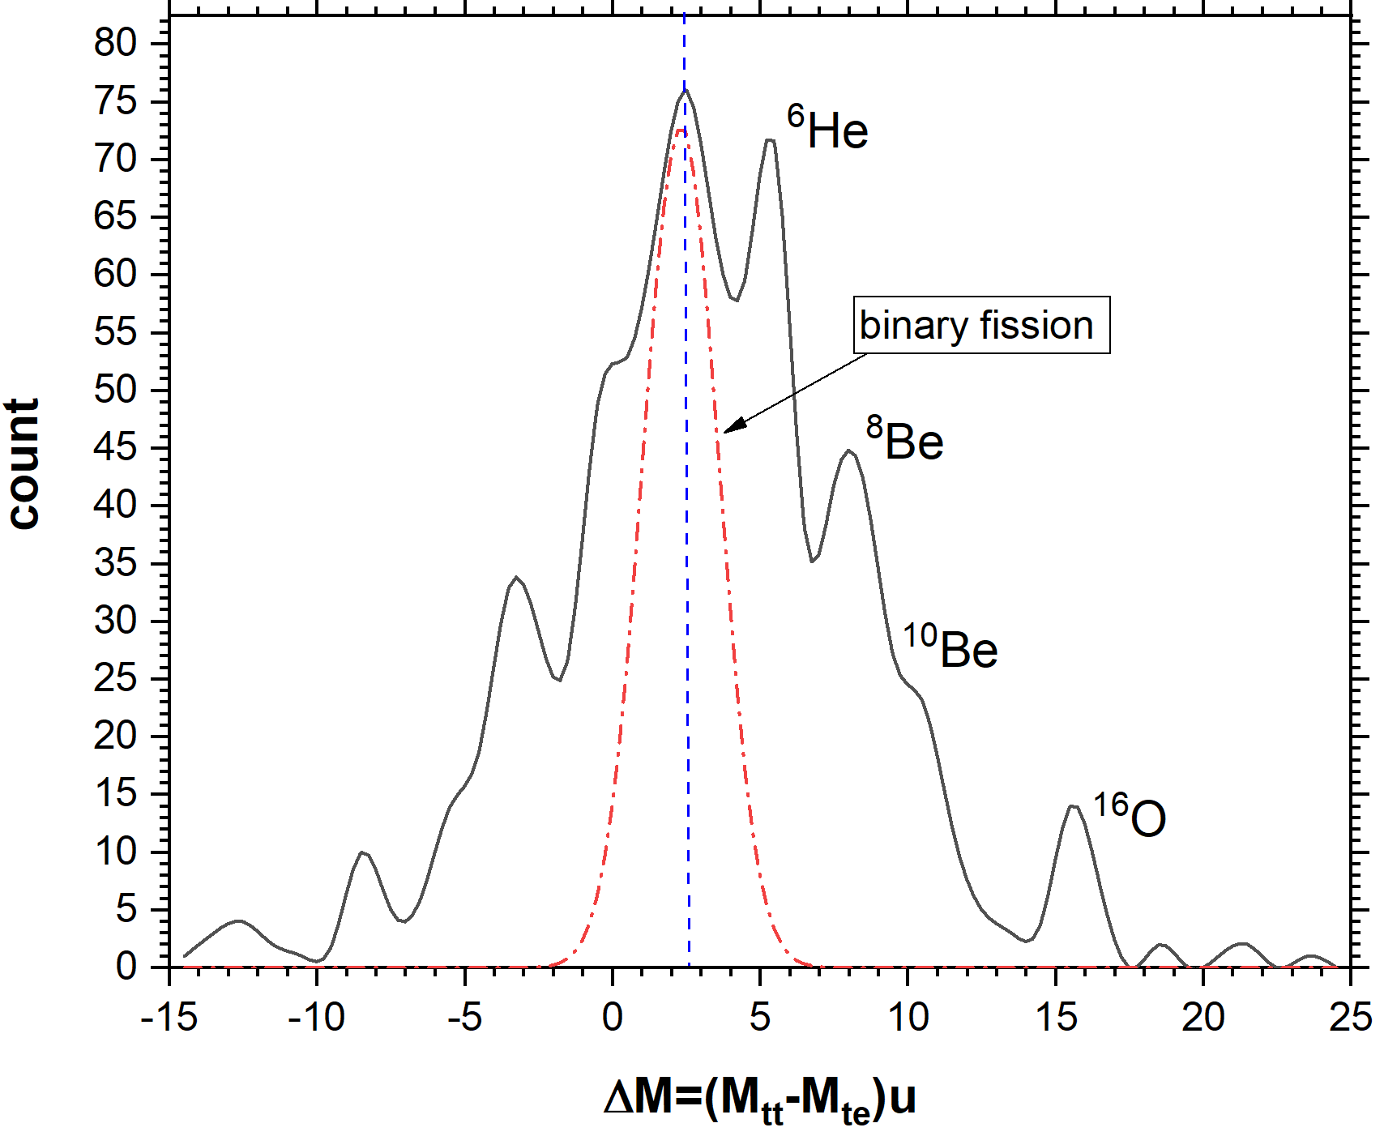
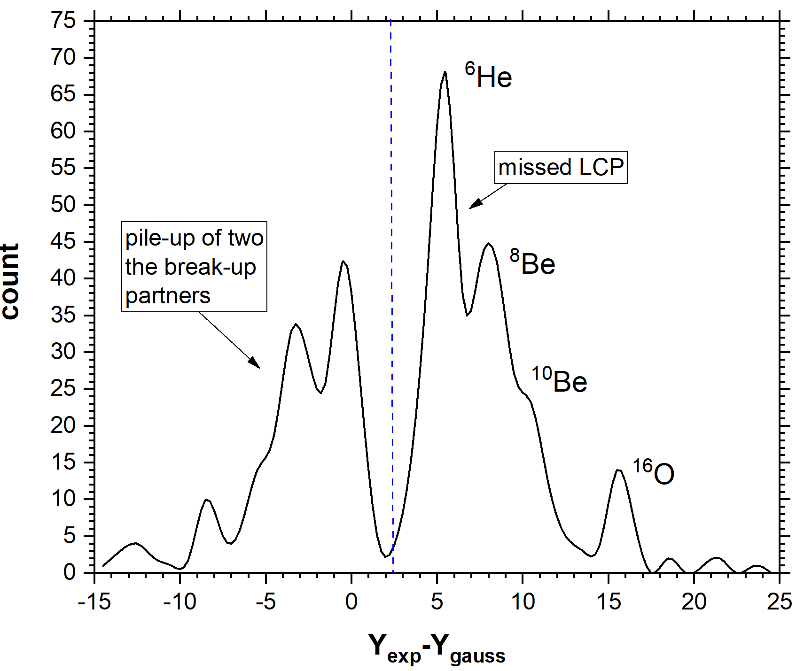
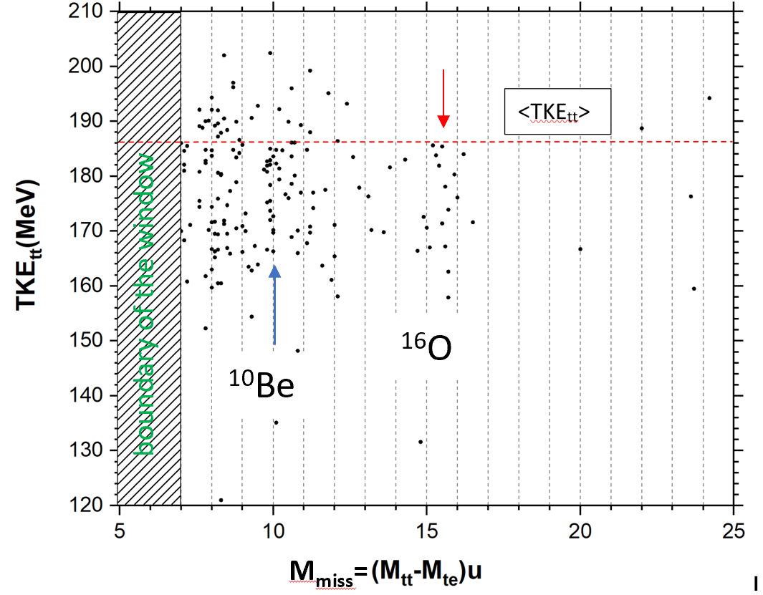
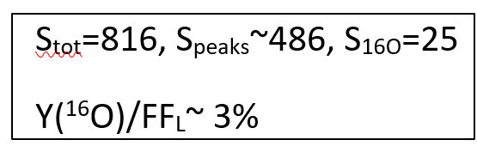
LCP accompanied break-up of the FFs from the light mass peak
Fig 1
Fig 3
Fig 4
S_{tot}~8000
Fig 5
Fig 2
Fig 6

Slide 4
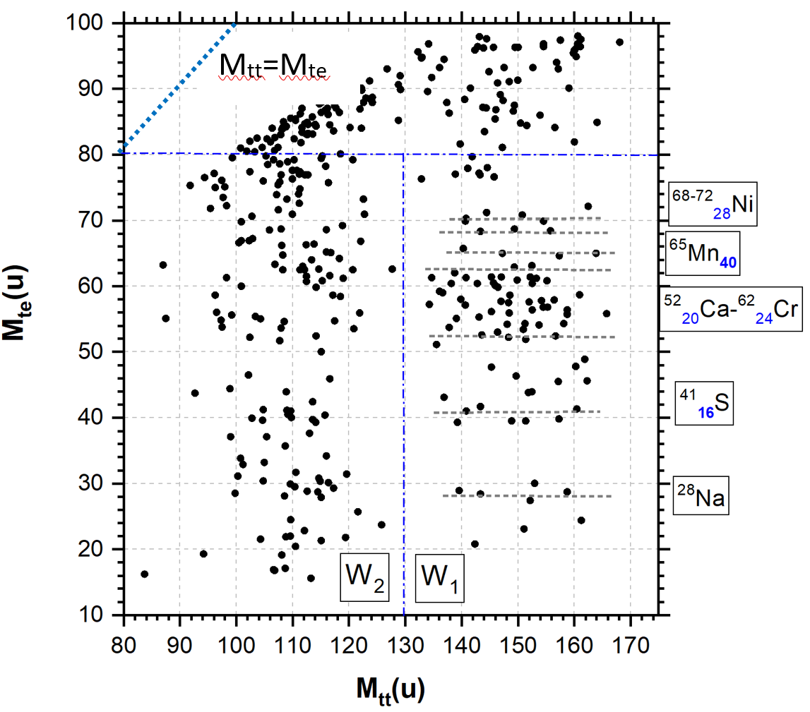
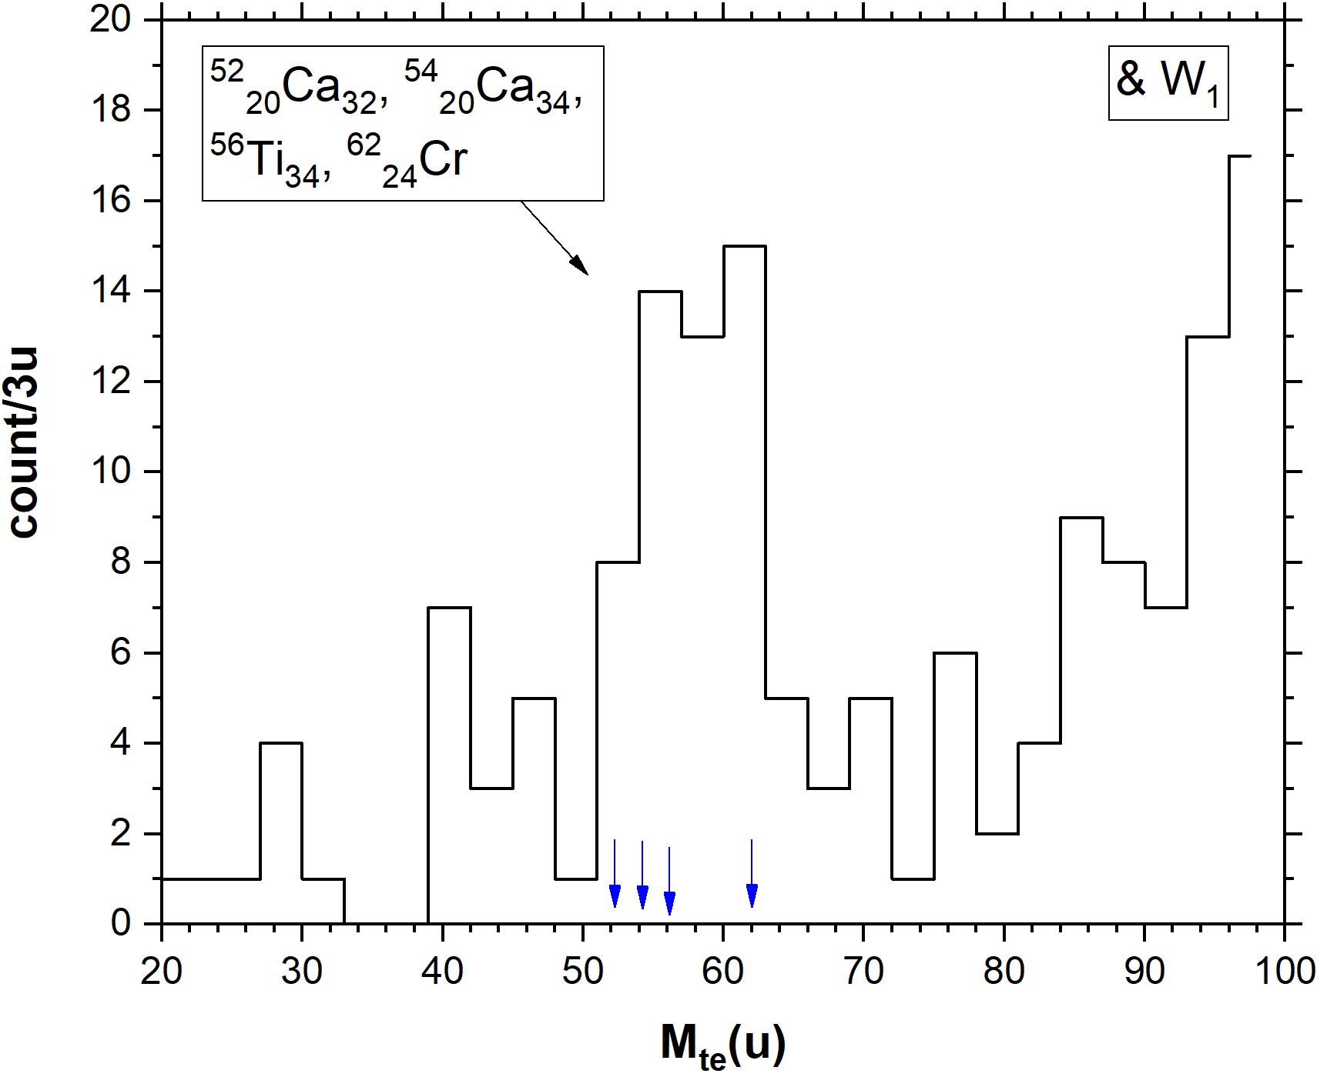
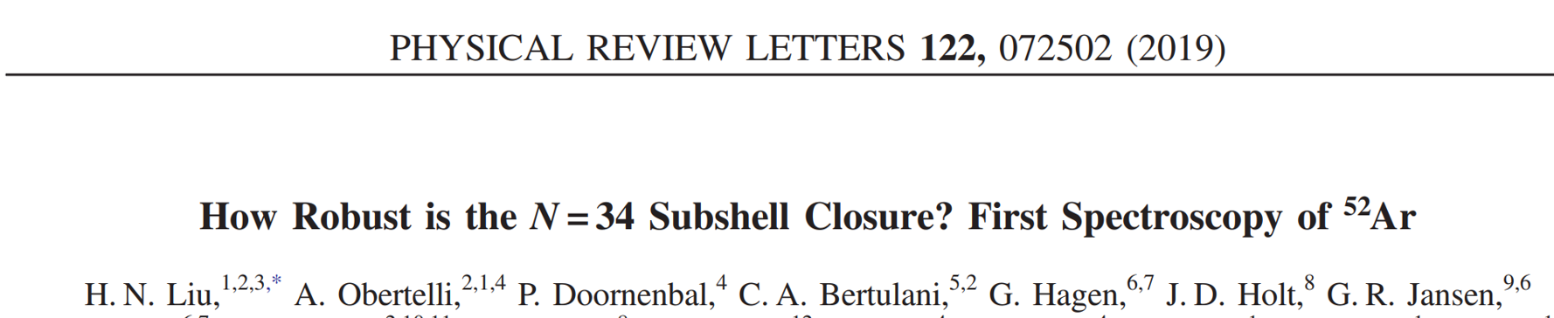
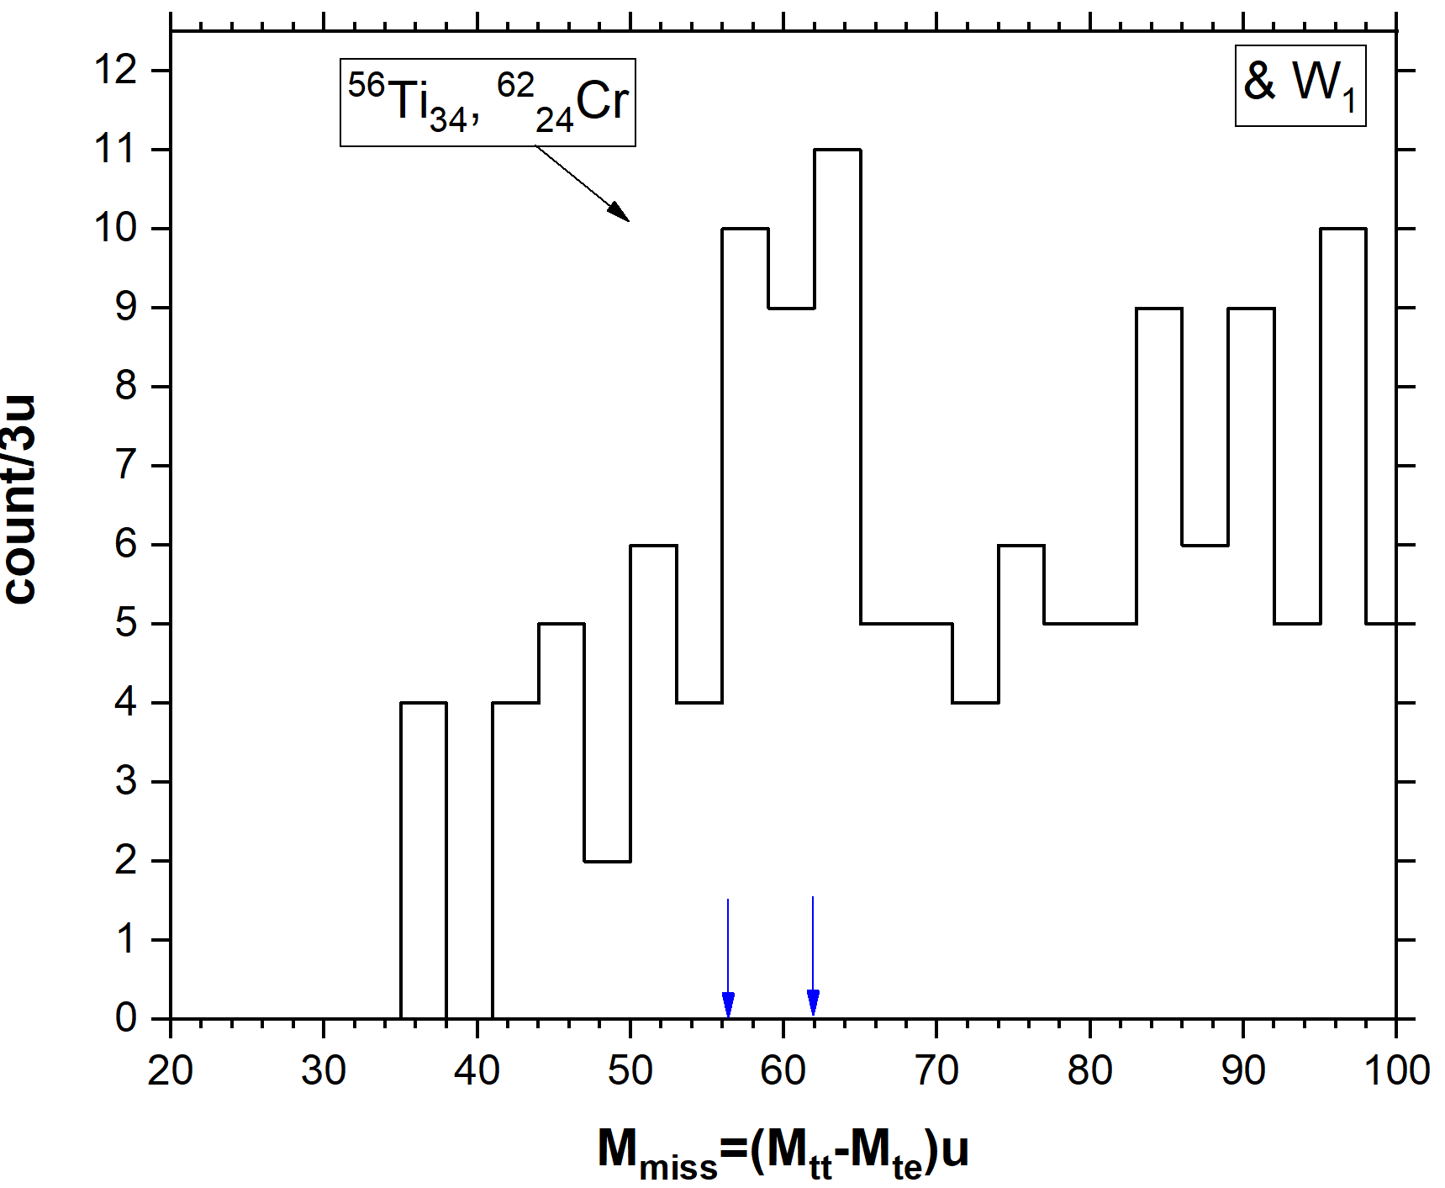
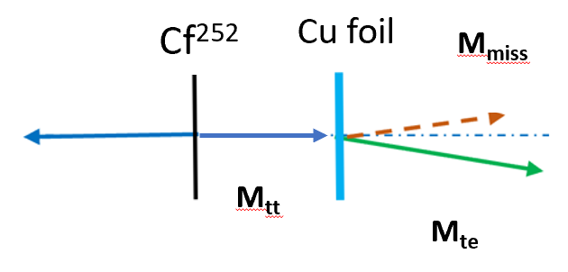
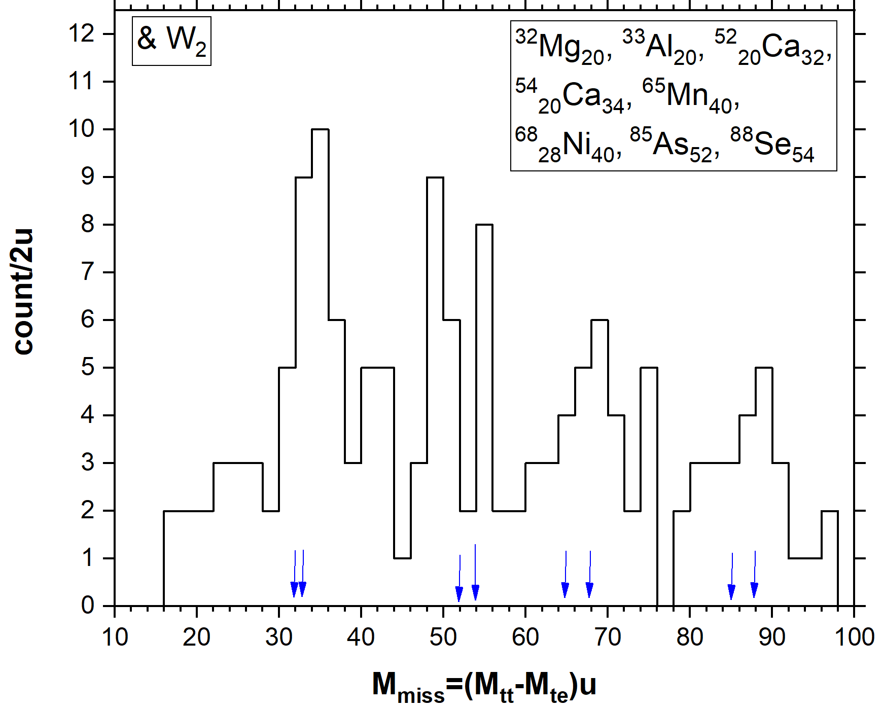
Twofold weighing at LIS spectrometer: light break-up partners
Fig 1
Fig 2
80 coauthors, RIKEN, fragmentation of a 345 MeV/u ⁷⁰Zn primary beam ; ⁵⁴Ca was concluded to be a doubly magic nucleus..
Manifestation of N=32, 34
subshells closures
The same fragments are seen both as detected and missed
S_{tot}~5*10⁵
^{much lower Y of}
^{the break-up}
Fig 4
Bright manifestation of clustering in the nuclear system before
the break-up
Fig 3
Yu.V.Pyatkov, D.V.Kamanin, et al.,EXON-2016", Confer. proc, World Scientific, 2017. p. 284-287

Slide 5
Discussion

Slide 6
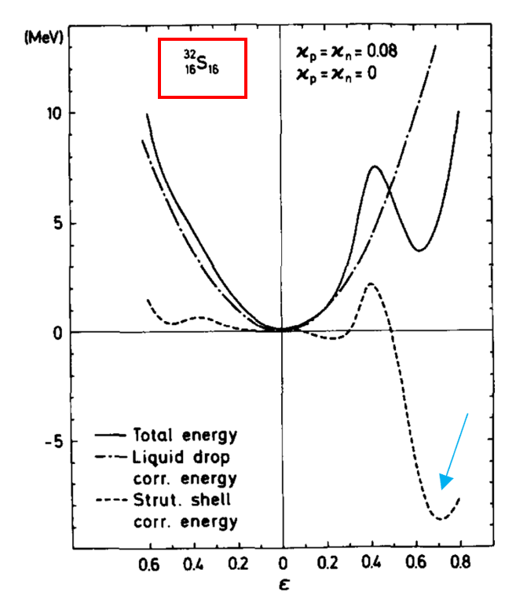
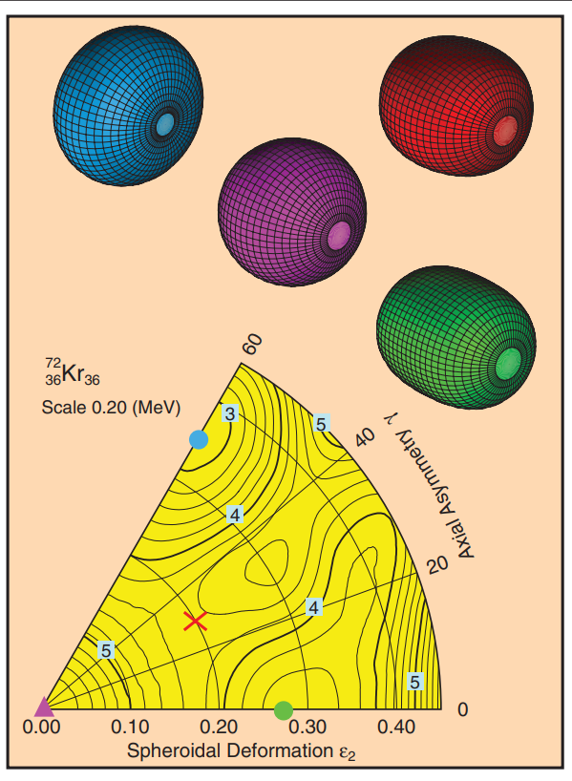
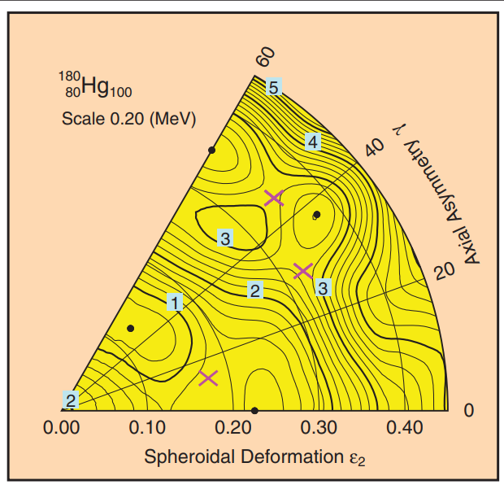
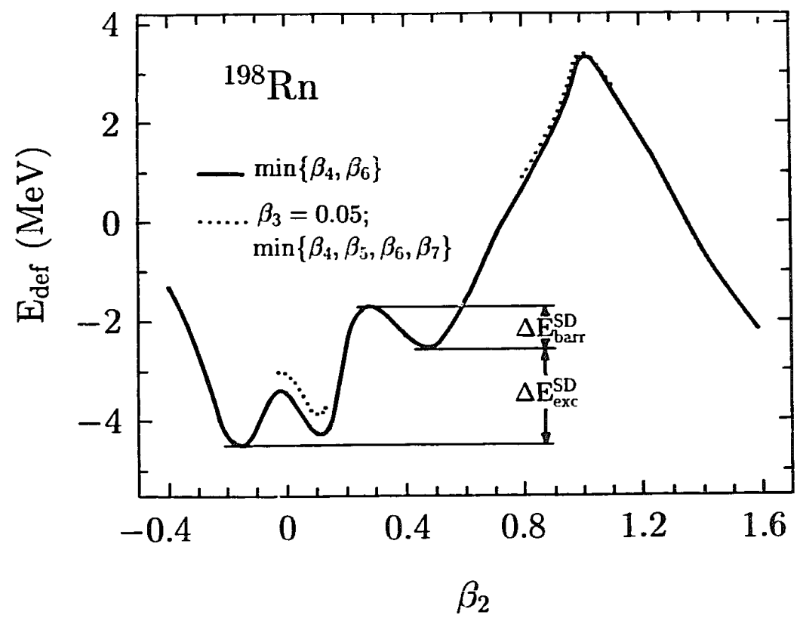
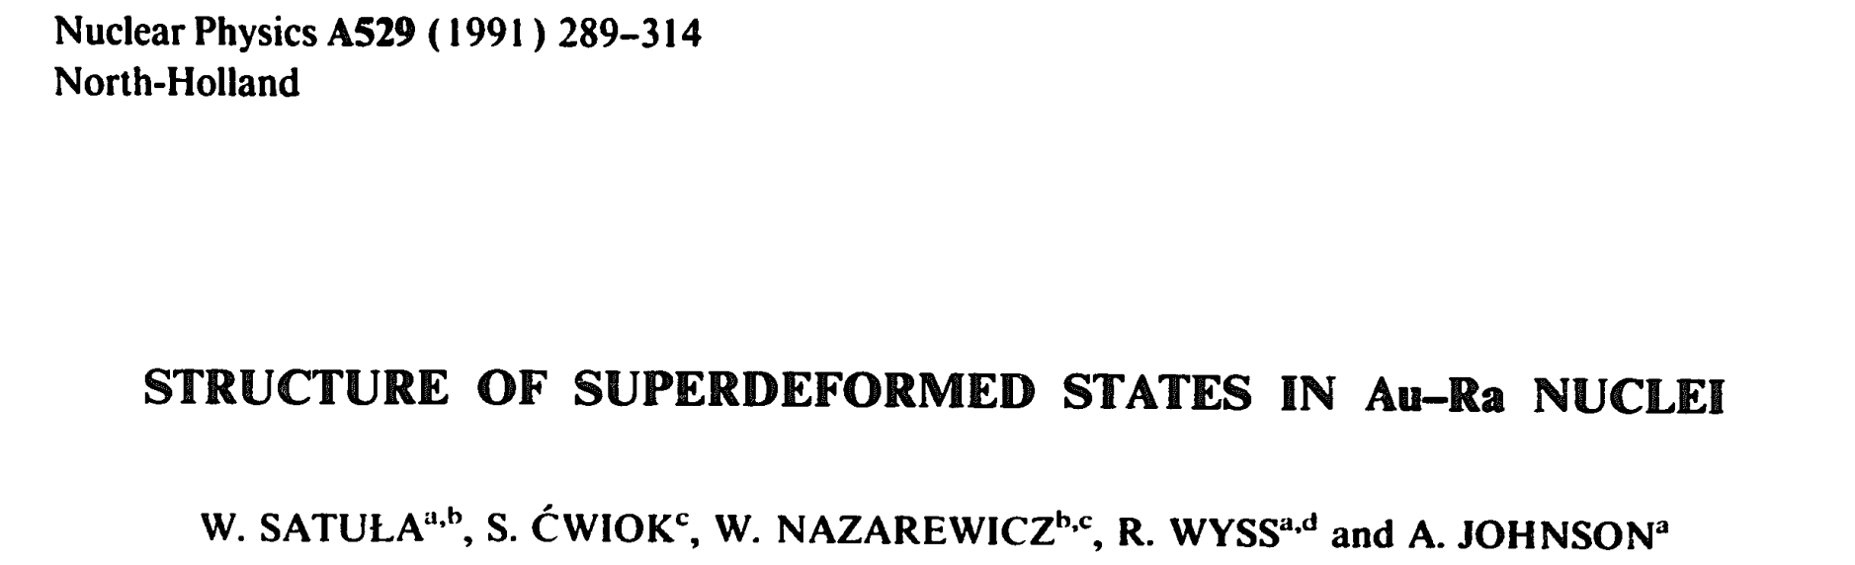
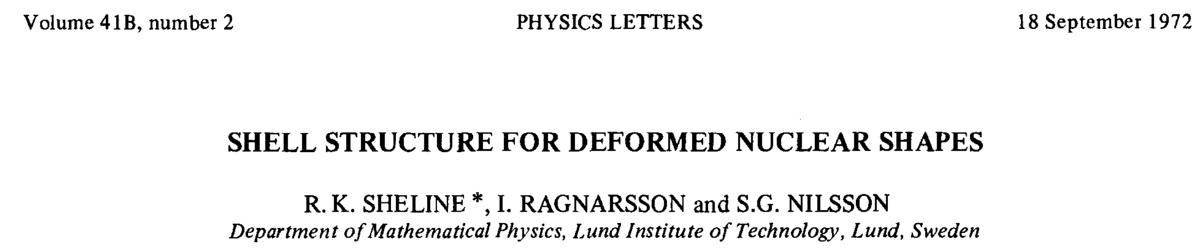
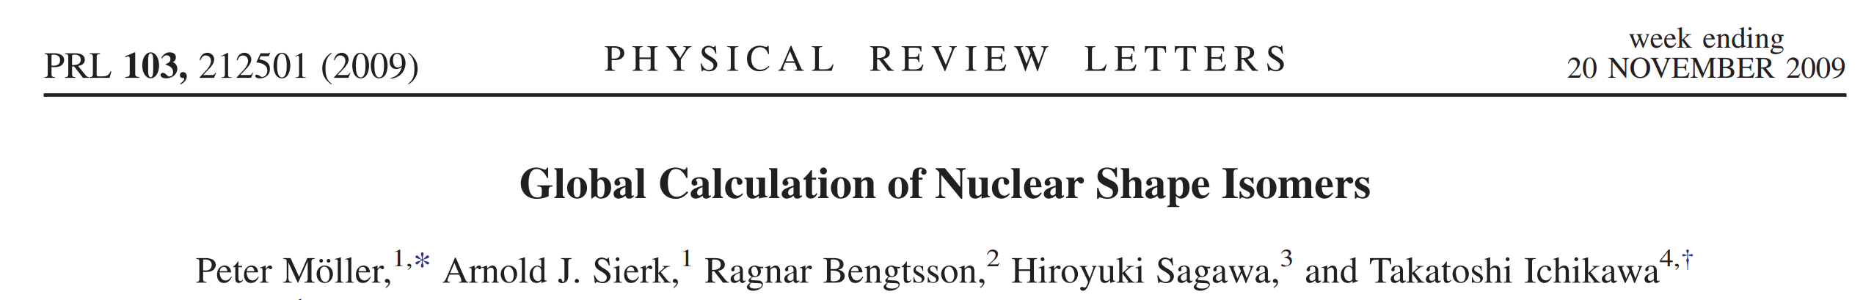
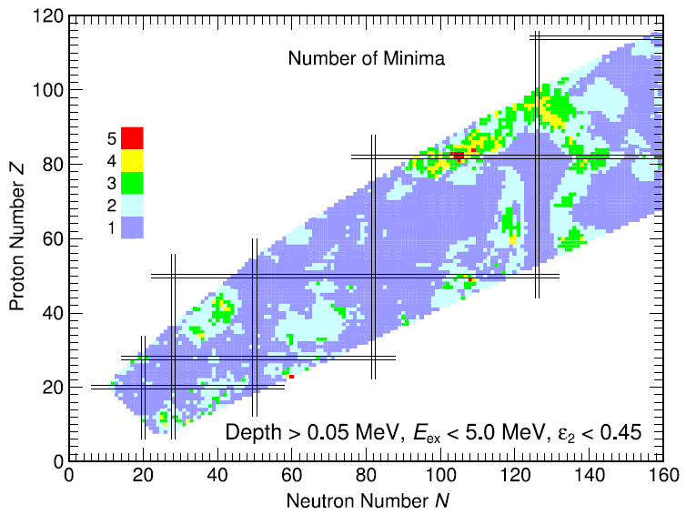
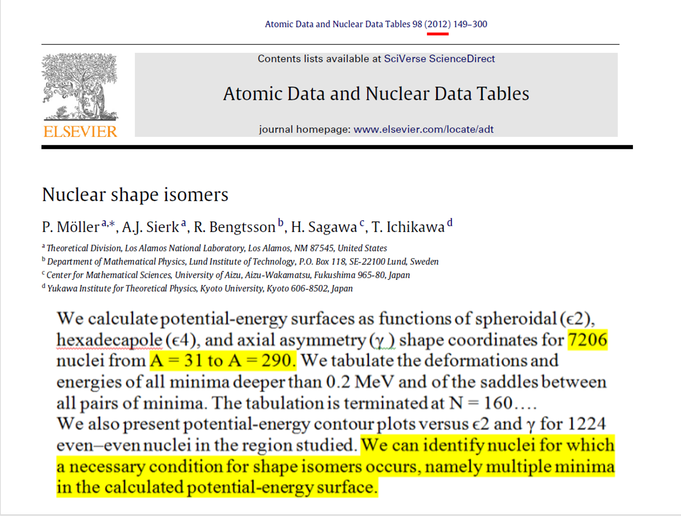
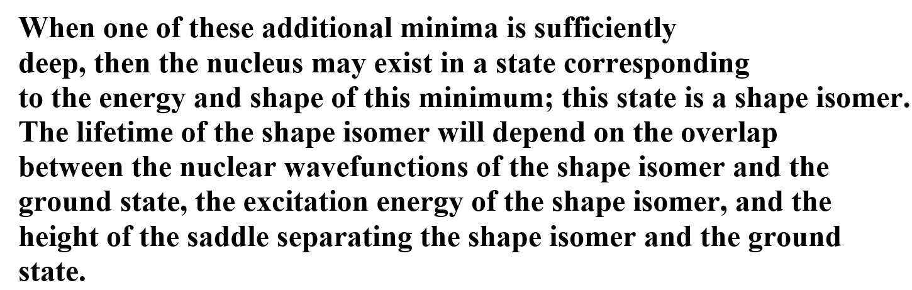
Shape isomers - predictions
FF region
Thus, the existence of numerous shape isomer states even in the same isotope are predicted in the wide range of nuclei from very light one as ³²S up to super-heavy.

Slide 7
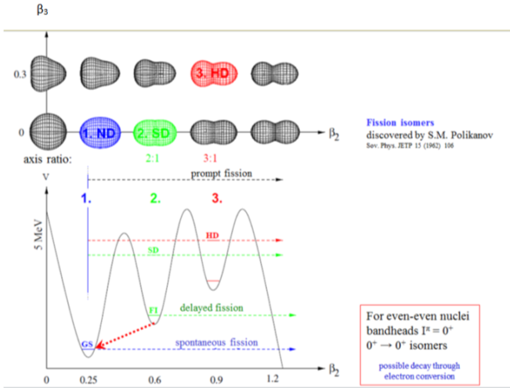
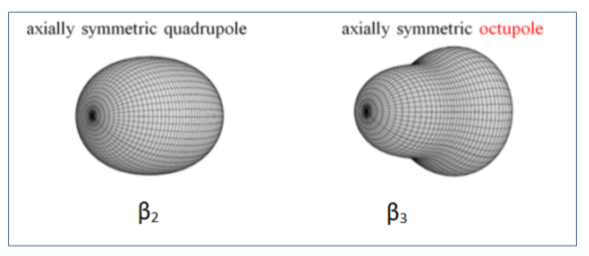
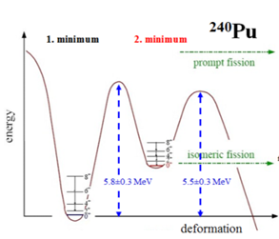

Next stage in studies of shape isomers : fission isomers
Fission isomers for the nuclei in the middle mass region including fission fragments
were not predicted theoretically
so far
Discovered in FLNR (JINR)
shape isomer state at the top of the fission barrier
-→ fission isomer
http://ns.ph.liv.ac.uk/posters/ptg/poster2.html

Slide 8
Historical remark

Slide 9
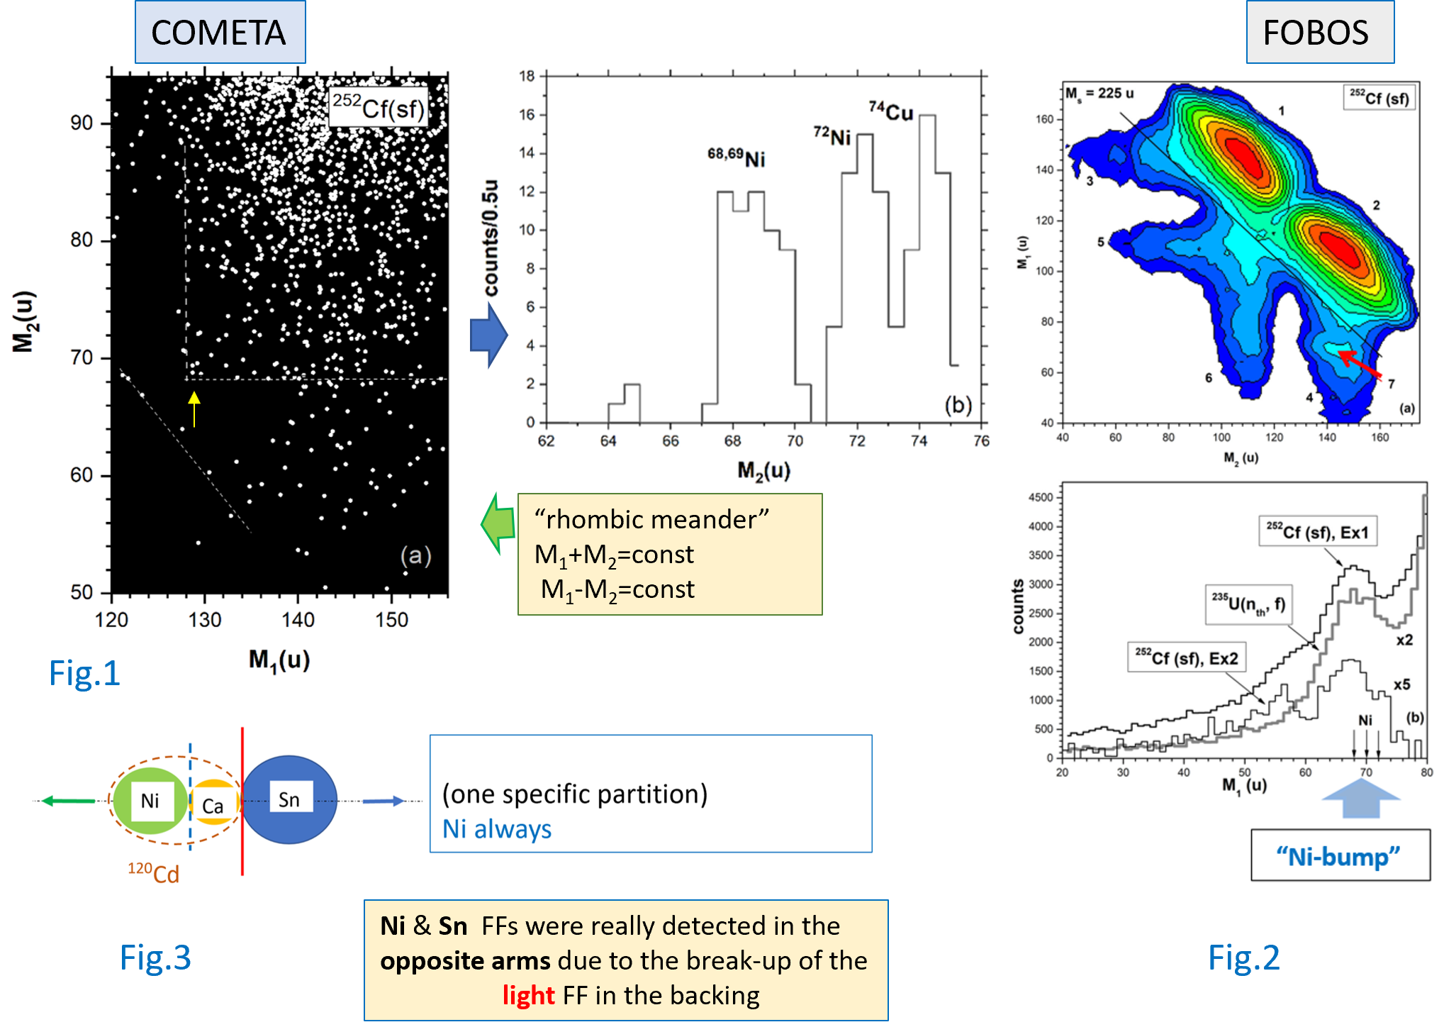
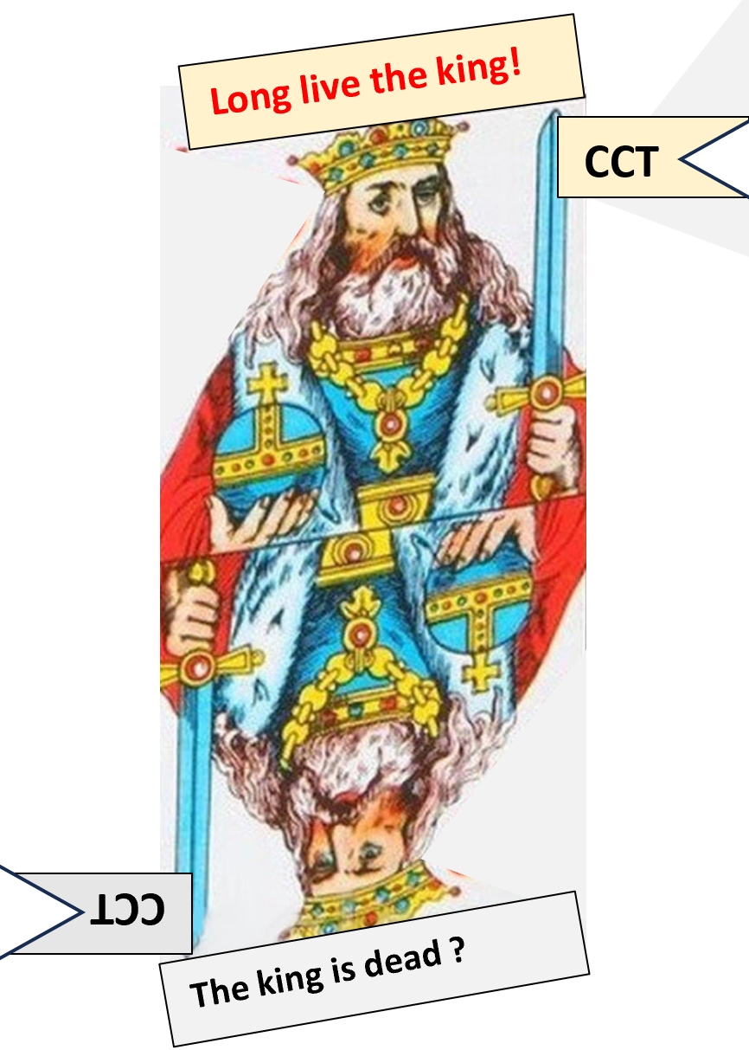
And what is about “good old “ CCT(Collinear Cluster Tri-partition )?
It is the research of the CCT gave evidence of the FFs break-up in the solid foil.
The main features of the break-up products were reproduced earlier in the CCT events.
In the CCT studies we had no opportunity to reveal that the FF break-up in the foil is delayed comparing a binary fission stage.

Slide 10

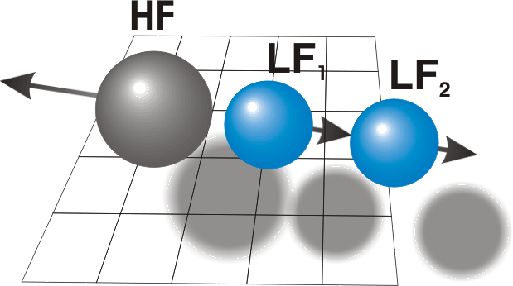


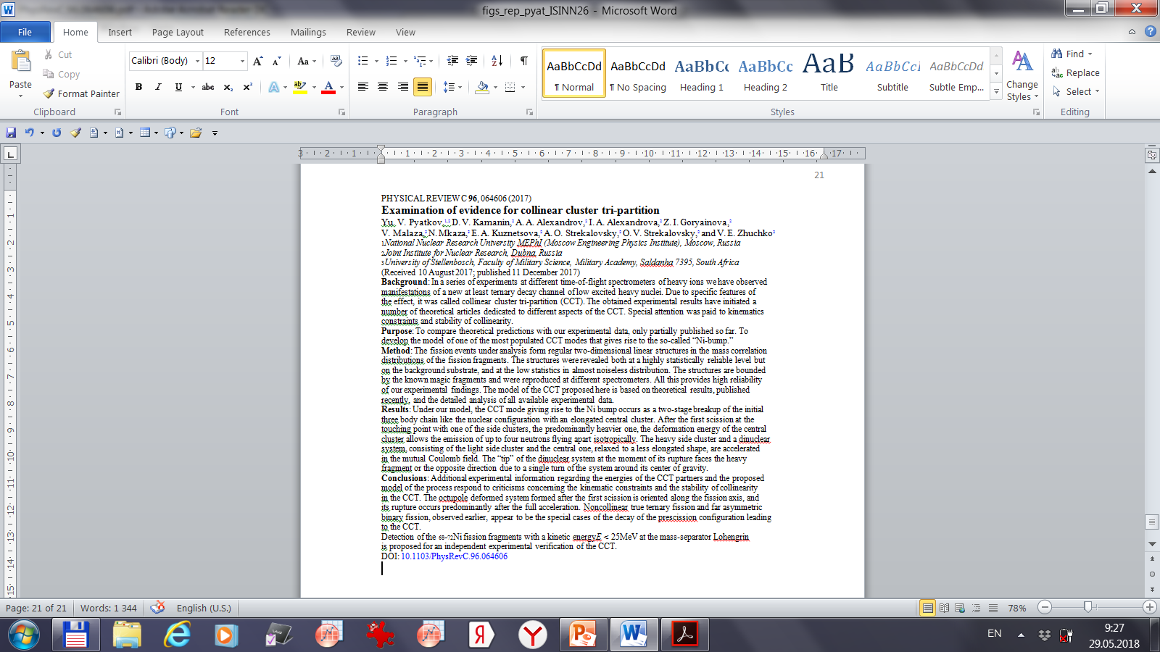
Collinear cluster tri-partition (CCT) – long lived history
Prescission ternary
configurations
supposed to be in game
The main benefit drown from the “CCT” studies:
confirmation of the effect
using the selection gates
which differ from that applied in a pure mass-spectrometry.
We mean the neutron multiplicity and nuclear charge gates used.
http://fobos.jinr.ru/

Slide 11
Conclusions
Using several experimental approaches, we have observed a break-up of some fraction of fission fragments (FFs) in the solid-state foils. The break-up is detained in relation to the binary fission which produced the FFs. The fact of delay gives evidence that the FF undergoing the break-up is born in the state of fission isomer.
In other words, for the first time we have observed the Coulomb induced break-up of the nuclei of middle masses prove to be the fission isomers.
Both facts were unknown in the past.
3. At least one of the break-up partners shows magic or semi-magic nucleon composition.
4. The yield of the break-up events changes in the wide range of values that indicates essential difference in the heights of the break-up barriers.

Slide 14
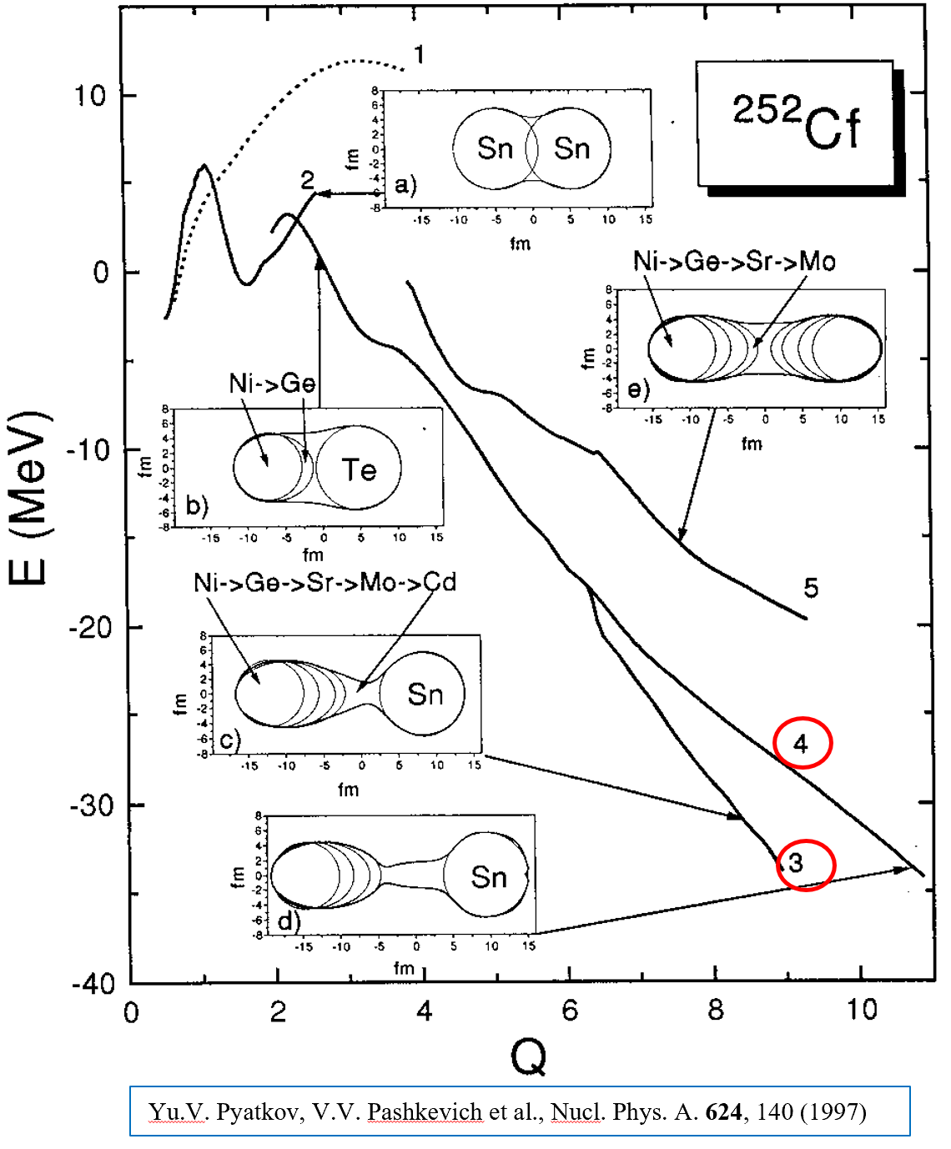
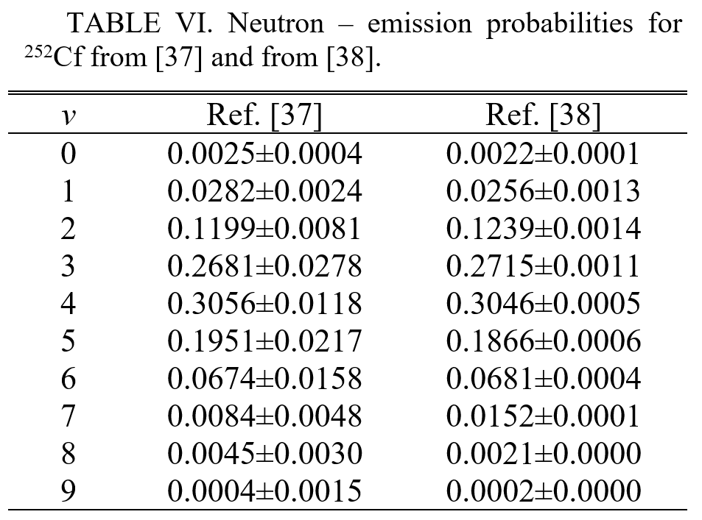
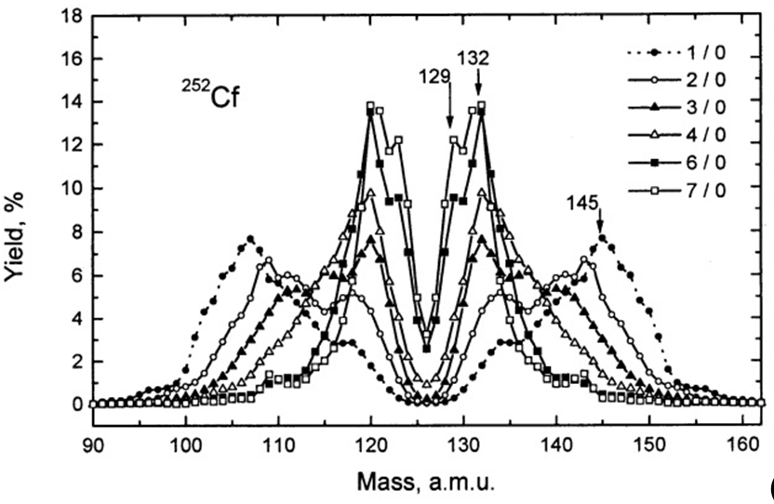
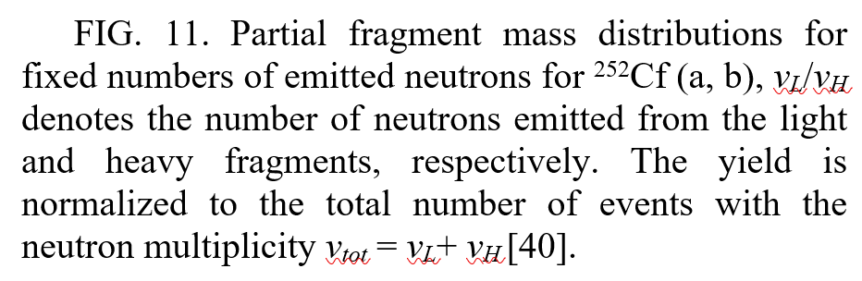
Clustering and division of deformation in prescission configuration of the mother nucleus
Fig 1
Fig 2
Fig 3
RIAN

Slide 15
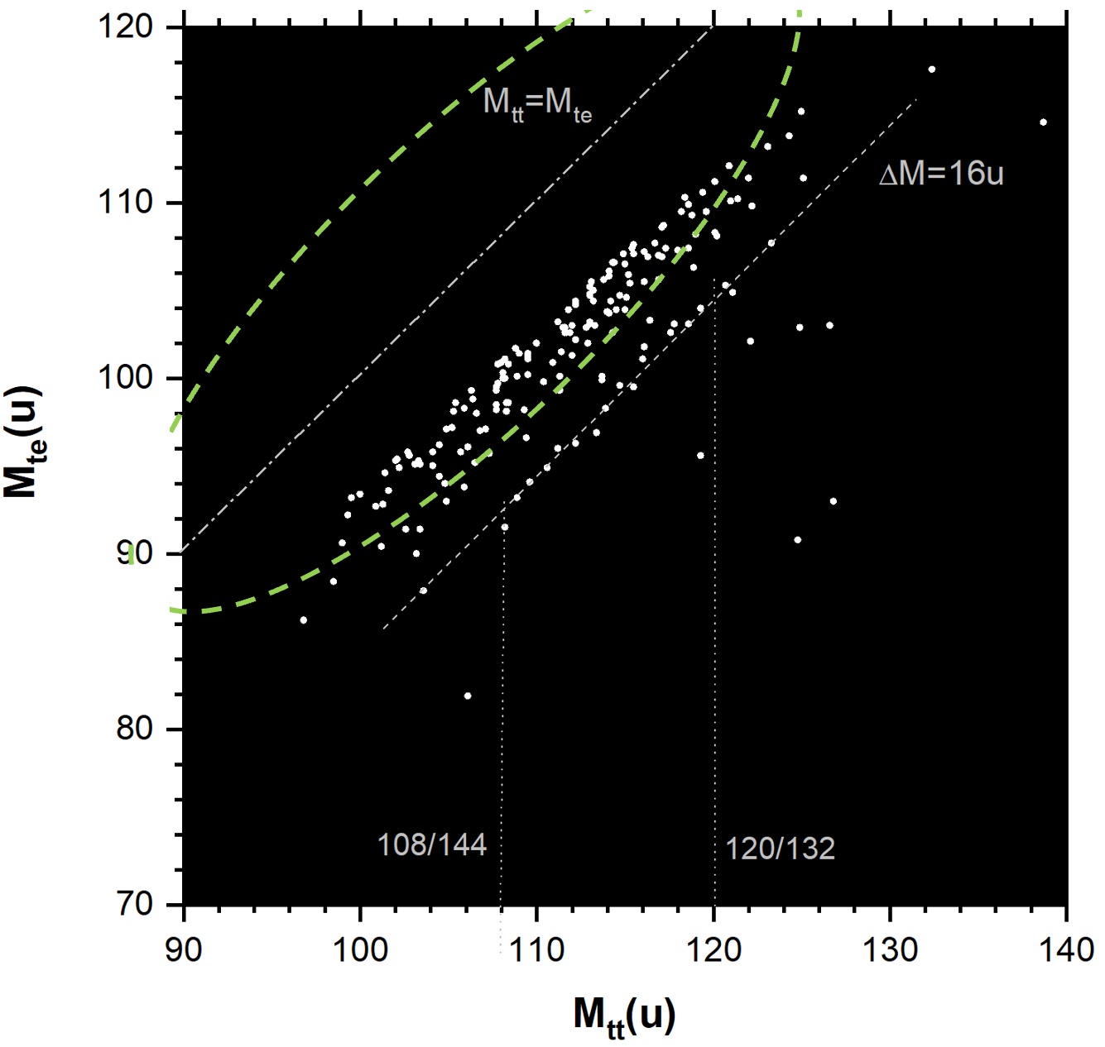
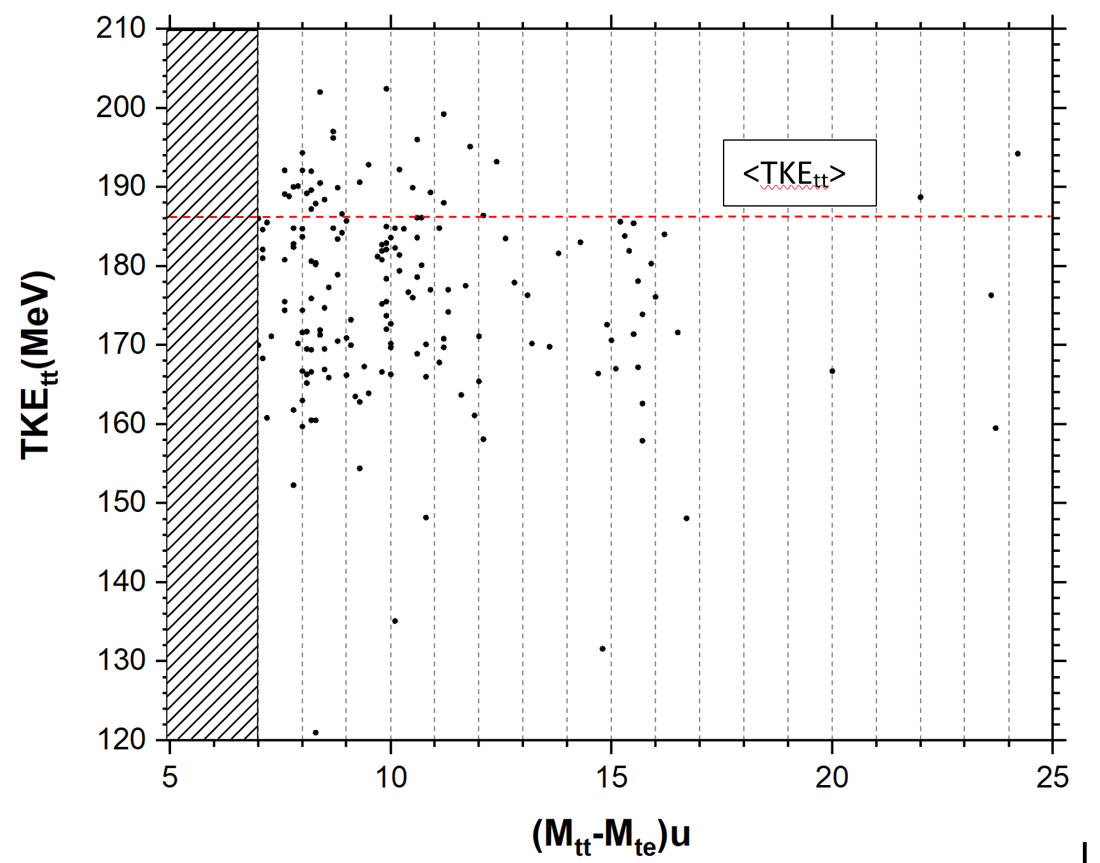
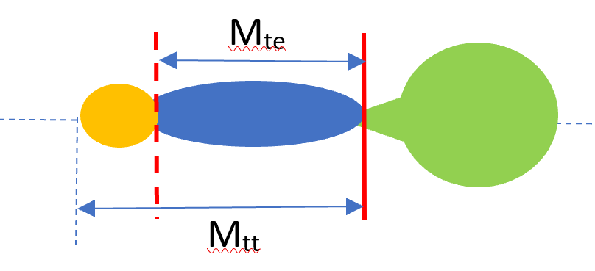
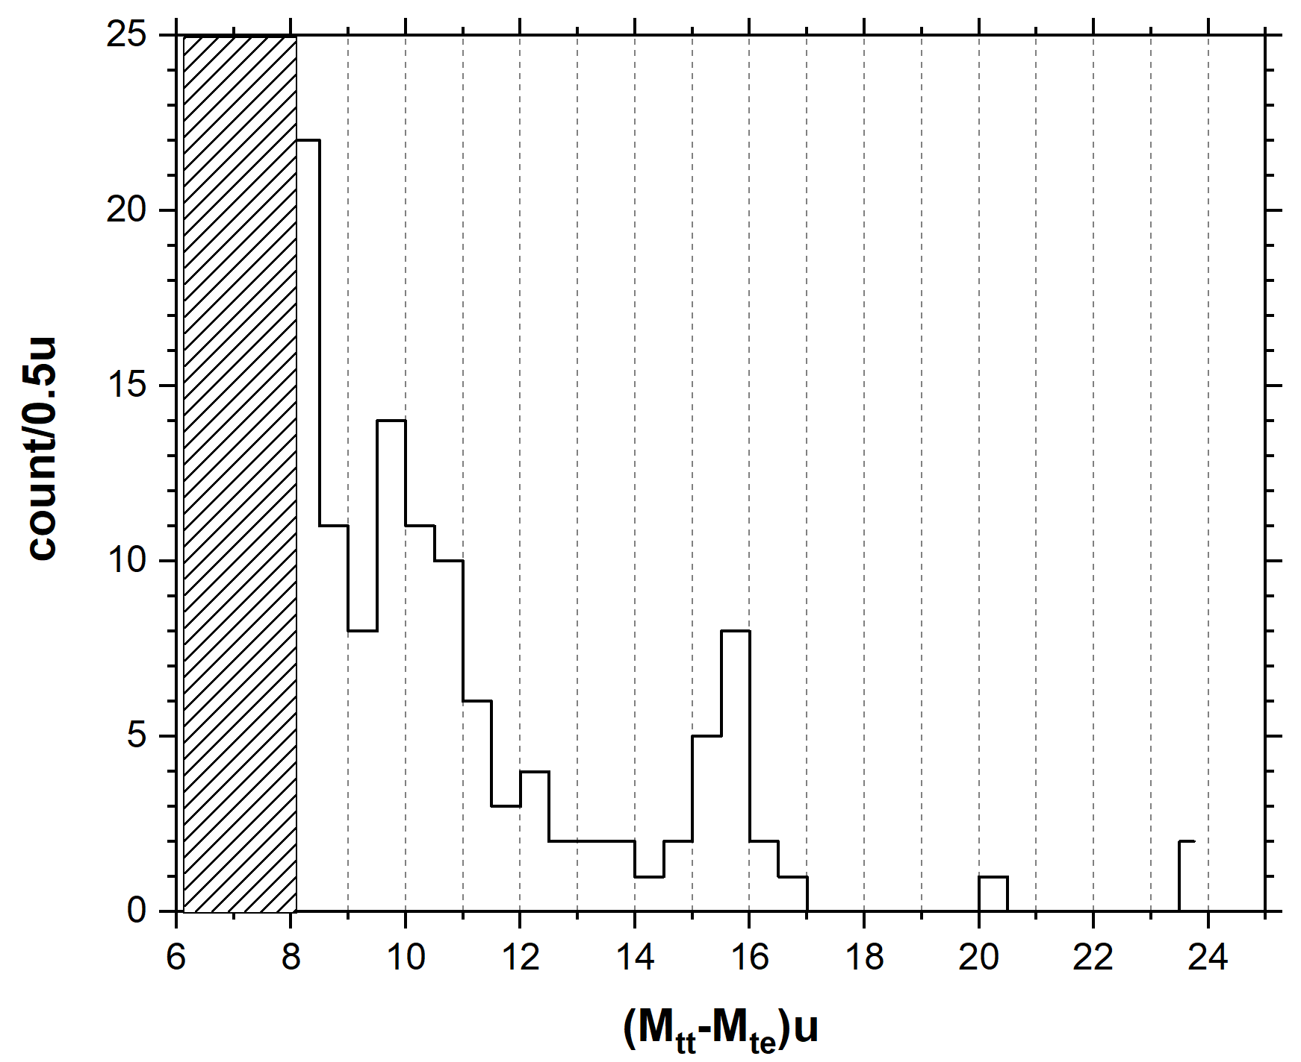
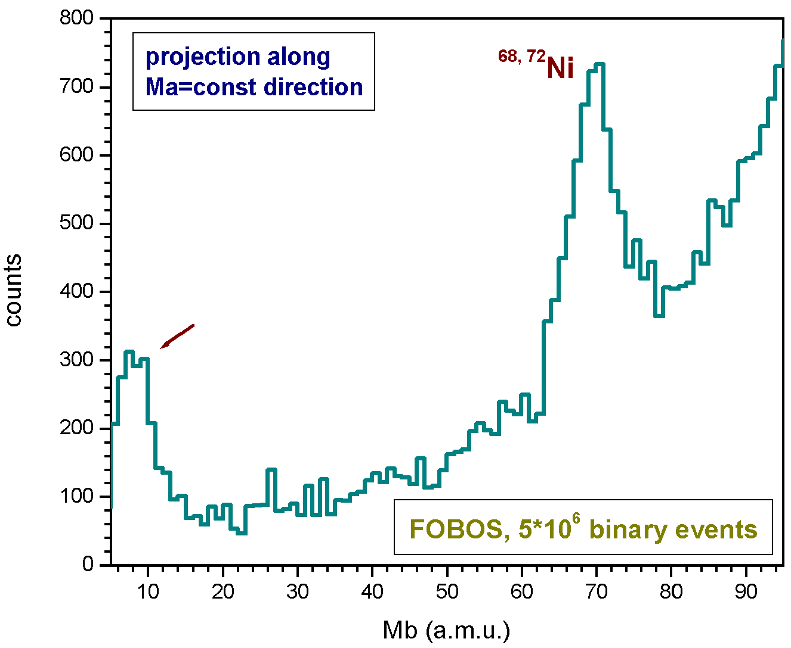

Twofold weghing & Cu foil @LIS spectrometer: missing light ions
Fig 1
Fig 2
boundary of the window
¹⁶O
¹⁰Be
& w1
M_{miss}=
S_{tot}~8000
Fig 4
Fig 3
FOBOS data
comparison
5*10⁻³/FF_{L} (¹⁶O)
¹⁰Be

Slide 16
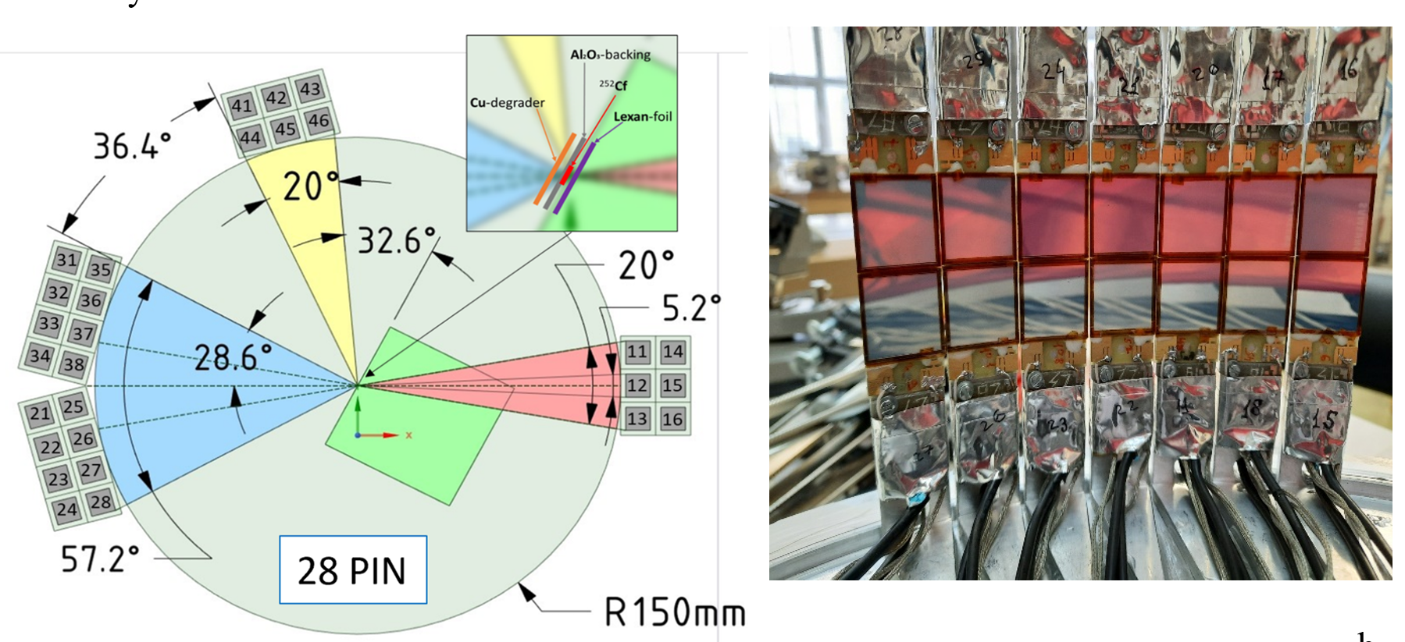
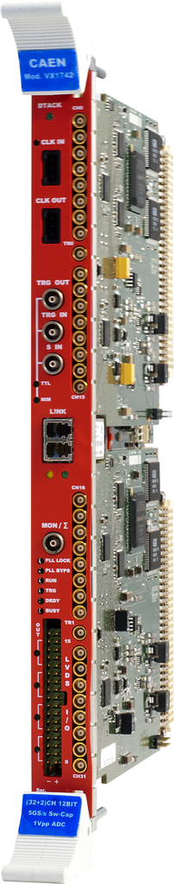
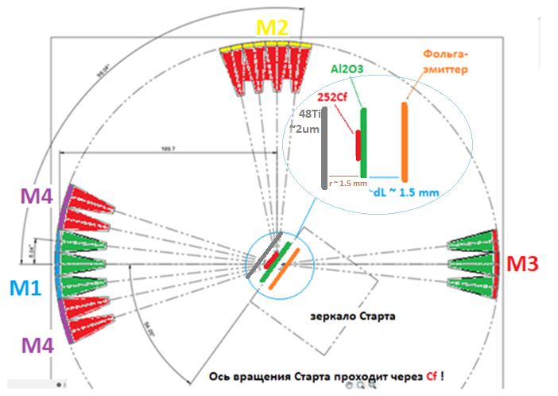
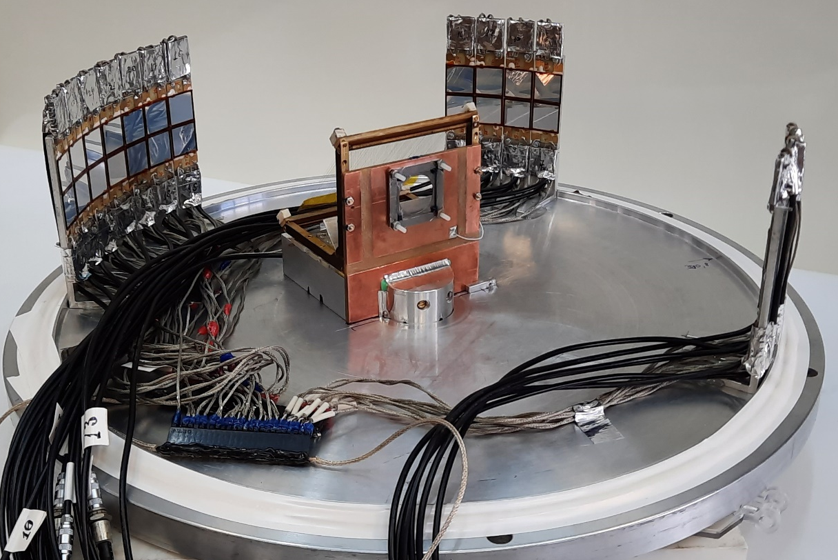
COrrelation M-E-T Array (COMETA) setup
ToF-E method for triple coincidences:
ToF_{i} & E_{i} -> M_{i}
i = 1,2,3
COMETA-f
angular uncertainty
arm_1
arm_2
²⁵²Cf (45 kBq)
Spot d= 3 mm on Al₂O₃ 65 ug/cm²
VX1742
32+2 Channel 12bit 5 GS/s Digitizer
200ps/ch

Slide 17
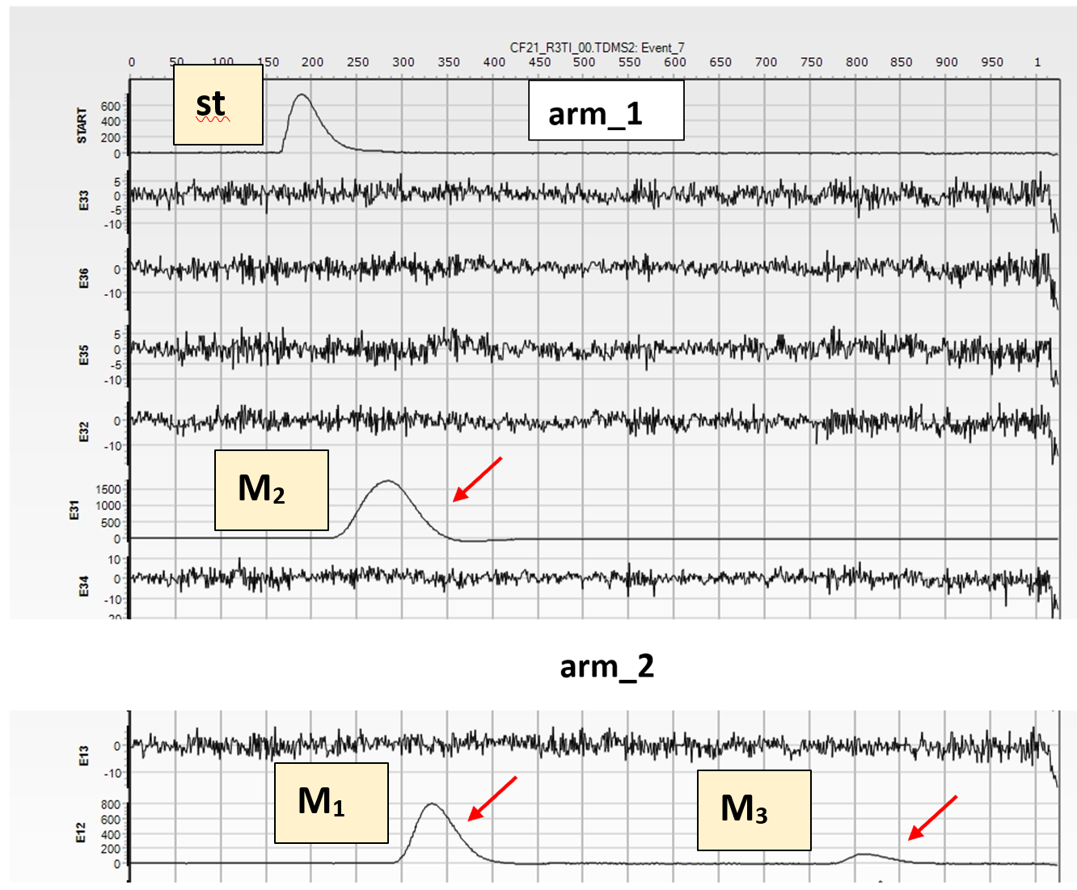
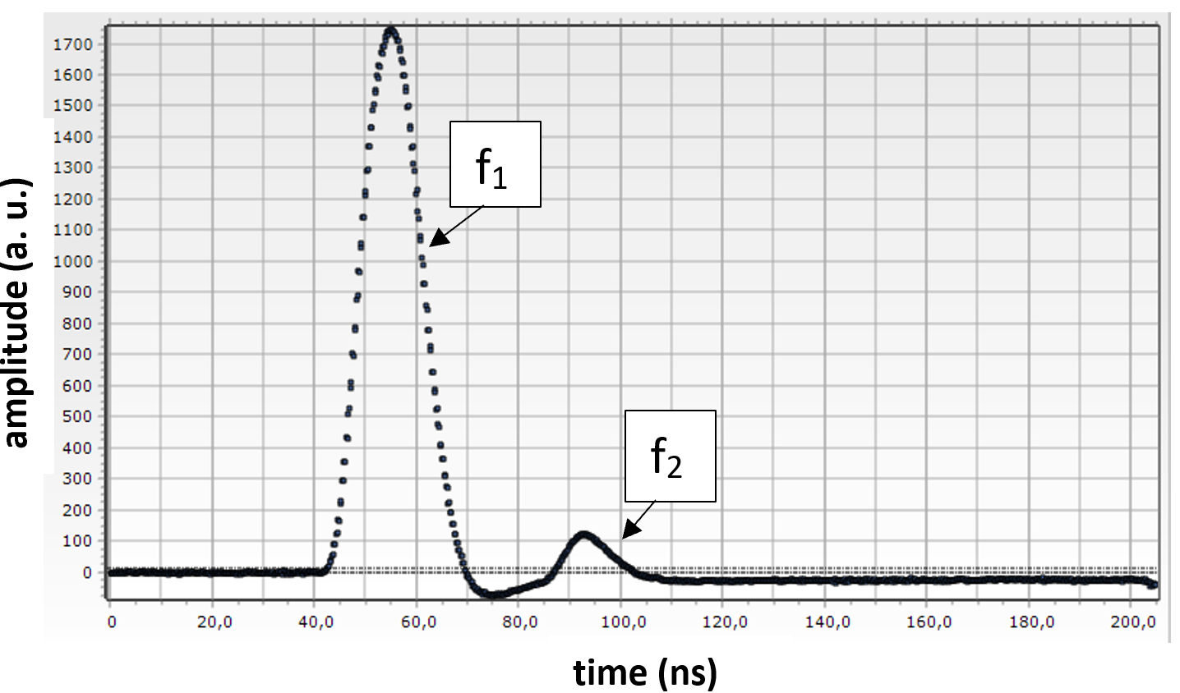
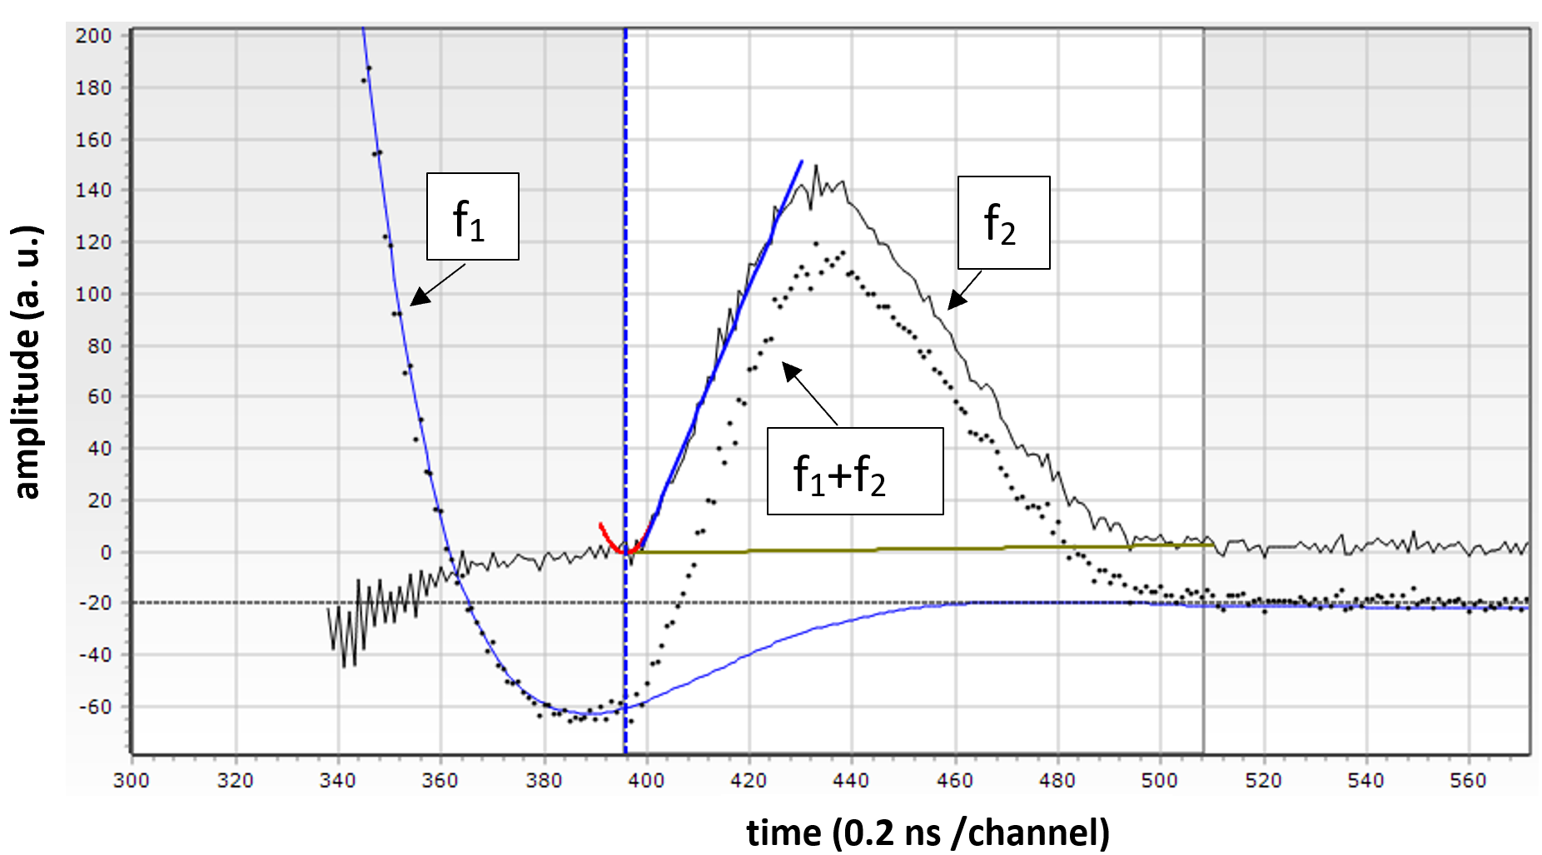
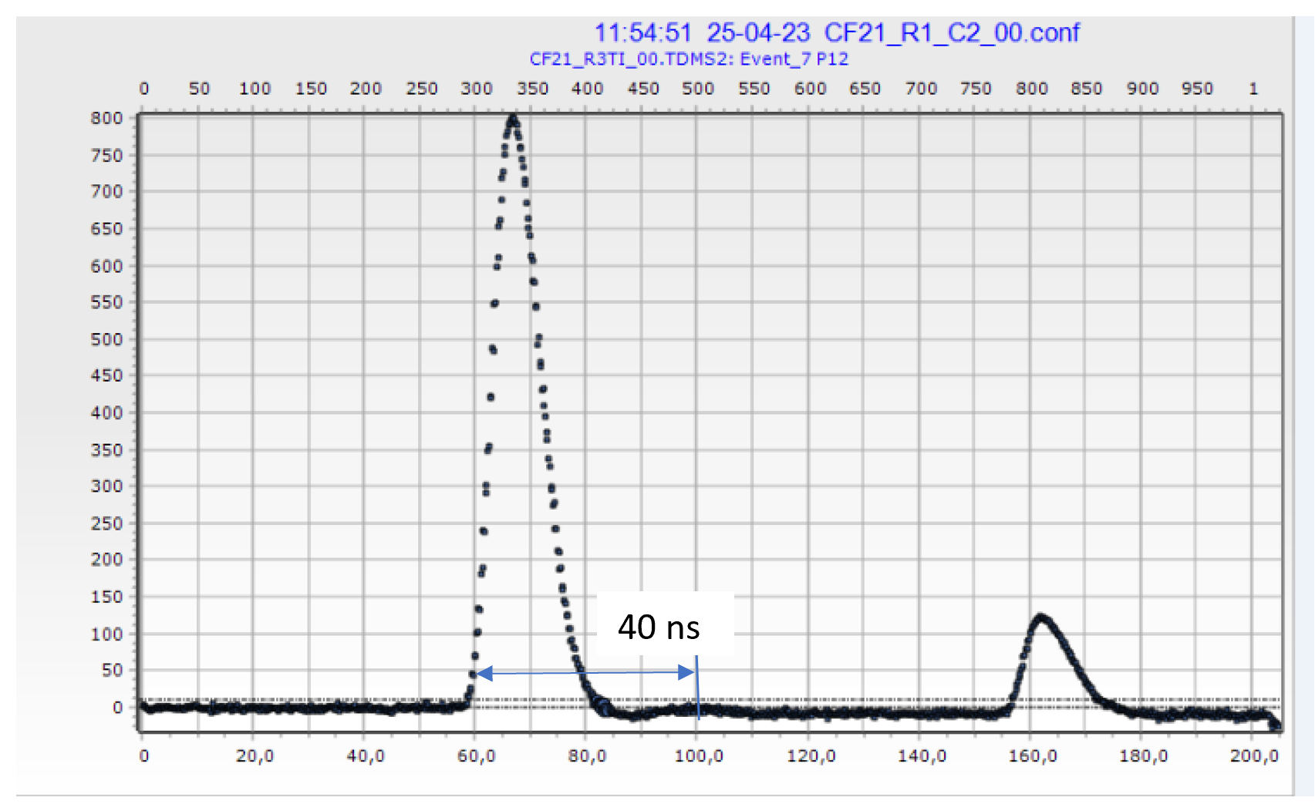
Fig 1
“Double-hit” approach for searching for the multi-body decays
Fig 3
Double-hit event, pile-up of the signals f₁ and f₂ detected in the same PIN diode
Fig 4
Restoring original signals f₁ and f₂ from pile-up.
The error in the time-stamps does not exceed 112 ps, while the relative difference in energies δE=0.35%. The two signals in the pile-up event were separated by approximately 30 ns.
Fig 2
Measurement of the current
value of the signal each 200ps

