Slide 1
Double-hit experimental approach in studies of the multibody decays of heavy nuclei
D.V. Kamanin¹, Yu.V. Pyatkov^{2,1}, V.E. Zhuchko¹, Z.I. Goryainova¹, E.A. Kuznetsova¹, P. Yu. Naumov², Yu. M. Sereda¹, A.N. Solodov¹, O.V. Strekalovsky¹, A.O. Zhukova¹
¹ Joint Institute for Nuclear Research, 141980 Dubna, Russia
²National Nuclear Research University “MEPHI”, 115409 Moscow, Russia

Slide 2
Introduction

Slide 3
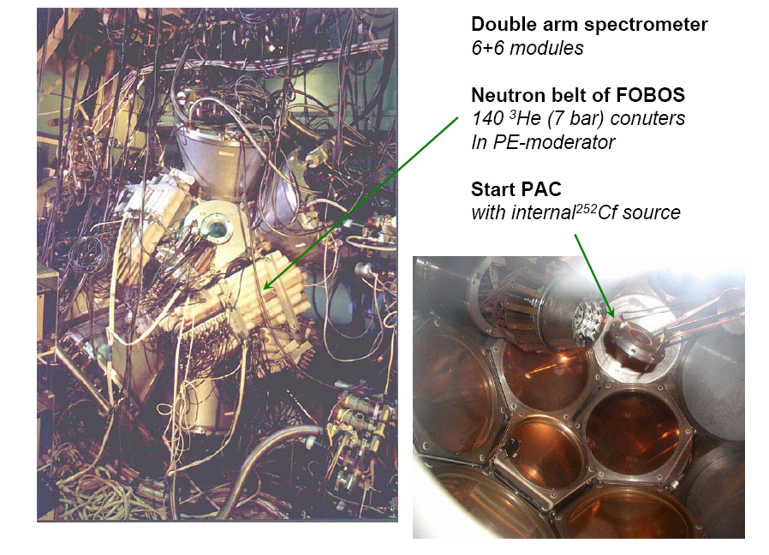
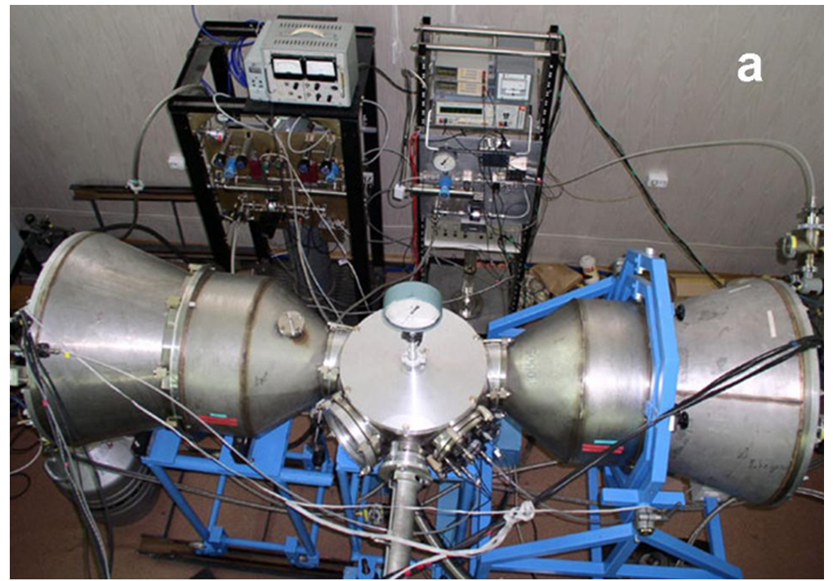
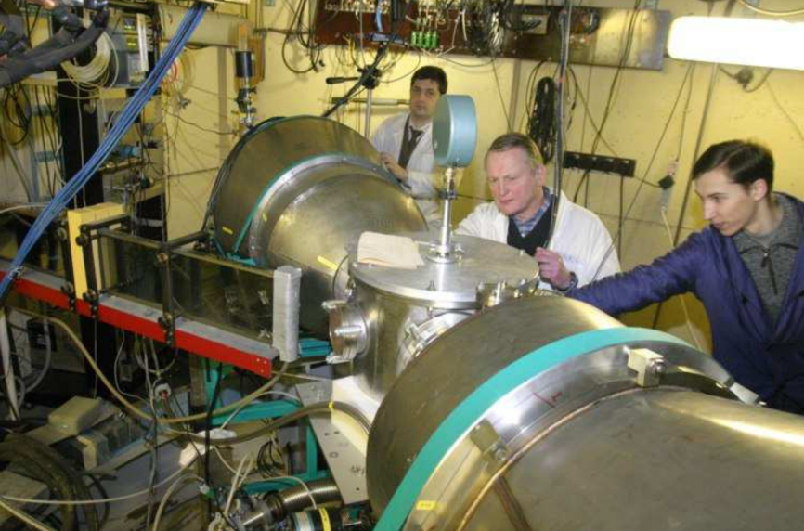
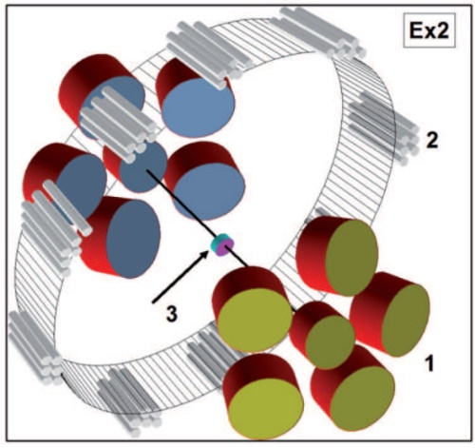
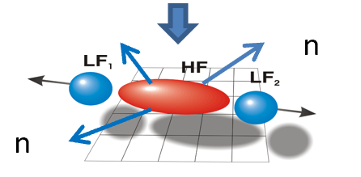
4-π FOBOS setup: gas filled detectors, CAMAC in data acquisition system,
“neutron belt”, Z-identification
Mini-FOBOS setup at the IBR-2 beam
FOBOS and modified FOBOS setups

Slide 4
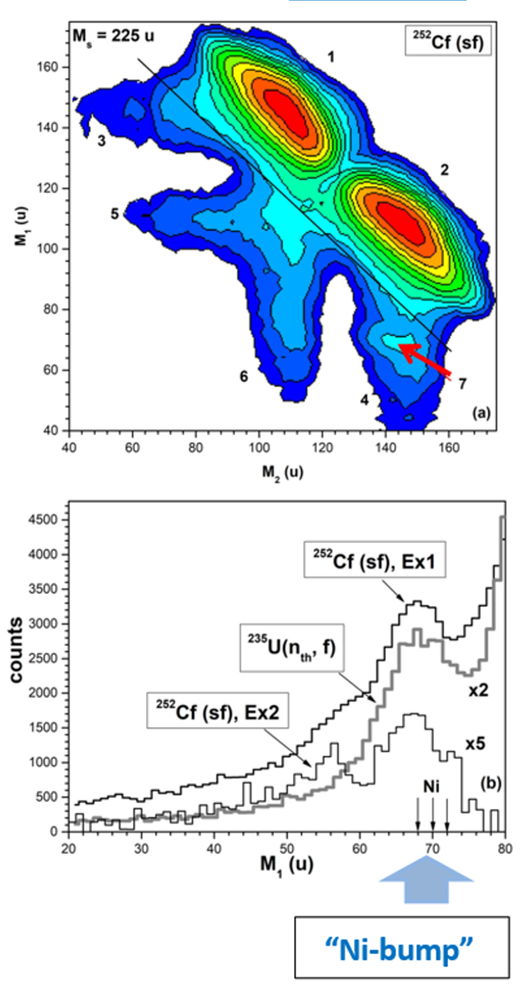
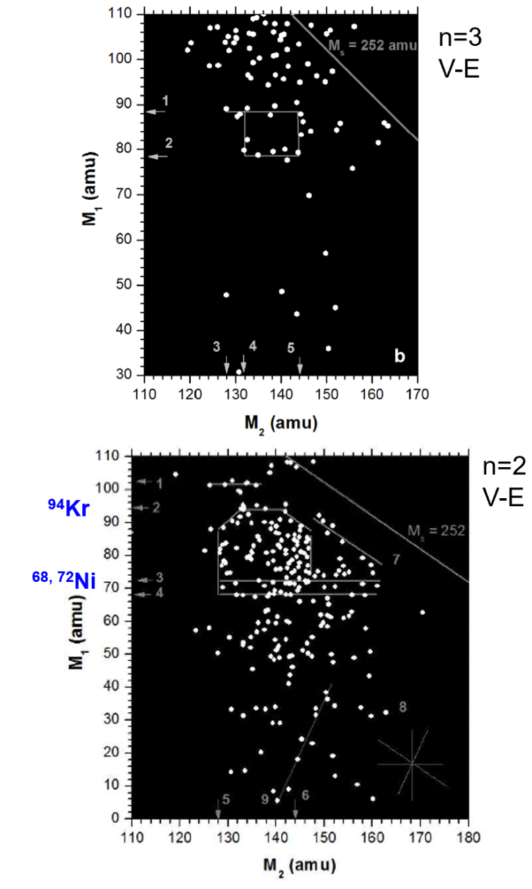
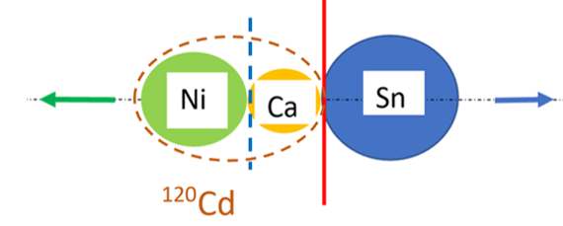
First observation of the FF break-up in the solid-state foil
missing
1
2
Methodical challenge:
detection of two
almost collinear fission fragments
from the rare decay
mode
Neutron gated structures

Slide 5
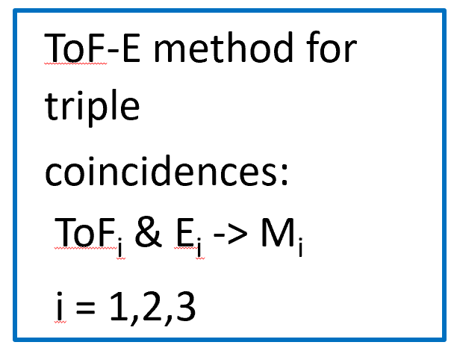
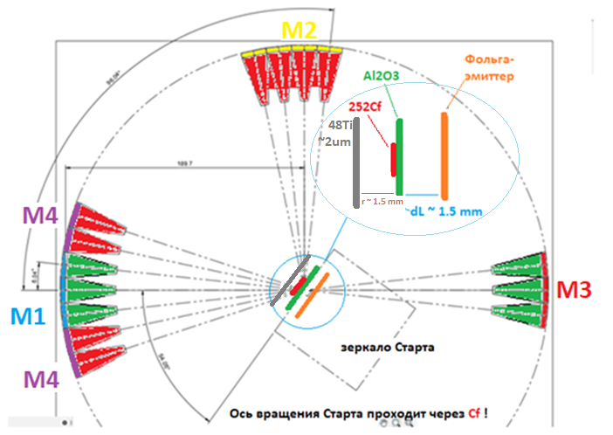
COrrelation M-E-T Array (COMETA) setup
1
Digital image of rare
events
²⁵²Cf (45 kBq)
Spot d= 3 mm on Al₂O₃ 65 ug/cm²
angular uncertainty in 2-hit
arm_1
arm_2
VX1742
32+2 Channel 12bit 5 GS/s Digitizer

Slide 6
Specific approach to the energy spectrometry with PIN diodes: : short waveforms
In the classic approach: Q~E = $\int_{−∞}^{∞}{i\left(t\right)dt}$
In classic spectroscopy voltage impulse looks like a tens microseconds stair-step, while the time interval between the sequential hits of two CCT products of a PIN-diode could be several nanoseconds.
For independent registration of such signals ( “double hit” mode)
they must be short shaped.
In such a case amplitude is not a good measure of energy any more because it depends on signal shape
This expression demonstrates that signal area can serve as a linear measure of particle’s energy:
C = const is the area of the response function
q is the charge created by the fragment in the detector.

Slide 7
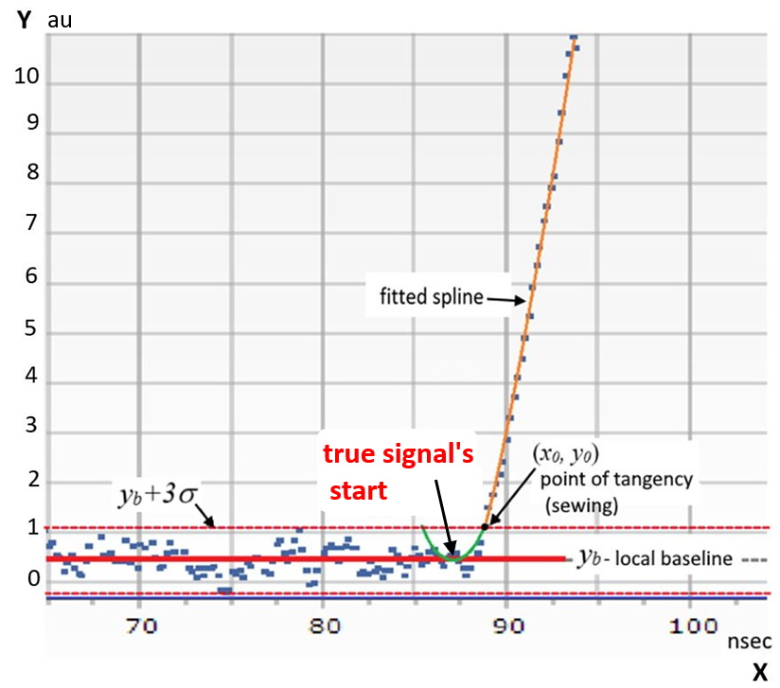
New time pick-off algorithm used for PIN diode signals from HI in the wide mass range
Plasma delay effect (PDE):
Due to generation of plasma in a heavy ion track in the PIN diode
Slowly growing function of unknown form at the start of PIN diode signal
To account for PDE :
“Paraspline” method finds actual beginning of signal by approximating its initial part that lies inside the “noise track” with parabolic function which vertex lies on the average of the noise. The Parabola is seamlessly sewed with a spline function that automatically approximates points above the noisy region.
Digital signal with Paraspline pick-off. Red line y_{b} – mean local baseline; in between dotted red lines [yb-3, yb+3] – noisy region; orange line – fitted spline; black dot (x0, y0) – point of functions’ tangency; green curve – parabola with vertex on the signal’s start

Slide 8
Double-hit experimental approach and restoring of the original signals from pile-up

Slide 9
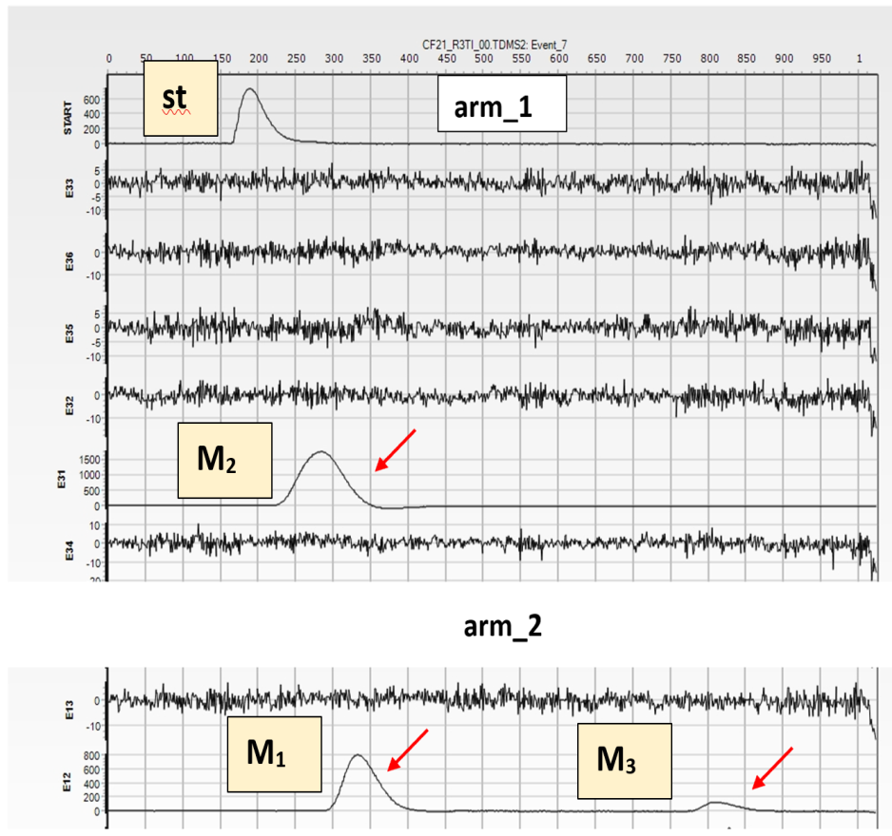
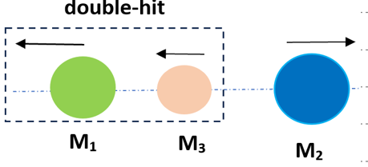
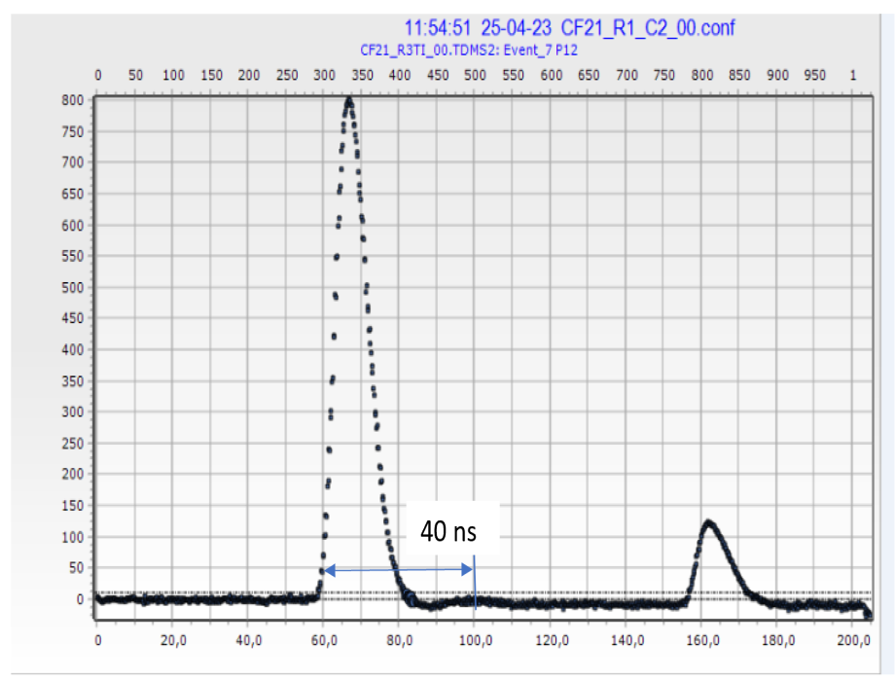
1
Double-hit registration approach
can provide direct solution
of the problem arisen
By definition, the double-hit means that two fragments are detected in the same PIN diode during one registration gate of 200 ns
2
Measurement of the current
value of the signal each 200ps
An open angle between the fragments do not exceed 5⁰

Slide 10
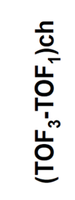
1
1)
2)
1)
2
2)
Pile-up signals

Slide 11
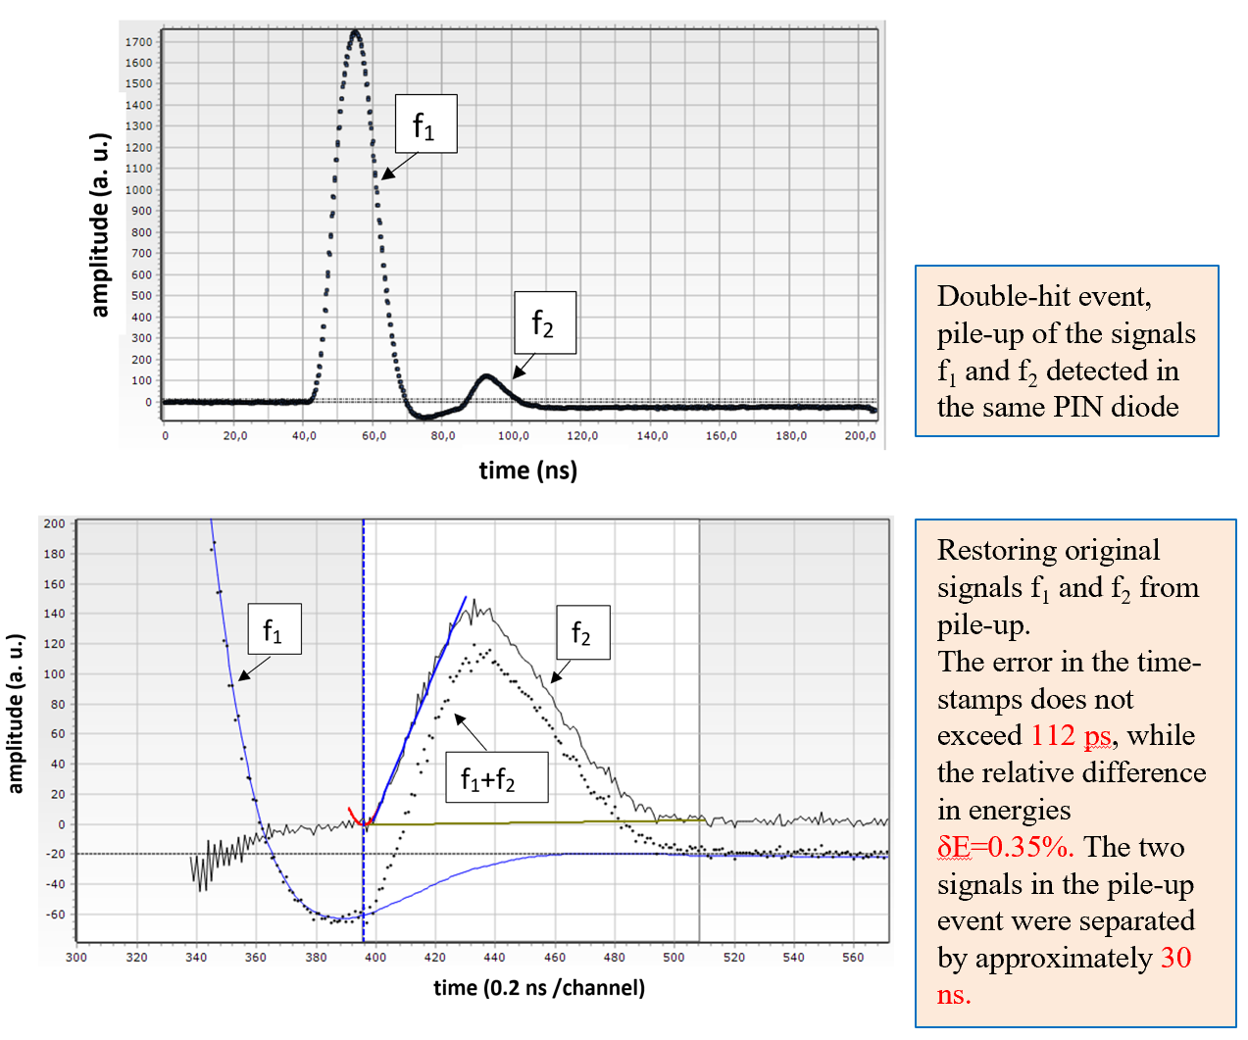
Restoring original signals from pile-up: final result
1
2

Slide 12
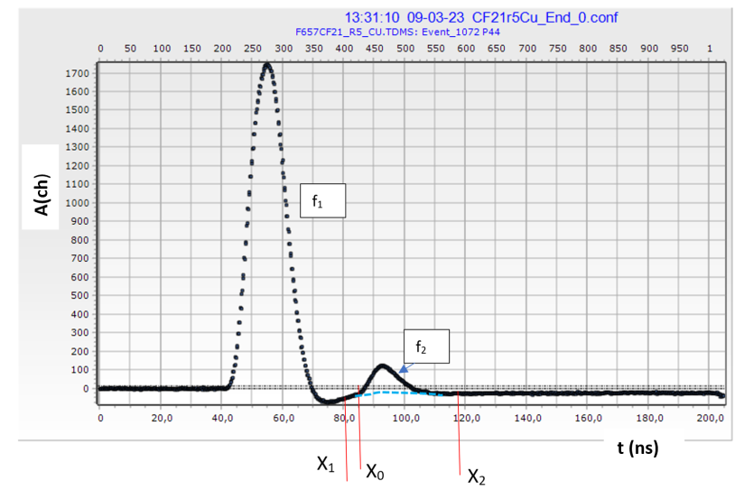
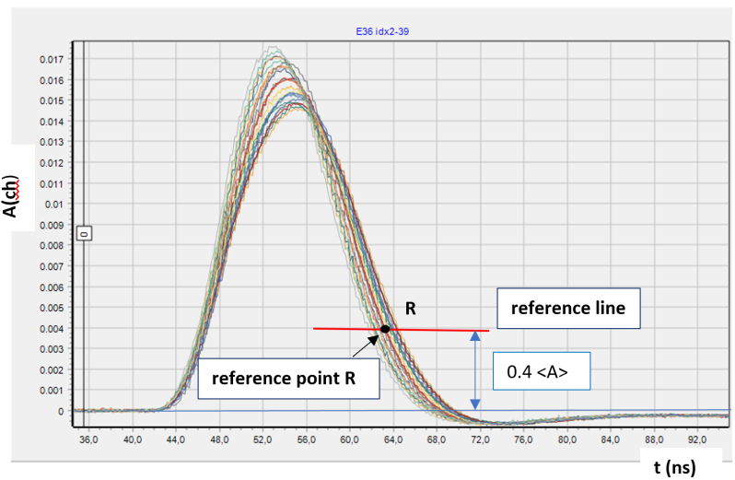
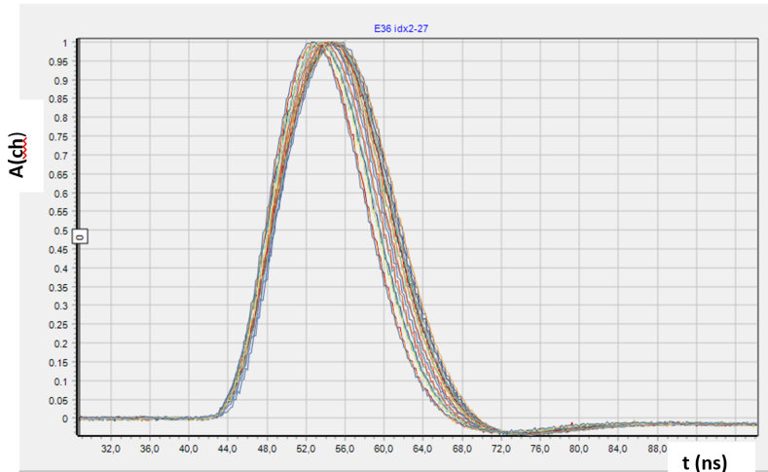
Restoration algorithm:
1
1. A sample of at least 800 signals, normalized to the area, is collected for a specific PIN and experimental run.
2. For every signal in the sample, we find the intersection point of its waveform with the reference line. Then we shift the waveform on the time axis until the intersection point matches point R.
3. The average signal’s "tail“<f> ​​is found for the sample.
4. We approximate <f> by an interpolation spline function f_{spl}.
5. The second signal shape is restored by subtracting the f_{spl} from the pile-up waveform.
a)
2
normalized to area
b)
3
normalized to area and amplitude
c)

Slide 13
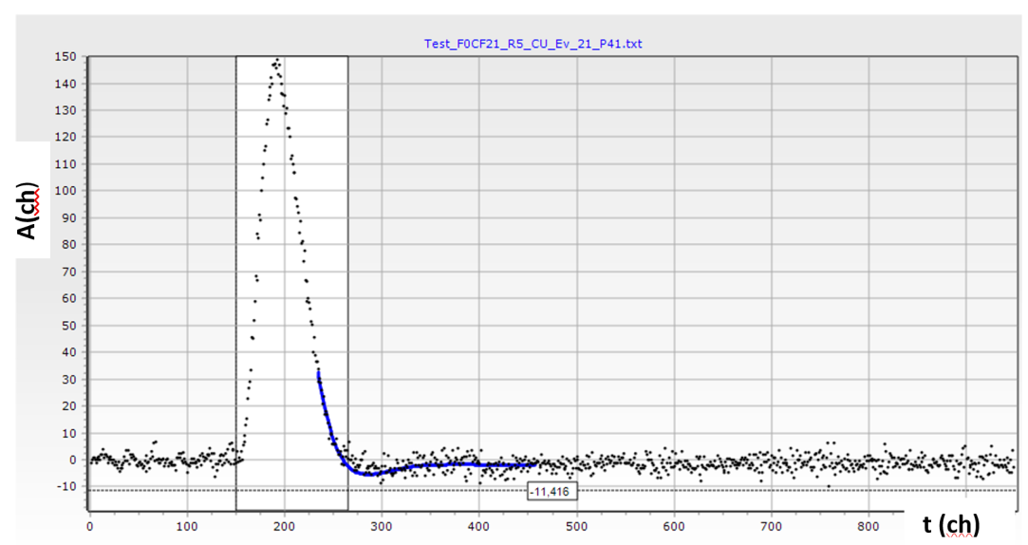
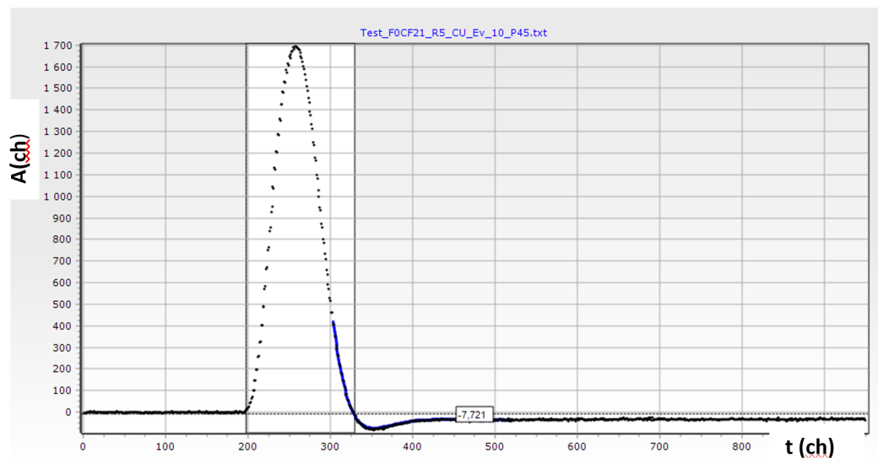
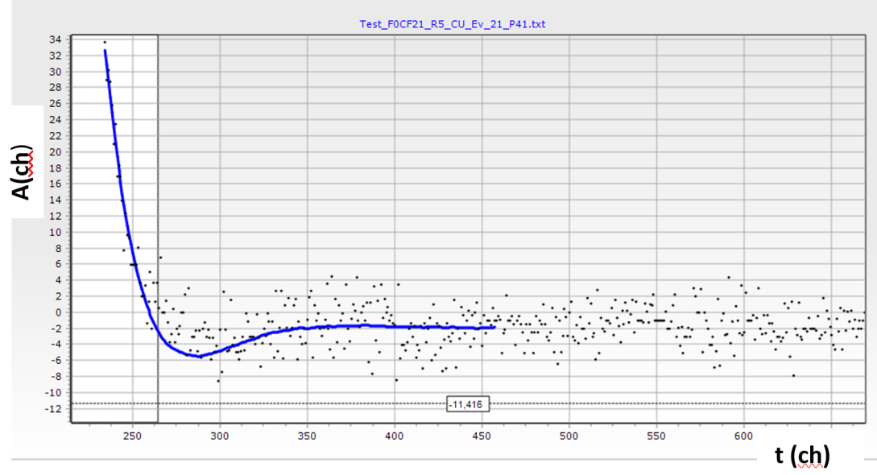
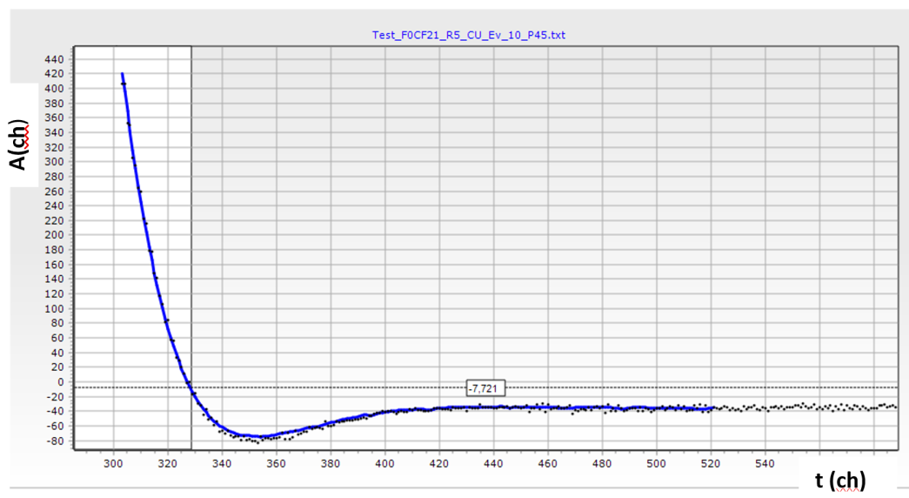
Comparison of signal shape and its universal description (f_{spl})
1
3
2
4
Signal from α-particle
Signal from fission fragment

Slide 14
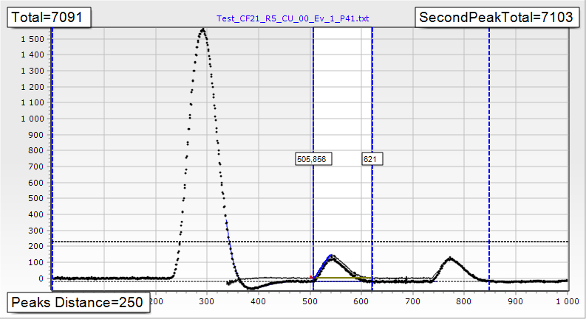
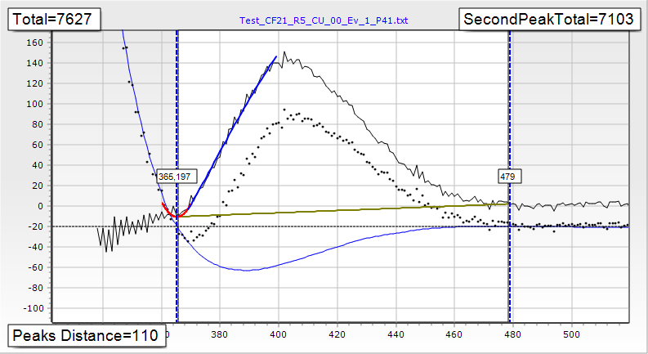
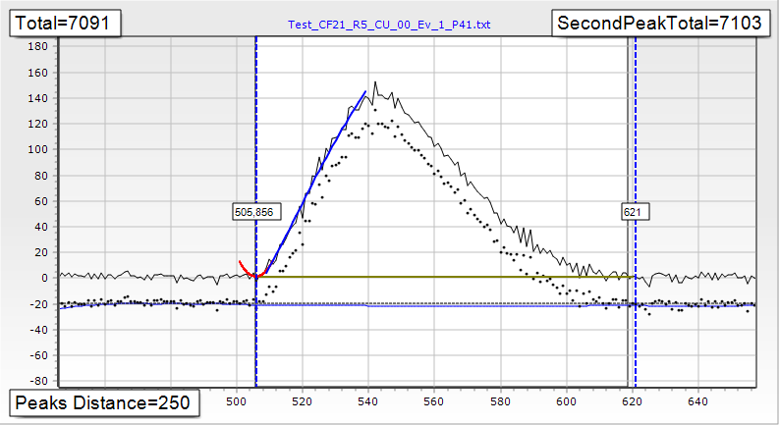
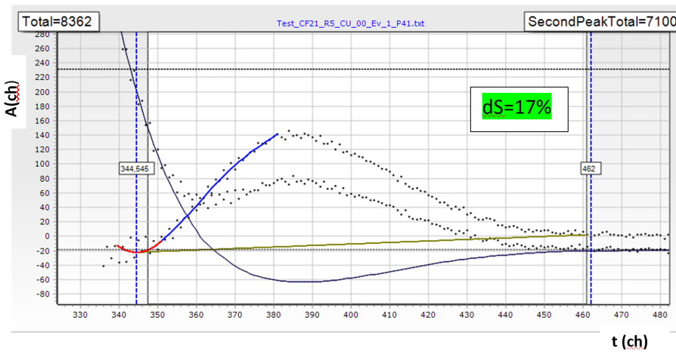
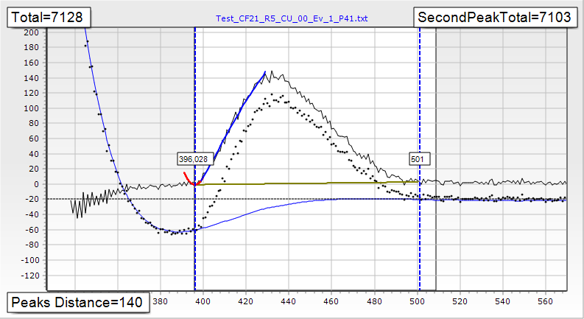
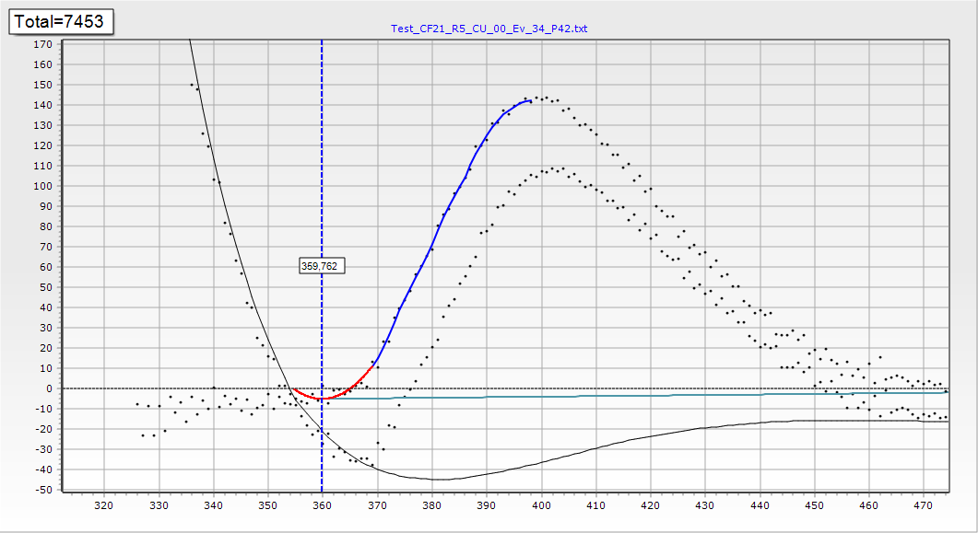
Testing restoration algorithm using double-hits with signals from fission fragments and α-particles
1
4
dT= +78ps
dS=+7.3%
b
a
2
dT=+53ps
dS=+0.16%
5
6
3
dT=-112ps
dS=+0.35%
real 2-hit event, restoring original waveform from pile-up

Slide 15
Experimental results

Slide 16
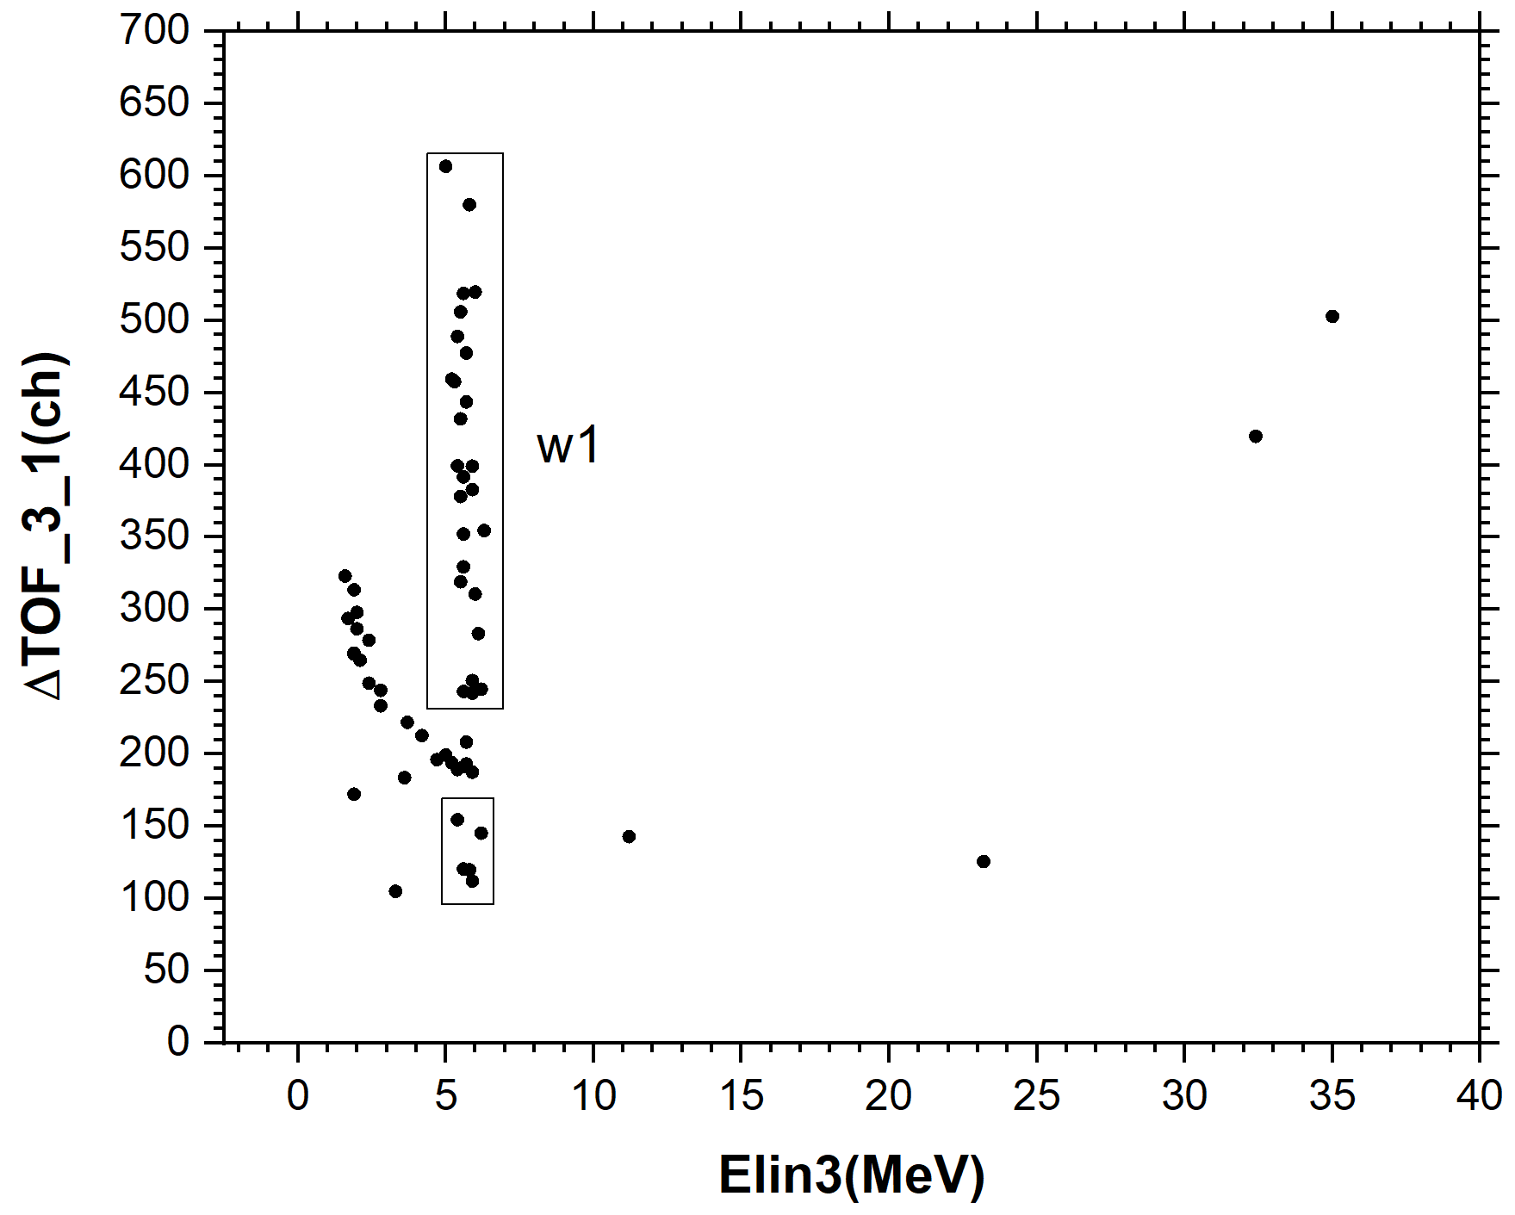
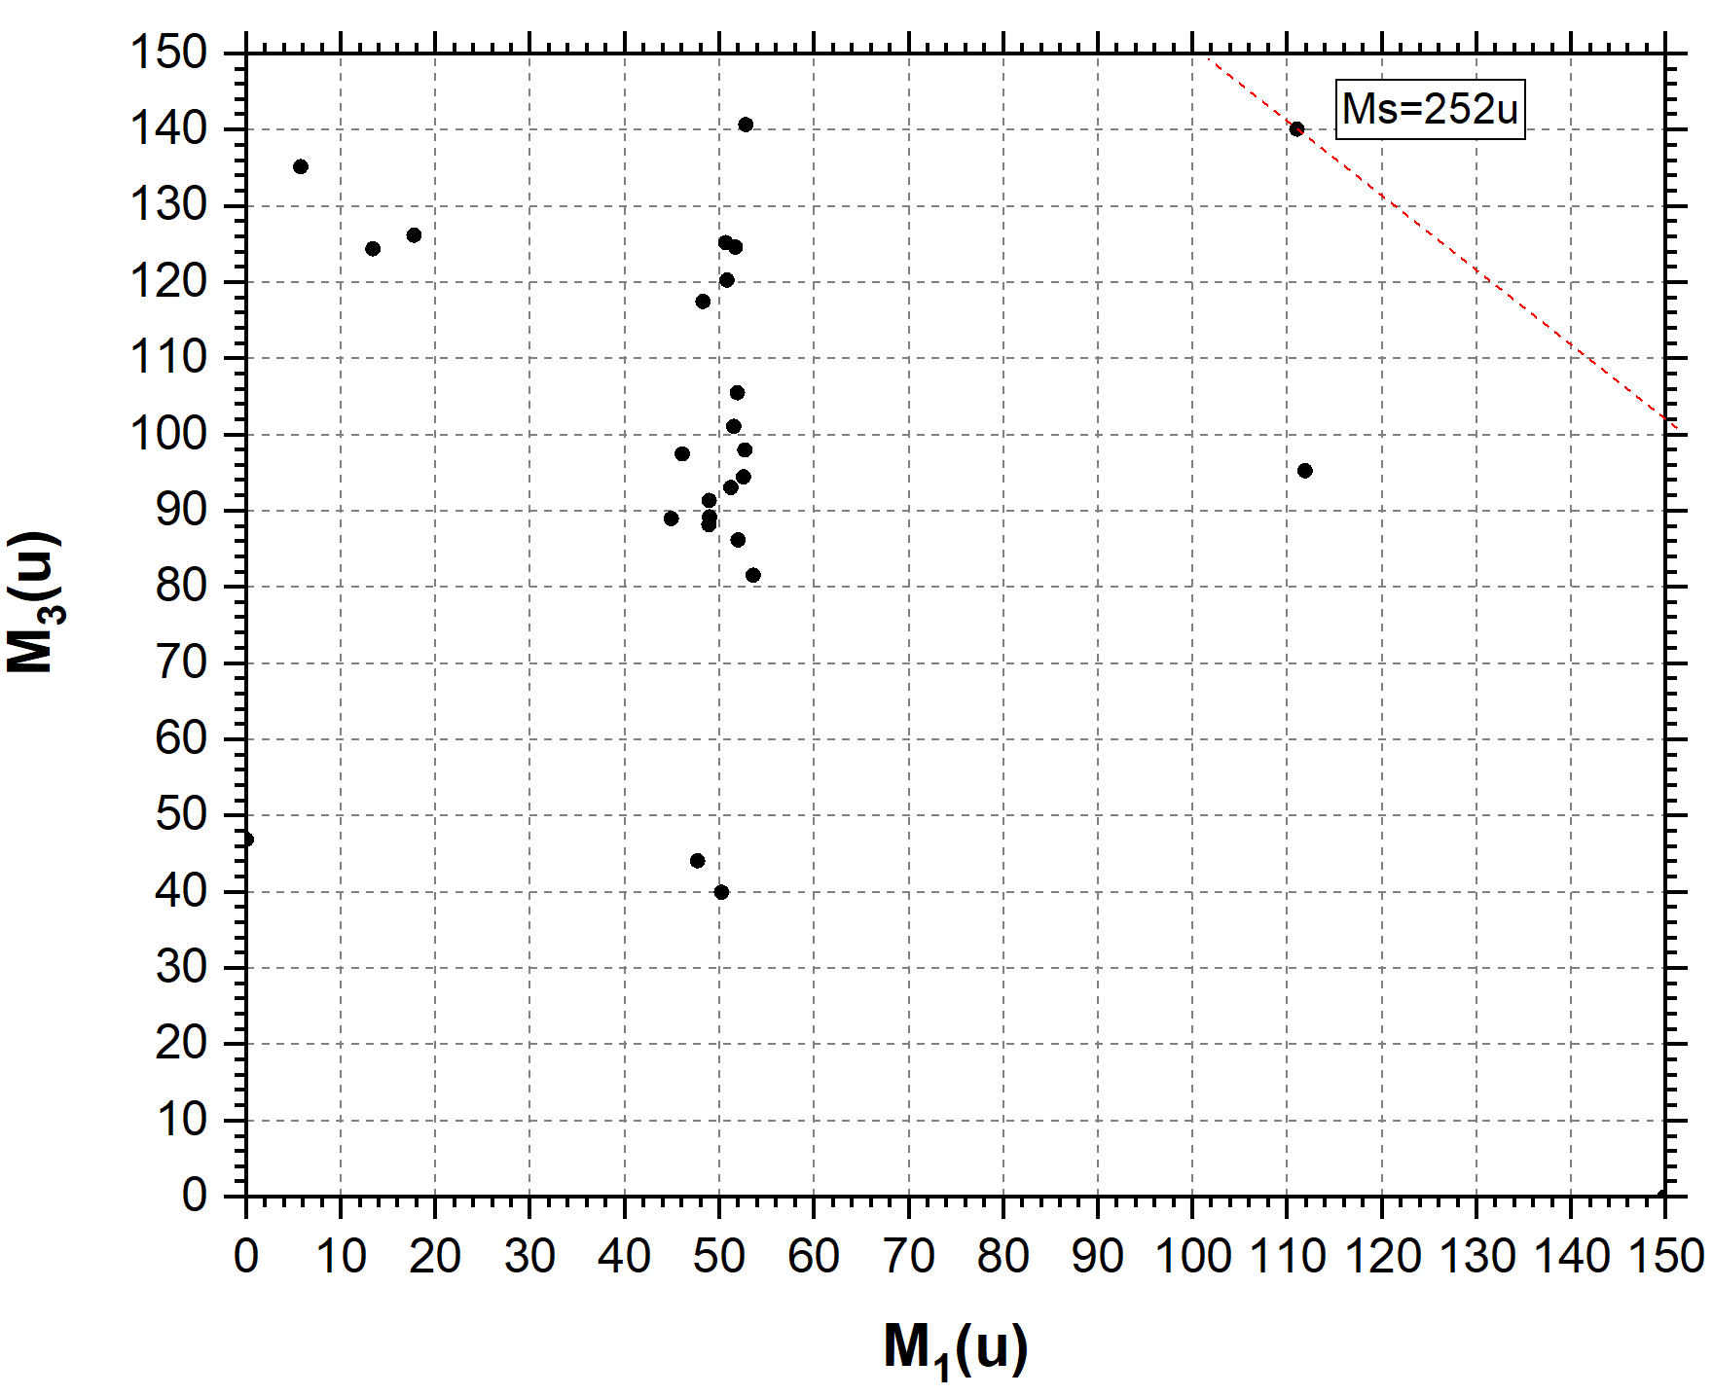
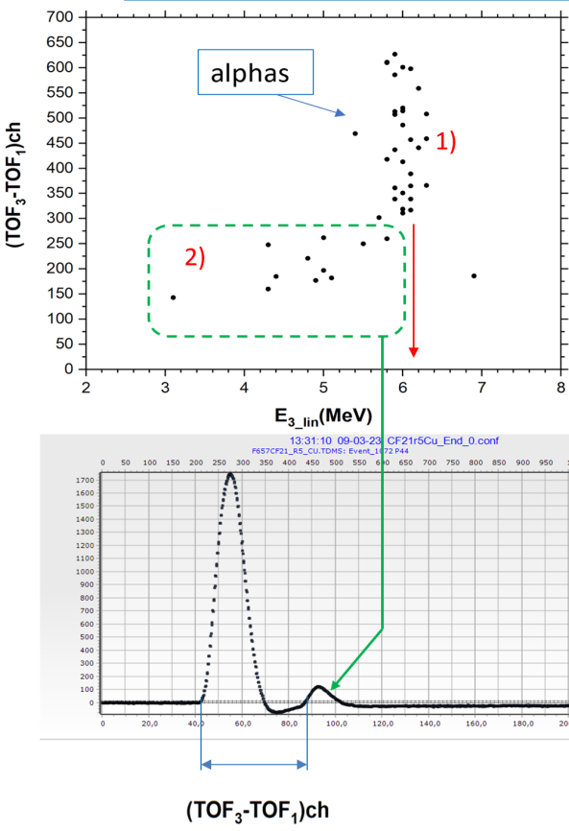
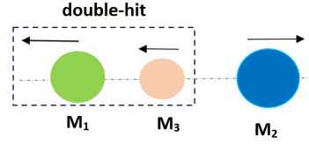
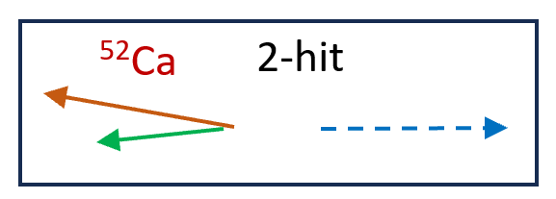
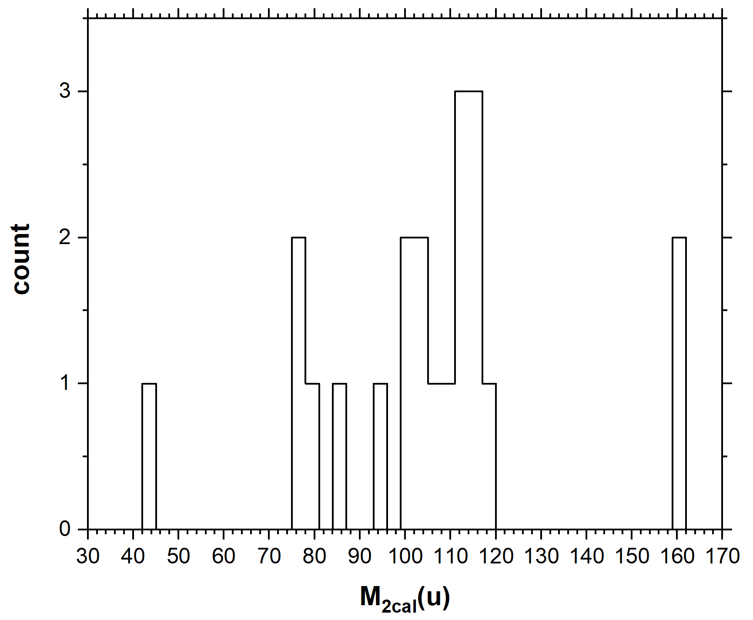
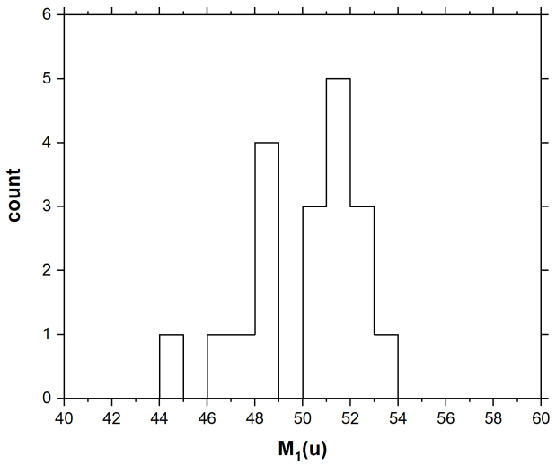
Double-hit events, Ti foil as a break-up medium
Restoring!
Test run
2
Ti foil run
1
α-particles
3
Filtering out of the random coincidences with α-particles.
4
⁵²Ca
were missed
Direct proof of the fission fragmeny break-up with almost collinear decay products

Slide 17
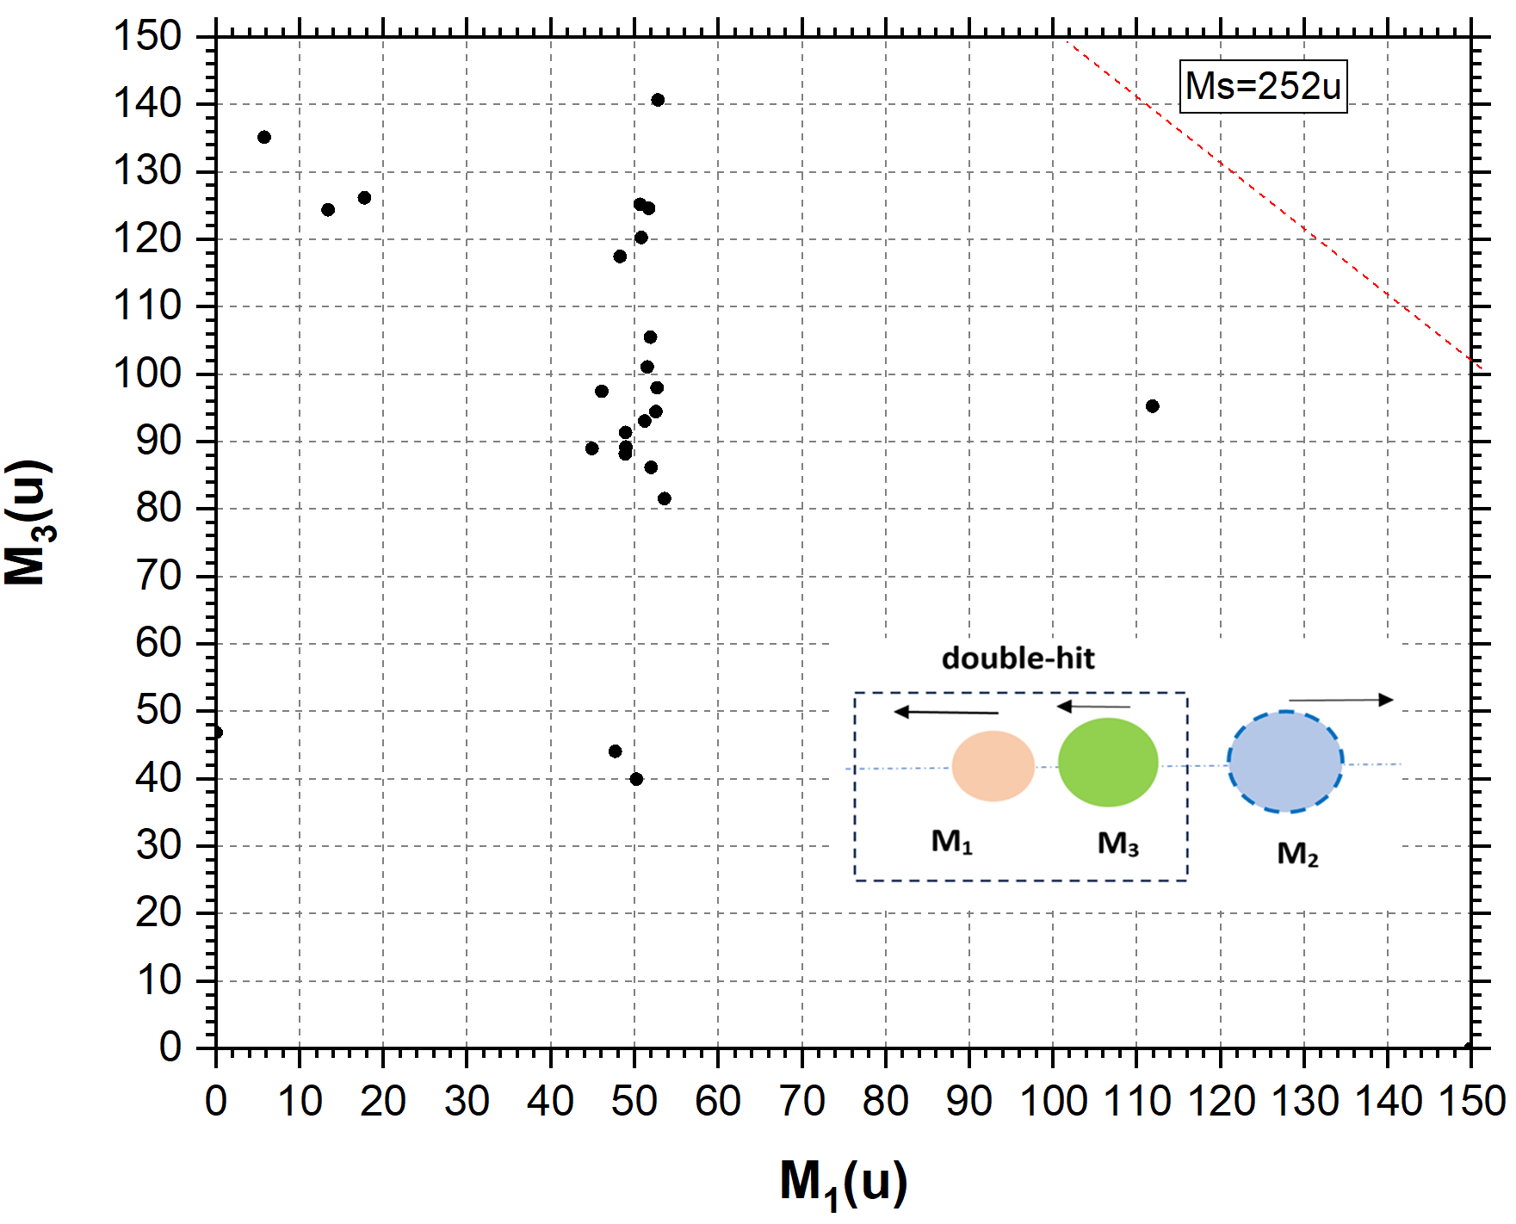
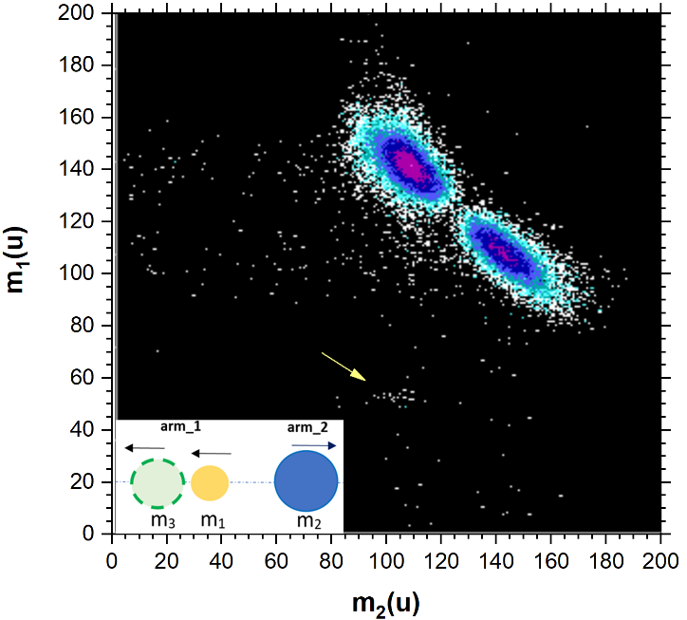
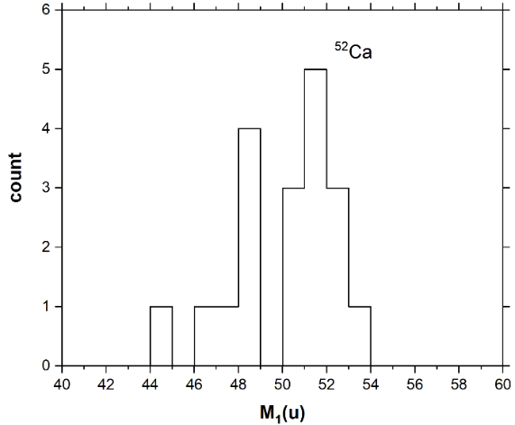
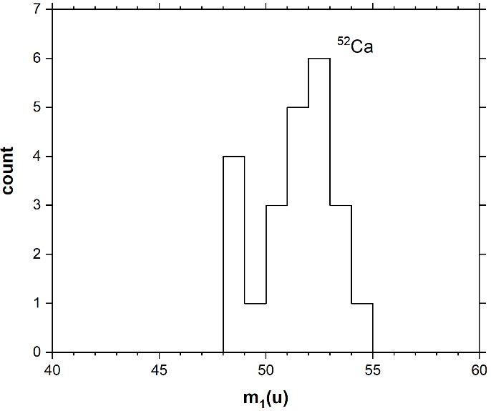
Comparison of two different experimental approaches
2-hit, Ti foil
mul_2, Ti foil
2
⁵²Ca
1
⁵²Ca

Slide 18
Conclusions:
A special procedure of restoring original signals from pile-up was developed and tested. Its use has been shown the possibility of quite satisfactory mass-spectrometry of pair of heavy ions with minimal time interval between them ≈ 30ns and open angle < 5⁰ in the frame of the “double-hit” experimental approach. The results obtained provide direct proof of the fission fragment break-up with almost collinear decay products in the solid-state foil. This effect was not observed previously.

Slide 21
is missed

Slide 22
In order to find the double-hit events the following algorithm are realized.
Preliminarily we calculate the average value for all 1024 channels; the found peaks must have an amplitude greater than the average value.
1. Calculate the area of the first 10 channels and remember it.
2. Shift to the right one channel and calculate the area again.
3. If the resulting integral is greater than the previous one, remember it.
4. Repeat steps 2-3 until we reach the maximum value of the integral over 10 channels, i.e. if the next iteration gives a value less than the previous one, then the position of the first peak has been found, remember its coordinate.
5. We move further to the right, but now we are looking for the minimum value of the integral in a similar way.
6. After finding the minimum, we continue searching for the second peak using steps 2-3.
7. Upon reaching the end of the spectrum, we have a set of peak positions.

