Slide 1
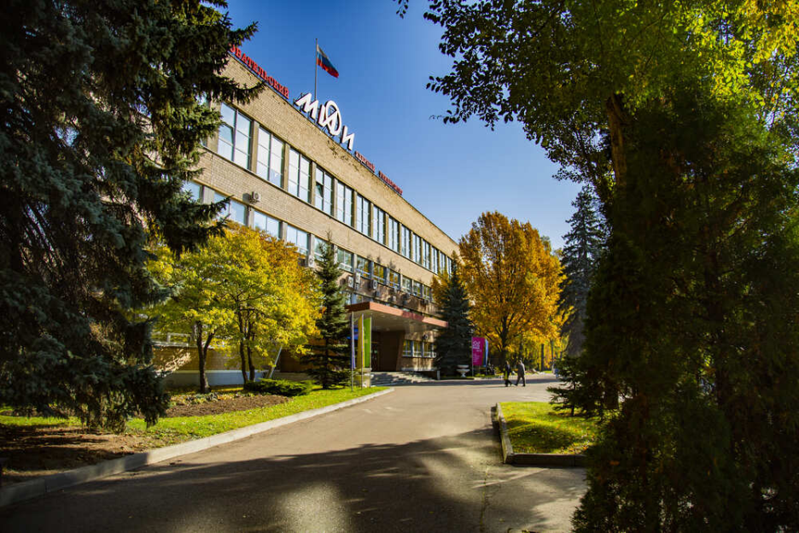
The 7rd International Conference on Particle Physics and Astrophysics
Formation of the multi-neutron systems ²n and ³n in the reactions of stopped pion absorption
B.A. Chernyshev
National Research Nuclear University “MEPhI”
Moscow, 2024
Notes:
Б.А.Чернышев

Slide 2
Multineutrons
The free neutron has a lifetime of almost 15 minutes :
$$n→p+e^{−}+{\tilde{υ}}_{e}$$
A neutron can live indefinitely in a bound state inside stable nuclei or neutron stars.
The issue of the existence of multi-neutron systems in a bound or unbound resonant state remains open, despite numerous experimental studies.
Understanding the structure of nuclei and how their properties emerge from the underlying forces between nucleons is a major goal of modern nuclear physics.
Light nuclei have long played a fundamental role in this respect, and those exhibiting very asymmetric neutron-to-proton ratios have proven to be particularly sensitive to details of the two- and few-body forces used in nuclear models.

Slide 3
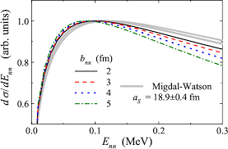
Dineutron
A system consisting of two neutrons - the dineutron, is unbound at ≈ 100 keV (0.1 MeV).
The virtual s-wave state.
Er ≈ 100 кэВ
The dineutron is an example of the manifestation of final state interaction (FSI), developed in the Migdal theory.
$$\frac{dσ}{dE}=F_{FSI}(E)∙F_{PV}(E)$$
$$F_{FSI}\left(E\right)=\frac{a^{2}}{1+2MEa^{2}}$$

Slide 4
Multineutrons (n > 2)
Multineutrons (n > 2)
Concerning the mass number of the multineutron candidate systems, although ³n is the simplest one, the pairing effects observed along the neutron dripline suggest that ^{4,6,8}n could more likely exhibit bound or resonant states. However, the availability of beams and targets, and the significance of the cross-sections involved, have mostly limited the search to ^{3,4}n.
Therefore, due to accessibility and pairing considerations, the tetraneutron has been the most natural aim of these searches.

Slide 5
Trineutrons (n = 3)
³He(π⁻, π+)3n
³H(π⁻, γ)3n
³H(n, p) 3n
³H(³H, ³He) 3n
⁷Li(⁷Li, ¹¹C) 3n
⁷Li(¹¹B, ¹⁵C) 3n
²H(¹⁴C, ¹³N) 3n
¹³⁸Ba(³n, n) ¹⁴⁰Ba
Bound or resonant states were not observed

Slide 6
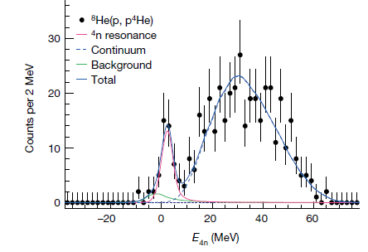
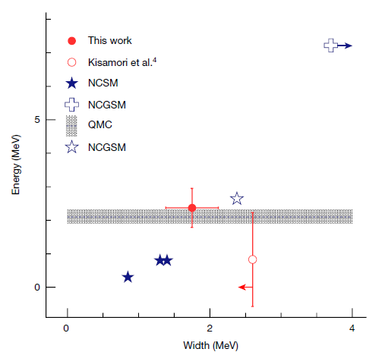
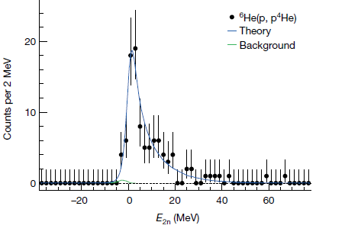
Tetraneutron
422 events
M. Duer et al, Nature | 606 | (2022) | 679

Slide 7
Theory
Various models agreed in the impossibility of a bound tetraneutron, based on the fact that the modifications of the NN (and eventually NNN) interaction required to obtain
a ³n ( ⁴n ) bound state were so large that the description of all the surrounding nuclear chart (⁴He, ⁴H, ⁵He...) would be destroyed, and not by a small quantity but by several
tens of MeV.
The overall conclusion was that ³n resonances could not exist near the physical region.
But, S. Gandolfi et al., Phys. Rev. Lett. 118, 232501 (2017). Er = 1.1(2) MeV.
J.G. Li et al., Phys. Rev. C 100, 054313 (2019). (Er, Γ) = (1.29, 0.91) MeV

Slide 8
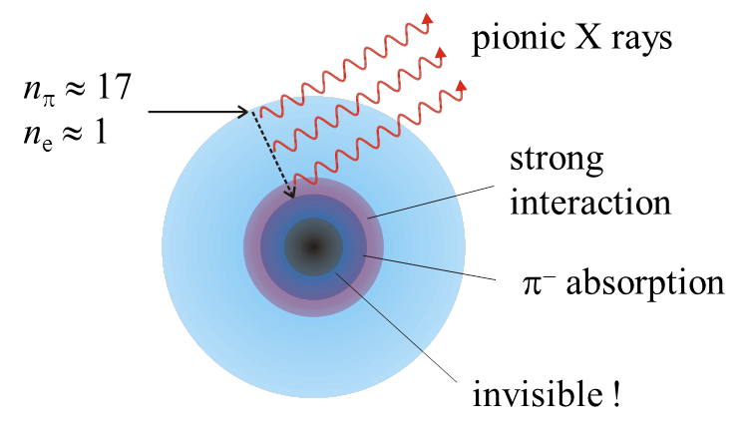
Stopped pion absorption by nuclei −
Tool for production of neutron-rich states
π⁻ + ⁹Be, ^{10,11}B, ¹²C → exotic nuclei + X
Superheavy hydrogen isotopes ⁴⁻⁷H
Heavy heliumn isotopes ⁵⁻¹⁰He
Heavy lithium isotopes ⁸⁻¹²Li

Slide 9
π⁻ + ⁹Be → d + ⁴He + nnn(³n)
π⁻ + ⁹Be → t + ³He + nnn(³n)
π⁻
²H
nn
⁹Be
⁴He
⁵He
π⁻ + ⁹Be → t + ⁴He + nn(²n)
π⁻
³H
nnn
⁴He
n
⁴He
⁹Be
⁵He
nn

Slide 10
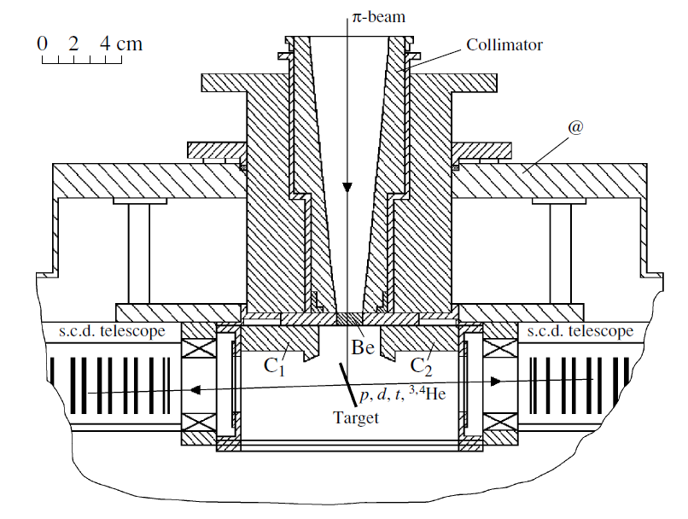
Layout of spectrometer (LANL)
Beam | Target | Sizes and Impurities | Stop rate, 1/s | SCD- telescopes | Threshold(MeV)
Еπ= 30 MeV (Δp/p=±1%) | ⁹Be ^{10,11}B ^{12,14}C | Thickness – 25 mg/sm², (135µm), diameter – 26 mm, | ∼ 6⋅10⁴ | 2 Si(Au) -Т=100, 450µm 14 Si(Li) -Т=3 mm, Wd≈0.1mm S=8 mm² Ω=55÷15 mster | Е_{p} ≈ 3.5, Е_{d} ≈ 4, Е_{t} ≈ 4.5, E_{He} ≈ 15.
FWHM
ΔЕ < 0.5 MeV (Z=1)
ΔЕ < 2.0 MeV (Z=2)
ΔMM < 1 MeV (Z₁=1, Z₂=1)
ΔMM < 3 MeV (Z₁=1, Z₂=2)
Gornov M. G. et al. // Nucl. Inst. and Meth. in Phys. Res. A 2000. V. 446. P. 461.

Slide 11
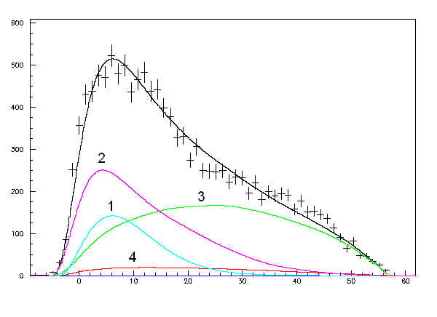
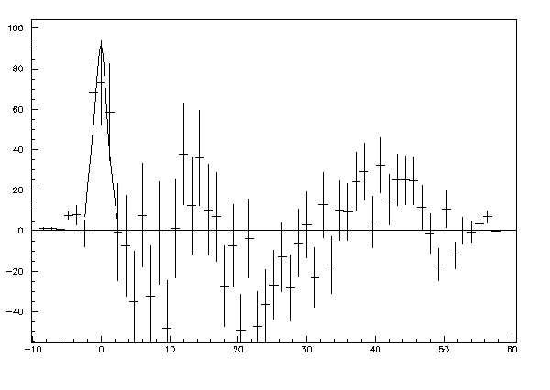
Dineutron
π⁻ + ⁹Be → t + ⁴He + X
n(sp)+t+⁵He
n(sp)+⁴H+⁴He
n+⁴H+⁴He
n+t+⁵He
total

Slide 12
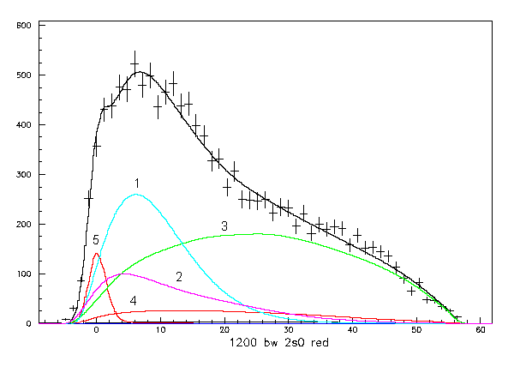
Dineutron
π⁻ + ⁹Be → t + ⁴He + X
Er ≈ 100 кэВ

Slide 13
Trineutrons
π⁻ + ⁹Be → d + ⁴He + X
²n+n+d+⁴He
n+d+⁶He*
³n resonance?
total
E_{r}, MeV | Г, MeV
≈ 5.5 | ≈ 2
≈ 14 | ≤ 2

Slide 14
Trineutrons
π⁻ + ⁹Be → t + ³He + X
²n+n+t+³He
n+n+n+t+³He
³n resonance?
total
E_{r}, MeV | Г, MeV
≈ 5.5 | ≈ 2
≈ 14 | ≤ 2

Slide 15
Conclusion
• In π⁻ + ⁹Be → t + ⁴He + X reaction dineutron (E_{r} ≈ 0.1 MeV) was observed.
Indications for the existence of highly excited states of trineutron were obtained in reactions π⁻ + ⁹Be → d + ⁴He + X and
π⁻ + ⁹Be → t + ³He + X.

Slide 16
Thank you
for your attention!

