Slide 1
7th International Conference on Particle Physics and Astrophysics
Resonant states of muonic three-particle systems with lithium, helium and hydrogen nuclei
Authors: Alexei Eskin (Samara U.)
Alexei Martynenko (Samara U.)
Fedor Martynenko (Samara U.)
Vladimir Korobov (JINR BLTP)
22-25 October 2024, mephi, Moscow, Russia

Slide 2
RELEVANCE
Low-energy interactions between atomic nuclei are of great importance, they provide valuable information on the nucleon–nucleon interaction [1], are used as input data in astrophysics and cosmology [2, 3].
Nucleus-nucleus collision data are not much available at energies below the keV region [6]. At the same time nuclear reactions occurring inside the stellar objects proceed dominantly with these low energies. On the other hand when nuclei are confined in a small molecular objects like muonic molecules [7], the fusion reaction rate may be measured with confident precision.
In this work we want to present precise numerical calculations of the Hepµ, Hedµ, Lipµ and Lidµ quasibound states, which may be of use for the study of the low energy reactions.
J.L. Friar, The structure of light nuclei and its effect on precise atomic measurements, Can. J. Phys. 80 1337 (2002).
A.M. Boesgaard and G. Steigman, Big bang nucleosynthesis: Theories and observations, Annu. Rev. Astron. Astrophys. 3, 313 (1985).
R.H. Cyburt, B.D. Fields, K.A. Olive, and Tsung-Han Yeh, Big bang nucleosynthesis: Present status, Rev. Mod. Phys. 88, 015004 (2016).
B.D. Fields, The Primordial Lithium Problem, Annu. Rev. Nucl. Part. Sci. 61, 47 (2011).
[5] J.R. Zhao et al., A novel laser-collider used to produce monoenergetic 13.3 MeV 7Li(d, n) neutrons, Nature Sci. Rep. 6, 27363 (2016).
[6] L.N. Bogdanova, S.S. Gershtein, and L.I. Ponomarev, Nuclear fusion in the mesic molecule dµ3He, JETP Lett. 67, 25 (1998).
[7] L.I. Ponomarev, Muon Catalysed Fusion, Contemporary Physics 31, 219 (1990).
2

Slide 3
PURPOSE AND TASKS
The purpose of this work is to study the energy spectrum of three-particle Hepµ, Hedµ, Lipµ and Lidµ on the basis of variational approach with exponential and Gaussian basis.
Tasks:
Analytical calculation of matrix elements for kinetic, potential energies and normalization for ground states.
Compile computer code to solve problems for bound state of several particles using variational method, which uses Gaussian or exponential basis to obtain a very accurate solution for three-particle systems.
Calculation of the energy of resonant states on the basis of variational method [1,2].
Previously, within the framework of the stochastic variational method, the energy levels
of mesomolecules of hydrogen, muonic helium, and other systems were studied.
K. Varga and Y. Suzuki, Comp. Phys. Comm. 106, 157 (1997).
A. V. Eskin, V. I. Korobov, A. P. Martynenko, F. A. Martynenko, Atoms 11, 25 (2023).
3

Slide 4
STOCHASTIC VARIATIONAL METHOD
A system of three particles with masses m₁, m₂ and m₃ and charges e₁, e₂ and e₃ is described by the Schrödinger equation in Jacobi coordinates and has the form:
The upper bound for the energy of the ground state of the system is given by the smallest eigenvalue of the generalized eigenvalue problem

Slide 5
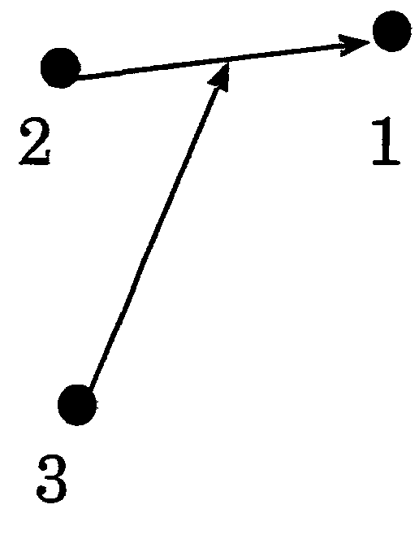
ORDER OF PARTICLES
We use the following order of particles:
The Jacobi coordinates are related to the particle radiuses-vectors as follows:
and back

Slide 6
MATRIX ELEMENTS
The operator of kinetic energy:
where:
Matrix elements of kinetic energy:

Slide 7
MATRIX ELEMENTS
The potential energy operator in the nonrelativistic Hamiltonian consists of pairwise Coulomb interactions U_{ij} (i, j=1, 2, 3). The convenience of using the Gaussian basis in this case also lies in the fact that all matrix elements of the potential energy operator are calculated analytically (in electronic atomic units):
All these matrix elements are expressed in terms of variational parameters A_{ij}, B_{ij}. These matrix elements are used below for solution of equation .

Slide 8
PROGRAM
To solve the problem, the code was written in Matlab. The program was based on the program of K. Varga and J. Suzuki, which was implemented in the Fortran language.
The work of the program begins with reading the input file, which contains the masses of particles, charges, and the boundaries of the intervals for the generation of nonlinear variational parameters.
Matrix elements of normalization, kinetic and potential energies, calculated analytically, are included in the program.After generating nonlinear variational parameters and calculating the normalization and energies from them, the standard MATLAB function is called to solve the eigenvalue problem.
The result of the program operation is the numerical values of the energies of the ground and excited states, as well as the matrix of nonlinear variational parameters and the vector of expansion coefficients of the wave function in terms of the basis states, which can be used to calculate corrections.
K. Varga, Y. Suzuki Computer Physics Communications 106 (1997) 157-168

Slide 9
CCR method
The main idea of ​​this method is a complex rotation of spatial coordinates:
Kinetic and potential energies scale as respectively, and the Hamiltonian can be written as:
In the theory of rotation of complex coordinates, the resonant state is defined as the solution to the eigenvalue problem
The corresponding discrete complex eigenvalues ​​are
where specifies the position, and Г is the width of the resonance.
Ho, Y.K. The Method of Complex Coordinate Rotation and its Applications to Atomic Collision Processes / Y.K. Ho // Phys. Reports –– 1983. –– Vol.99.–– P.1-68.

Slide 10
MATRIX ELEMENTS
To improve the accuracy of the energy level calculations, we take into account the contribution of a number of other terms in the spin-independent part of the Breit-Pauli Hamiltonian [1, 2], which have the following form:
Also in our work the matrix elements of the yellow functions were calculated, with the help of which the corrections for the structure of the nucleus and the contact interaction are calculated. But the numerical values ​​of these corrections are significantly lower than the corrections for relativity and recoil.
1. Bethe, H.A. and Salpeter, E.E. Quantum mechanics of one– and two– electron atoms // Plenum Publishing Co., New York –– 1977.
2. Berestetsky, V.B., Lifshitz, E.M. and Pitaevsky, L.P. Quantum electrodynamics // Oxford, Pergamon –– 1982.
10

Slide 11
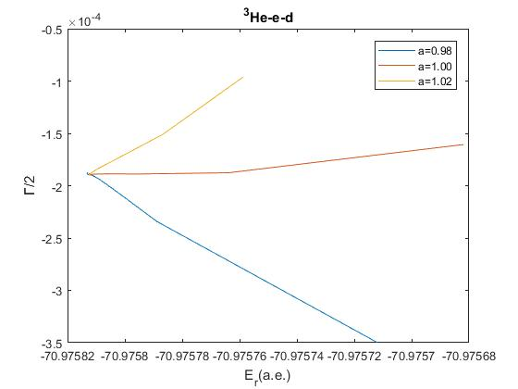
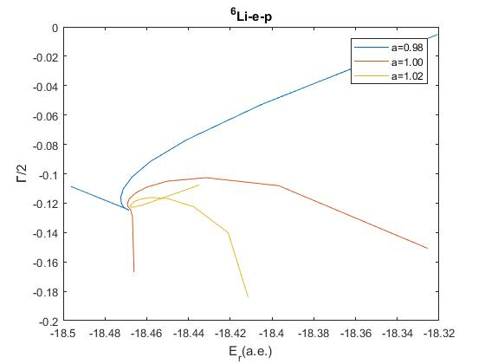
a is Re[ ]

Slide 12
RESULTS
State, eau | ³Hepμ | ⁴Hepμ | ⁶Lipμ | ⁷Lipμ
Energy | -95.662855[G] -95.636541[Exp] | -95.923451 [G] -95.927913[Exp] | -93.613903 [G] -93.599129[Exp] | -93.709229[G] -93.634051[Exp]
Relativism | -0.005359 | -0.005466 | -0.004969 | -0.004991
recoil | 0.000860 | 0.000824 | 0.000868 | 0.000867
State, eau | ³Hedμ | ⁴Hedμ | ⁶Lidμ | ⁷Lidμ
Energy | -100.451347[G] -100.479110[Exp] | -100.773057 [G] -100.789798[Exp] | -98.613119 [G] -98.617124 [Exp] | -98.650793[G] - 98.659293[Exp]
Relativism | -0.006192 | -0.006287 | -0.005952 | -0.005973
recoil | 0.000123 | 0.000102 | 0.000035 | 0.000031
Kravtsov, A.V. Calculation of the decay rates of hydrogen-helium mesic molecules / A.V. Kravtsov, A.I. Mikhailov, V.I. Savichev //Hyp. Inter. –– 1993. –– Vol. 82. – P. 205-210.
Belyaev, V. B.; Kartavtsev, O. I.; Kochkin, V. I.; Kolganova, E. A. Binding energies and nonradiative decay rates of Hedμ molecular ions. Phys. Rev. A, -1995. -Vol.52(2).-P.1765–1768.

