Slide 1
NRC «Кurchatov Institute»
Peculiarities of the momentum spectra of light fragments at ⁵⁶Fe fragmentation with incident
energy of 230 MeV/nucleon
A. A. Kulikovskaya, B. M. Abramov, S. A. Bulychjov, I. A. Dukhovskoy,
V. V. Kulikov, M. A. Martemianov, M. A. Matsyuk
7th International Conference on Particle Physics and Astrophysics (ICPPA – 2024)
National Research Nuclear University «MEPhI»
22−25 October 2024

Slide 2
Introduction
The FRAGM detector has been optimized to measure the yields of fragments produced in nucleus-nucleus collisions at the TWAC heavy ion accelerator complex
Experimental data were obtained at the ⁵⁶Fe fragmentation at 230 MeV/nucleon on three targets: ⁹Be, ²⁷Al and ⁶⁴Cu; the produced fragments were detected at an angle 3.5°
The FRAGM setup allows detecting in a wide range light and heavy fragments, that as a result of the analyzing correlation distributions: amplitude - time of flight. To improve the momentum profile, a hodoscope system located in the first focus of the magneto-optical channel was used
Differential cross sections for light fragment production as a function of momentum allow testing models of nucleus-nucleus interactions and investigate the different manifestation of nuclear structure
The obtained data showed for the first time that for small angles and for heavy projectiles the fragmentation peaks of light fragments in their momentum distributions have double humped structure, different from the Gaussian shape observed at large angles.
The dependence of this splitting effect on the fragment mass and on different targets was studied and compared with the predictions of ion-ion interaction models and to the results of the similar GSI-FRS experiment
Notes:
The
2

Slide 3
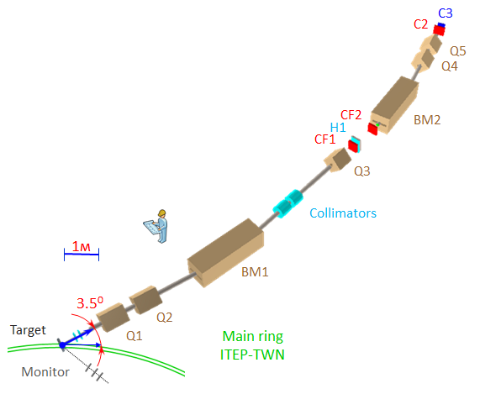
Experimental setup FRAGM
Data were collected on the heavy ion accelerator complex TWAC with ¹²C ions at different energies of 300, 600, 950, 2000, 3200 MeV/nucleon and with ⁵⁶Fe ions at energy of 230 MeV/nucleon
Measurements were performed on different targets: ⁹Be, ²⁷Al, ⁶⁴Cu
Total channel length: 42 m
Two bending magnets: BM1 (bending angle: α = 0.259 rad.), BM2 (α = 0.276 rad.)
Five quadrupoles: Q1, Q5 (vertical focusing) и Q2, Q3, Q4 (horizontal focusing)
Scintillation counters: CF1, CF2, C2, C3 (dE/dx, TOF)
СF1 − C2 coincidence gives trigger signal
H1 − hodoscope consisting from 20 vertical elements (scintillation counters, size 20×1×1 cm)
Beam monitoring system consists of three scintillation counters located at angle of 2° relative to the beam line
TWAC Main ring
[A. A. Kulikovskaya, et al., Phys. At. Nucl. 85, № 9, 1541 (2022)]
Notes:
3

Slide 4
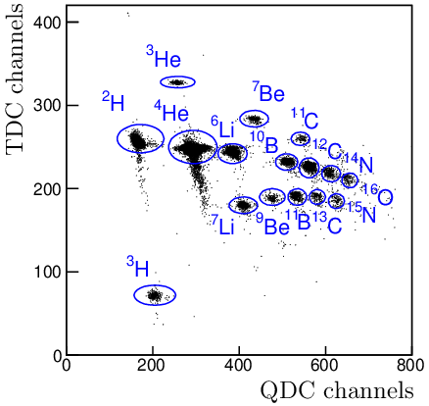
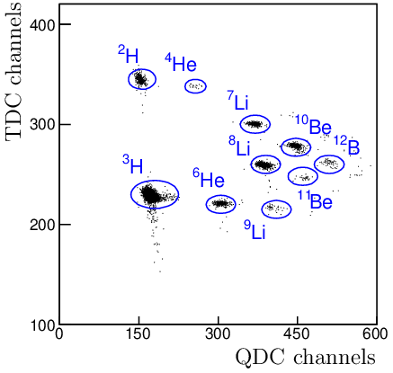
Fragments selection in the FRAGM experiment
Channel rigidity (p / Z) : 1.3 GeV/c
Channel rigidity (p / Z) : 1.8 GeV/c
The magneto-optical channel is adjusted to a certain rigidity selected for current data taking run
2Dim correlation distribution: TDC (TOF − function of the atomic mass number, measured between CF1 and C2) vs QDC (function of dE/dx and Z of fragment defined by counter CF1). TDC channel = 0.2 ns
Different fragments can be easily separated by analyzing the correlation distribution
Notes:
4

Slide 5
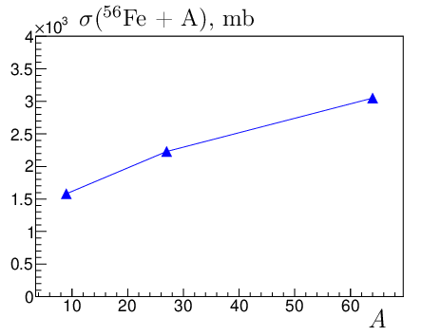
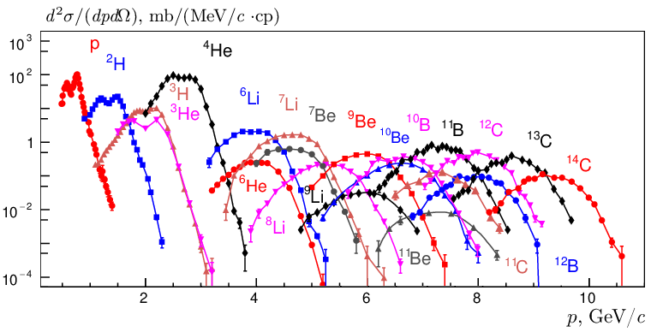
Differential cross section of ⁵⁶Fe fragments vs momentum
Tkin = 230 MeV/nucleon
⁹Be - target
To calculate differential cross section d²σ/dpdΩ, it’s important to obtain a total cross section σ_{tot} (⁵⁶Fe + A)
The value of total cross section is calculated using LAQGSM model of ion-ion interactions. For ⁹Be − target model gives σ_{tot} = 1579 mb
This picture demonstrates the measured differential cross section as function of momentum for different fragments from protons to ¹⁴C
Notes:
5

Slide 6
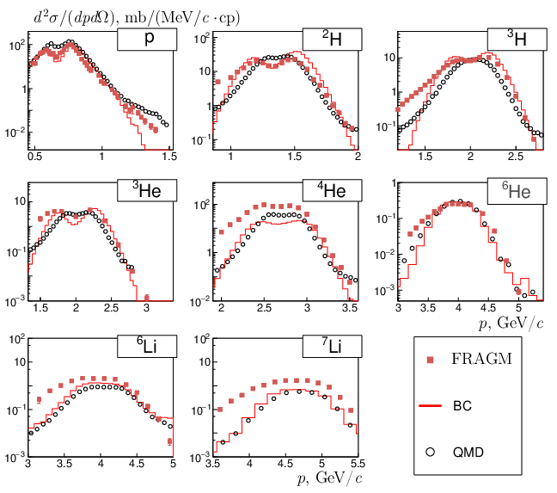
Splitting effect in peak momentum: data and models
⁹Be - target
The splitting effect is observed for light fragments up to ⁶Li
It’s clearly seen, that the double-humped peak structure decreases with increasing fragment mass number
Two models of nucleus-nucleus collisions (binary cascade − BC and quantum molecular
dynamics − QMD) demonstrate the same behavior
These models exhibit peak splitting, although they show different magnitudes of this effect
It is obvious that the BC model shows better agreement with our data and more accurately describes the peak splitting effect
Notes:
6

Slide 7
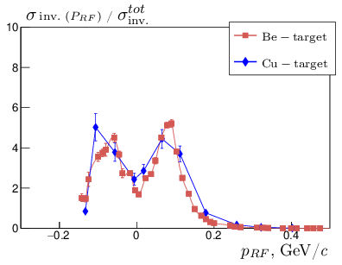
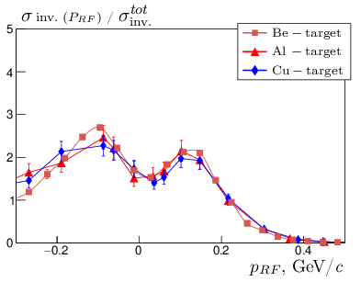
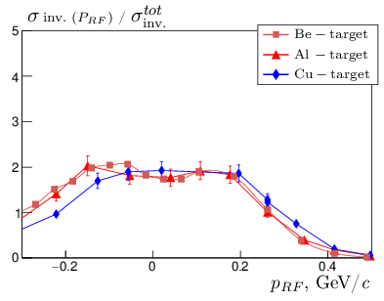
Double-humped structure on different target
¹H
²H
³H
The experimental invariant cross section σ inv. = E/p² dσ / (dΩ dp) was obtained on three target as function of momentum in the rest frame of incident nucleus. In the rest frame momentum distributions should be well described by Gaussian
To compare the spectra profile the normalization on total cross section was done. The experimental data obtained on ²⁷Al and ⁶⁴Cu – targets were measured at low statistics
It’s clearly seen that the magnitude and profile of the peak splitting on three different targets (⁹Be, ²⁷Al, ⁶⁴Cu) demonstrate the independence of the effect from the atomic mass of the target
Notes:
7

Slide 8
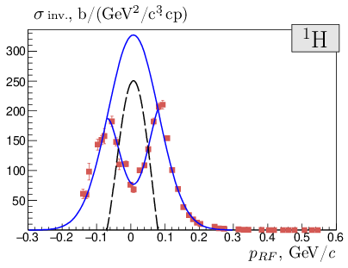
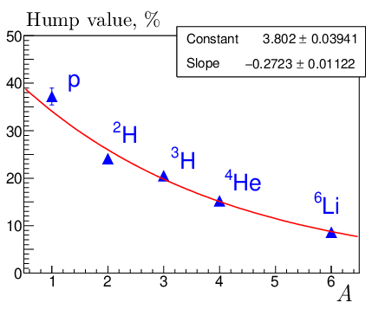
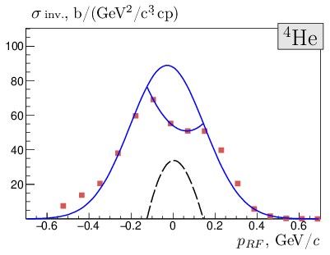
Magnitude of the splitting effect
To describe contribution of splitting effect to the fragmentation peak, the sum of two functions was used : Gaussian (total fragmentation peak) and polynomial function (due to splitting effect)
Momentum spectra of five light elements were analyzed
Hump size is calculated as the ratio of the integrals of the residue (dashed line) and total fragmentation peak (upper blue line)
This values changes from 37% (protons) to 8 % (⁶Li)
Notes:
8

Slide 9
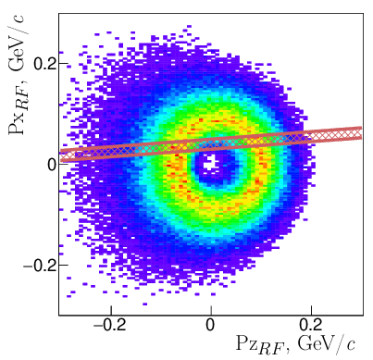
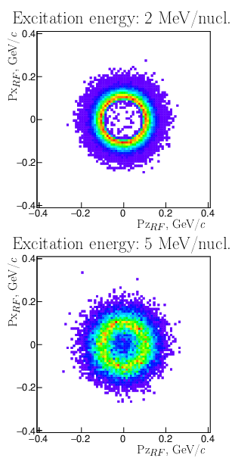
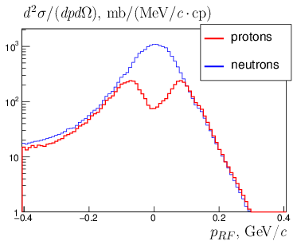
Protons splitting effect in the nucleus-nucleus interaction models
BC
SMM
Angular acceptance of the FRAGM setup
SMM
Coulomb effect /
ВС model
Notes:
9

Slide 10
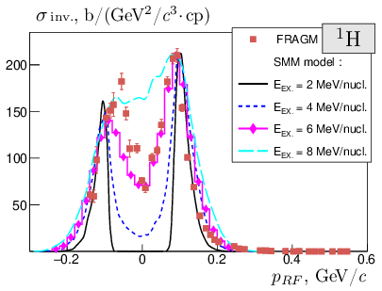
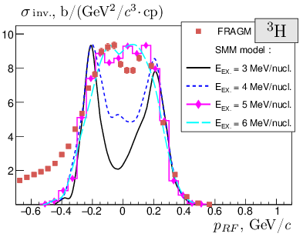
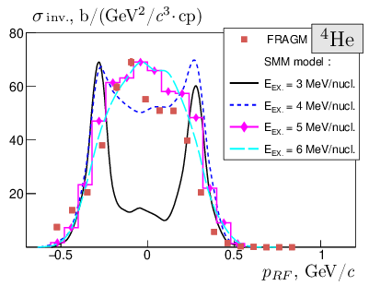
Splitting effect in the SMM model
Plots shows distribution of σ inv. as function of momentum in the rest frame of the projectile in comparison with theoretical predictions calculated in the Statistical Multifragmentation Model (SMM)
The SMM model (thanks to A. S. Botvina for code and explanations) uses the excitation energy (Eex.) as an input parameter
Model data was calculated for different excitation energies from 2 to 8 MeV/nucleon, these data are normalized on our experimental results to compare the distribution shapes
The best approximation with our data is given by the energy Eex. ∼ 6 MeV/nucleon for protons
For light fragments from ²H to ⁶Li, the value of excitation energy can be estimated in the range 4 − 5 MeV/nucleon
Notes:
10

Slide 11
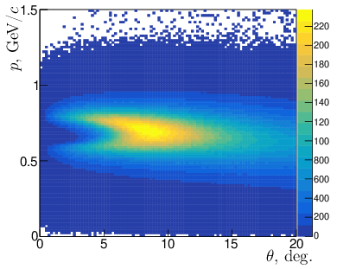
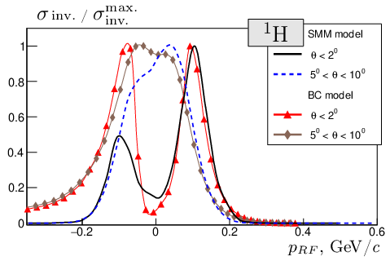
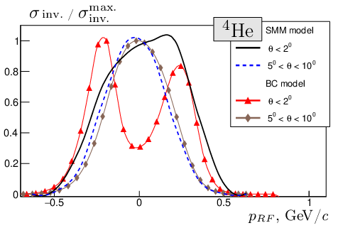
Angular dependence of the splitting effect
BC model
The data were obtained using the binary cascade (BC) and the SMM model for protons (fragmentation of ⁵⁶Fe at 230 MeV/nucleon) depending on the fragment angle θ relative to the initial beam
For the SMM model, excitation energy Eex. = 5 MeV/nucleon
It’s clear, that the peak splitting effect is strongly correlated with the angle for both models of nucleus-nucleus collisions
The effect of momentum peak splitting dominates at small angles and disappears at θ > 5°
Notes:
11

Slide 12
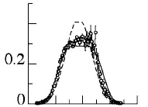
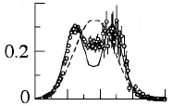
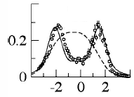
Experimental data from GSI-FRS
¹²C
Similar experimental data were obtained in the GSI-FRS experiment at the SIS heavy-ion synchrotron
Experimental data were obtained on the fragmentation of ⁵⁶Fe at an energy of 1 GeV/nucleon on various targets (hydrogen, titanium, etc.)
The detector was constructed as a magnetic spectrometer, which made it possible to measure the velocity β with high accuracy
A wide range of fragments heavier than ⁶Li were detected, where the distortion of the spectrum shape was most clear seen
It is assumed that the peak splitting effect is due to the process of asymmetric fission of the projectile nucleus
The influence of Coulomb forces in the nuclear fragmentation does not make a significant contribution to the process of asymmetric nuclear fission
Main paper : P. Napolitani et al. Phys. Rev. C 70, 054607 (2004)
¹⁰B
Capture angle
⁶Li
⁵⁶Fe fragmentation on hydrogen target;
(β|| , β⊥) in the rest frame of incident nucleus
Velocity spectra in the rest frame
Notes:
12

Slide 13
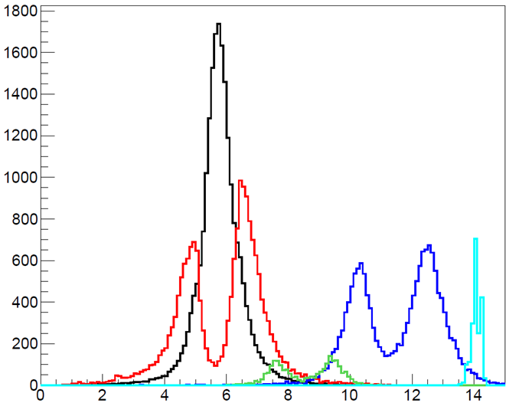
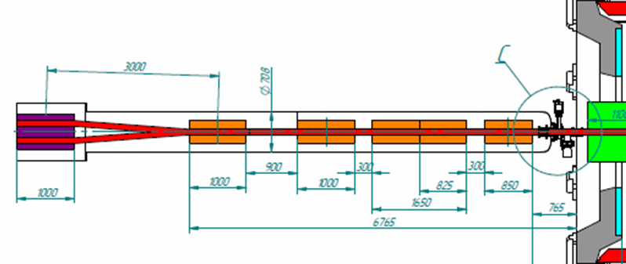
Light fragments from Au fragmentation at NICA
MPD detector
neutrons
Neutron
detector
Θ < 0.01 рад.
Beam-1
protons
¹⁹²Au
Beam-2
²H
Charged fragment detector
³He
p / z, GeV / с
One of the way to calculate the luminosity on heavy ion colliders is a fragmentation method
Data generated by LAQGSM model with Au − Au interactions at $\sqrt{S}=$11.5 GeV/nucleon was used to check the applicability of this method to measure the luminosity on the NICA collider
It’s clear seen, that splitting effect of the charged fragments has a strong double humped structure and can play an important role under designing charged particles detectors to measure the luminosity
Fragmentation method of the luminosity measurement demonstrate a high counting rate as for single detector as for coincidence between two detectors
Notes:
13

Slide 14
Conclusion
The ion yields were measured during the fragmentation ⁵⁶Fe nuclei with an energy 0.23 GeV/nucleon on three different targets. The data were obtained using the FRAGM setup at the heavy ion accelerator-storage complex TWAC
In our case, the presented data demonstrate the double humped structure of peak momentum observed on light fragments with A < 7. The effect is maximal for protons and decreases with increasing nuclear mass
Two models of nucleus-nucleus interactions (BC и QMD) shows the momentum peak splitting. The effect is due to the Coulomb field of the projectile nucleus
The SMM model clearly demonstrates the peak splitting effect depending on the excitation energy of the light fragments, which is the input parameter of the model. The best approximation with our data for protons gives an energy value of 6 MeV/nucleon
This effect was discovered in the GSI–FRS experiment only on a proton target and was not observed on heavy targets. It manifested for heavier fragments with Z = 3 – 5. According to the authors, the source of this phenomenon is the effect of asymmetric nuclear fission
Our measurements on three targets (⁹Be, ²⁷Al, ⁶⁴Cu) for the first time showed the independence of this effect from the atomic number of the target and agreement with model calculations indicates the dominant role of Coulomb effects and does not require the introduction of a new asymmetric mechanism divisions
Notes:
14

Slide 15
Thank for your attention
Notes:
15

