Slide 1


Results of modeling of multi-wire drift chamber used in TREK detector
National Research Nuclear University MEPhI
(Moscow Engineering Physics Institute)
Presenter: Uruj Abroo
E-mail: aun001@campus.mephi.ru
ICPPA 2024

Slide 2
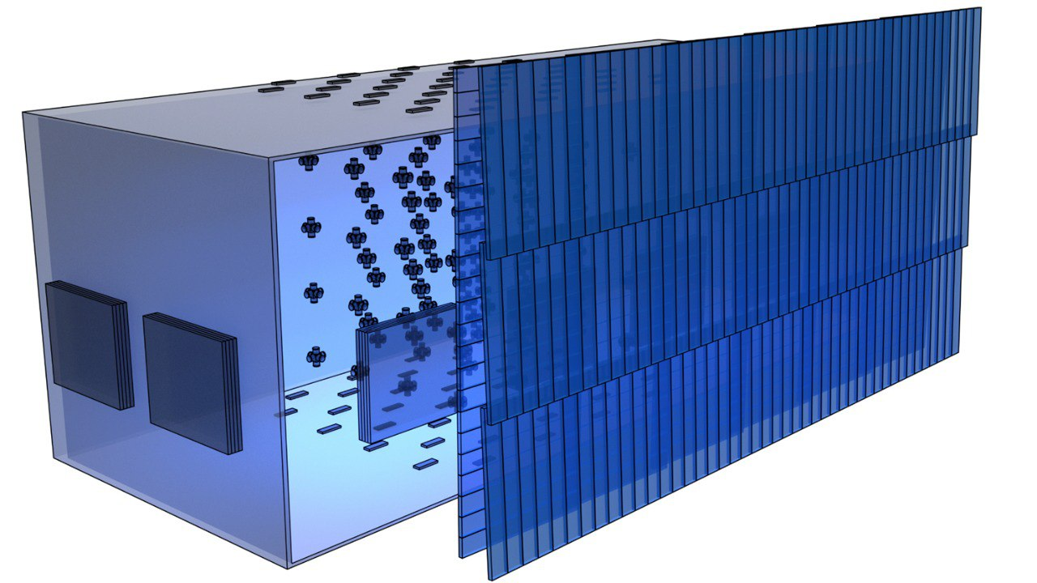
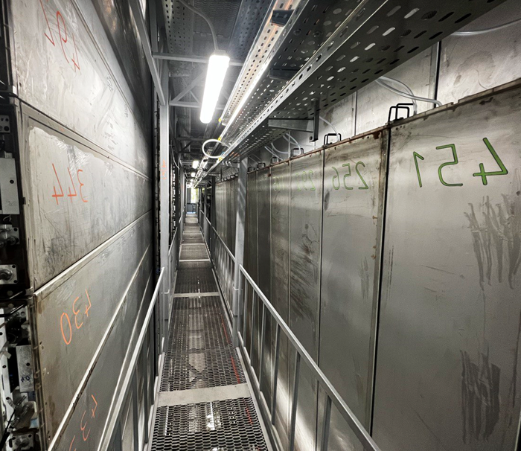
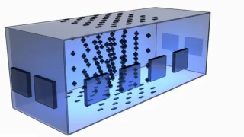
Detector TREK
System of calibration telescopes (SCT)
System of calibration telescopes (SCT)
Cherenkov Water Detector (CWD)
Cherenkov Water Detector (CWD)
DECOR
DECOR
Inner plane
of drift chambers
Outer plane
of drift chambers
TREK consists of 264 drift chambers.
The area of one chamber is 1.85 m².
Detector TREK area is 250 m².
Inner plane
of drift chambers
Outer plane
of drift chambers

Slide 3
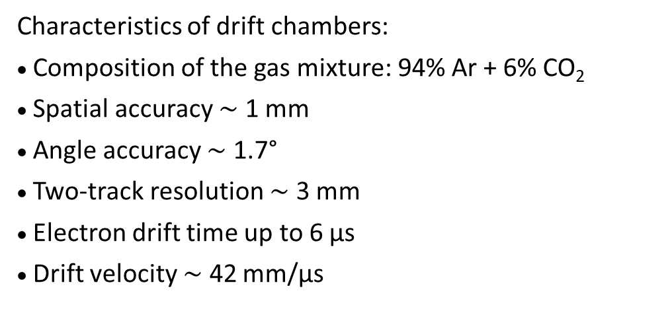
Drift chamber configuration
t
4
t
Field strength
3
t
2
60 mm
500 V/cm
t
1
250
mm
250
mm
Characteristics of drift chambers:
Composition of the gas mixture: 94% Ar + 6% CO₂
Spatial accuracy $\sim$ 1 mm
Angle accuracy $\sim$ 1.7°
Two-track resolution $\sim$ 3 mm
Electron drift time up to 6 μs
Drift velocity $\sim$ 42 mm/μs
–
field-forming wires,
–
signal wires,
–
cathode wires,
–
guard wires.
Two types:
1) nDC (field-forming wires from -12 kV to 0 V;
cathodic wires 0 V; signal wires +2.2 kV)
2) pDC (field-forming wires from 0 V to +12 kV;
cathodic wires +12 kV; signal wires +14.2 kV)

Slide 4
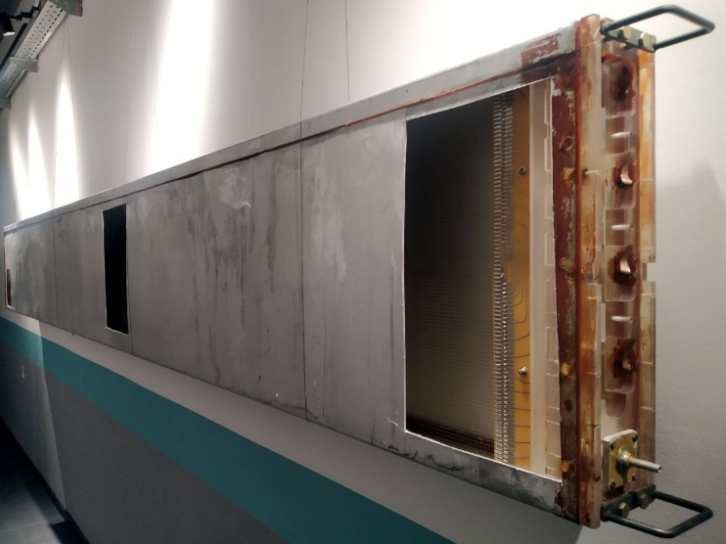
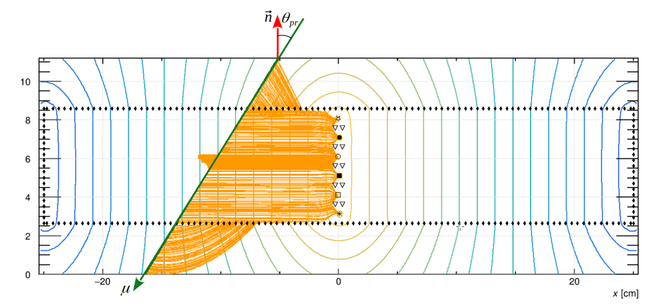
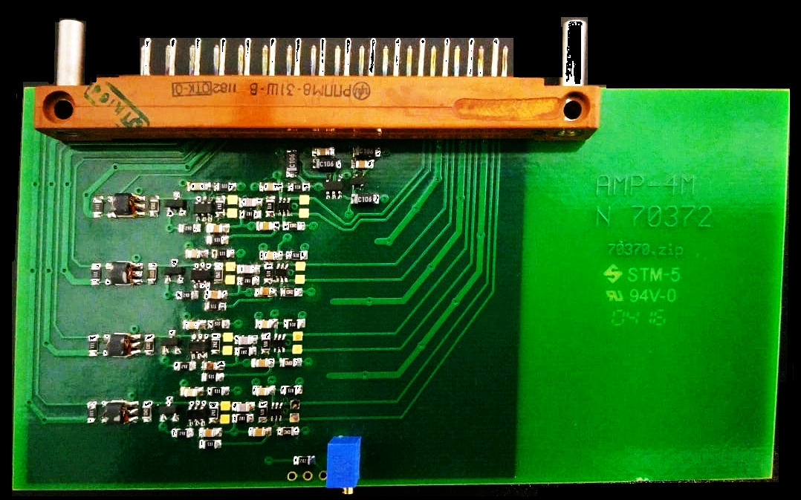
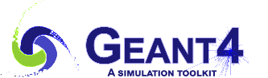


Sequence of simulations
Particle interactions with the chassis
Drift chamber
Electronics
Aluminum casing
Polyethylene separating the casing and the gas volume
Plexiglass blocks for fastening wires and electronics board
Wires
Uniform and constant gradient electric field
Gas mixture characteristics
Model of shaper amplifier producing a pair of time-based differential signals as output

Slide 5

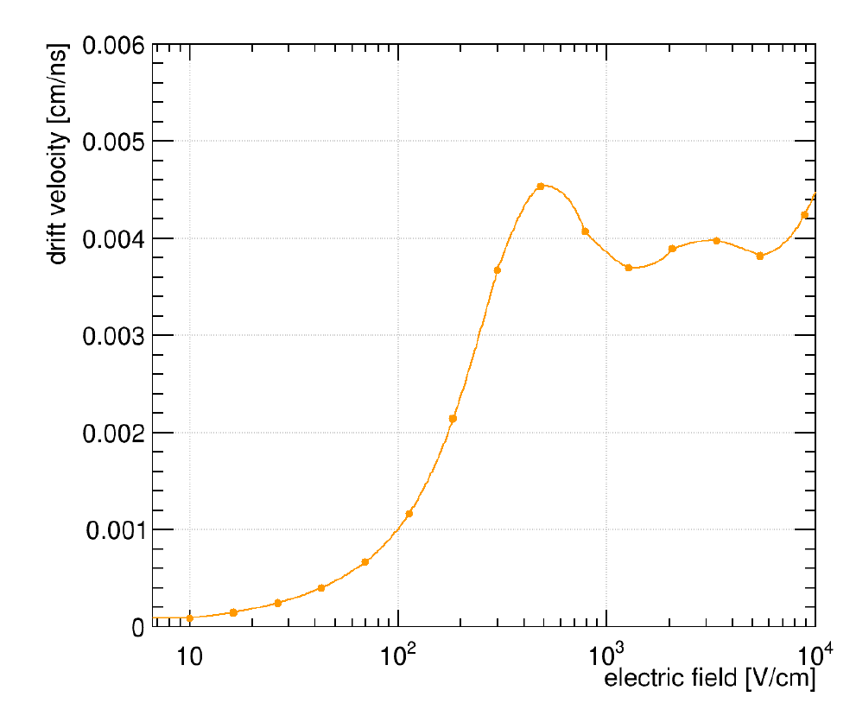
Results of simulation in
Output current signal
Operation characteristics of drift chamber for the given gas mixture and electric field
Time based current signal at anode
Drift velocity

Slide 6
Result of model of in
Low Voltage Differential Signals (LVDS)

Slide 7
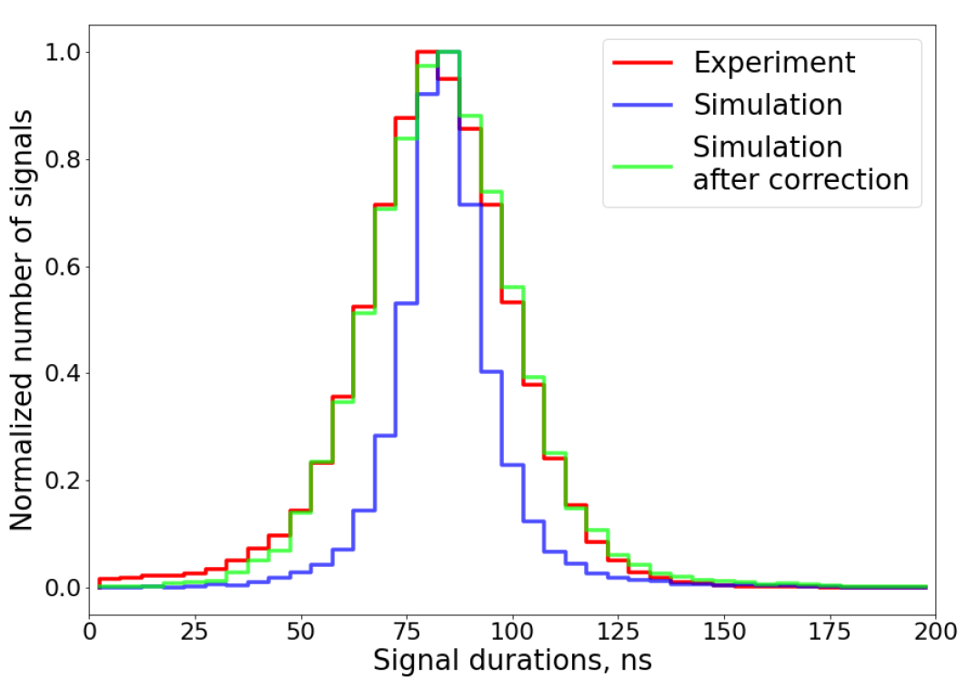
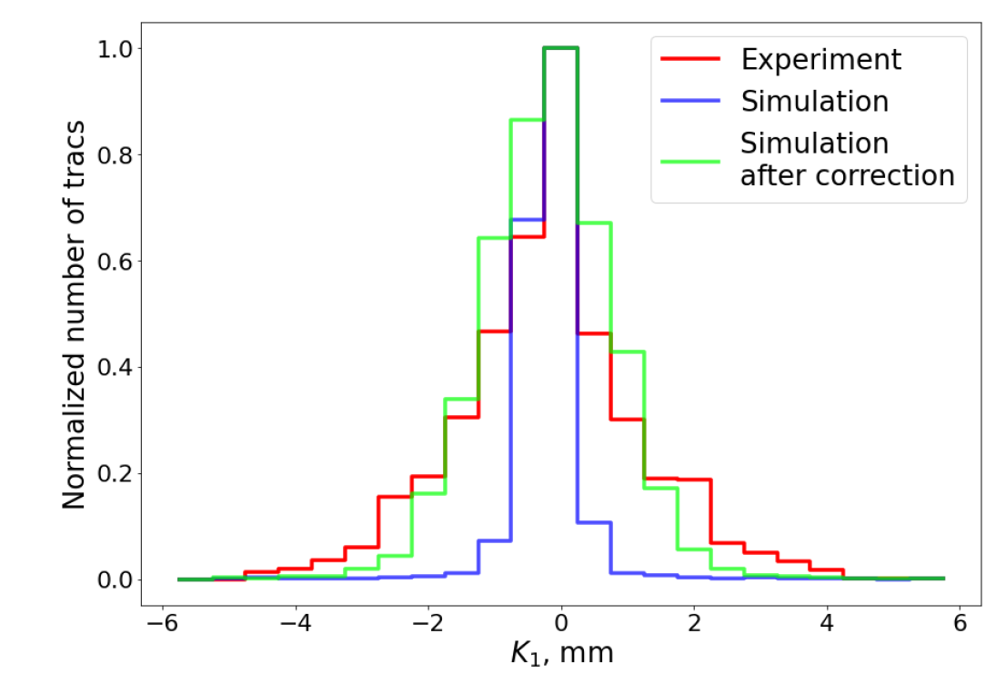
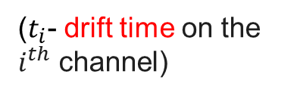
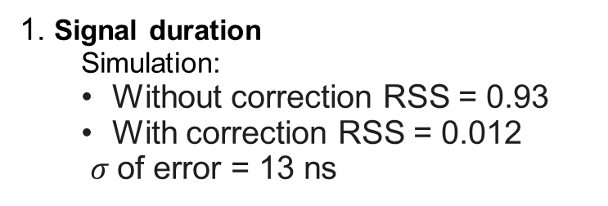
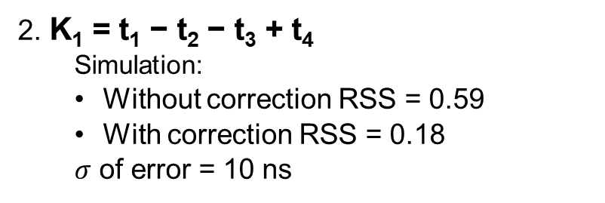
Results of comparison of experiment and sdfsdfsd+ + model
1. Signal duration
  Simulation:
  Without correction RSS = 0.93
  With correction RSS = 0.012
  $σ$of error = 13 ns
($t_{i}$- drift time on the $i^{th}$ channel)
2. K₁ = t₁ − t₂ − t₃ + t₄
    Simulation:
  Without correction RSS = 0.59
  With correction RSS = 0.18
  $σ$ of error = 10 ns

Slide 8
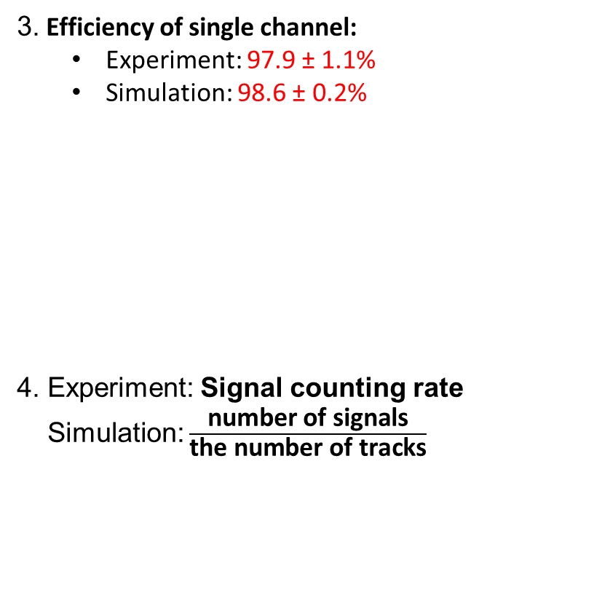
Results of comparison of experiment and sdfsdfsd+ + model
3. Efficiency of single channel:
  Experiment: 97.9 ± 1.1%
  Simulation: 98.6 ± 0.2%
4. Experiment: Signal counting rate
Simulation: $\frac{\text{number} \text{of} \text{signals}}{\text{the} \text{number} \text{of} \text{tracks}}$

Slide 9
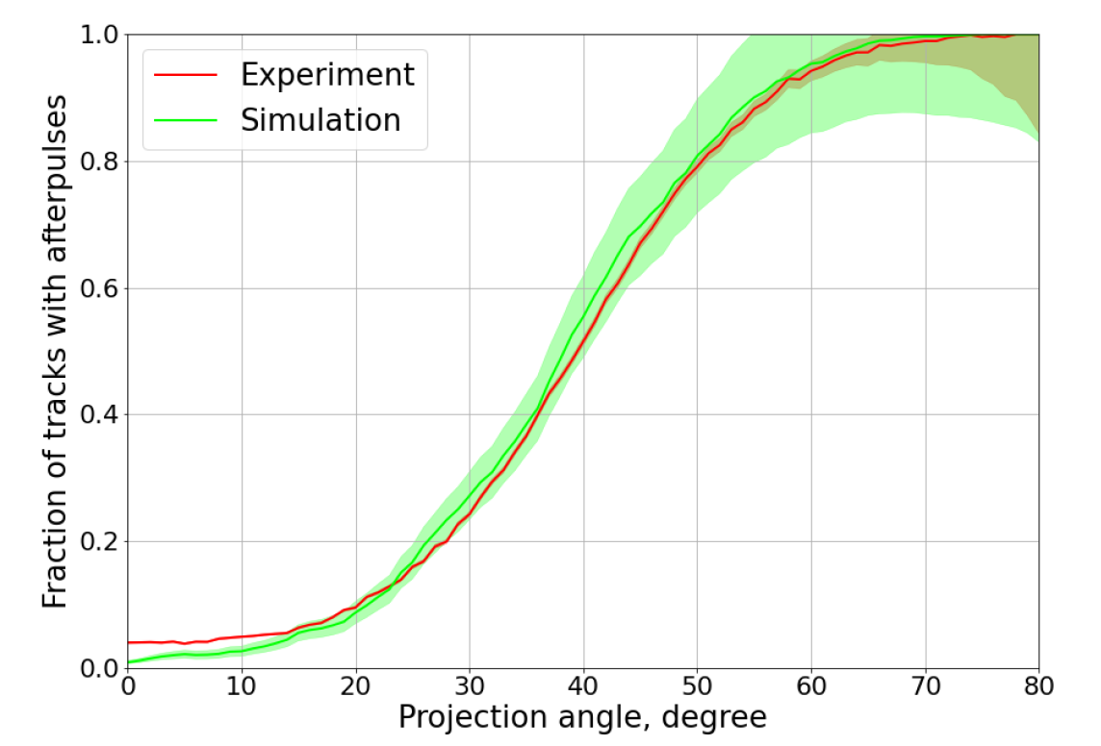
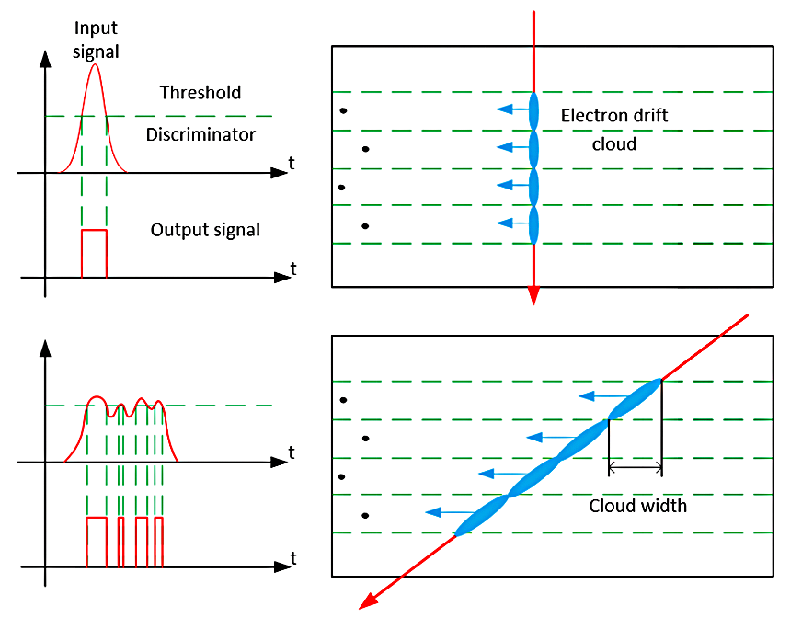
Results of comparison of experiment and sdfsdfsdf+ + models
5. After pulses
Proportion of tracks with after pulses depending on the projection angle

Slide 10
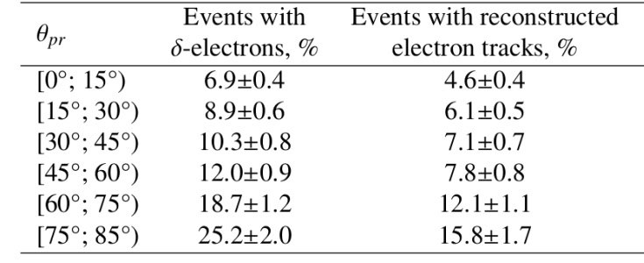

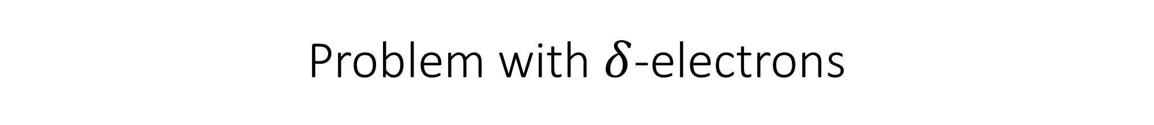
Problem with $δ$-electrons
Only electrons formed in the chamber body and in the gas volume are considered
Distribution of delta electrons over laboratory coordinate system:
$$dN\sim \frac{d cosψ}{\cos^{3}ψ}$$
+ +

Slide 11
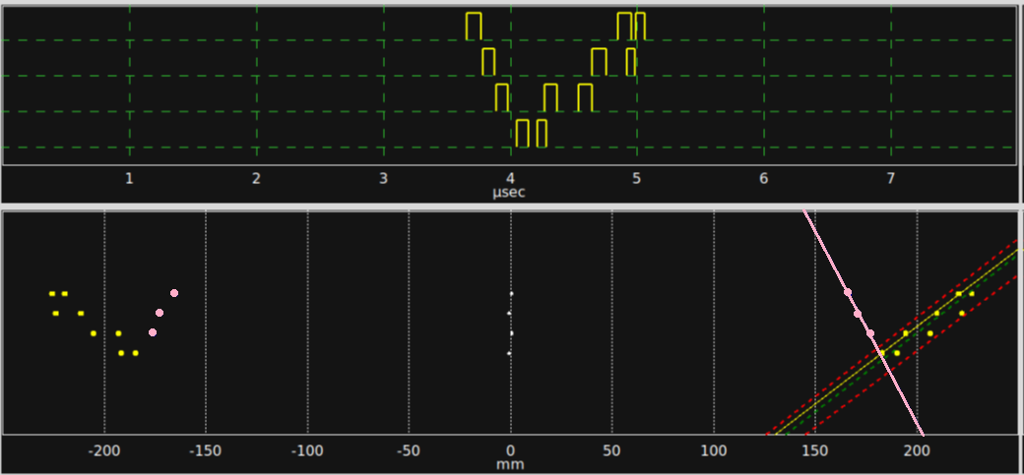

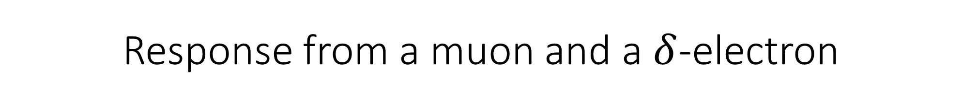
Response from a muon and a $δ$-electron
$$∆x= \frac{1}{2} \left({10}_{mm}\tan{θ_{pr}}\right)+5σ_{x}$$
Corridor:
Time based digital signals (above) and reconstructed hits of muon and δ-electron tracks in the projection plane (below)

Slide 12
Summary
Drift chambers’ signal channel Efficiency obtained as a result of sequential simulations in Geant4, Garfieldpp and LTspice is 98.6±02%, which is in good agreement with the experimental value of 97.9±1.1%
Comparison of other experiment specific parameters like signal duration, signal count rate, after pulses and K₁, with the analogous values obtained from the complete model as a whole were discussed, which prove to be in close correspondence
The angular dependence of reconstruction of delta electron tracks is estimated using this model and the results were presented
Further this model will be used to build datasets for training neural networks for reconstruction methods

Slide 13
Thank you for your attention
Presenter: Uruj Abroo
E-mail: aun001@campus.mephi.ru
ICPPA 2024

