Slide 1
Infrastructure of 5 ton Baksan Large Neutrino Telescope prototype
Lukanov Arslan
ICPPA, 2024

Slide 2
Introduction
Magnetic field compensation system
Geomagnetic field
Magnetometer and calibration
Magnetic field compensation system
Liquid scintillator purification methods
Chromatografic purification
Vacuum distillation

Slide 3
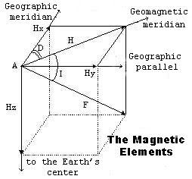
Geomagnetic field and its elements
At any point on the Earth’s surface there is a natural magnetic field, which can be represented by a three-dimensional vector.
H_x = 0.17 G
H_y = 0.03 G
H_z = 0.49 G

Slide 4
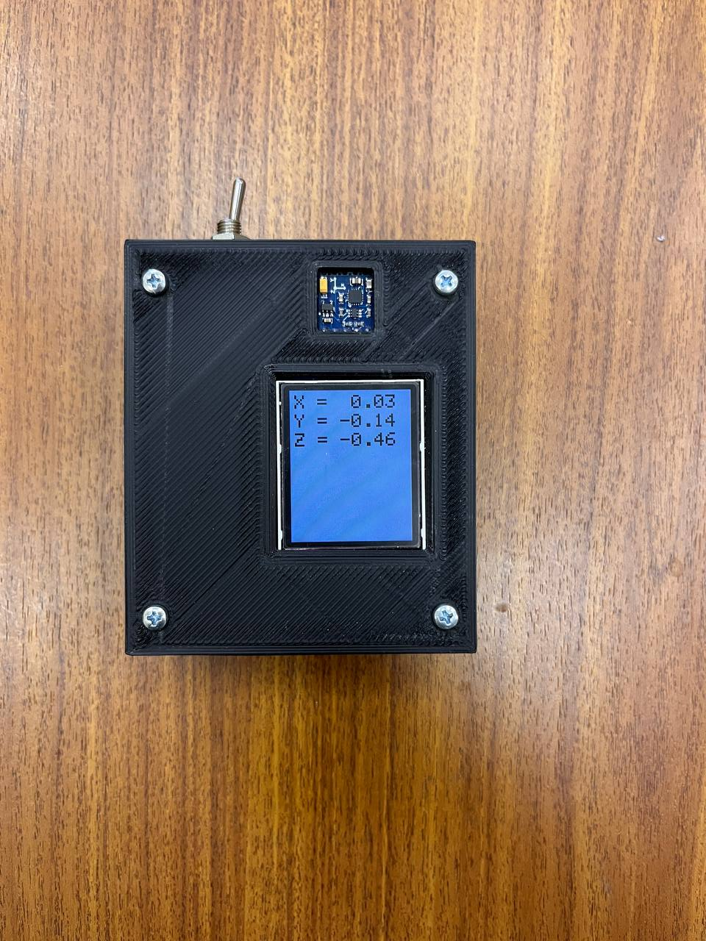
Magnetometer and calibration
Magnetic field in the place of prototype location was measured by magnetometer based on HMC5883L sensor.
To achieve correct data, HMC5883L sensor needs calibration.
${\vec{B}}_{calib}=A∗\left({\vec{B}}_{meas}−\vec{b}\right)$
Calibration coefficients were calculated by «Magneto» program.

Slide 5
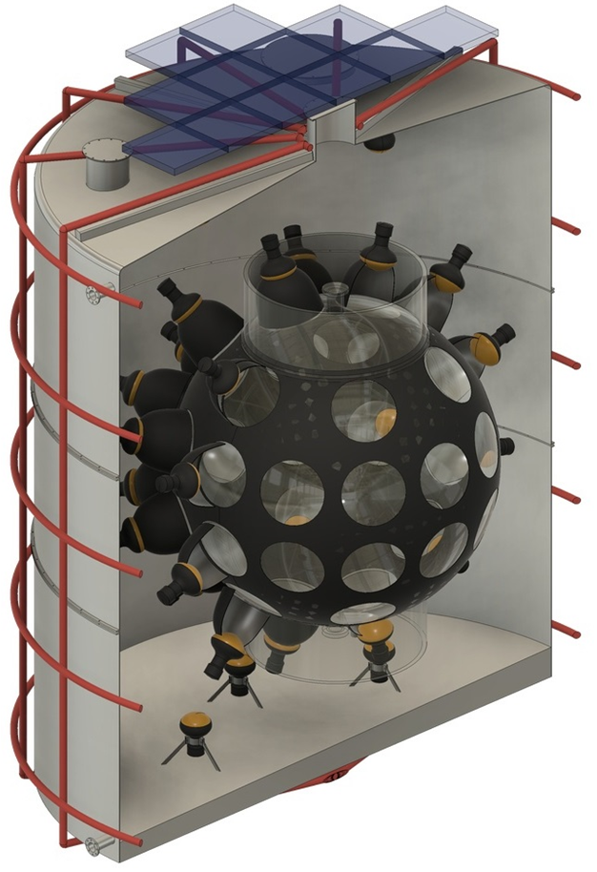
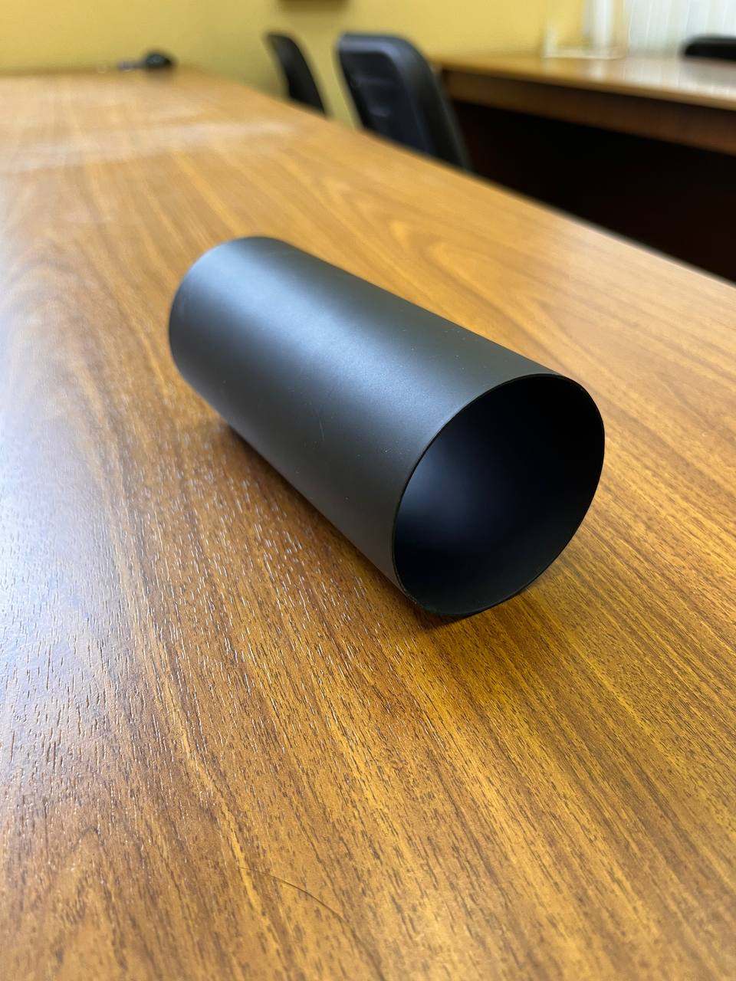
Magnetic field compensation system
Passive method – use of magnetic screens, materials with high magnetic permeability.
Active method – use Helmholtz coils.

Slide 6
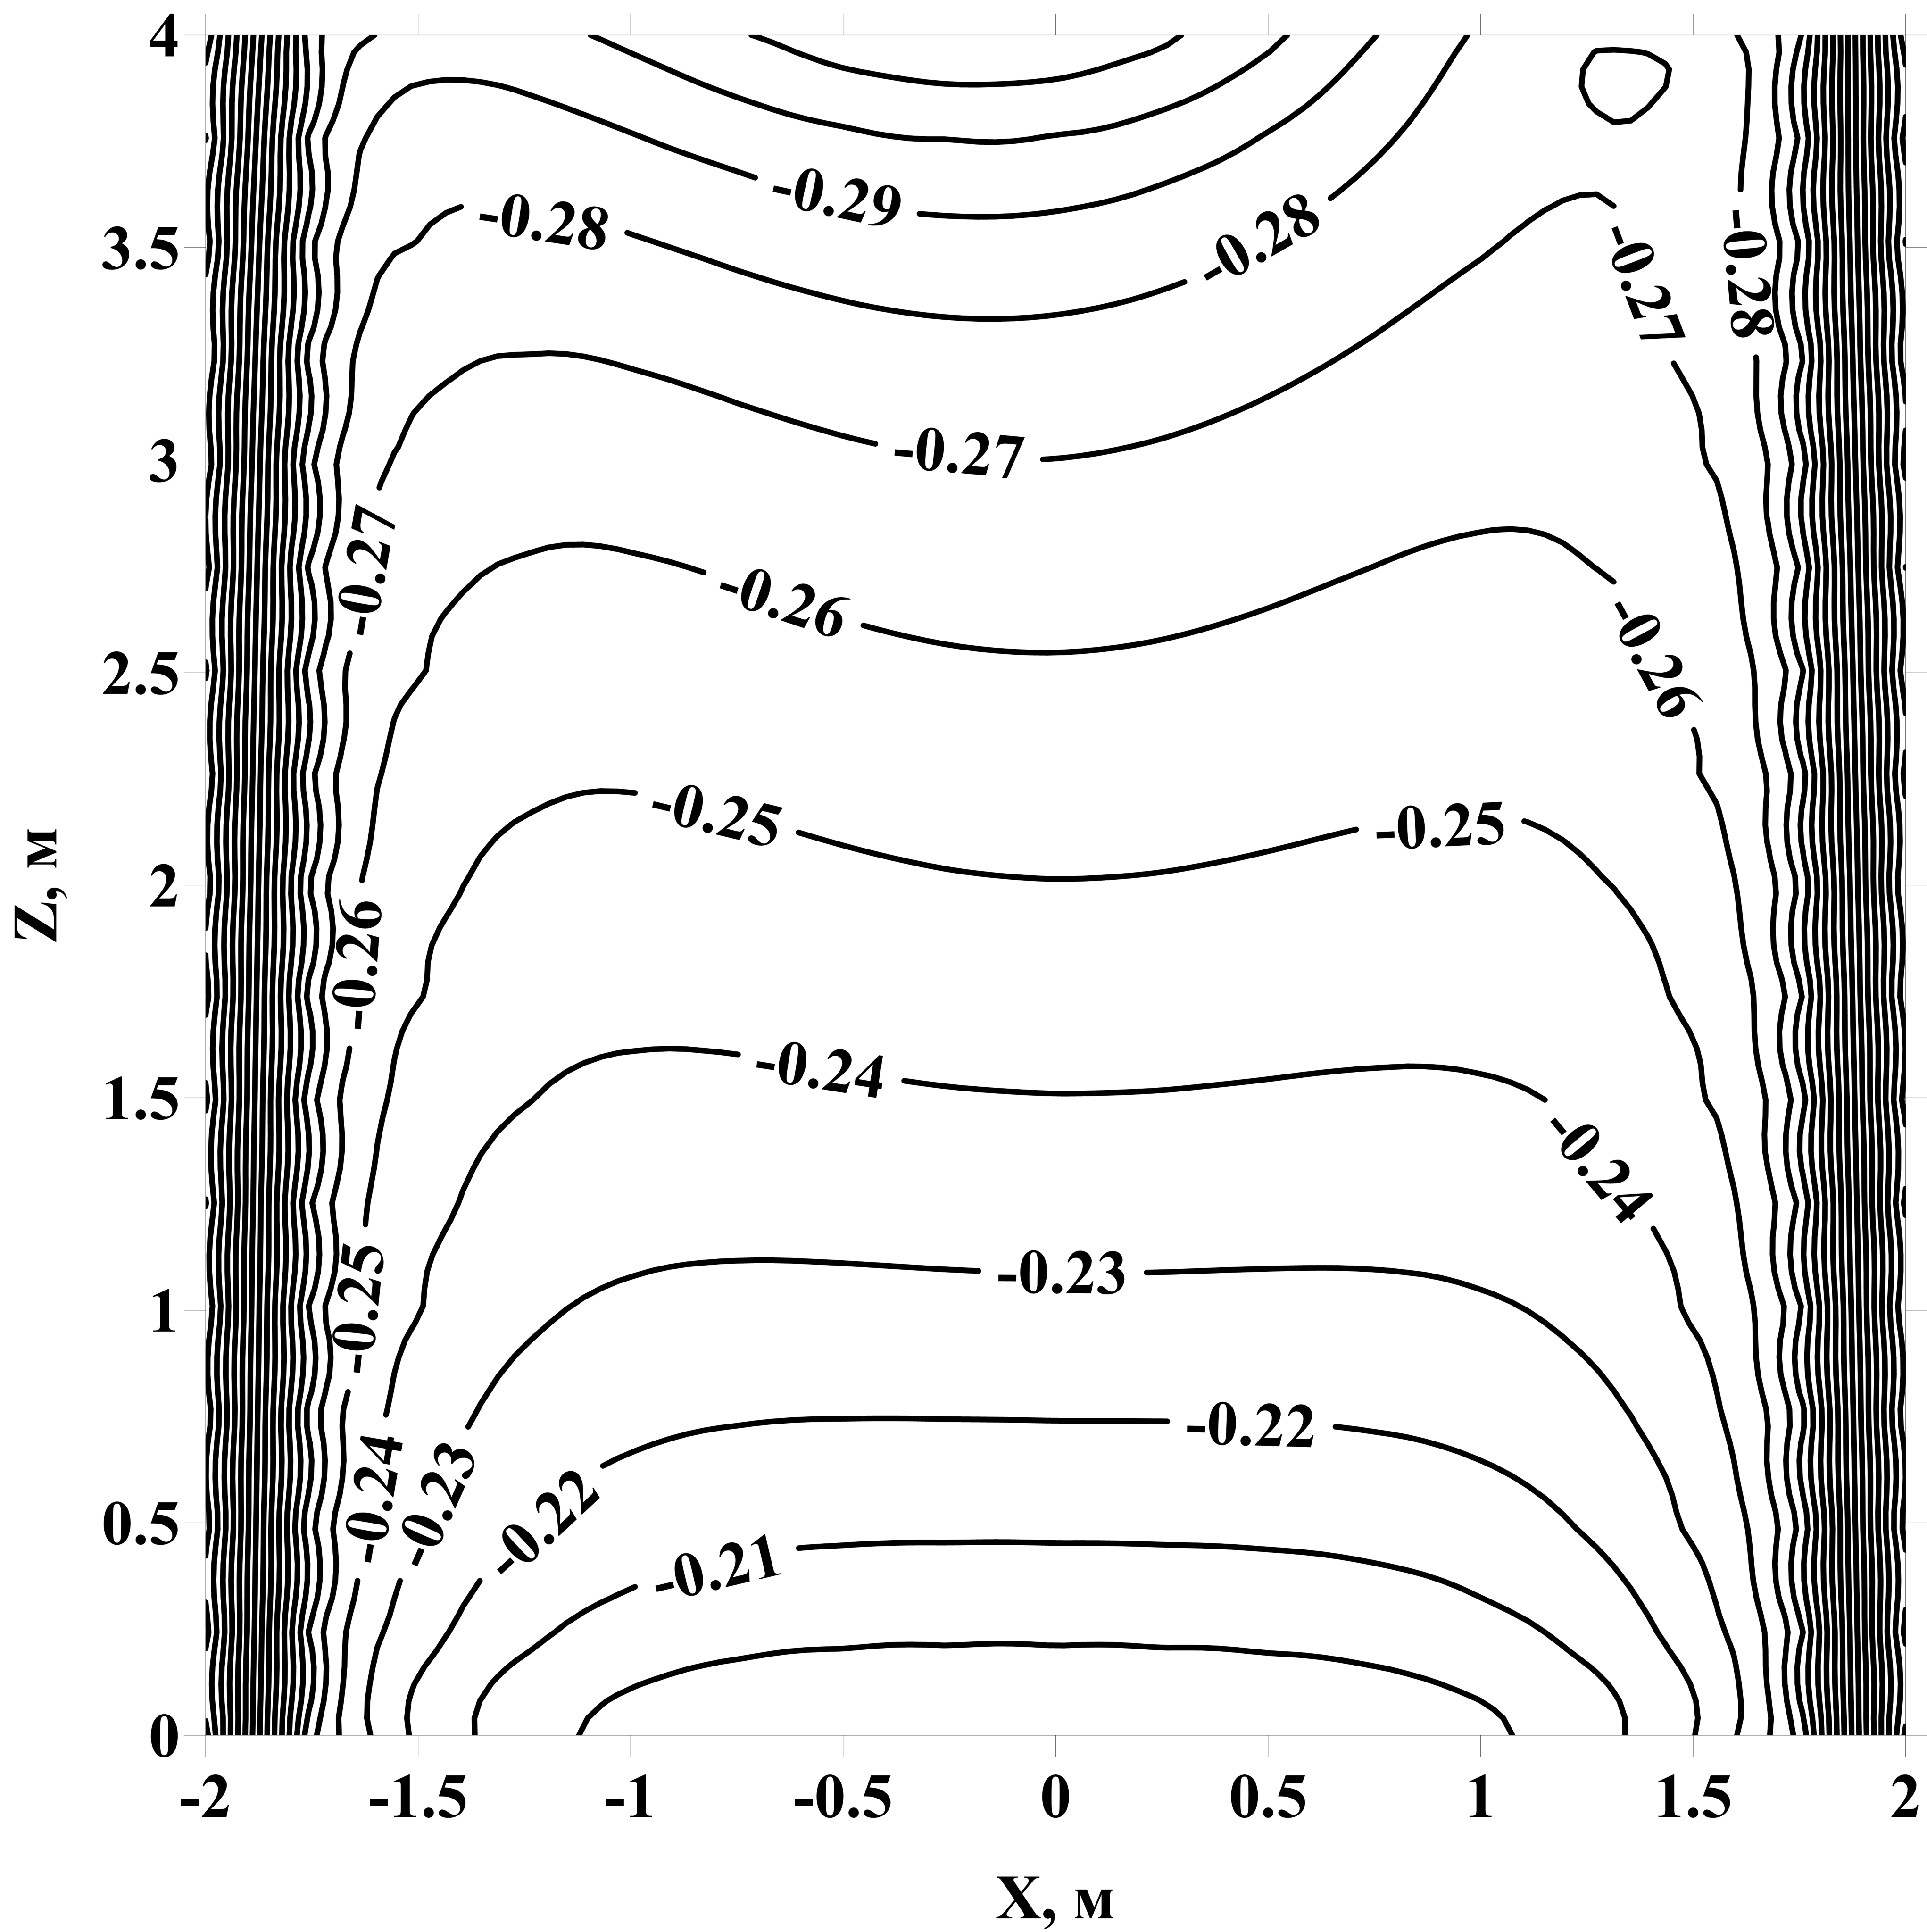
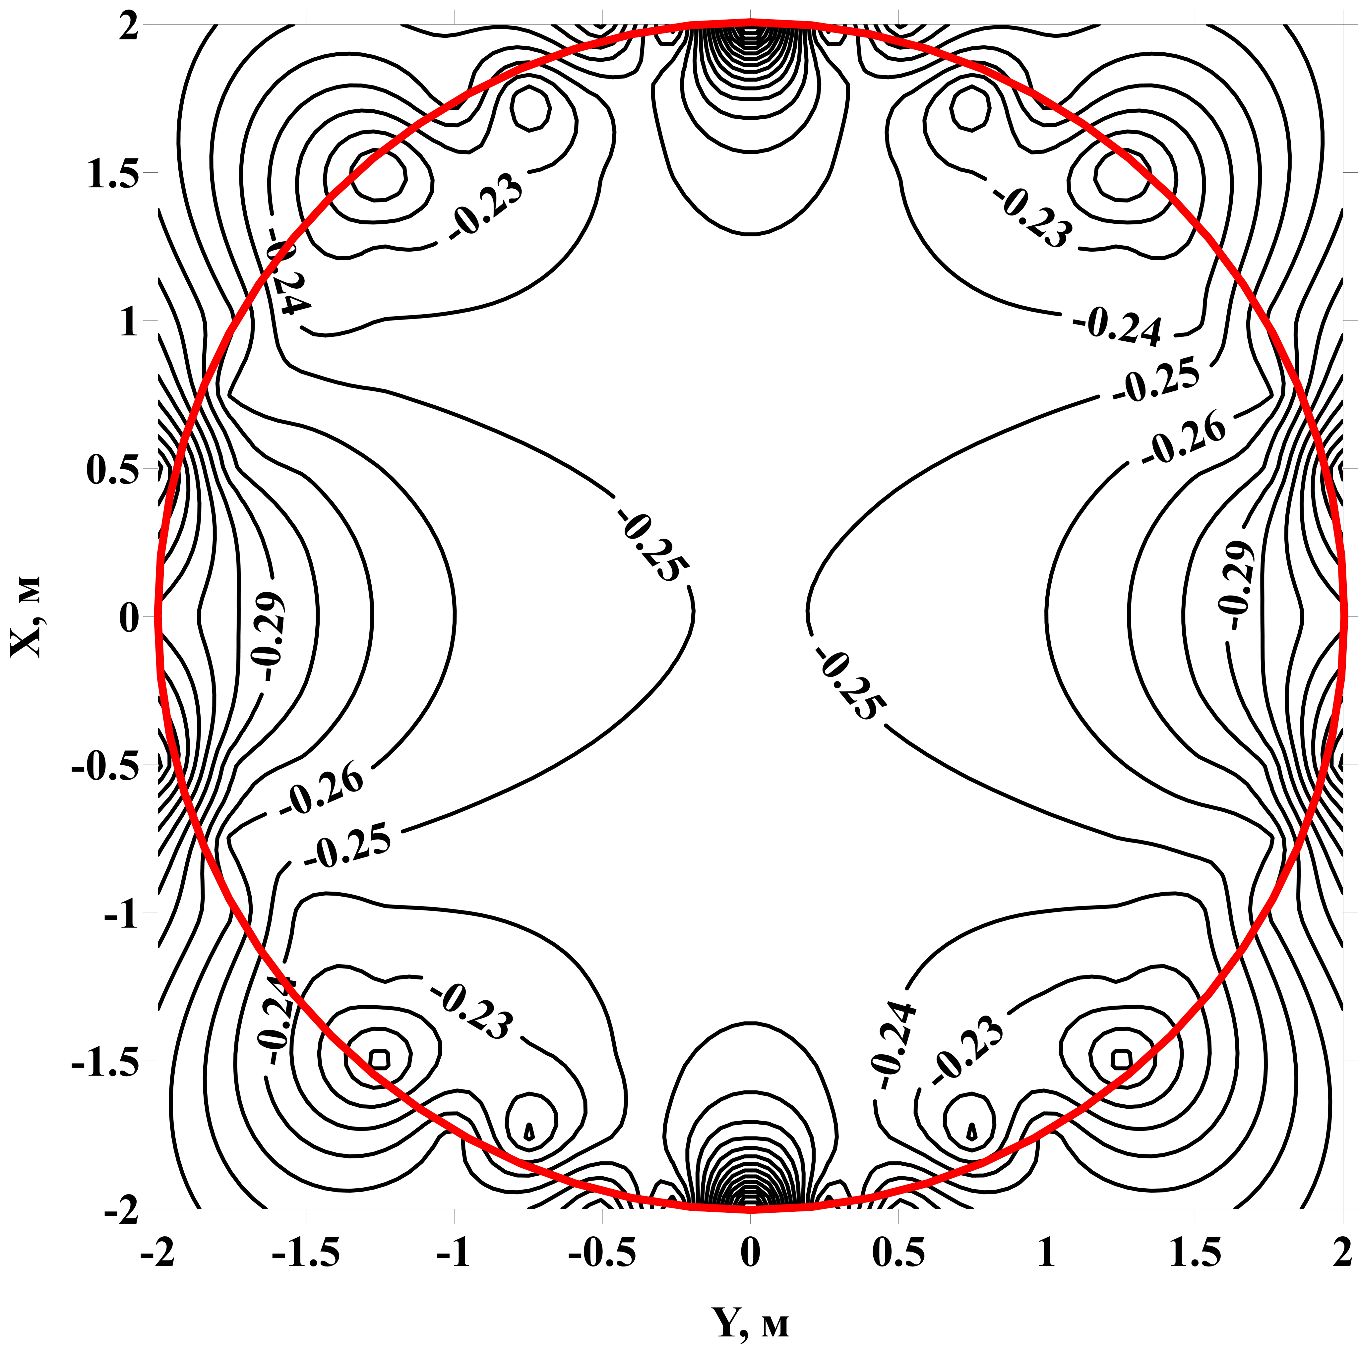
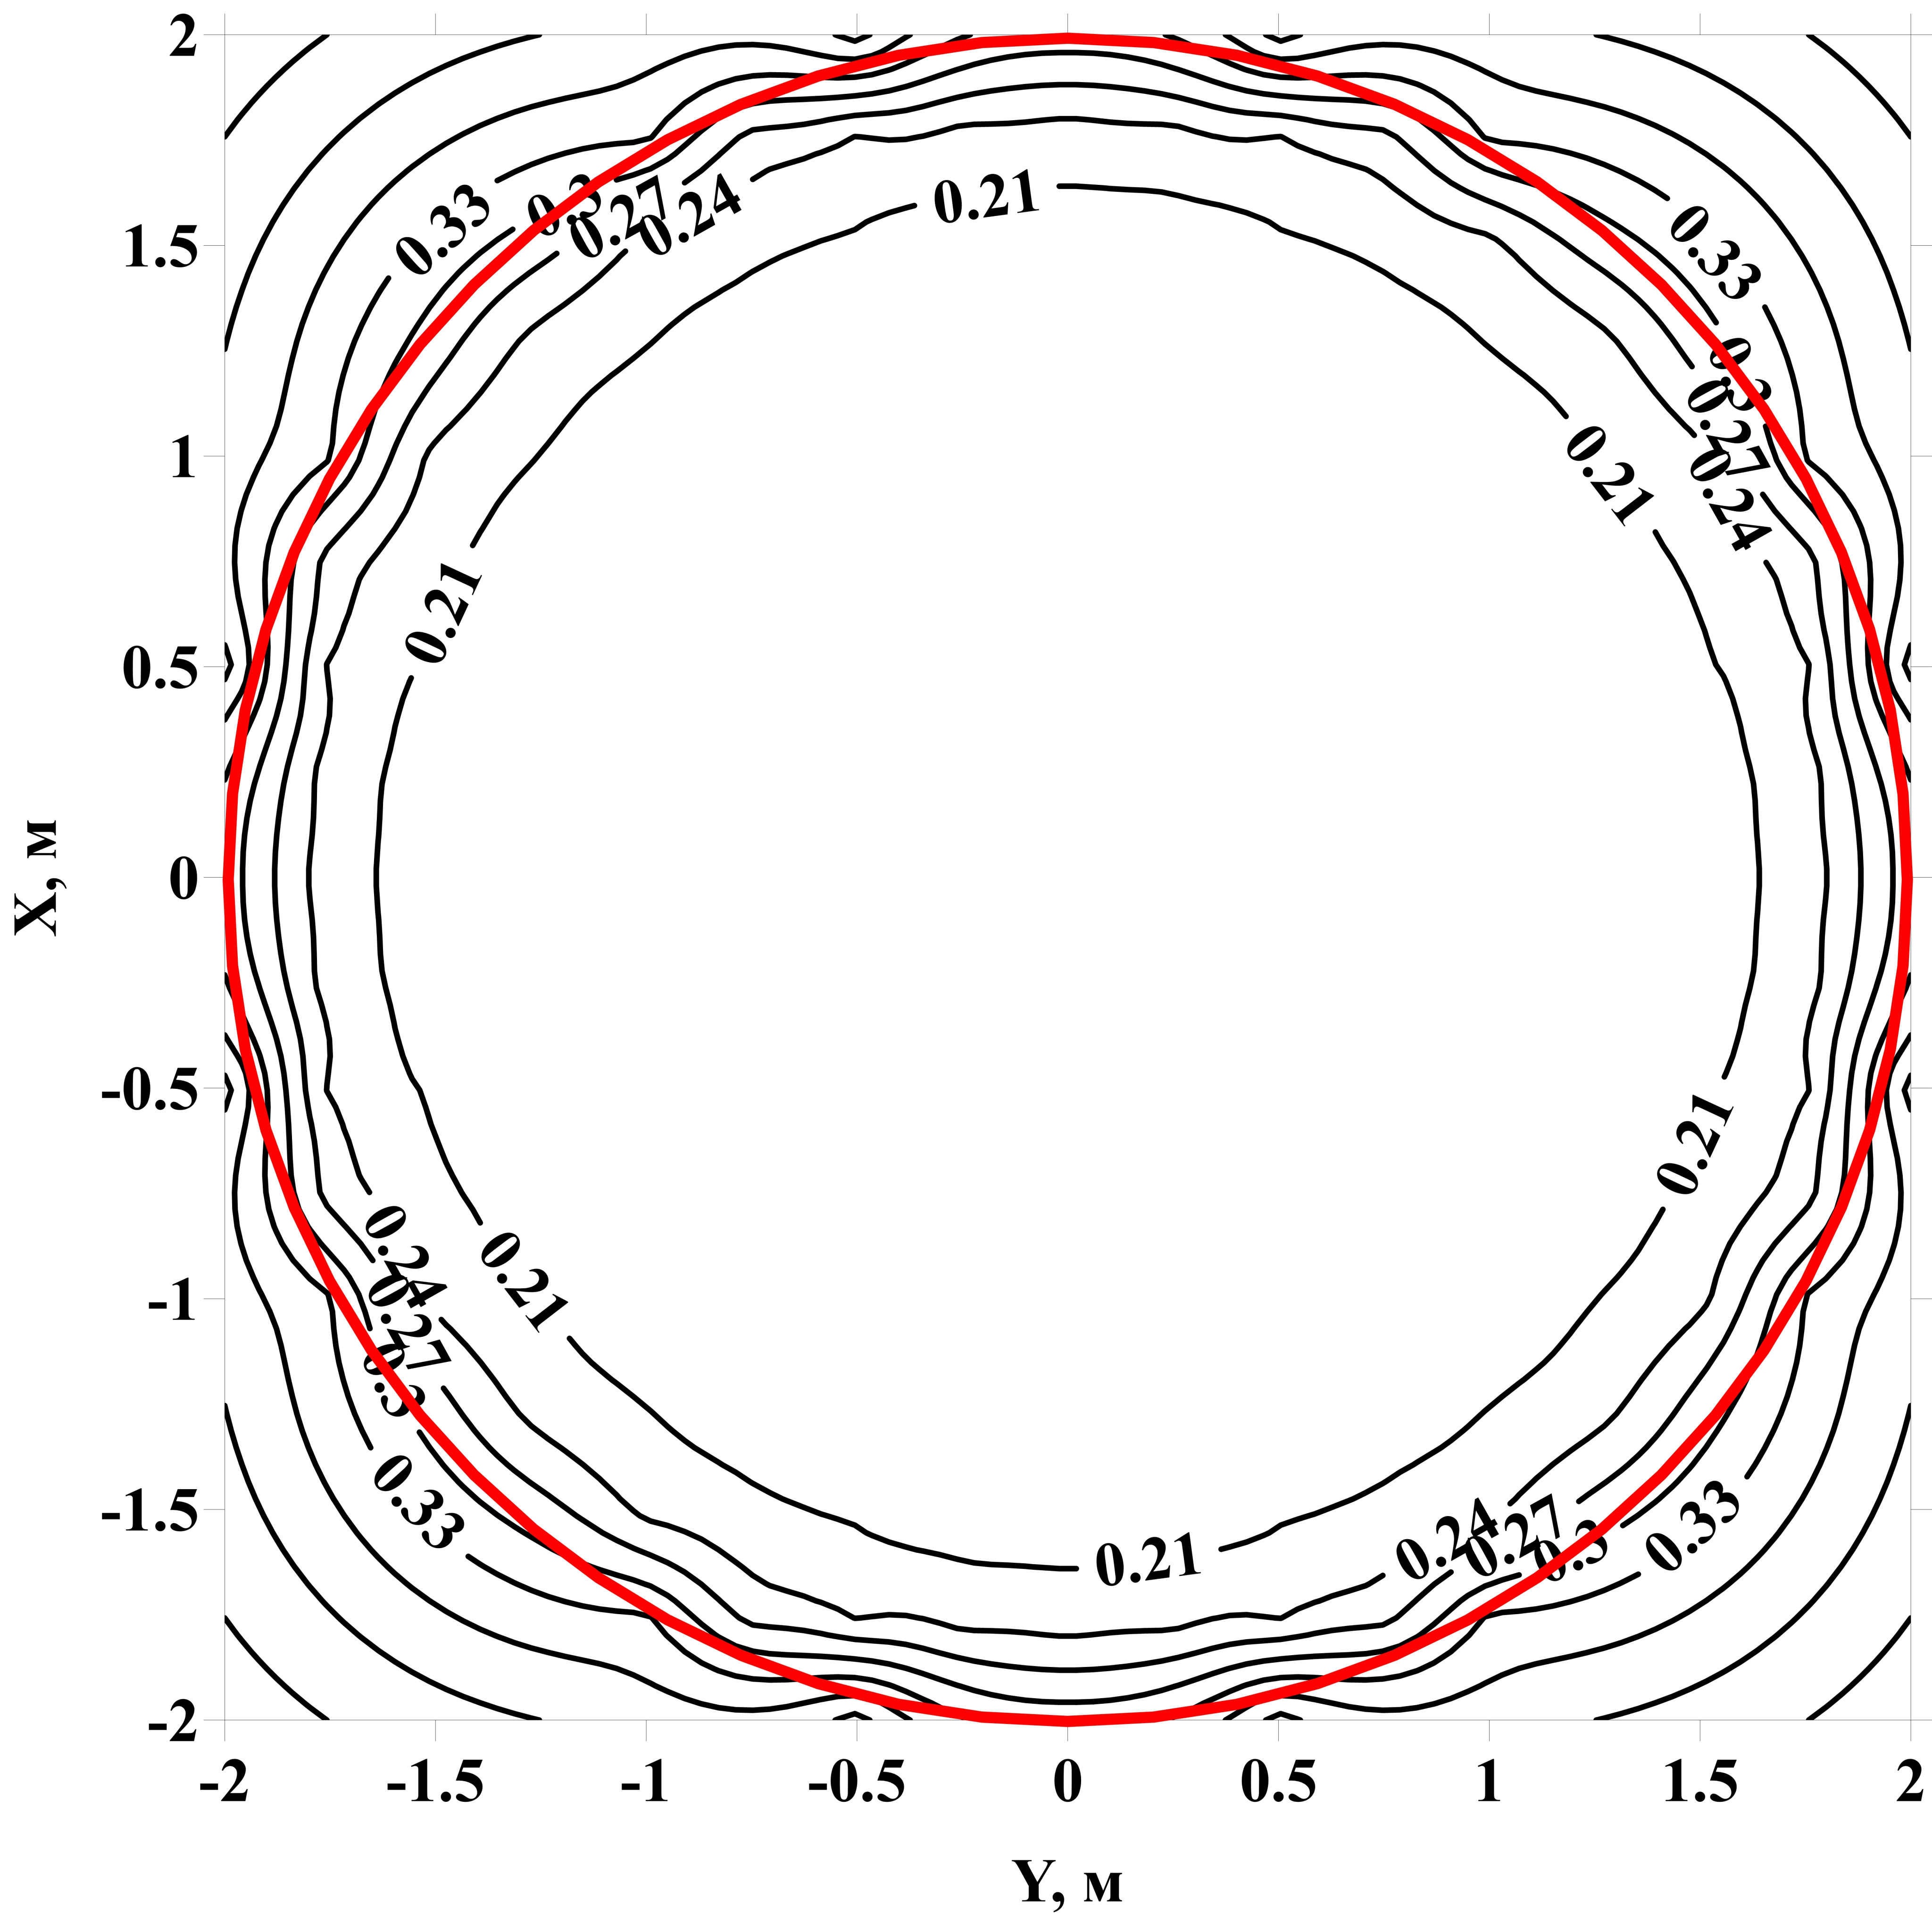
Magnetic field compensation system
Measured values of magnetic field in prototype location:
horizontal component – 0.265 G, vertical – 0.25 G
Horizontal component: Number of coils 12
Turns = 7
Vertical component: Number of coils 5
Turns = 10
ICPPA, 2022
16

Slide 7
Liquid scintillator purification methods
Chromatografic purification with columns filled with aluminum oxide (Al₂O₃) removes organic impurities and improves optical properties.
Vacuum distillation removes organic and radioactive impurities and improves optical properties.
Water extraction removes radioactive impurities.

Slide 8
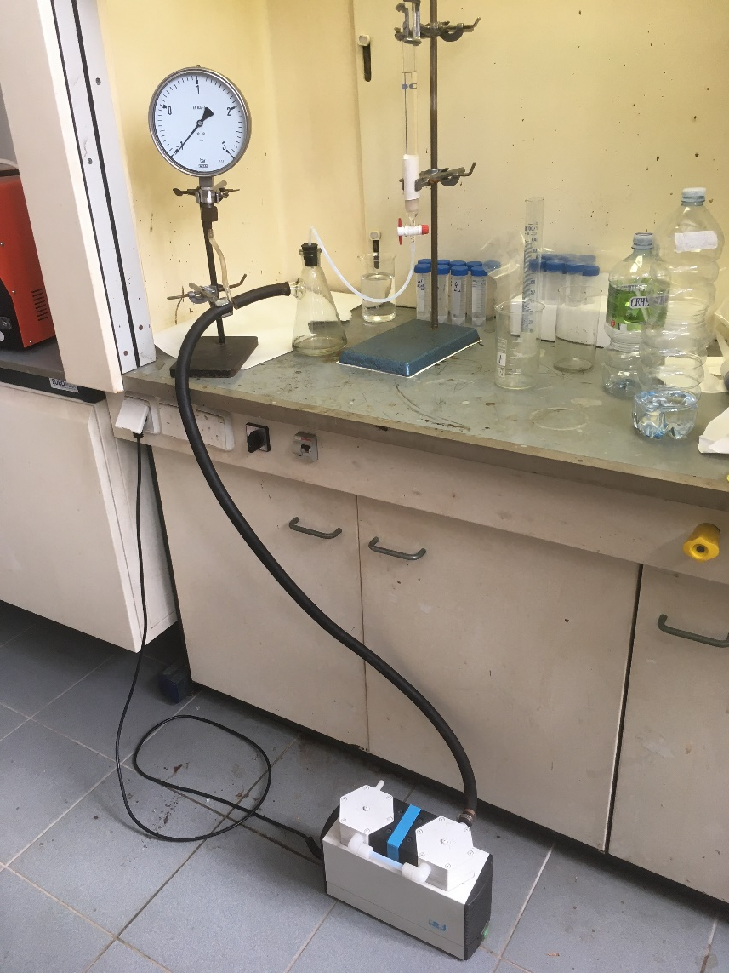
Chromatografic purification using non-activated Al₂O₃
Sorption purification was performed with column with diameter of 3 cm.
The volume of Al₂O₃ was 50 ml.
LAB was passed in 100 ml portions.
Measurements were performed by spectrophotometer Perkin Elmer Lambda-35.

Slide 9
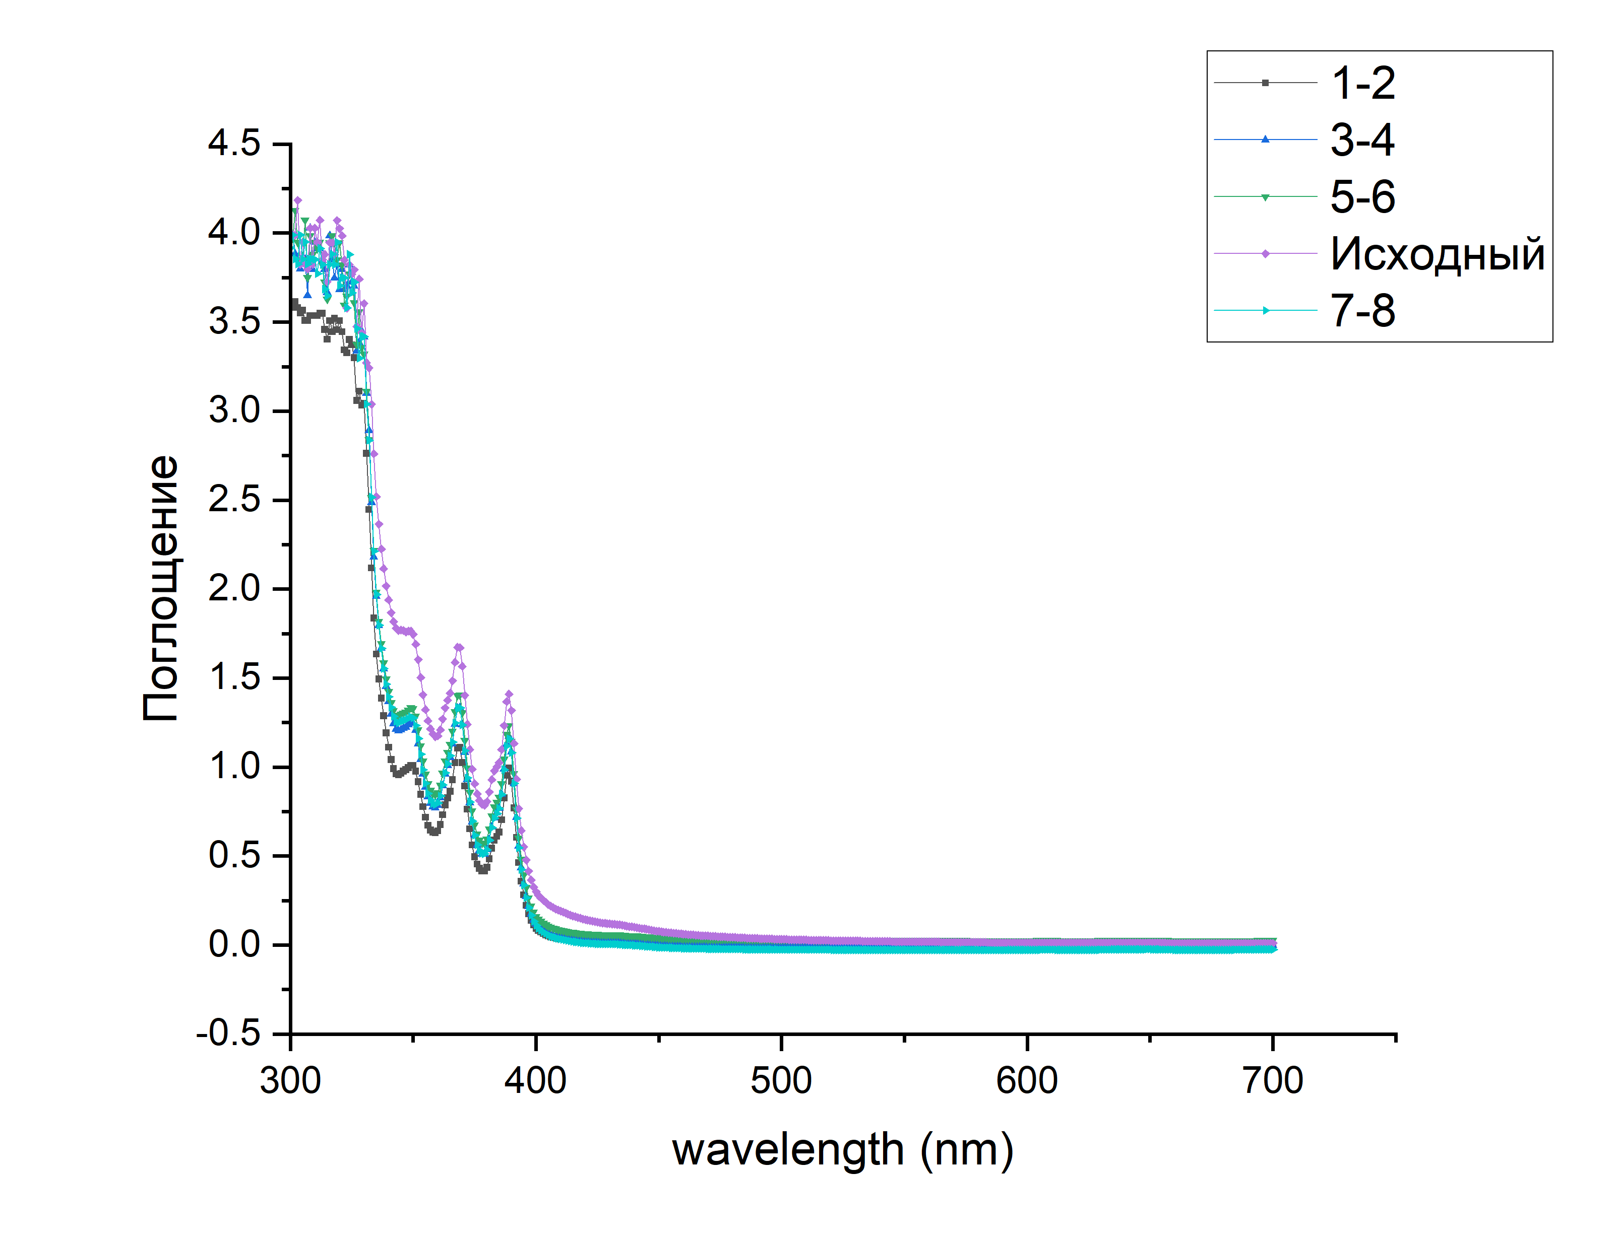
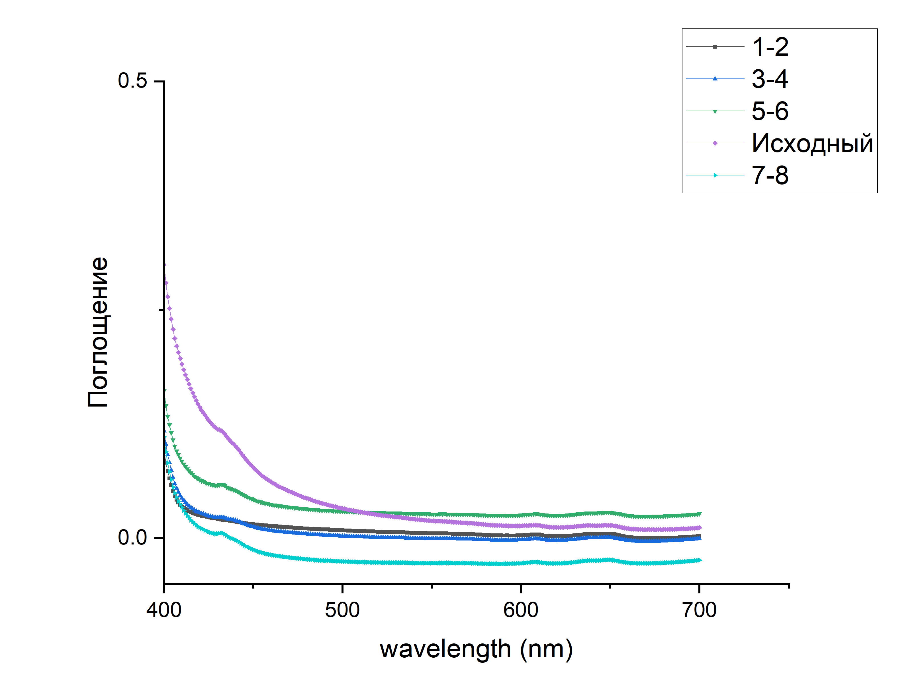
Chromatografic purification using non-activated Al₂O₃
Absorption
Absorption

Slide 10
Chromatografic purification using non-activated Al₂O₃
Sorption purification was performed with column with diameter of 3 cm.
The volume of Al₂O₃ was 50 ml.
LAB was passed in 100 ml portions.
Measurements were performed by spectrophotometer Perkin Elmer Lambda-35.
№ | Sample | A_min | A_420 | A_430 | A_440 | L_420 | L_430 | L_440
1 | 1-2 | 0,0028 | 0,0249 | 0,021 | 0,0181 | 1,9 | 2,4 | 2,8
2 | 3-4 | -0,0023 | 0,0275 | 0,0225 | 0,0194 | 1,5 | 1,8 | 2
3 | 5-6 | -0,025 | 0,0636 | 0,0578 | 0,0522 | 1,1 | 1,3 | 1,6
4 | 7-8 | -0,0282 | 0,0114 | 0,0048 | -0,002 | 1,1 | 1,3 | 1,6
5 | Initial | 0,0134 | 0,1431 | 0,1192 | 0,1008 | 0,3 | 0,4 | 0,5
Absorption length L is measured in meters

Slide 11
Chromatografic purification using activated Al₂O₃
Annealing took place at t = 250°C for 8 hours.
Sorption purification was performed with column with diameter of 3 cm.
The volume of Al₂O₃ was 50 ml.
LAB was passed in 100 ml, 200 ml portions.

Slide 12
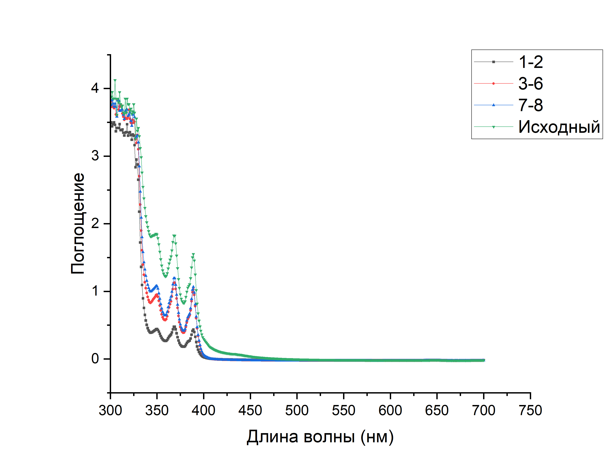
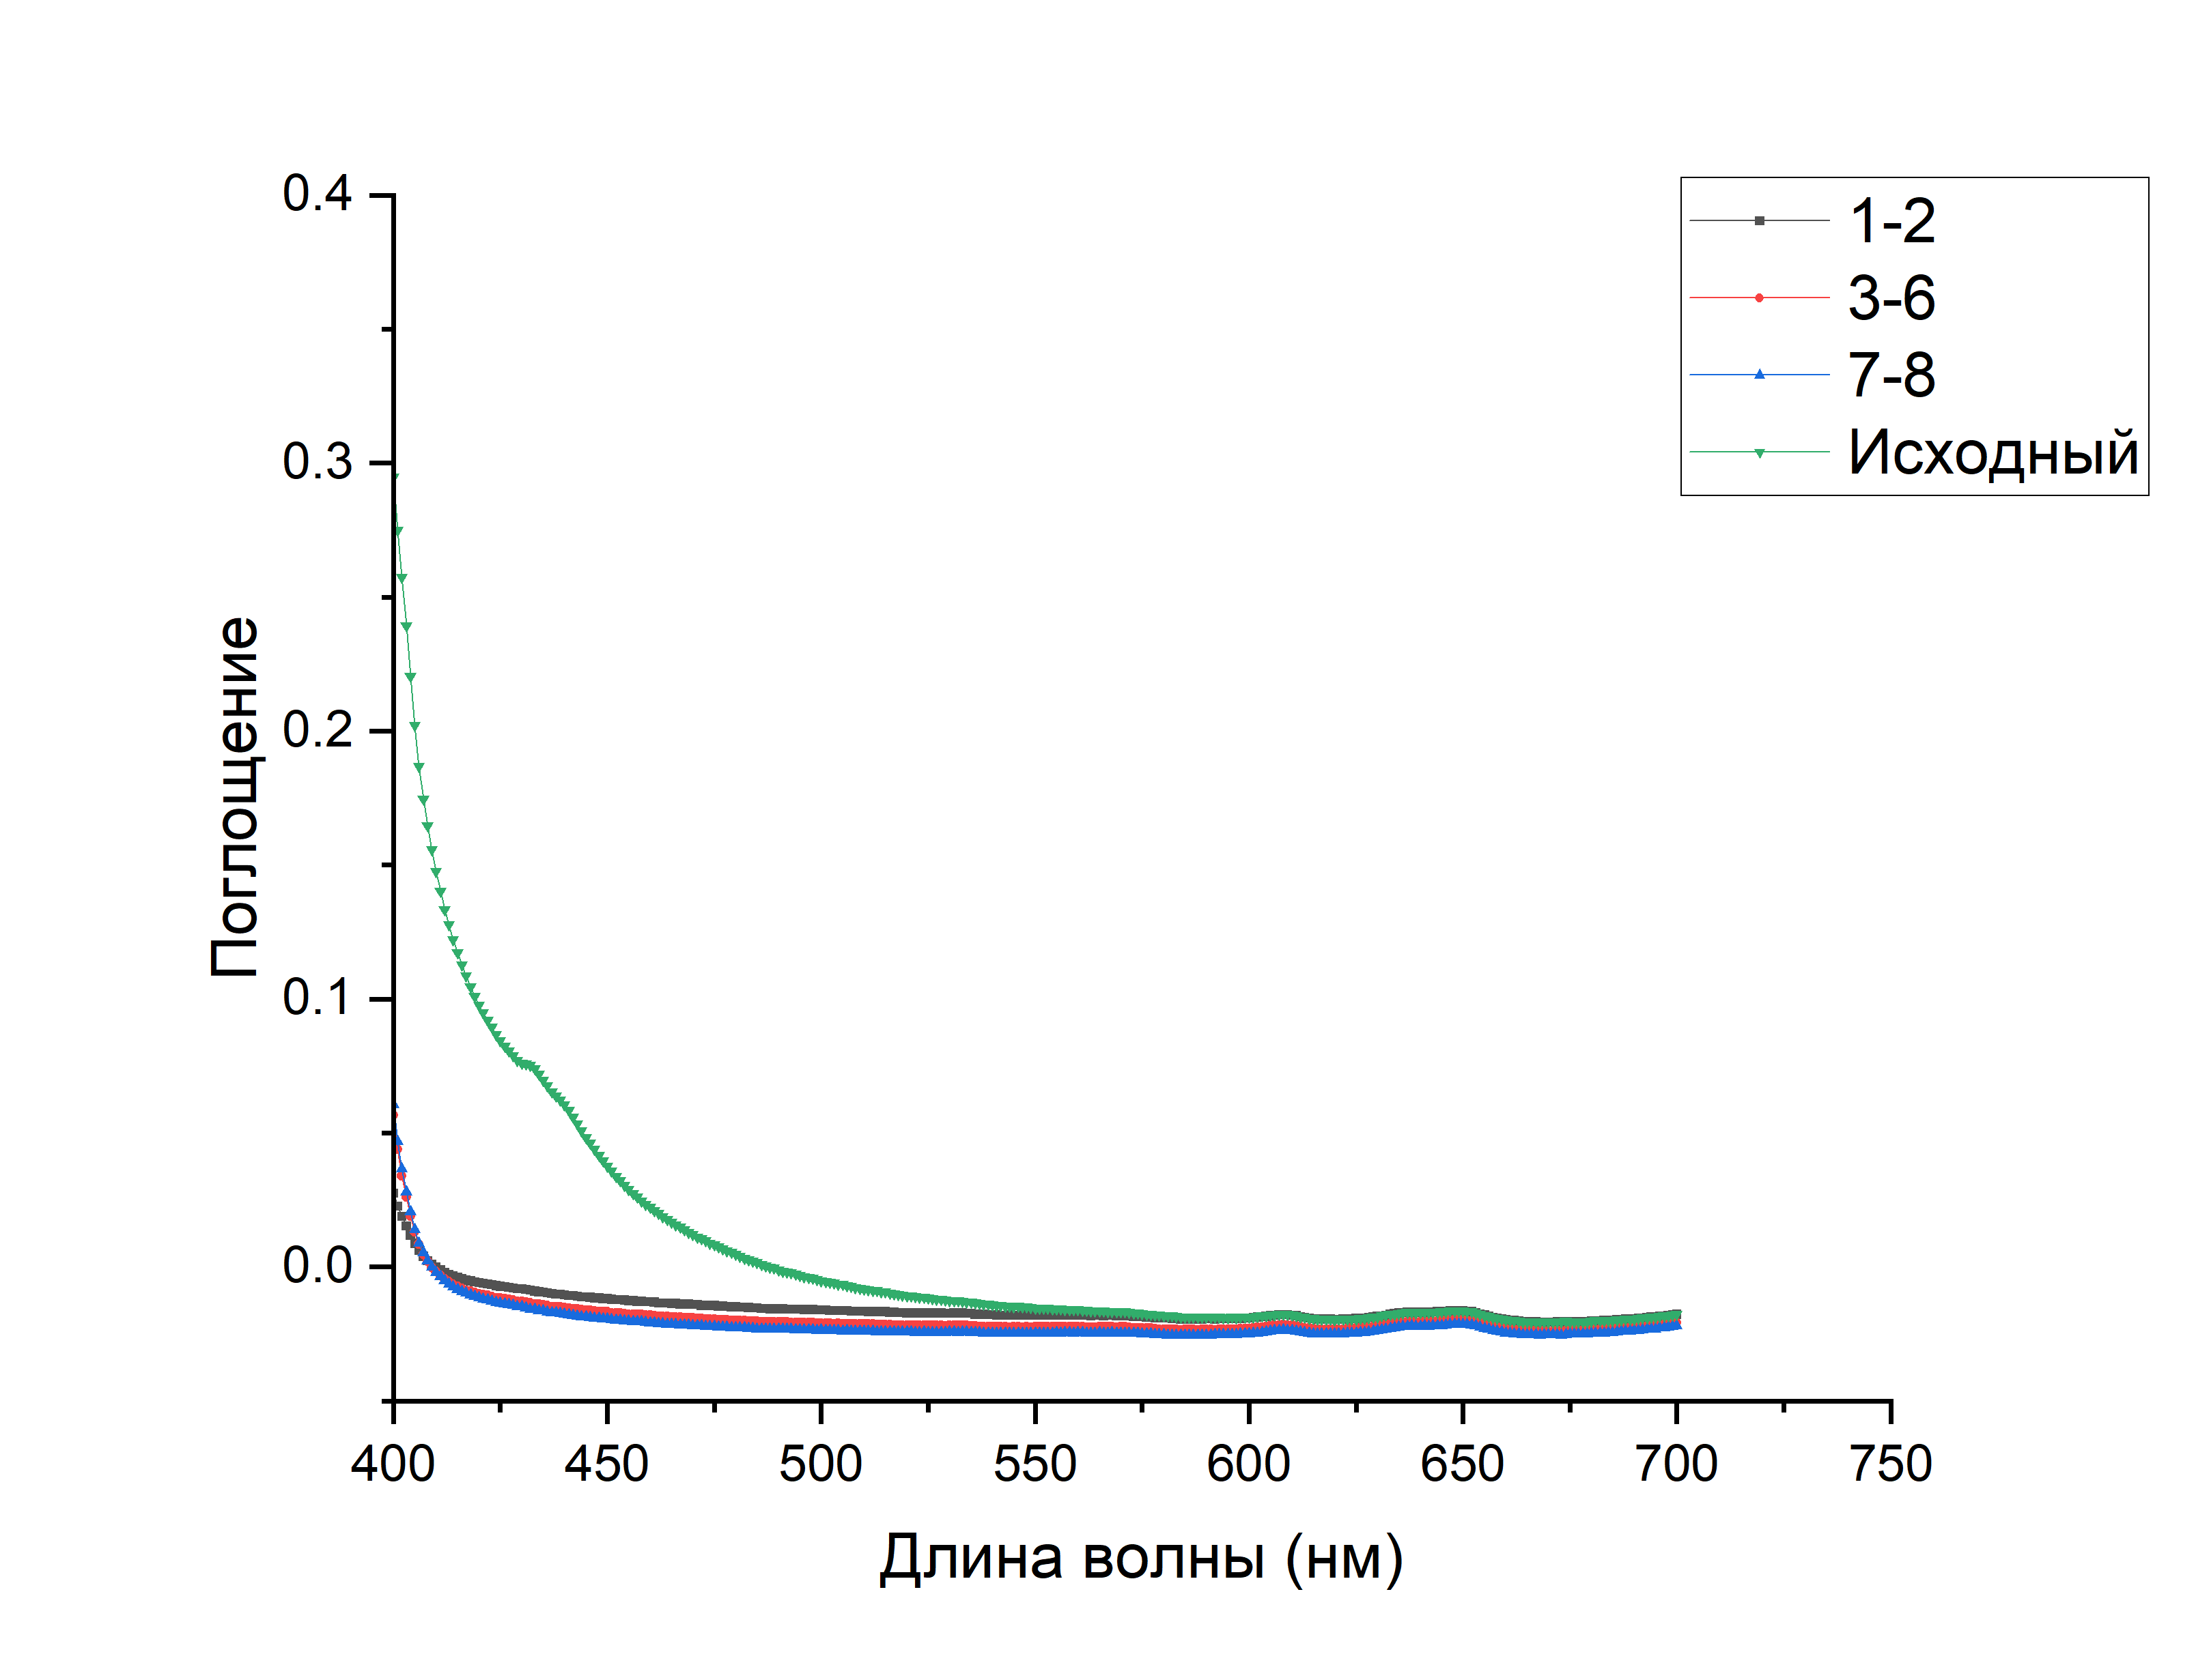
Chromatografic purification using activated Al₂O₃
Absorption
Absorption
Wavelength, nm
Wavelength, nm

Slide 13
Chromatografic purification using activated Al₂O₃
Annealing took place at t = 250°C for 8 hours.
Sorption purification was performed with column with diameter of 3 cm.
The volume of Al₂O₃ was 50 ml.
LAB was passed in 100 ml, 200 ml portions.
№ | Sample | A_min | A_420 | A_430 | A_440 | L_420 | L_430 | L_440
1 | 1-2 | -0,0194 | -0,0058 | -0,0081 | -0,0104 | 3,19 | 3,85 | 4,83
2 | 3-6 | -0,0234 | -0,01 | -0,0129 | -0,0153 | 3,24 | 4,14 | 5,37
3 | 7-8 | -0,0254 | -0,0115 | -0,0149 | -0,0177 | 3,12 | 4,14 | 5,65
4 | Initial | -0,0187 | 0,0978 | 0,0762 | 0,0606 | 0,37 | 0,46 | 0,55
Absorption length L is measured in meters

Slide 14
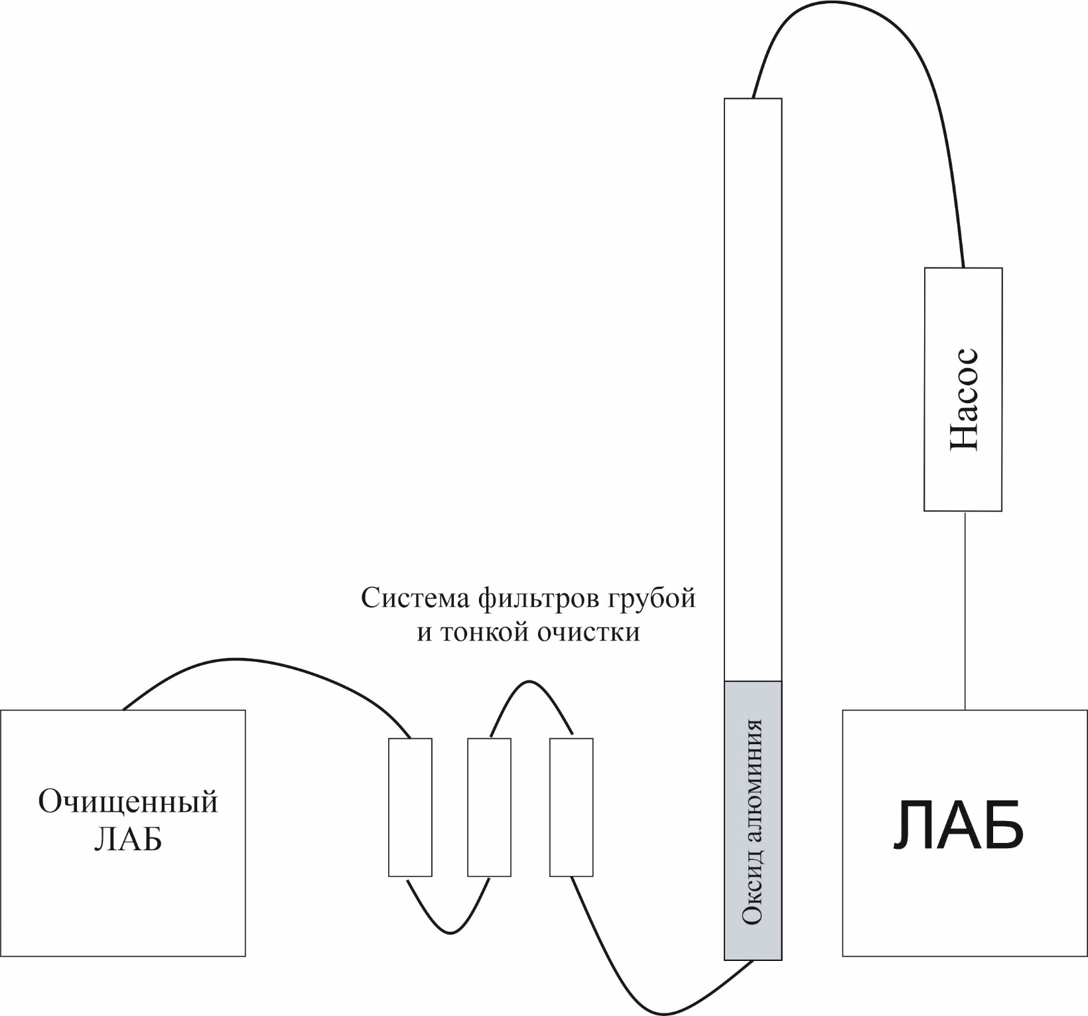
System of LAB chromatographic purification for 5-ton Baksan Large Neutrino Telescope prototype
The system is a set of 6 columns filled with aluminum oxide
Diameter of column - 10 cm, height - 1.5 m.
Device efficiency - 50 l/h.
The system is located in the underground infrastructure of the BNO

Slide 15
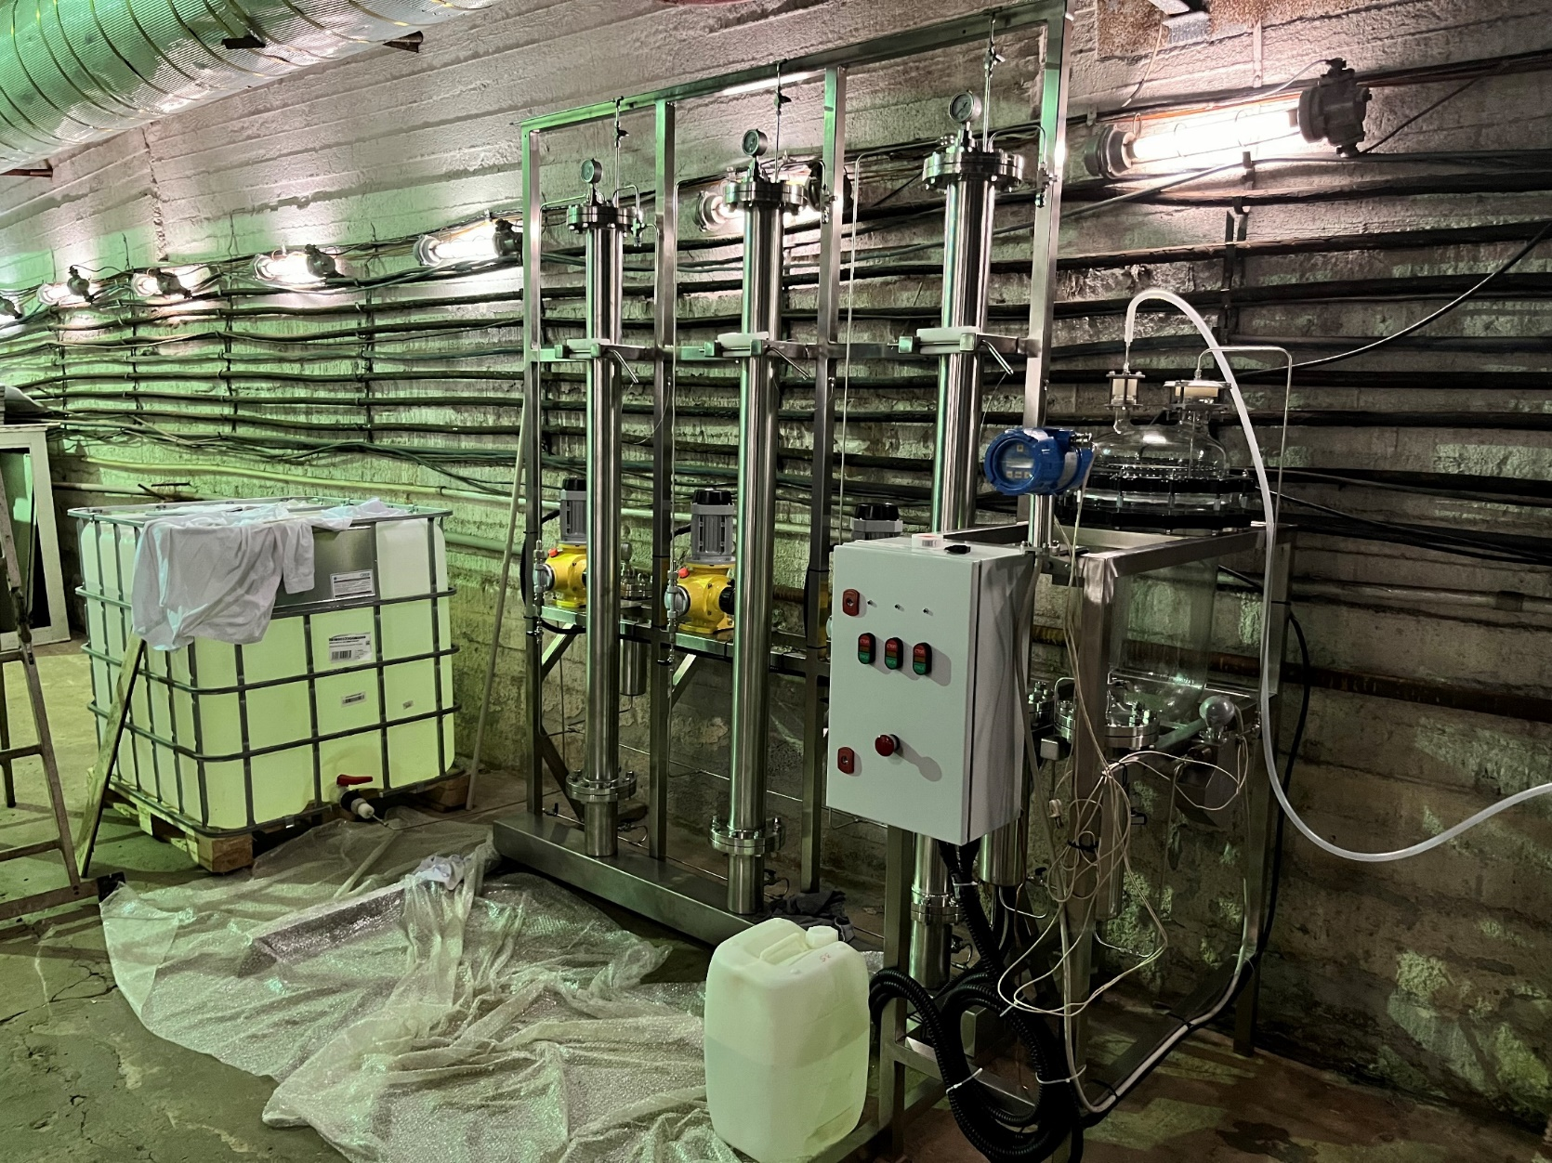
System of LAB chromatographic purification for 5-ton Baksan Large Neutrino Telescope prototype

Slide 16
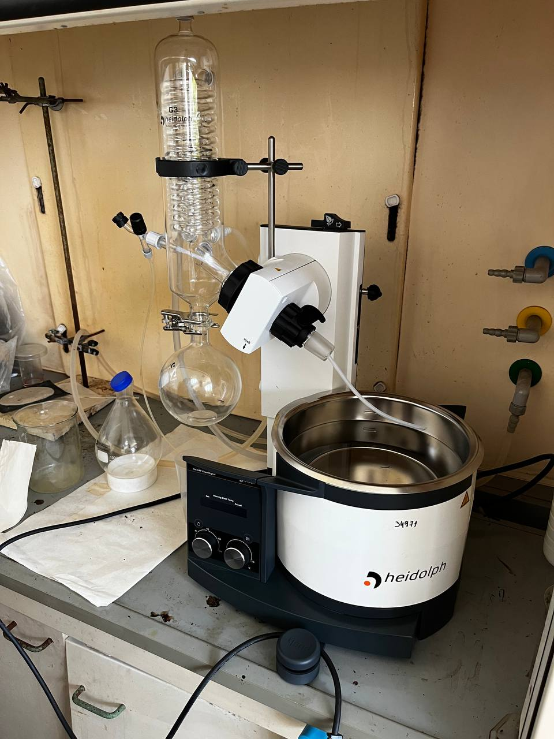
Vacuum distillation
Distillation was performed on rotary evaporator Heidolph.
Silicon oil PMS-20.
Oil heating temperature 180°С.
Samples were taken in 50 ml.

Slide 17
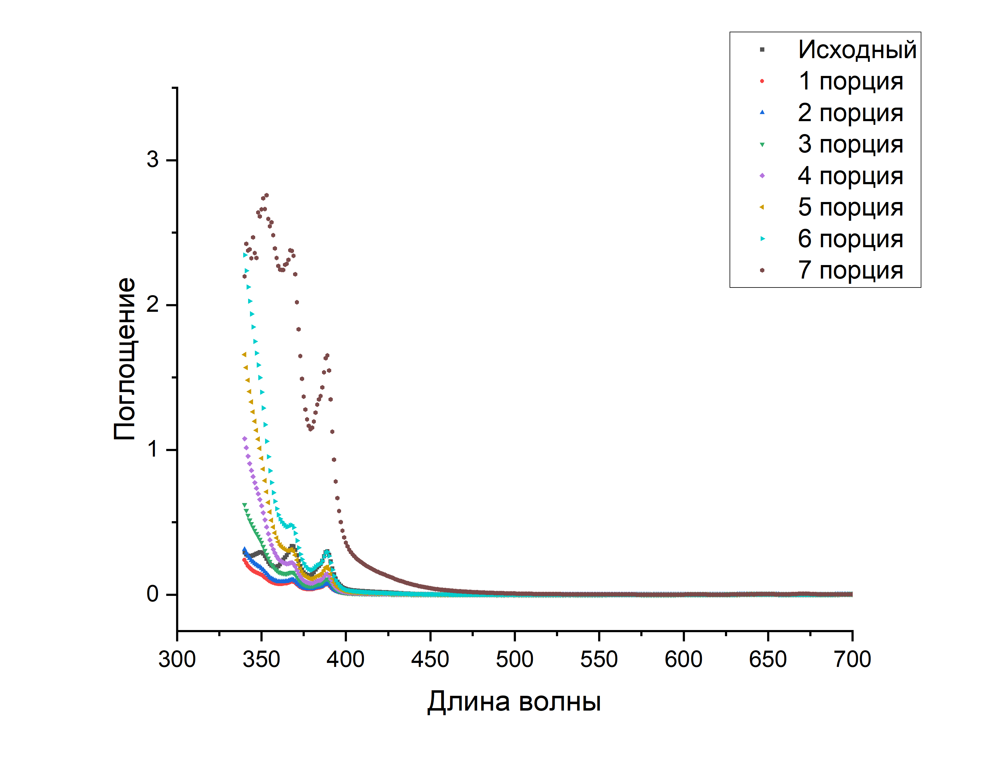
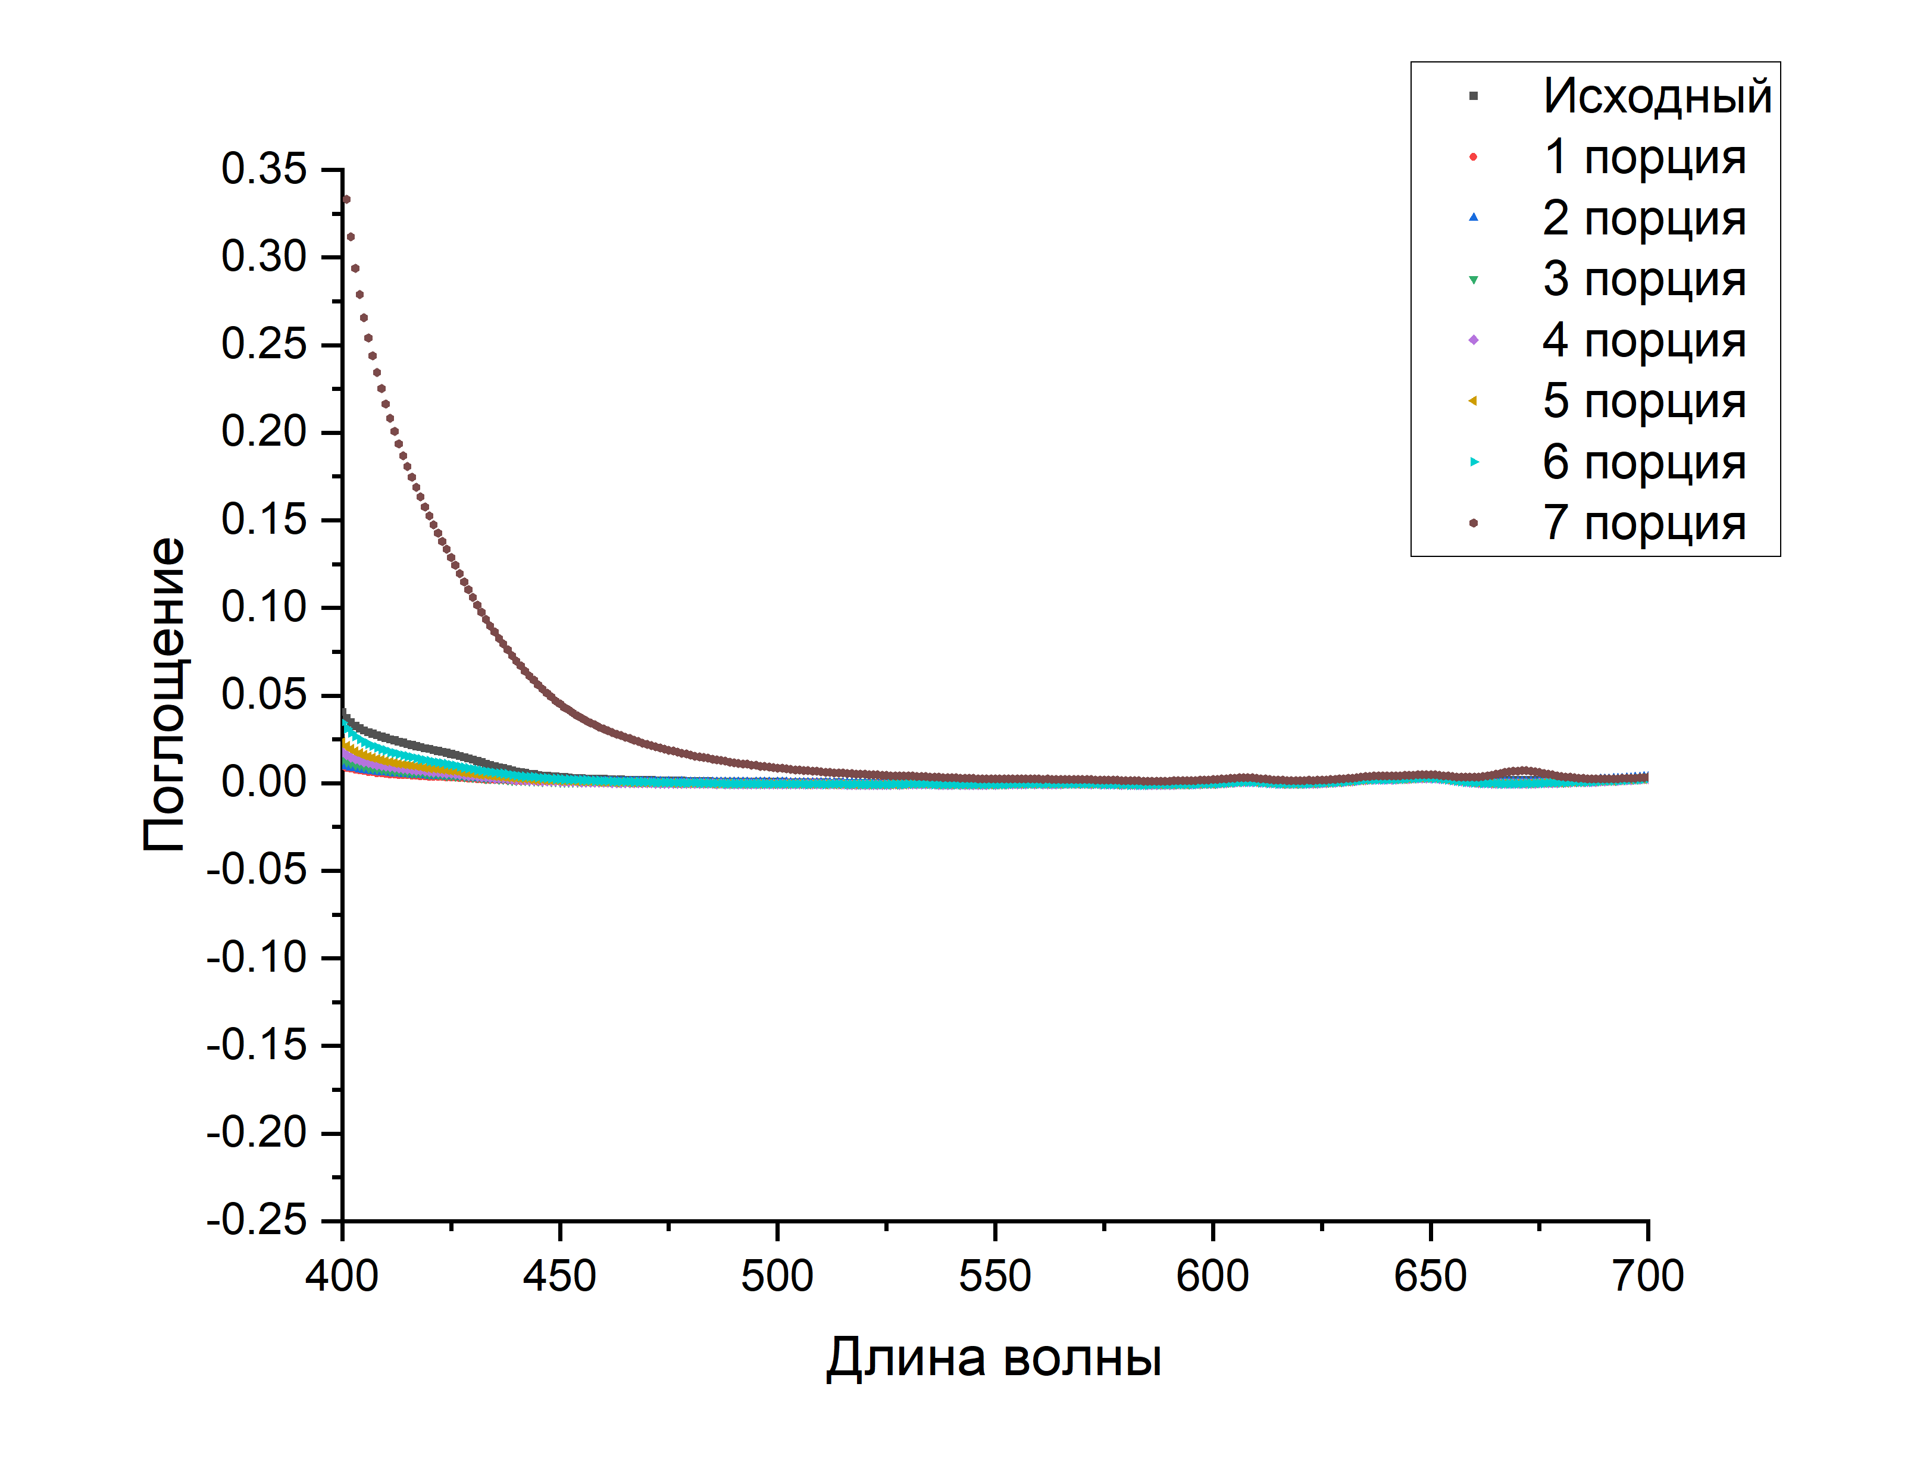
Vacuum distillation
Absorption
Absorption
Wavelength, nm
Wavelength, nm

Slide 18
Vacuum distillation
Distillation was performed on rotary evaporator Heidolph.
Silicon oil PMS-20.
Oil heating temperature 180°С.
Samples were taken in 50 ml.
Sample | A_420 | A_430 | A_440 | L_420 | L_430 | L_440
Initial | 0.0195 | 0.0134 | 0.0066 | 1.78 | 2.59 | 5.27
1 | 0.0038 | 0.0026 | 0.0014 | 9.15 | 13.38 | 24.8
2 | 0.0043 | 0.0031 | 0.0018 | 8.09 | 11.22 | 19.32
3 | 0.0053 | 0.0035 | 0.0018 | 6.56 | 9.94 | 19.32
4 | 0.0065 | 0.0041 | 0.0019 | 5.35 | 8.48 | 18.3
5 | 0.0085 | 0.0054 | 0.0028 | 4.09 | 6.44 | 12.42
6 | 0.0126 | 0.008 | 0.0043 | 2.76 | 4.35 | 8.09
7 | 0.1525 | 0.106 | 0.0698 | 0.23 | 0.33 | 0.49
Длина поглощения L в метрах

Slide 19
Conclusions
Methods of magnetic field compensation were considered
Geomagnetic field and its elements were considered
Active method is cheap, easy to construct and to use. Helmholtz coils produce homogenous field in the volume between them
Methods of liquid scintillator purification was considered
Chromatographic purification removes organic impurities and improves optical properties
Vacuum distillation removes organic and radioactive impurities and improves optical properties

