Slide 1
STUDIES OF SINGLE-PHOTOELECTRON RESPONSE OF 20-INCH NNVT MCP-PMT
Ushakov N.A*,
Lubsandorzhiev B.K.
The 7th International Conference on Particle Physics and Astrophysics (ICPPA-2024),
Moscow, Russia
22 – 25 October, 2024

Slide 2
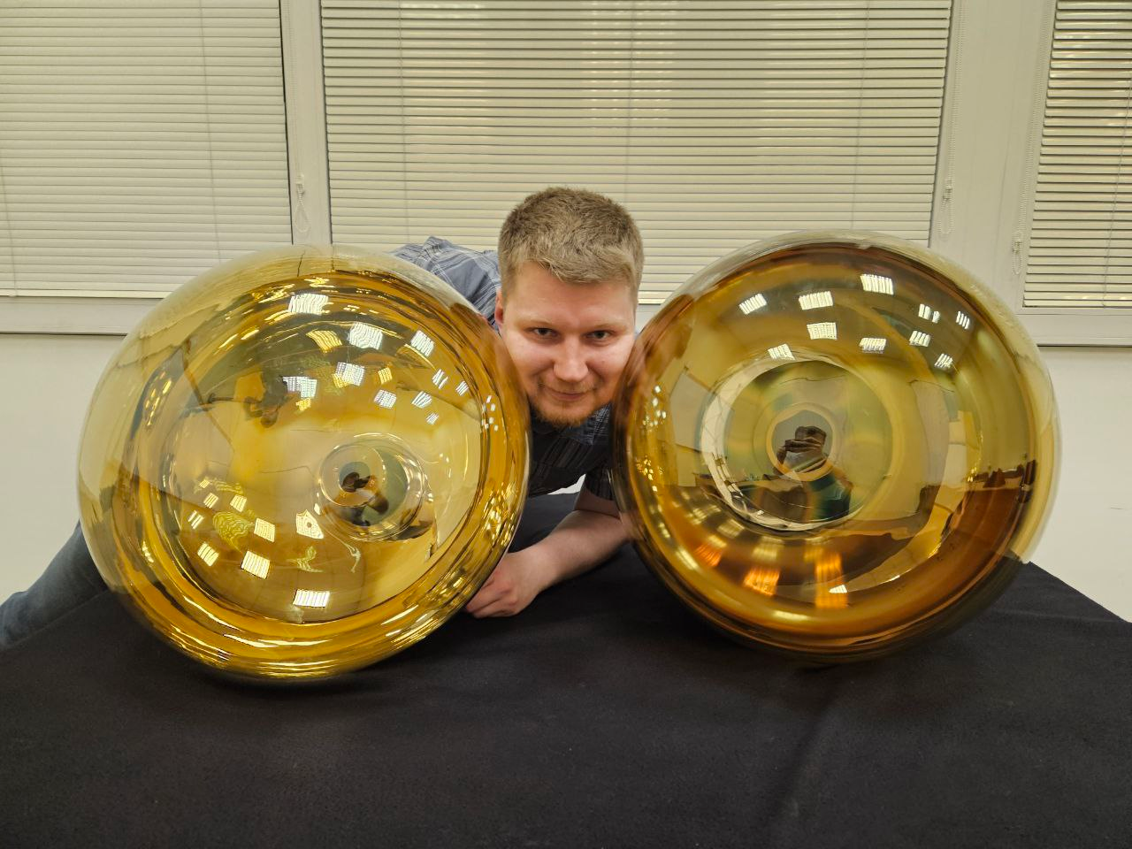
Large photocathode area PMTs
NNVT
MCP-PMT
(N6201)
QE ~35%
MCP are less susceptible to the influence of external magnetic fields than the dynode system.
HAMAMATSU
R12860
QE ~28%
More expensive
Currently not supplied to Russia

Slide 3
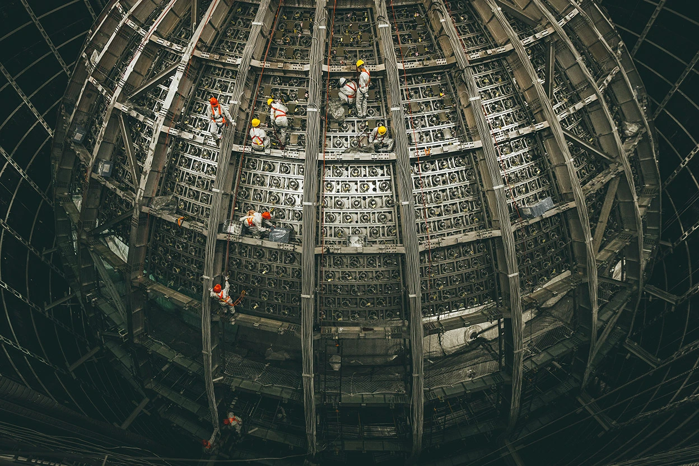
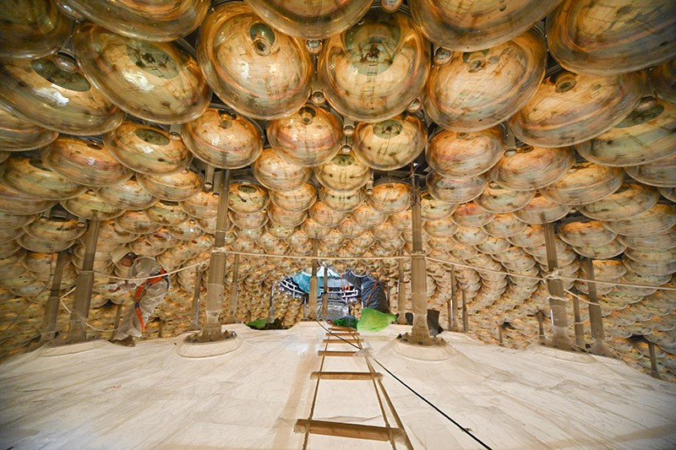
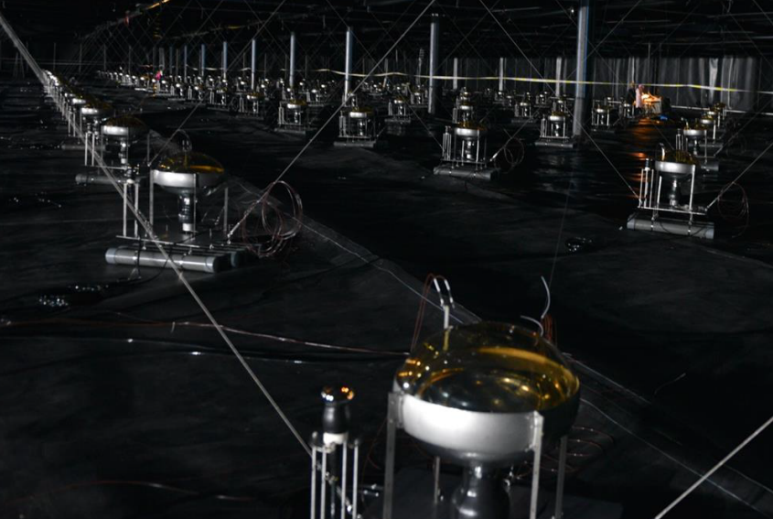
NNVT
MCP-PMT
JUNO
LHAASO
Energy of events
Number of photoelectron
Single photoelectron response

Slide 4
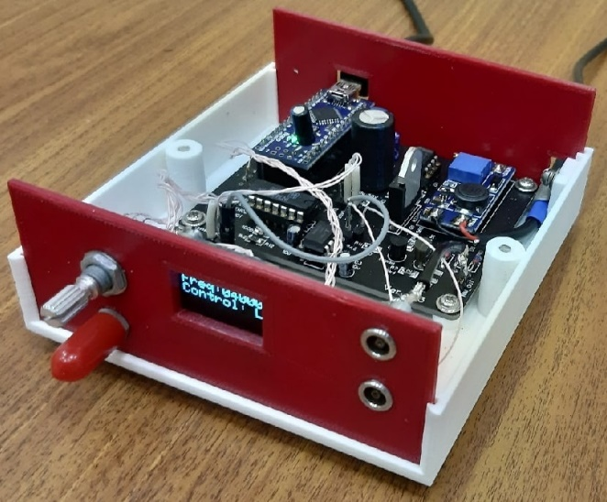
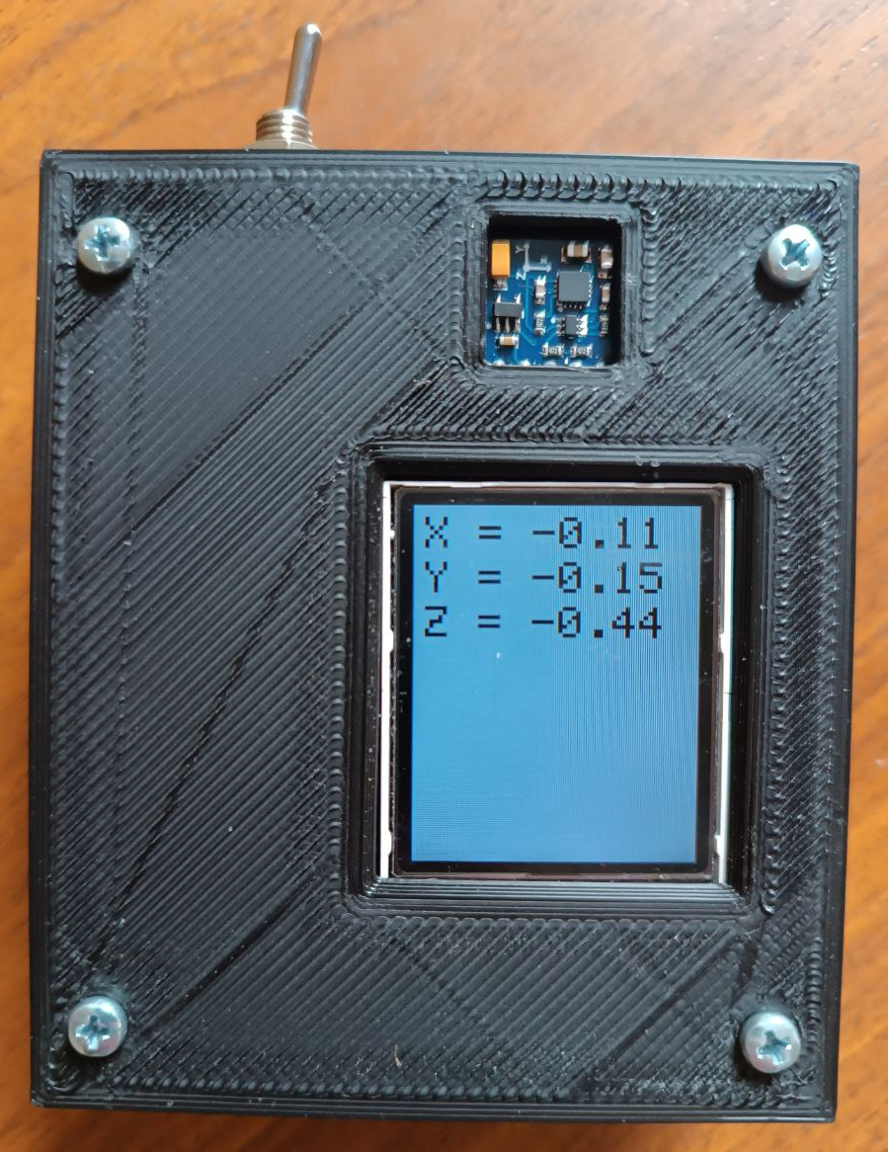
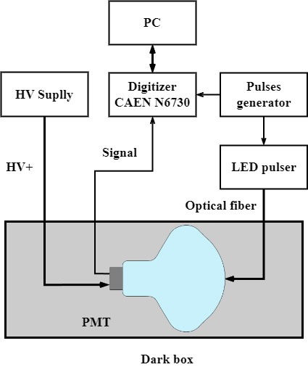
Measurement setup
Based on Arduino
Magnetometer
Helmholtz coils were used to compensate for the magnetic field.

Slide 5
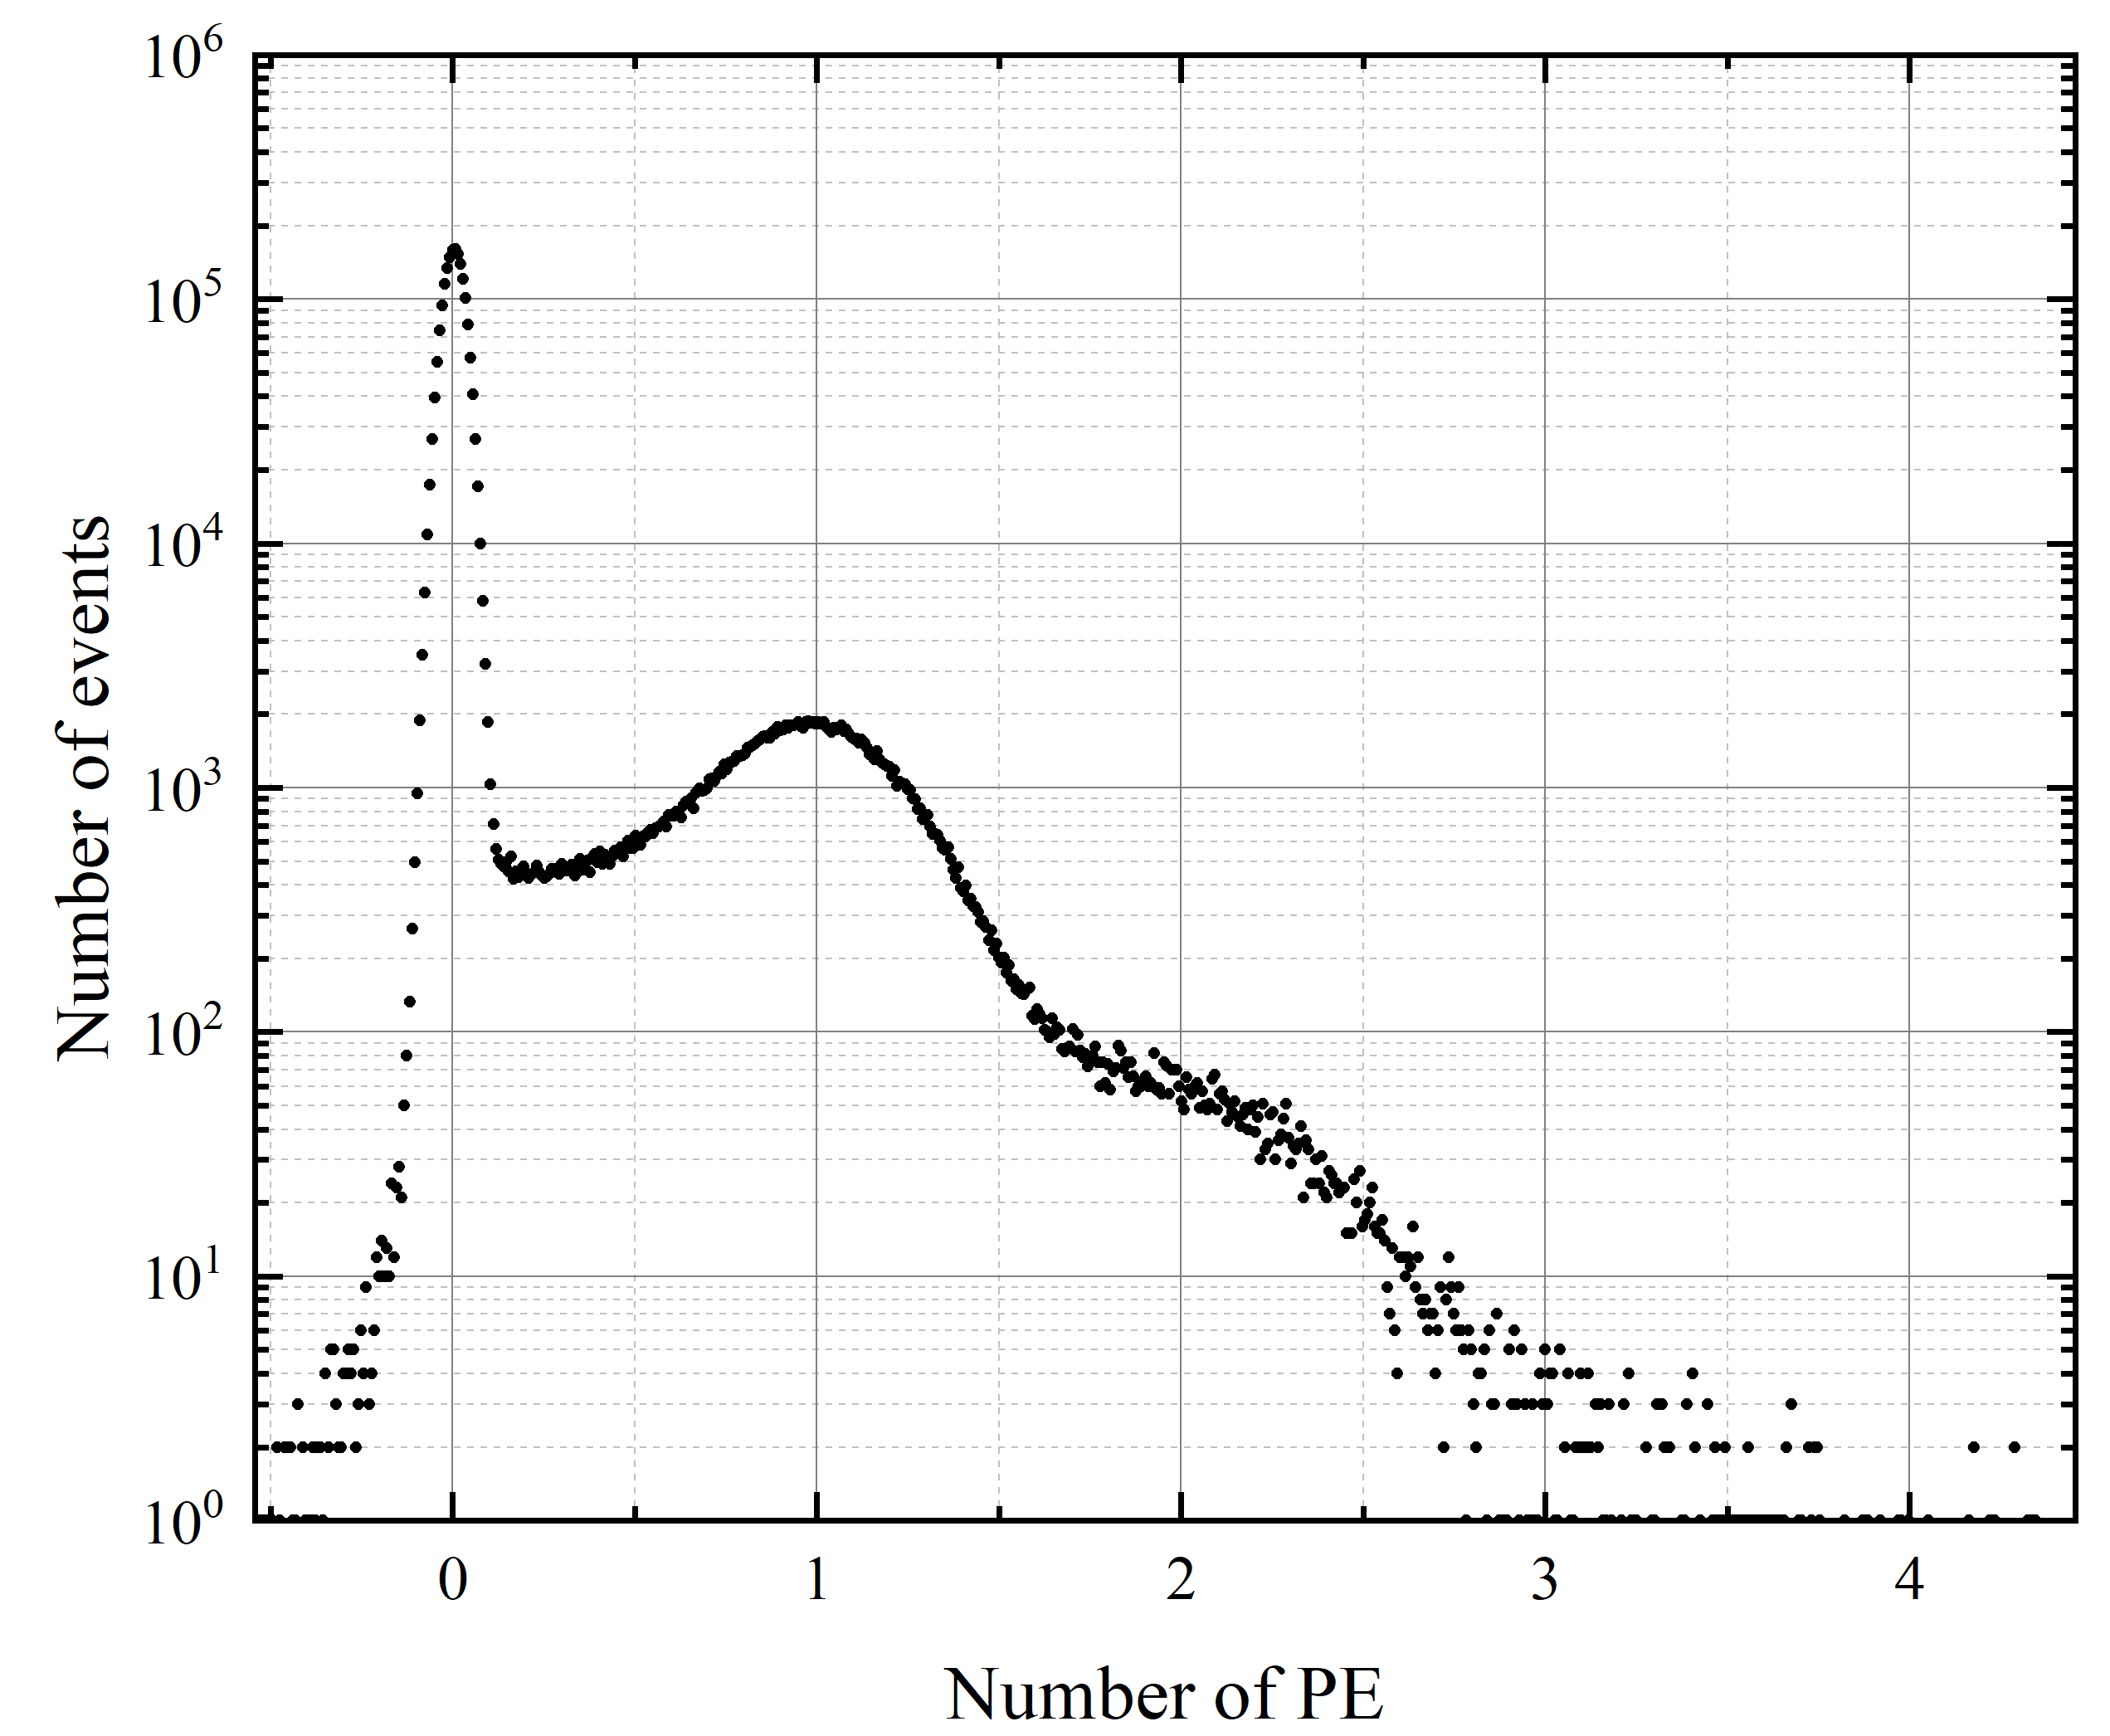
Charge distribution of SPE pulse
HAMAMATSU R12860
(Poisson ~ 0.1)
λ | 0.1 | 0.02
n
0 | 90.48 | 98.02
1 | 9.05 | 1.96
2 | 0.45 | 0.02
3 | 0.02 | ~0
4 | ~0 | ~0
P(n) $=\frac{λ^{n}e^{−λ}}{n!}$

Slide 6
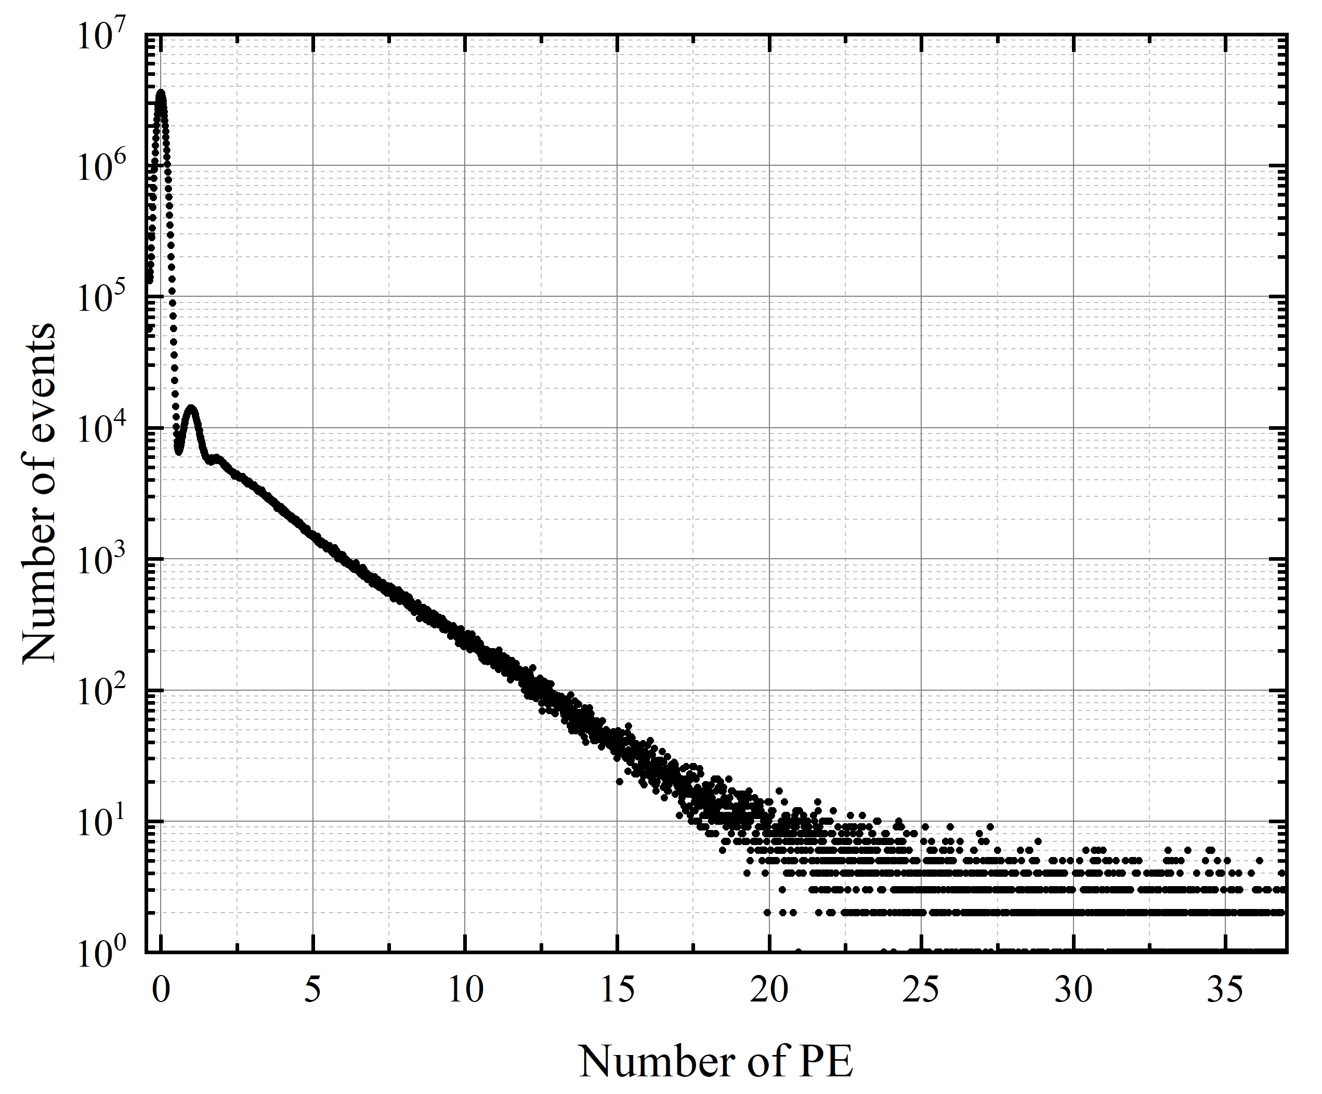
NNVT MCP-PMT
(Poisson ~ 0.02)

Slide 8
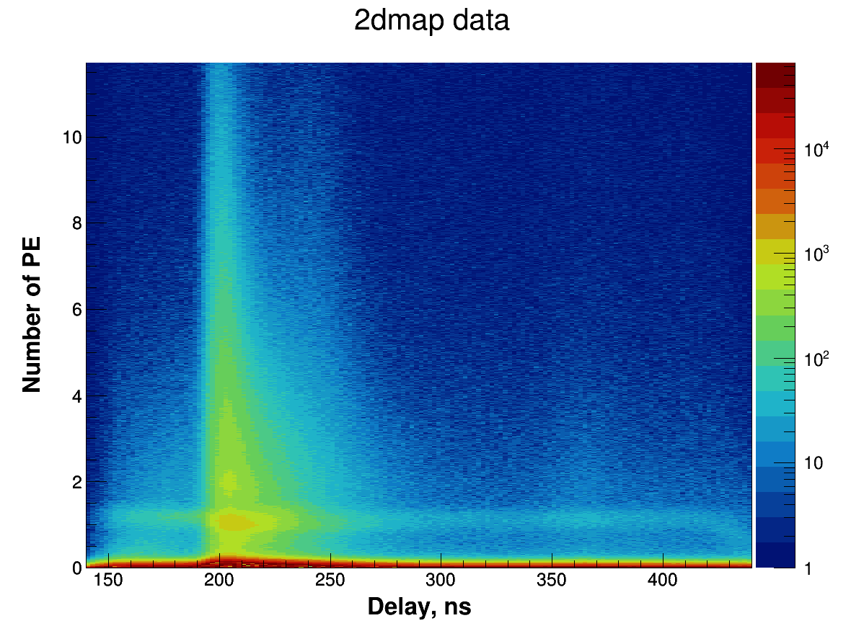
Delay-charge distribution of SPE pulse NNVTMCP-PMT

Slide 9
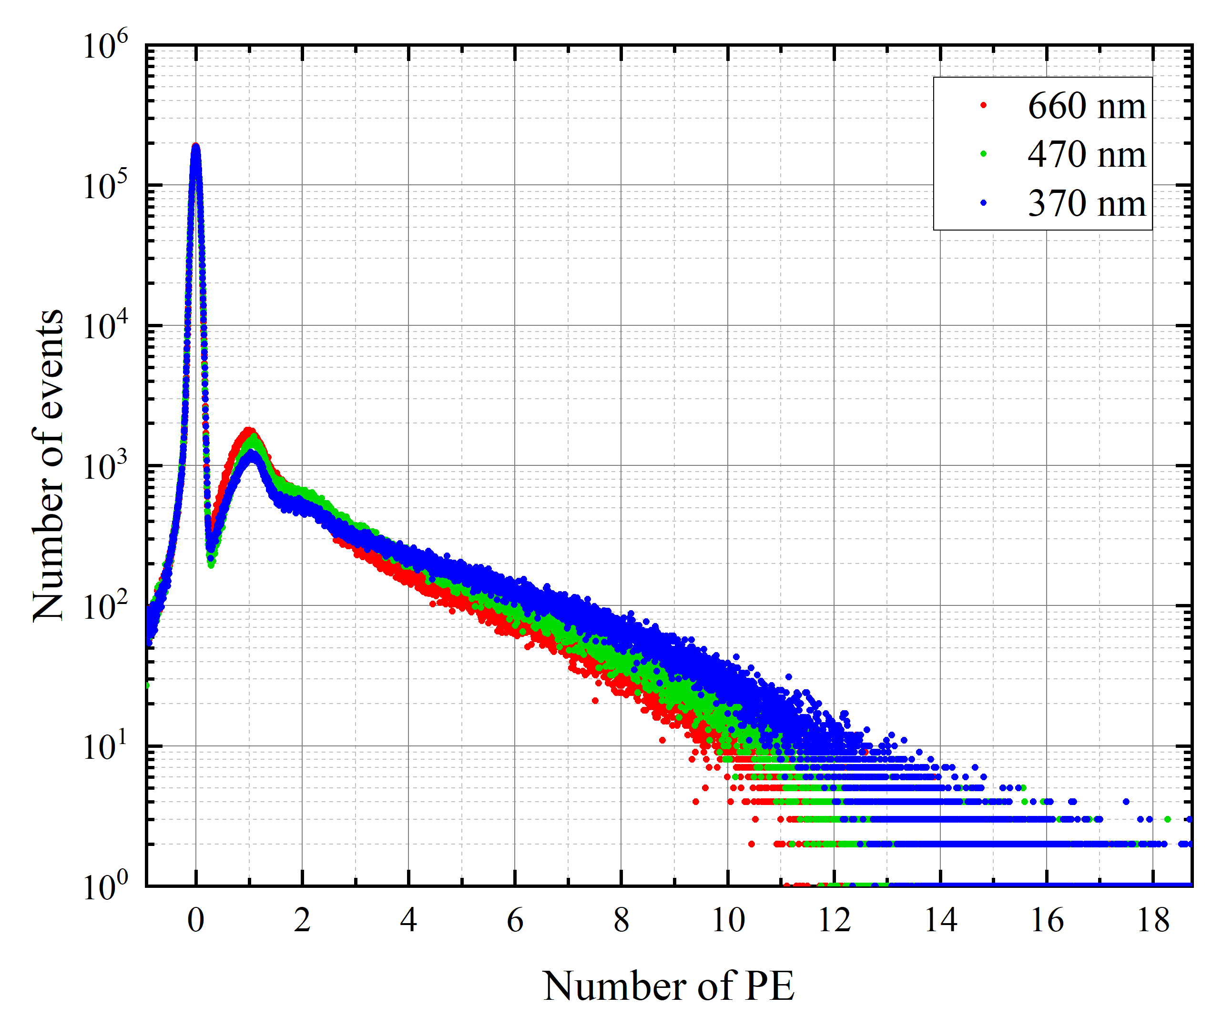
Effect of wavelength on SPE spectrum tails

Slide 10
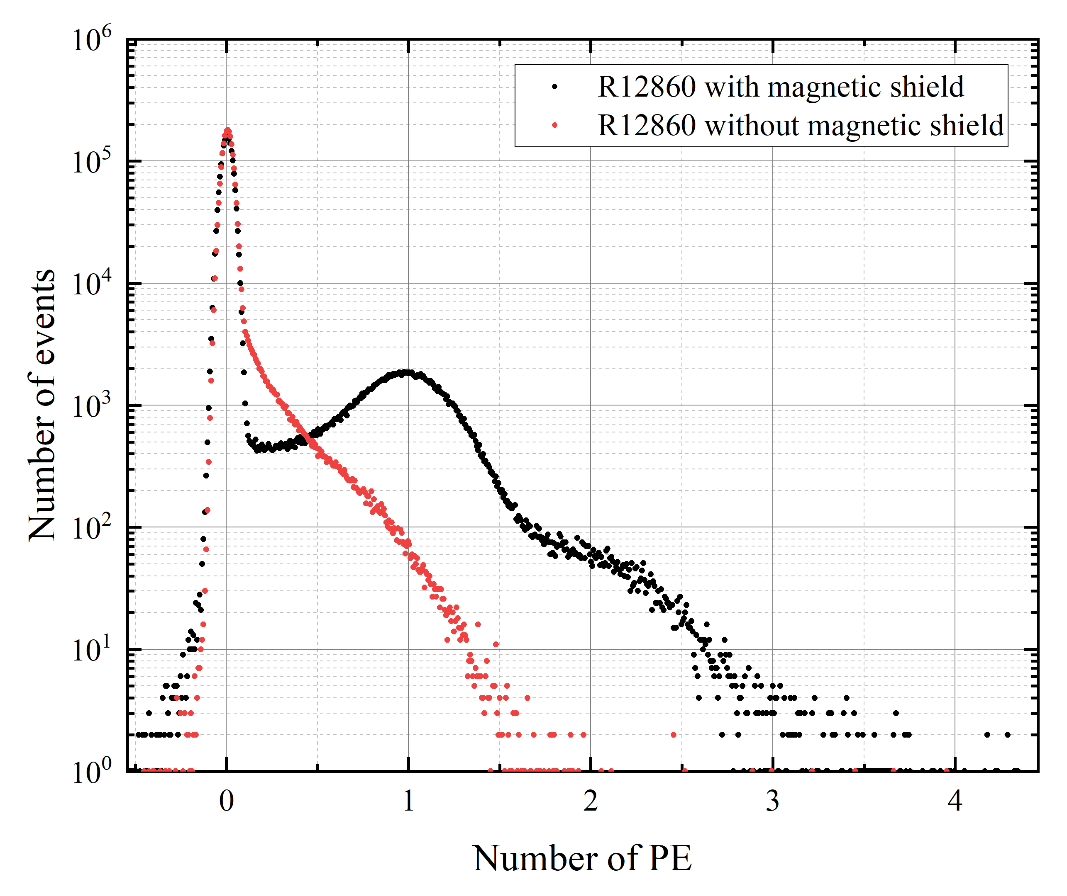
Effect of magnetic compensation (under the same illumination)

Slide 11
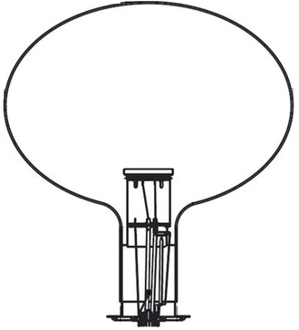
γ
λ'
$$e^{−}$$
$$\vec{B}$$
CE
λ = λ’ * CE (collection efficiency)
For standard Dynode-PMT CE ≈ 1
(under normal conditions),
For NNVT MCP-PMT CE = ?
(due to the strong influence of
the external magnetic field)

Slide 12
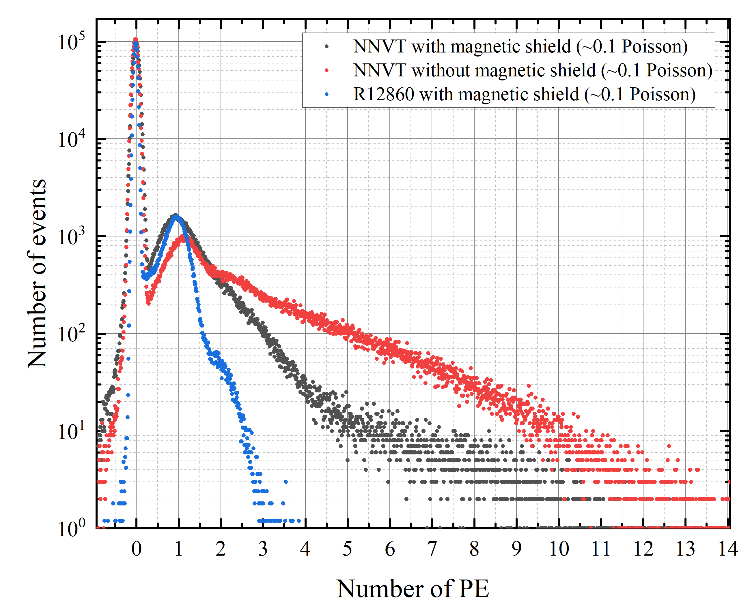

Slide 13
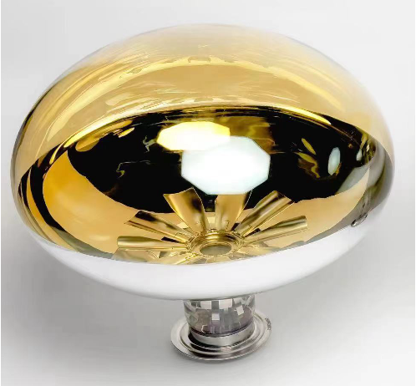
Lotus-like NNVT MCP-PMT for LHAASO (N6202)
The "petals" bend the electric field, which reduces the influence of the external magnetic field.
It was developed for the LHAASO to improve timing characteristics, but also improved the CE

Slide 14
The complex nature of MCP-PMT
Classic pre-pulse
Reflection
(delayed pulses)
γ
Lead glass coated with high SEY material (secondary emission yield) using ALD technology (atomic layer deposition)
Opening ratio ~70-80%, but due to the high SEY material the CE is 100% (without external magnetic field)
Without high SEY material σ ≈ 1-3,
with σ ≈ 5-7 → higher gain
High gain and CE, but tail in SPE spectrum and obviously worse the time characteristics
Pre-multiplied
$$e^{−}$$
$$e^{−}$$
Normal
$$e^{−}$$
γ
$$e^{−}$$
$$e^{−}$$
$$e^{−}$$
$$e^{−}$$
$$e^{−}$$

Slide 15
Conclusion
Tails in the SPE spectrum of NNVT MCP-PMT have two components
Tails due to the influence of external magnetic fields are eliminated by magnetic shielding, thanks to additional dynodes the disadvantage is minimized in the N6202 modification (lotus-like)
The coating of the MCP with high SEY material increases the gain, collection efficiency and lifetime of the PMT, but adds irremovable tails to the single-electron spectrum and worsens the timing characteristics.
It is necessary to introduce corrections when calculating the number of photoelectrons
It is necessary to improve the opening ration of the MCP
Research continues…

Slide 16
Thanks for your attention!

