Slide 1
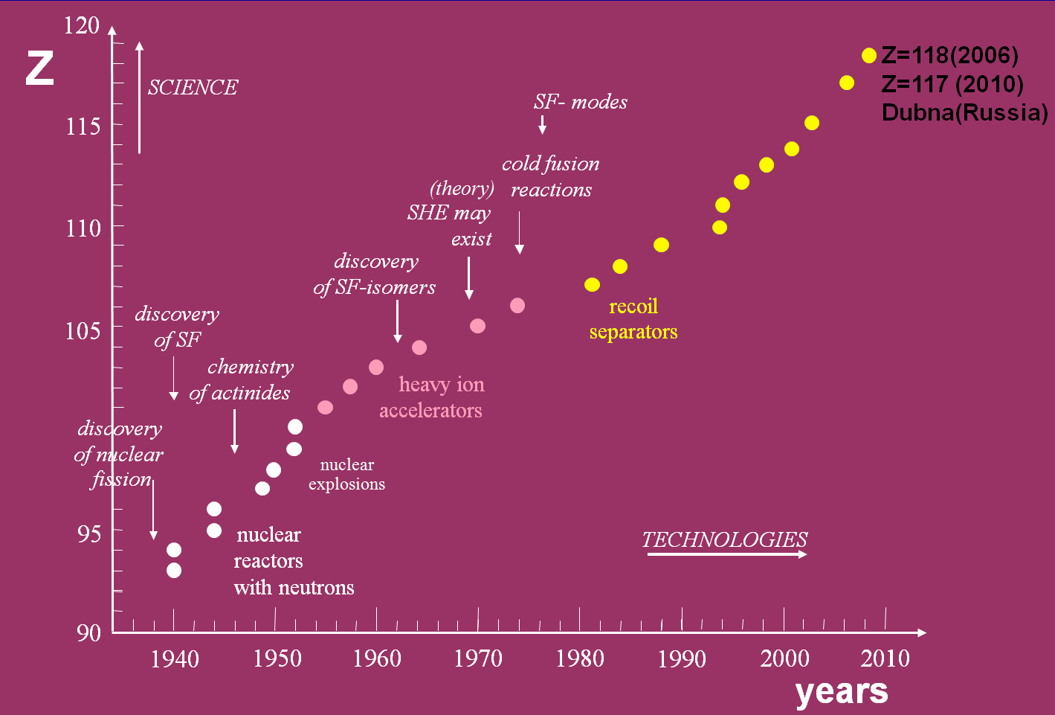
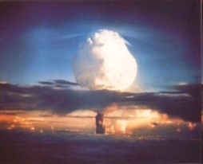
DSSD based detection system of the DGFRS-2 setup: design, results, developments Yu.S.Tsyganov¹, D.Ibadullaev^{1,2}, A.N.Polyakov¹, A.A.Voinov¹, M.V.Shumeiko¹ ¹-JINR(Dubna), ²-INP(Almaaty)1
ICPPA 2024,
October 22-25
Introduction:
Synthesis of SHE at the Dubna Gas-Filled Recoil Separator , ICPPA-2022 (SUMMARY)
New gas-filled separator (DGFRS-2), it’s DSSD based detection system : present status
Applications in long-term experiments with DC-280 HI beams; .., two last years new experiments: ⁴⁸Ca+²³²Th, ²³⁸U+⁴⁰Ar, ²⁴²Pu+⁵⁰Ti (preliminary), ²⁴²Pu+⁵⁴Cr , ..some problems
SUMMARY
SUMMARY p. 3) from me ICPPA 2022
3) System is ready for nearest future experiments
with ⁴⁸Ca, ⁵⁰Ti,⁵⁴Cr projectile.→ ICPPA 2024..
Field of interest:
Nucl. Phys.→ heavy ion-> synthesis/properties SHE→
detection system → Real -Time algorithm of background
signals suppression
Z=114-118
The Dubna Gas-Filled Recoil Separator,
FLNR(JINR)

Slide 2
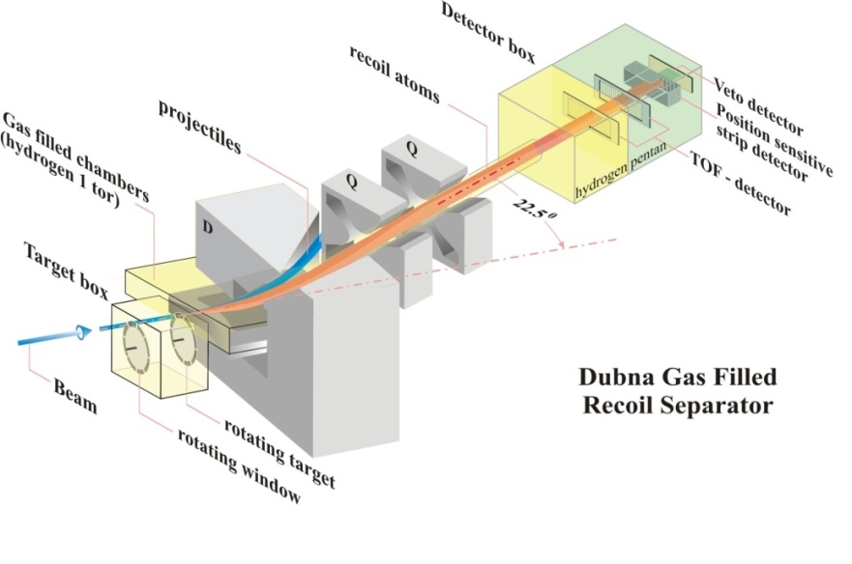
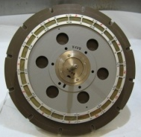
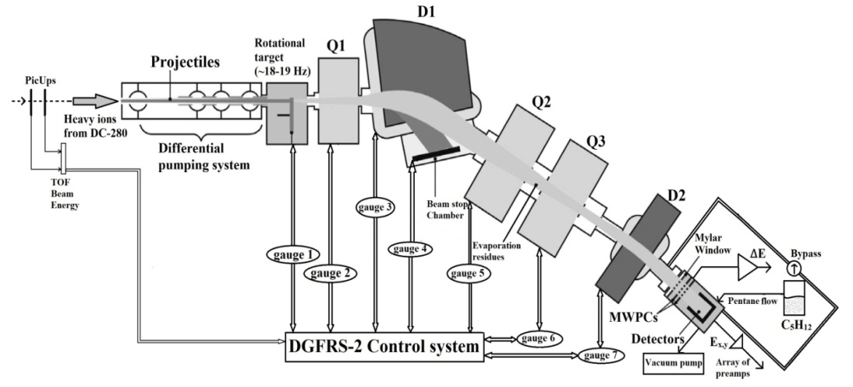
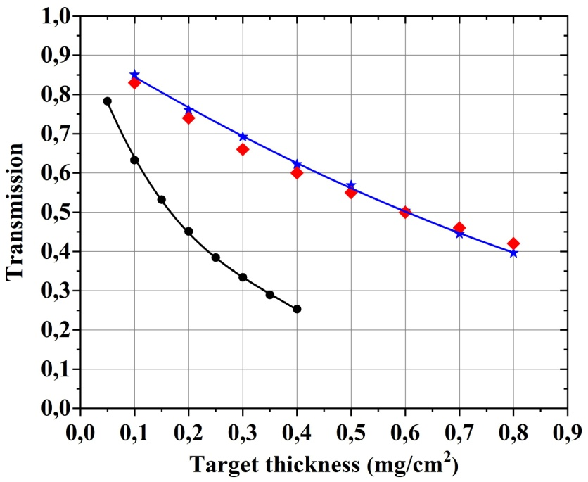
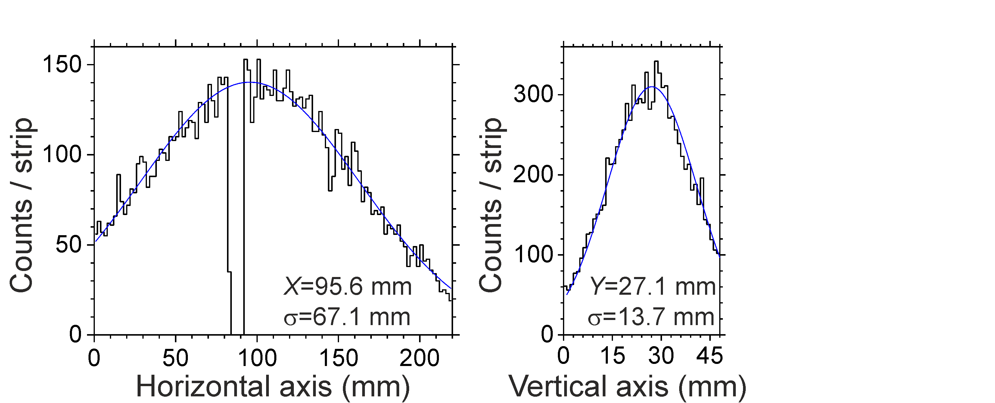
The DGFRS-2 setup…
DGFRS-1
Cyclotron ~ 1 pµA…10 (⁴⁸Ca beam, ⁵⁰Ti,⁵⁸Fe, ⁵⁴Cr in a nearest future >5 pµA)
Actinide target (rotating) to apply high intensity for a long time
differential pumping system
Gas –Filled Separator ( to suppress primary beam and other backgrounds )
Detection system ( DSSD+ΔE(gaseous)+electronics + software(Builder C++) )
1994-2017
24-cm target,
12 sectors
/present status/
Manufacturing of higher diameter
(48 cm) rotating target is in progress now..
DGFRS-2
Yu.Ts.Oganessian et al. NIM A 1033(2022) 0166640
DGFRS-2
new Dubna Gas-Filled Recoil Separator
(since 2020)

Slide 3
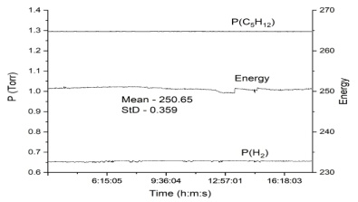
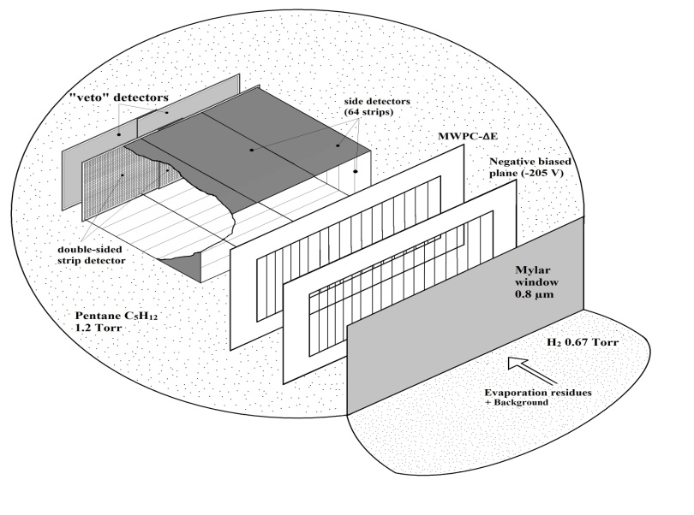
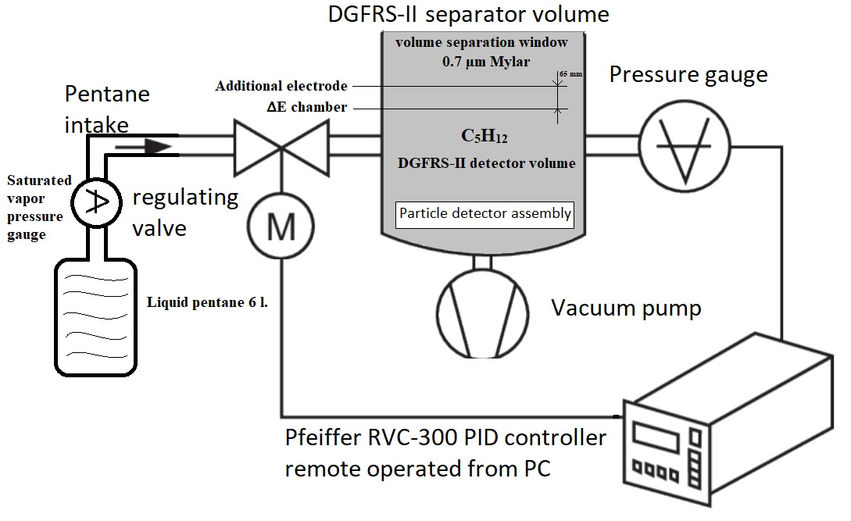
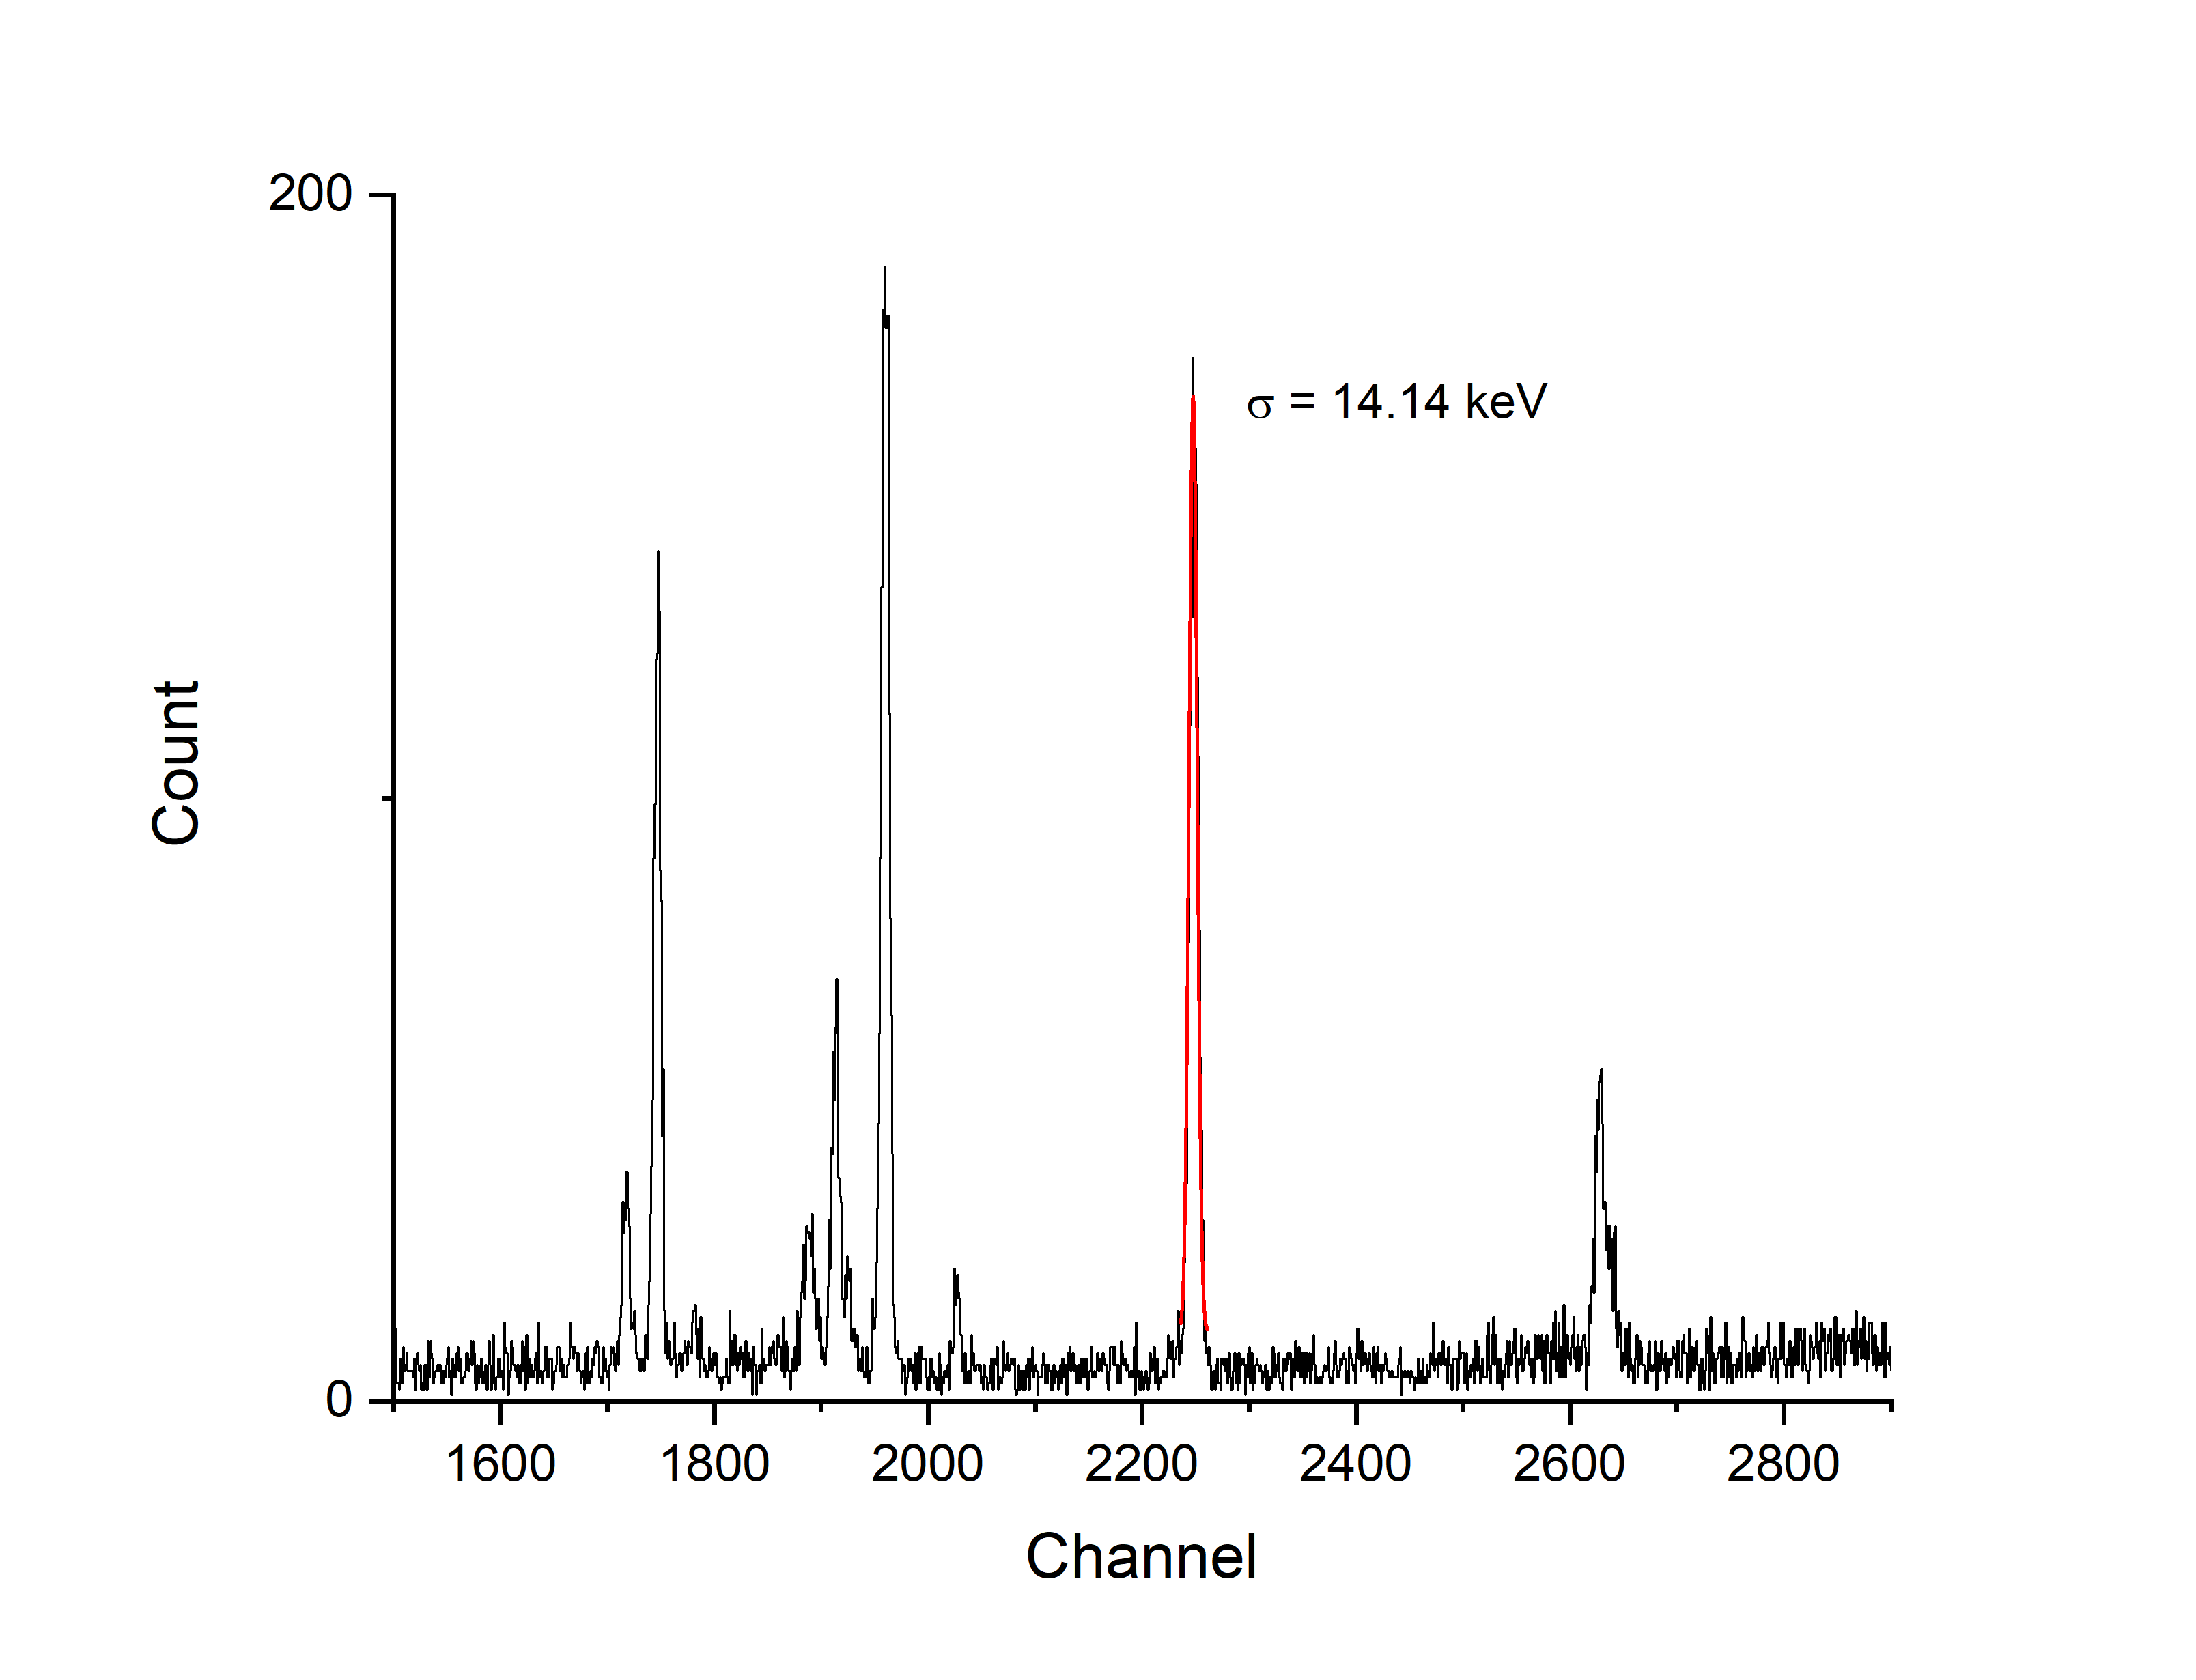
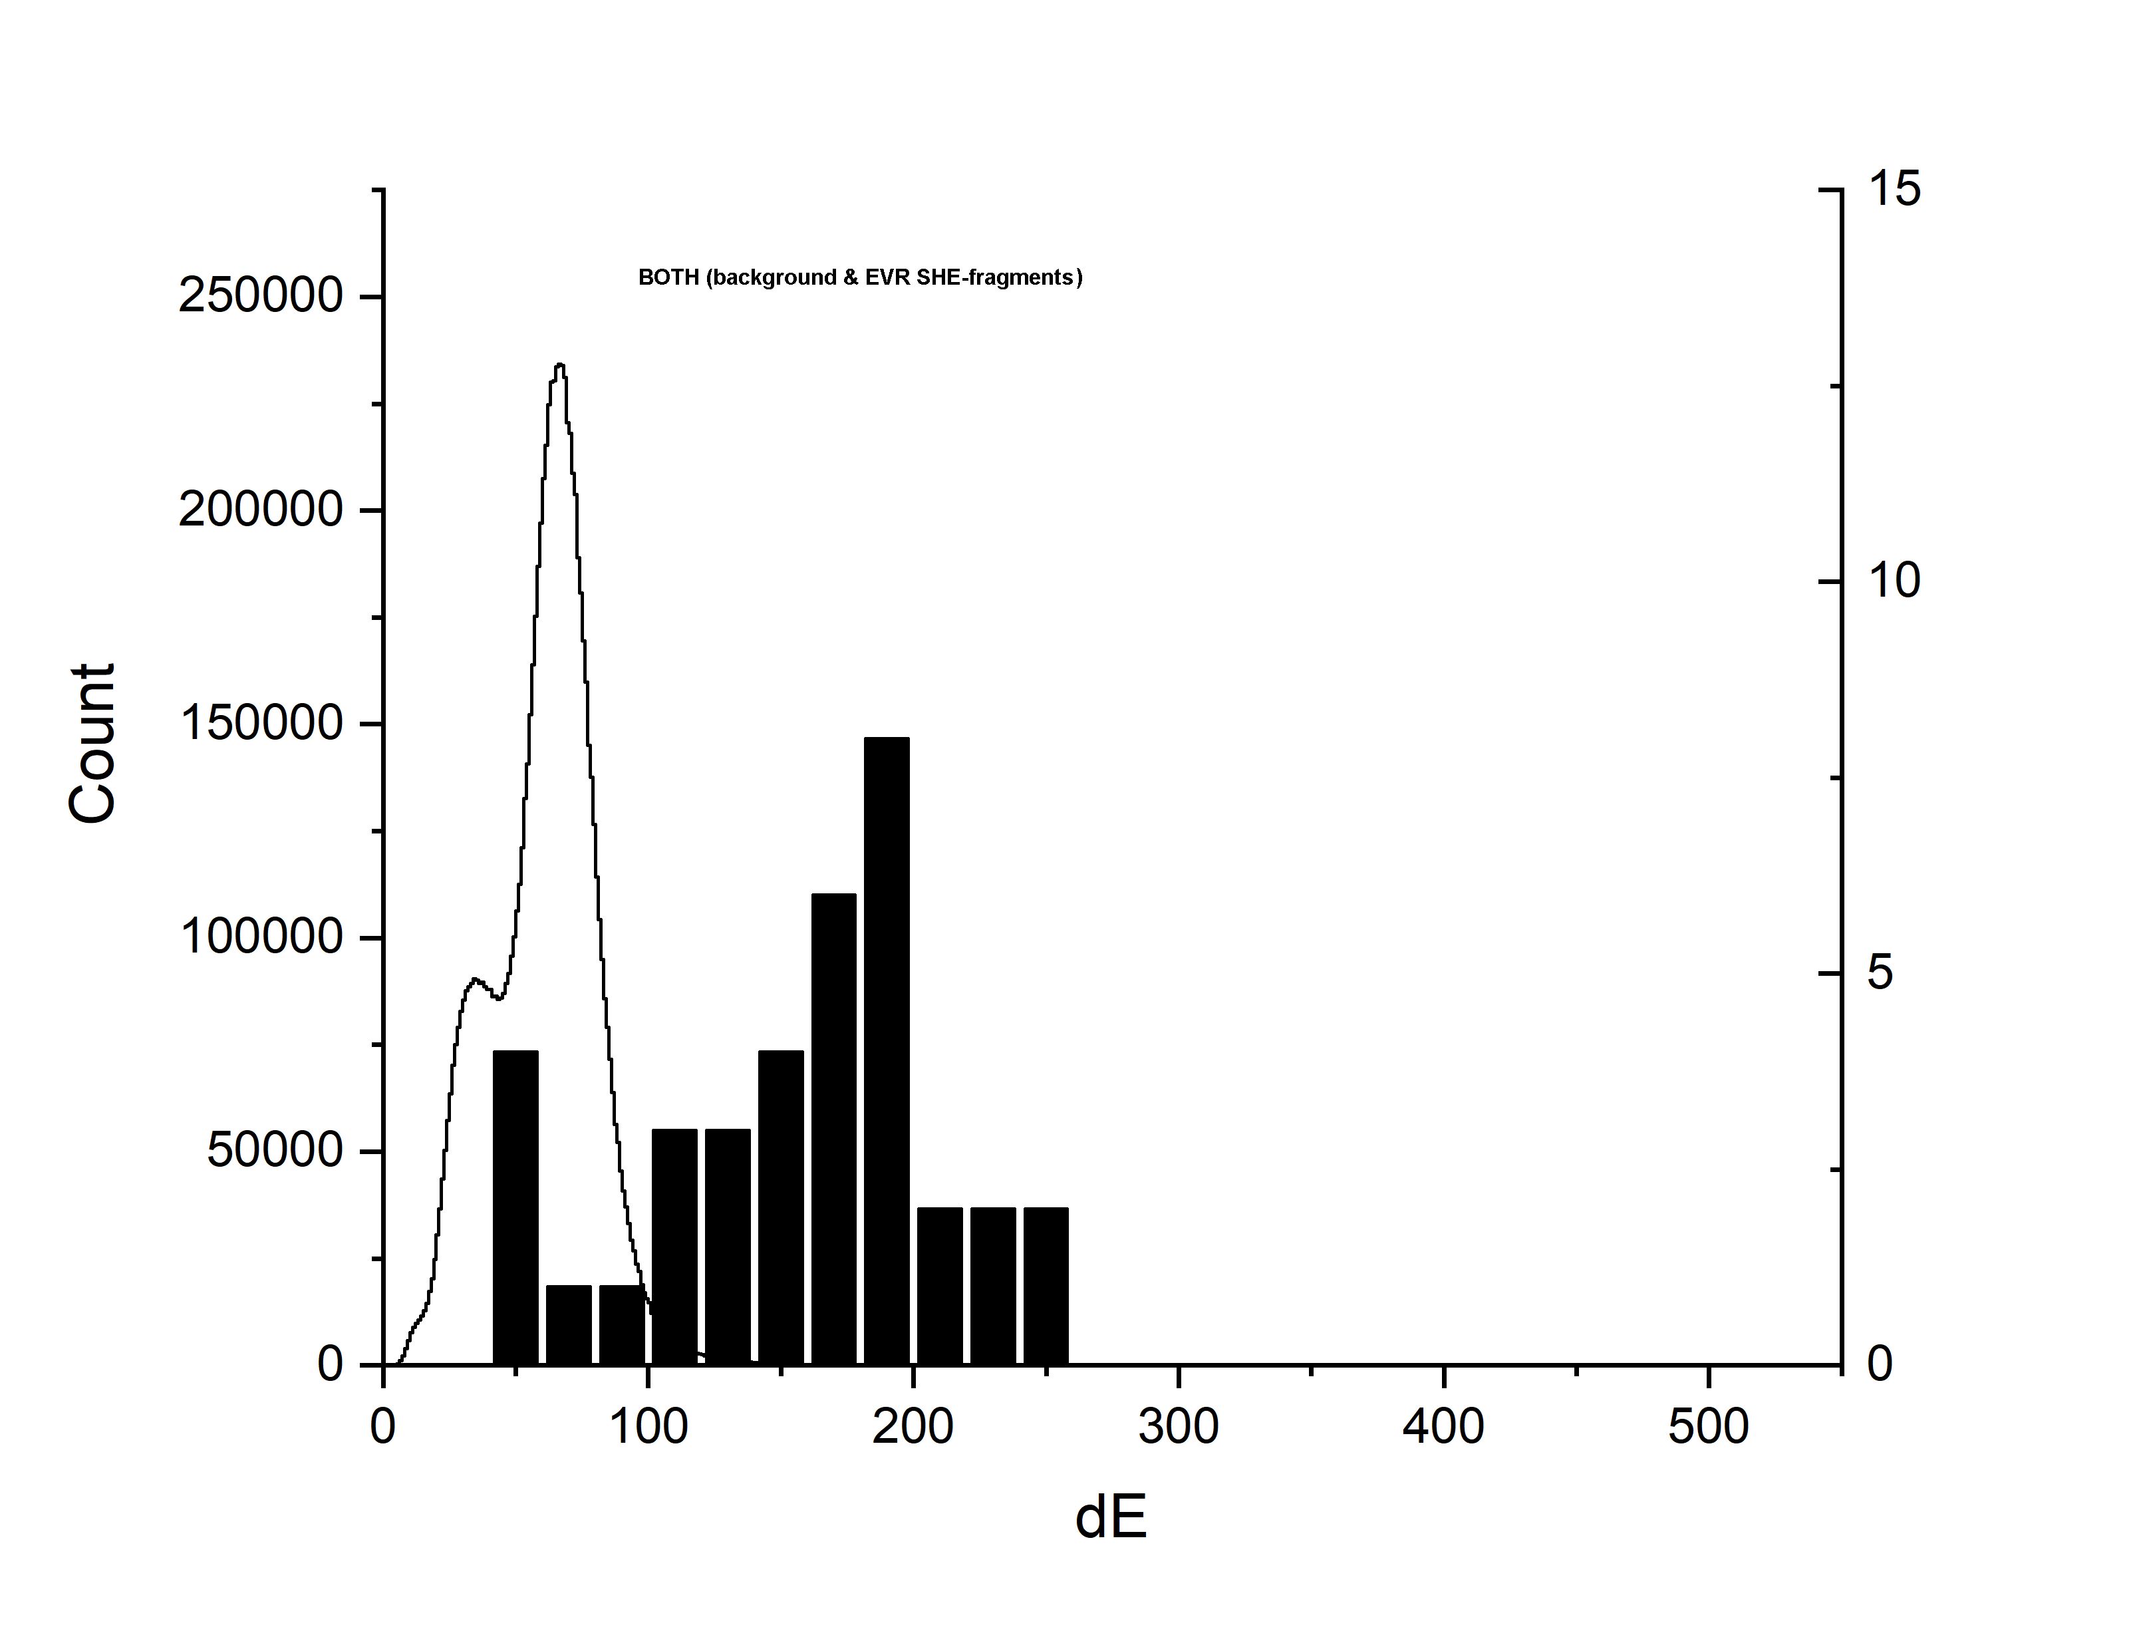
ΔE low pressure pentane-filled DGFRS#2 detector
Cathode 20µ-1mm…
W(Au) wire @ expense ~1L/month liquid
`
240 m x 60 mm
V_{c}=-100, V_{a}=+310 , V_{ADD} =-200 V
D(a-c)~ 6 mm; h_{a} =2 mm; h_{c}=1mm
W(a)=20 µ; W(c) =10 µ.
Alpha 5.4
~8.2 ch
¹⁷⁰Er+⁵⁰Ti
^{Calibration reaction}
Back strip #2
Front strip
~ 45 keV FWHM
~ 33 keV FWHM
background
Z=114
EVR
Digi 14.5 keV
²⁴²Pu+⁴⁸Ca→²⁸⁷Fl+3n (~2..4 pµA)

Slide 4
NEW DSSD from Micron Scd. ( since September 2024) strips: 48 /front, 96/ back, 80 /side

Slide 5
Block-diagram of THE DGFRS#2 two branch spectrometer
One horizontal and one vertical strip channels are shown (+ one ΔE)

Slide 6
2022 to 2024 experiments:
⁴⁸Ca → ⁵⁰Ti → ⁵⁴Cr
²⁴²Pu + ⁵⁰Ti ²⁹²Lv*
²³⁸U + ⁵⁴Cr ²⁹²Lv*
imperative
} Cross section?
// instrumentation
tests too…

Slide 7
View of Control system #1

Slide 8
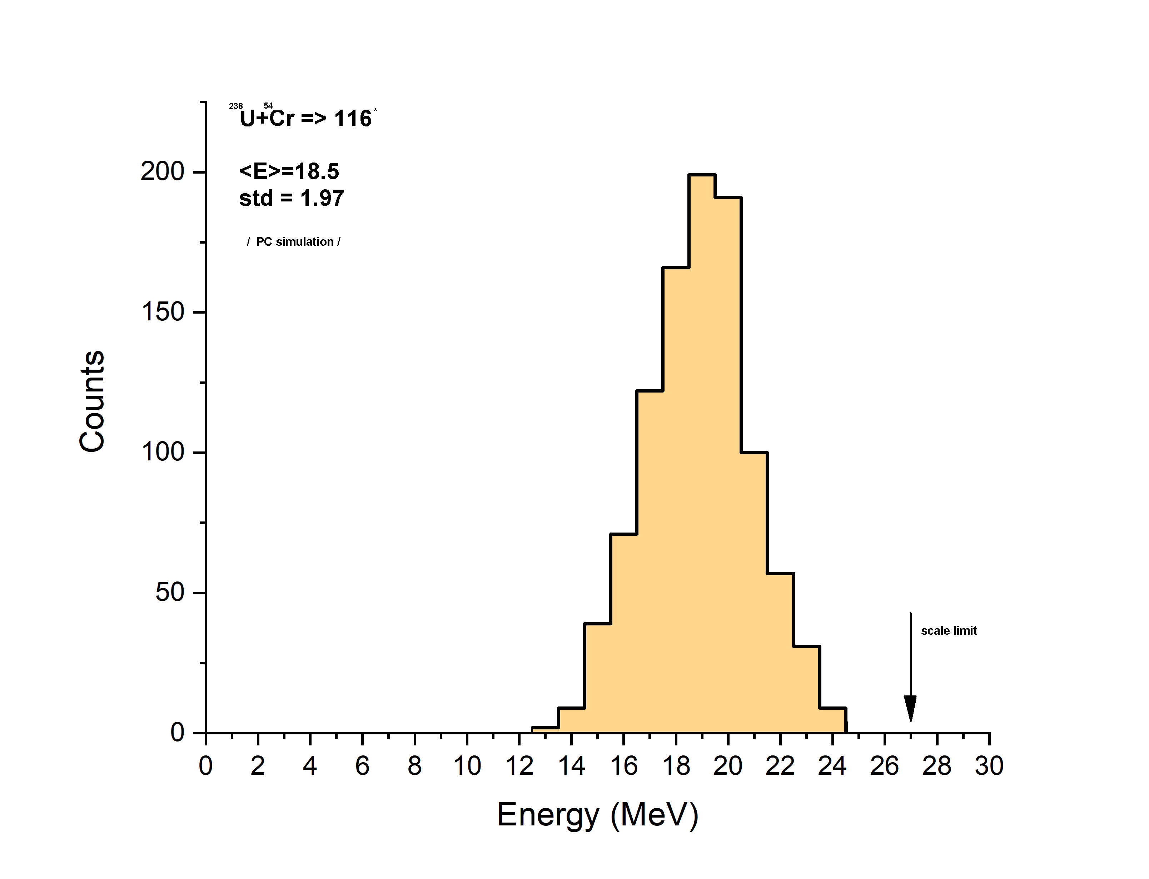
²³⁸U+⁵⁴Cr→ Lv*
,2023
EVR , Z=116
PC simulation
D.Ibadullayev, Yu.Tsyganow et al.
TechRxiv.20108918.v1, IEEE, 2022
First event of Lv EVR registered energy

Slide 9
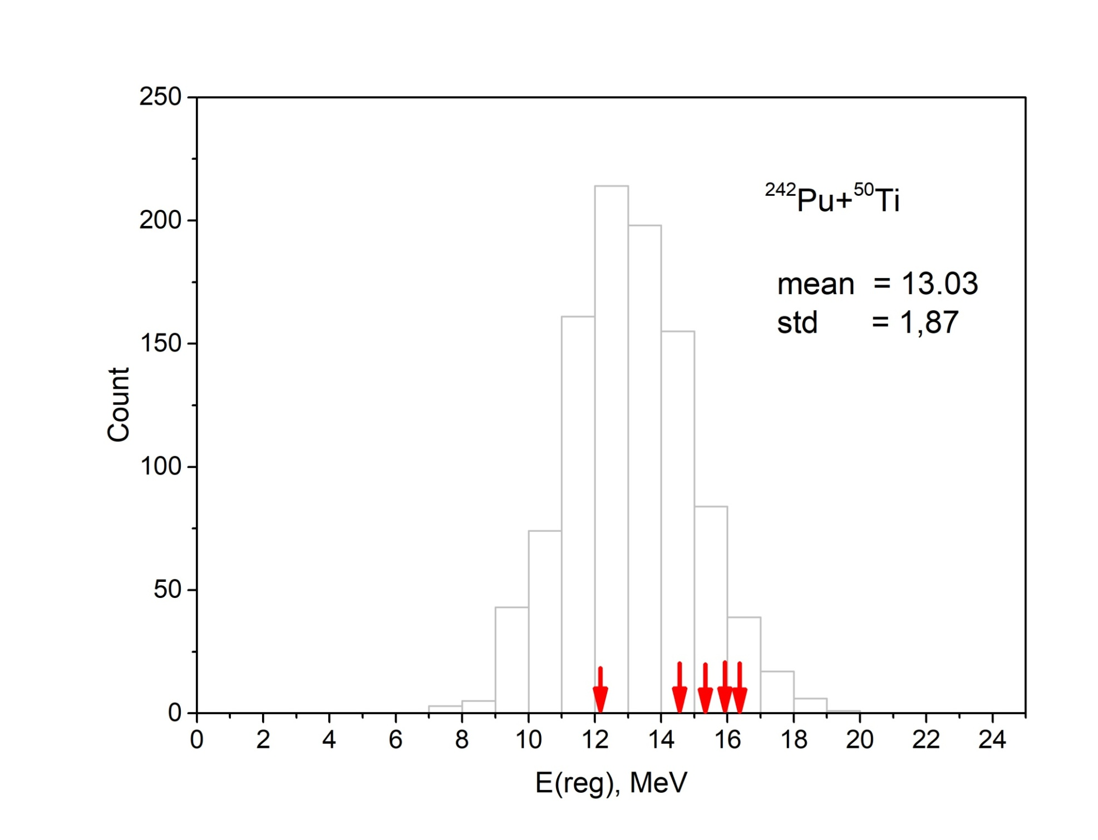
May-june 2024 experiment
+1 October 2024,
..preliminary
3n+4n

Slide 10
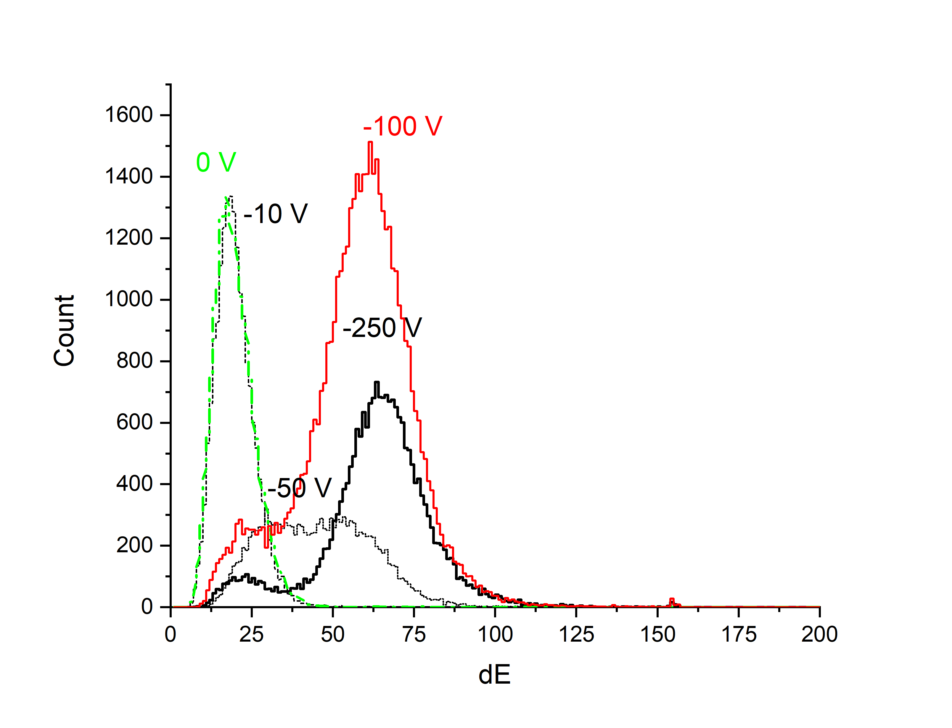
Problems, questions…
1) Rotating target D/24 cm now, j~2 -2.5 pµA both for ⁵⁰Ti and ⁵⁴Cr projectiles from DC-280. This design for ⁴⁸Ca ~ one week up to 7 pµA
Status: in progress now D/48 cm manufacturing and tests (DGFRS-3)
2) non stable ΔE chamber operation under rate greater ~4-6E+03 s⁻¹, drop of efficiency etc…
Status: solved by using additional
negatively biased plane (~ -200 Volts)
3) Radiation DSSD instability. (see below.., as far as I can see –main problem)

Slide 11
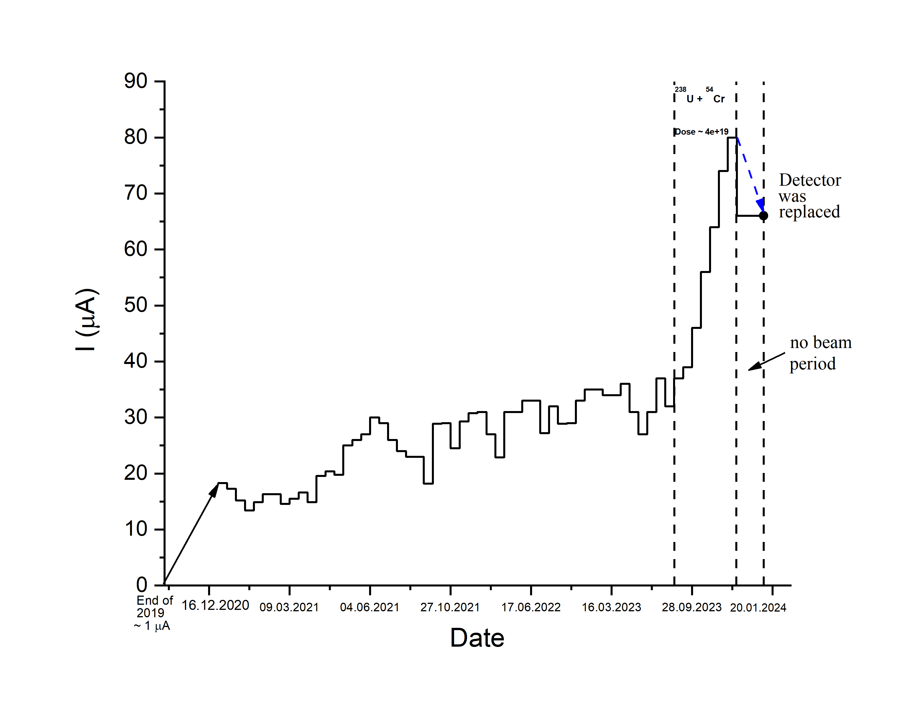
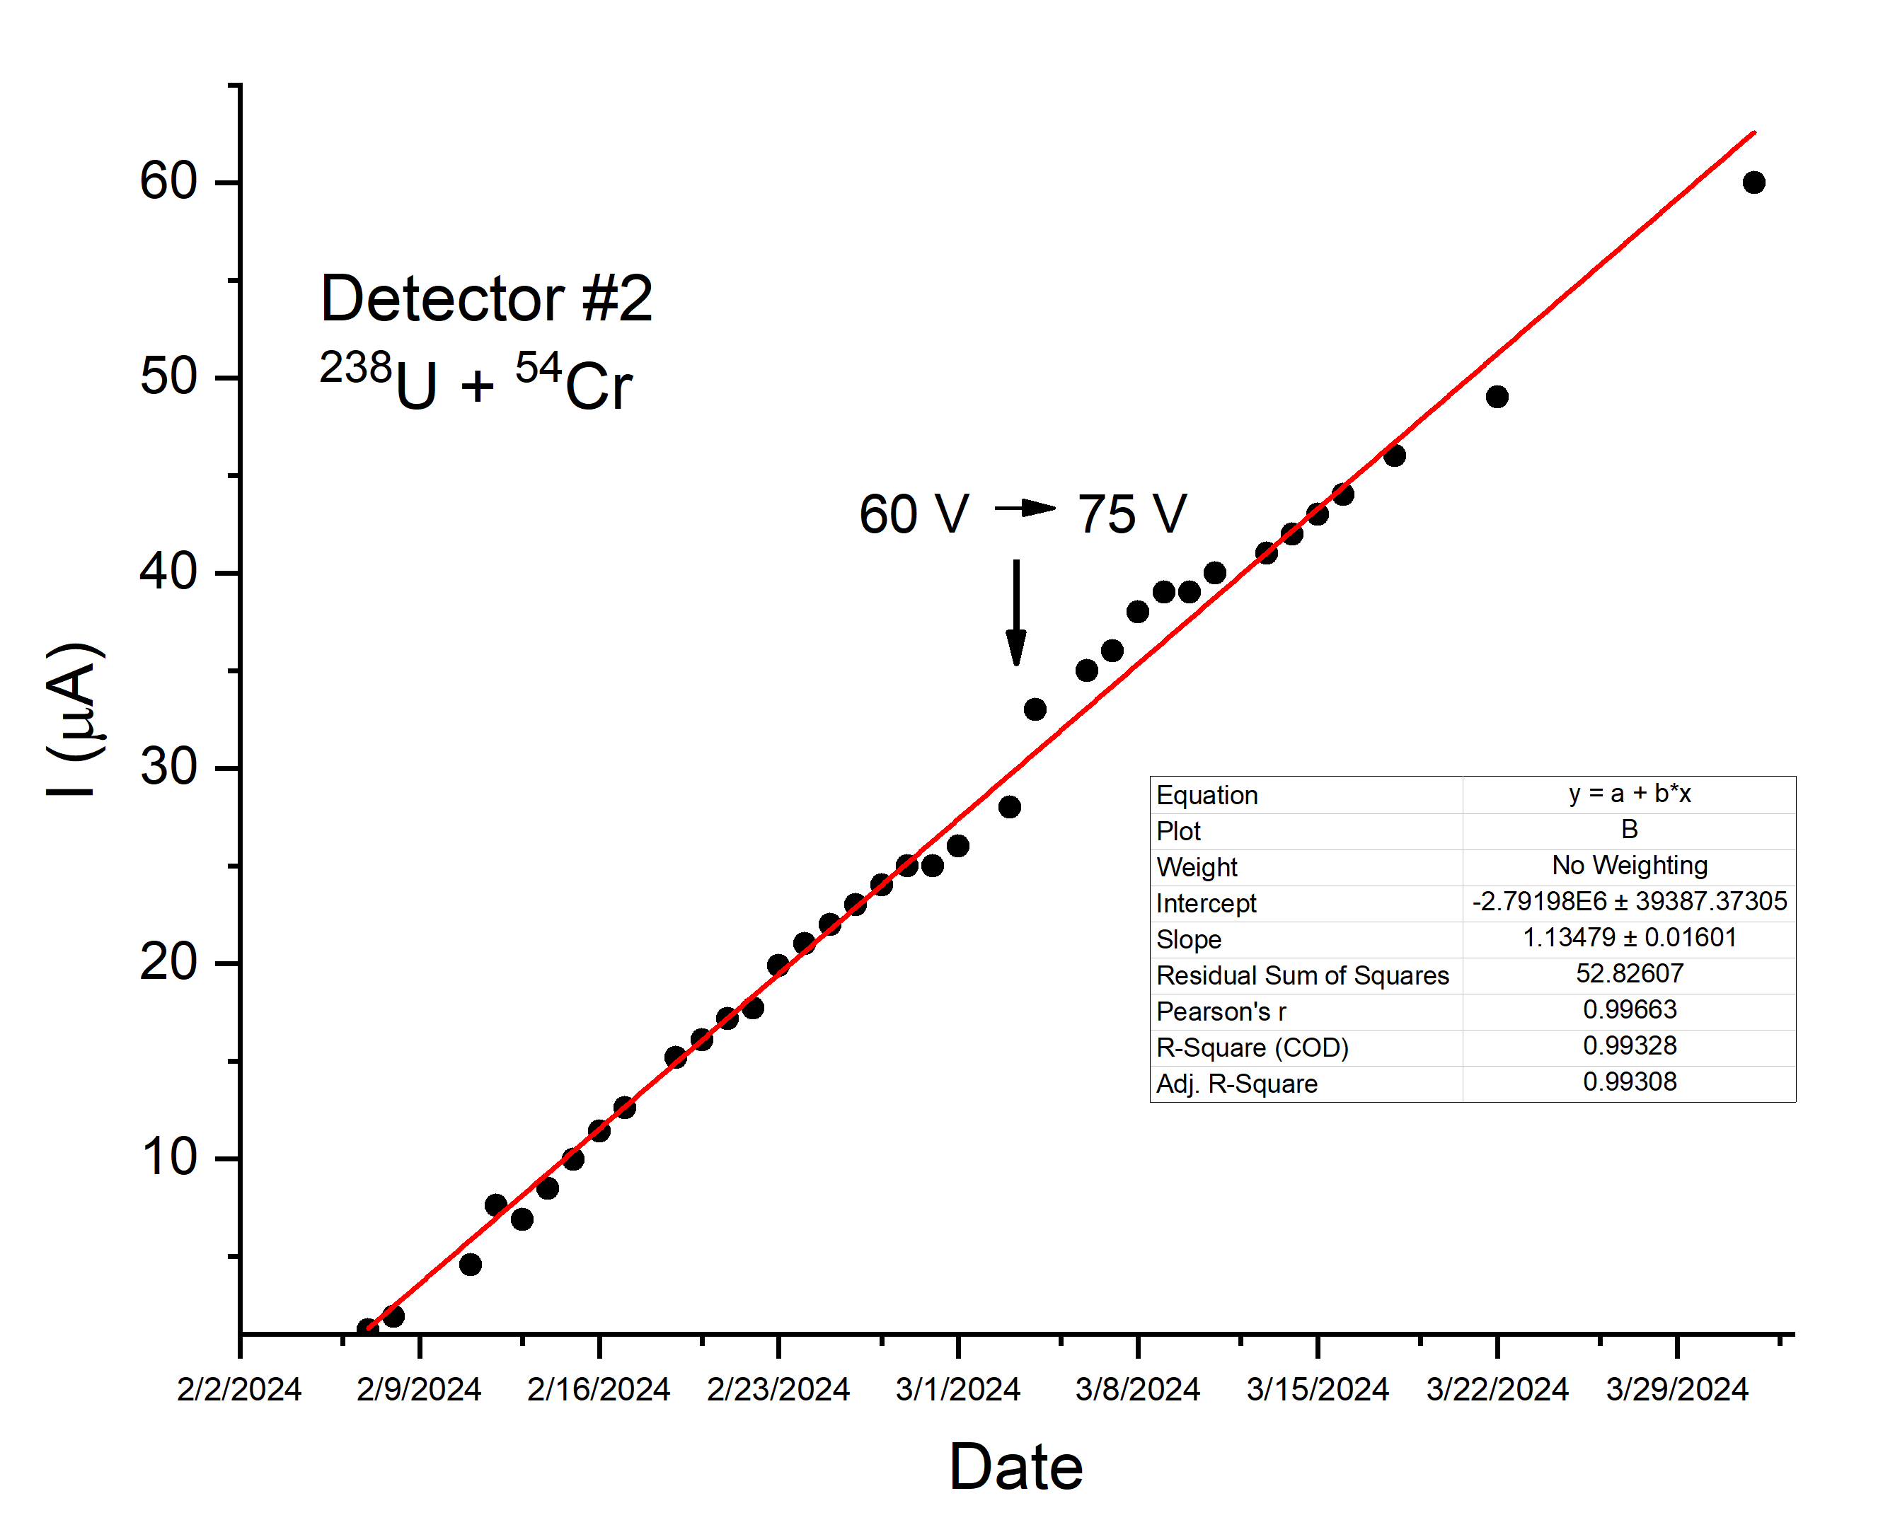
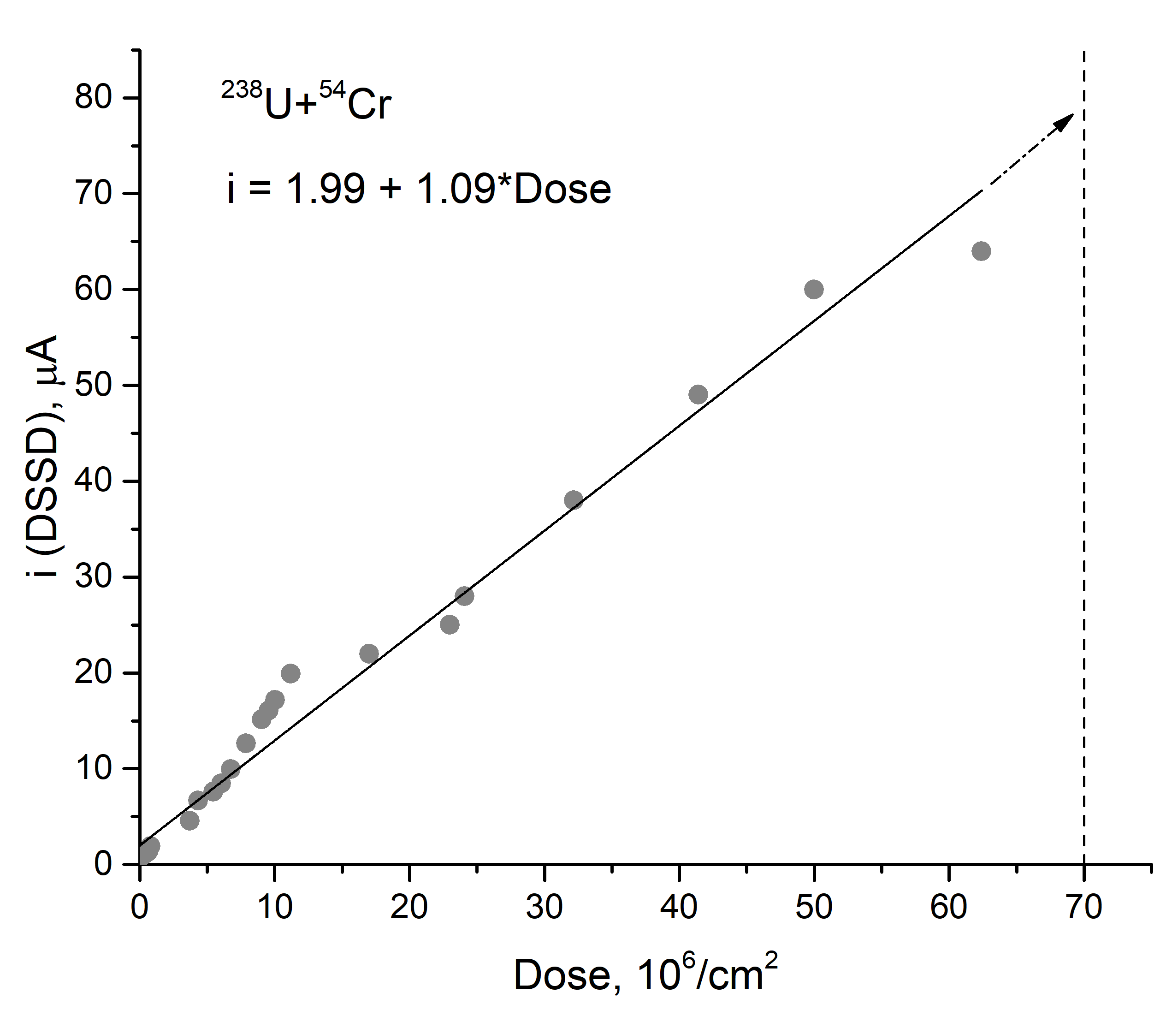
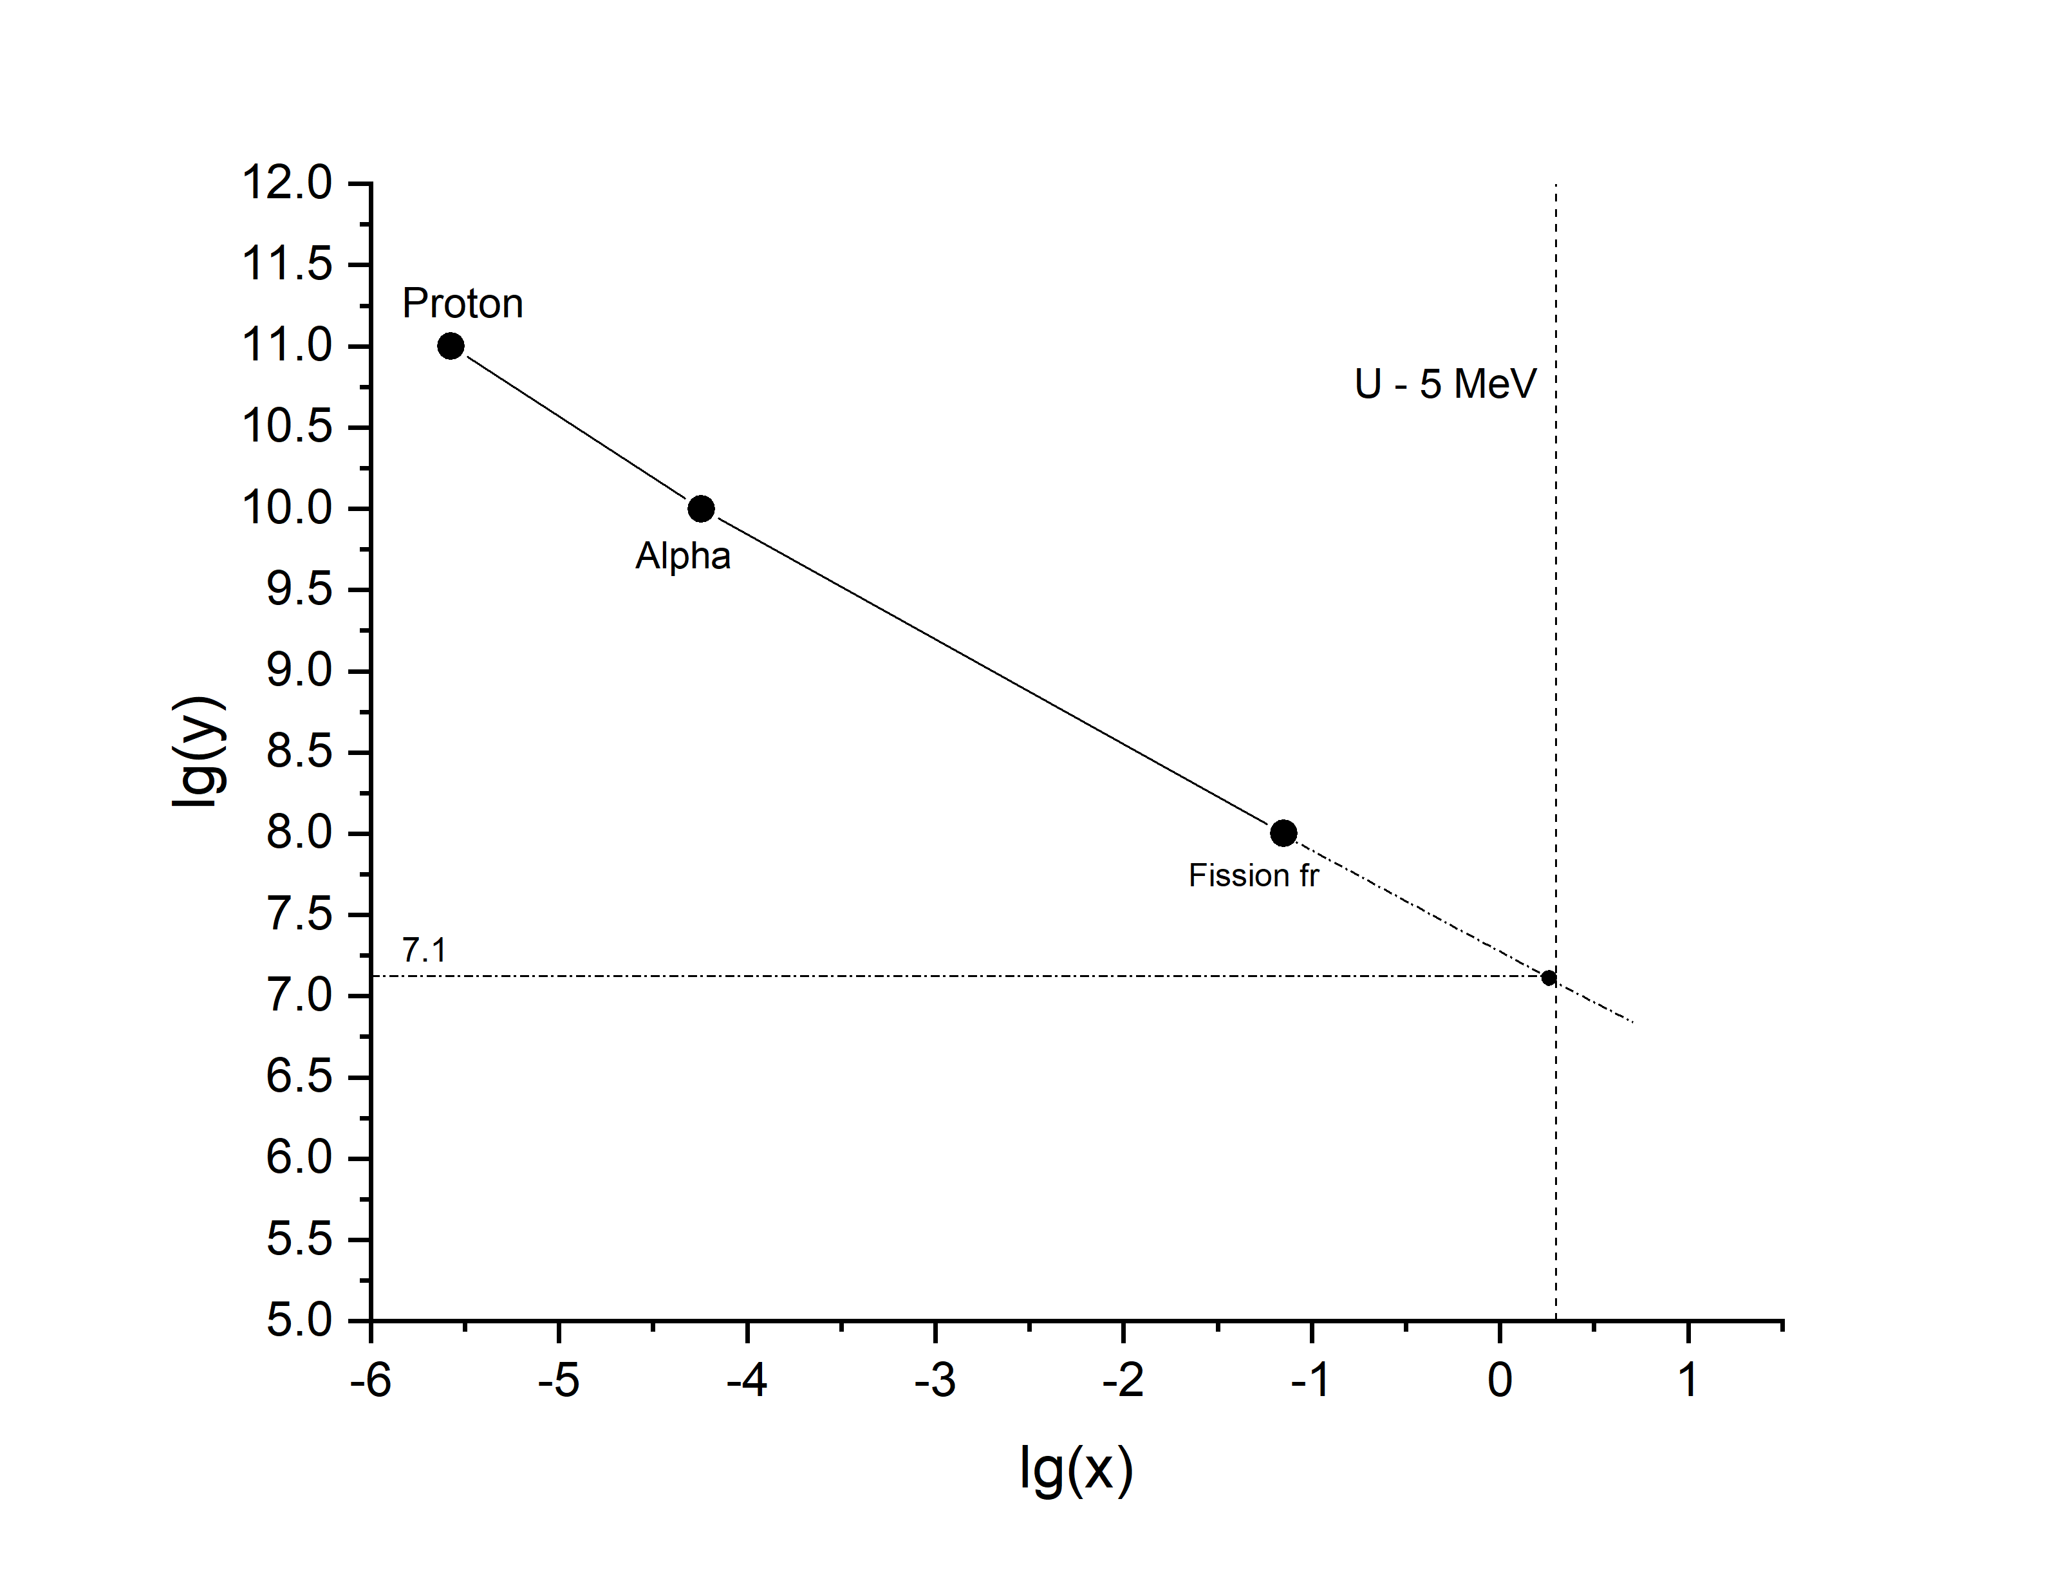
On the DSSD radiation damages (three DSSD since ~2020)
Detector #1
Detector #2

Slide 12
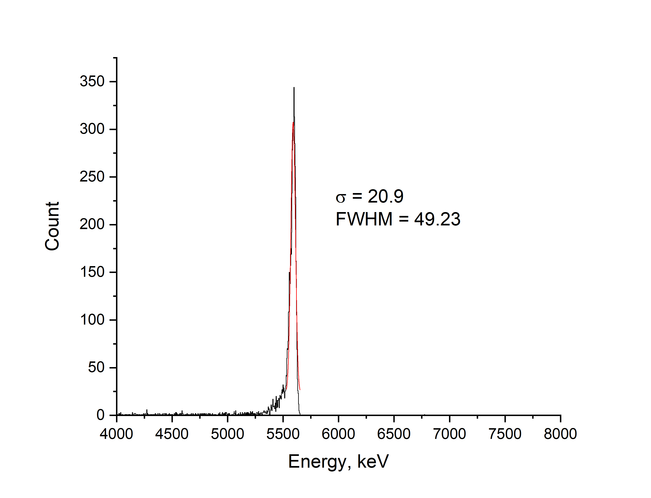
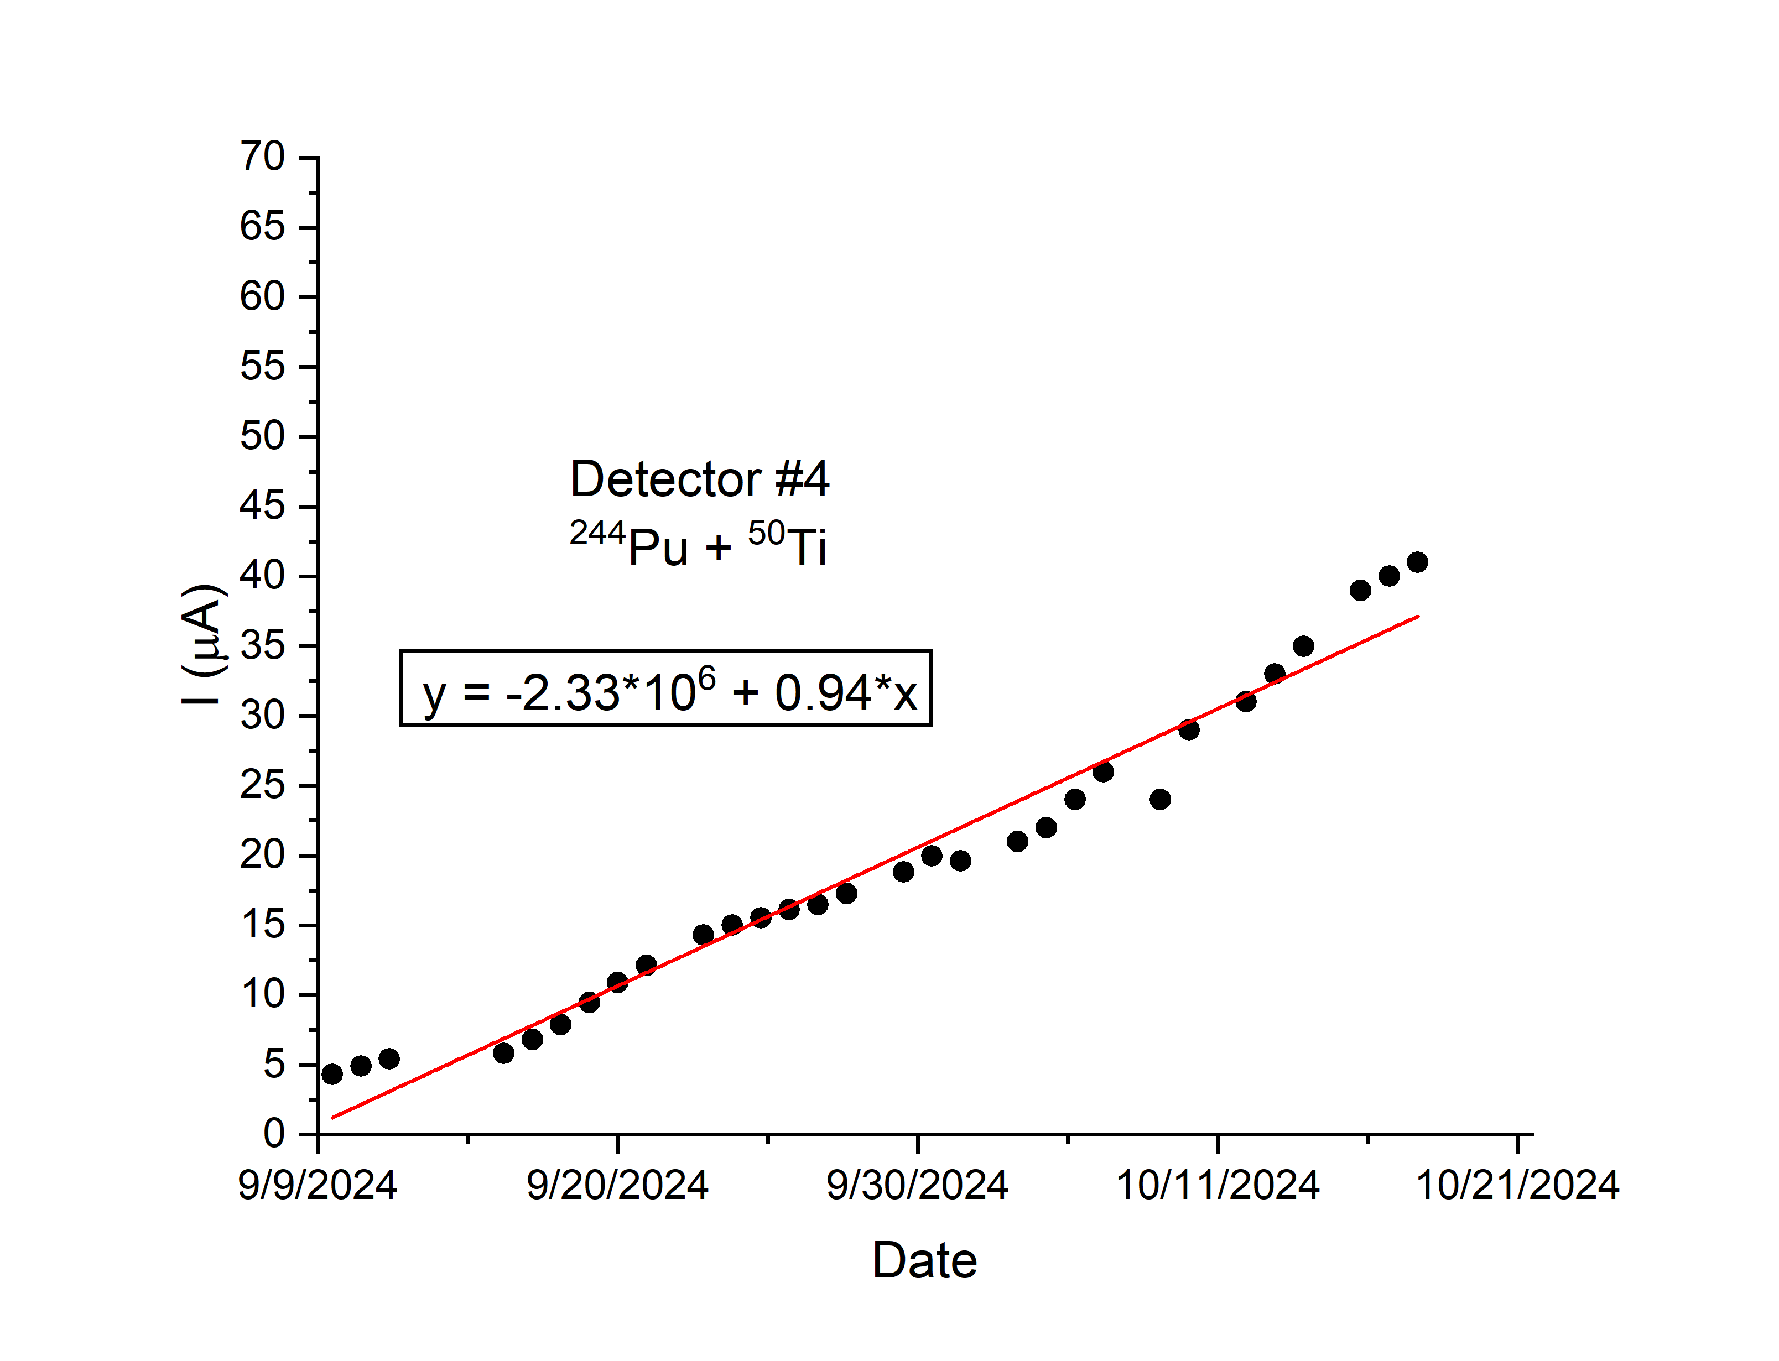
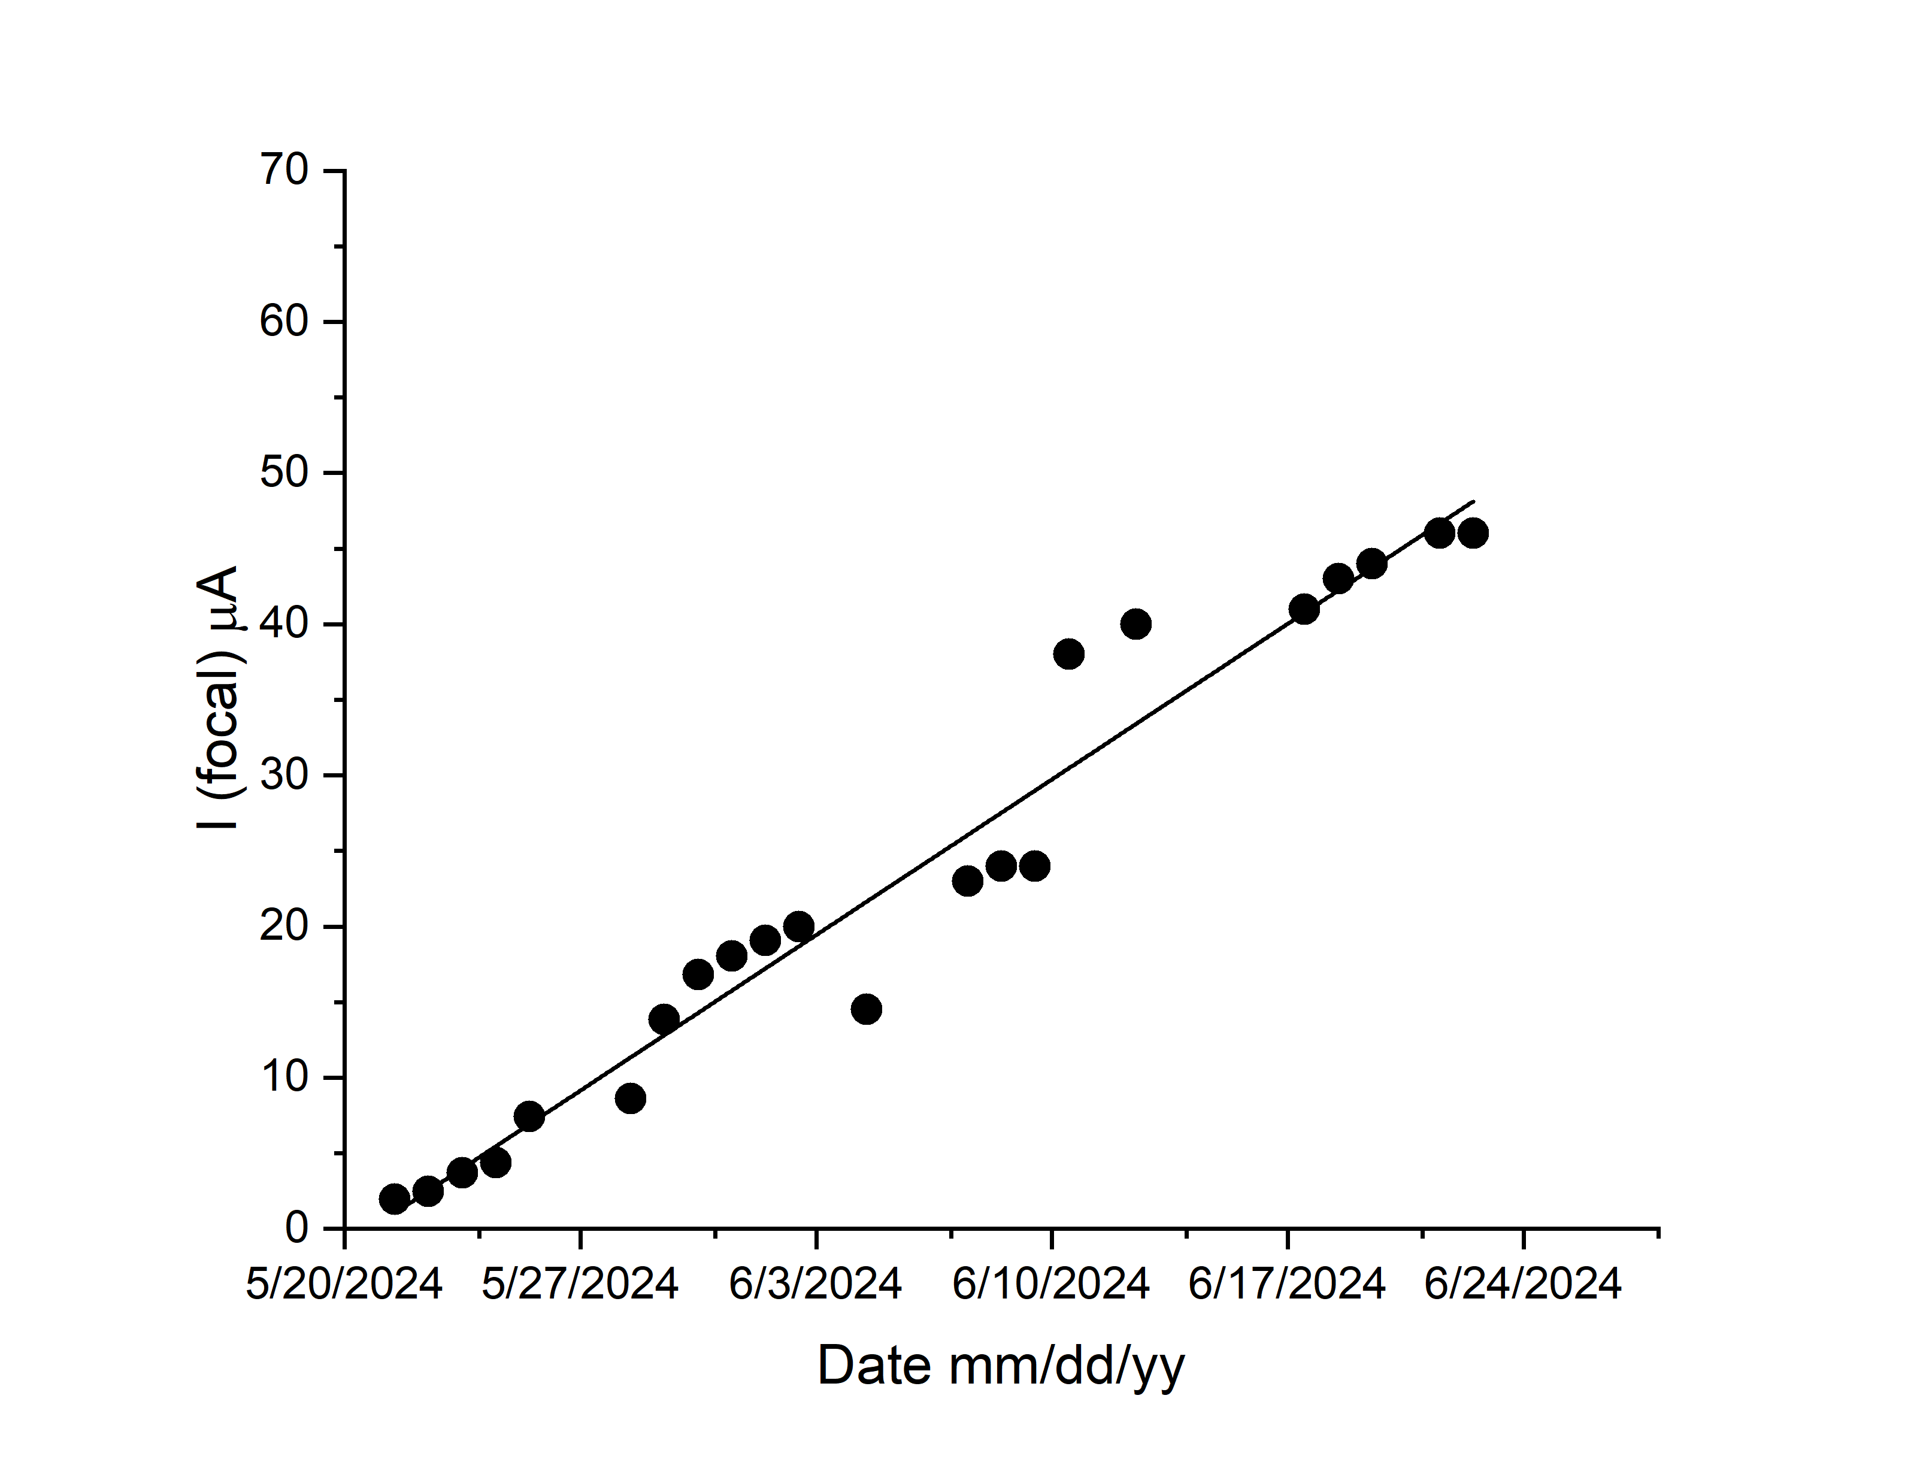
Reaction ²⁴²Pu+⁵⁰Ti→ Lv* May 22.. June 24 / 2024 + September 09 -October 28/2024
Strip back #2
It was before std=14.1 keV
September 09 -October 28/2024
Detector #3
Detector #4
Beam was switch off

Slide 13
Summary
The DGFRS-2 Detection system has been designed and successfully applied in long term HI experiments
Reactions: new superheavy isotopes were discovered, new decay modes:
²⁴³Am + ⁴⁸Ca , ²⁸⁶Mc, ²⁶⁴Lr, α-decay of ²⁶⁸Db, SF ²⁷⁹Rg,
²³²Th + ⁴⁸Ca , ²⁶⁸Sg, ²⁷²Hs, ²⁷⁶Ds, ²⁷⁵Ds
²³⁸U + ⁵⁴Cr , ²⁸⁸Lv
²⁴²Pu + ⁵⁰Ti , ²⁸⁹Lv, ²⁸⁰Cn
// problems with DSSD radiation stability & ΔE gaseous detector at J >~ 3..5 pμA from DC-280 cyclotron/
With ΔE ~ solved with applying additional negative ~ -200..220 V electrode
There are problems with DSSD at J ~10⁸ ions/ cm² (in progress now )(~ there are trivial solutions..→ not good, as far as I can see)
Nearest future general conclusions (as a reasonable scenario for Z=119 synthesis)
⁵⁴Cr ~ closed ; → ⁵⁰Ti = open.

Slide 14
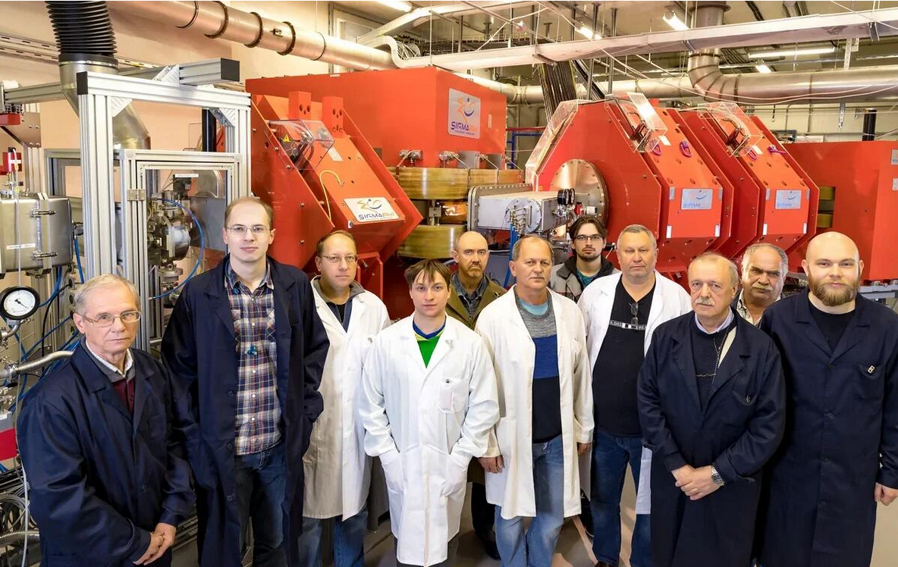
DGFRS-2 team
Thank you for YOUR attention!

Slide 15
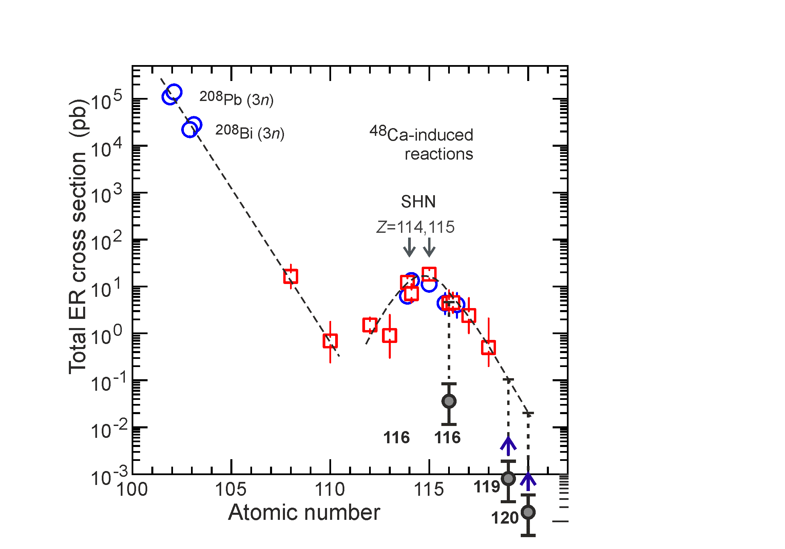
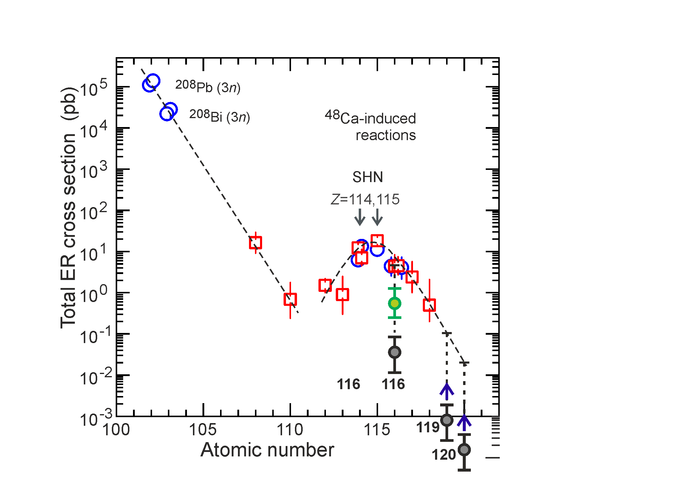
Help #1
⁴⁸Ca ⁵⁰Ti ⁵⁴Cr
²⁴⁵Cm + ⁴⁸Ca ²⁹³Lv*
²⁴²Pu + ⁵⁰Ti ²⁹²Lv*
²³⁸U + ⁵⁴Cr ²⁹²Lv*
Synthesis of the same nucleus in different reaction
Decrease of cross section in transition from ⁴⁸Ca to
⁵⁰Ti ~10
⁵⁴Cr ~(+)150
From presentation by N.Kovrizhnykh 01 July

Slide 16
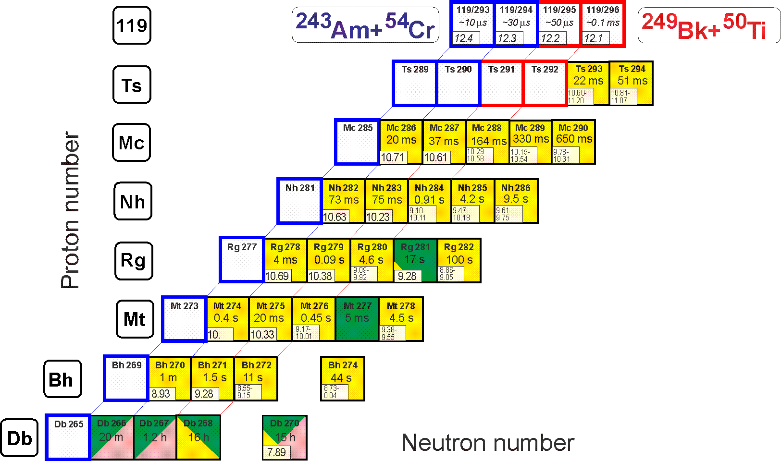
Perspectives
Synthesis of new element 119
²⁴³Am(⁵⁴Cr,3-4n)^{293,294}119 ²⁴⁹Bk(⁵⁰Ti,3-4n)^{295,296}119
Help #2
²³⁷Np(⁴⁸Ca,3-4n)^{281,282}Nh
Identification by correlation method

Slide 17
Help#3

