Slide 1
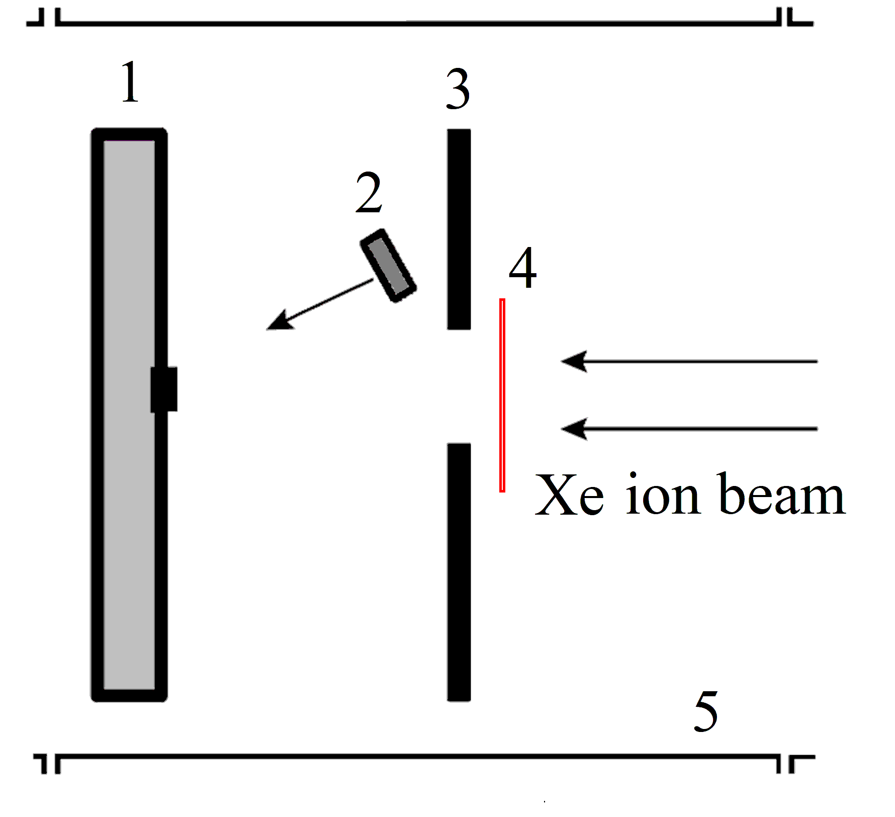
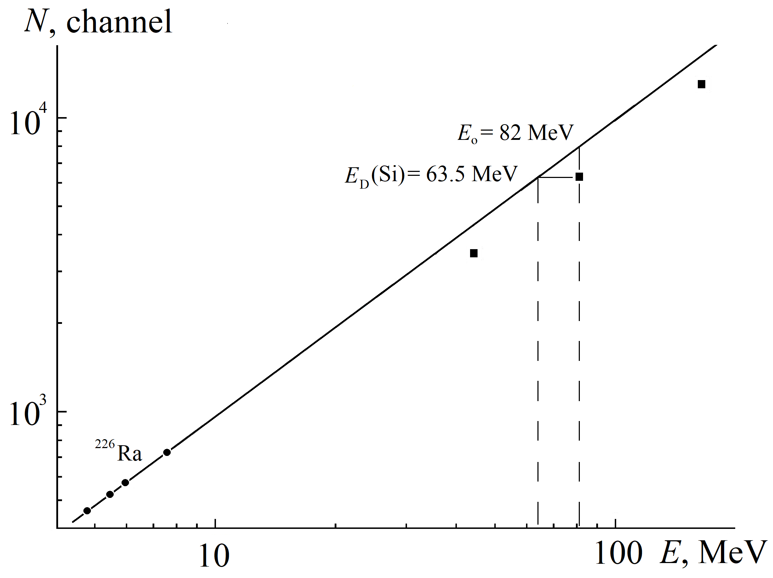
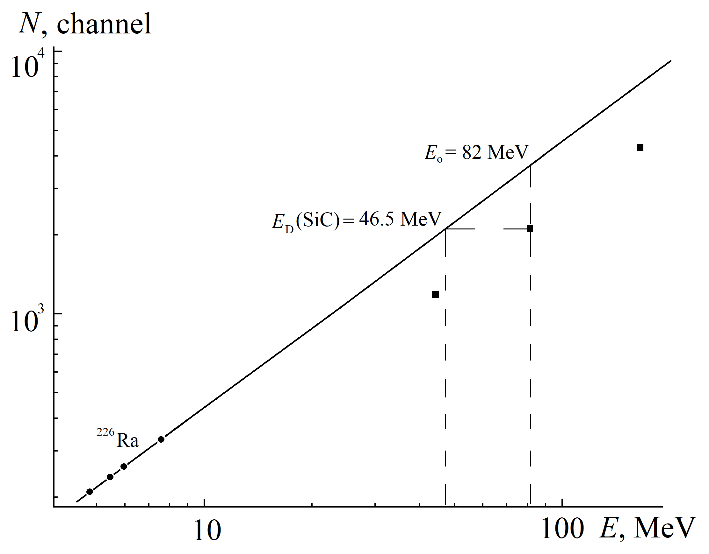
Charge Losses in SiC and Si Detectors at Registration of Heavy Ions
Yu. B. Gurov^{1,2,*}, B. A. Chernyshev², S. A. Evseev¹, M.S.Dovbnenko¹, S. V. Rozov¹, V. G. Sandukovsky¹ ¹ Joint Institute for Nuclear Research, Dubna, Russia ² National Research Nuclear University “MEPhI”, Moscow, Russia *e-mail: gurov54@jinr.ru
In experimental physics, semiconductor detectors (SCD) are widely used to register highly ionizing particles (heavy ions and fission fragments). At the same time, the main problem of PPD spectrometry of heavy charged particles is the lack of a linear relationship between the energy of the detected particle and the amplitude of the signal from the detector (unlike light charged particles, including alpha particles). This fact, associated with the loss of charge, is called an amplitude defect [1]. The magnitude of this defect is defined as the difference between the amplitudes obtained from a heavy ion and α particle when their energies are equal at the entrance to the detector. The specified parameter depends on the parameters of the measured particle (energy, mass) and the detector used (material, manufacturing technology, operating voltage).
Currently, silicon carbide (polytype 4H-SiC) [2] is actively used to create detectors with increased radiation resistance compared to Si detectors and good energy resolution. The following are the results of a study of charge losses in Si and SiC detectors when irradiated with ¹³²Xe ions of various energies.
Two detectors based on Si and SiC were used for measurements. Si detectors are manufactured using planar technology from n-type silicon (resistivity 6 kΩ⋅cm). Rectifying and ohmic contacts were formed by implantation of boron and phosphorus, as well as by spraying Al (thickness ~ 120 nm). The detectors had an active area of 4×4 mm² and a thickness of 300 μm.
SiC detectors were manufactured on the basis of an epitaxial layer of 4H-SiC n-type conductivity [3] which was obtained on 4H-SiC n+ substrates from L.P.E. (Italy). The diameter of the initial substrate is 4”, the thickness was 350 μm, the impurity concentration was 2 ⋅10¹⁸ cm⁻³. The epitaxial layers had a thickness of 50 μm and a donor impurity concentration of 1⋅10¹⁴ cm⁻³. The detectors were manufactured on samples measuring 6 × 6 mm² . The rectifying contacts with a diameter of 3 mm and ohmic contacts ∅ 5 mm were created by vacuum spraying of a double layer of Ni and Au, respectively, with a thickness of 20 and 40 nm.
Based on the measured current-voltage (I-V) and capacitance-voltage (C-V) characteristics, the operating voltage (reverse bias) in Si and SiC detectors was chosen to be 100 and 300V, respectively. The initial energy resolution of all detectors was 25 keV for α-particles (E = 5.5 MeV).
The samples were irradiated with a beam of ¹³²Xe ions with an energy of 165 MeV on the cyclotron IC-100 at the Nuclear Reaction Laboratory of JINR [4]. The measurement scheme for determining the amplitude defect is shows in Fig. 1. The detectors were placed in a vacuum chamber. Ions passing through an aluminum filter and a collimator ∅ 4 mm were recorded by the detector under study. The use of Al filters with a thickness of W = 0.0, 6.0 and 9.5 μm made it possible to determine the amplitude defect, respectively, for three values of the Xe ion energies: 165, 82 and 45 MeV. The energy values were calculated using the SRIM 2003 program [5]. ²²⁶Ra α-source (Eα= 4.8, 5.5, 6.0, 7.7 MeV) was also placed in the chamber at a sufficient distance from the beam trajectory, which was used to calibrate and control the stability of the characteristics of the studied samples.
Fig. 1
Set-up scheme:
1 - detector,
2 - α-source ²²⁶Ra,
3 - collimator,
4 - Al filter,
5 - accelerator vacuum chamber
In Fig. 2 and Fig. 3 show the amplitude spectra of Xe ions measured using Si and SiC detectors using Al filters of various thicknesses. Three peaks are visible, corresponding to the registered energies of 165, 82 and 45 MeV. Alpha peaks from the calibration source ²²⁶Ra are also observed at the beginning of the spectra.
Fig. 2
Fig. 3
E_{Xe}, МэВ | 165 | 82 | 45
E_{Д} (Si), МэВ | 133.5 | 63.5 | 35
δE, МэВ | 31.5 | 18.5 | 10
δE/E_{Xe} , % | 19 | 23 | 22
E_{Д}(SiС), МэВ | 96.5 | 46.5 | 25.5
δE, МэВ | 68.5 | 35.5 | 19.5
δE/E_{Xe} , % | 42 | 43 | 43
Fig. 4
Fig. 5
Table 1
The spectra measured by Si and SiC detectors and the calibration of energy scales carried out with the help of four α-peaks of the source ²²⁶Ra made it possible to determine E_{d} − the energy registered by the detector, and δE− the amplitude defect by the formula δE = E_{o} − E_{d}. E_{o} is the true ion energy, which was calculated with accuracy 2% by alpha calibration [6]. The obtained results are given in Fig.4, Fig. 5 and table 1. Table 1 also shows the ratio δE/E_{o} for the detectors under study.
Conclusion
It is shown that the energy loss (amplitude defect) during the registration of Xe ions with energies of 165, 82, 45 MeV is 20 and 40%, respectively, for Si and SiC detectors. The results obtained are due to the significantly shorter lifetime of charge carriers created by the particle in silicon carbide compared to silicon. This leads to significant recombination of electron-hole pairs in the region of the so-called "plasma cord", which is formed in the ion track.
REFERENCES
1. Moulton J. B. et al. //NIM/ 1978. 157. 325.
2. Kalinina E. V. // Semiconductors. 2007. 41. 745.
3. Yu.B. Gurov et al. Instrum. Exp. Tech. 2015. 58. 22. 5.
4. Gikal B. N. et al. // Phys. Part. Nucl. Lett. 2010. 7. 557.
5. Ziegler J. F. // NIM in Phys. Res. 2004. B220.1027.
6. Y.B. Gurov et al., Instrum. Exp. Tech. 2006. 49. 624.
The 7th international conference on particle physics and astrophysics. 22-25 October 2024

