Slide 1
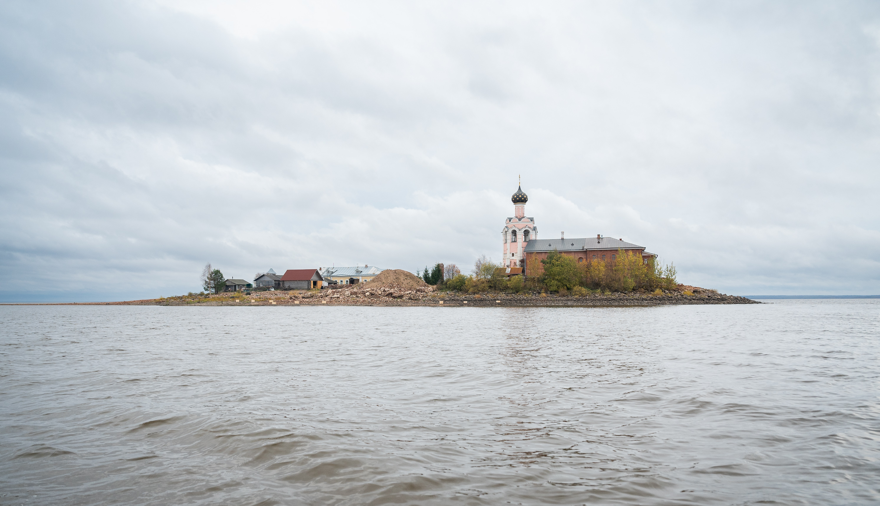
Muonography on Kamenny Island in Lake Kubenskoye

Slide 2
Research team:
A. Alexandrov, P. Babaev, A. Gippius, S. Gorbunov, V. Grachev, N. Konovalova, Y. Krasilnikova, A. Larionov, A. Managadze, I. Melnichenko, N. Okateva, S. Paramonov, A. Petrukhin, N. Polukhina, T. Roganova, Z. Sadykov, N. Starkov, E. Starkova, D. Strekalina, V. Tyukov, M. Chernyavskiy, V. Shevchenko, T. Shchedrina, D. Zainutdinov, A. Volkov, D.Vozdvizhenskii
2

Slide 3
Outline
1 OBJECT OF STUDY
2 MAIN STEPS IN THE EXPERIMENT
3 DETECTOR ASSEMBLY
4 DETECTOR EXPOSURE
5 GEODETIC SURVEY
6 DATA PROCESSING AND ANALYSIS
7 VERIFICATION
8 FINDINGS
3

Slide 4
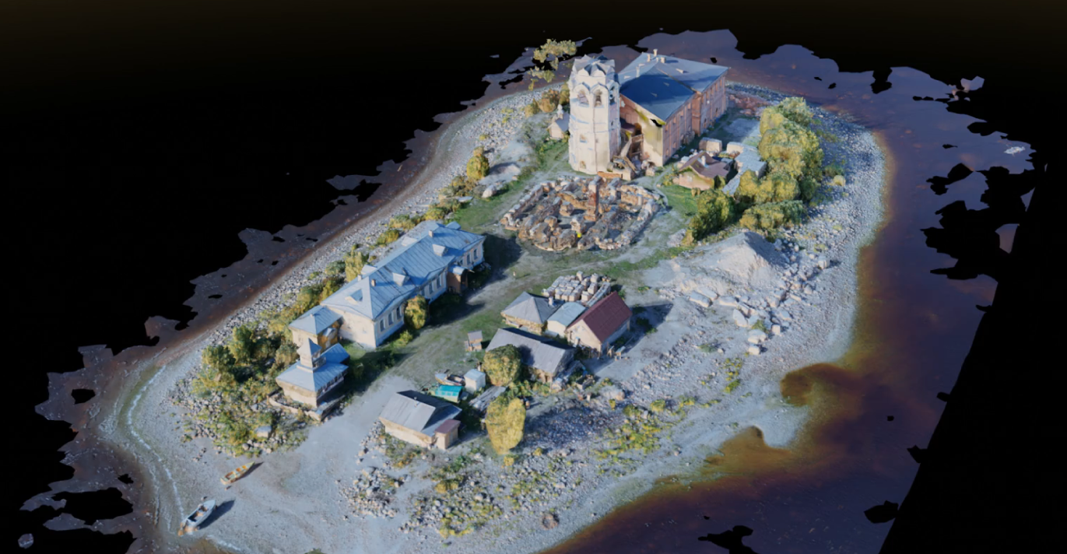
Object of study
Spaso-Kamenny Preobrazhensky Monastery in Lake Kubenskoye (Vologda Region)
Founded in 1260
The Preobrazhenskii Cathedral may contain the crypt of Metropolitan Varlaam, who died in 1533
In 1937, it was blown up
The Preobrazhenskii Cathedral
4

Slide 5
Main steps in the experiment
STEP 1
Preliminary resource estimation for the experiment
STEP 2
Production of emulsion by “SLAVICH” company
STEP 3
Detector assembly
STEP 4
Detector installation and geodetic surveying
STEP 5
Detector exposure
STEP 6
Deinstallation of detectors and emulsion development
STEP 7
Emulsion scanning
STEP 8
Track reconstruction and data analysis
STEP 9
Results
5

Slide 6
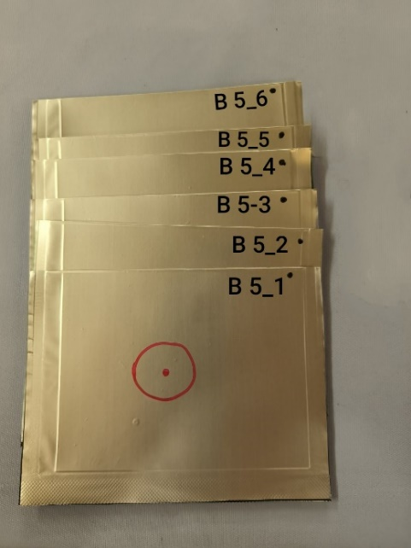
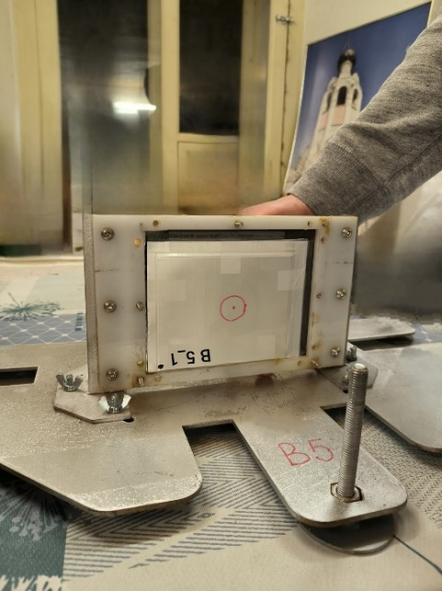
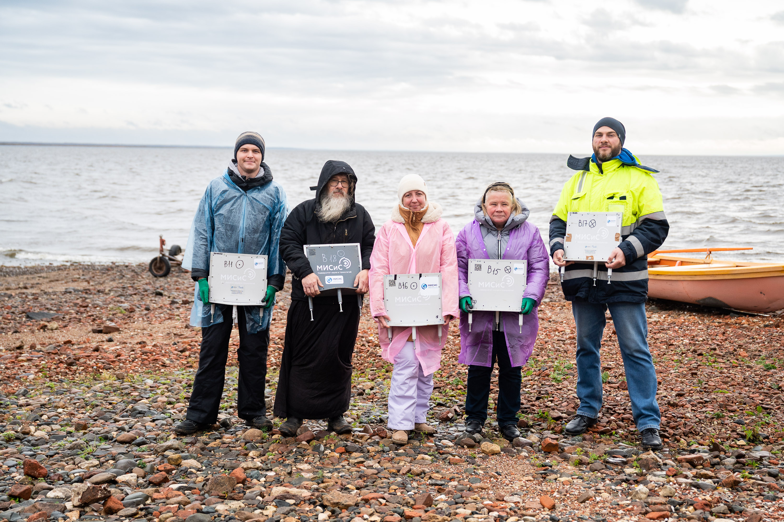
Detector assembly
Each detector contained 6 double-sided emulsion plates 10.0 × 12.5 cm² in size
1
2
3
Marking of emulsion plates
Stack of plates in the detector
Assembled detector
6

Slide 7
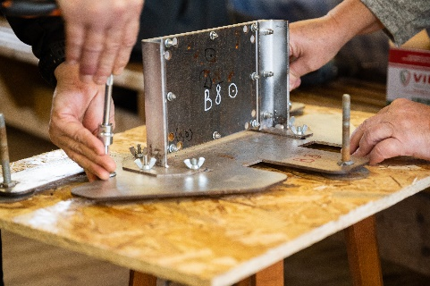
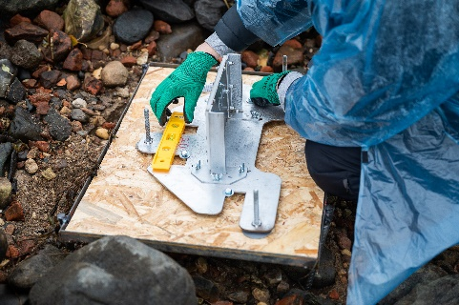
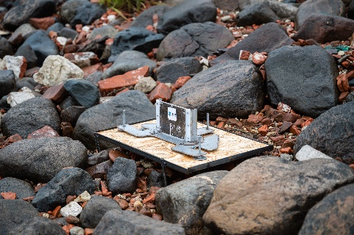
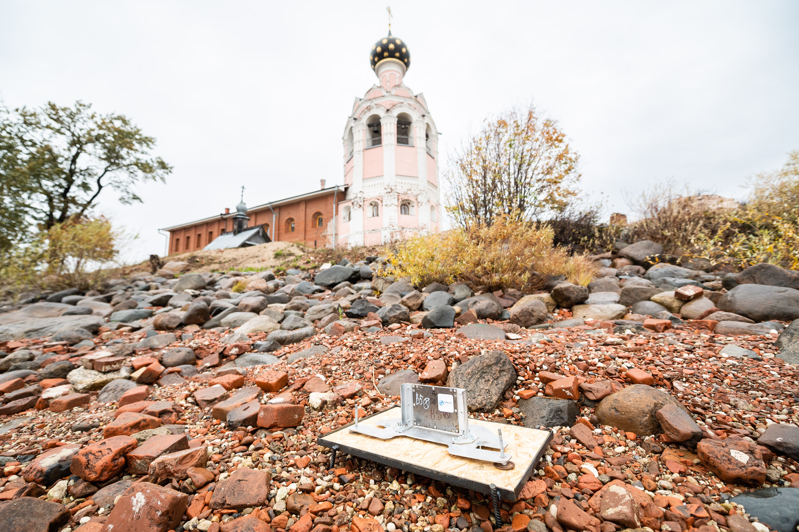
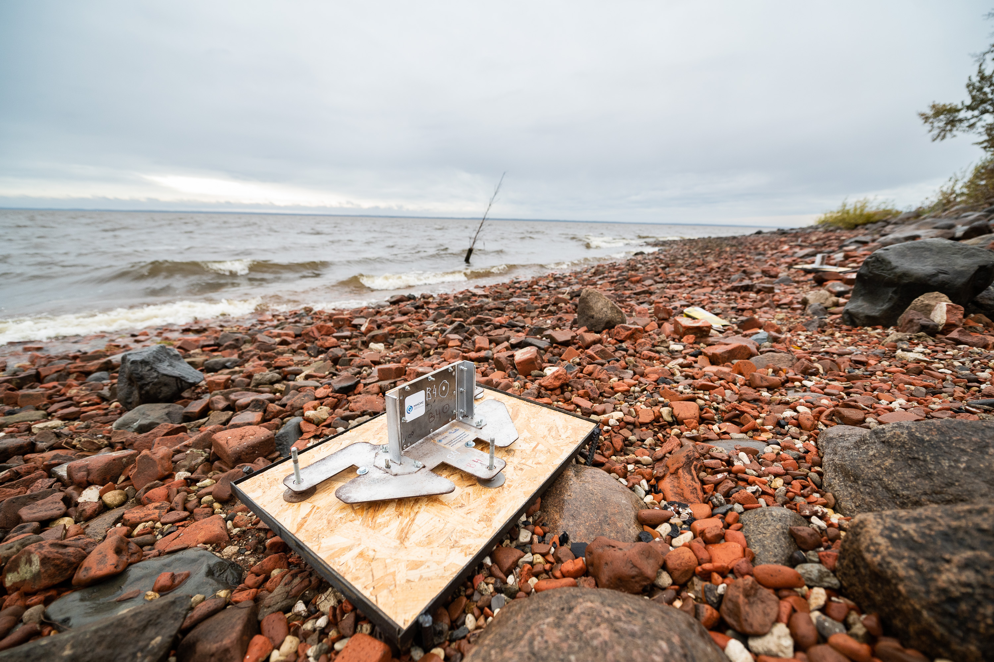
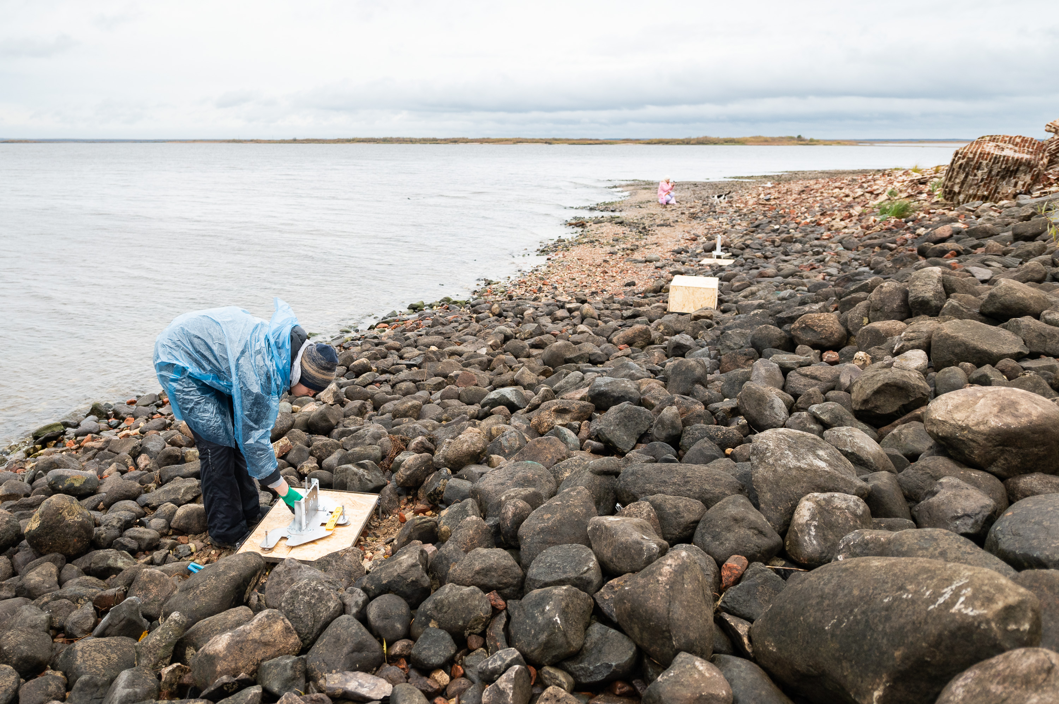
Detector exposure
Exposure time ⁓ 2 months
18 Detectors
Fixing the detectors on the platforms
7

Slide 8
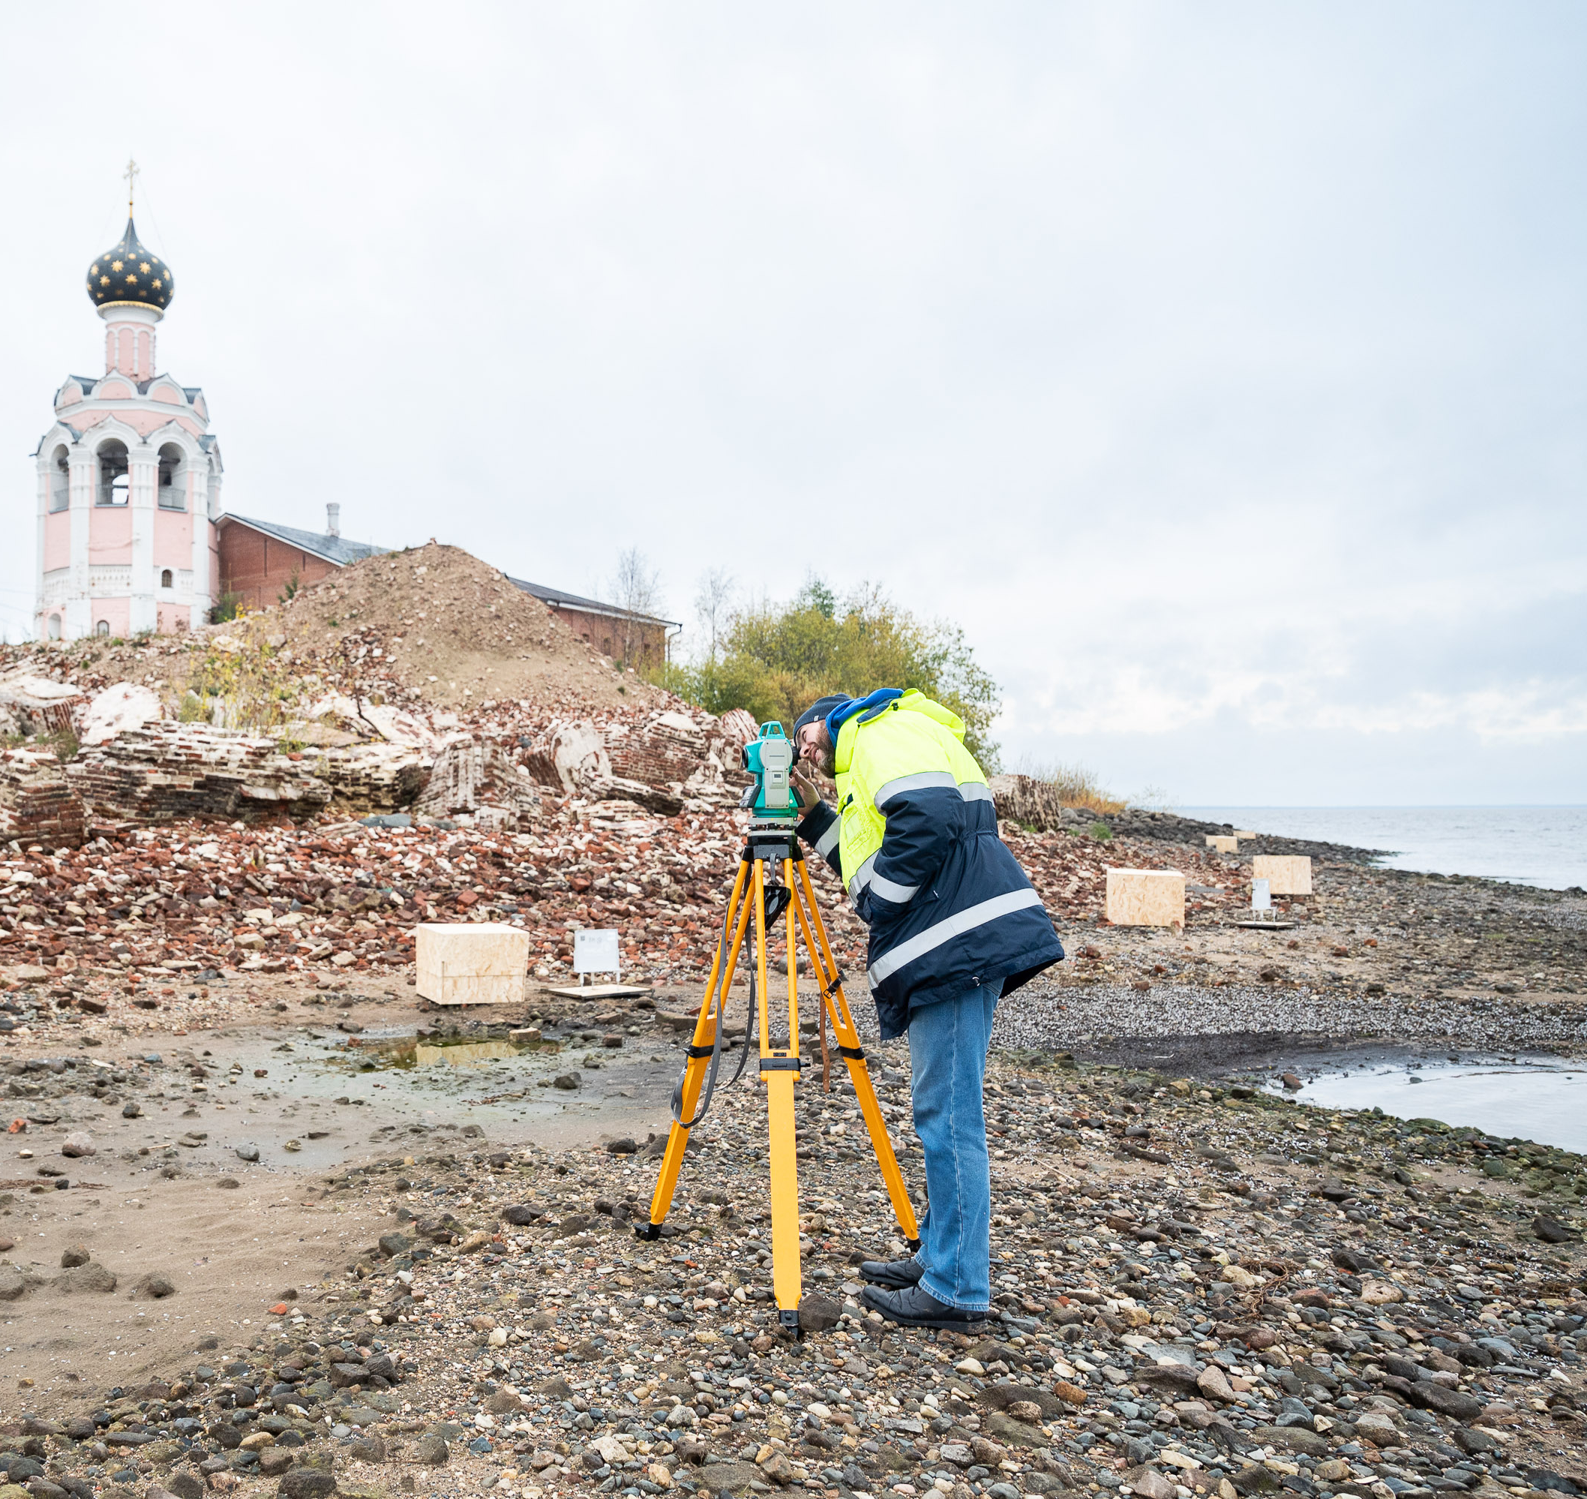
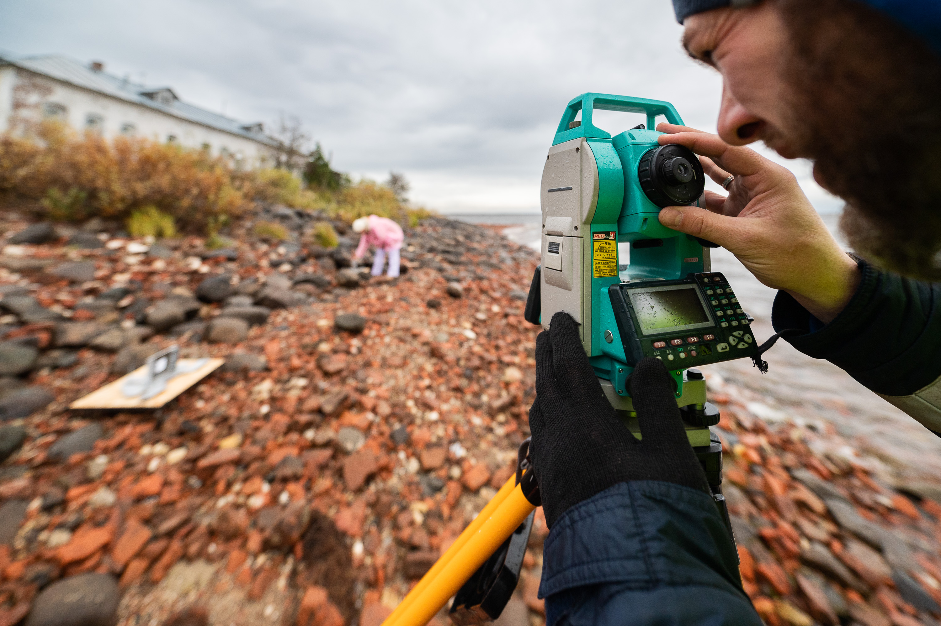
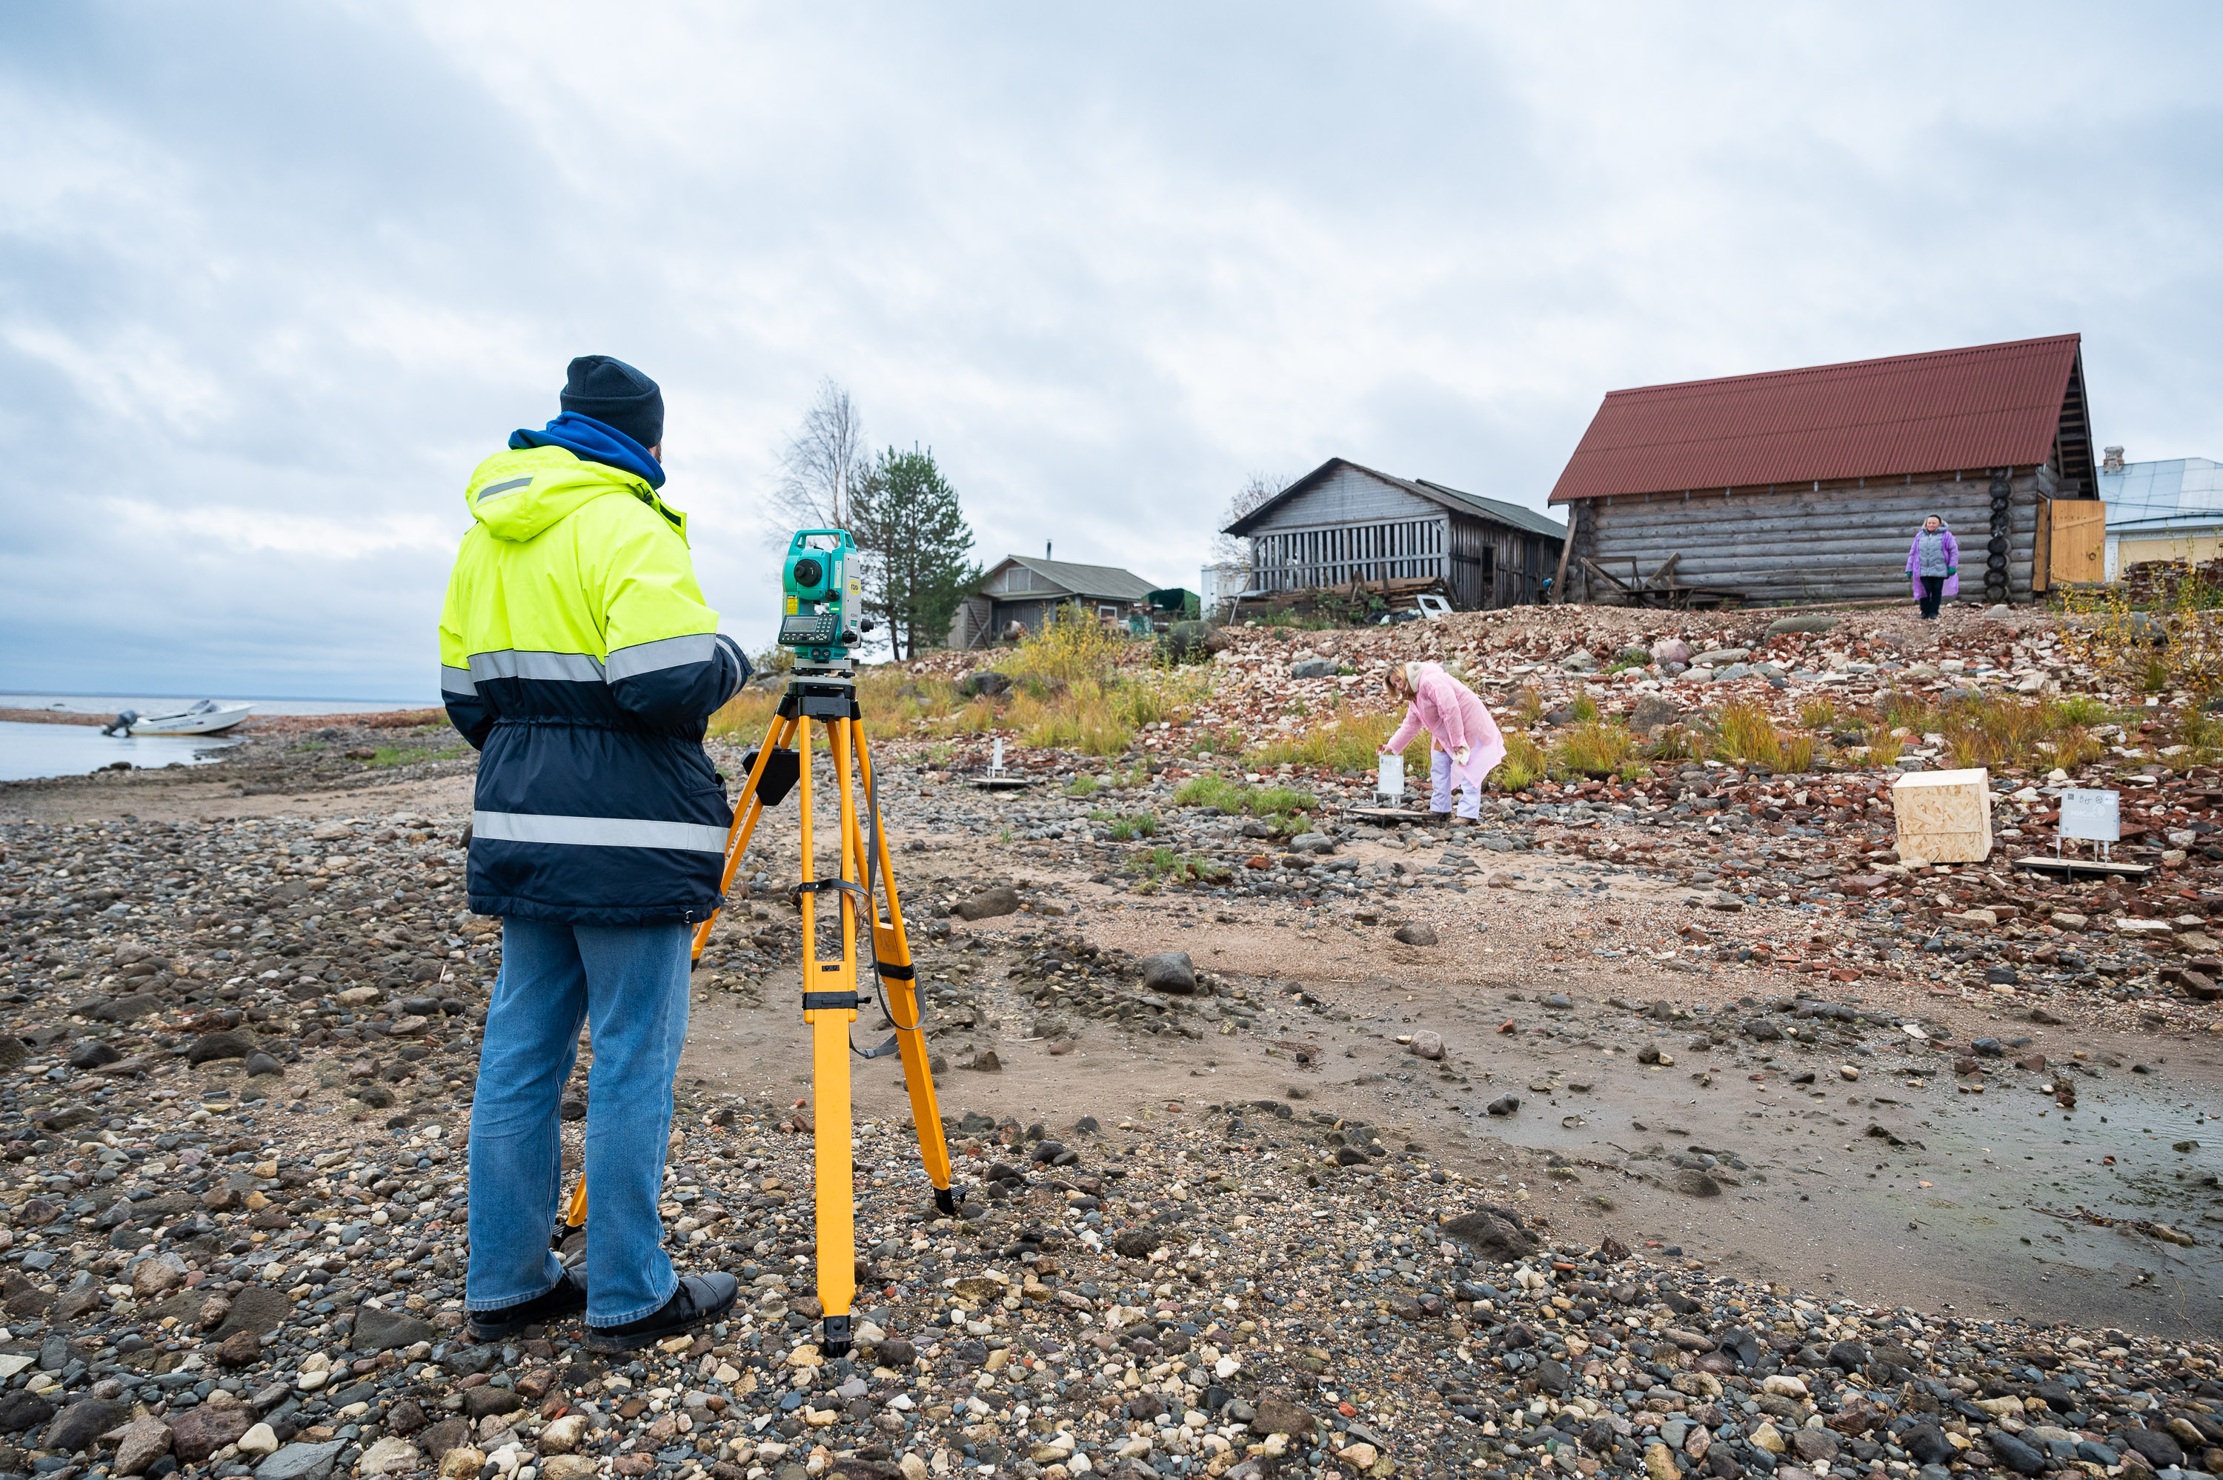
Geodetic survey
It is necessary to reference the spatial position of the detectors to a uniform coordinate system
8

Slide 9
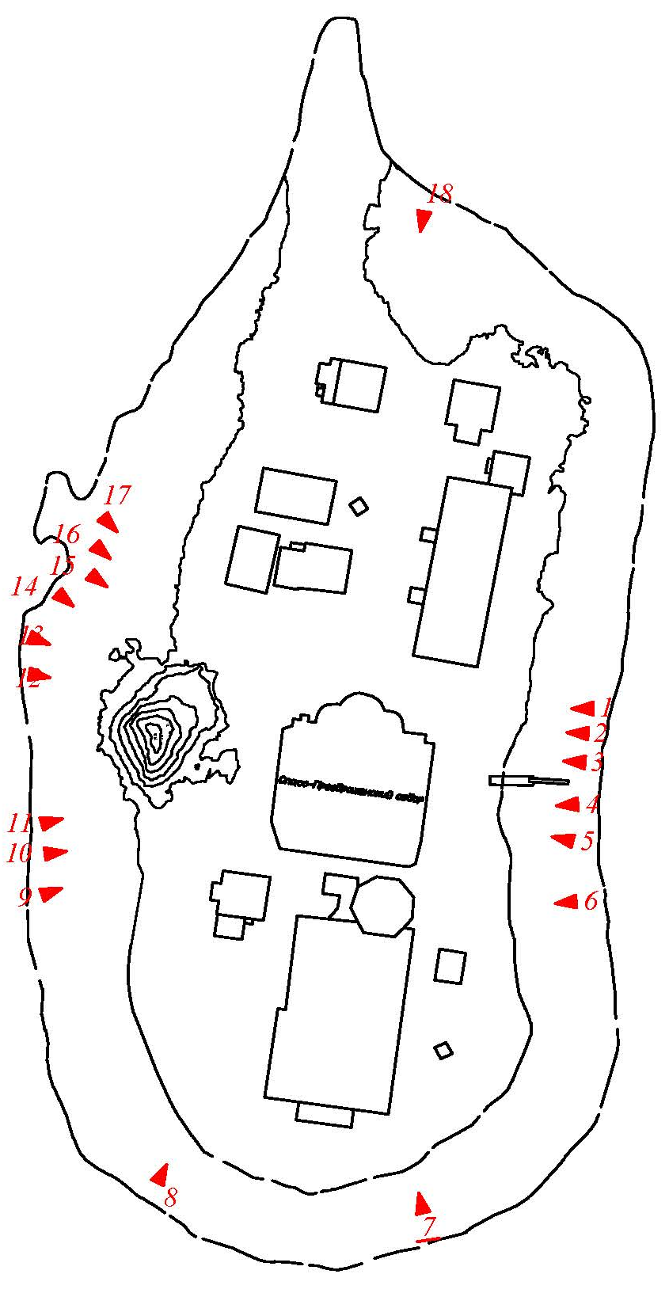
Geodetic survey
Horizontal positions between detectors
Detector coordinates
Distances between detectors
Detector position and direction
9

Slide 10
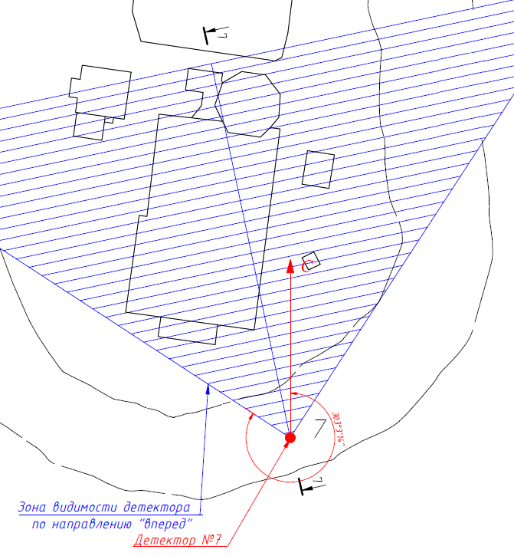
Geodetic survey for detector 7
Detector 7
Forward visibility area of the detector
Detector №7
Detector position and direction
10

Slide 11
Orthophotomap with terrain relief
The color scale designates the height difference on the ground
m
m
m
The detectors are located 3.5 m below the surface of the island in the vicinity of the ruined cathedral
11
Рисунок 5. Топоплан острова Каменный – а), схема р

Slide 12
Data processing and analysis
Side view of the plate assembly in the detector
Photoemulsion layers
VT
Plastic
MT1
MT2
BT
MT1
MT2
VT
Emulsion 1
Emulsion 2
Emulsion 6
From the obtained microtracks (MT), volume tracks (VT) are reconstructed in the detector
12

Slide 13
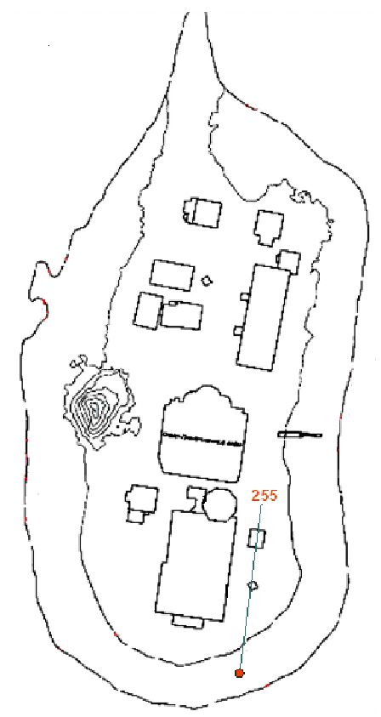
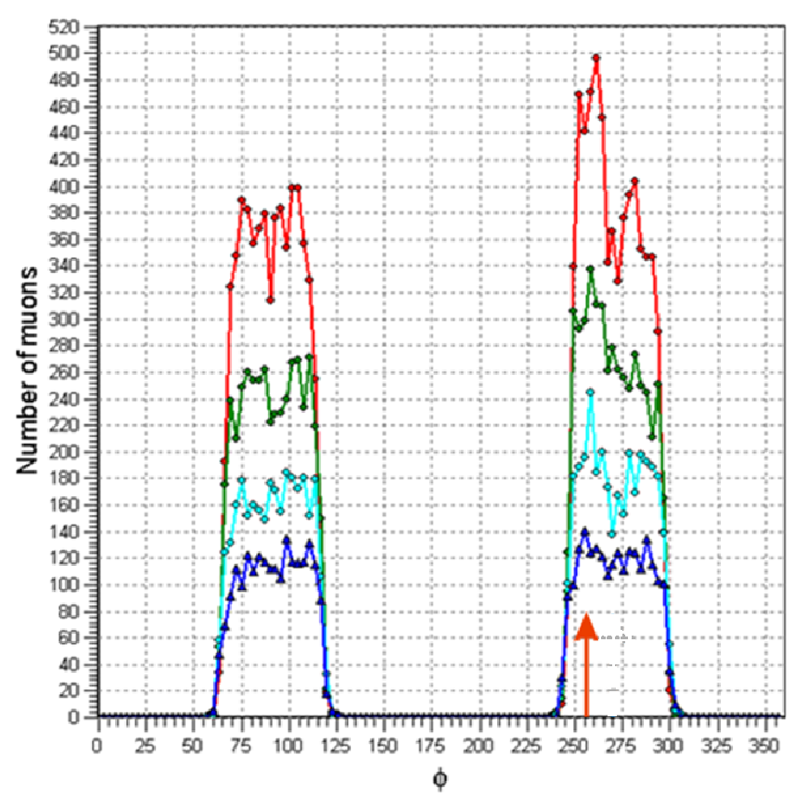
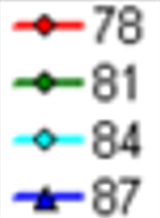
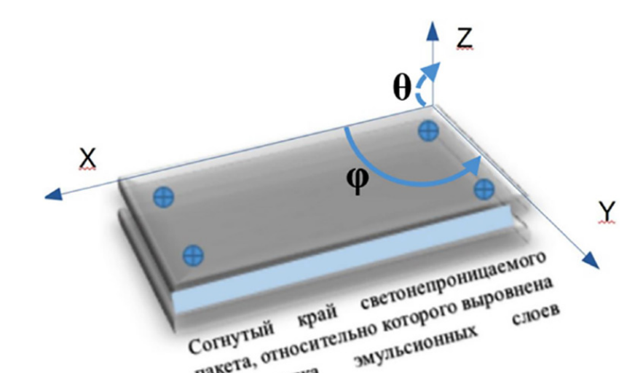
Data processing and analysis
Detector №7
Δφ = 3˚, Δθ = 3˚
$$θ$$
$$μ$$
φ~255˚
We count the number of muons in the direction (𝜃,𝜙) in solid angle element Δ𝜃Δ𝜙 (bin)
The maximum of muons corresponds to the rarefaction of the density along the (𝜃$\sim 84°$,𝜙$\sim 255°$) direction
The rarefaction is associated with the septic in the direction 𝜙$\sim 255°$
The rarefaction corresponds to a potential cavity
13

Slide 14
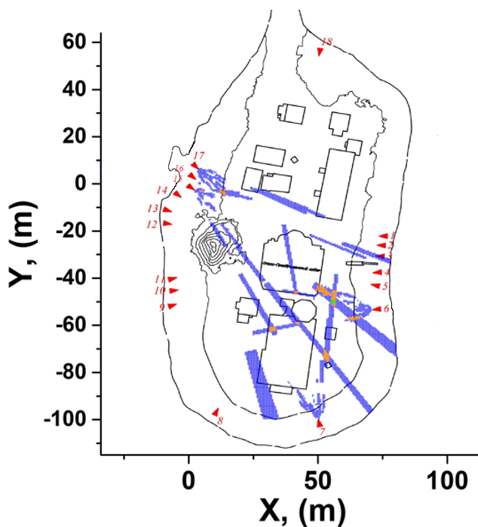
Data processing and analysis
Depth 0,5 – 1,0 m
Det6, Det7, Det15, Det17, 6 plates
We use maxima that are stable for more than two bins ($\{Δφ=1°, Δθ=1°\}$, $\left\{Δφ=1.5°, Δθ=1.5°\right\},\left\{Δφ=2°, Δθ=2°\right\},\{Δφ=2.5°, Δθ=2.5°\}$)
To determine the position of the cavities, we consider the intersection of maxima from several detectors
Notations:
Stable maximum from 1 detector
Stable maximum from 2 detectors
Stable maximum from 3 detectors
Stable maximum from 4 detectors
Stable maximum from 5 detectors
Depth is measured from the surface of the island in the area of the ruined cathedral (148.5 m above sea level).
14

Slide 15
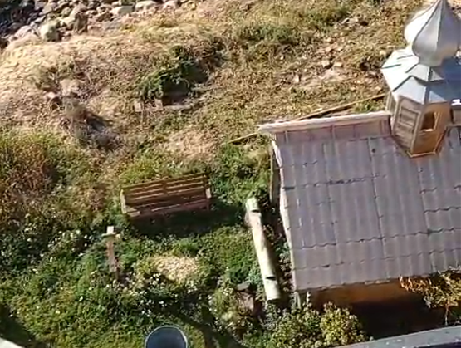
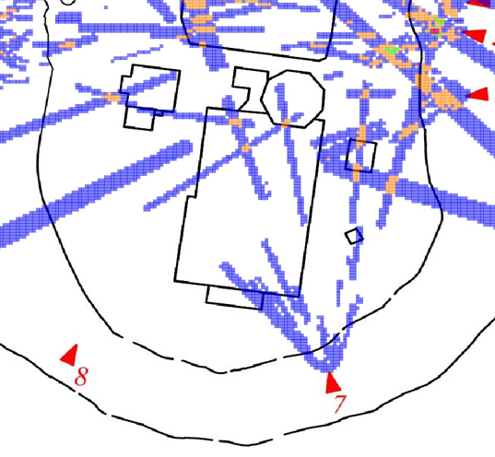
Verification
Depth 1,0 – 1,5 m
Registration of visible objects
The burial place of A. Piligin
Size of squares $0.5×0.5 m^{2}$
Stable maximum from Det6, Det7
15

Slide 16
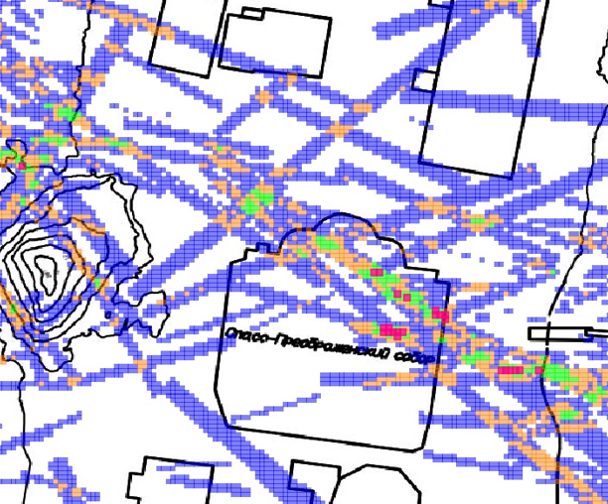
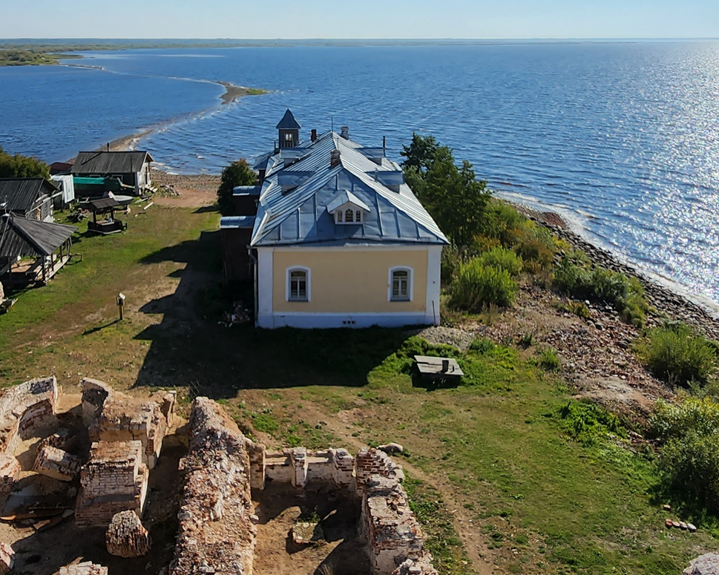
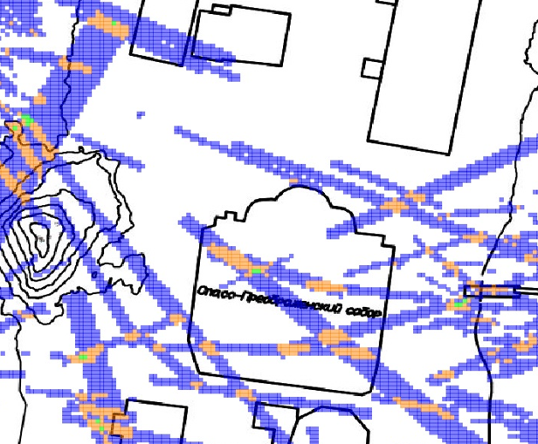
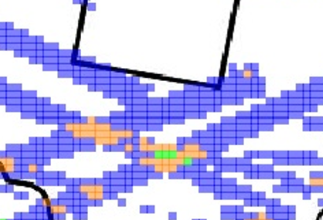
Verification
Depth 1,5 - 2,5 m
Septic
5.0m
Stable maximum from 2 detectors
Stable maximum from 3 detectors
16

Slide 17
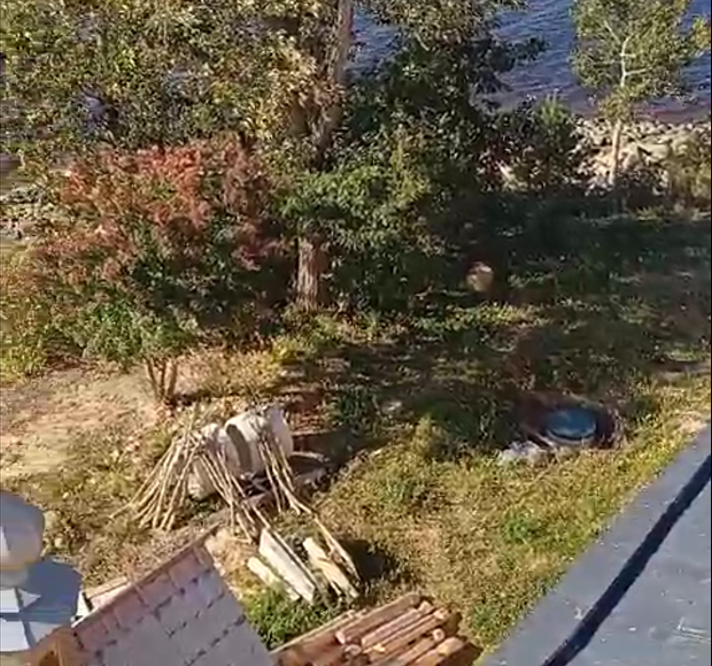
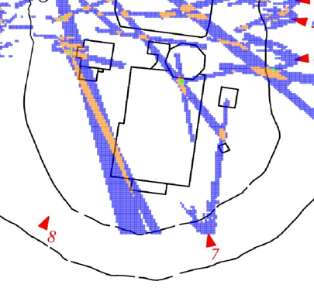
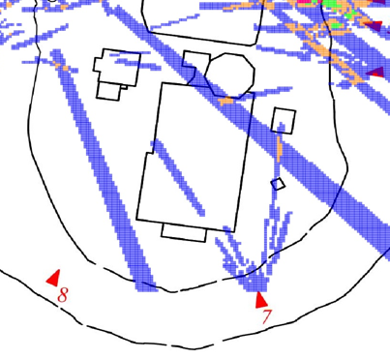
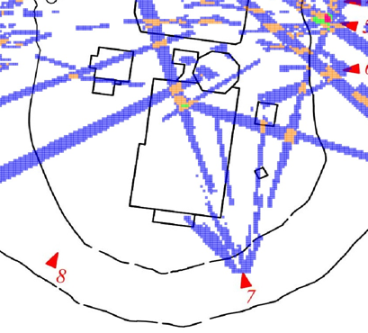
Verification
Depth 1,0 - 2,0 m
Det7, Det15
Det7, Det13
Det7, Det10
Septic
Stable maximum from 2 detectors
17

Slide 18
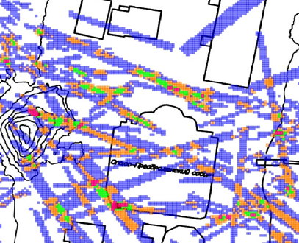
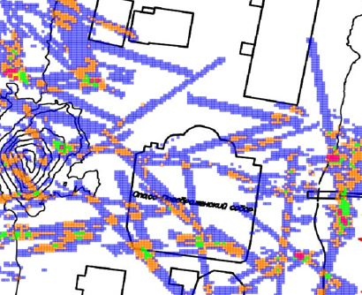
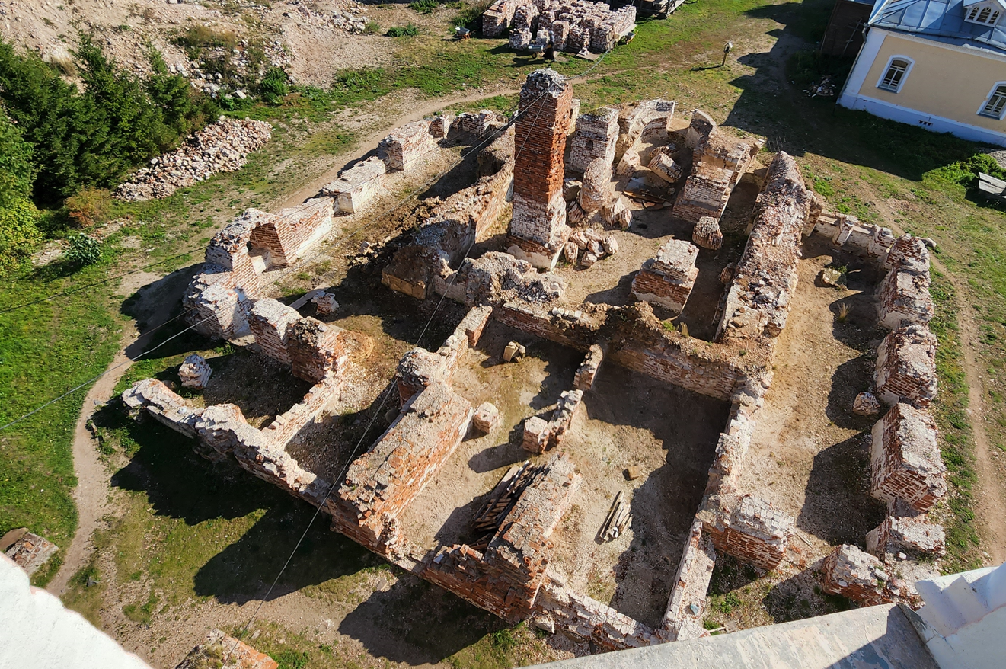
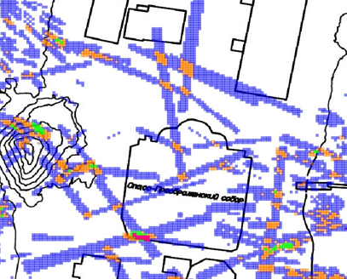
Findings
Depth 0,0 - 1,0 m
The size of the cavity is $\sim$0.5$×$1.0 m²
It is located at a distance of $\sim$1.5 m from the corner
1.5m
Stable maximum from 3 detectors
Stable maximum from 5 detectors
18

Slide 19
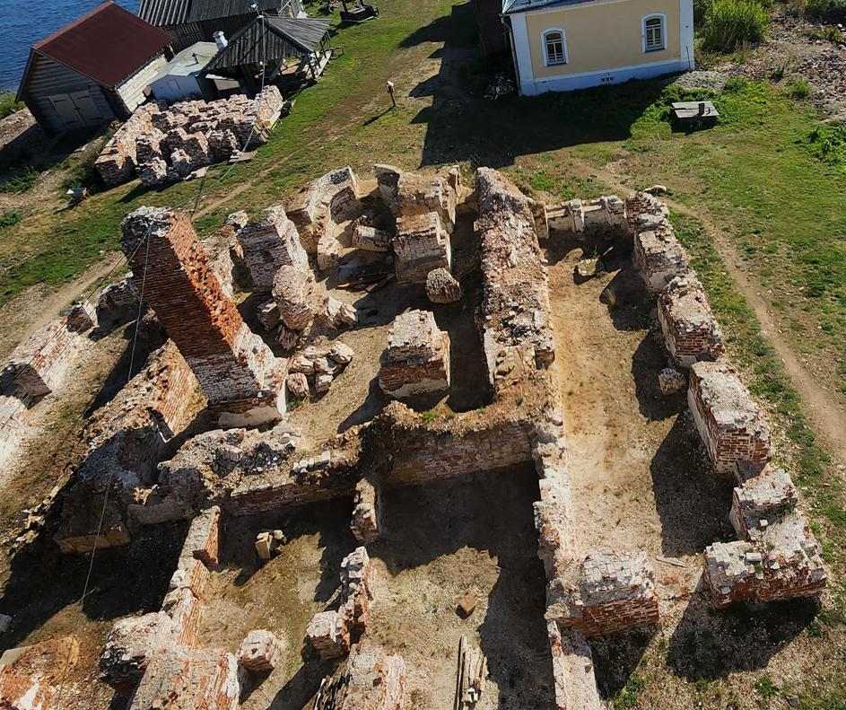
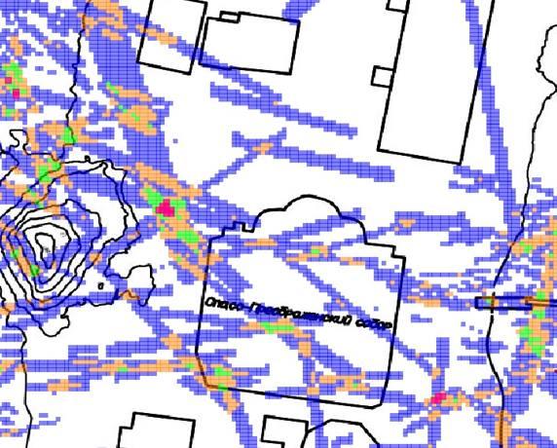
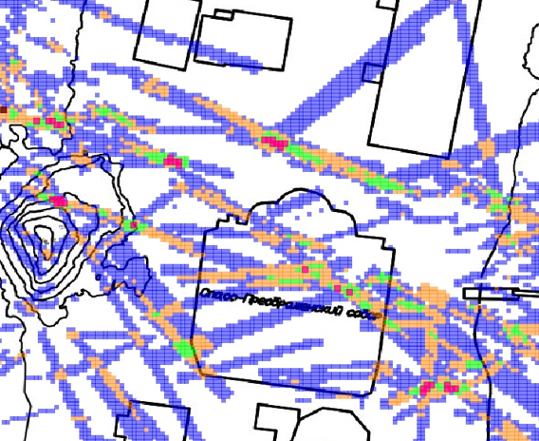
Findings
Depth 0,5 - 1,0 m
The size of the cavity is $\sim$0.5$×$1.0 m²
It is located in the center of the altar
Stable maximum from 3 detectors
19

Slide 20
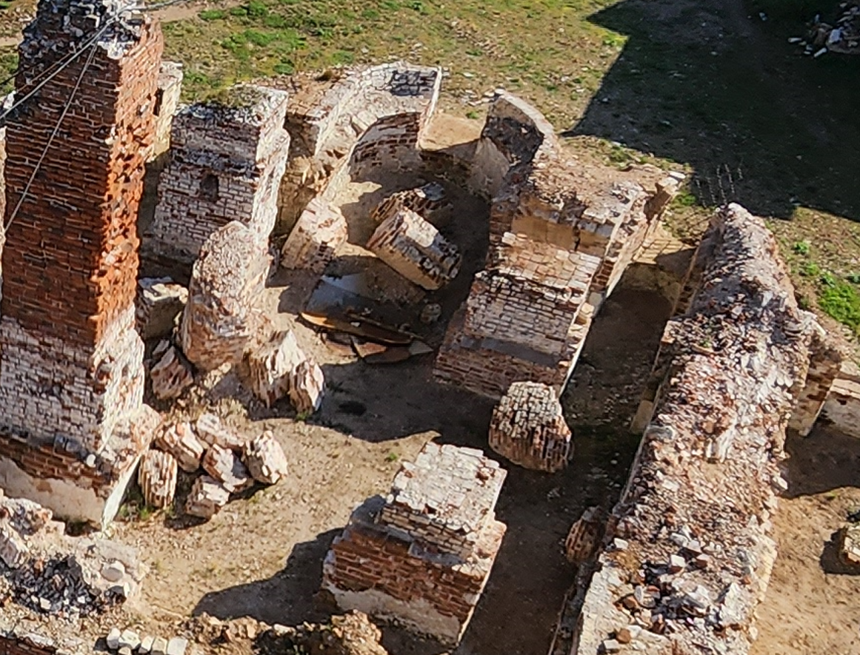
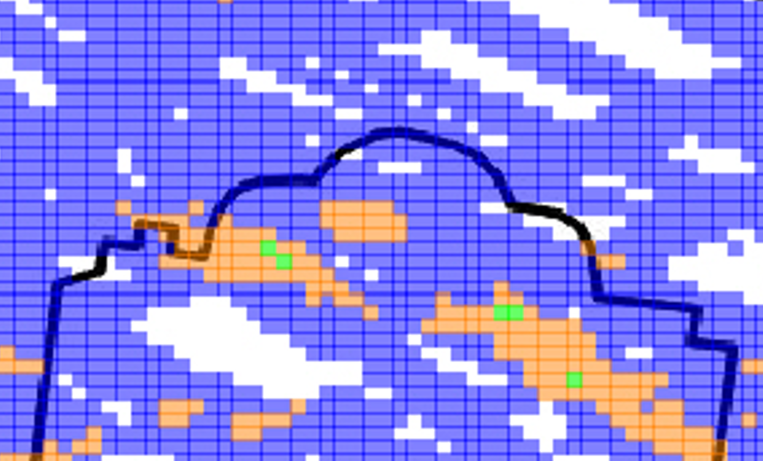
Findings
Depth 1,5 - 2,0 m
The cavities under the altar and in the area of the columns
The size of the cavity is $\sim 2$.0$×2$.0 m²
Stable maximum from 2 detectors
20

Slide 21
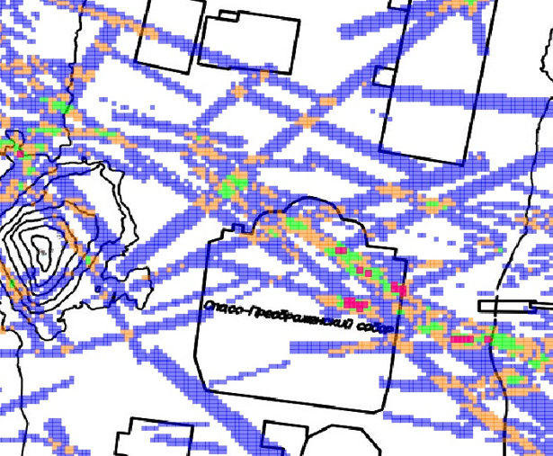
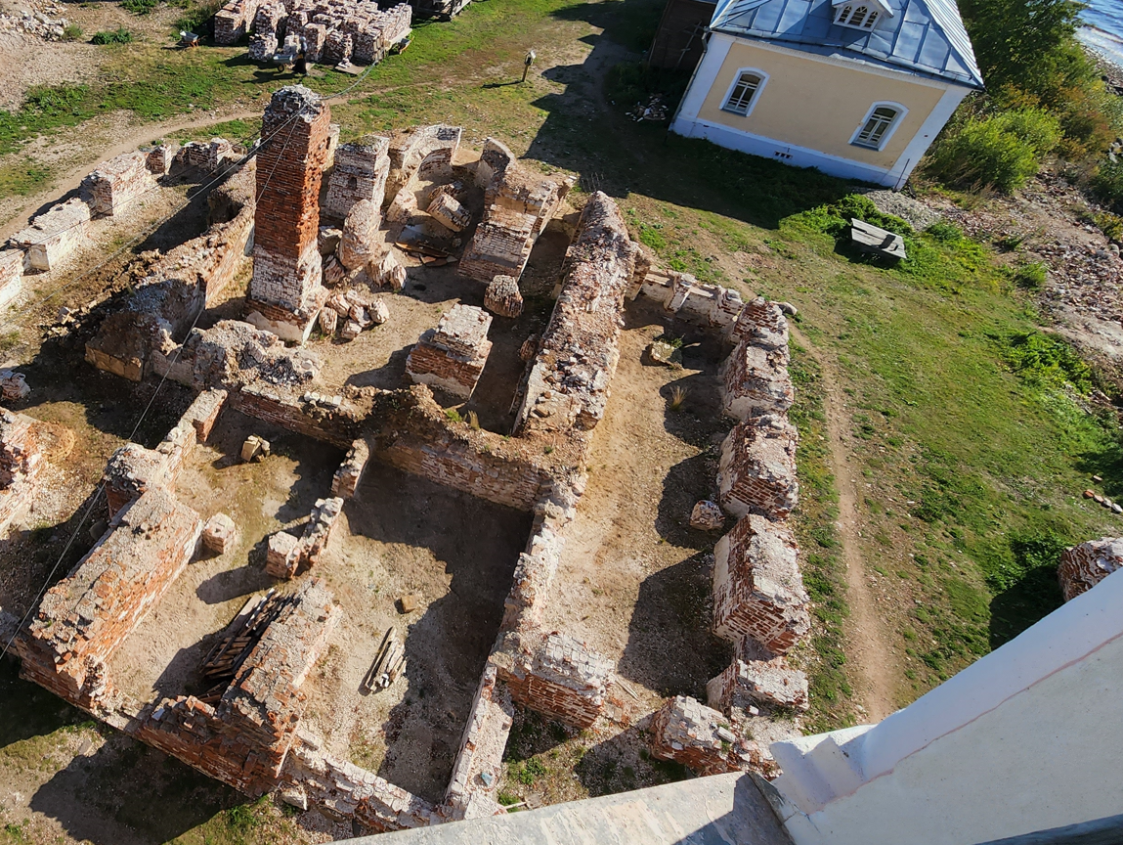
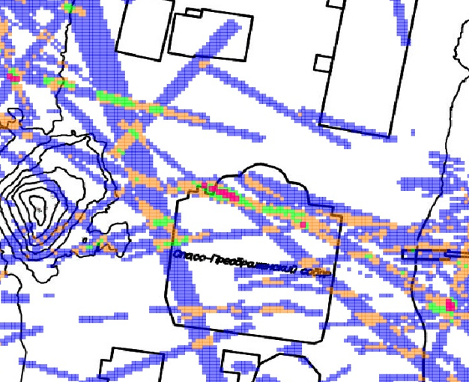
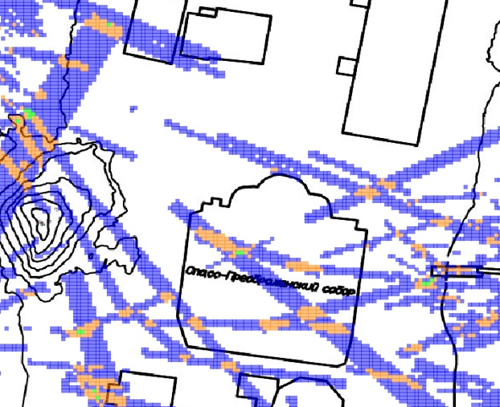
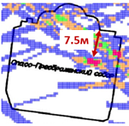
Findings
Depth 1,0 - 2,0 m
The size of the cavity is $\sim 1.0×2$.0 m²
It is brightly visible at a depth of 1.5-2.0 m
7.5 m
Stable maximum from 2 detectors
Stable maximum from 5 detectors
21

Slide 22
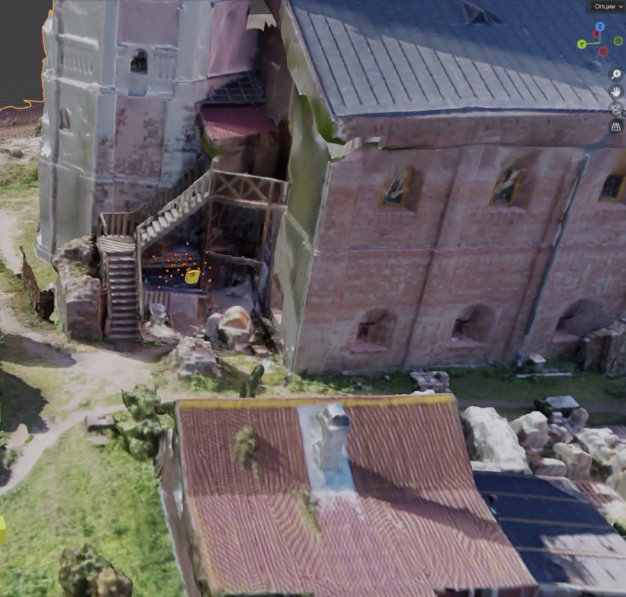
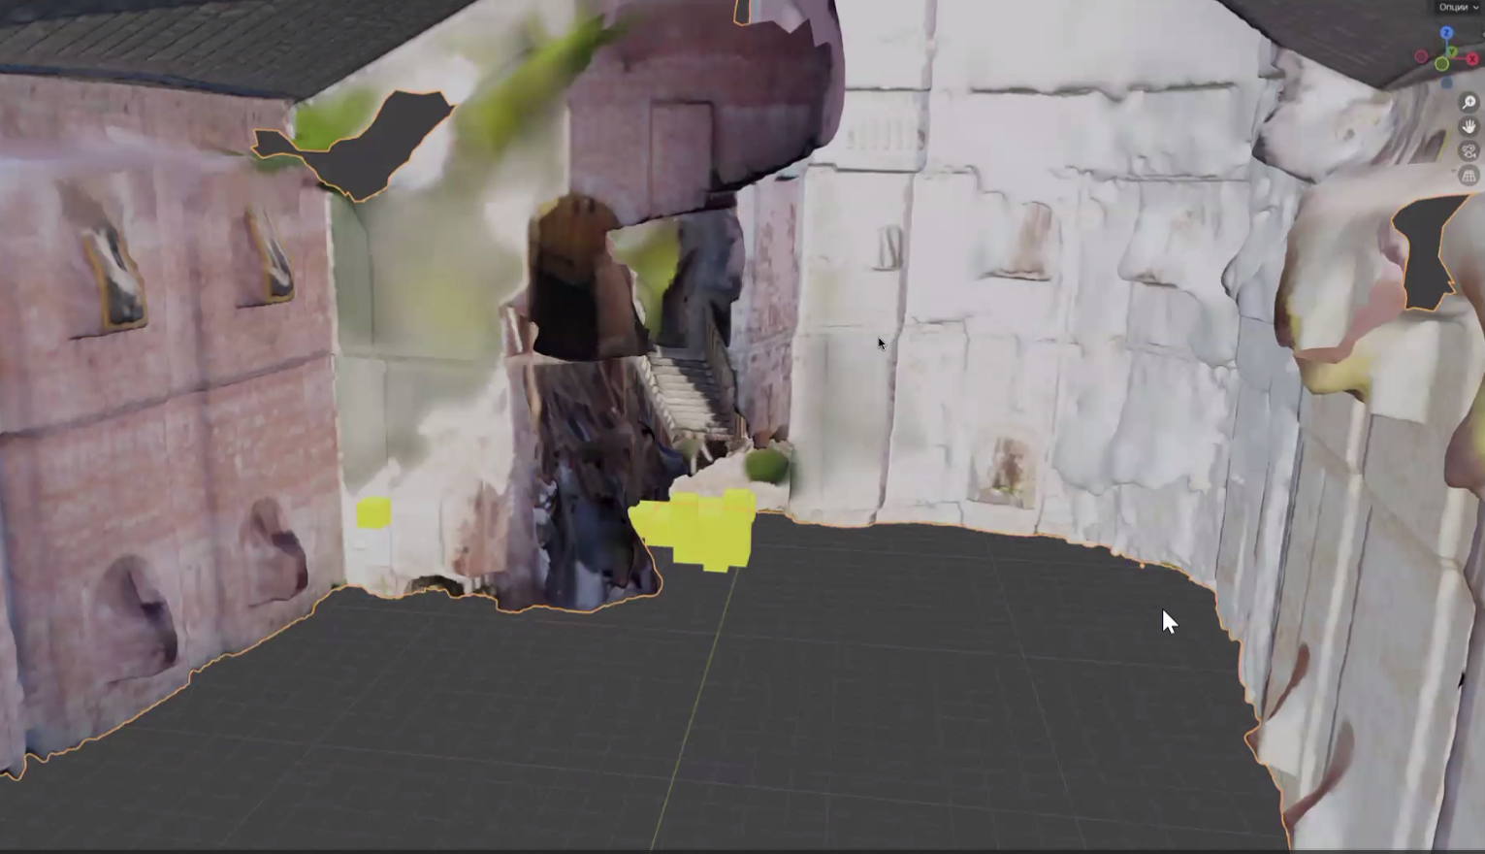
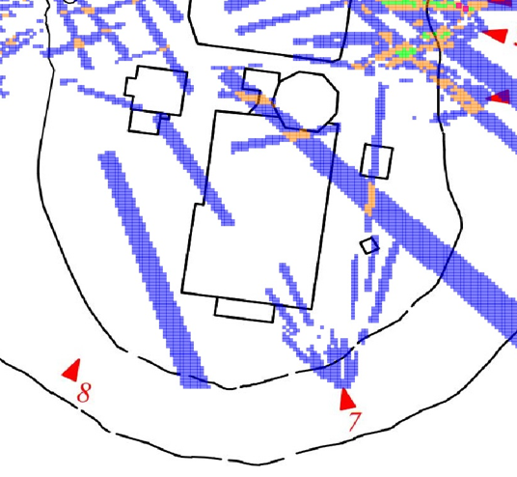
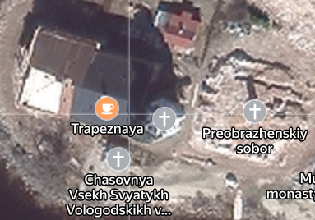
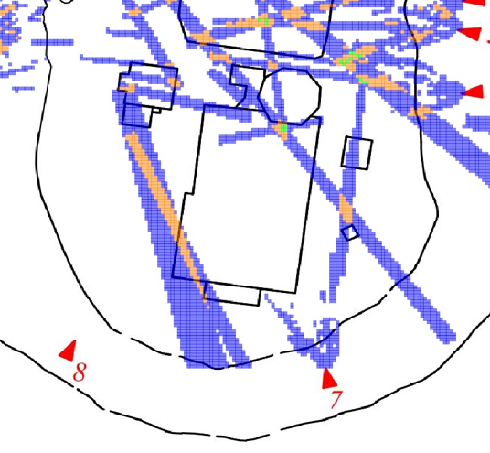
Findings
The cavity under the stairs
Depth 1,0 - 1,5 m
The size of the cavity is $\sim 1.0×1$.0 m²
Stable maximum from 2 detectors
The cavity between the bell tower and the brotherly building
Stable maximum from 3 detectors
22

Slide 23
Results
1. The stable registration of A. Piligin's grave, septic tank and well confirm the correctness of the methodology
2. Cavities have been discovered under the destroyed Preobrazhenskii Cathedral
3. Cavities were discovered between the bell tower and the brotherly building
23

Slide 24
THANK YOU FOR YOUR ATTENTION !

