Slide 1
Experimental study of CEvNS
A brief review of experiments and detection technique
Dmitry Akimov, NRNU MEPhI
Icppa2024 - The 7th international conference on particle physics and astrophysics,
22 - 25 October 2024, Moscow

Slide 2
CEνNS is Coherent Elastic Neutrino-Nucleus Scattering
It was predicted theoretically 50 years ago by:
D.Z. Freedman, Phys. Rev. D 9 (1974) 1389. USA
&
Kopeliovich V B, Frankfurt L L JETP Lett. 19 145 (1974); Pis'ma Zh. Eksp. Teor. Fiz. 19, 236 (1974). USSR
shortly after the discovery of a neutral current in neutrino interactions in the Gargamelle experiment at CERN. Phys. Lett. B 46, 138–140 (1973).
𝛎 + A => 𝛎 + A
Observed only in 2017 by the COHERENT collaboration: Science, Vol. 357,15 Sep. 2017, p. 1123
The intense study of CEνNSs started in 2017

Slide 3


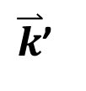
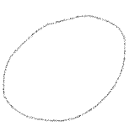

What is coherent scattering?
Explanation given by Freedman D Z, Schramm D N, Tubbs D L Ann. Rev. Nucl. Sci. 27 (1977) 167
Consider a system composed from A scatter centers
$\overset{⃑}{k}$’
$$ν′$$
- scatter amplitude on each center
$$\overset{⃑}{k}$$
R
$$ν$$
A
if qR ≳ 1, scattering amplitudes cancel each other
if qR << 1, are added together, and 𝜎 ~
where is scatter amplitude averaged over the system
For the heavy nuclei, the condition qR <<1 is satisfied for all scattering angles at E_{ν} ≲ several MeV

Slide 4


CEνNS cross-section
For the simplified case (even-even nuclei and T<< E_{𝛎}):
where T – nucl. recoil energy, F – nuclear FF
F=1 for qR << 1, but F < 1 for qR ≲ 1
T _{max}
T
– weak nucl. charge
sin²ϴ_{W} ~ 0.25
≈ N
~ N².
Z – number of protons
N – number of neutrons
total cm²
The ONLY signature of CEνNS is a nuclear recoil (NR) with energy of keV-scale for NPP reactor and 10s-keV-scale for πDAR
WIMP particle
Neutrino
Detection technique of CEνNS is similar to that for WIMPs!
$$χ$$
scattered
neutralino
Both processes produce nuclear recoils (NR)
Both processes are rare ones!
$$χ$$
10-s keV
Reactor: keV πDAR: 10-s keV

Slide 5
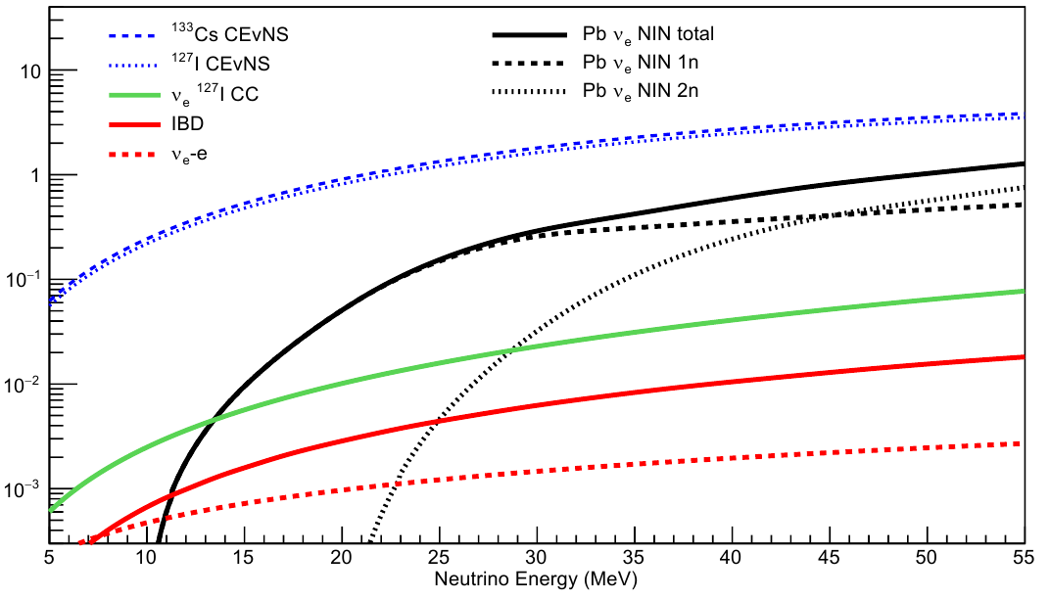
CEνNS cross-section
Dependence of the cross-section from 𝛎 energy
Dependence of the cross-section from neutron number
Cross-section 10⁻³⁸ cm²
Line: F(Q)=1
Green: Klein-Nystrand FF
For heavy nuclei
(Cs, I, Xe):
<σ> ~ 10⁻⁴⁰ cm² (averaged for the reactor antineutrinos: 0 – ~10 MeV)
<σ> ~ 10⁻³⁸ cm² (averaged for the “Pion-decay-at-rest” neutrinos: 0 – ~50 MeV)

Slide 6
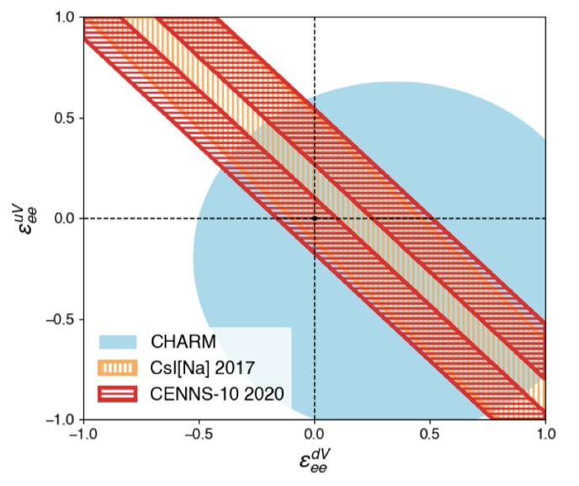
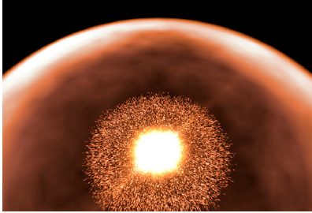
Motivation of CEνNS experiments
Physics, Standard Model
“Non-standard” physics; beyond SM:
ν magnetic moment
ν-quark interaction
Ge, μ_{B}=10⁻¹⁰
Knowledge on the precise CEνNS cross-section is very important in astrophysics.
Because it significantly affects the supernova dynamics:
99% of energy of SN goes to ν!

Slide 7
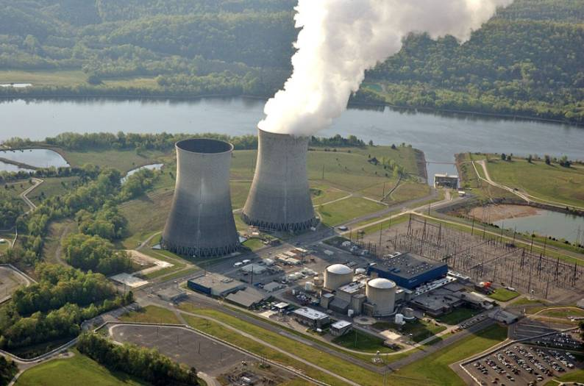
Motivation of CEνNS experiments
A new tool for monitoring of nuclear reactors

Slide 8
Motivation of CEνNS experiments
Knowledge on the precise CEνNS cross-section is very important for DM experiments:
CEvNS is an irreducible background floor for them
from arXiv:1207.4952v1 [astro-ph.IM]
(from arXiv:1707.06277 [hep-ph])
PandaX-4T:
arXiv:2407.10892 [hep-ex]
XENONnT:
arXiv:2408.02877 [nucl-ex]
Talk by R. Calabrese, parallel section today

Slide 9

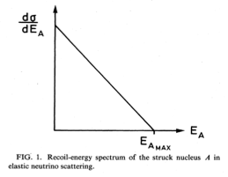
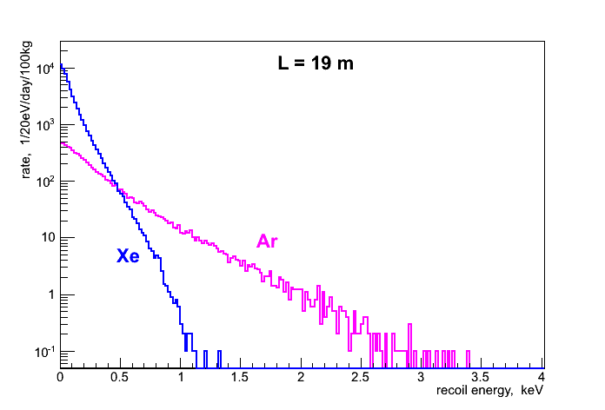
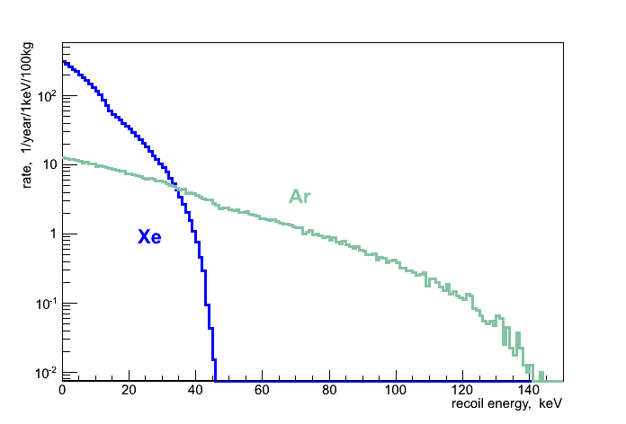
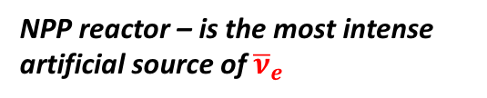
ν sources for CEνNS detection
πDAR - pion Decay At Rest - ν_{μ},ν_{μ},ν_{e}
NPP reactor – is the most intense artificial source of ${\overline{ν}}_{e}$
Proton accelerator, spallation n-source
Capture
~ 99%
Fragments
π ⁻
ν_{e}
ν_{e}
~ 6·10²⁰ с⁻¹ for 3 GW
τ ≈ 2200 ns
A
μ⁺
e⁺
~ 1 GeV
π⁺
F_{ν} @20 m
~ 1.2·10¹³ cm⁻²s⁻¹
τ ≈ 26 ns
ν_{μ}
p
ν_{μ}
Fragments
F_{ν} is by 10⁶ lower, but σ is by 10² higher
ν energy spectra
a.u
Nucl. recoil energy spectra
(Xe and Ar)
L = 40 m

Slide 10
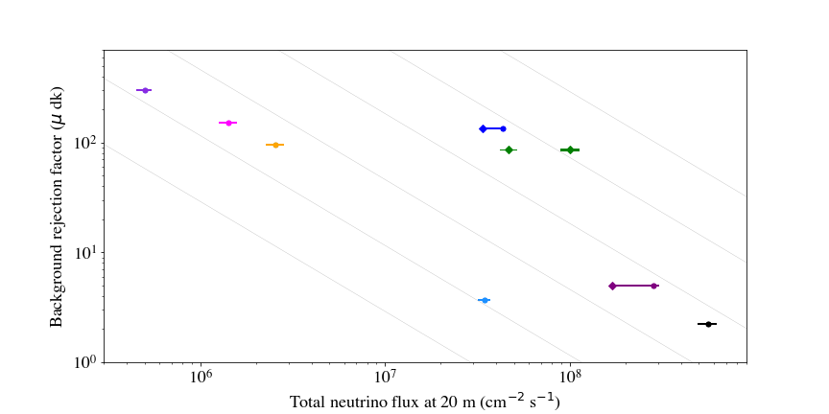
Accelerator - π Decay At Rest source
Pulsed beam of an accelerator is an essential factor of background reduction (by 1/Duty factor)!
Duty factor = T_{obs}/T ~ 10⁻¹ ÷ 10⁻⁵
(since measurements are synchronized with beam)
ν_{μ}
T, milliseconds
beam
~
ν_{μ},,ν_{e} τ=2.2μs
T_{b}
T_{obs}
better
Lujan | US (LANL)
ISIS | UK (RAL)
BNB | US (FNAL)
SNS | US (ORNL)
MLF | Japan (J-PARC)
LANSCE Area A | US (LANL)
ESS | Sweden (planned)
DAEδALUS | US (planned)
BNB
MLF
Lujan
~iso S/sqrt(B)
ISIS
SNS
SNS future
ESS
LANSCE Area A
DAEδALUS
By Kate Scholberg

Slide 11
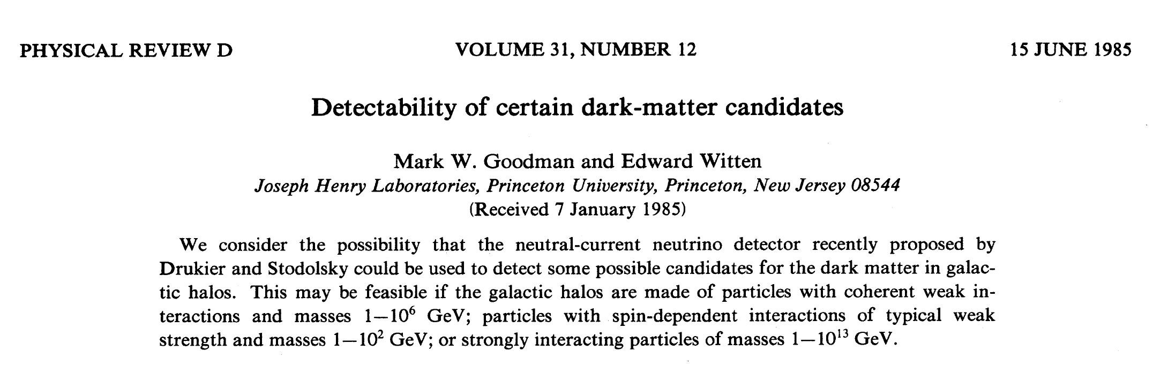
How to detect CEνNS? History
The 1-st proposal of experiment on CEνNS detection:
Idea:
Micron size metastable superconductive granules in a colloidal system placed in magnetic field
The temperature is tuned so that some granules loose conductivity when the very small energy deposition happens in the detector
This results to the measurable change of the magnetic field
In 1984
The idea has never been realized, but stimulated DM detectors development
In 1985
“The very large value of the neutral-current cross section due to coherence indicates a detector would be relatively light …”
“The recoil energy which must be detected is very small (10 – 10³ eV), however.”
“Various applications and tests are discussed, including spallation sources, reactors, supernova and terrestrial neutrinos.”
“We consider that the neutral-current detector recently proposed by Drukier and Stodolsky could be used to detect some possible candidates for the dark matter in galactic halos”.

Slide 12

List of experiments on CEνNS detection
Experiment | Mass, kg | Technology | Location | ν source
CoGeNT | 0.5 | HPGe PPC | USA, San Onofre | Reactor
TEXONO | 1.0 | HPGe PPC | Taiwan, Kuo-Sheng | Reactor
RECODE | 1-2, 10 | HPGe PPC | China, Sanmen NPP | Reactor
Dresden-II | 3.0 | HPGe PPC | USA, Dresden NPP | Reactor
CONUS CONUS+ | 4.0 | HPGe PPC | Germany, Brokdorf Switzerland, Leibstadt NPP | Reactor
νGEN | 1.4 | HPGe PPC | Russia, Kalinin NPP | Reactor
CONNIE | 0.04 | Si CCDs | Brazil, Angra dos Reis | Reactor
MINER | 10 | Ge/Si bolometers | USA, TRIGA | Reactor
ν-cleus | 0.01 | CaWO₄, Al₂O₃ bolometers | France, Chooz NPP | Reactor
Ricochet | 1/0.3 | Ge, Zn bolometers | France, ILL-H7 | Reactor
NEON | 13.3 | Scintillator NaI | South Korea, Hanbit | Reactor
RED-100 | 100 | LXe/LAr two-phase | Russia, Kalinin NPP | Reactor
RELICS | 50 | LXe two-phase | China, Sanmen NPP | Reactor
COHERENT |  | CsI, Ar, Ge, NaI | USA, SNS | πDAR
CCM | 10000 | LAr | USA, Lujan | πDAR
Most of them are reactor based

Slide 13
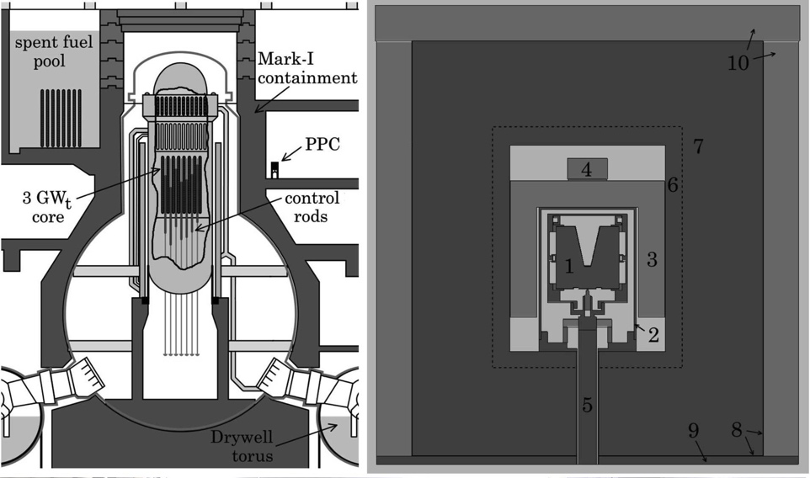
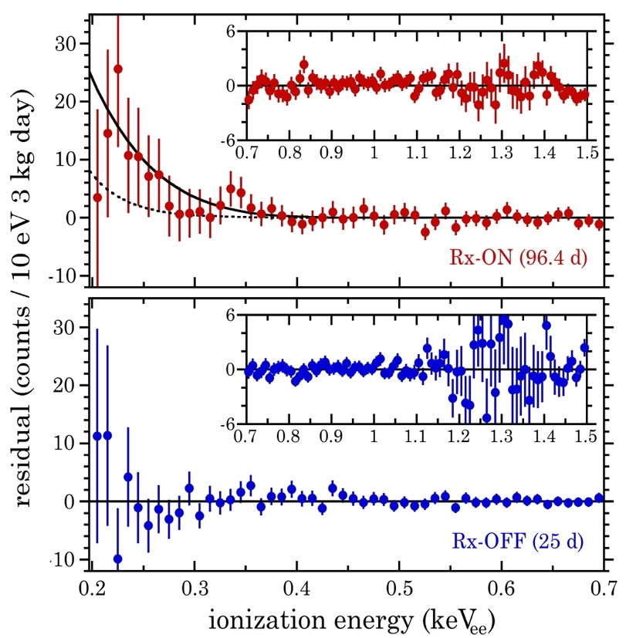
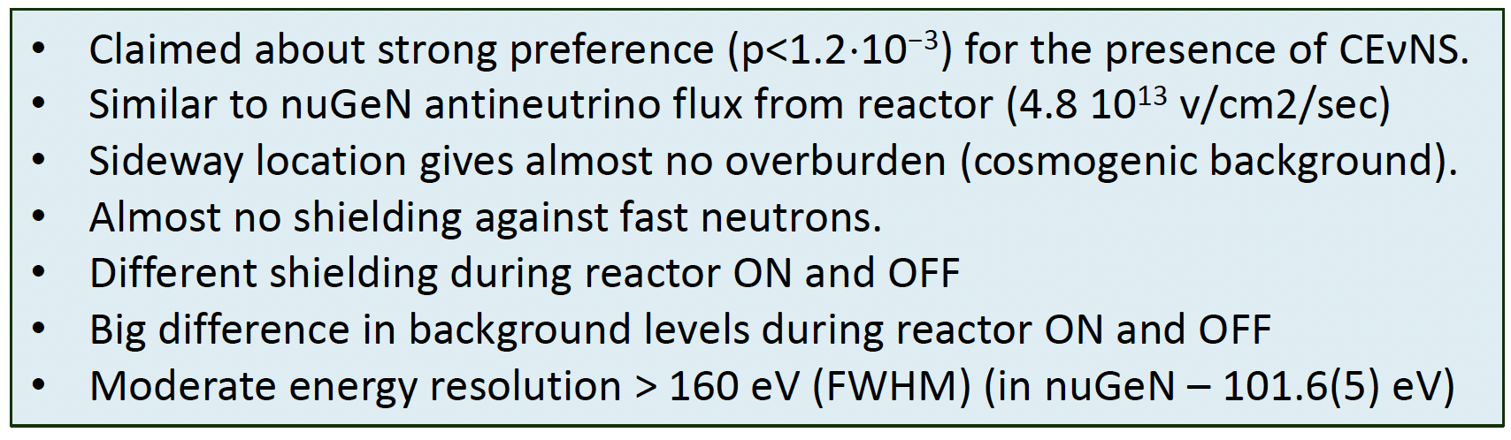

Dresden-II (NCC-1701) @Dresden NPP USA
Very close to the reactor core:
10.39 m center-to-center
Claims observation of CEvNS
(consistent with SM prediction)!
arXiv:2202.09672
Phys. Rev. Lett. 129 (2022), 211802
Very high ${\overline{ν}}_{e}$ flux: 4.8×10¹³ ${\overline{ν}}_{e}$/cm²s
But, practically no overburden
p-PC Ge 2.9 kg, 200 eVee threshold
However, there is a criticism from the CEvNS community:
see Enectali Figueroa-Feliciano talk @M7, 22.03.2023:
Residual betw. the data and bckg model
and measured QF is by >2 higher! arXiv:2102.10089 and see below
However, this result is in tension with the results of two similar experiments CONUS and ν GEN

Slide 14
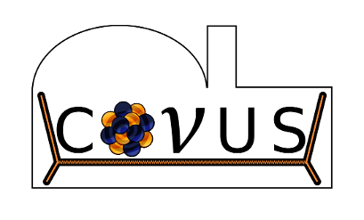
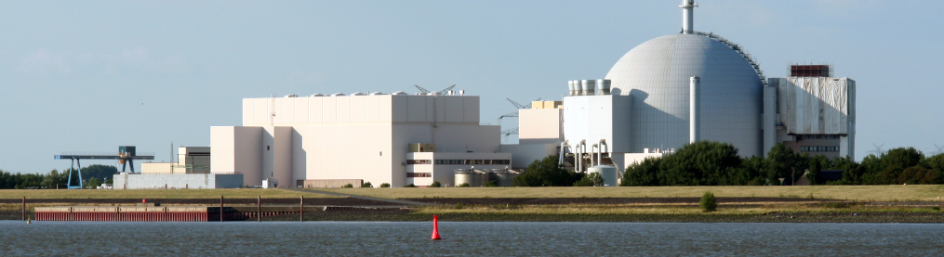
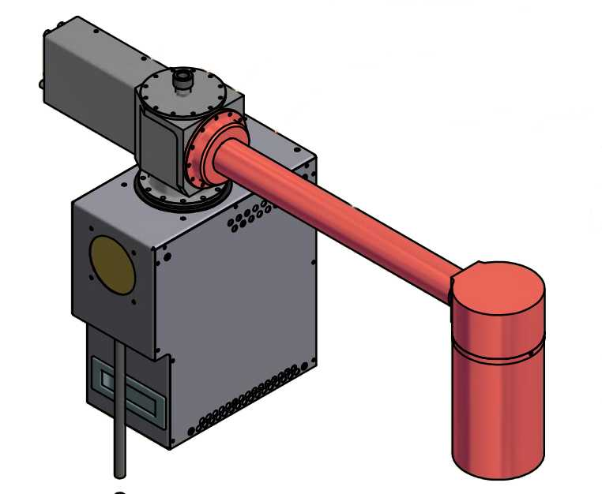
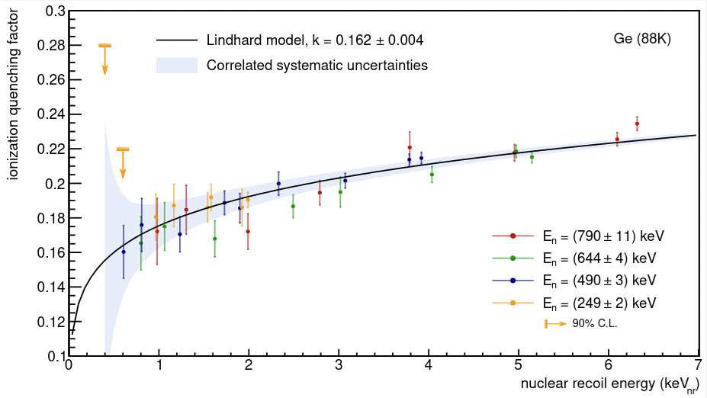
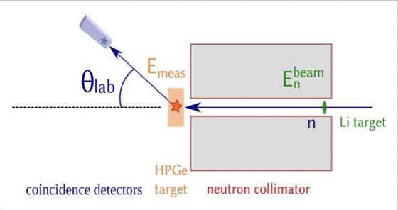
CONUS
Max-Planck-Institut für Kernphysik
NPP Brokdorf , Germany
3.9 GW reactor
5 years of successful operation
4 x 1 kg Ge detectors @17 m
Φ=2.3 x 10¹³ ν/cm²/s
Energy threshold ~200 eV_{ee}
Ultra-low bckg in ROI ~ 10 cpd/kg
x 4
Borated Polyethylene
25 cm radiopure lead
Active μ-veto
From W. Maneschg talk @M7, 22.03.2023
In ROI k=0.162+-0.004 (stat.+syst.)
Careful QF (k) measurements
Janina Hakenmüller talk @M7, 12.06.24; arXiv:2401.07684
Factor of 2 > SM, 90% CF
Next phase - CONUS+ @ Leibstadt NPP in Switzerland
Taking data @ new place now

Slide 15
Comparison of Dresden-II and CONUS QF measurements
Dresden-II
Comparison by vGen
Phys. Rev. D 103, 122003 (2021)
⁷²Ge(n;γ)⁷³Ge => NR from γ emission
n – monoline 24keV from iron filter
TUNL
https://hdl.handle.net/10161/25153
CONUS
Eur. Phys. J. C (2022) 82:815
All these data – by selection of scatter angle of n

Slide 16
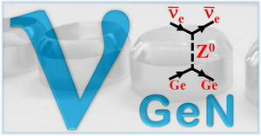
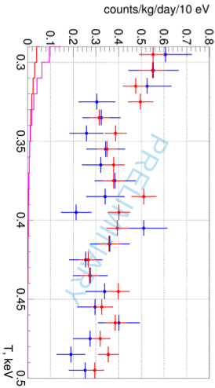
ν GEN
@ Kalinin NPP, Russia
ν flux:
(3.6-4.4) 10¹³ ν/cm²/s
10 ÷ 12 m
~50 m.w.e.
p-PC Ge
1.4 kg
10 ÷ 12 м
Phys.Rev.D 106 (2022) 5, L051101
data: red - ON
blue - OFF
from A.Konovalov talk @M7 12.06.2024
CEvNS prediction with CONUS QF
CEvNS prediction with Dresden OF
ROI: 0.29-0.4 keV
More details in A. Konovalov talk, this section

Slide 17
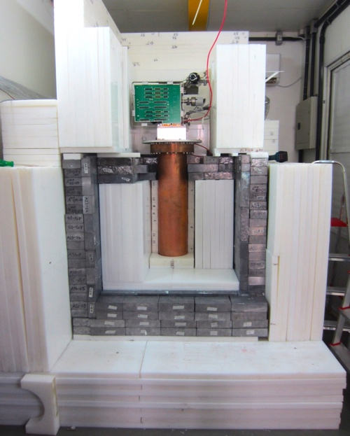
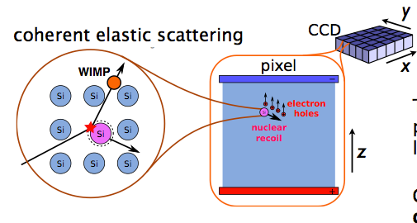
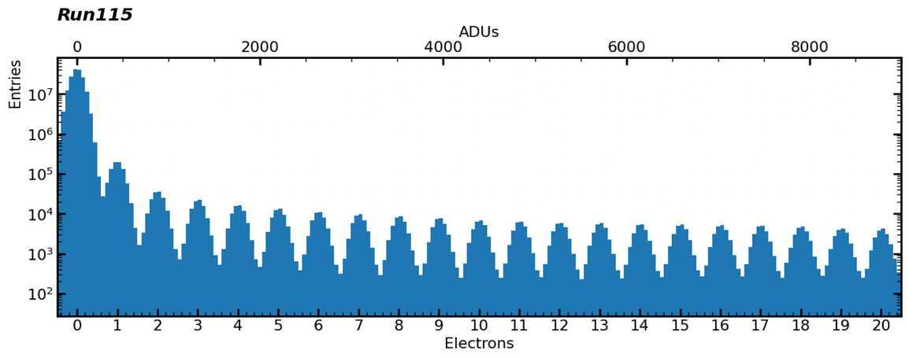
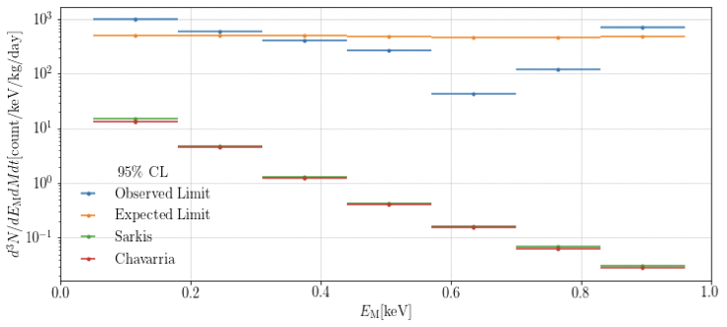
CONNIE (Coherent Neutrino Nucleus Interaction Experiment)
Si CCDs
Angra dos Reis NPP, Brazil
~ 50g
Rejection of ER interactions
and acception of only point-like NR events
Threshold ~ 50eV
Now testing the new technology – Skipper CCD
Allows to improve s/n ratio by multiple measurement (>1000 times!) of each cell charge
=> allows SE counting arXiv:2208.05434
arXiv:1608.01565, 2110.13620
Threshold => ~ 20 eV
2019 run
Limit ~70xSM
Now, only 0.5 g! Plans to install:

Slide 18
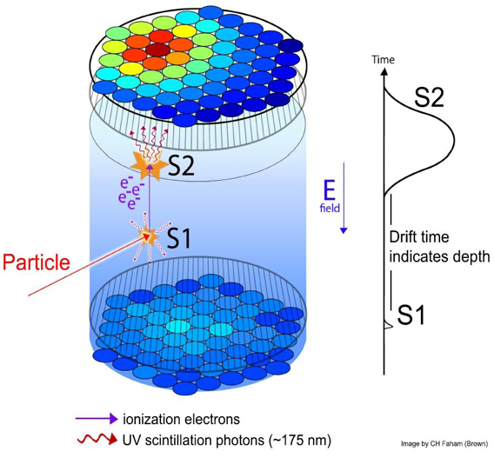
Two-phase detectors
Emission two-phase detector
The produced charge is extracted from the liquid to the gas phase
Two-phase method was proposed by Russian scientists in MEPhI in 1970s!
Later, successfully used in DM search
A two-phase method combines the advantages of gas detectors: the possibility of proportional or EL amplification, 3D positioning, SE counting, with the possibility to have the large mass (in the liquid phase)!
The progress in setting limits on SI WIMP-proton cross-section RAPIDLY increased with the use of two-phase detectors
Photodetectors
(photomultipliers)
The 1-st proposal for CEvNS detection was by C.Hagmann & A.Bernstein (LAr):
Picture by LUX Collaboration
IEEE Transactions on Nucl. Science V.51 (2004), no.5, p2151

Slide 19
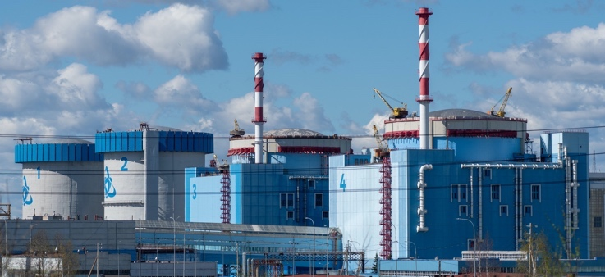
RED-100
@ Kalinin NPP, Russia
19 m from the core, ~50 mwe
ν flux: 1.35 10¹³ ν/cm²/s
26 PMTs Hamamatsu R11410-20 (19 in top PMT array, 7 in bottom PMT array)
Data taking run with LXe target:
mid Jan 2022–beg Mar 2022
2022 JINST 17 T11011 – technical description
Contains ∼200 kg of LXe or ~90 kg of LAr (∼ 100 and ~50 kg in FV)
342 kg∙days ON
115 kg∙days OFF
Energy threshold was set at 4 SE – corresponds to E_{NR} ~ 1 keV or E_{ν}~ 8 MeV!
because of the very high rate (~30 kHz) of SE events – tails from muons
Current status: lab tests with LAr target - 3x larger signal, but ³⁹Ar bckg
More details in O. Rasuvaeva talk, this section

Slide 20
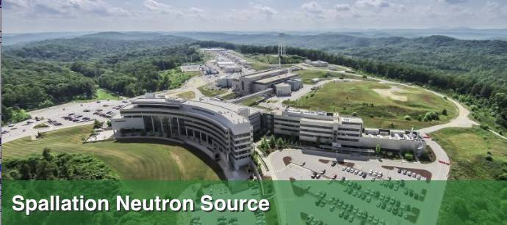
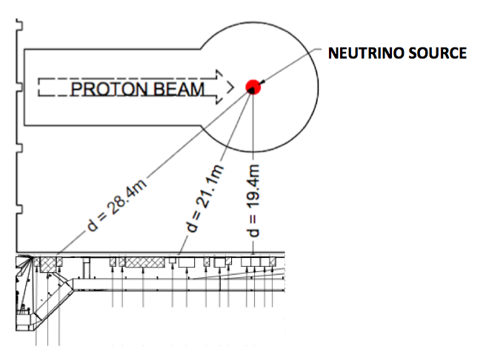
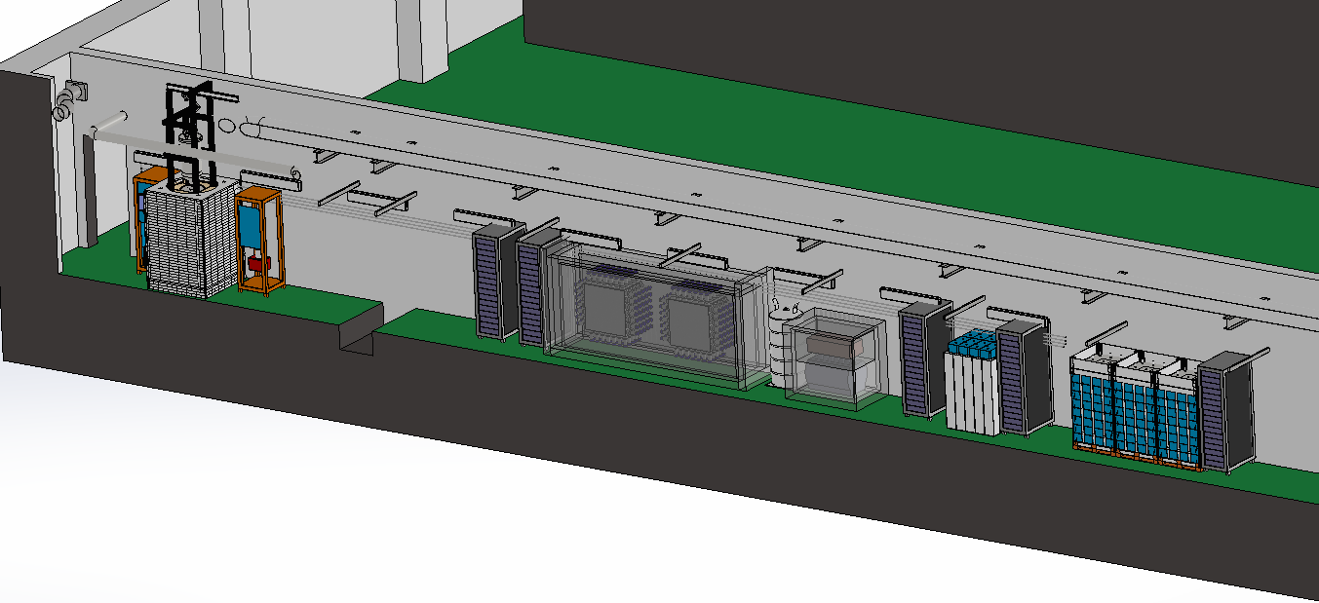
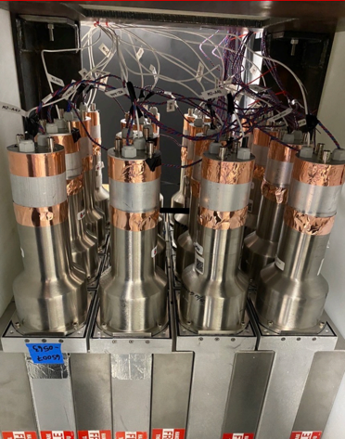
SNS, Oak Ridge, USA
COHERENT – multidetector experiment with different targets
Proton beam energy: 0.9-1.3 GeV
Total power: 0.9-1.4 MW
Pulse duration: 380 ns FWHM
Repetition rate: 60 Hz
Liquid mercury target
Averaged for “Pion-decay-at-rest” source energies
- πDAR
LAr
NaI
Ge
NIN cubes
CsI
Line: F(Q)=1
Green: Klein-Nystrand FF
Detectors in ”Neutrino alley”, basement, 8 mwe
COHERENT measured CEvNS cross-sections for Ar, Ge, Cs&I.
First observation in 2017
with CsI detector
CEvNS on CsI, full statistics
PRL 129 (2022) 081801
CEvNS on Ar
PRL 126 (2021) 012002
CEvNS on Ge 2024
arXiv:2406.13806v1 [hep-ex]
Coming soon:
Coming soon:
Planning:
Cryo-CsI (undoped with SiPM readout)
PE yield – up to 50 PE/keV
More details in A. Kumpan talk, this section
NaI detector
2425 kg of NaI crystals
CENNS-750 (750-kg LAr) is under construction
600 kg FV

Slide 21
CONCLUSION
CEvNS is a channel of the low-energy neutrino interaction with matter with the highest probability (by ~ 10² – 10³ higher than for other processes)
More than 40 y passed from the prediction of CEvNS to its experimental confirmation
Many experiments aimed on CEvNS observation and study are ongoing
For the moment, CEvNS is reliably detected by only COHERENT at SNS for Ar, Ge and Cs&I
The 1-st results on CEvNS from neutrino “fog” appeared
Sensitivity of reactor experiments on CEvNS detection is approaching the SM prediction
More results are expected very soon

