Slide 1
«Atomic electron shell excitations in neutrinoless double β decay»
M.I. Krivoruchenko¹, K.S. Tyrin¹, F.F. Karpeshin²
1) National Research Centre "Kurchatov Institute"
2) The D.I. Mendeleev All-Russian Institute for Metrology (VNIIM)
Funding:
RSF 23-22-00307
25.10.2024

Slide 2
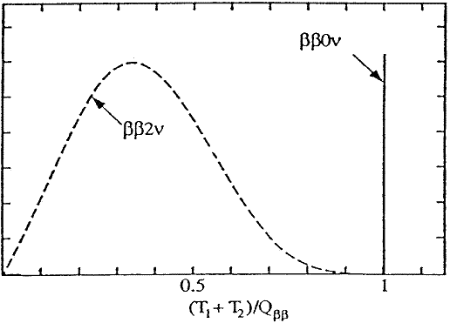
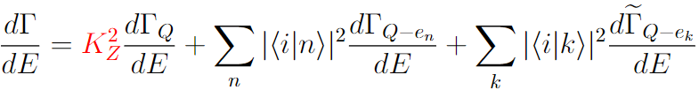

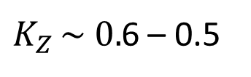
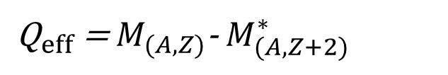
Atomic electrons in 0ν2β process
In experiments we observe the beta decay of an atomic system, not a bare nucleus.
${\text{Q}}_{eff}$ = $M_{(A,Z)}$-${ M}_{(A,Z+2)}^{∗}$
In the case of
neutrinoless double beta decay:
Nonorthogonality between ASF’s of the initial atom
and final ion due to the sudden change of the nuclear charge:
2
“shake-up”
“shake-off”
Δ Z=2
$K_{Z }\sim 0.$6 – 0.5
Excitation and ionization of the atomic electrons takes
energy away from the β particles. The spectrum changes shape.
Significant shaking probability

Slide 3
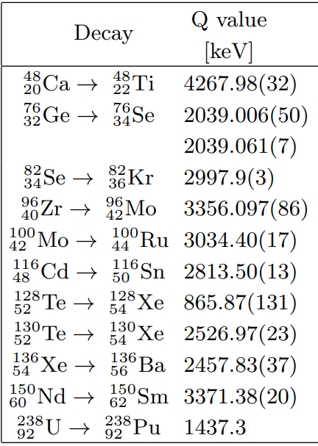





Atomic electrons in 0ν2β process
γ
e
…
The β particle flight duration
through the K-shell :
Z-1
…
N
A-2
(A,Z)
(A,Z+2)
Revolution time
(K-shell, worst case):
Direct collision of a β particle with an atomic electron
Instantaneous parameter
E. L. Feinberg (1941)
approx. 1/25 for Ge
The influence of β particles on atomic electrons can be neglected.
Shaking is dominant in 0ν2β.

Slide 4
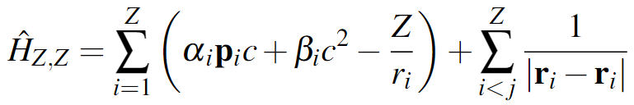
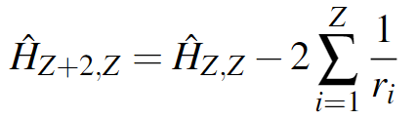

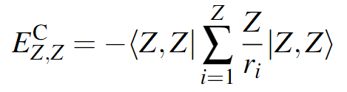

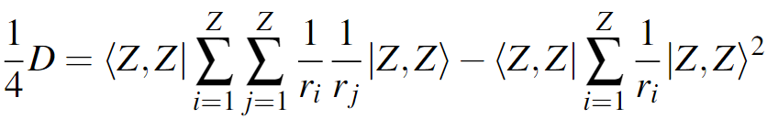
Mean shaking energy and its variance
Hamiltonian of parent atom
Hamiltonian of daughter ion
Average energy of old electrons in new Hamiltonian:
Mean shaking energy:
Thinking of it as the first two
moments of some probability distribution.
Variance:

Slide 5
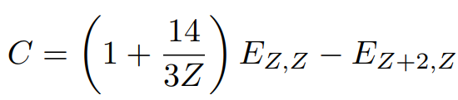

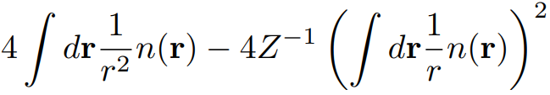







Methods to estimate C and D
Germanium-76
1. Thomas–Fermi:
383 eV
2160 eV
Divergent in origin, regularization near r=1/Z
2. Thomas–Fermi –Dirac – Weizsacker:
Approx. solution from E. K. U. Gross, R. M. Dreizler , Phys. Rev. А, 20, 1798 (1979)
Germanium-76
246 eV
3920 eV
3. Roothaan–Hartree–Fock:
Converges, significantly overestimates
Hartree–Fock in Roothaan basis, wave functions of orbitals are
parametrized analytically, tabulation available (for Z = 2..54)
Germanium-76
2620 eV
E. Clementi and C. Roetti, At. Data Nucl. Data Tables
14, 177 (1974)

Slide 6
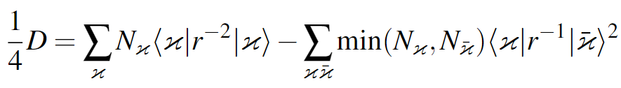
DHF computations
The GRASP-2018 code was used to perform DHF.
For all 11 elements and corresponding daughter ions ASF’s were found. We computed
overlap amplitudes
Numerical radial wave functions extracted and used for calculation of
Calculation of C is trivial
Nondiagonal terms noticeably
reduce variance
About GRASP
K. G. Dyall, I.P. Grant, C. T. Johnson, F.A. Parpia, E. P. Blummer,
Comput. Phys. Commun. 55, 425 (1989).
I.P. Grant, Relativistic Quantum Theory of Atoms and
Molecules: Theory and Computation, Springer (2007).
C. Froese Fischer, G. Gaigalas, P. Jönsson, J. Bieroń,
Comput. Phys. Commun. , 237, 184 (2019).

Slide 7
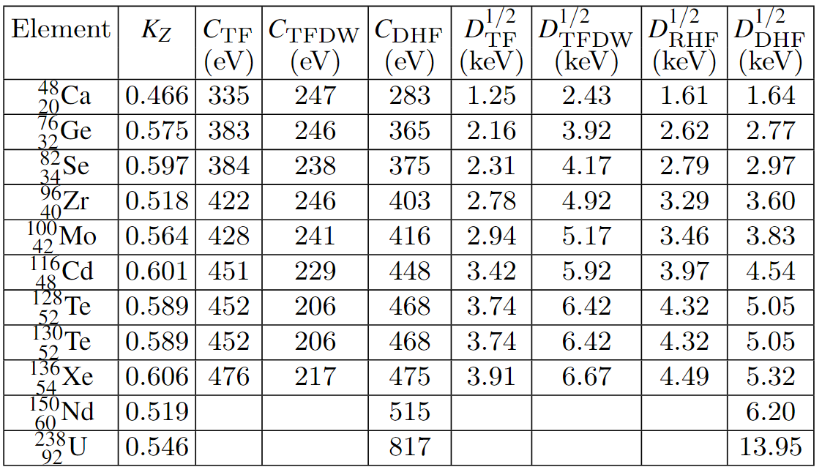
Numerical results

Slide 8

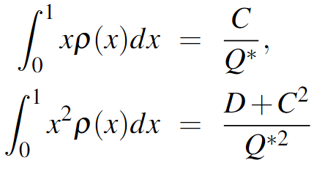
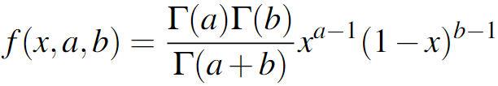





Shaking energy distribution.
Model based on Beta-distribution
fraction of energy spent on shaking
System of equations for a, b
Don’t forget we have ion as daughter element!

Slide 9
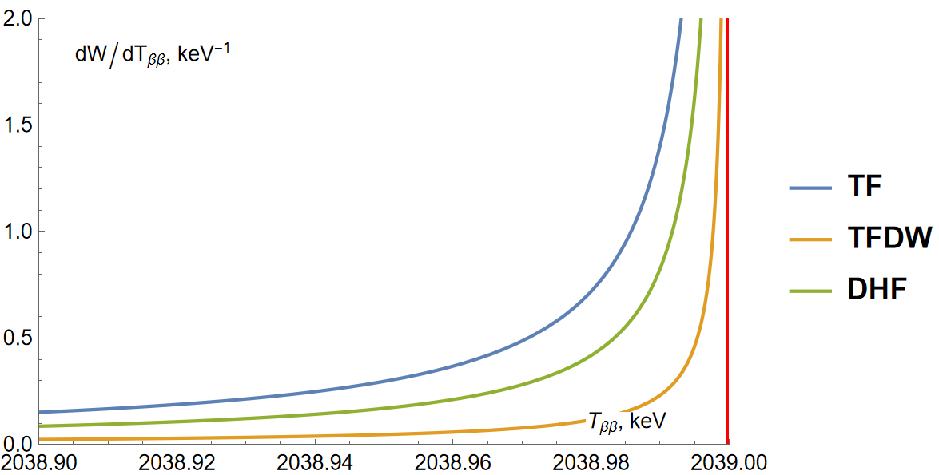
Example: Ge
Germanium-76
P[ε ≤ 18 eV]=0.9

Slide 10
Summary
We presented a method that allows to estimate the blurring of the distribution of the kinetic energy of β particles in 0ν2β decay, associated with atomic effects.
For 11 elements, the mean excitation (in fact shaking) energy and its variance were calculated using several methods. We performed Dirac-Hartree-Fock computations based on the GRASP software package. The results were compared with calculations performed within the non-relativistic Roothaan-Hartree-Fock model, as well as with estimates obtained using the Thomas-Fermi and Thomas-Fermi-Dirac-Weizsacker models.
This results based on our publications:
M.I. Krivoruchenko, K.S. Tyrin, and F.F. Karpeshin, JETP Lett. 117, 884 (2023).
M.I. Krivoruchenko, K.S. Tyrin, and F.F. Karpeshin, JETP Lett. 118, 470 (2023).
K. S. Tyrin, M. I. Krivoruchenko, Russ. Phys. J., 67, 11, (2024) (accepted)
THANKS FOR attention

