Slide 1
Preliminary results of the new precision measurements of ⁷¹Ge lifetime purposed for a solution of "gallium anomaly" problem
A. V. Derbin, I. S. Drachnev, D. V. Ivanov, V. N. Muratova, D. A. Semenov, M. V. Trushin and E. V. Unzhakov

Slide 2
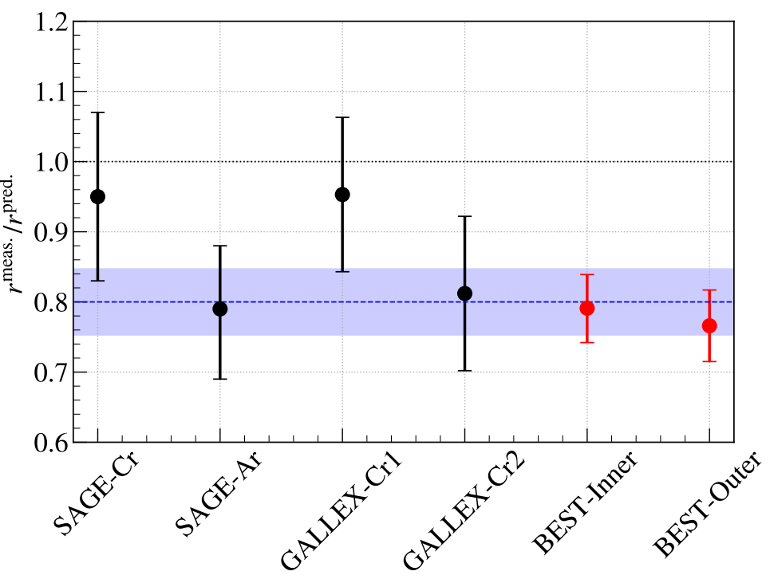
Introduction
2
Ga-Ge experiments SAGE, GALLEX, BEST have revealed a 20% deficit of the neutrinos detected from an artificial neutrino source in the reaction
u_{e} + ⁷¹Ga → ⁷¹Ge + e−
This effect is known now as “gallium anomaly".
The observed deficit may indicate on oscillation of some neutrinos into the sterile state, consequently - on the presence of a “new” physics beyond the Standard Model.
Alternative explanation of Ga anomaly may be related with errors in determination of ⁷¹Ge half-life time
T_{1/2}(⁷¹Ge) = 12,5 ± 0,1 days [Bisi et al 1955],
T_{1/2}(⁷¹Ge) = 10,5 ± 0,4 days [Rudstam, 1956],
T_{1/2}(⁷¹Ge) = 11,15 ± 0,15 days [Genz et al 1971],
T_{1/2}(⁷¹Ge) = 11,43 ± 0,03 days [Hampel et al 1985].
Theoreticians have shown that Ga anomaly could be eliminated completely if T_{1/2}(⁷¹Ge) ~ 13.5 days, whereas its statistical significance could be reduced to a level below 3σ if T_{1/2}(⁷¹Ge) ~ 12.5 days [C. Giunti et al 2023].
Ratios of measured and predicted ⁷¹Ge production rates in all Ga source experiments [V.V. Barinov et al 2022]
The latest T_{1/2}(⁷¹Ge) measurement to date performed at Lawrence Livermore National Laboratory has given T_{1/2}(⁷¹Ge) = 11.468 ± 0.008 days [Norman et al 2024].

Slide 3
Outline of the work
3
Fabrication of radioactive ⁷¹Ge source,
Assembling the measurement setup,
Determination of the count rate in specific ⁷¹Ga X-ray peaks for each measurements series,
Determination of a decay model that takes into account all the contributions of various germanium isotopes and their parent nuclei formed in the source during irradiation,
Fitting of the decay curve and extraction the value of ⁷¹Ge half-life period.

Slide 4
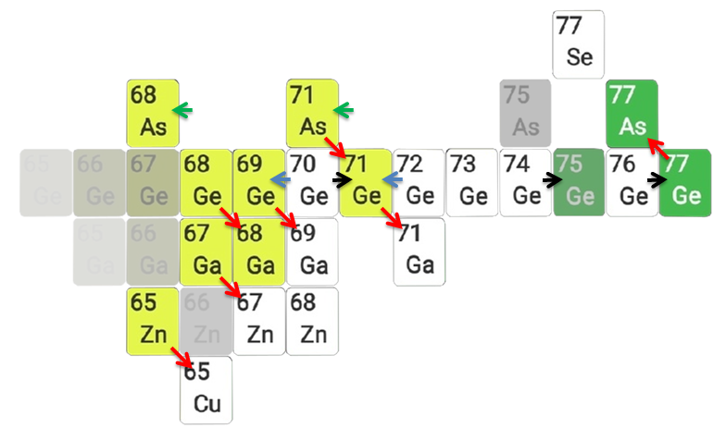
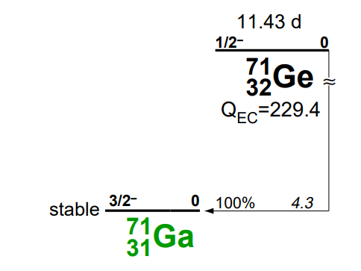
The ⁷¹Ge source
4
⁷¹Ge was obtained via (n,2n) reaction by irradiation of natural Ge wafers (⁷⁰Ge, ⁷²Ge, ⁷³Ge, ⁷⁴Ge, ⁷⁶Ge stable isotopes mixture) in a neutron/proton beam
of PNPI accelerator
⁷¹Ge decays into ⁷¹Ga by electron capture, emitting characteristic X-ray lines:
E_{Kα} = 9.24 keV and E_{Kβ} = 10.26 keV
- NO gamma-lines!
Basic nuclear reactions:
(n,γ)
(n,2n)
Correct determination of ⁷¹Ge count rate needs to account the accompanying decays.
(p,2n)
β-decays (only those that have T_{1/2} > 11 hours are shown),
ec
β⁻
Stable
The ⁷¹Ge decay scheme

Slide 5
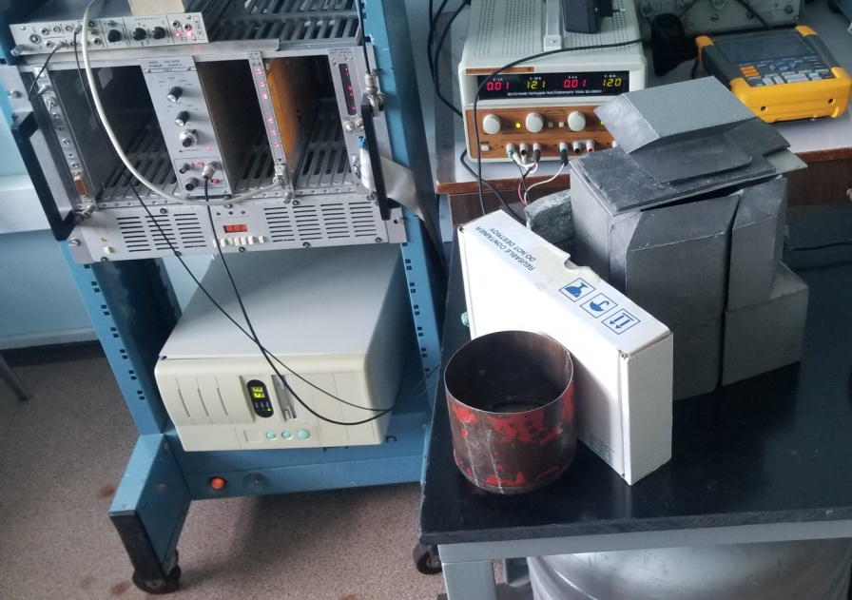
Experimental setup
5
Si(Li) detector produced in PNPI, S=2 cm², d=2,5 mm, C=8 pF, LN cooled
preamplifier operating without feedback resistor
preamplifier signal was processed with CR-3RC analog shaper (BUI-3K) and digitized with a 12-bit ADC
resolution: 350 eV FWHM for ⁵⁵Fe line 5.9 keV
71Ge source was placed directly on Be window 1cm above the detector
detector+source covered by Pb shield
spectra were collected in 1h-long series during 7 months

Slide 6
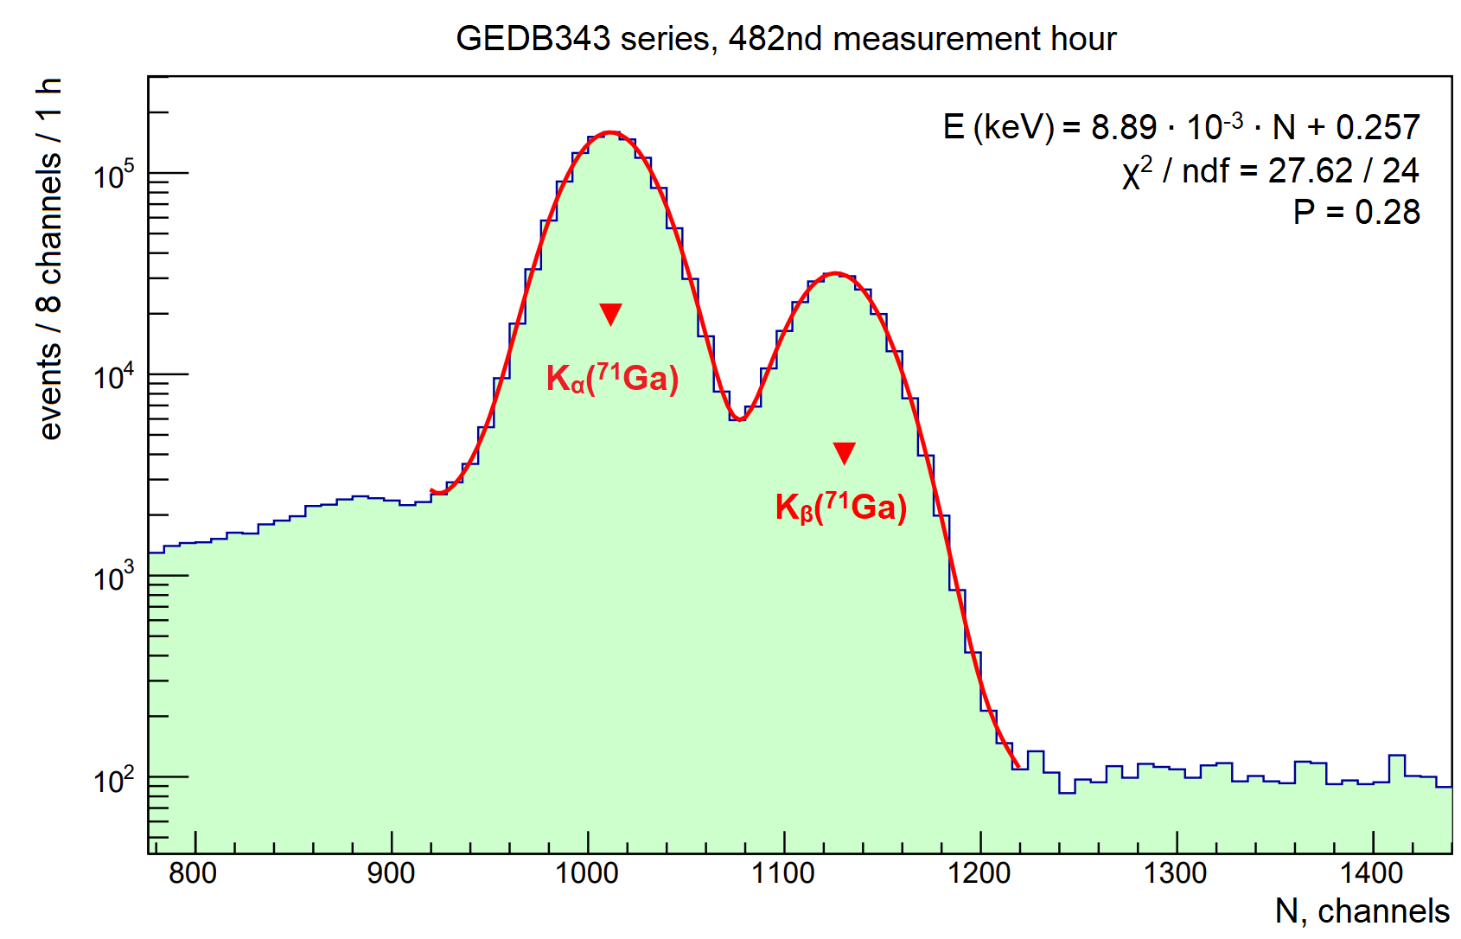
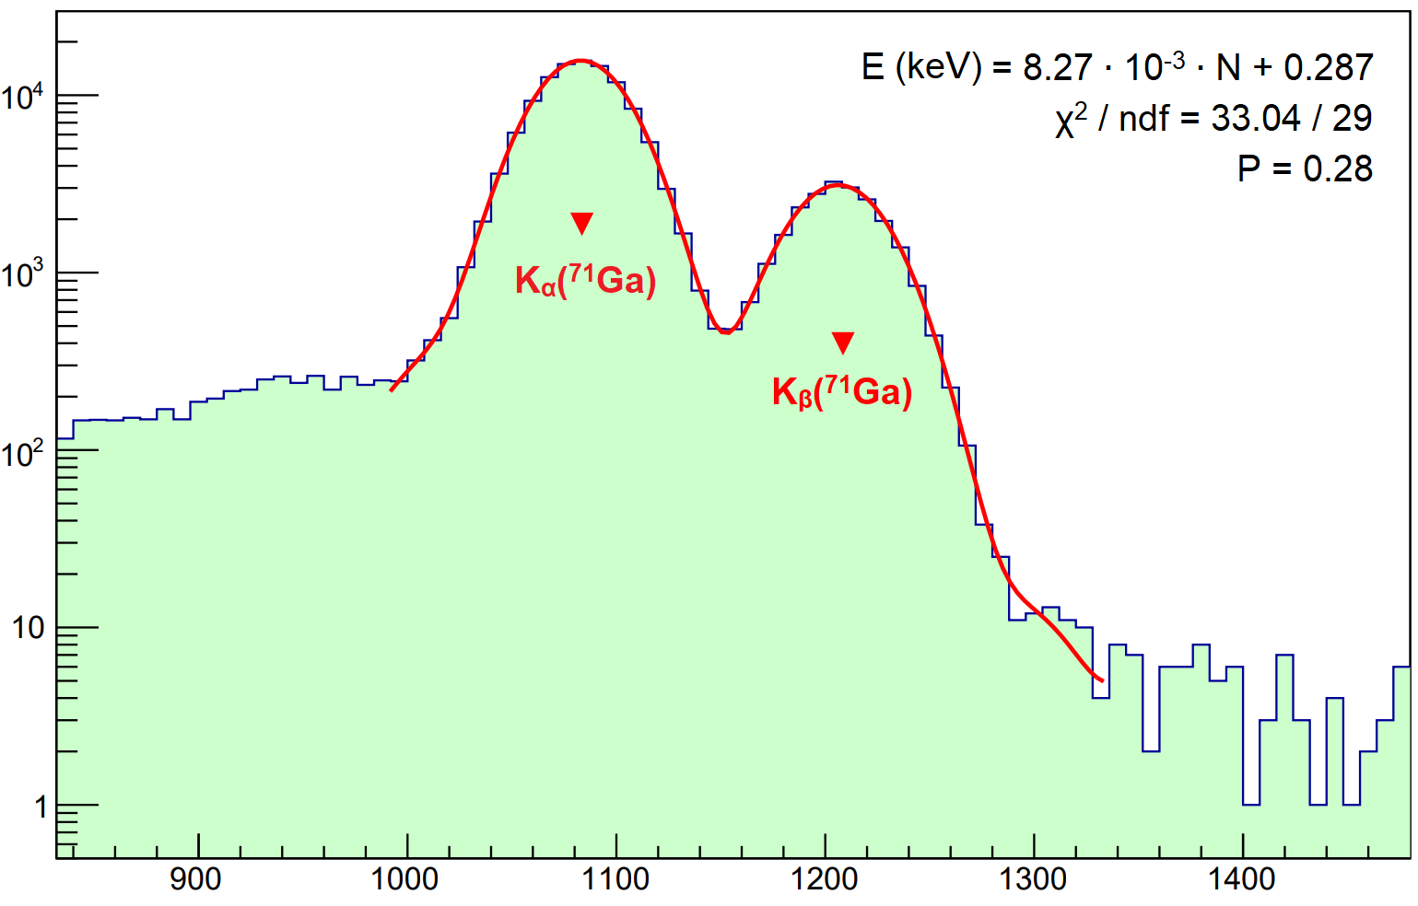
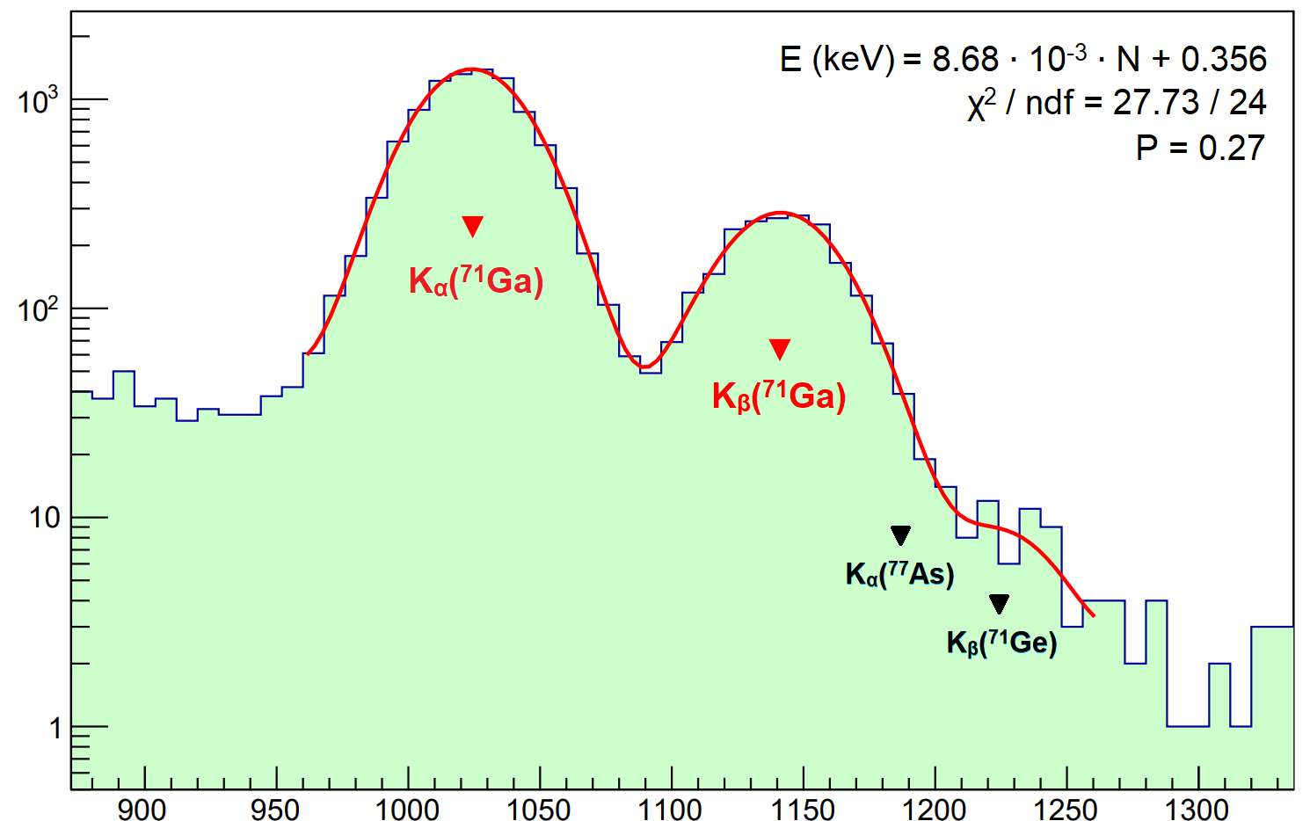
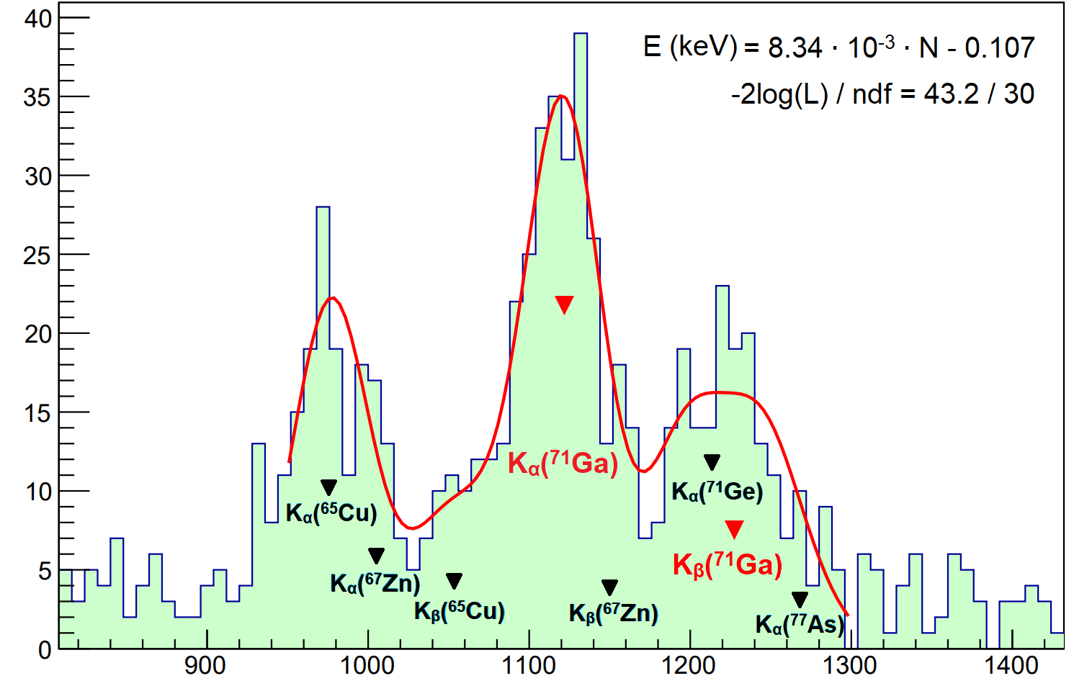
Fit of the amplitude spectra
482nd measurement hour
1555th measurement hour
ev. / 8 ch. / 1 h
ev. / 8 ch. / 1 h
2511th measurement hour
N, ch.
4988th measurement hour
N, ch.
ev. / 8 ch. / 1 h
ev. / 8 ch. / 1 h
N, ch.
N, ch.

Slide 7
Fitting model
Values of K_{α} peak amplitude were extracted by fitting 1h-spectra with fixed branches for components within the X-ray series (K_{α}, K_{β});
A total of 14 free variable parameters, 10 of which describe the amplitudes of the corresponding X-Ray components i (As, Ge, Zn, Ga, Cu K_{α,β} peaks).
<σ> ≈ 0.2 keV; FWHM ≈ 0.4÷0.5 keV.
(1)
482nd measurement hour
i = 1 – 10; j = 1 – 2÷4;
ev. / 8 ch. / 1 h
,
resolution [ch],
σ₀, σ_{lin} – free parameters;
ε_{j} – branching, constant;
A_{i} – amplitude [counts/h], free parameter.
N [ch] – variable; E_{j} [keV] – constant;
N, channels
a [keV/ch], b [keV] – coefficients, free parameters;

Slide 8
The decay model
The decay model takes into account the decays of the parent nuclei ⁶⁸Ge, ⁶⁹Ge, ⁷¹Ge and ⁷¹As:
,
(2)
,
,
,
.
The model also takes into account a correction for the dead time of the spectrometer:
,
(3)
τ – the dead time [μs],
<dt> – the inverse of the event count rate [μs/counts].

Slide 9
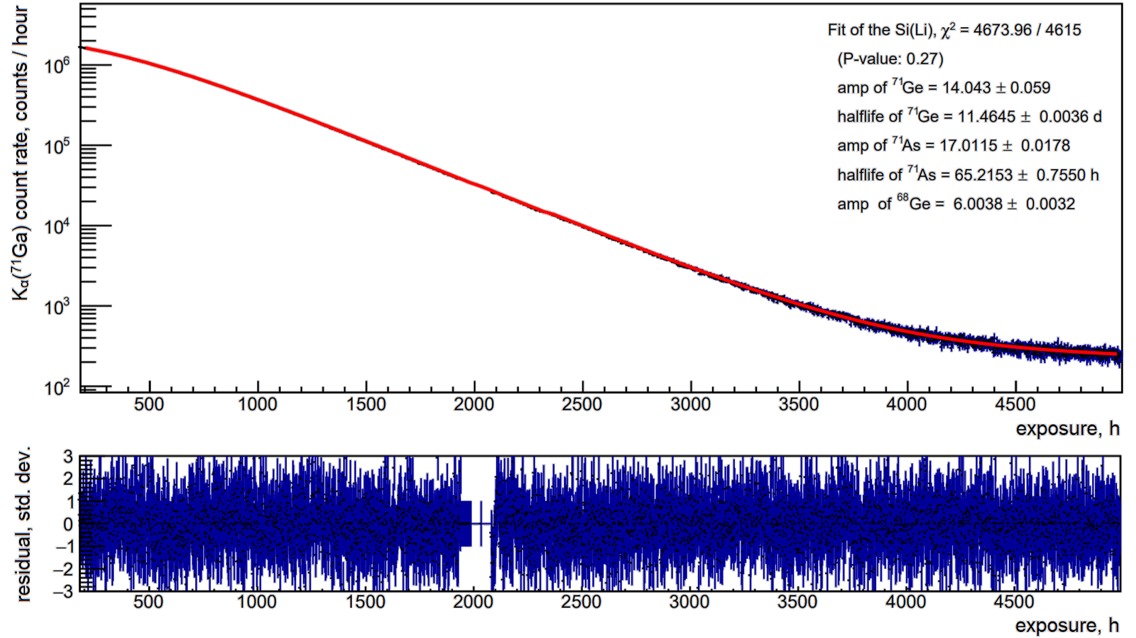
Decay curve K_{α}(⁷¹Ga)
T_{1/2}(⁷¹Ge) = 11.4645 ± 0.0036 d; χ² / ndf = 4674 / 4615; P = 0.27

Slide 10
Conclusions
Half-life time T_{1/2}(⁷¹Ge) = 11.4645 ± 0.0036 days was obtained, which is consistent with previously measurements
T_{1/2}(⁷¹Ge) = 11,43 ± 0,03 days [Hampel et al 1985].
T_{1/2}(⁷¹Ge) = 11,46 ± 0,04 days [Collar et al 2023].
T_{1/2}(⁷¹Ge) = 11.468 ± 0.008 days [Norman et al 2024].
but is 2÷8 times more precise.
Wherefore, obtained results strongly constrain the explanation of Ga anomaly based on the uncertainty of the half-life time of ⁷¹Ge.
In the near future, precision of T_{1/2}(⁷¹Ge) determination will be further increased by performing the K_{β}(⁷¹Ga) line fit, and by including the measurement results obtained on other experimental setups (Ge-detector & Si(Li) detector with FWHM<200 eV) in order to estimate the systematical error.

