Slide 1

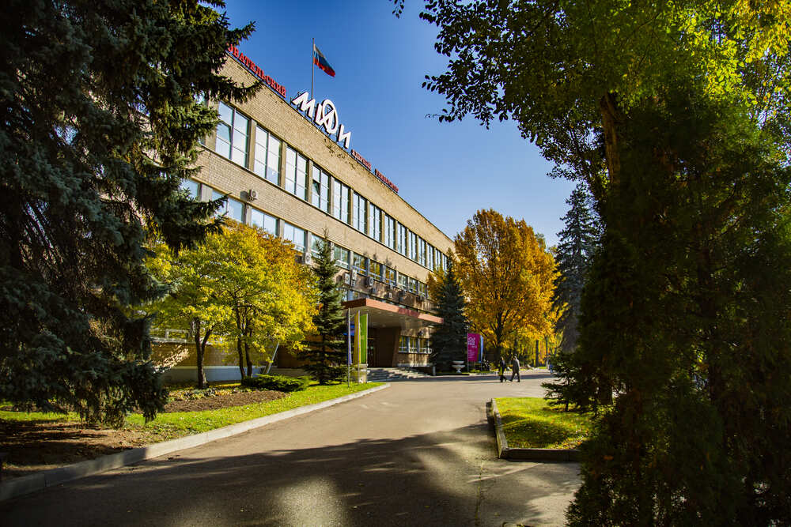
Status and perspectives of the AMoRE experiment
The 7th International Conference on Particle Physics and Astrophysics (ICPPA-2024)
22 - 25 October, 2024 (Moscow, Russia)
Kornoukhov Vasily
on behalf of the AMoRE Collaboration
MEPhI
(Moscow, Russia)
vnkornoukhov@mephi.ru

Slide 2

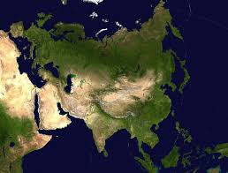









AMoRE (Advanced Mo-based Rare process Experiment): search for 0ν2β-decay of ¹⁰⁰Mo isotope with scintillation cryogenic bolometer
China
Germany
India
Indonesia
Korea
Pakistan
Russia
Thailand
Ukraine
9 countries, 25 institutes, ~ 106 members
2003 – the beginning of works on CaMoO₄ scintillation crystals growth in Korea (and in Russia as well)
2009 – foundation of International collaboration AMoRE
2006-2012 – JSC Fomos-Materials developed the technology of ^{48free}Ca¹⁰⁰MoO₄ crystals growth.
2013 – foundation of CUP (Center for Underground Physics IBS).

Slide 3
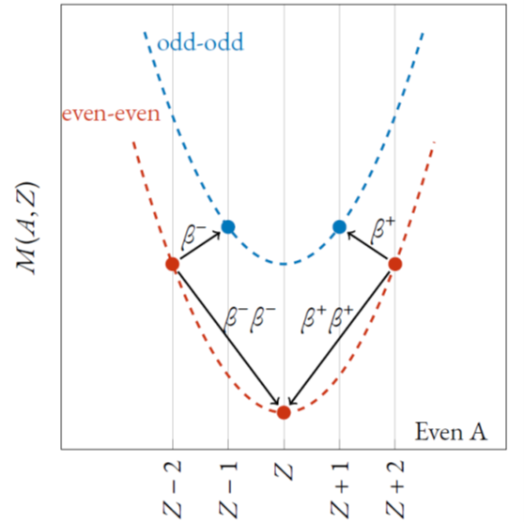
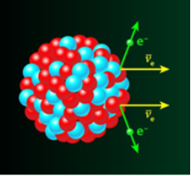
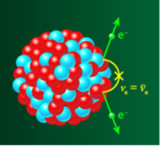

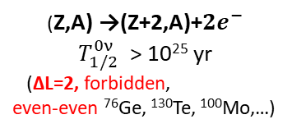
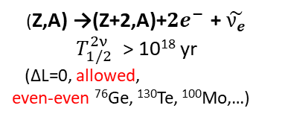
Neutrinoless double beta decay in neutrino physics
Question for neutrino physics: Dirac or Majorana nature of neutrino?
To observe 2νββ decay, the single
β-decay must be energetically forbidden due to energy conservation constraint →
(Z,A) →(Z+2,A)+${2e}^{−}$ + $\tilde{ν_{e}}$
$T_{1/2}^{2ν}$ > 10¹⁸ yr
(∆L=0, allowed,
even-even ⁷⁶Ge, ¹³⁰Te, ¹⁰⁰Mo,…)
(Z,A) →(Z+2,A)+${2e}^{−}$
$T_{1/2}^{0ν}$ > 10²⁵ yr
(∆L=2, forbidden,
even-even ⁷⁶Ge, ¹³⁰Te, ¹⁰⁰Mo,…)
Double Beta Decay is the rarest nuclear weak process
It takes place between two even-even isobars
In total 35 isotopes available and
~ 11 of them can be used for 0νββ search
If Neutrinoless double beta decay (0νββ) observed:
Neutrino behaves as a Majorana particle
Lepton number conservation violated
Neutrino mass could be defined

Slide 4






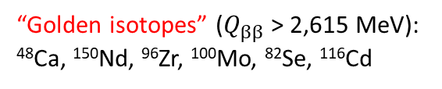
Sensitivity of 0ν2β-decay experiments: enrichment, background and energy resolution
For “sizeable” background
Experimental signature of 2νββ and 0νββ
“Zero” background
$$Q_{ββ}$$
“Golden isotopes” ($Q_{ββ}$ > 2,615 MeV):
⁴⁸Ca, ¹⁵⁰Nd, ⁹⁶Zr, ¹⁰⁰Mo, ⁸²Se, ¹¹⁶Cd
Cost effective = produced with centrifuge:
⁹⁶Zr, ¹⁰⁰Mo, ⁸²Se, ¹¹⁶Cd, ⁷⁶Ge, ¹³⁶Xe, ¹³⁰Te and ⁷⁶Ge

Slide 5
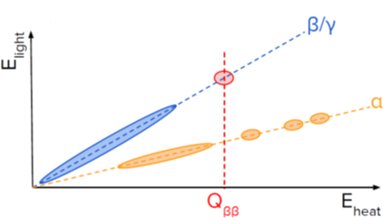
AMoRE scintillation cryogenic detector module
(X¹⁰⁰MoO₄) + MMC sensor + SQUID magnetometer + Cu frame
arXiv:2407.12227, EPJC accepted
Different light yield (LY) of α vs β/γ
to actively suppress background
Advantages of metal magnetic calorimeter
- High energy resolution ~ 10 keV FWHM at 2.6 MeV.
- Rejection of α-induced background
- Fast signal timing: a few msec rise-time for phonon signals at mK
- Low random coincidence background.

Slide 6
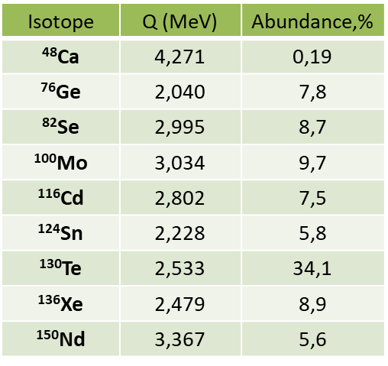
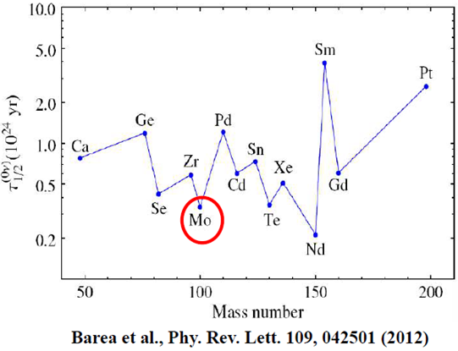
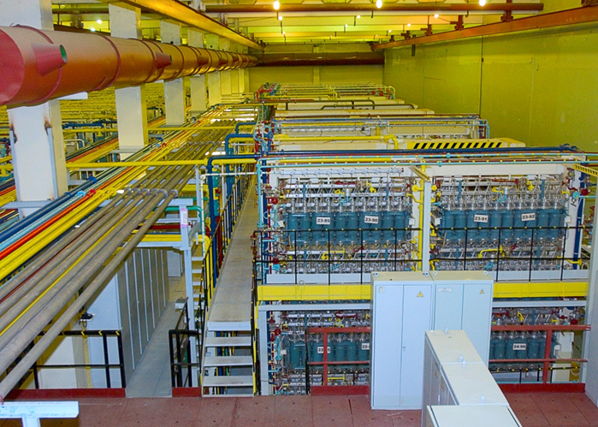
Why is ¹⁰⁰Mo isotope chosen for AMoRE detector?
High Q_{ββ} = 3034 keV > ²⁰⁸Tl γ-line (2615 keV) from rock and materials.
Relatively short half life (0νββ) expected from the theoretical calculation.
High natural abundance: 9.7%
Production of ¹⁰⁰Mo isotope at industrial scale: centrifuges (ECP, Russia).
¹⁰⁰Mo-based scintillation crystals (XMoO4) operated under cryogenic temperature.
¹⁰⁰Mo-based scintillation crystals: XMoO₄ (XMO, X =Ca, Li₂, etc, …) with simultaneous detection of light/heat signal → rejection of α-background
Detector = Source: high efficiency ~ 80÷85%.
Technology of Czochralski crystal growth: High purity → very low intrinsic radioactive background.
ECP (Zelenogorsk, Russia)

Slide 7
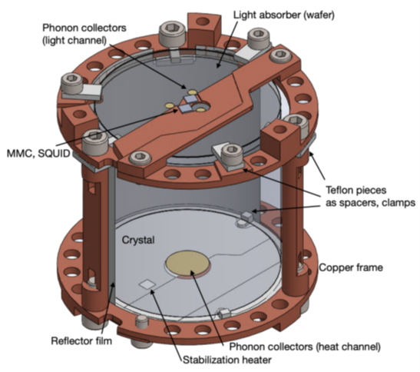
Implementation of AMoRE experiment (Stages Plan)
Completed
2015 ÷ 2018
6 CMO & 1.9 kg
^{48depl}Ca¹⁰⁰MoO₄
Completed
2020 – 2023
13 CMO + 5 LMO
Total mass: 6.2 kg
Planned since 2024 →
1st stage of AMoRE-II - 90 kg of LMO (10 towers)
Total mass of 157 kg Li₂MoO₄ (84,4 kg of ¹⁰⁰Mo)
40 towers ~ 360 XMoO₄ crystals
AMoRE-Pilot to demonstrate
the potential for 0νββ probe
Background at ROI A-Pilot AMoRE-I AMoRE-II
[counts/keV/kg/year] ~ 0.5 ~ 0.025 ~ 10⁻⁴
Li₂MoO₄ crystals
D 5 x 5 cm (~ 310 g)
D 6 x 6 cm (~ 520 g)

Slide 8

Cryostat with shielding/AMoRE-Pilot and AMoRE-I detector in YangYang lab
Pulse-tube dilution refrigerator:
Operating at 10 mK with 1.2 μW cooling power.
Damping system to reduce vibration noise signals from the impulse tube of the CF-DR cryostat.
- 15-20 cm Pb (γ), boron and polyethylene (neutrons),
- Plastic scintillator muon counter (muons veto).
YangYang underground laboratory
-700 m minimum vertical depth (2000 m.w.e)
Radon free air supplied

Slide 9
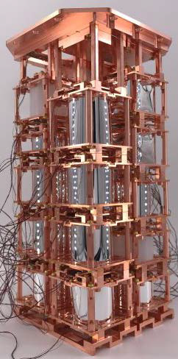
AMoRE-I experiment
Period: Aug 2020 – April 2023
18 crystals:
^{48free}Ca¹⁰⁰MoO₄:
13 from Fomos-Materials (4.58 kg)
Li₂¹⁰⁰MoO₄:
5 from NIIC + 1 from CUP (1.61 kg)
-Total crystal mass = 6.19 kg, ¹⁰⁰Mo mass = 3.1 kg
Upgrade from Pilot:
• Stabilization heater for all crystals.
•MMC sensor: AuEr ➔ AgEr.
•Using same cryostat + two stage temperature control: ⟨ΔT⟩ < 1 μK.
• Shielding enhancements:
-Outer Pb: 15 cm ➔ 20 cm;
- Neutron shields: boric acid silicon + more PE / Boron-PE.
- Better muon counter coverage (~ 4π).
- More supply of Rn-free air.

Slide 10

AMoRE-I physics spectrum
Muon veto
Alpha tagging
Hanbeom Kim, IBS/SNU, AMoRE Collaboration meeting, 2024-08-28

Slide 11
AMoRE-I result for $T_{1/2}^{0ν}$decay of ¹⁰⁰Mo
arXiv:2407.05618v1 [nucl-ex] 8 Jul 2024
18 (13 CMO+5 LMO) crystals.
Live exposure ~ 4 kgMo-100∙yr.
Bkg at ROI ~0.025 counts/keV/kg/yr.
> 2.9×10²⁴ yr at 90% CL.
The energy spectrum of selected events in the region of interest

Slide 12
AMoRE-II detector
Detector array: 84.4 kg of 100Mo, 157 kg of LMO crystals (360 modules)
Scintillating molybdate crystals Li₂MoO₄ (LMO) by NIIC and CUP and
CMO from Fomos-Materials:
large individual detector mass (300 ~ 500 g for D5 x 5 cm and D6 x 6 cm)
Recent R &D efforts at HQ: detector performance improved significantly:
Energy resolution (FWHM) at 2.6 MeV: < 10 keV at 10 mK
Alpha particle Discrimination Power (DP):
by L/H ratio: 14 - 19.5 @ ~ 5MeV
by PSD: ~5 @ ~ 5MeV
Fast time response

Slide 13

AMoRE-II shielding system

Slide 14
AMoRE-II detector Stage 1
Detector array of stage 1:
9 (modules/column) x 10 (columns) = 90 modules
Scintillating molybdate crystals Li₂MoO₄ (LMO) by NIIC and CUP
Data taking for no longer than a year, starting from 2025.

Slide 15
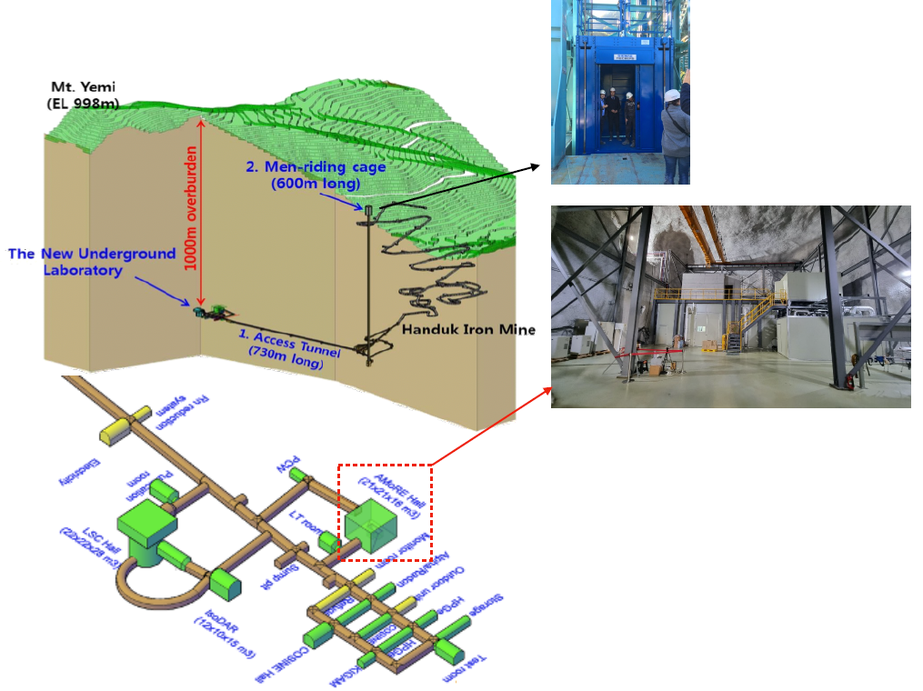
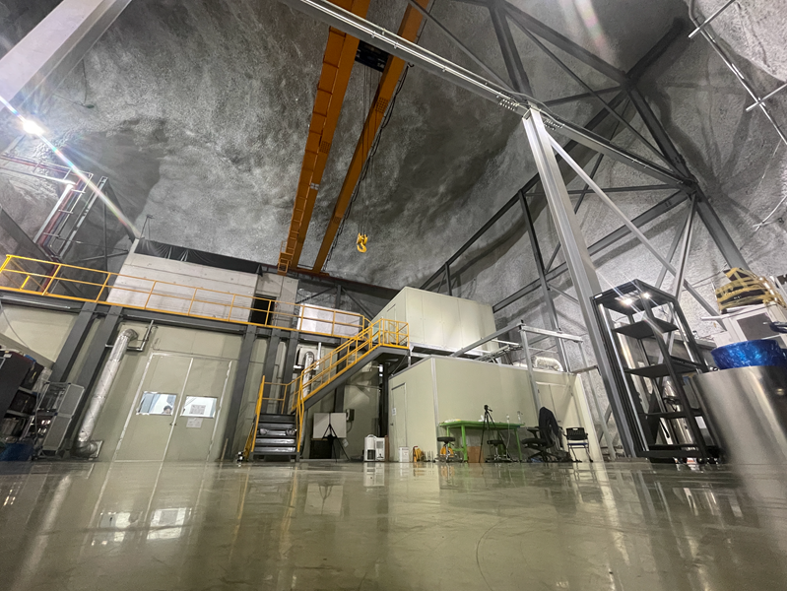
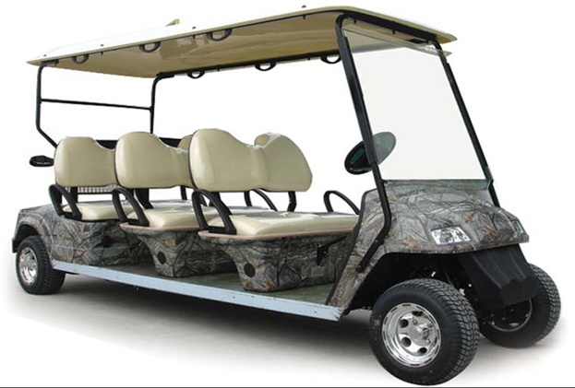
New Underground Laboratory Yemilab to host AMoRE-II
8-seats electric vehicle
The constructions have been done
(2017.09 – 2022.07)
2,500 m² of experiment dedicated area
1,000 m of rock underground
Since Sept 2022, the Yemilab is in operation

Slide 16
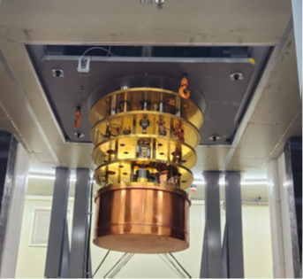

AMoRE-II construction at Yemilab (August 2024)
AMoRE Hall in Yemilab
DR installed in the Yemilab

Slide 17

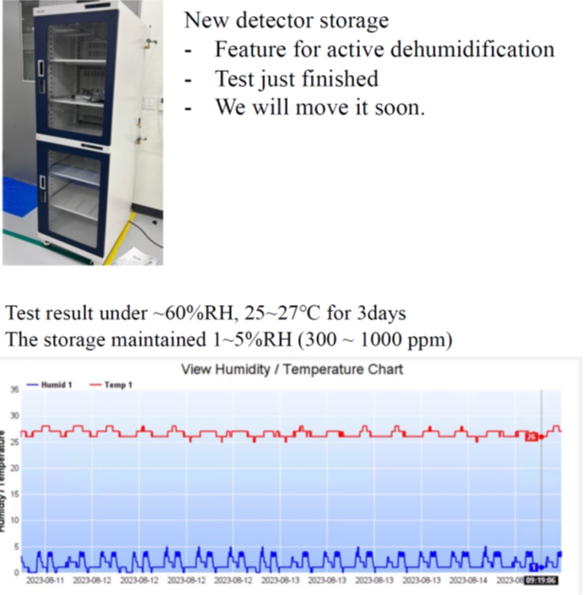
AMoRE-II construction: clean room

Slide 18
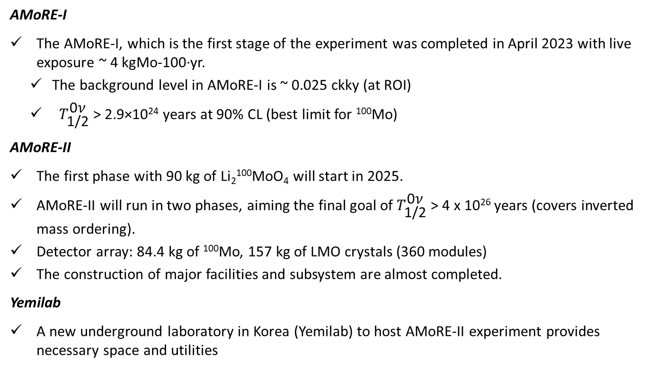
Conclusions
AMoRE-I
The AMoRE-I, which is the first stage of the experiment was completed in April 2023 with live exposure ~ 4 kgMo-100∙yr.
The background level in AMoRE-I is ~ 0.025 ckky (at ROI)
${ \text{T}}_{\text{1/2}}^{\text{0}\text{ν}}$ > 2.9×10²⁴ years at 90% CL (best limit for ¹⁰⁰Mo)
AMoRE-II
The first phase with 90 kg of Li₂¹⁰⁰MoO₄ will start in 2025.
AMoRE-II will run in two phases, aiming the final goal of ${\text{T}}_{\text{1/2}}^{\text{0}\text{ν}}$ > 4 x 10²⁶ years (covers inverted mass ordering).
Detector array: 84.4 kg of ¹⁰⁰Mo, 157 kg of LMO crystals (360 modules)
The construction of major facilities and subsystem are almost completed.
Yemilab
A new underground laboratory in Korea (Yemilab) to host AMoRE-II experiment provides necessary space and utilities

Slide 19
Back up slides

Slide 20
AMoRE-I detector performance (energy calibration & resolution)
External γ source: ²³²Th-doped welding rods
outside of OVC (Outer Vacuum System)
Slight second order non linearity
FWHM@2.6MeV ~ [8.9 ÷ 32.7] keV FWHM at 2615 keV,
~15 keV average

Slide 21
AMoRE-II: Limits & Sensitivities
Current best upper limit: KamLAND-Zen
Phys. Rev. Lett. 130051801 (2023)

