Slide 1
Effective potentials in LLA for diverse models in the large N limit
The 7th International Conference on Particle Physics and Astrophysics
ICPPA-2024
Iakhibbaev R.M., Tolkachev D.M.
Based on 2406.19005 (accepted to Mod.Phys.)
BLTP JINR

Slide 2
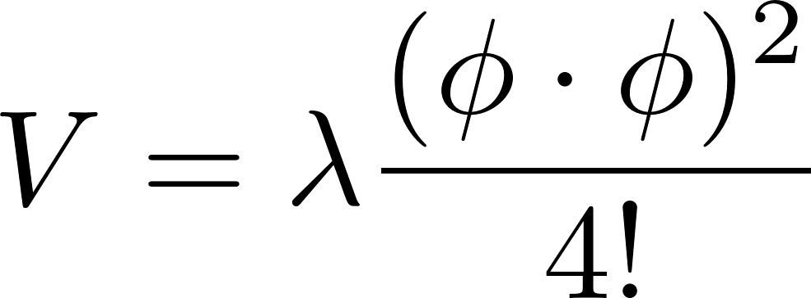
Non-renormalisable models in 4D
The Largangian of general scalar model in diverse dimensions (no higher derivatives)
Examples of potentials:
Renormalisable potential in 4D
Moscow zero and pole

Slide 3
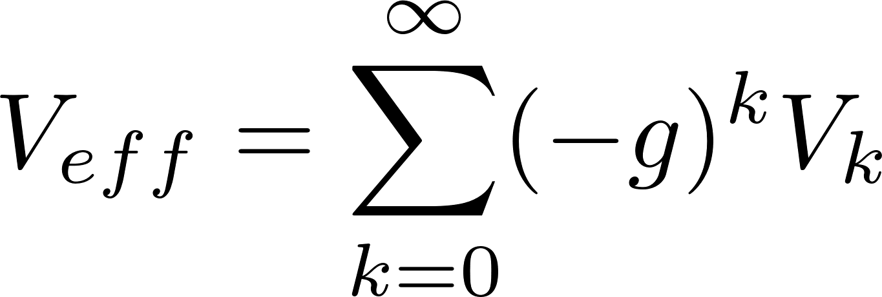
Jackiw‘74, Itsykson, Martin, Iliopoulos‘75
Effective potential
Generating functional
1PI generating functional and effective action
Shifted action
Expansion by quantum fields Effective potential

Slide 4
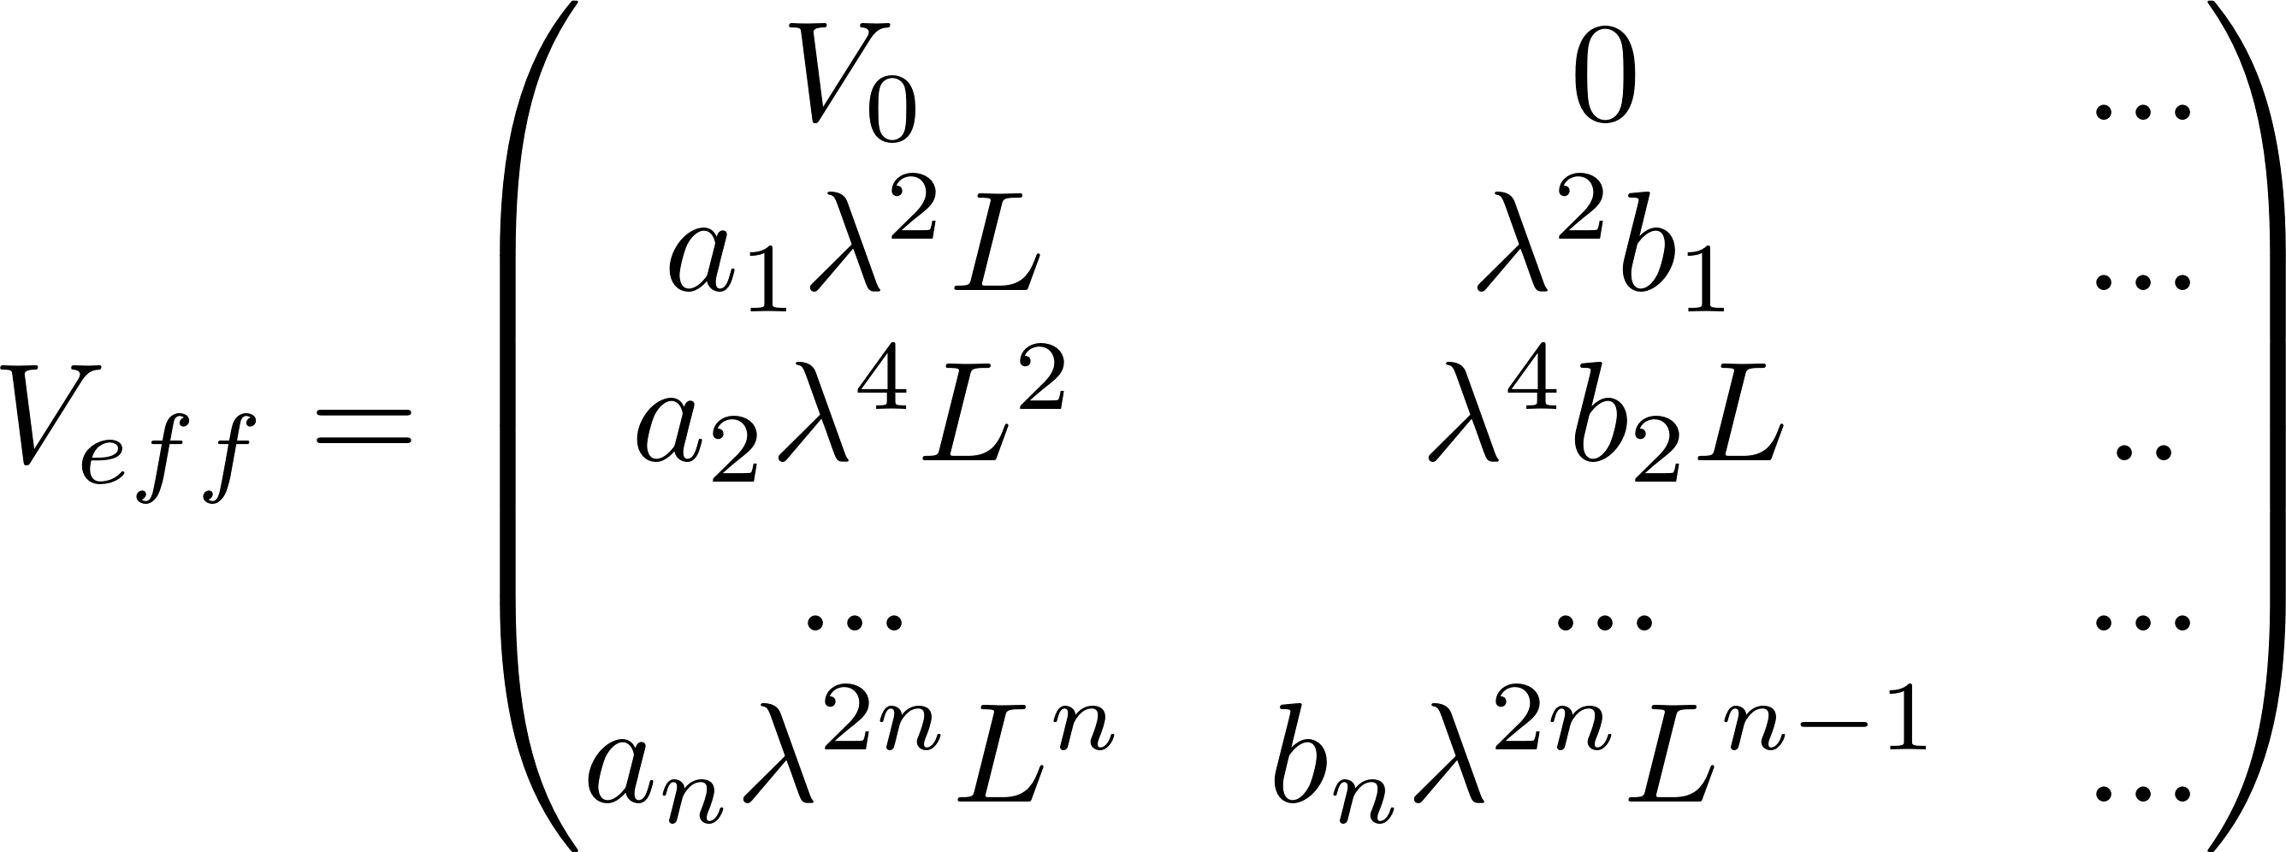
Effective potential in LLA limit
Tree-level
One-loop level
Two-loop level
…
…
…
n-loop level
LLA NNLA …

Slide 5
Jackiw‘74, Itsykson, Martin, Iliopoulos‘75
Feynman rules in SO(N)-models
Effective mass
Propagators in effective potential method
Effective vertices

Slide 6
Vacuum diagrams: one-loop
CC’98, Kastening’96
Vacuum one-loop 4D-graphs
Ф⁴-model:
Ф⁶-model:

Slide 7
Vacuum diagrams: two-loop
CC’98, Kastening’96
Ф⁴ model:
Coincidence with the results of [CC’98, Kastening’96] (even on 3-loop level)
Ф⁶ model:
Vacuum two-loop 4D-graphs
In the large N limit sunset-like diagrams are supressed

Slide 8
Higher loop diagrams in the large N limit
Ф⁴ model:
Other models:

Slide 9
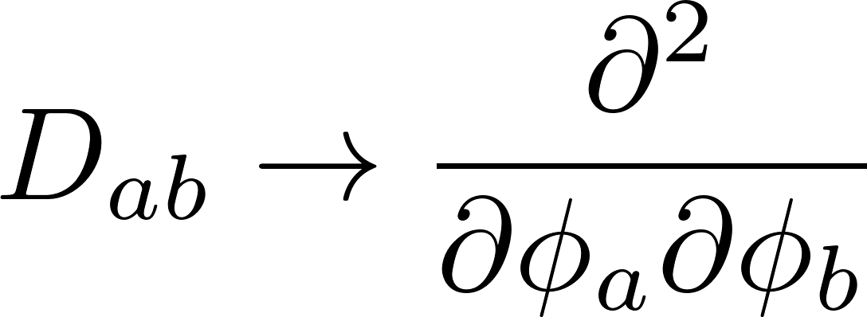
BPHZ and recurrence relation
n-loop divergence always is local due to Bogoliubov-Parasiuk theorem [BP’57, Hepp’66,Zimmerman’69], result of R’(G) must not contain terms like
Higher order leading divergences are governed by one-loop divergence
Recurrence relation can be expressed in the next equivalent forms:

Slide 10
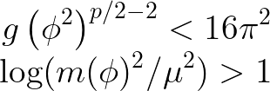
RG equation in the large N limit
Recurrence relation in the large N limit
Sum of leading poles
RG-PDE
Effective potential in the large N limit
The equation we study has initial condition
Conditions under which the limit of leading logarithms and the regime of smallness of the coupling constant are satisfied

Slide 11
Analytic solutions
Introducing ansatz for power-like potential
Introducing ansatz for log-potential
PDE turn to ODE
PDE turn to ODE
Introducing ansatz for exp-potential
Since all these ODE’s are the first order differential equations, so they can be solved analytically at least by quadratures
PDE turn to ODE

Slide 12
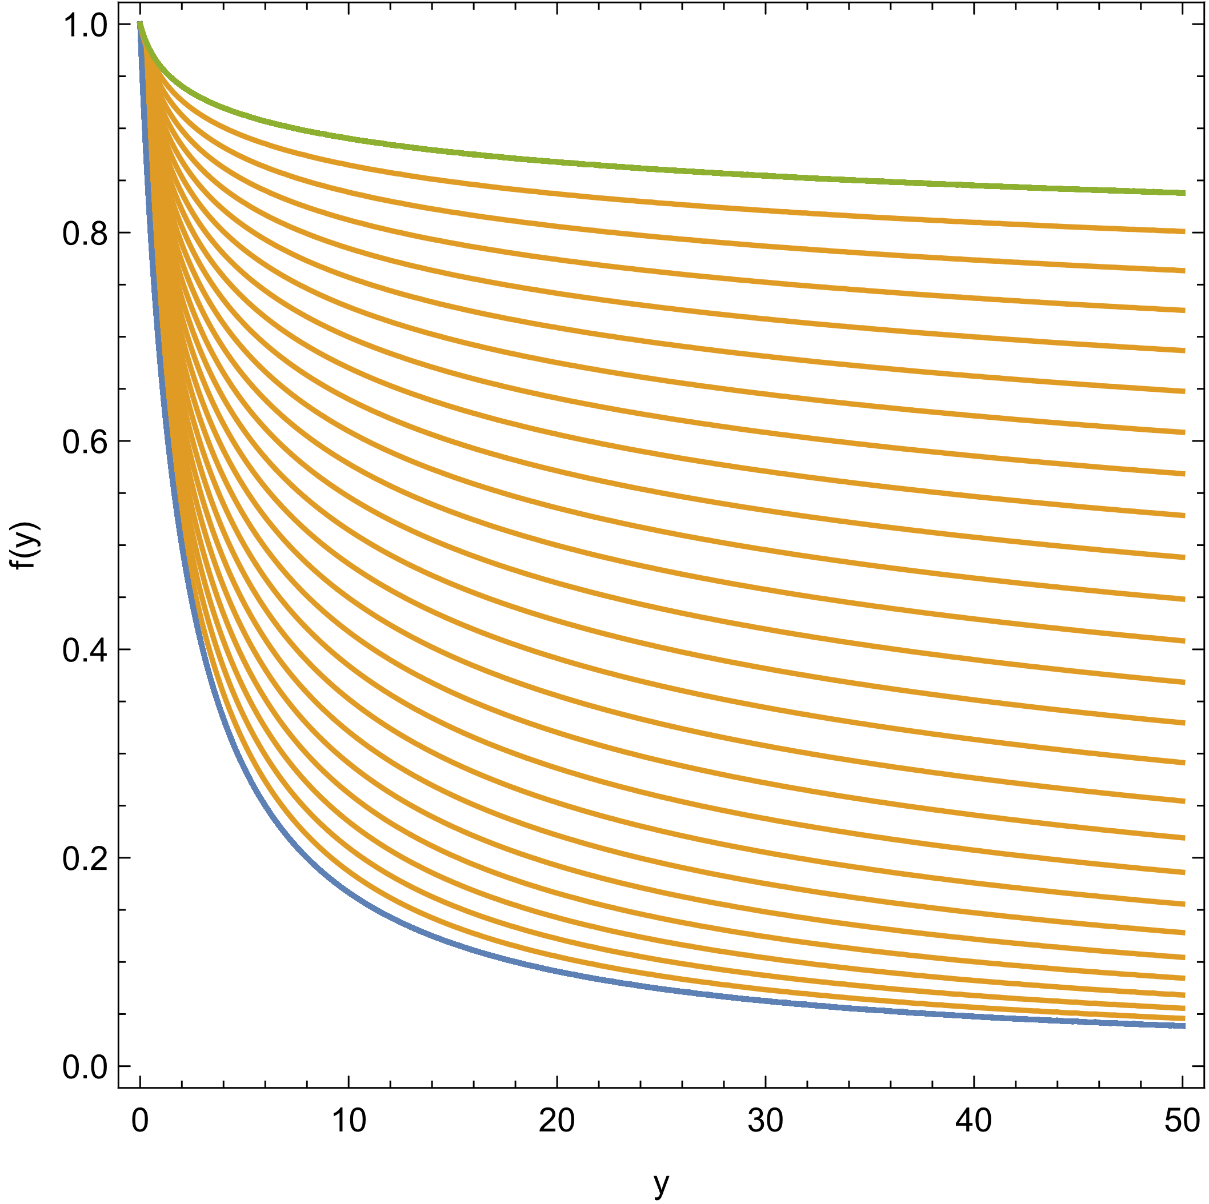
Solutions
Numerical solutions for
Power-like p=4
Power-like p=6
Exponential potential
Logarithmic potential
All the above functions have no singularities in the positive region and tend to zero at infinity (zero-charge behaviour), but may have a non-zero imaginary part

Slide 13
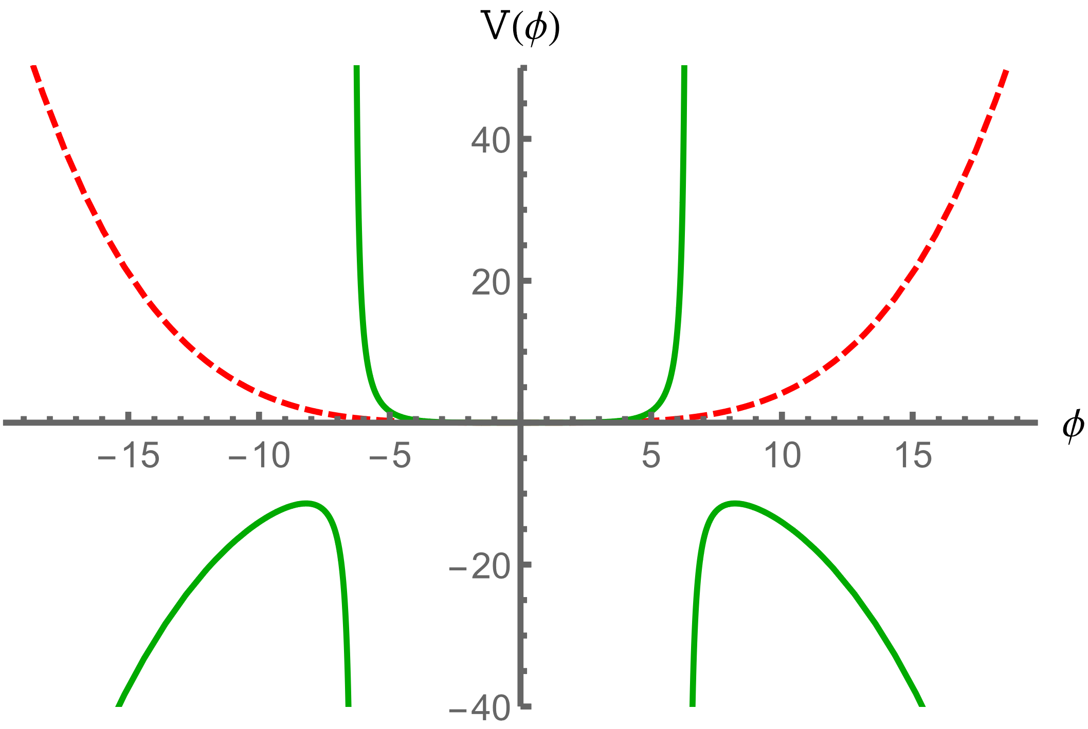
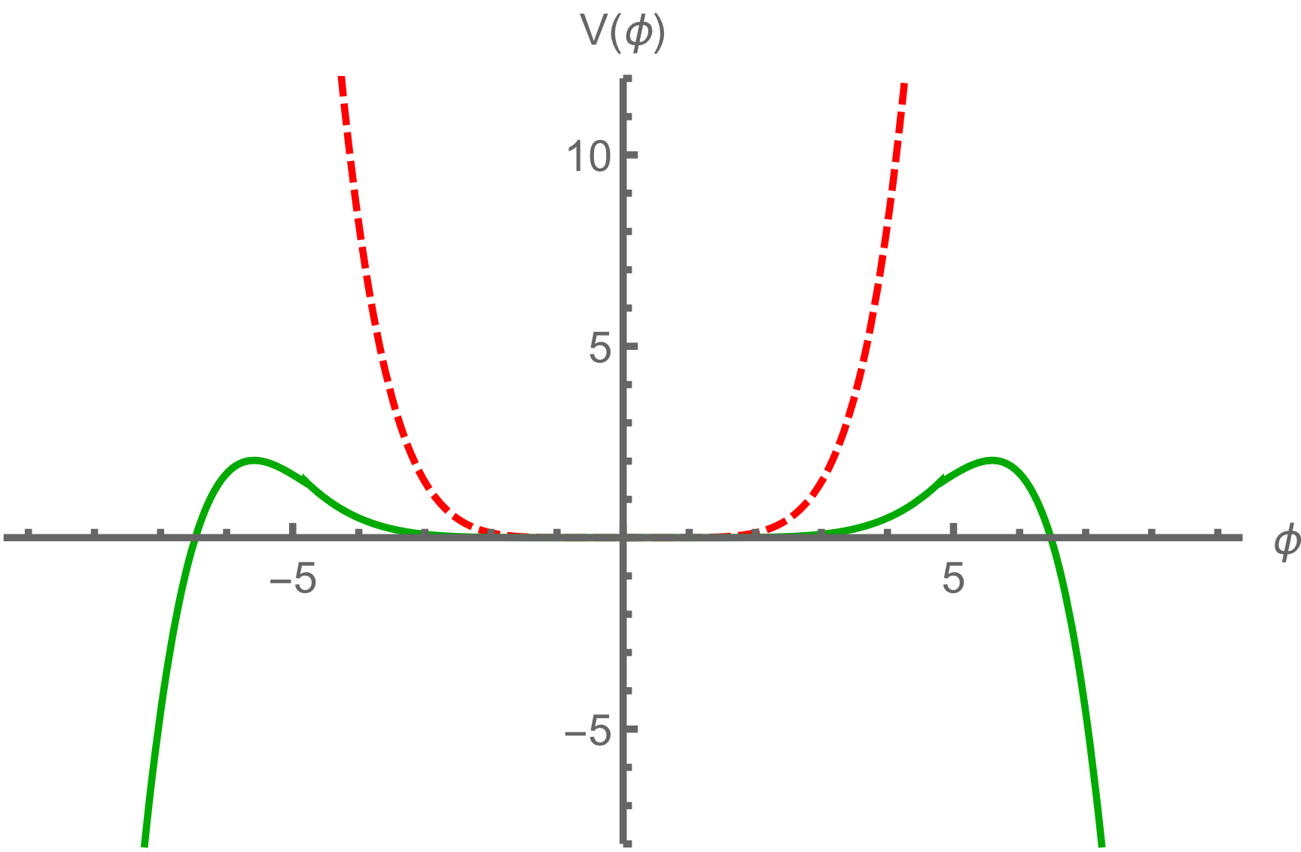
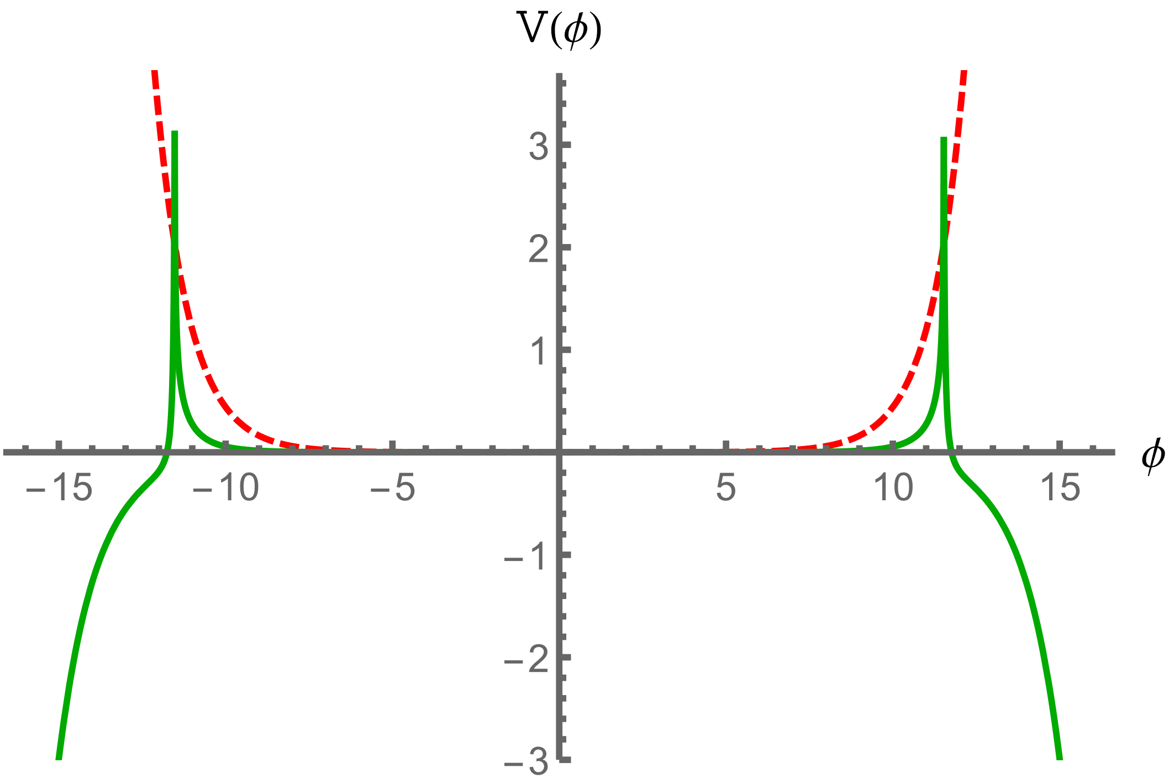
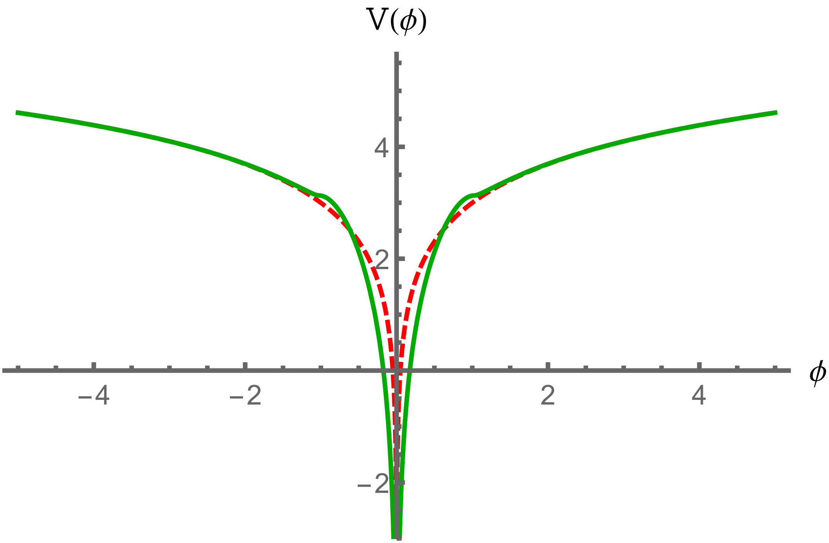
Effective potentials
All obtained potentials in the leading logarithmic approximation, except for the renormalisable one, are characterised by the metastability of the ground state
Power-like p=4
Power-like p=6
Imaginary parts of functions can be identified as decaying rate of metastable state
Exponential potential
Logarithmic potential

Slide 14
Conclusions
We calculated
Possible applications
Feynman rules
Loop Feynman diagrams up to third order for 4D in arbitrary general scalar models
Higher dimensions
Sigma-models
SUSY-models (Conifold-duals)
NJL-like models etc
We find
Theoretical perspectives
Iterative relation between leading poles of coefficients
Generalised RG-equations
Exact solutions of latters
Expansion of analysis on subleading orders and exploring anomalous dimensions
Studying effective actions
Scheme-dependence

Slide 15
Thanks
for attention!

