Slide 1
Study of φ(1020), ρ(770) and K*(892) resonance production in Bi+Bi collisions at √s_{NN} = 9.2 GeV in the MPD detector at NICA collider
Ya. Berdnikov, D. Ivanishchev, D. Kotov, M. Malaev, A. Riabov
(SPbPU and NRC «Kurchatov Institute» - PNPI) for the MPD collaboration
We acknowledge support from Russian Ministry of Education and Science, state assignment for fundamental research (code FSEG-2024-0033)
25 October 2024

Slide 2
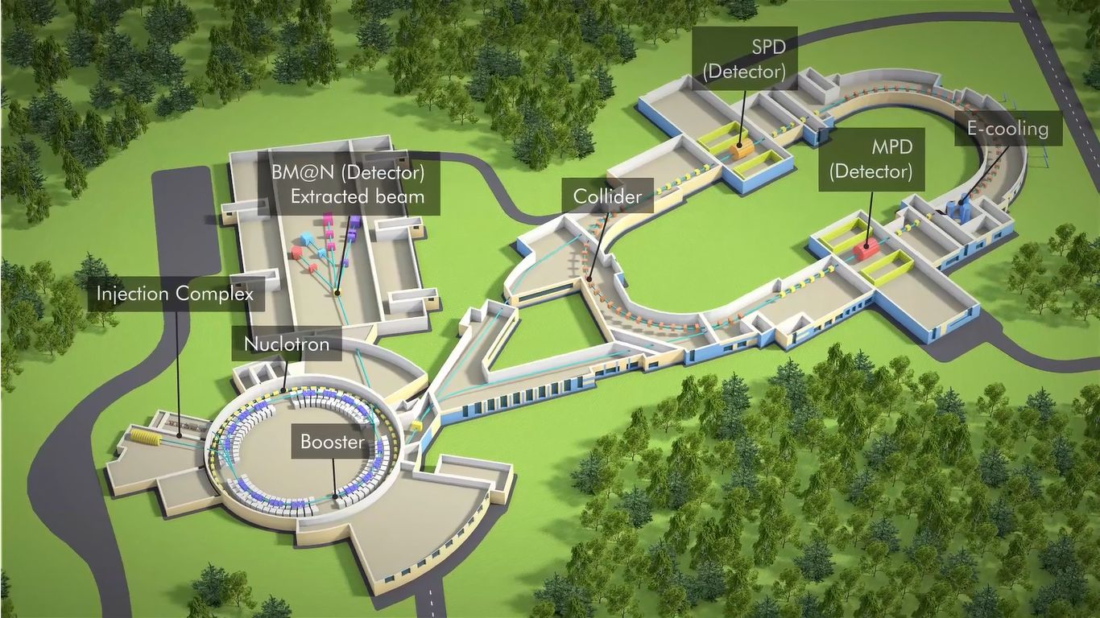
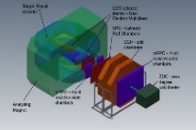
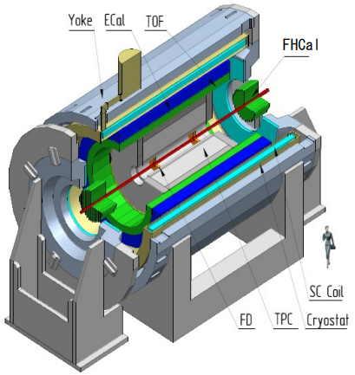
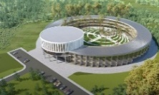
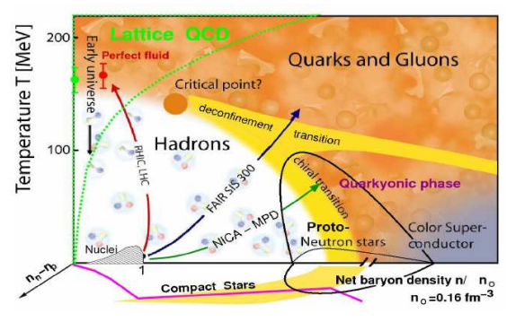
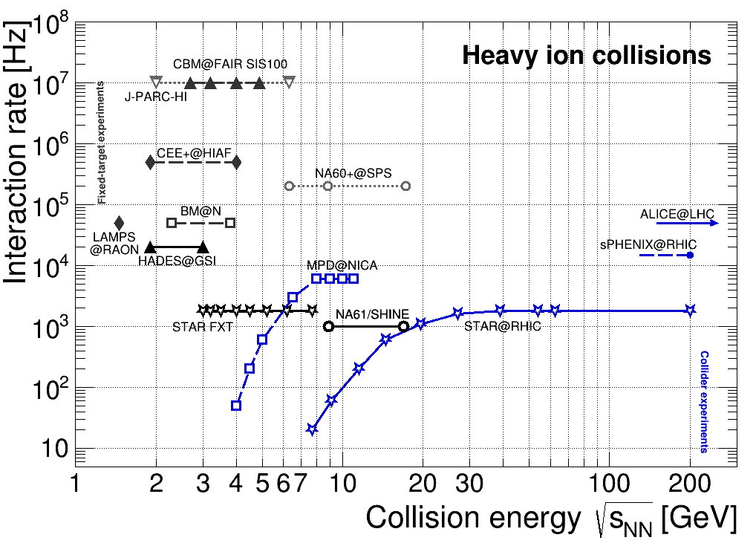
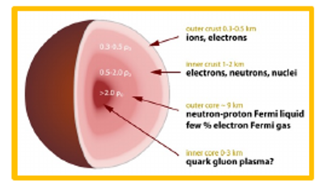
MPD at NICA
One of two experiments at NICA collider to study heavy-ion collisions at √s_{NN} = 4 – 11 GeV
Stage- I
TPC: |Δϕ| < 2π, |η| ≤ 1.6
TOF, EMC: |Δϕ| < 2π, |η| ≤ 1.4
FFD: |Δϕ| < 2π, 2.9 < |η| < 3.3
FHCAL: |Δϕ| < 2π, 2 < |η| < 5
high baryon densities → inner structure of compact stars
NICA will study QCD medium at extreme net baryon densities → 1st order phase transition + QCD CEP
Many ongoing (NA61/Shine, STAR-BES) and future experiments (CBM) in ~ same energy range

Slide 3
Resonances as a probe of heavy-ion collisions

Slide 4
Resonances in heavy-ion collisions
Wide variety of resonances in the PDG, most often/easily measured are:
Vacuum properties of the resonances are well defined (m, τ, BR etc.)
Copiously produced in heavy-ion collisions at ~ GeV energies, large branching ratios in hadronic decay channels → possible to measure
Probe reaction dynamics and particle production mechanisms vs system size and √s_{NN}:
hadron chemistry and strangeness production, φ with hidden strangeness is one of the key probes
reaction dynamics and shape of particle p_{T} spectra, p/K*, p/φ vs p_{T}
lifetime and properties of the hadronic phase
spin alignment of vector mesons in rotating QGP (polarization of quarks from spin-orbital interactions)
flow, comparison with e⁺e⁻ measurements, jet quenching, background for other probes etc

Slide 5
Hadronic phase and medium modifications
Resonances have small lifetime of τ ~ 1 – 45 fm/c, part of them decays in the fireball
Reconstructed resonance yields in heavy ion collisions are defined by:
resonance yields at chemical freeze-out
hadronic processes between chemical and kinetic freeze-outs:
rescattering: daughter particles undergo elastic scattering or pseudo-elastic scattering through a different resonance → parent particle is not reconstructed → loss of signal
regeneration: pseudo-elastic scattering of decay products (πK → K^{*0}, KK→ φ etc.) → increased yields
DOI: 10.1103/PhysRevC.107.034907
Precise measurements at NICA are needed to validate description of the hadronic phase in models
suppressed production of short-lived resonances (τ < 20 fm/c) in central A+A collisions → rescattering takes over the regeneration
no modification for longer-lived resonances, φ-meson (τ ~ 40 fm/c)
yield modification depends on event multiplicity, not on collision system/energy

Slide 6
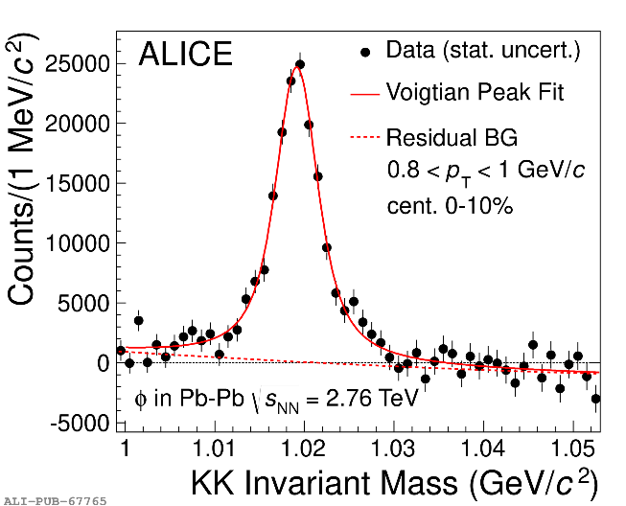
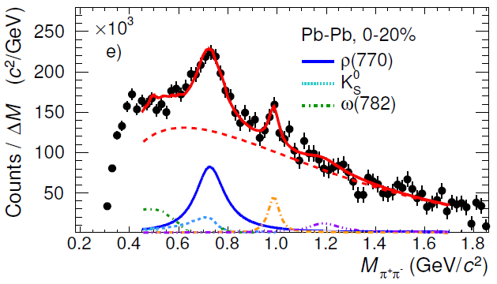
Resonance reconstruction
Hadronic decays of resonances are studied with the invariant mass method in the experiments
After subtraction of uncorrelated combinatorial background estimated with mixed-event pairs, like-sigh pairs, rotation pairs etc., the resonance peaks are approximated with a given peak-model (rBW + mass resolution + mass-dependent width + phase space correction + …) + background function
Examples of invariant mass distributions and fits from ALICE for φ, Λ(1520) and ρ(770)⁰:
For most of the cases, the peak models are inspired by theory and measurement in elementary e⁺e⁻ and/or pp collisions where medium effects are not as important
Line shape modifications will result in the change of the measured yield and masses/widths

Slide 7
Studies for resonances reconstruction possibility at NICA-MPD in Bi+Bi collisions at √s_{NN} = 9.2 GeV

Slide 8
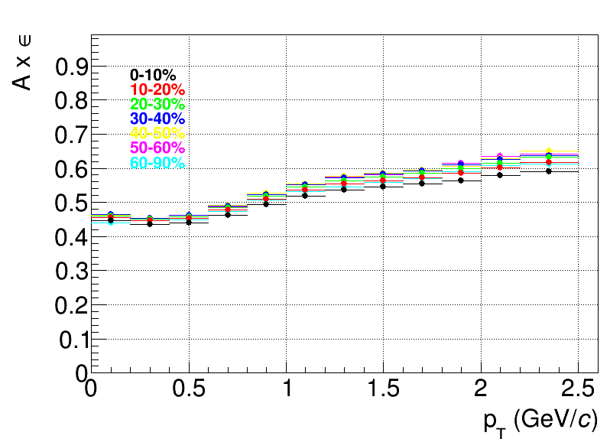
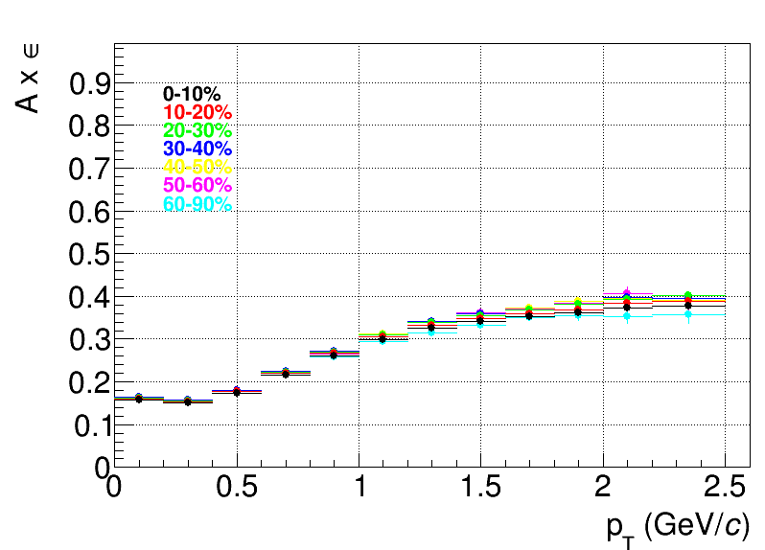
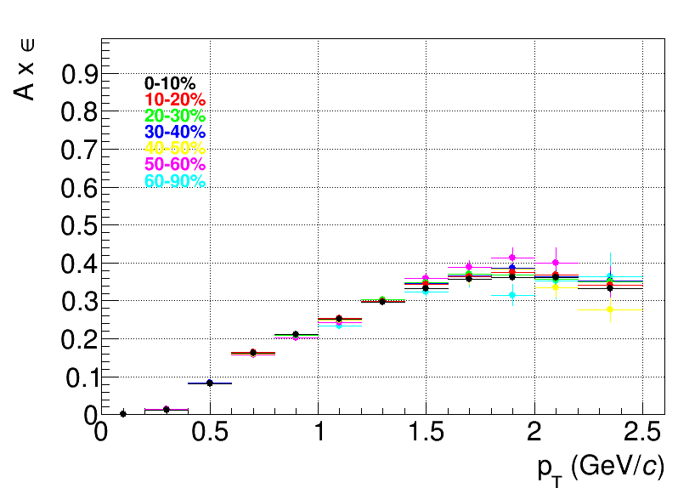
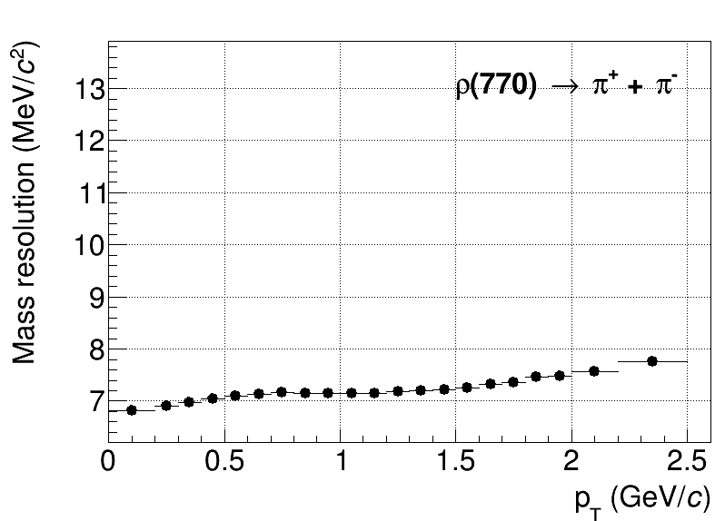
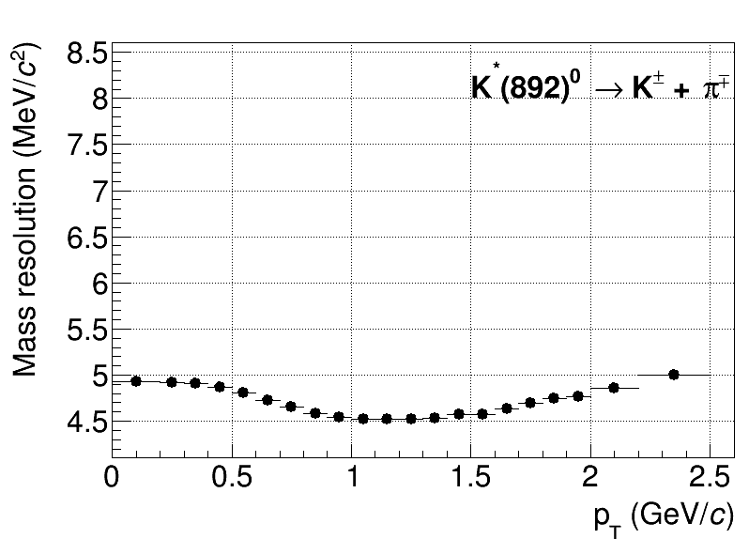
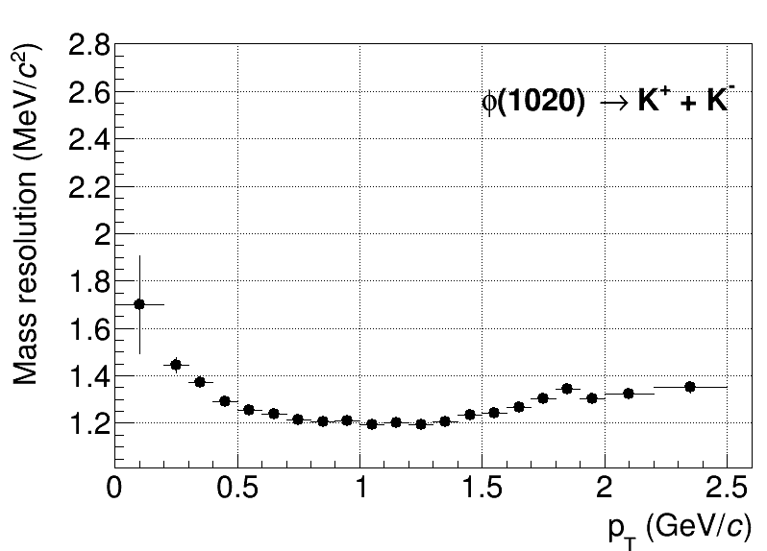
Reconstruction efficiencies and Mass resolutions
Full chain simulation and reconstruction with UrQMD v.3.4 (BiBi@9.2 GeV, 50M events)
Particles propagation through the MPD with ‘mpdroot’ (Geant v.4):
realistic simulation of subsystem response (raw signals)
track/signal reconstruction and pattern recognition
Typical reconstruction efficiencies (A x ∈) at different centralities, |y| < 0.5
ρ(770)→π⁺+π⁻
K*(892)⁰→π±+K∓
ϕ(1020)→K⁺+K⁻
Reasonable efficiencies in the wide p_{T} range, |y| < 0.5
Measurements are possible from 0 momentum for K*(892)⁰, ρ(770) and from 0.2 – 0.4 GeV/c for ϕ(1020)
Modest centrality dependence
Mass resolution is good enough to preserve the capability for the line shape analysis

Slide 9
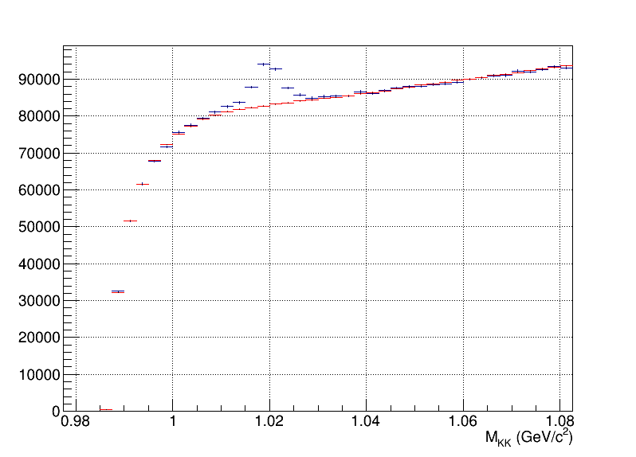
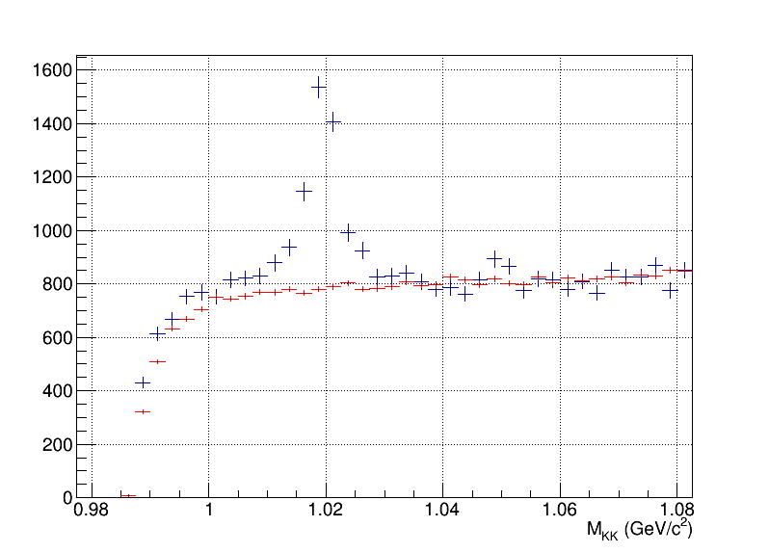
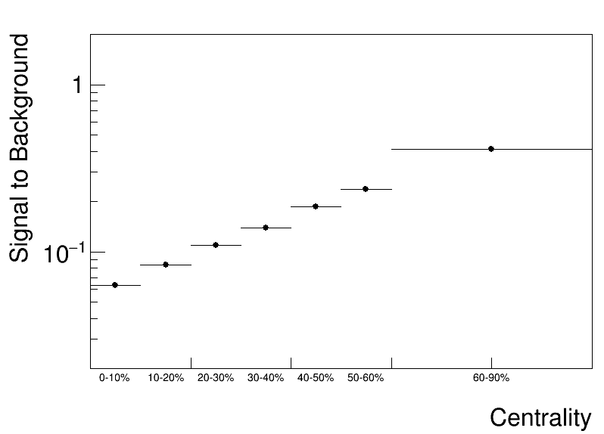
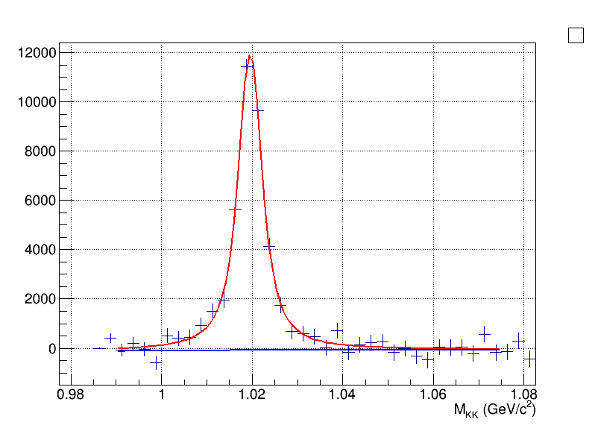
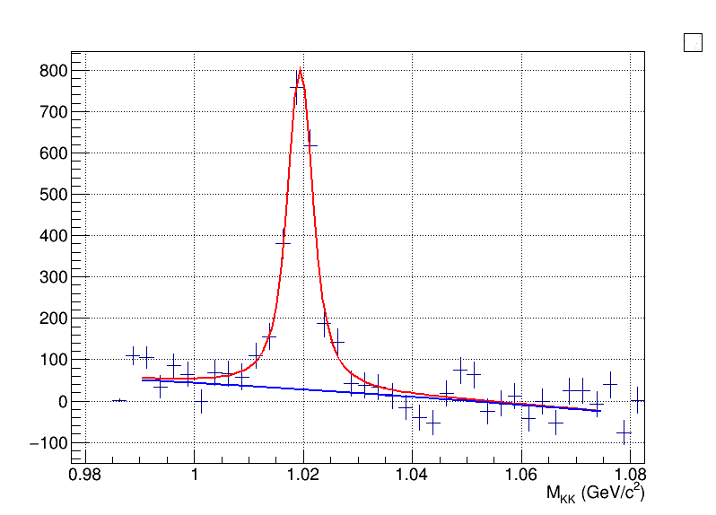
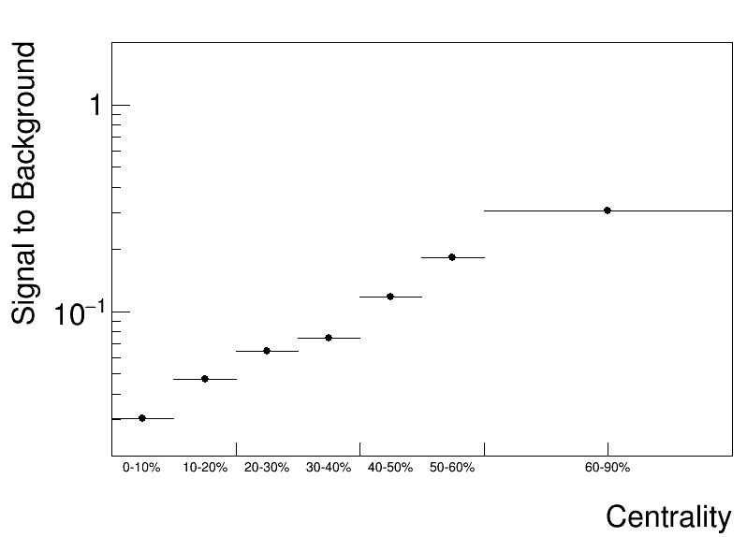
ϕ(1020), reconstructed peaks
Full chain simulation and reconstruction, p_{T} = 0.4 – 0.6 GeV/c, ϕ(1020)→K⁺ + K⁻, |y| < 0.5
0 – 10%
60 – 90%
0.4 – 0.6 GeV/c
Foreground
Mixed event
1.6 – 1.8 GeV/c
Mixed-event combinatorial background is scaled to foreground at high mass and subtracted
Distributions are fit to Voigtian function + polynomial (mass resolution fixed to estimated value, Γ – free parameter)
Signal can be reconstructed at p_{T} > 0.2 GeV/c, high-p_{T} reach is limited by available statistics
S/B ratios deteriorates with increasing centrality

Slide 10
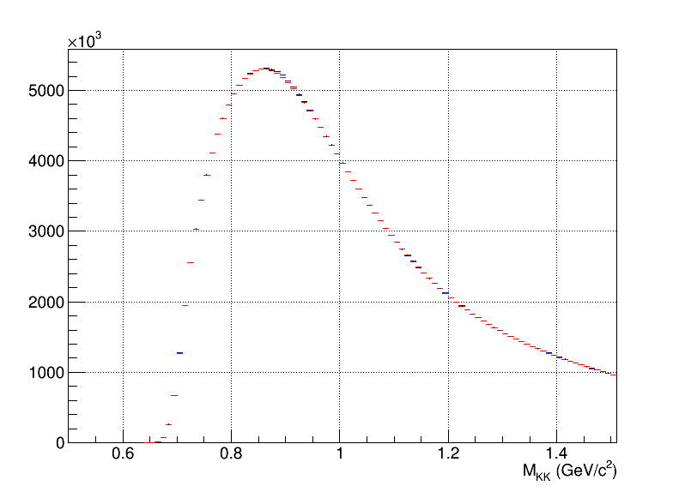
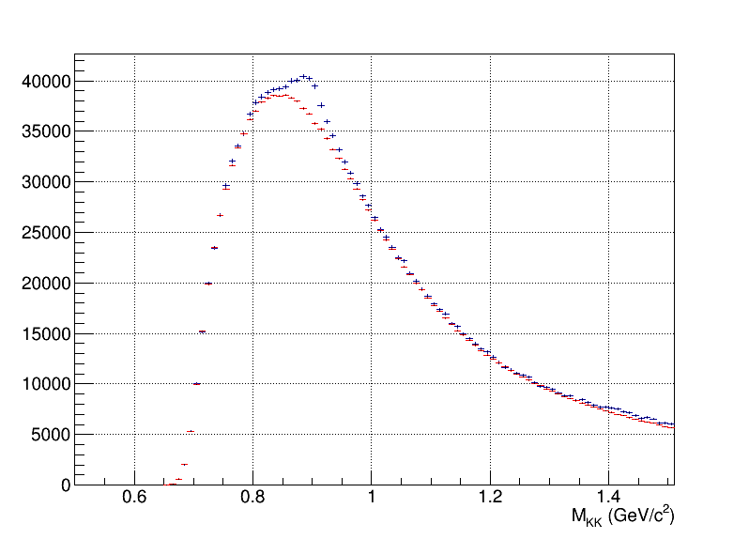
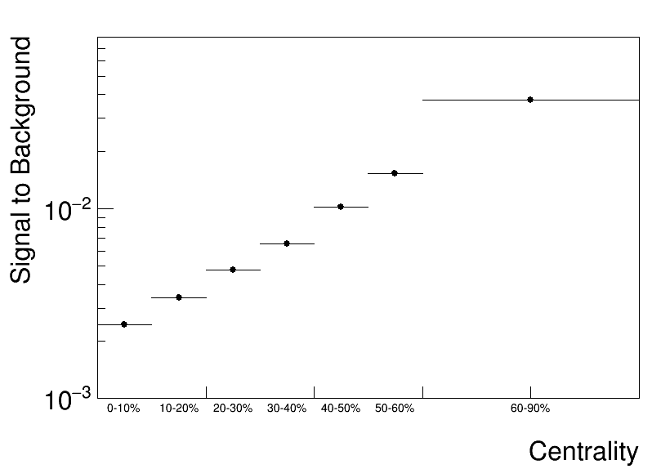
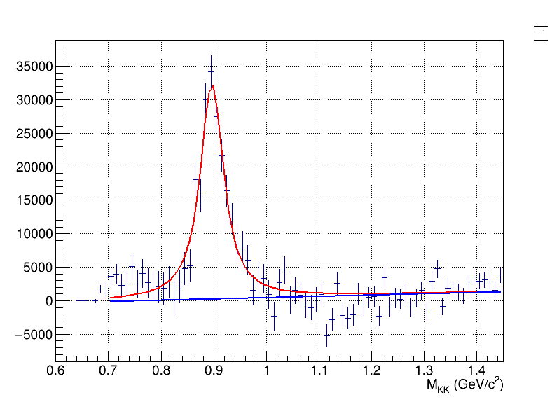
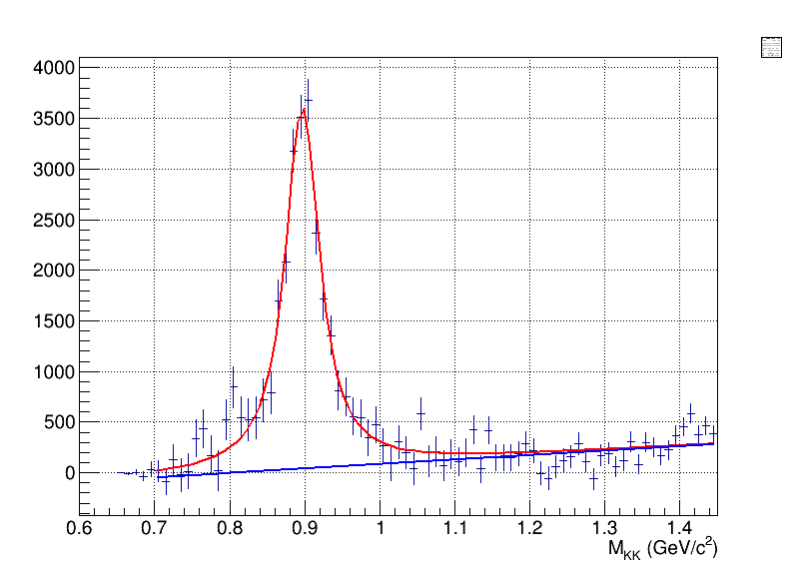
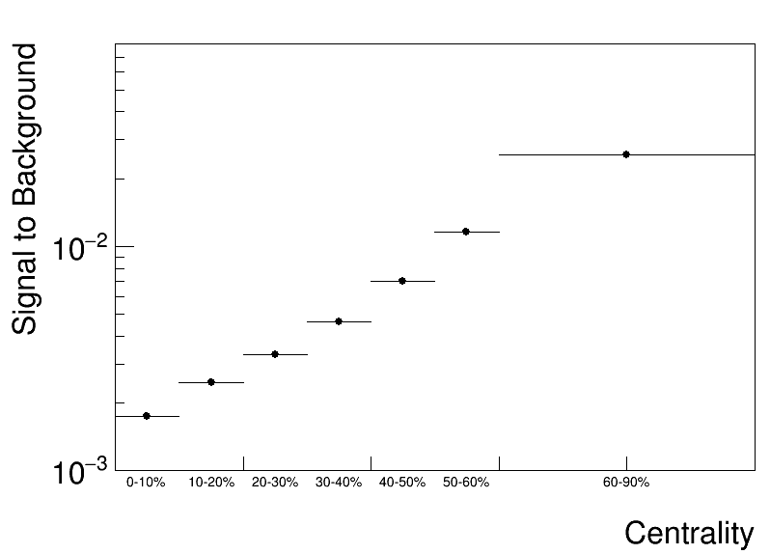
K*(892)⁰, reconstructed peaks
Full chain simulation and reconstruction, p_{T} = 0.0 – 0.2 GeV/c, K*(892)⁰→π± + K∓, |y| < 0.5
0 – 10%
60 – 90%
Foreground
Mixed event
0 – 0.2 GeV/c
1.6 – 1.8 GeV/c
Mixed-event combinatorial background is scaled to foreground at high mass and subtracted
Distributions are fit to Voigtian function + polynomial (mass resolution fixed to estimated value, Γ – free parameter)
Signal can be reconstructed at p_{T} > 0, high-p_{T} reach is limited by available statistics
S/B ratios deteriorates with increasing centrality

Slide 11
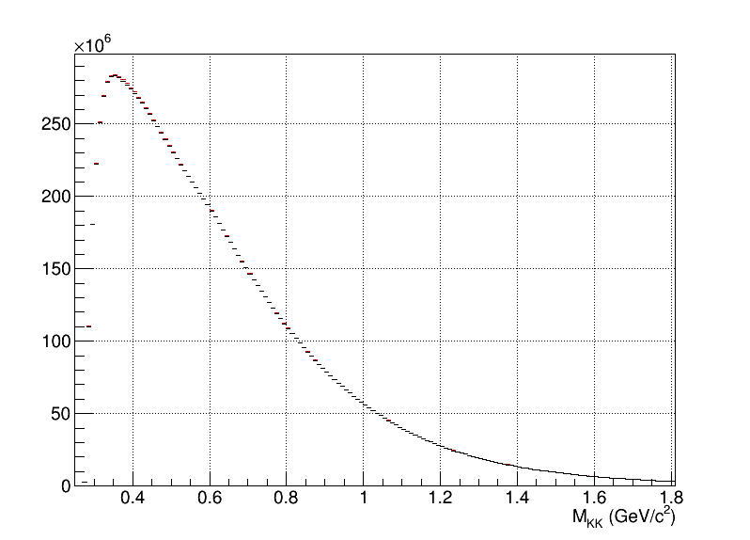
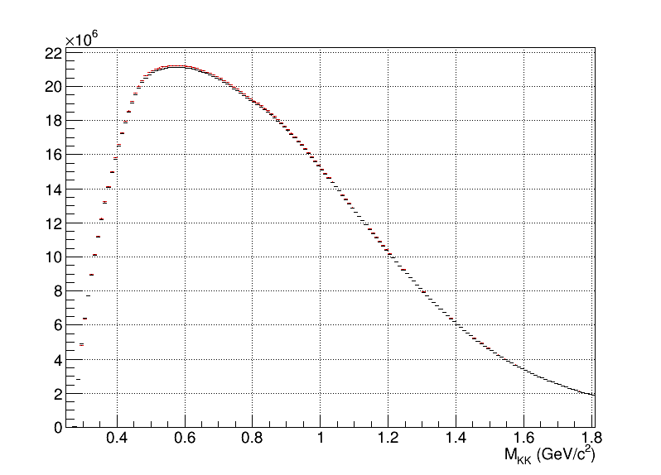
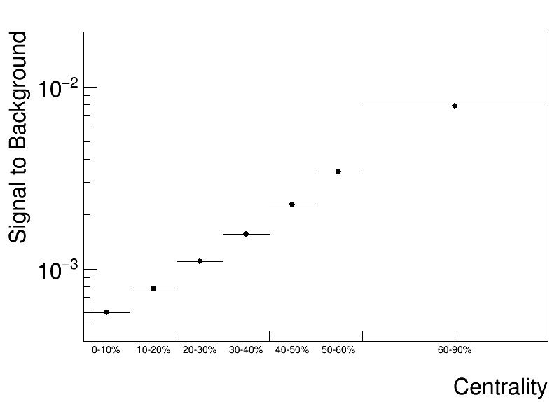
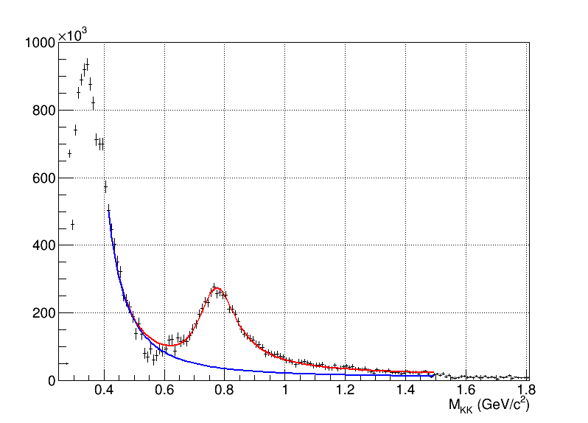
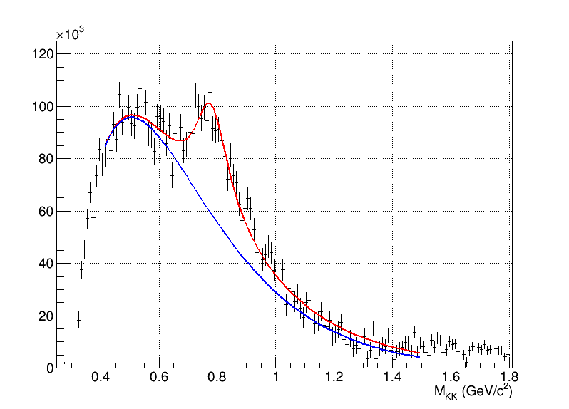
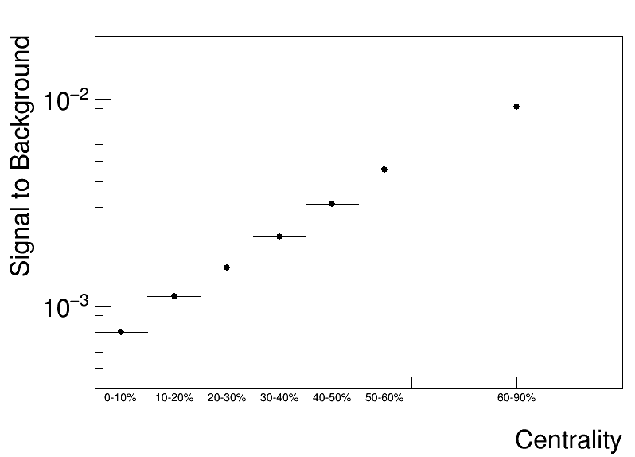
ρ(770), reconstructed peaks
Full chain simulation and reconstruction, centrality 0-10%, ρ(770)→π⁺ + π⁻, |y| < 0.5
0.4 – 0.6 GeV/c
1.4 – 1.6 GeV/c
0.4 – 0.6 GeV/c
Foreground
Mixed event
1.4 – 1.6 GeV/c
Mixed-event combinatorial background is scaled to foreground at high mass and subtracted
Distributions are fit to Voigtian function + polynomial (mass resolution fixed to estimated value, Γ – free parameter)
Signal can be reconstructed at p_{T} > 0, high-p_{T} reach is limited by available statistics
S/B ratios deteriorates with increasing centrality

Slide 12
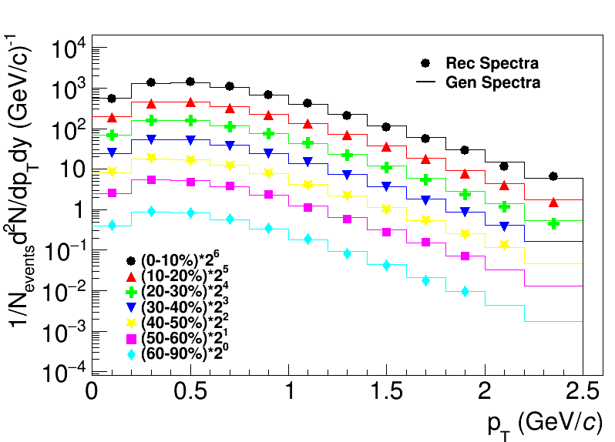
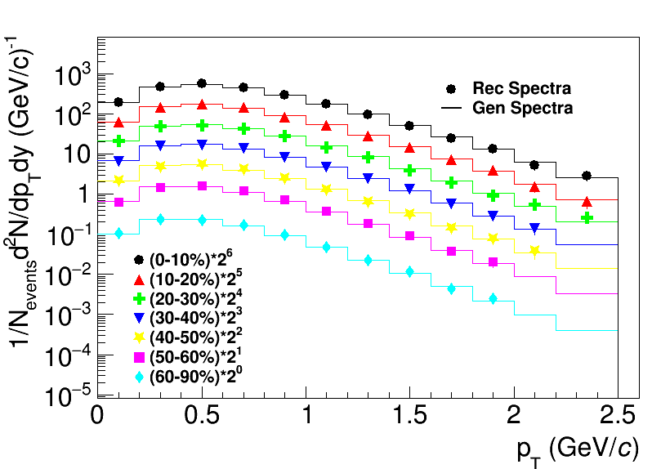
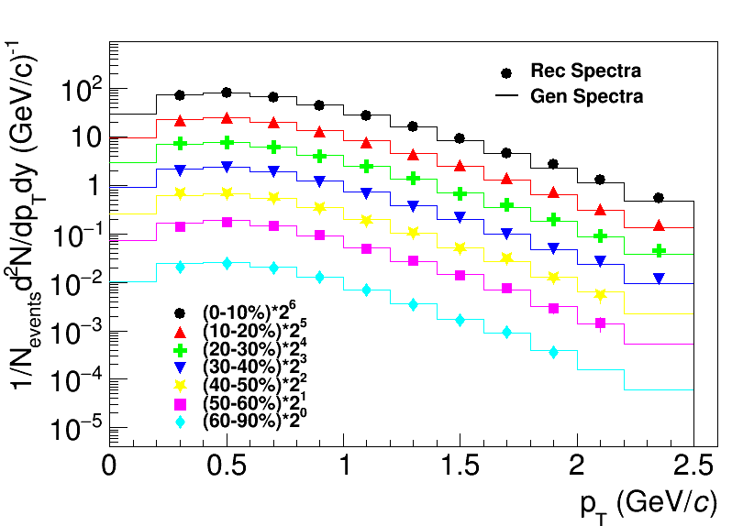
Production spectra and MC closure test
Full chain simulation and reconstruction, ranges are limited by the possibility to extract signals, |y| < 0.5
ρ(770)
K*(892)⁰
ϕ(1020)
Reconstructed spectra match the generated ones within uncertainties
First measurements for resonances in centrality dependent analysis will be possible with accumulation of ~ 10⁸ Bi+Bi@9.2 GeV events
Measurements are possible starting from ~ zero momentum → sample most of the yield, sensitive to possible modifications

Slide 13
Conclusions and outlook
Measurement of resonances contribute to the MPD physical program
hadronic phase properties, strangeness production, hadronization mechanisms and collectivity, hadrochemistry, spin alignment etc …
First measurements for ρ(770), K*(892)⁰, ϕ(1020) resonances in centrality dependent analysis will be possible with ~10⁸ sampled Bi + Bi collisions at √s_{NN} = 9.2 GeV
Measurements are possible starting from very low momenta (for most of the cases from zero momenta) with decent mass resolution → high sensitivity to different physics phenomena most prominent at low p_{T}
Feasibility study of the reconstruction of other resonances such as K*(892)±→π±K_{s}, Σ(1385)±→π±Λ, Λ(1520)→pK⁻ in Bi + Bi collisions at √s_{NN} = 9.2 GeV is required for systematic study of resonance production and is in progress
We acknowledge support from Russian Ministry of Education and Science, state assignment for fundamental research (code FSEG-2024-0033)

Slide 14
Backup

Slide 15
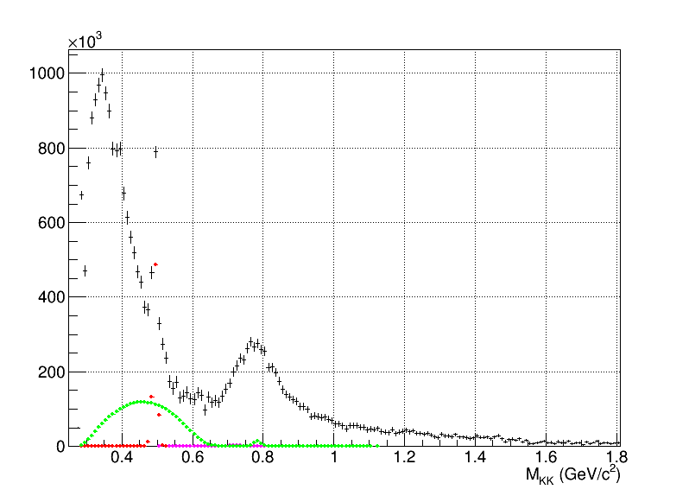
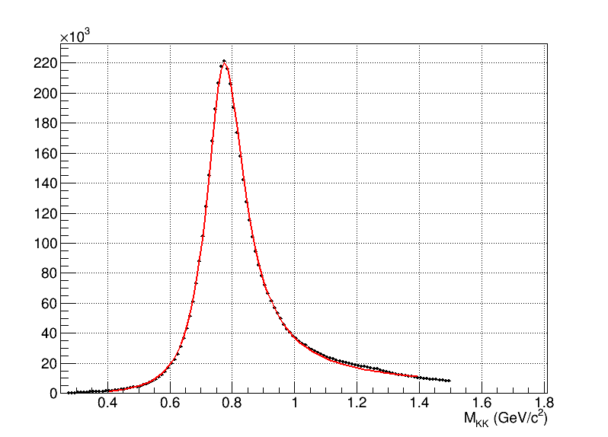
ρ(770), peak shape and correlated background
Full chain simulation and reconstruction, centrality 0-10%, ρ(770)→π⁺ + π⁻, |y| < 0.5
Peak-like contribution from:
K_{s}⁰→π⁺π⁻
ω→π⁺π⁻
ω→π⁺π⁻π⁰ (with missing π⁰)
K*(892)⁰→π±K± (with misidentified kaon)
Contributions must be measured in advance and subtracted (or accounted for)
K^{s}₀
ω
K*(892)⁰
Resonances peak shape Breit-Wigner (BW) with peak shape modifications:
detector mass resolution
dependence of resonance width on mass (for wide resonances)
phase space correction
Bose-Einstein correlations
mass dependence of reconstruction efficiency (for wide resonances)
(Partial) restoration of chiral symmetry
Hadronic phase modifications (rescatteringof daughter particles, regeneration)
$$BW(M)=A\frac{MM_{0}Γ(M)}{{(M_{0}^{2} − M^{2})}^{2}+ M_{0}^{2}Γ(M)}$$
$$Γ\left(M\right)= {[\frac{(M^{2} −4m_{π}^{2})}{(M_{0}^{2} −4m_{π}^{2})}]}^{3/2}∗Γ_{0}∗\left({M_{0}}/M\right)$$

Slide 16
Feasibility studies, framework
50M simulated minimum bias Bi+Bi collisions at √s_{NN} = 9.2 GeV using UrQMD 3.4 with default settings
Tracked simulated particles through the MPD detector using mpdroot
Decays of ρ(770)→π⁺π⁻ (τ ~ 1.3 fm/c); K*(892)⁰→π±K∓ (~4); ϕ(1020)→K⁺K⁻ (~46) were reconstructed by combining all daughter particles within an event
Analysis cuts were optimized for higher signal significance (no p_{T} variation)
Event selection:
|z_{vrtx}| < 130 cm, realistic distribution with σ_{z} ~ 50 см
Basic track selections:
number of TPC hits > 10
|η| < 1.0
p_{T} > 100 MeV/c
TPC-TOF combined PID within 2σ
TPC-refit for kaons and protons based on track PID hypothesis
Primary tracks:
|DCA(x,y,z)| < 2σ
Pairs:
|y| < 0.5
Combinatorial background:
event mixing ( |∆_{Zvrtx}| < 2 cm, |∆_{Mult}| < 20, N_{ev} = 10)

Slide 17
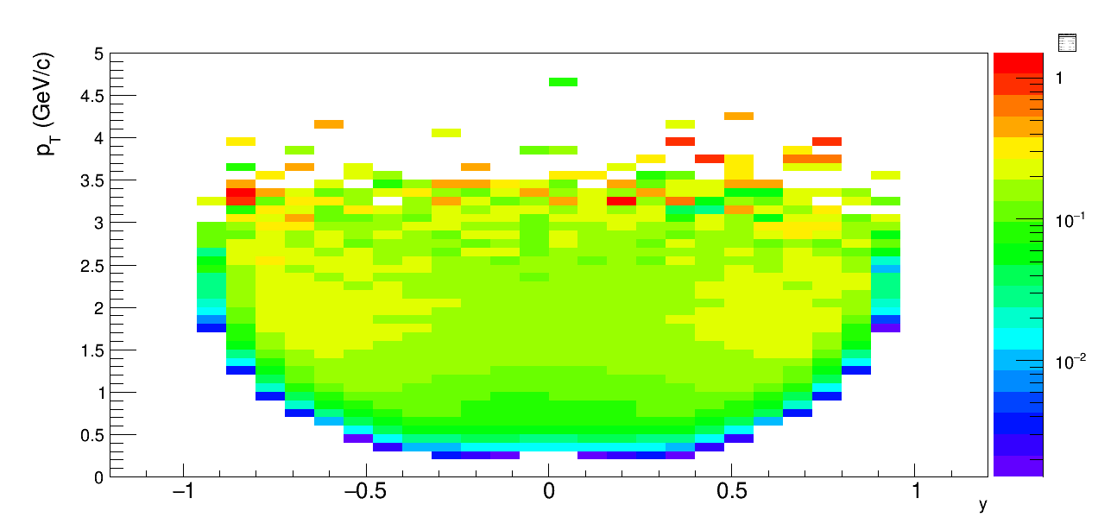
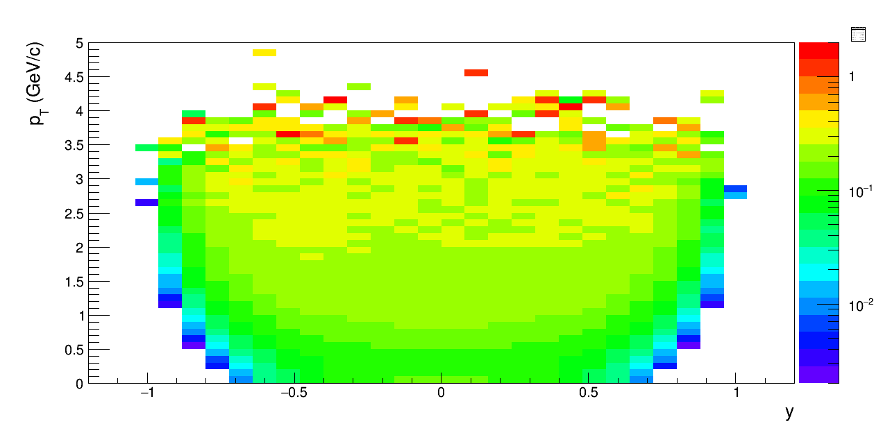
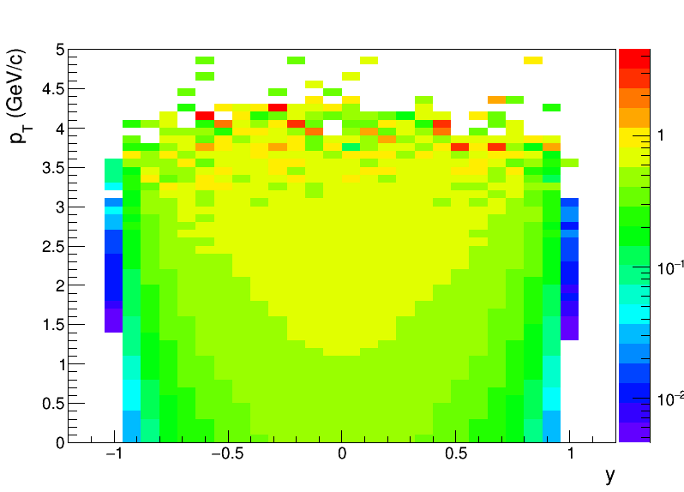
Reconstruction efficiencies 2D
ϕ(1020)
K*(892)⁰
ρ(770)
Reasonable efficiencies in the wide p_{T} range, |y| < 0.5
Measurements are possible from 0 momentum for K*(892)⁰, ρ(770) and from 0.2 – 0.4 GeV/c for ϕ(1020)

