Slide 1
On the study of the muon energy spectrum in the Baikal-GVD neutrino telescope
The 7th International Conference on Particle Physics and Astrophysics
Lisitsin M.V., Khokhlov S.S., Petrukhin A.A.
MVLisitsin@mephi.ru

Slide 2
Actuality of the study of TeV muons
Muon energy spectrum is important for estimating processes of muon generation including charmed particles and other fast processes.
Muon energy spectrum allows to evaluate the atmospheric neutrino background at searches of astrophysical neutrinos.
Currently, statistically reliable data on the energy spectrum of muons is available up to energies of ~20 TeV only.
So far, only giga volume water detectors, such as IceCube, Baikal-GVD, ANTARES, etc capable of detecting high energy muons
Goal of the work
Evaluation of statistics for the muon energy spectrum above 10 TeV in Baikal-GVD.

Slide 3
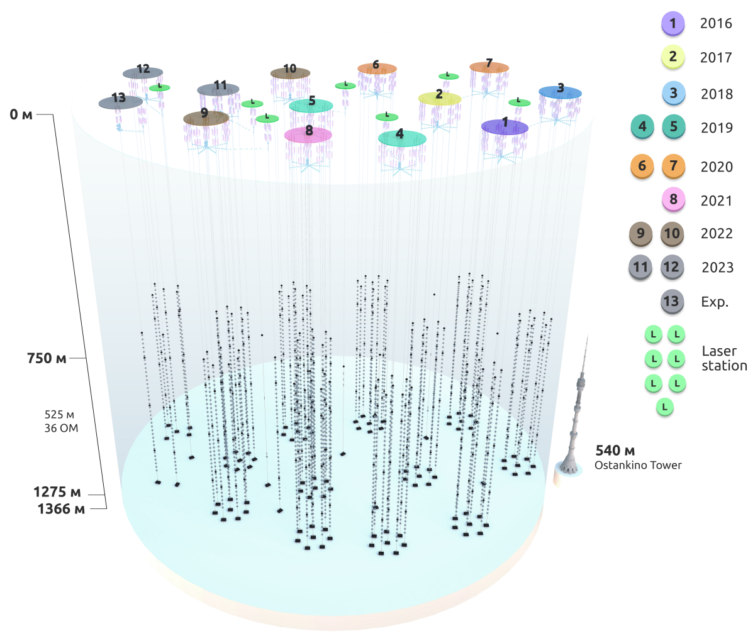
Cubic kilometer Baikal-GVD neutrino telescope
Under construction in the southern part of Lake Baikal since 2016
Total PMTs: >4100
Total clusters: 13
Instrumented depth: 750 m - 1275 m
Cluster radius: ~60 м.
Distance between two clusters: ~300 м.
1 km³ by 2027/2028
Schematic view of the Baikal-GVD detector

Slide 4
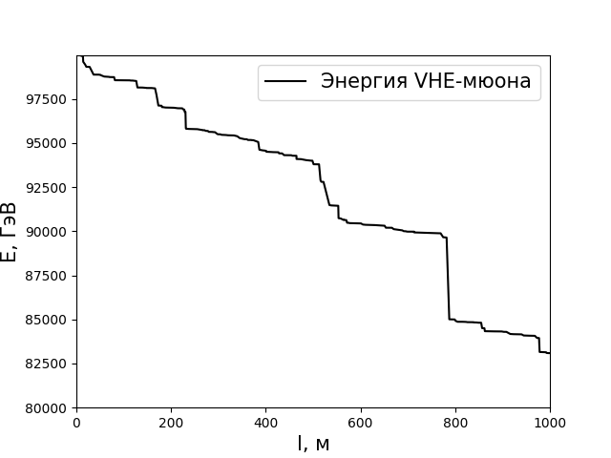
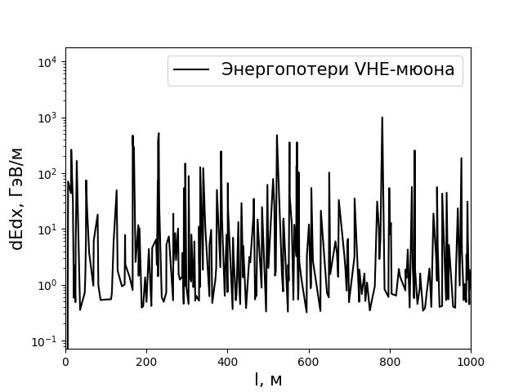
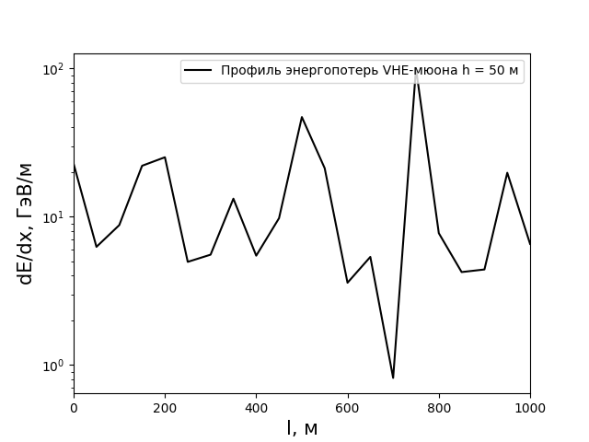
Muon energy and its loss in water
It is impossible to experimentally obtain the dependence of the muon energy on depth.
Longitudinal energy loss profiles can be measured in water detectors.
Example of simulated muon with energy of 100 TeV in the 1 km of water
VHE-muon energy
VHE-muon energy losses
VHE-muon longitudinal energy loss profile with step h=50
E, GeV
dE/dx, GeV/m
dE/dx, GeV/m
S, m
S, m
S, m
Dependence of muon energy on depth
Dependence of muon energy loss on depth
Dependence of muon energy loss on depth with a step of 50 m

Slide 5
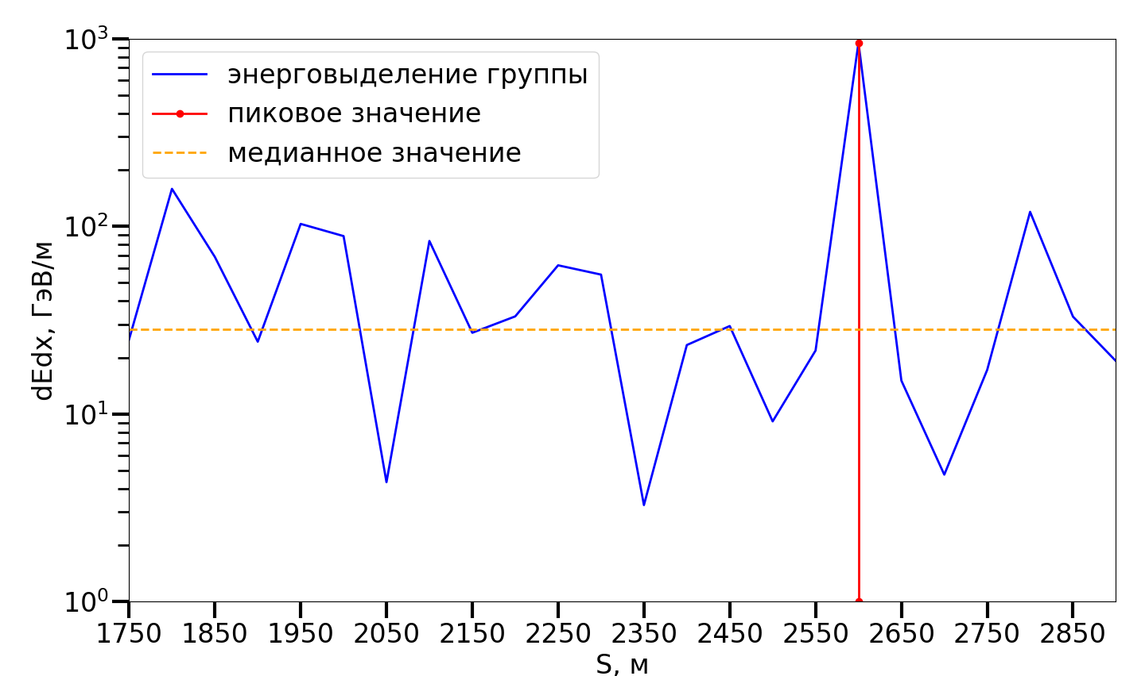
Peak-median parameter for searching VHE muon cascades
Energy loss of muons:
$$−\frac{dE_{μ}}{dx}=a(E_{μ})+b\left(E_{μ}\right)E_{μ}$$
$$E_{μc}=\frac{a}{b} − muon critical energy$$
$$(1029 GeV in water)$$
The contribution of various processes to the muon ($E_{μ}=100 TeV$) energy loss:
δ-electrons: ≈ 0.3 %;
pair production: ≈ 49 %;
bremsstrahlung: ≈ 35 %;
photonucl. interaction: ≈ 15 %.
$peak/med=\frac{\max\left(\frac{dE}{dS}\right)}{median\left(\frac{dE}{dS}\right)}$
Muon bundle energy loss
Peak energy loss
Median energy loss
dE/dx, GeV/m
S, m
Example on peak/med value estimation.

Slide 6
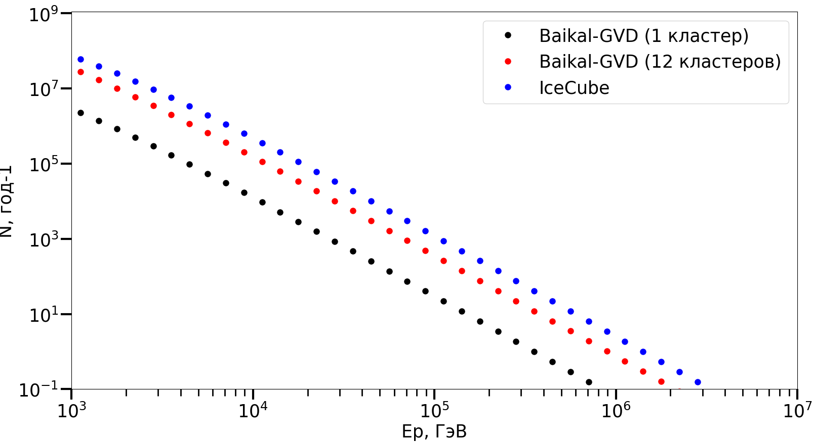
Calculation of the cascade spectrum for the Baikal-GVD Range of cascades for Baikal-GVD and IceCube detectors
Estimated number of registered cascades per year
> 10 TeV
Baikal-GVD (12 clusters): ~ 10⁵
IceCube: ~ 3*10⁵
> 100 TeV
Baikal-GVD (12 clusters): ~ 570
IceCube: ~ 1922
> 1 PeV
Baikal-GVD (12 clusters): ~ 2
IceCube: ~ 4
1 cluster )
12 clusters )
N, per year
Ep, GeV
Comparison of cascade spectra for Baikal-GVD installations (for the case with 1 and 12 clusters) and IceCube.

Slide 7
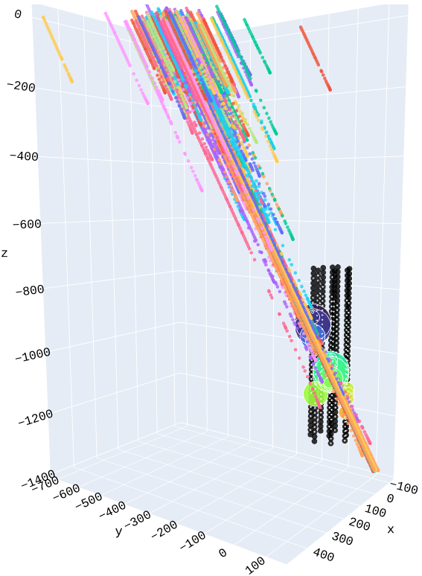
Simulated muon bundle at Baikal-GVD cluster
Muon bundle example, simulated with NtSim package.
Coloured dots – muons losses
Black dots – cluster PMTs
Muon bundle parameters
Primary particle: proton
Primary E_{p}: ~1241 TeV
Multiplicity: 288
maxEµ: ~4 TeV
maxLµ: ~1.5 km

Slide 8
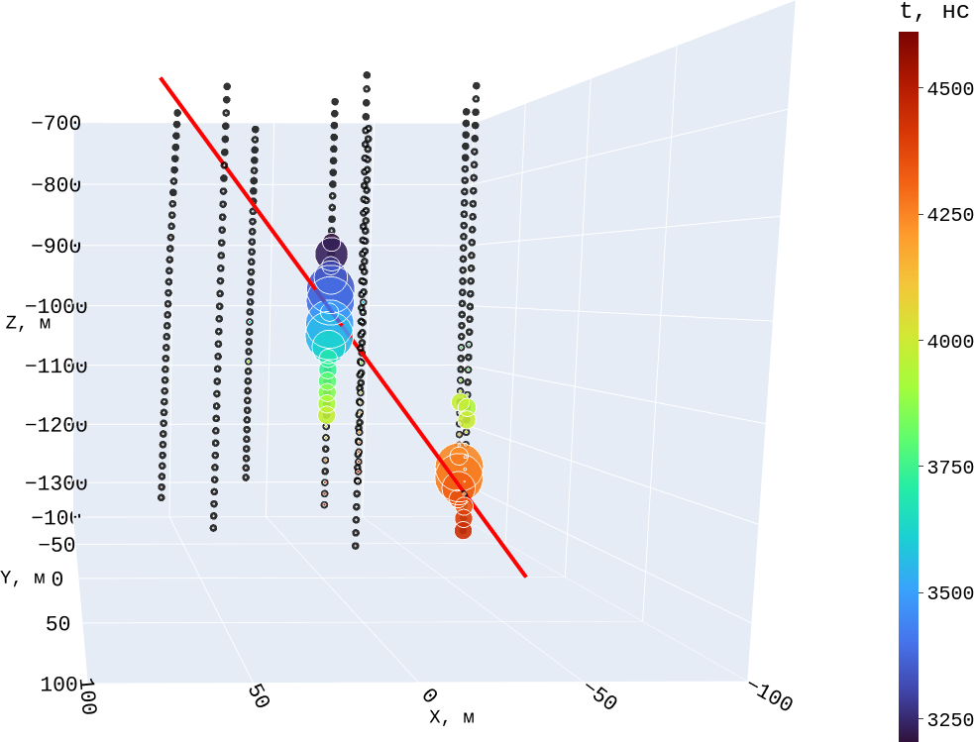
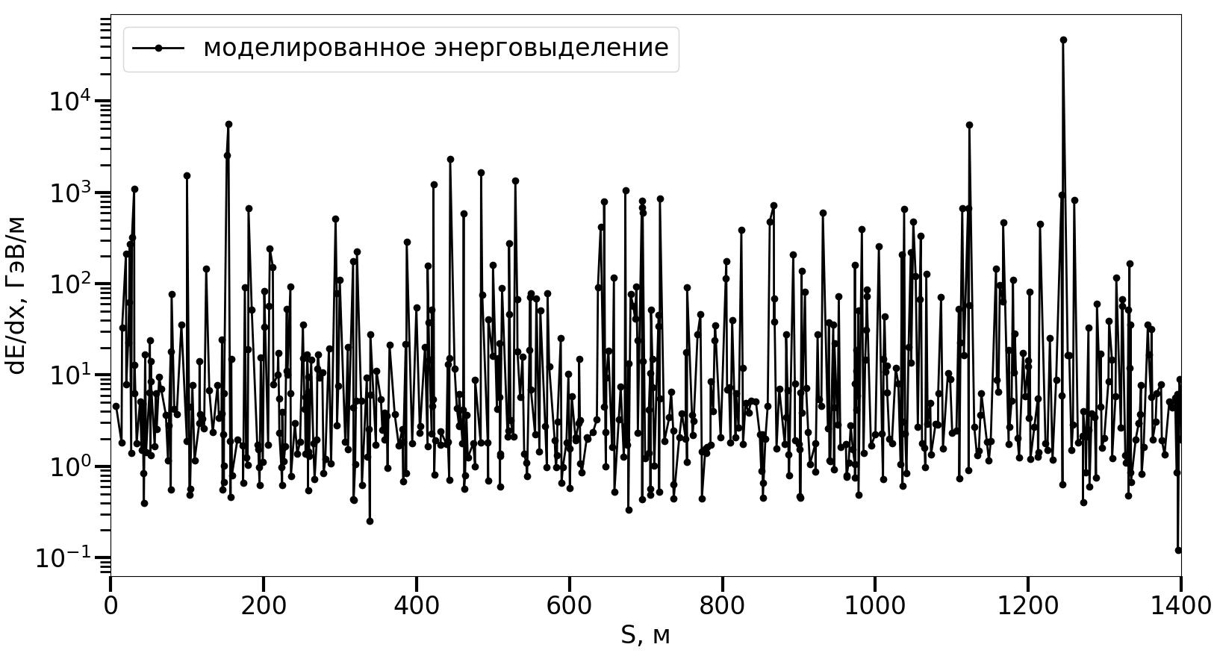
Single muon energy profile reconstruction
Simulated energy loss
250 TeV muon simulation in NtSim package.
250 TeV simulated muon energy losses.

Slide 9
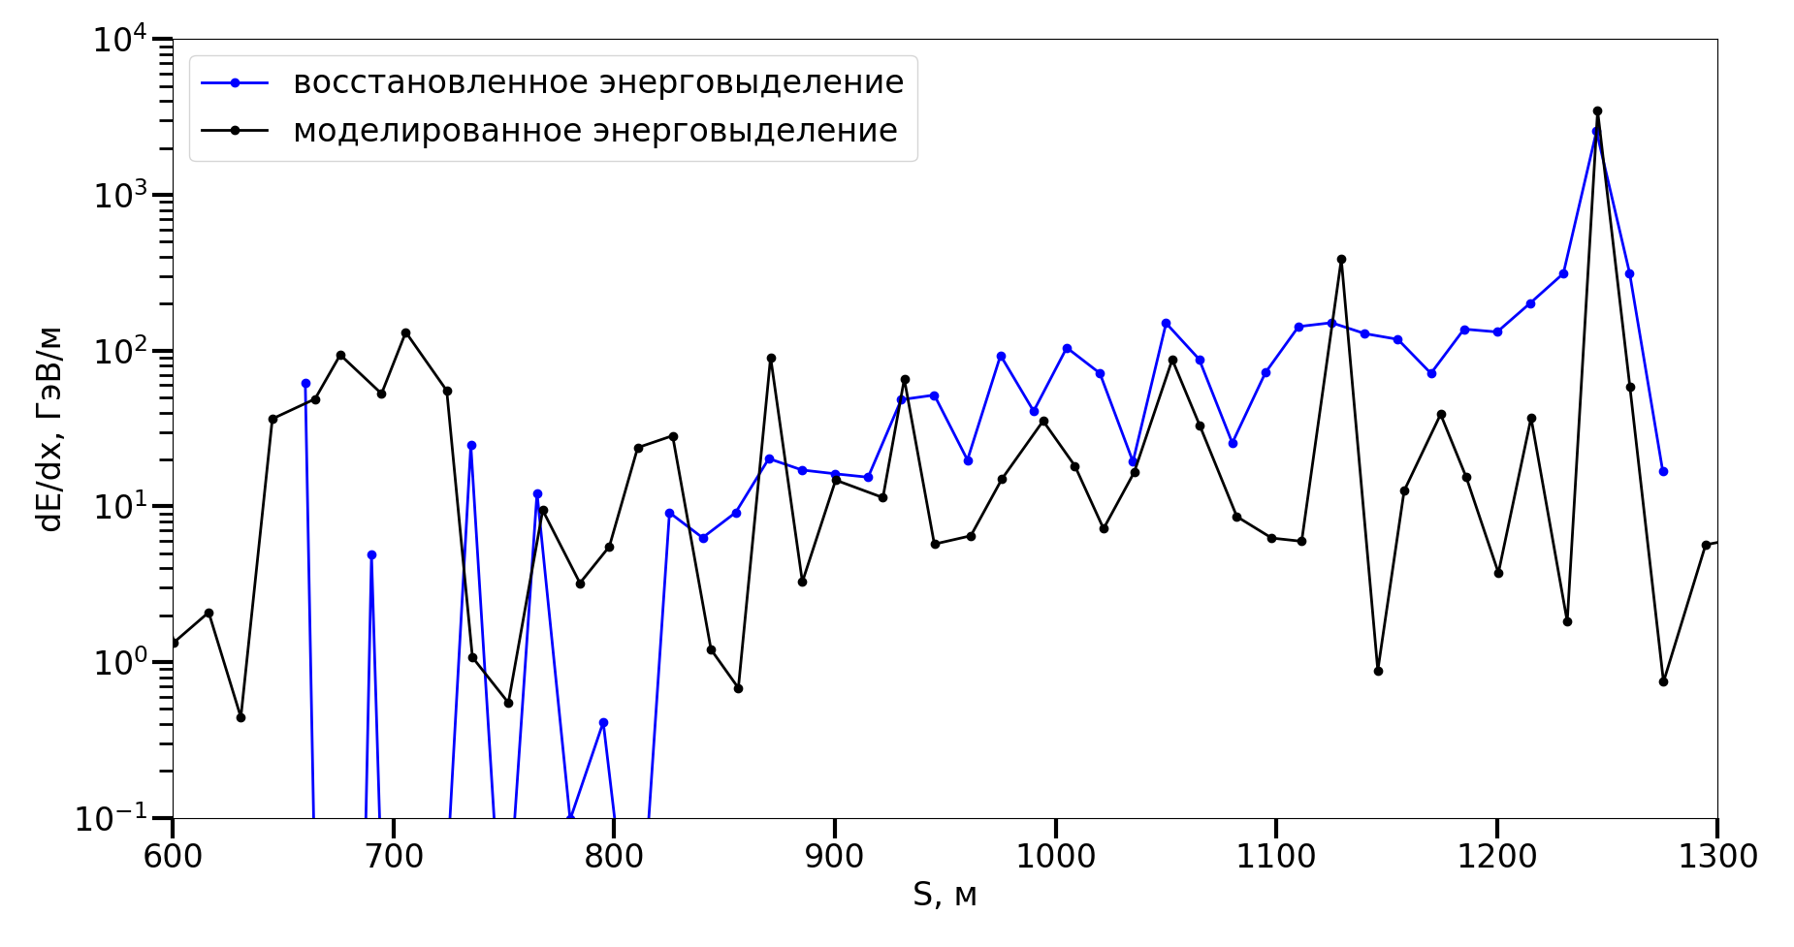
Singular muon energy profile reconstruction
Longitudinal energy loss profile characteristics comparison between simulated and reconstructed muon.
Reconstructed longitudinal energy loss profile
 | Simulated parameters | Reconstructed parameters
mean dE/dS, GeV/m | 119 | 128
median dE/dS, GeV/m | 15 | 41
max dE/dS, GeV/m | 3465 | 2556
peak/med value | 235 | 63
max dE, TeV | 47 | 51
Simulated longitudinal energy loss profile
dE/dx, GeV/m
S, m
Simulated and reconstructed energy loss profiles.

Slide 10
Conclusion
Preliminary calculations show that calorimetric method for analyzing muon events in Baikal-GVD allows measuring the muon energy spectrum up to PeV.
A preliminary technique for the longitudinal energy loss profile reconstruction allows measuring high energy losses.

Slide 11
Thank you for your attention!

Slide 12
On the study of the muon energy spectrum in the Baikal-GVD neutrino telescope
The 7th international conference on particle physics and astrophysics
Lisitsin M.V., Khokhlov S.S., Petrukhin A.A.
MVLisitsin@mephi.ru

Slide 13
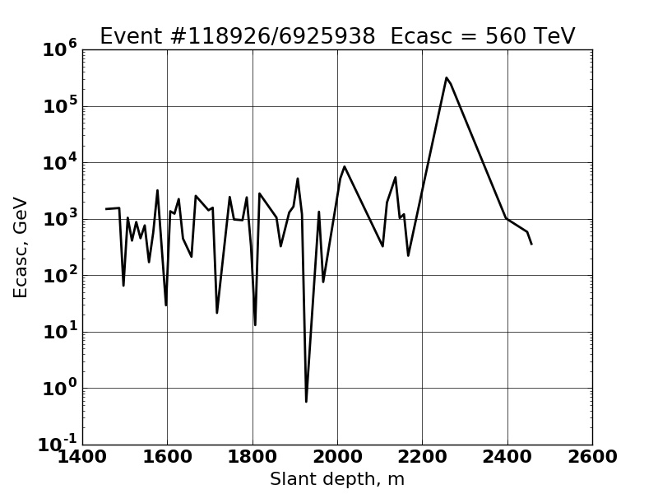
Example of VHE event cascade in IceCube
Estimation of VHE muon energy at the surface
E_{μ} > ε_{cascade}exp(depth∙b)
E_{μ}= 560 exp(2.2∙10⁵∙2.9∙10⁻⁶)
E_{μ} = 1.1 PeV
Candidate event for a very-high energy muon (ε = 560 TeV, Eμ > 1.1 PeV).

