Slide 1
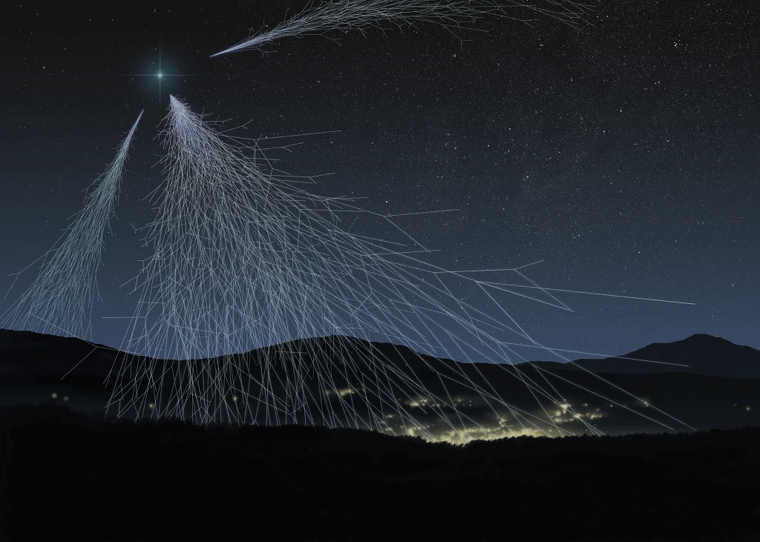

7th International Conference on Particle Physics and Astrophysics
Characteristics of EAS electron-photon and hadron components detected by the facilities of the Experimental Complex NEVOD
E.A. Yuzhakova, M.B. Amelchakov, A.G. Bogdanov, A.N. Dmitrieva, D.M. Gromushkin, A.Yu. Konovalova, K.R. Nugaeva, S.S. Khokhlov, I.A. Shulzhenko, S.Yu. Zhezhera, E.P. Khomchuk
October, 25
2024

Slide 2
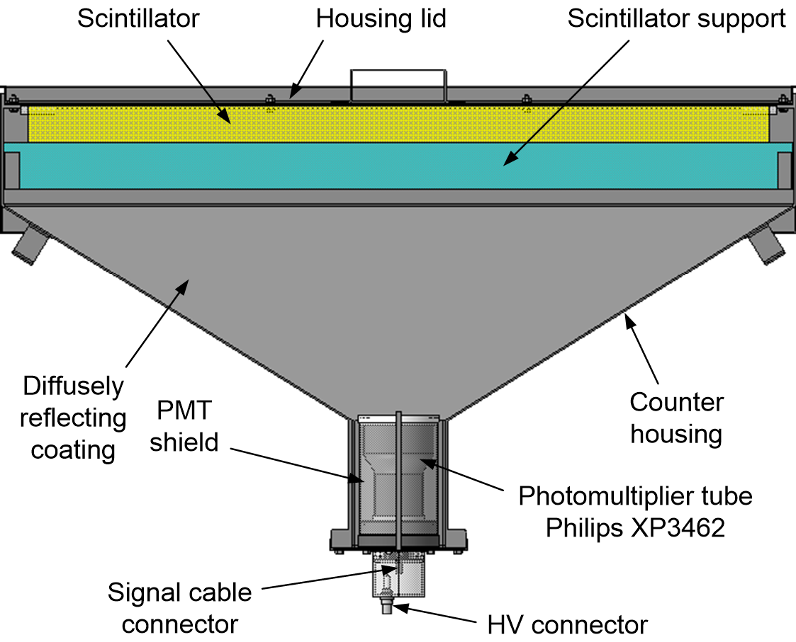
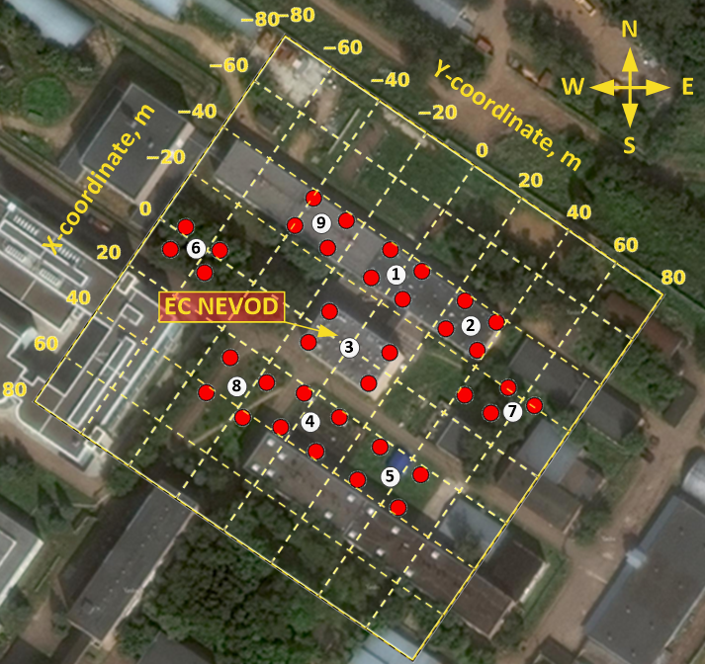
NEVOD-EAS array
9 clusters, 36 detector stations (DS);
144 detectors;
Array area: 10⁴ m².
2

Slide 3
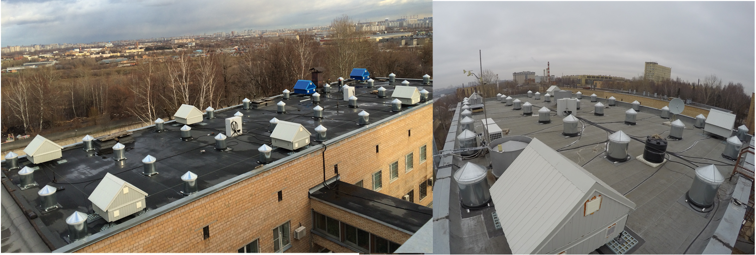
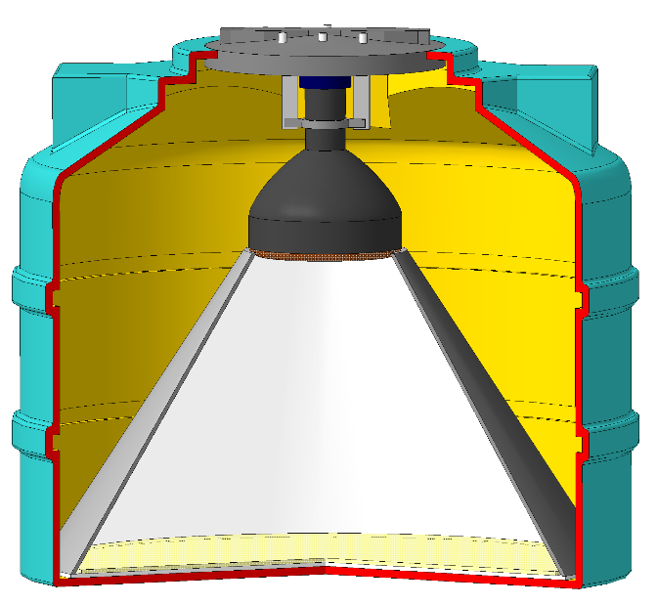
URAN array
72 en-detectors;
6 clusters;
Scintillator: ZnS(Ag) + B₂O₃;
Array area ~ 10³ m².
3

Slide 4
Data for analysis
Simulation:
CORSIKA using the hadron interaction model QGSJET-II-04 + FLUKA 2020.0.3;
p, E=10¹⁴ – 10¹⁷ eV (> 2.4 million events).
Experiment:
NEVOD-EAS data from 2018 to 2023, live-time ⁓ 48 months;
URAN data from January to June 2022, live-time ⁓ 6 months.
4

Slide 5
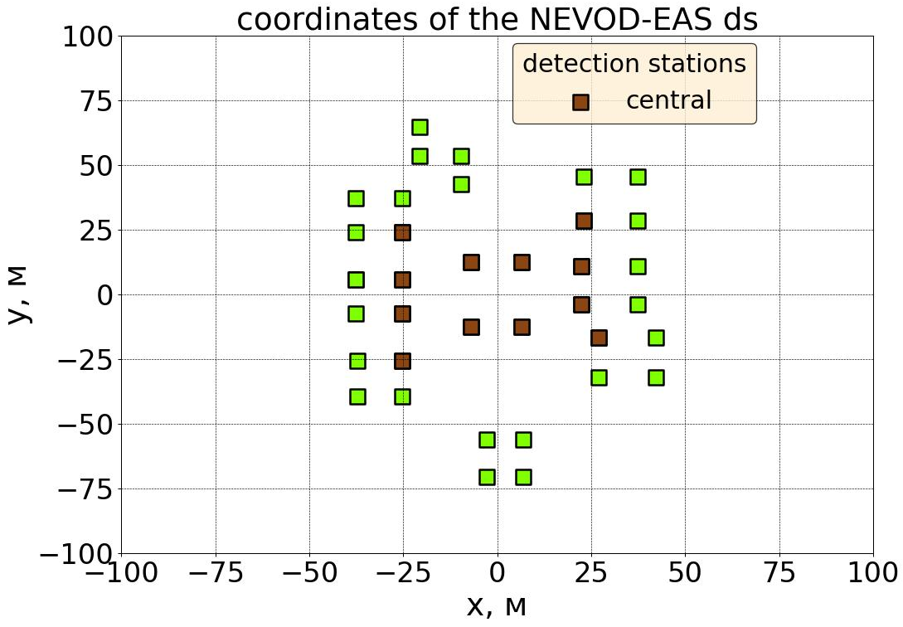
Selection conditions for NEVOD-EAS array
Coordinates of the NEVOD-EAS detector stations
Maximum energy deposit in central detector stations;
≥ 5 clusters triggered simultaneously;
Total energy deposit > 1 GeV;
Zenith angle < 18°.
Detector stations
central
peripheral
Y, m
X, m
5

Slide 6
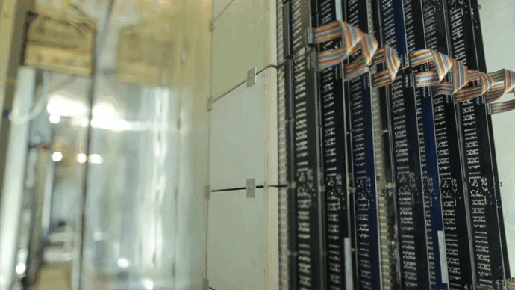
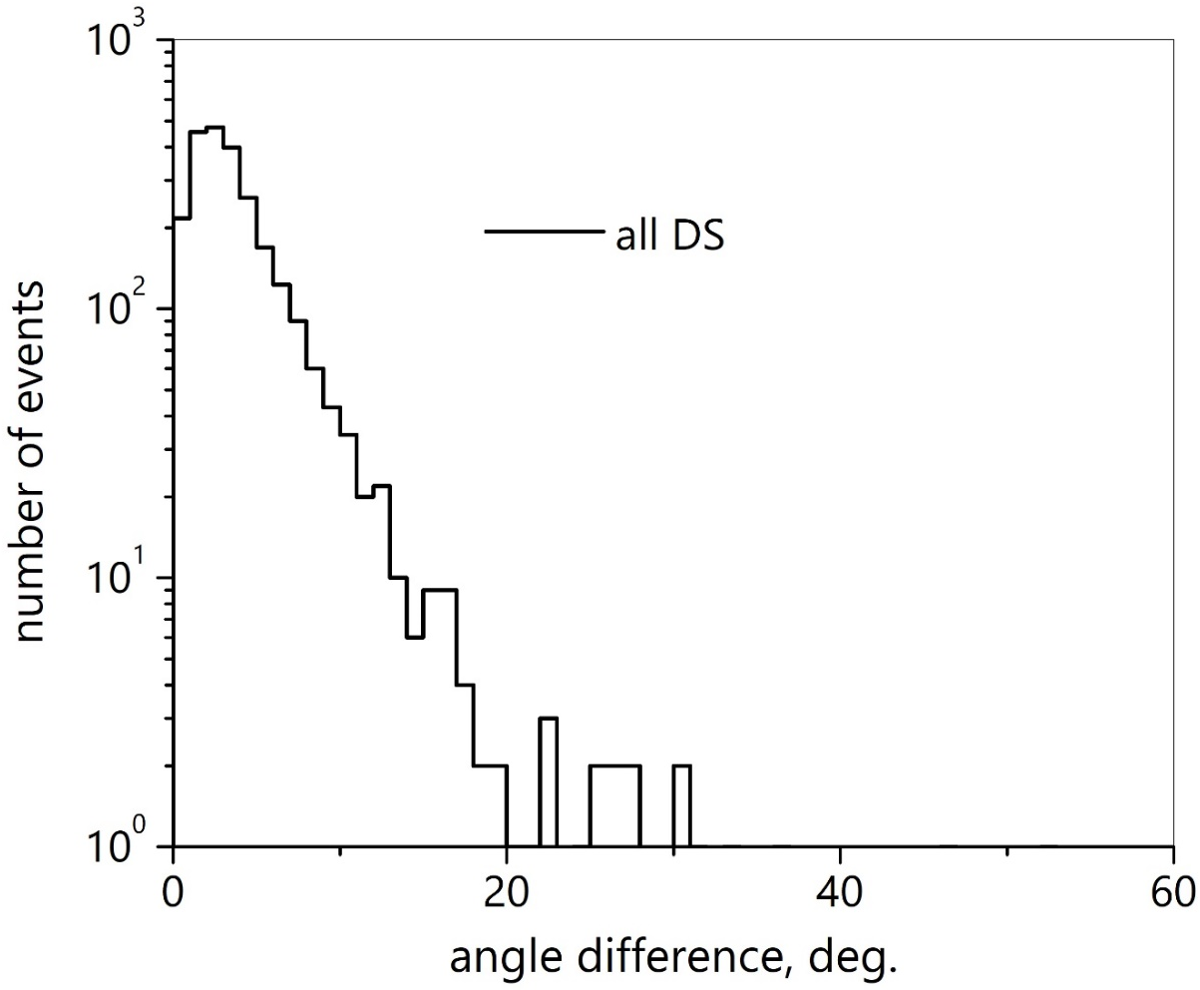
Accuracy of EAS arrival direction reconstruction
Сoordinate detector DECOR
The accuracy of the direction reconstruction is ~ 3.9°
The angle resolution of the DECOR is ~ 1°
6

Slide 7
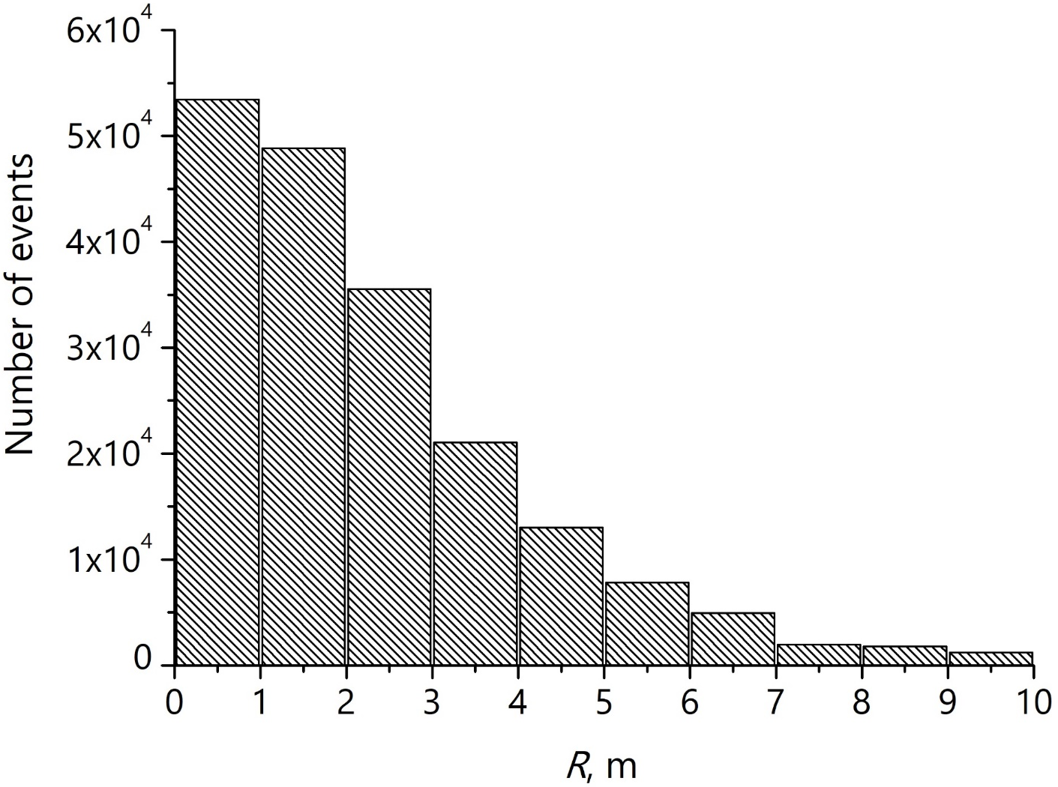
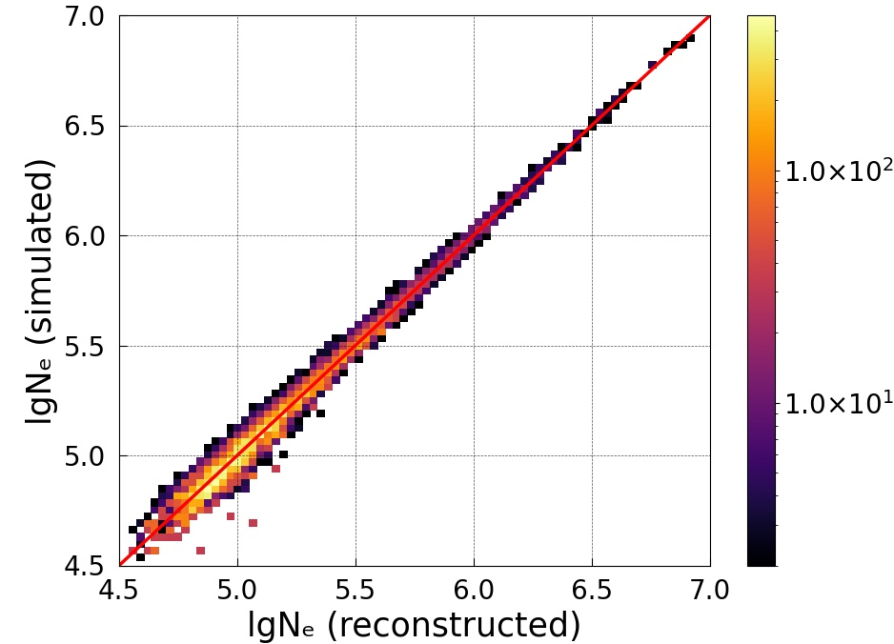
Accuracy of EAS parameters reconstitution
Correlation of the reconstructed and simulated shower size
Distribution of events by distance R
Axis reconstruction accuracy:
∆R ⁓ 3.4 m
Size reconstruction accuracy:
For N_{e(sim.)} = 10^{5±0.1}: 15 %
7

Slide 8
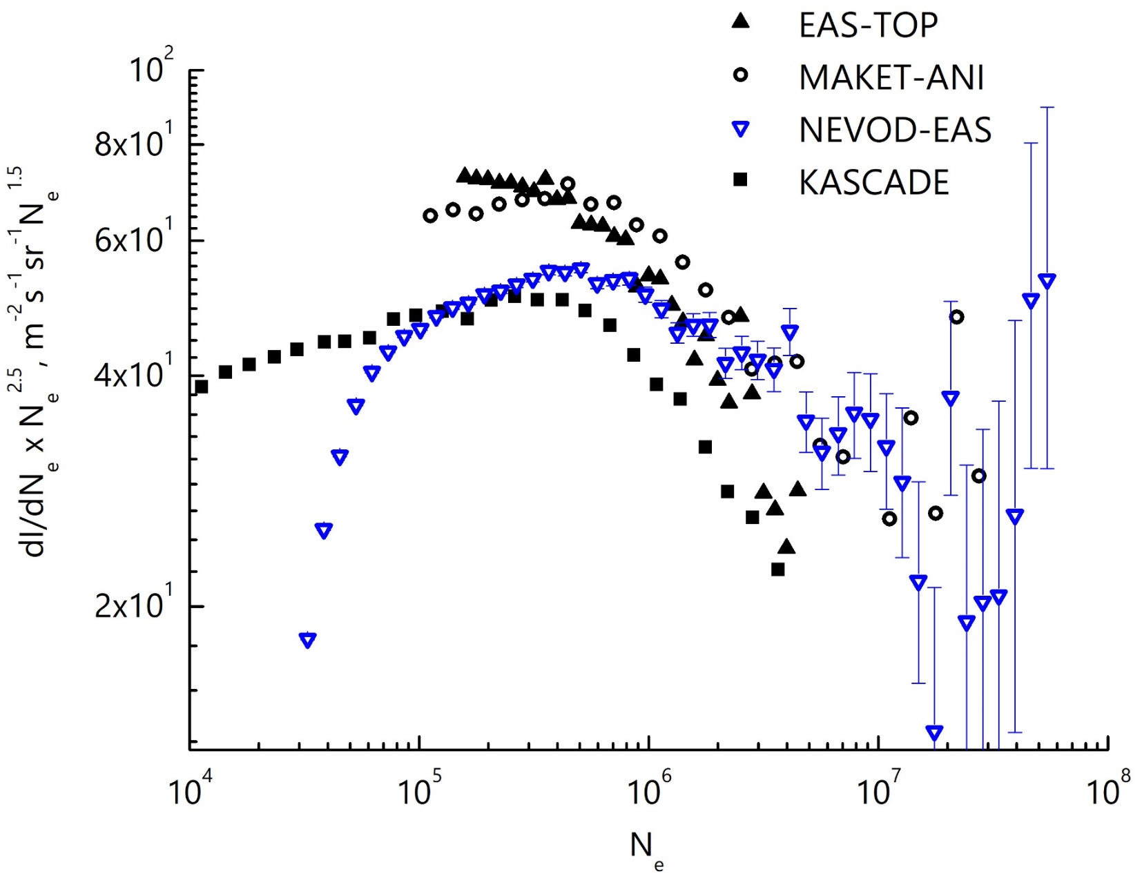
Shower size spectrum
EAS-TOP (M. Aglietta, 1999):
lgN_{ek} = 5.63 ± 0.07
∆k = 0.25 ± 0.07
MAKET-ANI (A.Chilingarian, 2007):
lgN_{ek} = 5.84 ± 0.07
∆k = 0.48 ± 0.04
NEVOD-EAS:
lgN_{ek} = 5.75
∆k = 0.3
KASCADE (K.-H. Kampert, 1998):
lgN_{ek} = 5.7 ± 0.07
8

Slide 9
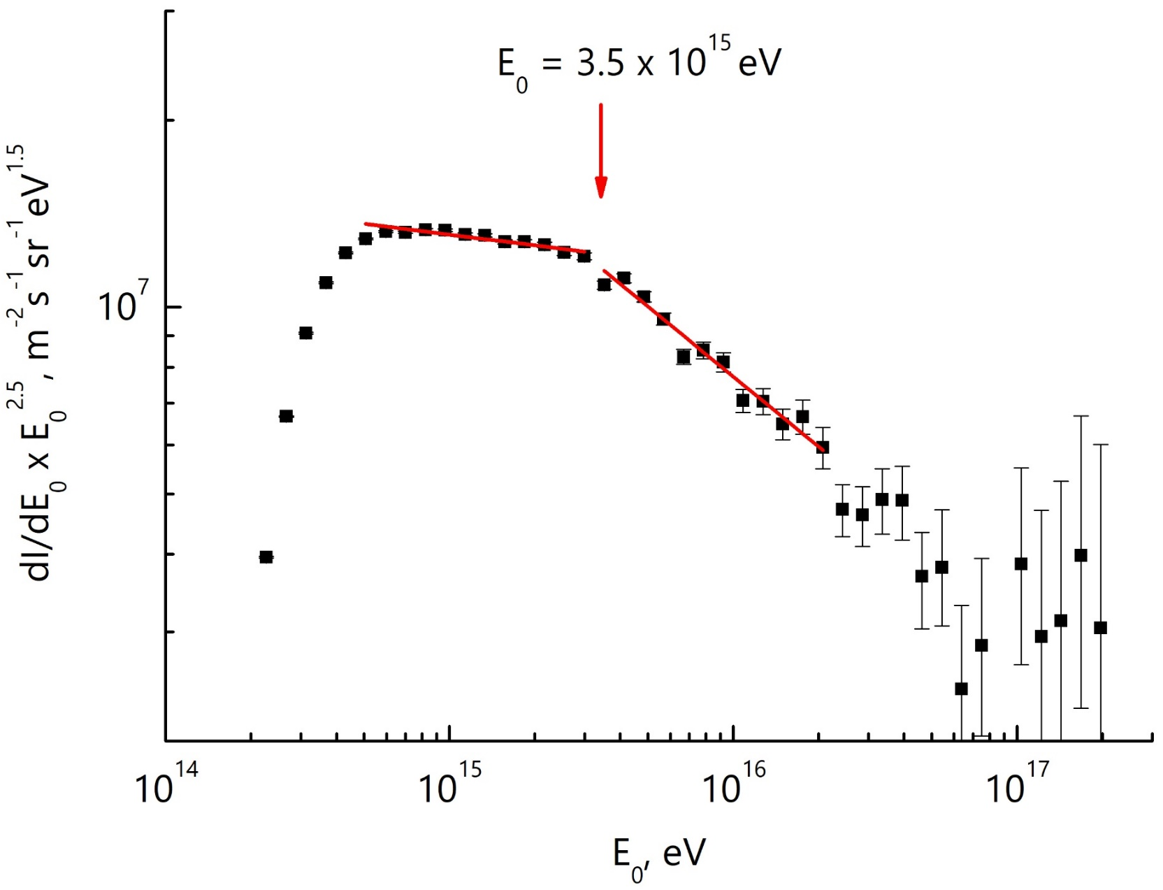
Energy spectrum by the NEVOD-EAS array
(preliminary)
γ₁ = 2.56
Knee position:
3.5 × 10¹⁵ eV
∆ γ = 0.32
γ ₂ = 2.88
9

Slide 10
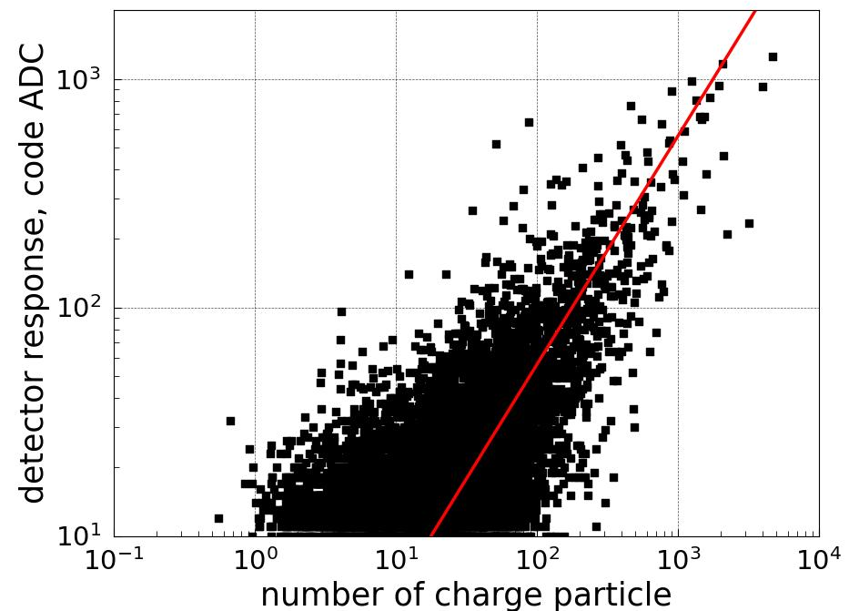
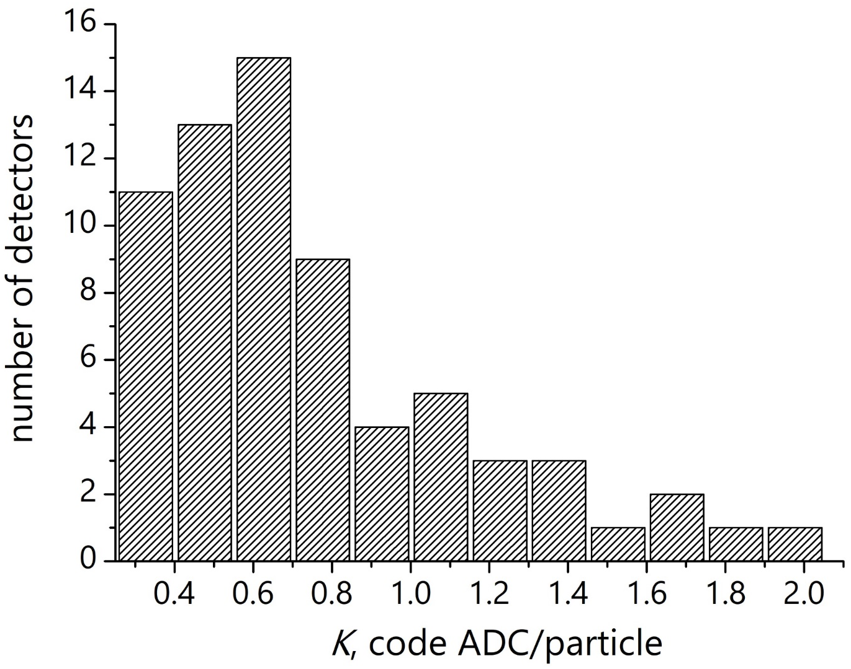
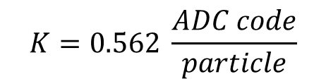
Calibration of URAN array
Calibration dependence
Distribution of calibration coefficients
$$K=0.562 \frac{ADC code}{particle}$$
K - calibration coefficient for 4 detectors of a cluster
10

Slide 11
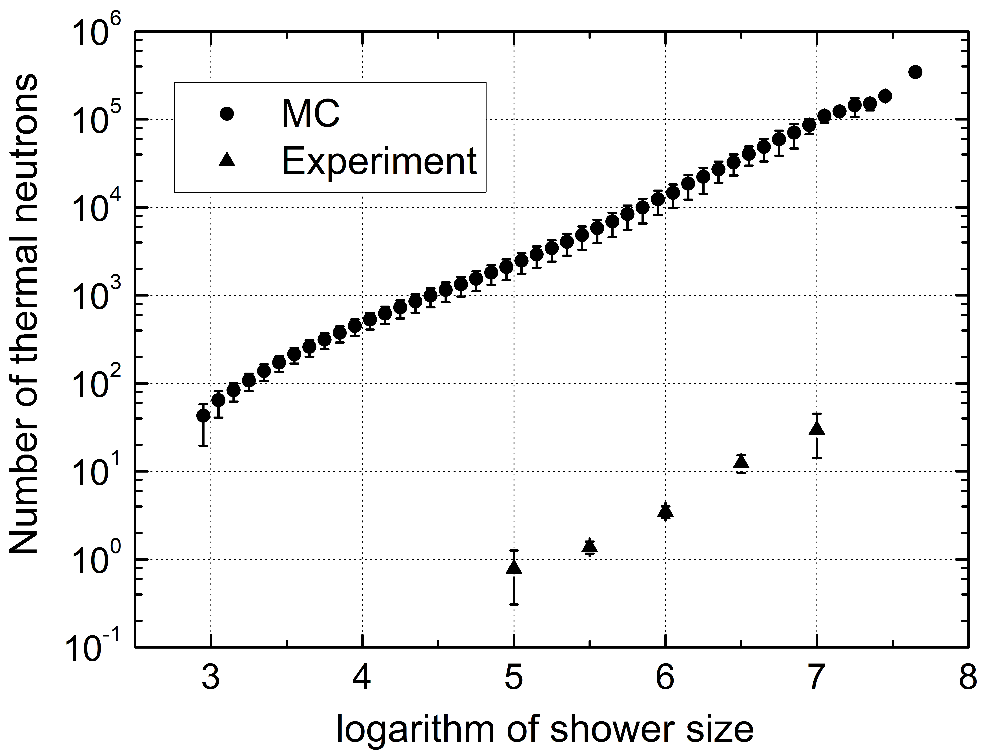
Thermal neutrons in EAS
Dependence of the number of hadrons on the shower size
α = 0.85 ± 0.02
α = 0.89 ± 0.09
11

Slide 12
Conclusion
The NEVOD-EAS array allows reconstruction of the shower parameters with accuracy of 4° for the direction, 3.4 m for the axis and 15% for the size.
According to the NEVOD-EAS data, the knee in the energy spectrum is (preliminary) observed in the region of E₀= 3.5 × 10¹⁵ eV. The spectrum slope changes by 0.32.
The NEVOD-EAS array allows cross-calibration of other installations detecting different EAS components.
The detection of thermal neutrons by the URAN array makes it possible to estimate the number of hadrons in the EAS.
12

Slide 13
Thanks for your attention!

