Slide 1
Measurement of the A_{NN} spin correlation parameter in elastic pp and p ̅p scattering reactions in the SPASCHARM experiment at U-70.
A.A. Bogdanov, V.P. Ladygin, V.V. Mochalov, V.V. Moiseev, M.B. Nurusheva, P.A. Semenov

Slide 2
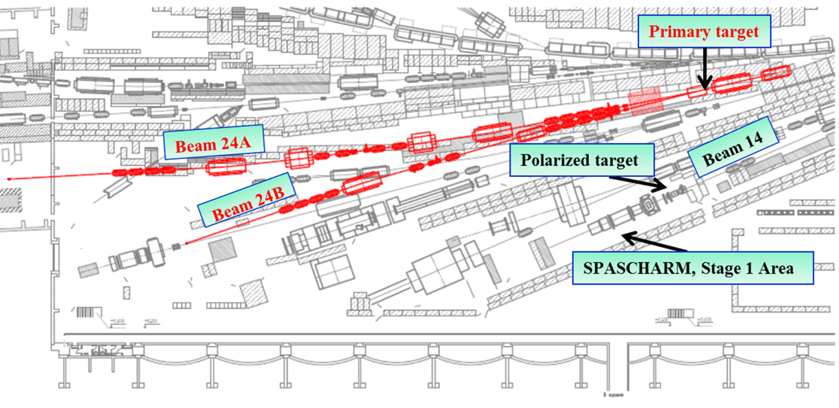
POLARIZED BEAM CHANNEL 24 AT IHEP
It is planned to create a new channel that will provide a unique opportunity to receive both polarized proton and antiproton beams with an intensity of up to 10⁷ and 10⁶ particles in a 10-second cycle

Slide 3
One of the goals of the experiment is to measure the complete set of 12 observables: σ, AN, P, ANN, ALL, ASL, DNN, DLS, KNN, KLS, NLLN, NSLN for direct reconstruction of elastic pp and p(bar)p scattering amplitudes at SPASCHARM experiment (analyzing power, spin correlations, depolarization coefficients, polarization transfer coefficients from the beam to the recoil particle, polarizations of the recoil particle).
The possibility of measuring spin correlation parameter in elastic proton-proton and antiproton-proton scattering in the SPASCHARM experiment at U-70 accelerator complex at Protvino is discussed. The measurements will be carried out using polarized beams and a polarized target of the experiment.

Slide 4
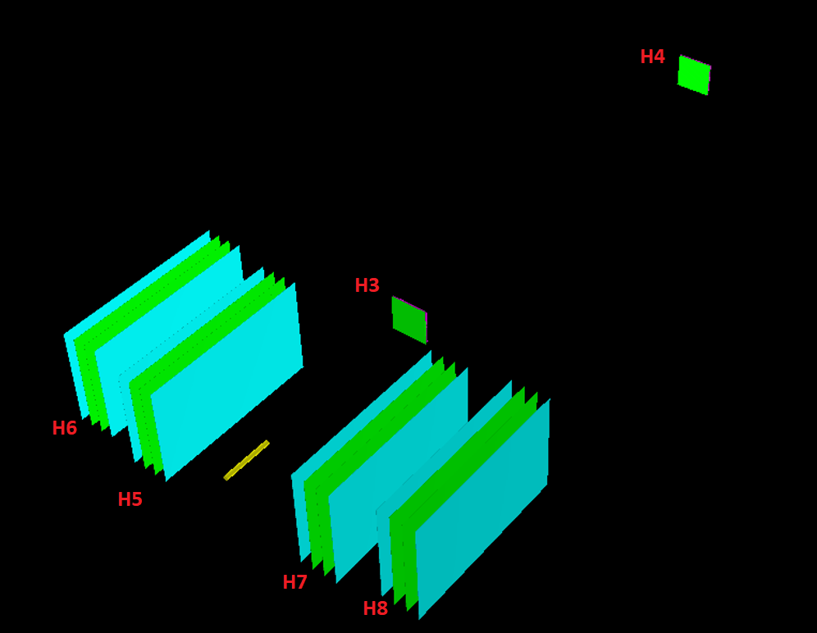

Slide 5
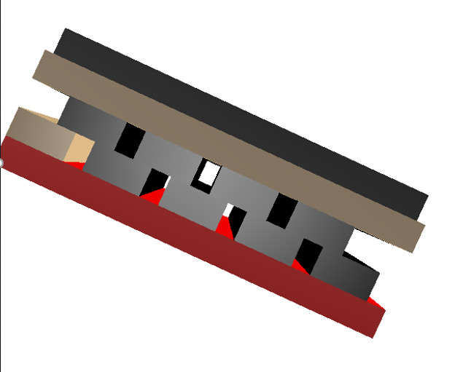
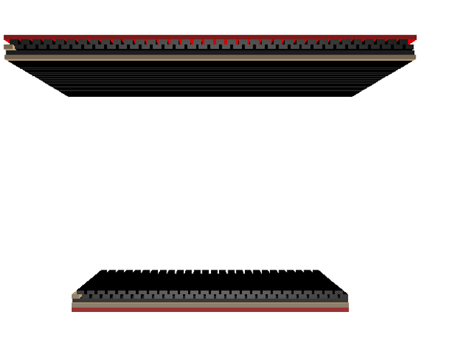
Scintillation hodoscopes
Layout of the hodoscope scintillators.
Elements S5H5 , S6H6
Element S3H3

Slide 6
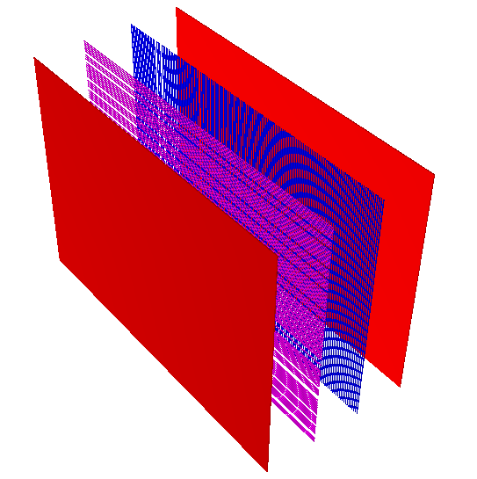
Proportional chambers and scintilliator
Elements S5H5. The distance between the planes is 9.7 cm . The distance between the wires is 2 mm. The width and length correspond to the dimensions of the detectors H5-H8
Element S4H4

Slide 7
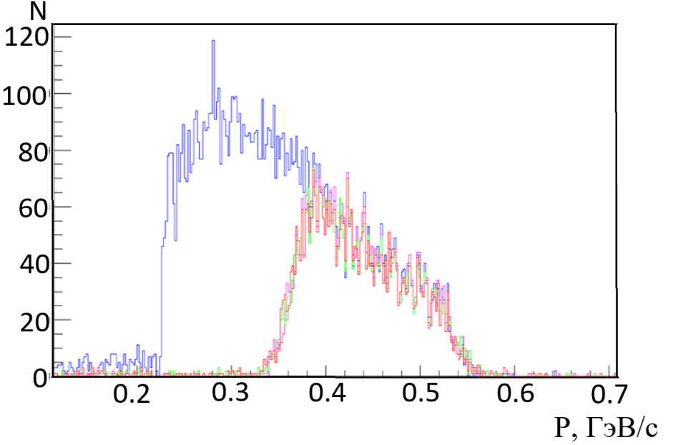
The number of reconstructed protons in the recoil detector for proportional chambers (in blue) and the scintillation detector (in red)
As a result of the simulation, it turned out that the efficiency of recording elastic events in different versions of the detector is different. If the recoil and scattering arm is made from scintillators, then the efficiency is about 2.5 times less than if the recoil detectors are made from proportional chambers.

Slide 8
Two-dimensional histogram for elastic events.
Two-dimensional histogram for diffraction events.

Slide 9
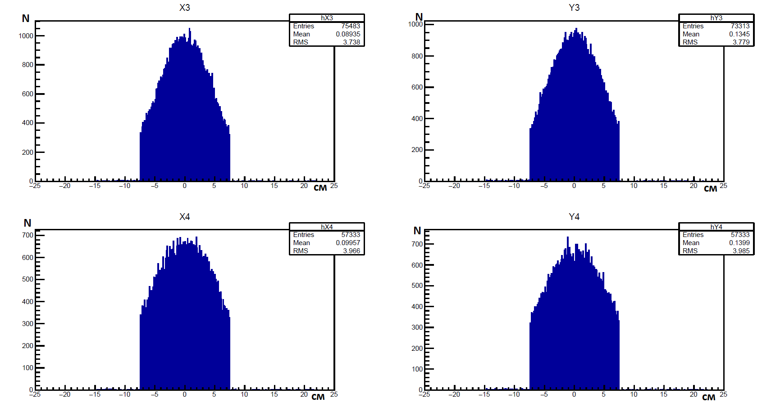
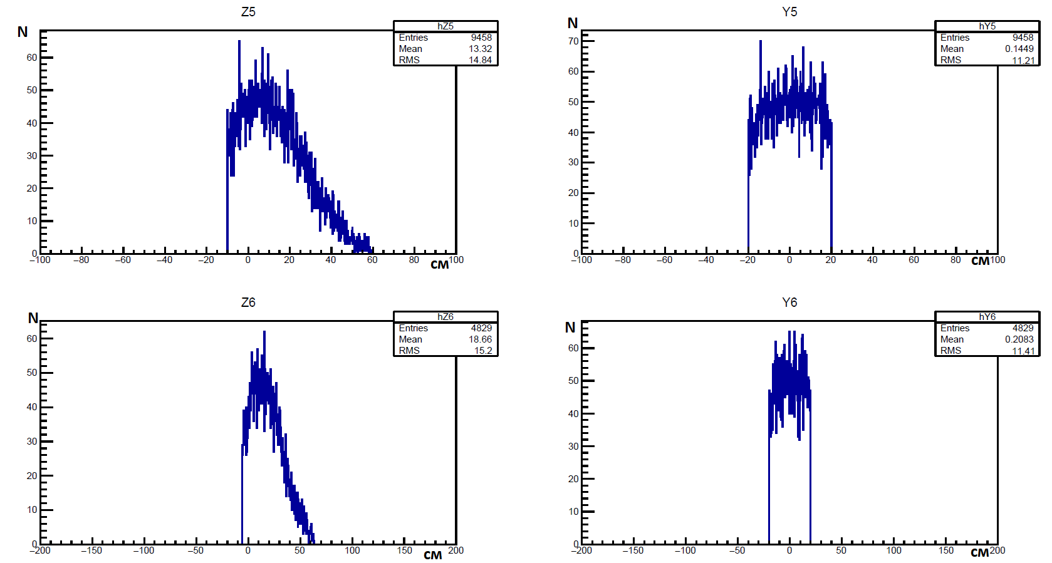
The X and Y distribution for scattered protons detectors in arm 3_4. With smearing in momentum and point of interaction. Without applying trigger conditions. Detectors are scintillation counters.
The Z and Y distribution for recoil proton detectors in arm 7_8. With a smearing in momentum and point of interaction. Without applying trigger conditions. Detectors are Proportional chambers.

Slide 10
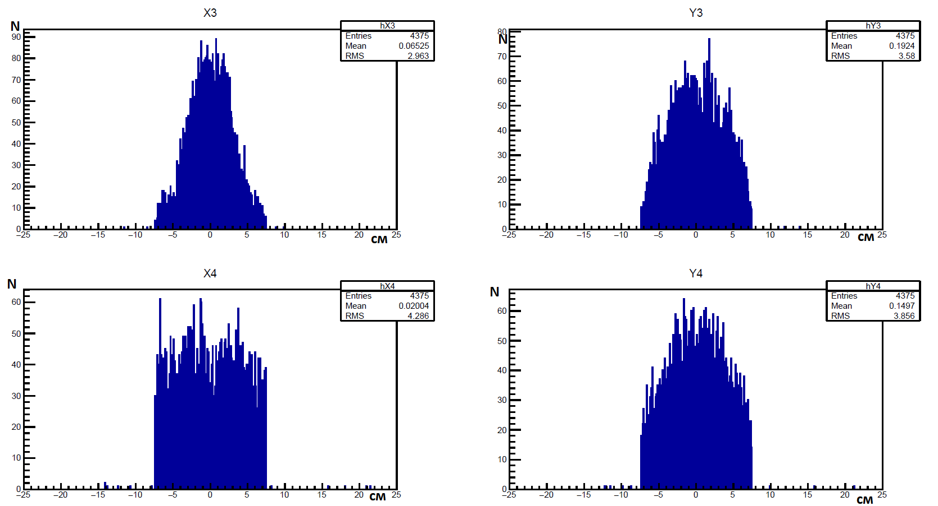
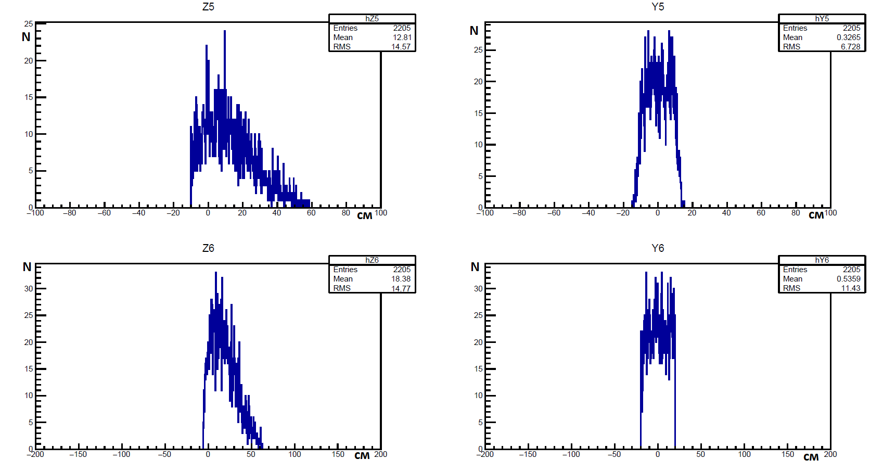
The X and Y distribution for scattered protons detectors in arm 3_4. With smearing in momentum and point of interaction. With applying trigger conditions. Detectors are scintillation counters.
The Z and Y distribution for recoil proton detectors in arm 7_8. With a smearing in momentum and point of interaction. With applying trigger conditions. Detectors are Proportional chambers.

Slide 11
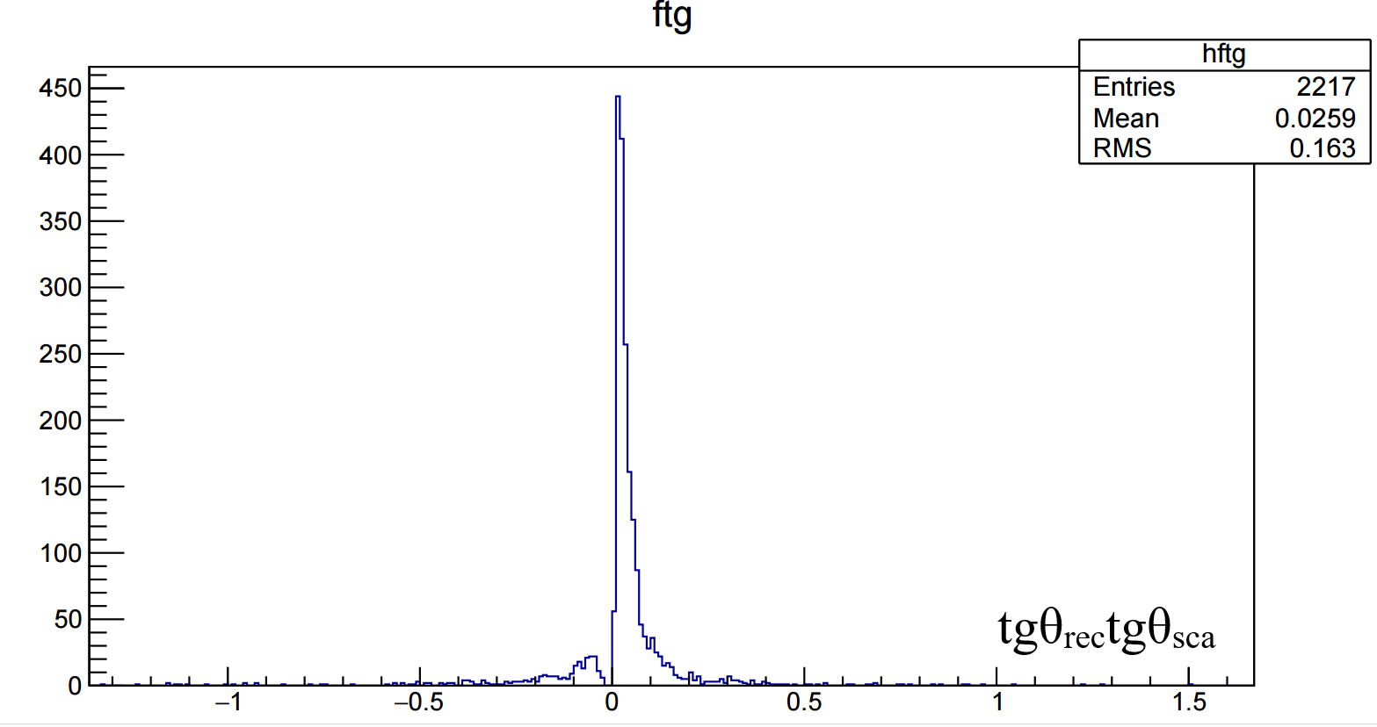
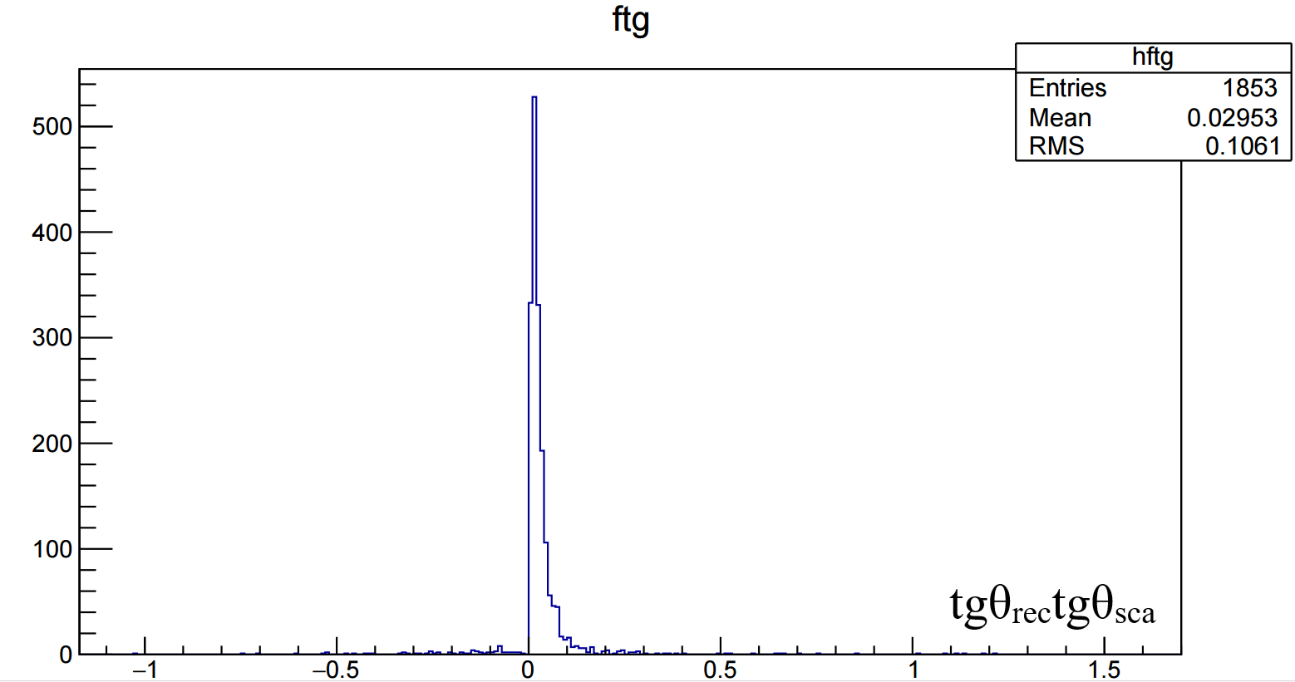
Distribution of the result of tangents multiplication for H3&H4&5&H6 arm. Elastic events
Distribution of the result of tangents multiplication for H3&H4&5&H6 arm. Inelastic events
Since inelastic background events do not have a significant bump in the negative region, taking cuts from -0.15 to 0.2 does not increase the background, but does not allow to cut off elastic events

Slide 12
Two-dimensional histogram for elastic events.
Two-dimensional histogram for diffraction events.

Slide 13
Momentum distribution of scattering protons and recoil protons. The blue distribution is all protons, the red one is only inelastic.
Momentum distribution of scattering protons and recoil protons with cuts. The blue distribution is all protons, the red one is only inelastic.

Slide 14
Estimation of measurement time
The measured asymmetry is determined by the ratio
If the polarization of the target and the polarization of the beam are known, then we can determine the spin correlation coefficient A_{NN}
Since P_{B} = 0,4, P_{T}= 0,7, A_{NN}=0,1 receive ε_{NN} =0,028, а Δε = 0,1ε_{NN} = 2,8х10⁻³,
The number of events required to achieve the required accuracy is N = 1/Δε_{NN}² = 1,276х10⁵
Taking into account the luminosity L~10²⁸ см⁻²сек⁻¹, cross sections $\frac{dσ}{dt}$ =3,8 mBn and acceptance will get the number of events in 1 hour n=6978
Thus, the measurement time on the beam is Т = N/n = 1,276х10⁵/3376,8 ≈ 18,28 час.
Estimate the measurement time taking into account dilution factors for a pentanol target D=(30+12+8)/12=4
Т≈3 days

Slide 15
Conclusion
A realistic simulation of the experiment was carried out and an evaluation of the accuracy of A_{NN} measurements of elastic pp and p p scattering at an energy of 16 GeV and the time required to measure this observable in both reactions was made.
The use of this selection criterion makes it possible to register almost only elastic events - the ratio of the signal to the sum of the signal and background events S/(S+B) is 0.99, thus, the contribution from inelastic events can be neglected to assess the accuracy of measurement and the required selection time.

Slide 16
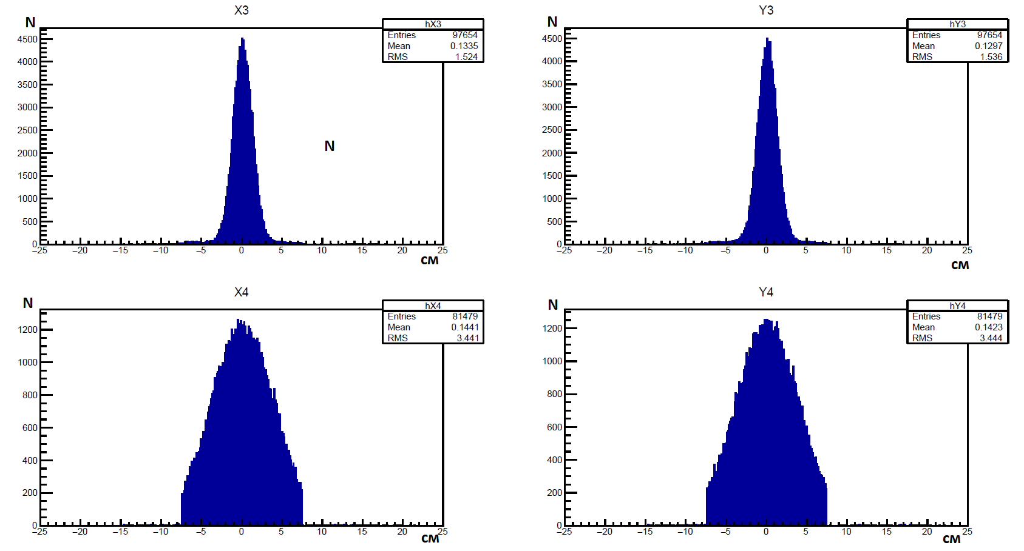
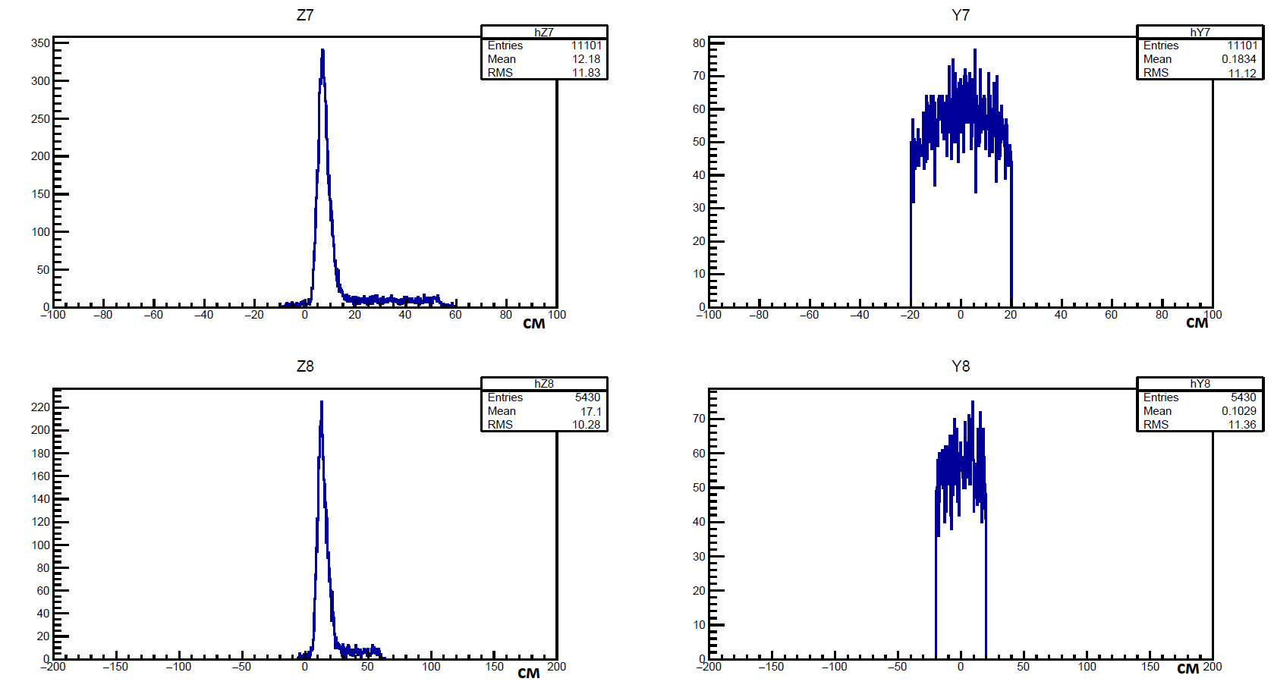
Рис. 2. Распределение по Х и У для детекторов протонов рассеяния плечо 3_4. В случае отсутствия размытия по импульсу и точки взаимодействия. Без применения триггерных условий. Детекторы - Сцинтилляционные счетчики.
Распределение по Х и У для детекторов протонов рассеяния плечо 3_4. В случае отсутствия размытия по импульсу и точки взаимодействия. Без применения триггерных условий. Детекторы - Сцинтилляционные счетчики.
Распределение по Z и У для детекторов протонов отдачи плечо 5_6. В случае отсутствия размытия по импульсу и точки взаимодействия. Без применения триггерных условий. Детекторы - Пропорциональные камеры.

Slide 17
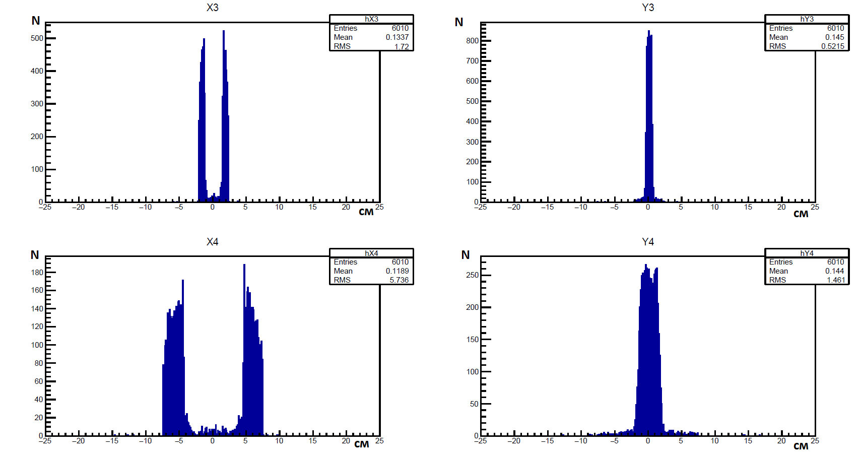
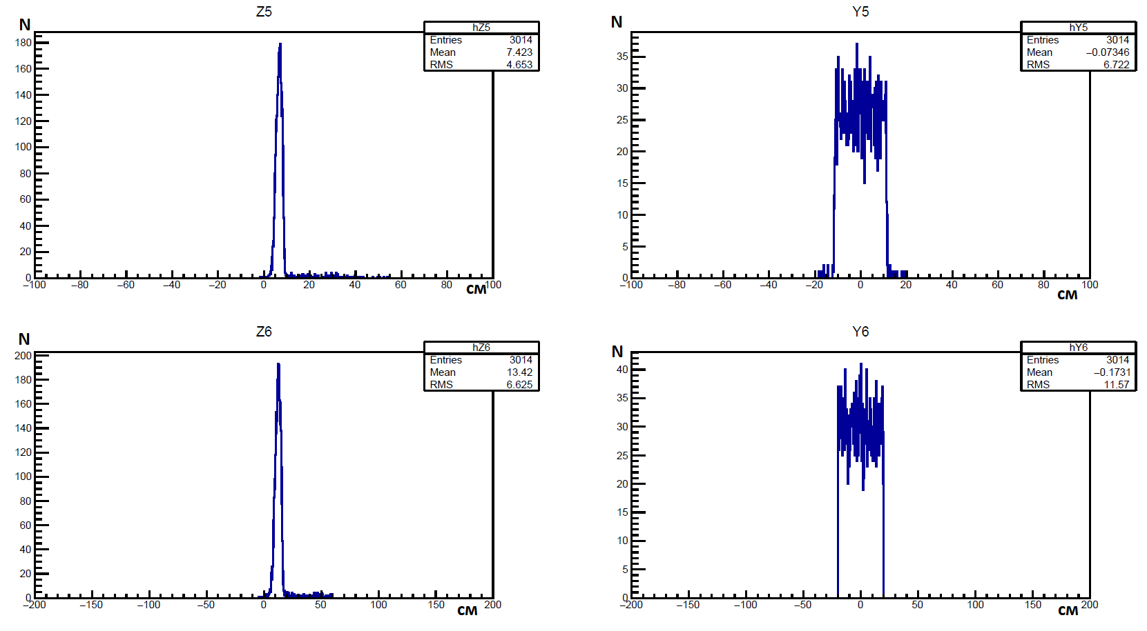
Распределение по Х и У для детекторов протонов рассеяния плечо 3_4. В случае отсутствия размытия по импульсу и точки взаимодействия. C применением триггерных условий. Детекторы - Сцинтилляционные счетчики.
Распределение по Z и У для детекторов протонов отдачи плечо 5_6. В случае отсутствия размытия по импульсу и точки взаимодействия. C применением триггерных условий. Детекторы - Пропорциональные камеры.

