Slide 1
Национальный исследовательский центр
«курчатовский институт»
Институт физики высоких энергий имени А.А. Логунова
Национального исследовательского центра
«Курчатовский институт»
K*⁻(892) meson production in 26.5 GeV/c K⁻N interactions at U-70 accelerator complex
SPASCHARM EXPERIMENT
Nikita Kalugin, NRC Kurchatov IHEP, Protvino, Russian Federation
On behalf of the SPASCHARM collaboraltion
ICPPA 2024
from the 22nd to 25th of October, 2024
VII International Conference on Particle Physics and Astrophysics
Moscow, Russia

Slide 2
Introduction
A-dependence is a traditional fundamental research topic in high energy physics.
Up to now there are only scarce data on the A-dependence (for C and Cu targets)
of K*⁻(892) meson (K*⁻(892) → К_{s}⁰π⁻) production for 0.0 < x_{F} < 0.8 and
0.0 GeV²/c² < p_{t}² ≤ 2.4 GeV²/c² performed by WA89 Collaboration (CERN)
in 345 GeV/c Σ⁻A and π⁻A interactions and in 260 GeV/c nA interactions .
We report about results of A-dependence (for C, Al, Cu, W targets) in
26.5 GeV/c K⁻A interactions for inclusive K*⁻(892) meson (K*⁻(892) → К_{s}⁰π⁻) production for 0.4 < x_{F} < 1.0 and 0.0 GeV/c < p_{t} ≤ 1.0 GeV/c
ICPPA, 22-25 October 2024
Nikita Kalugin (SPASCHARM coll.)
(2)

Slide 3
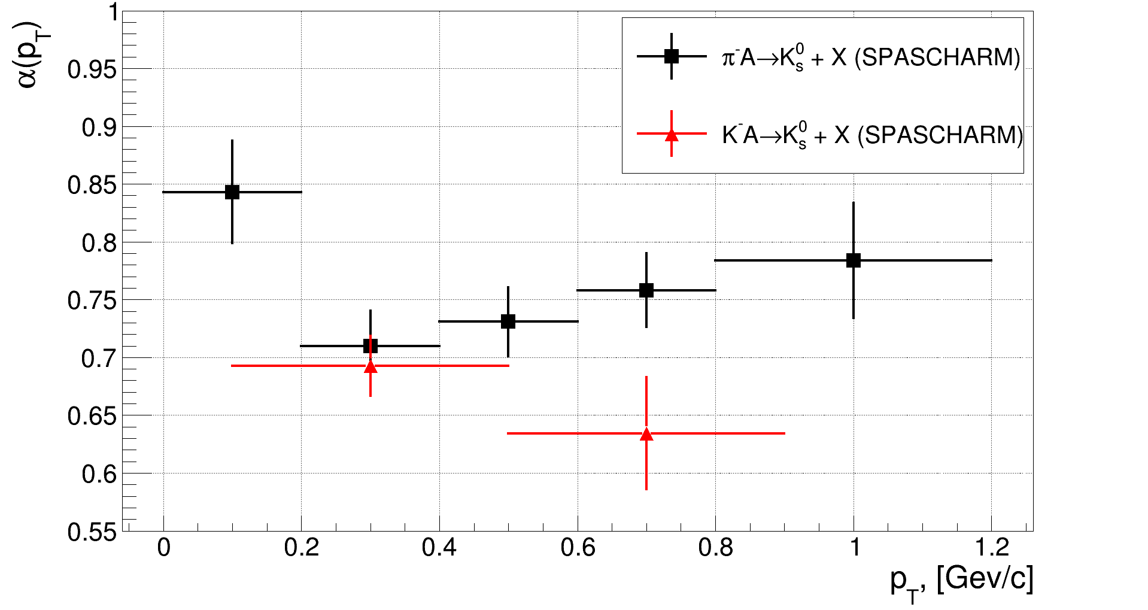
A-dependence of $K_{S}^{0}$ production (reported in RAS session, April 2024)
π⁻A | 0 < p_{T} ≤ 0.2, ГэВ/c | 0.2 < p_{T} ≤ 0.4, ГэВ/c | 0.4 < p_{T} ≤ 0.6, ГэВ/c | 0.6 < p_{T} ≤ 0.8, ГэВ/c | 0.8 < p_{T} ≤ 1.2, ГэВ/c
α(p_{T}) | 0.843±0.044 | 0.709±0.030 | 0.730±0.029 | 0.758±0.031 | 0.783±0.049
χ²/ndf | 3.365/3 | 1.85/3 | 4.583/3 | 1.939/3 | 3.218/3
K⁻A | 0.1 < p_{T} ≤ 0.5, ГэВ/c | 0.5 < p_{T} ≤ 0.9, ГэВ/c
α(p_{T}) | 0.695±0.026 | 0.642±0.048
χ²/ndf | 4.655/3 | 4.791/2

Slide 4
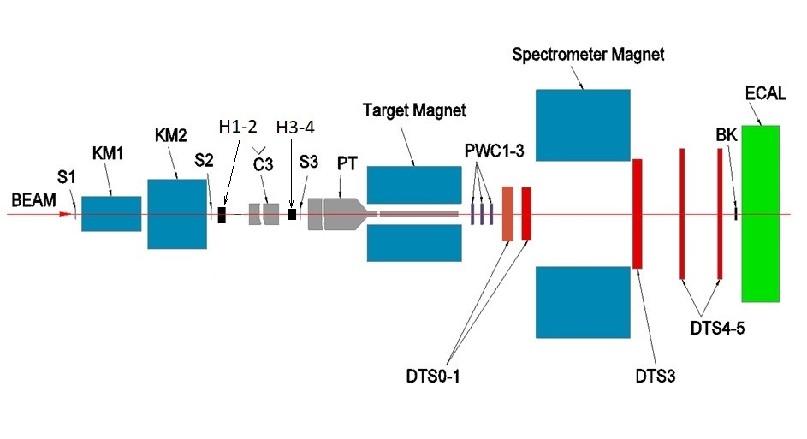
The SPASCHARM Detector
Nuclear targets location
We have carried out analysis of the experimental data had been collected in 2022
ICPPA, 22-25 October 2024
Nikita Kalugin (SPASCHARM coll.)
(3)

Slide 5
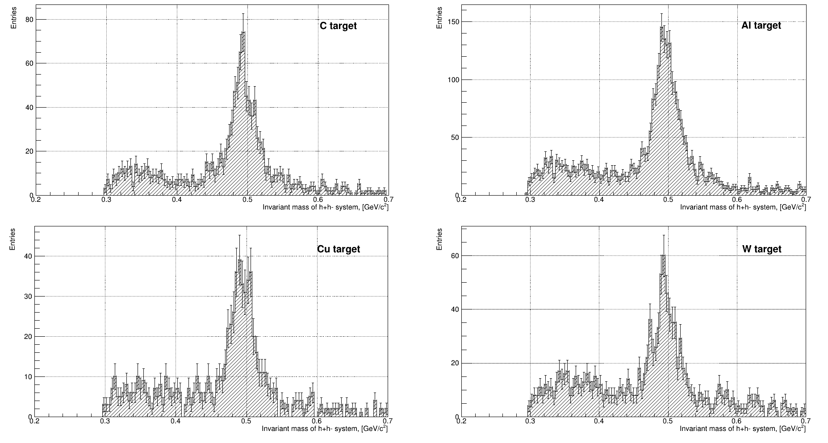
Event selection for K*⁻(892) → К_{s}⁰π⁻
Multiplicity of beam tracks is equal to 1
Identified K⁻ beam track by Č₁,Č₂,Č₃ Cerenkov beam counters
At least one positive charged reconstructed track and at least two negative charged reconstructed tracks
V⁰ were selected from all pairs of positive and negative reconstructed tracks which formed a vertex (decay point) in the decay zone: between Z_{decay} ≈ 31 cm and Z_{decay} ≈ 77 cm
The distance between the two opposite tracks at the decay point had to be smaller that ~0.6 cm
Rejection kinematical ranges corresponding to Λ⁰→ pπ⁻ decay and γ → e⁺e⁻ conversions
Z-coordinate of the reconstructed primary vertex was required to coincide with the center of a target(~23cm for all targets) to within 3 standard deviations (~2.5cm)
The cosine of the pointing angle, which corresponds to the angle between the V⁰ momentum and the line connecting the secondary vertex to primary vertex, is required to be larger 0.98.
Clearly visible signal from К_{s}⁰ → π⁺ π⁻
ICPPA, 22-25 October 2024
Nikita Kalugin (SPASCHARM coll.)
(4)

Slide 6
Kinematic fitting for К_{s}⁰ → π⁺ π⁻
Kinematic fitting is a powerful tool widely used in particle physics analyses, recognized for it’s ability to improve the resolution of measured particle track Parameters, suppress background, reconstruct undetected particles and to determine the position of vertices.
Our goal is to find an improved set of charged tracks parameters as close as possible to the true values (we need К_{s}⁰ ‘s 4-momenta with high accuracy)
For purely kinematic fit the charged track parametrization is follow:
Inverse momentum 1/p [MeV⁻¹ c]
Polar angle θ [radians] defined from 0 to π.
Azimuthal angle φ [radians] defined from -π to π relative to the beam (z) axis
Covariance matrix, where the diagonal entries corresponds to the uncertainties in parameters 1/p, θ, φ
ICPPA, 22-25 October 2024
Nikita Kalugin (SPASCHARM coll.)
(5)

Slide 7
Kinematic fitting for К_{s}⁰ → π⁺ π⁻
General formalism for kinematic fitting
We have set of measured charged tracks parameters: 1/p, θ, φ and errors: σ_{1/p} , σ_{θ} , σ_{φ}
We need to find improved set of charged tracks parameters and their corresponding errors, such they fulfill some kinematic or geometric constraints.
This concept can be translated quantitatively into a χ² minimization expressed as follow:
$${χ }^{2}={\left(\frac{{\frac{1}{p}}^{meas}\left(h^{+}\right)−{\frac{1}{p}}^{fit}\left(h^{+}\right)}{σ^{meas}\left(\frac{1}{p}\right)\left(h^{+}\right)}\right)}^{2}+{\left(\frac{θ^{meas}\left(h^{+}\right)−θ^{fit}\left(h^{+}\right)}{σ^{meas}\left(θ\right)\left(h^{+}\right)}\right)}^{2}+{\left(\frac{φ^{meas}\left(h^{+}\right)−φ^{fit}\left(h^{+}\right)}{σ^{meas}\left(φ\right)\left(h^{+}\right)}\right)}^{2}+$$
$${\left(\frac{{\frac{1}{p}}^{meas}\left(h^{−}\right)−{\frac{1}{p}}^{fit}\left(h^{−}\right)}{σ^{meas}\left(\frac{1}{p}\right)\left(h^{−}\right)}\right)}^{2}+{\left(\frac{θ^{meas}\left(h^{−}\right)−θ^{fit}\left(h^{−}\right)}{σ^{meas}\left(θ\right)\left(h^{−}\right)}\right)}^{2}+{\left(\frac{φ^{meas}\left(h^{−}\right)−φ^{fit}\left(h^{−}\right)}{σ^{meas}\left(φ\right)\left(h^{−}\right)}\right)}^{2}$$
Or shortly (matrix notation):
$${χ }^{2}={\left(\vec{y}−\vec{ η}\right)}^{T}·V^{−1}·\left(\vec{y}−\vec{ η}\right)$$
with constraint (in our case) : $\vec{f}\left(\vec{ η}\right)={\left(\sum_{i=1}^{2}{E_{i}}\right)}^{2}−{\left(\sum_{i=1}^{2}{{\vec{p}}_{i}}\right)}^{2}−M_{mother}^{2}=0$
ICPPA, 22-25 October 2024
Nikita Kalugin (SPASCHARM coll.)
(6)

Slide 8
Kinematic fitting for К_{s}⁰ → π⁺ π⁻
General formalism for kinematic fitting
This problem can be solved by the method of Lagrange multipliers. We should transform χ² and constraint function into:
$$L={\left(\vec{y}−\vec{ η}\right)}^{T}·V^{−1}·\left(\vec{y}−\vec{ η}\right)+2∙{\vec{λ}}^{T}\vec{f}\left(\vec{ η}\right)$$
Minimizing the Lagrange function (L) involves finding the derivatives of L with respect to unknowns $\vec{ η}$ and $\vec{ λ}$. By setting
These derivatives to zero and subsequently solving for $\vec{ η}$ , the minimization can be achieved
$$\vec{f}\left(\vec{ η}\right)={\left(\sqrt{{\left(\frac{1}{{\frac{1}{p}}^{fit}\left(h^{+}\right)}\right)}^{2}+m_{π^{∓}}^{2}}+\sqrt{{\left(\frac{1}{{\frac{1}{p}}^{fit}\left(h^{−}\right)}\right)}^{2}+m_{π^{∓}}^{2}}\right)}^{2}−{\left[\left(\frac{1}{{\frac{1}{p}}^{fit}\left(h^{+}\right)}\right)∙sinθ_{h^{+}}^{fit}∙cosφ_{h^{+}}^{fit}+\left(\frac{1}{{\frac{1}{p}}^{fit}\left(h^{−}\right)}\right)∙sinθ_{h^{−}}^{fit}∙cosφ_{h^{−}}^{fit}\right]}^{2}−$$
$$−{\left[\left(\frac{1}{{\frac{1}{p}}^{fit}\left(h^{+}\right)}\right)∙sinθ_{h^{+}}^{fit}∙sinφ_{h^{+}}^{fit}+\left(\frac{1}{{\frac{1}{p}}^{fit}\left(h^{−}\right)}\right)∙sinθ_{h^{−}}^{fit}∙sinφ_{h^{−}}^{fit}\right]}^{2}−{\left[\left(\frac{1}{{\frac{1}{p}}^{fit}\left(h^{+}\right)}\right)∙cosθ_{h^{+}}^{fit}+\left(\frac{1}{{\frac{1}{p}}^{fit}\left(h^{−}\right)}\right)∙cosθ_{h^{−}}^{fit}\right]}^{2}−M_{K_{S}^{0}}^{2}$$
As this problem is generally non-linear, an iterative procedure is employed, with each iteration yielding improved
approximations for $\vec{ η}$
Non-linear constraint !!!
ICPPA, 22-25 October 2024
Nikita Kalugin (SPASCHARM coll.)
(7)

Slide 9
Kinematic fitting for К_{s}⁰ → π⁺ π⁻
General formalism for kinematic fitting
$\vec{r}={\vec{f}}^{ν}+\frac{∂{\vec{f}}^{ν}}{∂η}\left(\vec{y}−{\vec{η}}^{ν}\right)$ Taylor expansion of a function to linear terms
$$S=\frac{∂{\vec{f}}^{ν}}{∂η}V{\left(\frac{∂{\vec{f}}^{ν}}{∂η}\right)}^{T}$$
$${\vec{λ}}^{ν+1}=S^{−1}\vec{r}$$
${\vec{η}}^{ν+1}=η−V{\left(\frac{∂{\vec{f}}^{ν}}{∂η}\right)}^{T}{\vec{λ}}^{ν+1}$ updated measured parameters
$V^{ν+1}=V−{\left(\frac{∂{\vec{f}}^{ν}}{∂η}\right)}^{T}S^{−1}\frac{∂{\vec{f}}^{ν}}{∂η}V$ updated covariant matrix
For ν = 0 : ${\vec{η}}^{0}=$ $\vec{y}$ . After each iteration L calculated and results compared with the previous iteration. Iteration process stops when $\left|L^{ν}−L^{ν+1}\right|<0.01$ (Convergence criteria)
ICPPA, 22-25 October 2024
Nikita Kalugin (SPASCHARM coll.)
(8)

Slide 10
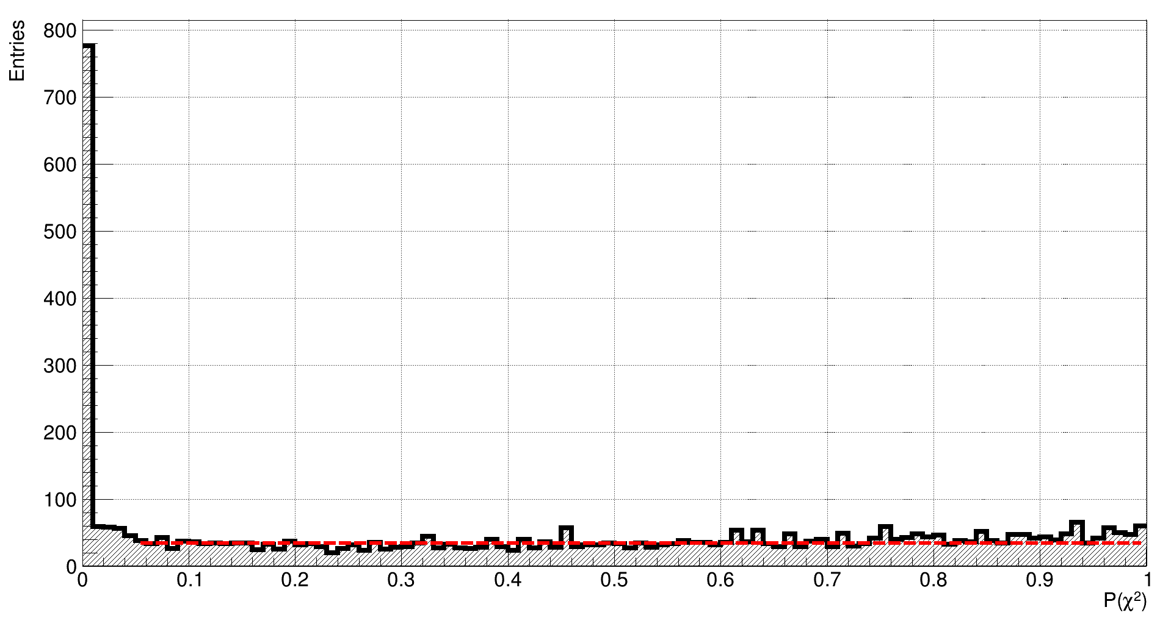
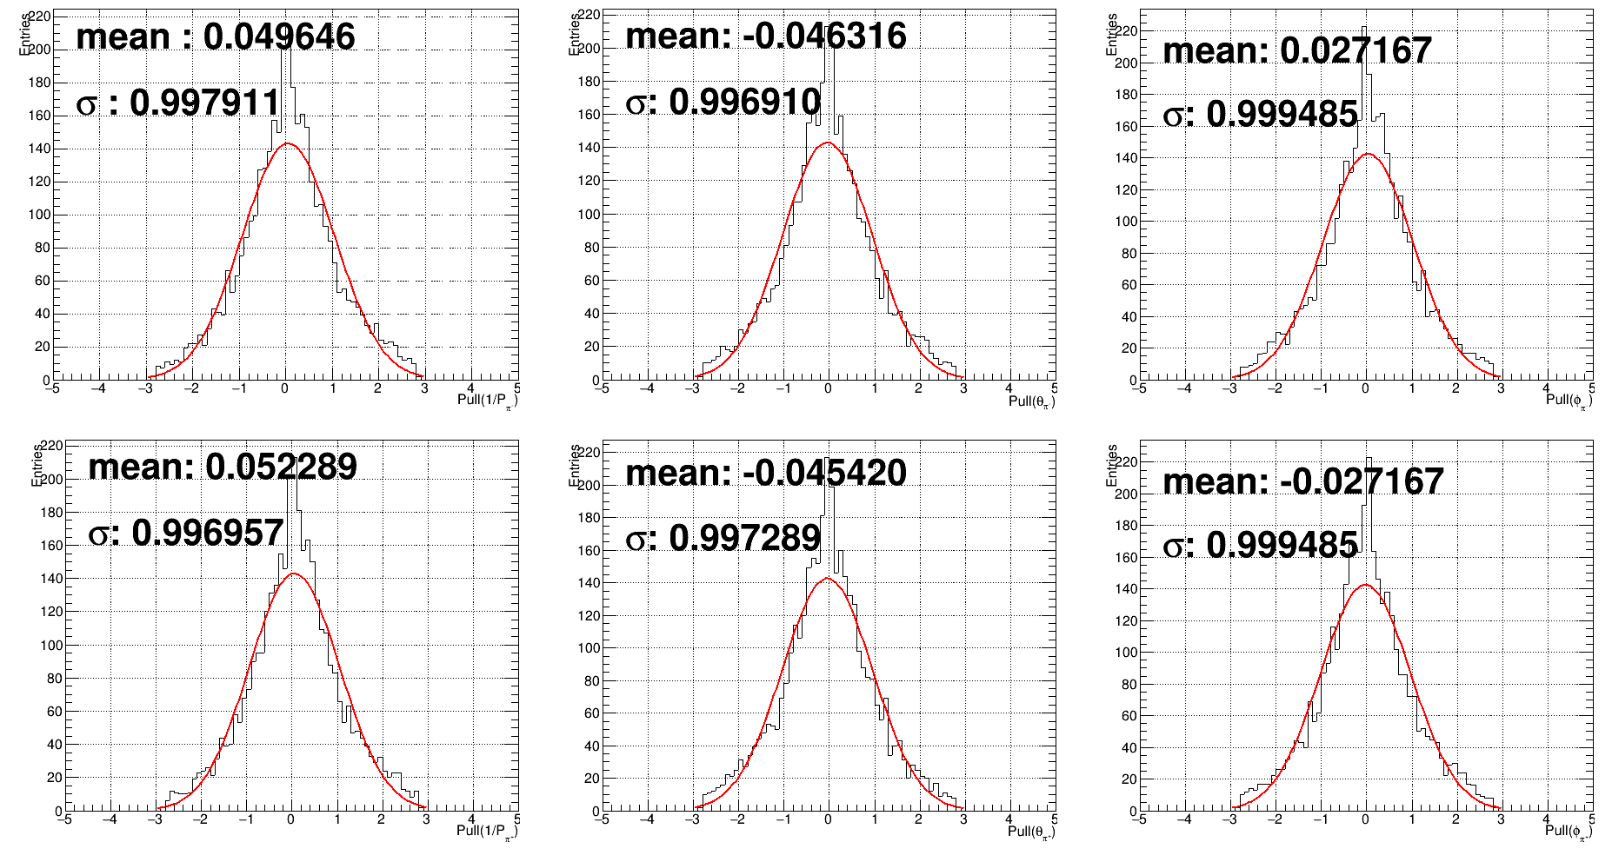
Kinematic fitting for К_{s}⁰ → π⁺ π⁻
$P_{ν}\left(χ^{2}\right)=\int_{χ^{2}}^{∞}{f_{ν}\left(χ^{′^{2}}\right)}dχ^{′^{2}}$(ν=1, 1C-FIT) value
has relatively a uniform distribution
for SPASCHARM experimental data
Pulls distributions(stretch function): ${pull}_{i}=\frac{\left({\vec{y}}_{i}−{\vec{ η}}_{i}\right)}{\sqrt{σ^{2}\left({\vec{y}}_{i}\right)−σ^{2}\left({\vec{ η}}_{i}\right)}}$is fairly close to N(0,1) and not asymmetric. So we don’t have a systematic error in the measurements of 1/p, θ, φ and σ_{1/p} , σ_{θ} , σ_{φ} defined correctly.
ICPPA, 22-25 October 2024
Nikita Kalugin (SPASCHARM coll.)
(9)

Slide 11
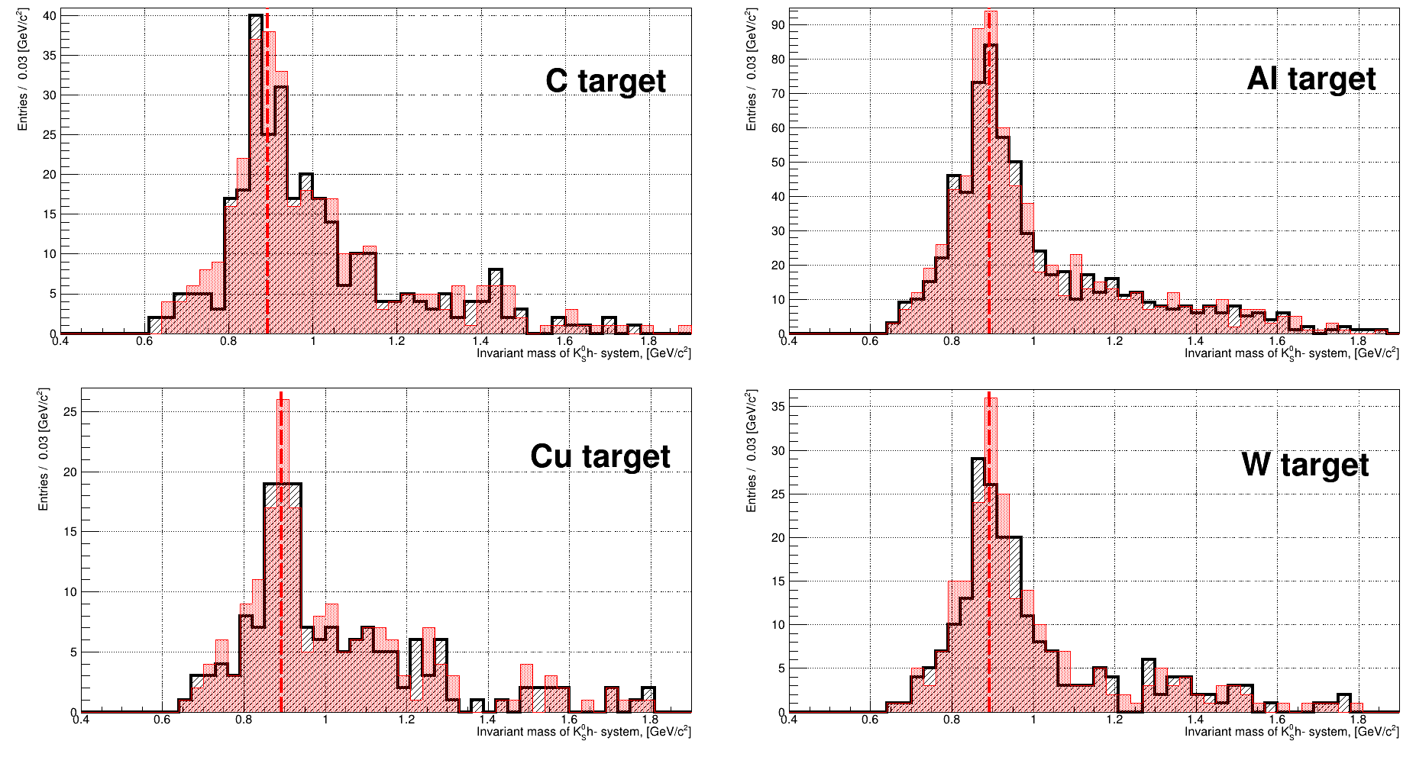
Kinematic fitting for К_{s}⁰ → π⁺ π⁻
Results
After 1C-Fit
The mass peak is centered near the PDG K*⁻(892) mass value for all targets
A slight increase in statistics at the peak for some targets
~6% improvement in the determination of the К_{s}⁰h⁻system invariant mass
There is not visible background suppression
Black filled histogram: invariant mass of К_{s}⁰h⁻system pre-1C-fit
Red filled histogram: invariant mass of К_{s}⁰h⁻system post-1C-fit
Red dashed line PDG K*⁻(892) mass. The results corresponds to events with confidence level 0.005
ICPPA, 22-25 October 2024
Nikita Kalugin (SPASCHARM coll.)
(10)

Slide 12
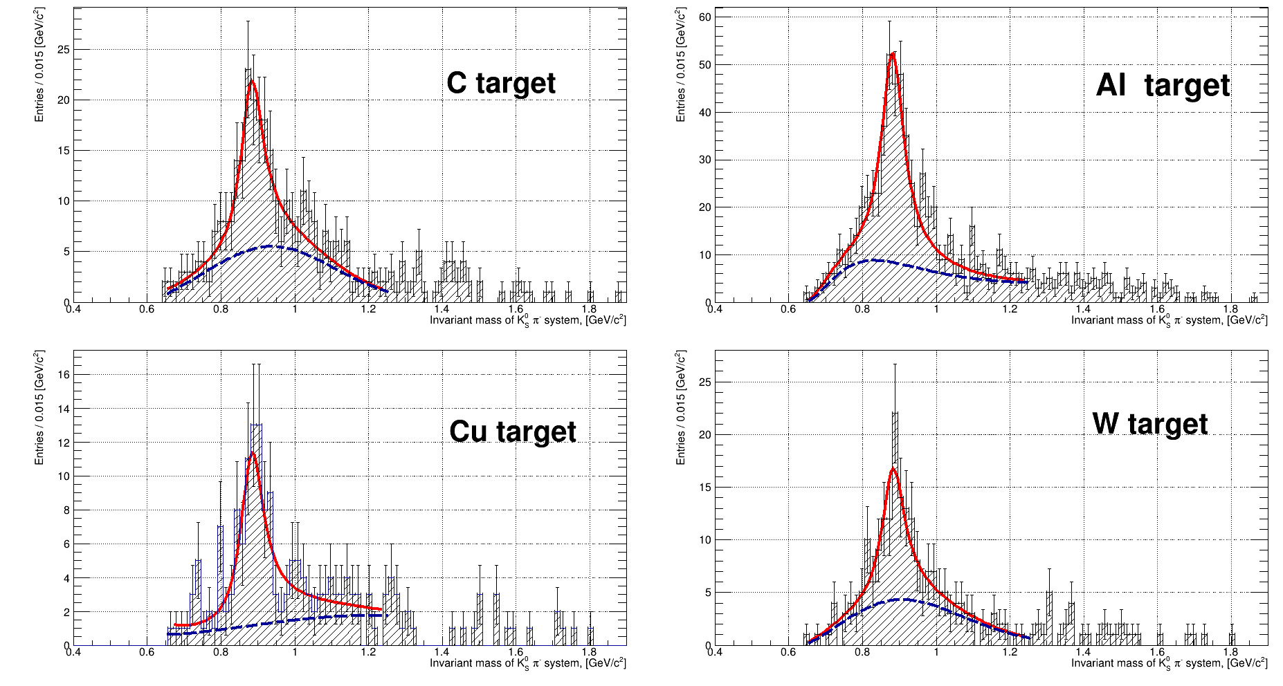
Total statistics of K*⁻(892) → К_{s}⁰π⁻
Invariant mass distributions have been fitted by the well-known formula:
$$\frac{dN}{dM}=BW∙PS+BG≈BG\left(1+α1BW\right)$$
Assuming PS≈BG
$$BW(M)=\frac{M}{p^{∗}}∙\frac{Γ\left(M\right)}{{\left(M^{2}−M_{0}^{2}\right)}^{2}+M_{0}^{2}Γ^{2}\left(M\right)}$$
BW(M) – relativistic p-wave Breit-Wigner function
with dynamical width:
$$Γ\left(M\right)=Γ_{0}∙{\left(\frac{p^{∗}\left(M\right)}{p^{∗}\left(M_{0}\right)}\right)}^{2l+1}\frac{ρ\left(M\right)}{ρ\left(M_{0}\right)}$$
$$ρ\left(M\right)≈\frac{1}{M}$$
$p^{∗}\left(M\right)$- the momentum of the decay product in the rest frame of the resonance
$l$ =1 orbital momentum.
Any details see in J.D.Jackson, Nuovo Cimento 34 (1964) 76
$BG\left(M\right)=$ $α2∙{\left(M−M_{tres}\right)}^{α3}∙e^{−α4\left(M−M_{tres}\right)−α5∙{\left(M−M_{tres}\right)}^{2}}$
Background is described by a two terms, involving at most 4 free parameters, which take into account possible threshold effects and quasi-exponential background far from threshold mass $M_{tres}$ .
144+/-12
367+/-19
105+/-10
93+/-10
Also taken into account experimental resolution in the invariant mass:
$$Γ\left(M\right)=Γ_{0}∙{\left(\frac{p^{∗}\left(M\right)}{p^{∗}\left(M_{0}\right)}\right)}^{2l+1}\frac{ρ\left(M\right)}{ρ\left(M_{0}\right)}+2\sqrt{2}∙σ(\text{К}\text{s}\text{0}\text{π}\text{−})$$

Slide 13
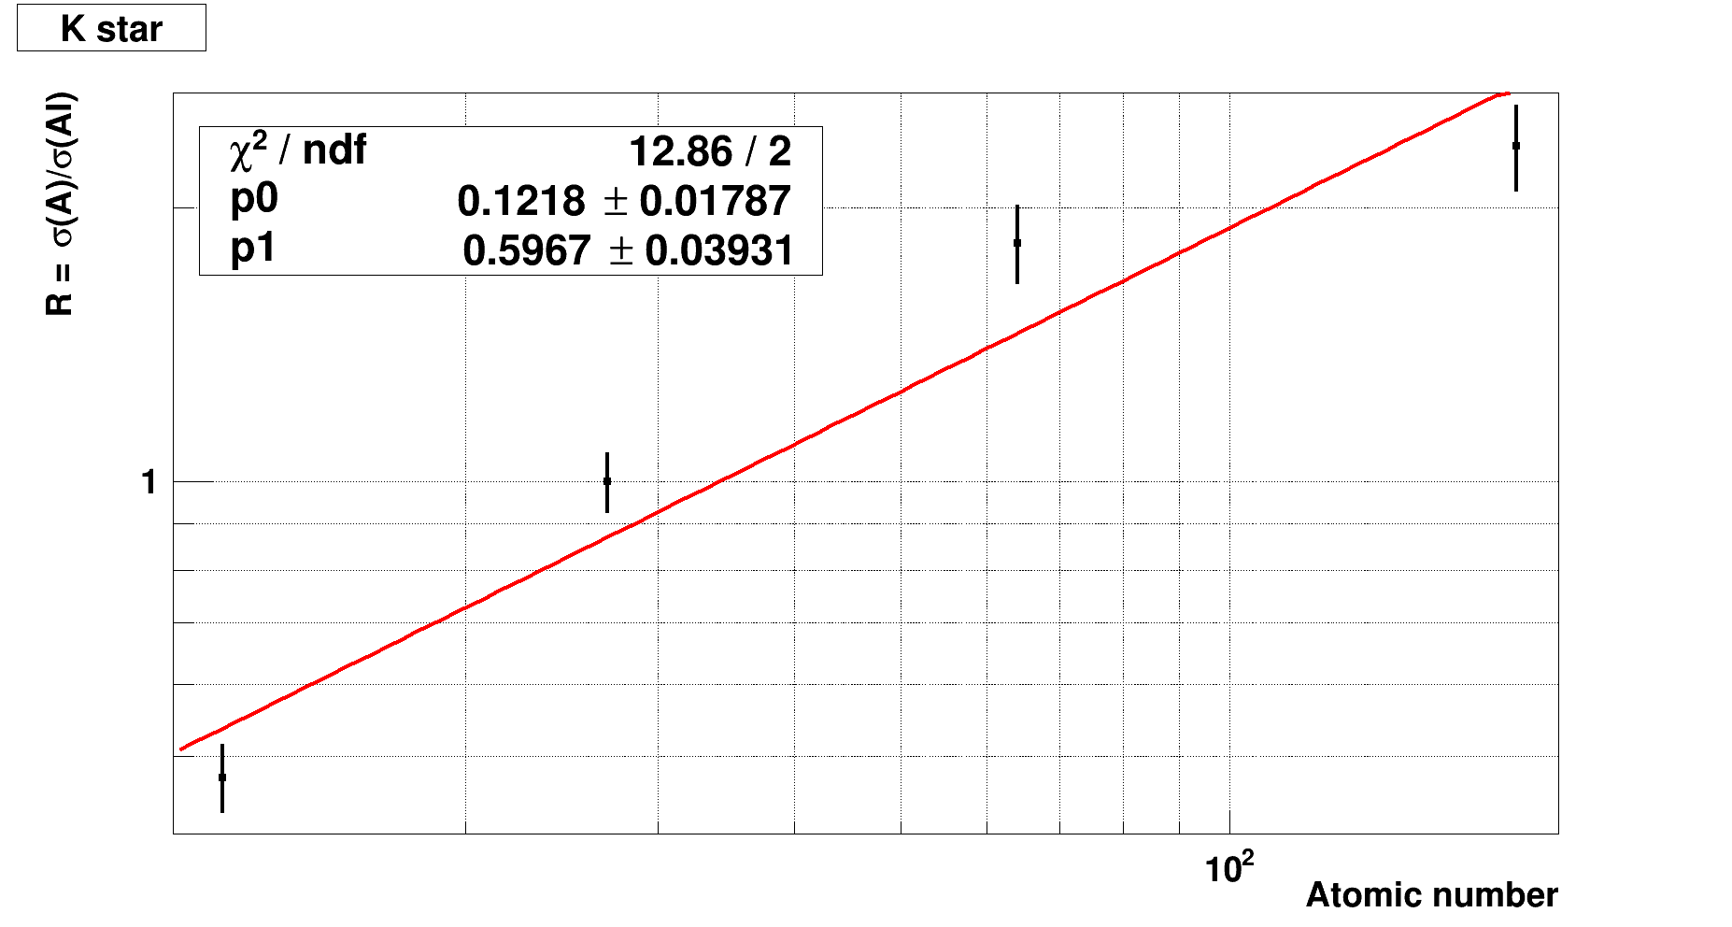
A-dependence
$$σ_{R_{\frac{A}{Al}}}=\sqrt{{\left(\frac{∂R_{\frac{A}{Al}}}{∂N^{A}}\right)}^{2}∙{\left({∆N}^{A}\right)}^{2}+{\left(\frac{∂R_{\frac{A}{Al}}}{∂N^{Al}}\right)}^{2}∙{\left({∆N}^{Al}\right)}^{2}+{\left(\frac{∂R_{\frac{A}{Al}}}{∂N^{Empty}}\right)}^{2}∙{\left({∆N}^{Empty}\right)}^{2}}$$
$$R_{\frac{A}{Al}}\left(x_{F}\right)=\frac{ε_{A}∙{\left(Acc×Eff\right)}_{x_{F}}^{Al}∙\left(\frac{{N\left(x_{F}\right)}^{A}}{J^{A}}−\frac{{N\left(x_{F}\right)}^{empty}}{J^{empty}}\right)∙A∙ρ_{Al}∙L_{Al}}{ε_{Al}∙{\left(Acc×Eff\right)}_{x_{F}}^{A}∙\left(\frac{{N\left(x_{F}\right)}^{Al}}{J^{Al}}−\frac{{N\left(x_{F}\right)}^{empty}}{J^{empty}}\right)∙A_{Al}∙ρ_{A}∙L_{A}}$$
ICPPA, 22-25 October 2024
Nikita Kalugin (SPASCHARM coll.)
(12)

Slide 14
Stability of results checking
Variations of background:
$BG\left(M\right)=$ $α2∙{\left(M−M_{tres}\right)}^{α3}∙e^{−α4\left(M−M_{tres}\right)−α5∙{\left(M−M_{tres}\right)}^{2}−α6∙{\left(M−M_{tres}\right)}^{3}}$
Alpha = 0.56 +/- 0.04 with χ² / ndf = 25.96/2
$BG\left(M\right)=$ $α2∙{\left(M^{2}−M_{tres}\right)}^{α3}∙e^{−α4\left(M−M_{tres}\right)−α5∙{\left(M−M_{tres}\right)}^{2}}$
Alpha = 0.59 +/- 0.04 with χ² / ndf = 14.09/2
$BG\left(M\right)=$ $α2∙{\left(M^{2}−M_{tres}\right)}^{α3}∙e^{−α4\left(M−M_{tres}\right)−α5∙{\left(M−M_{tres}\right)}^{2}−α6∙{\left(M−M_{tres}\right)}^{3}}$
Alpha = 0.57 +/- 0.04 with χ² / ndf = 14.95/2
Other experimental result
WA89 Collaboration(CERN):
Σ⁻A→ K*⁻(892) + X: alpha = 0.64 +/- 0.04
Σ⁻A→ K*⁺(892) + X: alpha = 0.59 +/- 0.04
π⁻A→ K*⁻(892) + X: alpha = 0.65 +/- 0.06
π⁻A→ K*⁺(892) + X: alpha = 0.56 +/- 0.06
nA → K*⁻(892) + X: alpha = 0.5 +/- 0.1
nA → K*⁺(892) + X: alpha = 0.7 +/- 0.1
ICPPA, 22-25 October 2024
Nikita Kalugin (SPASCHARM coll.)
(13)

Slide 15
Conclusion
We have determined the ratio of the inclusive differential cross sections for three targets (C,Cu,W) to Al in K⁻A → K*⁻(892) + X reaction for 0.4 < x_{F} < 1.0 and 0.0 GeV/c < p_{t} ≤ 1.0 GeV/c
For K⁻A → K*⁻(892) + X we have found A-dependence of the alpha-parameter : $R_{\frac{A}{Al}}\left(A\right)\sim A^{α}$
alpha = 0.59 +/- 0.04 . Other experimental results: 0.5 – 0.65
Comparison with our previous data
alpha= 0.77 +/- 0.02 in $π^{−}A→K_{S}^{0}+X$ reaction
alpha= 0.67 +/- 0.03 in ${ K}^{−}A→K_{S}^{0}+X$reaction
The data taking run to collect experimental data with 10-20 times more statistics and significantly improve accuracy will start in a week.
This work is a step to obtain intersting result on K*⁻(892) spin alignment (expecting this Fall).
We have developed an algorithm for kinematic fitting events with V⁰.
The work is supported by RSCF grant 22-12-00164
ICPPA, 22-25 October 2024
Nikita Kalugin (SPASCHARM coll.)
(13)

