Slide 1
Open and hidden strangeness in central A+A collisions from SPS to LHC: ratios of transverse energy density at midrapidity for the identified hadrons with different strangeness content
1.
7th International Conference on Particle Physics and Astrophysics
O.M. Shaposhnikova¹, A.A.Marova², G.A. Feofilov²
¹Lomonosov Moscow State University
²Federal State Budgetary Educational Institution of Higher Education "Saint-Petersburg State
University", Saint Petersburg, 199034 Russia
This work was supported by St. Petersburg State University project ID:94031112.

Slide 2
Interesting strangeness
2.
Hadrons with (multiple) strange quarks
Small hadronic cross section
Sensitive to dynamics of the medium
Can be easily reconstructed and identified in experiment!
→ Systematic study of medium properties!
φ -meson (1020)
The lightest meson with hidden flavor. Contains only strange quarks.
[1]
→ A dramatic increase prediction in the φ -meson after the formation of the quark-gluon plasma (QGP).
[1] - Asher Shor , PHYSICAL REVIEW LETTERS, 25.70.Np, 12.35.Ht, 21.65 (1985)

Slide 3
Motivation
3.
The ratio of particles with different strangeness can indicate whether there is an increased production of φ mesons.
ϕ, K, K₀^{S}, Λ, Ξ, Ξ⁻, Ω, Ω⁻

Slide 4
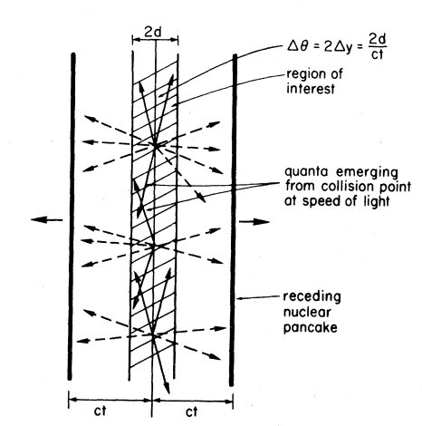
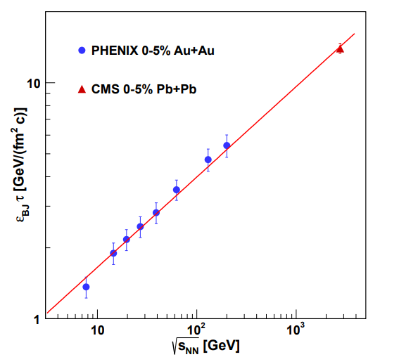
Transverse energy
4.
[2]
[3]
[2]
S⊥ - is the transverse overlap area of the colliding nuclei
[2] - J. D. Bjorken, Phys. Rev. D 27, 140 (1983)
ε - is the Bjorken energy density
[3] - J.T. Mitchell (for the PHENIX Collaboration), Transverse Energy Measurements from the Beam Energy Scan in PHENIX, Nuclear Physics A 00 (2022)
τ – is the formation time

Slide 5
Sources of experimental data used
5.
[4]Abelev et al.(ALICE Collaboration) “K₀^{S} and Λ production in Pb-Pb collisions at √S_{NN} = 2.76 TeV”, Phys.Rev.Lett. 111 (2013) 222301, 2013
[5]Adamczyk et al.“Probing Parton Dynamics of QCD Matter with Ω and ϕ Production”, Phys.Rev.C 93 (2016) 021903, 2016.
[6]Abelev et al.(ALICE Collaboration ), “Multi-strange baryon production at mid-rapidity in Pb-Pb collisions at sqrt(s_NN) = 2.76 TeV”, Phys.Lett.B 728 (2014) 216-227, 2014
[7]Adam et al. (STAR Collaboration) “Strange hadron production in Au+Au collisions at √S_{NN} = 7.7, 11.5, 19.6, 27, and 39 GeV”, Phys.Rev.C 102 (2020) 034909, 2020.

Slide 6
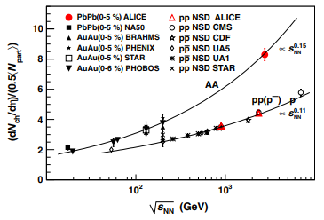
dN/dy​ vs. collision energy in A+A
7.
A+A collisions 0-5%
[8] K. Aamodt et al. (ALICE Collaboration)
Phys. Rev. Lett. 105, 252301 – Published 13 December 2010

Slide 7
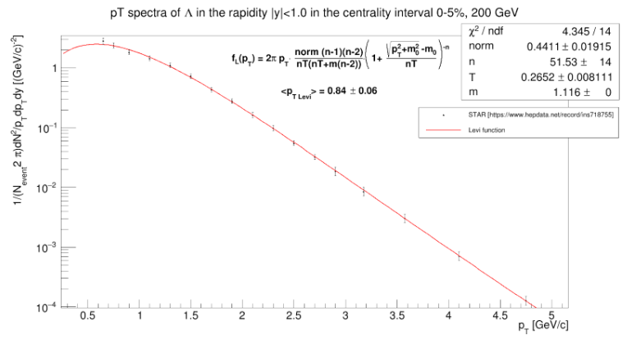
Calculating the average p⊥
6.
The Levy function:
n, T, and m₀ - fitting parameters
Average transverse momentum:
a and b are extended intervals over the entire range of p⊥
To estimate systematic errors we will use the blast-wave function.

Slide 8
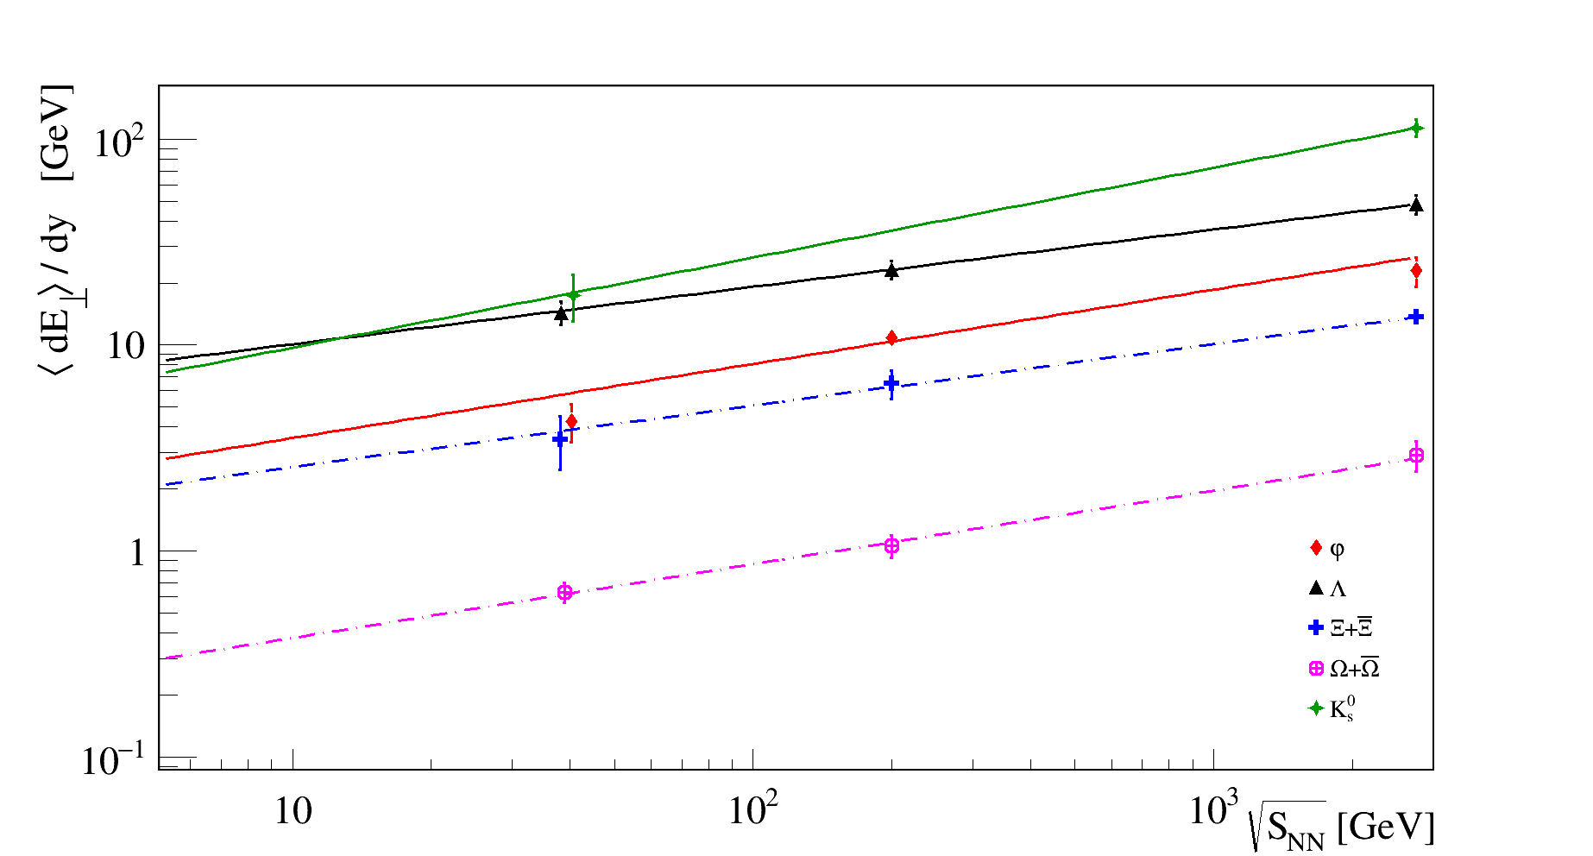
<dE⊥/dy> vs. √S_{NN}, very central (0-5 %) |η|< 0.5
8.
Approximation function: <dE⊥/dy> = Q *(√S_{NN})^{n}
Particles | n
φ | 0.36±0.04
Ξ +Ξ ⁻ | 0.30±0.05
Λ | 0.28±0.04
Ω+Ω⁻ | 0.39±0.08
K₀^{s} | 0.44±0.06
The dependence of <dE⊥/dy> on √S_{NN} for the most central collisions (0-5%) at energies of 39, 200, and 2760 GeV.
Similar functional dependencies for different particles.

Slide 9
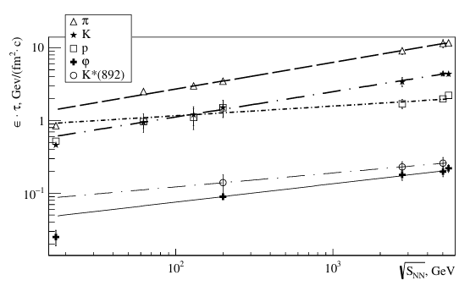
φ -meson and particles with u- and d- quarks [9]
9.
Approximation function: <dE⊥/dy> = Q *(√S_{NN})^{n}
Particles | n/2
φ | 0.18±0.02
π | 0.184±0.05
The slope of the function for π mesons is similar from that of strange hadrons.
[9] Shaposhnikova, Marova, Feofilov, “Open and hidden strangeness with kaons and ϕ-mesons in Bjorken energy density approach for central A+A collisions from SPS to LHC”, Physics of Particles and Nuclei

Slide 10
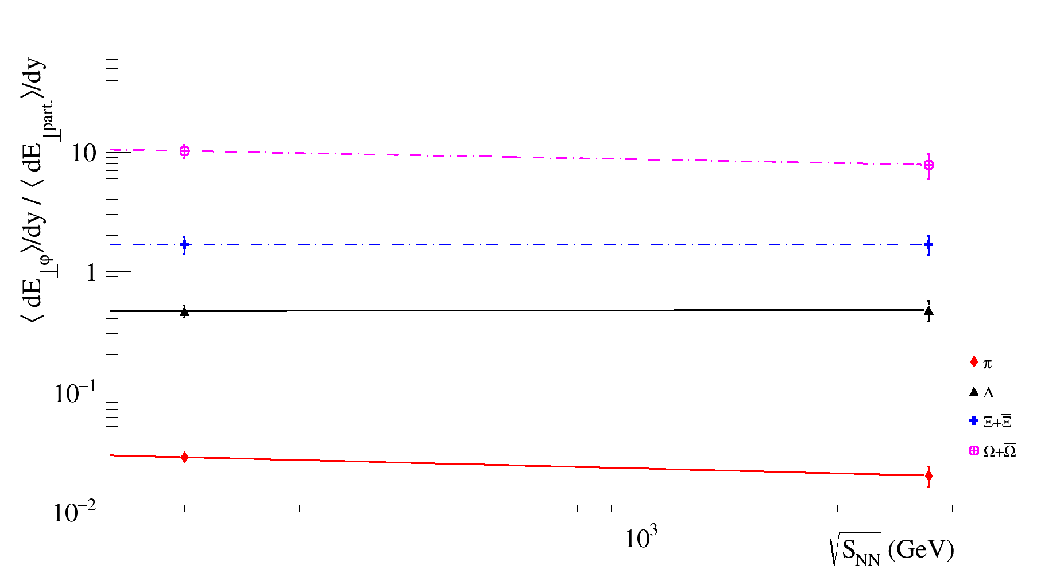
<dE⊥/dy> _{φ}/<dE⊥/dy> _{particles}
10.
<dE⊥/dy> _{φ}/<dE⊥/dy> _{particles} = Q *(√S_{NN})^{n}
A different energies, the fractions of energy expended on the prodaction of varios particles with strangeness remain constant.

Slide 11
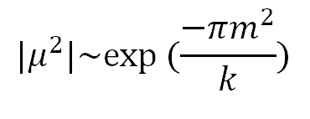
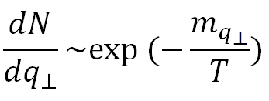
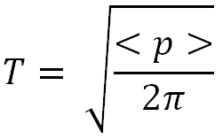
Theoretical models
11.
Schwinger-like formula
Thermal model
[10]
k is the string tension
k ≈ 1 GeV/fm
[11]
[10] S.A. Bass et al. “Microscopic Models for Ultrarelativistic Heavy Ion Collisions”, Nuclear Theory (nucl-th); High Energy Physics - Phenomenology
<p> — mean string tension.
[11]V.V.Vechernin, Physics of Particles and Nuclei, 2023, Vol. 54, No. 3, pp. 528–535, 2023.

Slide 12
Conclusions
12.
From the dependence of the mean transverse energy <dE⊥/dy> on √S_{NN}, we do not observe a relative increase of production of the ϕ-meson to the multistrange particles as it was predicted in [1].
The behaviour of multiplicity​ and the average transverse energy <dE⊥/dy> vs. √S_{NN} have similar (close) power-law indices.
3) The ratios of mean transverse energies <dE⊥/dy> of φ-mesons to <dE⊥/dy> part of other strange hadrons is found to be of some constant values at different collision energies.
4) The further analysis of these peculiar dependences of ratios is planned within the frameworks of string and thermal models. [10], [11]
[1] - Asher Shor , PHYSICAL REVIEW LETTERS, 25.70.Np, 12.35.Ht, 21.65(1985)
[10] S.A. Bass et al. “Microscopic Models for Ultrarelativistic Heavy Ion Collisions”, Nuclear Theory (nucl-th); High Energy Physics - Phenomenology
[11]V. V. Vechernin, Physics of Particles and Nuclei, 2023, Vol. 54, No. 3, pp. 528–535, 2023.

Slide 13
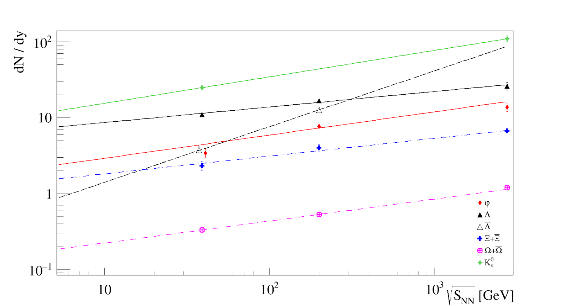
dN/dy vs. √S_{NN}
Approximation function: <dN/dy> = Q *(√S_{NN})^{n}
Particles | n
φ | 0.31±0.03
Ξ+Ξ ⁻ | 0.23±0.03
Λ | 0.20±0.03
Λˉ | 0.73±0.07
Ω+Ω⁻ | 0.29±0.07
K₀^{s} | 0.35±0.03
The dependence of <dN/dy> on √S_{NN} for the most central collisions (0-5%) at energies of 39, 200, and 2760 GeV.

Slide 14
Back-up slides

Slide 15
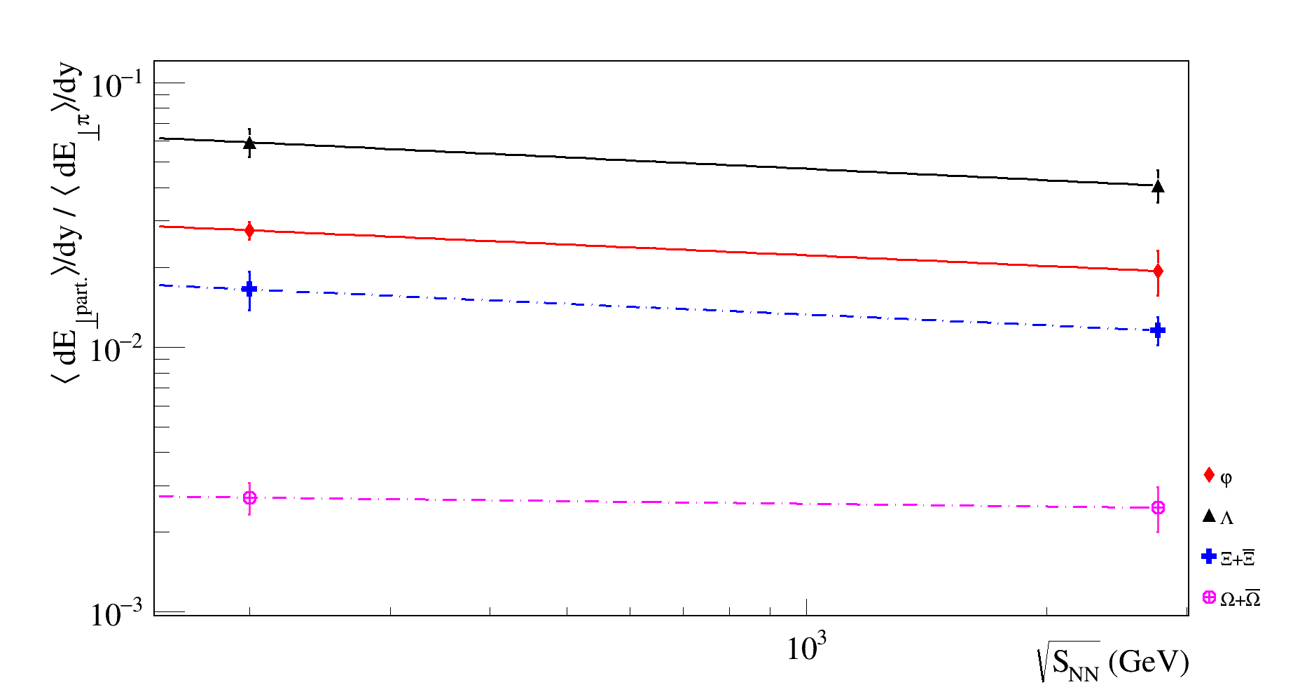
<dE⊥/dy> _{particles}/<dE⊥/dy> _{π}
10.
<dE⊥/dy> _{particles}/<dE⊥/dy> _{π} = Q *(√S_{NN})^{n}
Particles/π | n
Ξ +Ξ ⁻ | -0.14±0.08
Λ | -0.14±0.07
Ω+Ω⁻ | -0.03±0.09
φ | -0.13±0.08
The function graphs tend toward a constant.

Slide 16
