Slide 1
Reconstruction of photons and neutral mesons in heavy-ion collisions with MPD at NICA
Yonghong Wang（王永红）
for the MPD collaboration
Shandong University（山东大学）

Slide 2
Outline
NICA-MPD and motivation
Photon reconstruction
Neutral meson reconstruction
Summary
Photon identification in ECal (Electromagnetic Calorimeter)
Photon reconstruction using the PCM (Photon Conversion Method)
Neutral mesons reconstruction via invariant mass of two photons
Centrality dependence of $p_{T}$ spectra
Comparison of reconstructed and generated neutral mesons

Slide 3
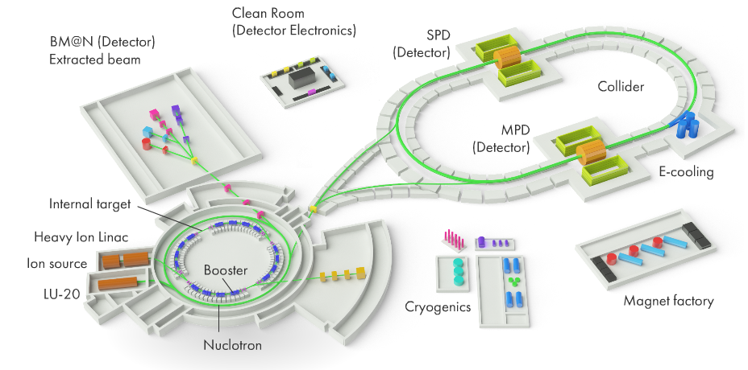
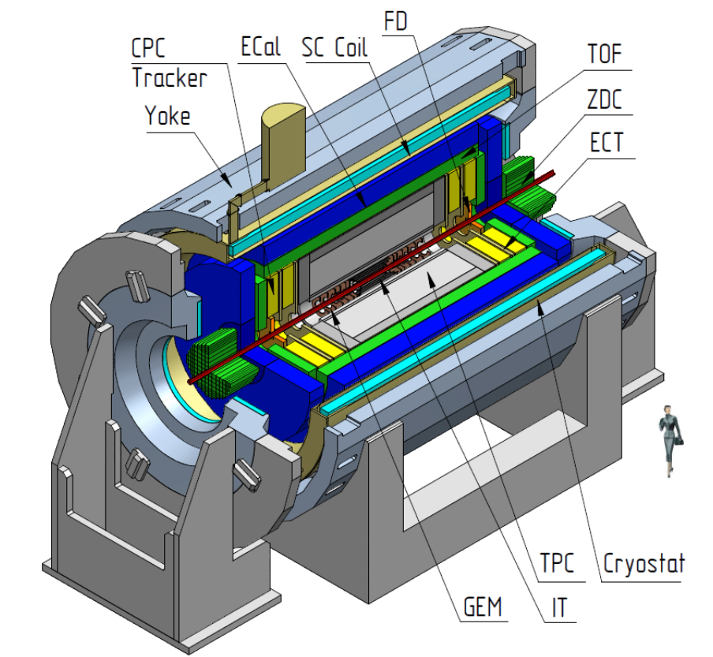
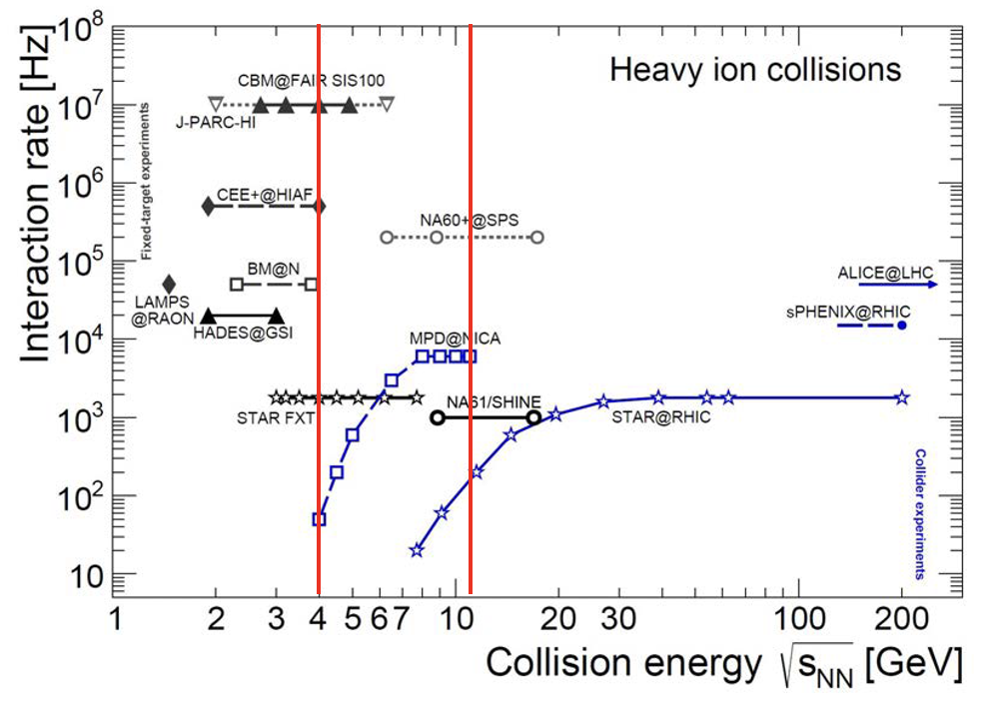
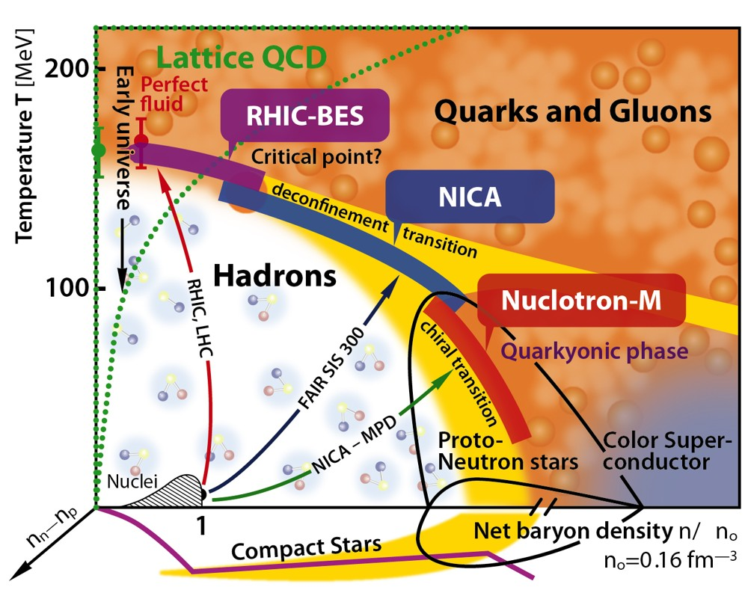
NICA-MPD and motivation
With heavy-ion collisions in the energy range $\sqrt{s_{NN}}$ = 4-11 GeV, the NICA-MPD will scan the baryon-reach region of the QCD phase diagram to look for the first order phase transition and critical end-point.
Use 50M UrQMD BiBi @ 9.2 GeV events to study detector performance for the measurement of photons and neutral mesons ($π^{0}$ and $η$).
Event cut: Primary vertex of event reconstructed and vertex_z cut < $\left|100\right|$ cm.
NICA complex
MPD detector
https://nica.jinr.ru/physics.php
Phase diagram

Slide 4
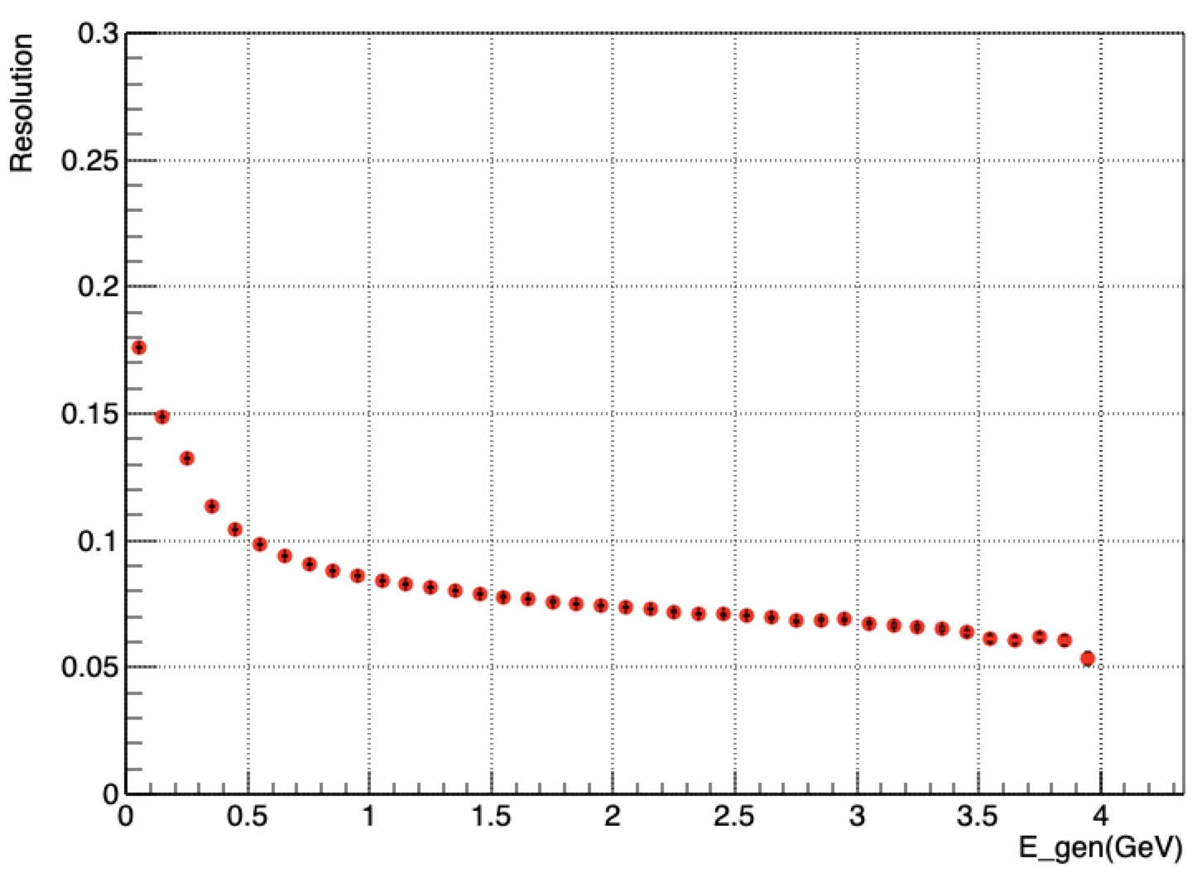
Photon identification in ECal
1、number of towers in the shower/cluster >=2
2、reconstructed energy>=75MeV
3、Chi2<=4(This variable says how close the cluster shape to the one expected for electromagnetic shower.)
4、tof<2ns( tof of the cluster, assumed ECAL time resolution dt = 0.5 ns)
5、optional charged particle veto cut (no matching to tracks reconstructed in the TPC and extrapolated to the ECAL within 10 cm) for systematic study
Photon’s Energy Resolution
UrQMD, Bi+Bi @9.2GeV

Slide 5
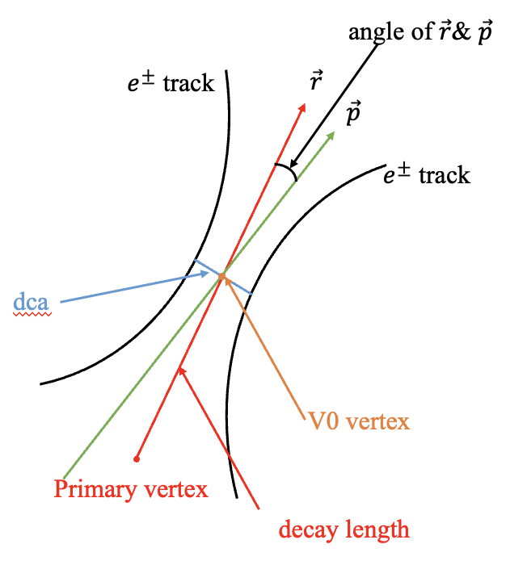
Photon reconstruction using PCM
The cuts of single $e^{+}{(e}^{−})$ track for PCM:
1、nhit>10 in TPC
2、$p_{T}$ > 50 MeV/c
3、TPC 2-sigma e-ID or TPC 2-sigma eID + 3-sigma TOF e-ID in case of track matching to the TOF
$e^{+}e^{−}$ pair’s variables for PCM:
1、dca: distance of closest approach for $e^{+}e^{−}$ tracks
2、Chi2: quality of the secondary vertex reconstruction
3、angle: between $\vec{r}$ & $\vec{p}$
4、decay length: the distance from primary vertex to V0 vertex
5、mass: the mass of mother particle of $e^{+}e^{−}$ pair

Slide 6
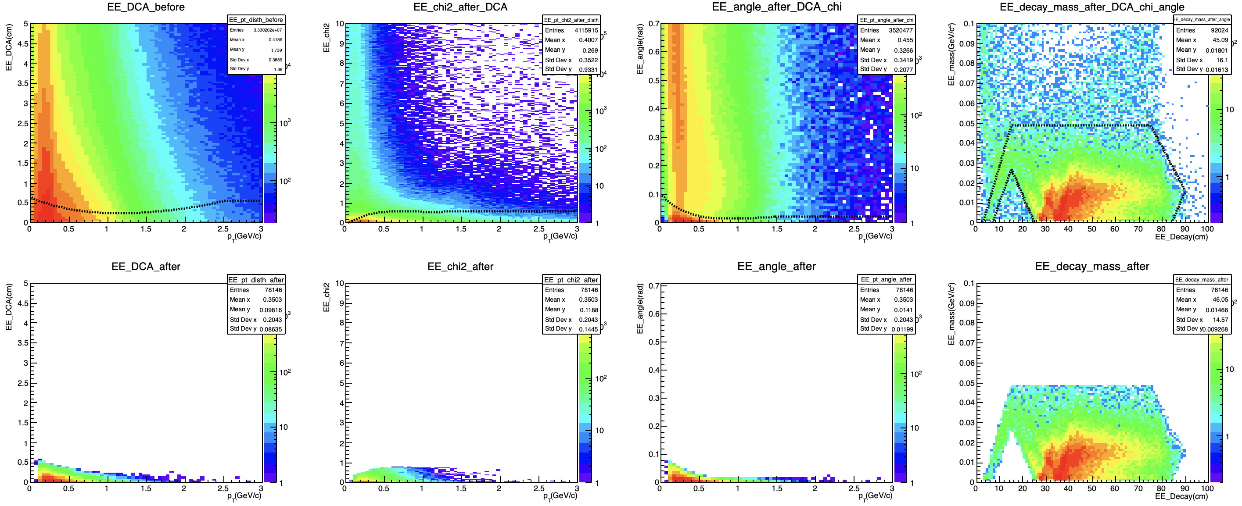
$e^{+}e^{−}$ pairs selection for PCM
The upper are distributions of true conversion $e^{+}e^{−}$ pairs.
The black dotted curves as 2*sigma selection, where sigma is either a Gaussian width (for distributions with Gaussian shape) or a range, which accounts for 65% of the total signal (2*sigma accounts for ~ 95% of the total signal).

Slide 7
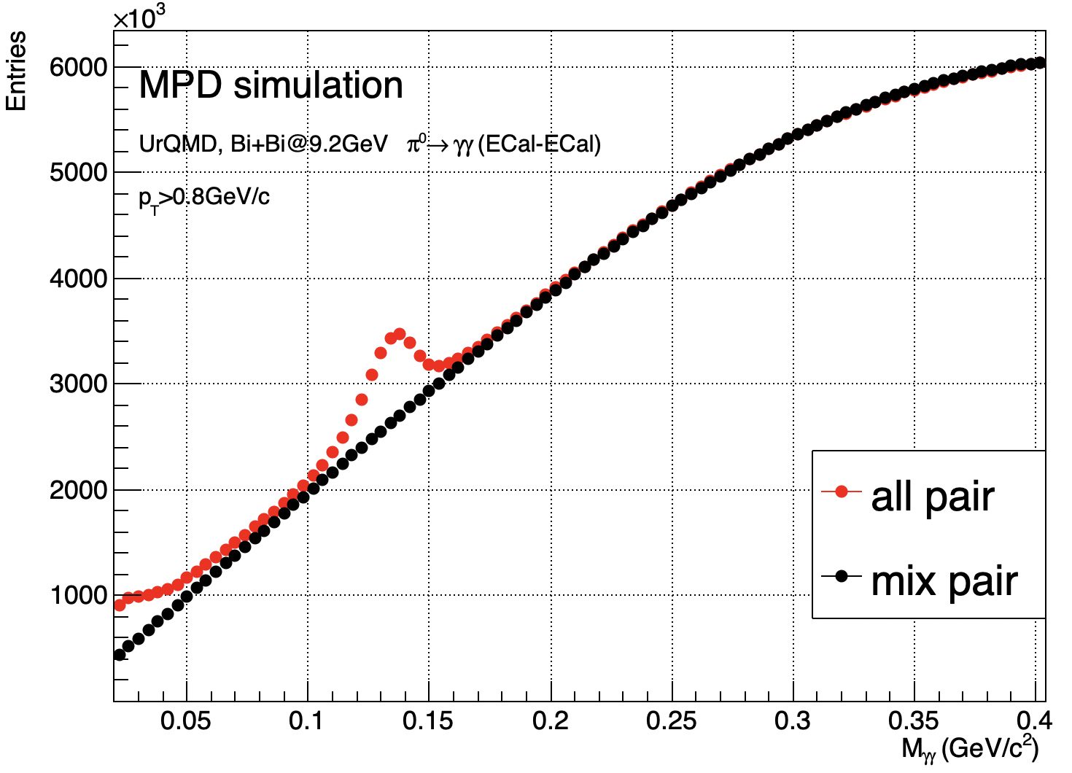
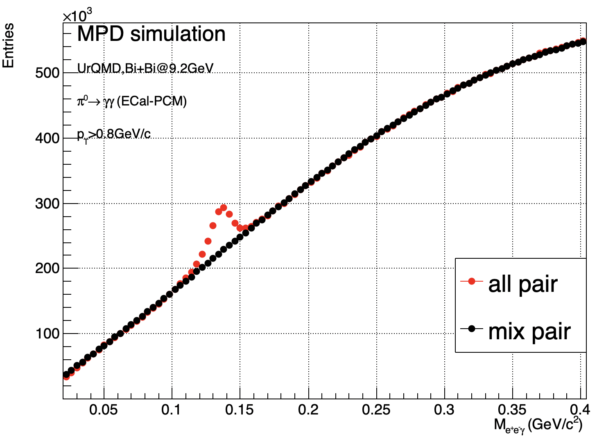
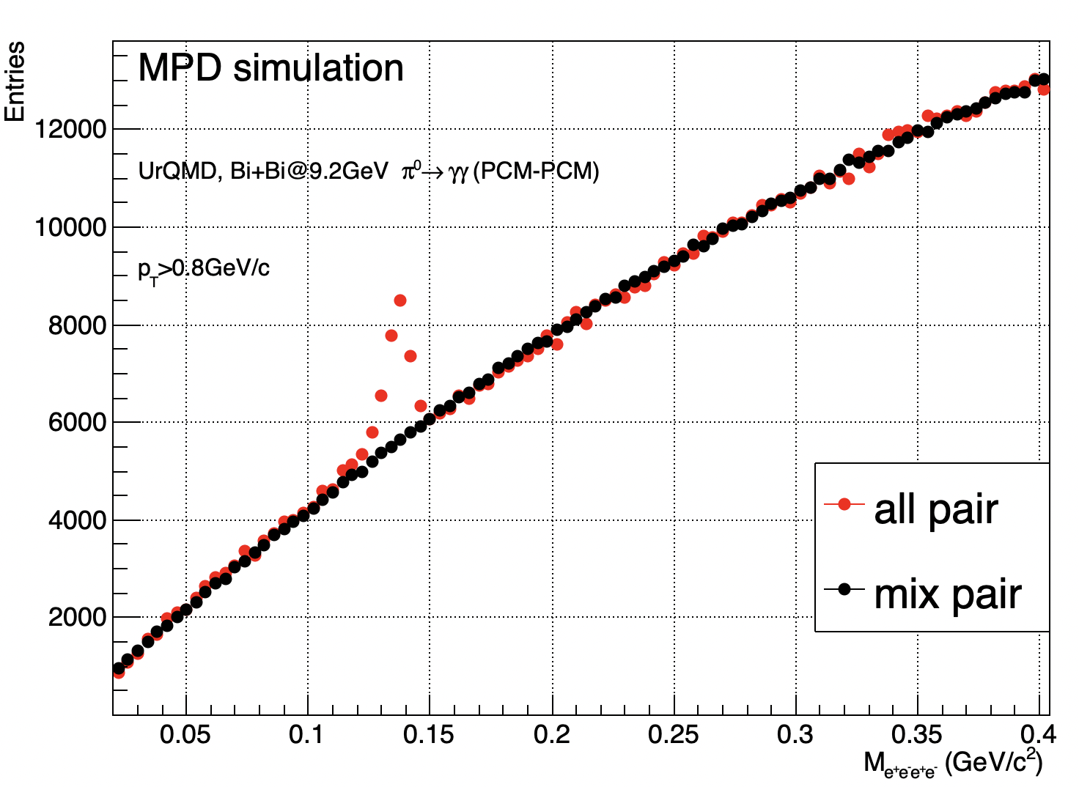
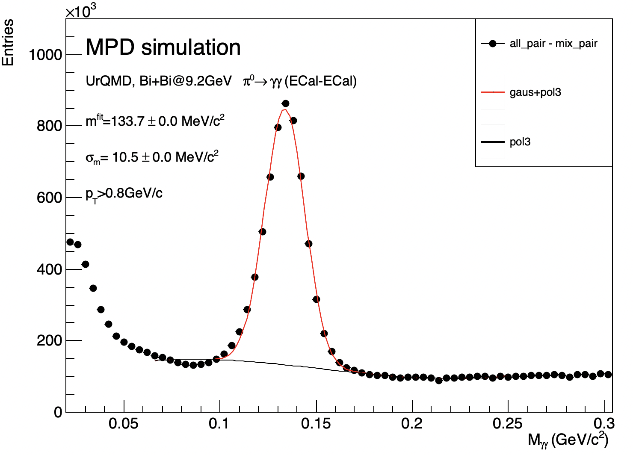
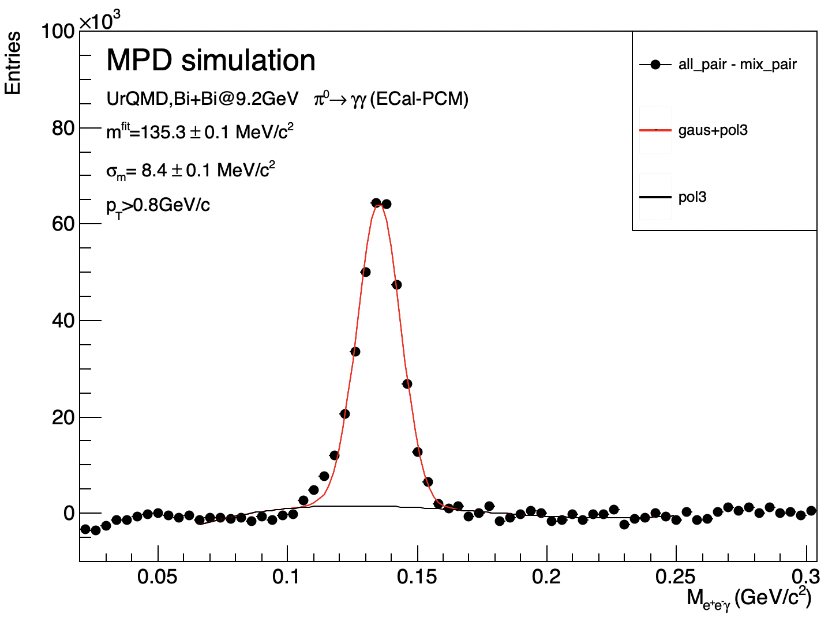
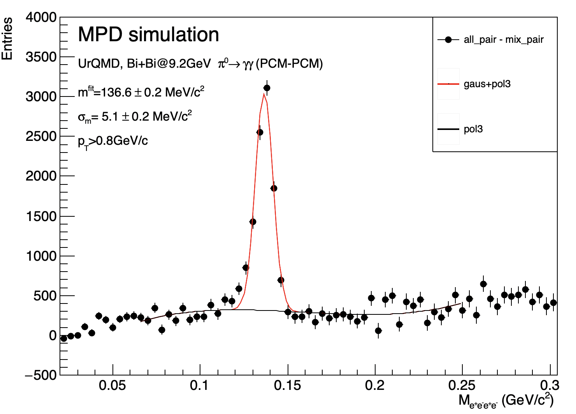
$π^{0}$ reconstruction via invariant mass of two photons
A clear excess is visible in distributions close to the nominal meson mass of 135 MeV/c² for the $π^{0}.$

Slide 8
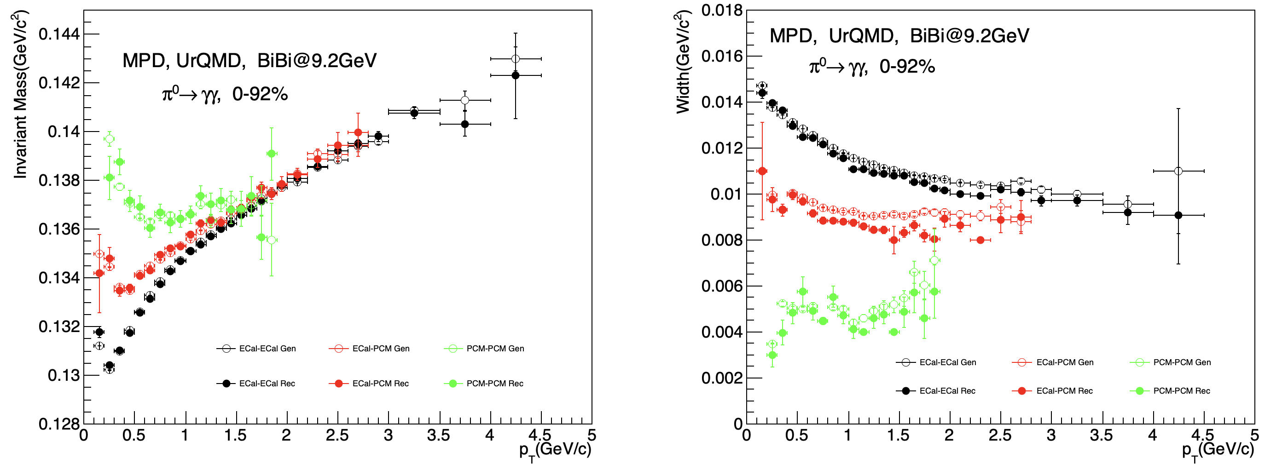
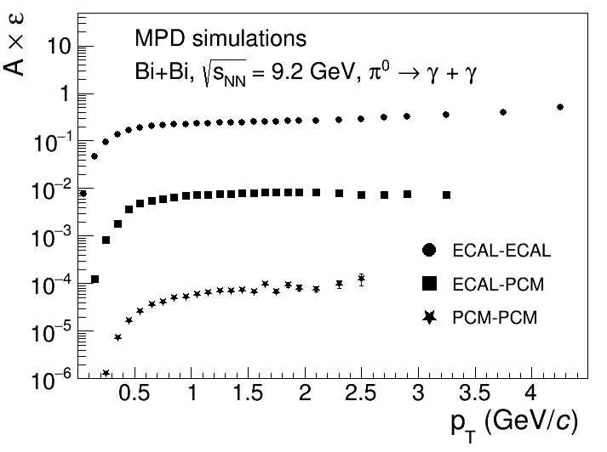
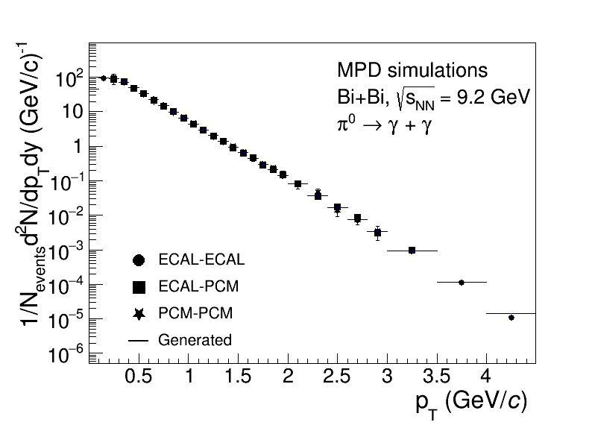
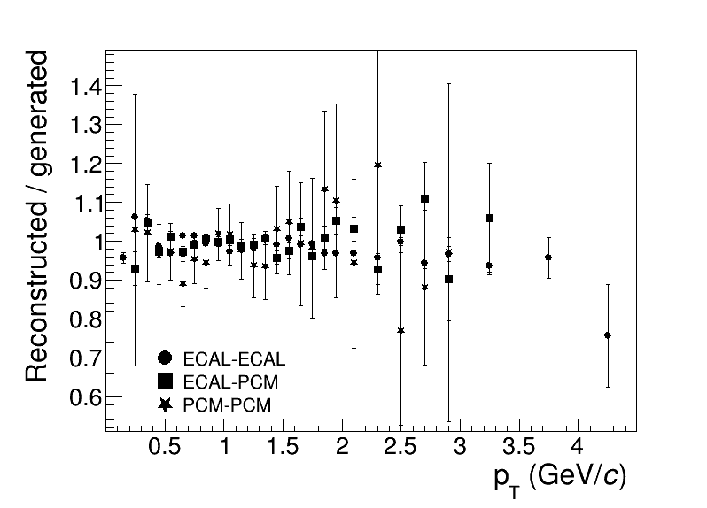
Comparison of reconstructed and generated $π^{0}$
Measurements for $π^{0}$ are possible starting from $p_{T}$ ~ 100 MeV/c in a wide rapidity range |y|<1.
The corrected yields obtained by three methods for $π^{0}$ are consistent with truly generated.
0-92%

Slide 9
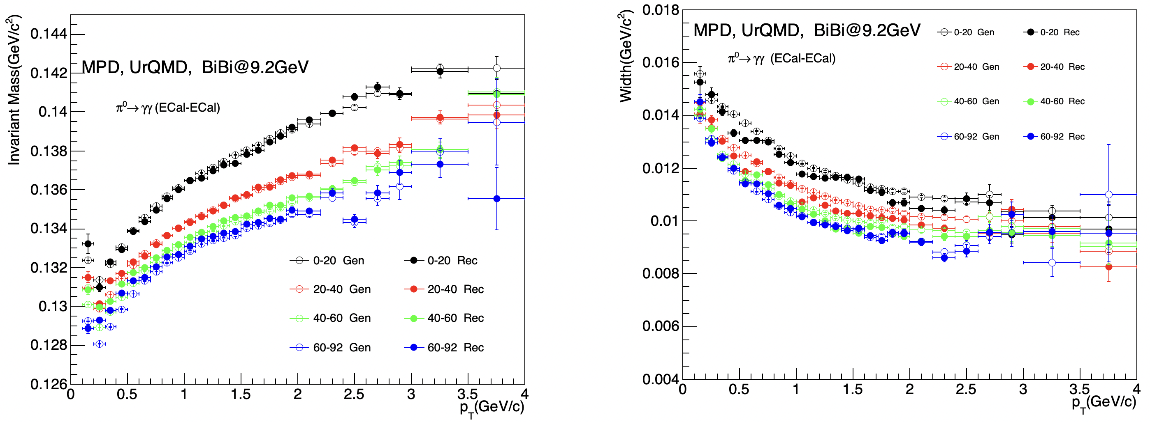
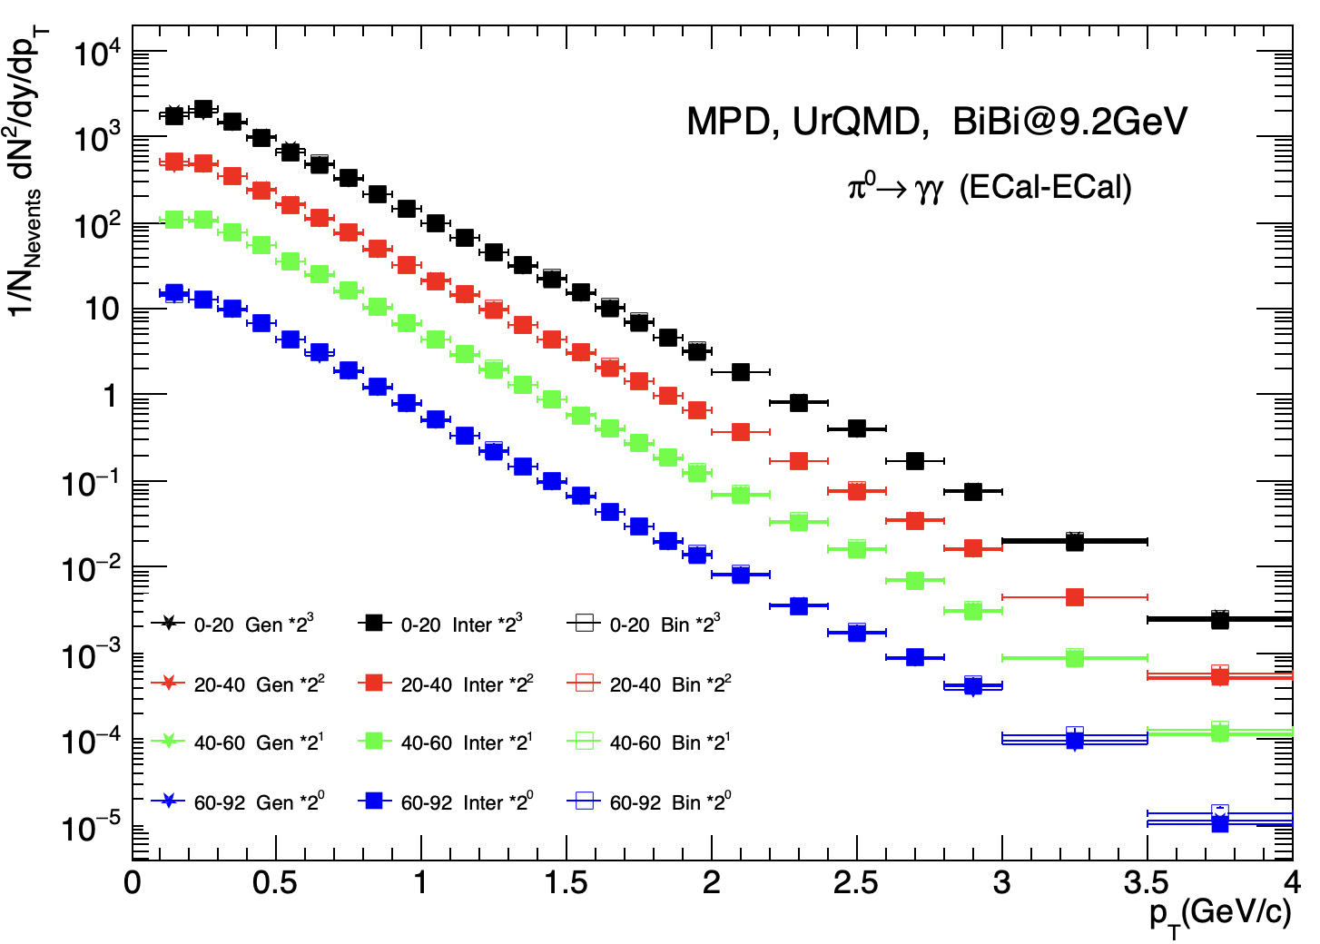
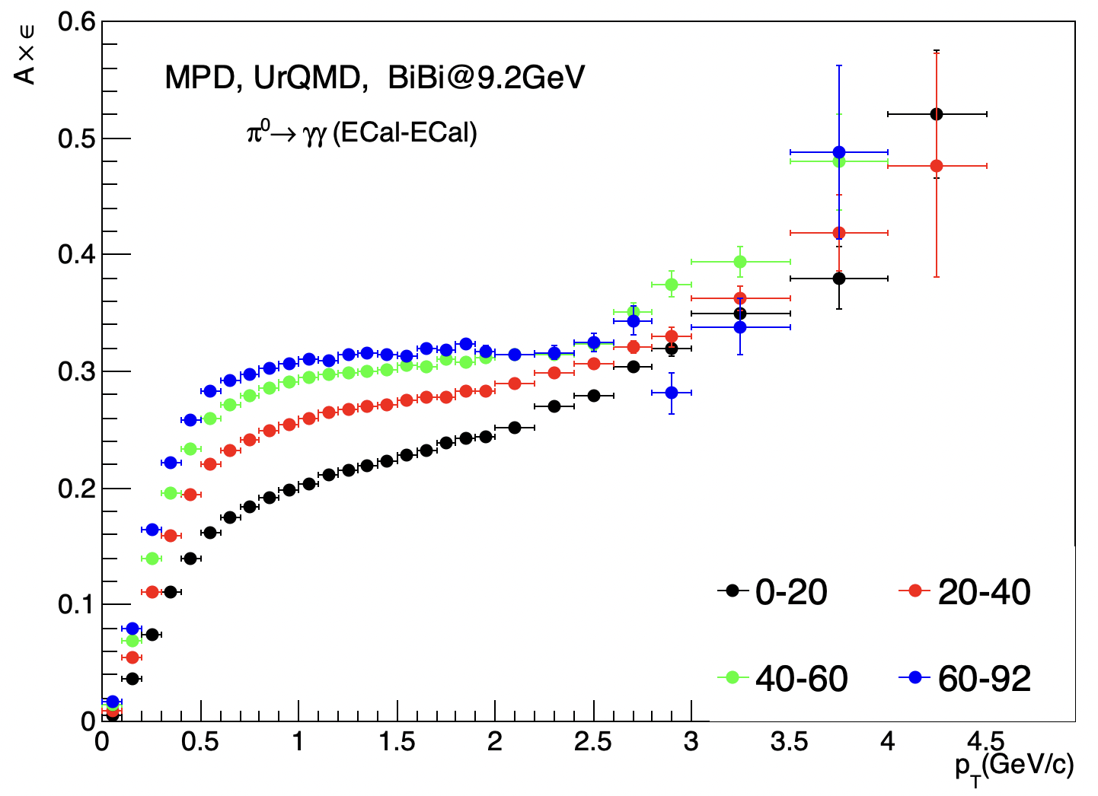
Centrality dependence of $π^{0}$ in ECal-ECal
Centrality dependence of the peak mass/width and reconstruction efficiency is observed.
The corrected yields for $π^{0}$ are consistent with truly generated ones in each centrality interval.

Slide 10
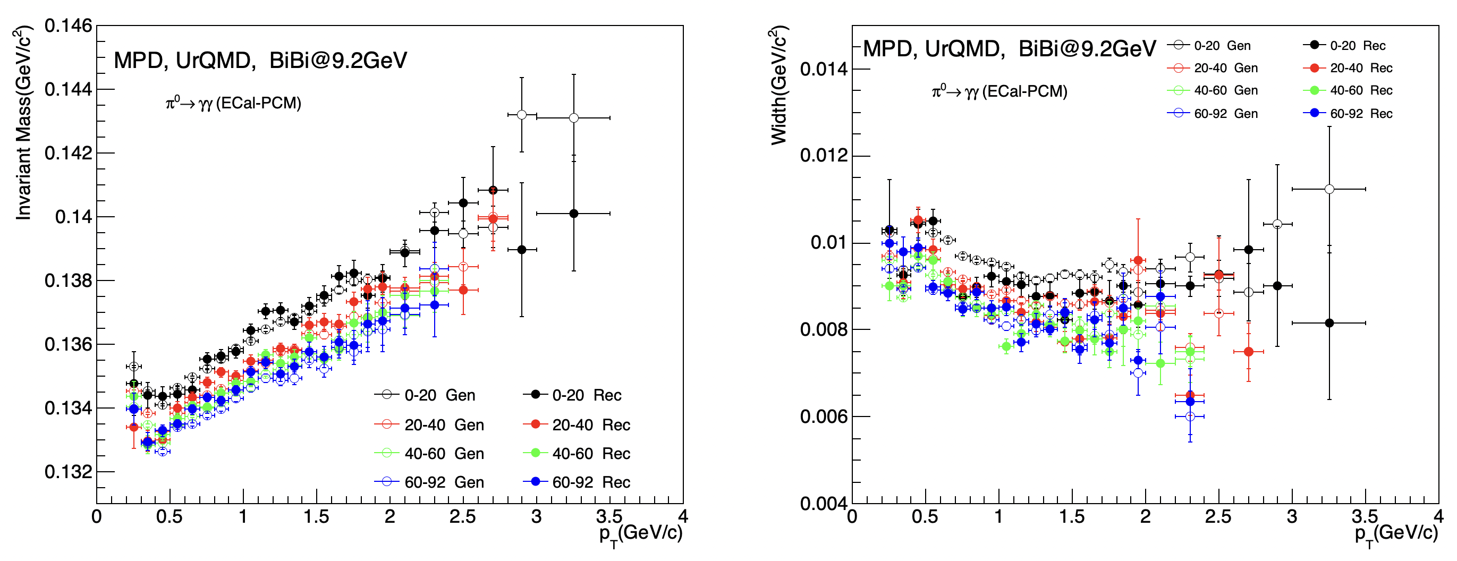
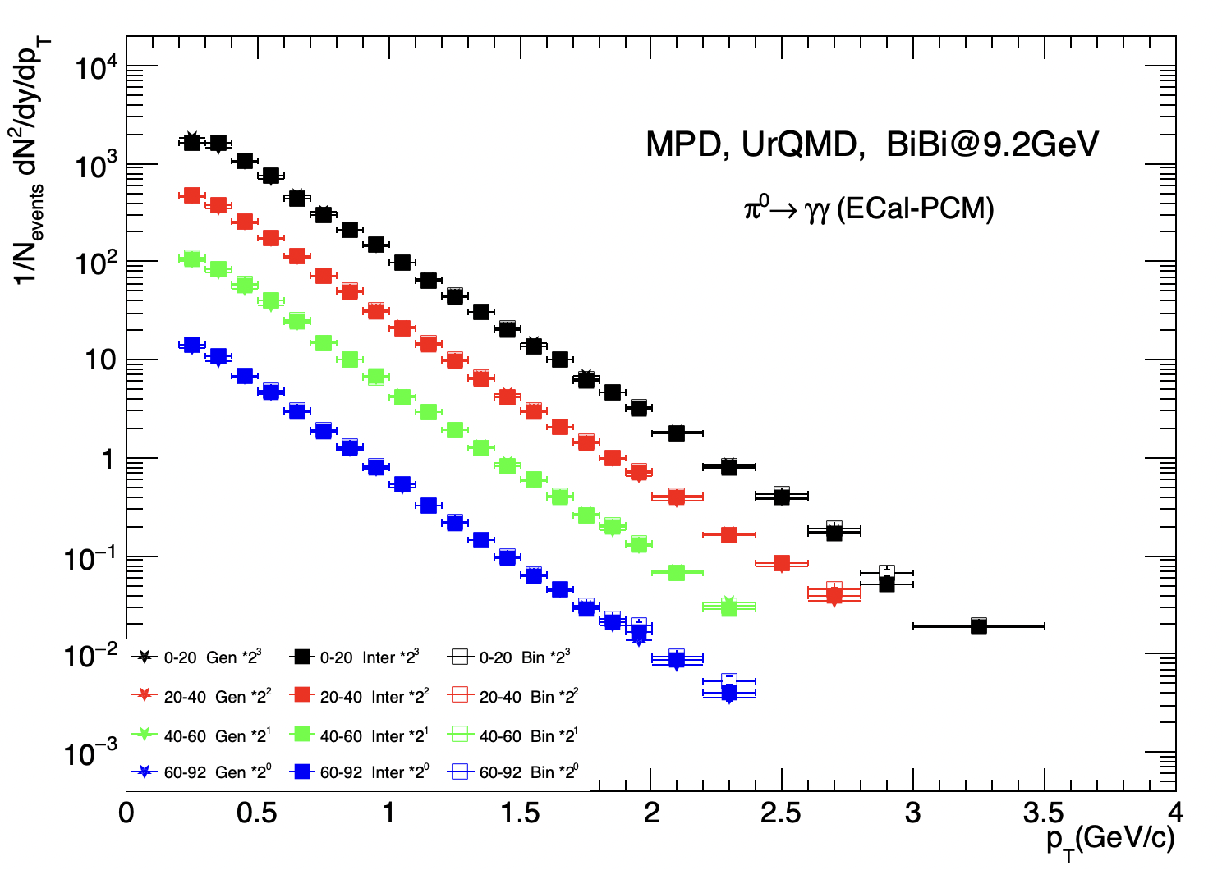
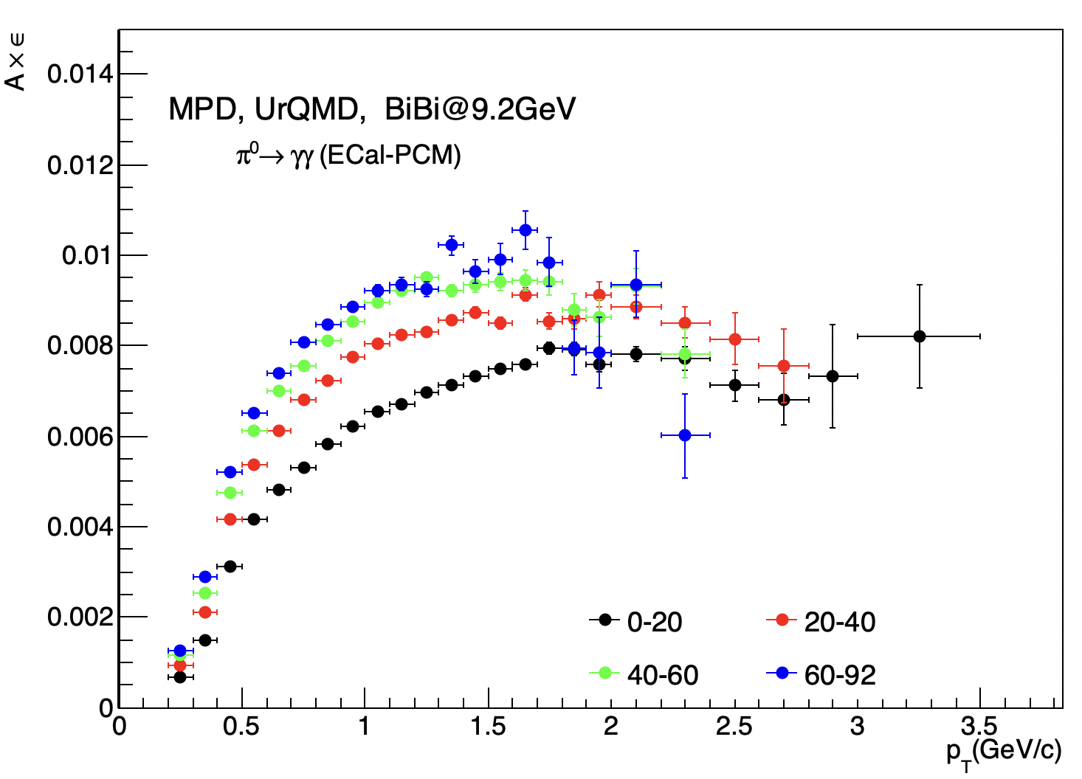
Centrality dependence of $π^{0}$ in ECal-PCM
Centrality dependence of the peak mass/width and reconstruction efficiency is observed.
The corrected yields for $π^{0}$ are close to truly generated ones in each centrality interval.

Slide 11
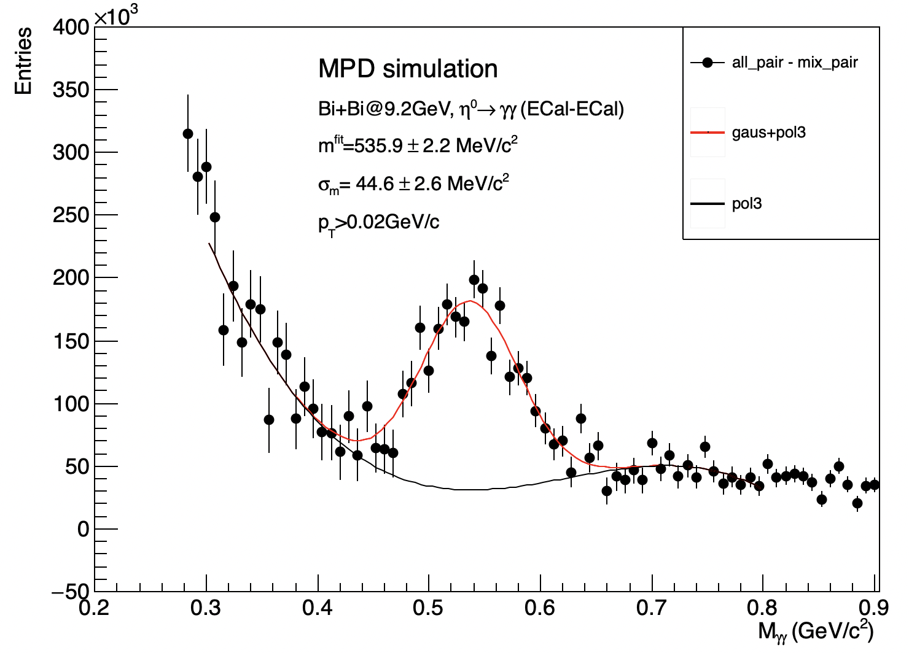
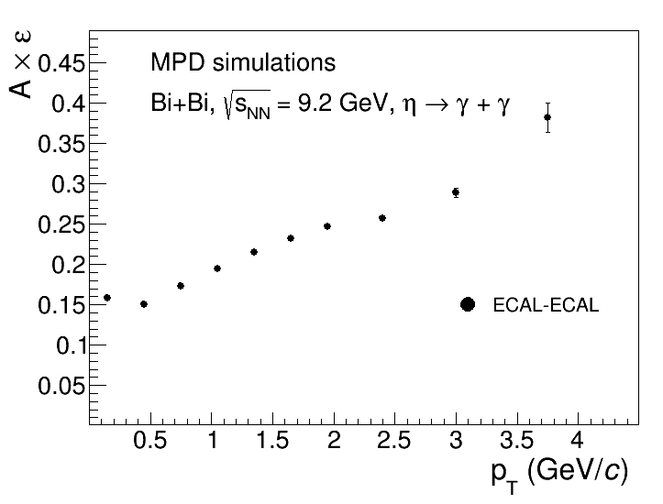
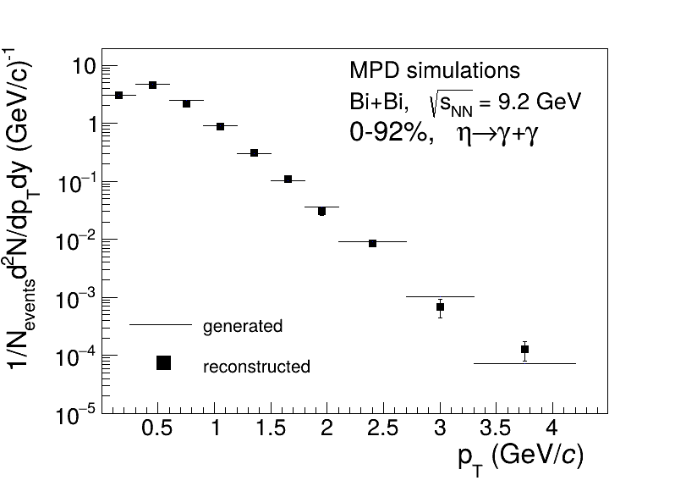
$η$ reconstruction via invariant mass of two photons
A clear excess is visible in distributions close to the nominal meson mass of 548 MeV/c² for the $η.$
The reconstructed results are consistent with the truly generated for $η$.

Slide 12
Summary
Developed two methods for photon reconstruction: ECAL and PCM.
With 50M Bi+Bi collisions at $\sqrt{s_{NN}}$=9.2 GeV:
Reconstructed $π^{0}$ and $η$ yields are consistent with truly generated signals.
reconstruct centrality dependent $π^{0}$ production with ECAL-ECAL and ECAL-PCM selections; PCM-PCM lacks statistics due to low efficiency
reconstruct $η$ production in minbias collisions

Slide 13
Summary
Developed two methods for photon reconstruction: ECAL and PCM.
With 50M Bi+Bi collisions at $\sqrt{s_{NN}}$=9.2 GeV:
Reconstructed $π^{0}$ and $η$ yields are consistent with truly generated signals.
reconstruct centrality dependent $π^{0}$ production with ECAL-ECAL and ECAL-PCM selections; PCM-PCM lacks statistics due to low efficiency
reconstruct $η$ production in minbias collisions
Thanks for your attention!

Slide 14
Backup

Slide 15
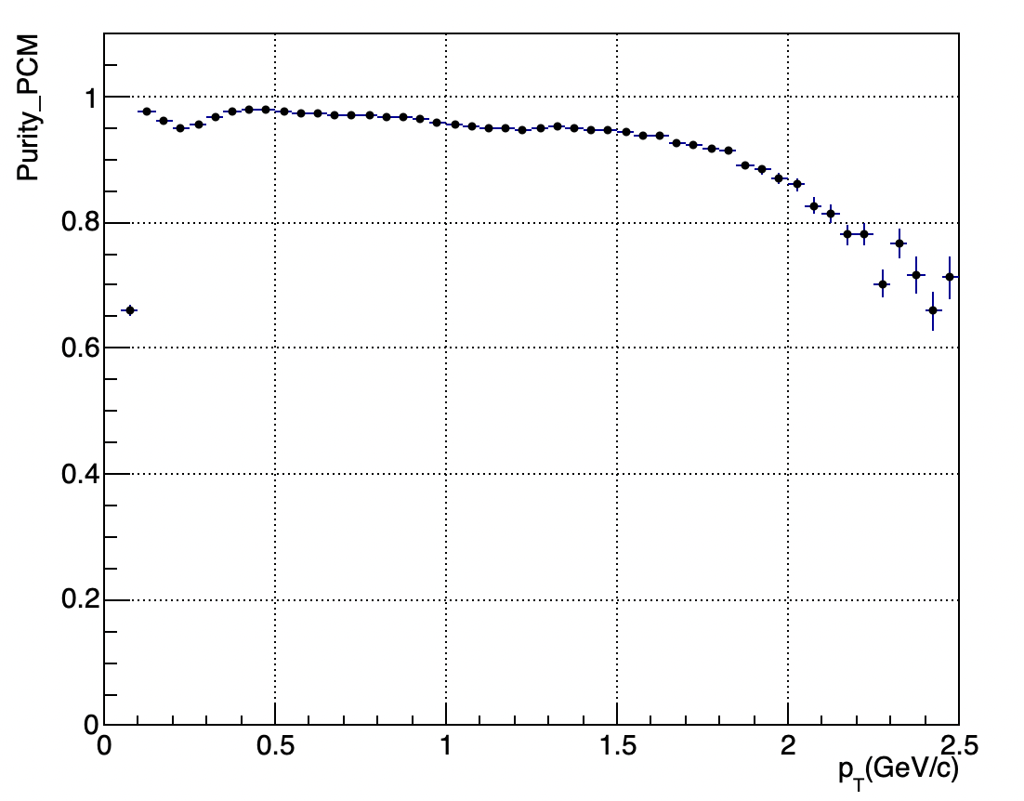
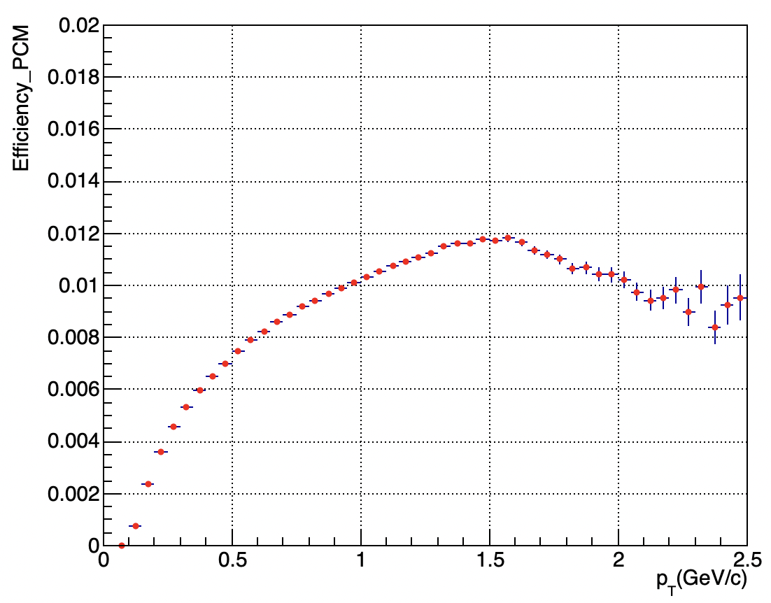
Photon purity and efficiency in PCM
$Purity=\frac{The number of e^{+}e^{−}pairs from photons after cut}{The number of e^{+}e^{−}pairs after cut}$ $Efficiency=\frac{The number of e^{+}e^{−}pairs from photons after cut}{The number of true photon(MC photon)}$
The photon purity obtained by PCM is higher than 80% at $p_{T}$ < 2GeV/c.

