Slide 1
X-Ray scanner development status
Zakharov A., Durov A.

Slide 2
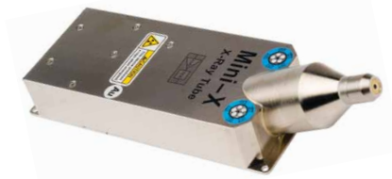
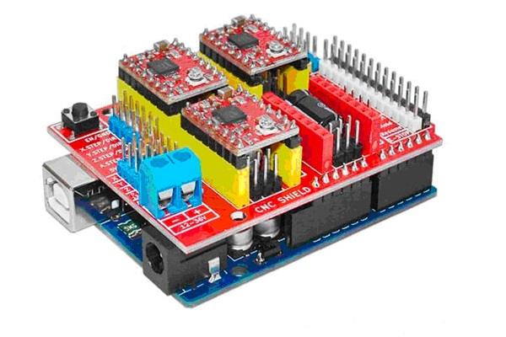
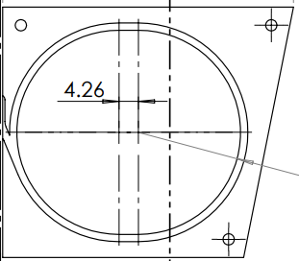
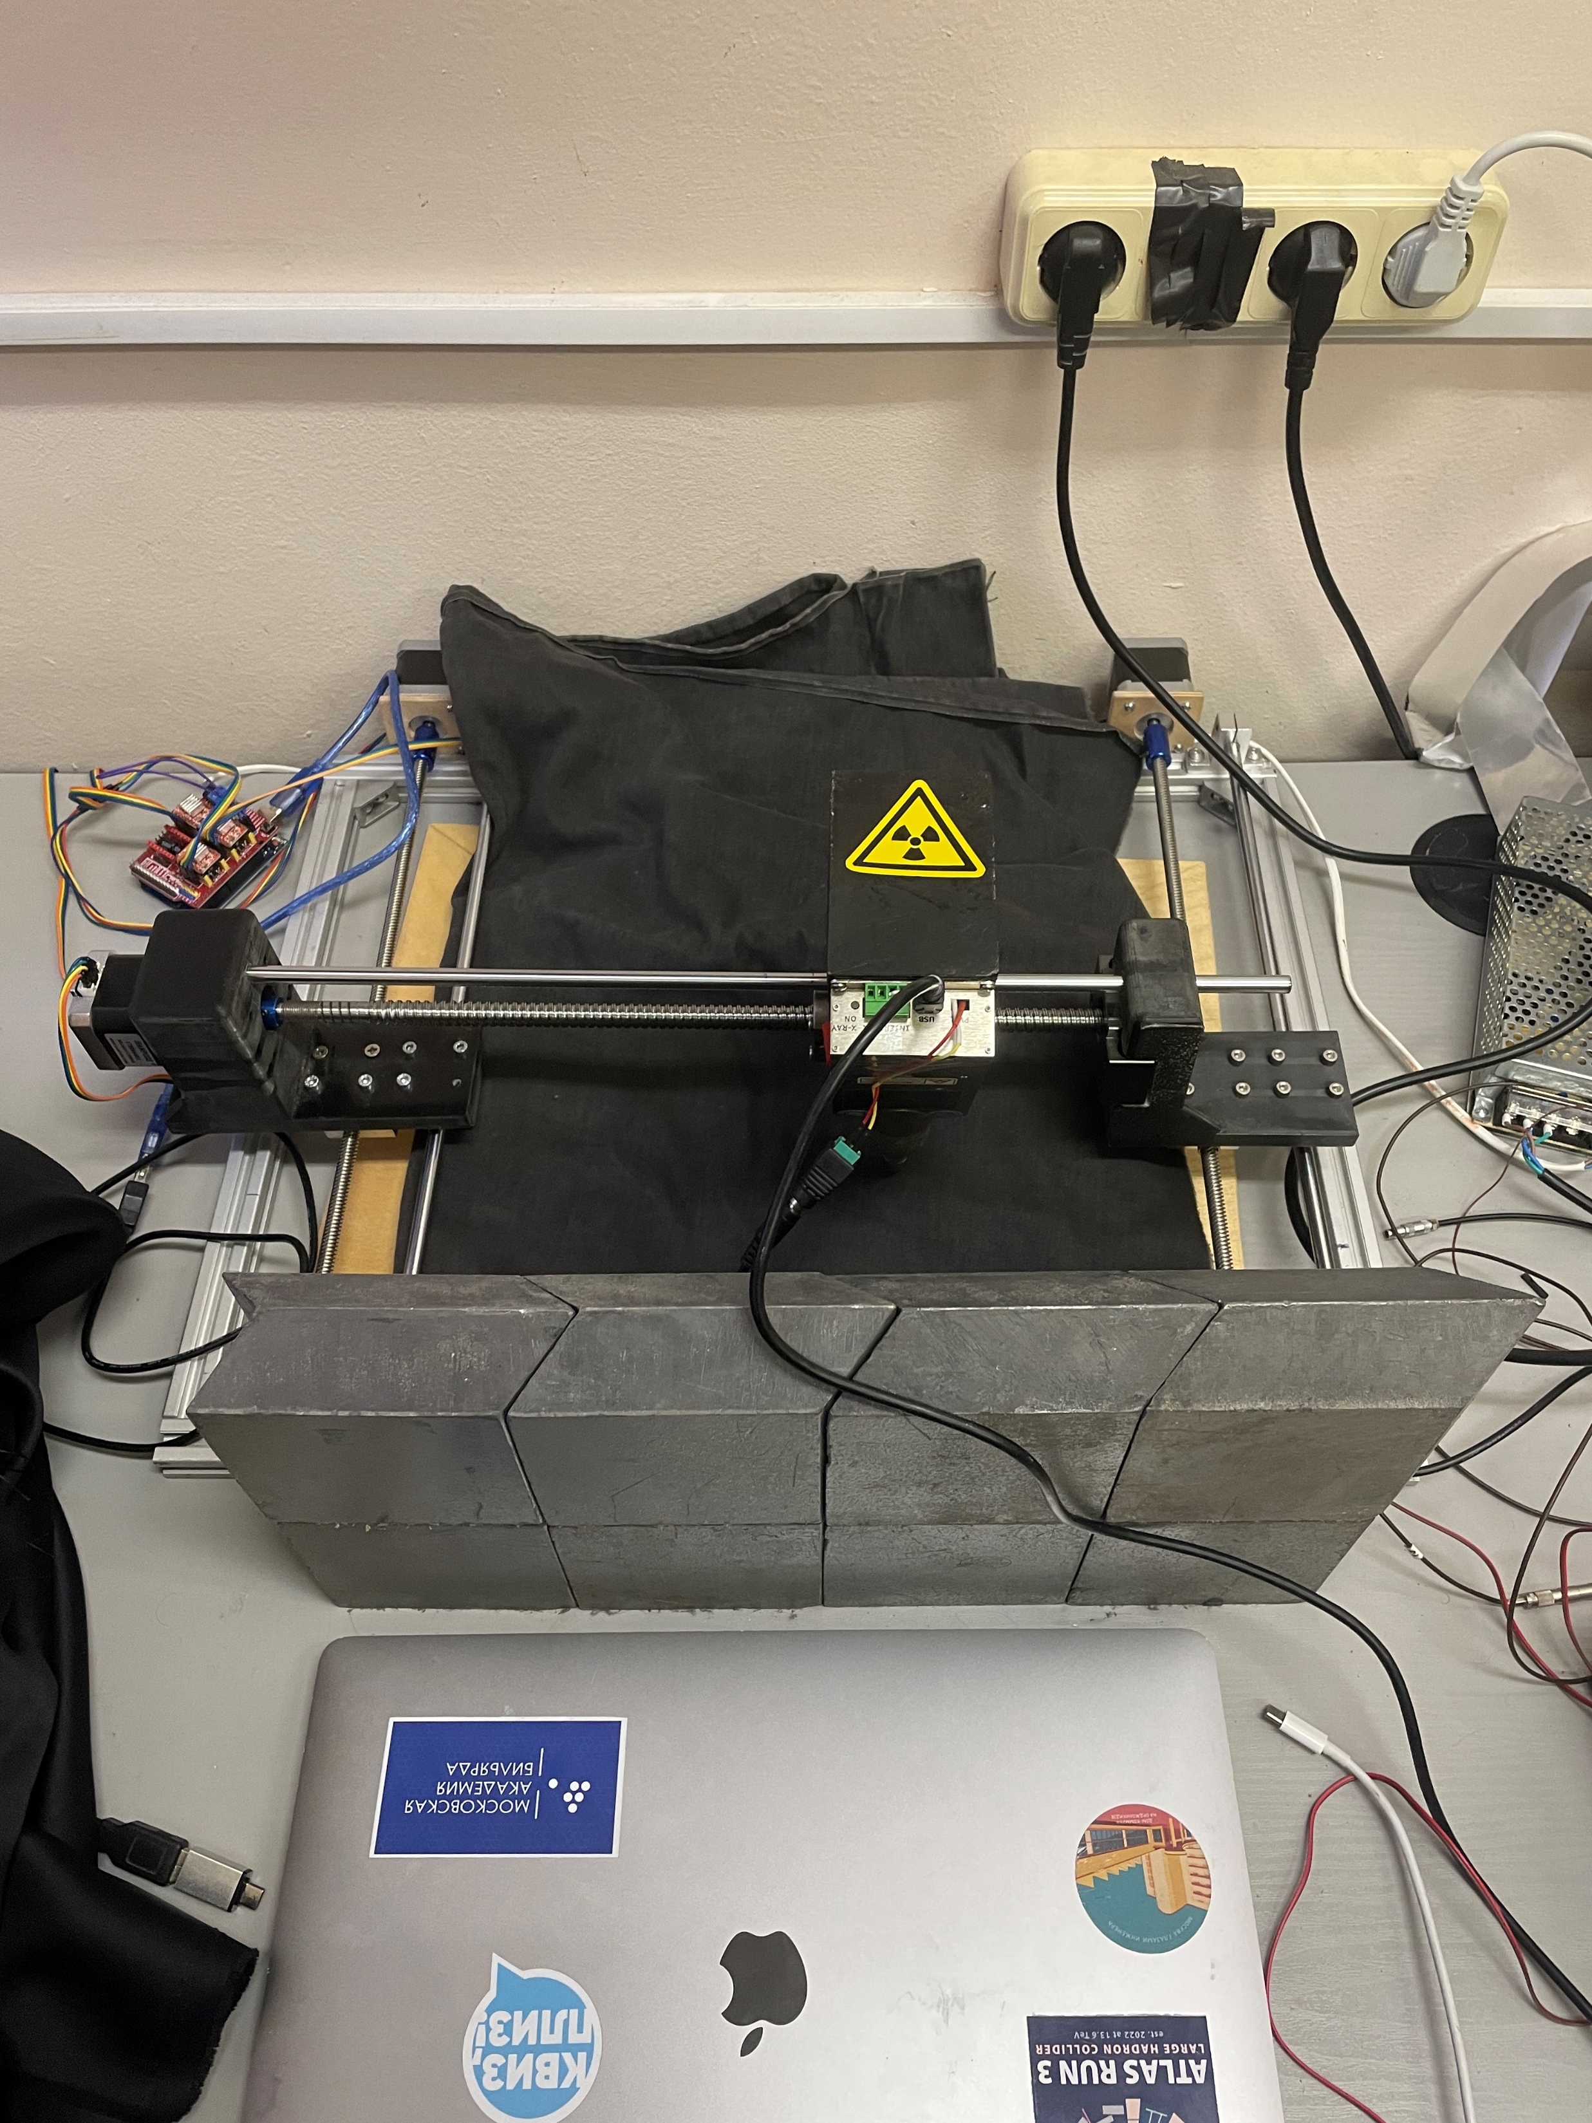
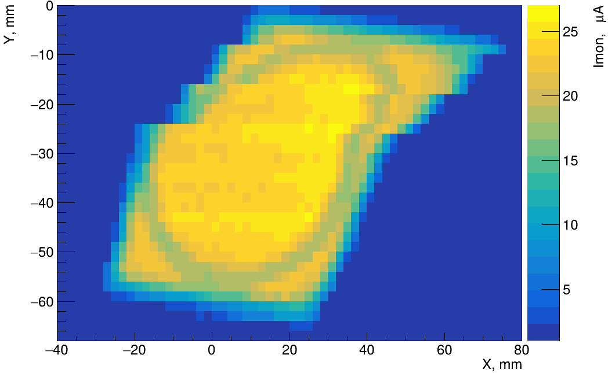
As you could probably remember, …
Mini-X X-ray tube
Arduino with CNC shield
and drivers
Row 3 tile with
SG BCF92
WLS fiber
Pb bricks for
radiation shielding
Coordinate table with X-ray tube:
AMPTEK Mini-X X-ray tube
Ag target, 50 kV / 80 μA, 2 mm collimator (5° X-ray cone) with ~ 2 cm from tile
NEMA 17 stepping motors
Angular step 1.8°, 20 & 40 μm resolution (X and Y axis correspondingly)
Arduino and CNC Sheild
Microcontroller board, enables movement automatization
CAEN DT5202
A7585D power supply with 1 μA resolution
Detector response VS. coordinate
(preliminary)
1

Slide 3
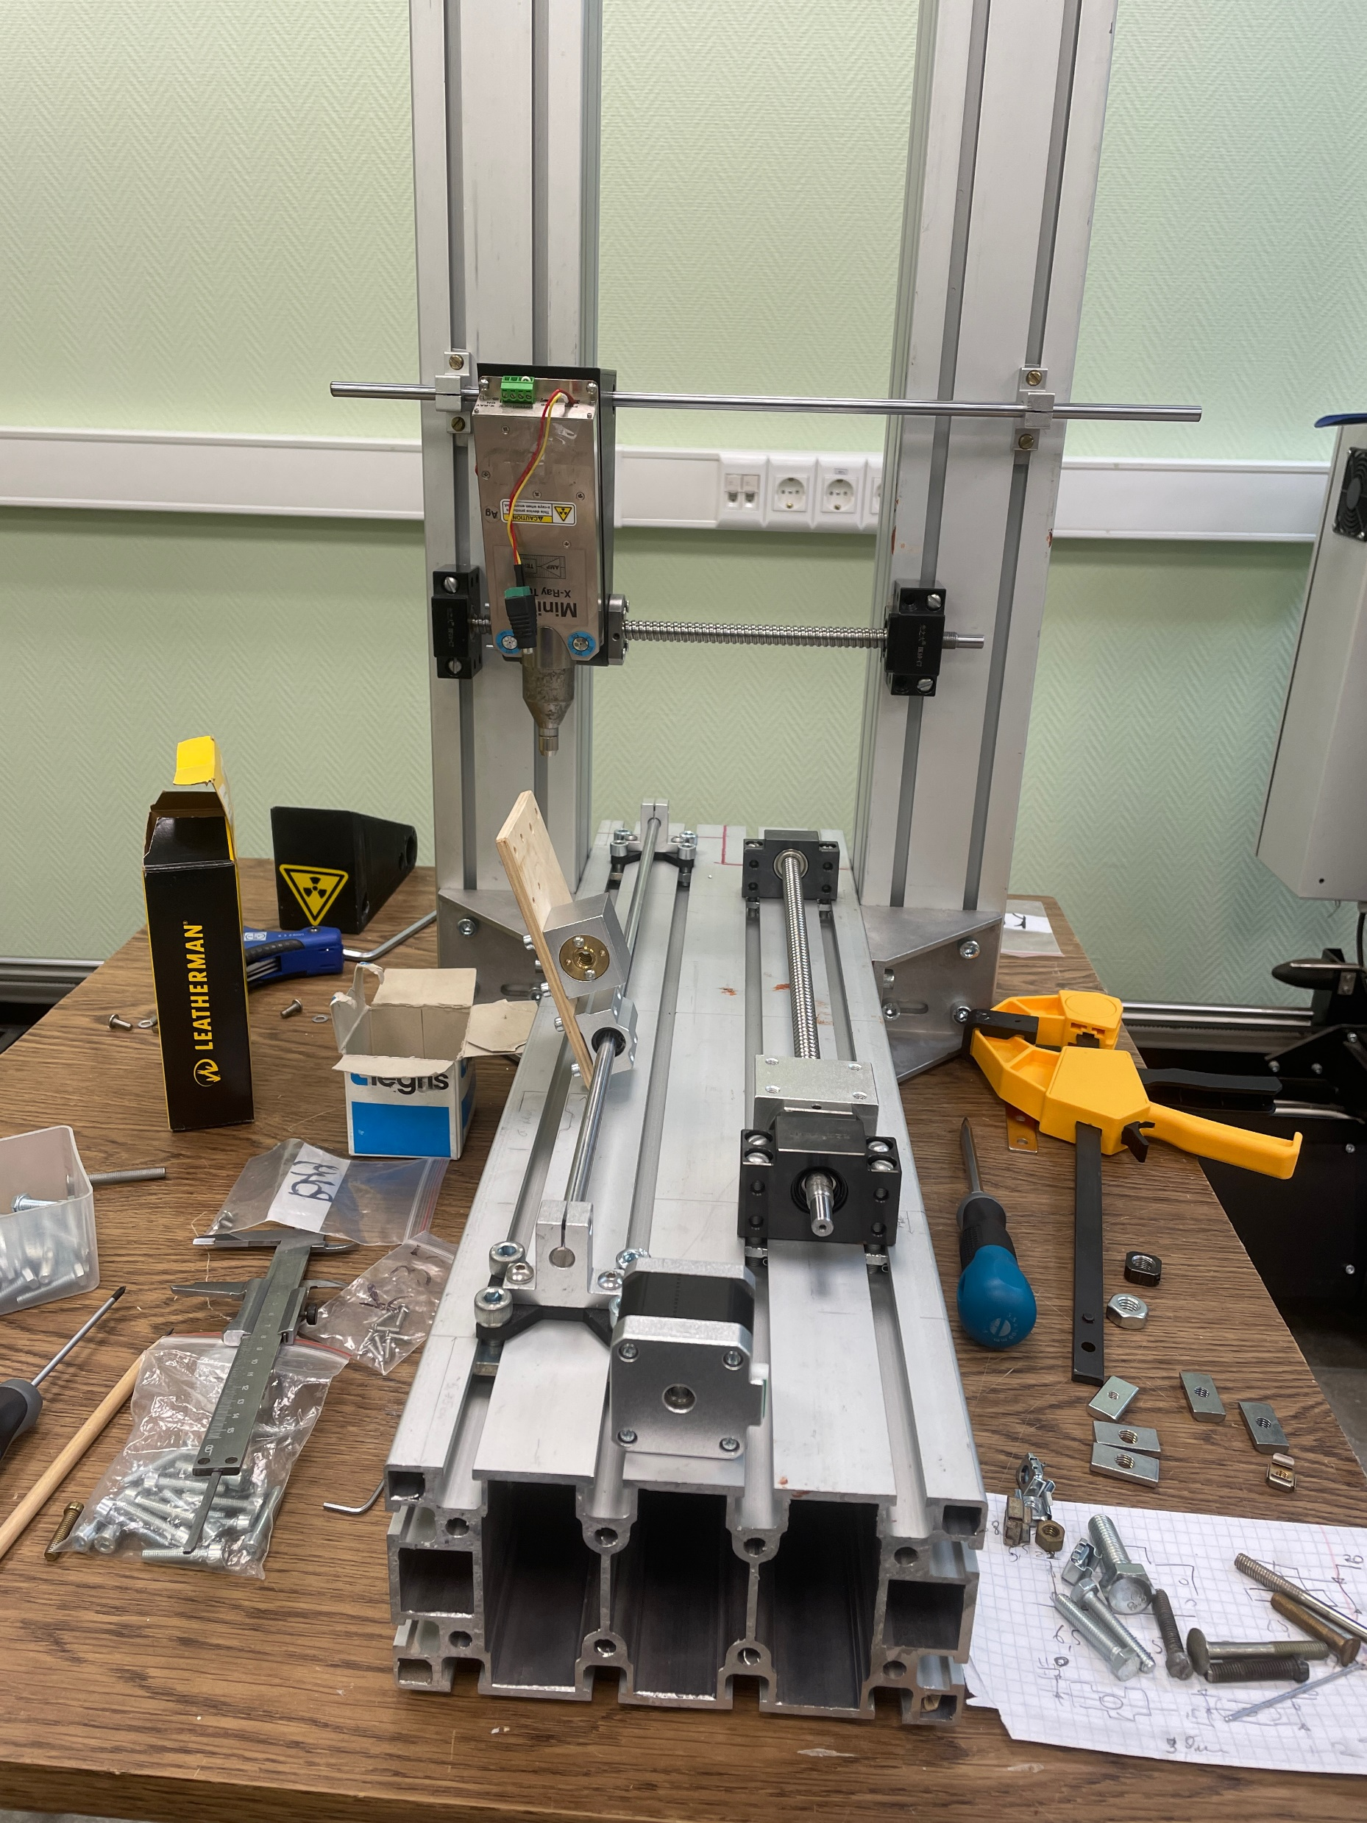
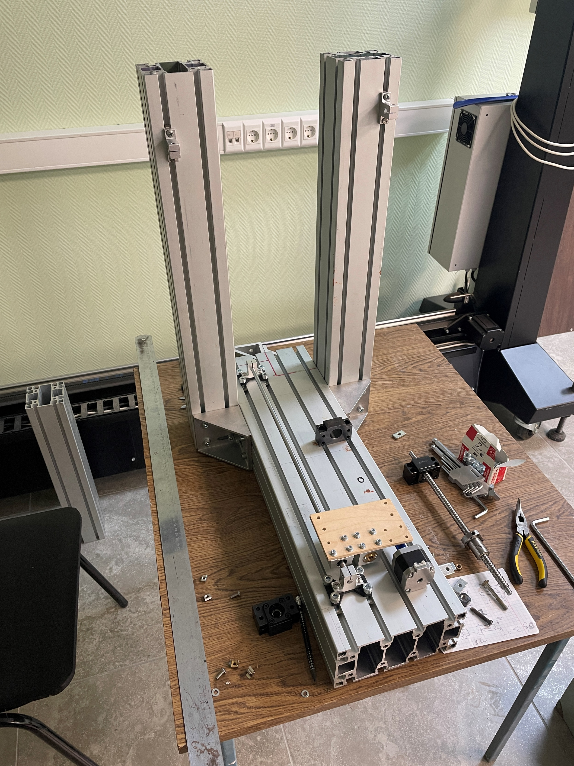
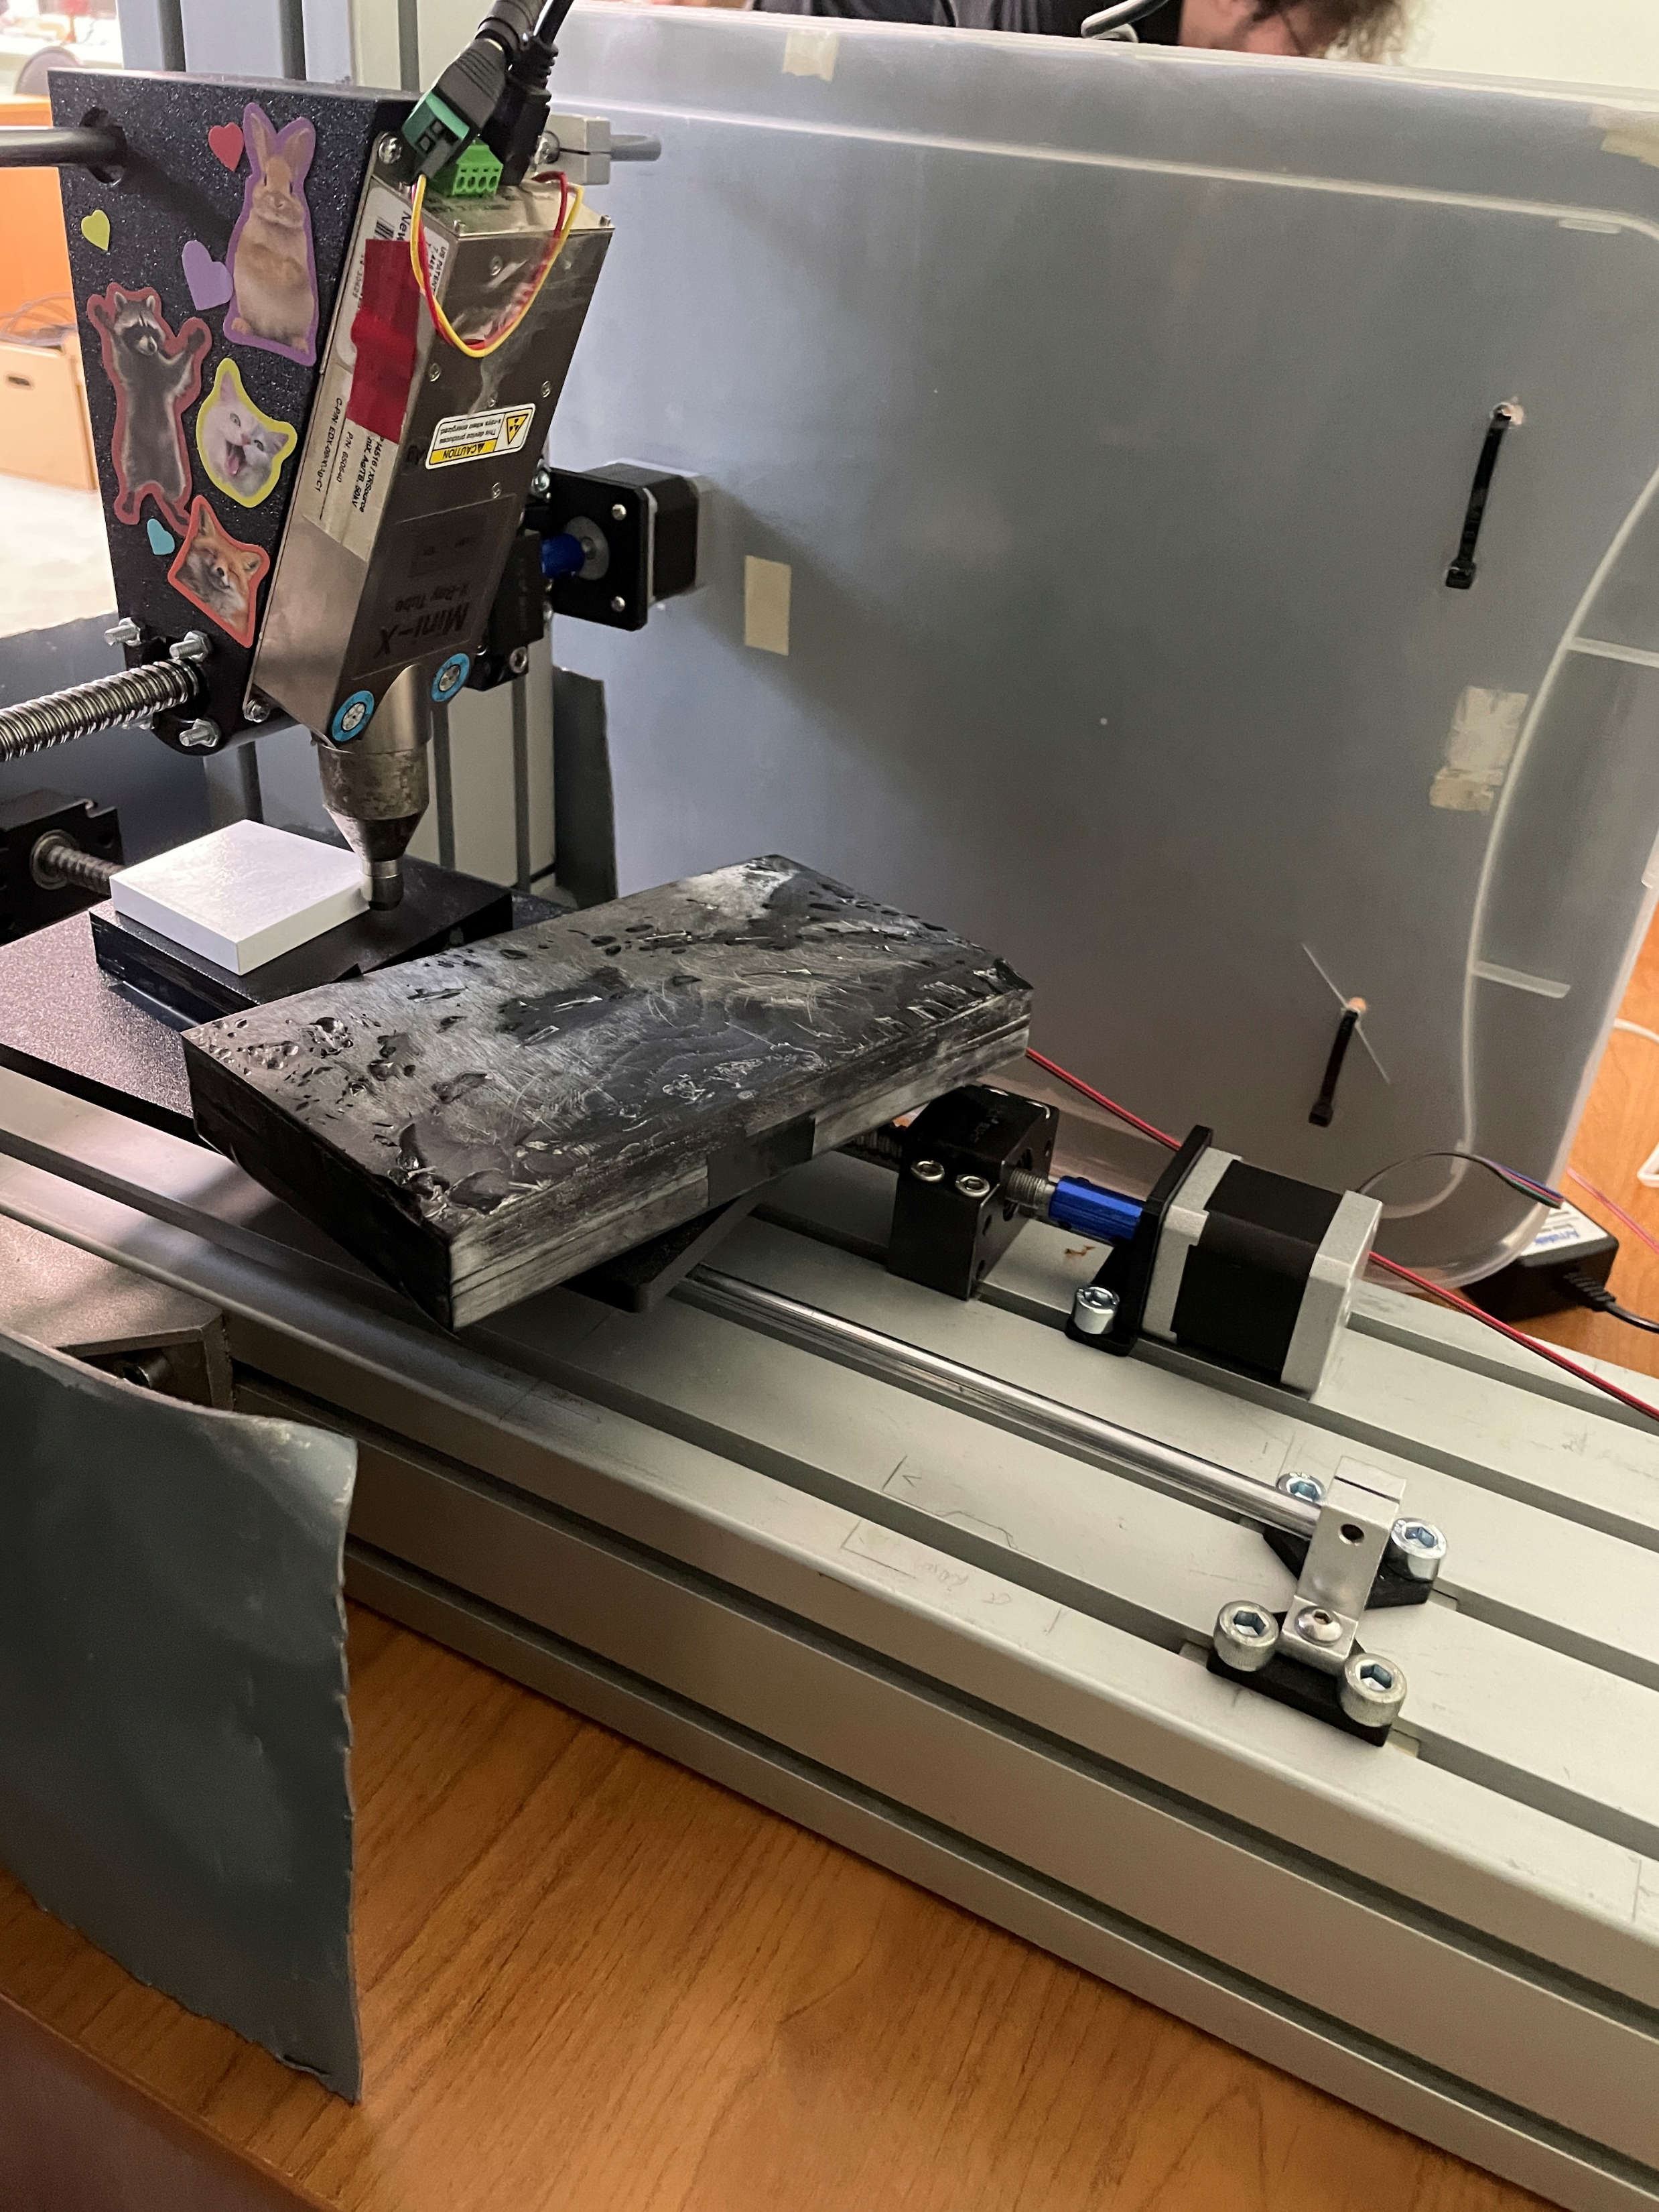
The new mechanics
Horizontal axis is perpendicular to the tube axis (precise);
3D-modeled table and stepping motor’s fixation;
Actually solved problems with overheating
2

Slide 4
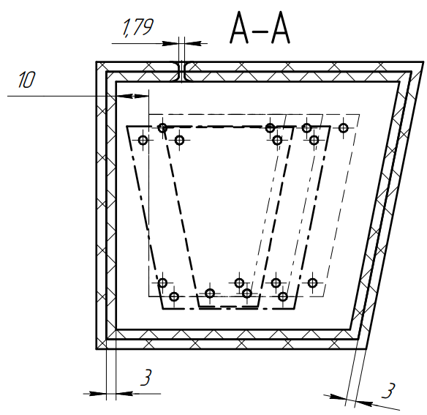
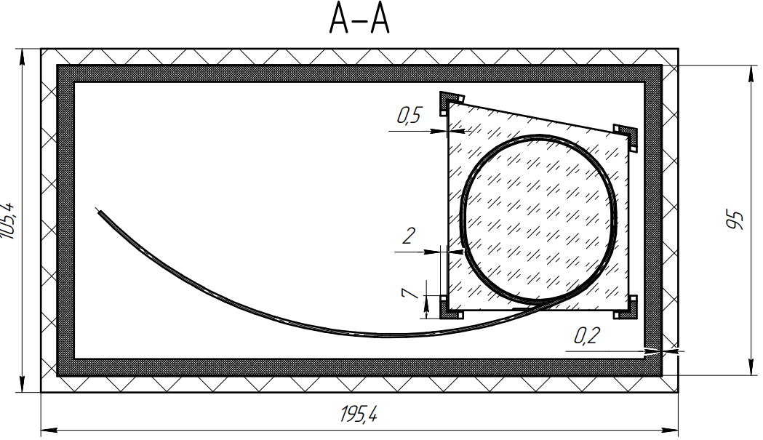
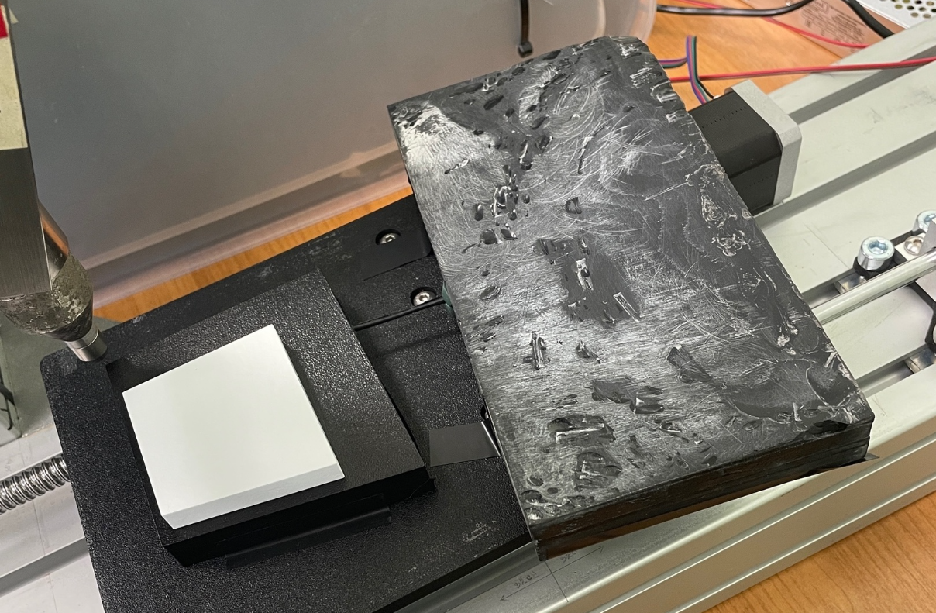
The Setup
Old vs new design:
New design is closer to
experiment conditions;
There is a way to use
thermostabilizing technologies for SiPM;
Absolutely inefficient in terms of mass production;
It is difficult to produce a single design for all tiles without potential breakage of WLS;
potentially zero repeatability.
Tile box design (updated)
Tile box design (former)
During first tests used as
SiPM black box
Fiber between two boxes is insulated via tape
Both boxes (including tile inside it) are fixed using tape
3

Slide 5
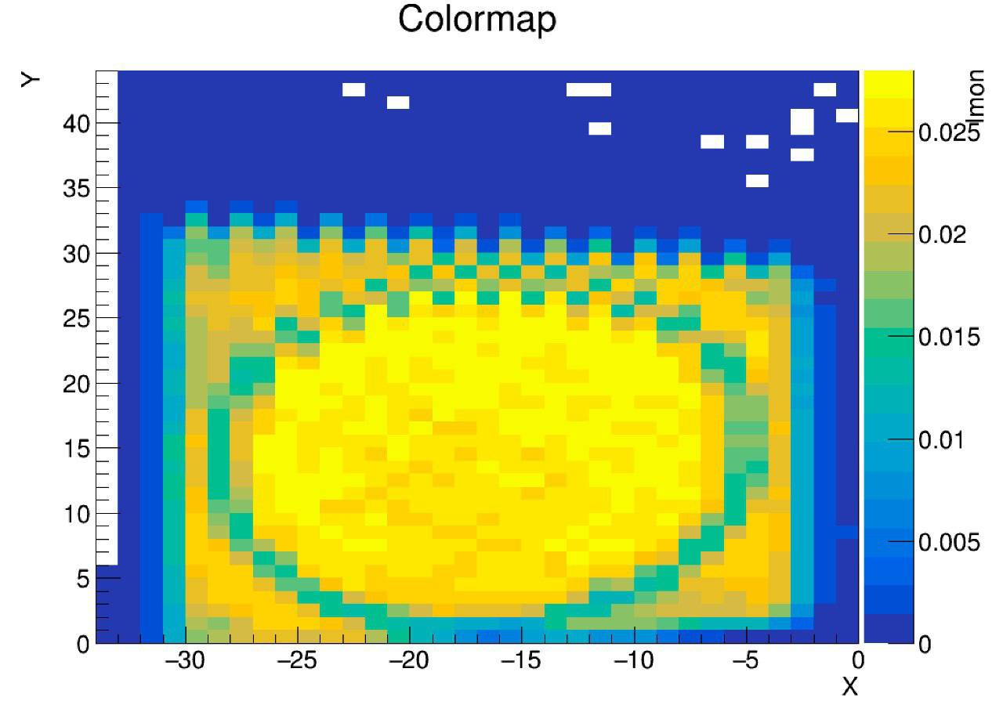
Results
???
Fiber
The largest response is observed inside the region bounded by the fiber;
The outer region of the tile has a slightly suppressed response;
In the area where the fiber passes through, the response is strongly suppressed
4

Slide 6
THANK YOU FOR YOUR ATTENTION!

