Slide 1
Activities BBC R&D
Dubinin F., Doronin S., Zakharov A., Tertyshnaya K.

Slide 2
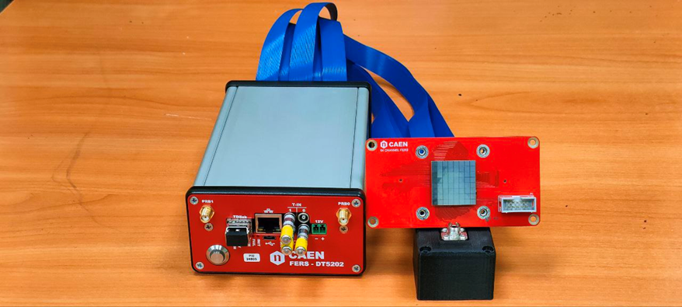
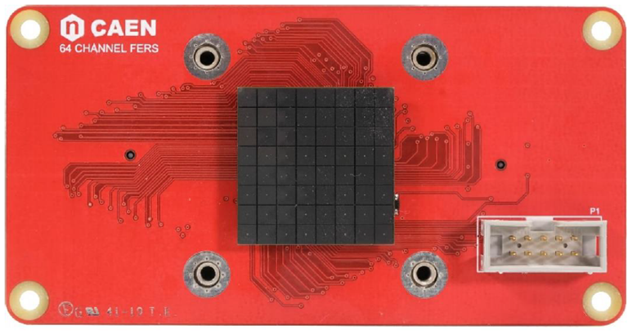
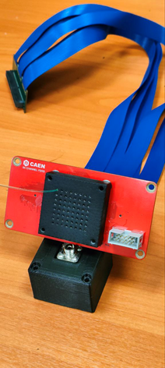
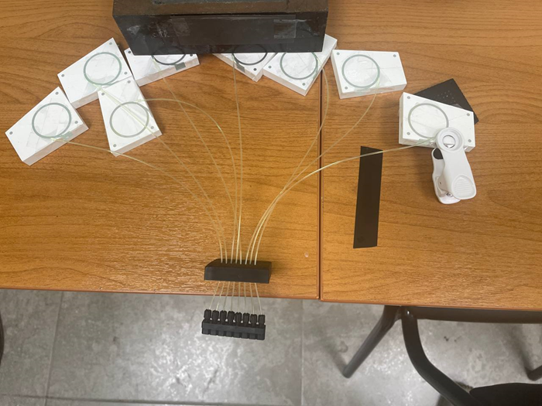
8-Tile telescope
Matrix Hamamatsu S13361‐3050AE‐08 (8х8 SiPM)
Unifide connecter matrix/WLS for each SiPM

Slide 3
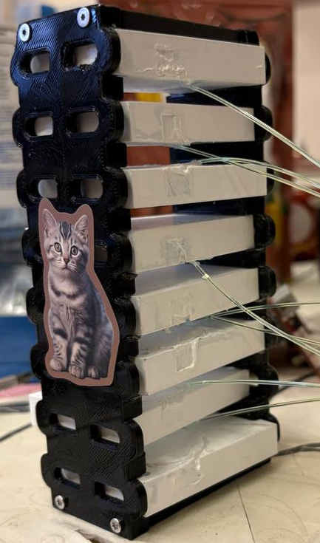
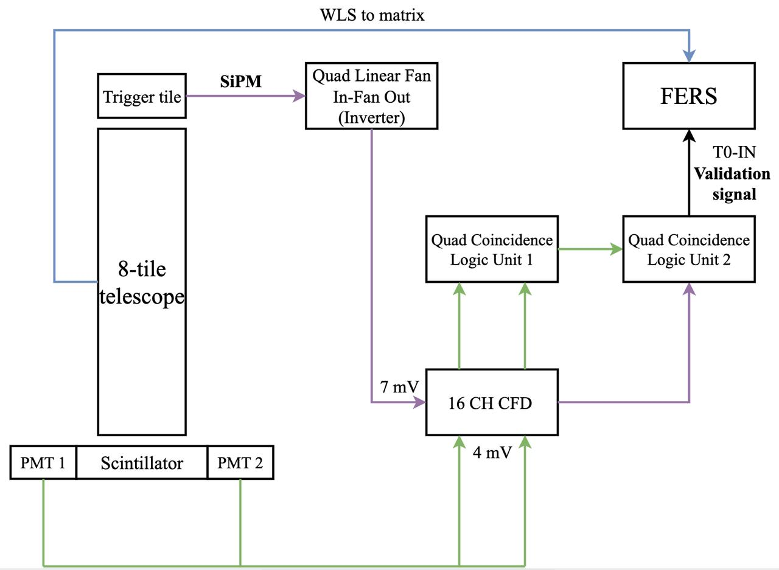
8-Tile telescope setup
Acquisition: Spectroscopy;
Bunch Trigger Source: T-OR - The OR signal from the channel TDs is used as bunch trigger source;
Validation Signal Accept;
Channel Trigger Width: 1000 ns;
T Discriminator Thd: 550 parrots

Slide 4
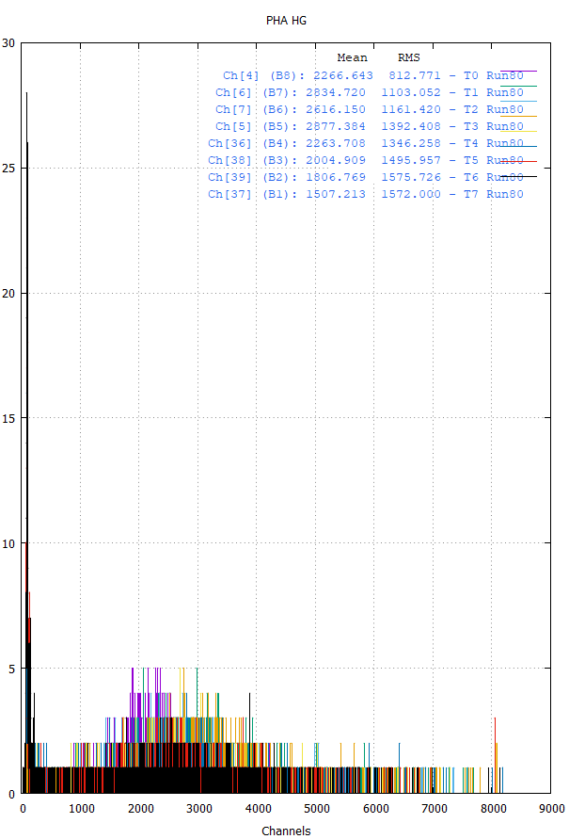
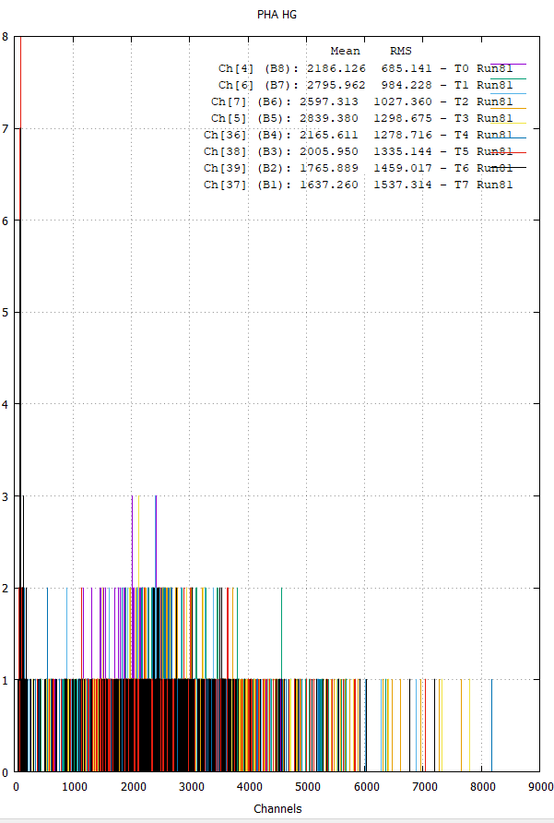
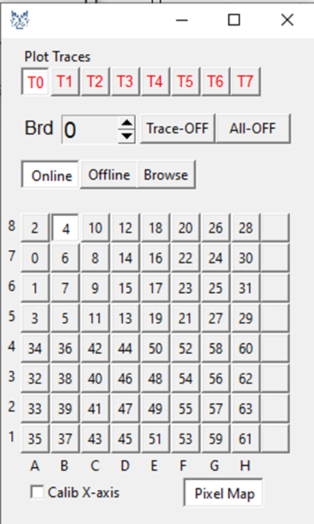

Slide 5
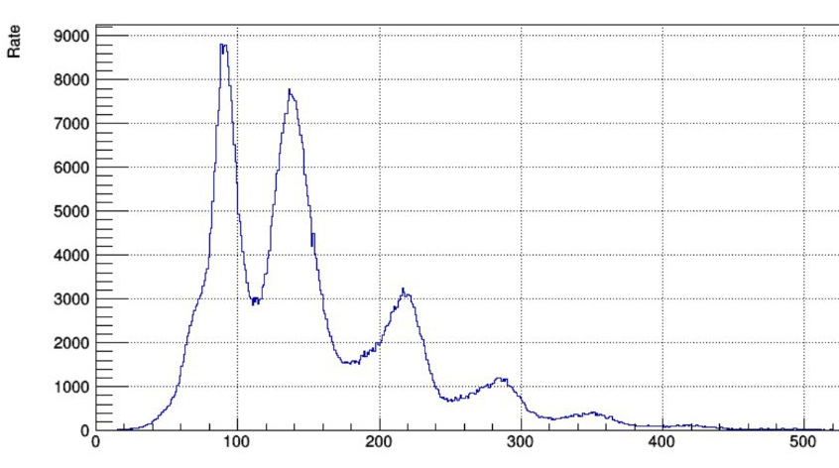
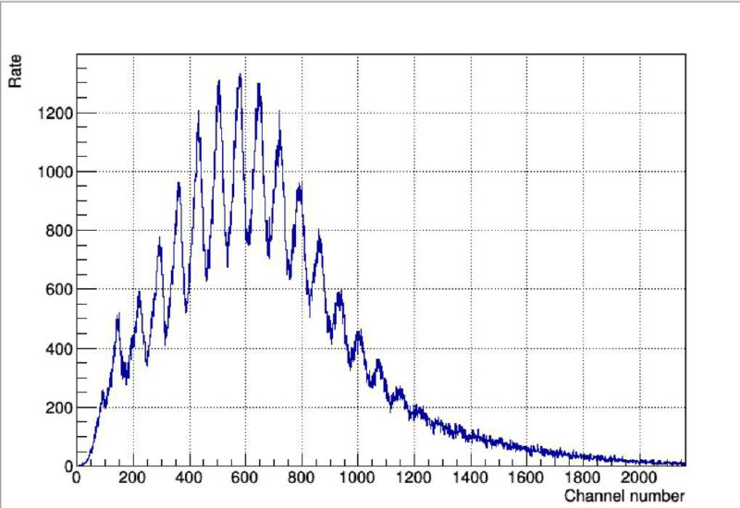
Single-electron spectrum
Channal | Value
4 | 79
5 | 77
6 | 79
7 | 77
36 | 85
37 | 88
38 | 86
39 | 88
1st Citioc-1A: 2, 5, 6, 7;
2nd Citiroc-1A: 36, 37, 38,39.

