Slide 1
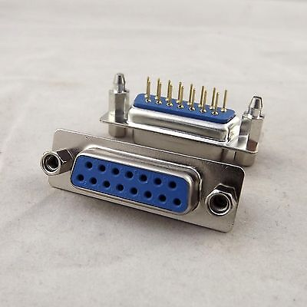
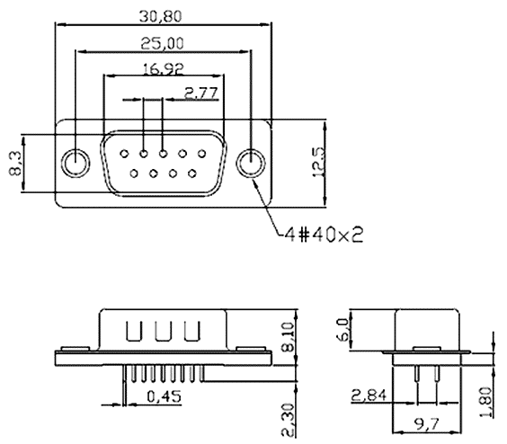
Connector and cable:
New requirements – reduce overall thickness and period
We consider 2 candidates
Polyamyde pipe 10x8 mm
Polyuretane pipe 10x6.5
Another proposal – rs232 or analogues

Slide 2
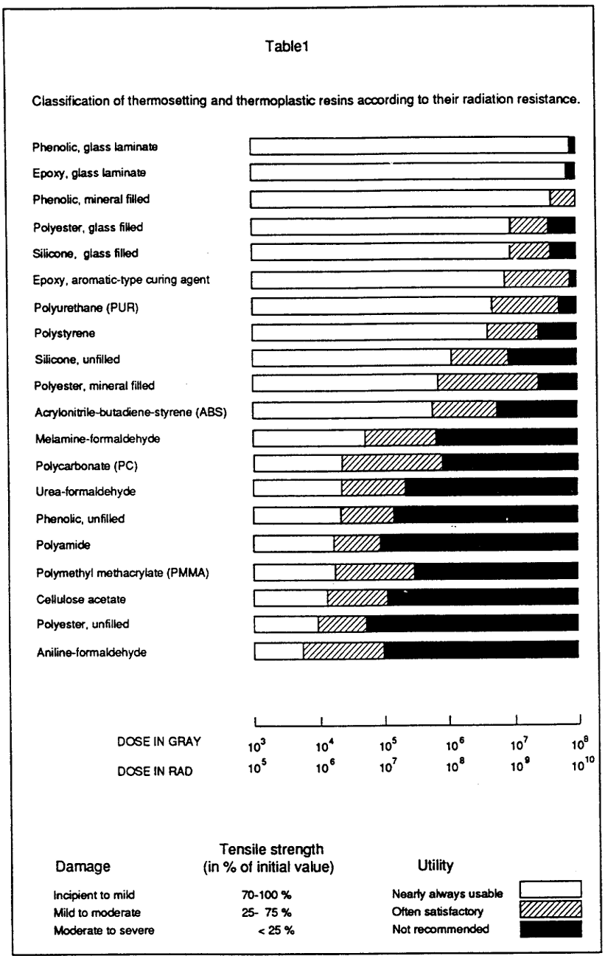
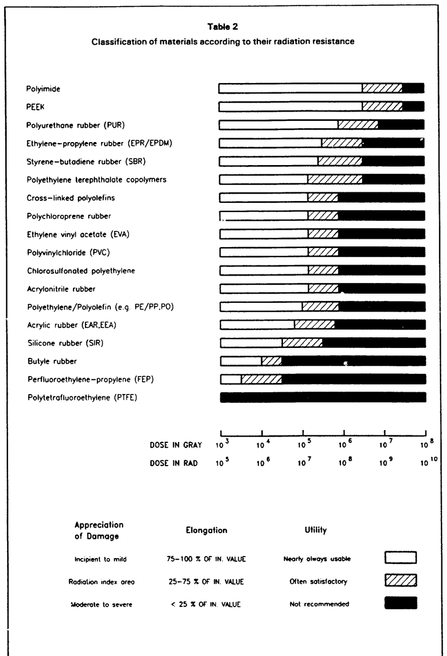
(CERN,1990)

