Slide 1


Исследование кластерной структуры атомных ядер и её проявлений в ядерных реакциях
Бажин Антон Сергеевич
1.3.15 Физика атомных ядер и элементарных частиц, физика высоких энергий
Кафедра № 40 «Физика элементарных частиц»
Научный руководитель: д.ф-м.н. Гуров Юрий Борисович
Консультант: д.ф-м.н Самарин Вячеслав Владимирович
2025, Москва

Slide 2
Общий план работы
Разработка методов для изучения структуры кластерных ядер: метод функций Йоста, метод Фейнмана по траекториям, метод гиперсферических функций.
Изучение структуры альфа-кластерных ядер на основе их экспериментальных данных. Проведено исследование ядер 9Be, 6Li, 12C, 18O и 16O.
Использование полученных пространственных структур в расчётах ядерных реакций с помощью метода DWBA.

Slide 3
In the recent time there was rising interest in the study of neutron-rich and exotic weakbound nuclei – exotic cluster structures (see, for example, [1]).
[1] W. von Oertzen, M. Freer, Y. Kanada-En’yo, Physics Reports 432 (2006) 43
Core + valence neutron structures can be identified near the alpha-cluster decay threshold. Also, cluster states and structures can be seen in the collisions reactions near the Coulomb barrier, for example, in
⁹Ве, ¹²С, ^{16,18}О, ²⁴Mg nuclei.
Alpha-cluster nuclei with the energy separation number.

Slide 4
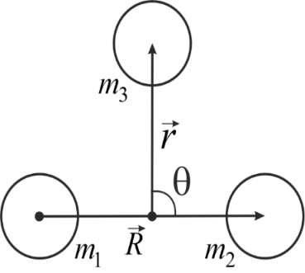
Hyperspherical functions method for three body problem
Jacobi’s vectors
(2)
(1)
x₀ = 1 fm, m₀ = 1 a.u.m.
Hyperspherical coordinates
Replacing wave function for the ground state ψ₀ by a series of hyperspherical functions,
l_{x} = 0,2,4,…; n = 0,1,2,…; K = 2l_{x}+2n;
Coefficient m_{i} of the cubic spline equals to the second derivative of hyperradial wave functions
(5)
(6)
(3)
The system of equations for the cubic spline
(7)
Matrices A and H can be found in
[Marchuk G.I. Methods of Numerical Mathematics. –Springer NY, 1982]
Functions are found from system of hyperradial equations l_{max} = 12, n_{max} = 12
(8)
The problem is reduced to the problem of eigenvalues and eigenvectors of matrix B
(4)
[Джибути Р.И., Шитикова К.В. Метод гиперсферических функций в атомной и ядерной физике. 1993 г.]
[V.V. Samarin. Study of spatial structures in α-cluster nuclei, Eur. Phys. J. A (2022) 58,117.]

Slide 5
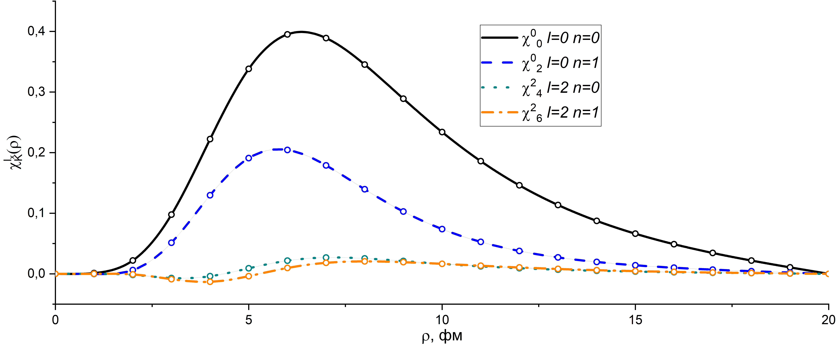
Cubic spline interpolation allows to get smooth function between grid points
The values of hyperradial wave fucntions in grid points are found from eigenvectors.
Smooth interpolation

Slide 6
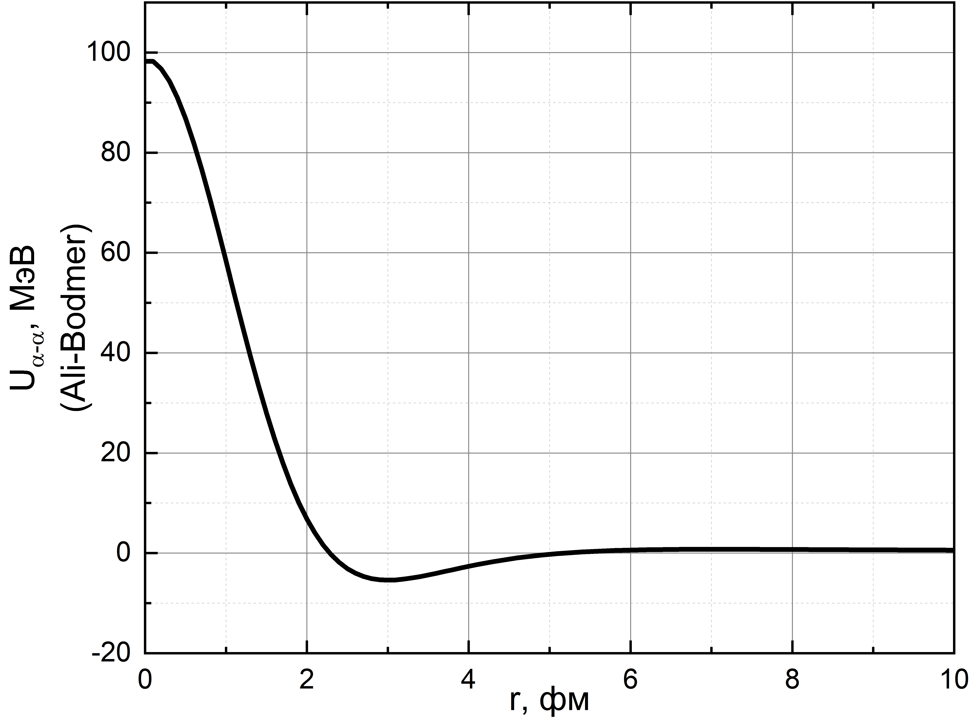
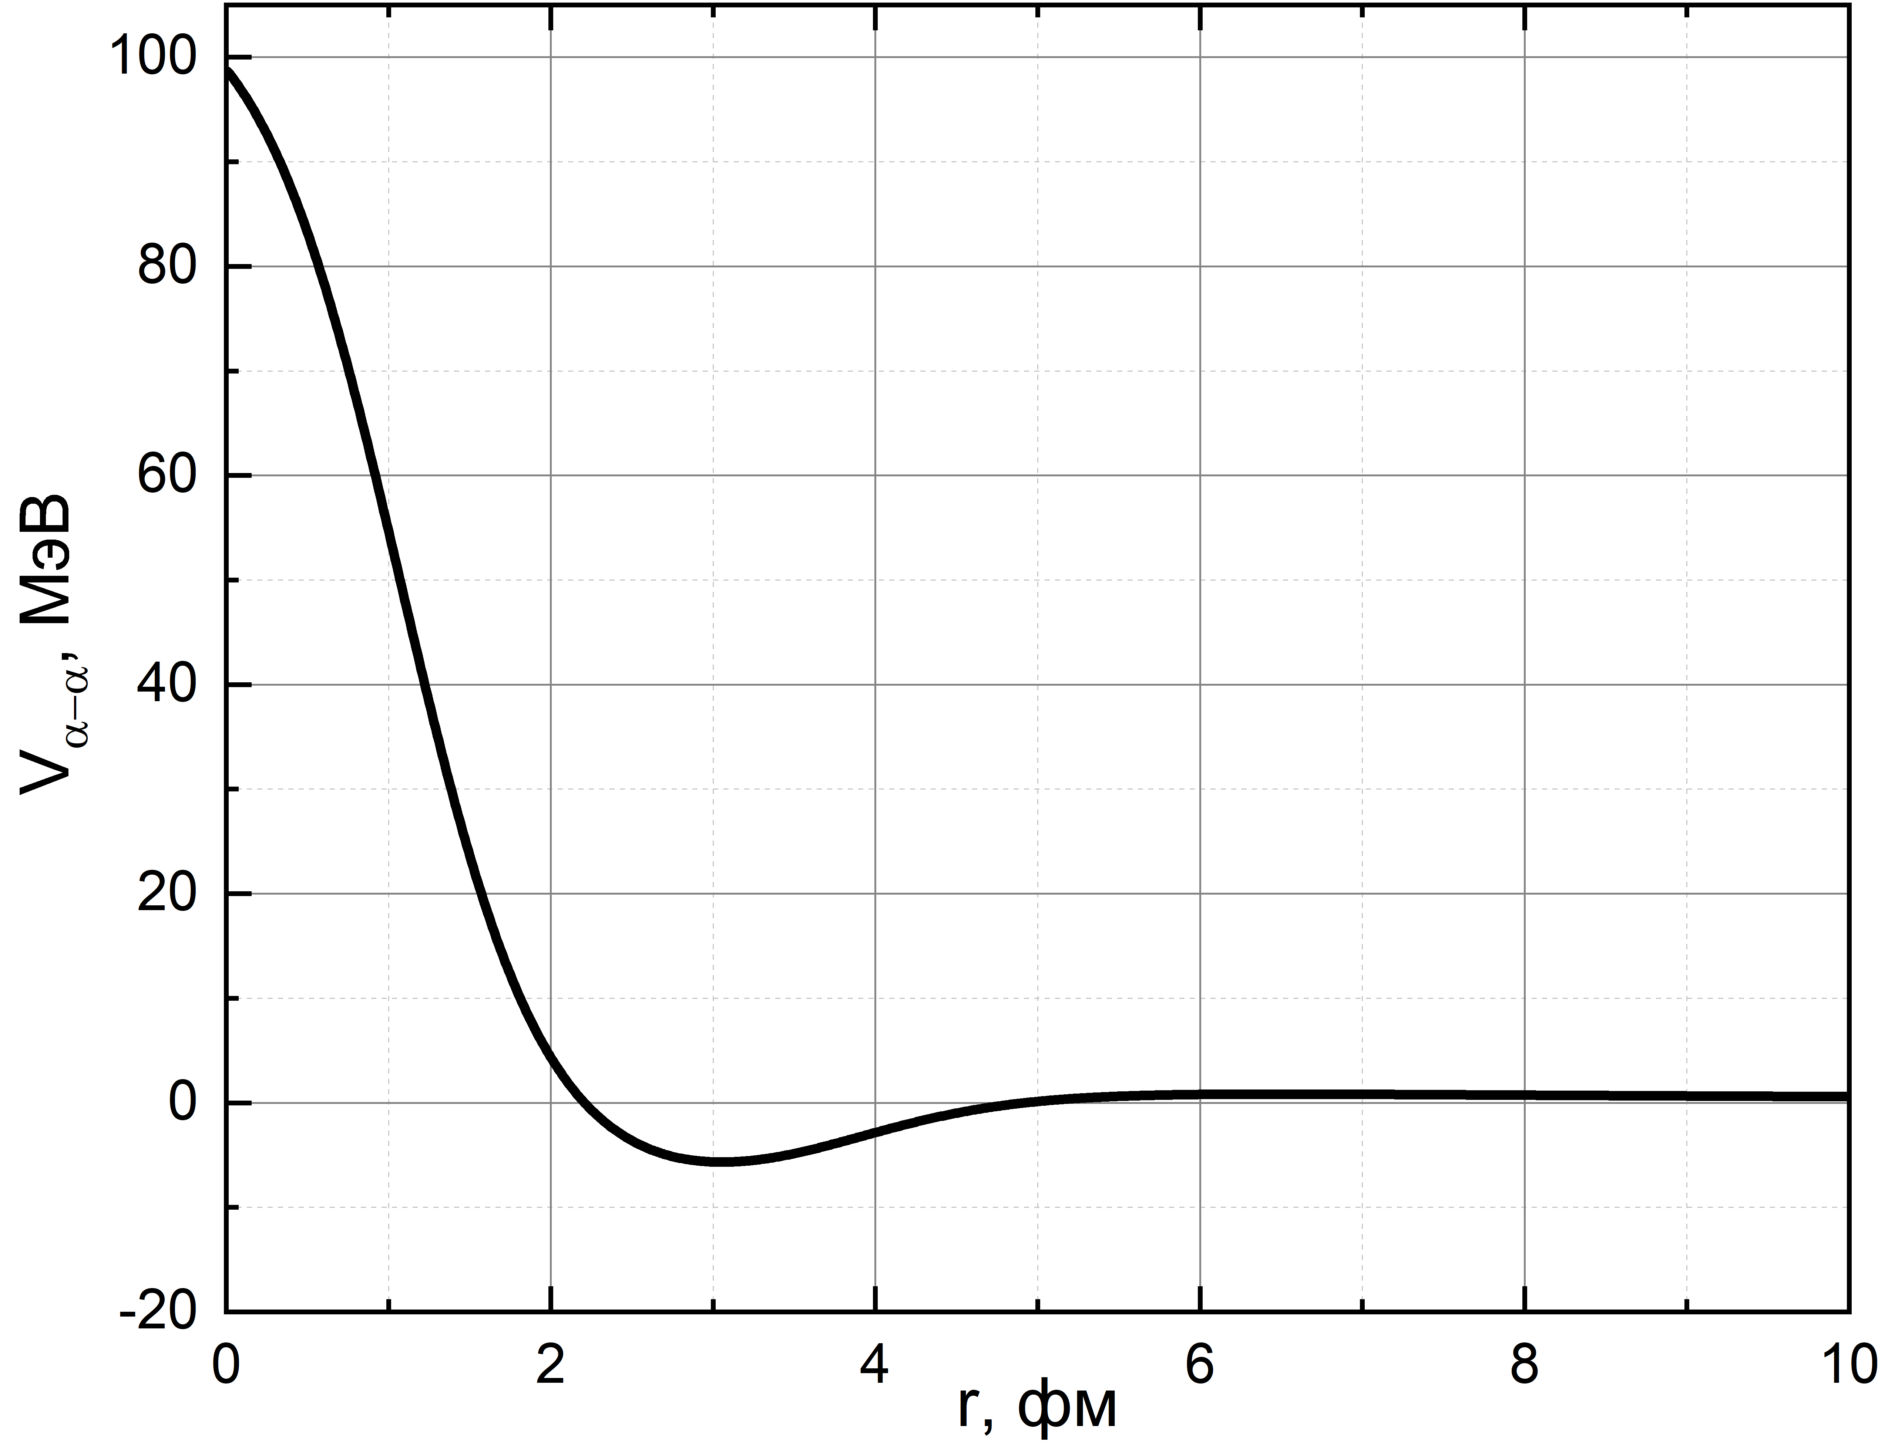
Interaction potential of alpha-particles
The potential of strong interaction V_{α-α} is
based on data of alpha-alpha scattering,
known as Ali-Bodmer (AB) potential [1]
[1]
[3]
Ali-Bodmer (AB)
2WS
(1)
Coulomb interaction obtained from [1,2].
(2)
Potential with two Woods-Saxon’s functions
(2WS) has more parameters. It is important when describing experimental data [3]
Alpha-alpha scattering potentials AB (left) and 2WS (right) are almost the same.
(3)
It is known that potential AB doesn’t fit for describing bound energy of alpha-cluster nuclei, for example ¹²C.
Because of that, potential 2WS was used for describing interaction of alpha-clusters.
Wood-Saxon’s type function f(r,B,a)
(4)
[1] S. Ali, A.R. Bodmer, Nucl. Phys. 80, 99 (1966).
[2] H. Suno, Y. Suzuki, P. Descouvemont, Phys. Rev. C 91, 014004 (2015).
[3] V.V. Samarin, Study of spatial structures in α-cluster nuclei, Eur. Phys. J. A, 58, 117 (2022).

Slide 7
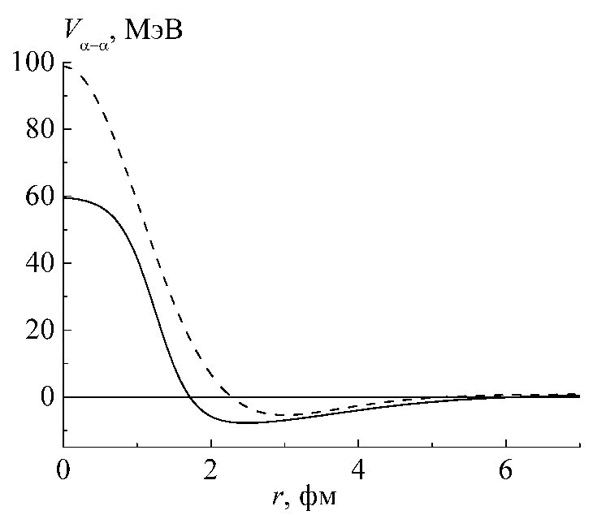
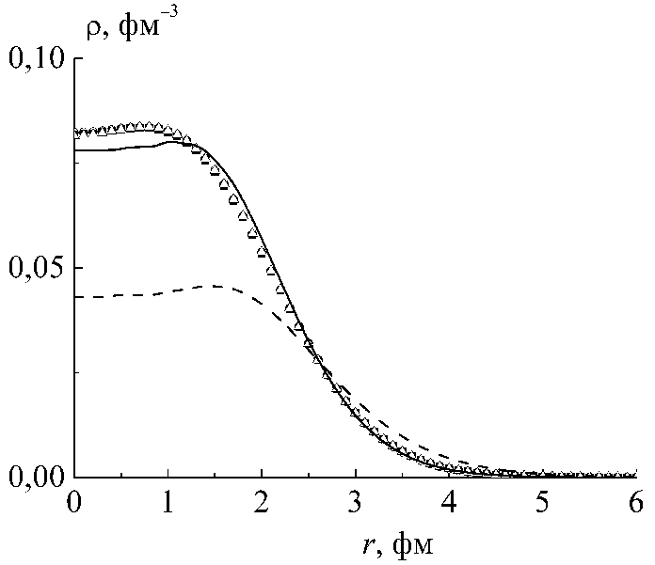
Selection of parameters of α‒α interaction potential for making an agreement with experimental properties of alpha-cluster nucleus ¹²C (3α)
V_{α‒α}, MeV
Interaction potentials V_{α‒α}
AB
1. To get an agreement with experimental data parameters of potential 2WS of ¹²C were modified. Obtained charge distribution and separation energy into 3α-particles of ¹²C are close to the experimental one.
Potential 2WS has more soft repulsive core unlike AB potential.
2WS
2. After α-particle separation in ¹²C, unbound nucleus ⁸Be is formed. Because of that, the ground state energy was obtained E₀=-7.272 MeV that is close to experimental value of α-particle separation of ¹²C E_{s}=7.366 MeV [1] (E₀≈-E_{s}).
r, fm
ρ, fm⁻³
Charge distribution of ¹²C.
3. Calculated root-mean-square (rms) charge radii is also close to the experimental one
Experimental data
2WS
The agreement with experimental charge distribution was obtained using 2WS potential unlike AB potential.
AB
The difference occurs because of the errors in calculation the charge distribution at the region of large radii, where the charge density is low.
r, fm
[1] Nuclear Reaction Video. Low Energy Nuclear Knowledge Base. http://nrv.jinr.ru

Slide 8
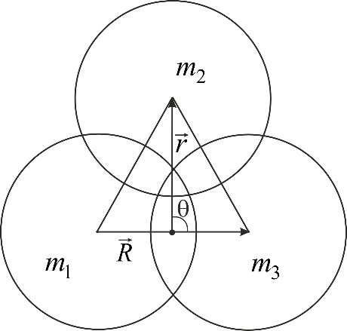

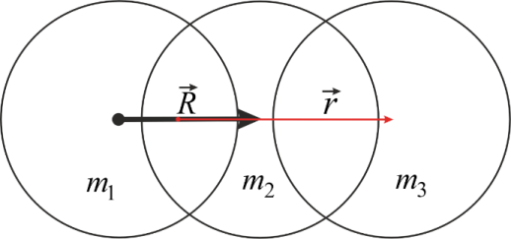
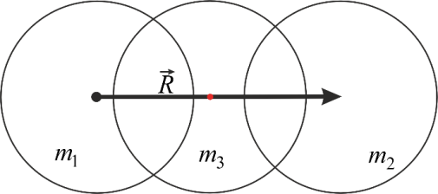


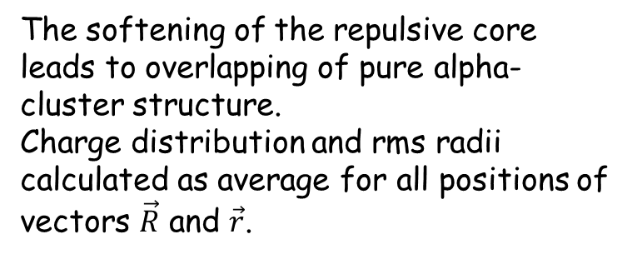
The probability density for the ground state of alpha-cluster nucleues ¹²C
Positions of alpha-clusters, radii of alpha-clusters was chosen as rms radii of ⁴He - 1.67 fm.
$θ=π/2$
r, фм
(logarithmic scale)
3
In different positions of Jacobi’s vectors
Triangular configuration
3
1
2
The most probable configuration is triangular, when alpha-clusters are located at the vertices of equilateral triangle with length of sides ~2.6 fm.
1
2
$θ=0$
The softening of the repulsive core leads to overlapping of pure alpha-cluster structure.
Charge distribution and rms radii calculated as average for all positions of vectors $\vec{R}$ and $\vec{r}$.
2
r, фм
3
1
Linear configuration
3
2
1
Less probable configurations

Slide 9
Selection of parameters of α‒α interaction potential for making an agreement with experimental properties of alpha-cluster nucleus ⁶Li (α-n-p)
The parameters of the SX variant [1] of the A-T-potential
The nuclear part of the nucleon–nucleon interaction may be described by the effective pairwise central soft-core Afnan-Tang (A-T) potential [7] for a triplet state (t) and for a singlet (s) state
We using effective nucleon-nucleon pseudopotentials V_{α-n} and V_{α-p} in calculations [1]. The pseudopotentials do not take into account the data on phase shifts, but their forms are similar to α–α and nucleon–nucleon potentials. The parameters of the pseudopotentials were determined from the condition of equality of the calculated and experimental values of the ground state energies for systems α-cluster + nucleons.

Slide 10
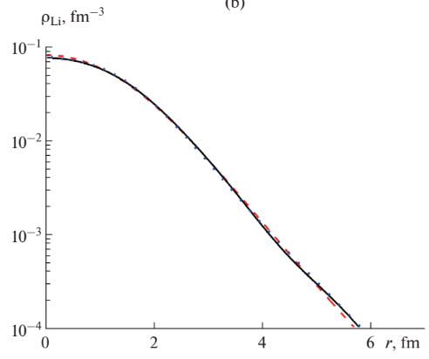
The probability density for the ground state of alpha-cluster nucleues ⁶Li
The ground state J=1:
Esep =3.725 MeV (to 3 paticles a, p and n).
The calculated energy of the ground state with the triplet state of (p+n) subsystem is -3.7 MeV.
The excited state J=0:
with E_{exc}=3.563 MeV, E_{sep} =0.162 MeV (to 3 paticles a, p and n) may be presented as the ground state with the singlet state of (p+n) subsystem, calculated energy is -0.3 MeV.
Electric charge distribution density (in units of elementary charge) for the ground state of the 6Li nucleus.

Slide 11
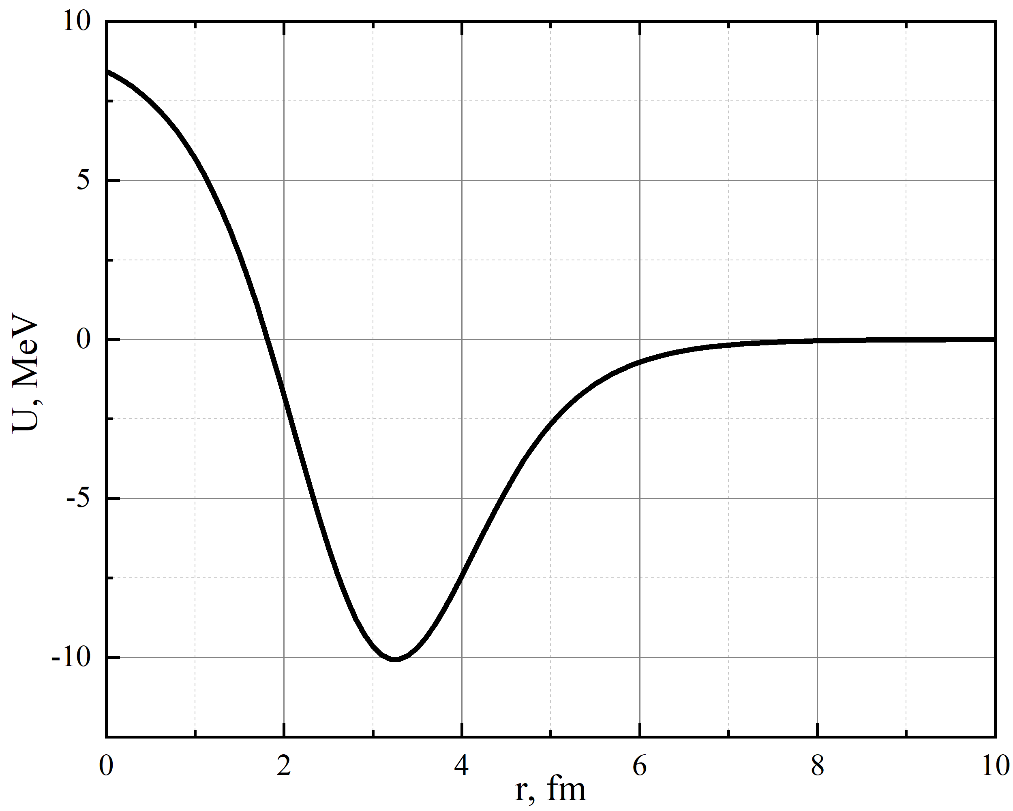

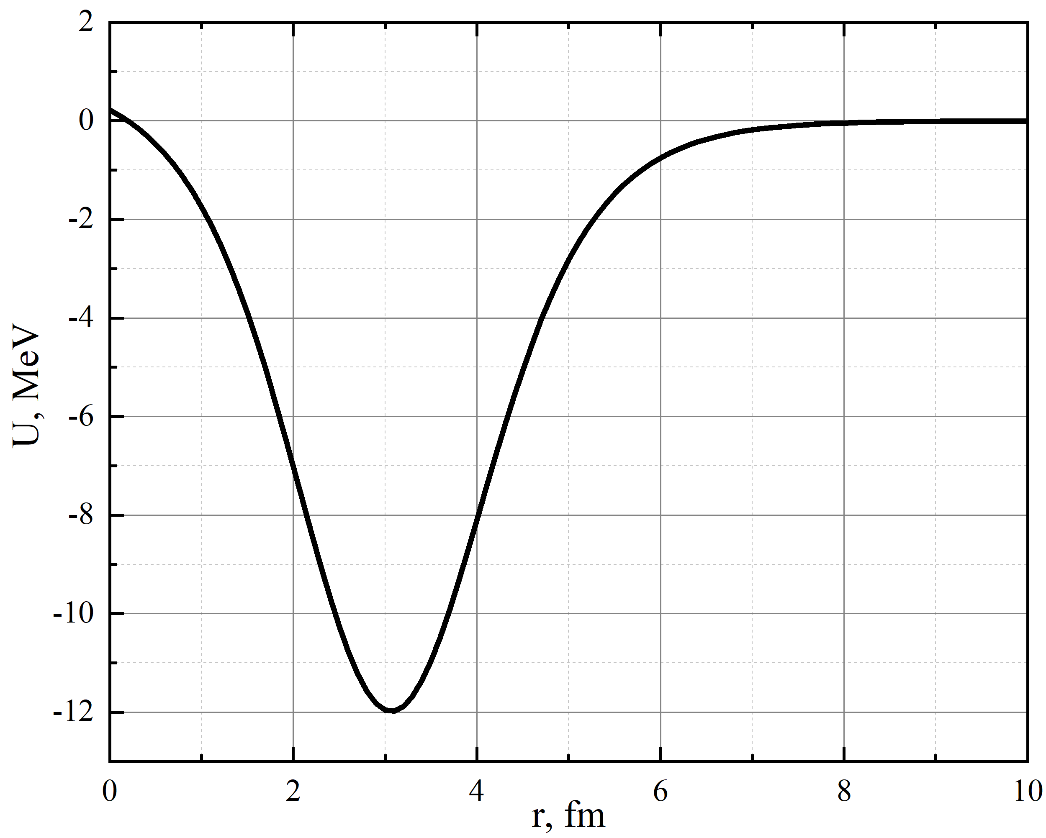
Core-nucleon potential in 17O, 18O
The two-body Schrodinger equation was also solver by spline-interpolation method. The calculated energy separation for ¹⁷O is -4.01 MeV and the experimental value is 4.14 MeV. This potential gives the correct energy.
In ¹⁷O
In ¹⁸O
The similar potential was used to calculate the separation energy of ¹⁸O.

Slide 12
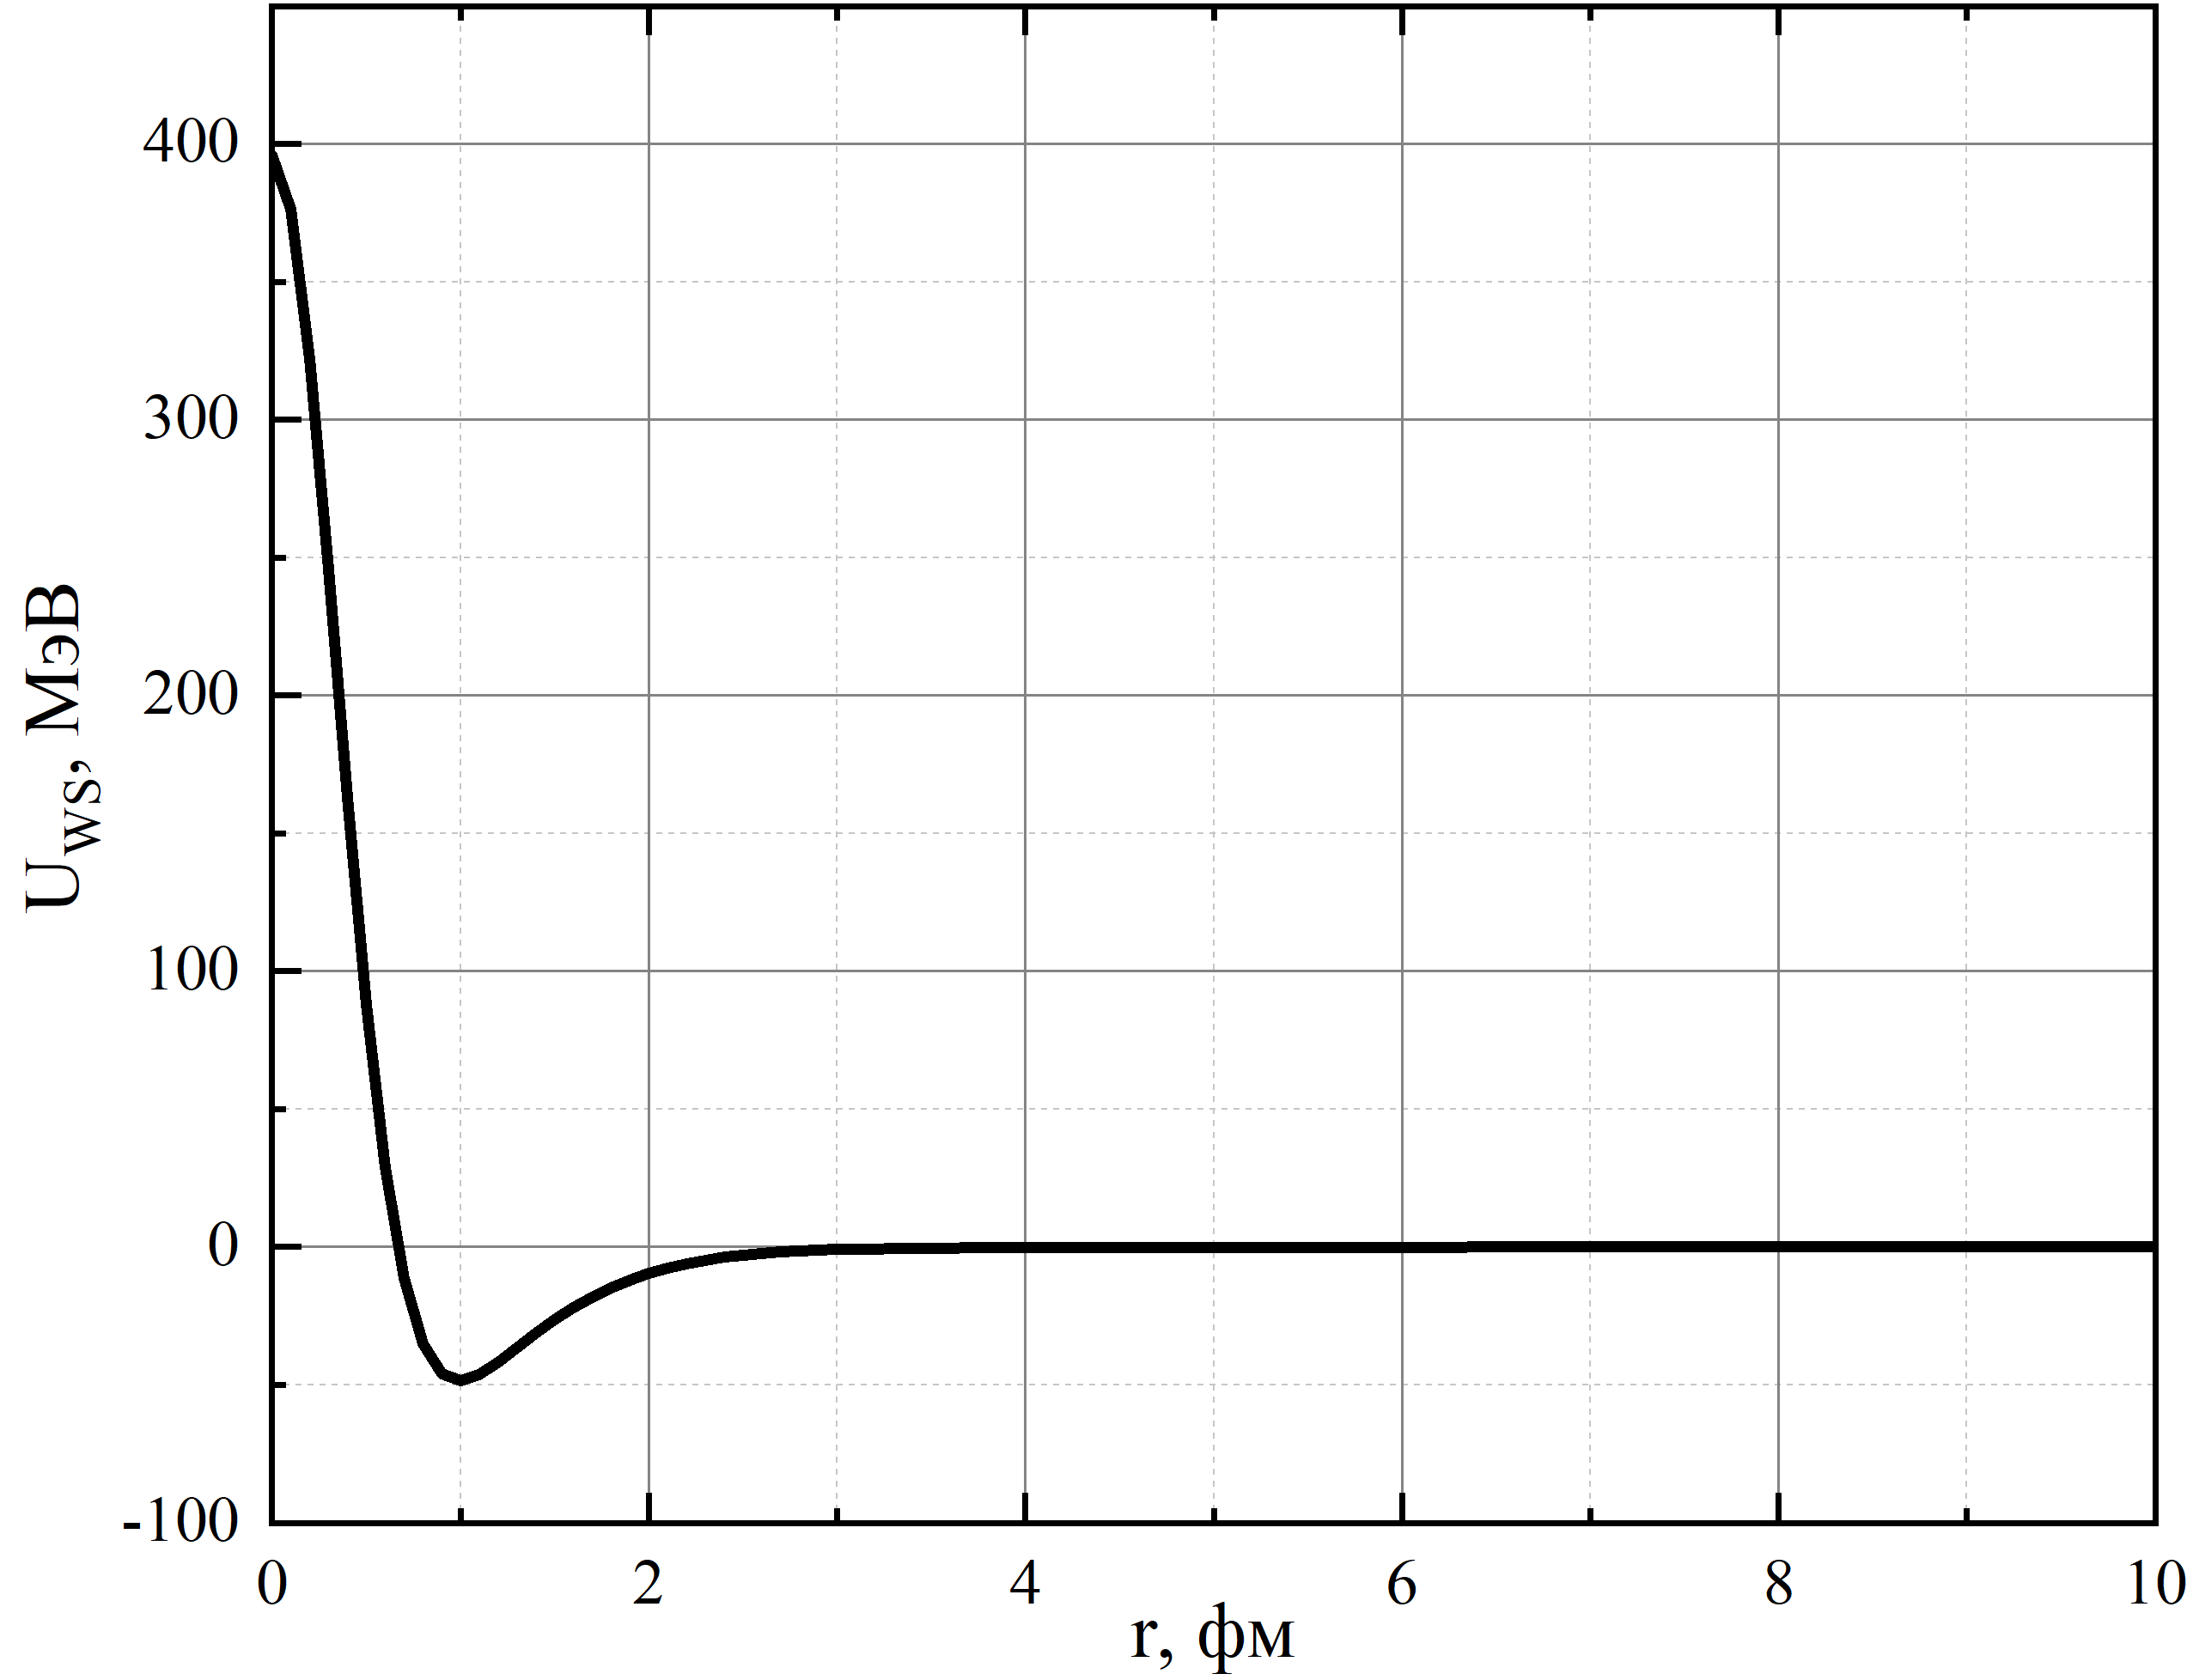
Nucleon–nucleon potentials for description of 18O
Below we use the nucleon-nucleon potentials SX and α-nucleon pseudopotential to calculate of the ground state energies for system 18O (core+n+n).
nucleon-nucleon
potential
Core-nucleon
pseudopotential

Slide 13
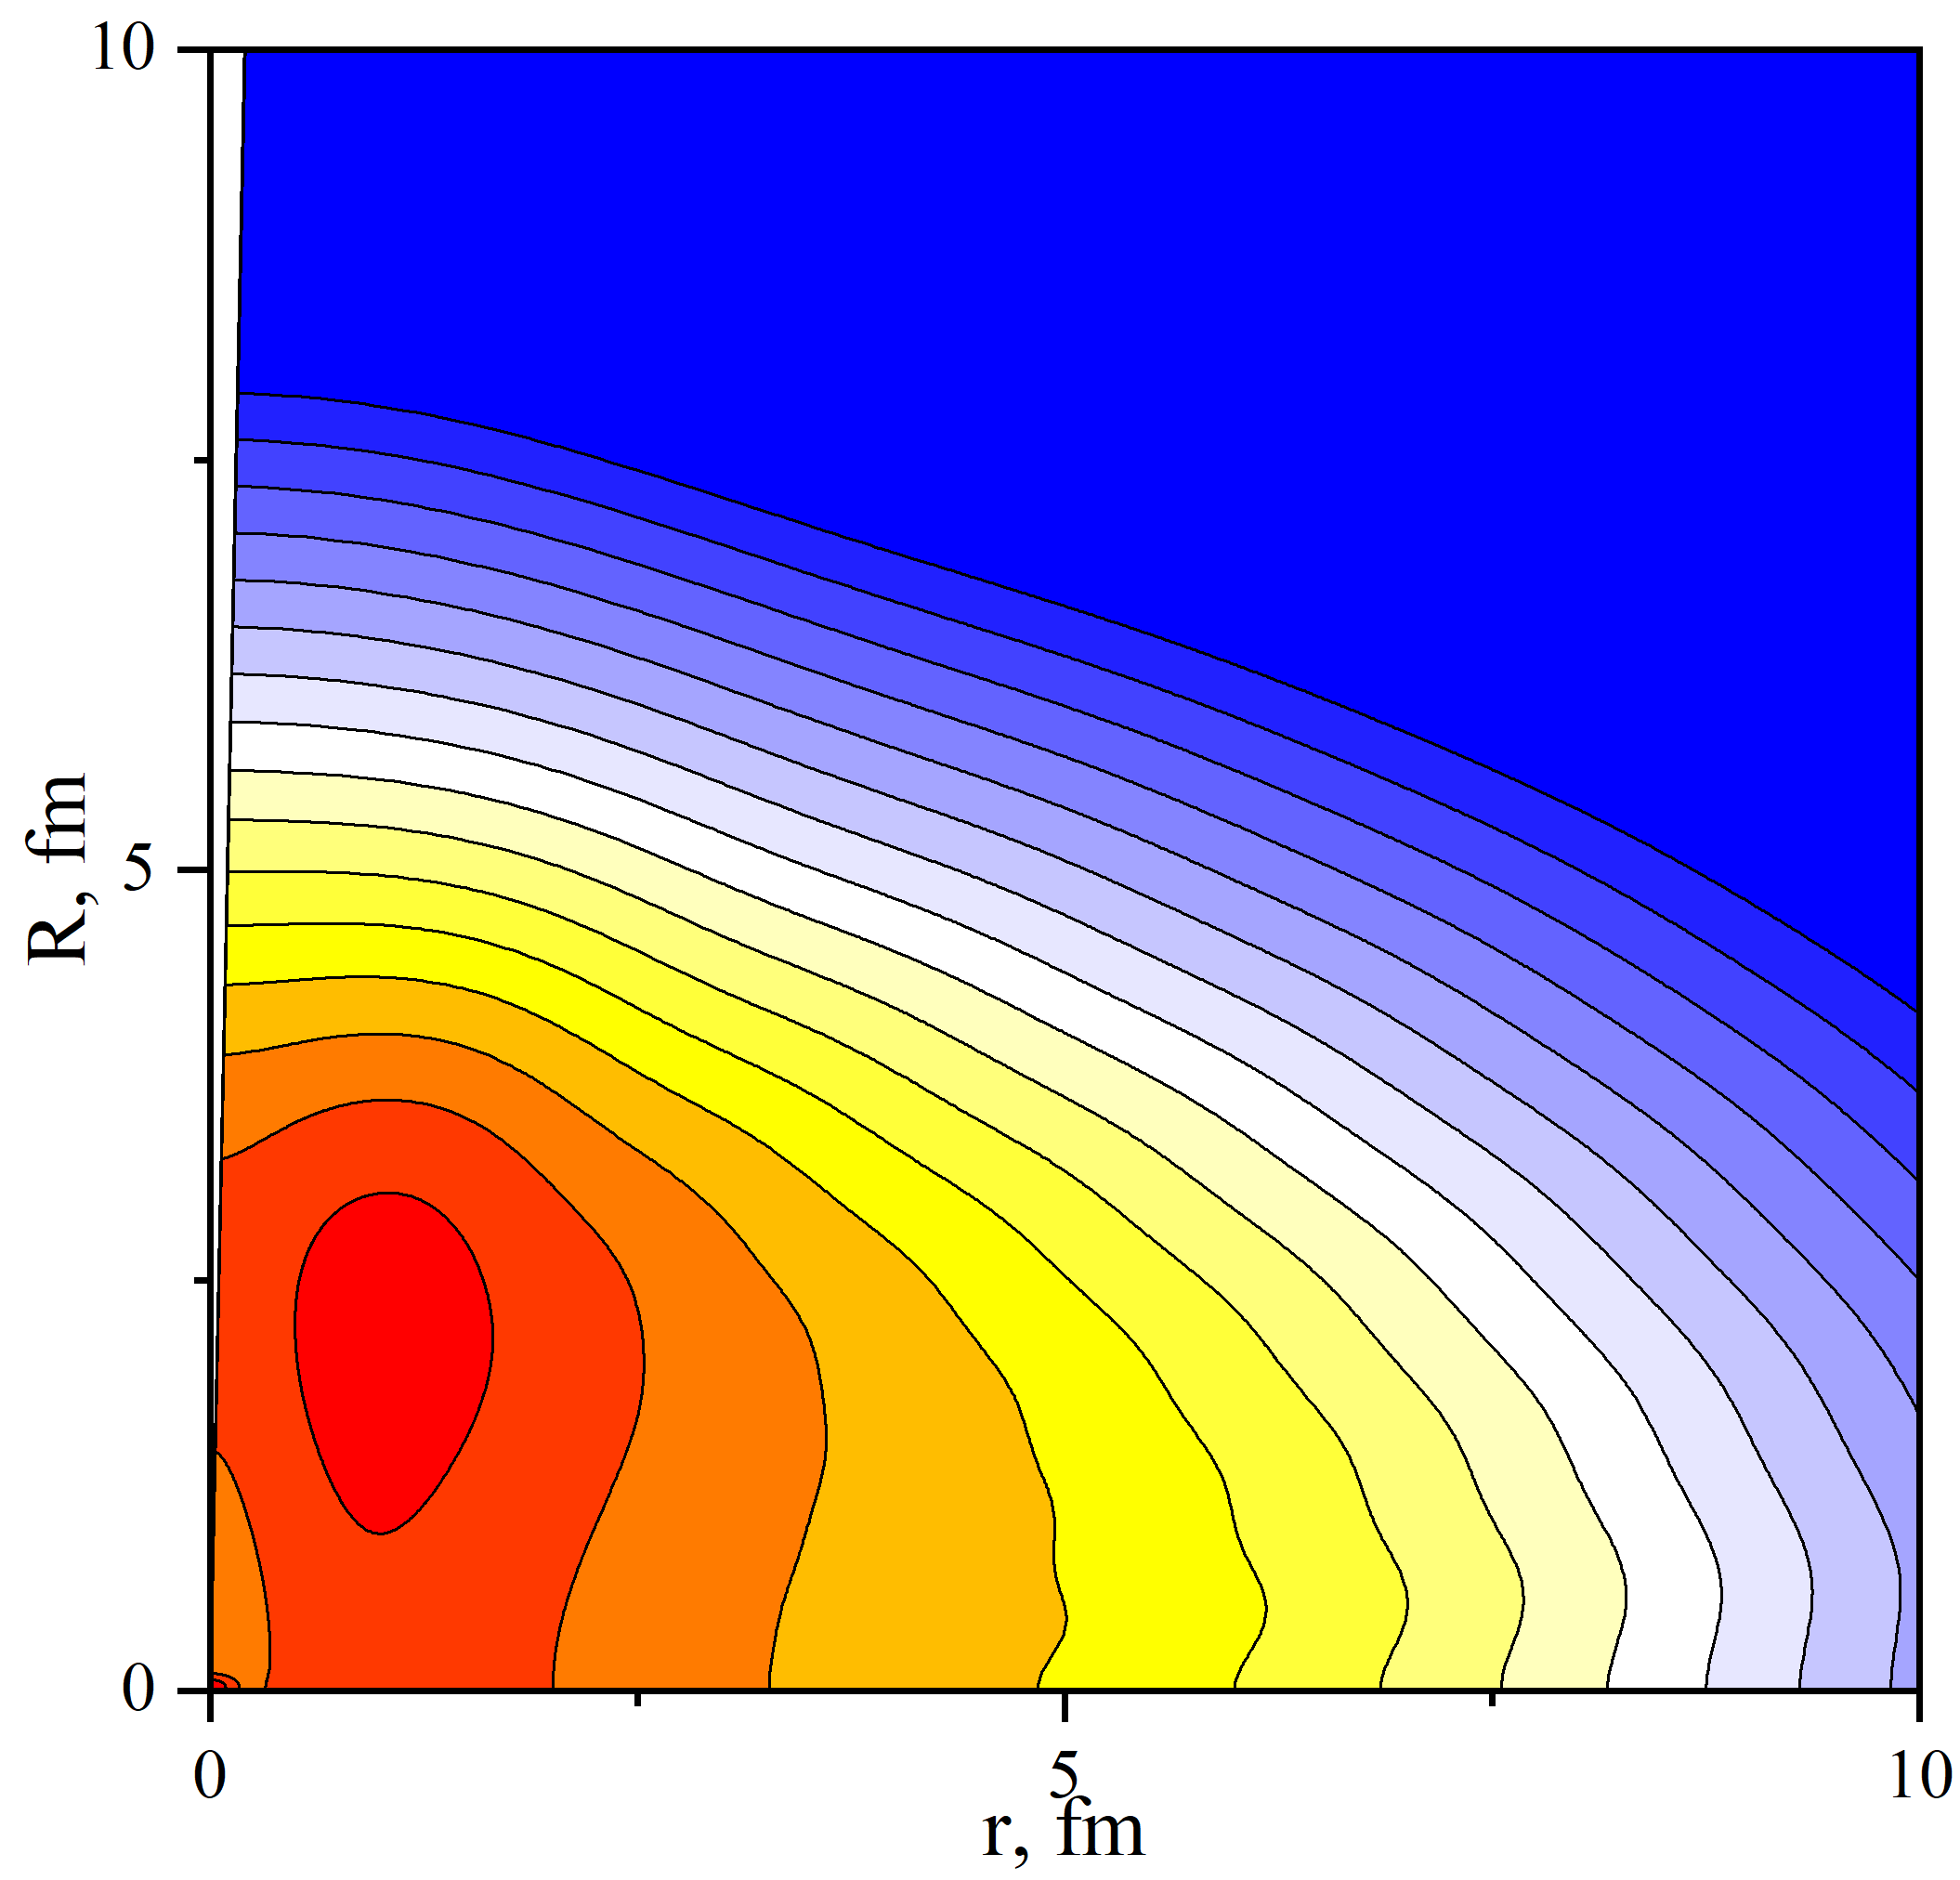
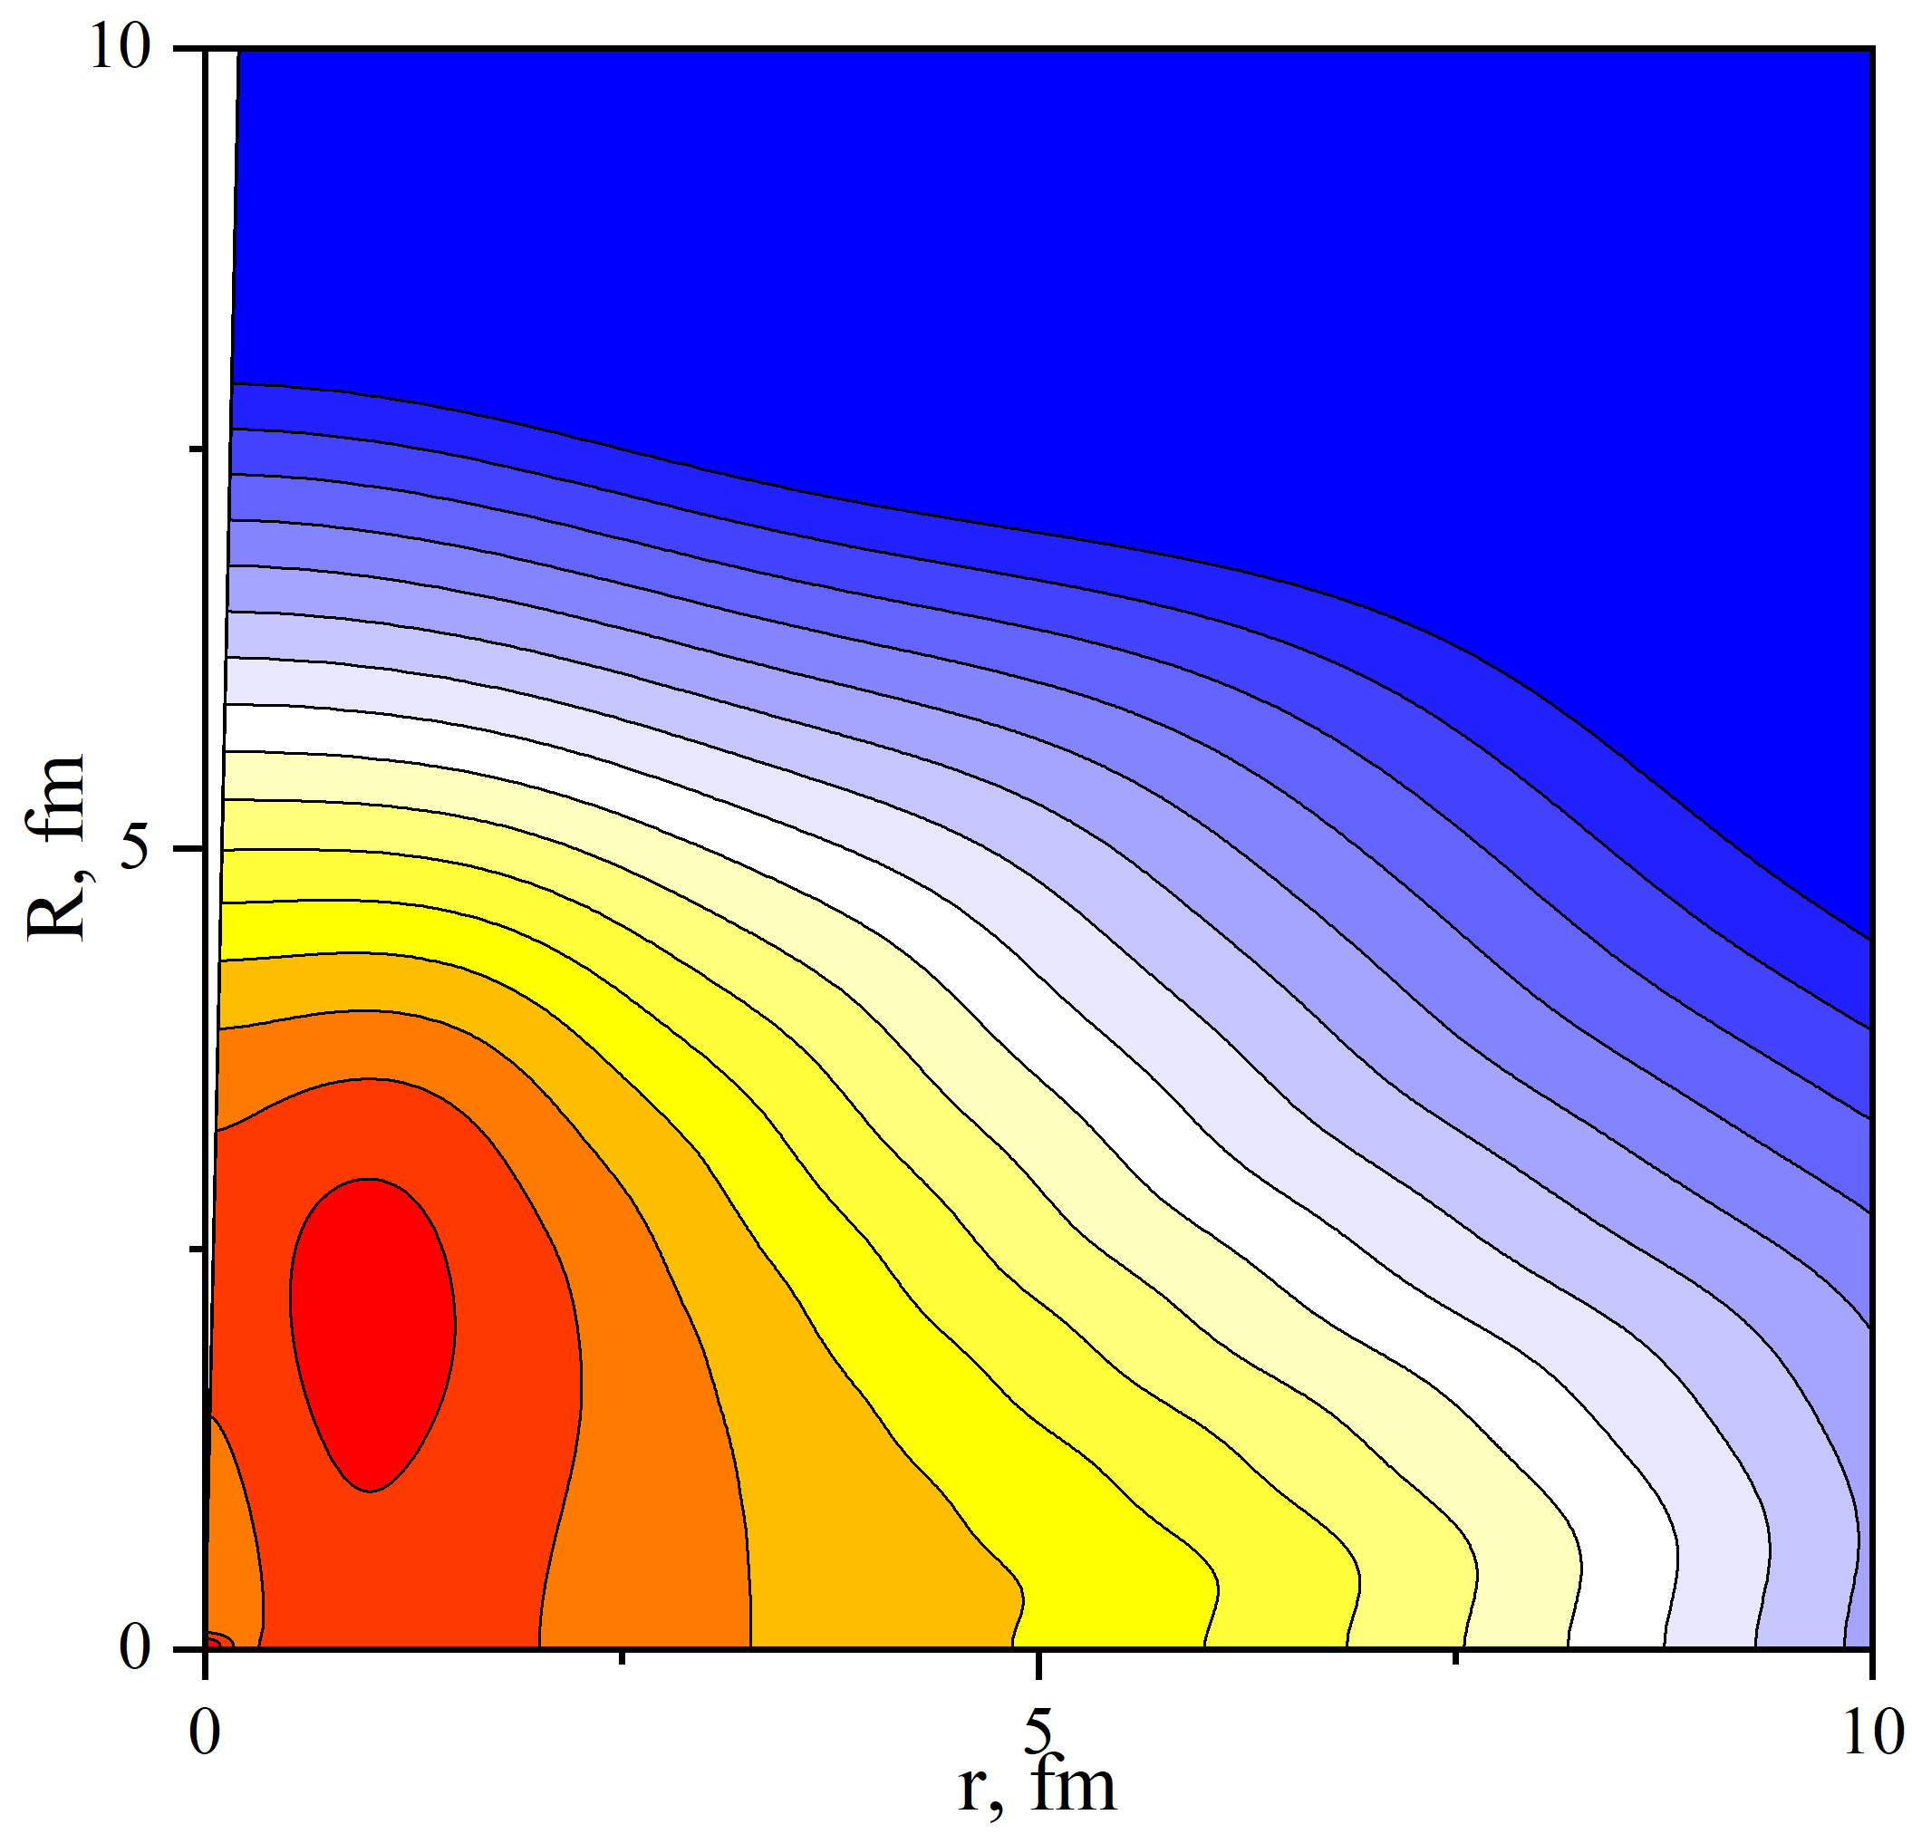
Wave function of the ground state of the ¹⁸O nuclei in the core+neutrons model is calculated hyperspherical functions [1,2].
For ¹⁸O the energy of separation is E₀ = -12.38 MeV and the experimental value is 12.188 MeV.
¹⁶O core
θ=90
r
r
n
n
R
R
θ=0
r
¹⁶O core
n
n
R
r
R
1. V.V. Samarin, Eur. Phys. J. A, 58, 117 (2022).
2. A.S. Bazhin, V.V. Samarin, Bull. Russ. Acad. Sci: Phys, 88, 1177 (2024).

Slide 14
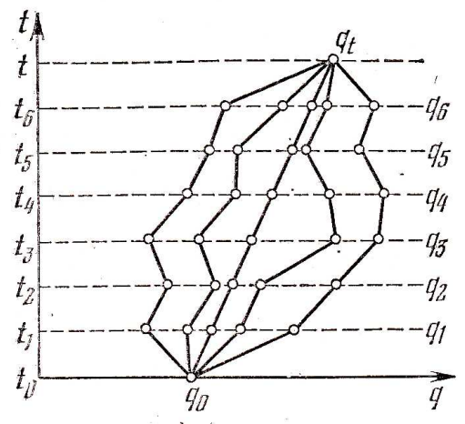
Feynman’s path integrals (FPI) method
Feynman’s approach [1] is not based on the Schödinger equation, and the Lagrange method is used instead of Hamiltonian one [2]. The main object in the Feynman formulation is a propagator K(q,t;q₀,t₀), which enables to express a wave function ψ(q,t) in terms of it’s initial value ψ(q₀; t₀) at the time t = t₀. Here q can stand for any dynamic variables describing our system at time t, and q₀ is the same variables at time t₀.
t
q
The propagator K(q,t;q₀,t₀) may be represented in the forms:
t``
q``
t₀
q₀
1. R.P. Feynman, A.R.Hibbs, Quantum Mechanics and Path Integrals (McGraw-Hill, New York, 1965).
2. D. I. Blokhintsev, Quantum Mechanics (Springer, 1964); QUANTUM MECHANICS (Chapter 25), https://vixra.org/pdf/2207.0018v1.pdf
Д.И. Блохинцев, Основы квантовой механики. М.: Наука, 1983.
Particle trajectories which are subject for integration over in the Markov chain. The time interval (t₀; t) is broken down into seven subintervals, q the particle coordinate.

Slide 15
The propagator in Feynman’s path integrals method has properties:
The propagator K for an infinitesimal time interval Δt = t_{k+1}– t_{k} is taken as
The propagator K for the total time interval (t₀; t) is:
The propagator K(x, t; x₀; t₀) is a matrix element of the evolution operator

Slide 16
Feynman’s path integrals method in imaginary time t = –iτ [1]
(1)
The formula (1) is used to obtain the ground state energy E₀ as the slope of the linear part of the graph of ln K_{E} as a function of τ . The squared modulus of the ground state wave function |ψ₀(q)|² in the points q of the finite region corresponding to finite motion can be determined based on expression (1) at τ values in the linear part of the graph of dependence ln K_{E}(q,τ;q,0) on τ.
(2)
The values of the propagator (2) in Jacobi coordinates were calculated using algorithm proposed in [2, 3] based on the Monte–Carlo method and parallel calculations [4] using NVIDIA CUDA technology [5, 6] were performed mainly on the Heterogeneous Cluster of the Joint Institute for Nuclear Research [7]. Also, the calculations can be performed on CPU using parallel libraries (for example, OpenMP, IntelTBB).
1. E.V. Shuryak, O.V. Zhirov, Nucl. Phys. B 242, 393 (1984); Э. В. Шуряк, УФН 143, 309 (1984).
2. V.V. Samarin, M.A. Naumenko, Phys. Atom. Nucl. 80, 877 (2017).
3. V.V. Samarin, Study of spatial structures in α-cluster nuclei, Eur. Phys. J. A, 58, 117 (2022).
4. M.A. Naumenko, V.V. Samarin, Supercomp. Front. Innov. 3, 80 (2016)
5. NVIDIA CUDA, http://developer.nvidia.com/cuda-zone/
6. J. Sanders, E. Kandrot, CUDA by Example: An Introduction to General-Purpose GPU Programming (Addison-Wesley, New York, 2011)
7. Heterogeneous Cluster, Joint Institute for Nuclear Research, http:// hybrilit.jinr.ru/

Slide 17
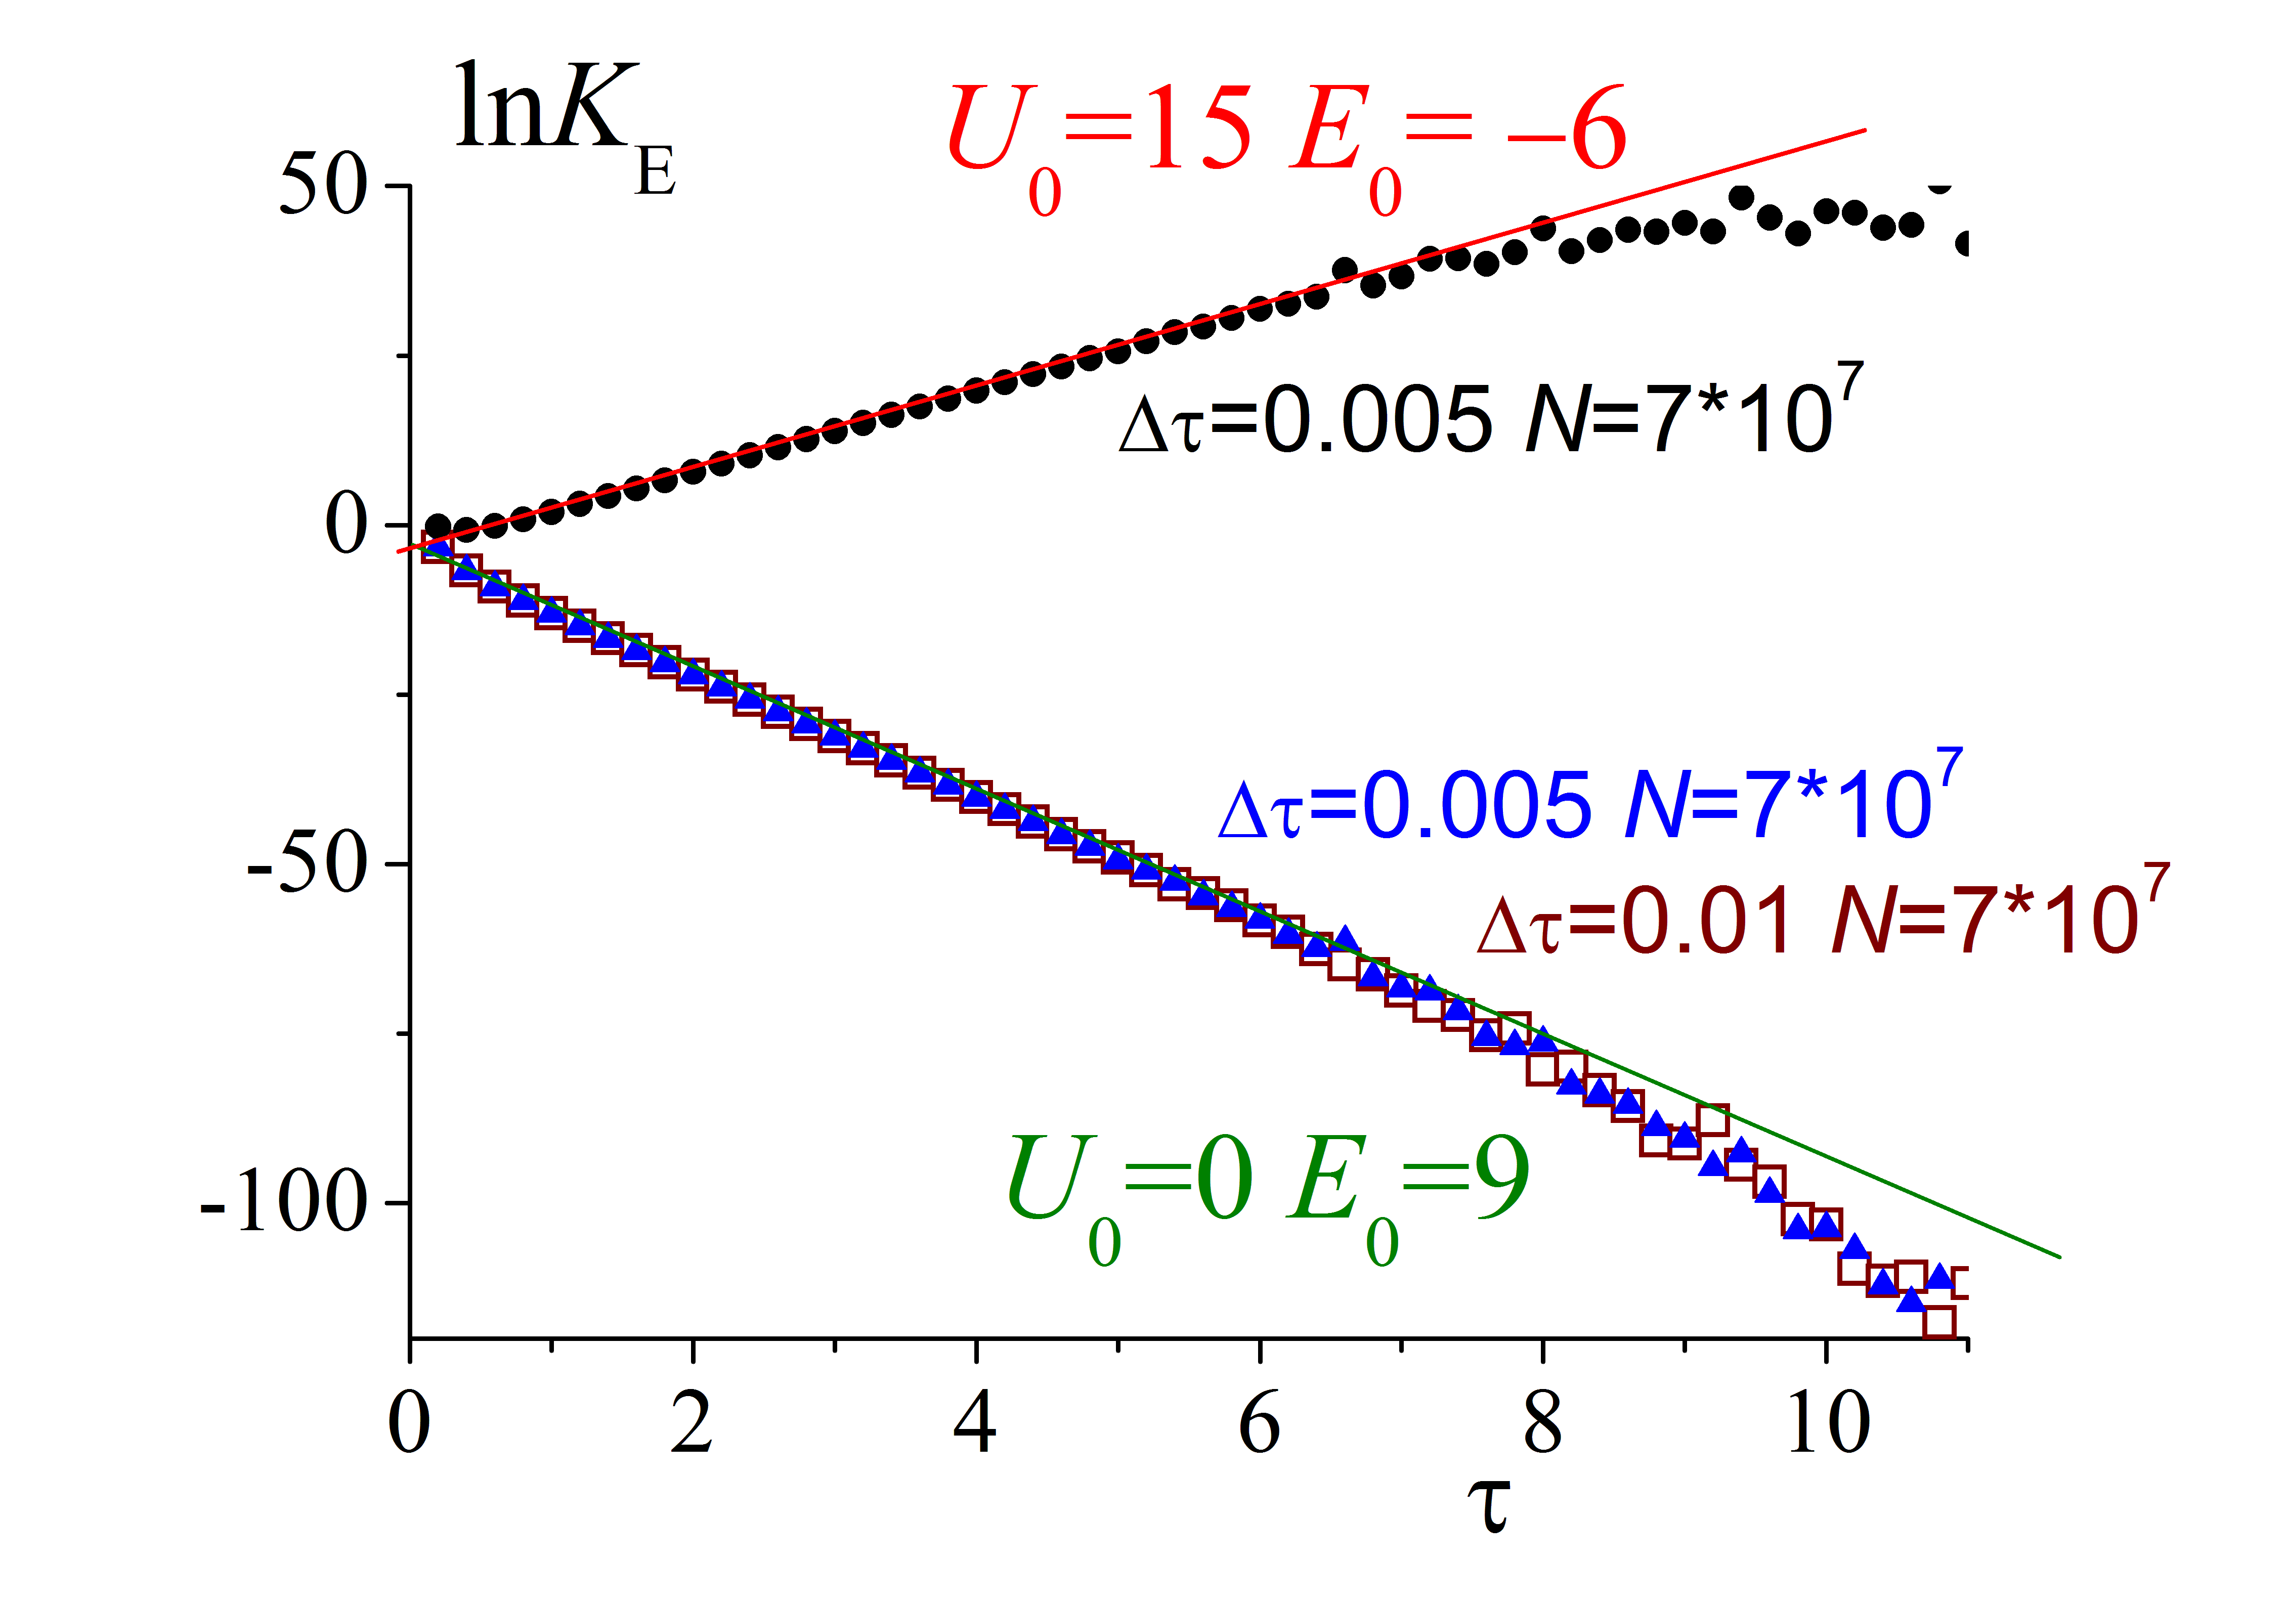
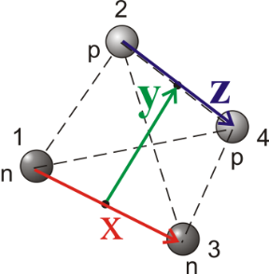
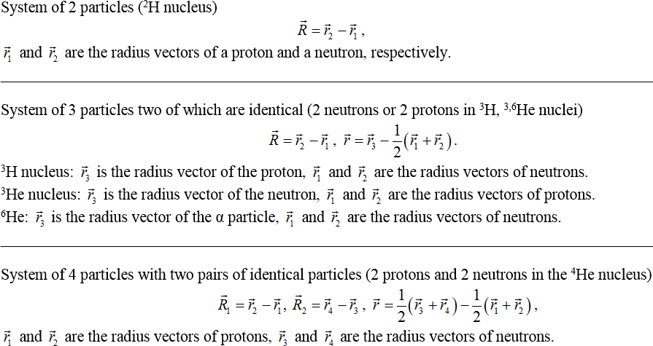
The capabilities of the FPI method is tested for exactly solvable oscillatory models with N=4
Jacobi coordinates:
N=4
Jacobi coordinates for 4 - body system
The slope of resulting straight lines equals the energy of the ground state
Exact E₀ value:
FPI Monte-Carlo calculations with statistics n=10⁷.
To demonstrate the capabilities of this method, we use it for harmonic oscillatory systems (exactly solvable) with exact expressions for the ground state energy.

Slide 18
The capabilities of the FPI method is tested for exactly solvable oscillatory models with N=4
Jacobi coordinates:
N=4
Jacobi coordinates for 4 - body system
The slope of resulting straight lines equals the energy of the ground state
Exact E₀ value:
One can see that the FPI method yields the exact values of the ground state energy with small uncertainties, which makes it possible to use this method in calculations of the ground state energies for nuclear N-body systems with N > 3.
N, U₀ | Exact value E₀ | Calculated value E₀
N = 4, U₀ = 15 | − 6 | −5.98±0.02
N = 4 U₀ = 0 | 9 | 8.98±0.02

Slide 19
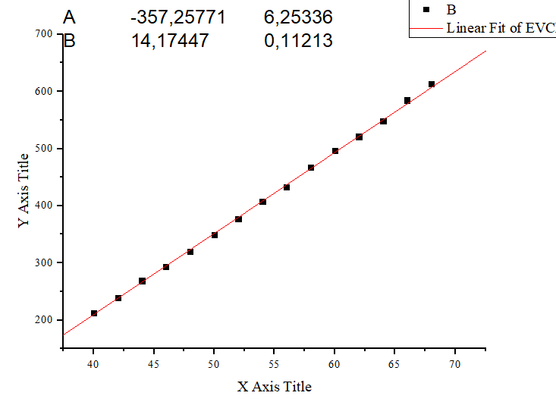
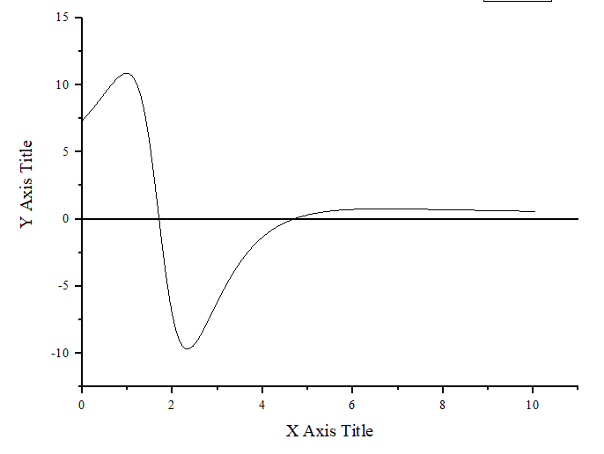
Calculation the energy of separation from 16O to 4-alpha
Calculation of K_{E} was performed using CUDA (float) with in-build generator of random numbers, the number of simulations is 10⁷ .
Potential alpha-alpha
with parameters
U_{α1} = 39.8, B_{α1} = 1.93, a_{α1} = 0.8;
U_{α2} = 40.0, B_{α2} = 1.7, a_{α2} = 0.25;

Slide 20
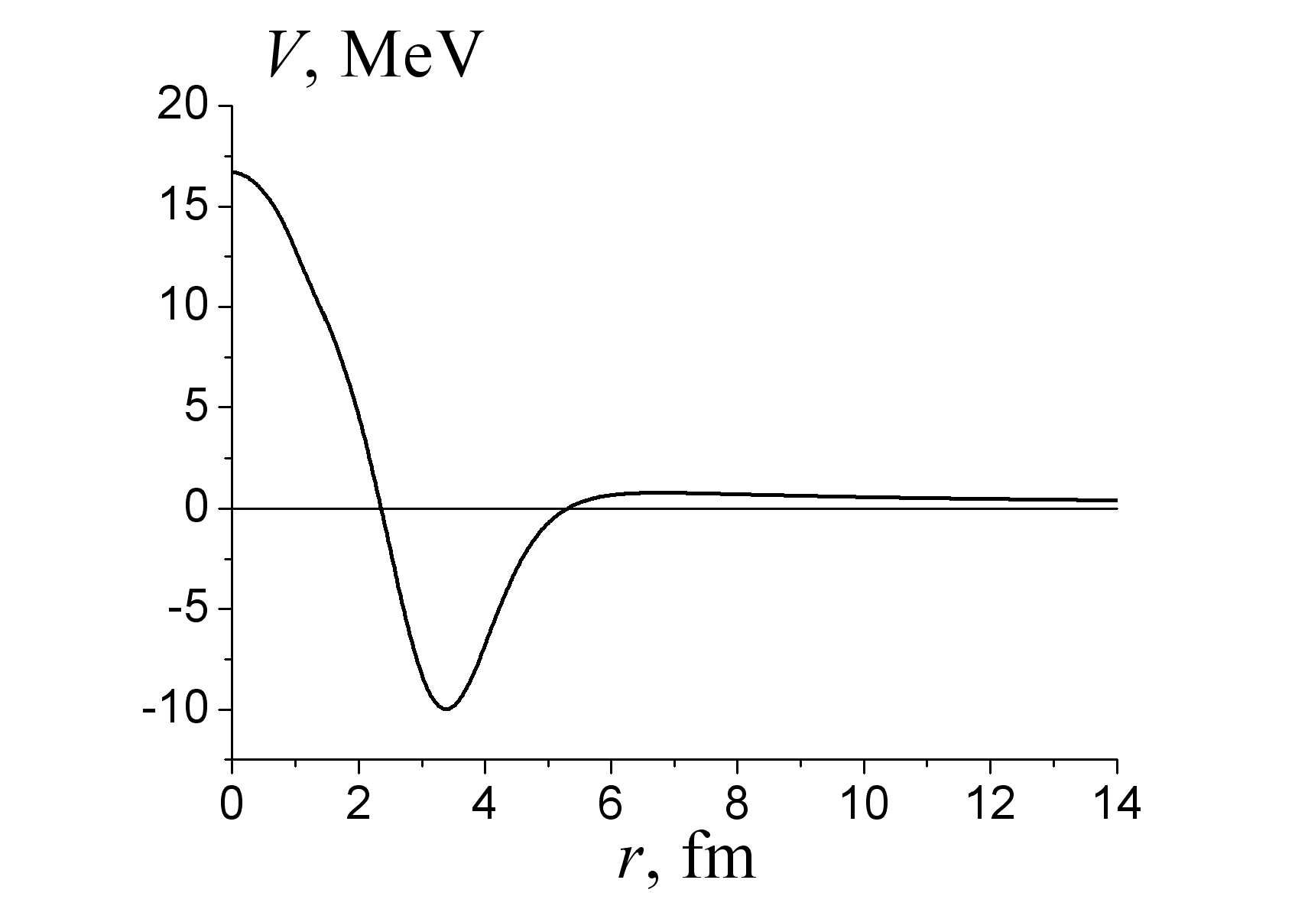
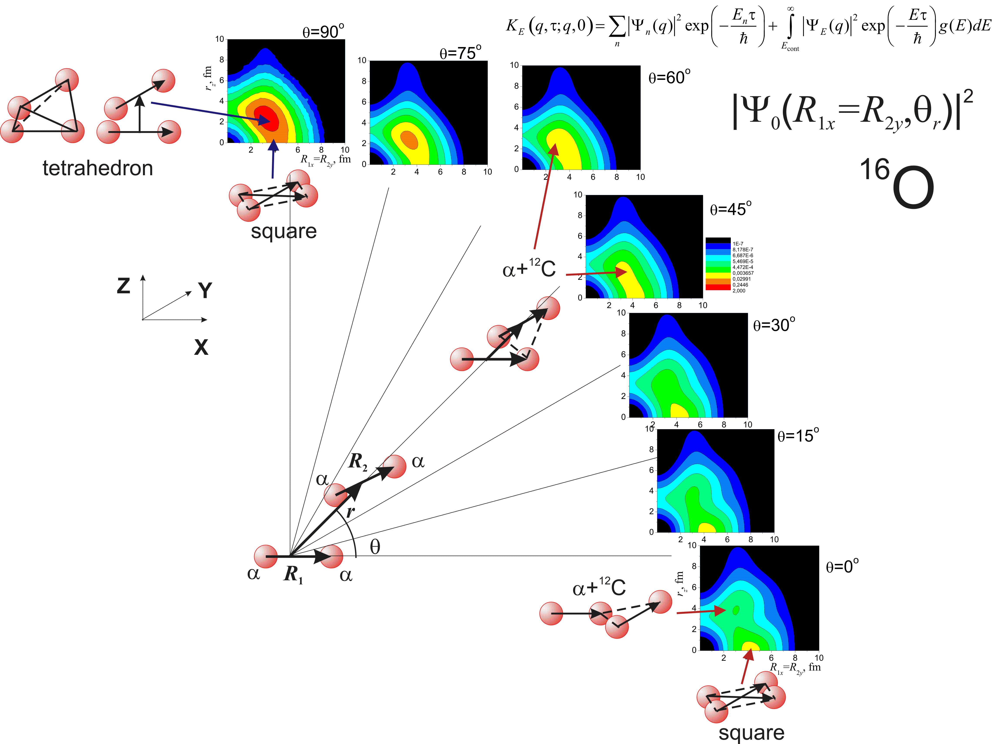
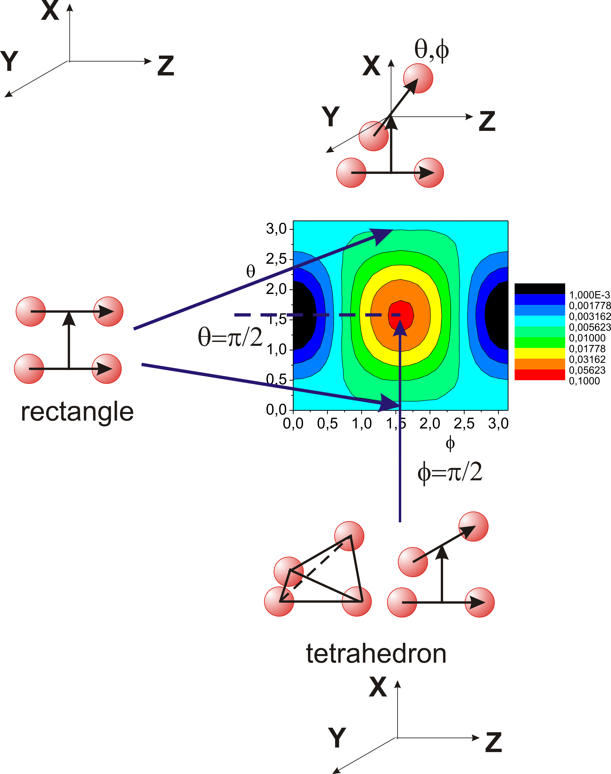
Probability density for ground state of ¹⁶O (4a) in α-cluster model using Feynman’s path integrals
This region is important for
the description of the one and
two alpha-cluster transfer
reactions and resonances.
α−α potential
The results was obtained from few alpha-alpha potentials.
This region is
important for
the description of
the alpha-
cluster transfer
reactions.
rotation of R₂
parallel shift of R₂
Jacobi
coordinates
(R₁, r, R₂)
Logarithmic
scale
Logarithmic
scale
Calculation of charge density for 16O is in process.

Slide 21
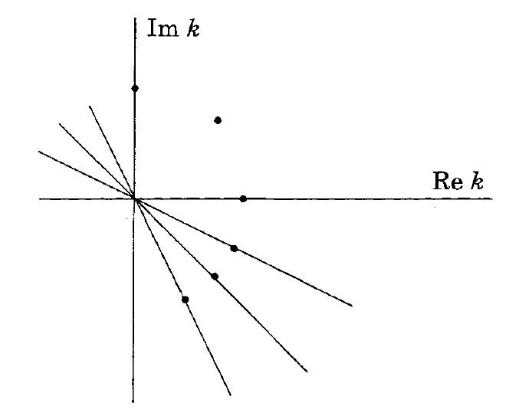


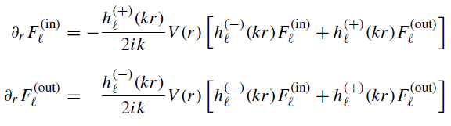

Метод функций Йоста
Метод функций Йоста основывается на переходе от дифференциального уравнения второго к двум дифференциальным уравнениям первого порядка, с помощью сферических функций Бесселя/Неймана
Начальные условия, для решения системы дифференциальных уравнений

Slide 22
Участие в конференциях
1. 7th International Conference on Particle Physics and Astrophysics
Bazhin A.S. STUDY OF THE STRUCTURE OF 12C AND 6Li NUCLEI IN THE ALPHA-CLUSTER MODEL BY HYPERSPHERICAL FUNCTIONS, 2024.
Сайт конференции https://indico.particle.mephi.ru/event/436/
2. 28th International Scientific Conference of Young Scientists and Specialists (AYSS-2024)
Bazhin A.S. Study of nuclei structure in alpha-cluster model by hyperspherical functions using cubic spline interpolation, 2024.
Сайт конференции https://indico.jinr.ru/event/4343/overview
3. South Africa - JINR Workshop on Theoretical and Computational Physics
Bazhin A.S. Study of the structure of nuclei in the alpha-cluster model by hyperspherical functions method, 2025.
Сайт конференции https://indico.jinr.ru/event/5349/overview
4. LXXV International Conference «NUCLEUS – 2025. Nuclear physics, elementary particle physics and nuclear technologies»
Bazhin A.S. Study of the structure of ^{16,18}O nuclei in the alpha-cluster model by hyperspherical functions and Feynman’s path integrals, 2025.
Сайт конференции https://indico.jinr.ru/event/4343/overview

Slide 23
Статьи
1. Известия РАН Серия физическая том 88, номер 8, 2024.
A.S. Bazhin and V.V. Samarin Study of the Structure of the 9Be Nucleus in the Alpha-Cluster Model by the Method of Hyperspherical Functions. Bulletin of the Russian Academy of Sciences: Physics, 2024, Vol. 88, No. 8, pp. 1177–1184. DOI: 10.1134/S1062873824707281
2. (Принято к опубликованию) Известия РАН Серия физическая том 89, номер 8, 2025.
A.S. Bazhin and V.V. Samarin “Study of the Structure of 12C and 6Li Nuclei in the Alpha-Cluster and Shell Models”. Bulletin of the Russian Academy of Sciences: Physics, 2025, Vol. 89, No. 8, pp. 1273–1283. DOI: 10.1134/S1062873825712048
3. (В планах) Известия РАН Серия физическая
A.S. Bazhin and V.V. Samarin "Исследование структуры ядeр 18O И 16O в альфа-кластерной модели с использованием метода гипесферических функций и метода Фейнмана по траекториям"

Slide 24
Заключение
Проведены расчёты структуры ядер ¹²C, ⁶Li, ¹⁸O и ¹⁶O. Полученные расчёты согласуются с экспериментальными значениями (энергия основного состояния, зарядовый радиус, зарядовое распределение)
Разработаны программы на C++ для методов: функций Йоста и Фейнмана по траекториям. Данные методы будут использоваться в дальнейшем изучении структуры ядер, как связанных состояний, так и возбужденных состояний.

Slide 25
Спасибо за внимание!

