Slide 1
Setup for fiber test
F. Dubinin

Slide 2
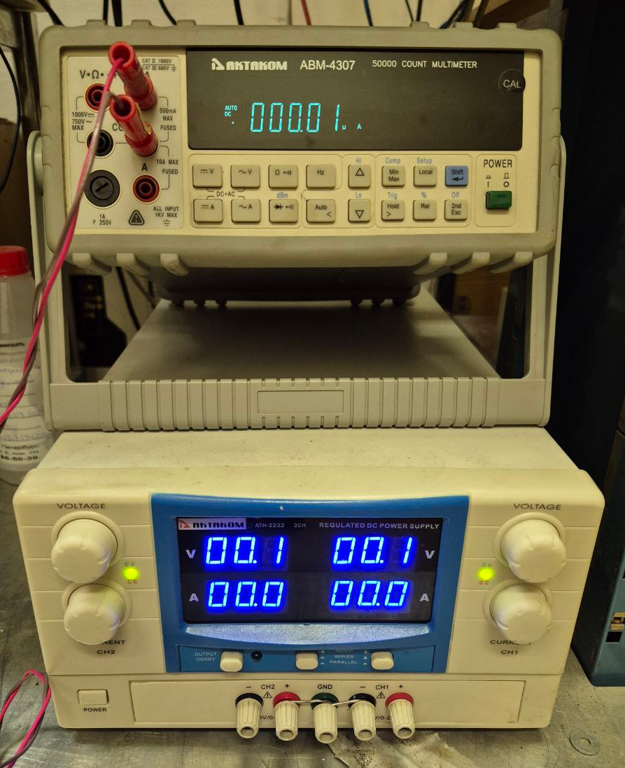
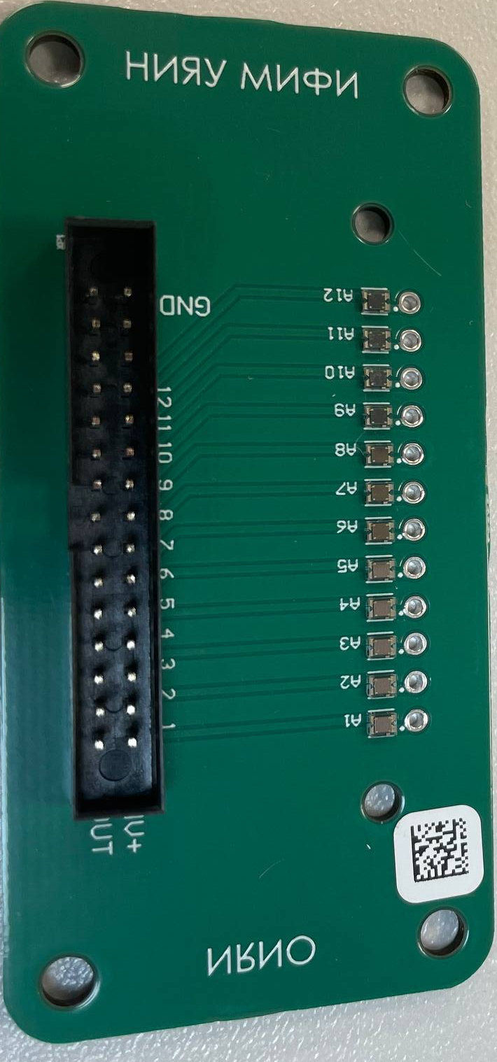
Proposal
Ampermeter
Power Supply
Power Supply
x12 channels
…
…
I/O switches
…
…
Fiber under test
I/O switches
…
…
…
x12 channels
SiPM
LED
Connector
Connector
…

Slide 3
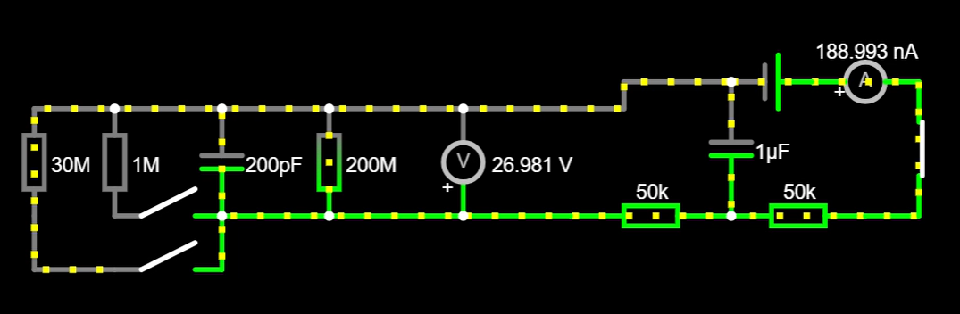
Hot swapping of test sample
50k + 50k resistors limits current by 25μA per SiPM
12 SiPM → 300μA
Power consumption by open SiPM: W = 25V * 25μA = 625μW
FR4 thermal conductivity: 0,3mW/(mm*K) along thickness
Voltage drop during regular operations: 0,1V @ 1μA
- not negligible but reasonable

Slide 4
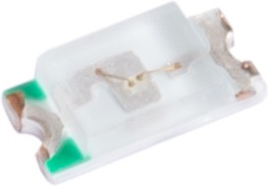
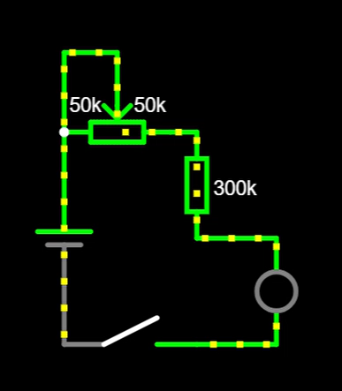
LED circuit
GNL-0603UBC
λ_max = 470nm
S = 1,6 x 0,8 mm²
Circuit designed to run LED at very beginning of open part of IV curve
Potentiometer allows to adjust LED brightness to get SiPM response of 1 μA

