Slide 1


status BBC SPD @ JINR
A.V.Tishevsky on behalf of JINR BBC workgroup
Workgroups meeting, Moscow
October 2025
Notes:
1

Slide 2
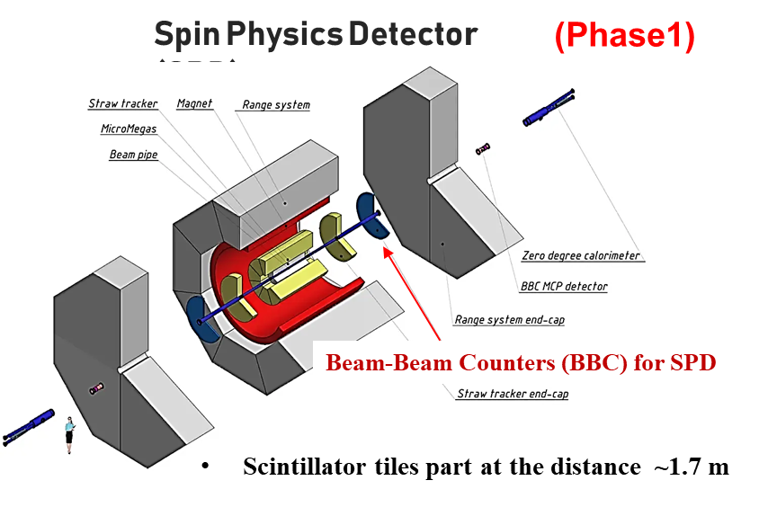
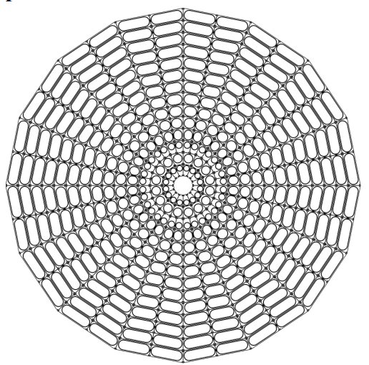
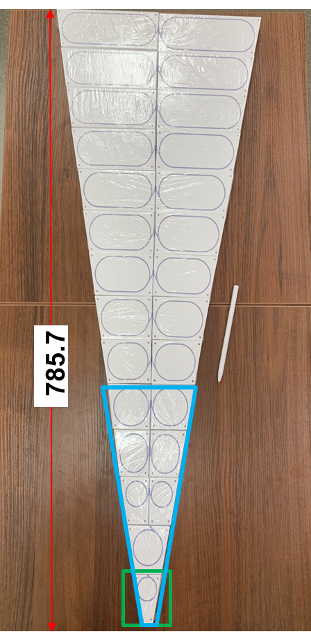
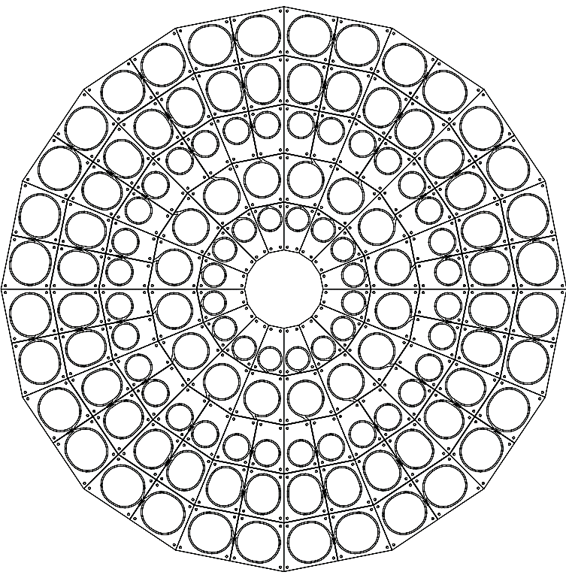
Introduction
BBC priorities
Selected options:
Scintillator: Uniplast-Vladimir (chemical mating)
Optical cement: CKTN Med mark B
WLS Fiber: Saint-Gobain Crystals (SG92S)
SiPM: SensL 1x1 mm² (MicroFC-10035 SMTPA)
Final options for Phase ≥1
are:
KURARAY (Y-11)
Hamamatsu (S14160-1315PS)
(Phase0)
BBC Sector (1/16 of wheel) design
(Phase1)
Step 1-st
Intermediate step
skill + changes (?)
Step 2-nd
2

Slide 3
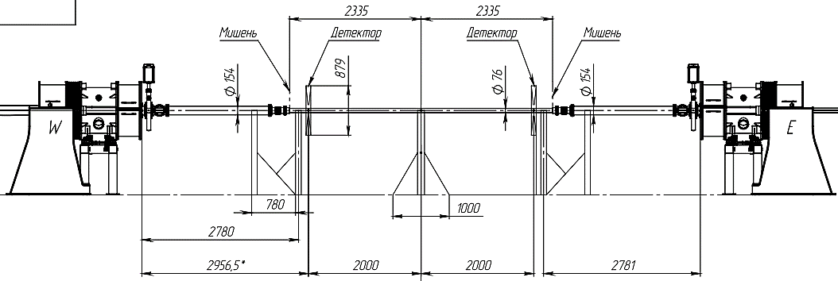
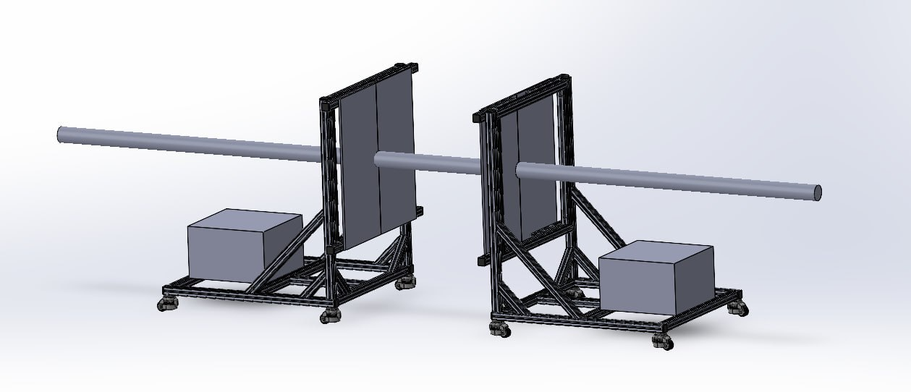
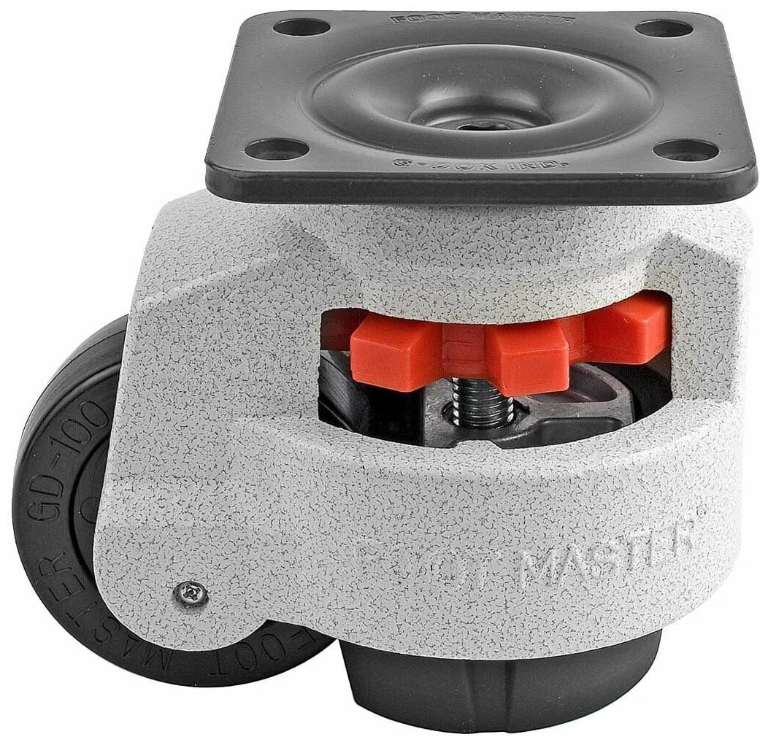
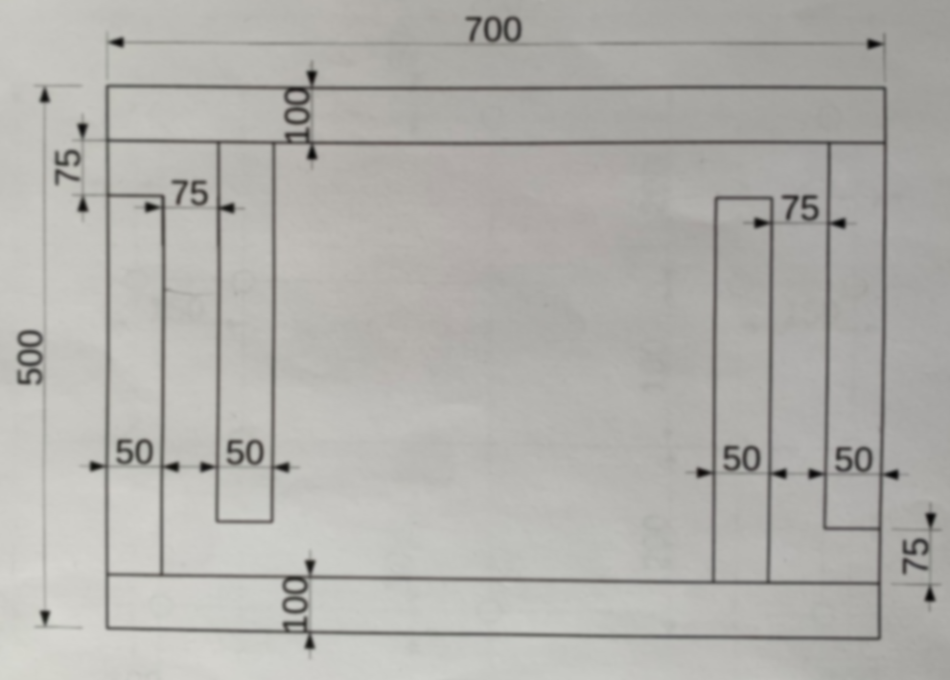
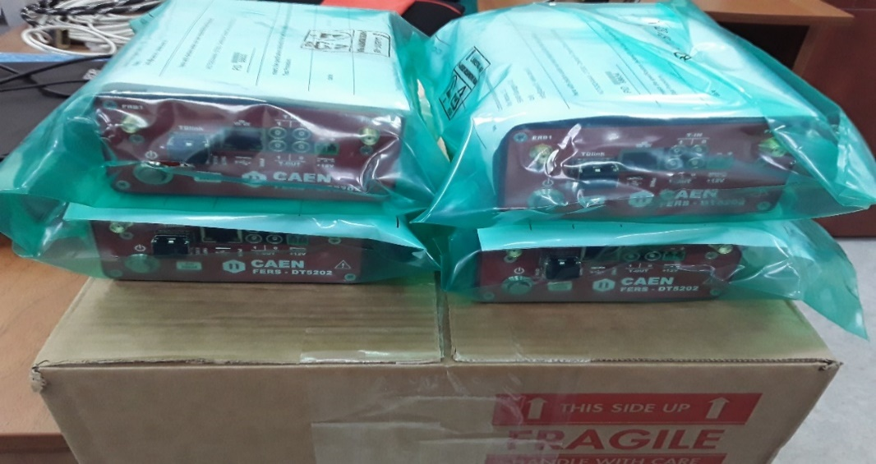
SPD Phase0
Xe124+ target collisions (FT mode)
MPD pipe
Pipe (Al or Fe) (1.5 mm thick, 83 mm diameter)
targets (Au, Cu).
distance to collision point
talk by Volkov I.
Needs:
2 Wheels 128 scintillator tiles each
-scintillator -yes
-WLS – yes
- SiPM – yes
In progress
DT5202 – yes
DT5215 – yes
Optical fiber – yes
30% boronated polyethylene plates (ПБ-30)
for BBC/ZDC SPD
ООО «НПК Динамика»
(700х500х50 mm^3)
thanks to V. Poliakov
purchase is agreed

Slide 4
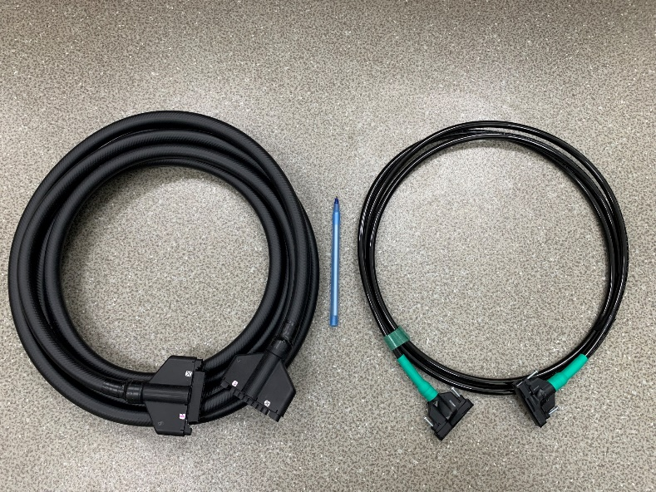
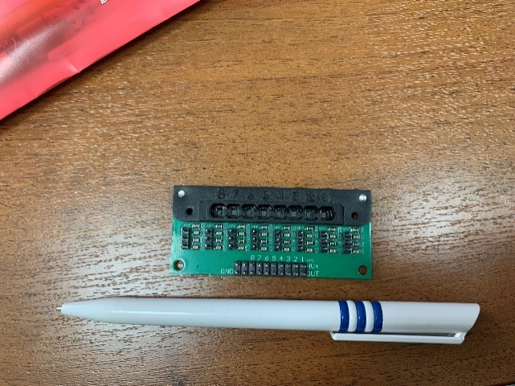
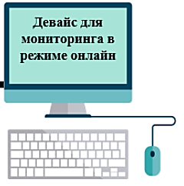
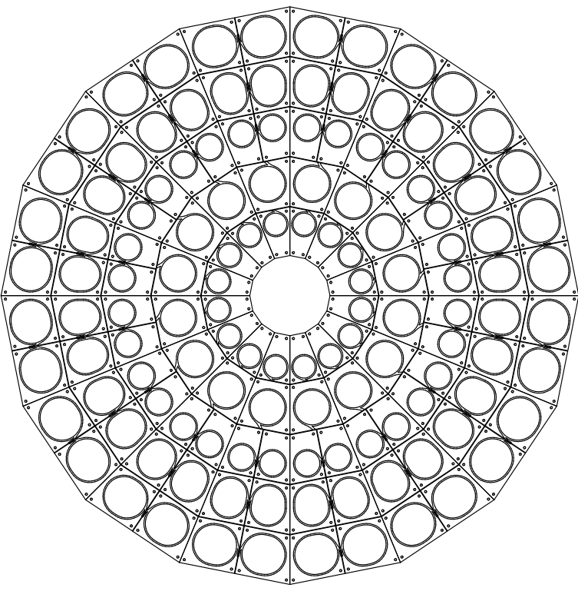
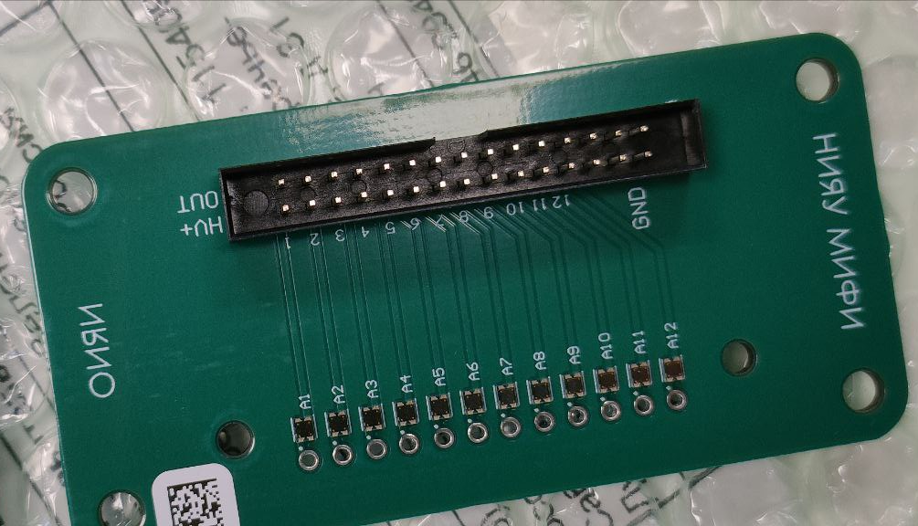
BBC assembling part
Proposal for reduced wheel prototype
talk by Solonbekov M.
8 ch
CAEN FERS-5200
128 tiles (8x16)
for Phase0
WLS
Connector for
WLS-to-clear fibers
Transmission box for
clear fibers to SiPMs
Front‐end
&
Readout
PC
12 ch
NEW ELECTRONICS (needs)
for Phase ≥1
talk by Dubinin F.
talk by Nekrasov P.
reduced prototype wheel (x2)
(the 1-st priority)
Mass production issues:
R&D tests (+ mechanisms of verification)
Backplate
4

Slide 5
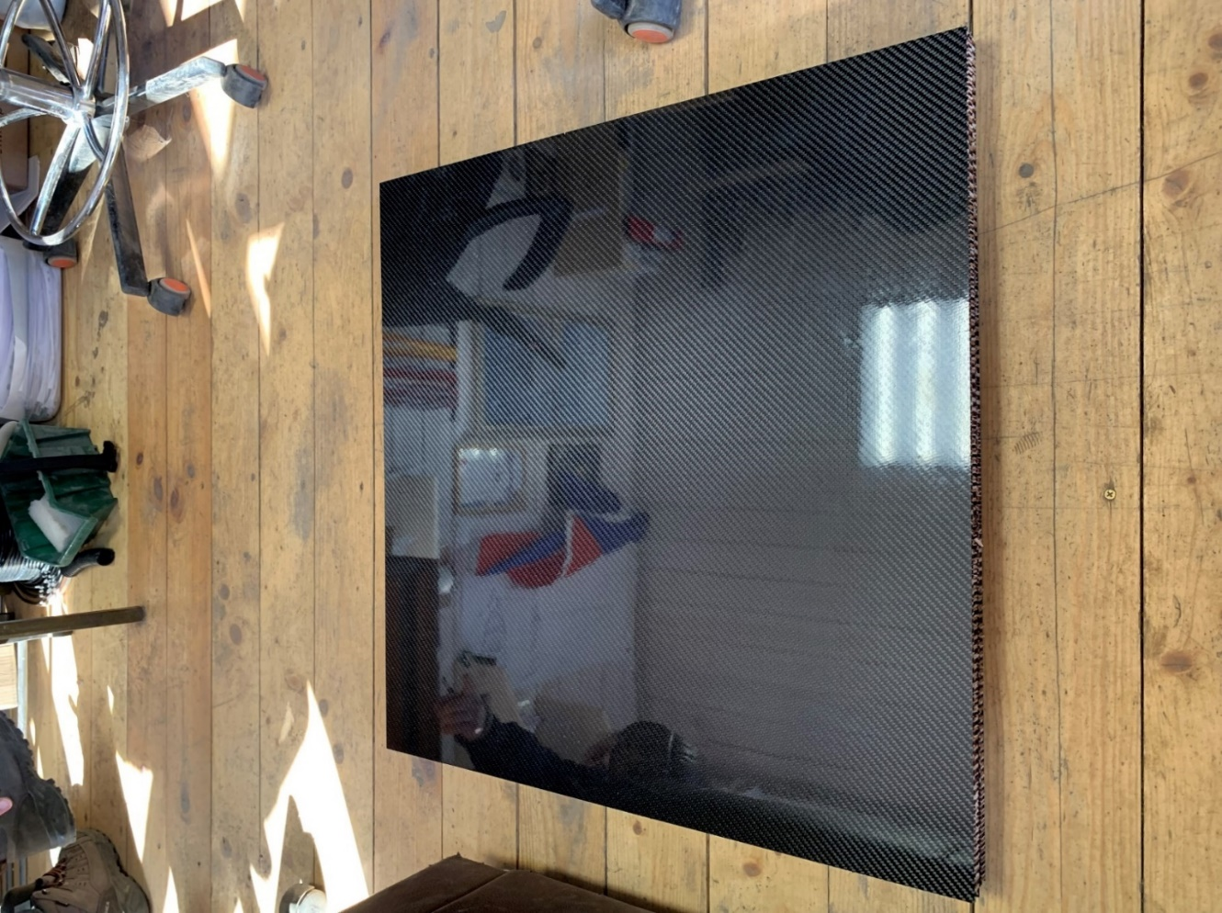
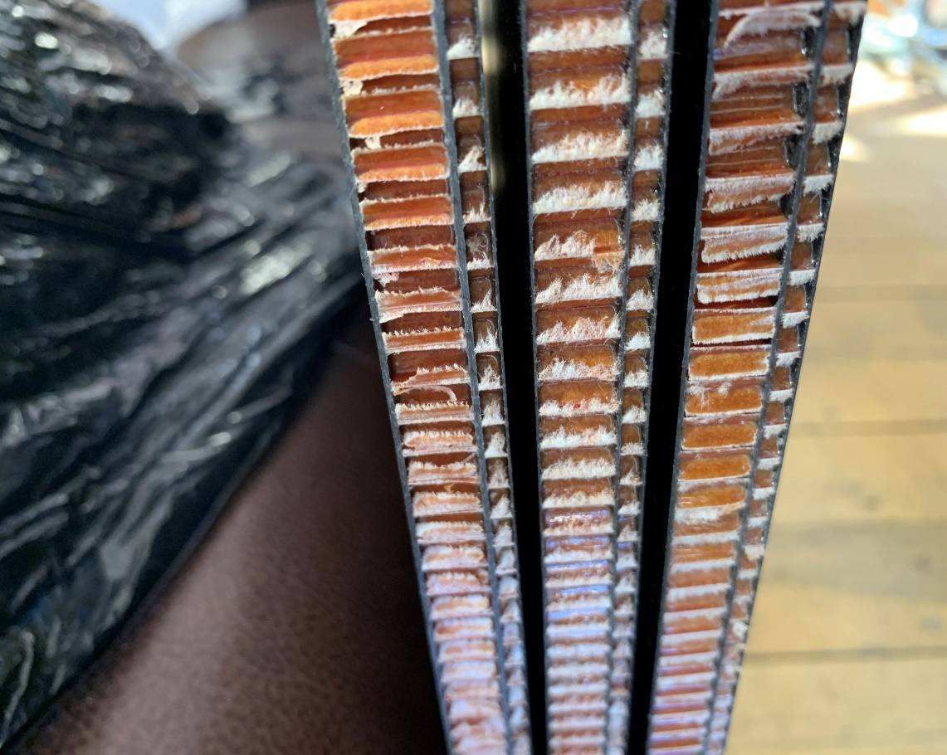
BBC assembling part
Sandwich backplate for BBC
Honeycomb
(3-options with
different thickness
of carbon layers)
thickness of each
~ 20 mm
728 x 728 mm²
The next steps are:
simulate the deformations of the backplate,
select main option.
The grooving map has been done.
I.
II.
I.
II.
I.
II.
Parts:
Infrastructure (grooved)
Detector support
5

Slide 6
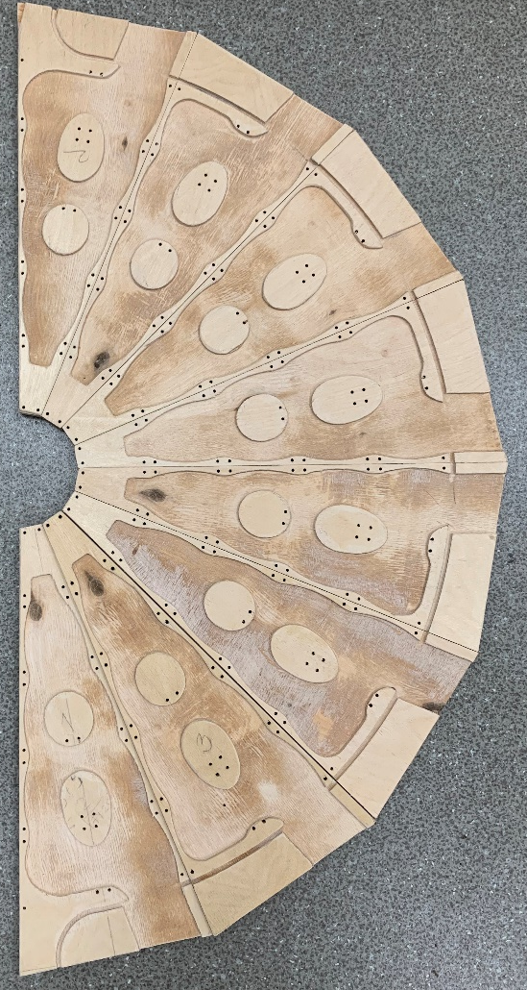
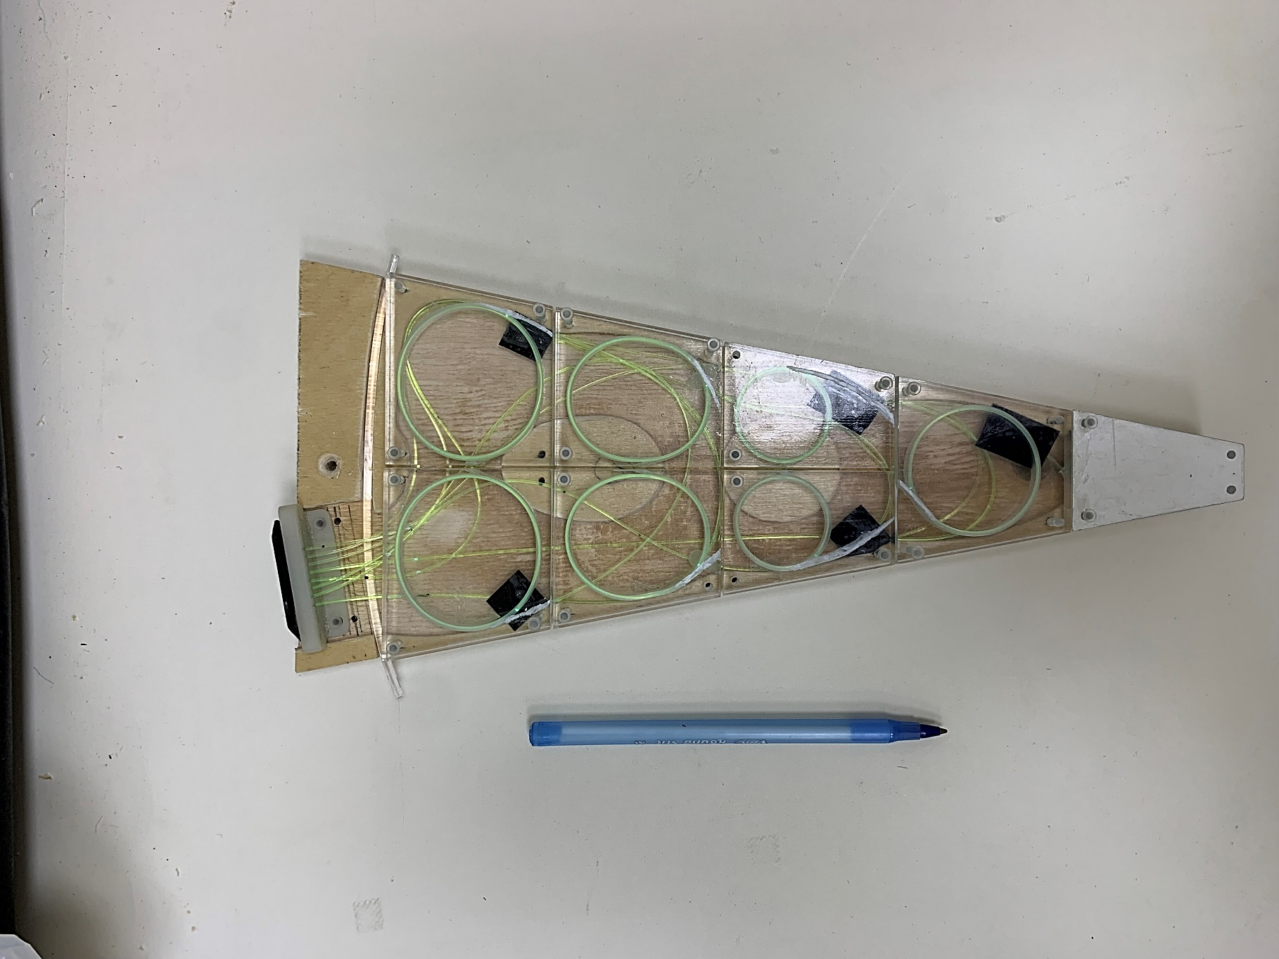
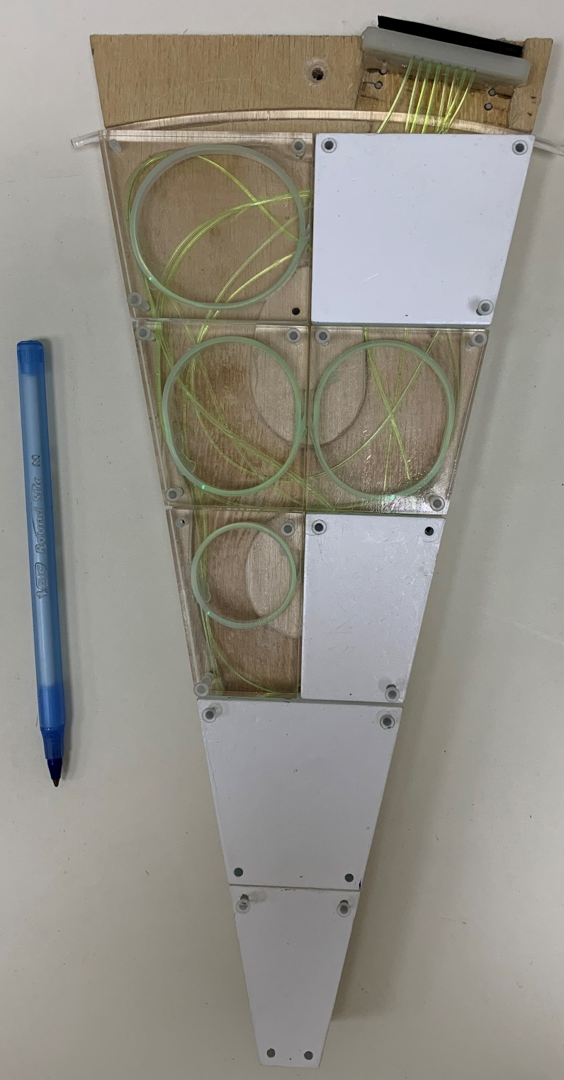
BBC assembling part
The sandwich backplate grooves for BBC
The grooving map
½ of wheel
Grooved wood backplate V.4.3
left output
right output
the verification method has been implemented
the ability to quickly the connector substitution
6

Slide 7
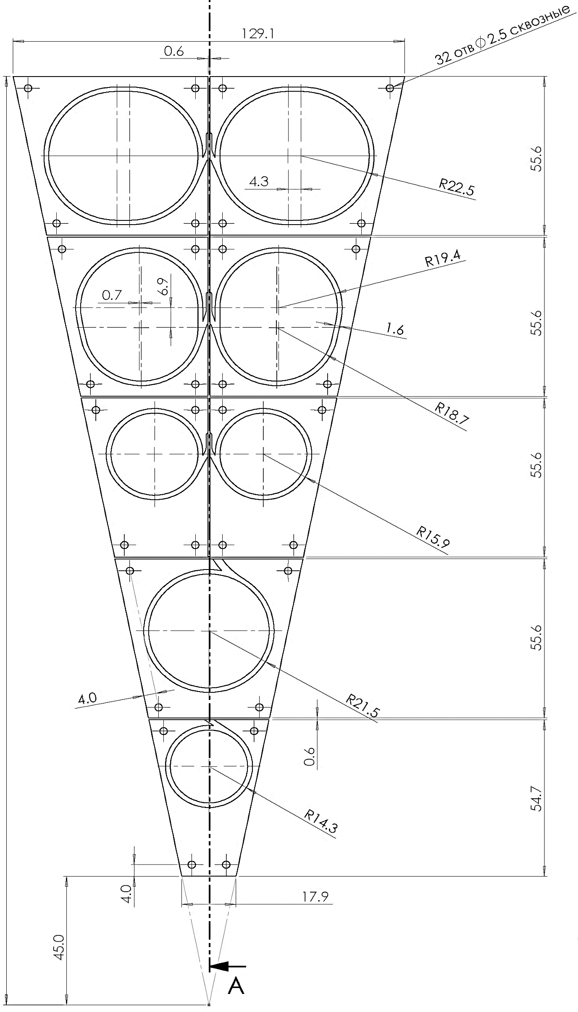
BBC assembling part
The fiber laying
Длина, см | ряд | Длина, см
63 | 4 | 73.5
61.5 | 3 | 72.2
54.5 | 2 | 61.5
70 | 1 | 68
62 | 0 | 61
Reserve (min. 40mm)
Left/right output symmetry
The minimum diameters are the same
hard to transported
7

Slide 8
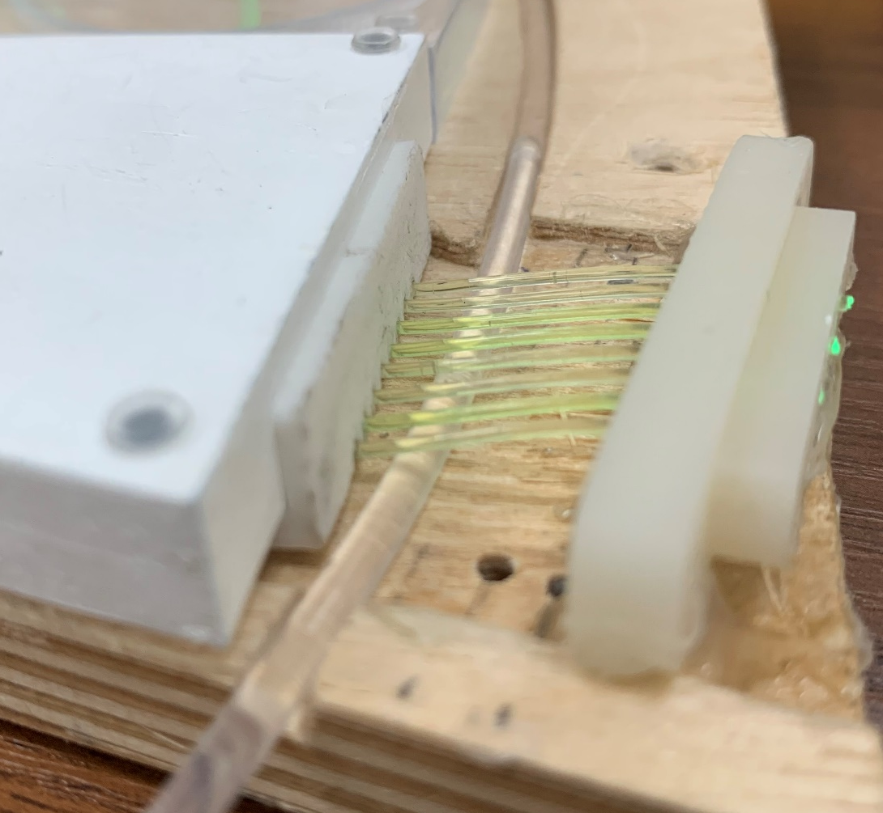
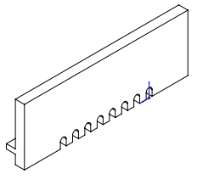
BBC assembling part
The sandwich backplate grooves for BBC
the connector mounting is not reliable
WLS tension
not light shielded
8

Slide 9
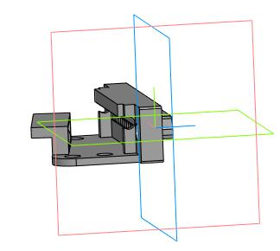
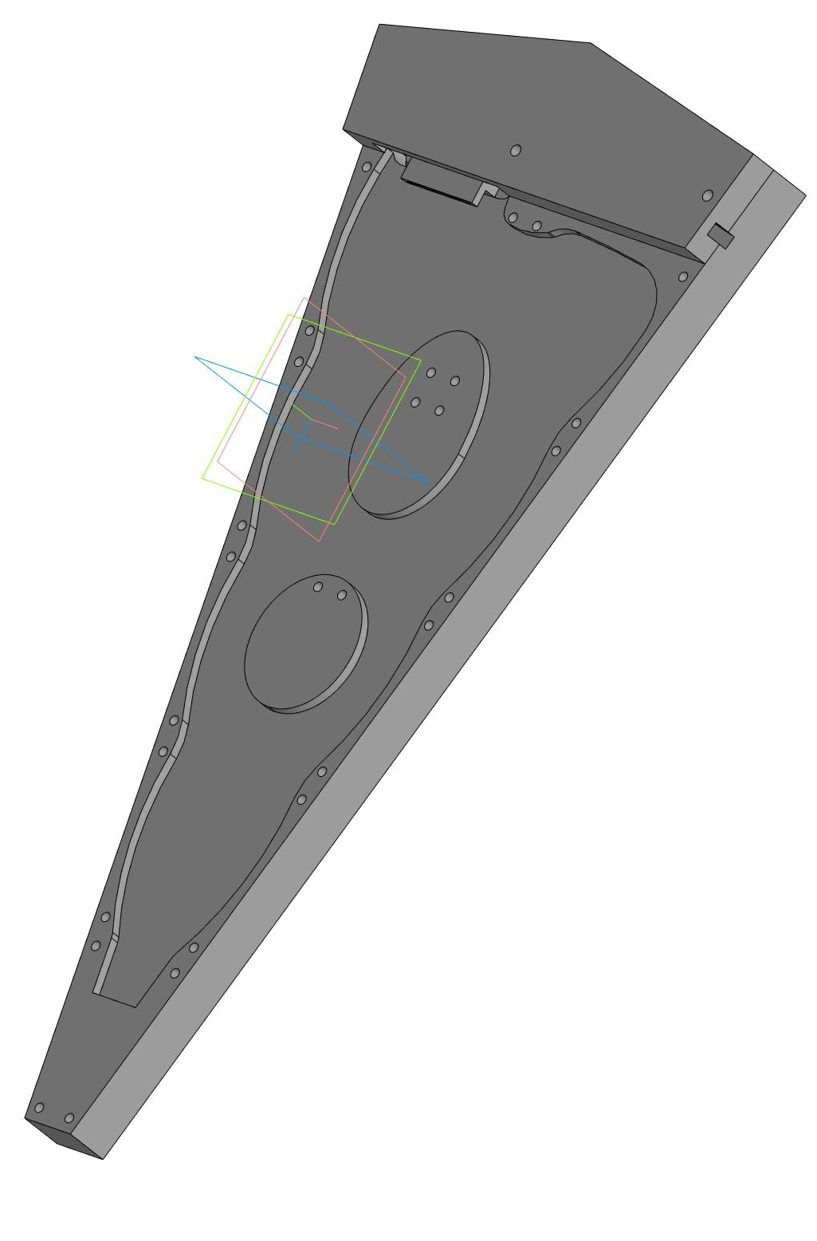
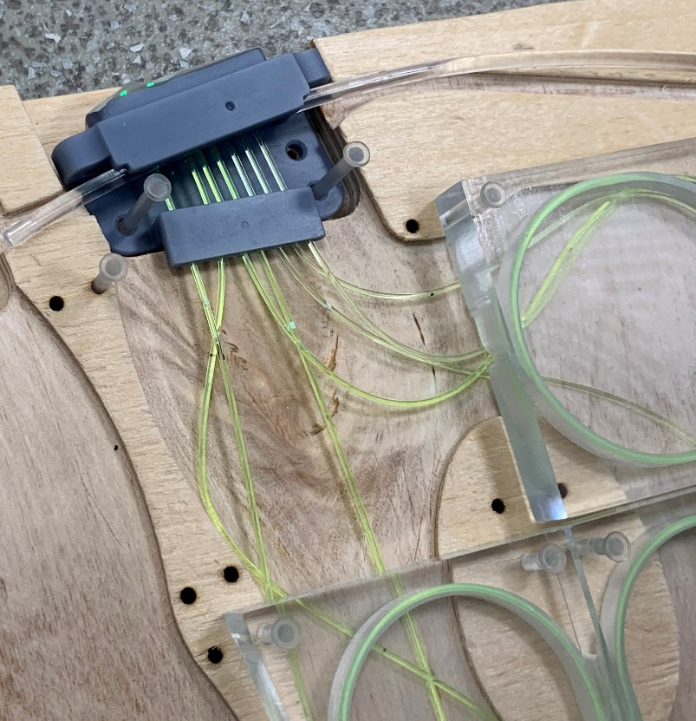
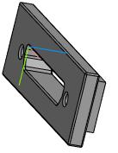
BBC assembling part
The sandwich backplate grooves for BBC
Grooved wood backplate
V.4.4 (final)
with uniform illumination (SGF)
kind of light-shielding tape (?)
9

Slide 10
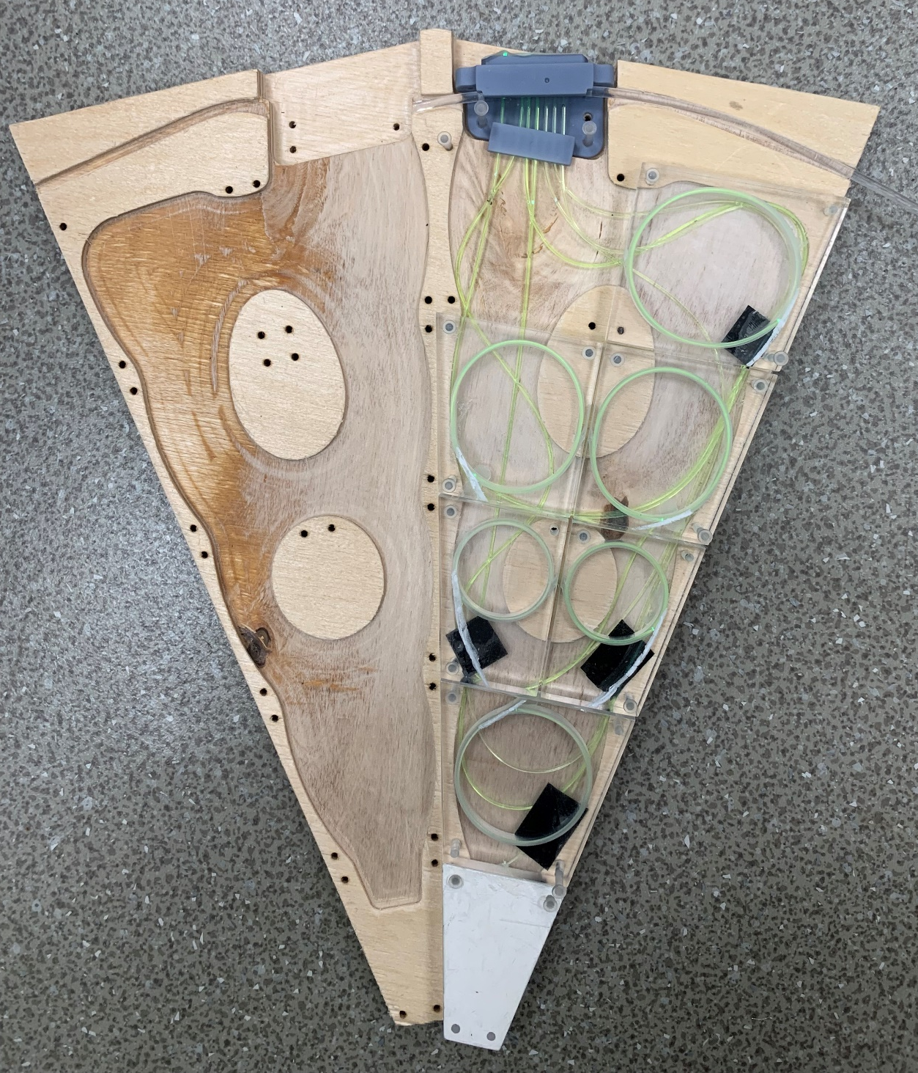
BBC assembling part
The sandwich backplate grooves for BBC
problem with tiles of neighboring sectors
10

Slide 11
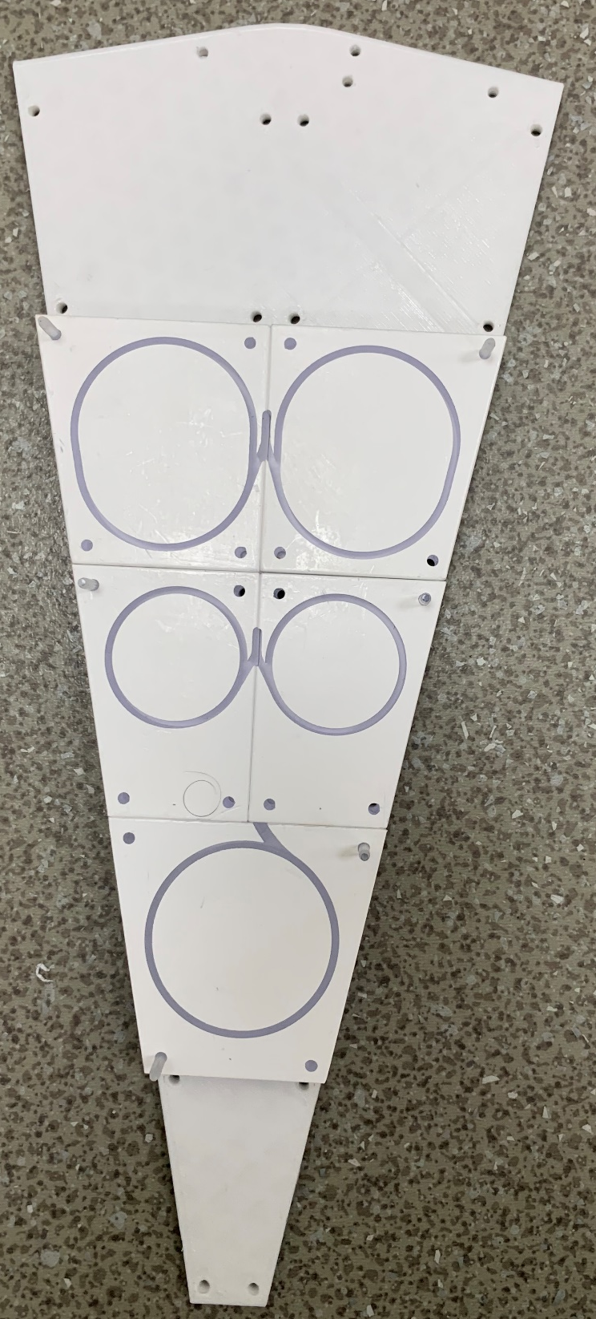
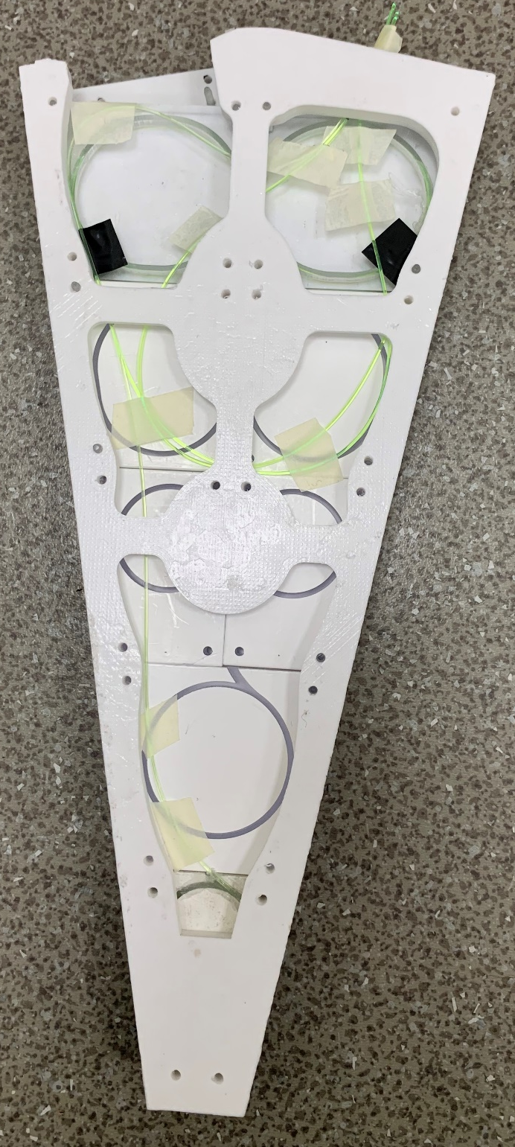
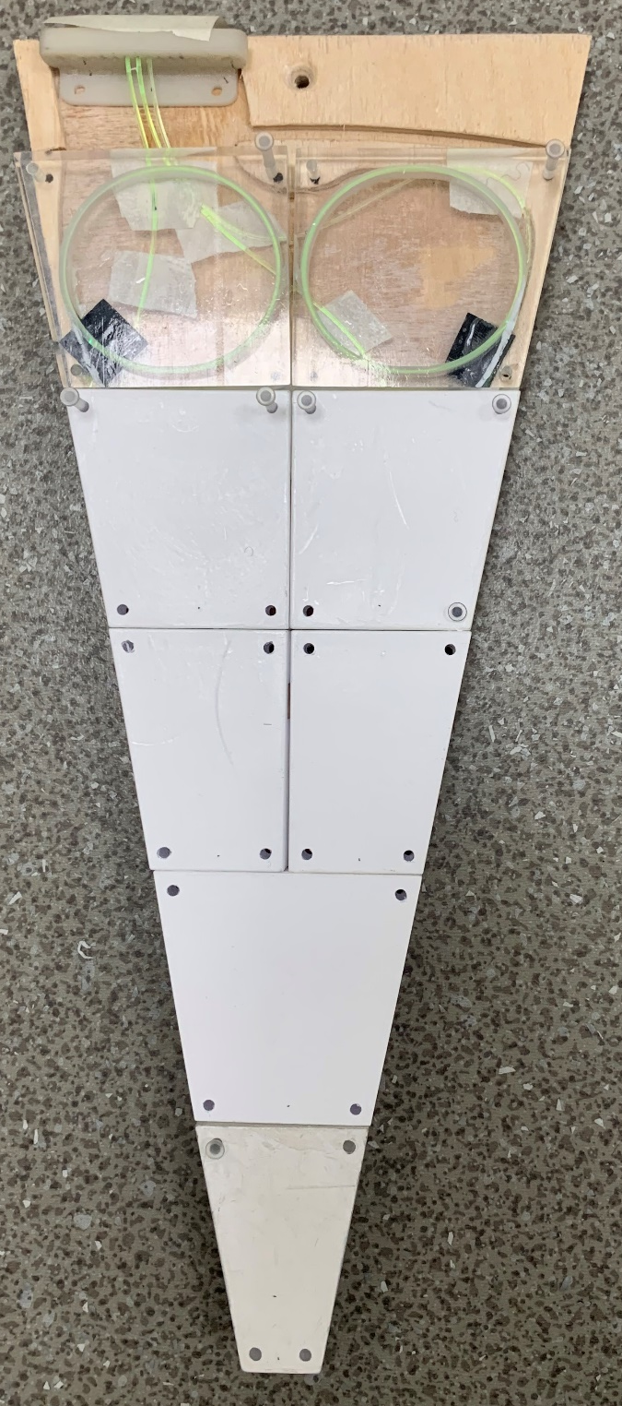
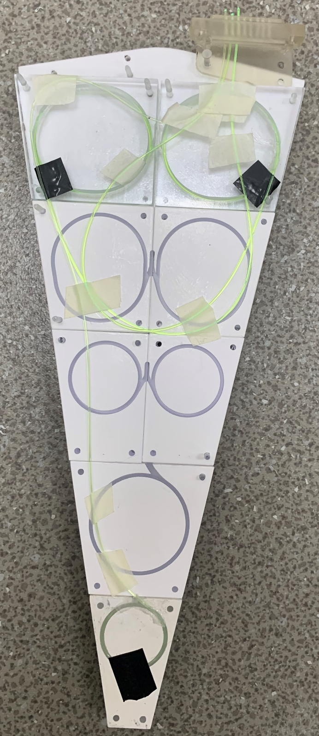
BBC assembling part
The mechanism of transported
https://1drv.ms/f/c/472043d3e6891bfc/ElejW62pvfVNpLCiogbmTfEBrmcCOR8yEwmVpFafLmUUkA?e=07G2Mb
shared models & etc.
11

Slide 12
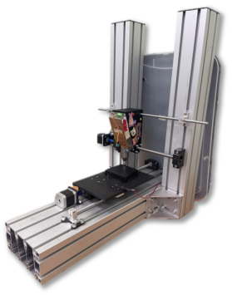
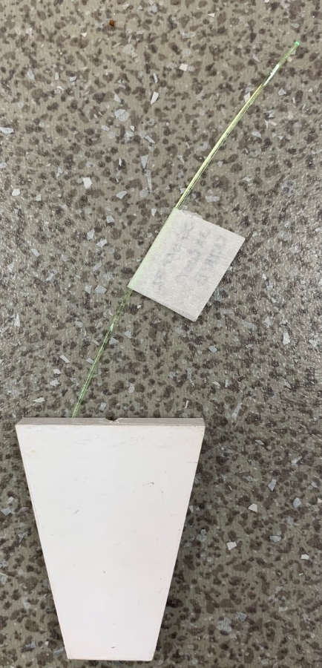
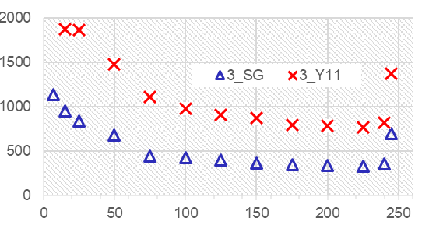
R&D
Mechanisms of verification
Method. Full-map (scintillator homogeneity, I) or coarse-grid X-ray scans (II).
Cement concentration (CKTN-E):
2.5/100 vs 3.2/100 (datasheet-recommended) → 24.6 vs 29.2 µA
(≈ 12%).
WLS turns (OK-72):
1 vs 3 → 14.5 vs 25.0 µA (≈ ×1.7).
For definition of:
defects
technological deviations (cement presence/quality, concentration; WLS turns)
The verification for the mass production process
check the uniformity of the tiles
method for estimating the efficiency of an optical and electronic path
Comparing of WLS
(3mm SGF diameter)
The method based on side glow fiber (SGF).
(WLS <-> Clear Fiber <-> SiPM <-> DT5202 unit)
Mean, channels
⌀3 mm is approved
fast method (immediately + the changes over time)+R&D
The distance from LED, cm
application for new backplate grooves design is required
WLS Kuraray (Y11) is effective.
12
Notes:
12

Slide 13
Results
Current status
The details of BBC assembling part have been described.
The mechanism of transported have been proposed.
The verification for the mass production process have been proposed. The methods are promising.
To do list
modeling of the sandwich base hardness;
detailing the mechanics
finalizing the method of express sector check (NEW test samples + test of the upgraded optical cable and transmission box);
start the mass production process
13
Notes:
13

Slide 14
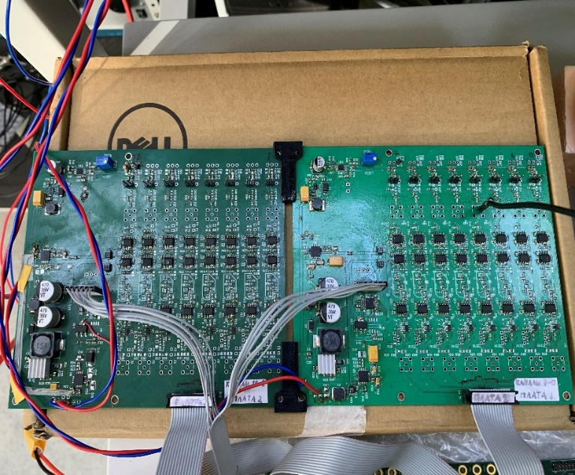
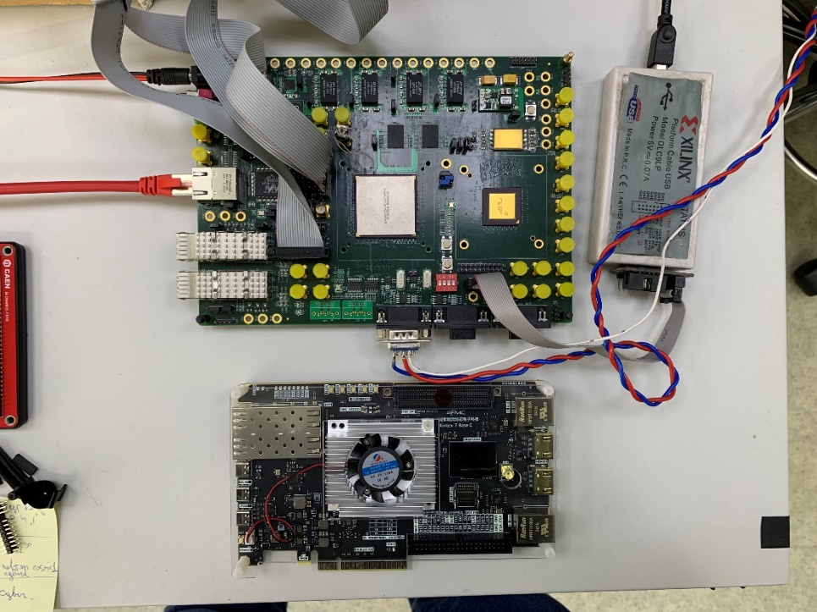
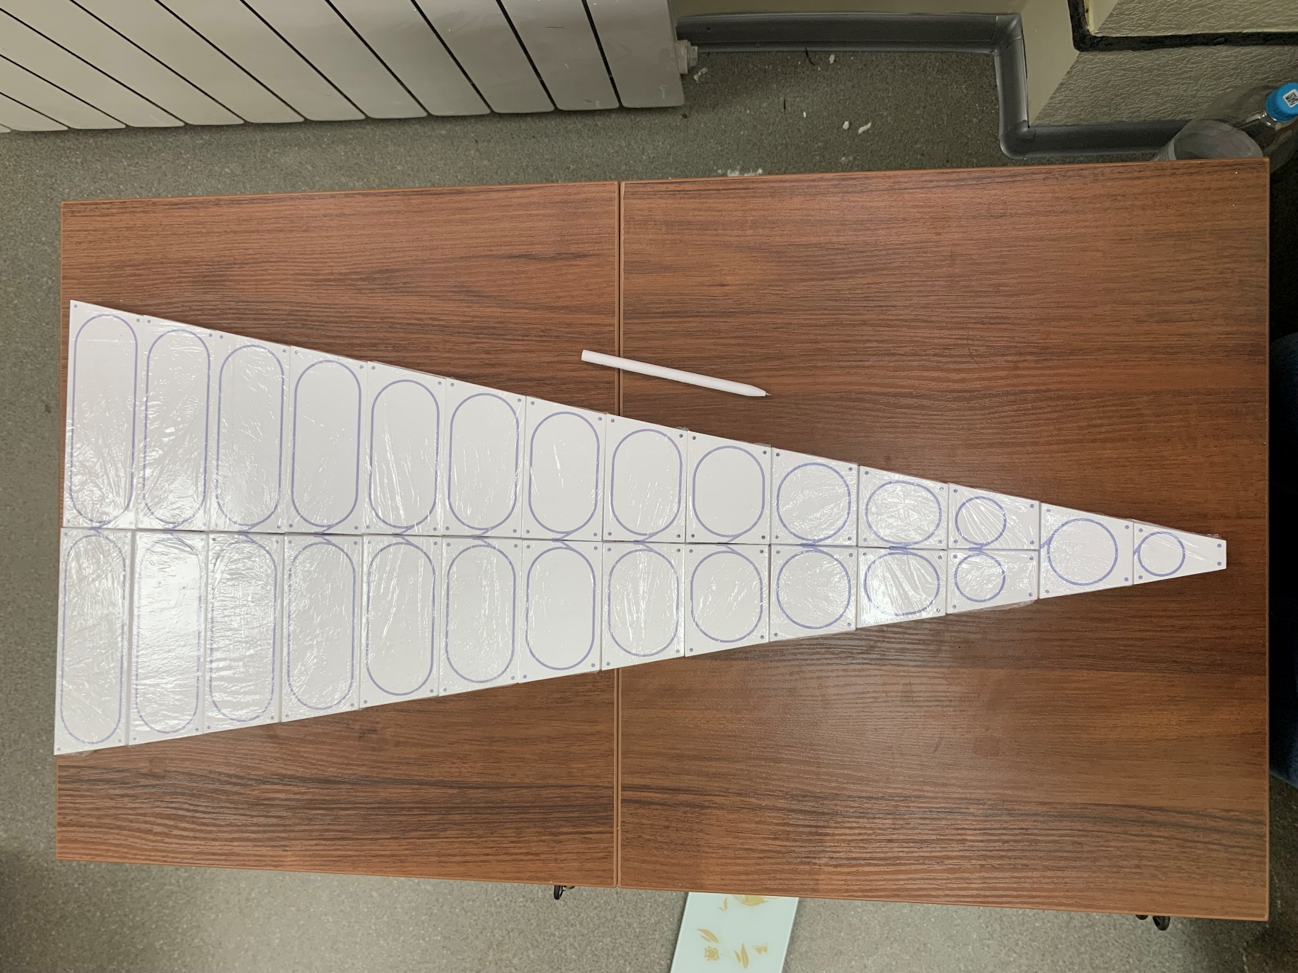
SPD Phase1
Two full-size BBC sectors production
BBC Sector (1/16 of wheel) design
26 tiles
Analog part versions
XILINX VIRTEX-5 FPGA (current)
V.1
V.2
785.7
KINTEX-7 FPGA (new)
The version of FEE that uses KINTEX-7 FPGA and new analog part is under active development.
1/16 of reduced
prototype wheel
14

Slide 15
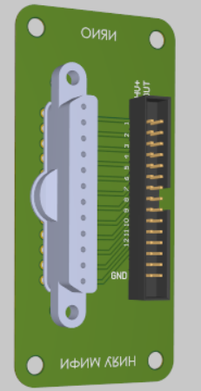
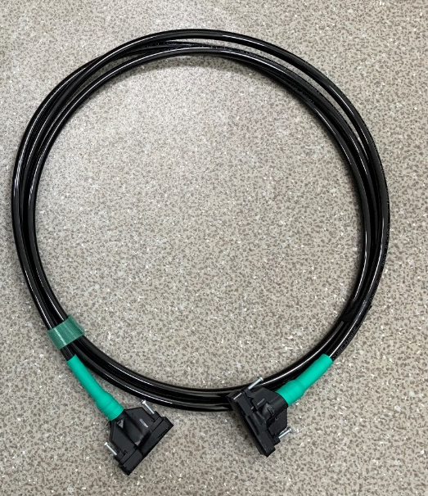
Schedule of works
~ 5-7 months delay
~ 5-7 months delay
full-size BBC sectors
Not JINR
15
Notes:
15

Slide 16
Thank you for the attention!

Slide 17
Backup

Slide 18
Introduction
Outline
Introduction
BBC assembling part
Hardware
R&D tests
Results (current status)
SPD Phase0 plans
Simulation (Phase0)
SPD Phase1 plans
18

Slide 19
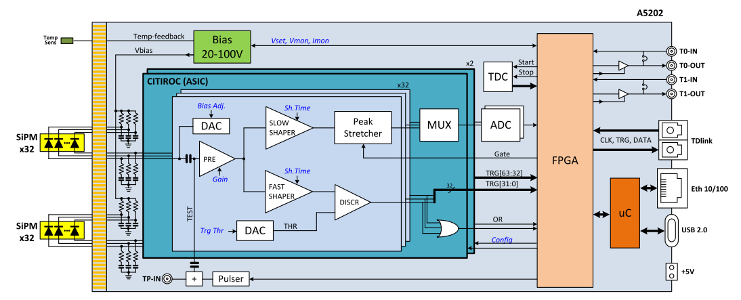
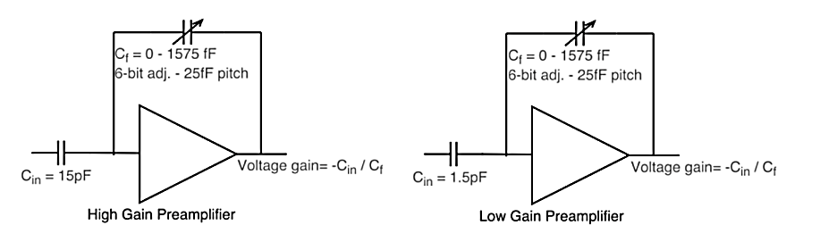
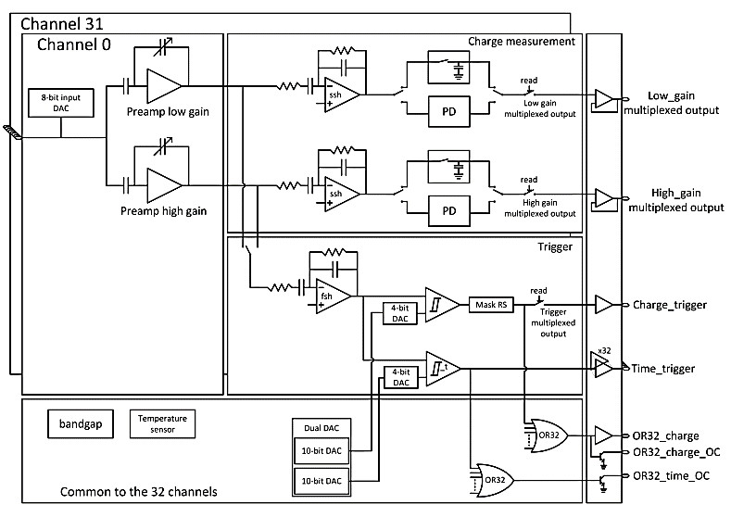
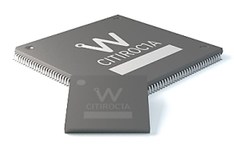
Simplified block diagram of the DT5202 FERS‐5200 unit
Citiroc‐1A block scheme
Each channel has low (LG) and high (HG) gain preamplifiers providing a wide dynamic range.
Triggers of consecutive channels are sent to an AND logic operator (e.g. CH0&CH1, CH2&CH3, etc.). The 32 outputs are then sent to an OR logic operator.
Schematic view of the LED

Slide 20
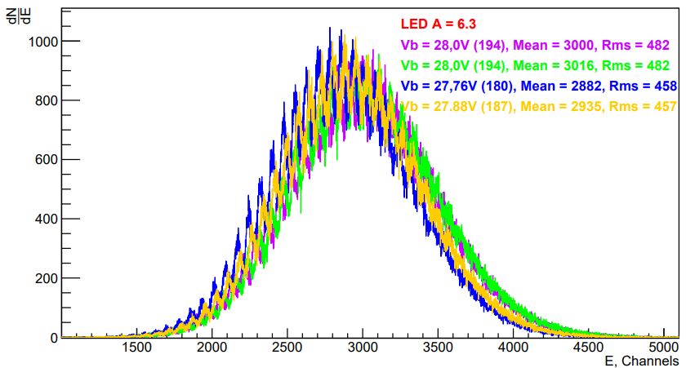
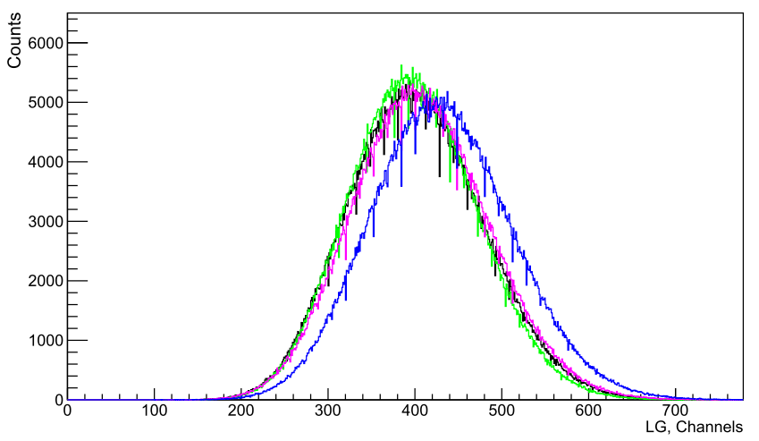
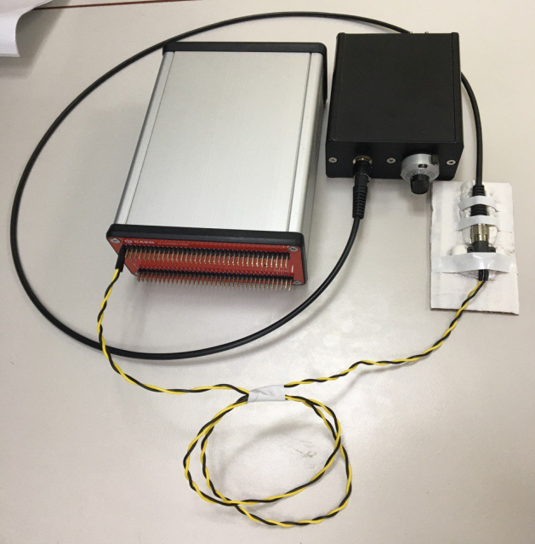
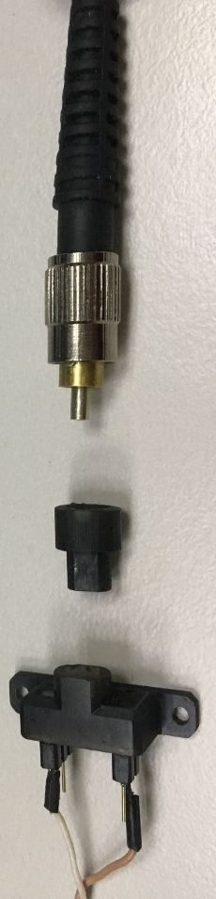
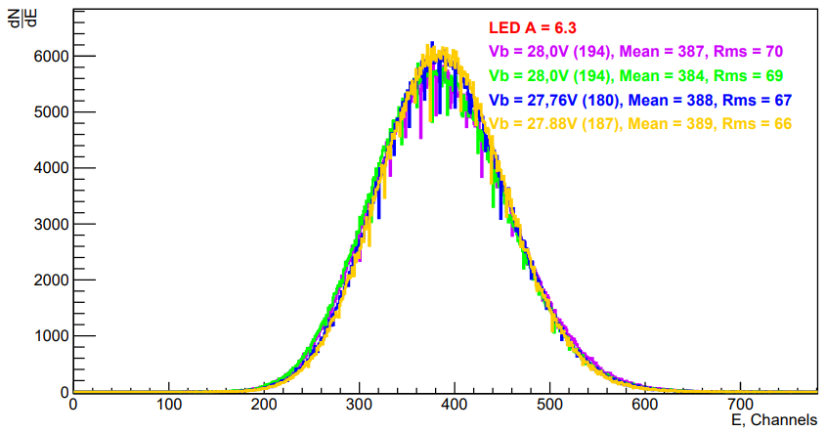
The hardware of BBC tests part
Calibration method (Led source)
DT5202 with CAEN
LED Driver (SP5601)
Not calibrated
Into TDR

Slide 21
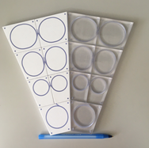
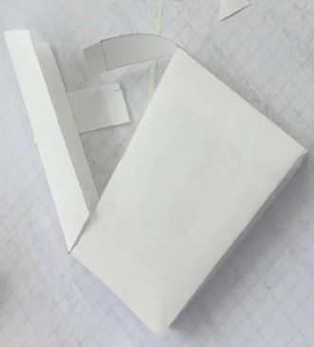




Materials selection test part
Scintillator cover
External trigger by coincidence of two scintillators with PMTs readout
The amplitude spectra of the BBC prototype scintillation tile coated with Mylar or Tyvek, as well as covered with Matted options.
BC-404
PMT Hamamatsu H10720-110
Matted
or
Mylar
or
Tyvek
SensL SiPM (27.34 V.)
S.G. (WLS)
CKTN (opt. cement)
The “FersRun” framework has been designed.
PMTs
Cosmic rays
Fited by convolution of Gauss and Landau functions “Langau”,
χ2 /NDF ~ 1.2
The option with matted tiles is more priority for mass production.
21

Slide 22



Materials selection test part
Optical cement and WLS
for
Prototype
tests
for
Phase 1
tests
CKTN
The results of tests of Kuraray WLS fiber and Saint-Gobain Crystals (SGC) WLS fiber with different types of cement are presented.
CKTN mark B paired with SGC WLS fiber are the most appropriate candidates for prototype assembly tests.
CKTN mark B paired with Kuraray WLS fiber are the most appropriate candidates for future testbeam.
Light collection peak position on dependence of A component amount for optical cement.
Datasheet ratio will be used and closely monitored for mass production.
22

Slide 23


Prototype assembling test
Amplitude spectra of two sectors
1-st sector prototype
2-nd sector prototype
There are 2 specific channels, but the debugging process of mass production continues.
The stable tiles were taken for following tests
23

Slide 24




Prototype assembling test
The 1-st step for working with the timing mode
LG correlations
ToT correlations
LG vs ToT (channel №3)
ToT linearity.
CAEN [3]
Correlation of energy deposition for 2 channels, as well as the time information for these channels.
The calibration of the charge scale is required
24

Slide 25



The hardware for BBC
New FEE & Readout electronic
Simplified block diagram
Front-end units
(SiPM supply, signal reading)
TDC based on FPGA (XILINX VIRTEX-5)

Slide 26







The hardware tests
The electronics test
Ch 2a
Ch 2
Ch 0a
Ch 0
Ch 1a
Ch 1
FERS
NE
V.2
Hybrid mode
“Majority (3ch) ”
Trigger logic
FERS reference channel (T_{ref})
Ch 3
NE
NE
Channels
(x3)
ToT
Tiles
ToT
Ch 2a
Ch 2
Ch 0a
Ch 0
T_{ref}
Ch 1a
Ch 1

Slide 27

The hardware tests
Results
FPGA XILINX VIRTEX-5
LG vs ToT (channel 1)
V.1
V.2
TOT
LG, channels
Analog part versions
(next V.3)
FPGA KINTEX-7
NE
Ch 2
Ch 2
Improvement the "FersRun" framework for the correlations between different electronic channels
Further research
NE improvements
Ch 0
Ch 0
Ch 1
Ch 1
are required
Ch 0
Ch 0

Slide 28


R&D tests
The optical cable prototype (clear fiber)
SensL 3x3 mm²
(MicroFC-30035)
to DT5202
LED
Schematic view of the LED
5 meters
tile
Kuraray (clear fiber) cable prototype with 8 channels connector
Light loss at 1 meter ~7%
28

Slide 29



SPD Phase0
Application of DT5215 concentrator
SPD is planned to operate without T0 (start) so we need to work with free-streaming mode. (first step - Hybrid mode for DT5202)
Tests with SiPM’s array
Generator (signal)
LED
SiPM's array
SiPM
Inner generator (Tref)
FERS
Data
Hits acquisition ranges
Tref may be provided by
- outer generator (T0)
- inner generator (PTRG)
Tref period
Full range!
Continuous data reading can be made only with fine-tuning of board parameters.
Tref delay
upgrade f/w and tests are required
Tref window
29

Slide 30




Application of DT5215 concentrator
Tests with different unit-concentrator links configurations
DT5215 (FW v. 6.0 )
Generator (signal)
link[0]-unit[0,1,2]
Inner generator (Tref)
FERS
Data
LINKS (1 & 0)
Concentrator to boards opto-fiber connection
link[0]-unit[0]
link[1]-unit[1]
link[2]-unit[2]

Slide 31



SPD Phase0
ZDC activities
DT5202 with 2X31 SiPM PLATES
The first stage of ZDC is – 6 planes + 1 veto with trapezoid geometry
was tested
Working on the beam BBC & ZDC (?)
“FersRun” framework
DT5215 concentrator

Slide 32




Prototype assembling part
Mass production issues
Preparation of infrastructure for mass production (obtaining equipment, equipping rooms, etc.)
Development of methods of mass production (tools + algorithm)
Tiles and sectors: gluing frames
The algorithm for polishing the connector has been proposed. The further developments are required:
mechanism working group BBC@MEPhI
tool working group BBC@JINR
32

