Slide 1

FERS-DT5202 tests
Solonbekov M.V.

Slide 2
Introductory plan
Objective:
To determine the most probable number of photons in MIPs.
Tasks:
1) Determining the position of the pedestal.
2) Obtaining conversion graphs for LG, HG, TOT, and TOA.
3) Determining the offset voltage and threshold for minimum noise.
4) Collecting statistics on cosmic radiation and processing data.
2

Slide 3
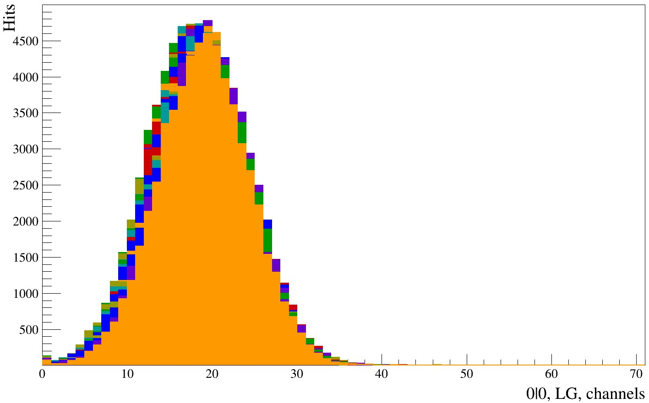
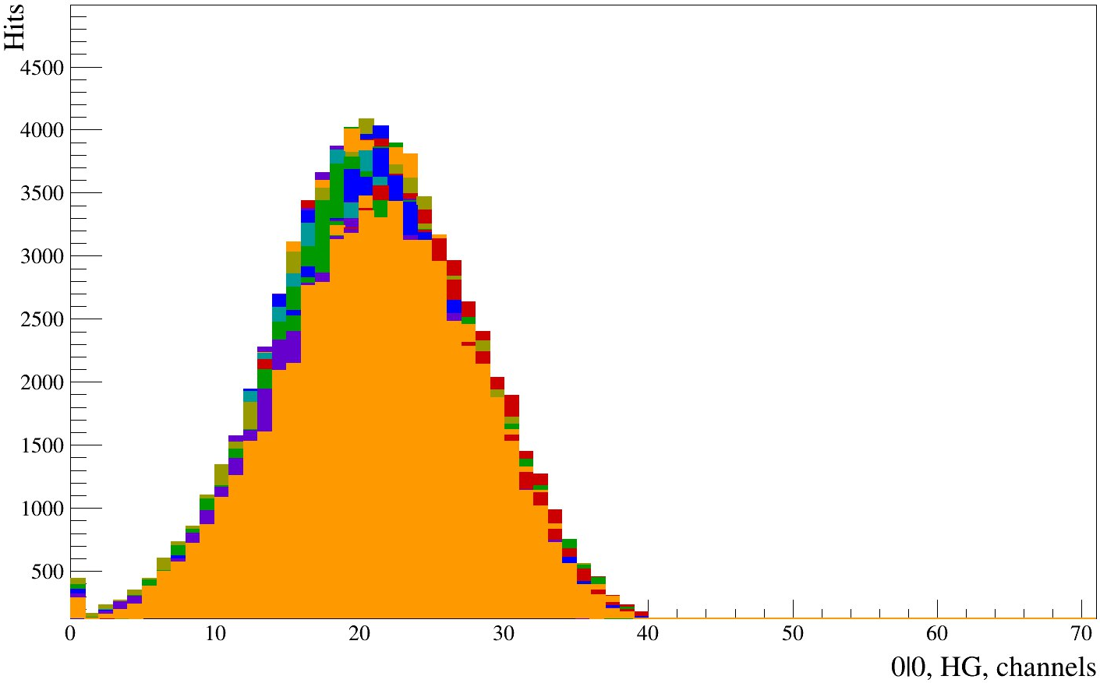
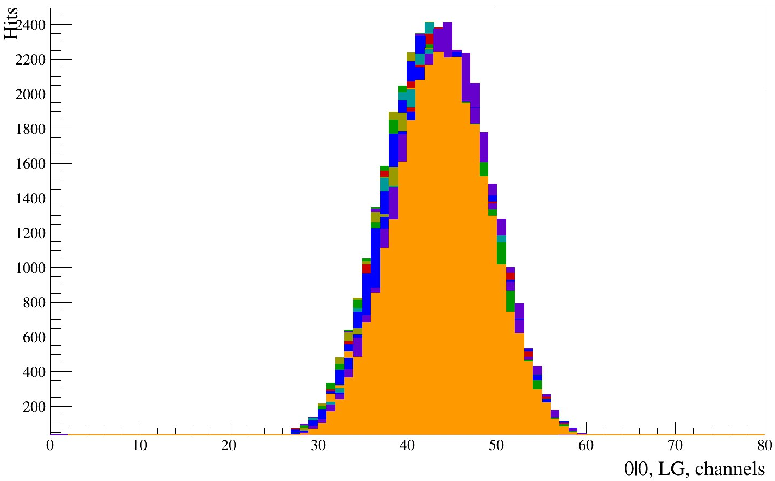
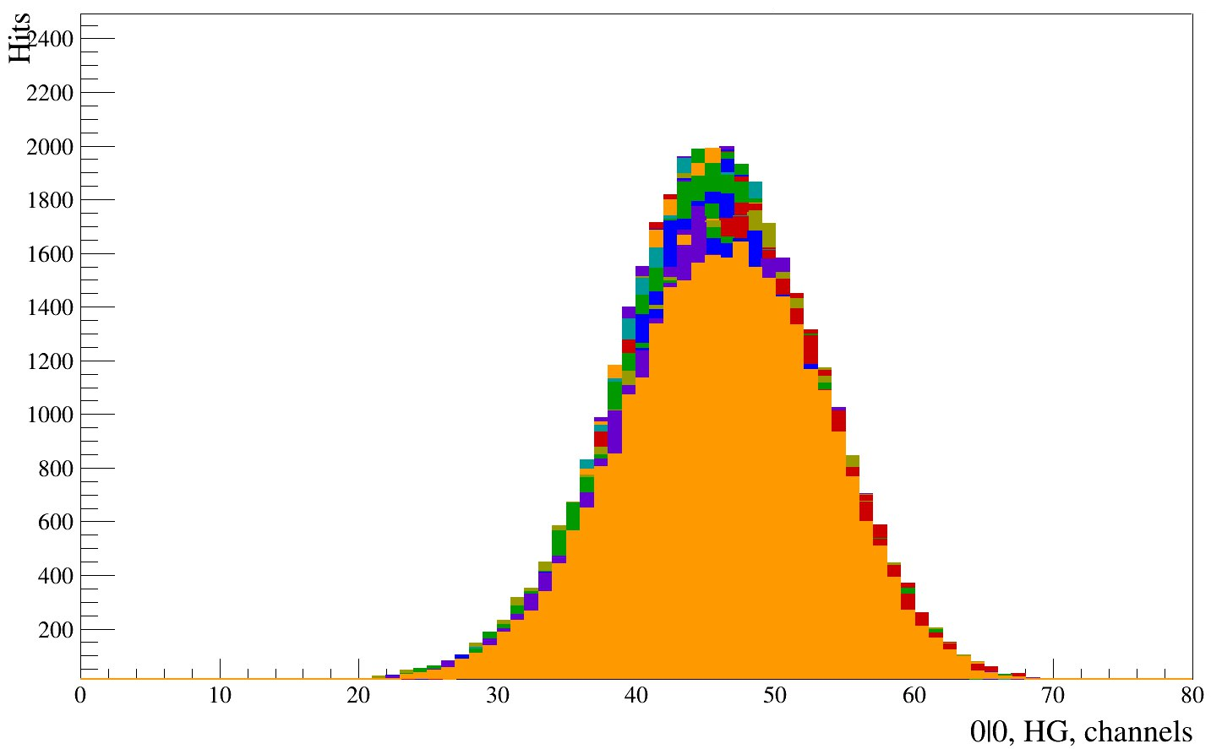
Test for the position of the peak depending on the "Pedestal position"
LG
HG
The test was conducted from "Test Pulse Source", with an HG and LG gain of 50 each.
The position of the peaks was found to change depending on the "Pedestal Position" parameter.
50
Pedestal position
100
3

Slide 4
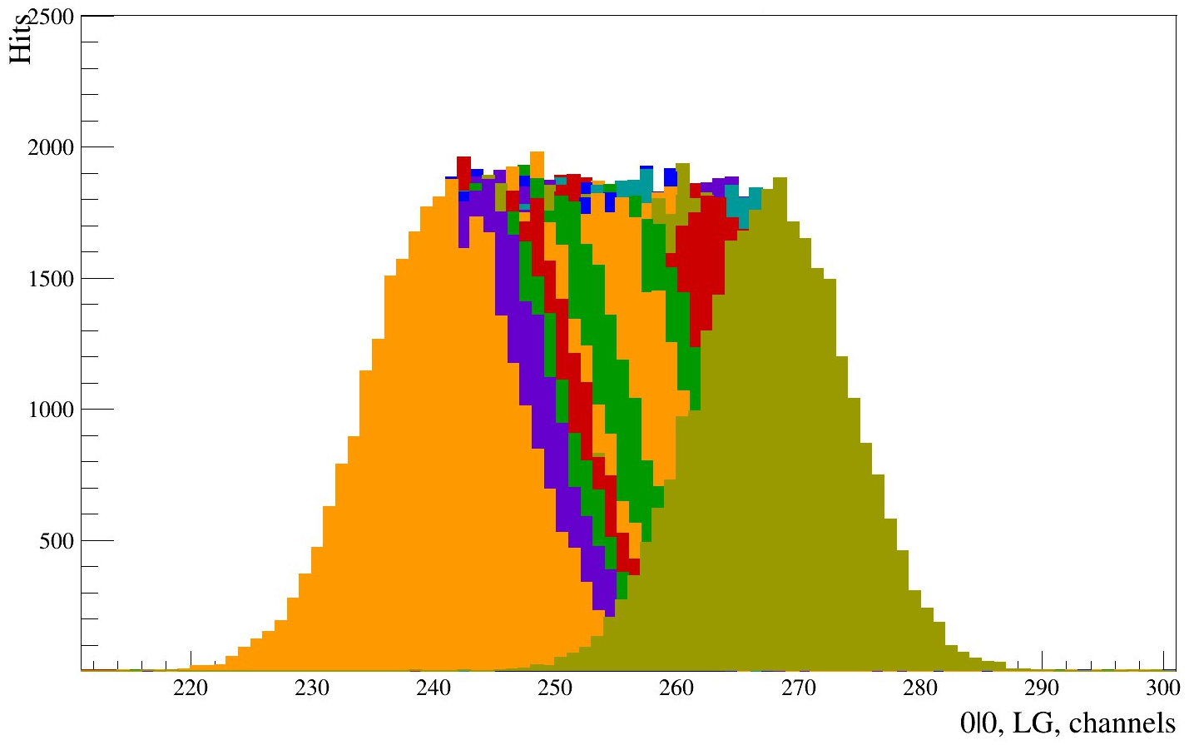
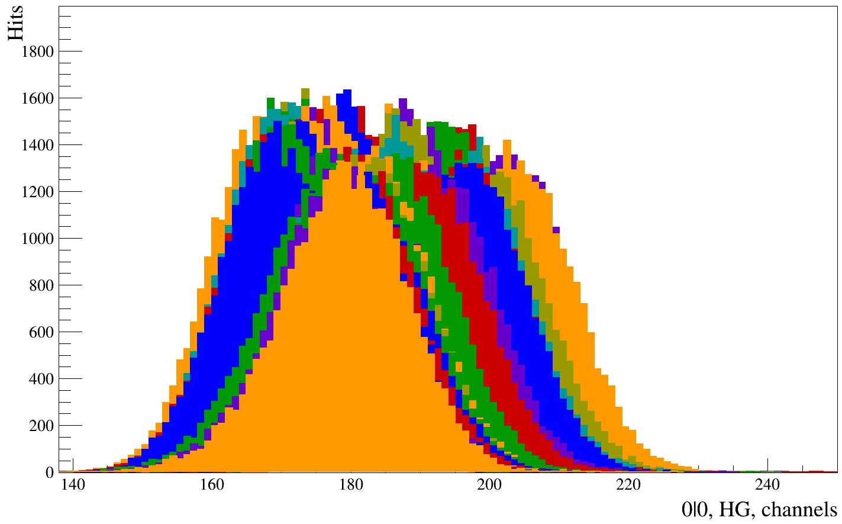
Test for the position of the peak depending on the parameters "HG Gain" and "LG Gain"
LG
HG
LG
HG
The test was conducted from "Test Pulse Source", with a pedestal position of 50.
50
50
55
The calibration is broken! The calibration depends on the configuration parameters at the time of calibration.
55
Gain
4

Slide 5
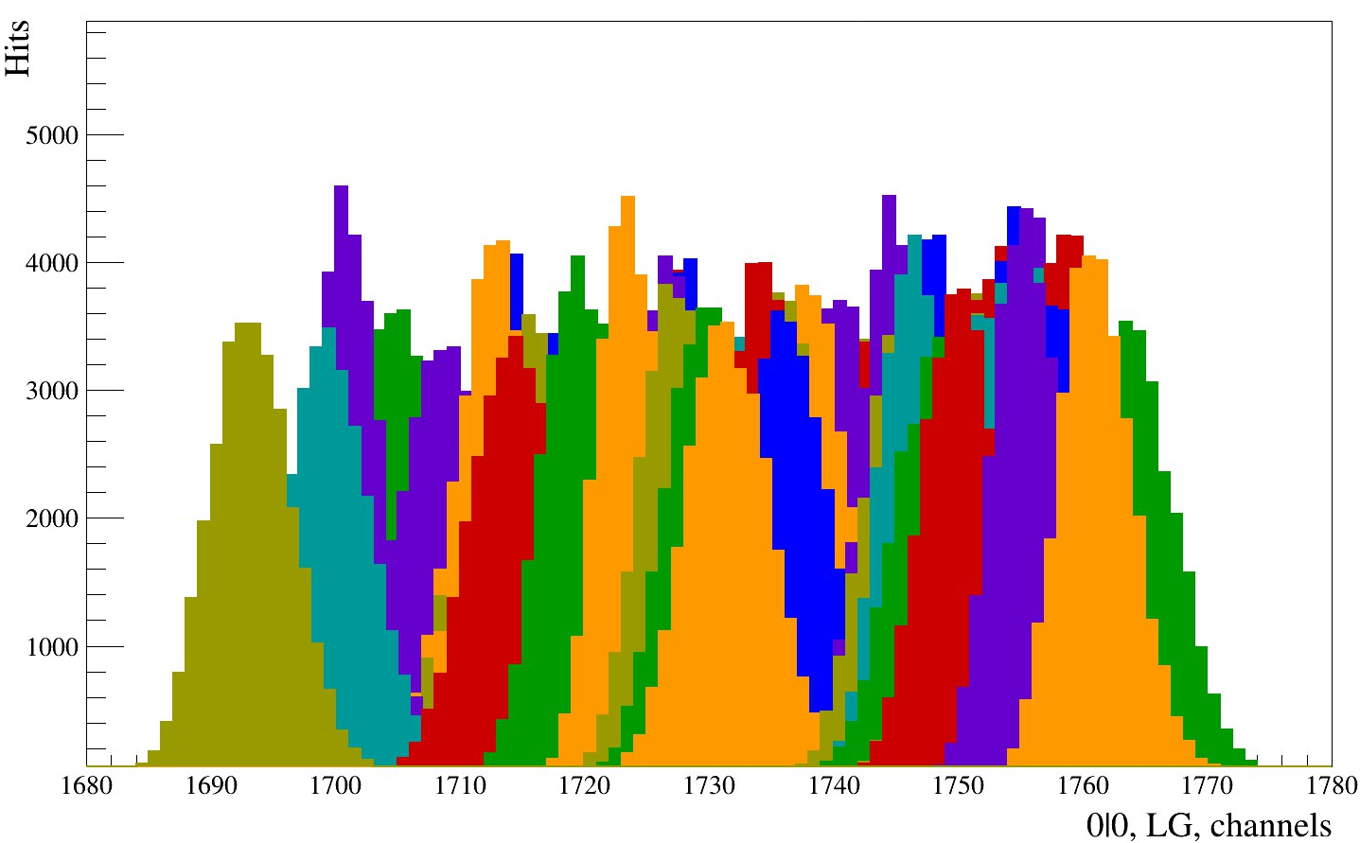
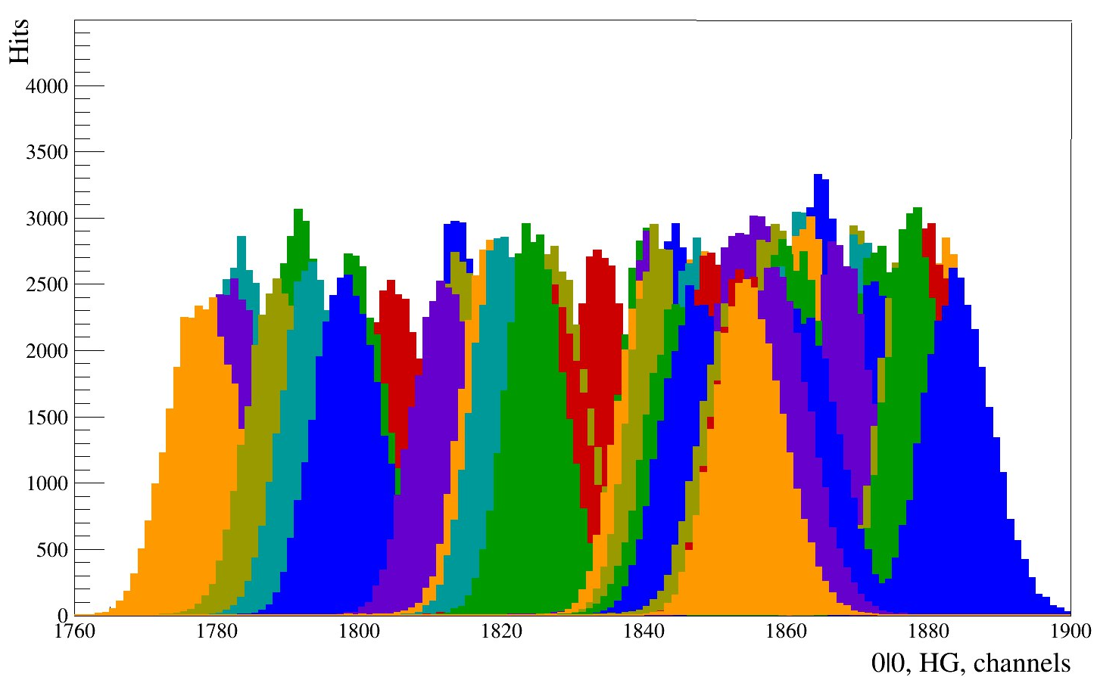
Test for pedestal position depending on the "Pedestal Position" parameter
LG
HG
Pedestal position: 5000.
During the test, the inputs and the internal generator are disabled. Pedestals have been detected.
5

Slide 6
Tests from the generator through the splitter
Generator
Splitter
FERS-DT5202
Laptop
Generator Parameters:
frequency: 100 Hz
Voltage range: 0.06 - 1.25V
DT5202 Parameters:
Bunch Trigger Source: T0-IN
TD Coarse Threshold: 220
HG Gain: 50
LG Gain: 50
Pedestal: 1800
6

Slide 7
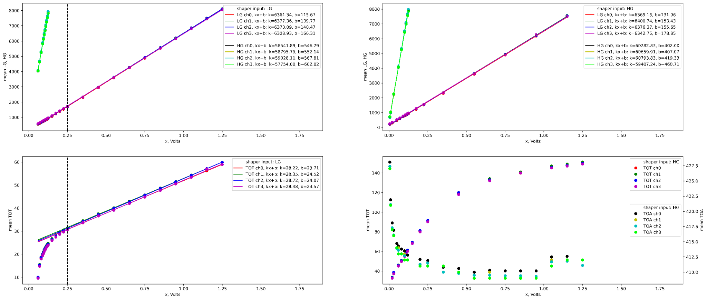

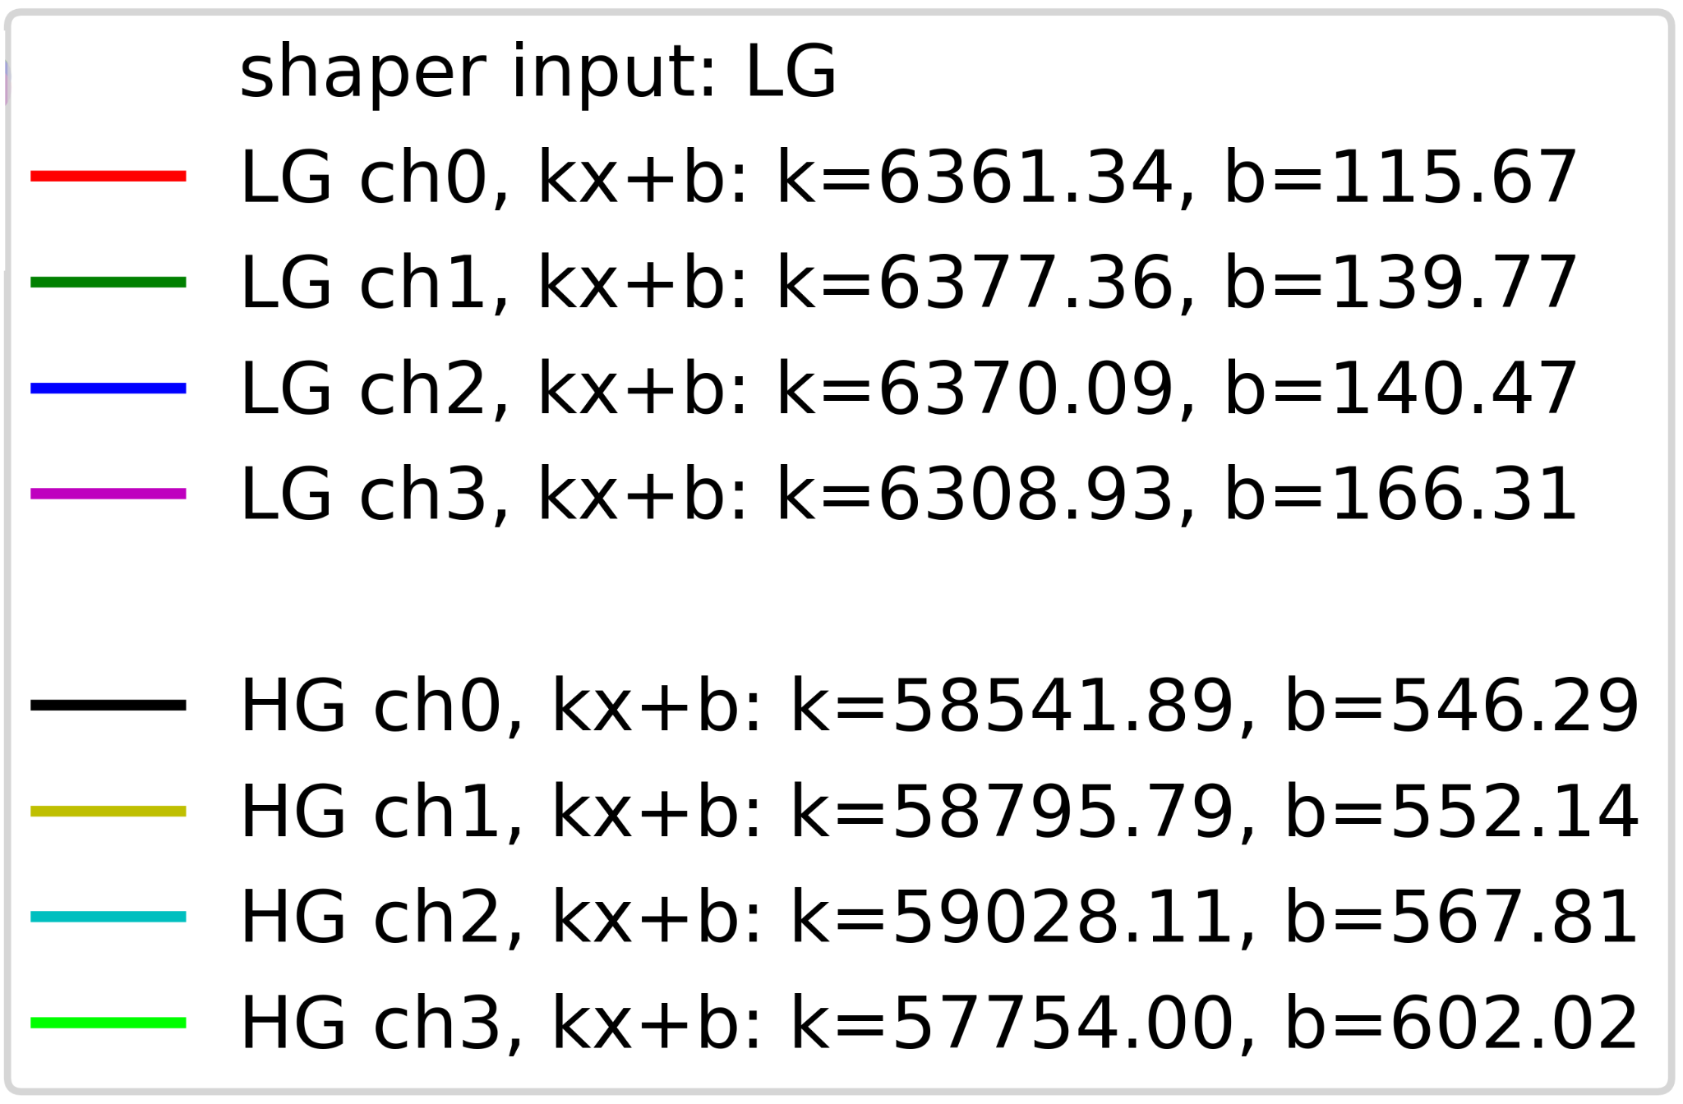
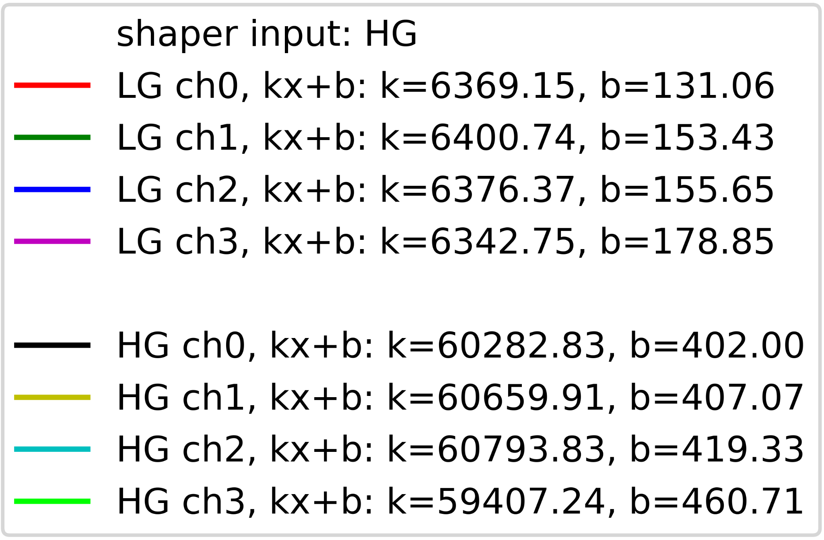

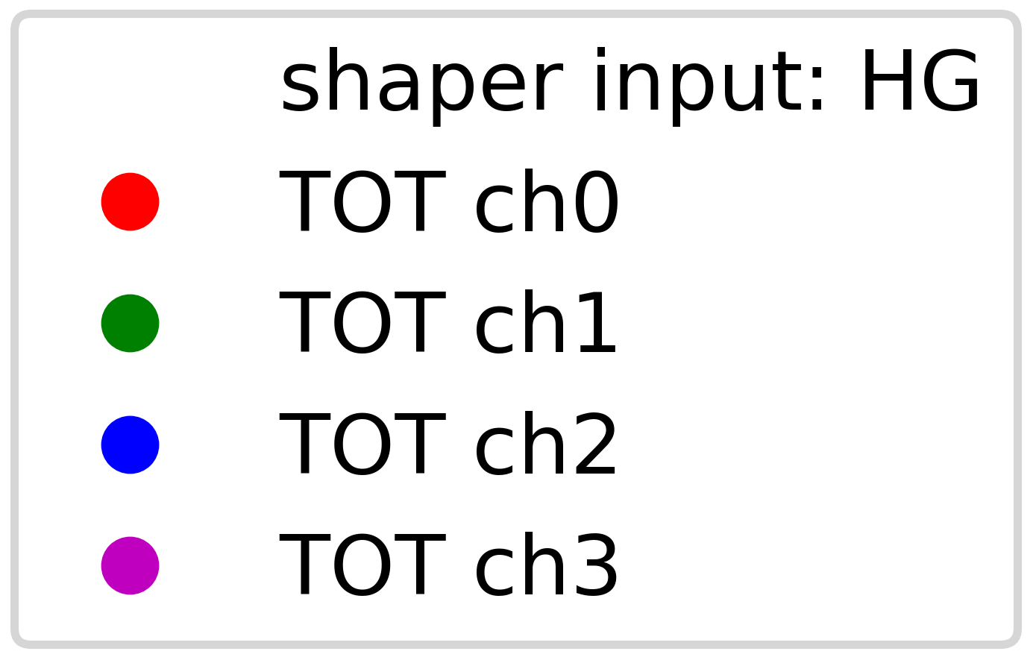
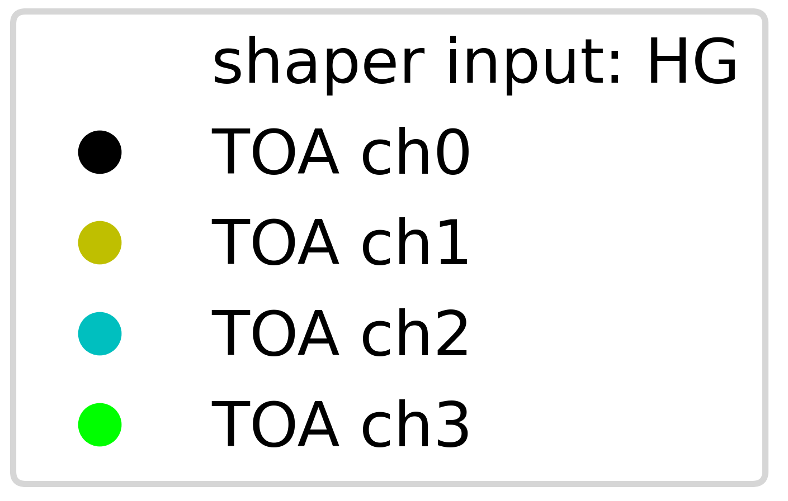
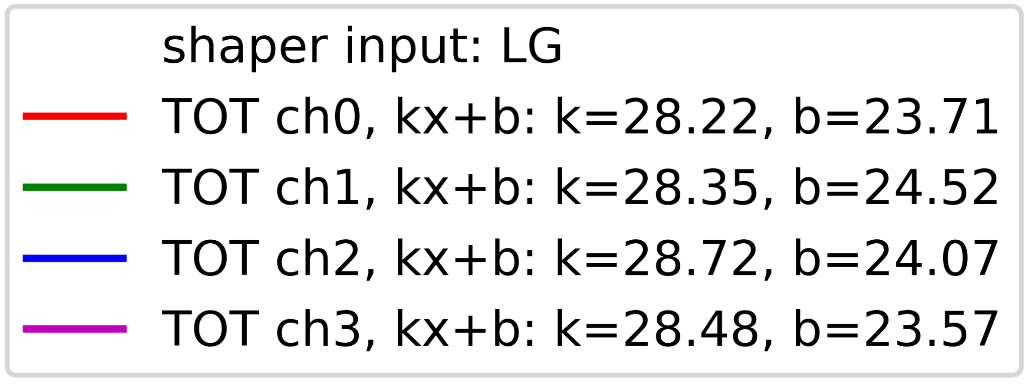
Parameter recalculation schedules
LG shaper input
HG shaper input
LG, HG
mean LG, HG
mean LG, HG
x, Volts
x, Volts
TOA, TOT
mean TOT
mean TOT
mean TOA
7
x, Volts
x, Volts

Slide 8
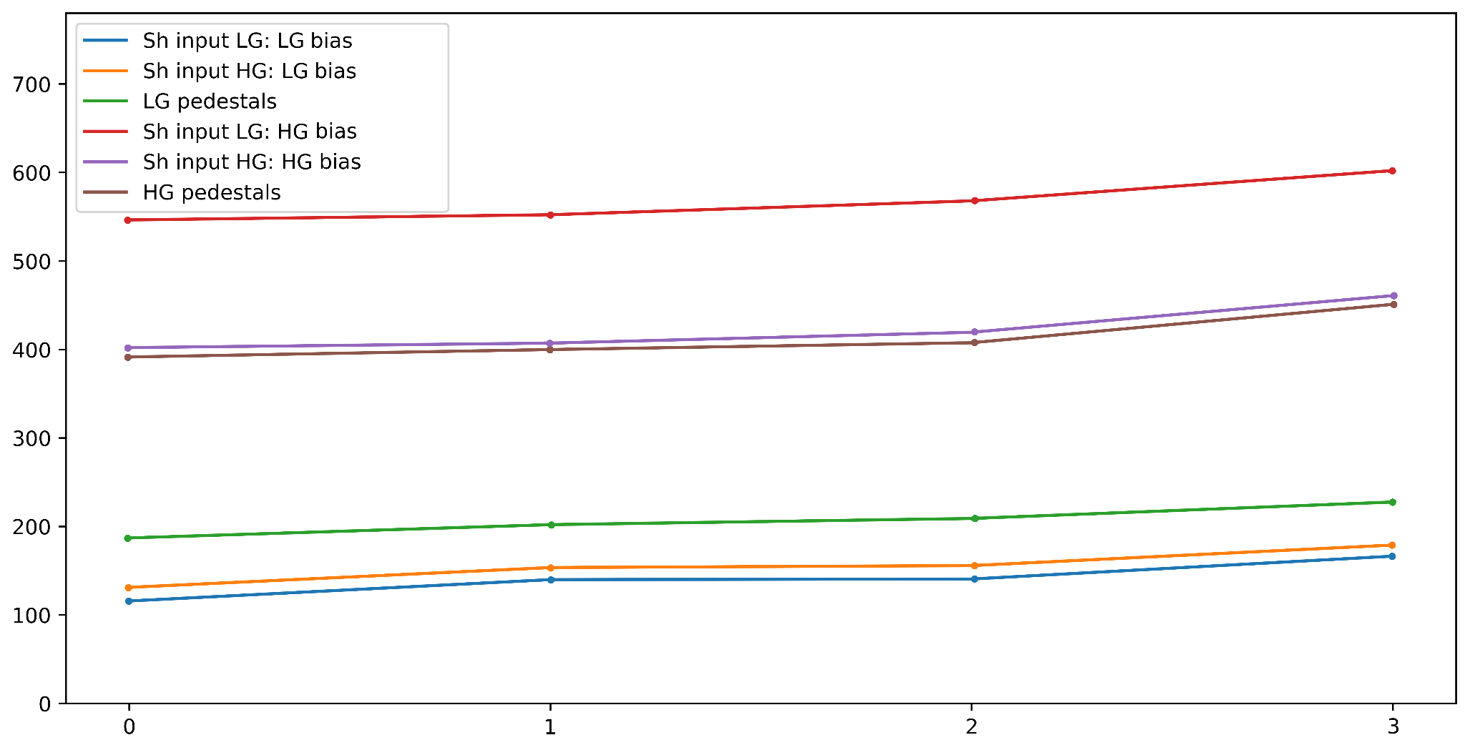
Two versions of the pedestal
channel position
Input channel number
8

Slide 9
Tests from a generator with SiPM
Generator
LED
SiPM
FERS-DT5202
DT5202 Parameters:
Bunch Trigger Source: TLOGIC
TD Coarse Threshold: 320 - 580
HV VBias 27.5 - 28.5
HG Gain: 50
LG Gain: 50
Pedestal: 1800
Fast Shaper Input: LG-PA
Laptop
DT5215
9
10

Slide 10
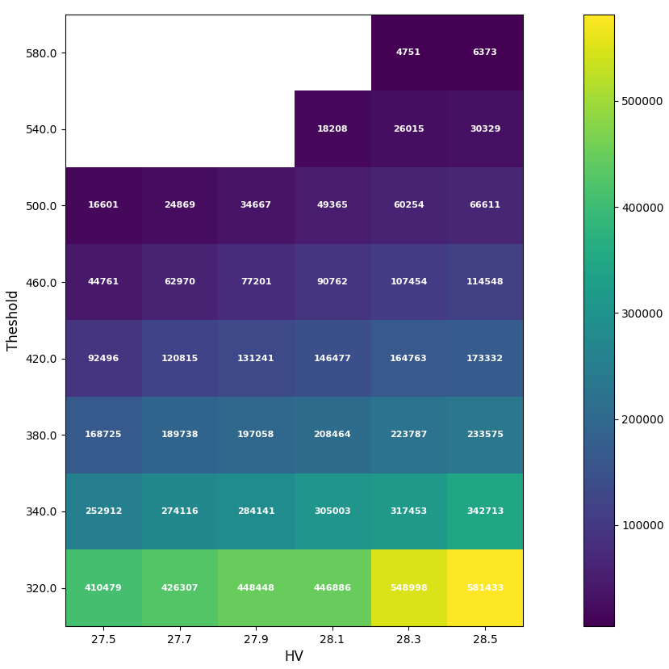
Grid of data set parameters
The generator operated at a frequency of 1 kHz for 5 minutes.
The data was collected using two variables: Voltage (HV) and threshold.
The data in the empty cells is missing due to the low statistics.
Threshold
10
HV

Slide 11
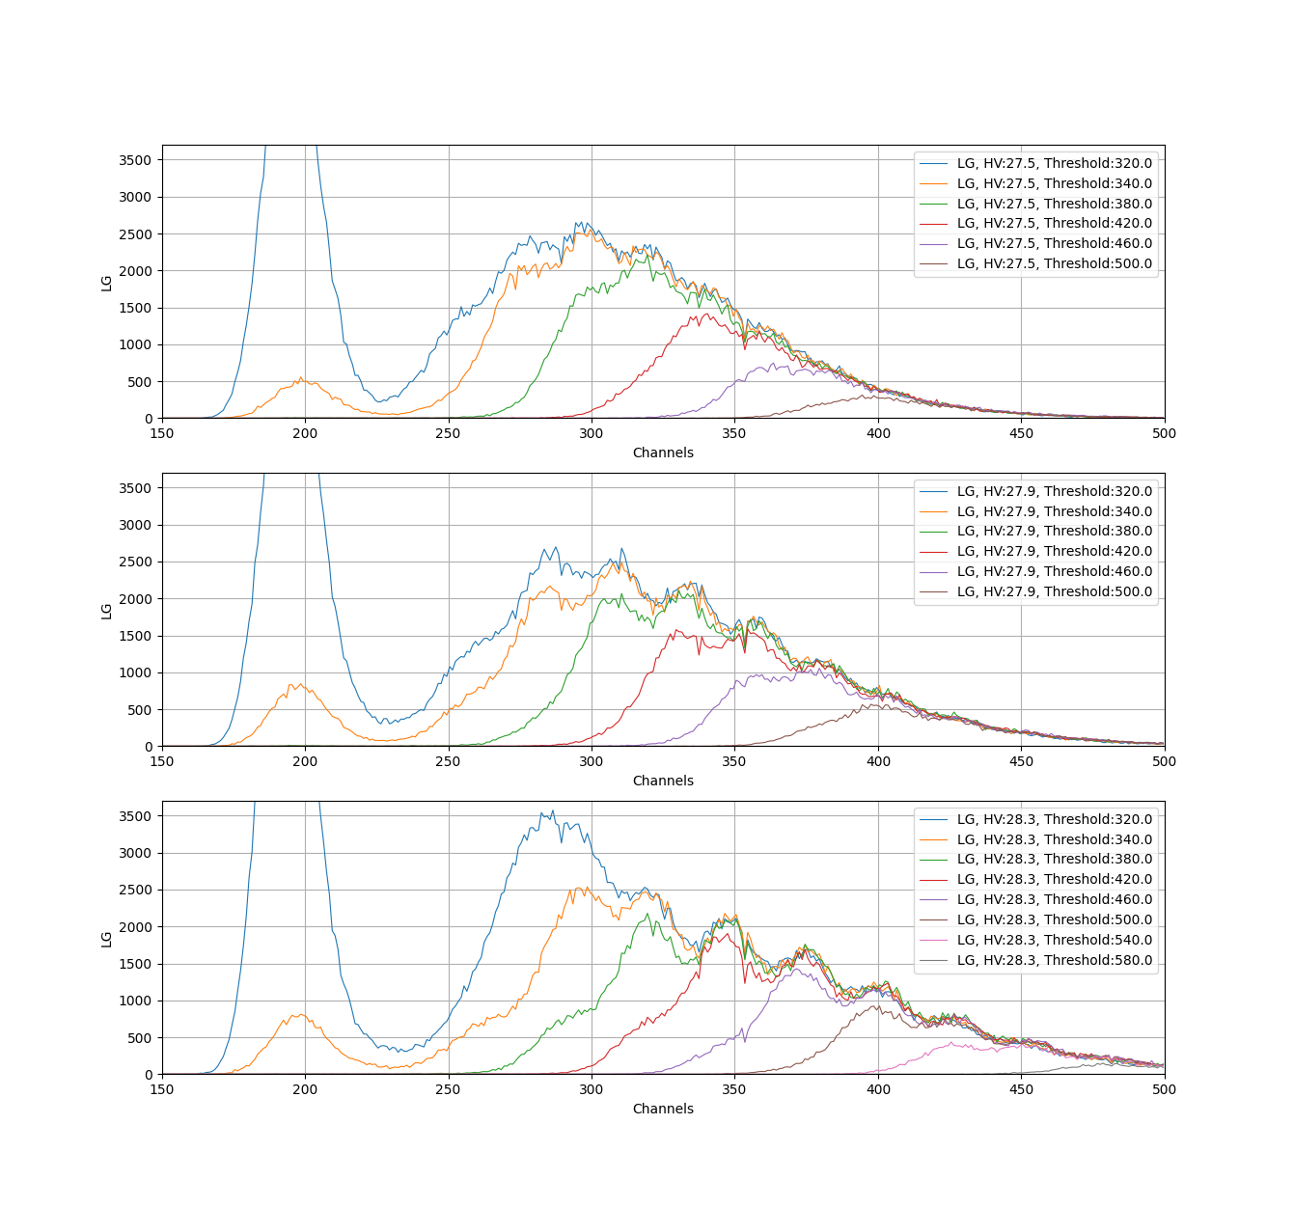
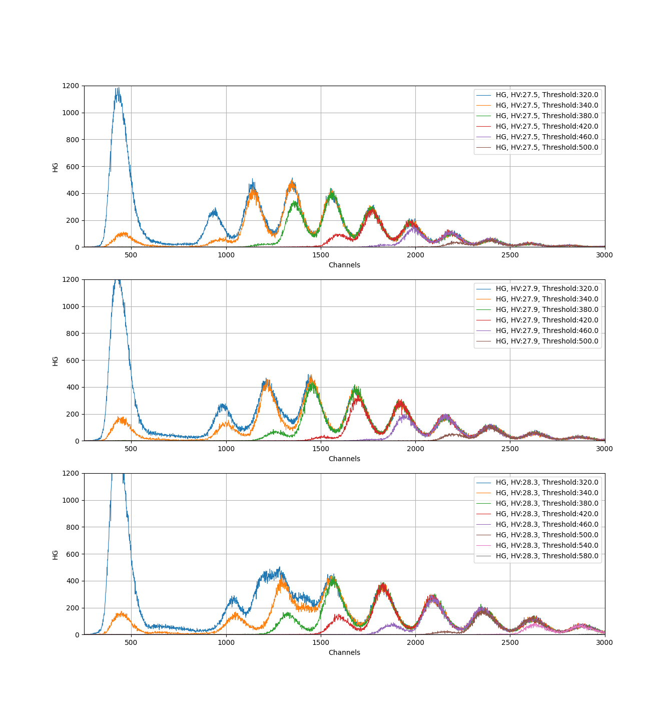
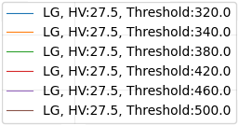
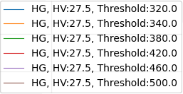
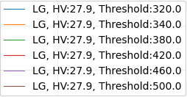
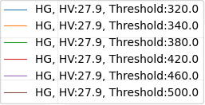
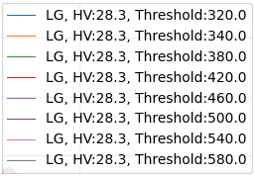
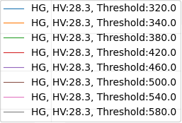
Examples of data for 27.5, 27.9, and 28.3 volts
LG
HG
LG
HG
Channels
Channels
LG
HG
Channels
Channels
LG
HG
Channels
Channels
11
1

Slide 12

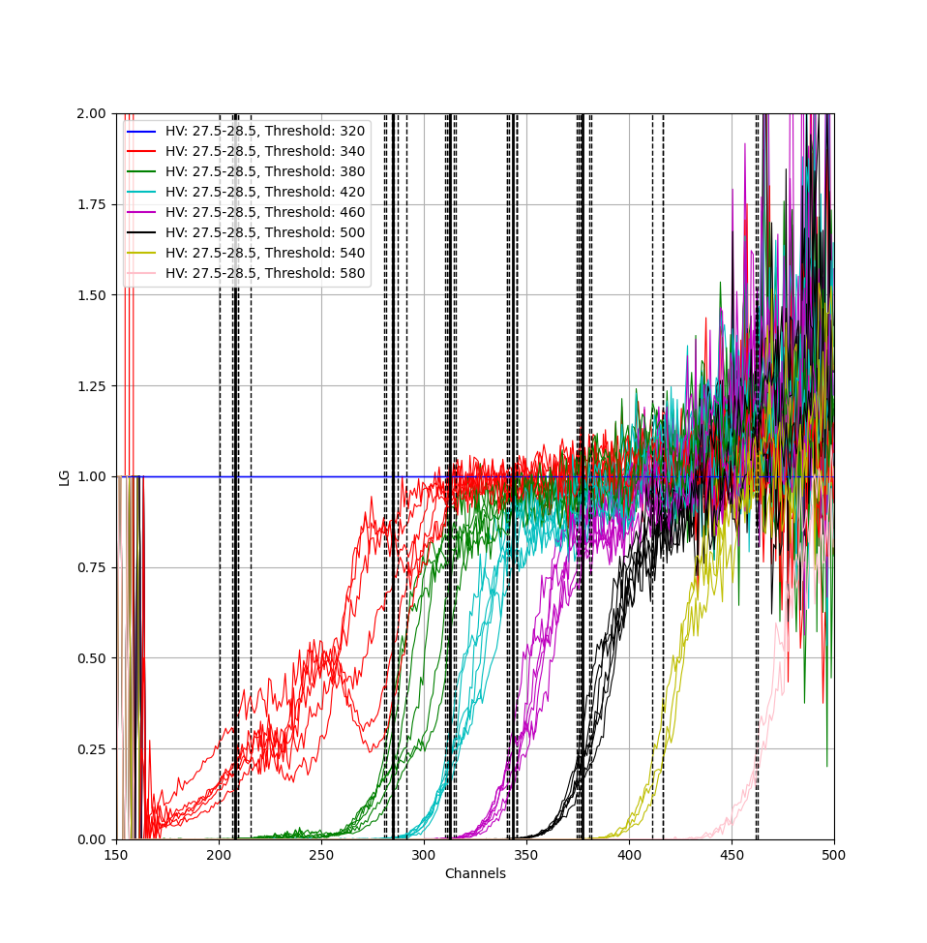
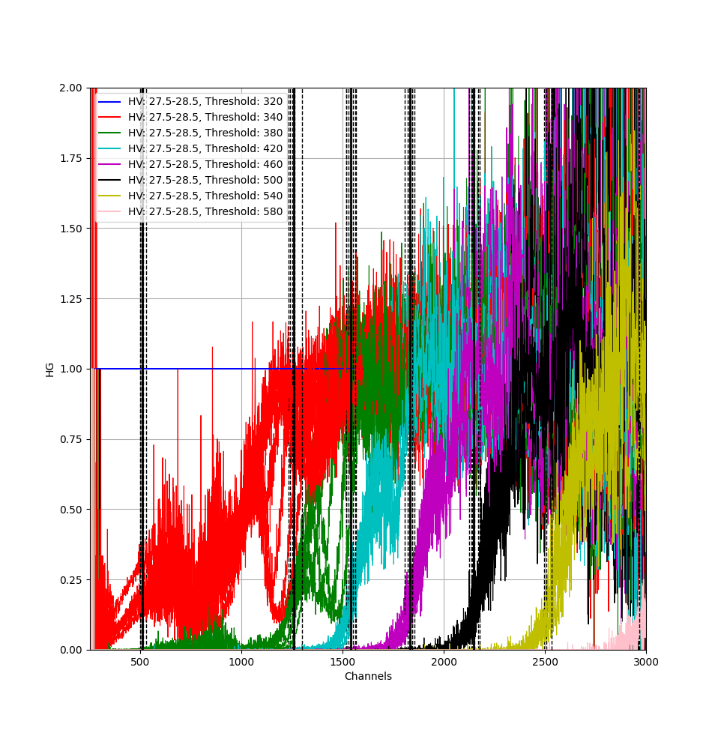
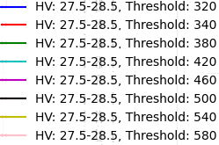
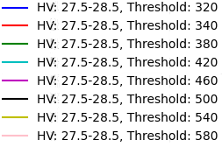
Threshold transfer characteristic
Transfer
characteristics: H
Input: X
Output: Y
Y=HX
Y
H =
LG
X
HG
12
Channels
Channels
1

Slide 13
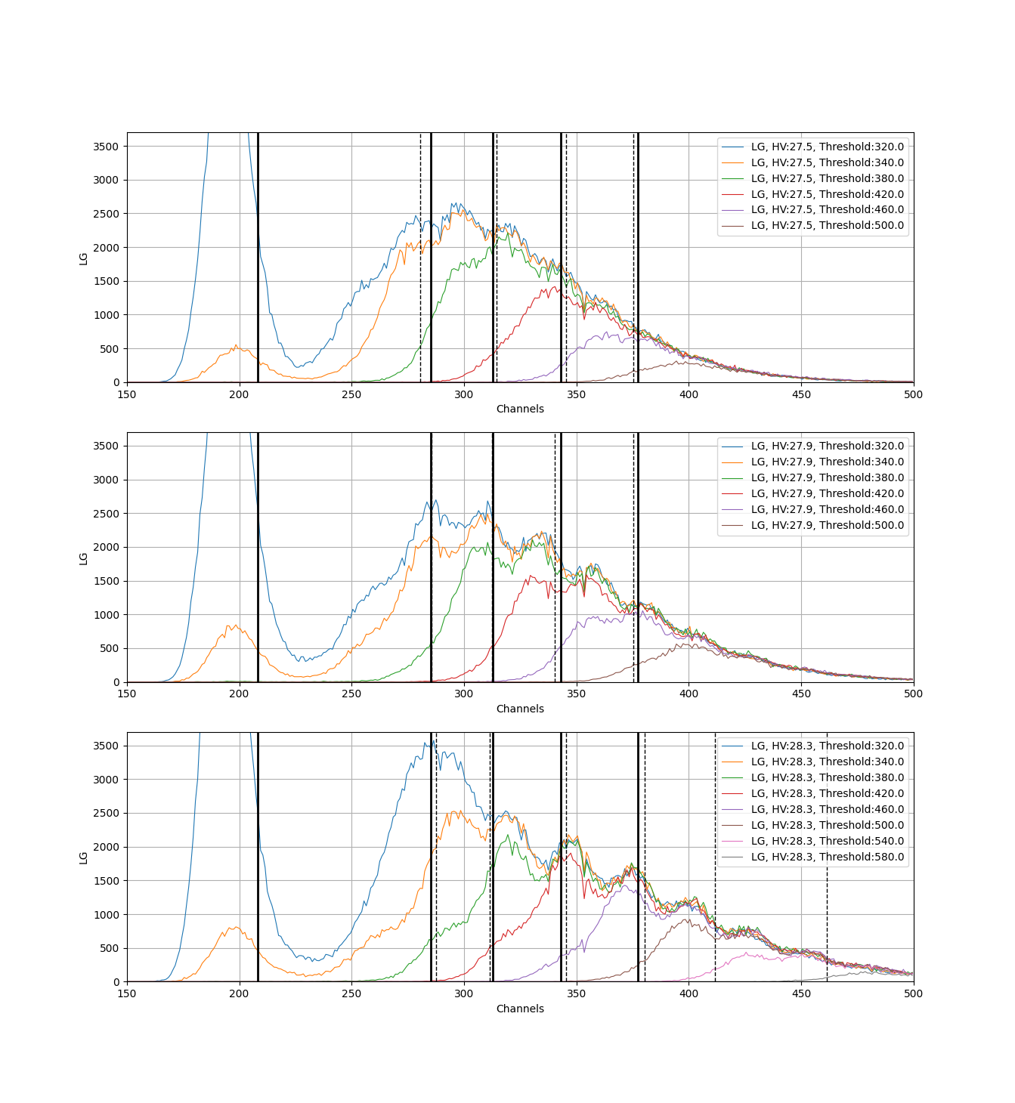
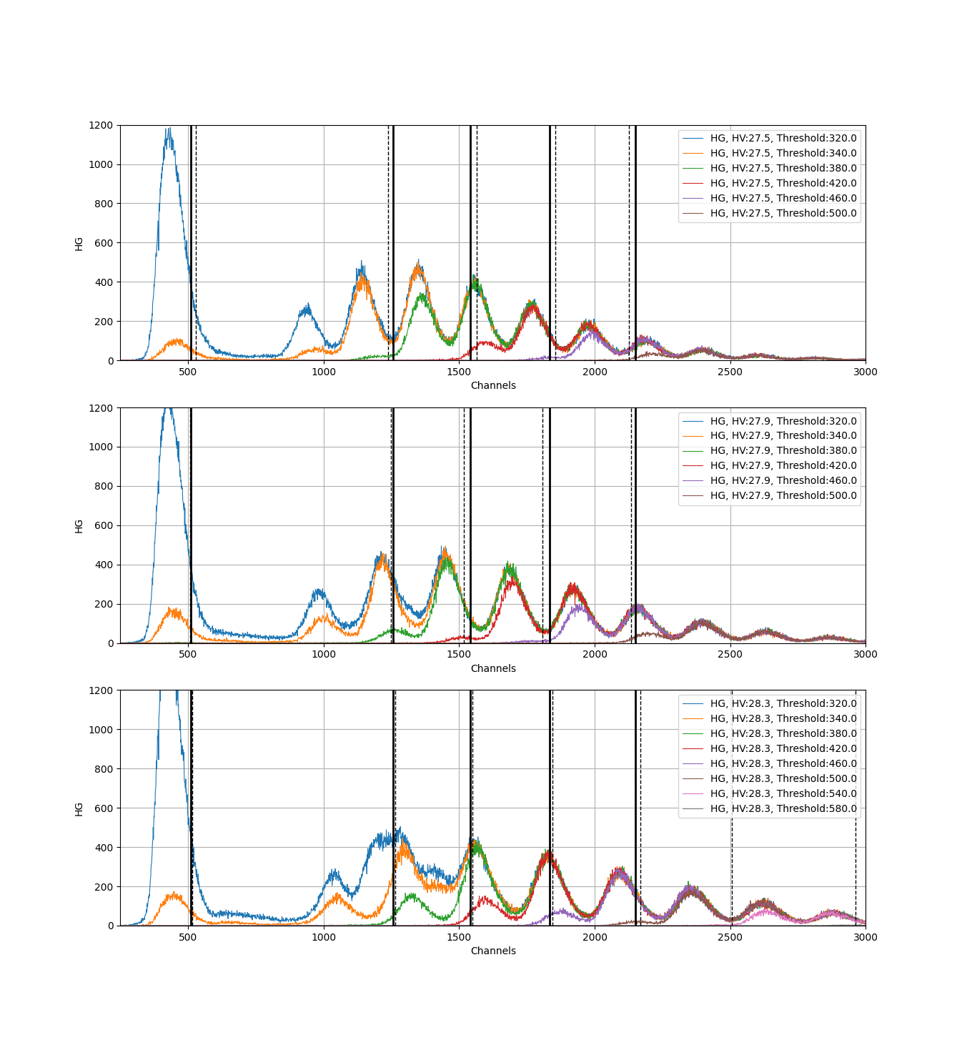
Examples of data for 27.5, 27.9, and 28.3 volts with threshold
LG
HG
Channels
Channels
LG
HG
Channels
Channels
LG
HG
Channels
Channels
13
1

Slide 14
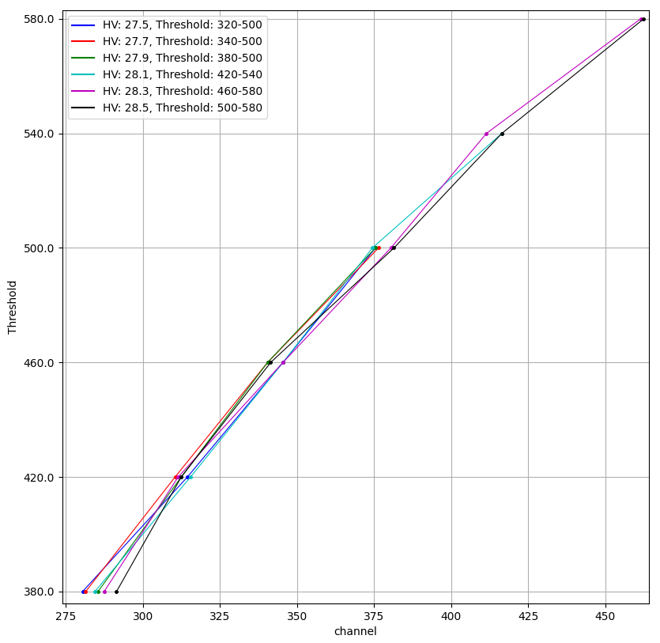
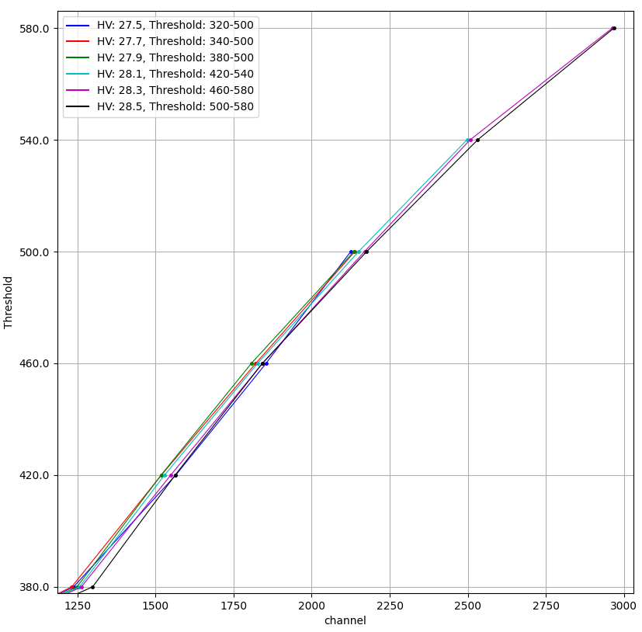
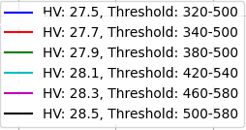
The schedule for converting the threshold into channels
LG
HG
Threshold
Threshold
14
Channel
Channel
1

Slide 15
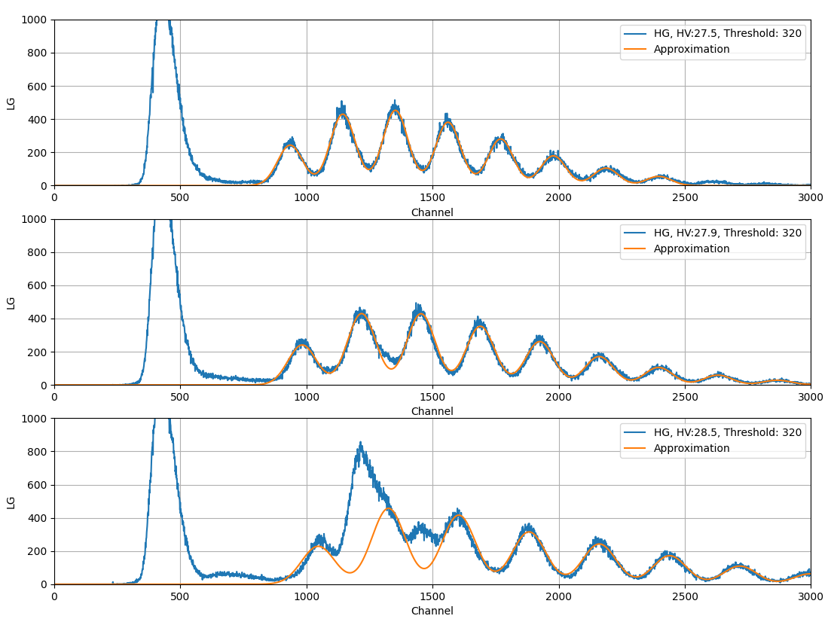
Pixel approximation
We assume that the minopixel signal is periodic.
To describe the position of all pixels, we need to know the position of the first pixel and the period.
We approximate the data with a sum of Gaussian functions with a periodic offset.
LG
Channels
LG
Channels
LG
15
1
Channels

Slide 16
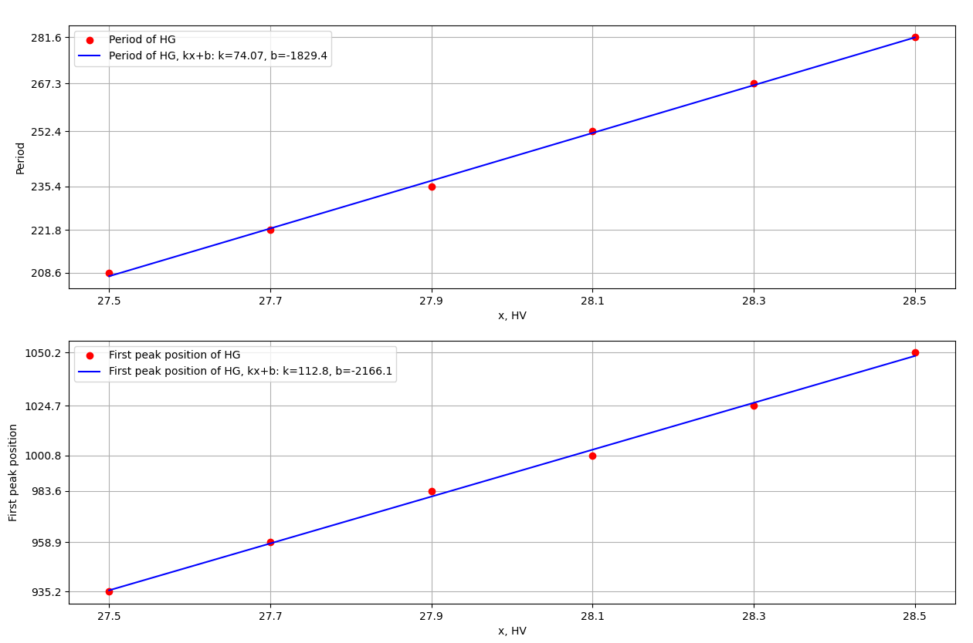


The first pixel position and period
Period
x, Volts
First peak position
16
1
x, Volts

Slide 17
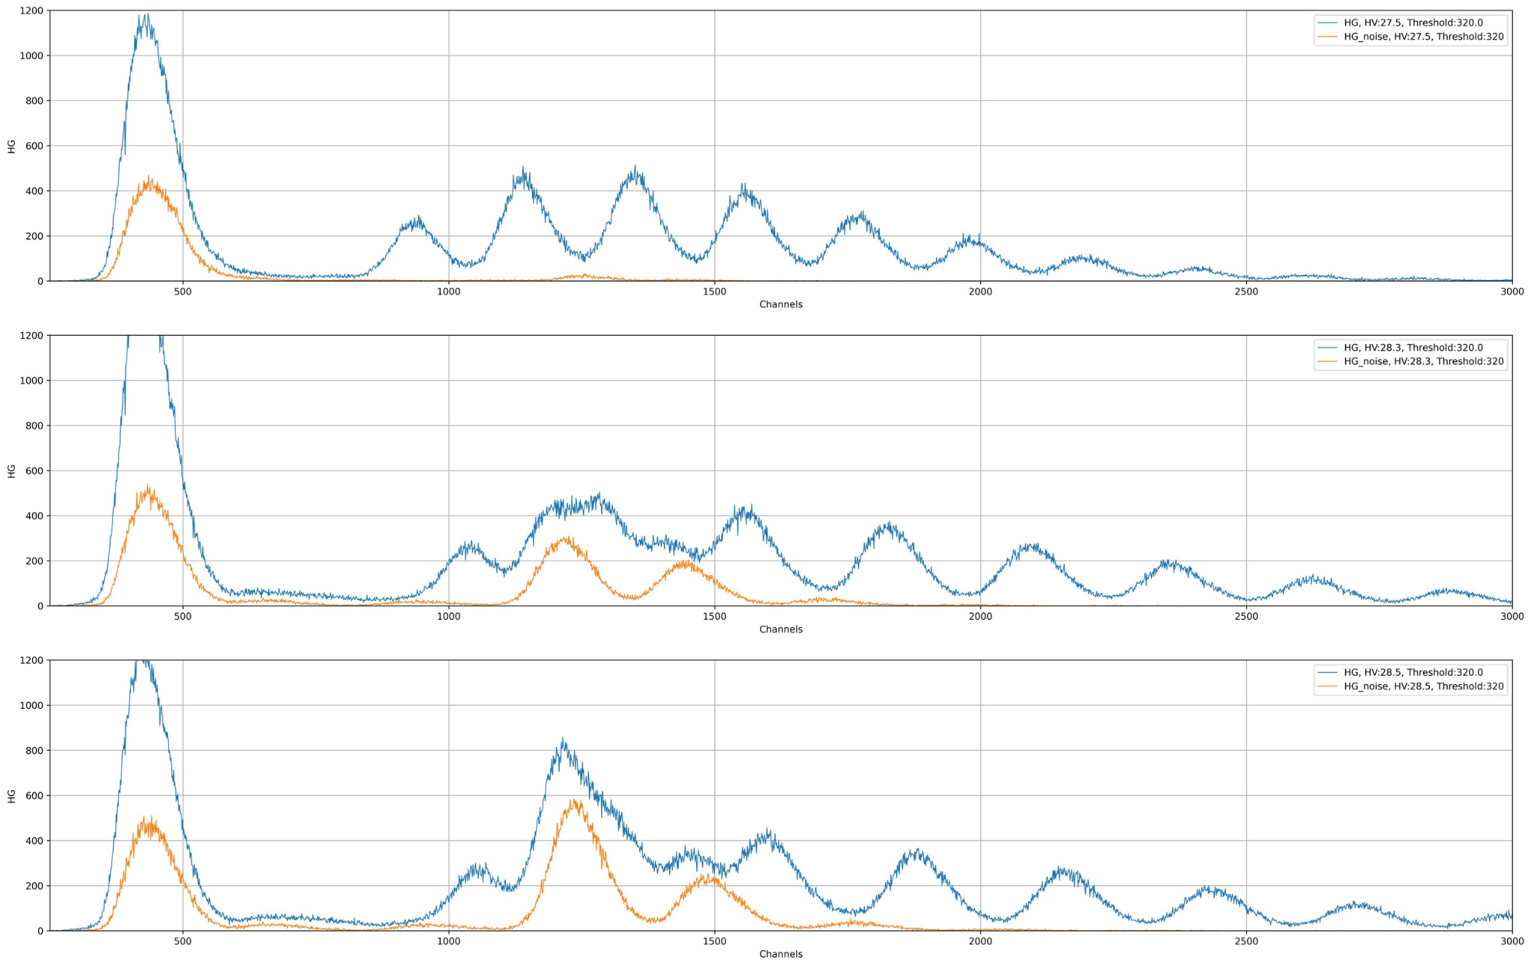



Exposure to noise
Additionally, data was collected without the generator turned on.
The noise data is displayed in orange, and the generator data is displayed in blue.
The noise appears between the first and second pixels and between the second and third pixels.
HG
Channels
HG
Channels
HG
17
Channels
1

Slide 18
Cosmic radiation tests
Upper scintillator
SiPM
FERS-DT5202
DT5215
Lower scintillator
SiPM
DT5202 Parameters:
Bunch Trigger Source: TLOGIC
Trigger Logic: AND2_OR32
TD Coarse Threshold: 380
HV VBias 28.1
HG Gain: 50
LG Gain: 50
Pedestal: 1800
Fast Shaper Input: HG-PA
Laptop
18
1

Slide 19
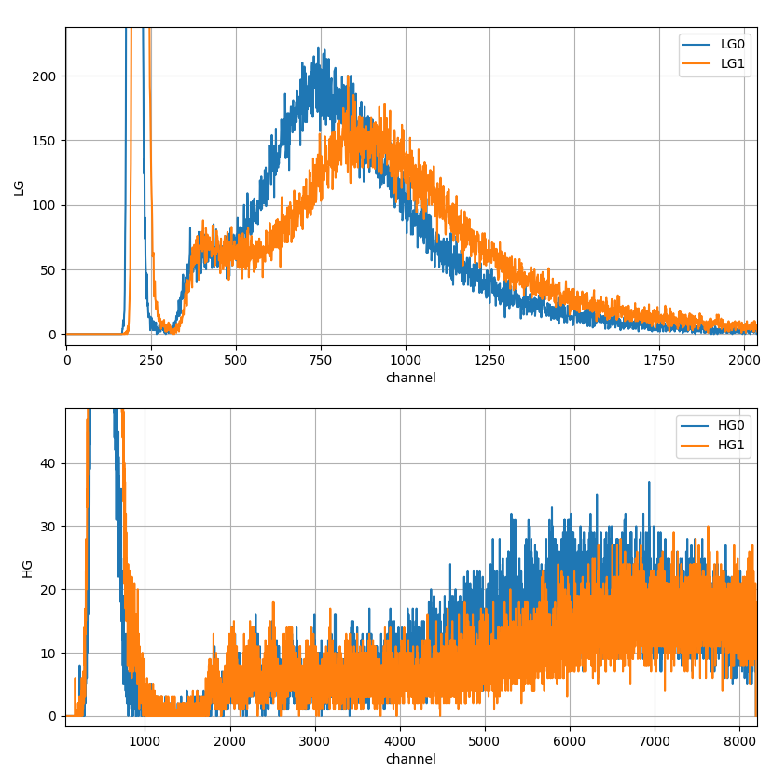
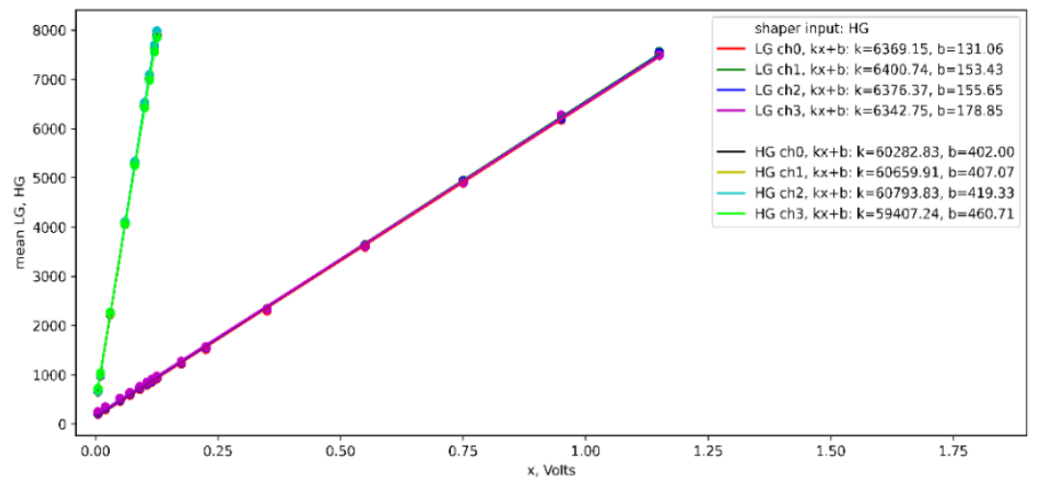
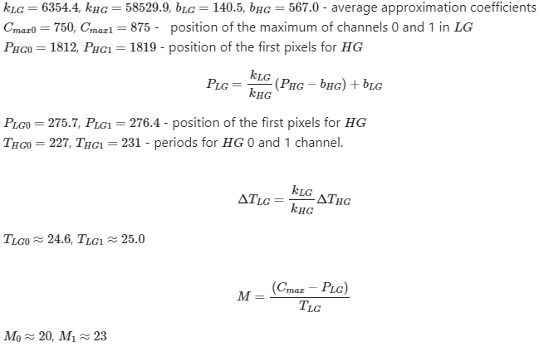
Cosmic radiation tests
LG
mean LG, HG
Channels
x, Volts
HG
19
1
Channels

Slide 20
Conclusion
It was completed:
The position of the pedestal was determined
conversion charts for LG, HG, TOT, and TOA were obtained
offset voltage and threshold for minimum noise were determined
The number of photons in MIPS was determined to be 20 and 23 for tile 0 and 1, respectively
To do list:
Refinement and approximation of the threshold conversion graph into channels
Determine the cause of the noise offset relative to the pixel signal
Defining parameters for other SiPMs
20
1

Slide 21
Thanks for your attention!

Slide 22
Backup

Slide 23
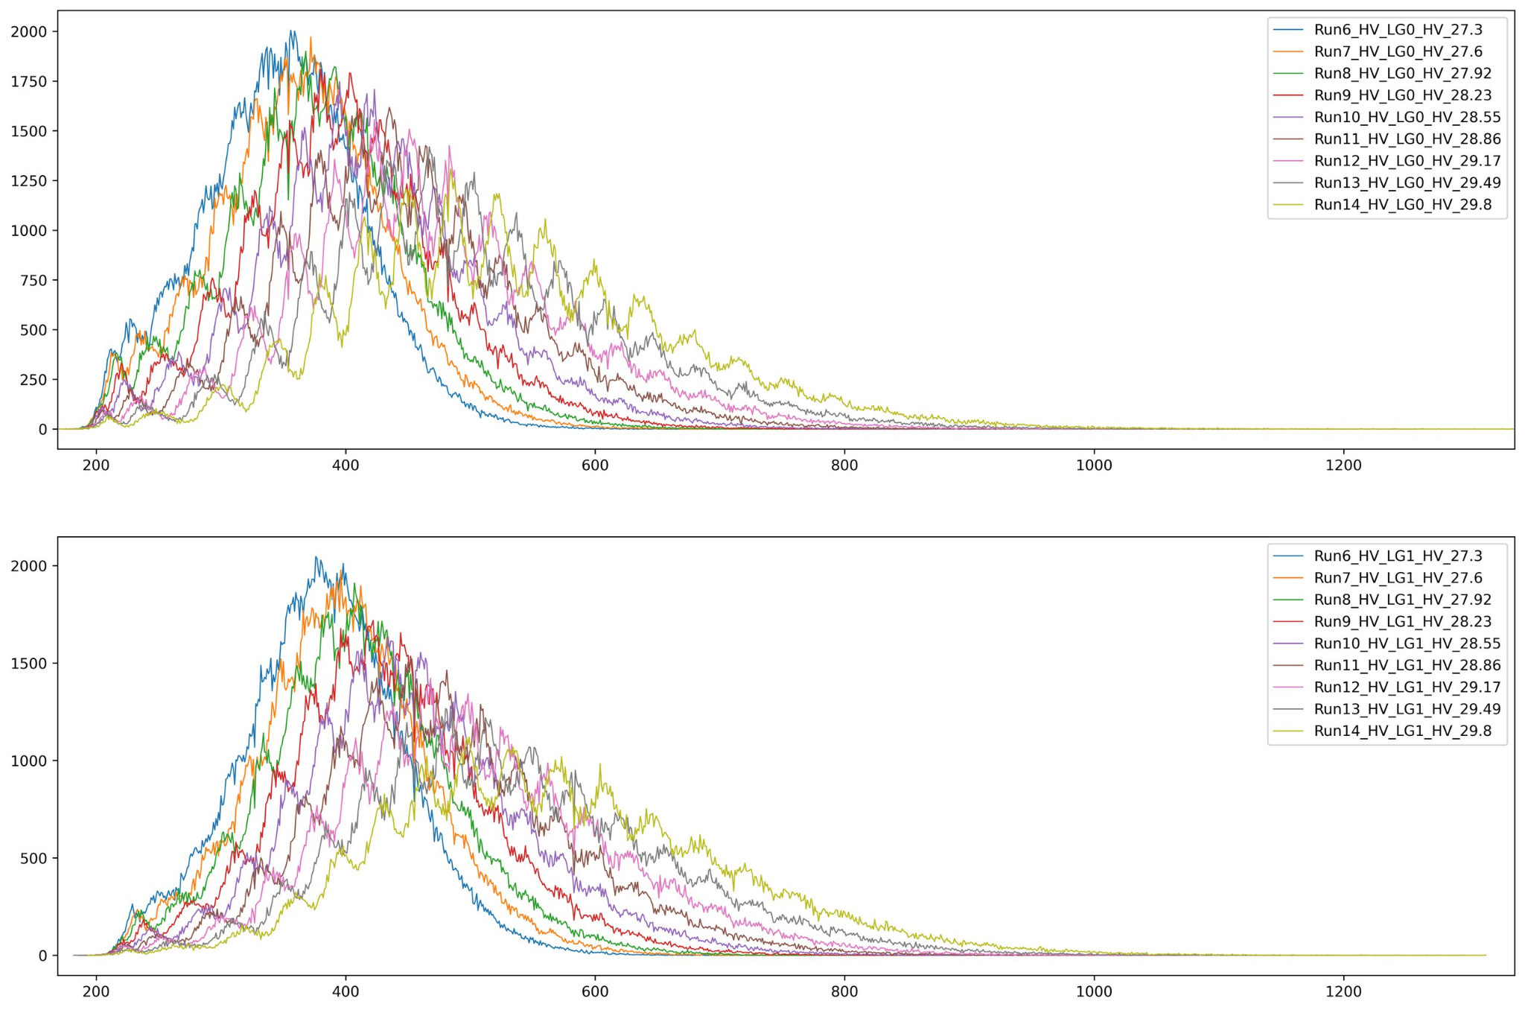

Slide 24
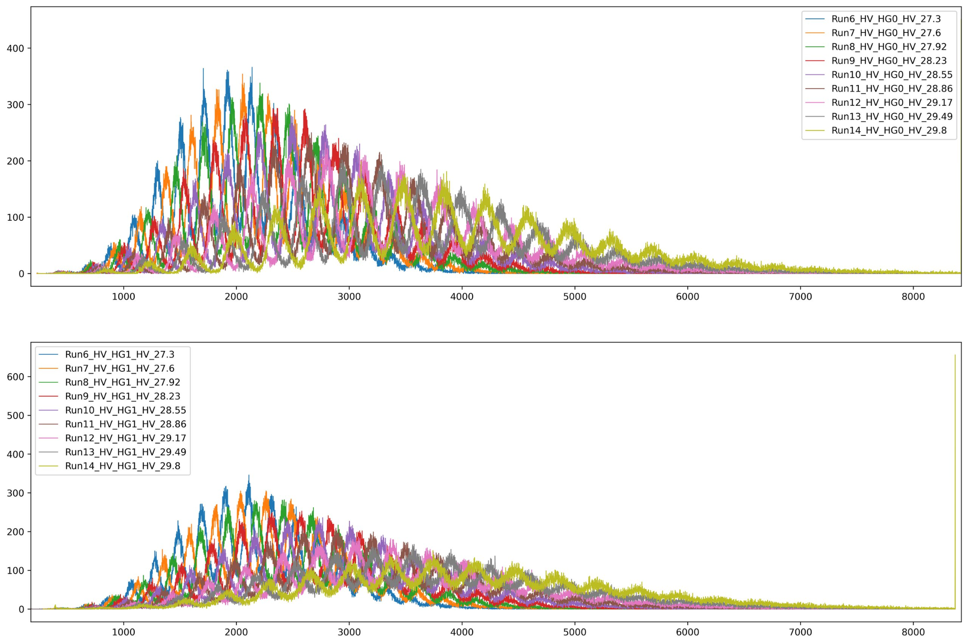

Slide 25
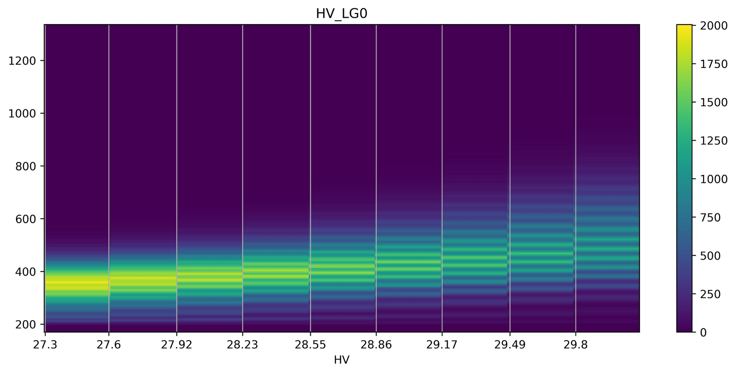
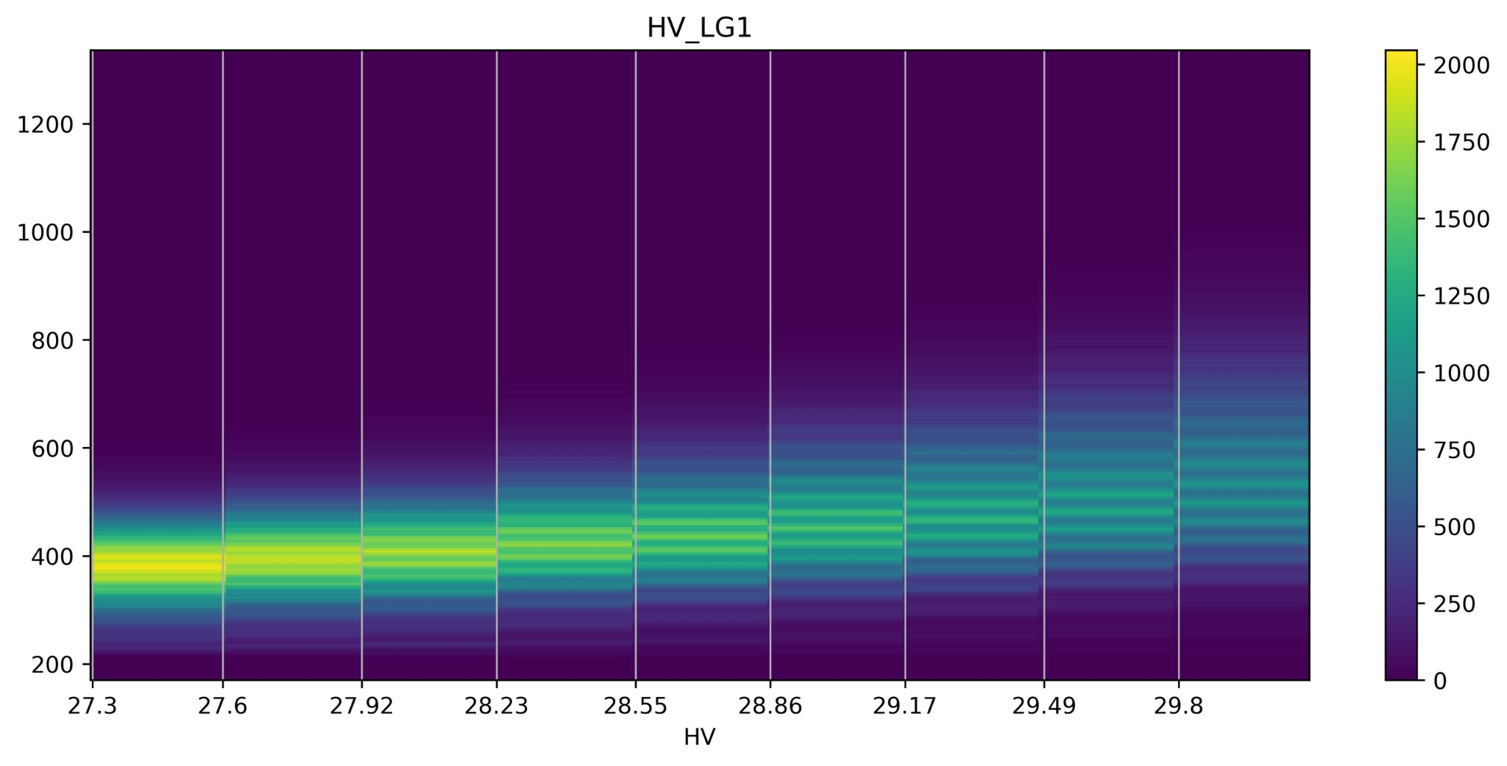
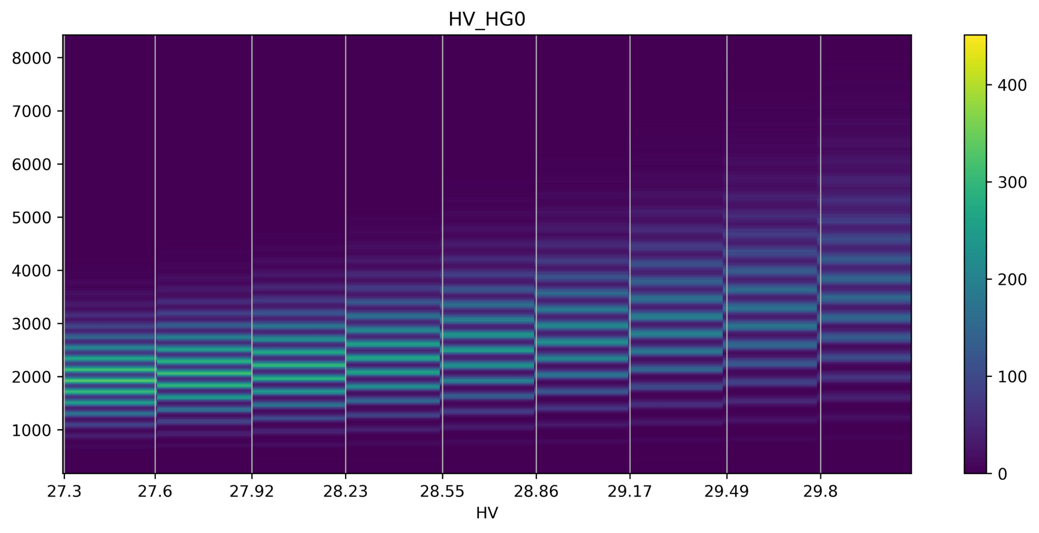
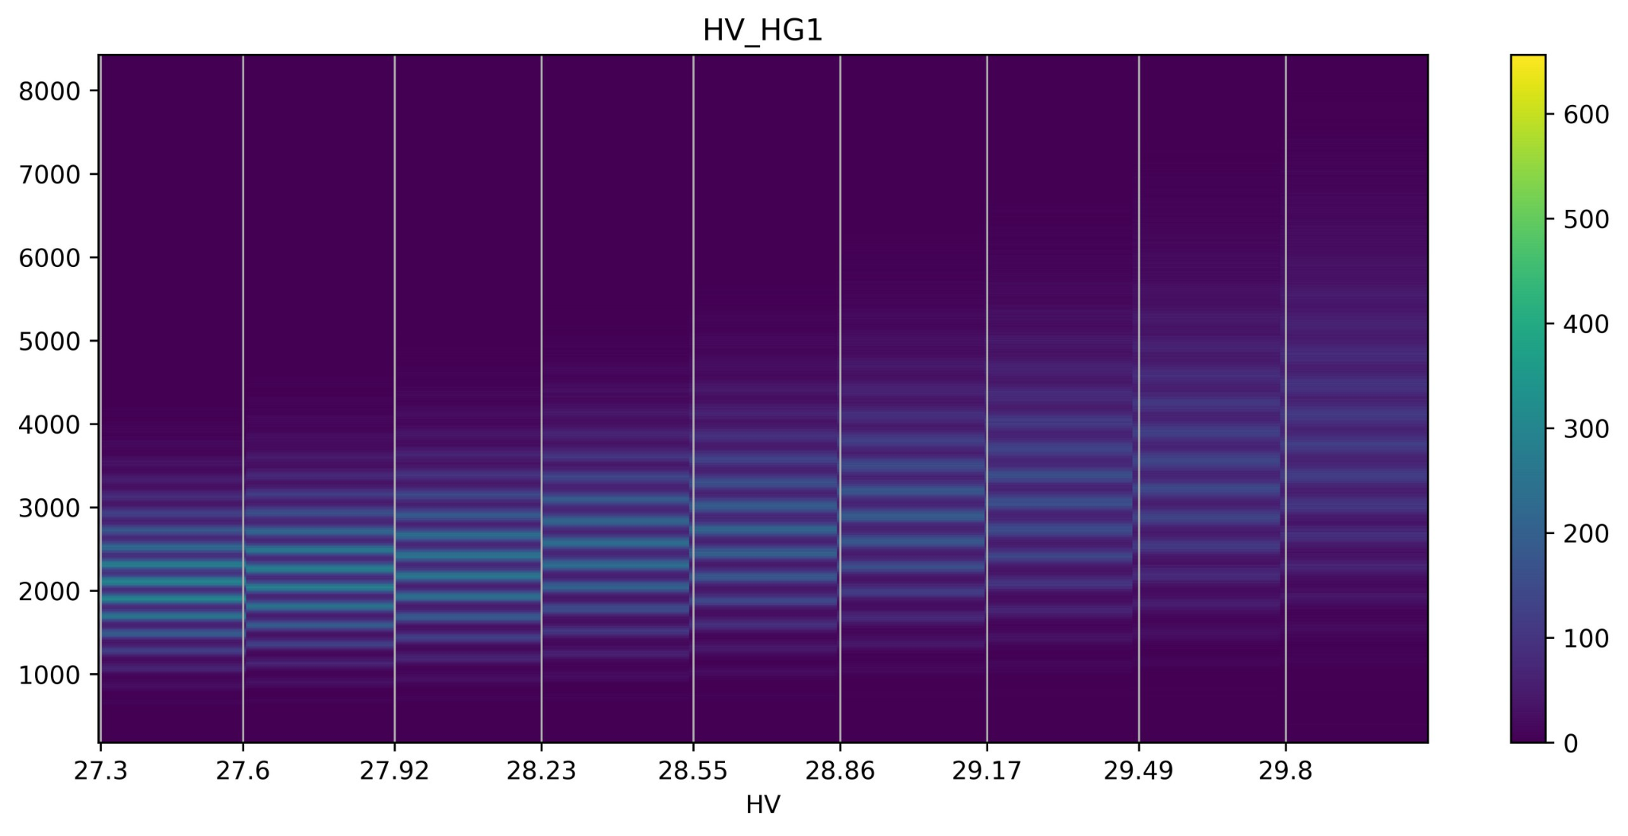

Slide 26
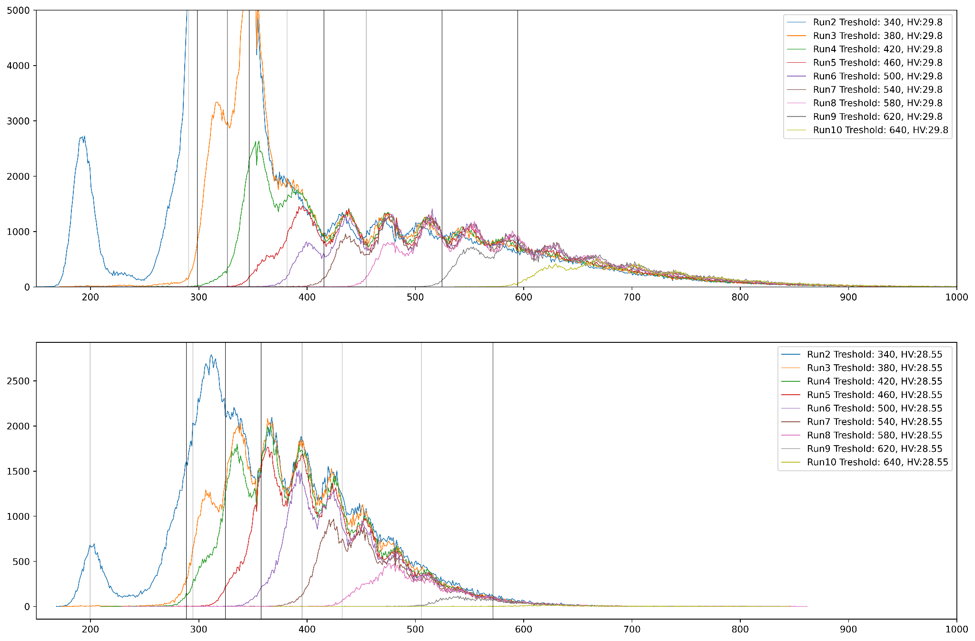

Slide 27
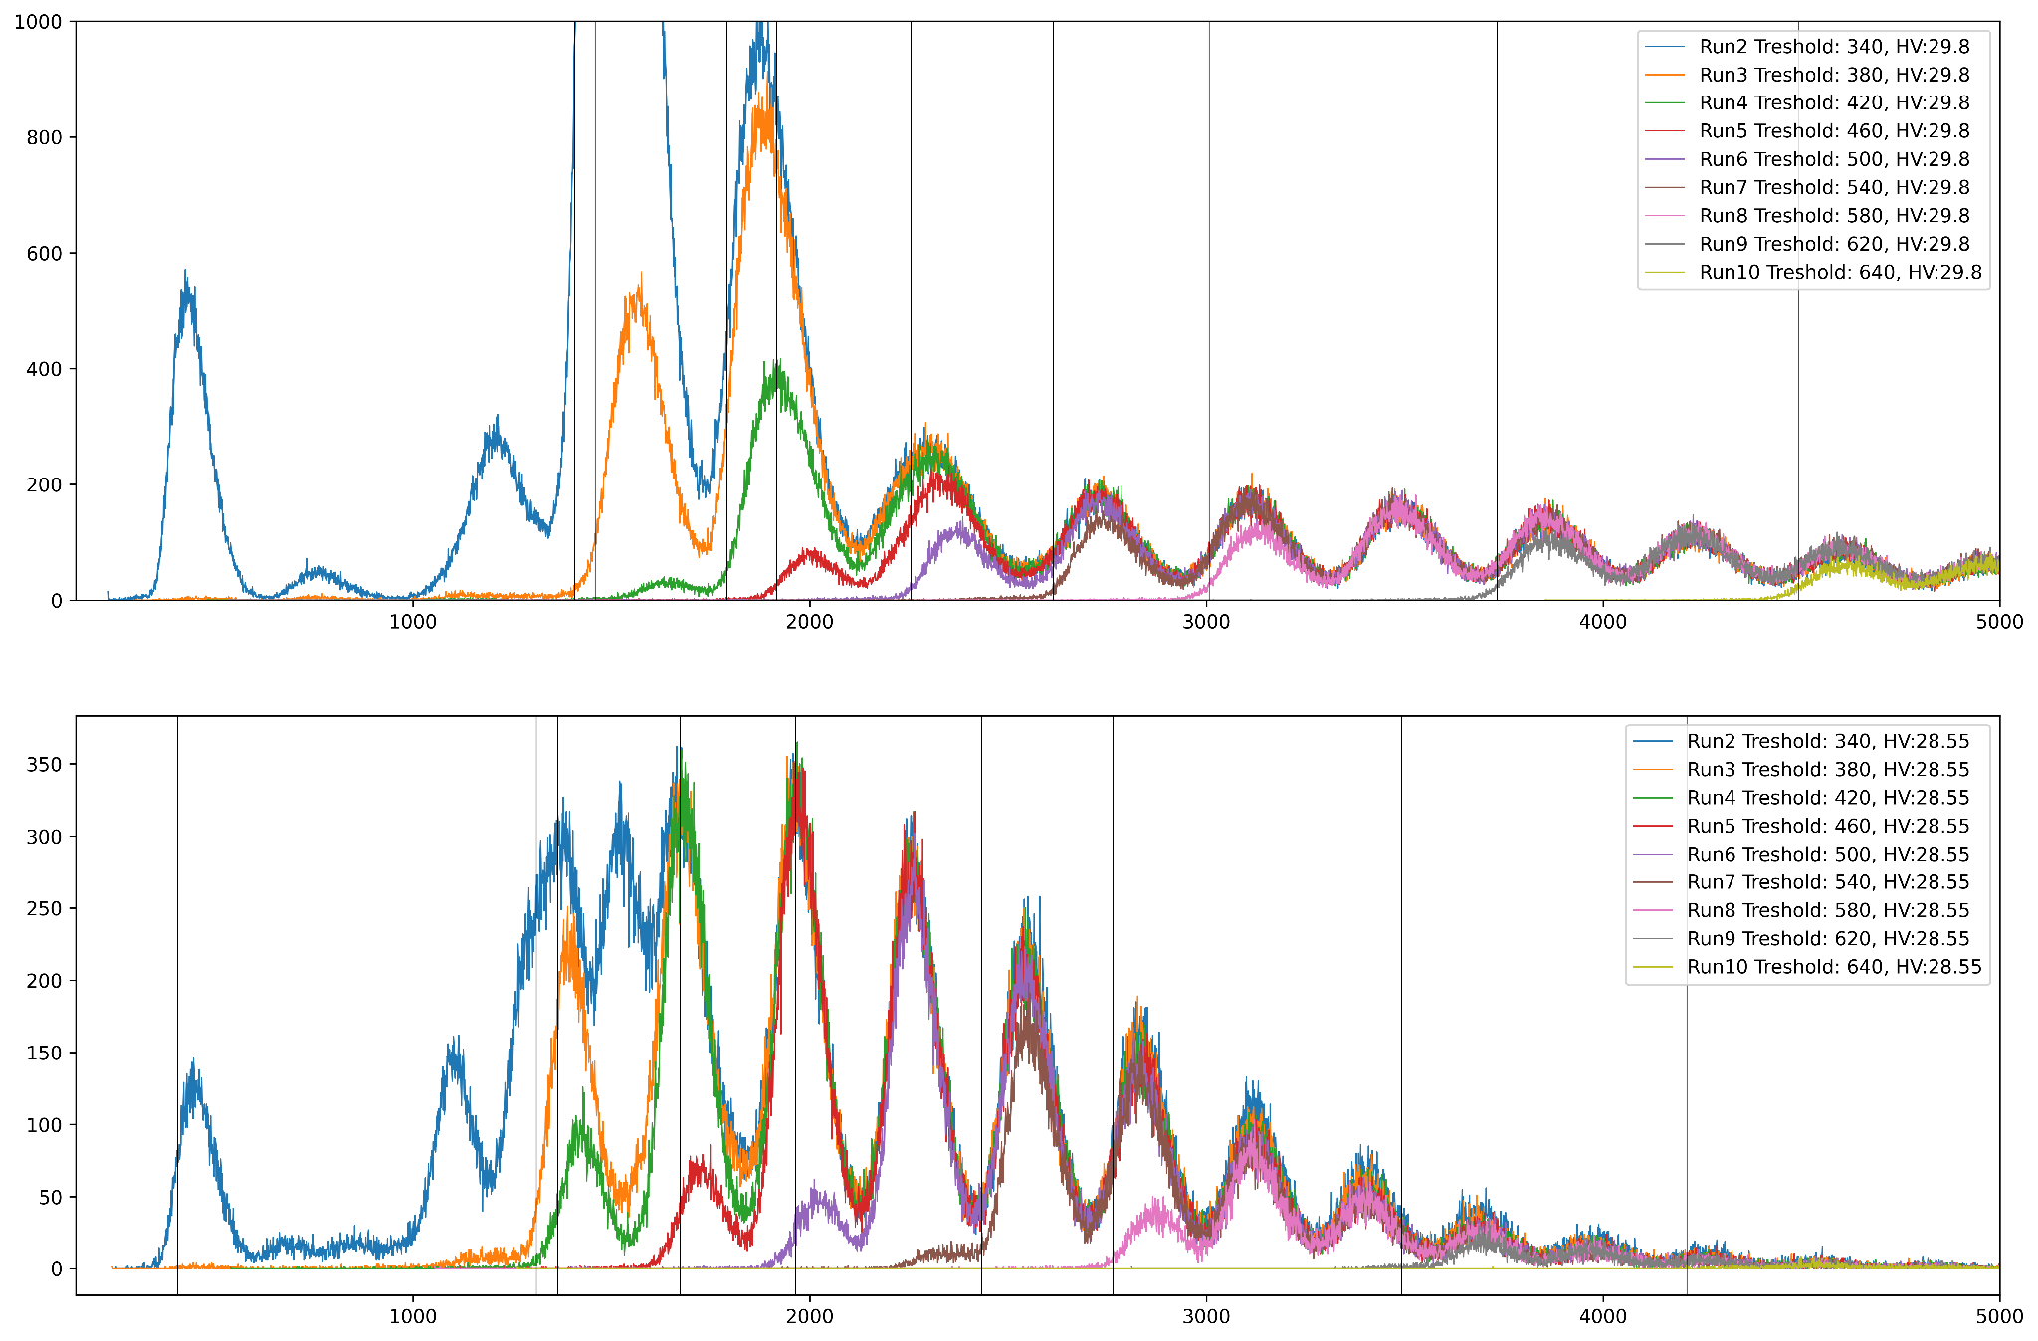

Slide 28
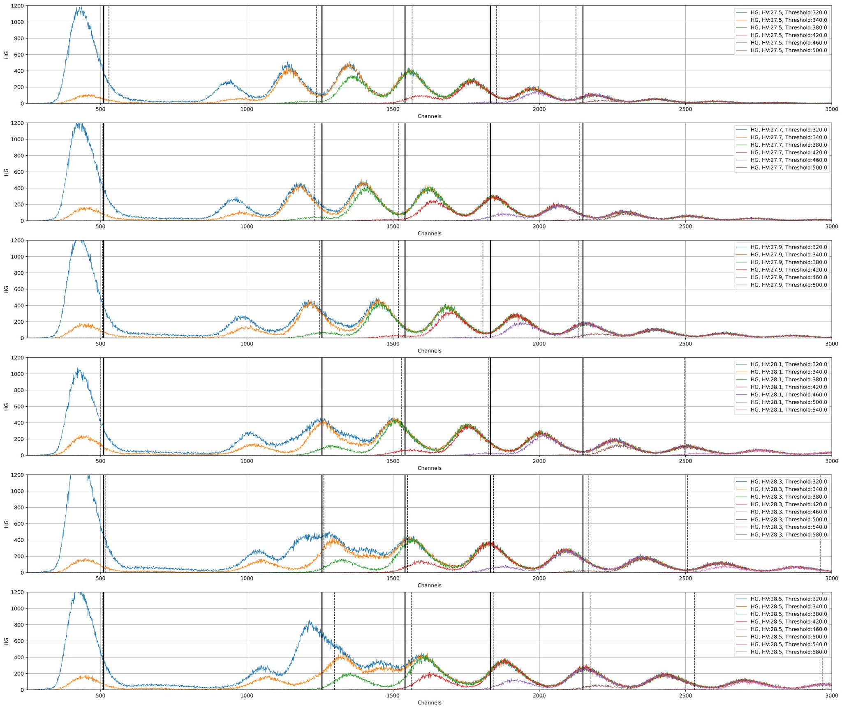

Slide 29
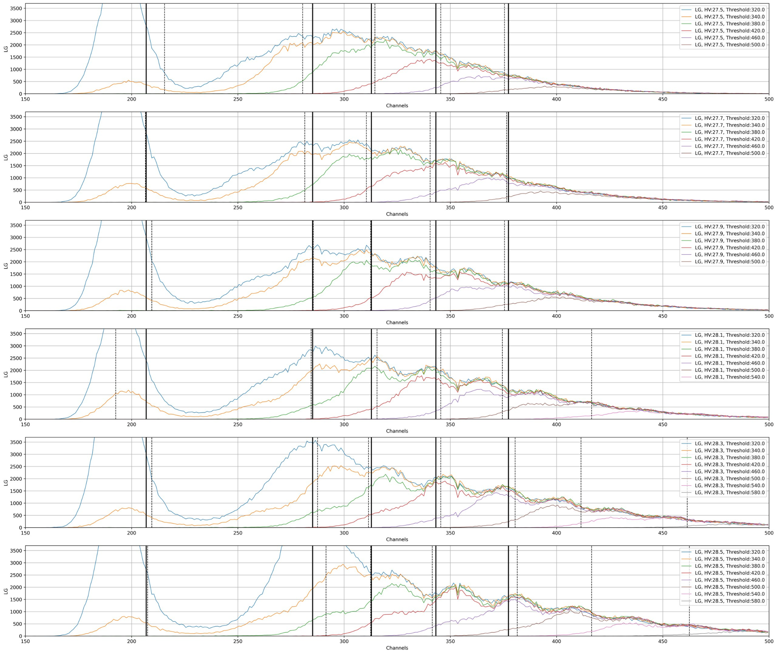

Slide 30
