Slide 1



A FISSION FLASH IN THE INNER CRUST OF AN EXPLODING LOW-MASS NEUTRON STAR
Speaker: Anton Ignatovskiy
Affiliations: NRC «KI» (Sr. Res. Fellow)
MIPT (Assoc. Prof.)
Coauthors: Igor Panov, Andrey Yudin
October 2026
ICPPA, Moscow

Slide 2
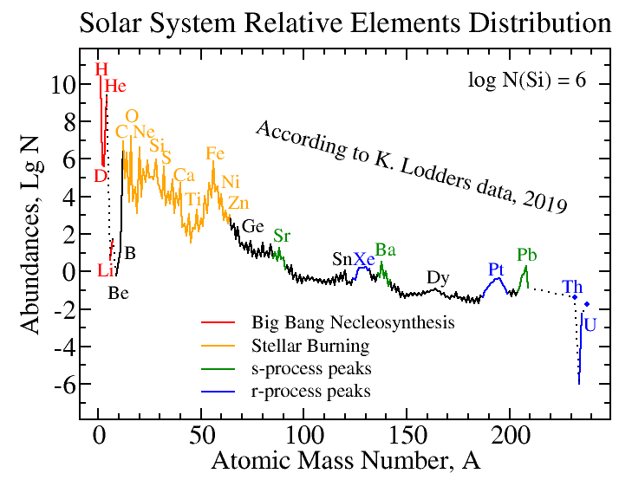


trans-iron:
s-/r-processes
s-process
r-process

Slide 3
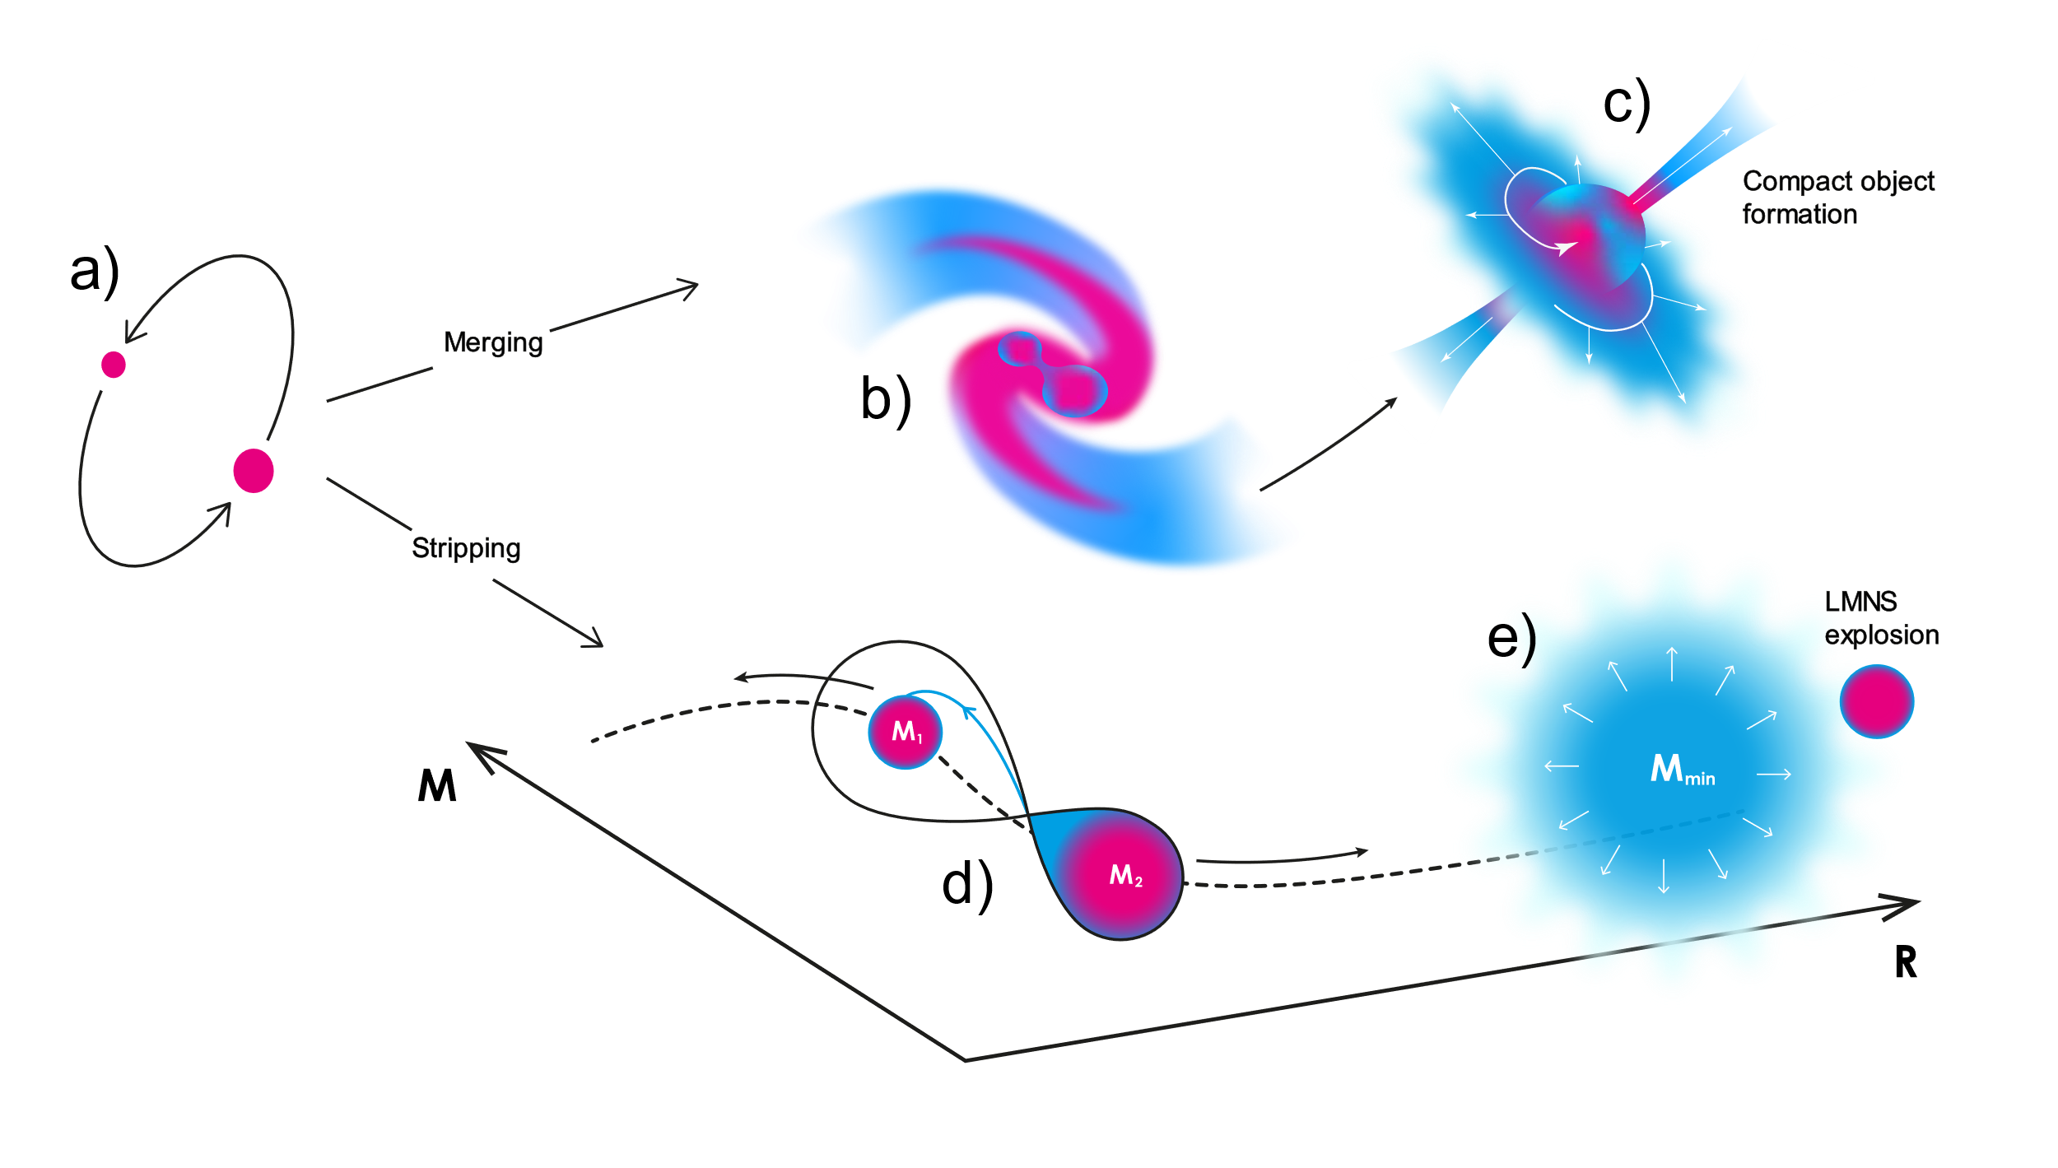
Close binary neutron stars
Observations:
GW & GRB: Abbott et al./ Astrophys. J. Lett. 848/ 1-59 (2017)
Lanthanides: Tanaka et al./ Publ. Astron. Soc. Jpn. 69 (6)/ 102 (2017)

Slide 4


Slide 5
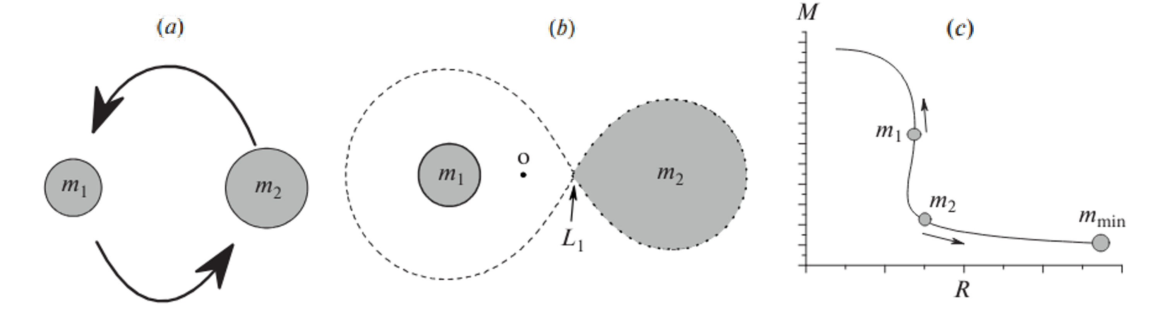
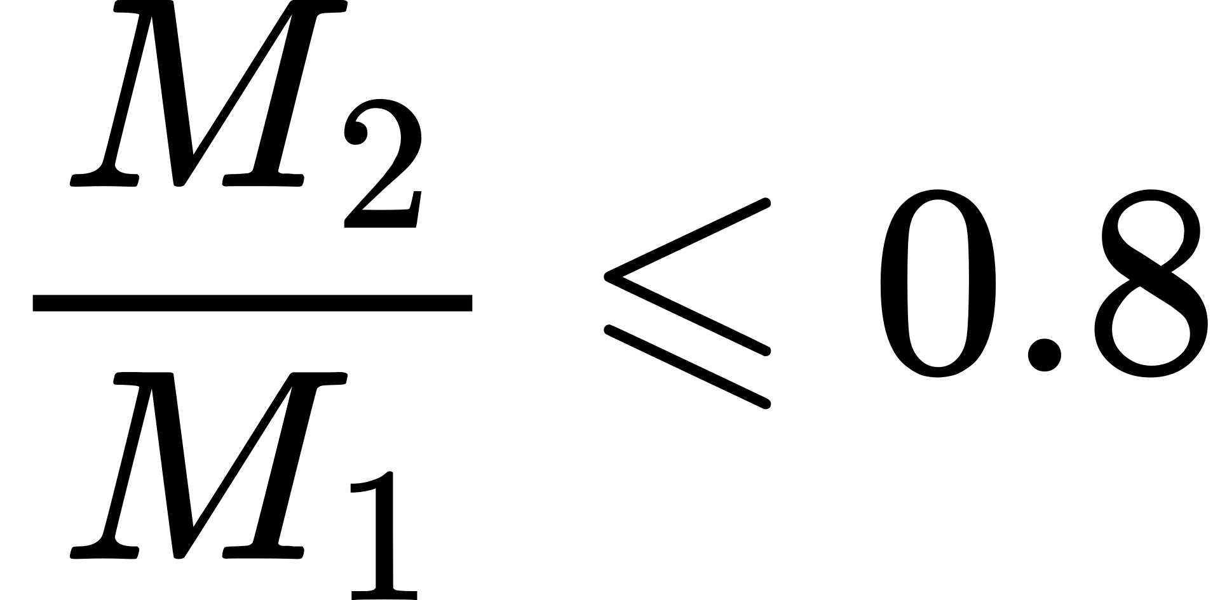

Stripping scenario
a) Close binary neutron star system evolution with mass asymmetry
b) LMNS is the first to fill its Roche lobe
c) LMNS approaches the lower mass limit , reaching a hydrodynamically unstable configuration and exploding
Blinnikov et al./ Astronomy Reports 65/ 385-391 (2021)

Slide 6
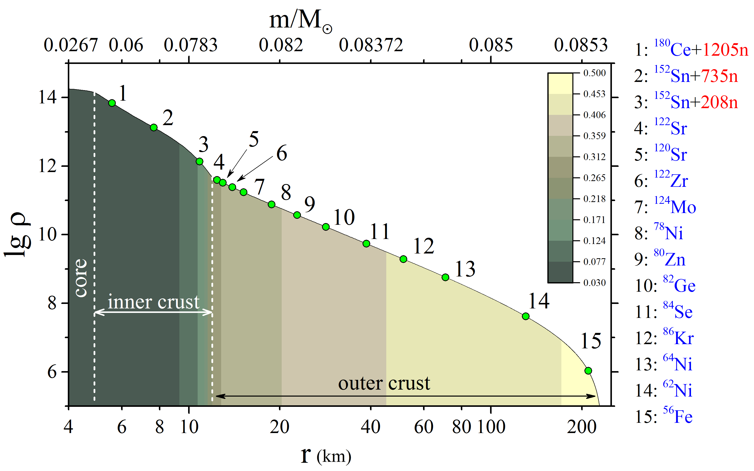
LMNS structure before the explosion
The one we need

Slide 7
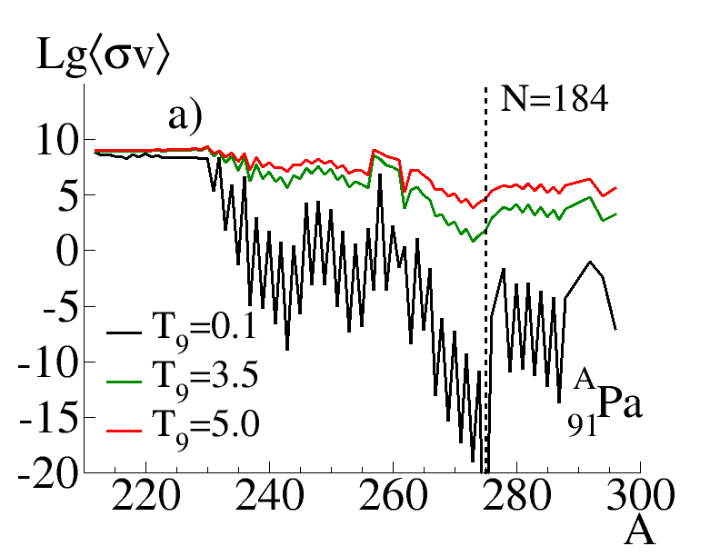
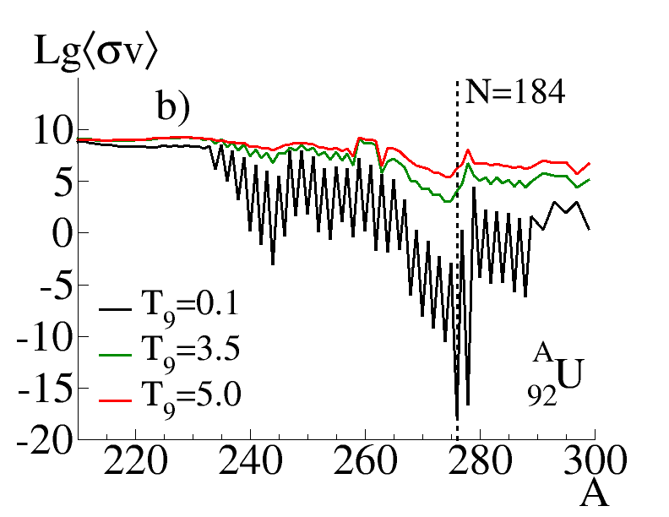
Neutron induced fission rates of
Protactinium (a) and Uranium (b) isotopes for T₉ range

Slide 8
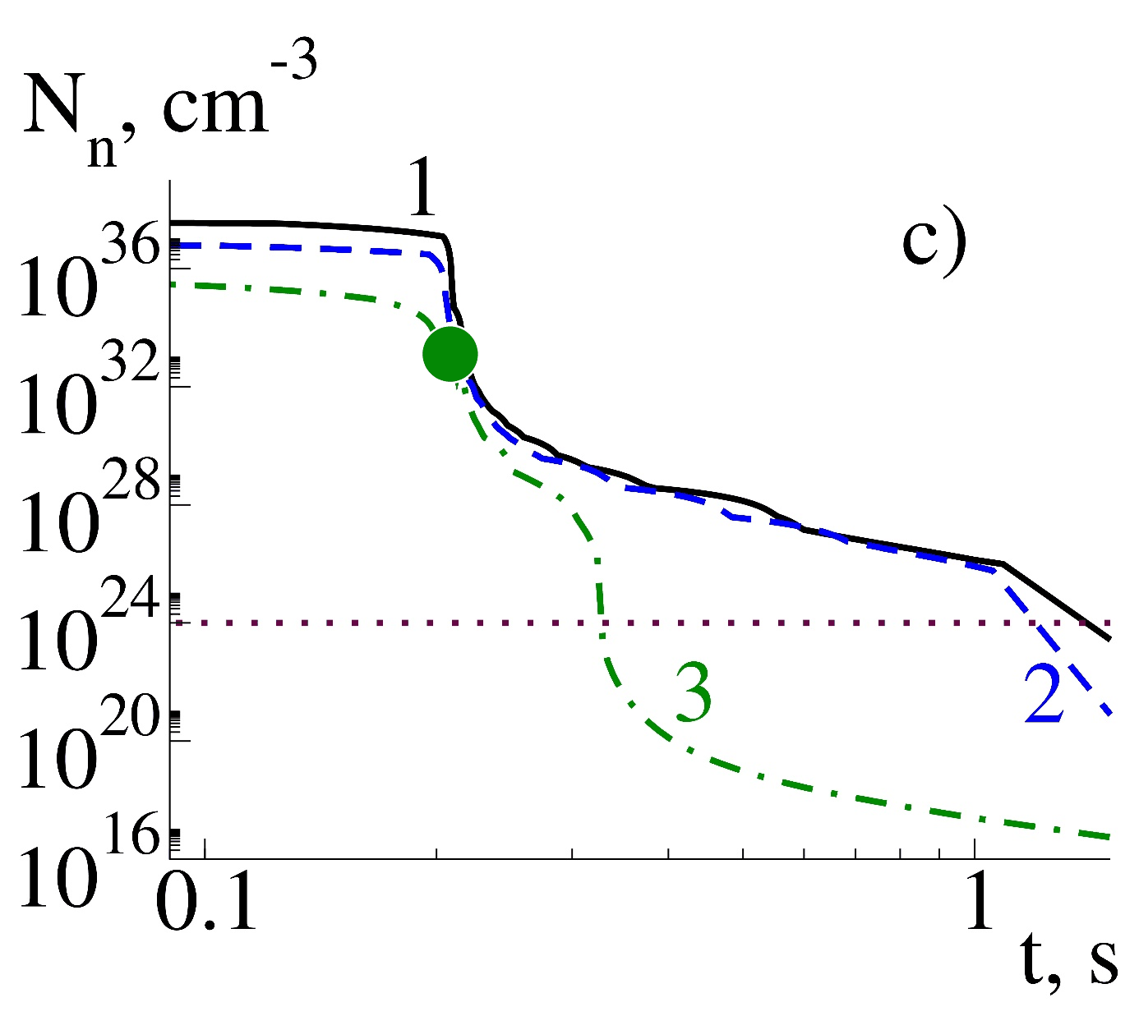
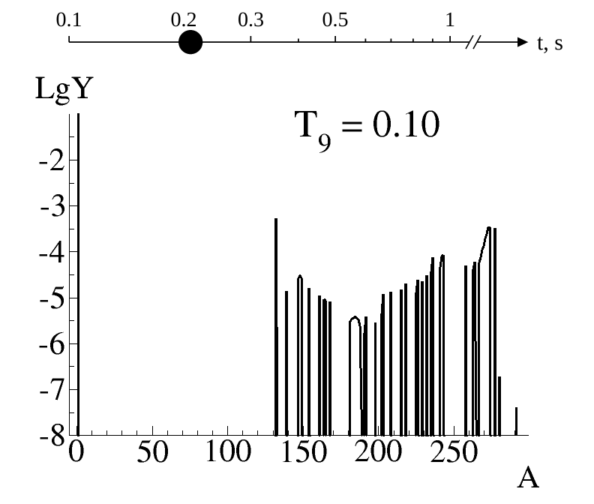
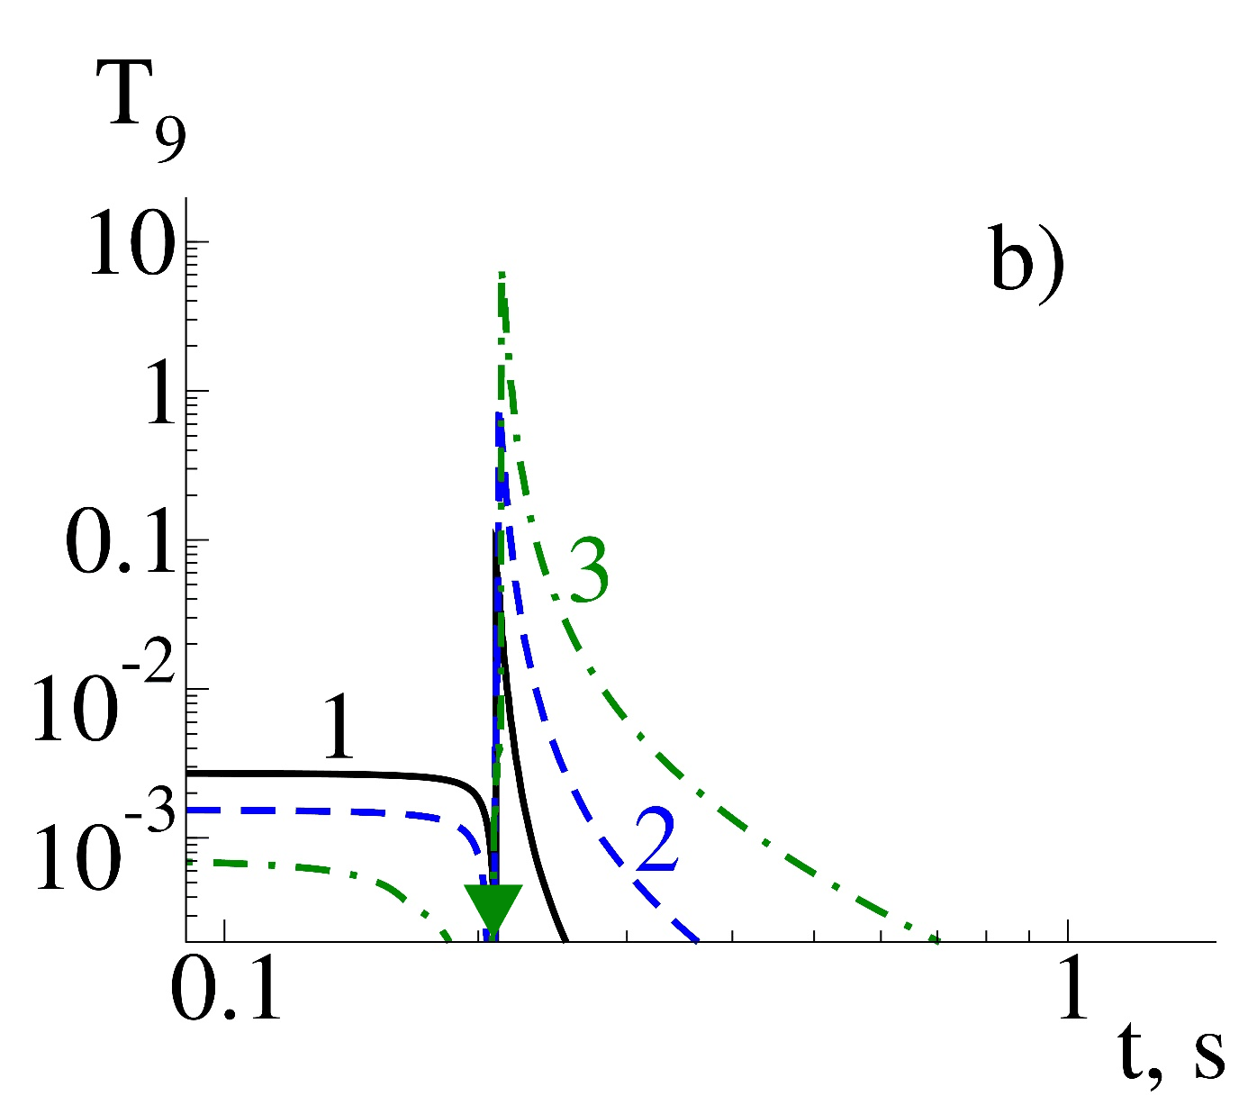
Layer 3 composition evolution

Slide 9
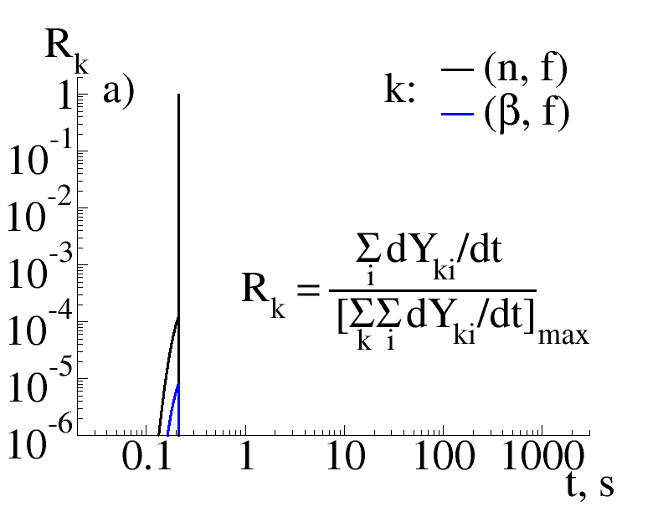
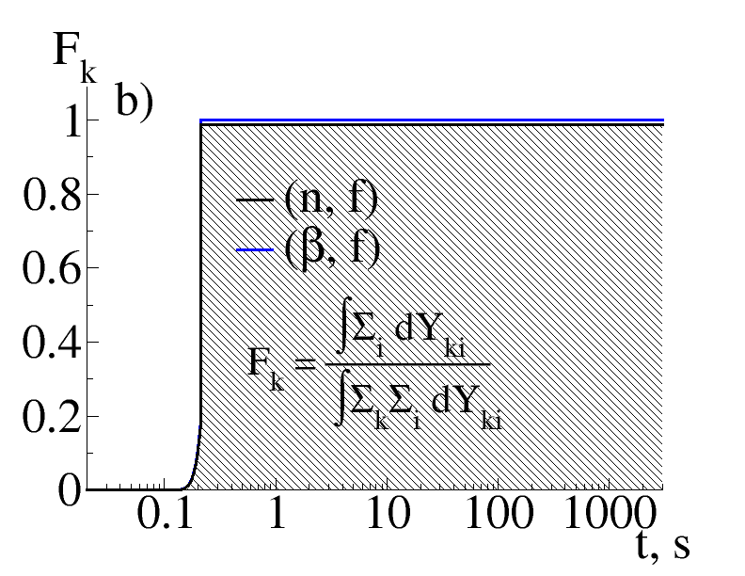
Layer 3 fission channels contribution
fission flash

Slide 10
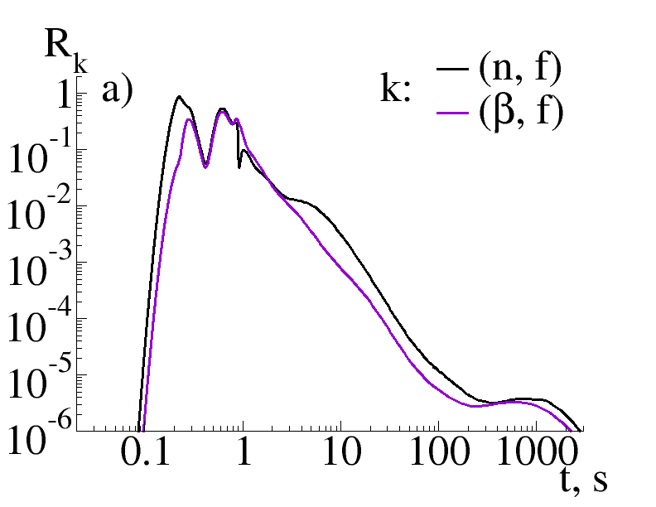
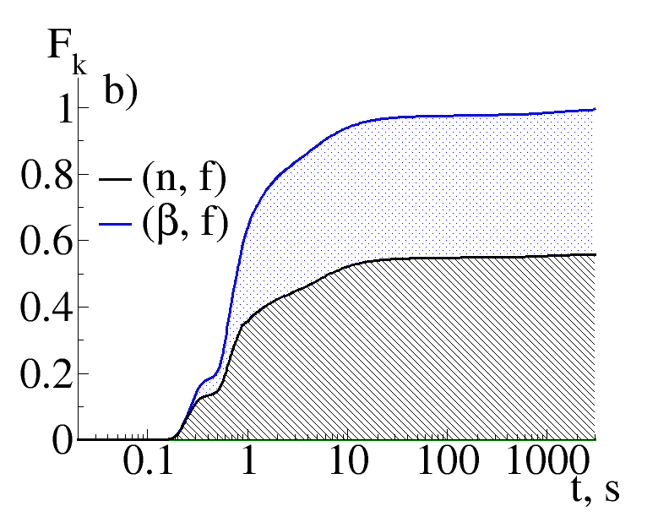
Layer 2 fission channels contribution

Slide 11
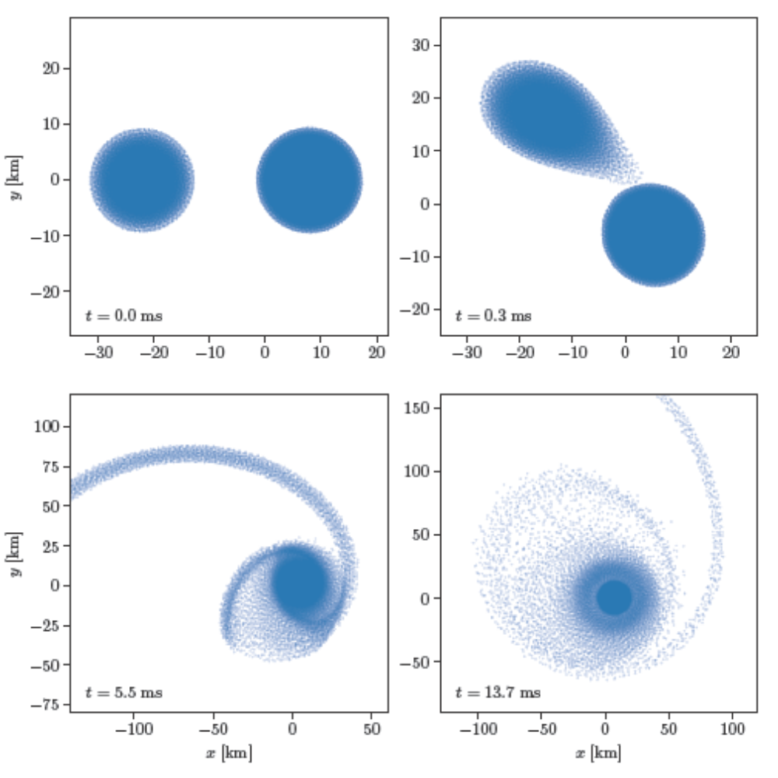
Conclusions and Discussion
1
It was found that the generated shock wave strongly heats the expanding matter for a short time and dramatically increases nuclear reaction rates, especially neutron-induced fission, which becomes dominant and changes the nucleosynthesis mode.
2
As a result, the actinides created in the inner crust of the LMNS fission almost instantly. We call this new phenomenon the «fission flash».

Slide 12
Appendix

Slide 13
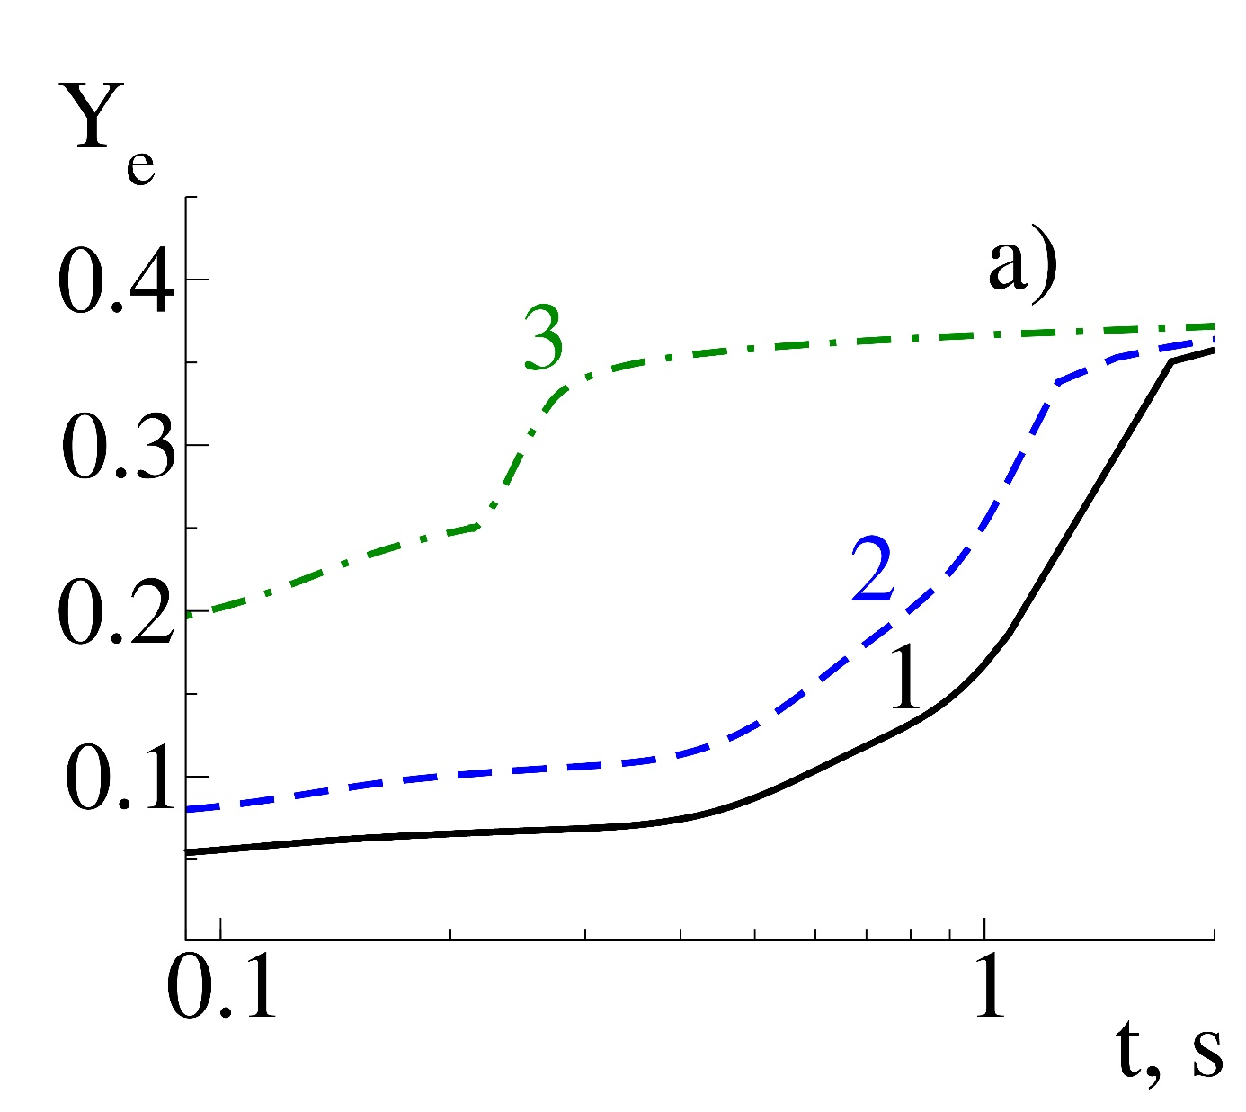
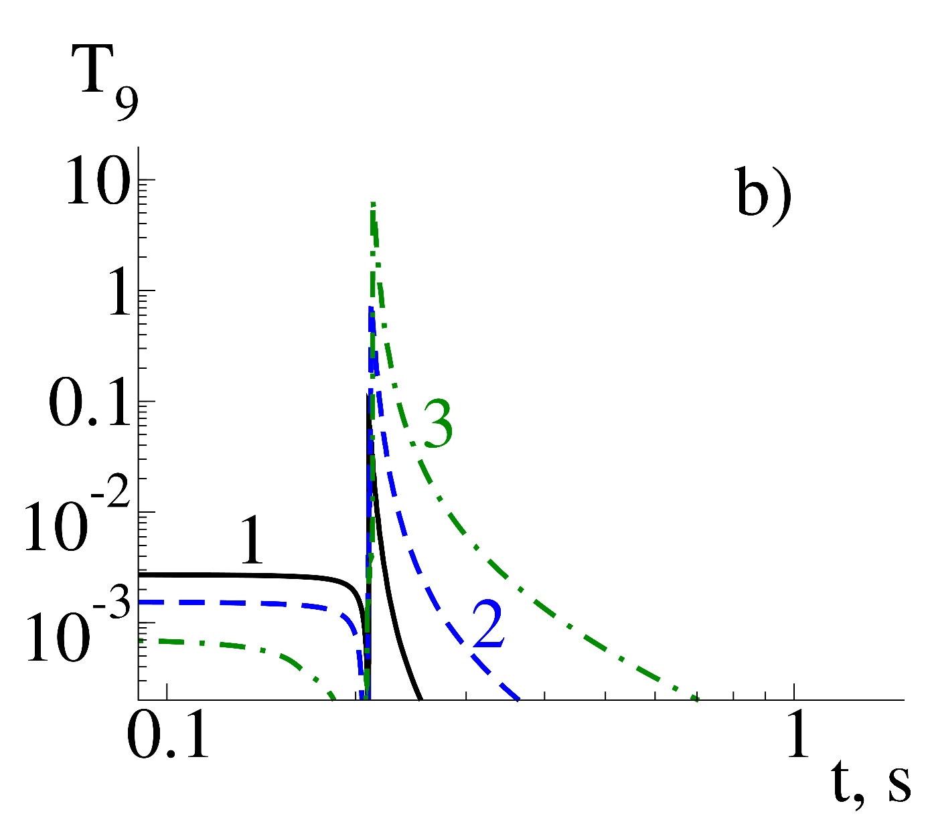
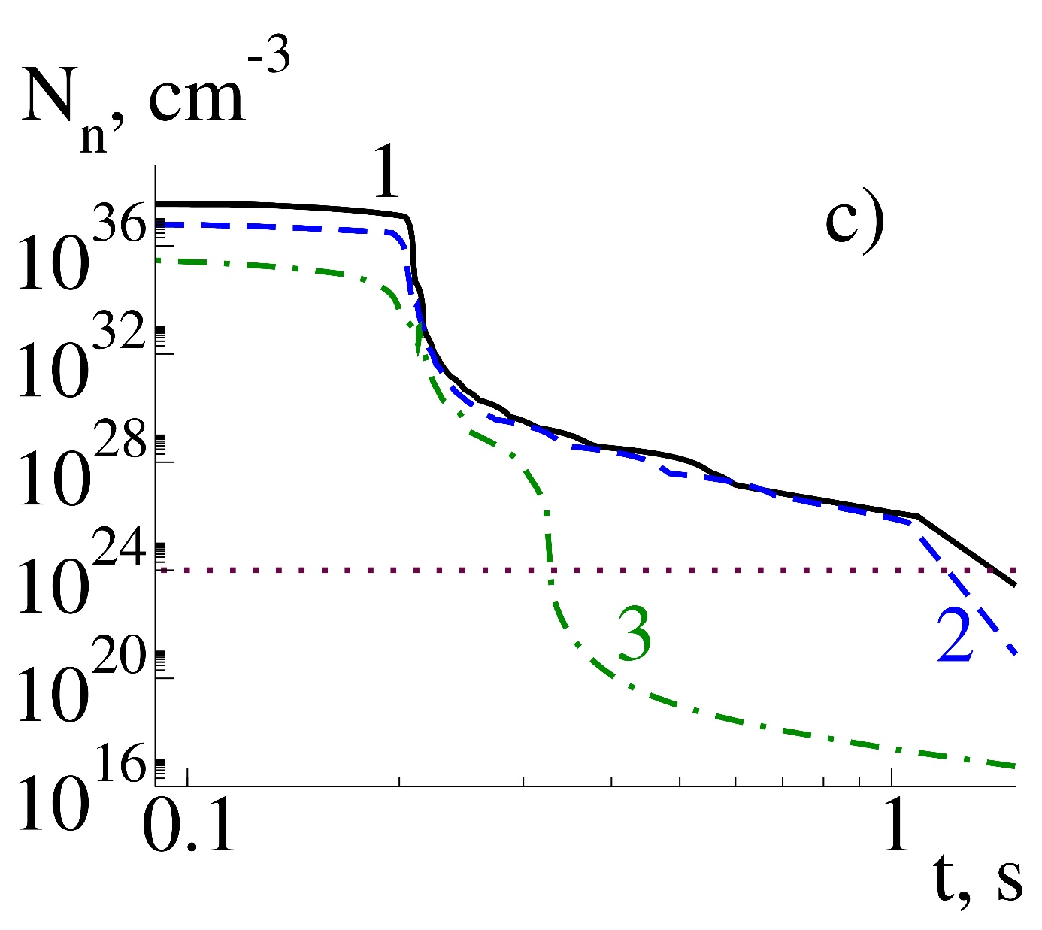
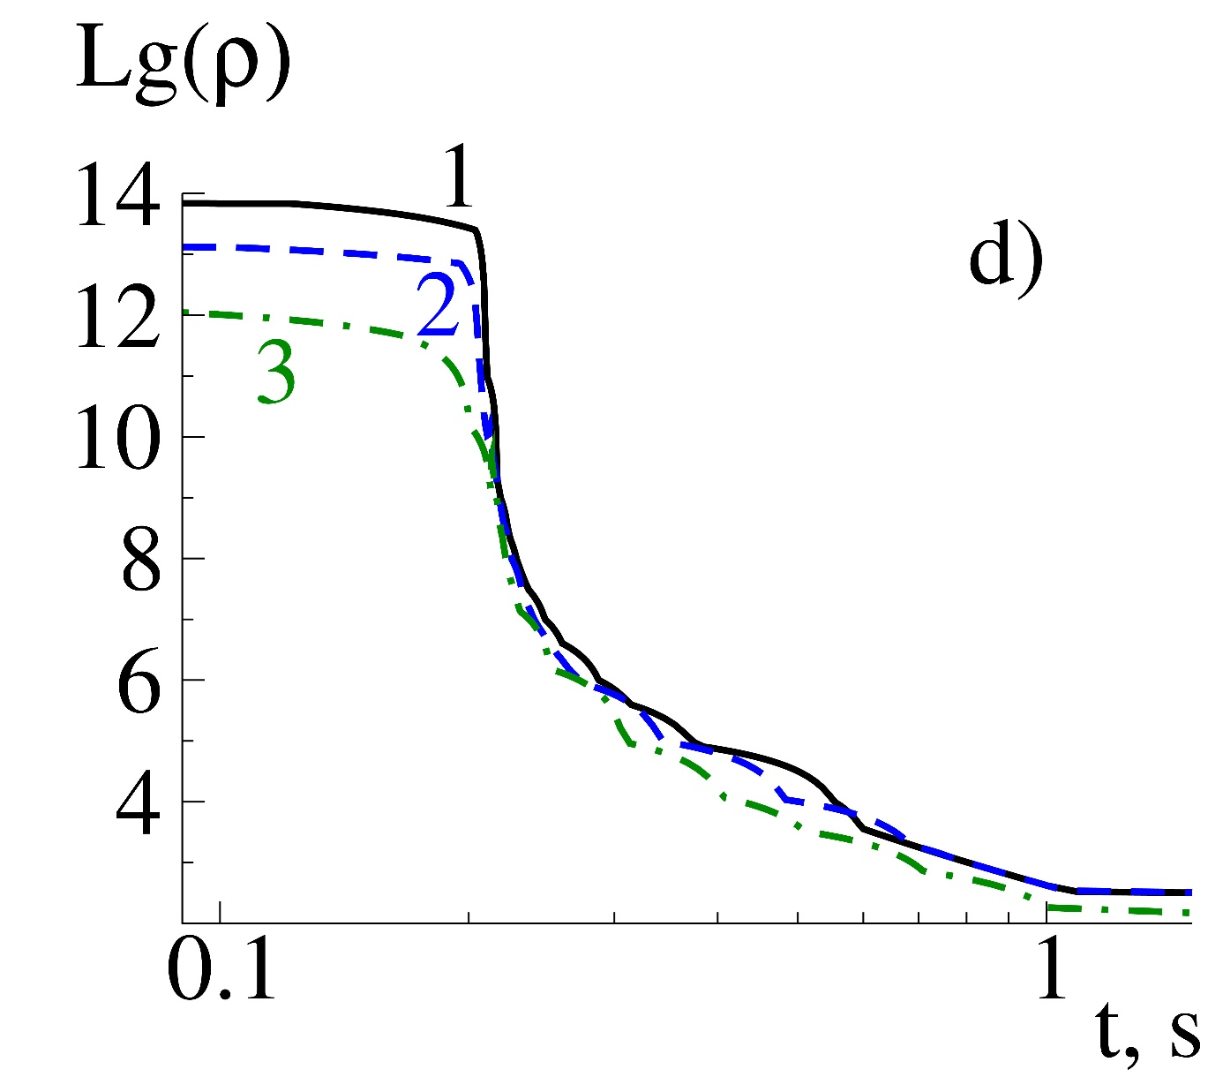
Inner crust conditions evolution
a) Electron per nucleon
b) Temperature GK
c) Free neutrons concentration
d) Density g cm⁻³

Slide 14
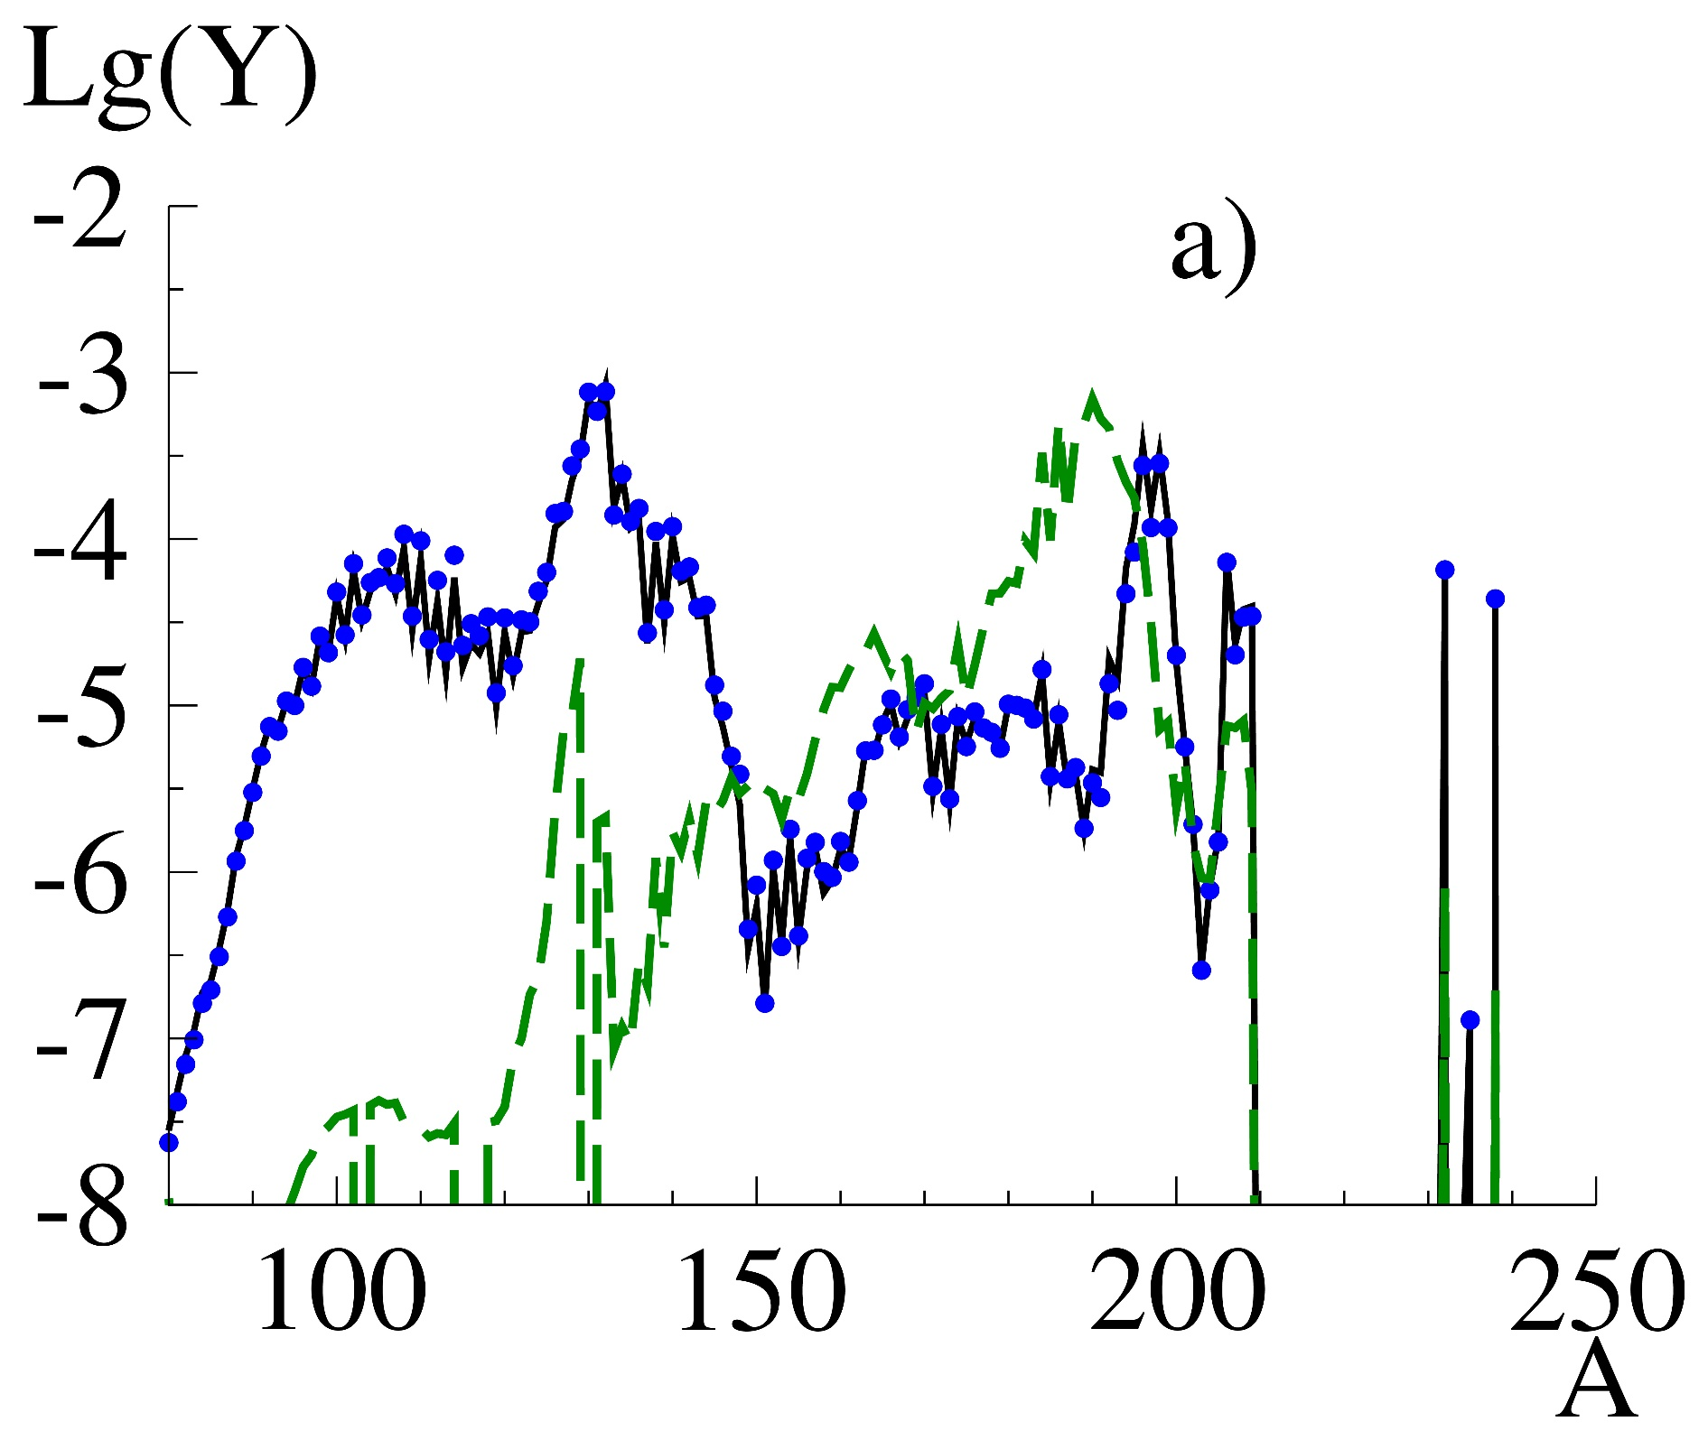
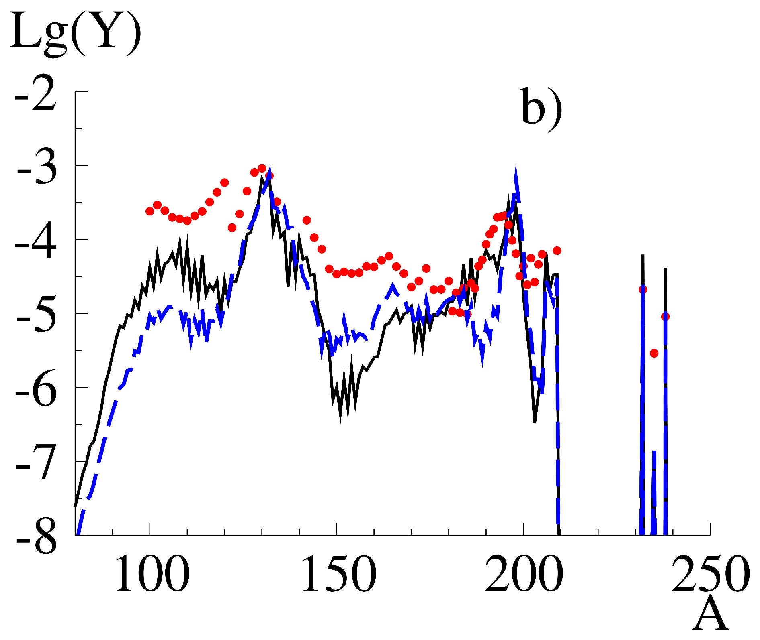

Slide 15
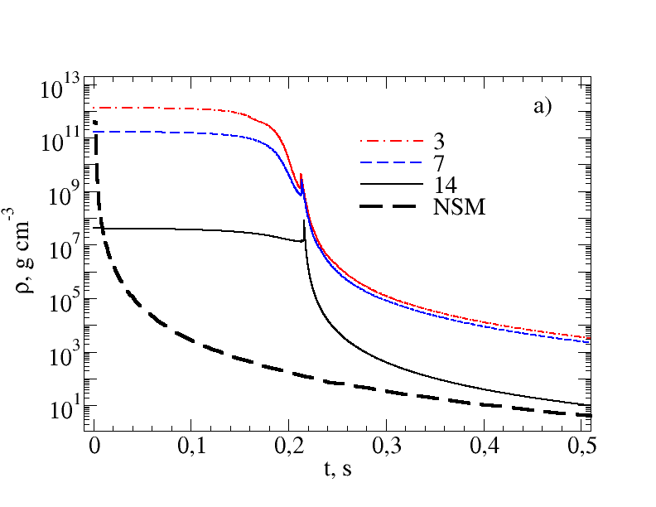
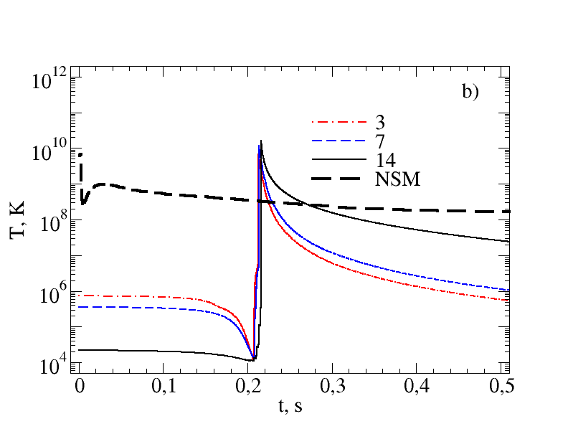
Stripping (3, 7, 14) + merging (NSM)

Slide 16
