Slide 1
Optimization of detector structure based on flow field numerical simulation with the assistance of artificial intelligence
Reporter: Haoyu Wang
Corresponding: Zhou Wang
E-mail: hywangsjtu@sjtu.edu.cn; wangzhou0303@sjtu.edu.cn.

Slide 2


Content:
1. Background
2. Model reliability validation with experimental data
3. Structure and single boundary condition optimization
4. Optimal flow field with fixed flowrate at present
5. Conclusion

Slide 3
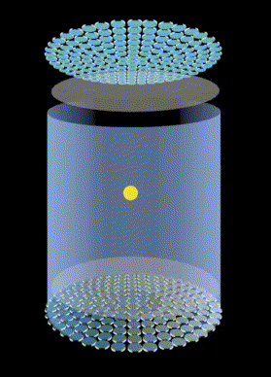
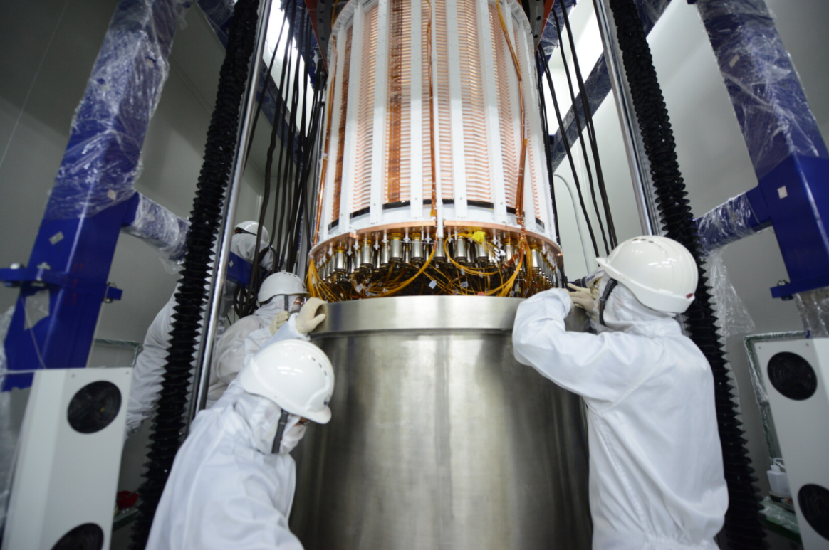
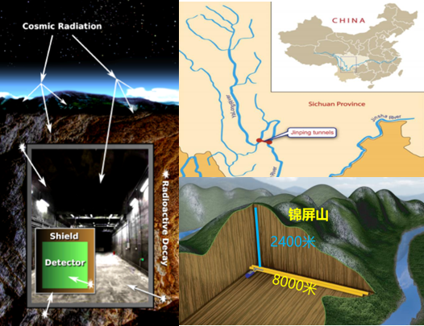
1. Background:
Xenon is a favored detection medium for dark matter (WIMP(Weakly Interacting Massive Particles))–nucleus elastic scattering.
PandaX is a dual phase liquid/gas xenon Time Projection Chamber (TPC) operated at cryogenic temperature for the direct search of the dark matter WIMPs.
The detector is located in the China JinPing Deep Underground Laboratory, 2400m from the ground for shielding against cosmic rays.

Slide 4
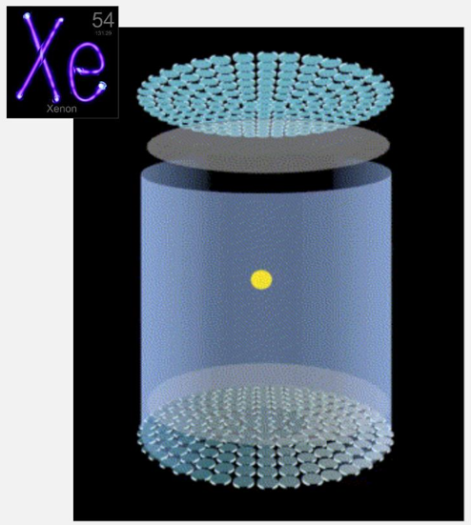
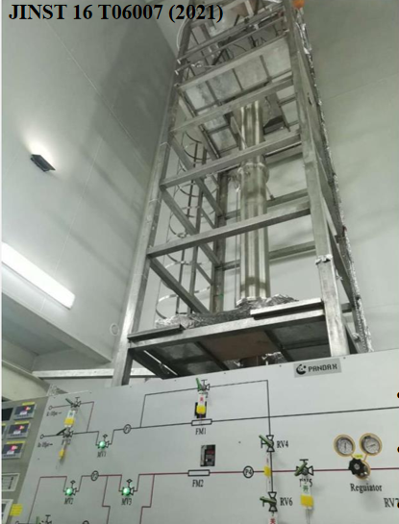
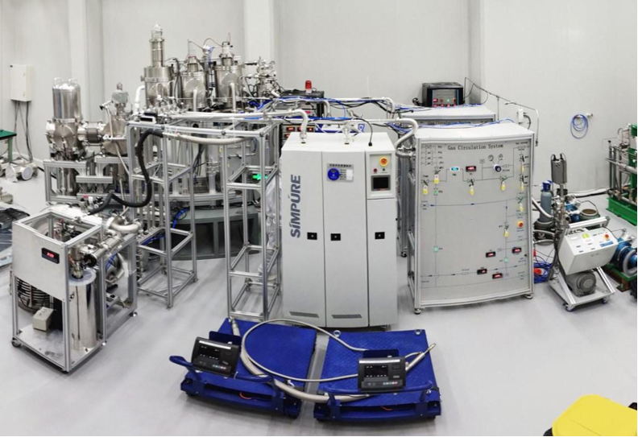
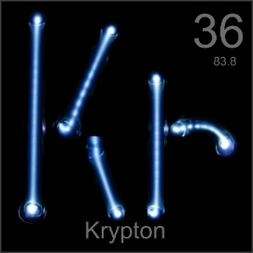
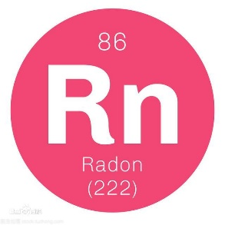
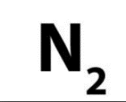
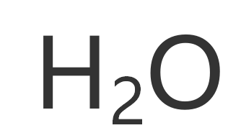
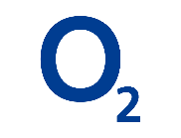

1. Background:
Low background leads high sensitivity
Two types of impurities:
(1) radioactive noble gas: Kr-85 and Rn-222, removed by distillation system;
(2) Electron-negative impurity, removed by the getter via purification system;
background control becomes decisive.
Radioactive
Impurity
Distillation
System
Electro-negative Impurity
Purification
System
Krypton-85 (Beta decay half-life of 10 years)
Even small amounts could effect detector sensitivity
Detector requirement: Kr<1ppt
Radon-222 generated from the decay of uranium and thorium inside the detector
Minuscule amount could effect detector sensitivity
Detector requirement:
Rn ~uBq/kg level
Absorb photon to effect detector sensitivity
Detector requirement: ~1ppb

Slide 5
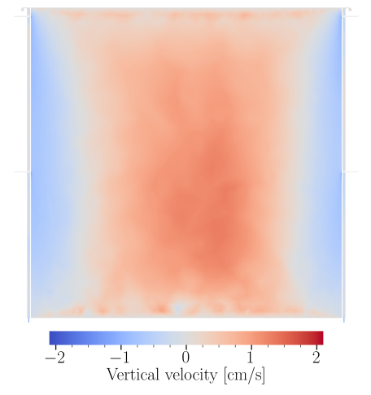
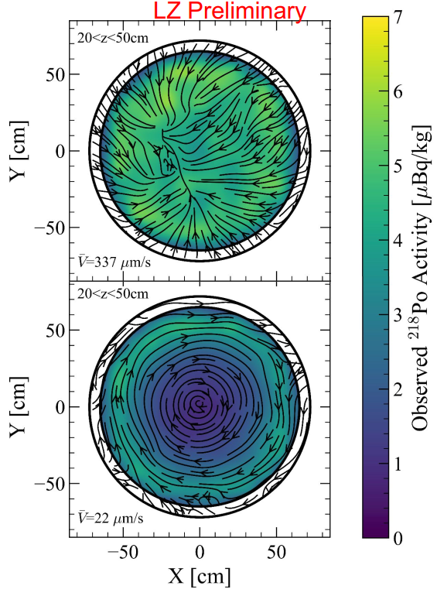
1. Background:
During circulation, the inlet/outlet configuration and flow field inside the detector affect the purification efficiency through dilution effects.
Related studies have been carried out in both the liquid-argon experiment DarkSide-20k [1] and the liquid-xenon experiment LZ [2].
[1]Acerbi, F., Ahmad, I., Aprile, E., Azzolini, O., Back, H. O., Bhowmick, P., … Zhu, T. (2025). Flow and thermal modelling of the argon volume in the DarkSide-20k TPC. Journal of Instrumentation, 20(6), P06046.
[2] LZ Collaboration, Background reduction and modeling in LZ: Flow-tag and double electron capture [Conference presentation slides], UCLA Dark Matter 2025, Los Angeles, America.

Slide 6
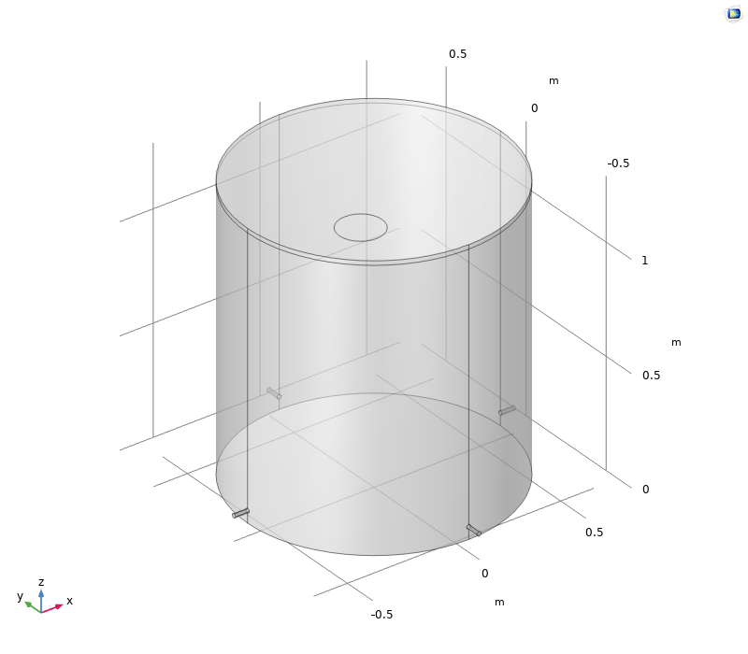
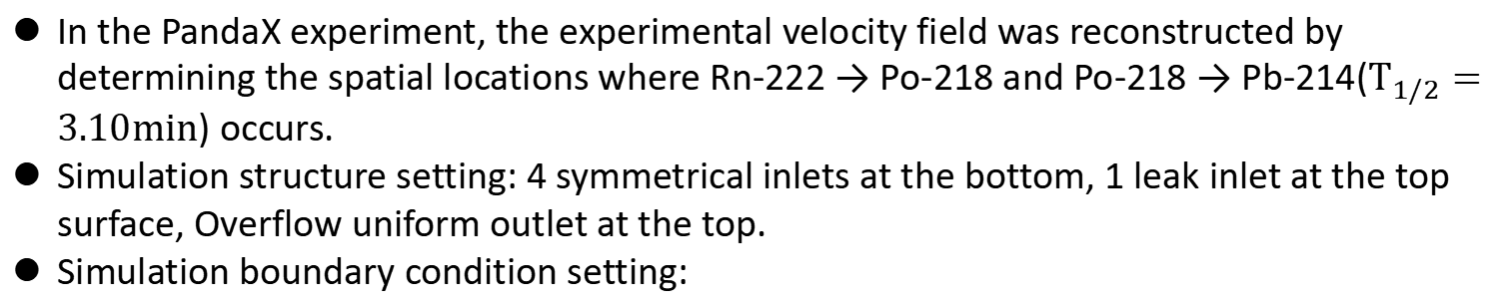
2. Model reliability validation with experimental data
In the PandaX experiment, the experimental velocity field was reconstructed by determining the spatial locations where Rn-222 → Po-218 and Po-218 → Pb-214($T_{1/2}=3.10min$) occurs.
Simulation structure setting: 4 symmetrical inlets at the bottom, 1 leak inlet at the top surface, Overflow uniform outlet at the top.
Simulation boundary condition setting:
Boundary Condition | Parameters
Circulation flowrate | 13.05 kg/h (37.5 SLPM)
Inlet temperature | 178.0K
Top temperature | 178.0K
Bottom temperature | 177.6K
Lateral wall heat leak | 4.5W

Slide 7
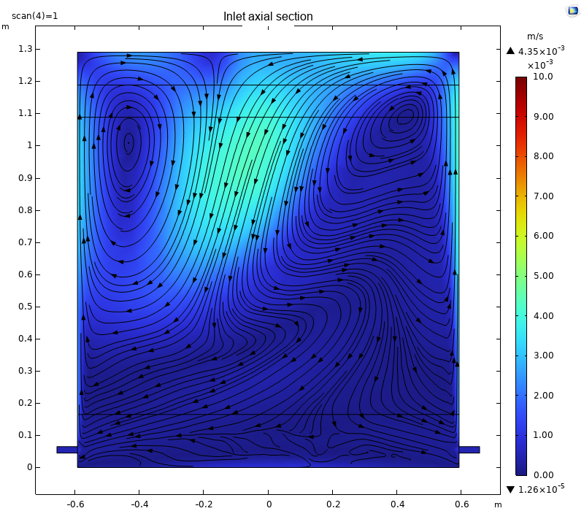
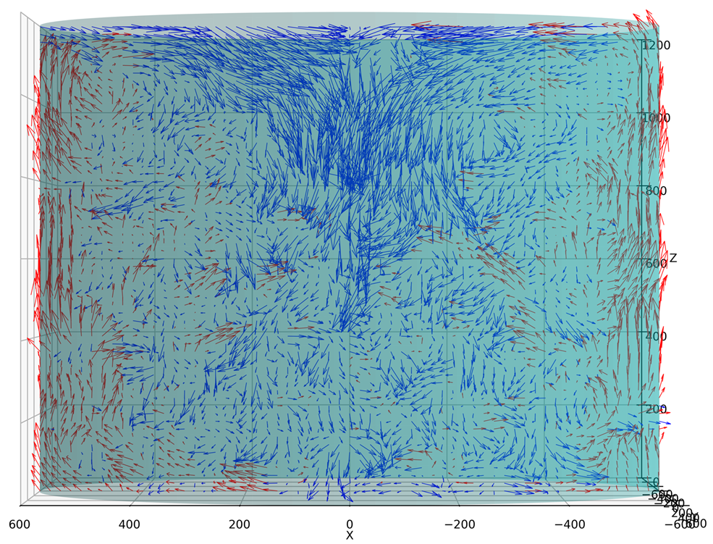
2.1 Model reliability validation – flow-field comparison
Experimental result
Simulation result

Slide 8
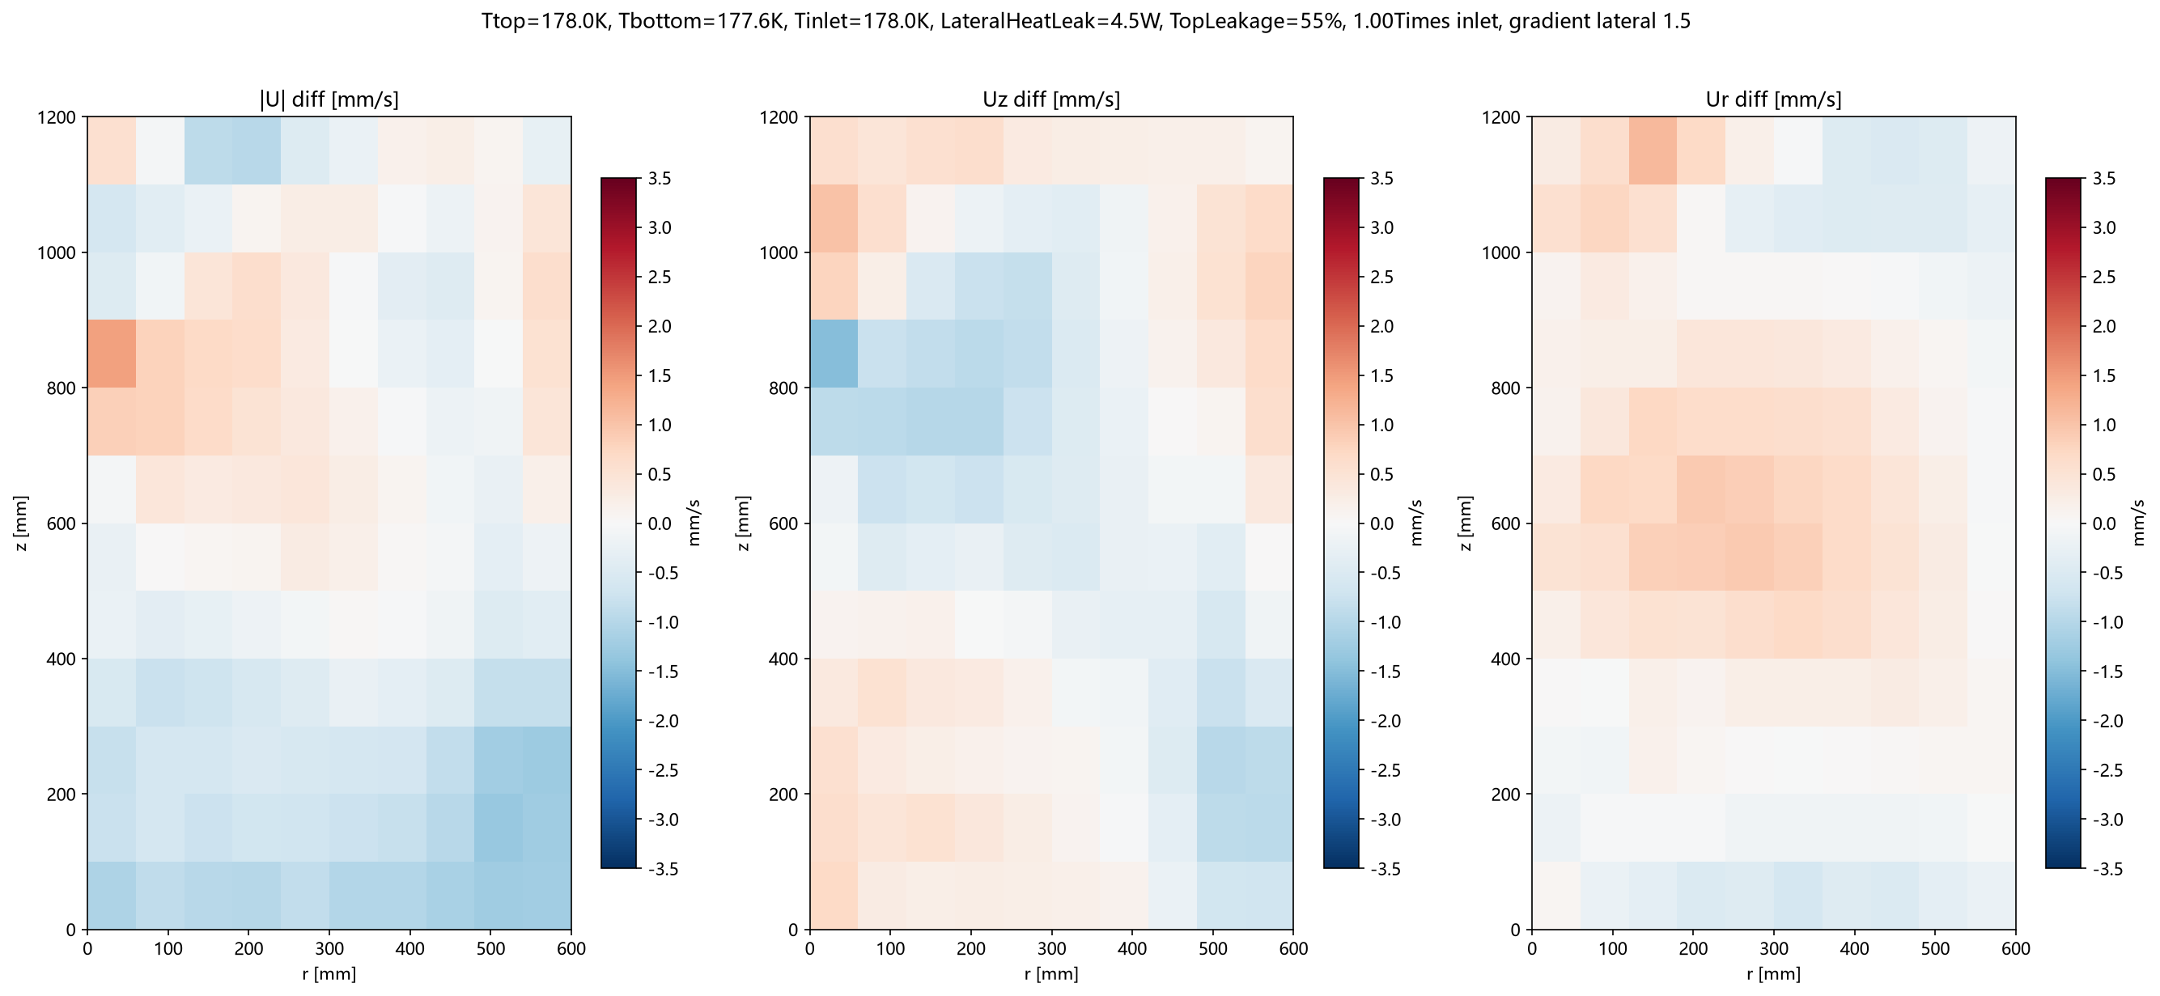
2.1 Model reliability validation – flow-field comparison
The (r, z) plane is divided into 8×6 = 48 bins; for each bin, the mean differences of |U|, Uz and Ur between simulation and experiment are computed.
The model is reliable, especially in the middle and lower parts.
Notes:
定量的 - quantitative

Slide 9
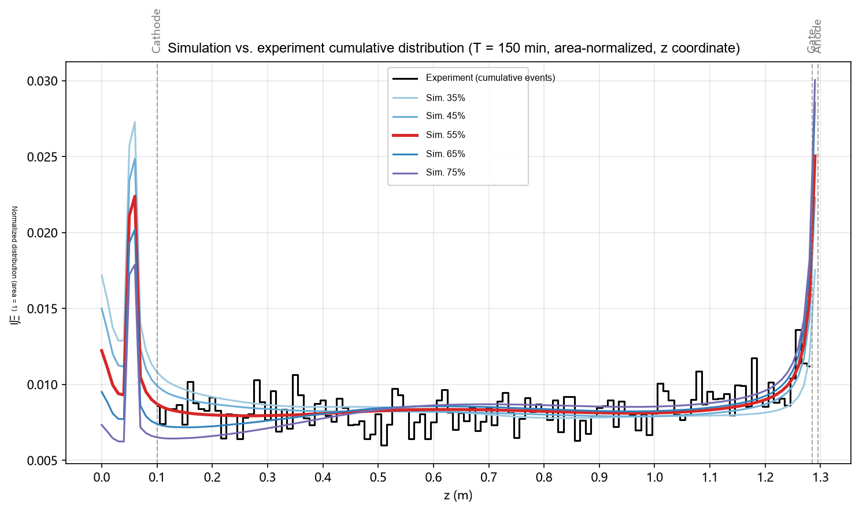
2.2 Model reliability validation – concentration-field comparison after Kr-83m injection
Simulation and experiment are compared by tracking the spatial distribution after Kr-83m injection. The measurement area has been normalized.
RMSD = sqrt(mean((sim_n − exp_n)²))，RMSD corresponding to 55% = $\text{1.1×}{10}^{−3}$
Notes:
验证 - verify，Kr-83m - Krypton eighty-three metastable

Slide 10
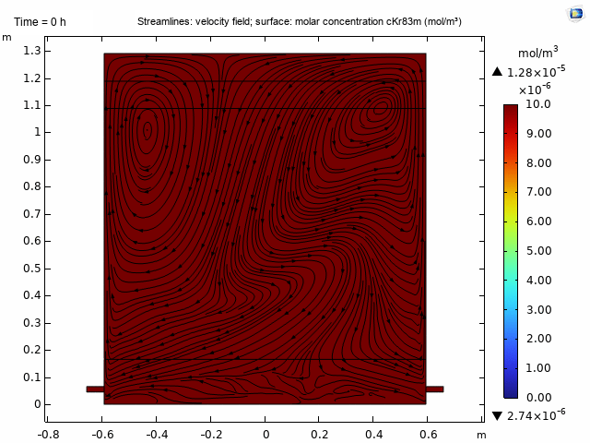
3. Structure and single boundary condition optimization
PandaX-4T Purification Process
Distillation
Remove Kr and Rn
Getter
Remove electron-attracting impurity
Before purification
After purification

Slide 11
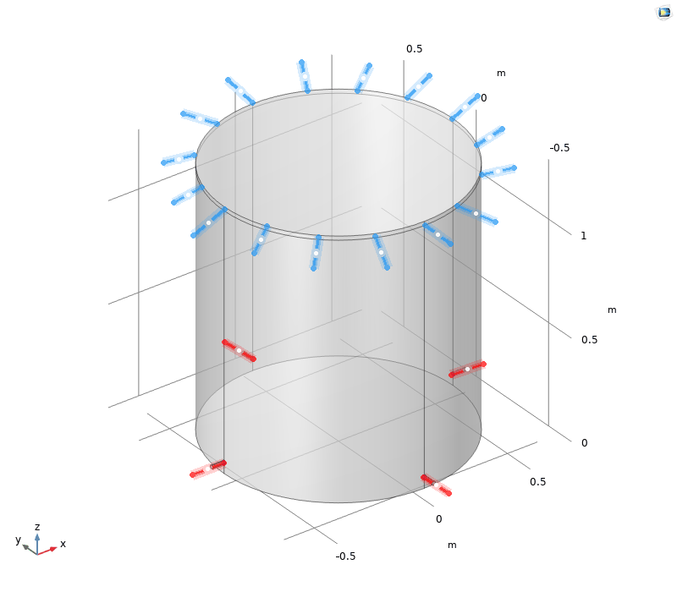
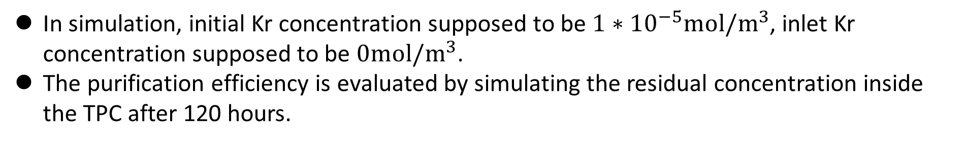
3. Structure and single boundary condition optimization
Initial simulation structure (corresponding to PandaX-4T TPC) setting: 4 symmetrical inlets at the bottom, Overflow uniform outlet at the top.
Initial simulation boundary condition setting:
Boundary Condition | Parameters
Circulation flowrate | 13.05 kg/h (37.5 SLPM)
Inlet temperature | 178.0K
Top temperature | 178.0K
Bottom temperature | 177.6K
Lateral wall heat leak | 4.5W
In simulation, initial Kr concentration supposed to be $1∗{10}^{−5}mol/m^{3}$, inlet Kr concentration supposed to be $0mol/m^{3}$.
The purification efficiency is evaluated by simulating the residual concentration inside the TPC after 120 hours.

Slide 12
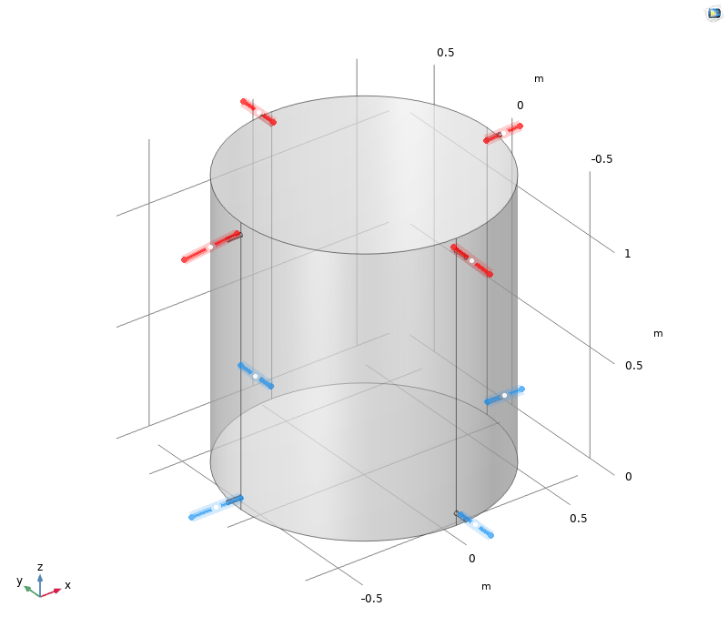
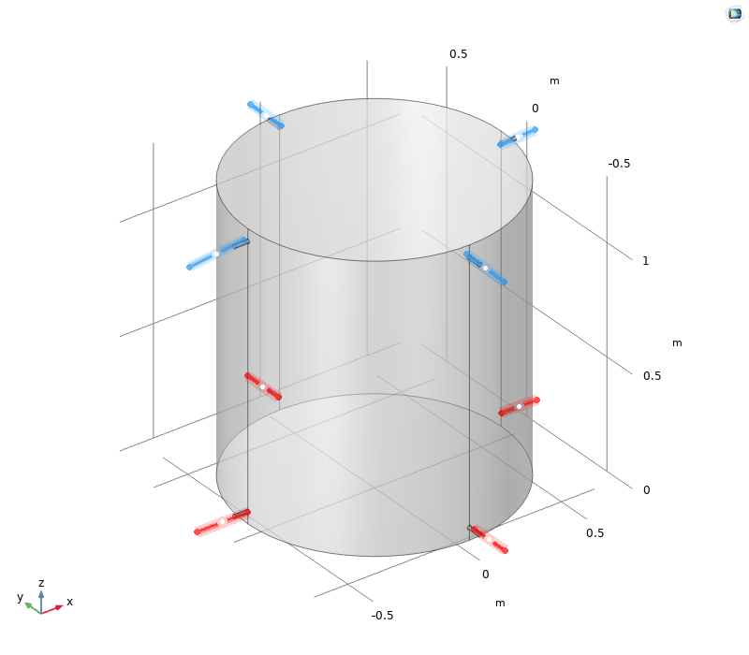
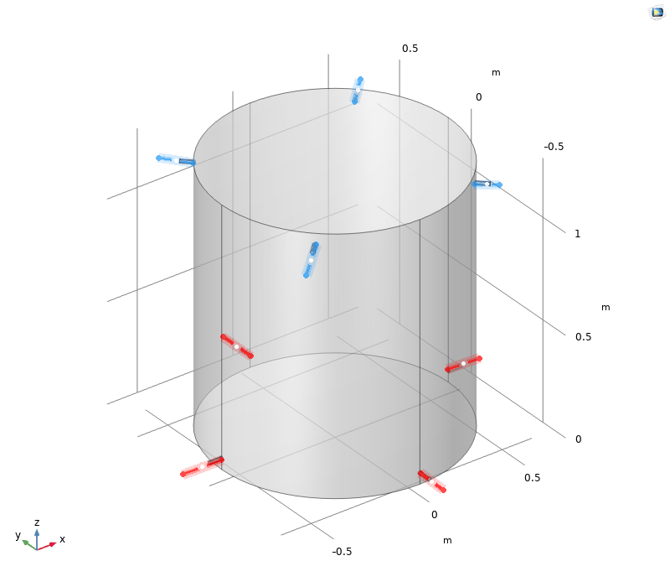
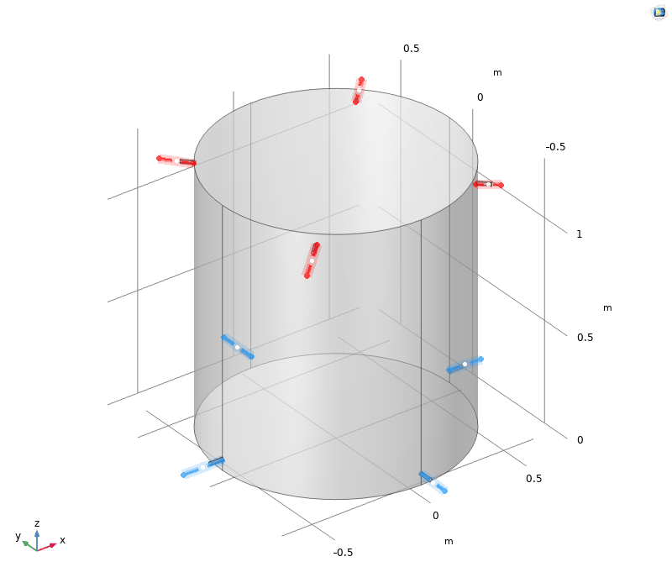
3.1 Structure optimization – inlet/outlet distribution
initial
2
5
3
4
 | inlet | outlet
initial | 4 symmetrical, bottom | Overflow uniform, top
bottom in, top out – pipes for outlet
2 | 4 symmetrical, bottom | 4 symmetrical, top | aligned
3 |  |  | cross
top in, bottom out
4 | 4 symmetrical, top | 4 symmetrical, bottom | aligned
5 |  |  | cross

Slide 13
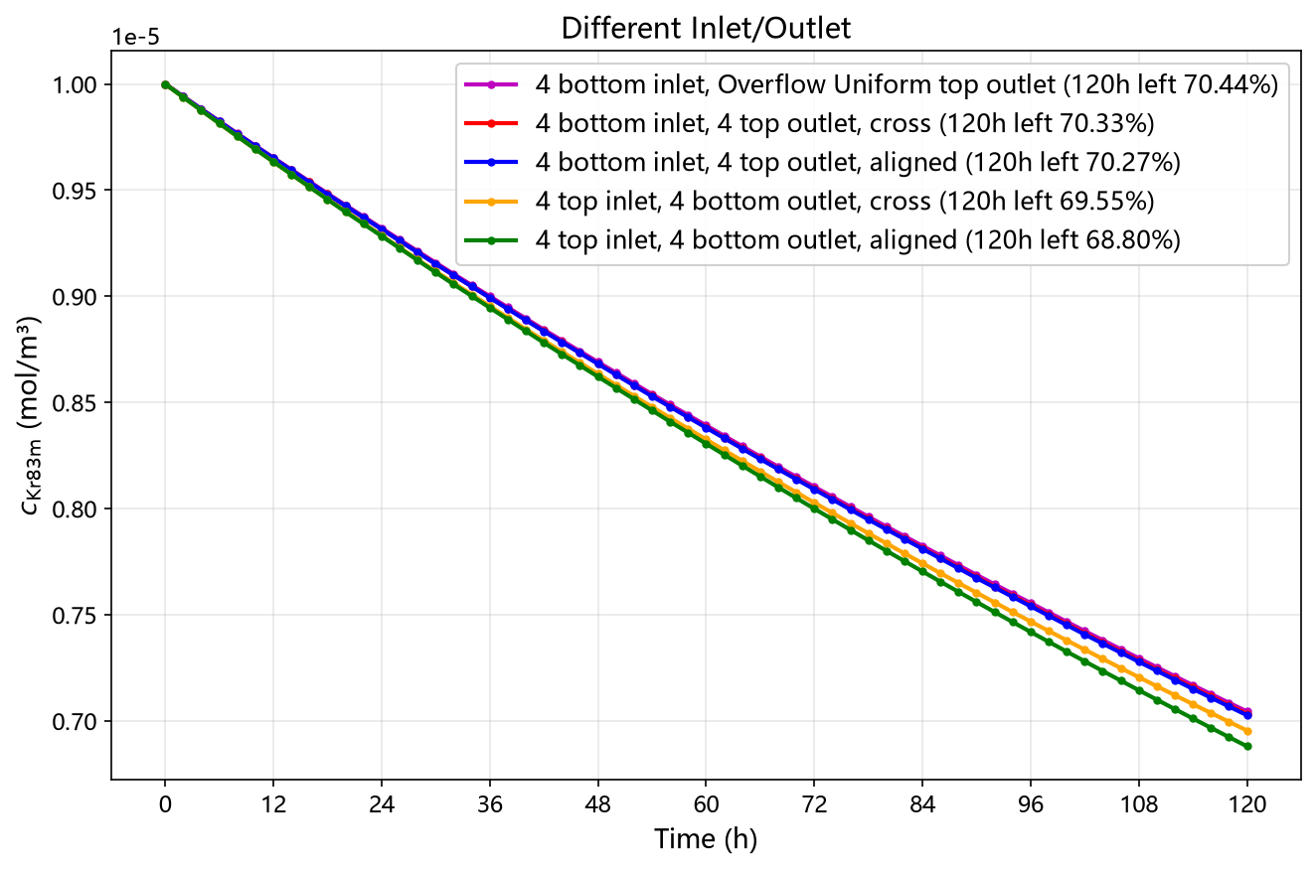
3.1 Structure optimization – effect of inlet/outlet distribution
Conclusion: 4 symmetrical top inlet, 4 symmetrical bottom outlet, aligned, is optimal.

Slide 14
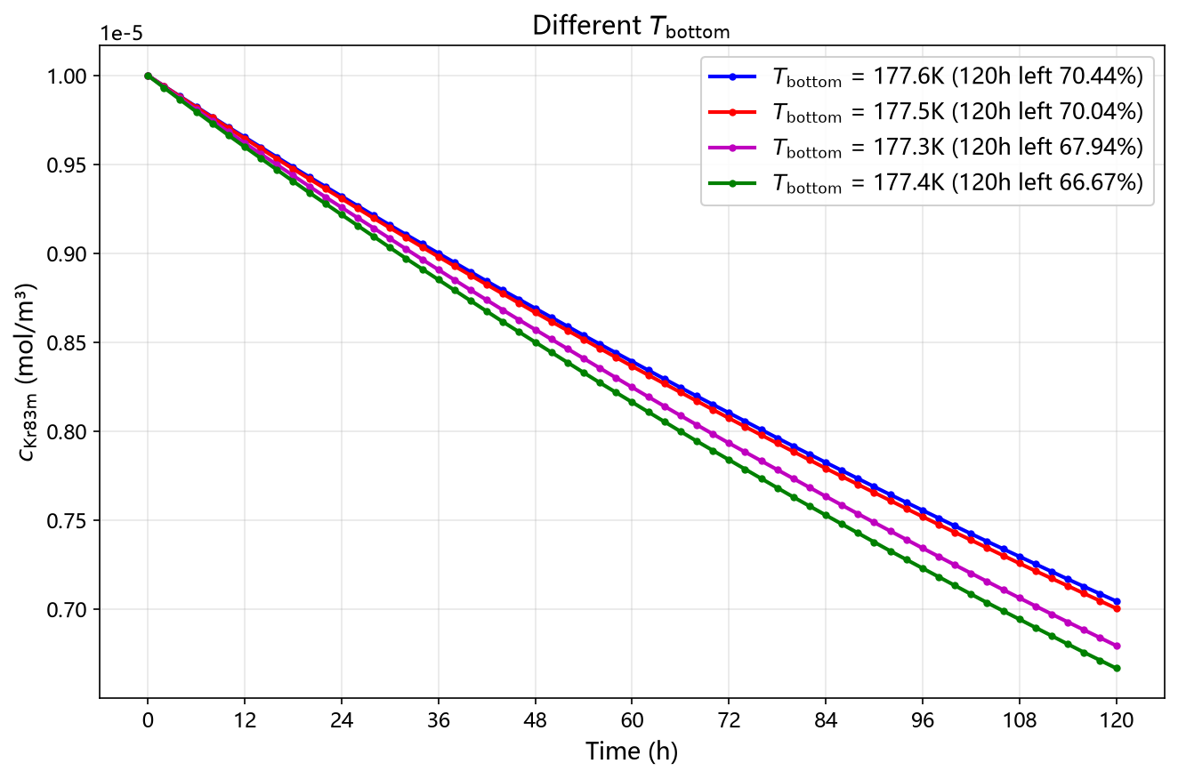
3.2 Single boundary condition optimization – effect of bottom temperature
Conclusion: $T_{bottom}$ = 177.4K is optimal with $T_{top}$ = 178.0K and lateral wall heat leak 4.5W.

Slide 15
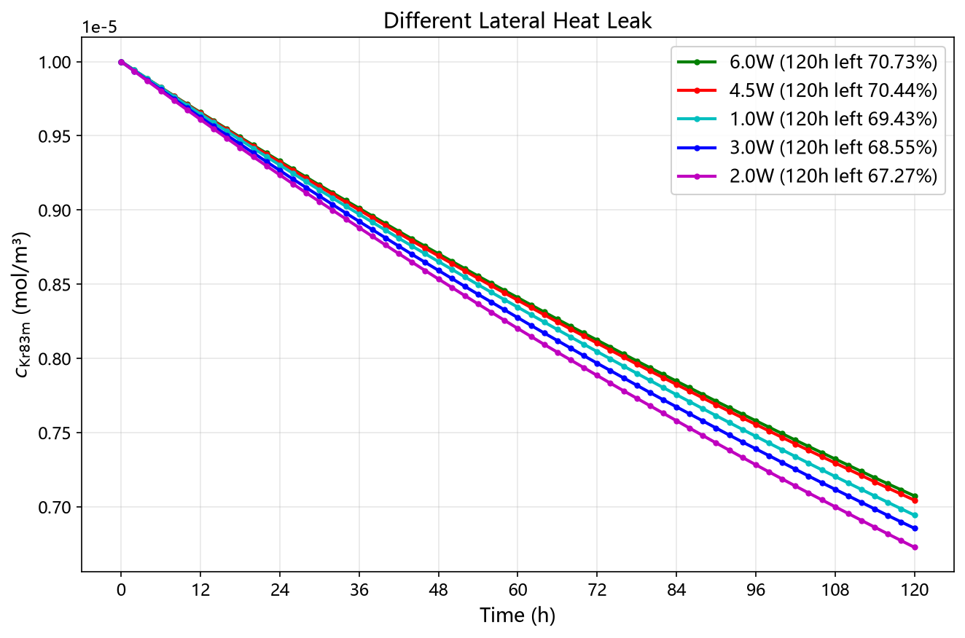
3.3 Single boundary condition optimization – effect of lateral wall heat leak
Conclusion: lateral wall heat leak 2.0W is optimal with $T_{top}$ = 178.0K and $T_{bottom}$ = 177.6K.

Slide 16
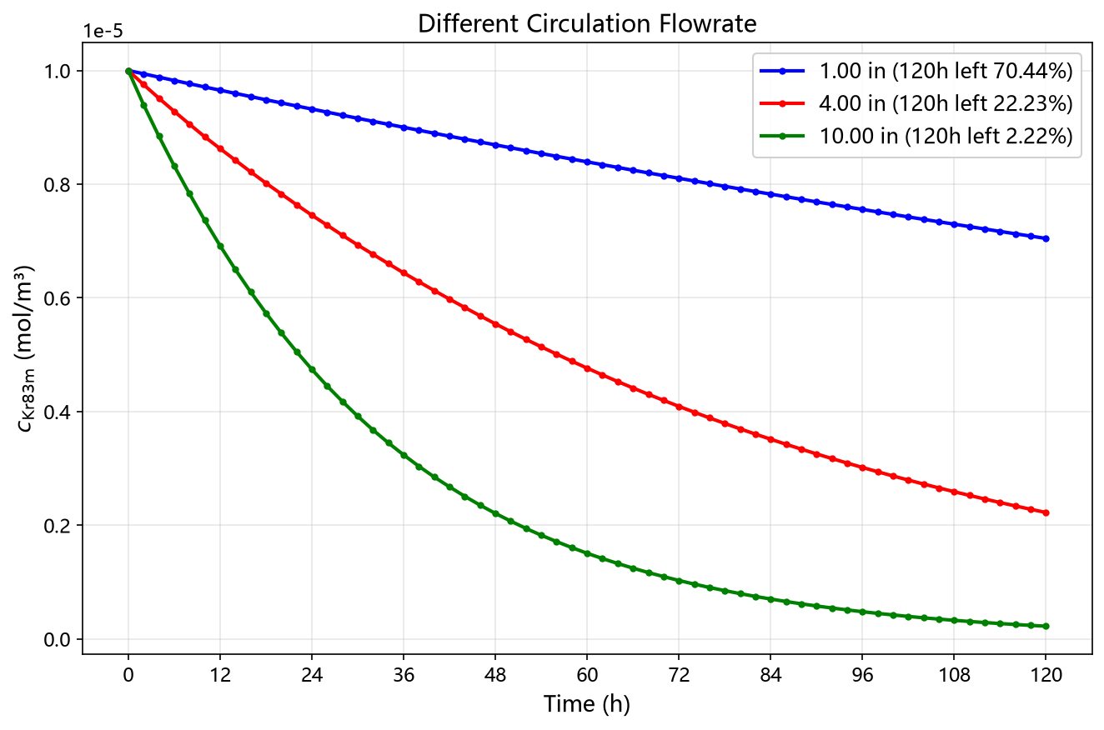
3.4 Single boundary condition optimization – effect of circulation flow rate
Conclusion: increasing the circulation flow rate is highly beneficial.

Slide 17
4. Optimal flow field with fixed flowrate at present
Through cross-testing simulations of structure, bottom temperature and lateral wall heat leak, the optimal result at present is below:
Structure setting: 4 symmetrical inlets at the bottom, Overflow uniform outlet at the top.
Simulation boundary condition setting:
Boundary Condition | Parameters
Circulation flowrate | 13.05 kg/h (37.5 SLPM)
Inlet temperature | 178.0K
Top temperature | 178.0K
Bottom temperature | 177.4K
Lateral wall heat leak | 4.5W

Slide 18
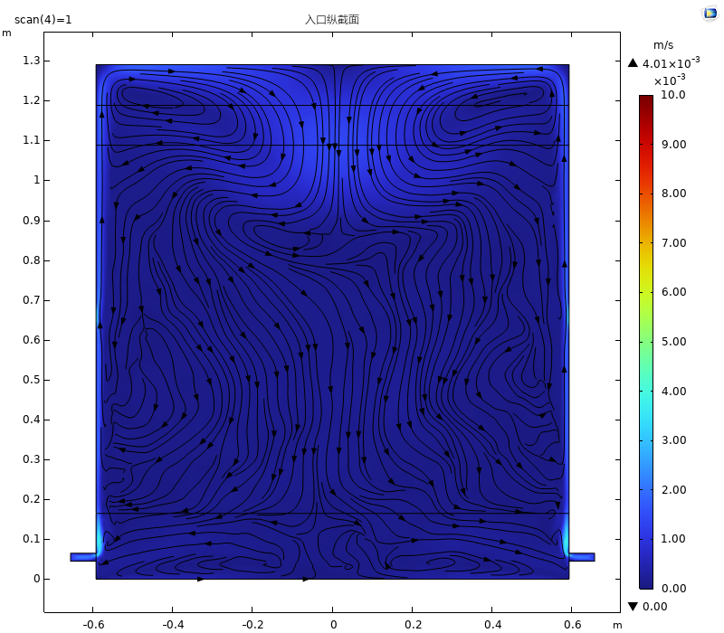
4.1 Optimal flow field with fixed flowrate - compared with initial
Before optimization
After optimization

Slide 19
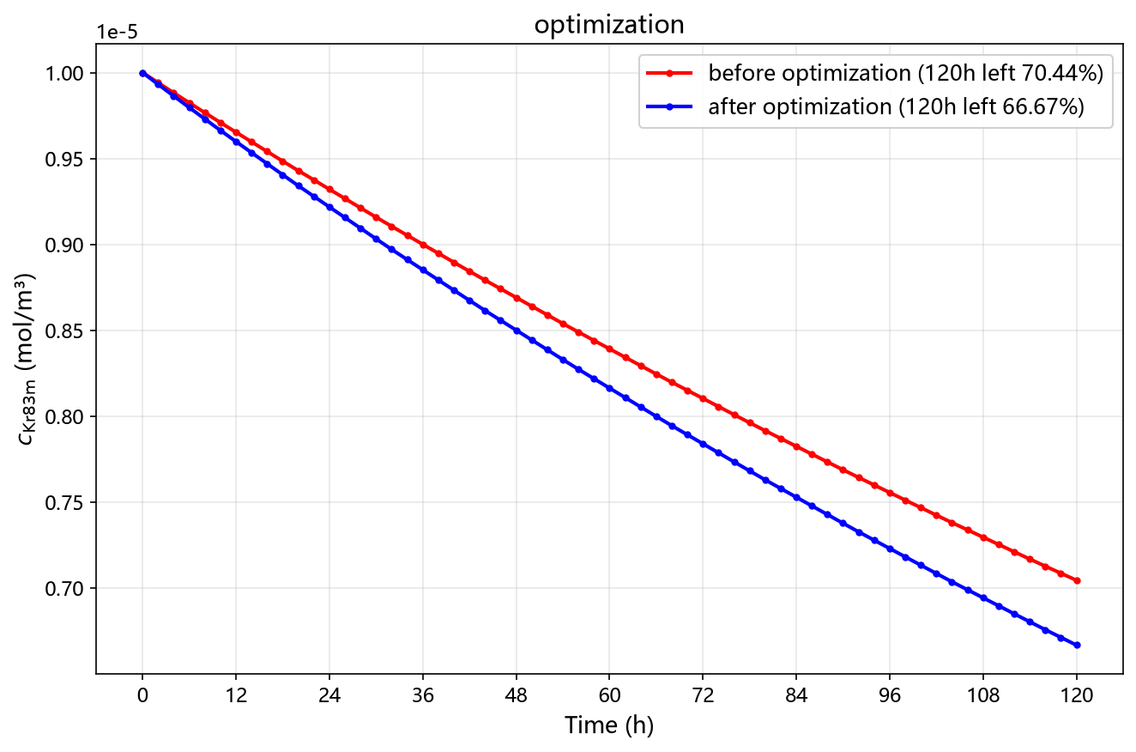
4.2 Optimal purification efficiency - compared with initial
Conclusion: Purification efficiency increase 12.75% (from 29.56% to 33.33%) after optimization.

Slide 20
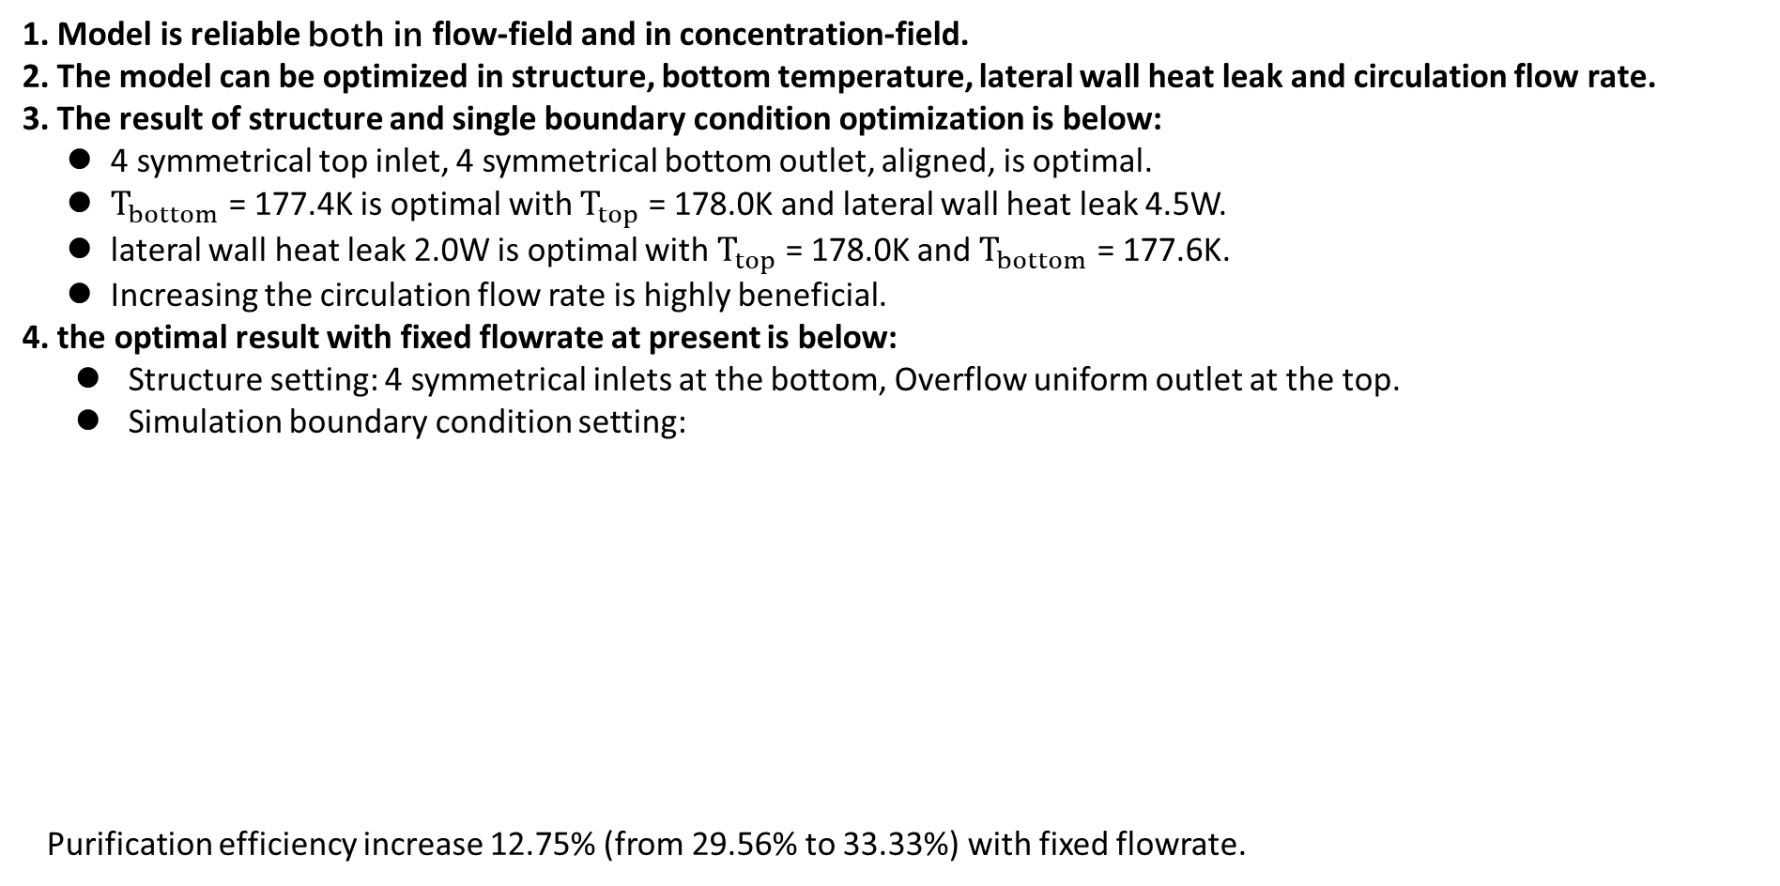
5. Conclusions
1. Model is reliable both in flow-field and in concentration-field.
2. The model can be optimized in structure, bottom temperature, lateral wall heat leak and circulation flow rate.
3. The result of structure and single boundary condition optimization is below:
4 symmetrical top inlet, 4 symmetrical bottom outlet, aligned, is optimal.
$T_{bottom}$ = 177.4K is optimal with $T_{top}$ = 178.0K and lateral wall heat leak 4.5W.
lateral wall heat leak 2.0W is optimal with $T_{top}$ = 178.0K and $T_{bottom}$ = 177.6K.
Increasing the circulation flow rate is highly beneficial.
4. the optimal result with fixed flowrate at present is below:
Structure setting: 4 symmetrical inlets at the bottom, Overflow uniform outlet at the top.
Simulation boundary condition setting:
Purification efficiency increase 12.75% (from 29.56% to 33.33%) with fixed flowrate.
Boundary Condition | Parameters
Circulation flowrate | 13.05 kg/h (37.5 SLPM)
Inlet temperature | 178.0K
Top temperature | 178.0K
Bottom temperature | 177.4K
Lateral wall heat Leak | 4.5W

Slide 21
Thank you for your attention !

Slide 22
Back up

Slide 23
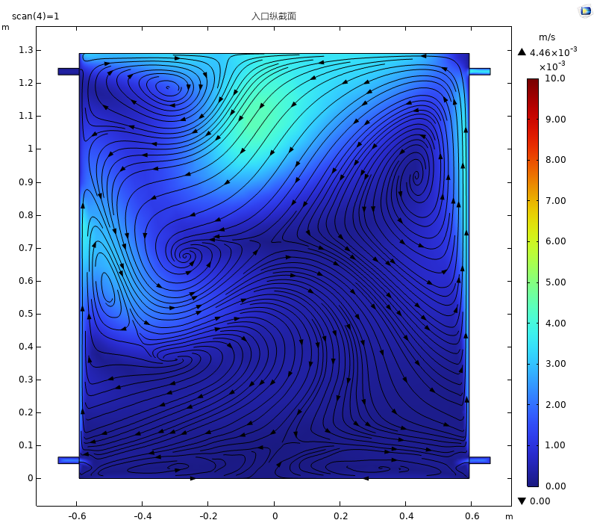
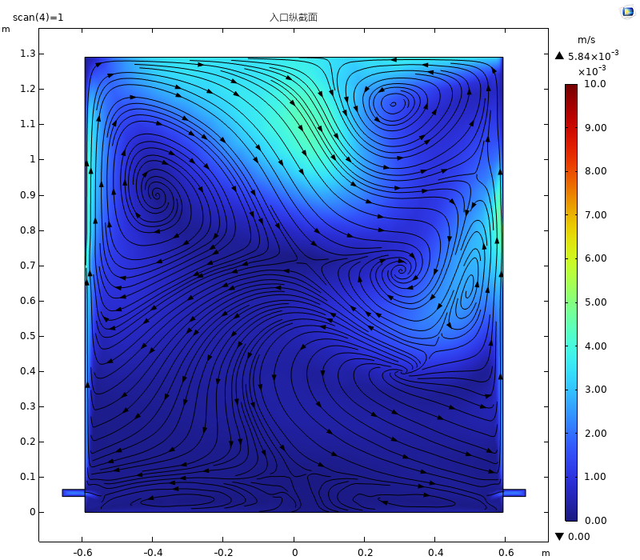
3.1 Structure optimization – effect of inlet/outlet distribution
4 bottom inlet, 4 top outlet, aligned
4 bottom inlet, 4 top outlet, cross

Slide 24
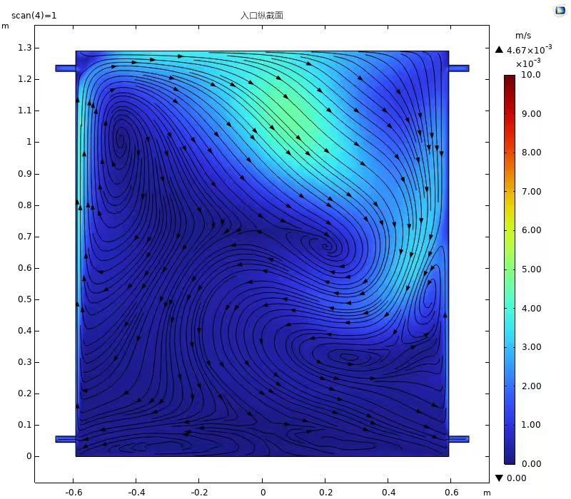
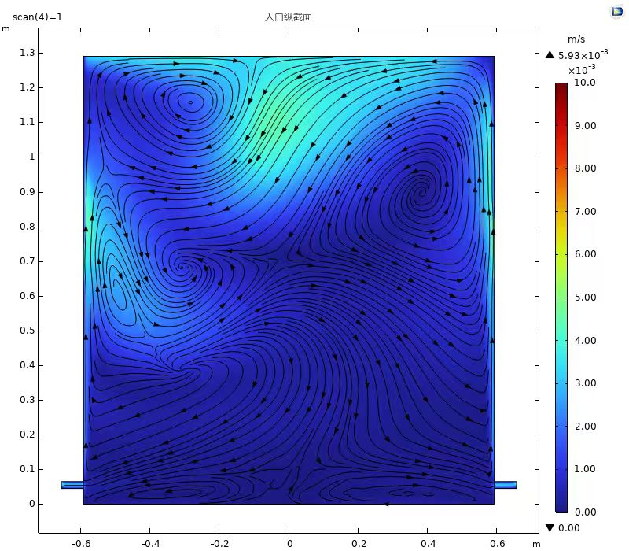
3.1 Structure optimization – effect of inlet/outlet distribution
4 top inlet, 4 bottom outlet, aligned
4 top inlet, 4 bottom outlet, cross

Slide 25
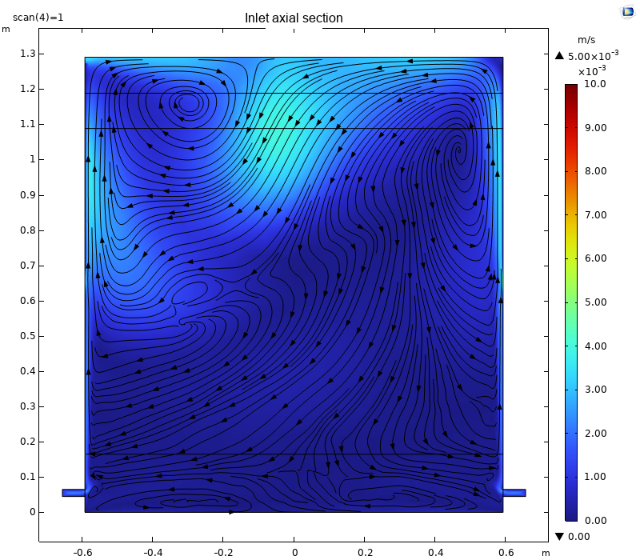
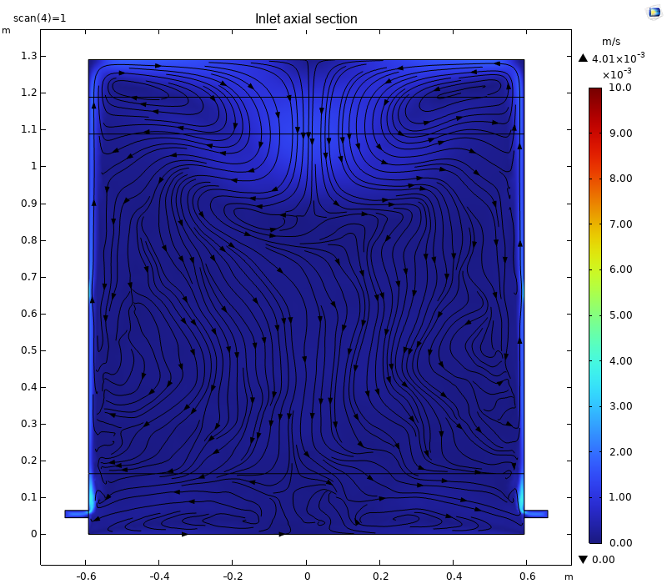
3.2 Structure optimization – effect of bottom temperature – flow field
T_bottom=177.5K
T_bottom=177.4K

Slide 26
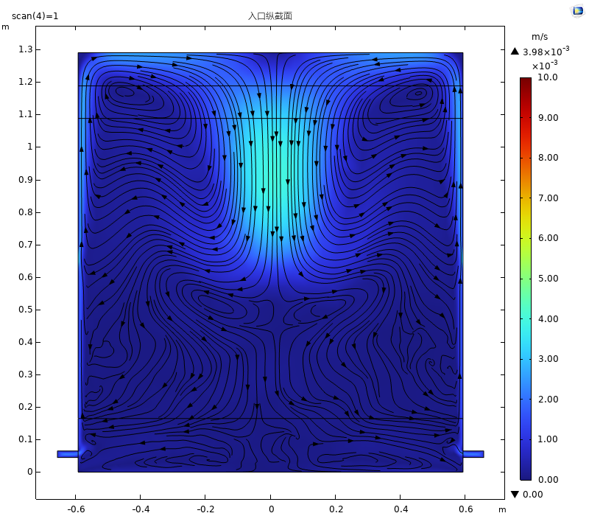
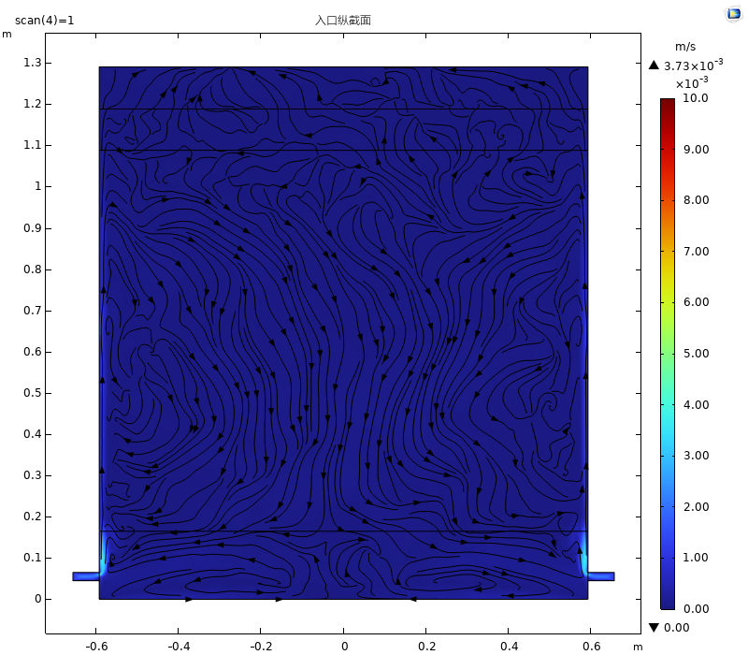
3.3 Boundary condition optimization – effect of lateral wall heat leak
Lateral wall heat leak 3.0W
Lateral wall heat leak 2.0W

Slide 27
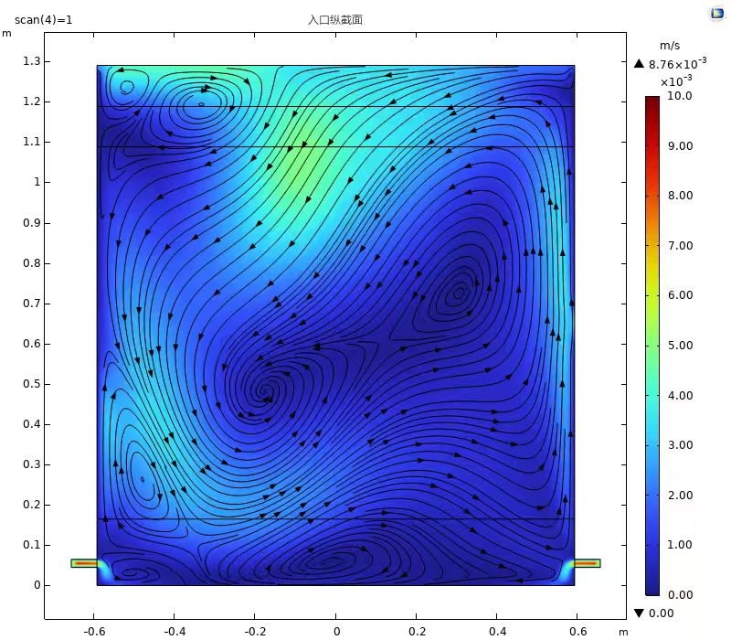
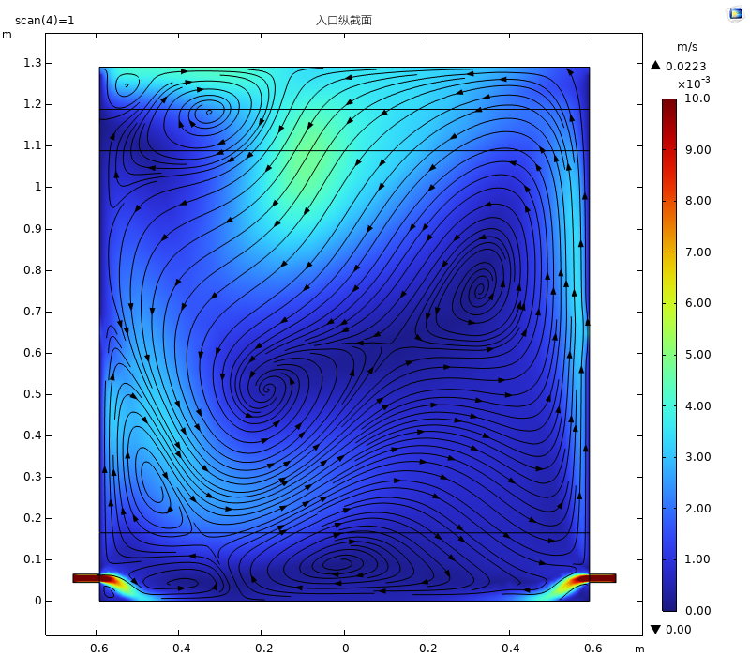
3.4 Boundary condition optimization – effect of circulation flow rate
Circulation flow rate 4 times
Circulation flow rate 10 times

Slide 28

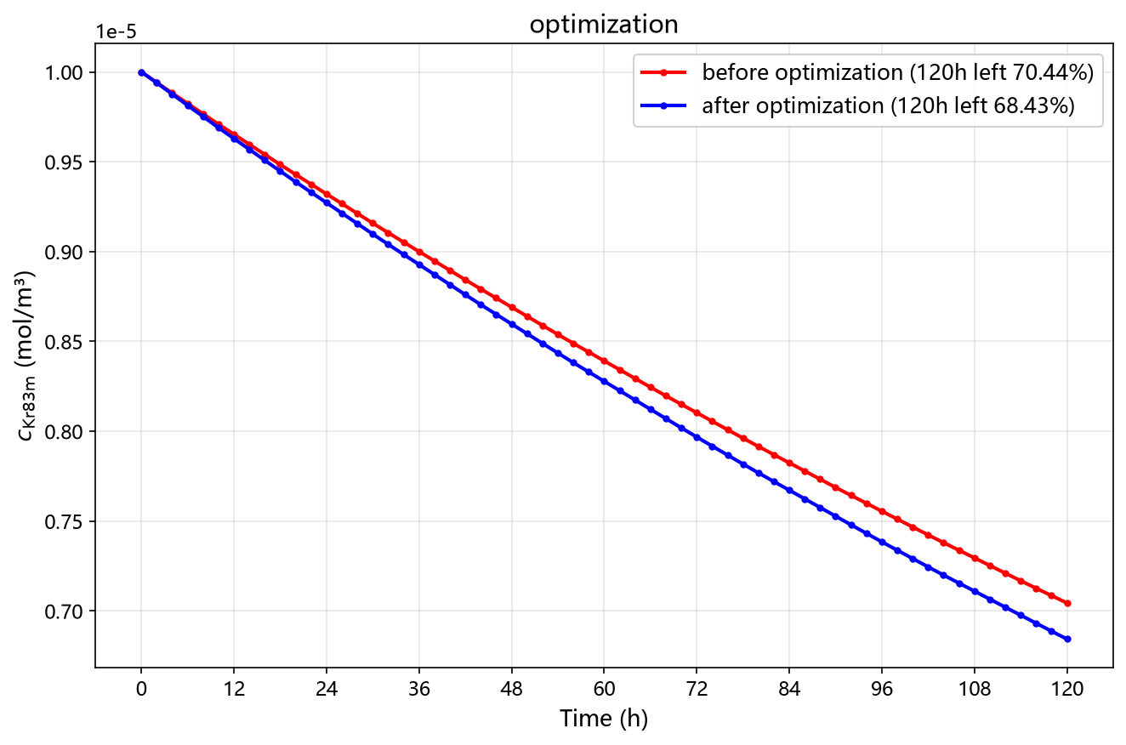
4. Optimal flow field with fixed flowrate at present
Structure setting: 4 symmetrical top inlets, Overflow uniform outlet at the top.
Simulation boundary condition setting:
Kr concentration at t=120h is 68.43%, worse than just optimizing the bottom temperature (66.67%).
Boundary Condition | Parameters
Circulation flowrate | 13.05 kg/h (37.5 SLPM)
Inlet temperature | 178.0K
Top temperature | 178.0K
Bottom temperature | 177.4K
Lateral wall heat Leak | 3.0W

Slide 29
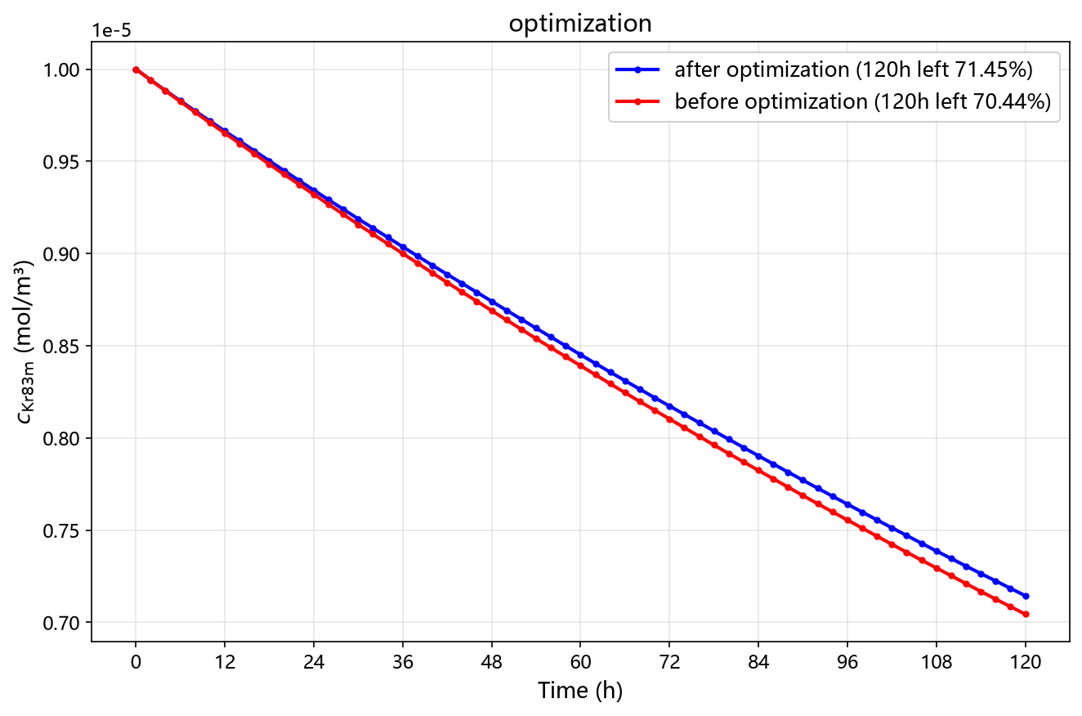
4. Optimal flow field with fixed flowrate at present
Structure setting: 4 symmetrical top inlet, 4 symmetrical bottom outlet, aligned.
Simulation boundary condition setting:
Kr concentration at t=120h is 71.45%, even worse than initial (70.44%).
Boundary Condition | Parameters
Circulation flowrate | 13.05 kg/h (37.5 SLPM)
Inlet temperature | 178.0K
Top temperature | 178.0K
Bottom temperature | 177.4K
Lateral wall heat Leak | 2.0W

