Slide 1
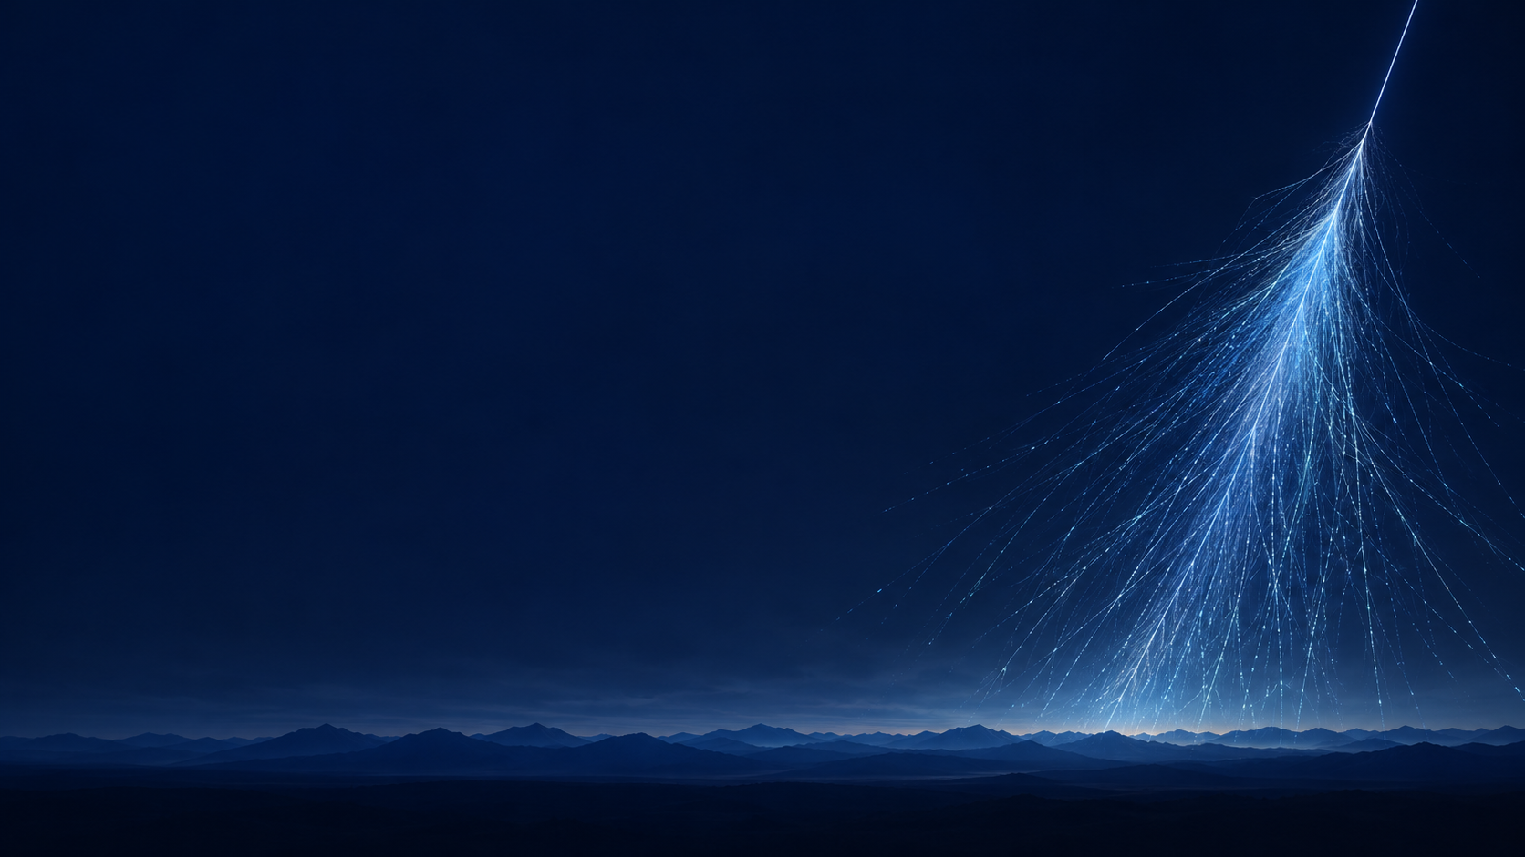


The 8th International Conference on Particle Physics and Astrophysics
Analysis of the electron-photon and hadron components of EAS according to the data of the NEVOD-EAS and PRISMA-32 installations
E.A. Yuzhakova, A.G. Bogdanov, D.M. Gromushkin, A.Yu. Konovalova, D. V. Fedorov, Yu. V. Stenkin, S.S. Khokhlov, I.A. Shulzhenko, E.P. Khomchuk
October, 30
Moscow, 2026

Slide 2
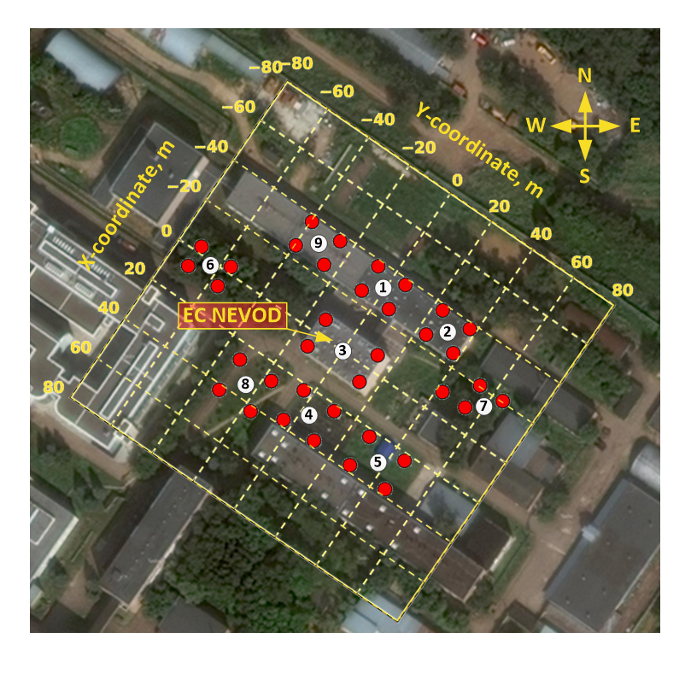
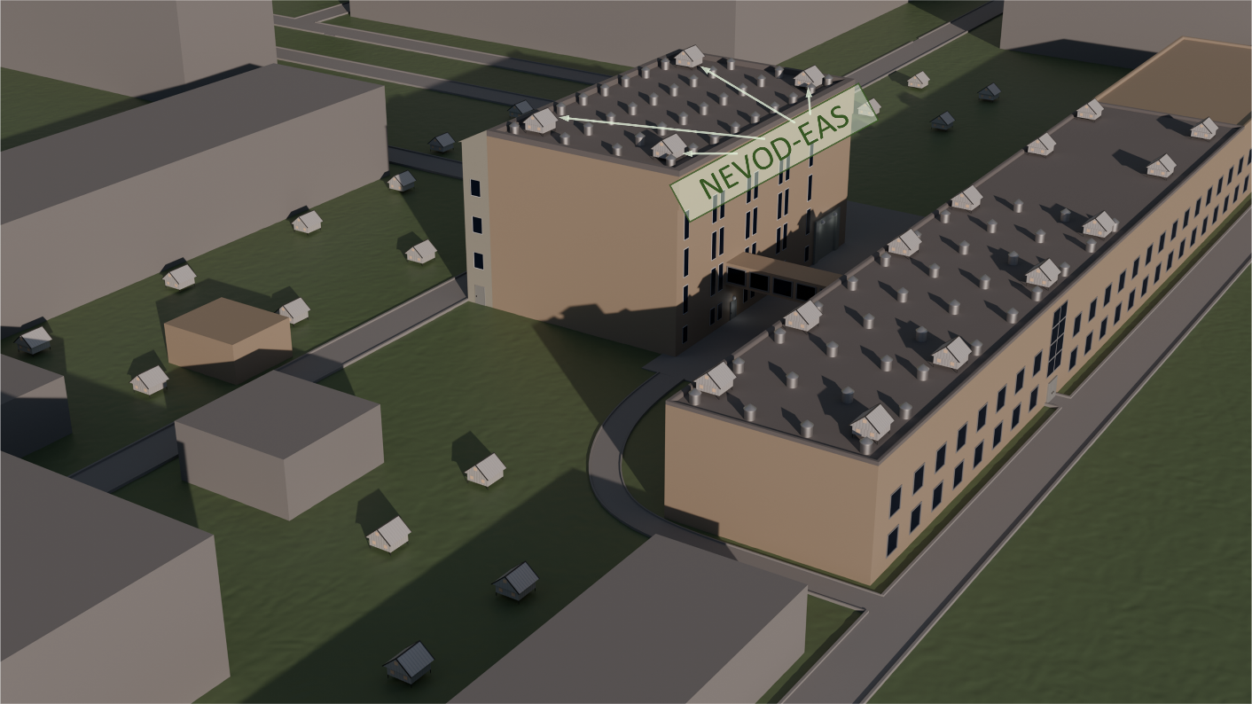
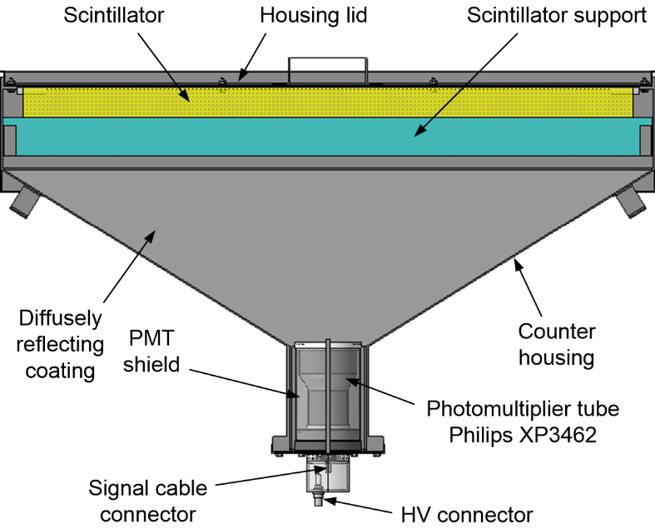
NEVOD-EAS array
Electron-photon component of showers
9 clusters, 36 detector stations;
Array area: 10⁴ m².
The array gives the main shower parameters:
arrival direction and axis position,
shower size and shower age.

Slide 3
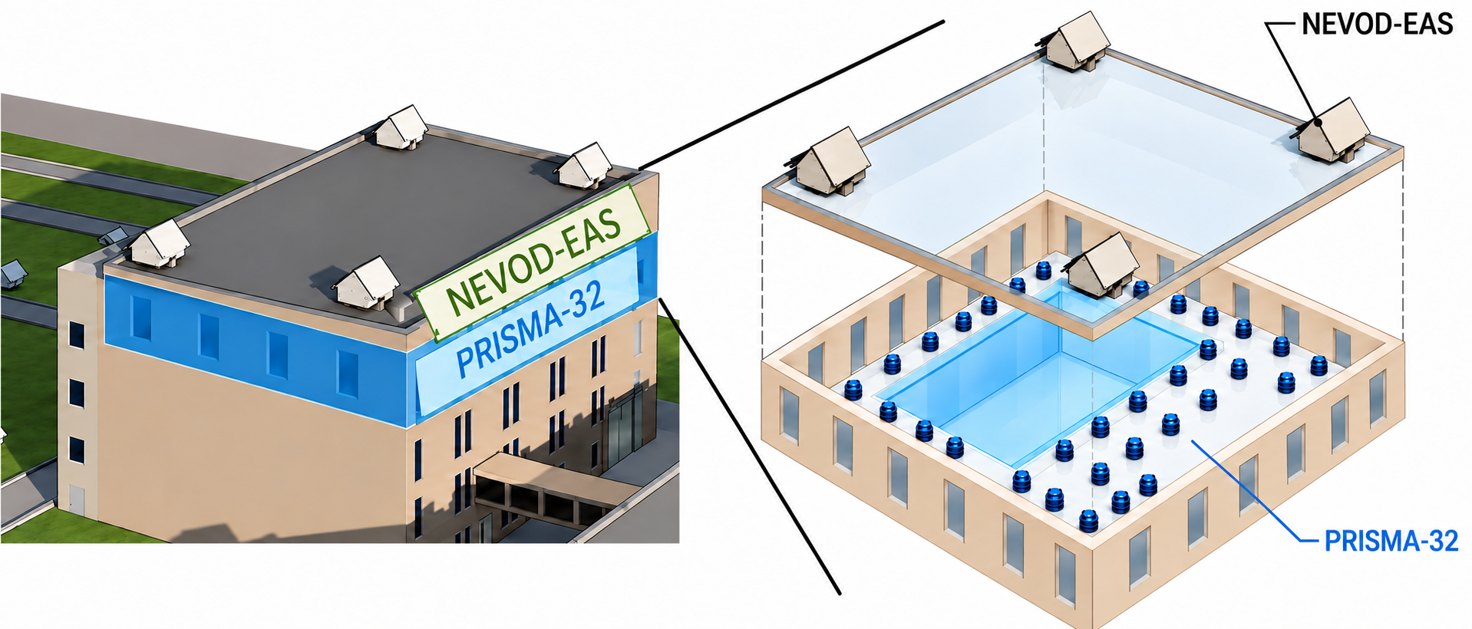
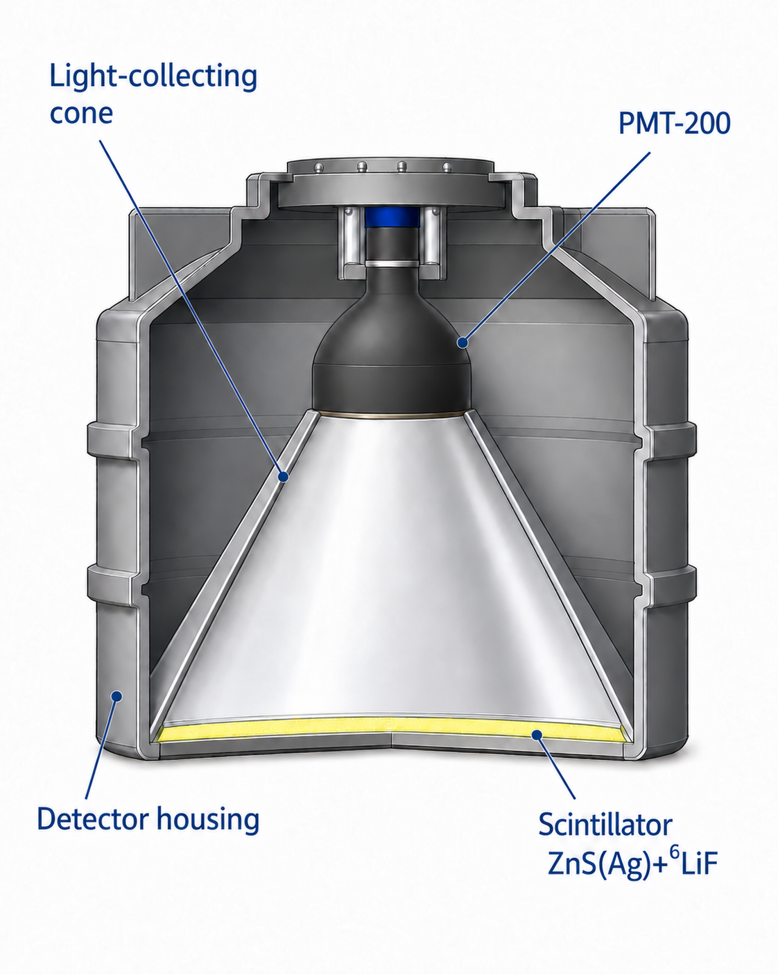
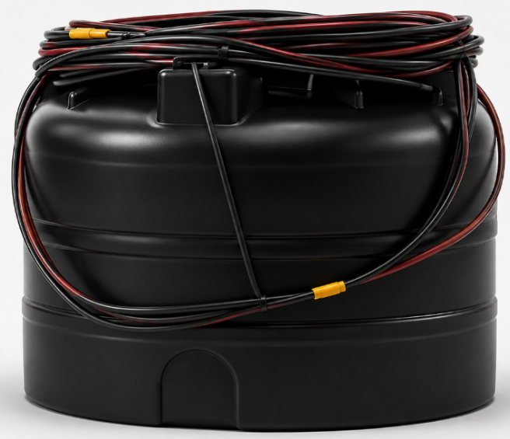
PRISMA-32 array
Hadron + charged component
32 en-detectors;
Area: 500 m².
Scintillator: ZnS(Ag) + ⁶LiF
⁶Li + n → ³H + α + 4.8 MeV

Slide 4
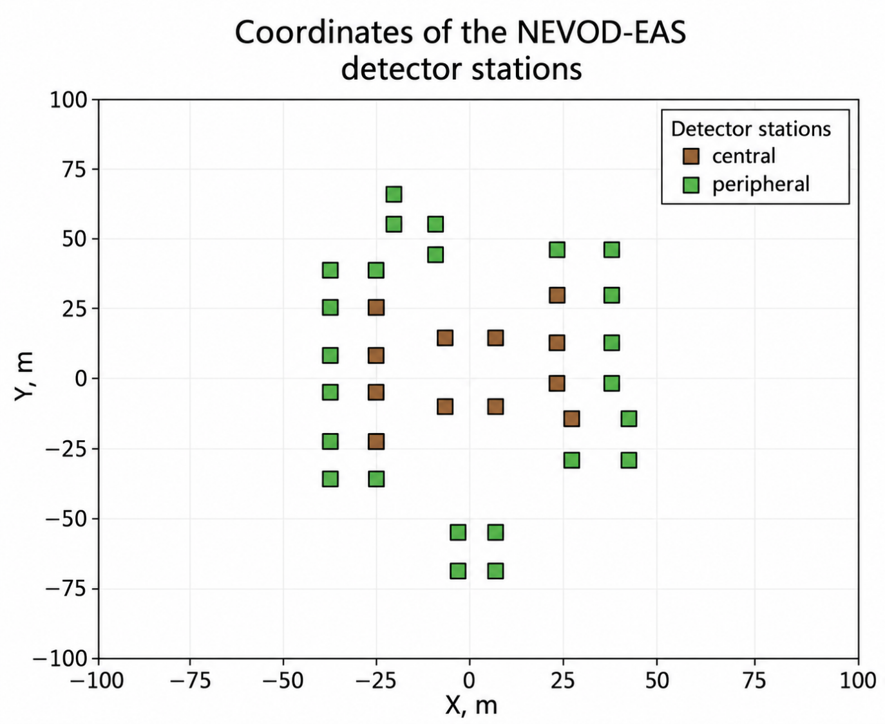
Data for analysis
NEVOD-EAS and PRISMA-32 data from 2018 to 2023
Joint events: 152 000
ρ_{max} in central detectors
Energy deposit ≥1 GeV
Zenith angle < 30°
After selection criteria: 9 900 events

Slide 5
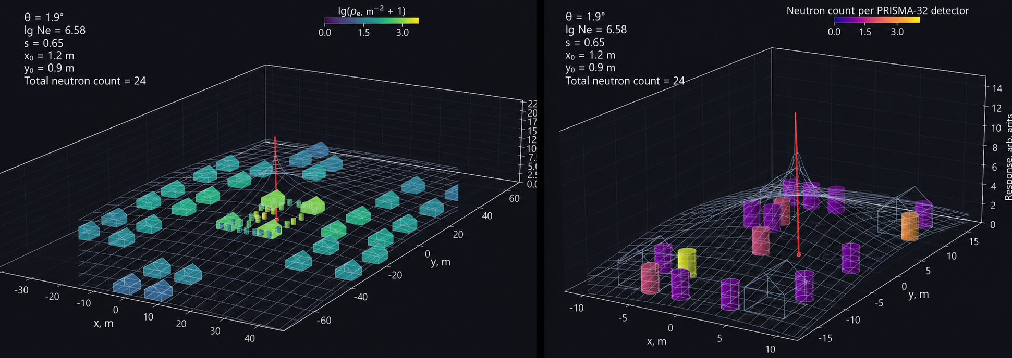
Example of a coincident event
Charged-particle: NEVOD-EAS
Thermal neutrons: PRISMA-32

Slide 6
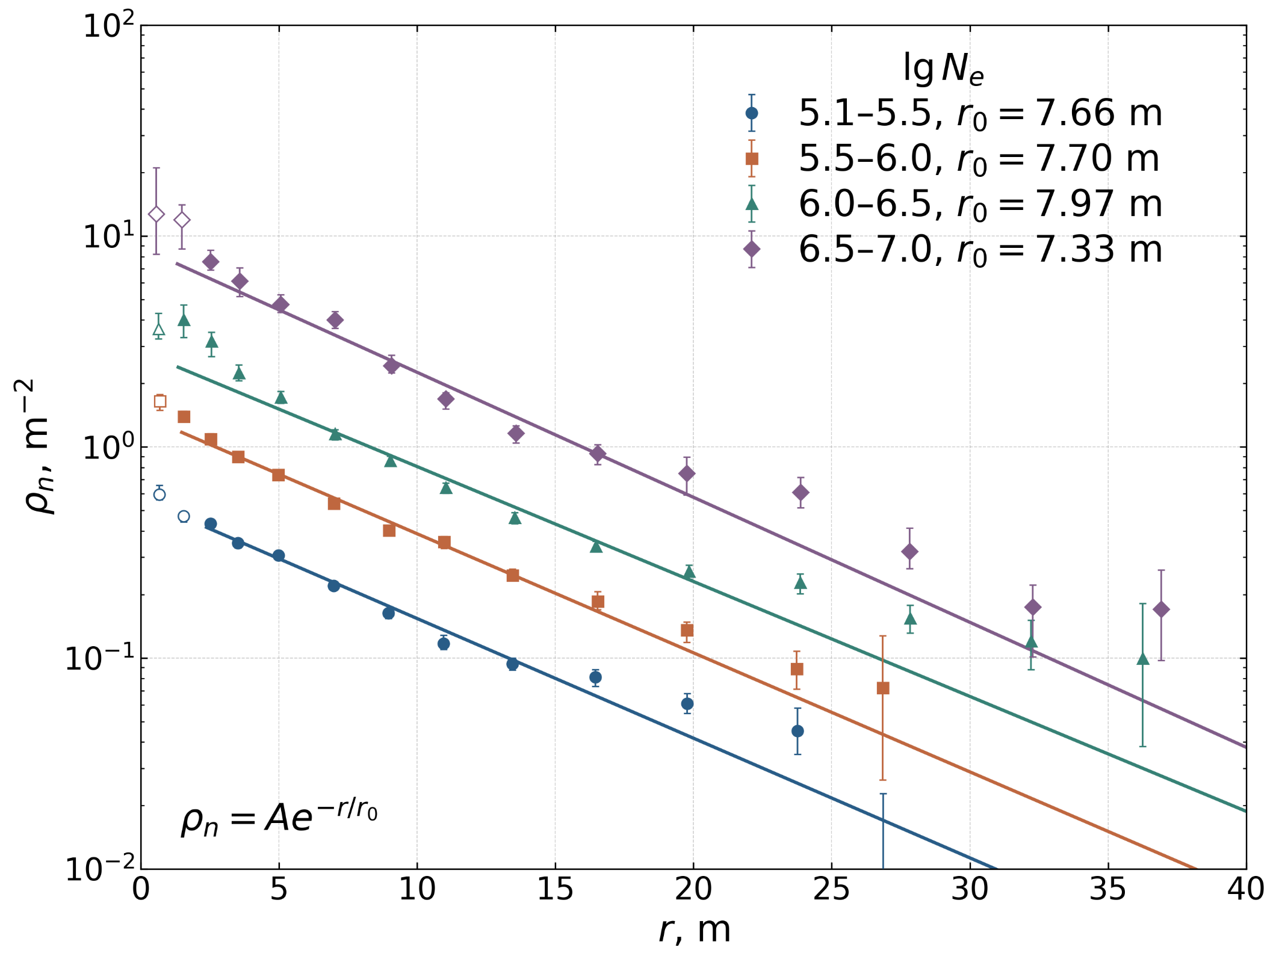
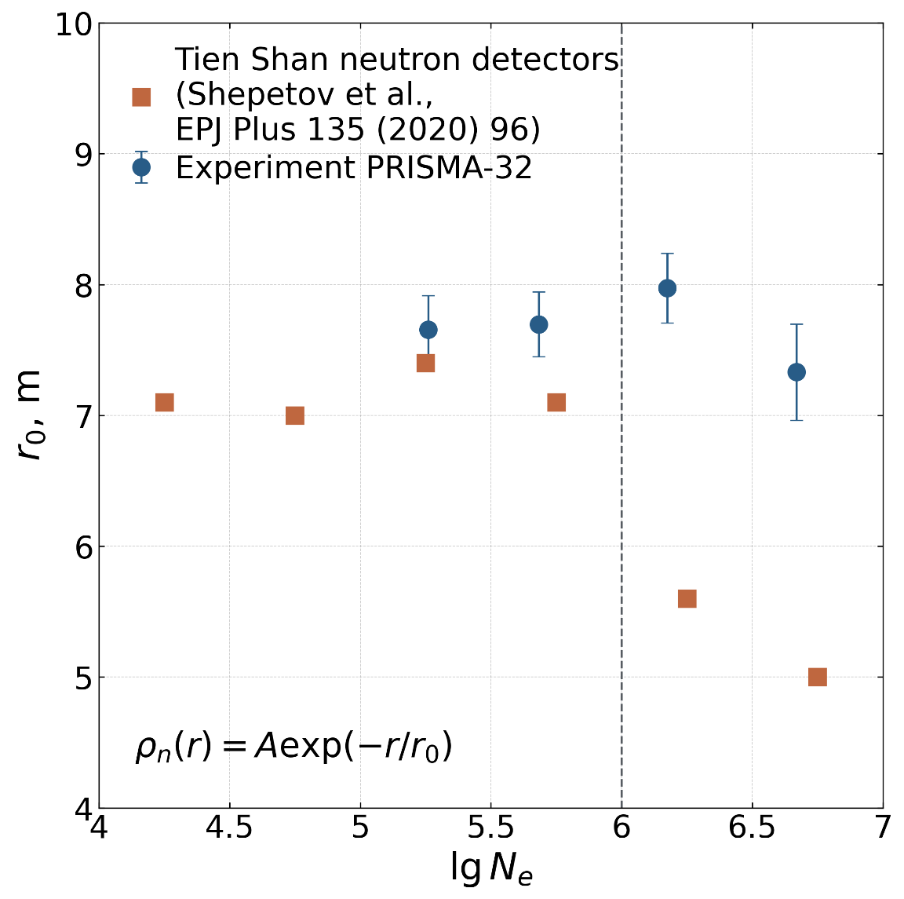
Lateral distribution of thermal neutrons
The r₀ parameter is independent of shower size within uncertainties.
The mean radius is 7.56 ± 0.21 m.
Mean radius from Tien Shan data:
below the knee 7.15 m and 5.30 m above the knee at lgNₑ = 6.00.

Slide 7
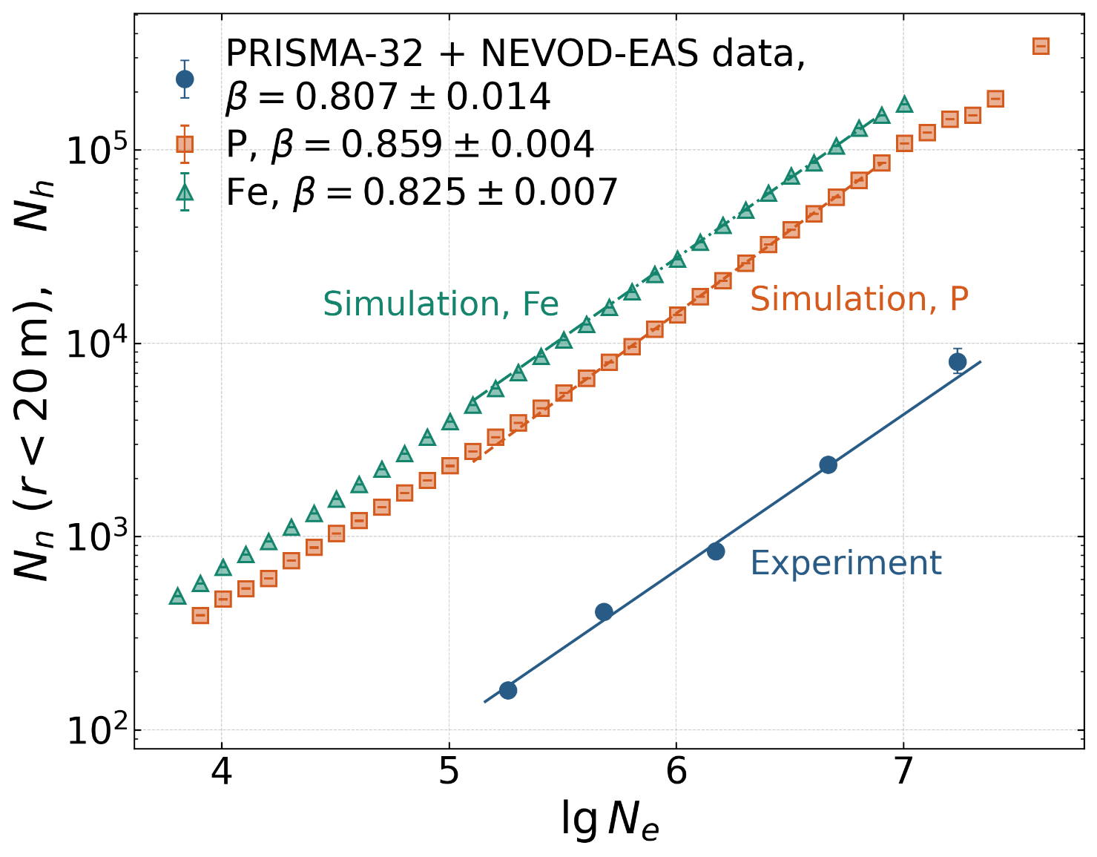
Dependence of the number of hadrons and the shower size
N_{h} ⁓ N_{e}^{β}
Kiel + Yakutsk^{[1]} (sea level, neutron monitors)
β = 0.92
β₁ = 0.58
Knee lgN_{e} ≈ 6
β₂ = 1.04
Tien Shan^{[2]}
(3340 m,³He counters)
This work
PRISMA-32 + NEVOD-EAS
β = 0.807
CORSIKA (QGSJET-II-04 + FLUKA 2020.0.3); p, Fe E =10¹⁴ – 10¹⁷ eV, (γ + 1) = 2.7 (3 million events).

Slide 8
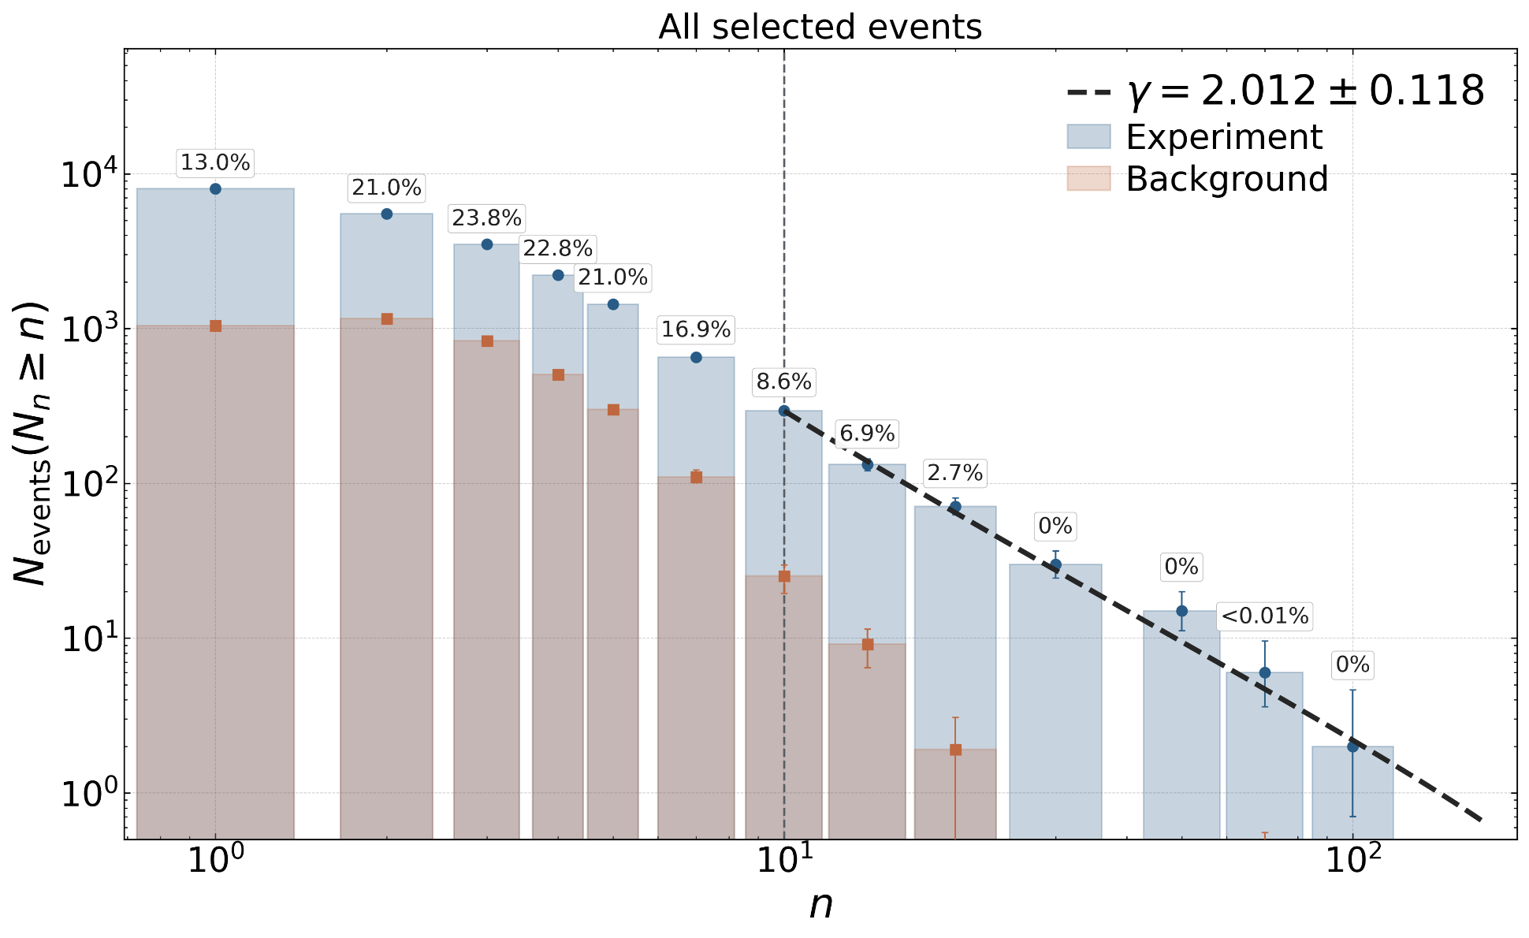
The integral spectrum of thermal neutrons
PRISMA-YBJ^{[3]} (4300 m)
γ = 1.95 ± 0.05
ENDA-64 LHAASO ^{[4]} (4410 m)
Simulation
γ ≈ 2.1
This work
PRISMA-32
γ = 2.012 ± 0.118
The spectral indices agree within uncertainties

Slide 9
Conclusion
We combined data on the electron-photon and neutron components of EAS.
The r₀ parameter is independent of shower size within uncertainties.
The integral neutron spectrum index is γ = 2.012 ± 0.118.
Within uncertainties, the number of neutrons in a shower follows the number of hadrons at observation level.
12

Slide 10
Thanks for your attention!

Slide 11
Bibliography
P.K.F. Grieder, Extensive Air Showers, Vol. 2, Springer, 2010, Sect. 13.6.1, Fig. 13.28a, p. 718.
A. Shepetov et al., Low-energy neutron and gamma-ray accompaniment of EAS in the knee region, arXiv:1912.13173.
B. Bartoli et al., Detection of thermal neutrons with the PRISMA-YBJ array in EAS, Astropart. Phys. 81 (2016) 49.
Li et al., Study of the lateral distribution of EAS thermal neutrons based on ENDA, PoS(ICRC2025)265.

Slide 12
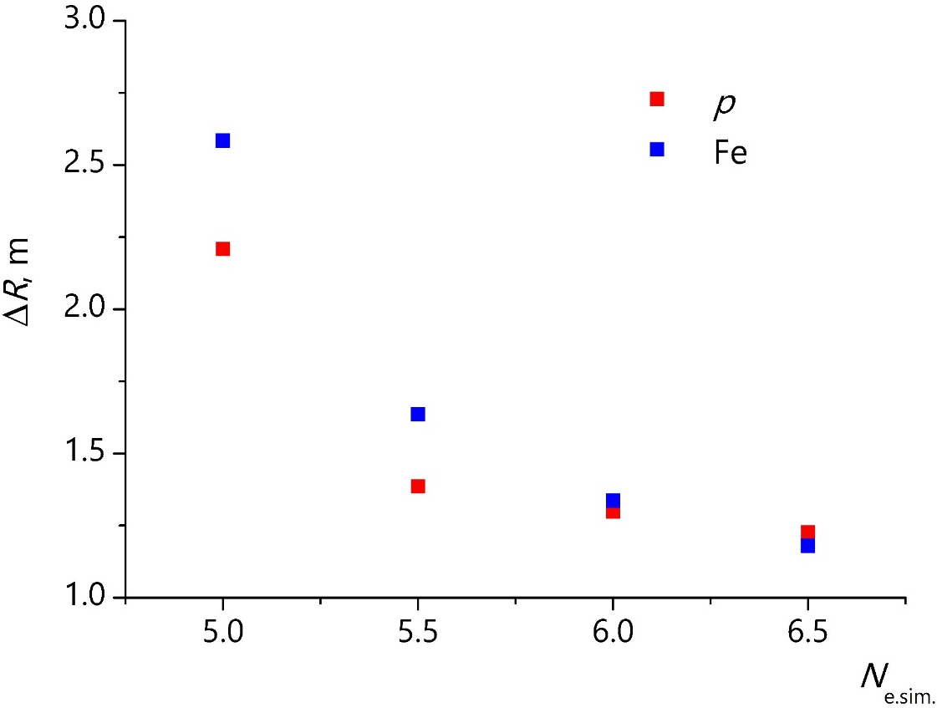
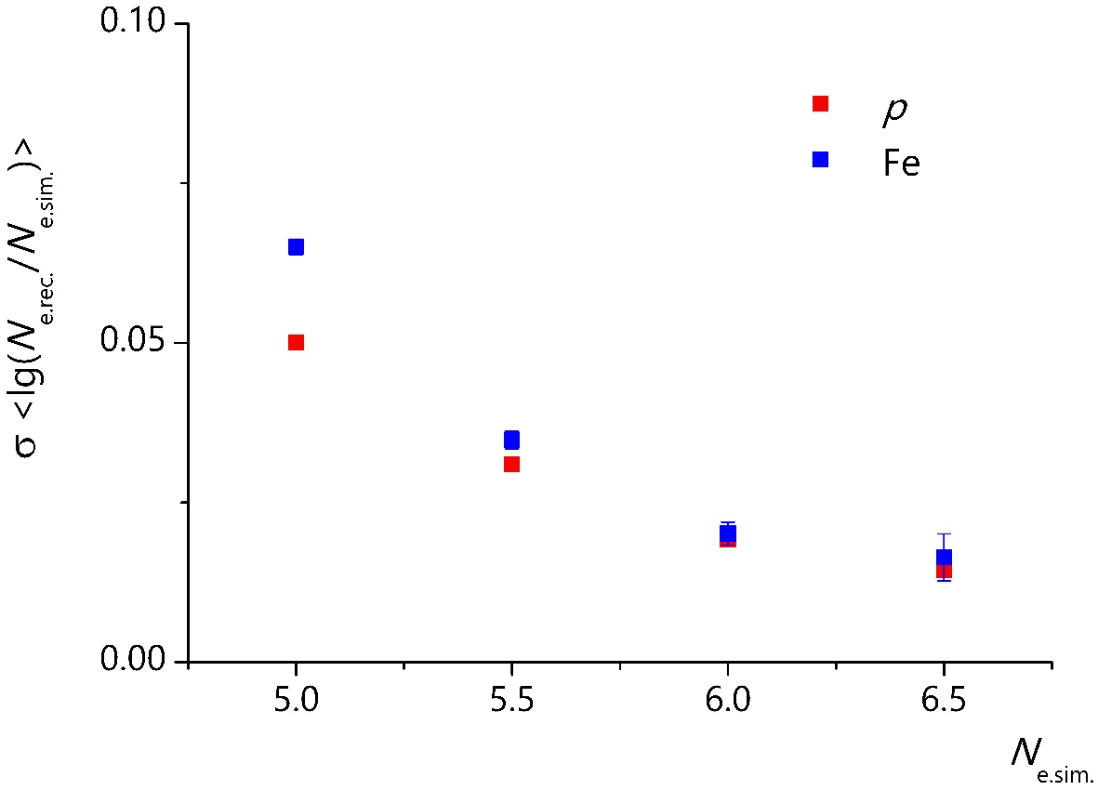
Simulation
CORSIKA (QGSJET-II-04 + FLUKA 2020.0.3); p, Fe : E =10¹⁴ – 10¹⁷ eV, (γ + 1) = 2.7 (3 million events).
Direction reconstruction accuracy: p ~ 2.6°, Fe ~ 2.2°
Axis reconstruction accuracy
Size reconstruction accuracy
∆R (p) ⁓ 2.2 m
∆R (Fe) ⁓ 2.6 m
∆N_{e} (p) ⁓ 0.05
∆N_{e} (Fe) ⁓ 0.06
For lgN_{e(sim.)} = 5±0.1:
For lgN_{e(sim.)} = 5±0.1 :
5

Slide 13
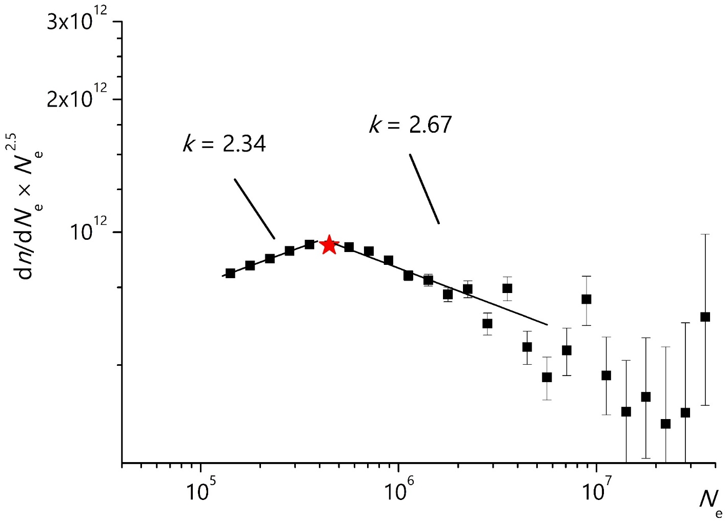
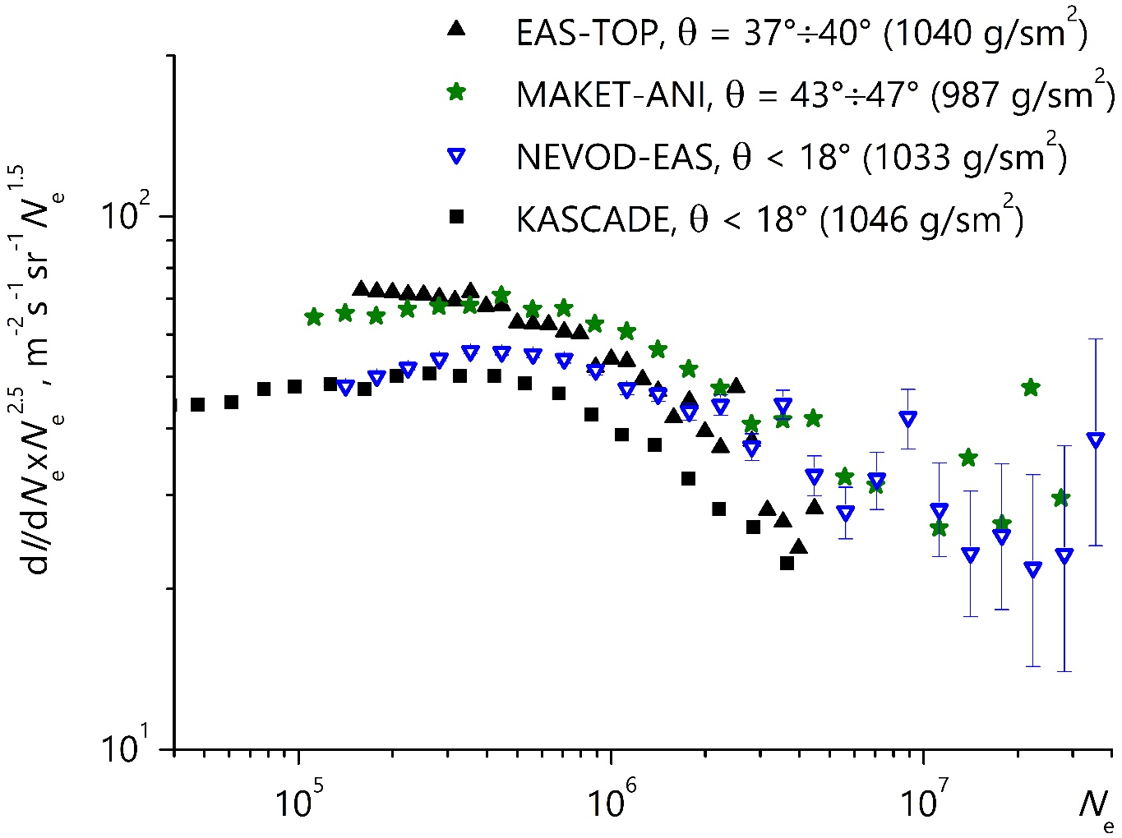
Shower size spectrum
NEVOD-EAS
lgN_{ek} = 5.65
∆k = 0.33
EAS-TOP
(M. Aglietta, 1999):
lgN_{ek} = 5.63 ± 0.07
∆k = 0.25 ± 0.07
MAKET-ANI
(A.Chilingarian, 2007):
lgN_{ek} = 5.84 ± 0.07
∆k = 0.48 ± 0.04
KASCADE
(K.-H. Kampert, 1998):
lgN_{ek} = 5.70 ± 0.07
9

Slide 14
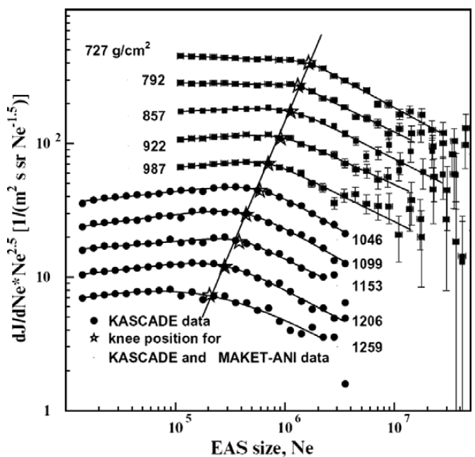
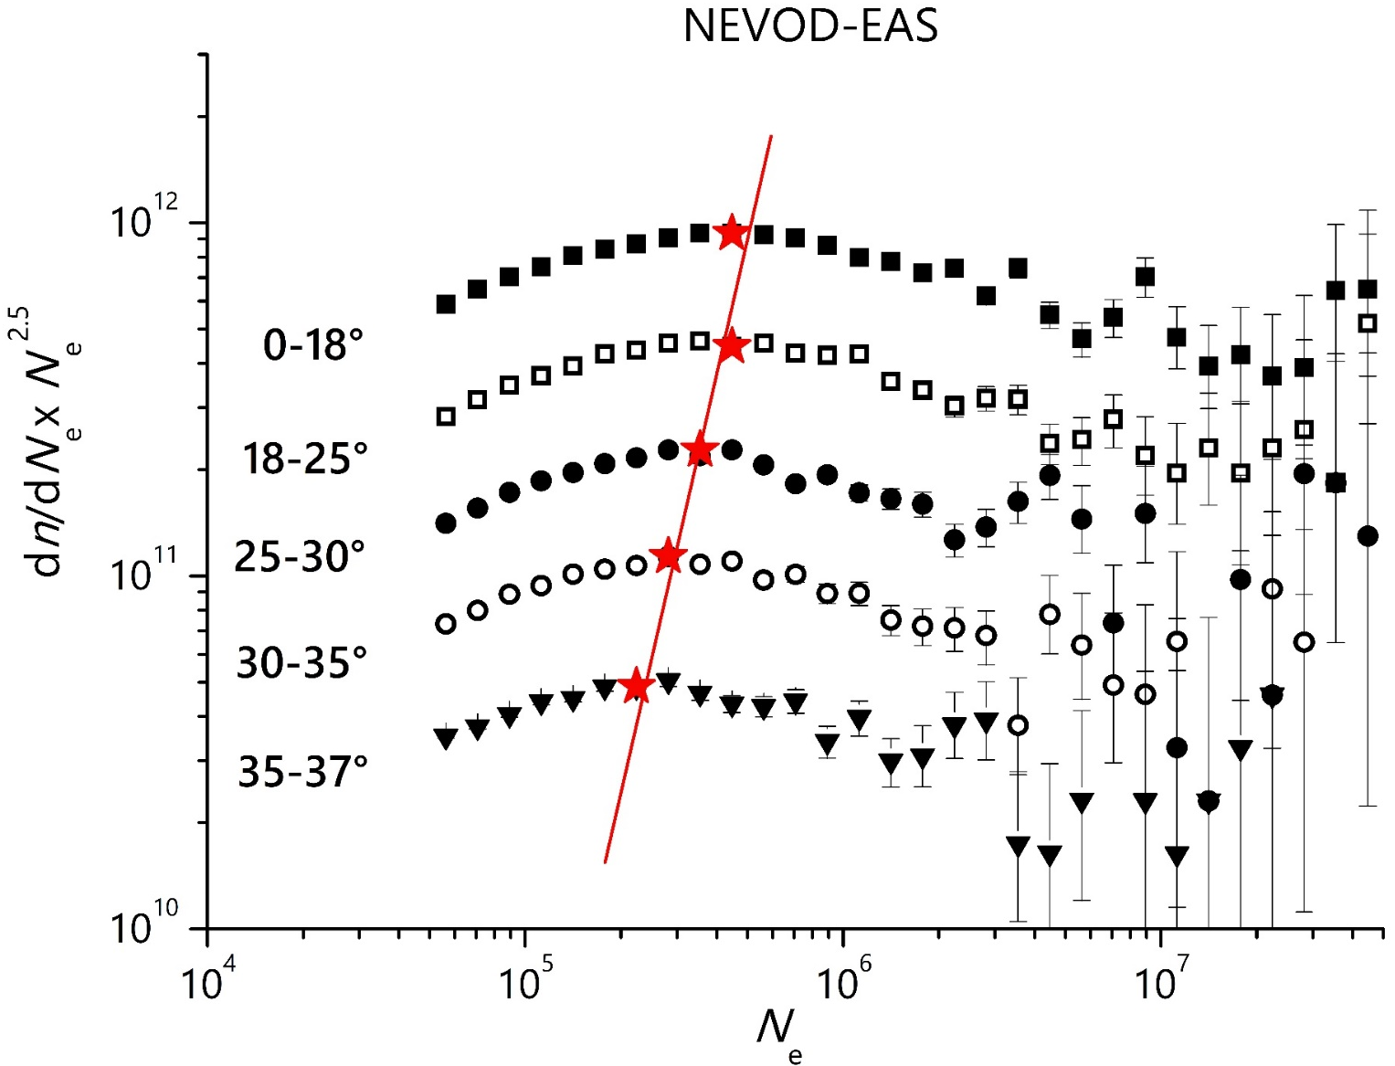
Shower size spectrum
The position of the knee is changing :
from N_{e} (35°÷37°) = 2.2×10⁵ to N_{e} (0°÷18°) = 4.5×10⁵.
A. Chilingarian et al. Astroparticle Physics 28 (2007) 58–71.
10

